Slide 1

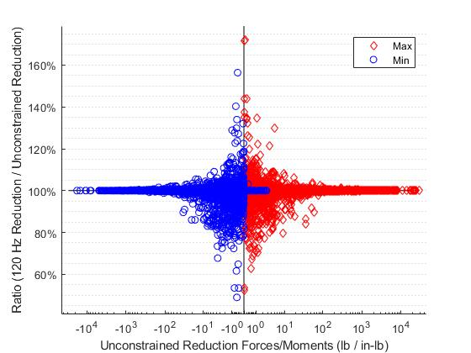
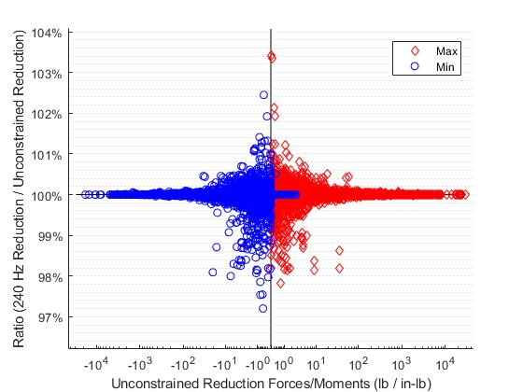
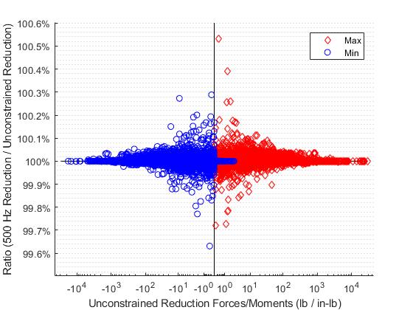


Alternate Methods of Model Reduction to
Avoid Dynamic Modal Truncation Error
National Aeronautics and Space Administration
Erin Simmons – JSC/ES6
13th Annual SLAMS Early Career Forum - NASA White Sands Test Facility – July 2024
Project Objective:
Determine the adequacy of loads generated by a Hurty-Craig-Bampton model reduction
Procedure:
Model reductions performed using Nastran and in-house developed Python tools
The Mode Acceleration Method was used to account for truncated modes
L&D team performed an independent model reduction using the Unconstrained Mode Acceleration Method (described below)
Provider performed Hurty-Craig-Bampton model reduction for use in their analysis
A forcing function was selected to run on both model reductions and results were compared at selected responses
To address differences identified in results, L&D Team generated multiple model reductions using the Hurty-Craig-Bampton method using different cutoff frequencies
Conclusion:
Despite following standard model guidance for frequency cutoff in reduced models and applying the mode acceleration method to account for truncated flexibility of the missing modes, the dynamic response was not sufficiently captured
When sufficient dynamic information is retained, the Hurty-Craig-Bampton method shows close agreement with the Unconstrained Mode Acceleration method
Lessons Learned:
Selection of constrained points when performing a Hurty-Craig-Bampton reduction is critical to prevent grounding issues
Unconstrained Mode Acceleration Method:
The equation for the GSET recovery in the Mode Acceleration method can be simplified for a free-free run due to the TSET (all physical boundary degrees) being empty
Output transformation matrices (OTMs) can be calculated from the Displacement Method OTMs, which can be generated using responses from a Nastran SOL 101 run
$$\left\{u_{g}\right\}=\left[GGAF\right]\left[Amp\right]+\left[GGAA\right]\{{\ddot{u}}_{g}\}$$
Error less than ~40%
$$\left[GGAF\right]=\left[GGF\right]{\left[K_{oo}\right]}^{−1}{\left\{P_{f}\right\}}_{applied}^{∗}$$
$$\left[GGAA\right]=−\left[GGF\right]{\left[K_{oo}\right]}^{−1}\left[M_{oo}\right]\left[TCB\right]$$
$$\left[TCB\right]=\left[GOQ\right]=Uncontrained modes$$
$${\left[LTMA\right]}_{mode acc method}=−\left[MEF1\right]{\left[K_{qq}\right]}^{−1}=−\left[MEF1\right]\left[\frac{1}{λ}\right]$$
Comparison of results from 120 Hz CB to unconstrained reduction
$${\left[LTMF\right]}_{mode acc method}=Responses from unit loads in SOL 101$$
$${\left[ATMA\right]}_{mode acc method}=[MUG1]$$
Models:
All models used the Mode Acceleration method and kept unconstrained modes to 60 Hz
Three Hurty-Craig-Bampton model reductions were performed with different frequency cutoffs
  120 Hz – matched the frequency cutoff of the provider and was 2x frequency content of interest
  240 Hz – 4x frequency content of interest
  500 Hz – 8.3x frequency content of interest
One model generated using the Unconstrained Mode Acceleration Method
Additional Hurty-Craig Bampton models were generated with different constrained grids selected
Cutoff Frequency:
NASA-STD-5002 recommends a minimum cutoff frequency for the fixed-base modes (QSET) of 1.5x the frequency content of interest
The minimum cutoff frequency was 2x the frequency content of interest
Results did not match until the cutoff frequency was increased to ~8x the frequency content of interest
Error less than ~3%
Comparison of results from 240 Hz CB to unconstrained reduction
Error less than ~1%
Results:
Increasing the cutoff frequency of the Hurty-Craig-Bampton reduction caused the results to approach those of the Unconstrained Mode Acceleration method, as shown in plots on right
Grounding issues from the selected constrained grids were identified as the cause of the discrepancies seen with lower cutoff frequencies
Comparison of results from 500 Hz CB to unconstrained reduction
References
NASA-STD-5002
“Mode Acceleration Method” by Tim McGhee
“Unconstrained Mode Acceleration Method” by Matt Hernandez
National Aeronautics and Space Administration
Johnson Space Center
2101 E NASA Parkway
Houston, TX 77058
www.nasa.gov
Thanks to Alex Chin, Jon Austin, Matt Hernandez, and Jeremy Priest for their help with the analysis

