Slide 1

COBRA
Introduction
Data and Systems Branch (FTK)
Barrett Hubbard, HX5 Sierra / TFOME II
NASA Glenn Research Center at Lewis FIeld
GTTC – Data Systems Focus Group – August 1, 2024

Slide 2
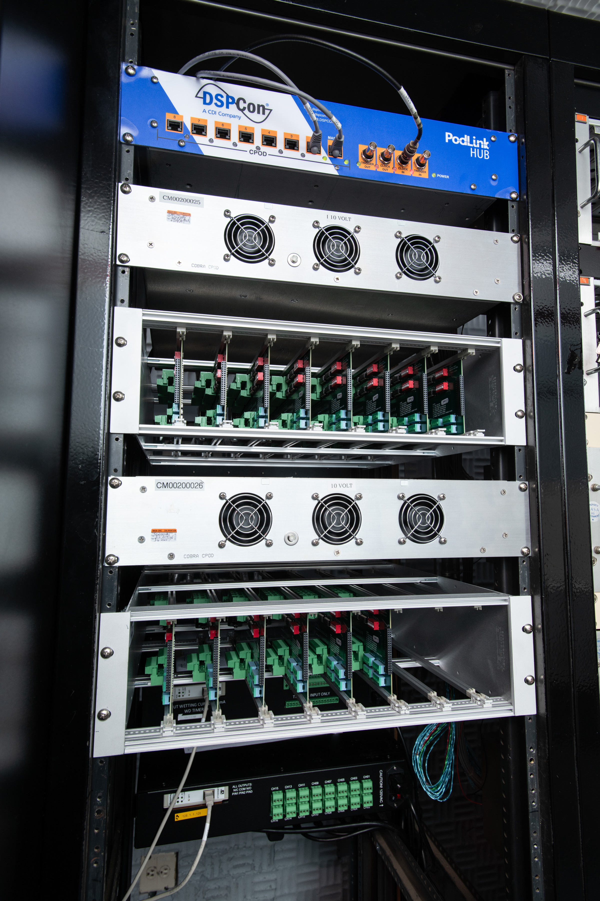
Base Components (COBRA 101)
IRIG / PTP / NTP / 10 MHz Reference Clock
Time Server
Data Collection, Archive, Alignment, and Publication
Calculator
Primary Data Storage
Software Repository
UDS
Reprocessor (Calculations)
Data Export
Secondary Data Storage
RDE
Configuration (Data System, Reprocessing, and Export)
Calculation Routine Creation
Data Visualization
Operator Station
Data Visualization
Data Viewer
DB Server
Storage of Configuration Data
Compilation of Calculation Routines
Storage of Monitoring Information
Third Party Data Source Integration
ADAS
OSS
Third Party Output Device Integration
Analog Inputs

Slide 3
Acquisition Devices and Protocols
Velmex
VXM Motion Controllers
Bustec
ProDAQ
(TC’s)
ARINC 429
Bus Monitor
1553
ESP
8400
NI 6612
Freq.
Counter
Tescom ER 3000 / 5000
Black
Stack
1560
DTS
(Digital TemperatureScanner)
Modbus
Analog
Inputs
Digital
Inputs
Mensor
GPG2500
CPT Series
Optimus
Renisaw Linear / Rotary Encoders
Keithley 2182
(nV Meter)
Keysight
34420 A
(nV Meter)
Net
Scanner
Ovation
RS232
PACS
(Positional
Control)
Setra 370
VTI 1538
Freq. Counter

Slide 4
Highlights
COBRA is the low-speed data acquisition system for larg(er) scale installations
  Sample rates of 12.5, 25, 50, 100, 200, 400, and 800 Hz
  Deployed with up to 10,000 calculated channels
  Deployed installations with thousands of acquired channels (including ADAS acquired channels)
8 Ingestion Ports which can be:
  Analog Shelves (128 Channel Capacity)
    Sampled at 12,400 Hz, decimated by UDS
  ADAS (May be multiple)
    Supports multiple attached 3rd party acquisition devices
    Flexible hardware interfaces (Linux based with PCI Card expansion)
Software Developed at Glenn (adapted from DSPCon COTS Product)
  Standard tooling and OS (Enterprise Linux / C++ / Qt)
Common Core / Extensible Capabilities
Market Available computing platform (Dell / KOI / Superlogics)

Slide 5
Diverse Use
Installations across Lewis Field and Armstrong Test Facility (Data Acquisition)
  Currently installed (or being installed) in 17 facilities (Including all AETC Facilities)
  Approximately 5 remaining facilities still running ESCORT only
  Installations at Lewis Field (Glenn Research Center – Cleveland) and Armstrong Test Facility (Sandusky, approximately 1 hour west of Cleveland)
Stand Alone Reprocessing Stations x 3
  Allow for additional test support
  Secure reprocessing
Diverse needs
  Complex Computing Requirements
  Large scale visualization needs
  High Channel Count
  High Testing Cadence
  Supersonic Wind Tunnels, Acoustic Facilities (non-dynamic), Icing, Propulsion, Engine Research (Combustion / Turbine / Calibration)

Slide 6
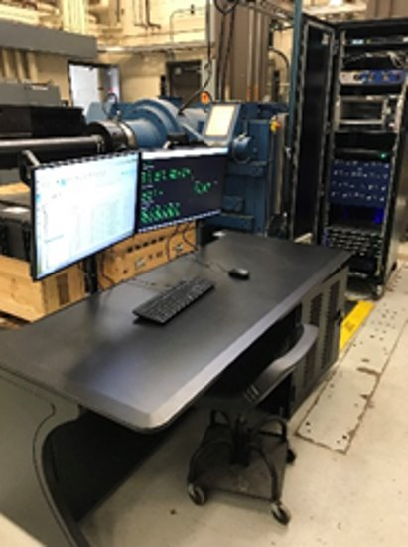
Case Study – Build-up Area (8’x9’ SSWT)
Problem Statement: How small of a physical footprint (½ Rack) can we make COBRA, and how cheap ($50K – Hardware Cost) for a minimal checkout area, while staying compatible with calculations and test programs of production data system
The original “Small Form Factor” COBRA Installation
Used for build-up and checkout
Single Rack, Operator Station (With DataViewer Application) and single mobile data viewer
128 Analog Channels
Combined ADAS and OSS (“Small-IO”)
No Backup Capabilities / Transient check-out data only
1-U Form Factor for all systems, including UDS, RDE

Slide 7
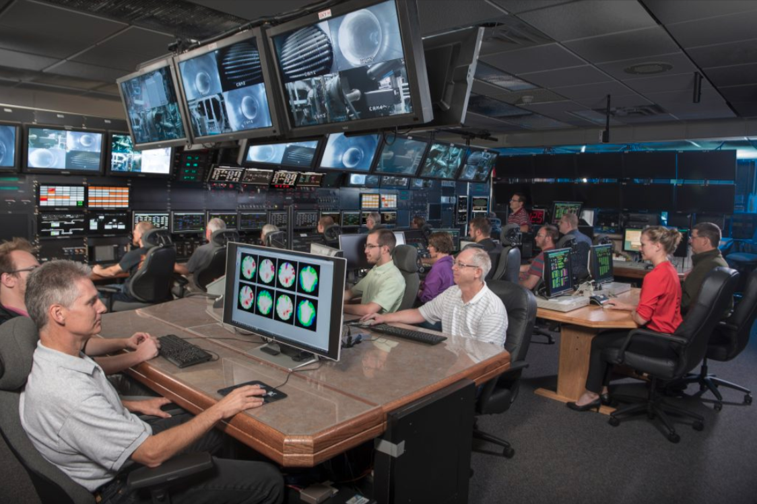
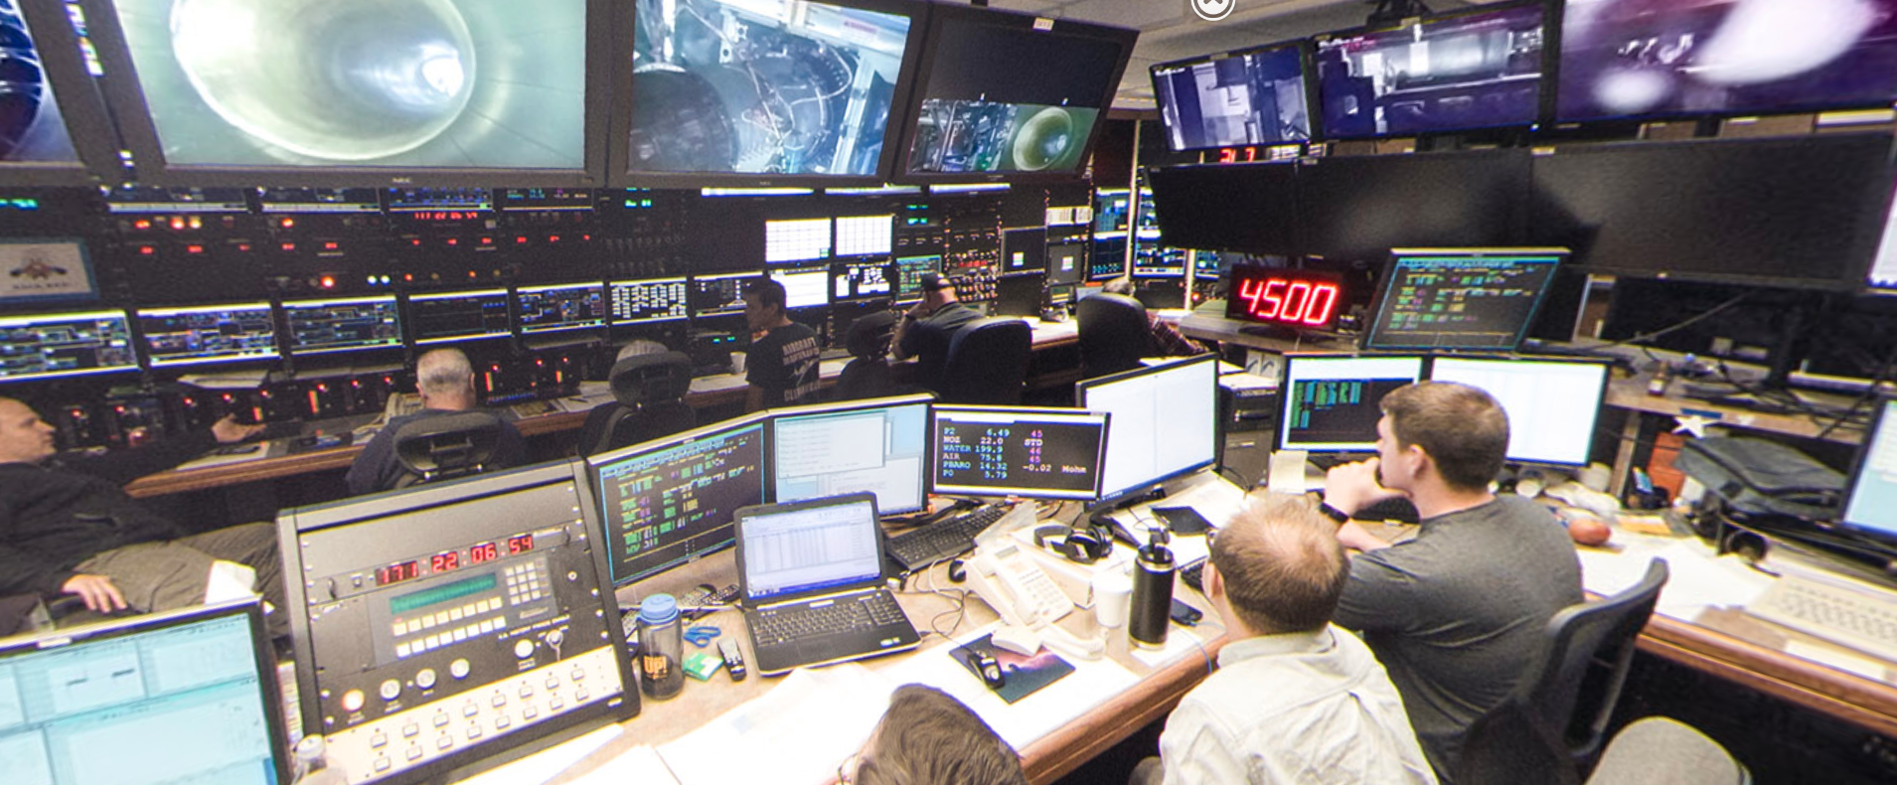
Case Study – Propulsion Systems Laboratory (PSL)
Problem Statement: Can we support high channel count, computation complexity, high visualization needs (32 DataViewers with multiple screen support)
2 Test Sections, Shared Control Room (KVM Network, Some Shared Facility Data Viewers, Independent Acquisition and Control Components)
Multiple Operator Stations
Digital Inputs / Contact Closures (Outputs)
3 ADAS (in multiple physical locations – Control Room / Test Section / Data Room / Mezzanine)
3rd Party Pressure and Temperature Systems (Netscanner 9034 / DTS 4050), 1553
Support for customer legacy FORTRAN code and routines
Standalone HID Control Hardware (GPP)
High frequency of classified and sensitive testing

Slide 8
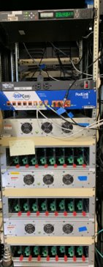
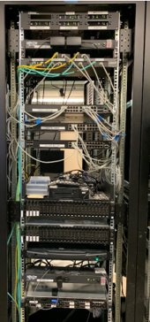
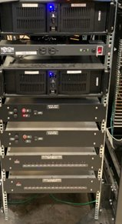
Case Study – Propulsion Systems Laboratory (PSL)

Slide 9
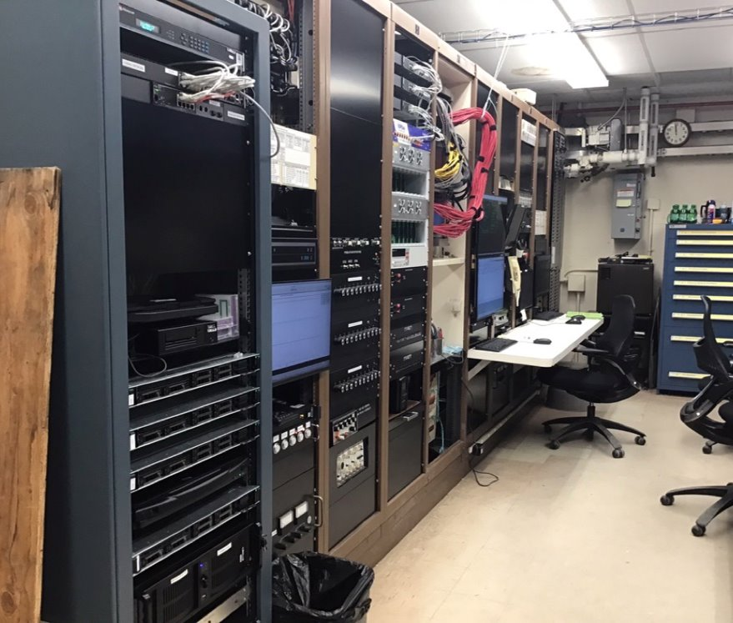
Case Study – ERB – Transonic Turbine Blade Cascade Test Facility - CW-22
Problem Statement: Can we install a small footprint, production system
High cadence recording (5 second readings taken in rapid succession
High reading count (~700 unique configuration points per 8 hour run)
> 40,000 readings taken so far in current campaign
No dedicated data engineering support (Researcher and EE operate the system)

Slide 10
Additional Considerations (“Everyone is Special”)
Engine Research Building - ERB
  Diverse Storage Needs
  High Cadence Recordings (5 second readings acquired on 15 second intervals)
  Large quantity of readings (>50,000 condition points as part of test campaign)
  Short cycling of system (Short time allowed between conditions)
  Limited Engineering Resources (Shared Data Engineering Support)
Space Environmental Complex (ATF)
  Long duration vacuum testing (40 days of continuous testing)
Icing Research Tunnel (IRT)
  Quick-test turnaround – Build up in the morning / testing in the afternoon
All Facilities
  Need / ability to have secure testing
  System must be designed for our man-made disasters (Easy to re-instantiate from baseline state)

Slide 11
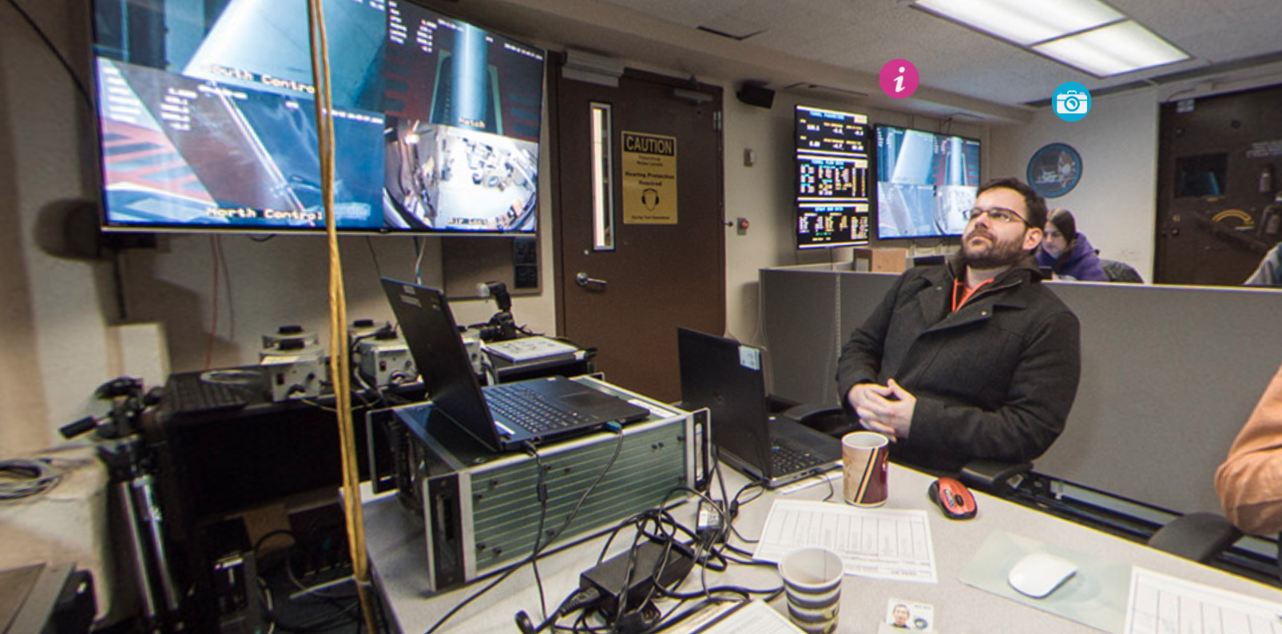

Case Study – Icing Research Tunnel (IRT)
First Permanently Deployed COBRA Install (2016)
Deployed with:
  Windows Operator Station / Data Viewers / ADAS
  CentOS 6 RDE and UDS
  Excel based configuration tool
  Software installed with file copies and installation scripts (Every developer updates their software)
  Calculation routines requiring modification of Calculator binary
  Monolithic ADAS
Has been constantly updated and continues to run current version of COBRA
  Windows replaced with Linux and updated
  DBServer component added for configurations
  COBRA Configuration Tool replaced Excel Spreadsheet based Configuration
  Introduction of CODI (User Developed COBRA Calculation Routines)
  Modular ADAS Device Implementations

Slide 12
What is Common?
Each COBRA System has the following characteristics in common:
Operating System
Software load (per component)
Capable of interfacing with all supported instrumentation types (although may not have the necessary hardware interfaces)
General Purpose Modules (Commonly used calculator functions, including Thermocouple conversion routines, NIST REFPROP, Ames Report 1135 Compressible Flow Functions)
Presence of base component functionality:
  UDS
  RDE
  Database Server
  Operator Station

Slide 13
What is Not?
The following characteristics will vary from facility to facility
Number of Channels
Instrumentation
Number of Data Viewers / ADAS units / Output Subsystems / IDDs / Additional attached hardware
Test Program Definitions
Facility baseline programs
Channel definitions
Facility developed Calculator routines
Hardware (size of components, generation of server used)
  Several facilities use one or more “Small Form Factor” components, which typically replace a 2U server with a 1U implementation, with the compromise of lower available storage and reduced processing
  Replacements and new installs are sourced from currently available equipment. This results in different hardware versions or generations, for example, there are presently deployed Dell PowerEdge 730 and 740 units
  Any differences in drivers and other required configurations are handled through the kickstarts

Slide 14
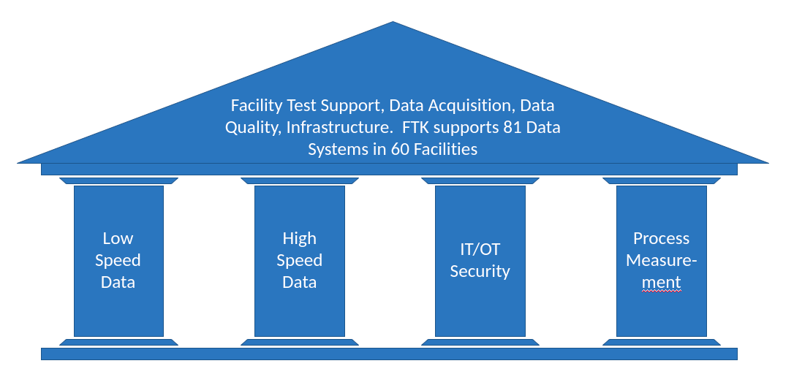
Our Approach
What is the Data and Systems Branch (FTK)
FTK is a Testing Division Resource with a mission to “Partner with NASA programs to develop, implement, and maintain NIST traceable real-time data acquisition and systems solutions for the Glenn Research Center’s aerospace research test facilities. Provide IT security and best practices guidance and data to the customer in a safe, consistent, reliable and repeatable manner.”
Support for various data systems on lab (High Speed / Low Speed, including Dewesoft, LabView, COBRA, Escort Legacy Support)
Provides Data System and OT infrastructure support
Provides logistics
Development of DAS solutions, including COBRA Development, temperature and measurement system evaluation and support, and hardware development (trigger boxes, relay boxes, breakout panels)

Slide 15
Software Philosophies
All Facilities maintained at the current version
  Subject to Testing Needs
  Unless data or test critical, no software update during test campaign
Named Releases
  Collection of software tied to a “named” release, for easy reference, discussion, and memory
  Short-hand to identify state of system (past, present, or future) for Production and Support, development planning, testing, and troubleshooting
  Exposed to the system in /etc/cobra-release (Able to be queried)
  Easily identified by End-Users
User Space vs. Program space
  To the extent possible, test specific configurations and needs should be configurable and able to be accomplished within the user space (calculated channel definitions, calculator routine development (CODI), export templates and automation (Atlas))
  Software should not be “side-loaded” for configuration management and disaster recovery
Easy and repeatable to update and install
  We have been able to support a facility applied update over the phone at one of our ATF facilities

Slide 16
Software Deployment
RPMs
  FTK developed software is packaged into RPMs, which contain:
    Executable binary code
    Additional configuration files, scripts, or other files necessary and related to the specific application or service
    Installation scripts
    Uninstall scripts
    Dependencies which must be met for installation
  Produced through by our CI/CD scripting (gitlab runners / rpms placed in Artifactory)
Yum repository
  Employ YUM / dnf as method for delivering software to facilities (through air-gap)
  Entire release is packaged as a single rpm for installation on the UDS (within the air-gap)
  UDS contains separate repository of non-ftk developed packages available for install (we control the “universe”)
  All systems point to the UDS as their sole yum source (defined in /etc/yum.repos.d)
Kickstarts
  Script the “cold start” of new machines from bare-bones state through installation of OS
  Developed for each unique hardware platform to automate placement in state to accept COBRA software
  Allows for repeatable and scripted installs (using Ansible and PXE Boot), in recognition of continued need to re-instantiate systems, either due to hardware failure / replacement, or replacement of drives following secure / sensitive testing
Parent Packages
  Each core system component has a parent package that brings in all software and configuration for that component (i.e. Operator Station / UDS / RDE)
  Allow for validation of install and ease of system provisioning

Slide 17
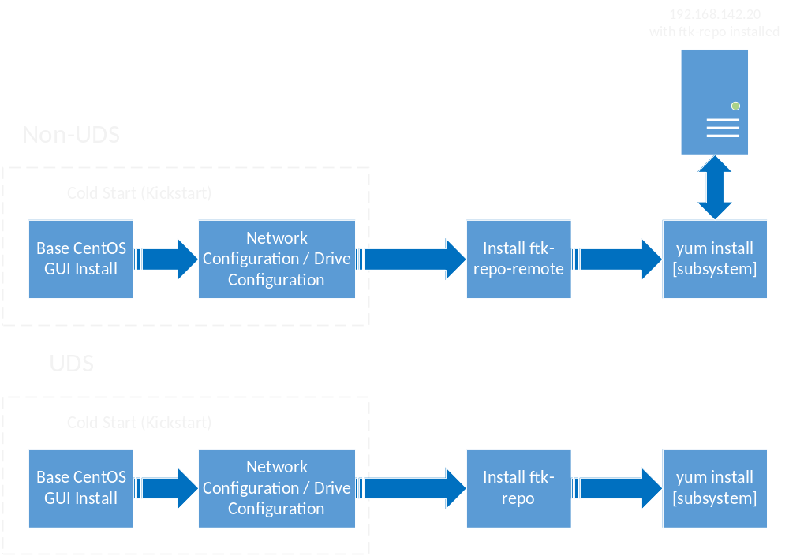
Provisioning
Examples:
yum install cobra-operator-station
yum update
Note: Since the development of the initial process, additional tooling has been put in place, leveraging Ansible to provide more automation for upgrading installations within facilities, and validating the installation once complete.

Slide 18
Additional Resources

Slide 19
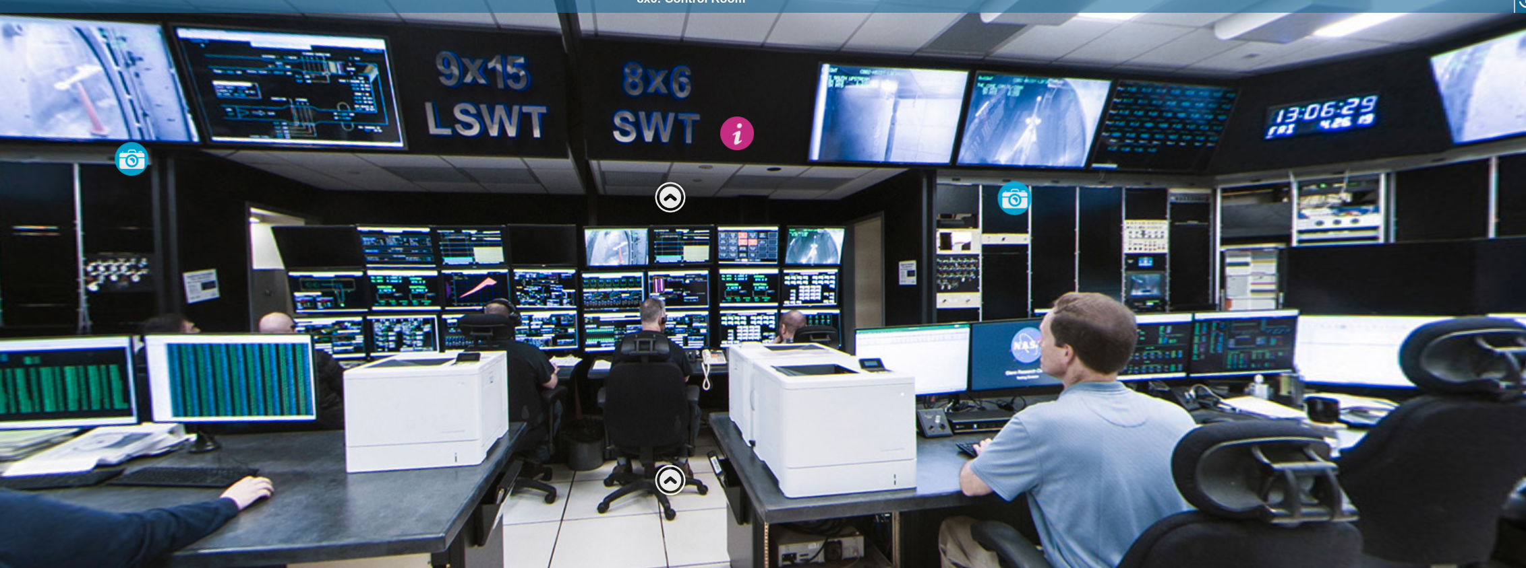
8x9x Control Room
8x9x Combined Control Room with duplicate COBRA installs

Slide 20
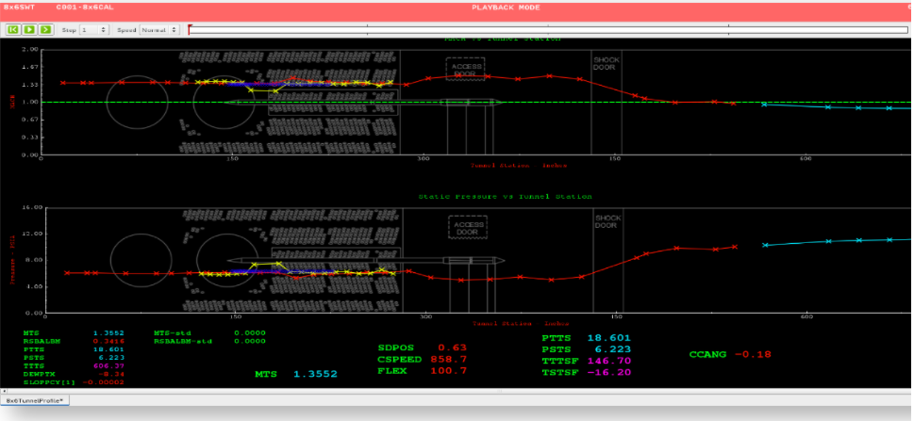
Sample DataViewer / Data Playback
Representative Dataviewer Page – Playback Viewer – 8x6 Calibration

Slide 21
END OF PRESENTATION

