Slide 1
BSCW High-Angle of Attack Computations Using KESTREL and AEROM
Walt Silva
Aeroelasticity Branch
NASA Langley Research Center
July 11, 2024
AePW-4 High Angle Working Group Meeting

Slide 2
Outline
Benchmark SuperCritical Wing (BSCW), Aeroelastic Prediction Workshop (AePW)
Background
AEROM
Results
  Alpha=0, 1, 3, and 5 degs (skip alpha=1 deg; similar to alpha=0 deg)
  Amplitudes = 0.04, 0.01, 0.08, and 0.001 (modal)
  Comparison of full solution GAFs vs ROM GAFs (error quantification)
  Root locus
  Comparison of full solution transients vs ROM transients (at a specified Q)

Slide 3
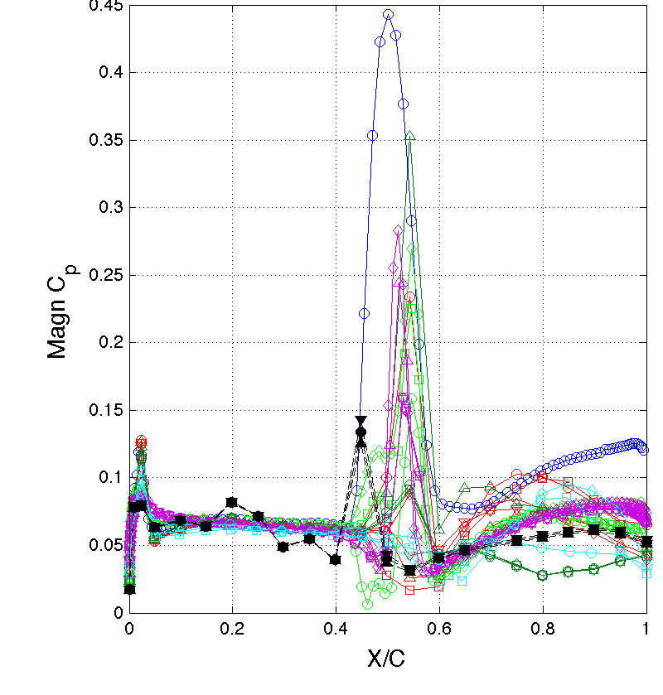
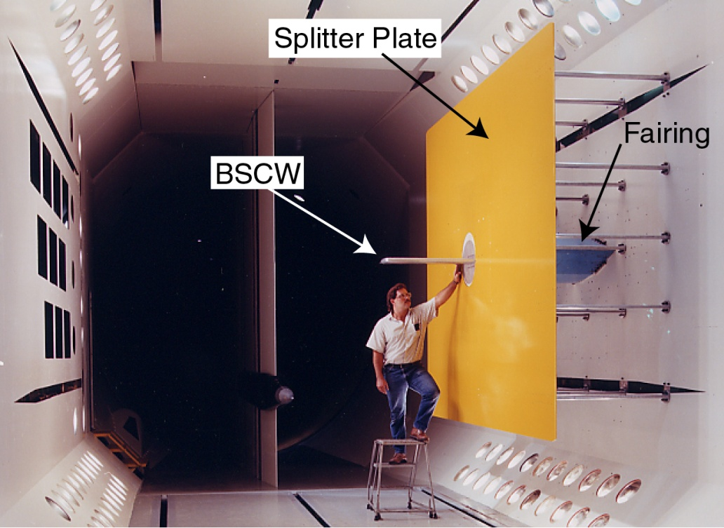
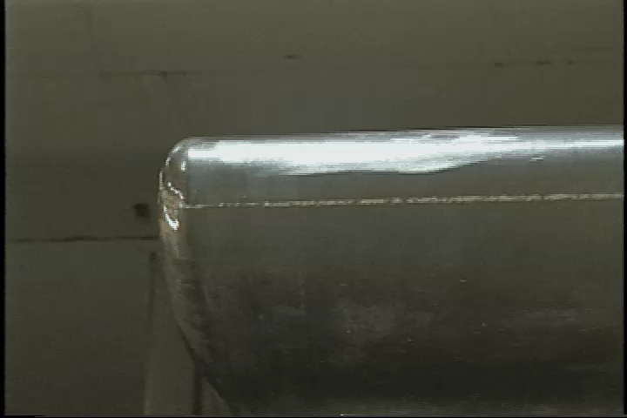
Benchmark Supercritical Wing (BSCW)
Chosen as a challenging test case, flow-wise, but simple geometry
  Strong shock with suspected shock-induced separated flow
Some preliminary assessments from AePW
  Computational methods had difficulty producing converged solutions due to flow field complexity
  Complex flow field also observed in experimental data; Largest magnitude of dynamic behavior appears to represent shock oscillations
  CFD solutions vary widely, even for static solution;
M=0.85, Re_{c}=4.49 million, test medium: R-134a, α = 5°, θ = 1°, freq 1 & 10 Hz
Likely plan of action:
Form technical working group of BSCW analysts
Extensive study of available experimental data; characterize different flow phenomena
Benchmark against more benign cases- lower Mach number, lower angle of attack
Analyze the static (unforced) problem using time-accurate evaluation methods
Study of time convergence criteria
From AePW-1 Debrief

Slide 4
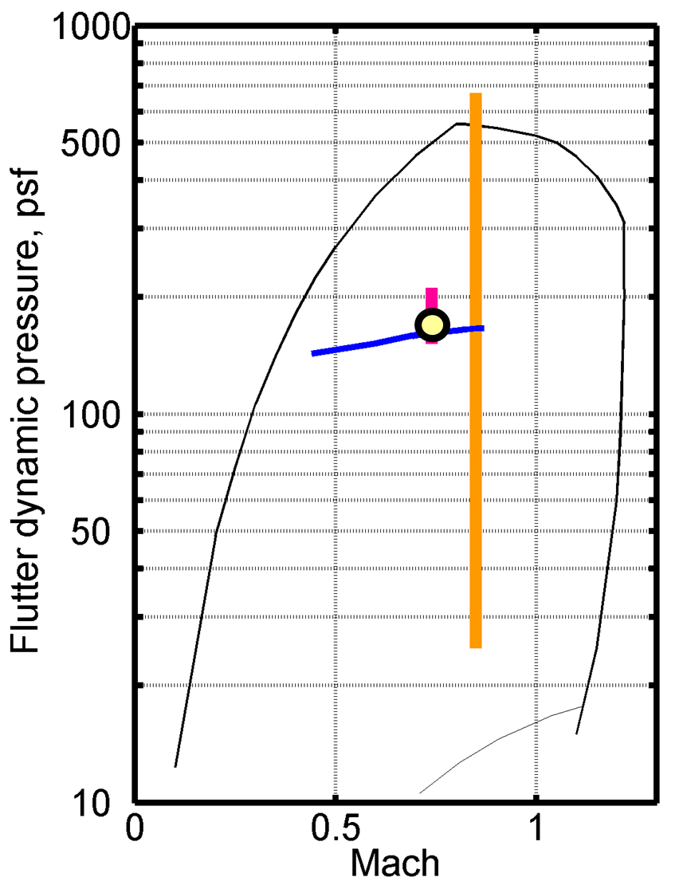
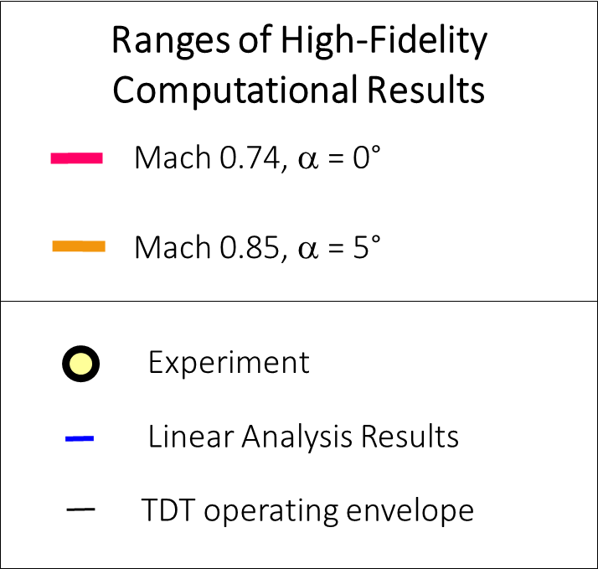
AePW-2 Summary of Results
At Mach 0.74, α = 0°
  Small variation in computational results
  Match the experimental results well
  Match the linear results well
At Mach 0.85, α = 5°
  Significant variation in predictions
  No experimental data for comparison

Slide 5
Background
Application of KESTREL and KESTREL/AEROM to BSCW wing
At M=0.74, alpha=0 deg, KESTREL, KESTREL/AEROM, FUN3D, and FUN3D/AEROM all compare nearly exactly with data
At M=0.85, alpha=5 deg, large flow separation/unsteadiness; very challenging problem
Large variance from one code to another at this condition; differences between KESTREL and FUN3D
Goal of this analysis: evaluate application of AEROM using KESTREL at M=0.80 and alpha=0, 1, 3, and 5 deg (similar unsteadiness to M=0.85) using multiple amplitude excitations (Walsh functions)
Follow-up with investigation of code-to-code comparisons

Slide 6

Kestrel
Fixed-wing product in CREATE-Air Vehicles
High-fidelity simulation tool
  Full spectrum of flight conditions and missions
    Incompressible to hypersonic
    Cruise, maneuvering, take-off/landing, refueling, store carriage and release, precision air-drop, test facility modeling, and more…
  Full spectrum of aircraft/weapons types
    Fighter, bomber, tanker, cargo/transport, UAV/UAS, munitions
  Coupled physics: aerodynamics, thermochemistry, structural dynamics, propulsion, flight controls, separation/contact/collision, 6-DoF motion w/ generalized constraints, aero-heating
  Easy for users to learn, use, customize, and extend
    “Simple things are easy, complex things are possible.”
Thanks to Dr. Steven Lamberson for this slide
HIFIRE-6 Shroud
Separation

Slide 7
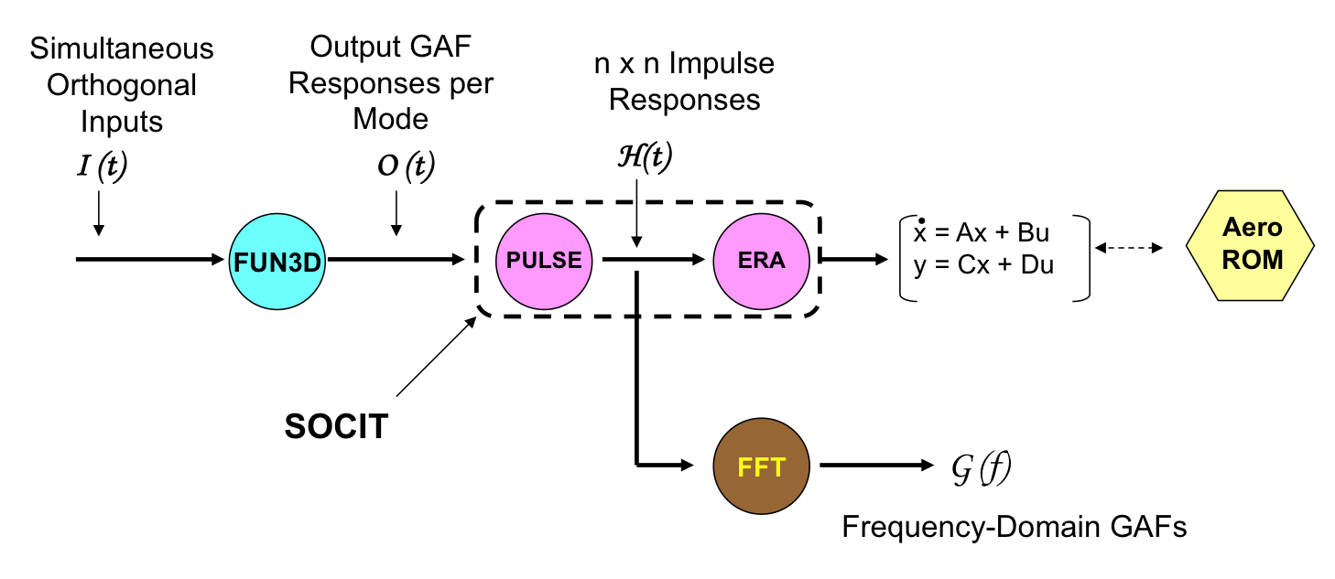
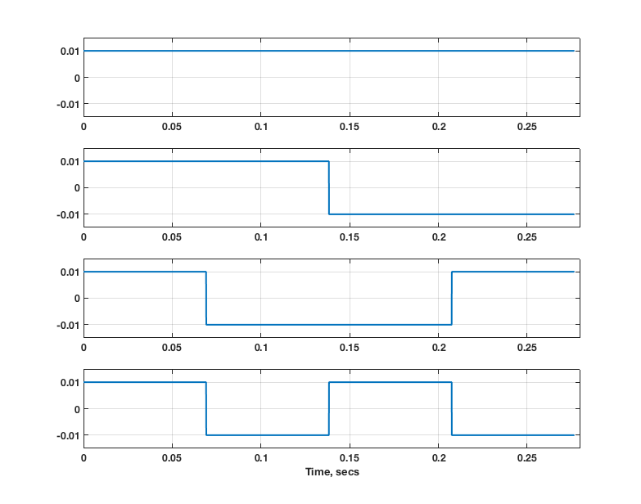
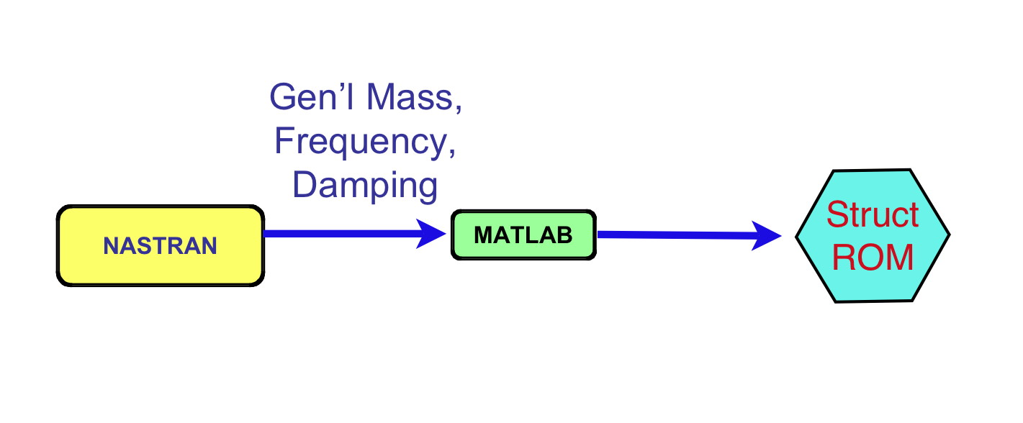
AEROM: ROM Development Process
Unsteady Aerodynamic State-Space ROM
Walsh Functions
(modal)
KESTREL
1
2
3
4
Structural state-space ROM

Slide 8
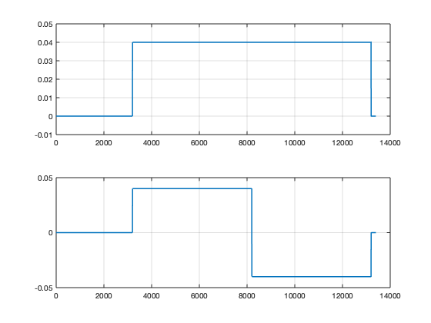
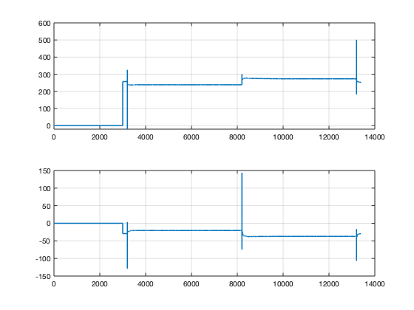
BSCW Application (KESTREL), Two modes
*.fmh file
*.modes file
KESTREL
BSCW
2 inputs x 2 outputs =
4 impulse responses/GAFs
Two Walsh input functions
Two GAFs output functions
Intentional accounting for nonlinearity:
  Input amplitude variation (amplitude-dependent nonlinearity)
  Simultaneous inputs (capture nonlinear cross-terms missed by one-at-a-time inputs )

Slide 9
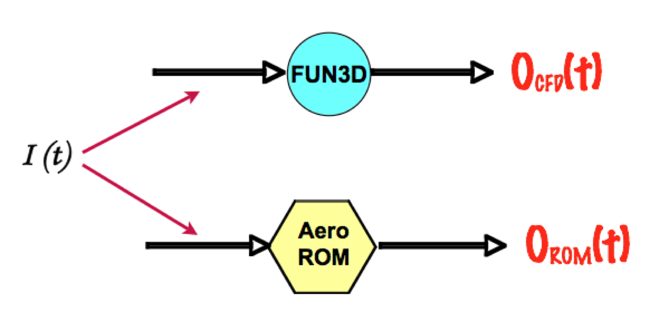
AEROM: ROM Development Process
Error Minimization (Unsteady Aerodynamics)
Low
Error
?
Yes
Continue
No
ERA
PULSE

Slide 10
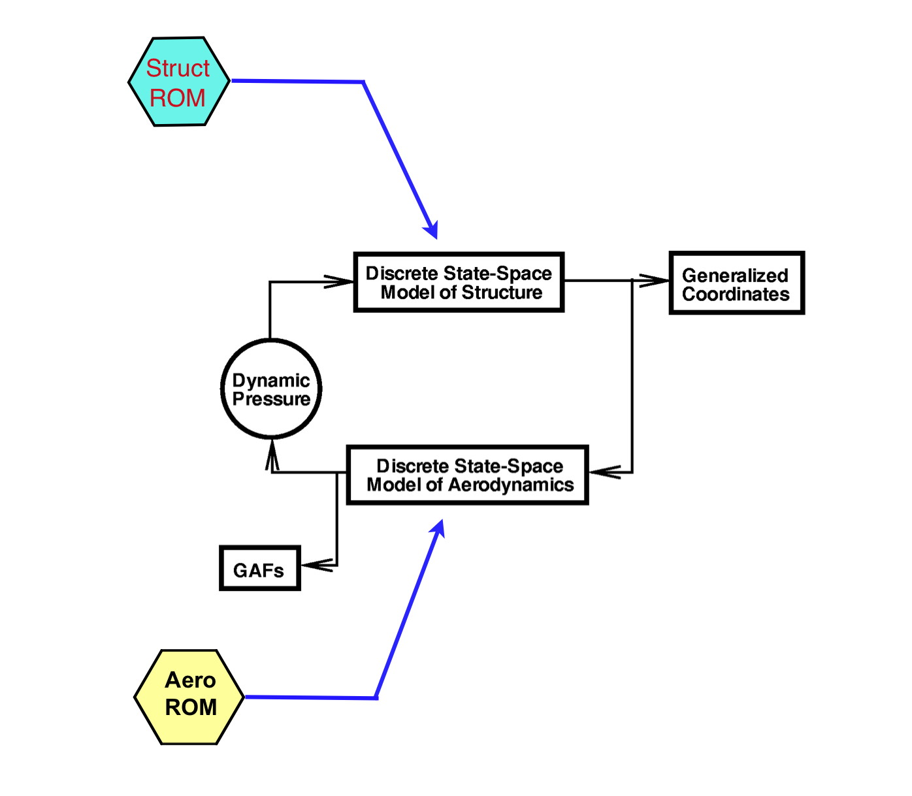
AEROM: ROM Development Process
Aeroelastic Simulation ROM (Simulink Model)
Includes Unsteady Aero ROM and
Structural Dynamic ROM
A MATLAB-based replica of the CFD aeroelastic solution process
Used to compare ROM responses at any
dynamic pressure with full KESTREL or
FUN3D solutions
Computes generalized coordinates and GAFs
Can be used for static and dynamic AE solutions

Slide 11
AEROM: ROM Development Process
Aeroelastic Root Locus Plot Using Aeroelastic Simulation ROM
Modeled as a closed-loop
system with gain (dynamic
pressure) in MATLAB
Eigenvalues
Z-Plane
Root Locus
Frequency vs
Damping Ratio
Root Locus
S-Plane
Root Locus

Slide 12
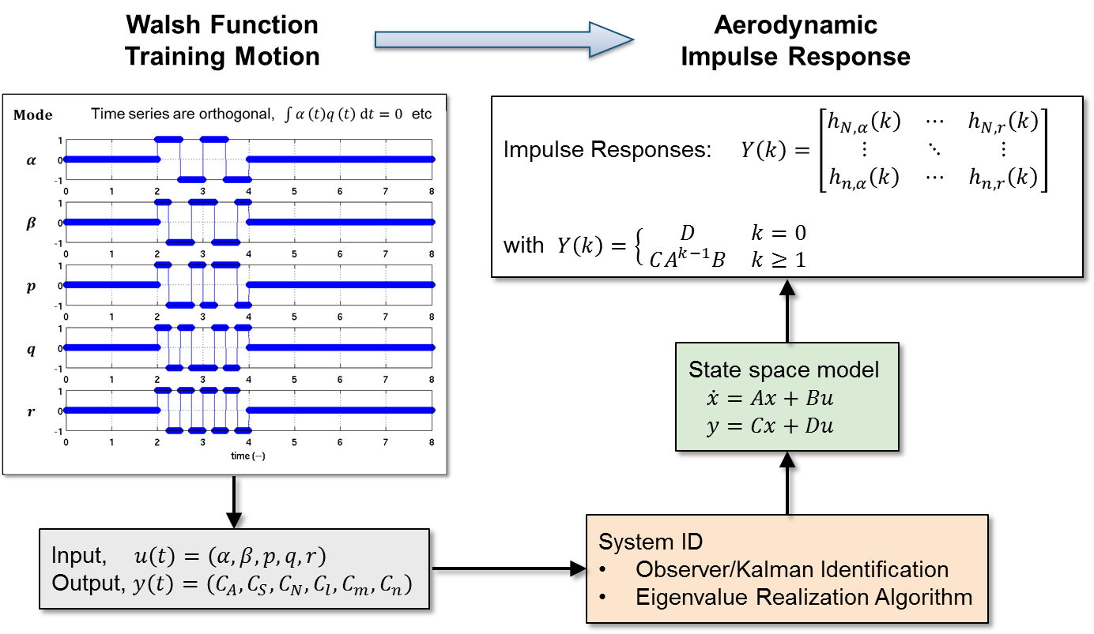
System Identification for MIMO Stability & Control Systems
”Characterizing Aerodynamic Damping of a Supersonic Missile with CFD”, Shelton (AF), Martin (AF), Silva (NASA), SciTech 2018
Computational Fluid Dynamics
(Kestrel or FUN3D)
System/Observer/Controller Identification Toolbox
(SOCIT)

Slide 13
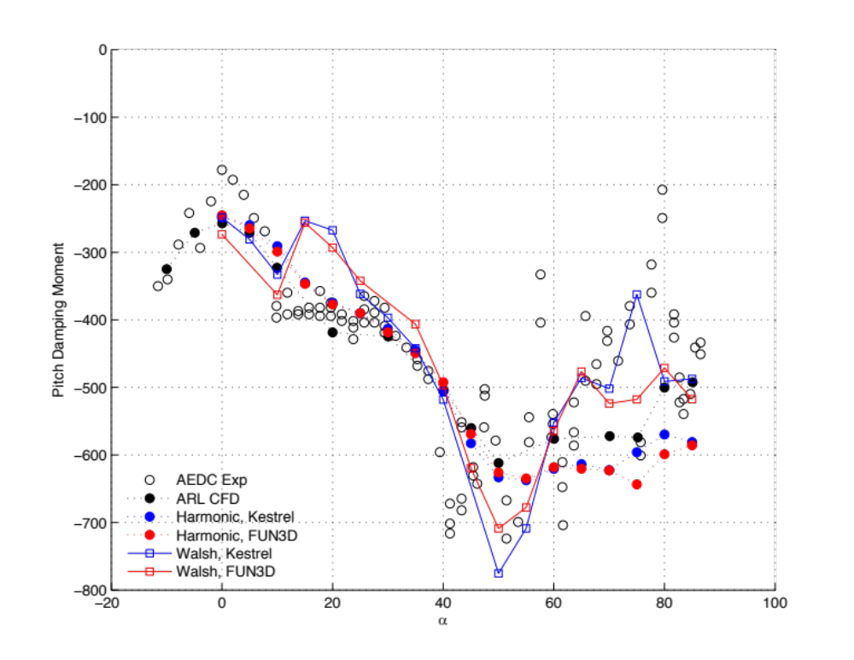
Pitch Moment Damping
Walsh Functions vs Harmonic Motion and Reference

Slide 14
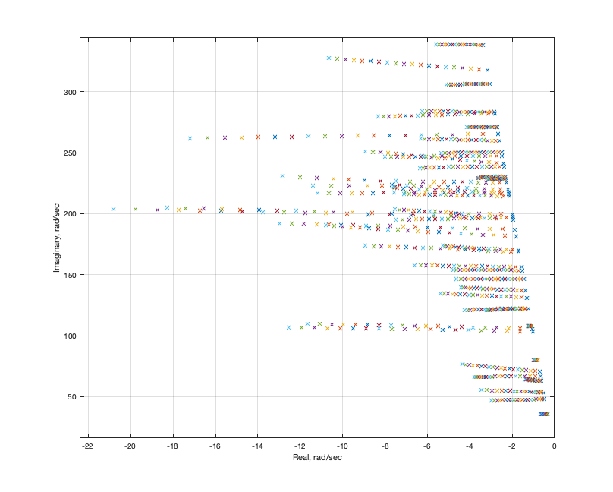
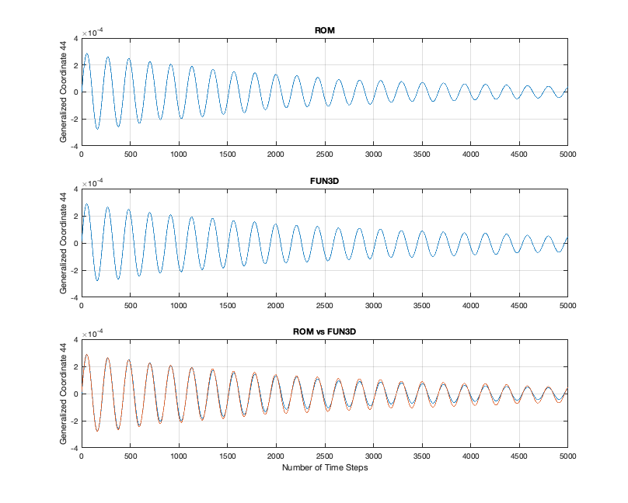
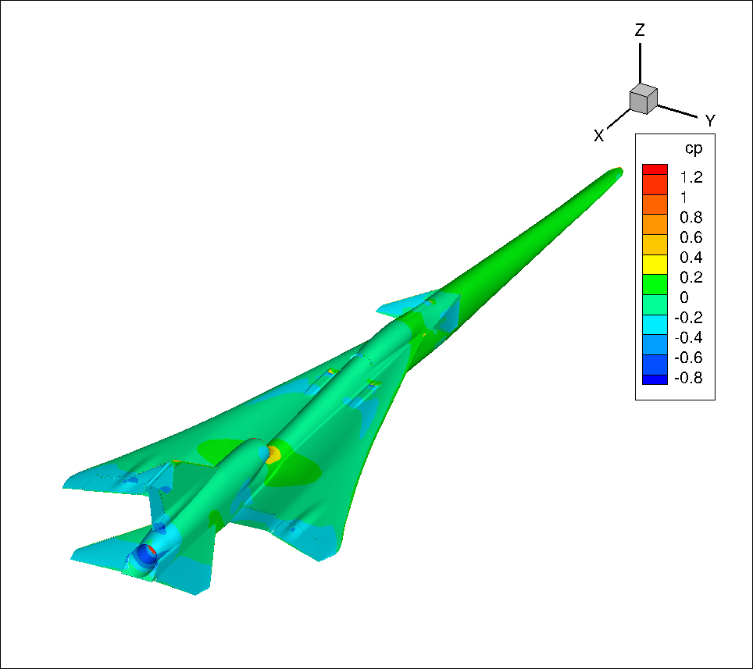
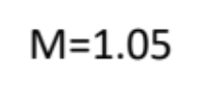
AEROM Applied to X-59
Transonic conditions, 44 modes
Mode 44 FUN3D/ROM Comparison
ROM
FUN3D
STABLE
BOTH
Aeroelastic Root Locus Plot
44 modes, 2% struct damping
(from single CFD solution-AEROM)
CFD-based analyses (full and ROM FUN3D) indicated
stability for previous FEM
Repeating analyses for latest FEM
14

Slide 15
Walsh Function Amplitudes and Alphas
Modal Amp/Alpha (deg) | 0 (K) | 1 | 3 (K) | 5 (K)
0.04 | M8A0a | M8A1a | M8A3a | M8A5a
0.01 | M8A0b | M8A1b | M8A3b | M8A5b
0.08 | M8A0c | M8A1c | M8A3c | M8A5c
0.001 | M8A0d | M8A1d | M8A3d | M8A5d
K = comparison with full KESTREL solution available or underway; using ‘Venkat’ limiter
KESTREL Solutions: Alpha = 0 deg, Q = 100 psf, Initial Modal Velocity = 5
Alpha = 3 deg, Q = 100 psf, Initial Modal Velocity = 5
Alpha = 5 deg, Q = 50 psf, 130 psf, Initial Modal Velocity = 5
NAS CPU Cost
ROM solution: 10K steps, 240 cores, 9hrs 45min (set up for high alpha case; shorter duration for benign cases)
Full Solution per Q: 15K steps, 240 cores, 53 hrs 04min (~5.5 cycles)

Slide 16
Alpha = 0 deg

Slide 17
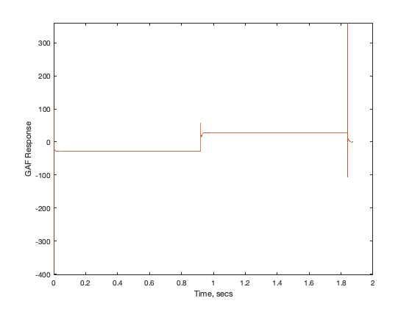
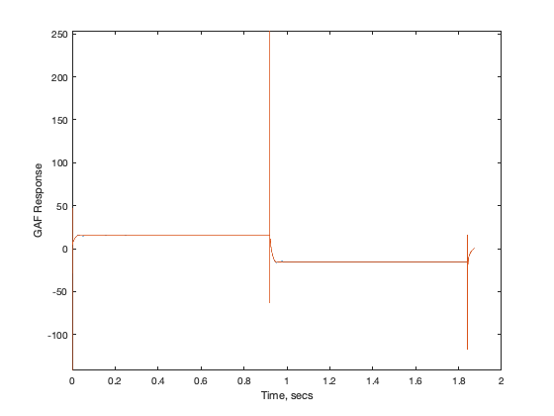
M8A0a – ROM/KESTREL GAFs
a | .04
b | .01
c | .08
d | .001

Slide 18
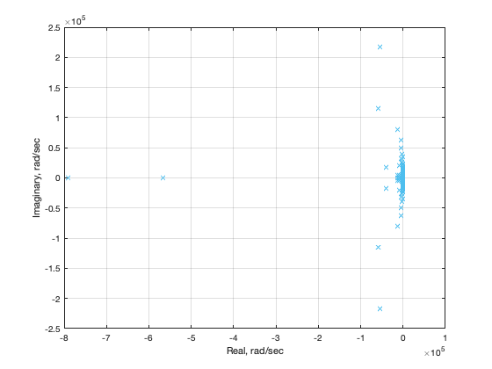
M8A0a – ROM/KESTREL Root Locus
Zoom into structural/aeroelastic
roots …
Full set of unsteady
aerodynamic roots

Slide 19
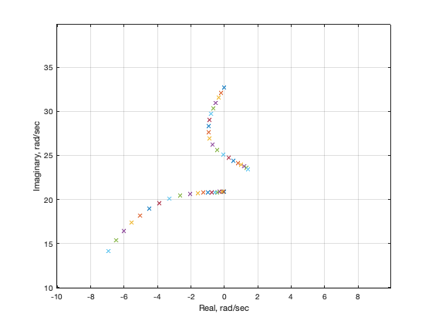
M8A0a – ROM/KESTREL Root Locus

Slide 20
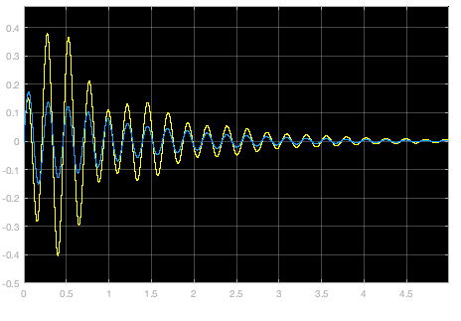
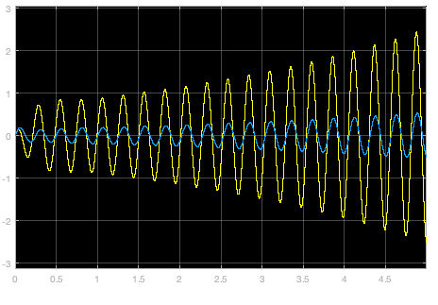
M8A0a – ROM Responses (SIMULINK)
Q = 129.6 psf
Q = 187.2 psf

Slide 21
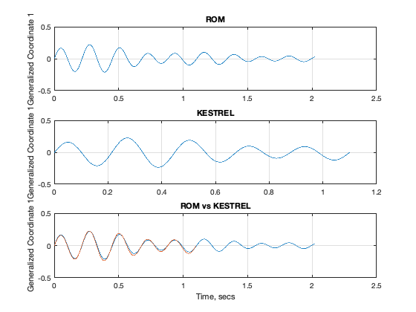
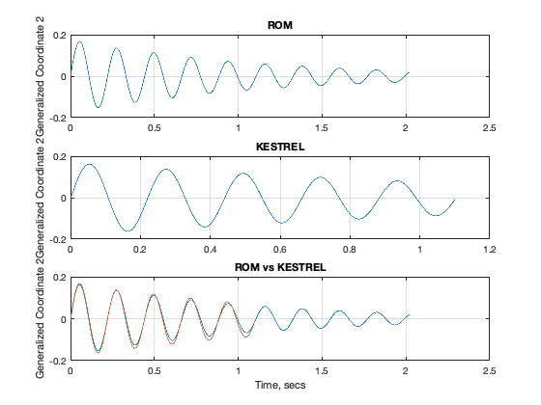
M8A0a – ROM/KESTREL Responses, Q=100 psf
Mode 1
Mode 2

Slide 22
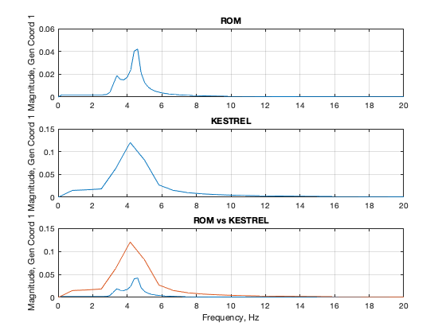
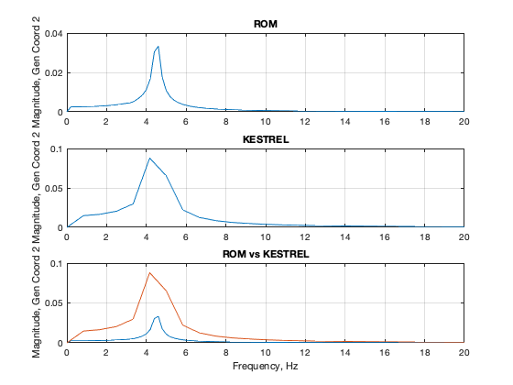
M8A0a – ROM/KESTREL Responses, Q=100 psf
Mode 1
Mode 2

Slide 23
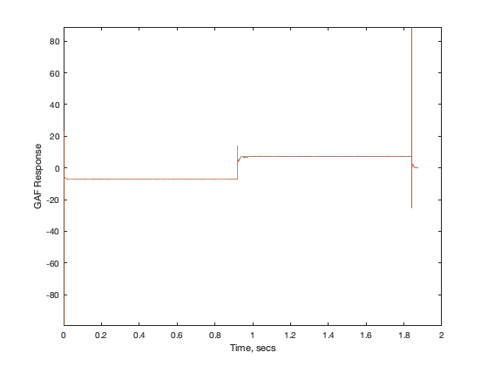
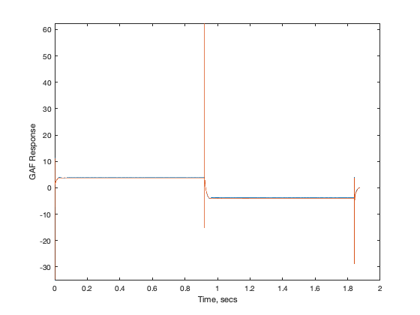
M8A0b – ROM/KESTREL GAFs
a | .04
b | .01
c | .08
d | .001

Slide 24
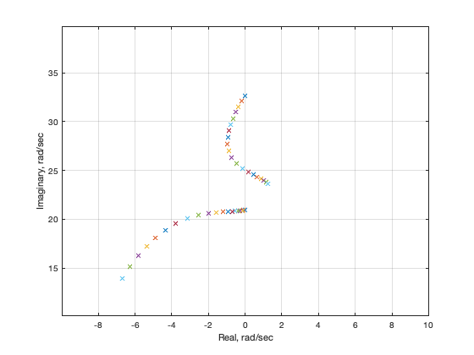
M8A0b – ROM/KESTREL Root Locus

Slide 25
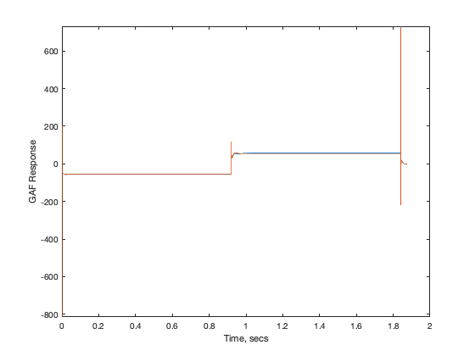
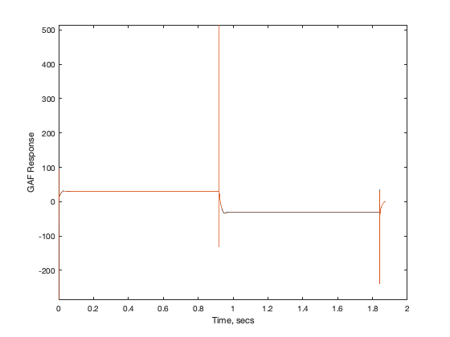
M8A0c – ROM/KESTREL GAFs
a | .04
b | .01
c | .08
d | .001

Slide 26
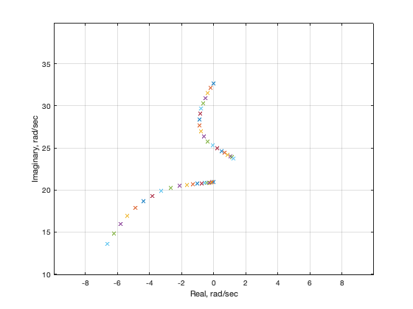
M8A0c – ROM/KESTREL Root Locus

Slide 27
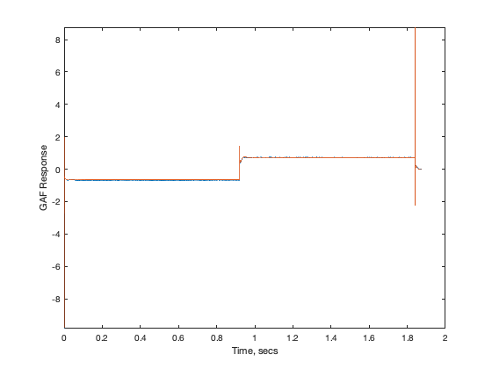
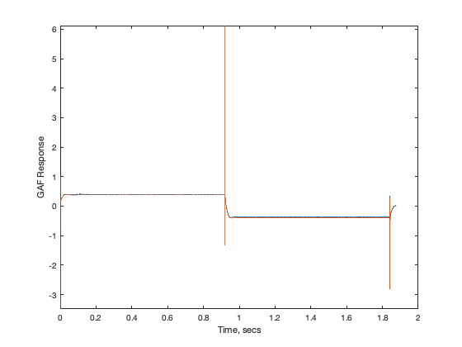
M8A0d – ROM/KESTREL GAFs
a | .04
b | .01
c | .08
d | .001

Slide 28
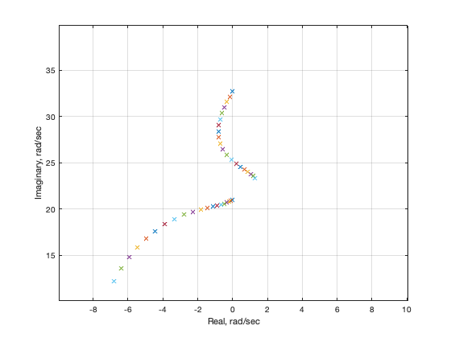
M8A0d – ROM/KESTREL Root Locus

Slide 29
Alpha = 3 deg

Slide 30
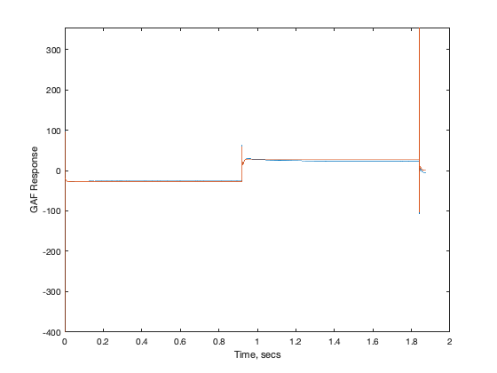
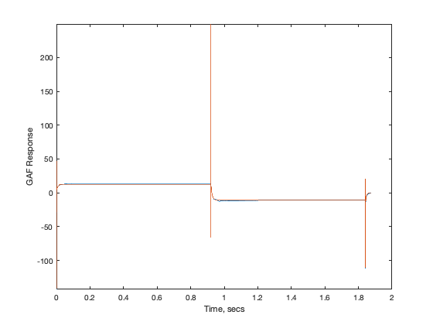
M8A3a – ROM/KESTREL GAFs
a | .04
b | .01
c | .08
d | .001

Slide 31
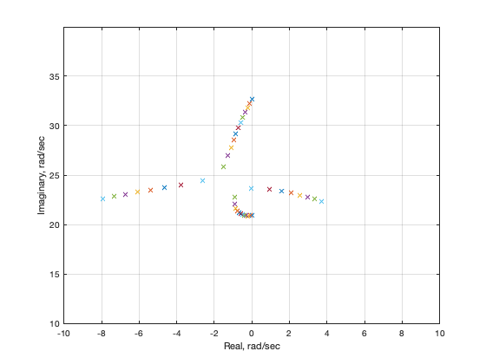
M8A3a – ROM/KESTREL Root Locus
a | .04
b | .01
c | .08
d | .001

Slide 32
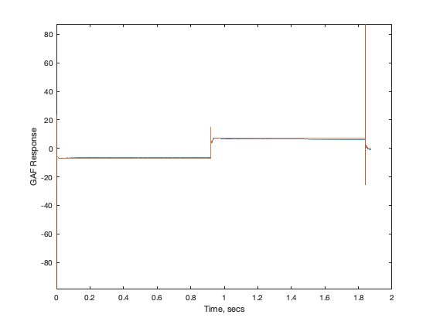
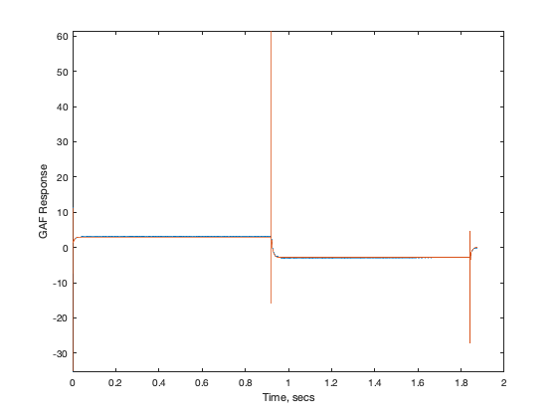
M8A3b – ROM/KESTREL GAFs
a | .04
b | .01
c | .08
d | .001

Slide 33
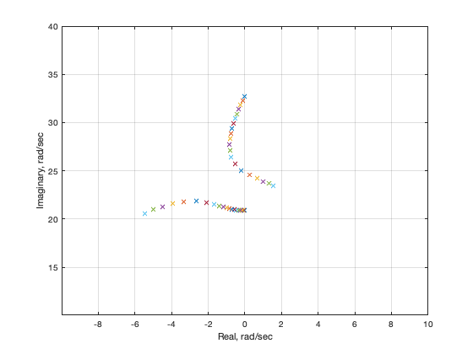
M8A3b – ROM/KESTREL Root Locus
a | .04
b | .01
c | .08
d | .001

Slide 34
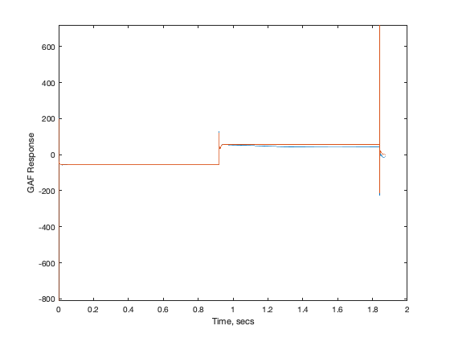
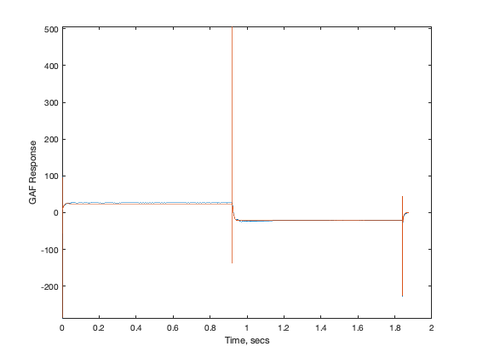
M8A3c – ROM/KESTREL GAFs
a | .04
b | .01
c | .08
d | .001

Slide 35
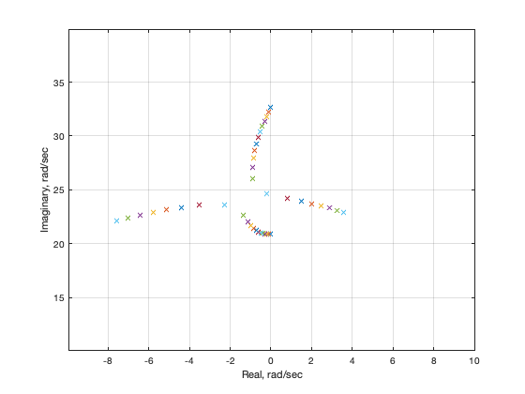
M8A3c – ROM/KESTREL Root Locus
a | .04
b | .01
c | .08
d | .001

Slide 36
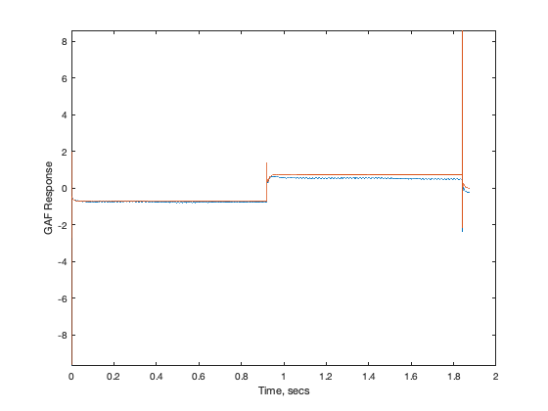
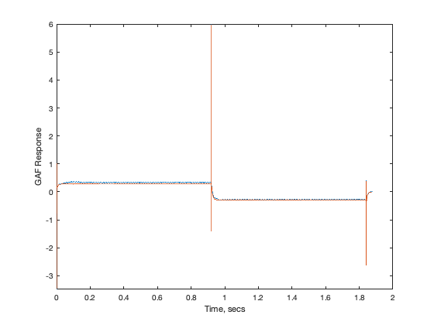
M8A3d – ROM/KESTREL GAFs
a | .04
b | .01
c | .08
d | .001

Slide 37
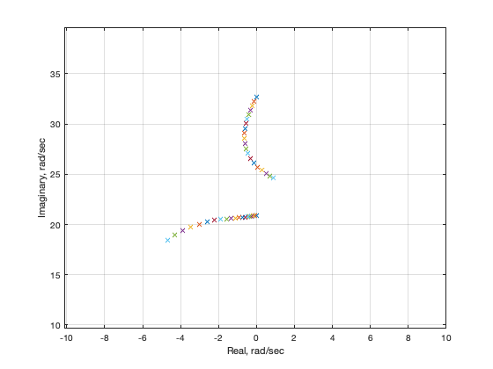
M8A3d – ROM/KESTREL Root Locus

Slide 38
Alpha = 5 deg

Slide 39
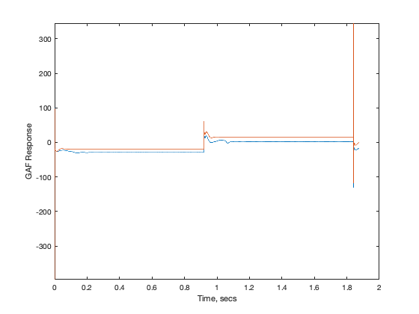

M8A5a – ROM/KESTREL GAFs
a | .04
b | .01
c | .08
d | .001

Slide 40

M8A5a – ROM/KESTREL Root Locus

Slide 41


M8A5a – ROM and KESTREL Responses
Q = 50 psf, Mode 1
Frequency
Time

Slide 42


M8A5a – ROM and KESTREL Responses
Q = 50 psf, Mode 2
Frequency
Time

Slide 43


M8A5a – ROM and KESTREL Responses
Q = 130 psf, Mode 1
Frequency
Time

Slide 44


M8A5a – ROM and KESTREL Responses
Q = 130 psf, Mode 2
Frequency
Time

Slide 45


M8A5b – ROM/KESTREL GAFs
a | .04
b | .01
c | .08
d | .001

Slide 46

M8A5b – ROM/KESTREL Root Locus
a | .04
b | .01
c | .08
d | .001

Slide 47


M8A5c – ROM/KESTREL GAFs
a | .04
b | .01
c | .08
d | .001

Slide 48

M8A5c – ROM/KESTREL Root Locus

Slide 49


M8A5d – ROM/KESTREL GAFs
a | .04
b | .01
c | .08
d | .001

Slide 50

M8A5d – ROM/KESTREL Root Locus

Slide 51
ROM/KESTREL
Root Locus Plot Comparison
M=0.80, alpha=0, 5 deg

Slide 52
Alpha=0 deg Alpha=5 deg

Slide 53
Conclusions (Thus Far)
At benign conditions (alpha=0 deg), all ROMs provide same result; gratifying, as it indicates linearized flow dynamics
As alpha is increased, variations between the different ROMs (amplitudes) start to become obvious
At alpha=5 deg, there are noticeable differences between the ROMs, indicating that the higher-amplitude ROMs do a better job (at this condition) of predicting the aeroelastic responses at multiple dynamic pressures
So far, ROM Flutter Q=179 psf; KESTREL Flutter Q=168 psf (~6.5%)
Will continue analyses at AePW-4 recommended conditions.

Slide 54
Simultaneous Inputs for NL Systems
Superposition fails for Nonlinear Systems
y(t) = x²(t)
Input: x(t) = cos(w₀t)
Output: y(t) = 1/2 + 1/2 cos(2w₀t)
Bias New frequency!!
Check:
(ax₁ + bx₂)² = a²x₁² + 2abx₁x₂ + b²x₂² ≠ (ax₁)² + (bx₂)²
Simultaneous inputs
One-at-a-time inputs

