Slide 1
Designing an ultraviolet sterilization system for Mars Sample Return’s Capture, Containment & Return System
Dr. T. Hardwick,
F. Micalizzi, D. Hughes
NASA Goddard Space Flight Center
COSPAR 45th General Assembly
Busan, South Korea
July 17, 2024

Slide 2
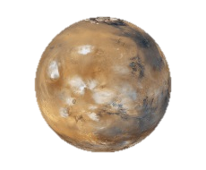
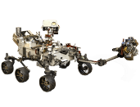
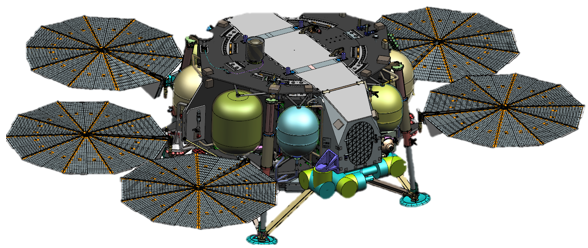

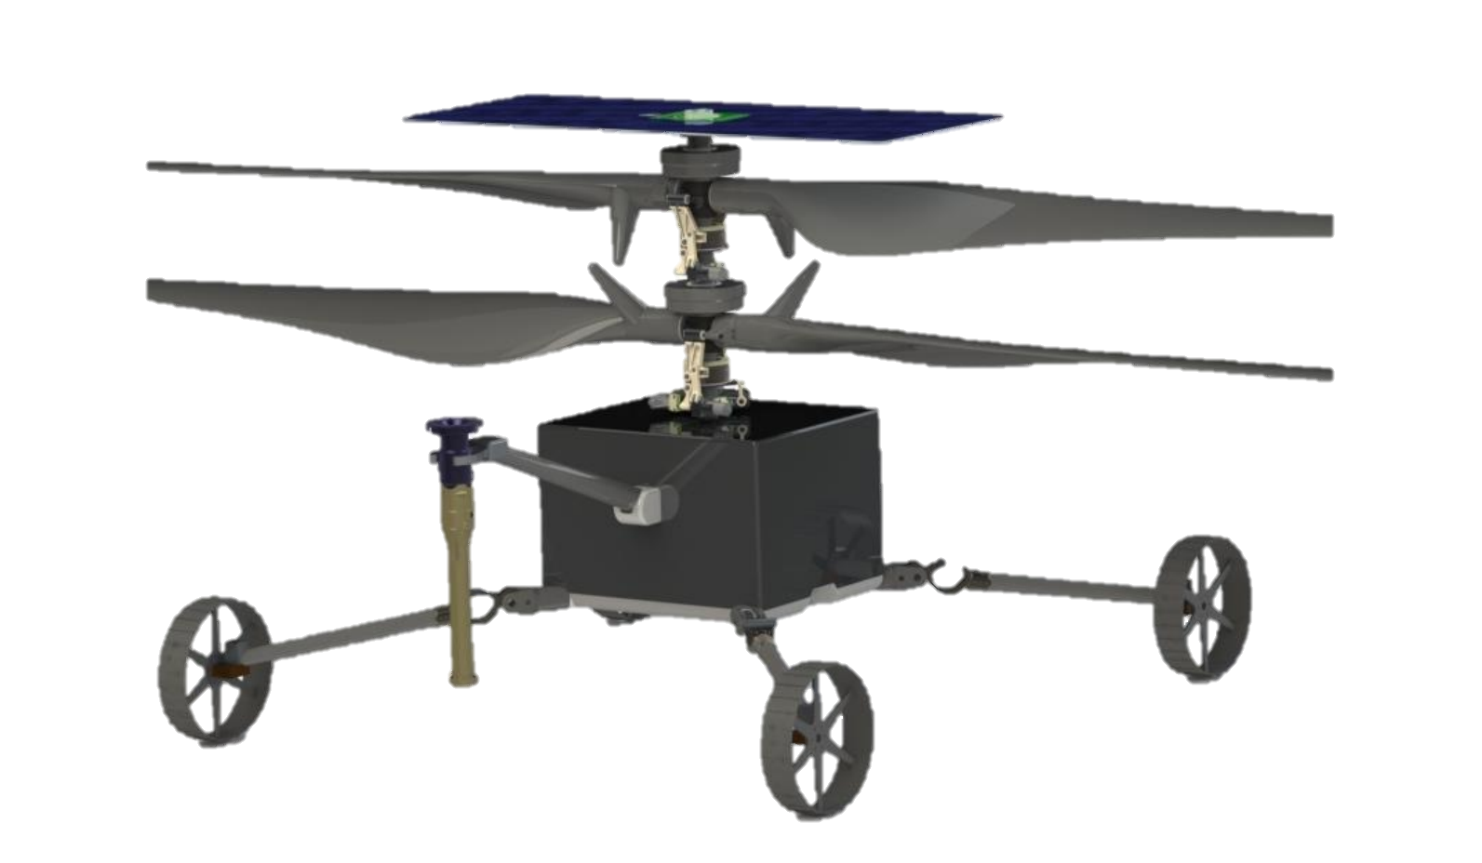
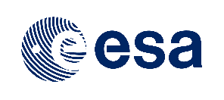
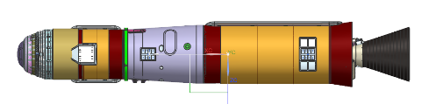
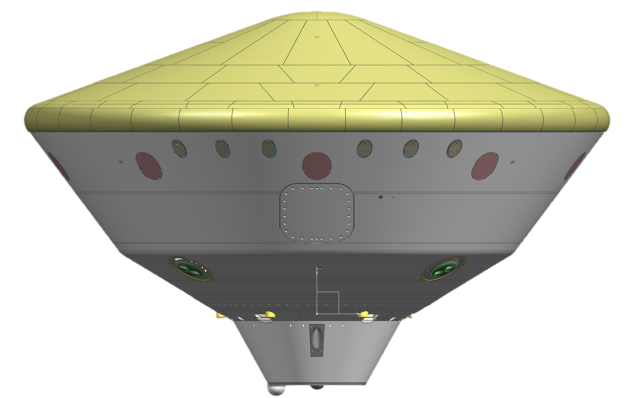

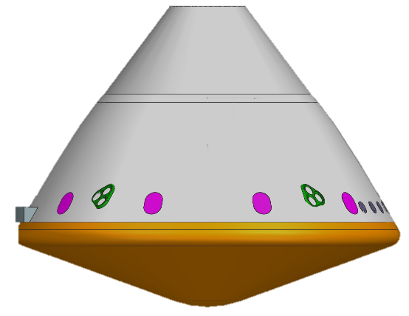
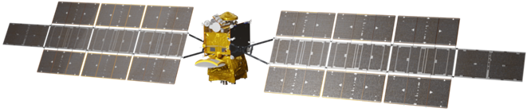
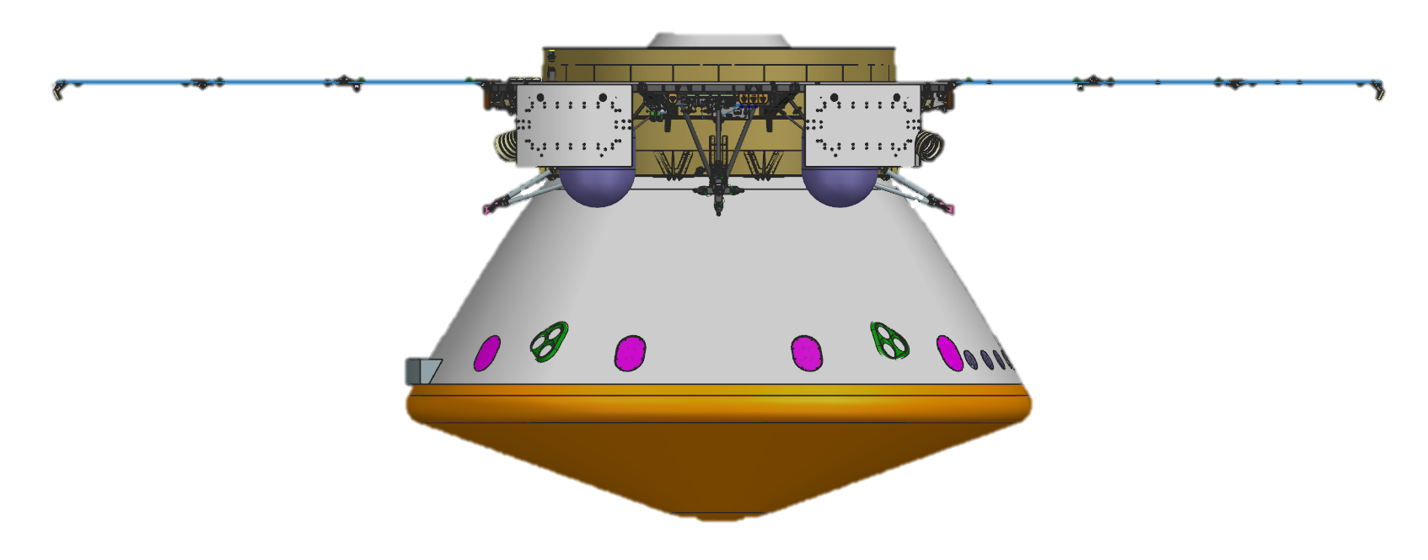
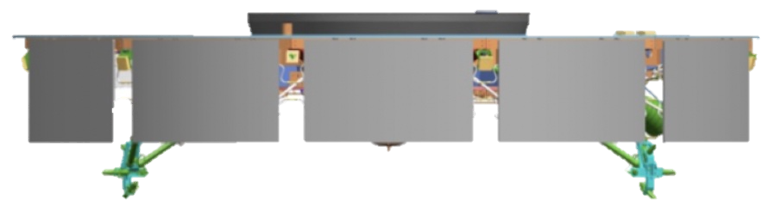




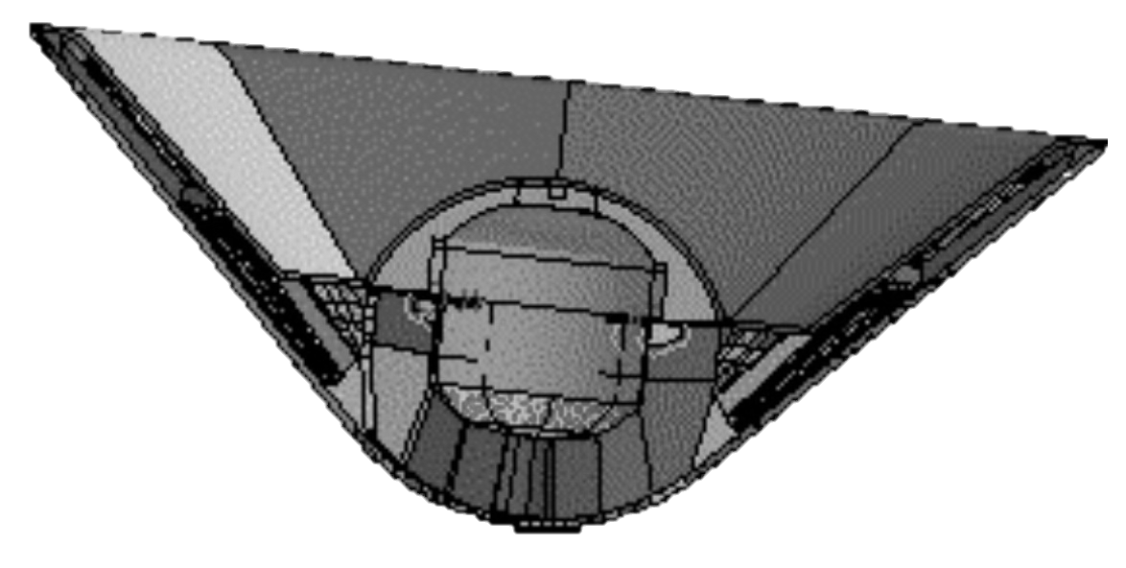

Planned MSR Campaign Architecture Overview
Mars
Perseverance
Tube Delivery
SRL with
STA
MAV
Content of this package represents status at CCRS Preliminary Design Review in December 2023.
Current architectural studies, motivated by funding profile challenges, may alter the approach.
In the interim, the MSR Program Planetary Protection team has developed an architecture-independent approach for backward planetary protection.
Tube Collection and Depot
Tube Retrieval
SRH
Orbiting Sample Container
Retrieve OS
ERO with CCRS payload
Relay Support
Break-the-Chain
Avoid Earth
COSPAR 2024
Earth Entry System
Use or disclosure of data contained on this page is subject to the restriction(s) on the title page of this document.
2
2020
Year N
Year N+1
Year N+6
Earth
MSR Program
Mars 2020 (JPL)
Earth Return Orbiter (ERO) (ESA), with
Capture, Containment, and Return System (CCRS) (GSFC)
Sample Retrieval Lander (SRL) (JPL),
with
Sample Transfer Arm (STA) (ESA),
Mars Ascent Vehicle (MAV) (MSFC), and Sample Recovery Helicopter(s) (SRH) (JPL)
Sample Receiving Project (SRP) (NASA/ESA)
Credit: MSR Program Office

Slide 3
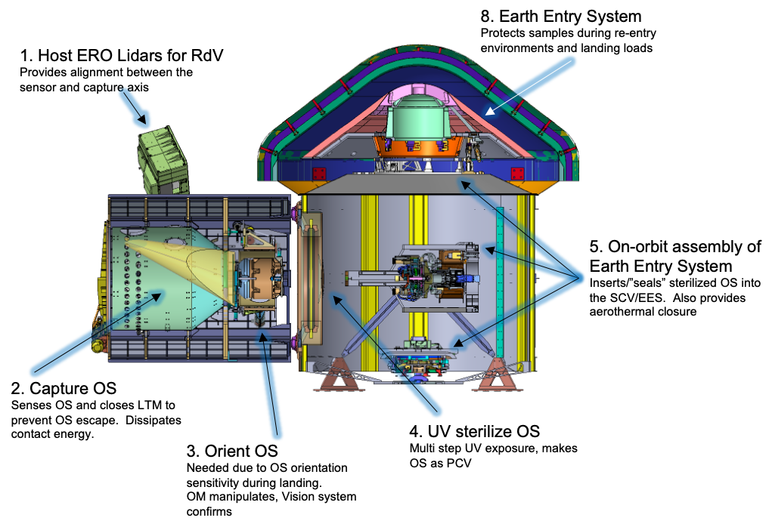
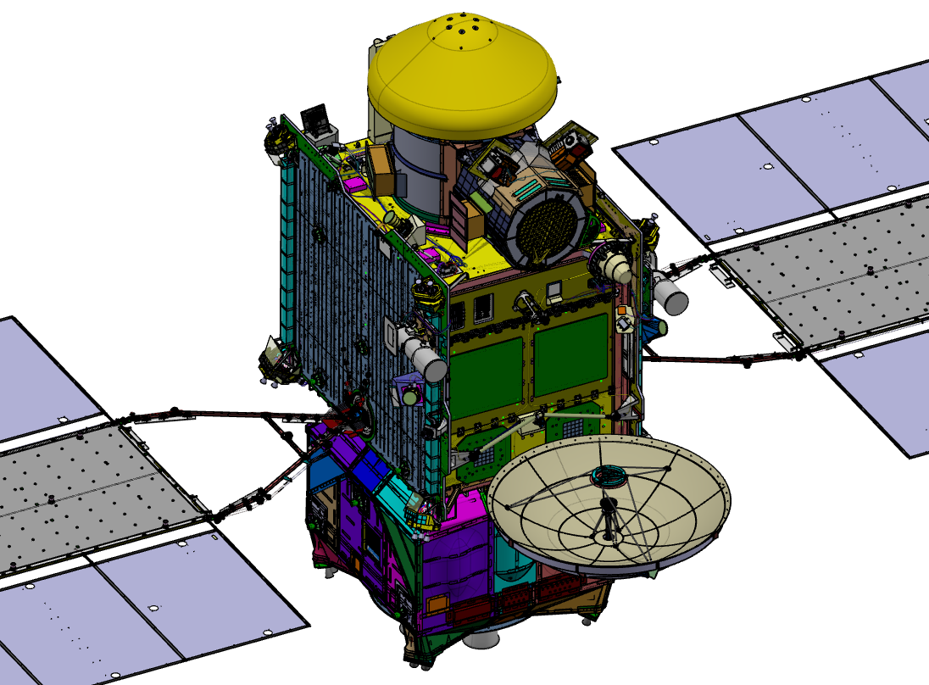
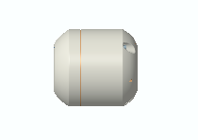
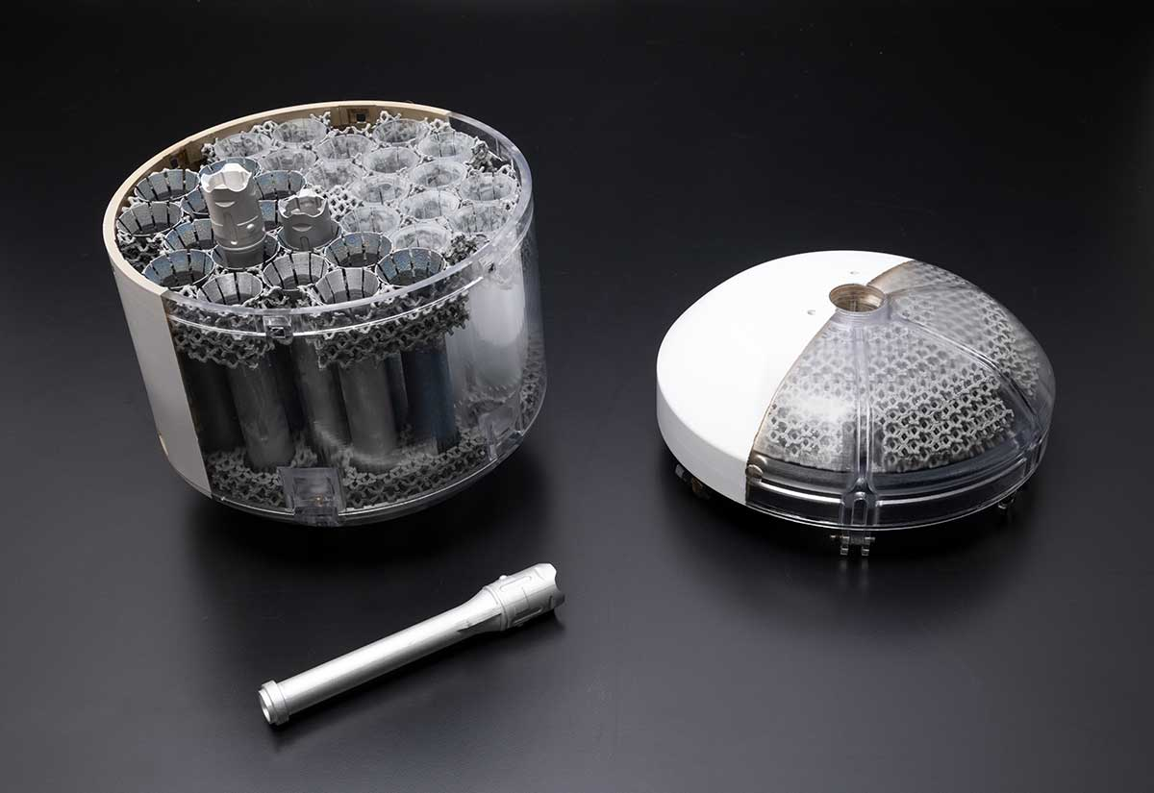
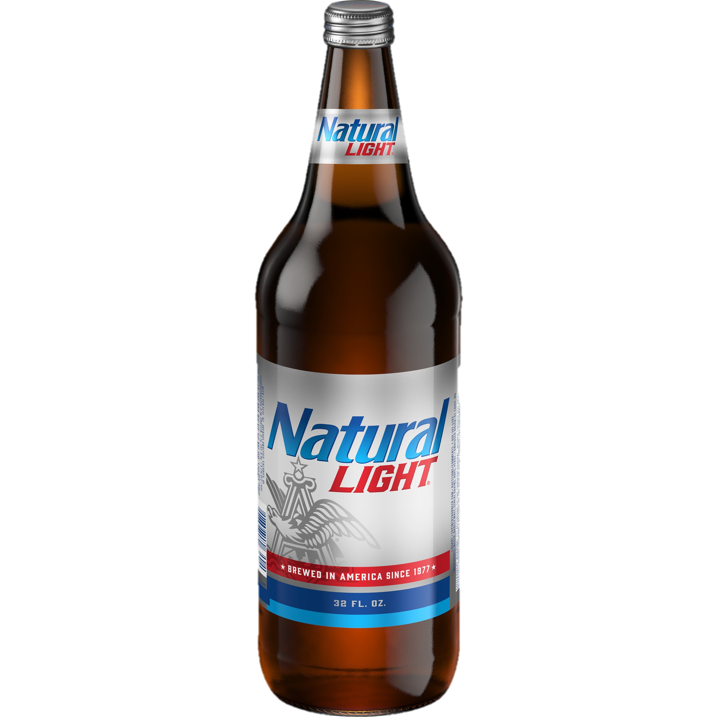
Summary of CCRS Architecture and Key Functions
CCRS
Earth Return Orbiter Spacecraft
Orbiting Sample (OS) Concept (2020)
*beverage for scale

Slide 4
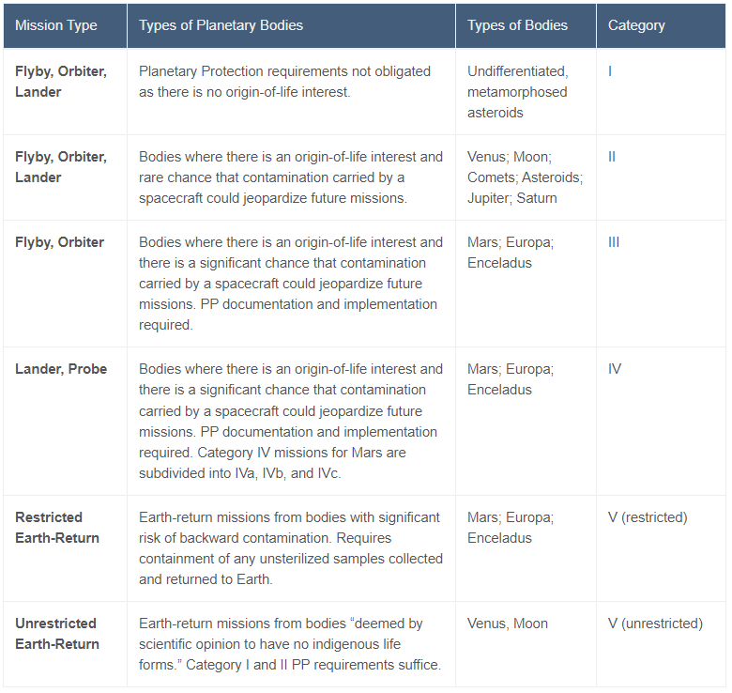
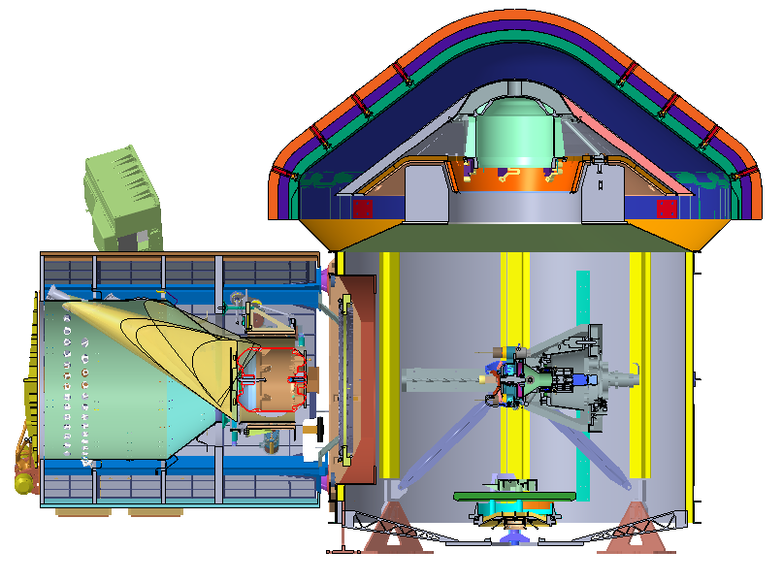
Planetary protection is a key priority of MSR
“Planetary Protection is the discipline of protecting solar system bodies such as planets and moons from possible contamination by Earth life, and protecting Earth’s biosphere from any potential adverse effects that could result from bringing material collected from these bodies back to our planet.” - Mars Sample Return Safety Factsheet (nasa.gov)
MSR follows a ‘container within a container’ approach
Sample tube container – OS – is first externally sterilized
OS then returns to Earth inside of another sterile container
The nested containers are only opened in a specialized clean room upon Earth return
https://planetaryprotection.jpl.nasa.gov/missions
See talk PPP.2 #16 by G. Cataldo et al., “Planetary protection trades and lessons learned from designing Mars Sample Return’s Capture, Containment & Return System”

Slide 5
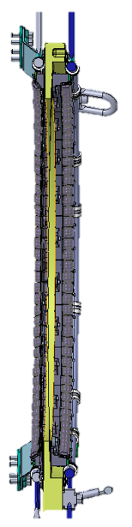
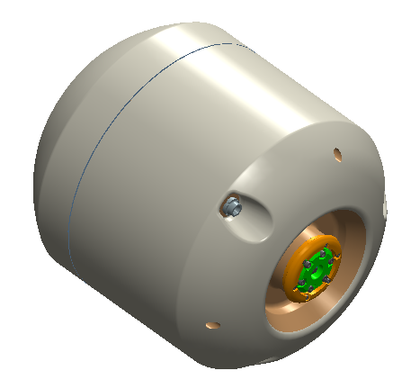
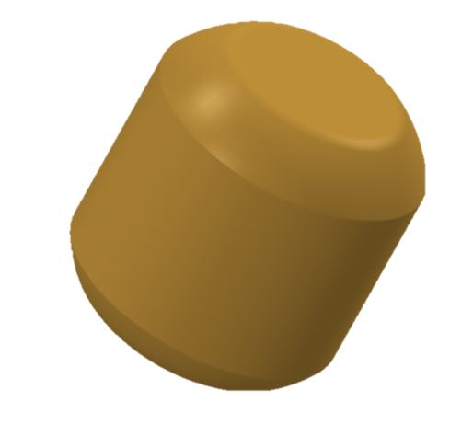
UV sterilization system inside CCRS irradiates outside of OS
CCRS uses UV-C to sterilize potential microorganisms on the outside of the Primary Containment Vessel (OS)
damage DNA → prevent protein expression → inactivate organism
The entire surface of the OS Outer Mold Line
must be irradiated with 375 W/m² UV-C
UV System
Unsterilized
Sterilized
Parameter | Requirement
Dose at particle | 20 kJ/m² (W*s/m²)
Peak wavelength | 275-285 nm
Full width at half max | 10 nm
Min unprotected flux | 3.75 W/m²
Protective factor | 100x ➔ 375 W/m²
OS
OS Outer Mold Line
OS Lid
OS Body
OS Base

Slide 6
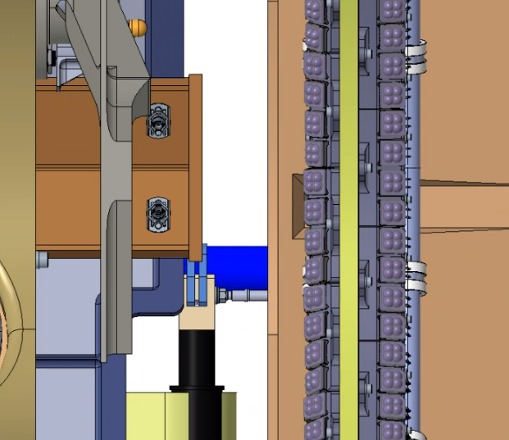
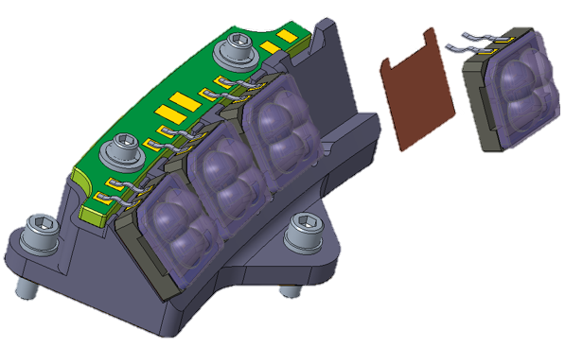
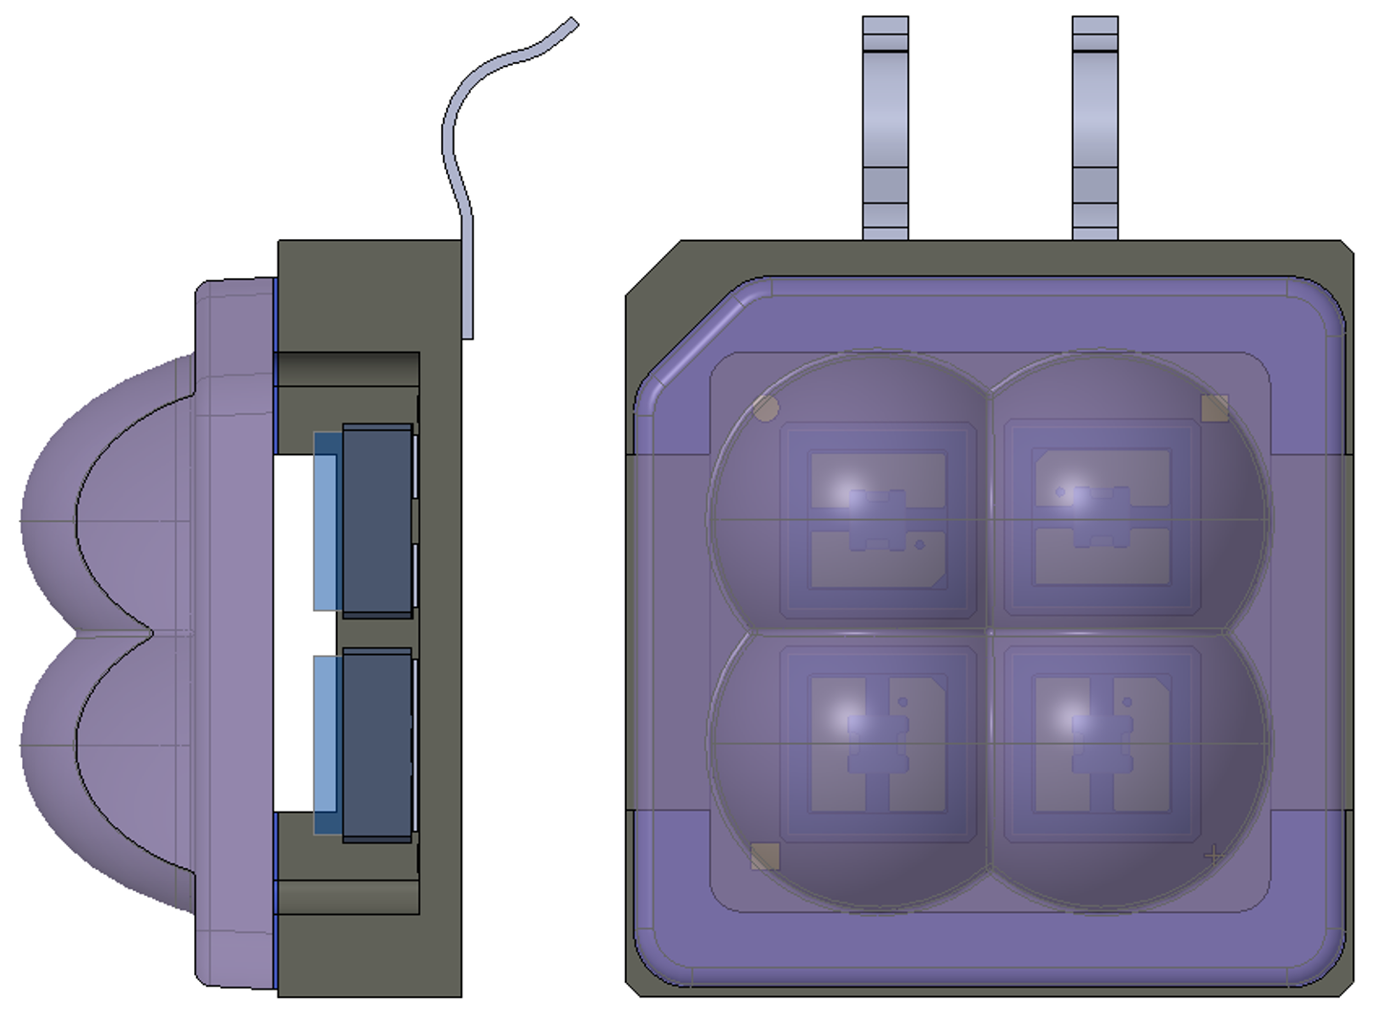
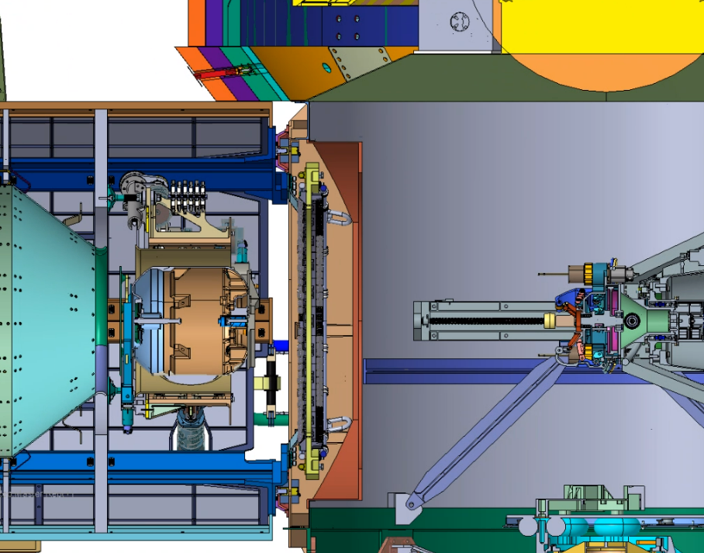
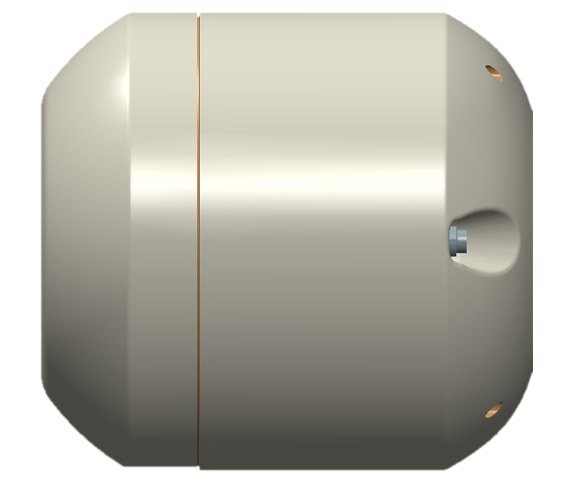
UV System is comprised of 2 UV modular Rings
Module Assemblies
Module
Light Engine
UV System comprised of two rings of UV-C LEDs + concentrating optics to direct light onto OS in a stepping procedure
Ring are illuminated in series to accommodate two phases of OS advancement through the spacecraft
Arrayed Nichia LEDs + aspheric microlens arrays
Modular ring design for ease of manufacturing, assembly, as well as a scalable testing plan
OS
Lid
OS
Body
OS
Base
See D. Hughes, G. Cataldo, et al., “Lessons learned in designing a proposed ultraviolet sterilization system for space”, Aerospace, 11(7), 2024

Slide 7
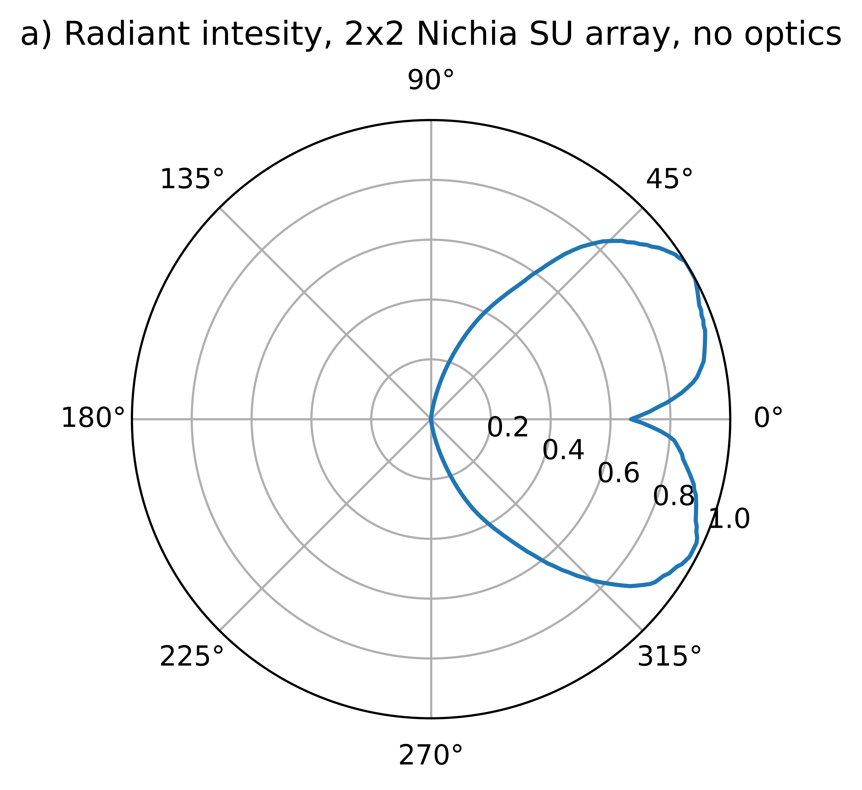
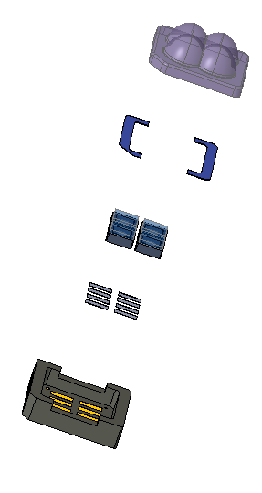
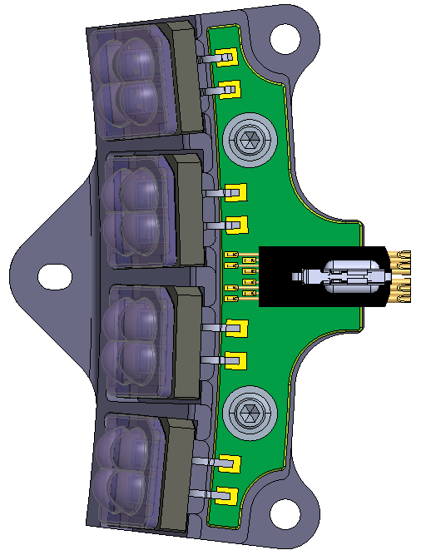
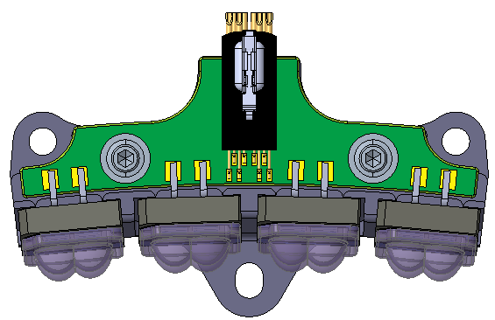
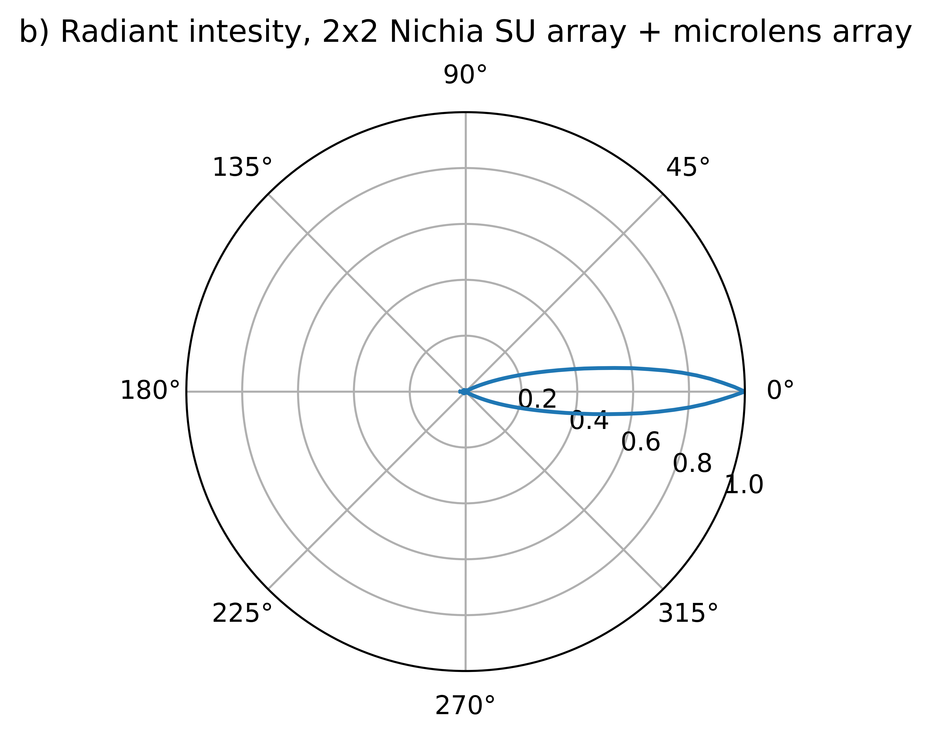
Optomechanical Design
Two Ring design enables full OS coverage under two sets of conditions in series
Array of UV LEDS + Microlens array concentrates LED output towards OS
with minimal mass and volume
UV Base Ring
Illuminates OS Base under stationary conditions from fixed location away
Light engines point at 4 angles in repeating pattern to cover OS Base entirely
UV Body Ring
Illuminates OS Body and Lid as OS is translated through the UV ring
Light engines point at 1 angle to illuminate strips of the OS Base and Lid at a time
Intensity distribution, bare LEDs
  Lens Array
  Lens Epoxy
  4x Nichia SU UVC LEDs
  Solder
Intensity distribution, LEDs + microlens array
  Submount

Slide 8
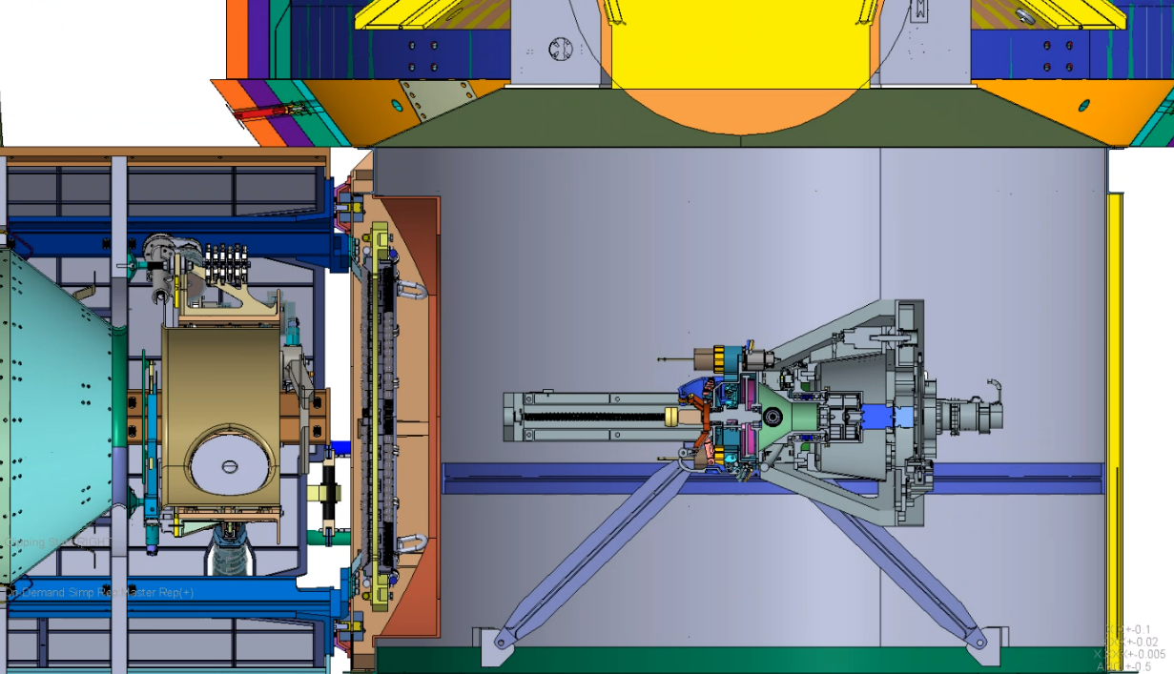
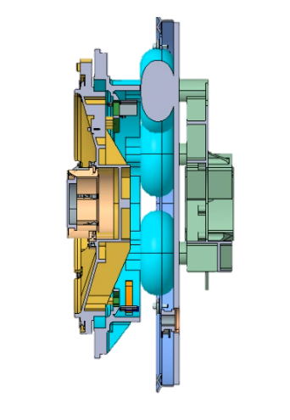

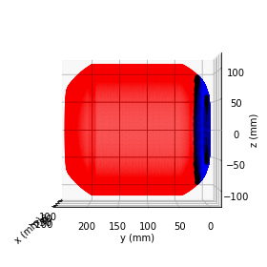

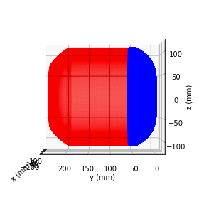
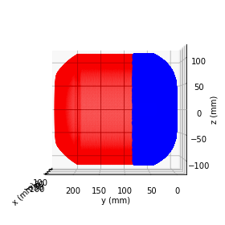
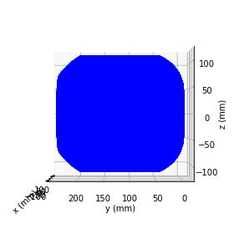
Outer surface of OS is sterilized in discreet steps
1. UV Base Ring irradiates OS Base while OS is stationary in Orientation Mechanism (OM) holding position
2. Extendable robotic arm approaches OS in OM and latches to OS Base – OS can now translate through the Rings
3. Robotic arm pulls OS through UV ring in discreet steps; UV Body Ring irradiates OS Body and Lid at each step
4. Body ring finishes Lid illumination prior to RTAS hard stop.
Step 1
Step 2
Step 3
Step 4
…
Step 11
…
OS Base illumination: 97 hours
(Step #1)
OS Body/Lid illumination: ~ 770 hours
(Step #2-12 @ ~70 hours each)
OS fully sterilized

Slide 9
Optical Design – Optical Error Budget
Design minimum irradiance established by accounting for all possible losses in the system
Irradiance reaching OS after all losses must ≥375 W/m² design must provide 563 W/m² (375 W/m² + 50%)
Optical Requirement | End-of-Life Requirement | Design Minimum Irradiance | Manufacturing | Alignment | Test | Post Launch Random Loss | Post Launch Systematic Uncertainties | Design performance after loss | Design margin
Irradiance | 375 W/m² | 625 W/m² | 8.5% | 14.4% | 7.0% | 8.9% | 15.0% | 405 W/m² | 8.0%
Manufacturing & Alignment errors account for irradiance loss from LED mount in die to the UVIA (UV Optical bench) relative to the OS
  LED Die
  LED
  Submount
  Submount Assembly
  Lens Array
  Light Engine
  Module Mount (1 & 2)
  Module (1 & 2) Assembly
  Base Ring & Lid Ring
  UV Optical Bench
  UV Optical Bench Flexures
Test Uncertainties
  Telemetry Uncertainty (Fresnel loss, angle uncertainty)
  Other
Design providing 8% additional margin on top of required 563 W/m²
Post-Launch Random Loss:
OS Position Uncertainty
  Thermal impact on Pointing Angle
  Vibration
    Thermal impact on LED output
    Current uncertainty impact on LED strings
Post-Launch Systematic Loss:
Molecular Contamination
Particle Contamination
Radiation (Diode Irradiation)
Diode aging
Legend:
UVIA pointing to OS
OS relative to UVIA
Losses to radiance

Slide 10
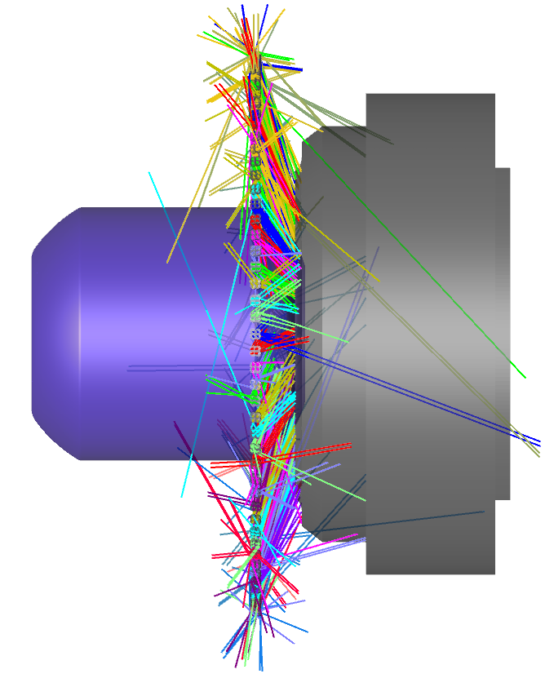
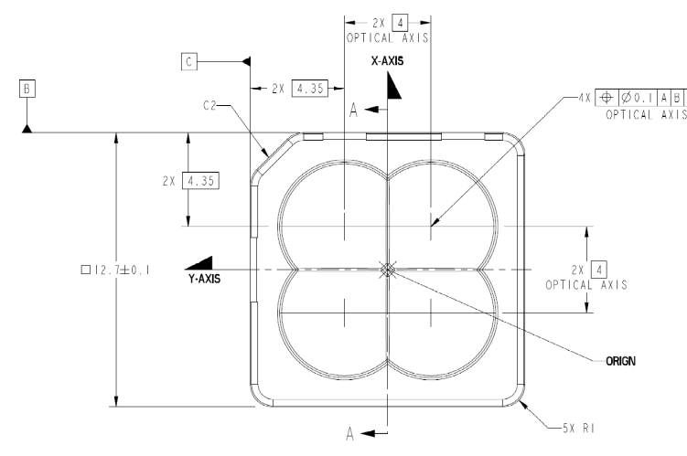
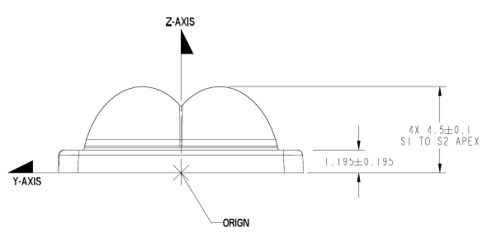
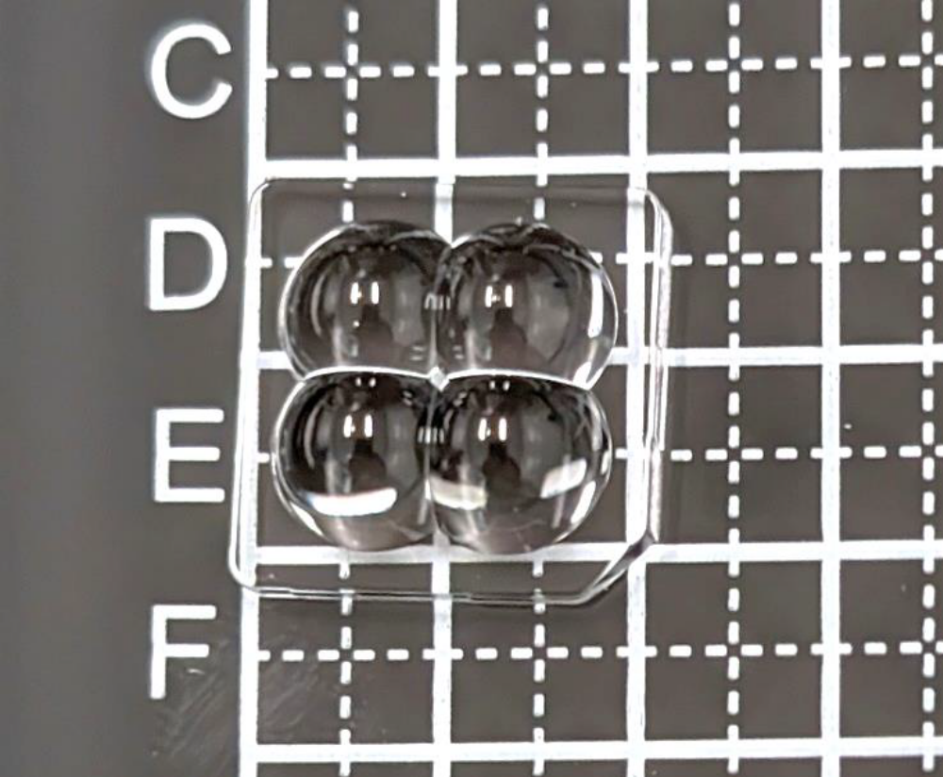
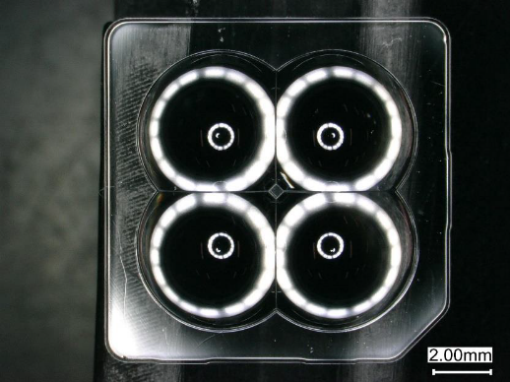
Optical Design – Lens Arrays with 2x2 Nichia SU LEDs
Final optical design leverages arrays of aspheres to concentrate over 400 UV LEDs onto the surface of the OS simultaneously
Each microlens array has 4 identical aspheres merged; each asphere is centered over one of the four Nichia LEDs in the 2x2 LED array
Mission Requirements:
375 W/m²
  End of Life requirement
Design Goals:
563 W/m² (375 W/m² + 50%)
  Estimated errors end of life
  No reserve margin
Current Design:
625 W/m² (375 W/m² + 67%)
  Reserve margin
OS as it is pulled through UV Body Ring
Design Parameters
LEDs: Nichia NCSU434C(T)
Power: 150 mW per LED (overdriven)
Bandwidth: narrow band centered on 280 nm
Lens Array: Molded fused silica substrate of 4x aspheres
Light Engine: Lens Array + 2x2 LEDs, 4 per Module
Module: 4 Light Engines, 26 per Ring (104 Light Engines)
Delivered prototype microlens arrays

Slide 11
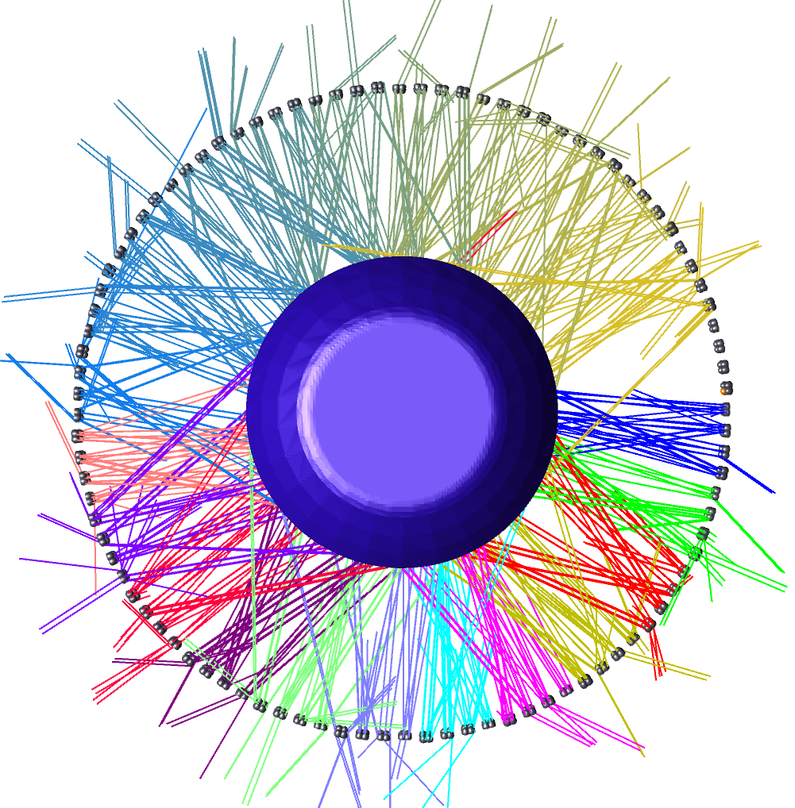
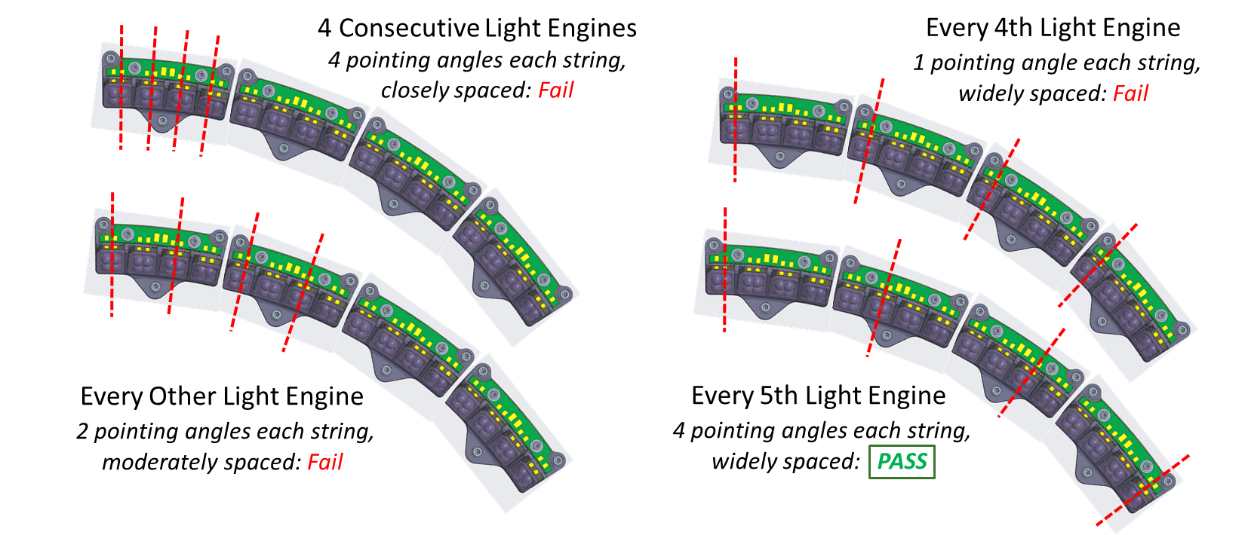
Optical Analysis – String Failure Fault Tolerance
UV system is NOT redundant
However, impact from string failure can be minimized by clever choice of how to wire up a string
A single electrical string is comprised of 4 Light Engines wired together
Minimum spacing of 5 light engines between those strung together ensures that a single string failure will not result in failure to meet requirement
If multiple strings fail but are distributed far from each other, requirements could still be met

Slide 12
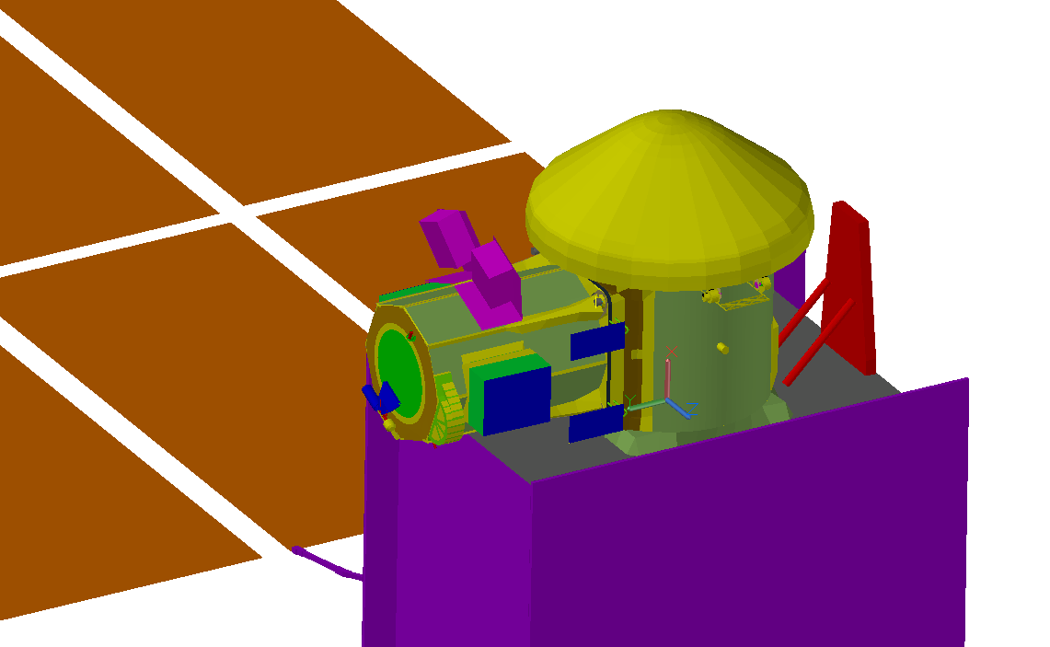
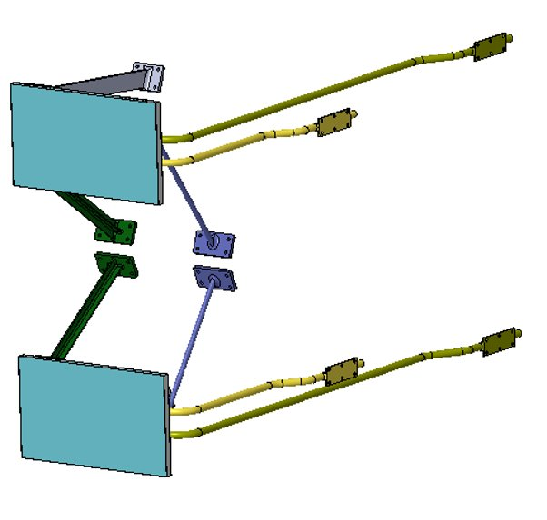
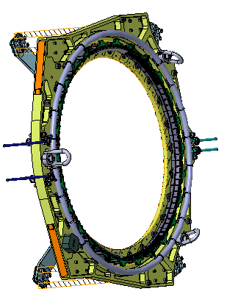
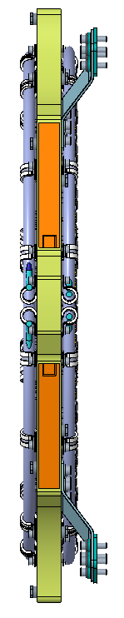
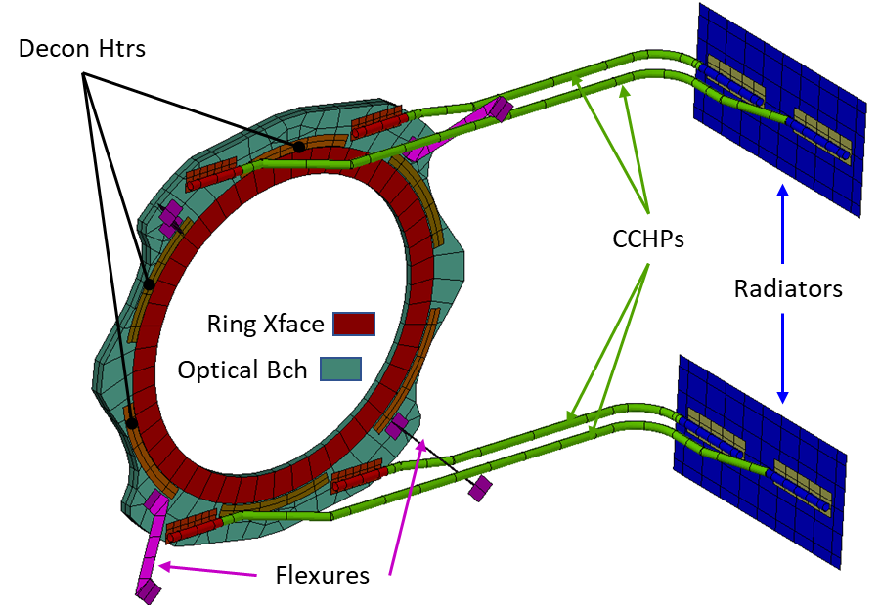

UV Illumination System Mechanical and Thermal Components
UV Rings mounted on the UV Optical Bench along with:
Base and Lid facing SMR Nests
Module and Thermal Harnessing
Optical Bench Flexured Assembly
Hoist Rings
416 UV LEDs on simultaneously require sophisticated heat rejection system
  UV Thermal Radiator and Heat Pipes
  UV Electronics Box

Slide 13






Nichia SU LEDs and lens material meet system allocations
LED Thermal Cycling: passed
Thermally cycled from –40C to +85C (survival temperature range) for a total of 500 cycles
Expected degradation (<9%)
LED Burn-in: passed
Average optical power degradation for the 3 CW LEDs after 1000 hours of on-time was -8.11%, within manufacturer’s expectations
LED Cold Storage: passed
Parts stored at –40C, –50C for 100 hours each
Minimal/no optical power degradation witnessed
Lens Material Radiation: passed
Temperature controlled runs in CW and pulsed for up to 1000 hours
~8% degradation after 1000 hours, within expectations
LED Radiation: passed
LEDs subjected to increasing proton radiation dosage from 10 – 450 krad
No overall degradation
LED spectra: passed
Requirement: 275-285 nm
Measured spectral peak: 277 nm
Notes:
Frankie: note that these parts were not burned in, so this is a combination of burn in runtime AND temp cycling. So if we were to burn in, we'd see some degradation.
Not done in vacuum.
Frankie: 1. we validated specs on operating and storing, and exceeded specs for –40.
Wendy: Jim will have already introduced flight limits. Maybe add the flight limits, circle back to what we care about. Add a Bang Box at the bottom: parts tested and performed at mission environment, etc.
Oscar: will show 8% degredation, which Dillon will show later and its less than 8%.

Slide 14




Prototype light engine development and testing underway
Testbed at GSFC to measure irradiance of prototype light engines
Testbed will measure single light engine irradiance over section of the OS OML for model verification
Delivery of first prototype light engines August
End-to-end tests already run on single Nichia LED (no optic) have verified model (with same parameters) to within test measurement error (5.25%)
  Results show measurements match or exceed model predictions, in agreement with prior measurements showing Nichia LED output exceeded data sheet assumptions
UV-C photometer
TEC mount
LED assembly
SMR targets
hexapod
  Test error = 5.25%
Measured irradiance of single LED is
within test error or higher than modelled

Slide 15
Conclusions
A design was developed that meets sterilization irradiance requirements
  A dual-ring design enables full OS OML coverage before and during OS transit through the spacecraft, establishing a ‘dirty’ space (to be jettisoned) and ‘clean’ space
  Requirements met at end-of-life, considering all error allocations
  Design holds 8% margin and is tolerant to single string failure
Light engine prototype manufacturing and testing underway
  First microlens arrays delivered
  First Light Engines delivered in a month
  Testing and analysis pipeline developed and pre-tested with single LEDs

Slide 16




Acknowledgements
Co-authors:
  David Hughes, Giuseppe Cataldo, Fernando Pellerano, Frankie Micalizzi, Victor Chambers, Brian Bean, Berton Braley, William Cook, Ratna Day, Thomas Emmett, Clark Hovis, Stefan Ioana, Dillon Johnstone, Amandeep Kaur, Wendy Morgenstern, Nicholas Nicolaeff, Lawrence Ong, Len Seals, Richard Schnurr, Laurie Seide, George Shaw, Kevin Smith, Oscar Ta, William Thomes, Honam Yum
Presenter:
  Brian Clement, JPL
The entire ERO-CCRS team from both sides of the Atlantic
The MSR Program
Any questions?
Reach out at terra.hardwick@nasa.gov
Learn more here:

Slide 17
Backup

Slide 18

Acronyms

Slide 19



CCRS Key and Driving UV Requirements and Implications
Proof of sterilization protocol viability is the responsibility of the Campaign
CCRS requirements, and therefore verification, are to provide UV light exposure for a given time to particles that are not contained
  Containment is defined by a particle not being able to be released so it can be applied to particles in seams or crevices as well as those that a casual observer would call “inside” the containment vessel
Parameter | Active UV
Biological stasis* | T ≤ -28°C or Wa ≤ 0.5
Sterilizing dose | 20 kJ/m²
Peak wavelength | 250-280 ± 2 nm
Full width at half-maximum | 10 nm
Minimum unprotected flux** | 3.75 W/m²
Protective factor *** | 100
UV Outer Mold Line
OS
OS
*We are relying on vacuum to keep water activity (Wa) low and permit discontinuous treatment
**Flux at outer mold line of OS (3 times the maximum experienced at the top of Mars atmosphere)
*** Shielding provided by macro and microscopic features
Protection Factor

Slide 20





OS (Orbiting Sample Container) as of Nov 2023
OS Base
OS UV Outer Mold Line (OML)
OS Lid
OS Body
OS Lid
OS Base
OS Base
OS Lid
OS Body
OS Lid
OS Base
221mm
239mm
EXTERIOR SURFACE COATING:
CERANOVIS V-14 ACF WITH INORGANIC SEALANT
Same dimensions, no features

Slide 21

Mech Design – UVIA Elements
Base and Lid facing SMR Nests
TC105’s and P-clamps will be used to tie down both Module and Thermal Harnessing bundles (zip ties or lacing cord)
Module 1 & 2 Assemblies
Optical Bench Flexured Assembly
Hoist Rings
  Optical Bench
  Thermal/Flexured Assembly
  (2338581)
  TC105 and P-Clamp Attachment Hardware
  Lid facing SMR Nests
  Module 1 and Thermal Harnessing
  Base facing SMR Nests
  Module 2 and Thermal Harnessing
  Hoist Rings
  Module 2 Assemblies
  (2338620)
  Module 1 Assemblies
  (2338610)
  TC105 and P-Clamp Attachment Hardware

Slide 22









Con-Ops – OML Base, Body and Lid Illumination in 12 Steps
Goal + margin met: 625 W/m² Base illumination plus 11 Lid Ring translations, 25 mm each step
Base
Step 1
Step 2
Step 3
Note: Steps 1-10 alone do not provide full coverage at the inner Lid transition point.
Step 11 is necessary for complete coverage.
Step 1
25 mm
25 mm
Step 4
Step 5
Step 6
Step 7
Steps 1-10, Lid View
25 mm
25 mm
25 mm
25 mm
Step 8
Step 9
Step 10
Step 11
25 mm
25 mm
25 mm
25 mm
Base + 11 steps meets requirements

Slide 23


Thermal Environments
Hot and Cold case parameters from ERD
Hot Case for UV System
  Low Mars Orbit (LMO), Altitude 275 km
  Orbit Period 112.6 min, 33.1 min eclipse
  Beta 51
  Solar flux 720 W/m2
  Albedo 0.4
  Planetshine +20C sun side, -140C dark side
Cold Case for UV System
  High Mars Orbit (LMO), Altitude 440 km
  Orbit Period 120.3 min, 41.6 min eclipse
  Beta 0
  Solar flux 439 W/m2
  Albedo 0.1
  Planetshine -60C sun side, -140C dark side
Attitude is ‘roll control’
  SEP thrusters anti-ram (antenna is ram side)
  ERO rolls about body Y to maximize array power
  Arrays track sun
Optical Bench
+Y Ring (red)
CE structure transparent
B51 LMO: Orbit Raising w Roll Control
UV EBox
RAM
UV EBox
HRS Radiators

