Slide 1
Egg-stronautics
Systems Engineering for Descent and Landing
Workshop
Dr. David Korsmeyer
Deputy Center Director
NASA Ames Research Center

Slide 2
Workshop Concepts:
For this Workshop we will not Consider Atmospheric Re-entry, due to $ and time.
The Focus of our Effort is “Descent” and “Landing”, and how that will effect our Egg.
The Workshop Goal is to understand how Space Systems are driven by their Requirements, and the Systems Engineering Process that enables a team to “Solve” or satisfy those Requirements.
You will be broken into Teams and given limited supplies and limited time to achieve your Goal.

Slide 3
What is Systems Engineering:
Systems Engineering: An interdisciplinary field of engineering that focuses on how to design and manage the engineering of a System made up of many elements
The SE process starts with:
  Documenting the Problems that need to be resolved
  Creating specific “Requirements” to measure a successful Solution,
  Tracking those Requirements to each element of the Solution,
  Identifying the highest impact failures that can occur in your and stopping them.
References:
NASA Systems Engineering Handbook:
http://ntrs.nasa.gov/archive/nasa/casi.ntrs.nasa.gov/20080008301.pdf
NASA NPR 7123.1, Systems Engineering Processes and Requirements
http://nodis3.gsfc.nasa.gov/displayDir.cfm?t=NPR&c=7123&s=1B
And wikipedia’s overview: https://en.wikipedia.org/wiki/Systems_engineering
Brooks, F., ( 1995 ). The Mythical Man Month: Essays on Software

Slide 4
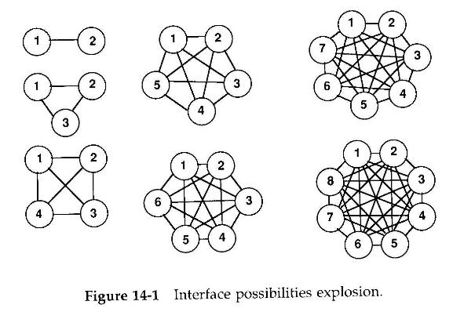
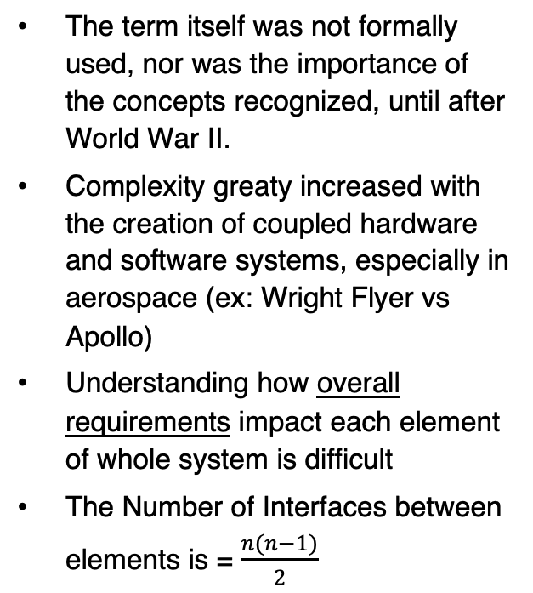
Why has Systems Engineering Emerged as A Distinct Discipline?
The term itself was not formally used, nor was the importance of the concepts recognized, until after World War II.
Complexity greaty increased with the creation of coupled hardware and software systems, especially in aerospace (ex: Wright Flyer vs Apollo)
Understanding how overall requirements impact each element of whole system is difficult
The Number of Interfaces between elements is = $\frac{n(n−1)}{2}$

Slide 5
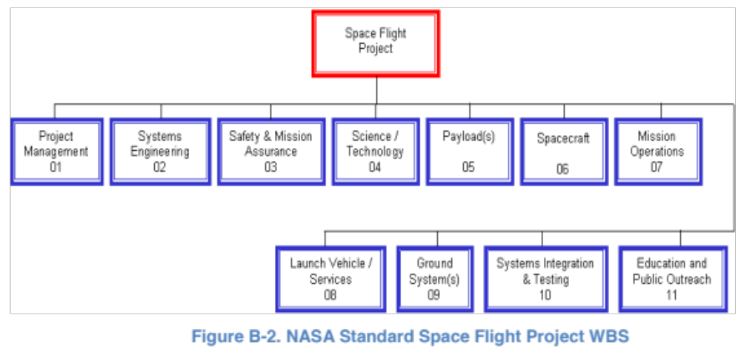
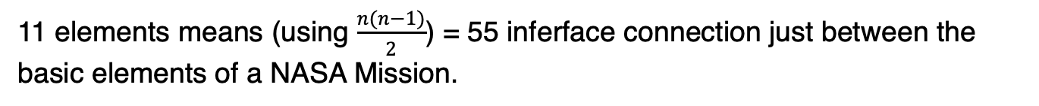
How many elements are in a basic NASA Mission?
11 elements means (using $\frac{n(n−1)}{2}$) = 55 inferface connection just between the basic elements of a NASA Mission.

Slide 6
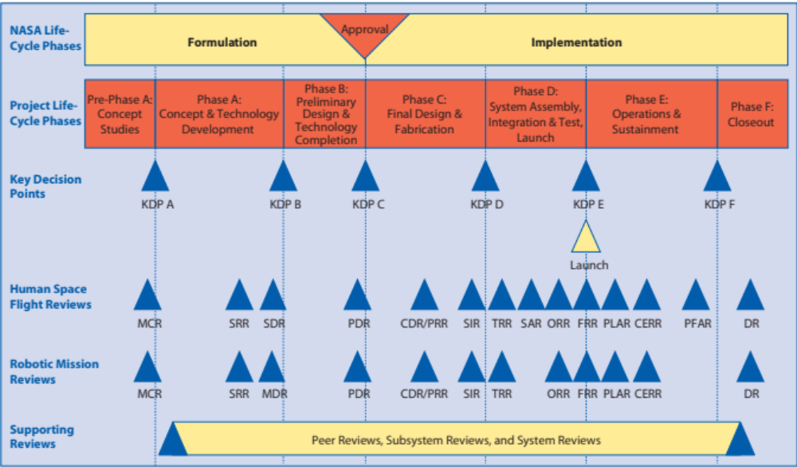
NASA Project Life Cycle; Reviews

Slide 7
Applying Systems Engineering:
Understand the Milestones that define a Successful Mission
  (What are you trying to achieve?)
Determine the Requirements that must be met to achieve the Milestones
  (How is that Achievement Measured?)
Track and Review the solution approach to understand your risks, at critical times during the development of your solution.
  (Can you explain/show your solution to others, and have them agree with you?)

Slide 8
Systems Engineering: Entry, Descent, and Landing
SSP19 Students have been tasked to design a next-generation “Egg Landing Vehicle” (ERV).
Team Objective: Conceive, Design, Develop, and Operate a system to (safely, repeatedly, and easily), put a precious cargo (an Egg) onto the surface of the ISU Campus from a great height.
Level 1 Milestone: Safely put a precious cargo (an Egg) onto the surface of the ISU Campus from a great height, multiple times, and quickly
L1 Requirements:
The Egg must not break
The ELV must be able to be reused
The Egg must be easily accessible when on the ground

Slide 9
Landing an Egg on the Surface of a planet:
What are the most important criteria for landing an Egg?
  X for Egg-survivability (ES):
    Undamaged eggs – 100% and be certified fit-for-lunch,
    Damaged, unbroken eggs – 50 % and placed on medical leave,
    Broken eggs – 0 %.
  Y for Egg-Access (EA): How easy to access the Egg in the vehicle post-landing?
    Under 15 seconds – 100%,
    15-30 seconds – 75%,
    30-60 seconds – 50%,
    Inaccessible – 0%
  Z for ERV System Reusability (ER):
    Available for Immediate Re-use – 100% (no repairs allowed),
    Minor Repairs – 50%,
    Major Repairs (Rebuild/Redesign) – 0%
Score = 10*{(X * ES) + (Y * EA) + (Z * ER)}
  What should the factors X, Y, Z be? What is most Important?

Slide 10
Schedule
Dave, and the TAs are the Standing Review Board (SRB) for today’s Workshop.
All Teams must hold an Preliminary Design Review by ~30 mins into the workshop
All Teams must hold a Flight Readiness Review on or before the next 45mins
All Team’s Launch Windows open 1:30 hrs after Presentation ends.
30 min Break into Teams, Vehicle Design & Preliminary Design Reviews
1 hour Vehicle construction & Flight Readiness Reviews
1:15 hours Mission Launch and Landing Demonstrations
15 - 30 min Mission Evaluations, and Debrief

