Slide 1

Solar Active Region Coronal Jets: Hidden-onset Jets
  Alphonse C. Sterling¹
  Ronald L. Moore^{2,1}
  and
  Navdeep K. Panesar^{3,4}
NASA/MSFC, Huntsville, AL, USA
U of Alabama, Huntsville, USA
Bay Area Environmental Research Institute
Lockheed Martin Solar and Astrophysics Laboratory, USA
Supported by NASA’s HSR and HSOC programs, and the MSFC/Hinode project.

Slide 2
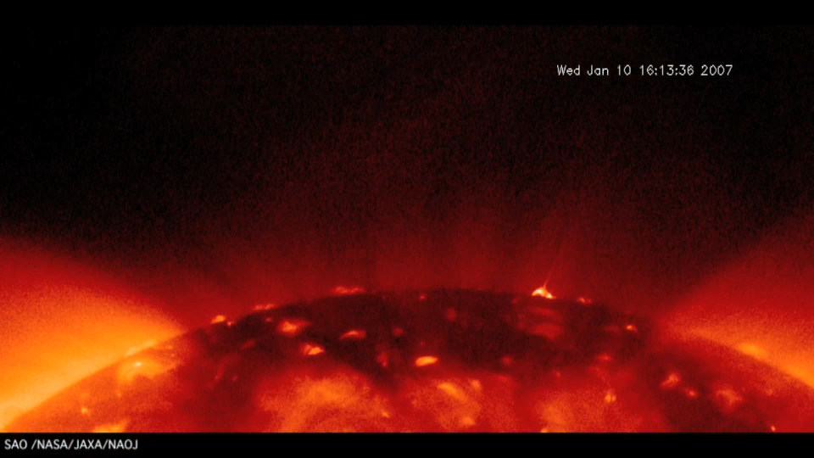
Cirtain et al. (2007)

Slide 3
Solar Coronal Jets
Solar coronal jets have been regularly observed since the Yohkoh days (Shibata et al. 1992; Yokohama & Shibata 1995 & 1996; Shimojo et al. 1996; Nisticò et al. 2009, 2015; Cirtain et al. 2007; Savcheva et al. 2007; Moore et al. 2010; etc). For reviews see Shibata & Magara (2011), Raouafi et al. (2016), Hinode Review Team et al. (2019, section by Sterling), Shen (2021).
In polar coronal holes: size ~50,000 km x 8000 km; rate ~60/day (Savcheva et al. 2007).
Often have a “hot loop’’ at the jet’s base, located asymmetrically off to one side of the base.
Many jets show twisting motions during their growth phase (e.g., Pike & Mason 1998, Kamio et al. 2010, Moore et al. 2015).
Sterling et al. (2015) argued that they form from “minifilament eruptions”; small-scale versions of large-scale filament eruptions.

Slide 4
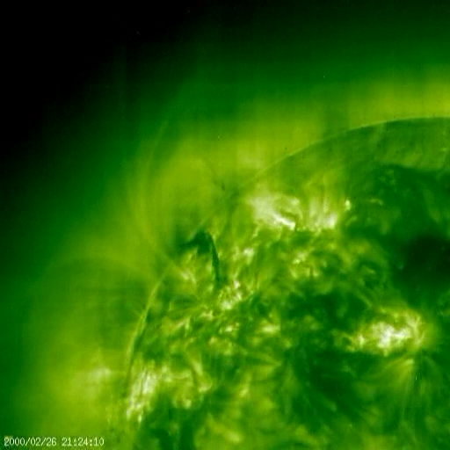
“Normal” Filament Eruption (SoHO/EIT)
(Sterling & Moore 2004)

Slide 5
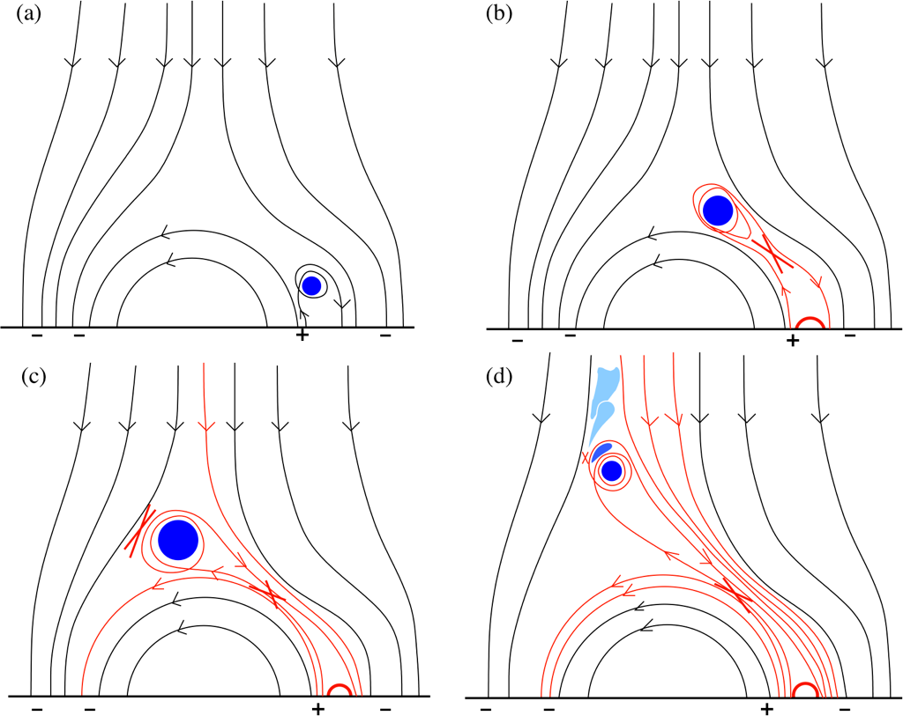
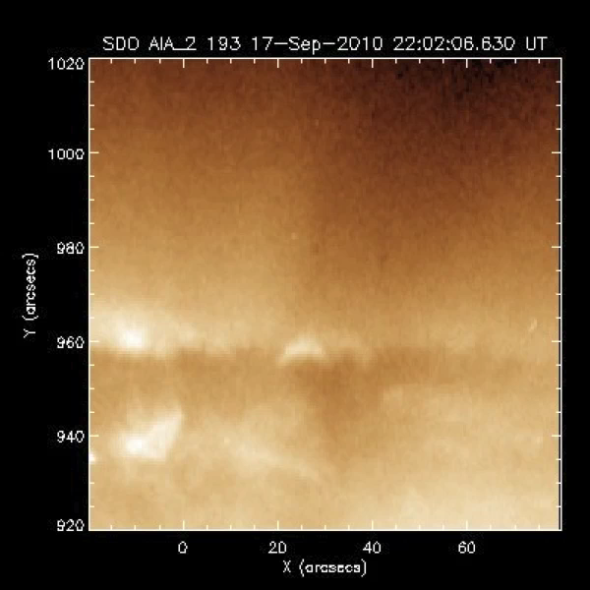
Minifilament-Eruption Model for (X-Ray) Jets
Sterling et al. (2015, 2016, 2017)
Quiet Sun jets work the same way (Panesar et al. 2016)
Modeled by Wyper et al. (2017, 2018)
A. Sterling

Slide 6
What Causes Miniature-Filament Eruptions?
Several studies found flux cancelation leading to jets (e.g., Hong+2011, 2014; Huang+2012; Young & Muglach 2014a,b; Adams+2014; McGlasson+2019; Muglach 2021).
A. Sterling, 2015

Slide 7
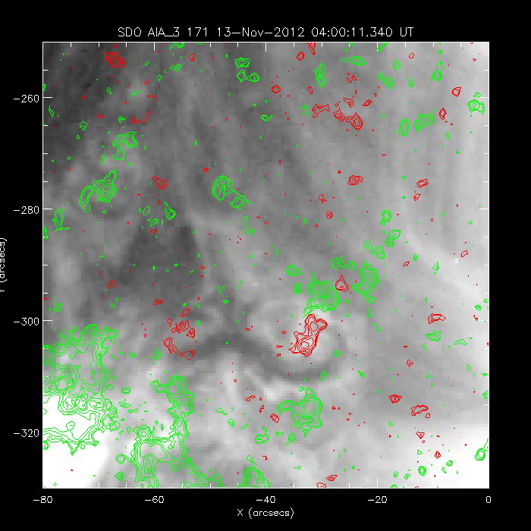
(cf. Panesar et al. 2016)
A. Sterling

Slide 8
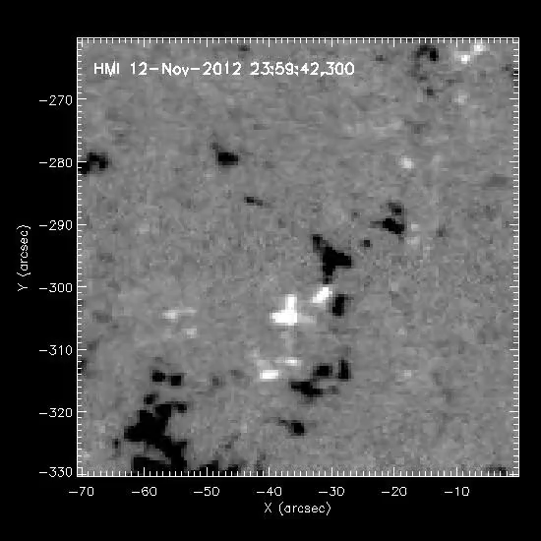
Panesar et al. (2016)
A. Sterling

Slide 9
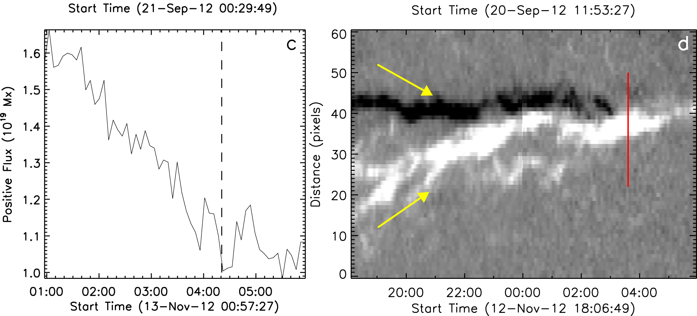
Same for QS jets: Occur at cancelation sites.
(Ave. Cancelation rate: ~10¹⁸ Mx/hr.)
Panesar, Sterling, & Moore (2016b)

Slide 10
Active Regions Jets are often not so “clean”

Slide 11
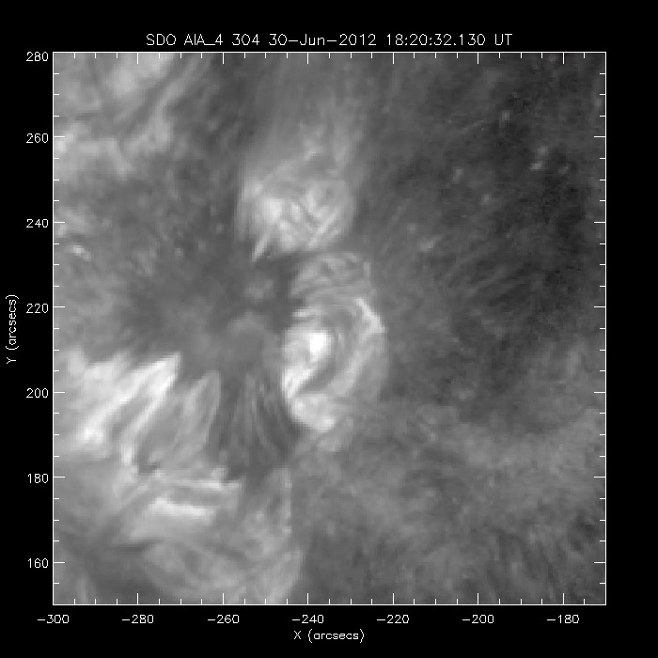

Slide 12
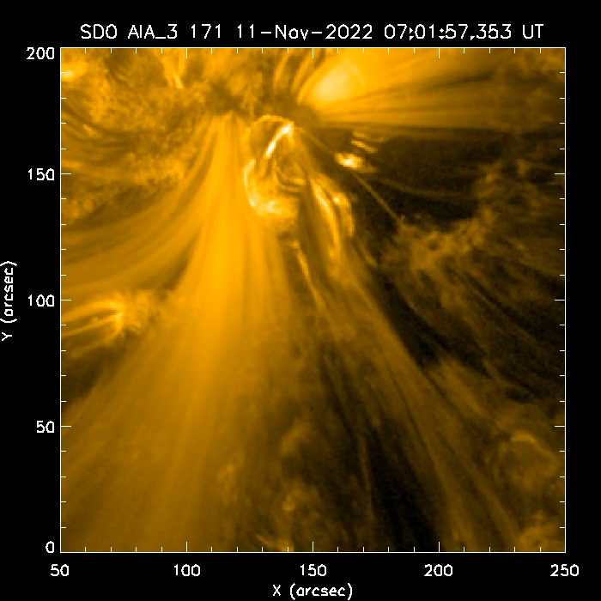
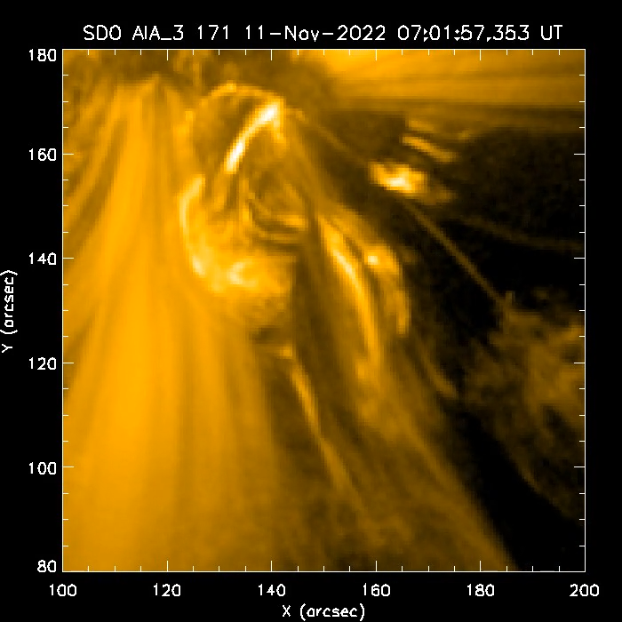
(Event of Gou, Liu, Su, Astrid, et al. 2024, arXiv)

Slide 13
Jets in NOAA AR 12824
This AR had copious jetting, largely from two separate locations: its south side and its northwest side.
Jets in the south looked “typical,” while those in northwest were harder to see.
A. Sterling, 2015

Slide 14
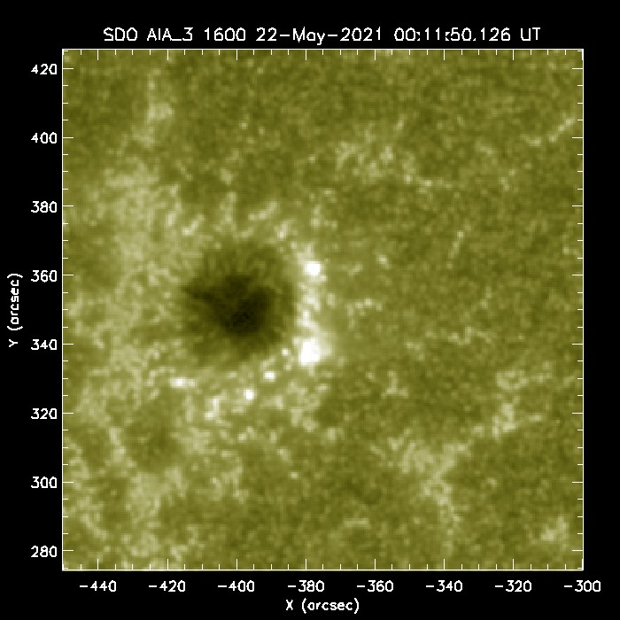
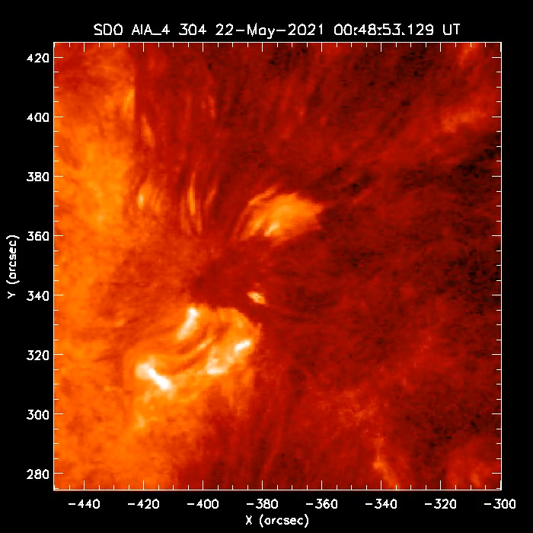

Slide 15
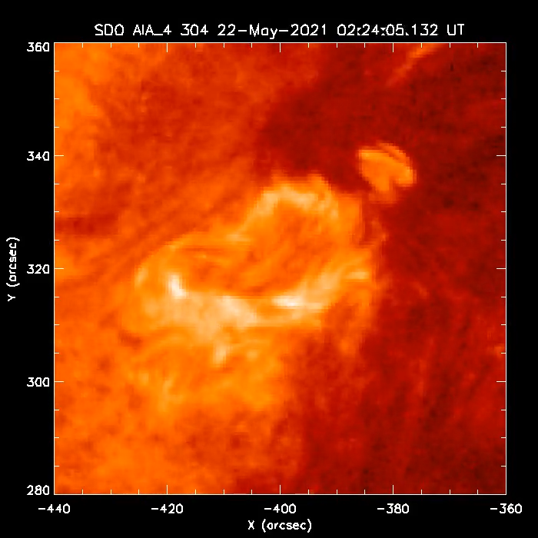

Slide 16
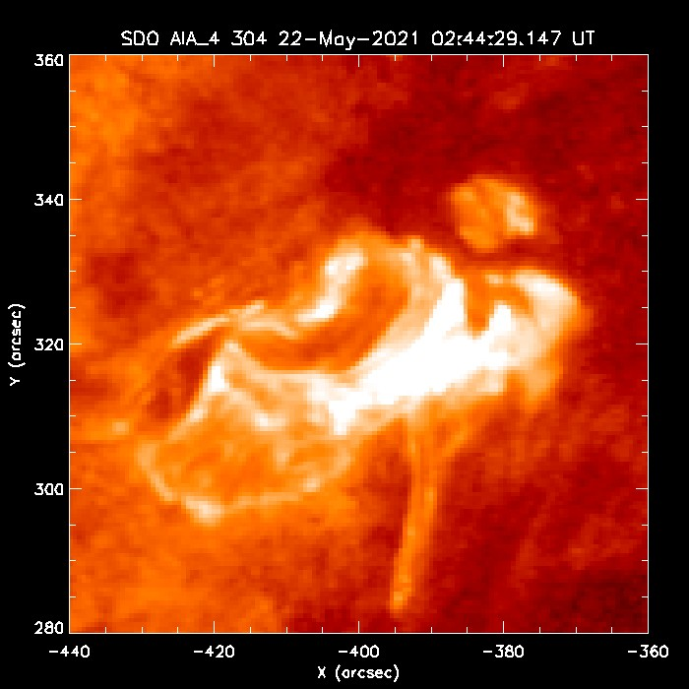
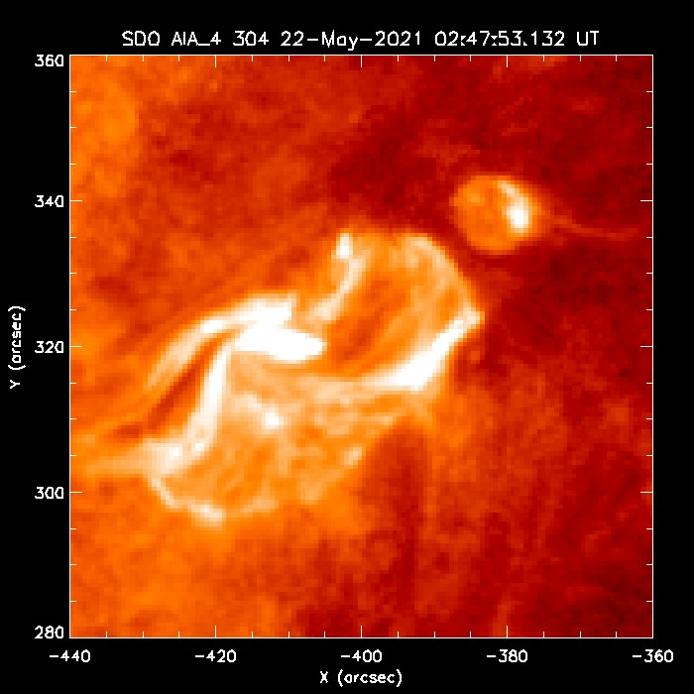
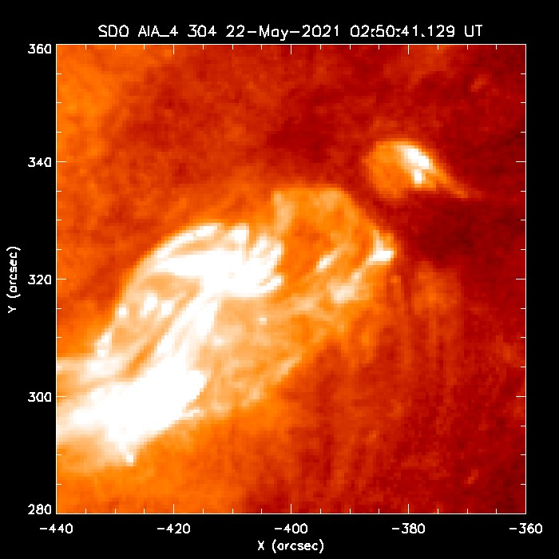

Slide 18
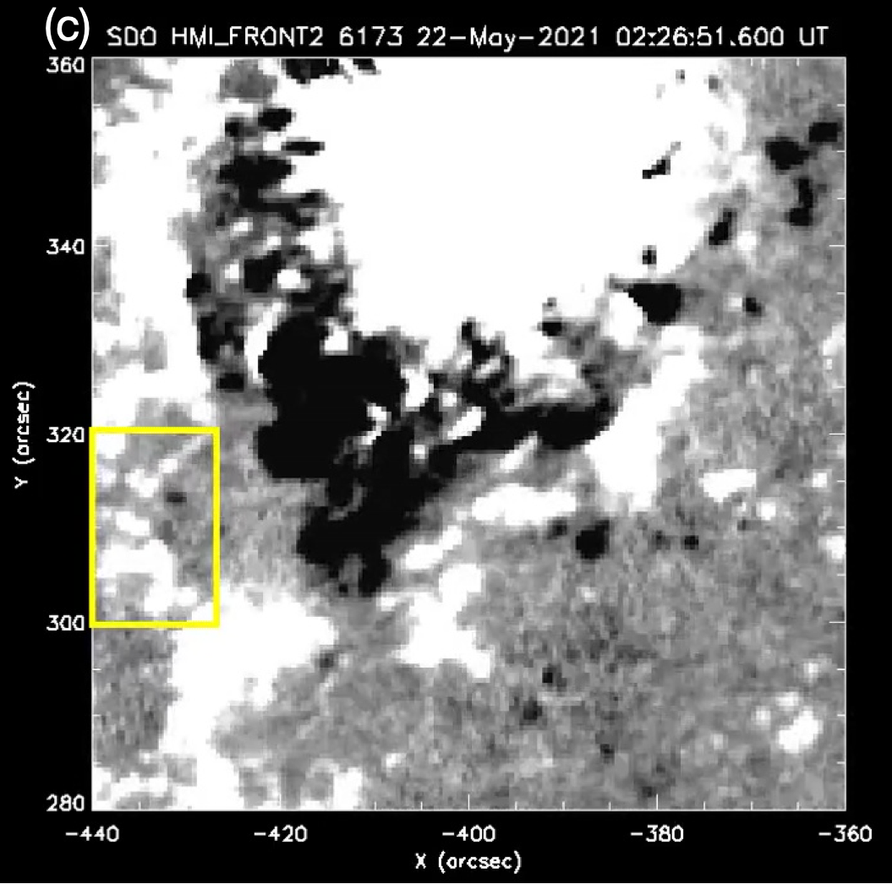
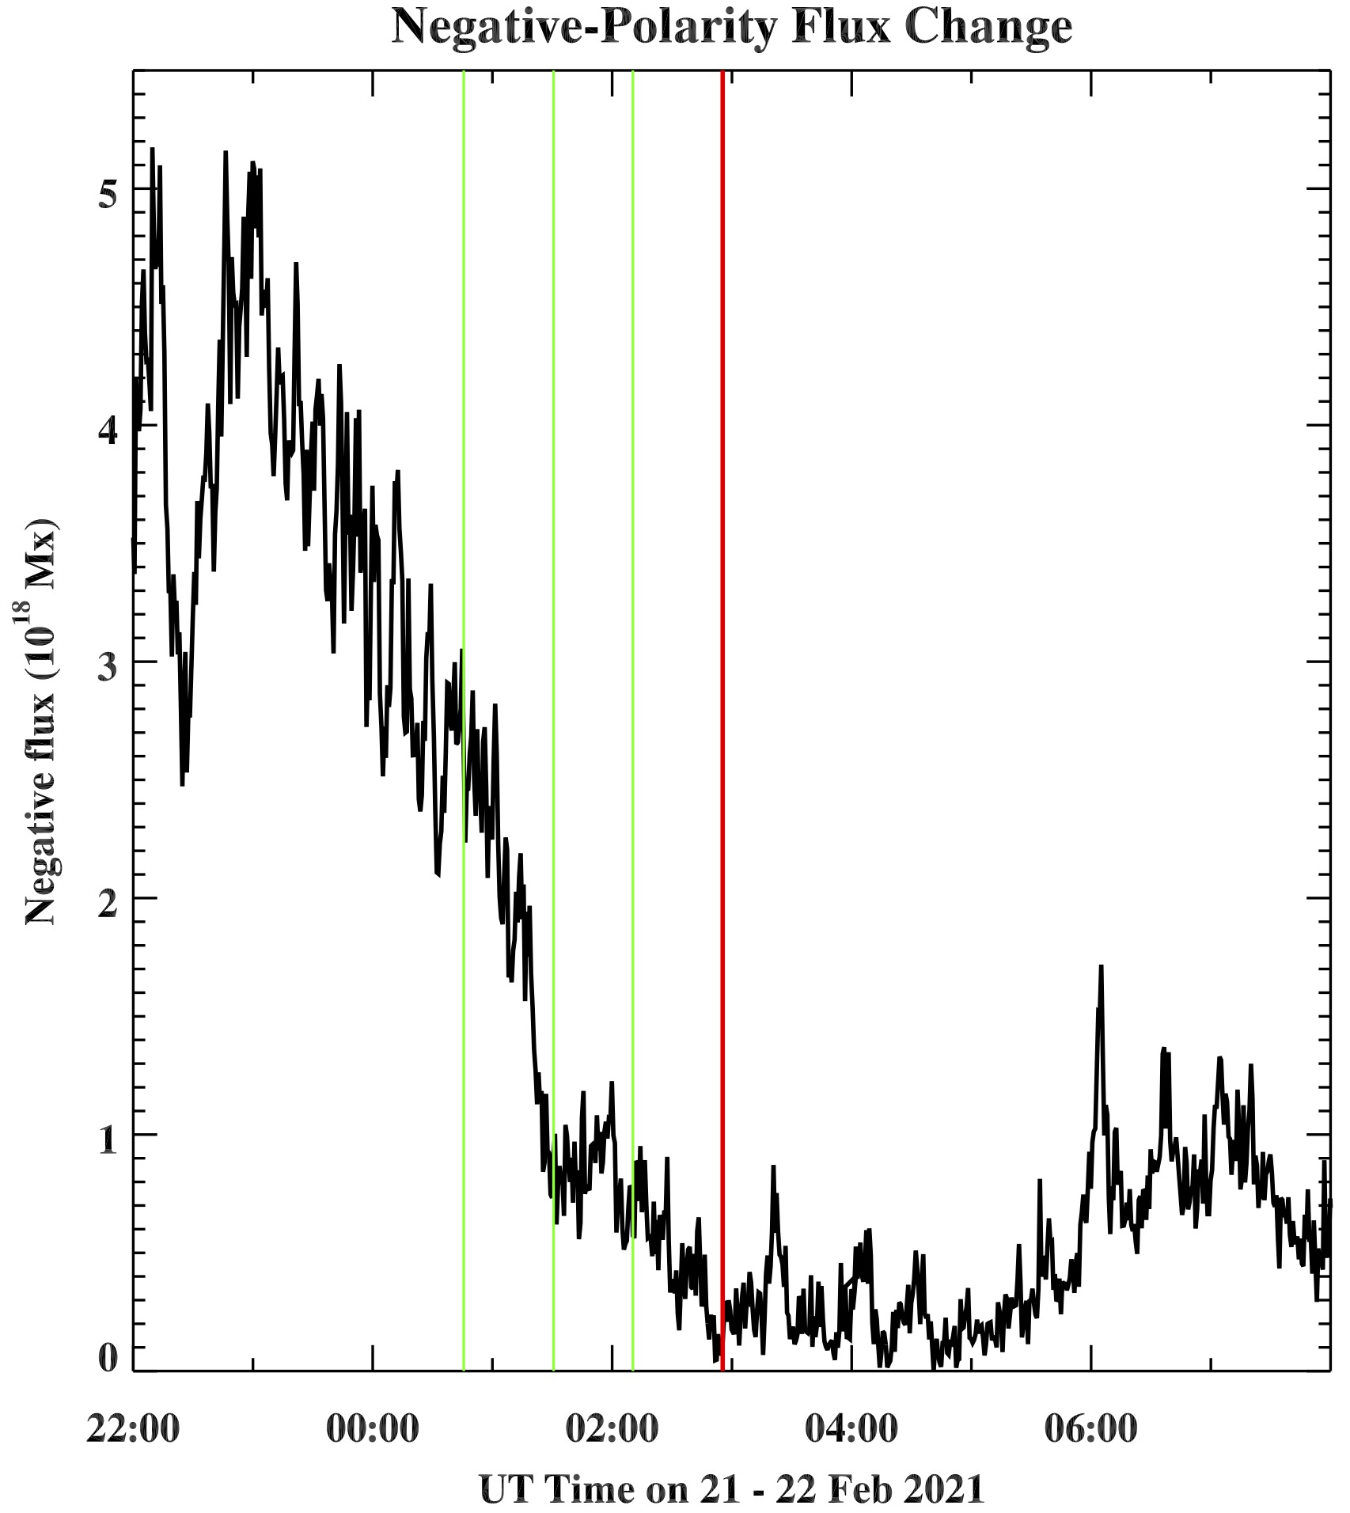

Slide 19
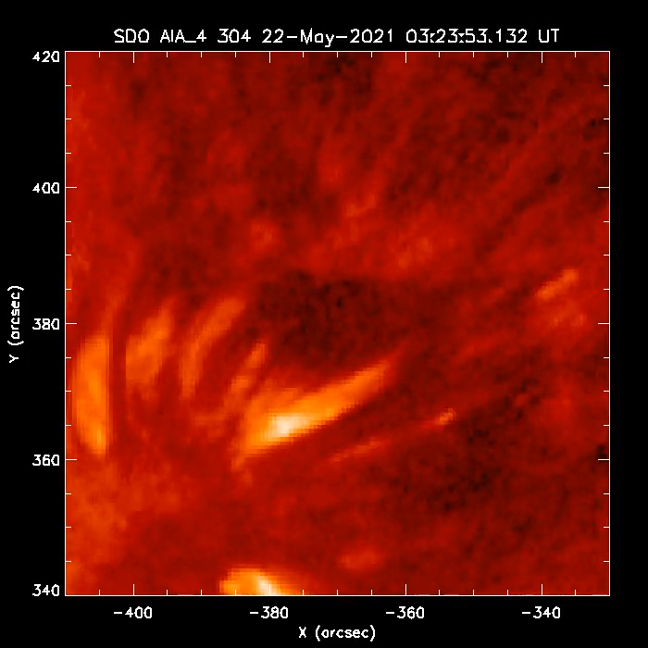

Slide 20
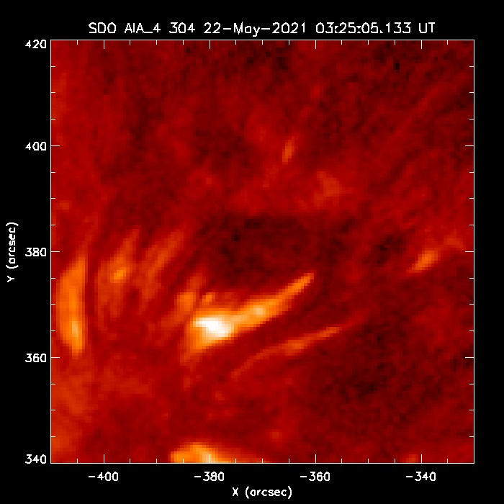
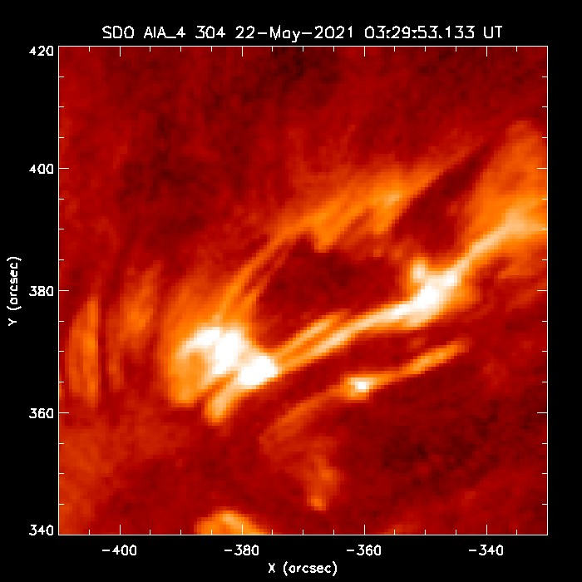
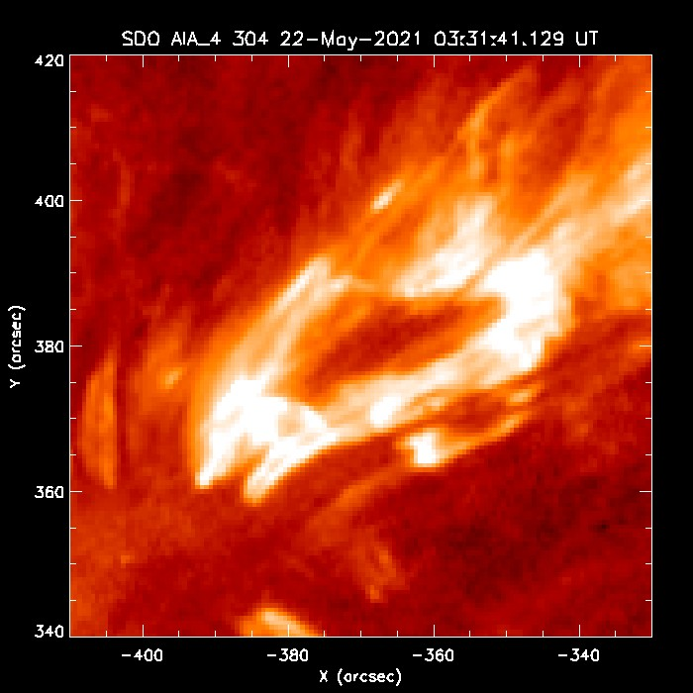

Slide 22
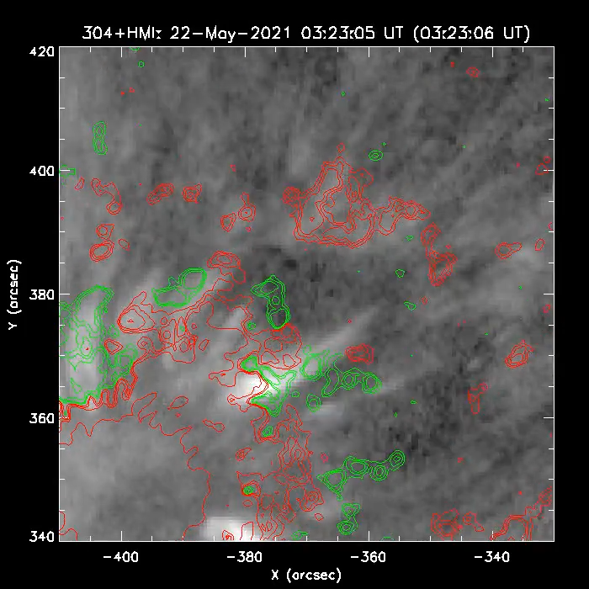

Slide 23
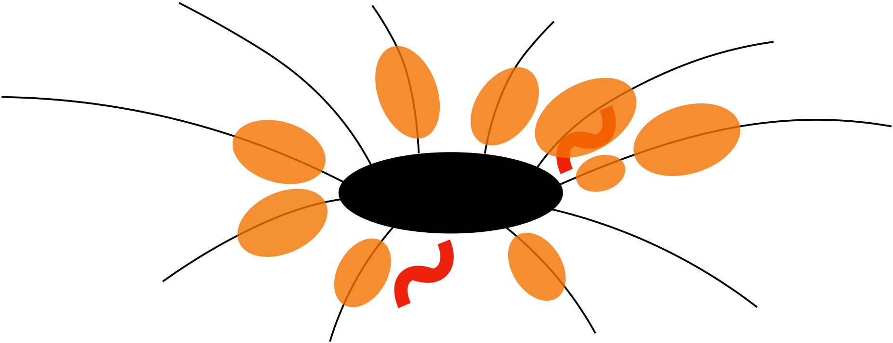
A. Sterling, 2015

Slide 24
Conclusion
Jets in south are typical: flux cancelation —> erupting minifilaments —> jet.
Jets in the northwest do not show their origin location.
Assuming jets from both regions work the same way, those in the northwest appear different because their launch location is hidden below overlying absorbing material.
A. Sterling, 2015

Slide 25
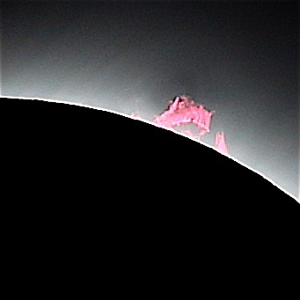
Summary
Many (most? all?) coronal hole and quiet Sun jets originate with flux cancelation leading to an erupting minifilament leading to a jet (via reconnection).
Some AR jets obviously behave this way, but others do not.
We examined jets from an AR that makes jets in two places: The jets obviously obey this scenario from one place, but not from the other place.
If we assume (which seems reasonable) that all the jets form the same way, then then for the second location the onset-sites of the jets is hidden by obscuring material, resulting in them having an apparent different onset appearance.
Image:
Alphonse Sterling
21 August 2017,
Lewisville, Idaho

