Slide 1
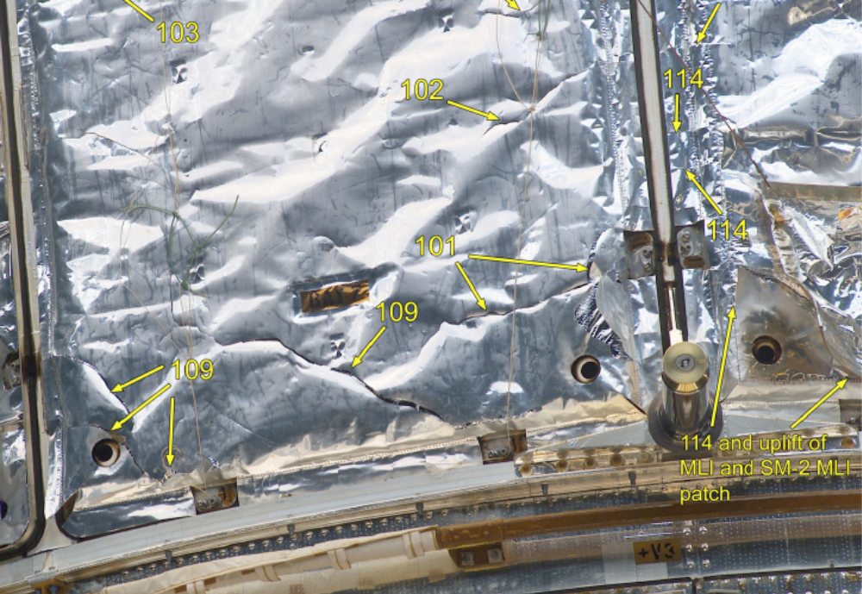
Servicing Hubble:
Contamination Perspectives
For Future Missions
David Hughes
NASA GSFC

Slide 2
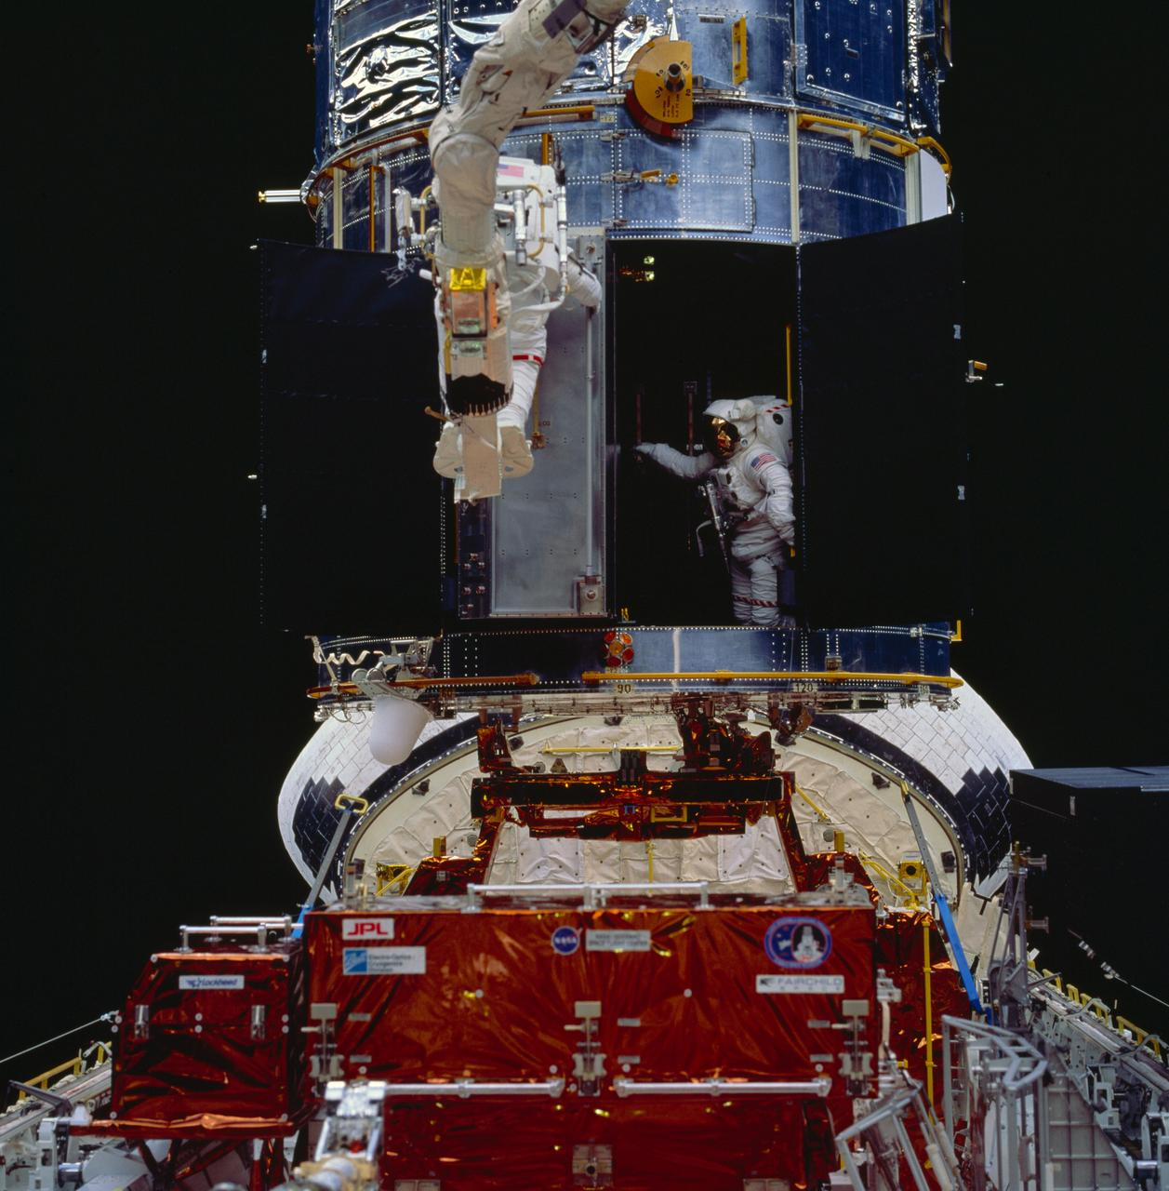
Scope of Activities
Open and close doors
Replace components designed for servicing
  Bolted interfaces
  Electrical connectors
Install new hardware
  Cooling system, external radiators
  Covers for degraded MLI
Fix instruments NOT designed for servicing
  Open chassis (small screws)
  Replace circuit board

Slide 3
Contamination Sources
Servicing Vehicle
Propulsion
Outgassing
Particles
Debris
New Hardware
Outgassing
Water
EMU Suit (robot)
Particles
Outgassing
Water
Activities
Particles
Debris
Contact
Damage

Slide 4
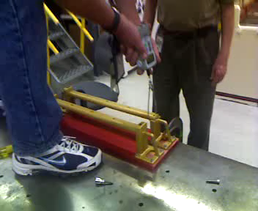
Specifics
Orbiter tile waterproofing (silicone outgassing)
EMU glove pads (silicone particles)
Paint pigment transfer by gloves (due to atomic oxygen degradation)
Fragments of MLI (could be liberated by proximity of astronaut because of electrostatic attraction)
Harness labels (floating loose)
Washers (floating loose)
Stripping of bolts (generate particles)
Breaking things (generate particles)
Ground test of removing a handrail by brute force

Slide 5
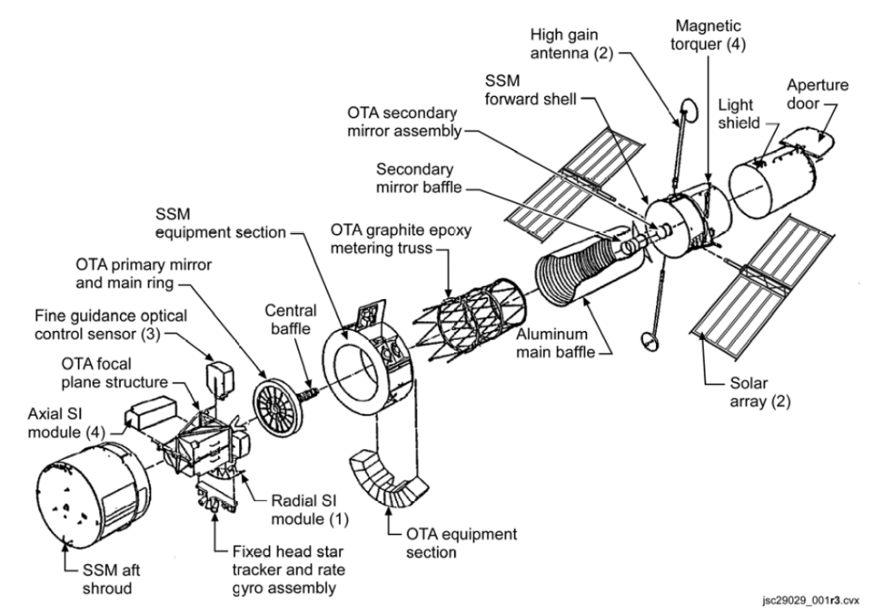
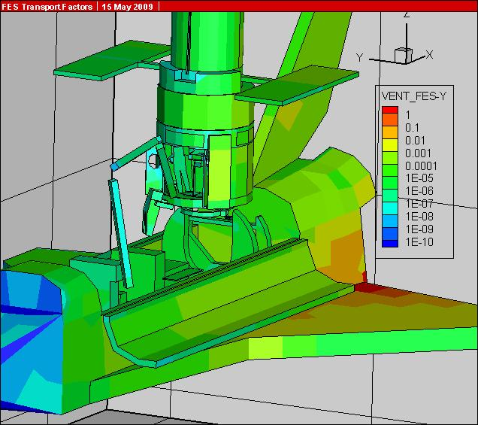
How did we get away with it all? Isolation
To get to the instrument apertures here, the flash evaporator system (FES) has a 10 order of magnitude reduction

Slide 6
You will bring contamination with you
The observatory will have contamination sources on board that can be moved around
Design to limit the transport path to sensitive surfaces
Design for separate doors to minimize the time any door is open
Design for easy separation – small turn count, use of cams to provide locking – to reduce time spent in servicing
Design servicing hardware to allow bakeout and cleaning
Design thrusters to allow off-axis pointing during capture and release
Observatory
Servicing

