Slide 1
Expanded Materials Options for High Strength Steels on Ground Support Systems Using COTS Coatings
NASA Engineering Safety Center (NESC) Materials Annual Meeting Presentation
Presenter: Monroe Willis KSC-NE-L7
July 9-11, 2024
Contributors:
Jeff Sampson, Monroe Willis, Brian Cheshire, Elizabeth Tomsik, Mya McMullen, Jerome Curran, Mark Kolody, Teddy Back , Jon Lott, Michael Wisnom, Bill Couch, Anthony Marketon

Slide 2
Agenda
Background
  About me
Project Overview
  Project Background, Project Approach
Test Procedures
  Hydrogen Embrittlement, Stress Corrosion Cracking, Atmospheric Testing
Summary
  Success Story, Forward Work

Slide 3














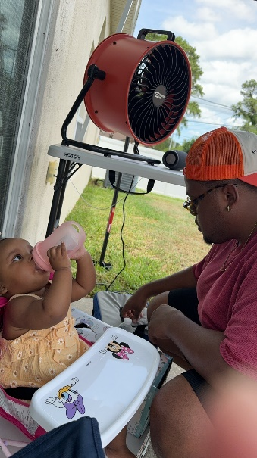
Background

Slide 4
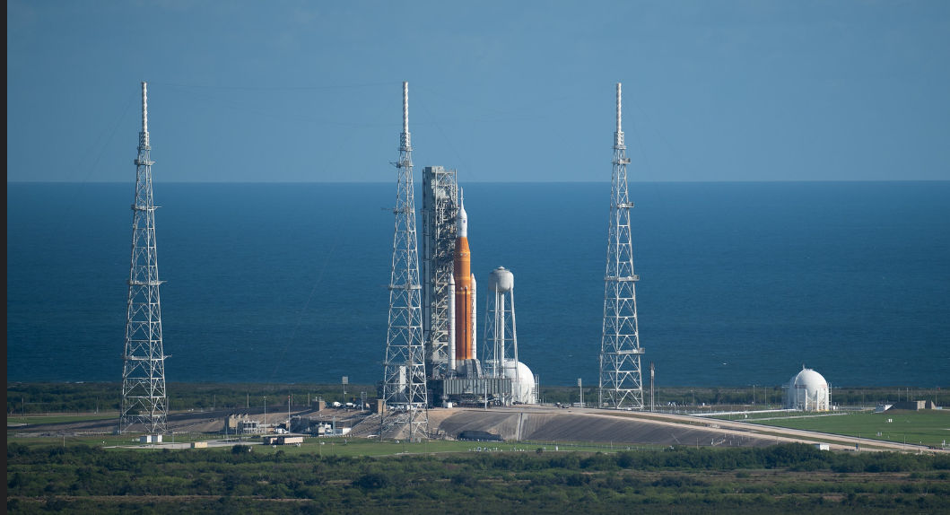
Kennedy Space Center Marine Enviornment

Slide 5
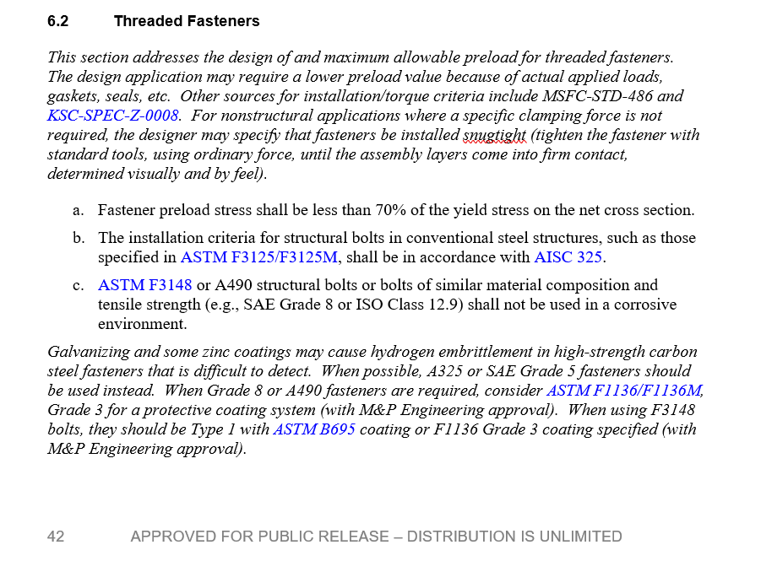
Project Background
Problem
High-strength steel alloys above 180 ksi are sensitive to stress corrosion cracking and hydrogen embrittlement when galvanized.
Galvanized, plated, and other chemically applied zinc coatings are prohibited on high-strength steel fasteners for ground support equipment (GSE).
Chemically applied zinc coatings causes hydrogen embrittlement in high-strength steel alloys due to hydrogen infusion into the coating.
Leads to a more expensive high-strength material option such as currently used nickel base Inconel fasteners.
Proposed Solution
Zn/Al flake coatings applied to high-strength steel fasteners (A490, Grade 8) as a replacement for high strength Inconel fasteners.
KSC-DE-512-SM Ground Systems Development Standard
Comparison cost of a typical bolt assembly (1"x3.25")
 | Cost | Coating | Total Cost
Inconel | $ 138.00 | $ - | $ 138.00
A490 | $ 27.00 | $ 2.00 | $ 29.00
Grade 8 | $ 12.00 | $ 2.00 | $ 14.00
Galvanizing and some zinc coatings may cause hydrogen embrittlement in high-strength carbon steel fasteners that is difficult to detect.
Notes:
High strength steel are sensitive to SCC and HE
These high strength steel fastener are prohibited due to the chemically applied zinc coating for corrosion protection
The chemically applied coatings cause HE concerns
Which lead to a more expensive high strength material option such as Inconel
As you can see in the comparison chart below
The solution is to apply

Slide 6
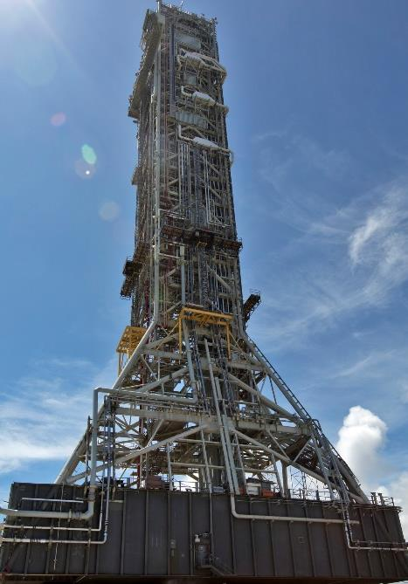
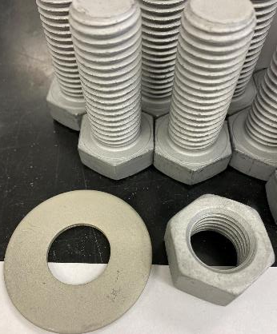
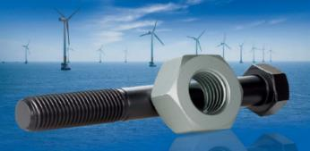
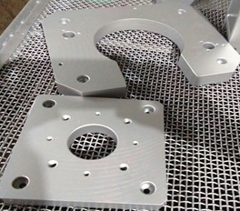
Project Background
Purpose:
Evaluate zinc/aluminum (Zn/Al) flake coatings applied to high strength steel bolts as a replacement for Inconel bolts for GSE, including hundreds of areas on a Mobile Launcher.
Zn/Al flake coatings are commercially available and are already approved through ASTM F3393.
These coatings will be qualified for use at KSC on ground support structures using corrosion and tensile testing to meet corrosion resistance and strength-related KSC-DE-512 requirements.
Common high strength fasteners, such as A490 (Type 1 and Type 3) and Grade 8 bolts, are limited for GSE use because they are susceptible to stress corrosion cracking (SCC) failures in KSC's aggressive marine environment.
Fasteners
Large size parts
The Mobile Launcher (left) and Zn/Al flake coating applied to high strength fasteners and large size parts (right)

Slide 7
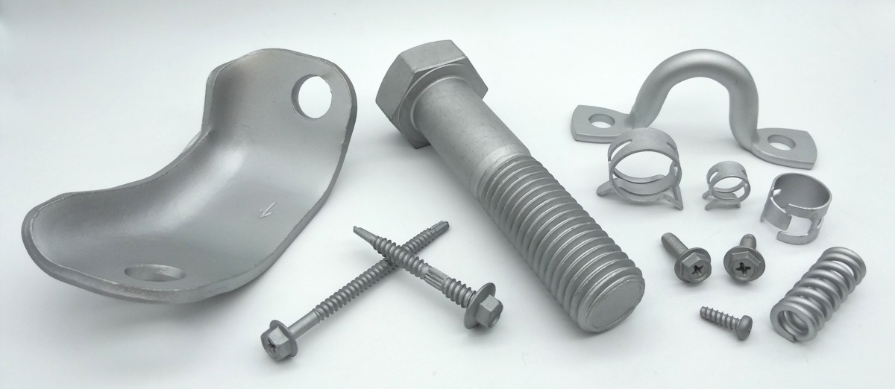

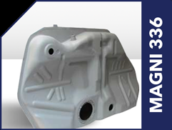
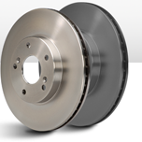
Zinc Aluminum Flake Coating (Zn/Al)
Industry Use
Defense
Aerospace
Oil & Gas
Automotive
Wind Turbine Industry
Railways
Energy and Chemical Processing
Petroleum & Gas
Application
High strength fasteners
Bolts, nuts, rivets, screws and other threaded connecting hardware parts
Springs, clips, clamps, brackets and other stamping parts
Brake disc, brake drum, brake rotors
Tower construction bolts and foundation bolts and springs
Fasteners
Fuel Tank
Big size parts
Brake Rotor
https://magnicoatings.com/products/browse-by-industry/

Slide 8
Project Approach
Task Description: Zn/Al Flake Coating Systems and Qualification Testing
Three Zn/Al Coating Systems were selected to evaluate corrosion, stress corrosion cracking (SCC), and hydrogen embrittlement (HE) in KSC’s aggressive marine environment:
Zn/Al Coating Qualification Testing
Hydrogen Embrittlement
Stress Corrosion Testing *
Atmospheric testing *
    Doerken Delta Protekt MKS®
    Magni 567
    GEOMET® 321 Plus L (coating
    was included later in the study)
    Commercial space partners have started to use GEOMET® for similar applications, which is also the private label coating from Fastenal (labeled EcoGuard). They are interested in our test results for their own ground support equipment.
ASTM F519-12a Standard Test Method for Mechanical Hydrogen Embrittlement Evaluation of Plating/ Coating Processes and Service Environments
MSFC-STD-3029 Guidelines for the Selection of Metallic Materials for Stress Corrosion Cracking Resistance in Sodium Chloride Environments
NASA-STD-5008B Protective Coating of Carbon Steel, Stainless Steel, and Aluminum on Launch Structures, Facilities, and Ground Support Equipment
Incremental Step Load (ISL) Testing Method
Stressed and unstressed samples exposure in parallel
Stressed samples locked in position to maintain 75% yield strength **
A490 (Type 1 and Type 3) and Grade 8 bolts
* This test set contained both scribed and non-scribed samples.
** The YS was determined by tensile testing AISI 4340 rods (control) according to ASTM E8.

Slide 9
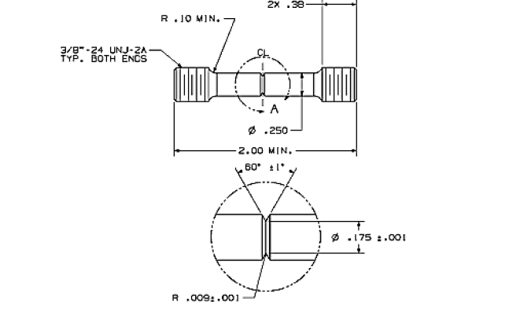
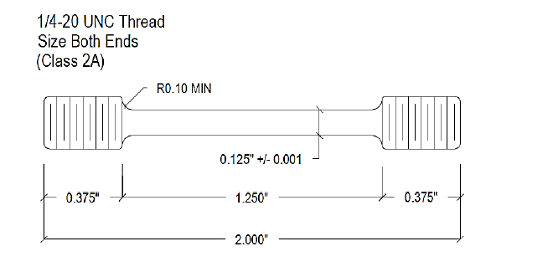
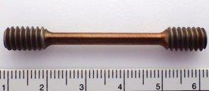
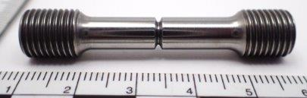
Material Selected: AISI 4340 Steel
AISI 4340 Steel Rods
Heat treated per AMS 2759/2 Class A to a tensile strength between 260 and 280 ksi (51 to 53 Rockwell C Hardness Scale (HRC))
High-strength steel alloy
Similar material composition as A490, Grade 8
MSFC-STD-3029 specified use for test methods (SCC) and ASTM F519 specified use for test methods (HE)
Specimens for Stress Corrosion Cracking Testing
Specimens for Hydrogen Embrittlement Testing
Notes:
AISI-American Iron and steel institute
We are using 260 for AISI 4340 because that is this material’s HS – makes it comparable to the A490 and Grade 8

Slide 10
Hydrogen Embrittlement Testing

Slide 11
Hydrogen Embrittlement (HE)
The loss of ductility that occurs in a susceptible material due to the presence of hydrogen.
Susceptible Material
High-strength steel alloy fasteners
Susceptible Material
Hydrogen
(Internal Environment)
Residual hydrogen from steelmaking or from processing steps such as pickling and electroplating
HE
Hydrogen
(Internal Environment)
The presence of hydrogen in combination with a tensile stress can cause stress corrosion cracking in high-strength steel alloys.

Slide 12
HE Test Procedures: Incremental Step Load (ISL)
The ISL test uses a combination of a sustained load and slow strain rate.
This technique measures the threshold stress at the beginning of the subcritical crack growth (SCG) using incremental loads and hold times under displacement control.
The threshold stress at the onset of the SCG is used to specify quantitatively the maximum stress before failure caused by residual hydrogen in the steel as a result of processing.
*ASTM F519 -Standard Test Methods for Mechanical Hydrogen Embrittlement Evaluation of Plating/Coating Processes and Service Environments1

Slide 13
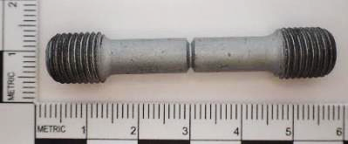
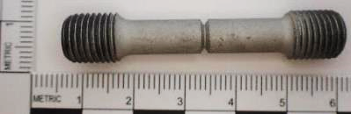
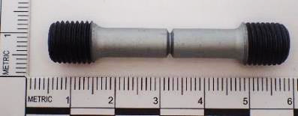

HE Testing Summary
Coated 4340 Samples | Threshold Tensile stress (ksi) | Pass/Fail
Doerken Delta-Protekt® | 308 | Pass
Magni 565 | 323 | Pass
GEOMET® 321 Plus L | 329 | Pass
Zinc Plated | 81 | Fail
HE Results:
New Zn/Al coatings tested to ensure that hydrogen embrittlement is not a failure mode.
The threshold stress range is used as a pass/fail criterion for a non-embrittling coating process. Specimens that fall between the threshold stress range of 205-335ksi are considered to have a non-embrittling process.
Zinc plating is the standard coating for high strength bolts such as A490 (Type 1 and Type 3) and Grade 8 bolts.
Hydrogen Embrittlement
tensile rods
coated with the
Zn/Al systems:
Doerken, Magni, and GEOMET
Doerken
Magni
GEOMET

Slide 14
Stress Corrosion Cracking Testing

Slide 15
Stress Corrosion Cracking (SCC)
A failure process that occurs because of the simultaneous presence of a tensile stress, a corrosive environment and a susceptible material.
Susceptible Material
High-strength steel alloy fasteners
Susceptible Material
Corrosive Environment
Marine chloride environment
SCC
Tensile Stress
Sustained or residual load
Tensile Stress
Corrosive Environment
Failure by SCC happens at stresses well below the yield strength of the metal.
Notes:
..

Slide 16
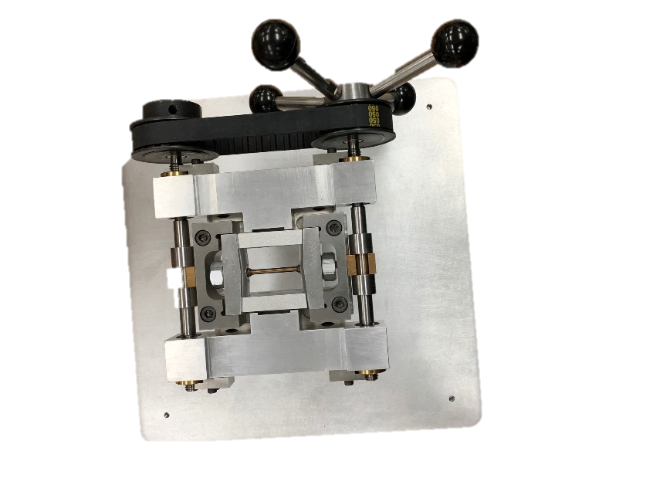
SCC Test Procedure: Constant Strain Test
Stress Loading
Device
The constant strain test methods is for determining susceptibility to stress corrosion cracking in seacoast environment and in high humidity.
The constant strain test for stress corrosion cracking requires a stress loading device and frame assembly.
The specimen will be loaded up to 75% of its yield strength.
Frame Assembly
Nut
Crosshead
SCC Specimen
Sidebar
*MSFC-STD-3029 Guidelines for the Selection of Metallic Materials for Stress Corrosion Cracking Resistance in Sodium Chloride Environments

Slide 17
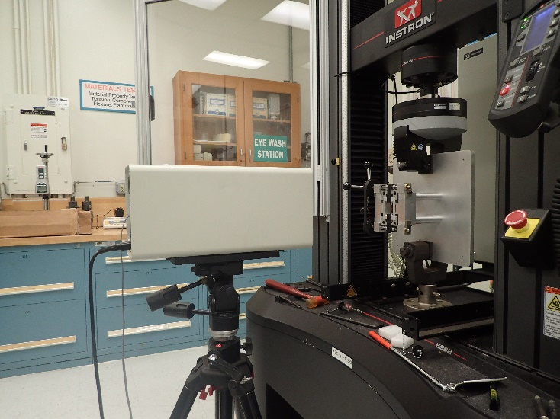
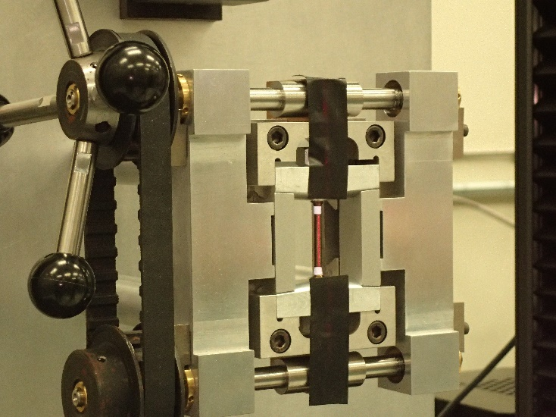
Test Procedure: Constant Strain Test
Laser extensometer is a device that is used to measure the strain on the specimens.
Laser Extensometer
Reflective Tape
Average Strain at 75% YS = 0.0058±.0003
Reflective Tape
*ASTM E8/E8M -Standard Test Methods for Tension Testing of Metallic Materials

Slide 18
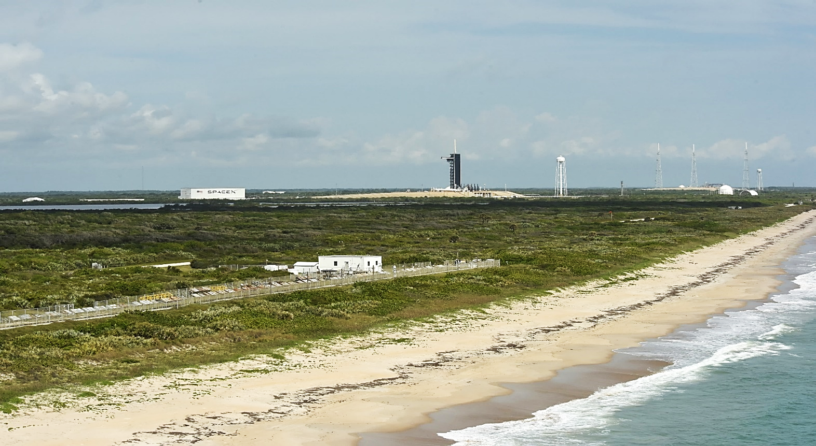


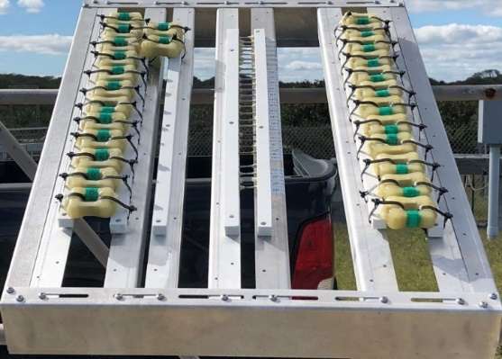
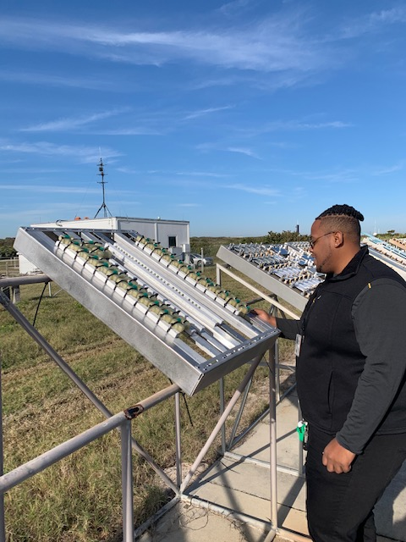
NASA KSC Beachside Atmospheric Corrosion Test Site
Beachside Atmospheric Corrosion Test Site
Stress Corrosion Testing:
The test specimens are exposed in the marine environment at the KSC Beachside Atmospheric Corrosion Test Site for a duration of 240 days. Timeframe was chosen because it equates to 2 times the SLS pad stay.
If stress-corrosion cracking occurs, it generally results in complete fracture of the specimen. Samples will be pulled and examined if a fracture occurs.
0.75 mi
150 ft

Slide 19
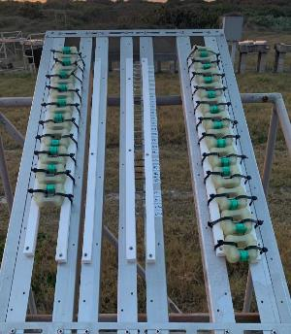
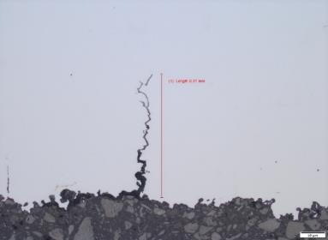
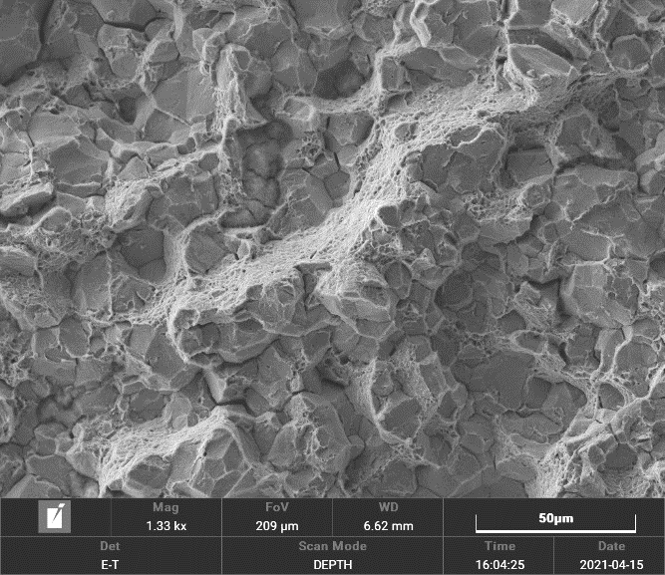
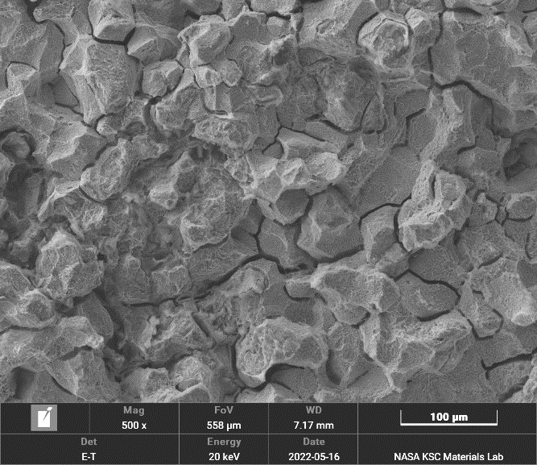
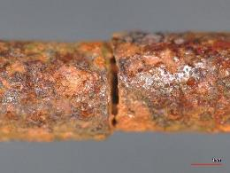
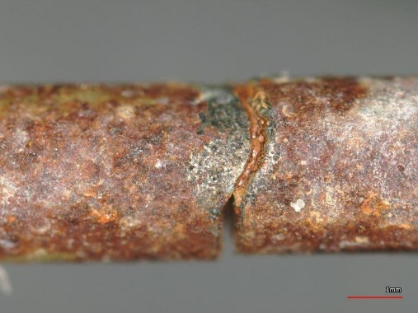
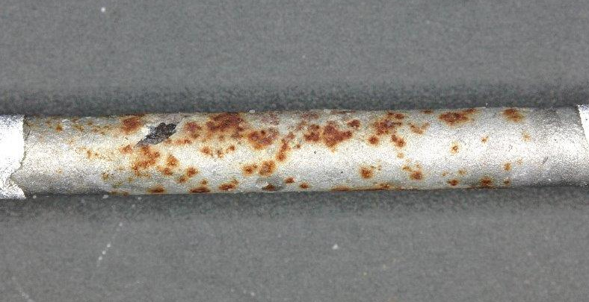
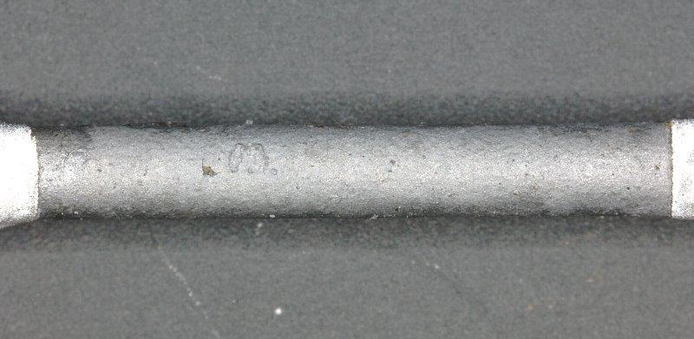
SCC Testing Summary
SSC Results after 2x Pad Stay (240 days) at the Atmospheric Beachside Test Site:
AISI 4340 (controls) – failed within 7 days
  As expected, both stressed and unstressed samples had intergranular cracking in the microstructure
  Zinc Plated (controls) – no failures observed
    The stressed and non-stressed samples showed a significant reduction in tensile strength (15.6-22.1%)
  Doerken Delta Protekt MKS – no failures observed
    The stressed and non-stressed showed no sign of tensile strength reduction (≤3.5%)
  Magni 567– no failures observed
    The stressed and non-stressed showed no sign of tensile strength reduction (≤3.5%)
  GEOMET® 321 Plus L – failed in 228 days
    The stressed and non-stressed showed reduction in tensile strength reduction (≤9%)
0.27 mm, Intergranular cracking
SCC samples
Cross-section metallograph image (200x) of the
non-coated, stressed specimen showing intergranular crack 0.27mm in depth, parallel to the stress applied on the specimen.
Magni (240days)
Doerken (240days)
Representative SEM image of the non-coated (left) and Geomet (right), stressed specimen fracture surface showing intergranular cracking and micro-void coalescence (MVC).
AISI4340 (SCC)
Geomet (SCC)
19
Stress Corrosion Cracking tensile rods

Slide 20
Atmospheric Testing – Fasteners

Slide 21

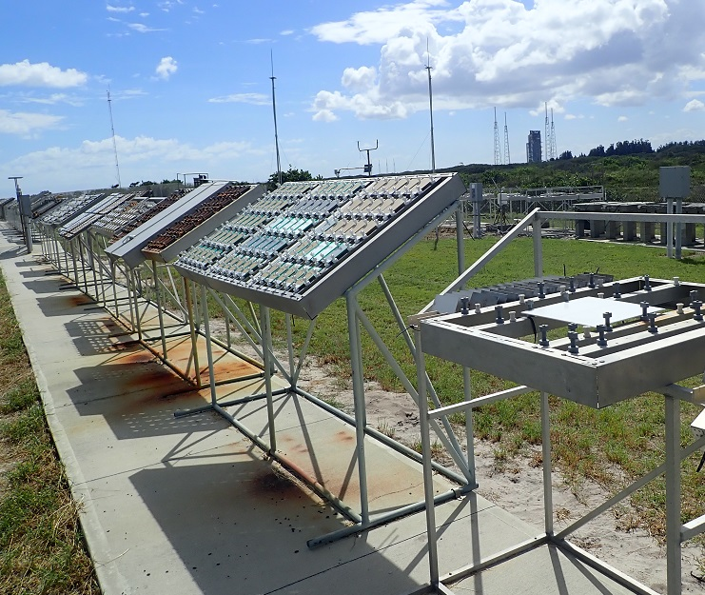
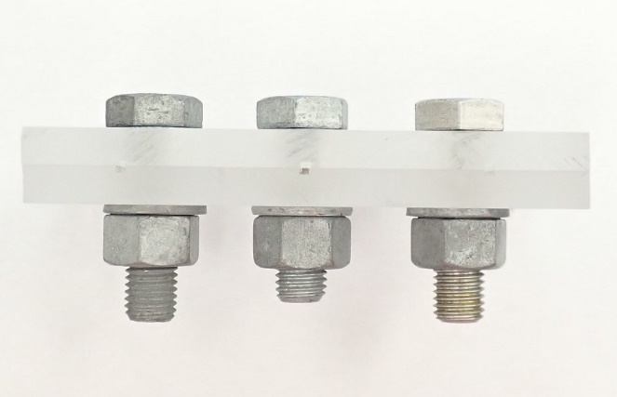
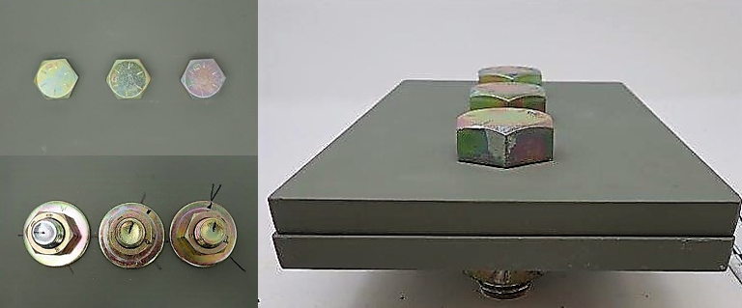
Atmospheric Test Procedure: Fasteners
A490 Type 1 and 3, Grade 8 bolt/panel configuration mocks corrosion issues installed fasteners end use GSE application.
0.75 mi
150 ft
Bolt/panel configuration
Atmospheric Testing
Test panels used for corrosion testing to mimic fasteners installed in structural steel

Slide 22
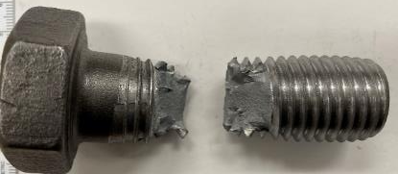
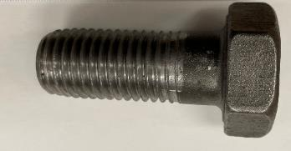

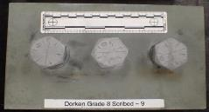
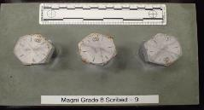
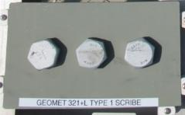
Fasteners Testing Summary
Fastener Tensile Strength Results using NAS Fastener Test Methods, Method 8:
Bolts were tensile tested to verify no loss in mechanical properties.
Vendor specification is 150ksi for min ultimate tensile strength (UTS).
Samples after 18/24 months exposure:
  All Scribed and Non-Scribed fasteners met the minimum UTS.
Samples after 36 months exposure:
  All Non-Scribed fasteners met the minimum UTS.
  Geomet samples are in test.
1 cm
1 cm
Representative bolt prior to tensile pull (left) and after tensile pull (right)
Zn/Al flake coated fastener pass/fail results
as a function of atmospheric exposure time
Pass/Fail Minimum UTS Requirement of 150ksi | Plain | Zinc Plated | Doerken Delta-Protekt® | Magni 565 | GEOMET® 321 Plus L
18 months
Grade 8 | Pass | Pass | Pass | Pass | Pass
A490 type 1 | Pass | Pass | Pass | Pass | Pass
A490 type 3 | Pass | Pass | Pass | Pass | Pass
24 months
Grade 8 | Pass | Pass | Pass | Pass | Pass
A490 type 1 | Pass | Pass | Pass | Pass | Pass
A490 type 3 | Pass | Pass | Pass | Pass | Pass
36 months
Grade 8 | Pass | Pass | Pass | Pass | Testing
A490 type 1 | Pass | Pass | Pass | Pass | Pass
A490 type 3 | Pass | Pass | Pass | Pass | Pass
1
Controls, Magni & Doerken Bolt panel configurations using 10 test stands

Slide 23
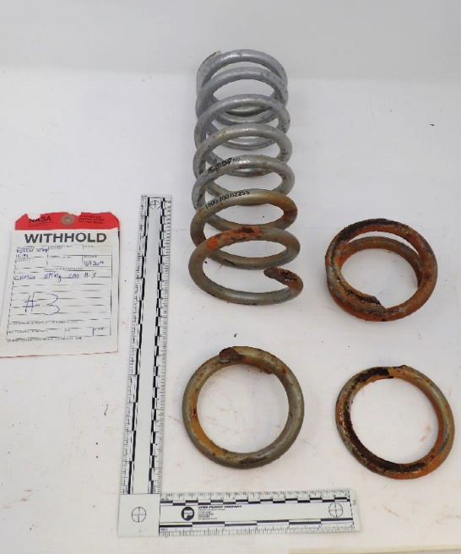
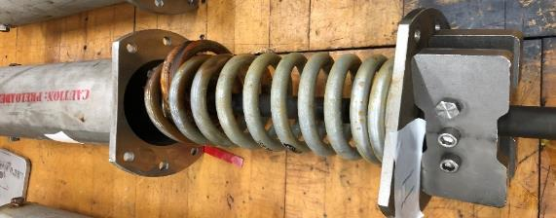
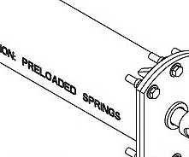
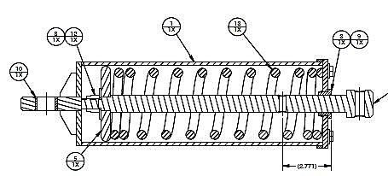
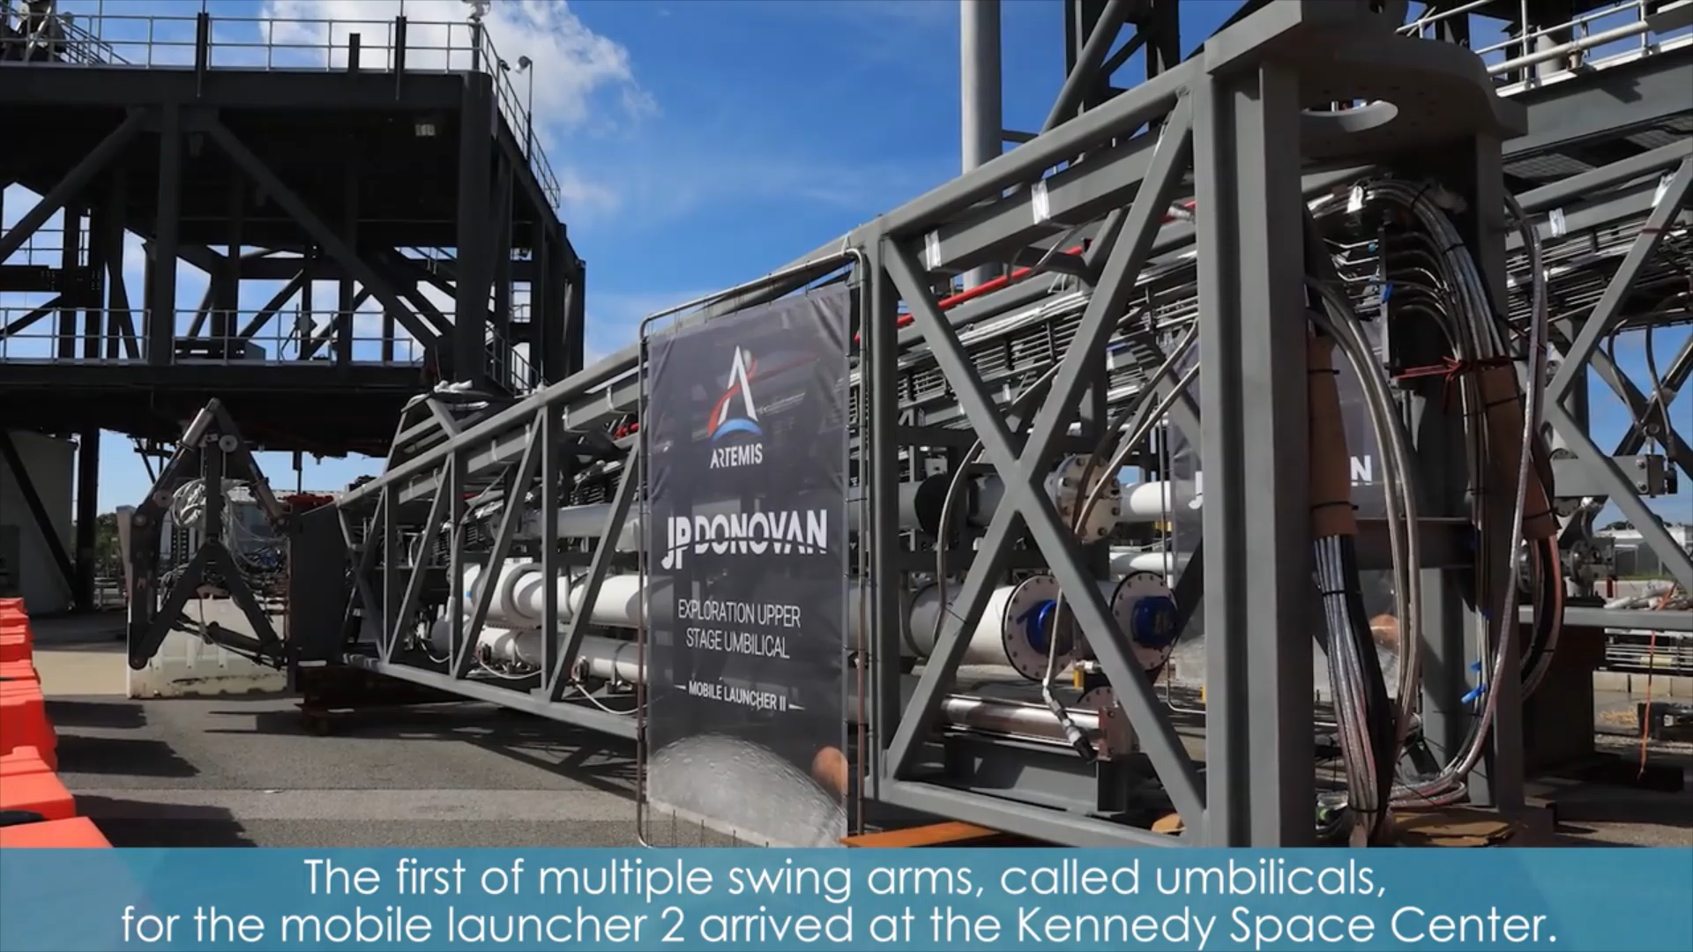
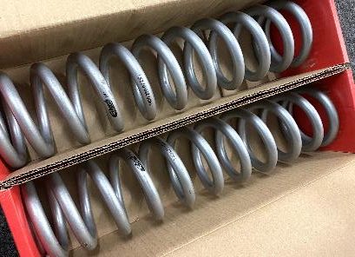
Success Story: Zn/Al Coating
M&P situational approval on Zn/Al coating system at KSC:
Core Stage Forward Skirt Umbilical (CSFSU) Spring Can failure discovered in 2020 (in-service from 2016): fractured springs due to unexpected long-term water immersion leading to coating failure, and then general corrosion leading to hydrogen embrittlement and stress corrosion cracking (NASA 4672 report).
Failures were also found in the Core Stage Inter-Tank Umbilical (CSITU), so Spring Cans on all umbilicals in jeopardy of spring failures prior to Artemis I launch.
All springs were replaced and included new Zn/Al coating.
Fractured spring
PROBLEM: Several AFT Spring cans fractured and were removed from the CSFSU due to corrosion and hydrogen embrittlement after only 4 years of service.
Exploration Upper Stage Umbilical on ML2 will provide power, communications, and propellants to the larger configuration of the SLS rocket. The Zn/Al coated spring cans are on ML1 and ML2.
SOLUTION: Zn/Al flake coating system applied to the AFT springs for use on the CSFSU ML with approval given by M&P.

Slide 24
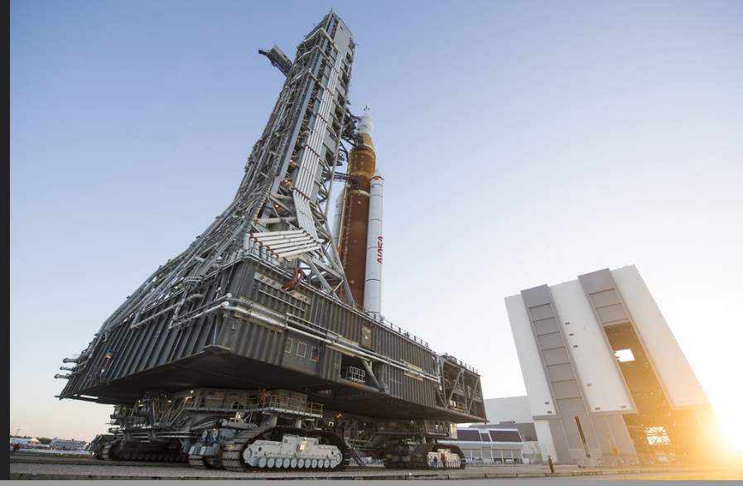
Forward Work for Qualifying Zinc Aluminum Coating on GSE
Qualifying Zinc Aluminum Coating on GSE:
Hydrogen Embrittlement Testing: Complete
Stress Corrosion Testing: Complete
Atmospheric Corrosion Testing of Fasteners: On-going Corrosion testing of the three coating systems will continue testing at 36, 48, and 60 months.

Slide 25
Thank you!
  Questions/Comments

