Slide 1
HWO Technology Development
Breann Sitarski

Slide 2
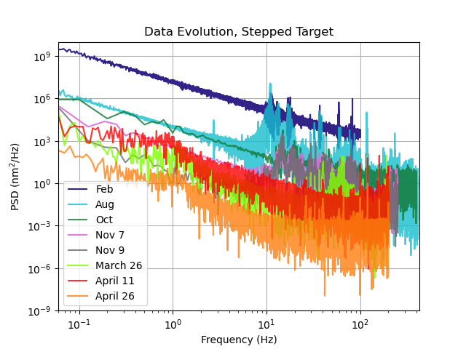
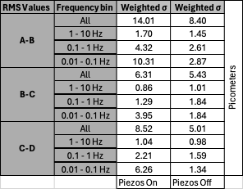
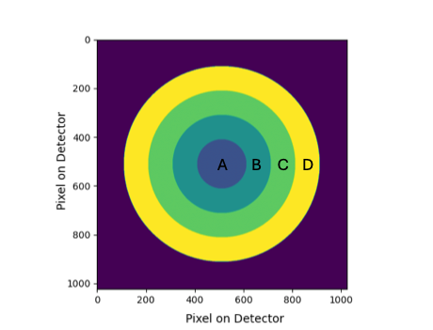
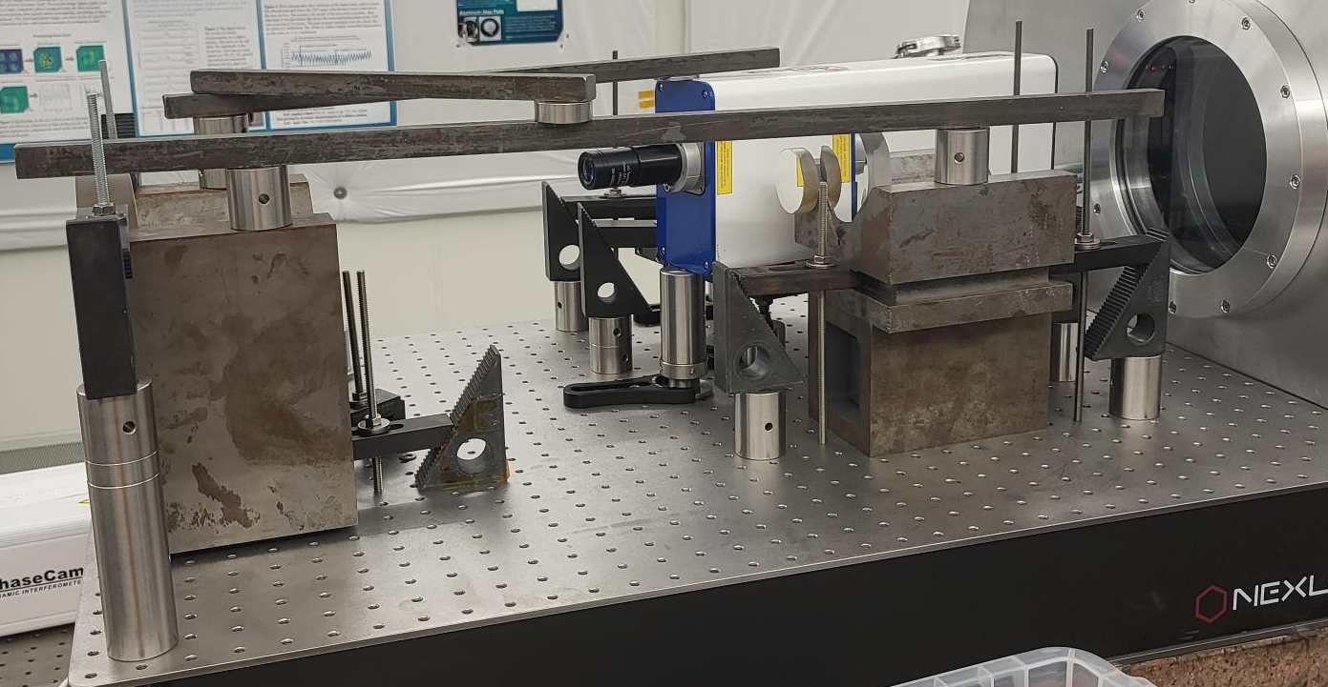
Ultra-Stable Metrology
Can achieve single-digit, picometer-level measurements at low (0.01 – 0.1 Hz) and mid (0.1 – 1 Hz) temporal frequencies for concentric rings on mirrors
20 data sets per configuration, 100 seconds each, taken throughout a day, looking at concentric rings over ~3” flat in OAP configuration

Slide 3
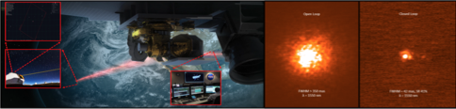
Orbiting Laser Guide Star
ORCAS at Keck Observatory provides some concept
  Concept is a highly-elliptical orbit with laser that points at Keck Observatory (Peretz+ 2024)
  LCRD pointed at Keck, and loop was able to close with high Strehl ratio
Laser guide star can provide:
  Reference PSF for PSF calibration
  Substantial photon count for focal plane wavefront sensing (common—path sensing)
    Could ease stability requirements by ~2 orders-of-magnitude (Clark, thesis)
LCRD concept
Open Loop
Closed Loop

Slide 4
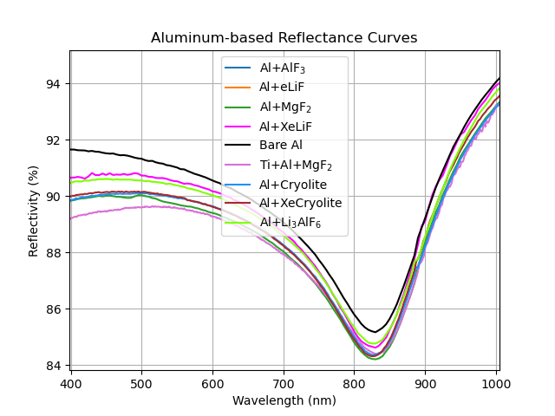
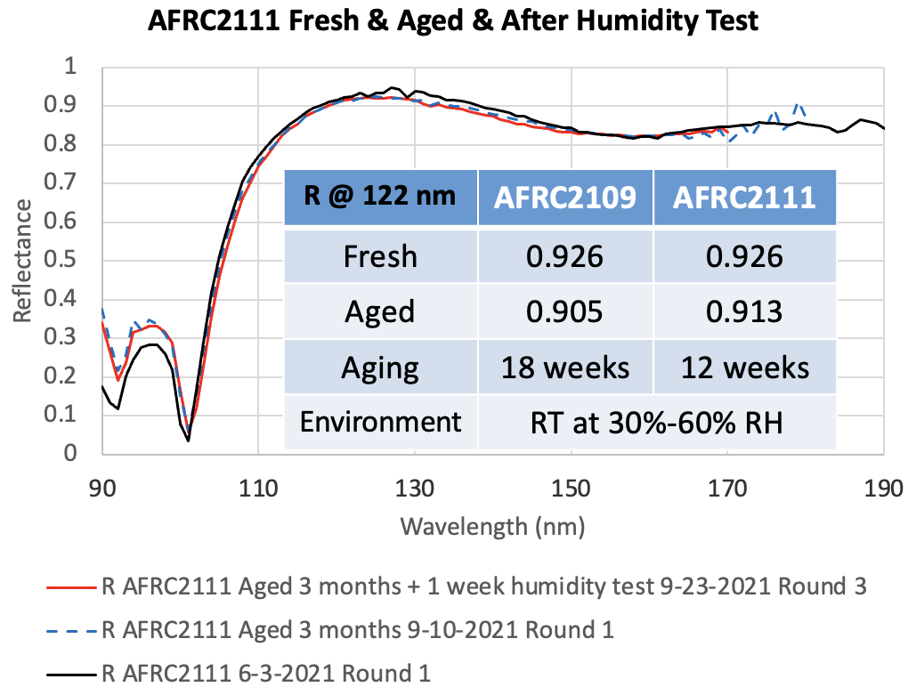
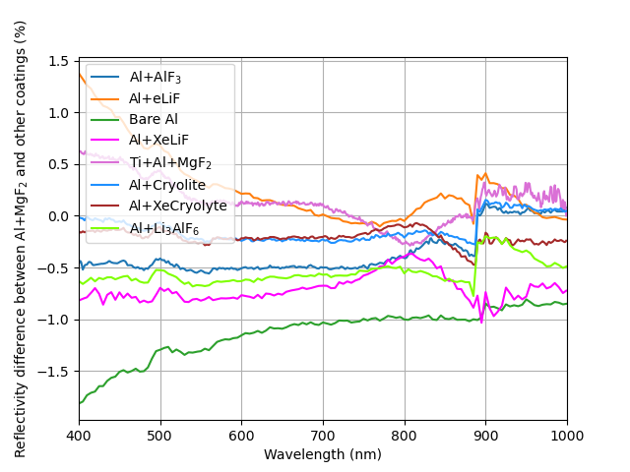
UV Coatings
Aluminum-based coatings can provide high reflectance (better than Al+MgF₂₎ in the UV (i.e., Al+XeLiF) with excellent aging statistics
Challenges:
  Scaling up while maintaining high uniformity (2-3%) between segments
  Need to test surface roughness and coating-induced stresses
  Full characterization of polarization-induced aberrations
Al+XeLiF does better than Al+MgF₂ and is only slightly worse than bare Al

Slide 5
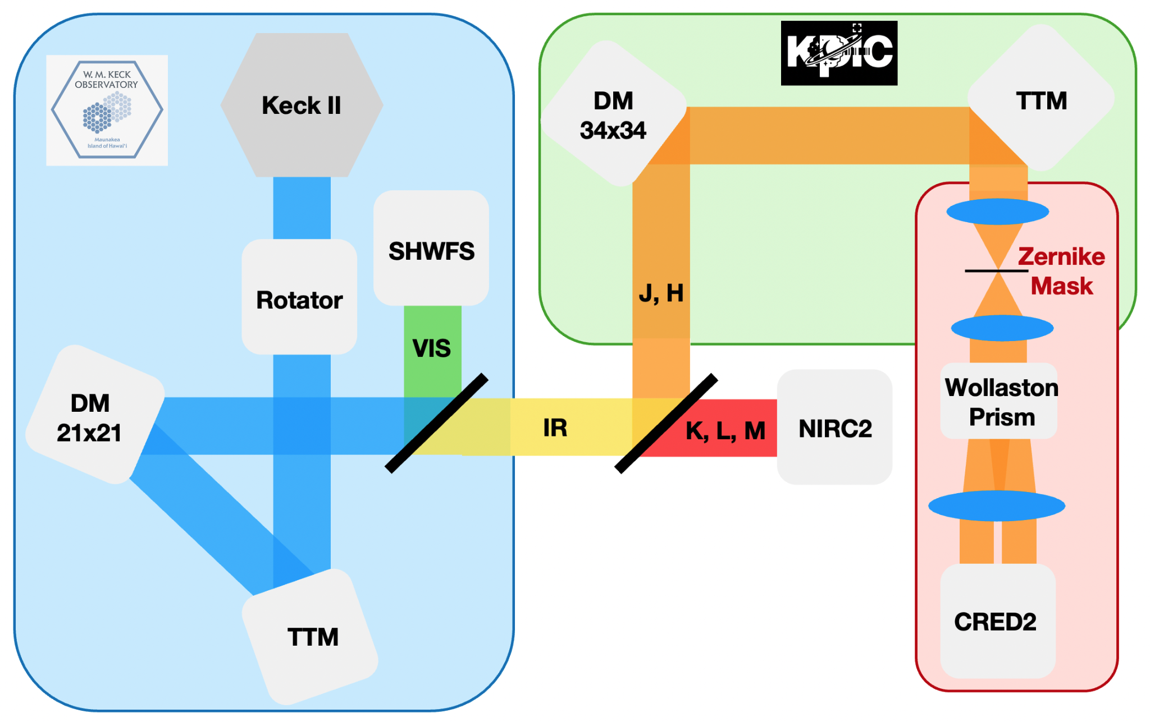
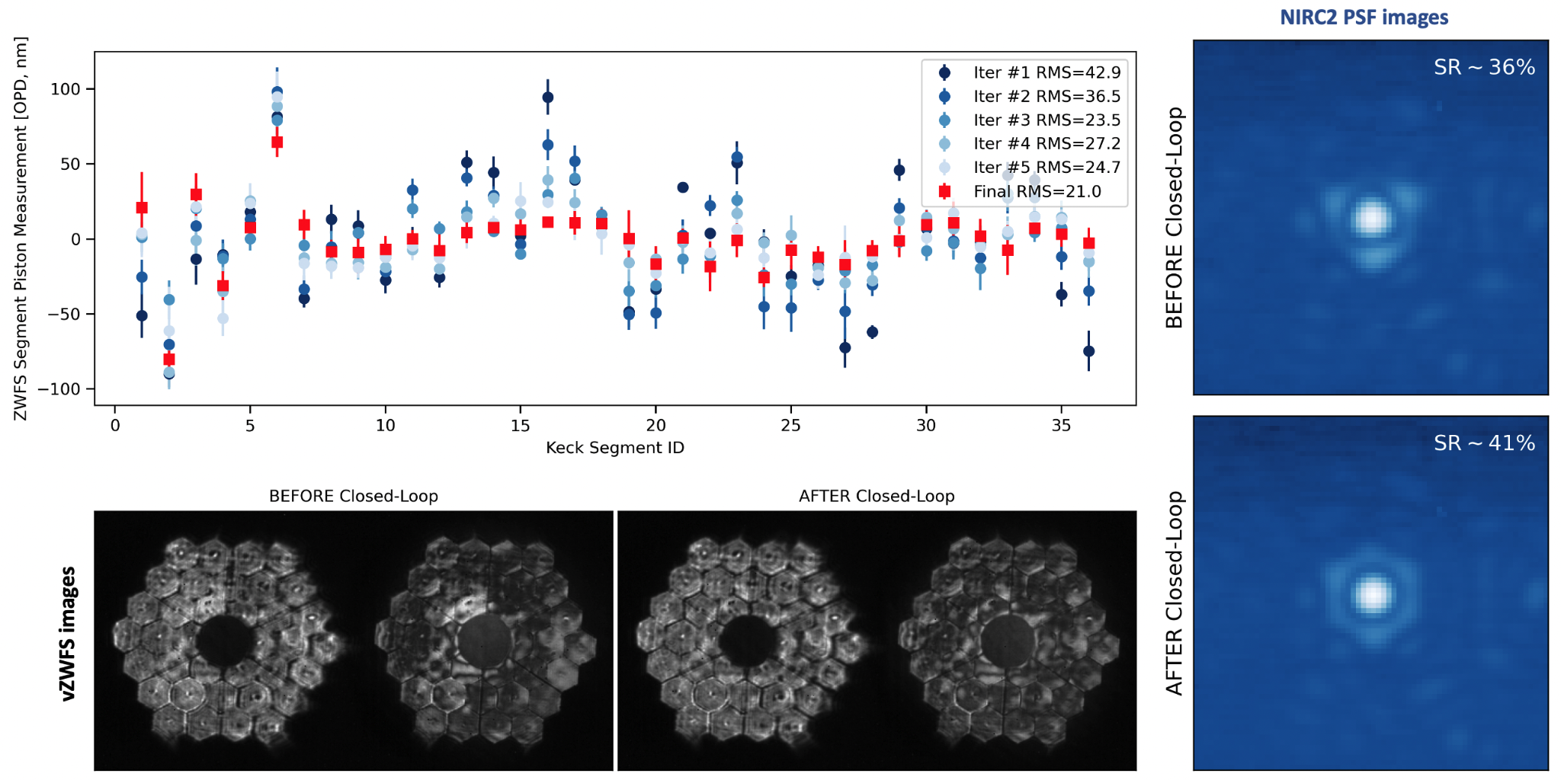
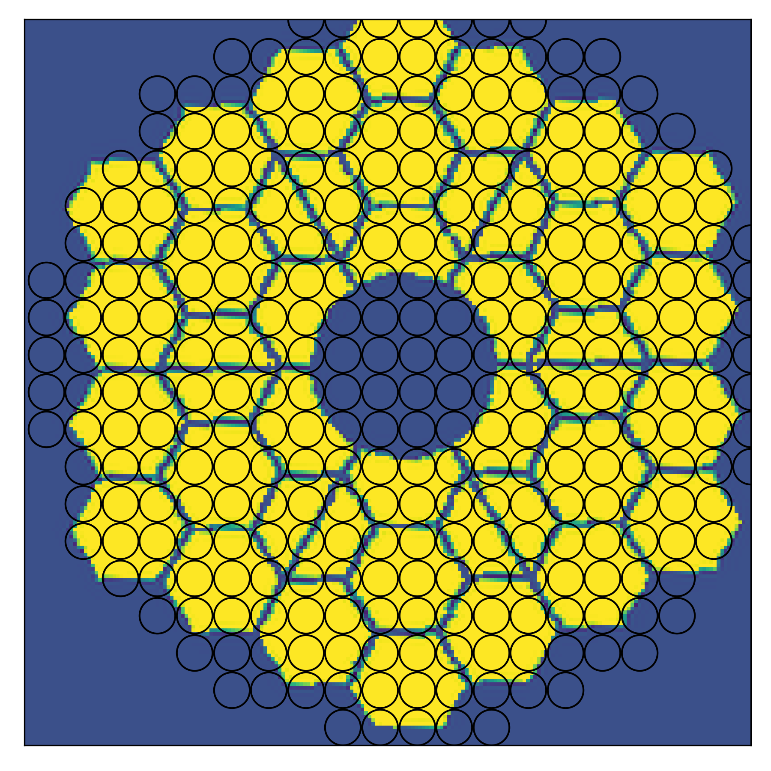
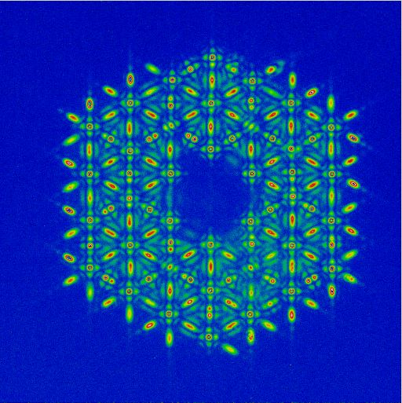
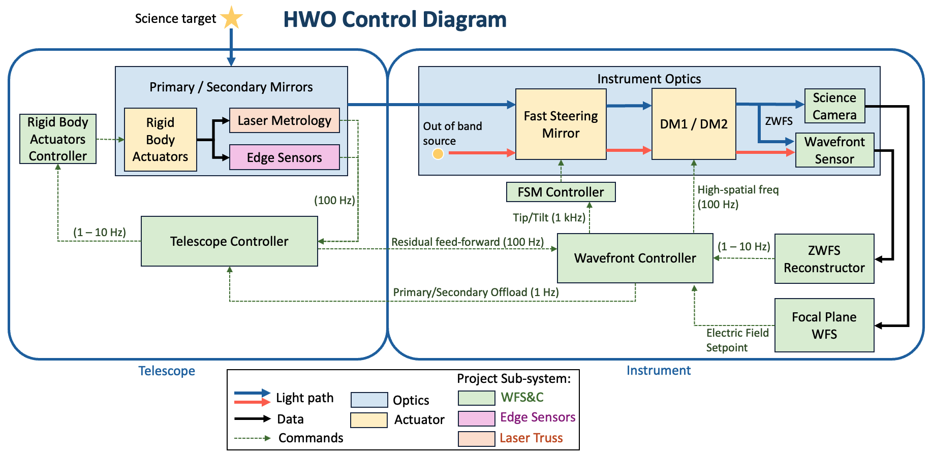
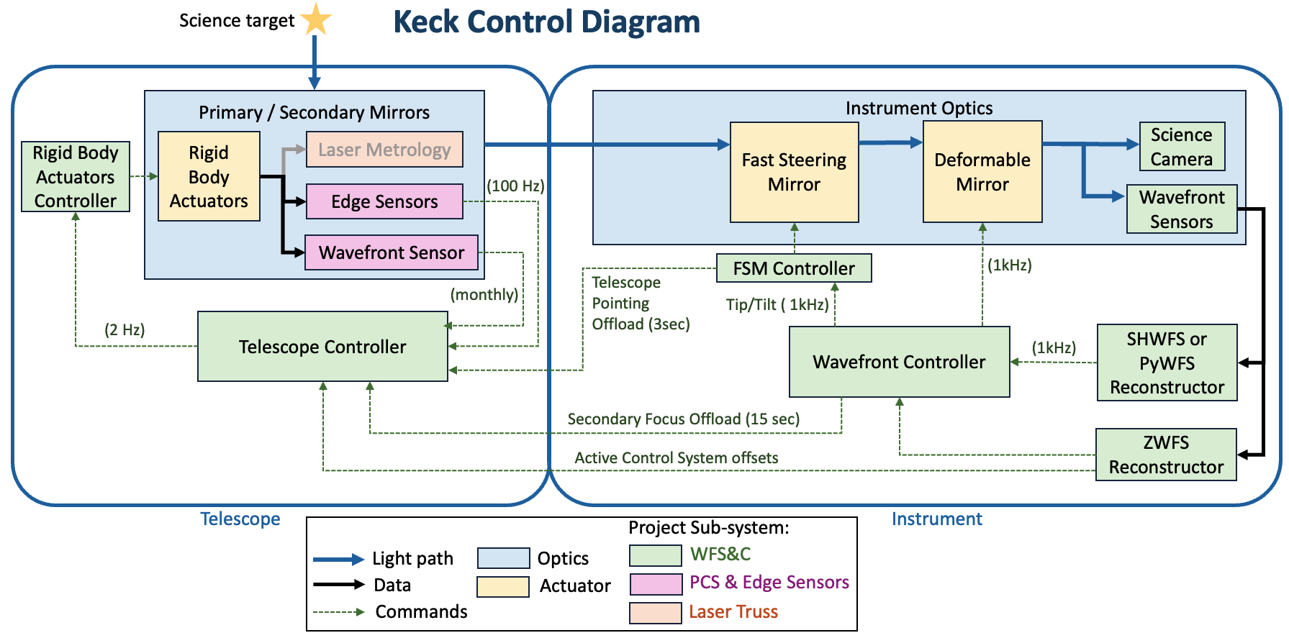
First on-sky closed-loop control of Keck primary mirror segments using a vZWFS (Salama+24)
Vector-Zernike WFS: 2 simultaneous phase shifts for increased dynamic range
POST closed-loop
Working towards understanding interactions between primary mirror segment co-phasing and AO system
On-sky demonstration of Strehl improvements via post-AO ZWFS control of primary mirror
Comparing vZWFS phasing with PCS phasing to determine optimal segment co-phasing technique for best AO performance
WFS architecture and control schemes are comparable to HWO, helping to verify and inform the HWO architecture

