Slide 1
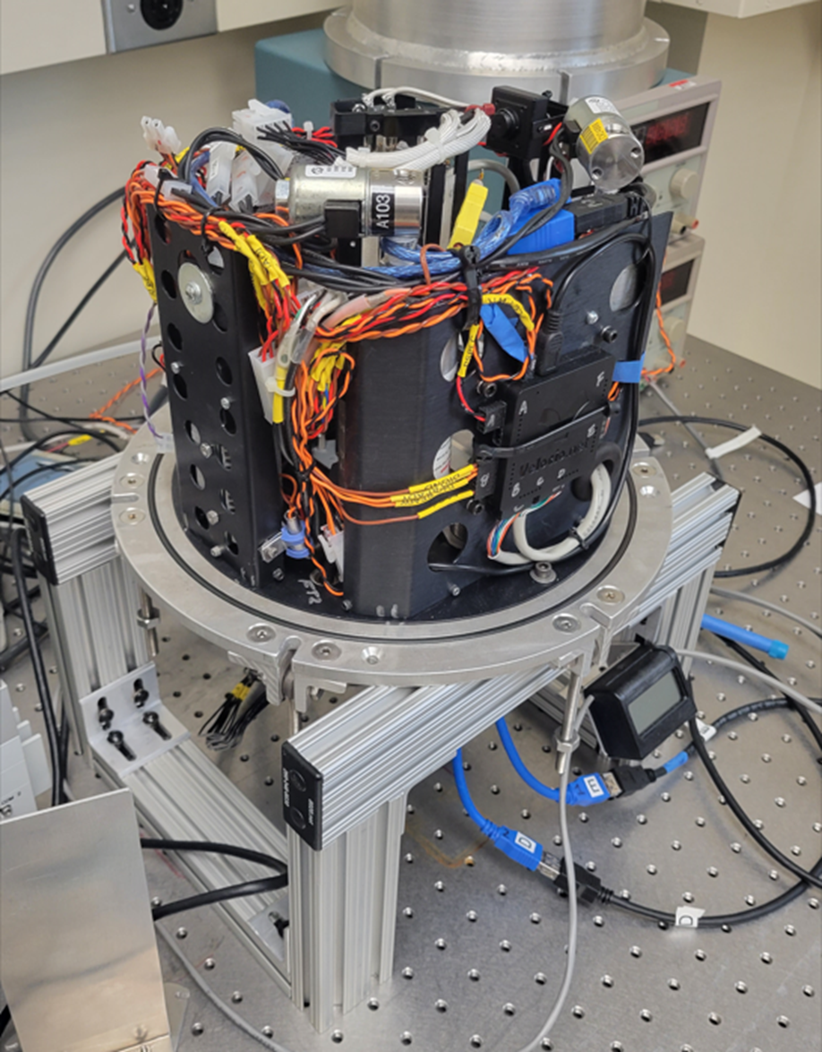
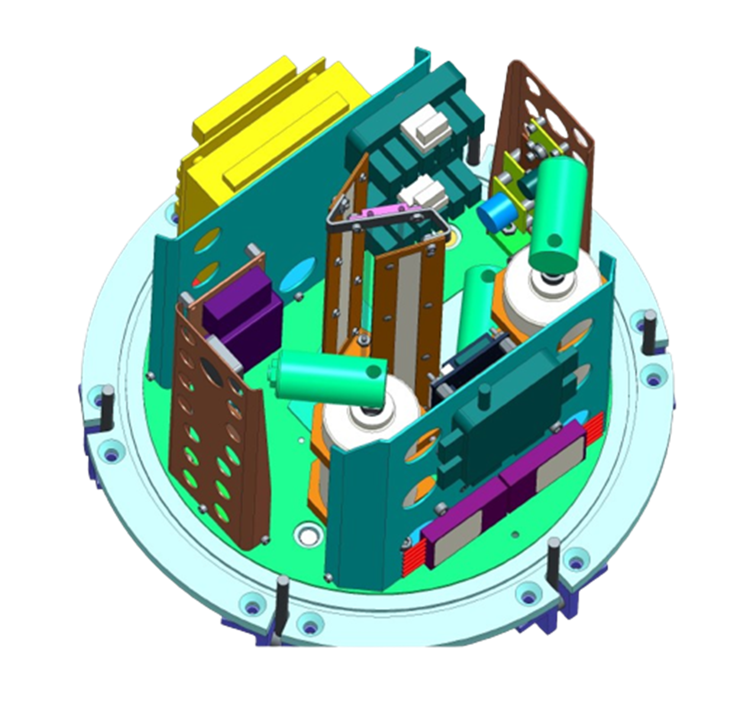
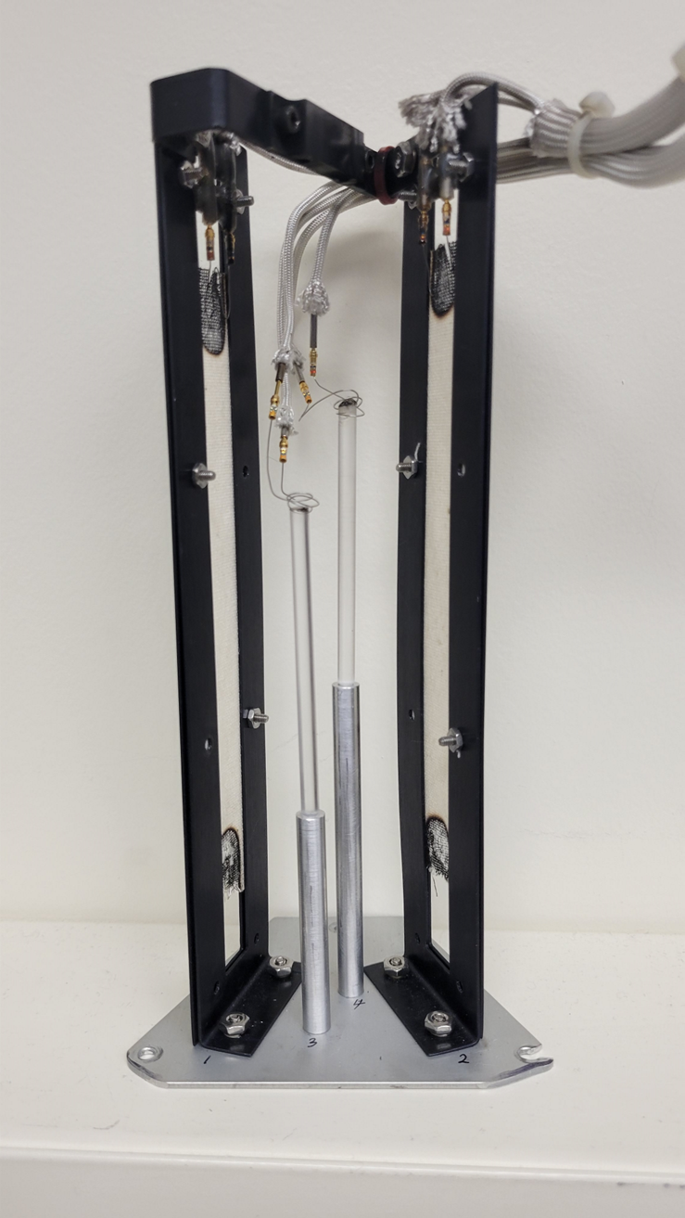
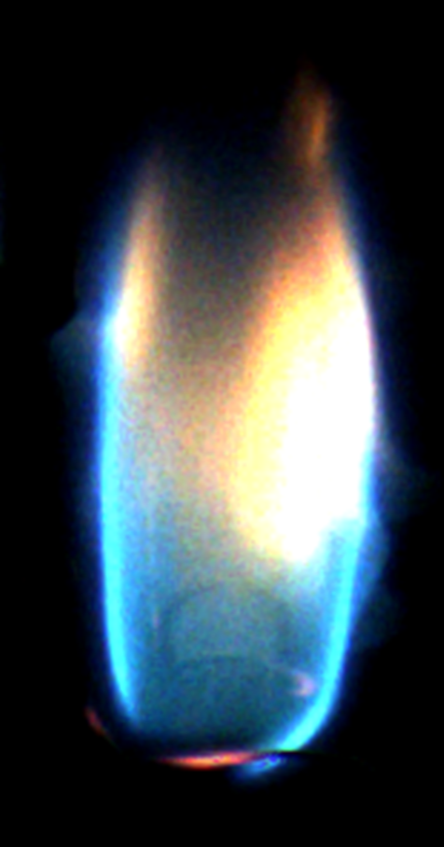
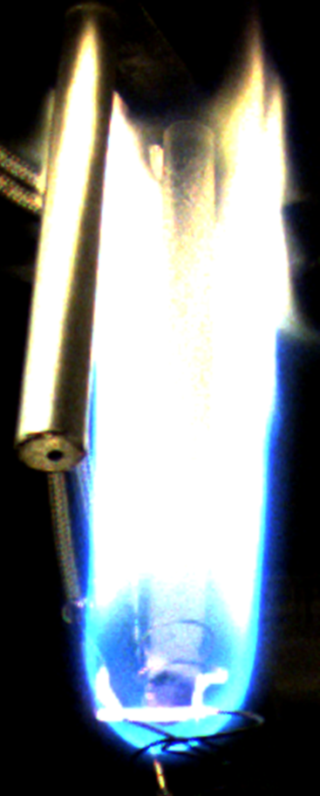
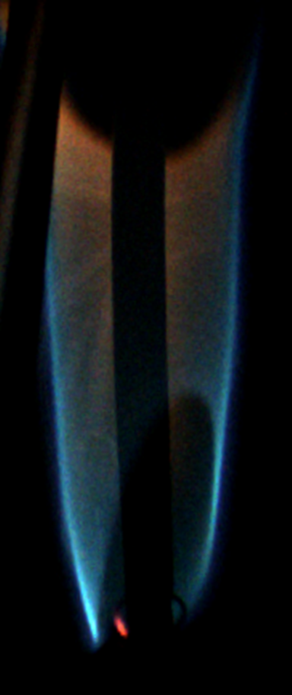
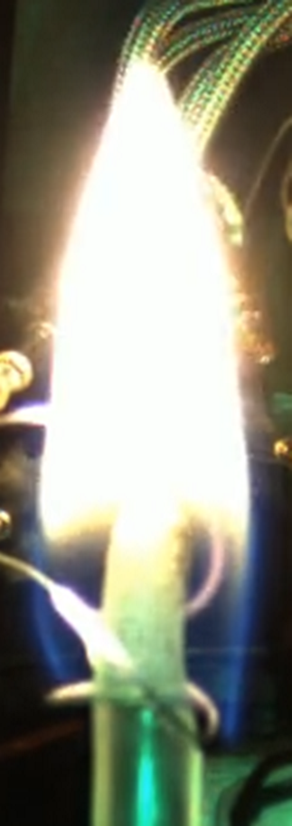
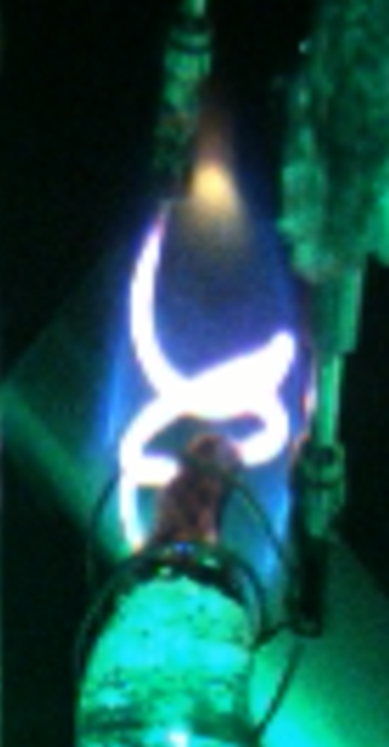
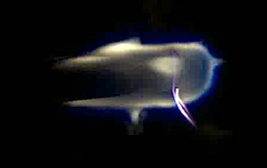
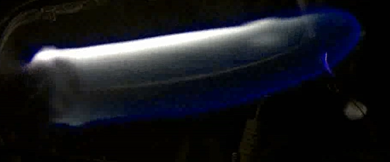
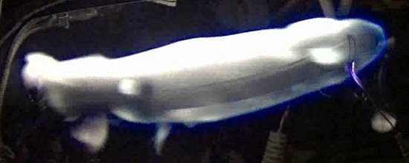
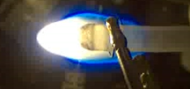
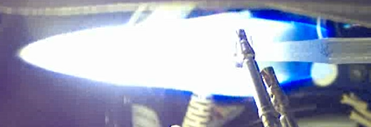
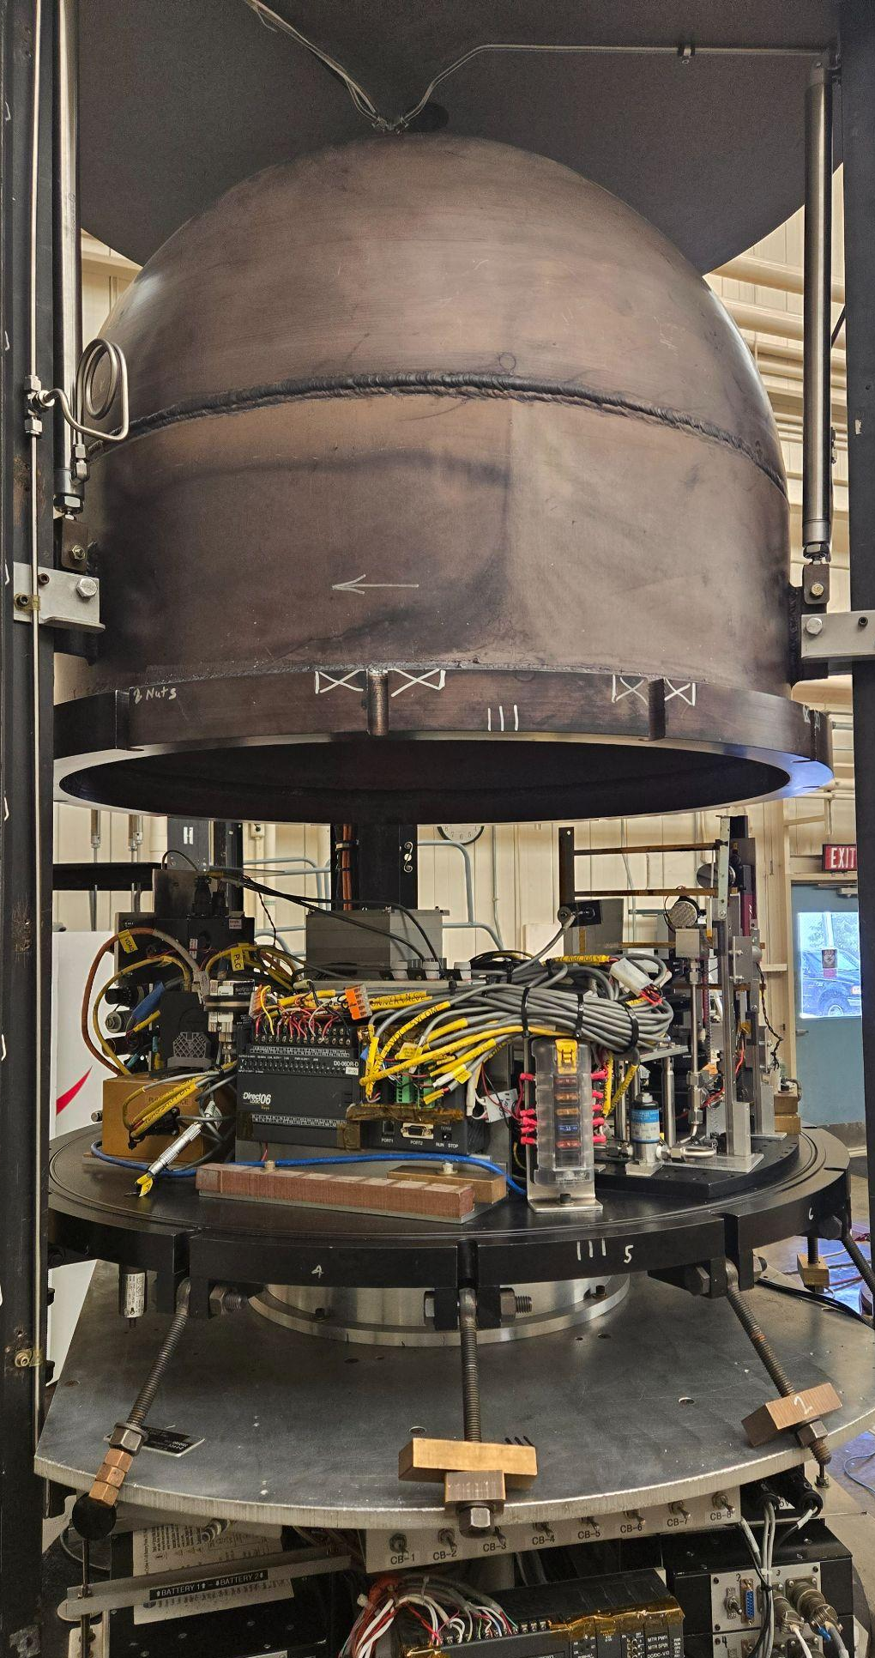
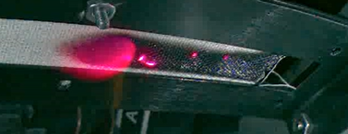
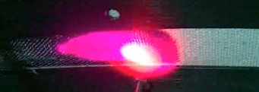
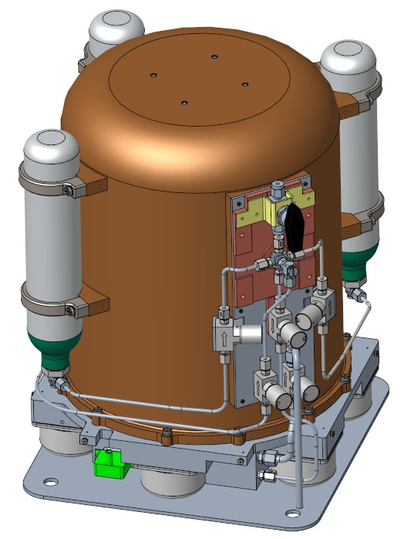
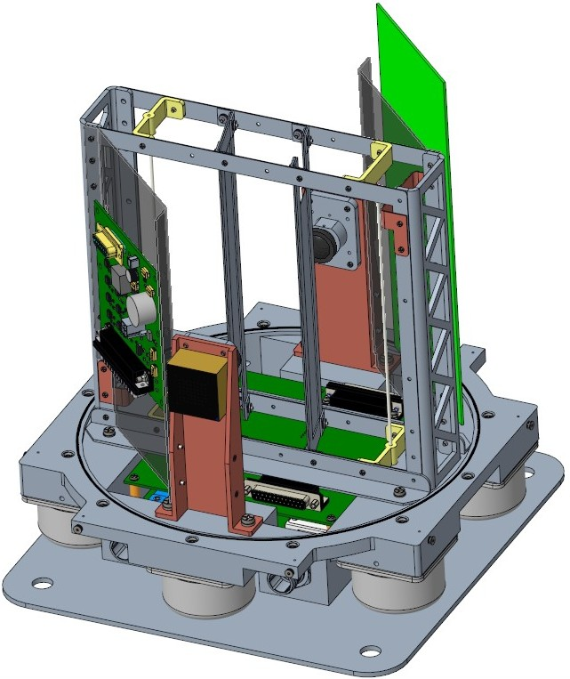
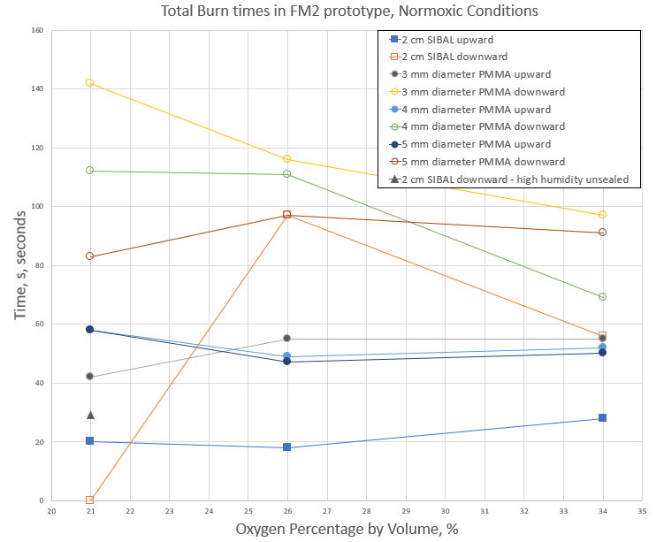
2024 Glenn Space Technology Symposium
Flammability of Materials on the Moon
Jennifer Zayac^{1,2}, Michael Johnston², Gary Ruff ² and Paul Ferkul^{2,3}
¹Ohio Northern University, Ada, OH,
²National Aeronautics and Space Administration, Cleveland, Ohio,
Universities Space Research Association, Cleveland, OH
Introduction
Lunar gravity has been found to increase the limits of flammability for some materials compared to Earth gravity, presenting a goldilocks zone of reduced convective heat loss, while generating enough buoyant flow to replenish fresh oxygen into the flame zone. Combined with the elevated oxygen concentrations of planned Space Exploration Atmospheres (Sea), a long duration fire experiment in Lunar gravity is important to help understand and mitigate the increased risk.
Flammability of Materials on the Moon (FM²) is a robotic, self-contained, combustion chamber which will be sent to the surface of the Moon on a Commercial Lunar Payload Services (CLPS) lander mission CP-21. The environmental control system can replicate and conduct fire experiments automatically in the expected atmospheres, specifically 21% oxygen at 14.7 psia, and 34% oxygen at 8.2 psia, which are of immediate interest to the Human Lander System (HLS) and Lunar Rover.
The laboratory prototype became operational this summer. There are four samples currently planned; two SIBAL fabrics (cotton/fiberglass blend) which will be burned in air and two acrylic rods which will be burned in Normoxic Space Exploration Atmospheres (SEA). One of each fuel will be burned upward and downward. SIBAL fabric has been found to only burn downward in air in lunar gravity (via Lunar gravity centrifuge and parabolic flight) where on Earth’s gravity it extinguishes immediately after ignition.
Fabric Fuel 1
Fabric Fuel 2
Fuel Rod 1
Fuel Rod 2
Flammability of Materials on the Moon (FM²) Laboratory Prototype
Flammability of Materials on the Moon (FM²) Solid Fuel Module
4 mm PMMA Rod
Key Features
•Onboard Gas Cylinders
•Pressure/temperature sensors
•Single trigger PLC controlled
Upward, 21% 14.4 psi
Downward 21%, 14.4 psi
•Two Color Cameras
•LED Illumination
•Four Independent Ignitors
•Self Contained System
• 0-1 atm, 0-34% O₂
•O₂, CO₂, CO, %RH Sensors
Upward (1g), 34%,8.2 psi
Downward (1g), 34%,8.2 psi
The flame tip opens as the chamber loses oxygen and near extinction, allowing a greater amount of oxygen to flow through the middle, letting the flame burn a little longer.
As the oxygen begins to deplete, the flame becomes smaller and turns blue just before extinction. Flame size, strength, propagation speed, and extinction oxygen can be recorded.
Centrifuge Testing
The upward flame images in 34% oxygen, 8.2 psi appear dimmer than the above 21% oxygen time series, because the camera gain adjusts to the extreme brightness of the soot, making the blue tip appear dim. The high heat experienced by the rod begins to curl it to the side.
The 34% oxygen downward burning flame is very obviously hotter and brighter in this image series.
Provides Increasing evidence that materials have lower oxygen limits of flammability in Lunar gravity than in Earth gravity according to the 5.18 second tests using the zero-gravity drop facility.
SIBAL
Upward (1g)
Left: 14.4 psi
Right:8.2 psi
Downward (1g)
Left: 14.4 at 21% psi
Right:8.2 psi at 34%
Left: Polycarbonate sample in 30% oxygen in 1g, initial tests for finding extinction limit Right: Centrifuge drop rig and hardware
This material burns upward in 21% oxygen at 14.4 psi (and 1 atm) (Left). A smaller, but stable flame persists is shown to persist 8.2 psi as well (Right).
The SIBAL fabric fuel on the left is seen to have extinguished. It was ignited at 14.4 psi in 21% oxygen, and the right at 8.2 psi in 34% oxygen. The 14.4 psi (and 1atm) case will persist in Lunar gravity as found in centrifuge and parabolic flight tests. A bright flame burns SIBAL fuel downwards in 34% oxygen at 8.2 psi
Future Work
Flammability of Materials on the Moon will be sent to the Lunar surface on the SpaceX Human Lander System demonstration flight. It will provide the reference for how materials burn under the effect of long term Lunar gravity to help understand and mitigate the risk for future surface exploration missions. The flight hardware is currently being constructed by ZIN Technologies. Future student work will consist of Matlab analysis of Earth laboratory tests including flame size, flame spread rate and distance, oxygen concentration at extinction, and atmosphere changes during and after each burn.
The spaceflight unit of Flammability of Materials on the Moon (FM²) will add various features and upgrades to increase free internal volume, hardened systems for space travel, and facilitate communications to the lander, then Earth.
Acknowledgements
This work was made possible by the funding provided by Biological and Physical Sciences (BPS and )Mars Campaign Office (MCO) as well as the Staff at the Zero Gravity Research Facility staff and Dan Gotti for building the engineering unit. ZIN Technologies will build the flight unit to fly on a Human Lander System (HLS). Intern funding has been provided by the NASA Mars Campaign Office, NASA Biological and Physical Sciences division, and the Ohio Space Grant Consortium.

