Slide 1

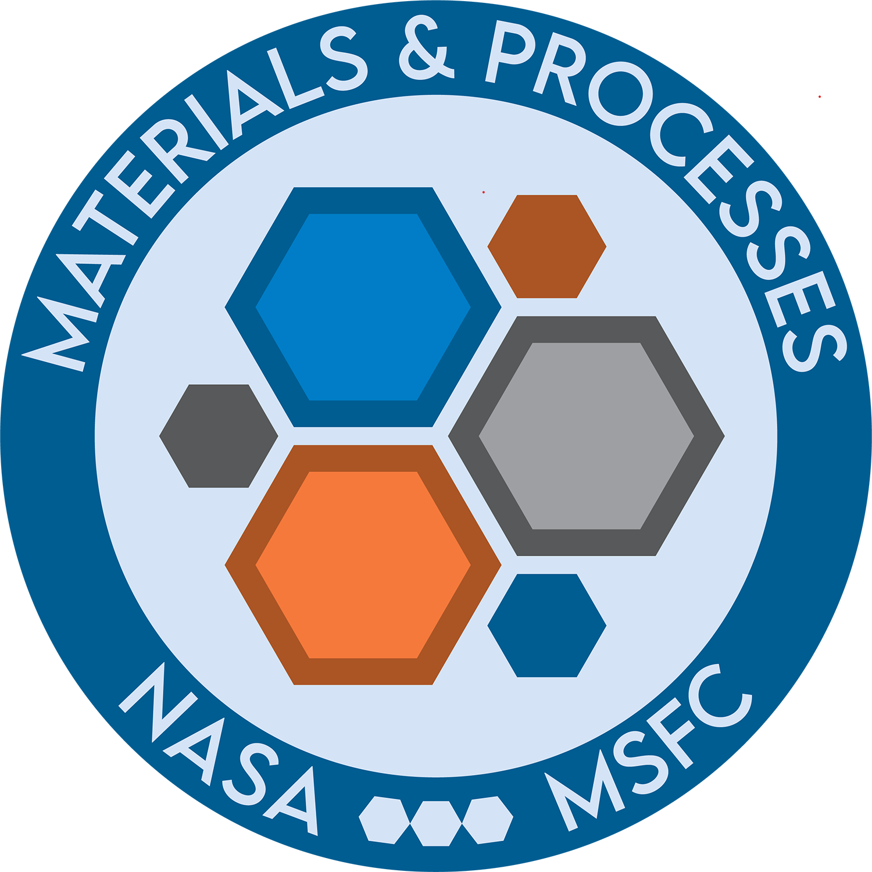
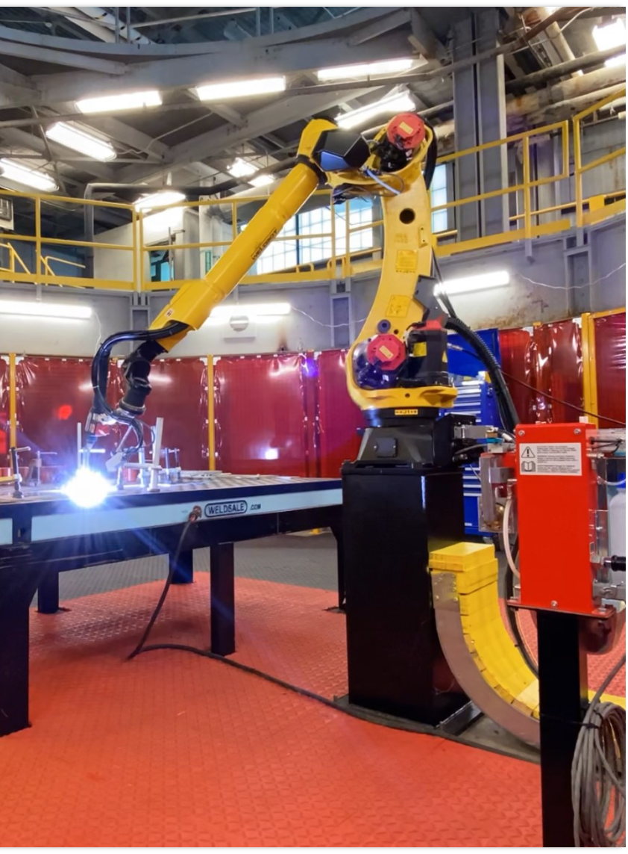
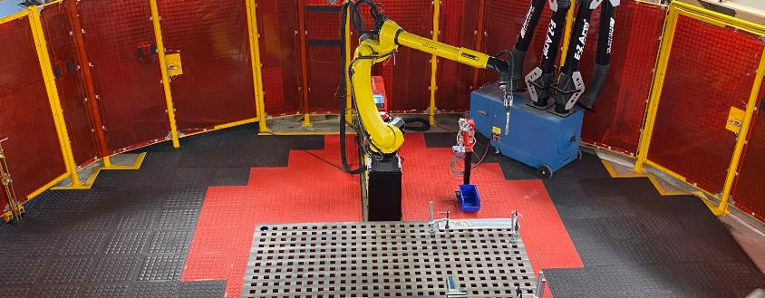
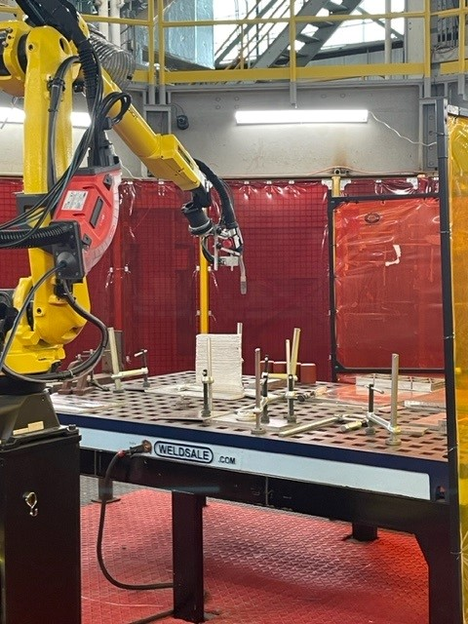
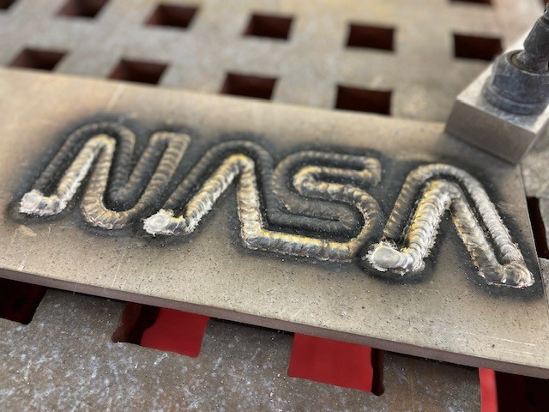
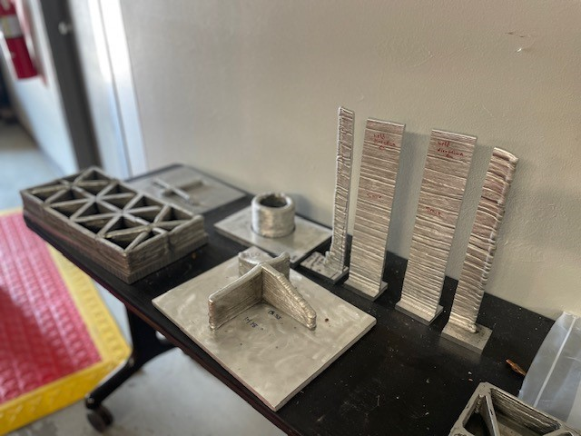
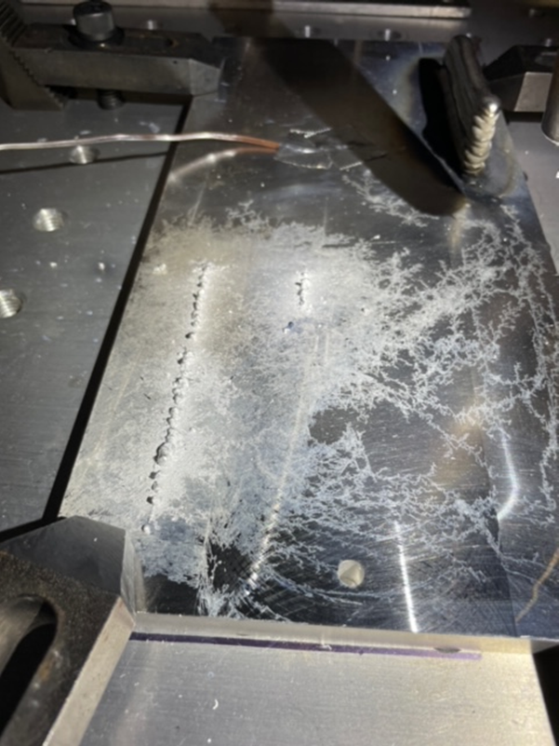
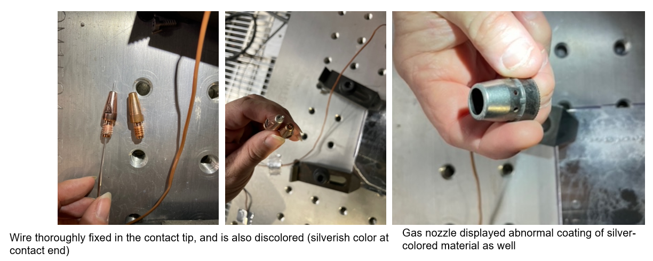
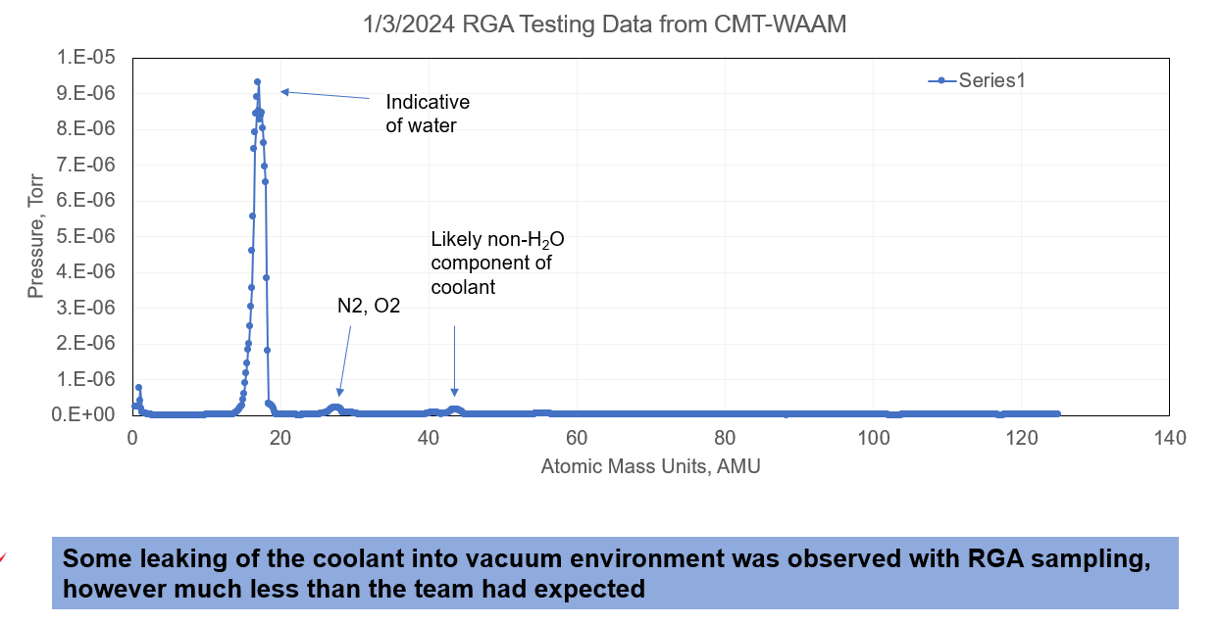
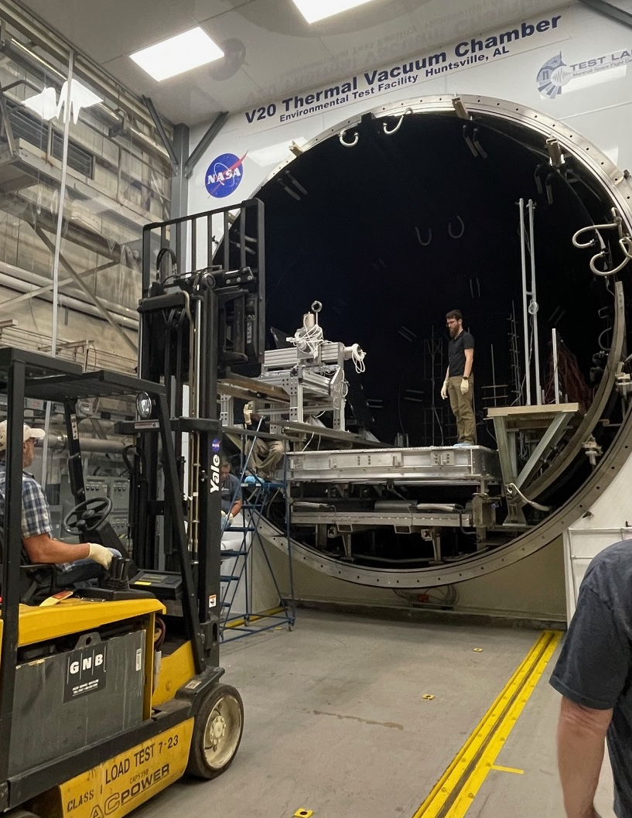
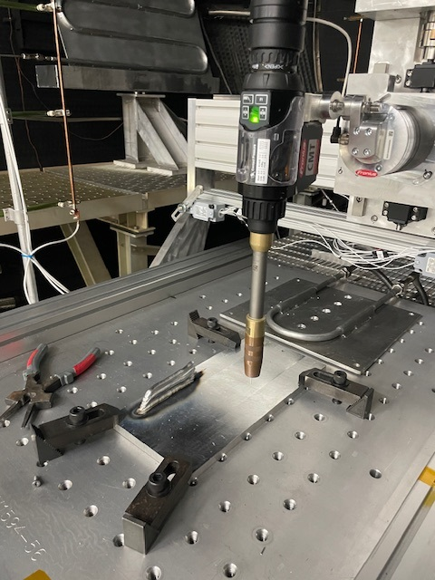
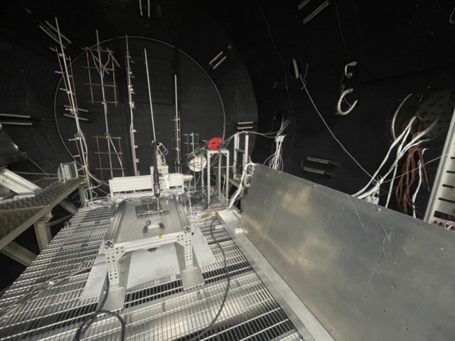
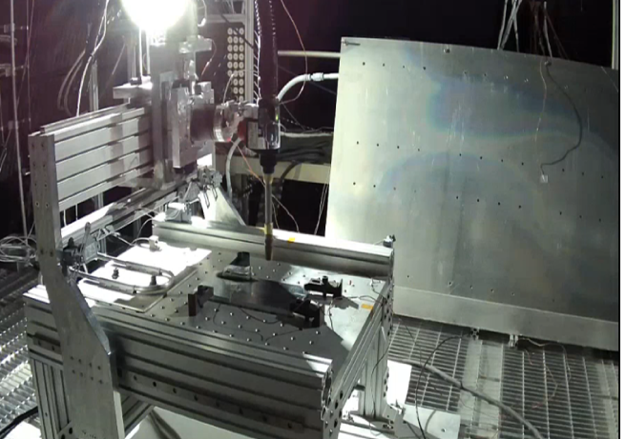
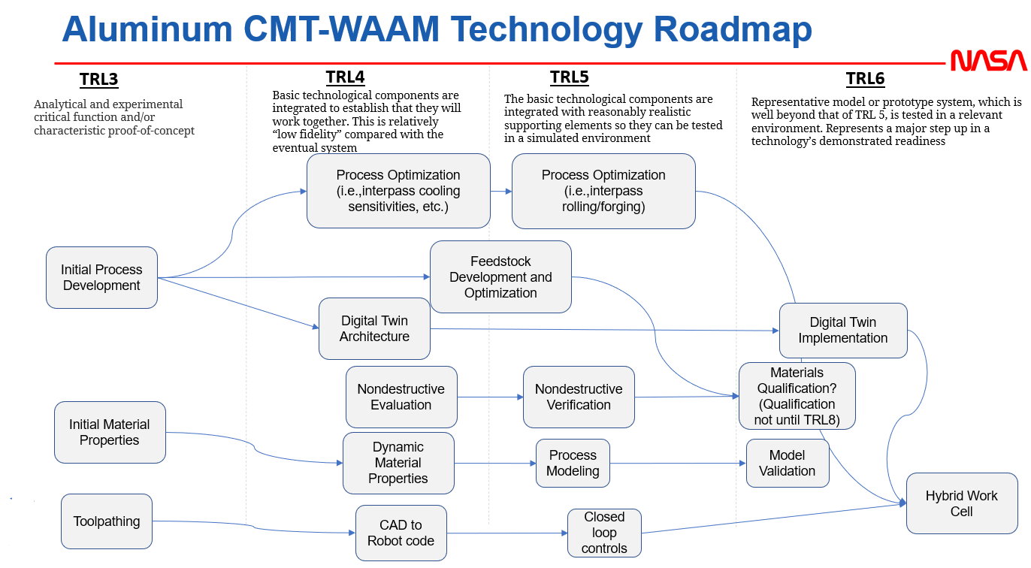
Cold Metal Transfer (CMT) Wire-Arc Additive Manufacturing (WAAM) in a high vacuum environment
Ilana Lu | EM42 Additive Manufacturing Team
ilana.k.lu@nasa.gov
Background and Objective
Aluminum has been identified as a compound within regolith and is likely to become a core component of our infrastructure on the lunar surface as in-situ resource utilization (ISRU) capabilities are advanced
Large-scale components, outfitting, and repairs of aluminum materials can be fabricated with robotic wire arc additive manufacturing (WAAM) in order to inhabit the moon’s surface long term. WAAM is a high value process for lunar advanced manufacturing as it does not require special containment to reduce explosion hazards such as powder-based additive processes and feedstock
The welding process of cold metal transfer (CMT) is a relatively new variation of gas metal arc welding (GMAW, also known as MIG) that relies on the detection of a short circuit in the welding process to control the deposition droplet action, resulting in lower heat input and splatter compared to conventional MIG welding
Part of the strategy to explore the CMT-WAAM process for use as an in-space manufacturing method is to evaluate its behavior in the anticipated environments of reduced gravity and high vacuum. Traditional MIG processes are not anticipated to work directly in such environments, but due to the novel short circuit droplet action of this welding process it was unknown if it would perform with these conditions
This project was initiated to perform the CMT-WAAM process within a TVAC chamber at MSFC and evaluate if it would be able to print under high vacuum by use of a custom fixture, controls system, and commercial CMT welding equipment
Robotic CMT-WAAM cell at MSFC for large scale additive manufacturing
Results
The commercial welding equipment and MSFC-designed and fabricated positioner functioned within the high vacuum environment of V20, with minimal leakage from the coolant lines within the system and under vacuum
A visible welding arc was struck and sustained; however, the resulting deposition shows highly reduced volume of material “printed” compared to its inert gas environment counterpart
Silvery, aluminum-like powder was found on many surfaces surrounding the print, including the gas nozzle and contact tip of the structure, indicating much of the intended printing volume was instead vaporized as a byproduct of the chaotic arc within these conditions
Chemical testing of the resulting print is still in work, with anticipated results by the end of FY24
Resulting printed material
Fixture being loaded into the V20 TVAC chamber
Operating welding torch and bench test wall made with the final system before vacuum
Fixture, welding equipment, and scavenger plate within the V20 chamber
General Approach
The MSFC team designed a fixture to withstand the anticipated high vacuum conditions:
  Stepper motors rated for the environment
  Welding power supply and motion controls outside the chamber, using the hermetic feed through of the V20 TVAC chamber for power and communication
A LabVIEW interface to V20 and controls was also developed for this at MSFC
  Preprogrammed toolpaths and ability to “home” and avoid overtravel with limit switches
Fabrication of the fixture was also completed at MSFC
The system was tested assembled outside vacuum chamber to ensure functionality
Vacuum was drawn down once the fixture was finally assembled inside V20, individual parts were pre-baked to reduce outgassing, and communications troubleshooting was complete
Alignment to MSFC and Agency
Gap | Description | CMT WAAM Solution
STMD-AMSM-030 (MANU-650, HEOMD 3084) | Very large-scale additive manufacturing | The goal is to design and additively manufacture a “bracket” demonstrator, from CAD-to-part no less than 3” in height. Several cylinders of 3.25” height have been consistently printed with this system to date
STMD-AMSM-022 (MANU-651, HEOMD 3088) | High-fidelity physics-based simulations for design, certification, production, and operations | TE for FY23 was awarded to begin instrumenting the robot and cell with sensors for a future thermal digital twin.
STMD-OSAM-022 (MANU-651, HEOMD 3088) | Materials Process Modeling | Thermal data for a 5-layer wall has been acquired and will be used to populate temperature profiles and thermal history of a rudimentary model
STMD-OSAM-009 (MANU-642, HEOMD 3061) | Fabrication and repair of on-orbit and lunar surface hardware, components and structures using advanced manufacturing processes | The large-scale AM and vacuum/gravity evaluations of this technology within the next year will provide key knowledge and methods for the fabrication of large-scale lunar surface infrastructure
STMD-AMSM-028 (MANU-644, HEOMD 3061) | Lunar surface manufacturing, recycling, reuse, repurposing, and repair capabilities | Aluminum feedstock is chosen for this process due to availability in regolith (an ISRU identified potential capability). Solid state wire extrusion from billet is also being evaluated with this process as a potential feedstock that can be derived from scrap material in situ and repurposed for new parts, repairs, or outfitting
This project intended to address CMT-WAAM potential for an equivalent TRL5 condition of a vacuum environment –similar to what it might experience in space or on Lunar surface
Awarded and Related Work
FY22 Center Innovation Fund (CIF)
FY22 Cooperative Agreement Notice (CAN) with The University of Tennessee Knoxville (UTK)
FY23 Technical Excellence Awards
FY23 Cooperative Agreement Notice (CAN) with Fronius USA
FY24 Technical Excellence Awards
Special Thanks To:
Jonathan Bonebrake and the MSFC ET30 TVAC Team
Gary Sellers, Adam Gebus, and John Hutchison with MSFC ET50
Mike Terry, Craig Habeck, and David Riggs with MSFC EM32 Welding and Manufacturing Team
Colton Katsarelis and the EM31 Material Diagnostics Team

