Slide 1
OSIRIS-REX Conjunction Screenings: Earth Gravity Assist & Earth Return Analysis & Results
Dolan Highsmith, Roger Thompson
The Aerospace Corporation
August 14, 2024

Slide 2
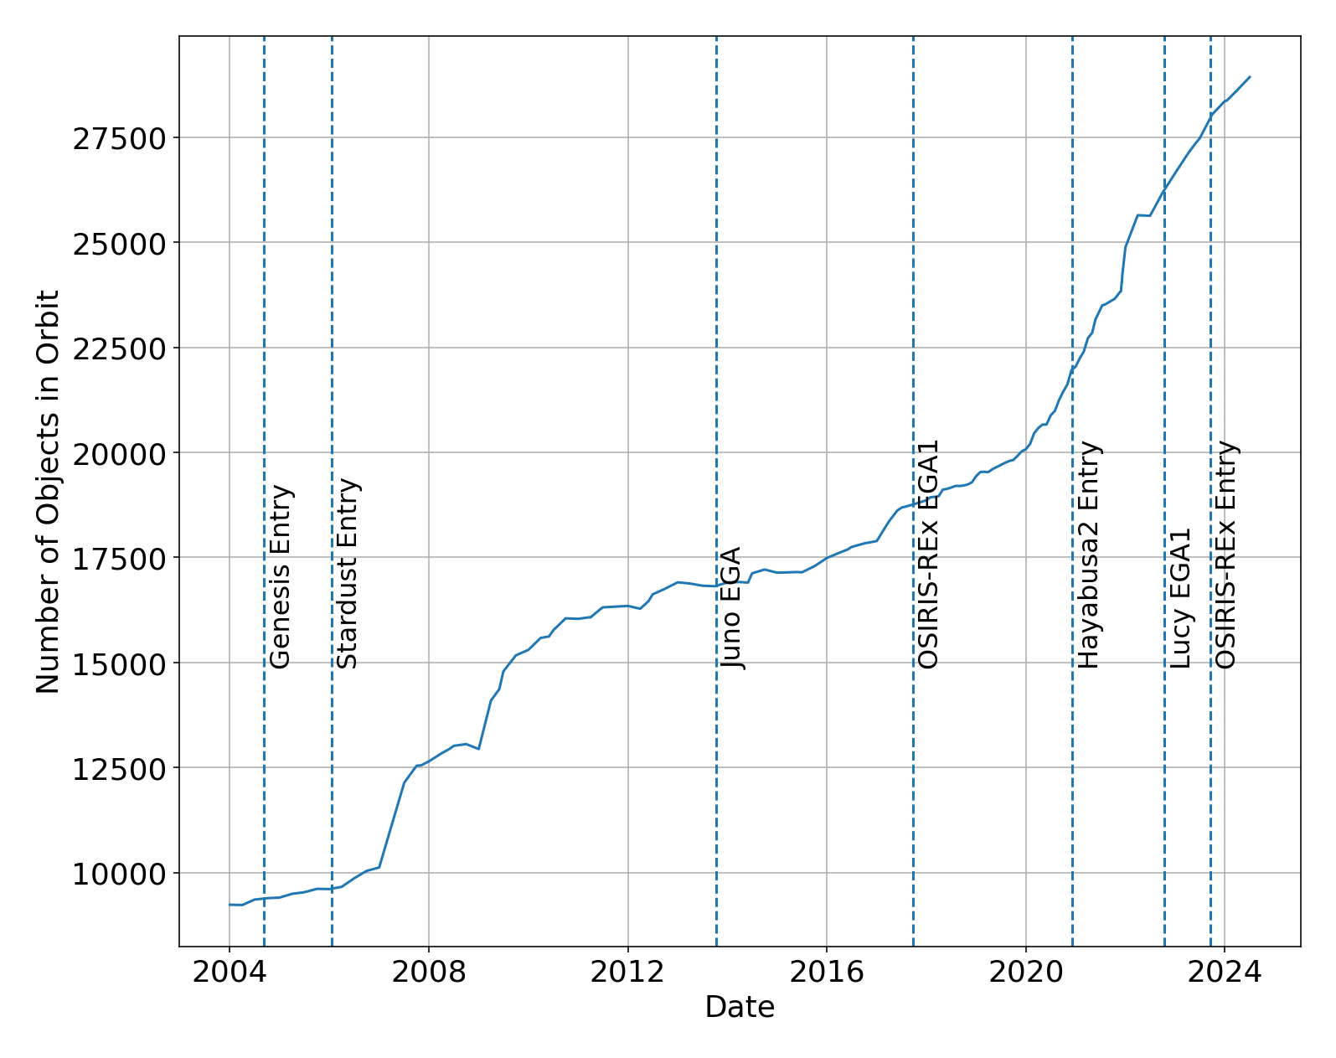
Motivation
Earth flyby and entry missions face increased collision risk due to significant increase in resident space object (RSO) population in recent years
  CARA began screening Earth flyby/ entry missions with Juno in 2013
Document OSIRIS-REx screening experience to highlight knowledge gained and lessons learned by CARA
  Rare mission profile, but frequent enough to normalize support
2

Slide 3
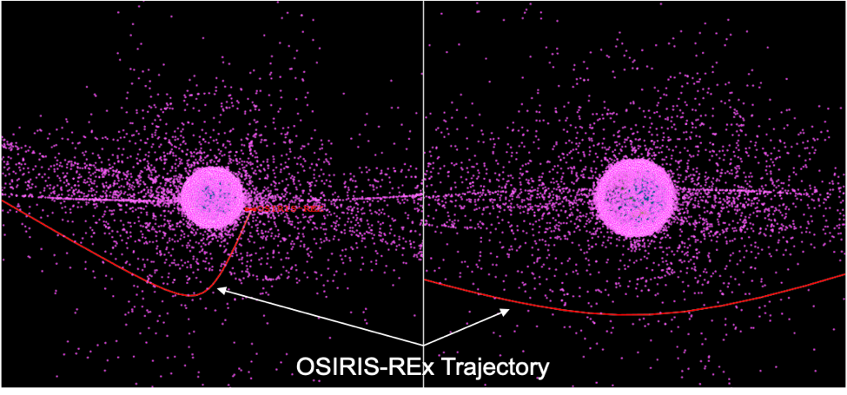
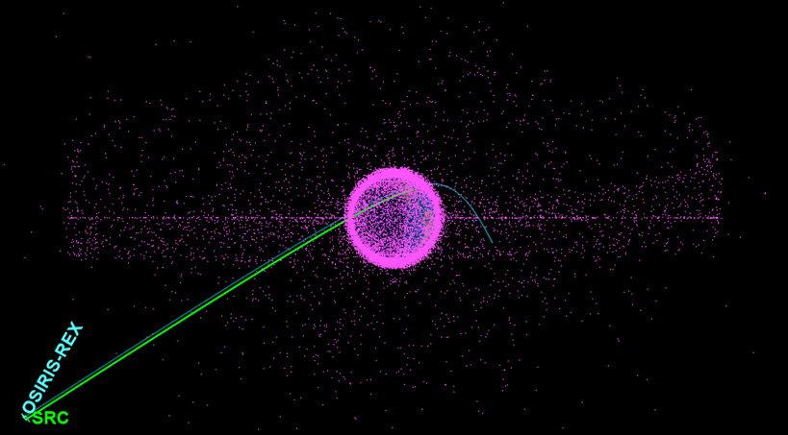
2017 & 2023 Trajectories
2017 EGA
2023 Earth Entry & Flyby
Perigee ~17,200 km altitude over South Pole
Orbit crossing forecasting analysis indicated few objects would pose significant risk
  Trajectory passed through ~660 orbit planes of objects with apogee > OREX perigee
1 CAM option:
  Change TCA by +2 sec
Bus perigee ~780 km altitude
SRC landing in Utah
3 CAM options:
  Change TCA by -0.5, -1.0, -2.0 sec
CAM @ EI-13h, SRC Release @ EI-4h
  CAM affects both objects
3
CAM = Conjunction Avoidance Maneuver TCA = Time of Closest Approach SRC = Sample Return Capsule EI = Entry Interface

Slide 4
CARA Support for 2023 Earth Return
Development and execution of Conjunction Assessment Operations Implementation Agreement (CAOIA) Document
  Coordination between CARA and mission on details of support
Orbit crossing forecasting analysis > 10 days out
  Identify objects with small relative node separation distances and time from node
  Similar to JPL MADCAP conjunction metrics for non-Earth environments
Participation in pre-arrival testing/simulations
  Created conjunction scenarios for table-top discussions and mission operational readiness tests
Operational screenings
  Relied on mission ephemerides since no passive ephemeris would be available
4
MADCAP = Multi-mission Automated Deep-space Conjunction Assessment Process

Slide 5

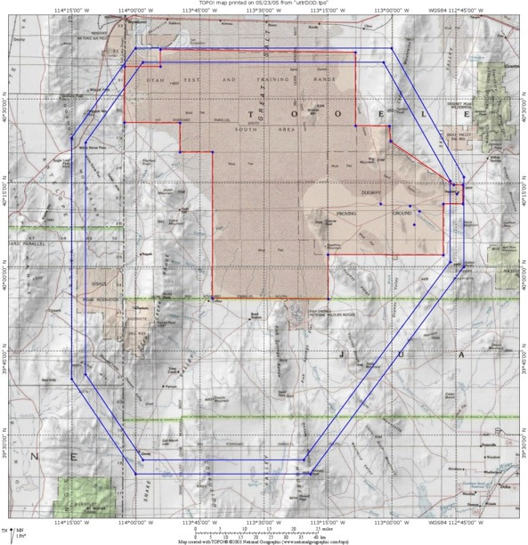

Baseline Earth Return Concept of Operations
Entry Targeting Maneuver Sequence
Landing Ellipse Comparison
Entry Interface (EI)
(130 km, FPA –8.2°± 0.08°)
Bus Flyby ~780 km
Entry Interface (EI)
(130 km, FPA –8.2°± 0.08°)
Bus Flyby ~780 km
x
Stardust
Divert Burn
(EI-3.67 hrs)
x
×
Divert Burn
(EI-3.67 hrs)
×
CAM Opportunity (EI-13 hrs)
SRC Release (EI-4 hrs)
UTTR Tracking
Stations
CAM Opportunity (EI-13 hrs)
SRC Release (EI-4 hrs)
×
Genesis
×
×
Flyby Target ~200 km
Ground Target
Wig Fallback
TCM-12(@ EI-7 days)
Flyby Target ~200 km
3σ
TCM-12(@ EI-7 days)
OREx
×
TCM-11 (@ EI-14 days)
TCM-11 (@ EI-14 days)
Flyby Target ~2000 km
Flyby Target ~2000 km
TCM-10 (@ EI-60 days)
TCM-10 (@ EI-60 days)
UTTR Restricted Range Land
  Walk-in/entry TCMs to lower periapsis from flyby to Entry Interface
  SRC Release after final TCM and potential CAM
  Divert burn ~20 min after SRC Release for safe spacecraft bus flyby
UTTR Restricted Airspace
(95% Dispersion)
  Walk-in/entry TCMs to lower periapsis from flyby to Entry Interface
  SRC Release after final TCM and potential CAM
  Divert burn ~20 min after SRC Release for safe spacecraft bus flyby
(99% Dispersion)
Scale: 1 in = 30 km
5
EI = Entry Interface SRC = Sample Return Capsule TCM = Trajectory Correction Maneuver CAM = Collision Avoidance Maneuver

Slide 6
Earth Return: Conjunction Screening Timeline
OREX Flight Dynamics to deliver CCSDS Orbital Ephemeris Message (OEM)-formatted ephemerides to CARA for both bus & SRC
  Start daily deliveries at E-12 days with preliminary TCM-12 modeled at E-7 days
  Deliver nominal post-TCM-12 ephemeris starting at E-6 days
  Deliver nominal plus CAM ephemerides starting at E-3 days (total of 8 ephemerides)
Timeline for final OD delivery:
Event | Hours to Entry | Hours to CAM | Date (UTC) | Date (EDT) | Date (MDT) | Comment
OD Data Cutoff | 47.7 | 34.7 | 9/22/23 14:00 | 9/22/23 10:00 | 9/22/23 08:00 | Final OD for screening
Deliver 8 OEMs to CARA | 38.7 | 25.7 | 9/22/23 23:00 | 9/22/23 19:00 | 9/22/23 17:00 | 2 no-burn & 6 CAM ephems
Receive CARA Report | ~35.7 | ~22.7 | 9/23/23 02:00 | 9/22/23 22:00 | 9/22/23 20:00 | Updates at 1000 & ~1600 UTC
CAM Go/No-Go | 20.7 | 7.7 | 9/23/23 17:00 | 9/23/23 13:00 | 9/23/23 11:00
Start of CAM Go U/L Window Deliver SPK, ESF | 20 | 7 | 9/23/23 18:41 | 9/23/23 14:41 | 9/23/23 12:41 | Passes at Canberra, Madrid
CAM Execution | 13 | 0 | 9/24/23 01:41 | 9/23/23 21:41 | 9/23/23 19:41 | If needed
6

Slide 7
Earth Return: Pre-Arrival Testing Scenario
Screening results summary presented at test CAM Go/No-go meeting
No clear option – exercise decision process and discuss relative risk tolerance
Difficult to devise credible “failure” scenarios

Slide 8
Earth Return: Pre-Arrival Testing Summary
Date | Days to Entry | Activity | Description | Lessons
4/25/23 | 152 | OREX Operational Proficiency Exercise 7a | Tests of varying sophistication (tabletop to full simulation) for which CARA provided support by defining conjunction scenarios to exercise CAM decision. | Detailed expectations of CARA support should be defined well ahead of time, e.g., during CAOIA development.
5/1/23 | 146 | OREX Operational Readiness Test 8
6/12/23 | 104 | OREX Operational Readiness Test 9
8/2/23 | 53 | OREX Operational Proficiency Exercise 7a'
8/15/23 | 40 | OREX Operational Proficiency Exercise 7b
8/23/23 | 32 | Discussion on screening volume size options | Due to hyperbolic velocities with large radial component, is there a volume available bigger than HEO (40 x 77 x 107 km RIC)? Chose 250 km sphere used for LEOP. | Need to analyze proper volume for hyperbolic/ impact trajectories. JSC uses 50 km cube for Artemis.
8/30/23 | 25 | CARA Screening Test | Performed screening of bus and SRC trajectories against current catalog by simulating entry on Aug 30. Discussed CARA products and timeline with OREX Flight Dynamics. | Certain missions would benefit from more sophisticated CARA simulation capabilities. Engage early with flight dynamics teams of missions without routine CARA support.
9/7/23 | 17 | CARA Discussion with Mission Flight Dynamics

Slide 9
Earth Return: Operational Screening Results
None of these objects are a concern
Maneuver trajectories change miss distances by a few km, so also not a concern

Slide 10
Earth Return: Operational Screening Summary
Date | Days to Entry | Activity | Description | Lessons
9/8/23 | 16 | First OREX operational ephemeris delivery | Discovered propagation time > 10 days too long for entire catalog | No need for screenings beyond 10 days out.
9/14/23 | 10 | Successful screening on nominal trajectories (Bus & SRC) using nominal 10-day propagations for GEO/HEO run | 250 km volume not part of baseline, so Bus & SRC had to be screened separately | Determine appropriate reasonable screening volume and include in baseline
9/15/23 | 9 | CDMs posted to SpaceTrack | No reportable conjunctions, but interest in seeing objects within screening volume | For missions with transitory encouters with Earth, provide additional context of objects within screening volume to go along with (typically) empty CARA report
9/16/23 | 8 | Continued MSA on Bus & SRC, successful process achieved | Continued MSA on Bus & SRC, successful process achieved
9/21/23 | 3 | Begin delivering/screening 8 trajectories | 1 nominal + 3 burn options for both primary objects
9/22/23 | 2 | Decisional Screenings for CAM | To support Go/No-Go at E-20h on 9/23/2023 | Work with mission to define clear criteria for remediation decision and, if needed, adjudication of conflicting recommendations
9/24/23 | 0 | Entry/Flyby | Continued screening past Go/No-Go for situational awareness
10

Slide 11
Conclusions
Overall Lessons:
  Develop a baseline for support of flyby & entry missions
    Including appropriate screening volume and expanded reporting of results
  Clearly define simulation/testing and operations support for non-routine missions well ahead of time
    Understand any special requests and their implications to the CARA system and process
  Understand that orbit crossing forecasting analysis defines the conjunction environment in broad strokes and the results are subject to the limitations of long propagations
Next up:
  Lucy flyby on Dec 12, 2024
  OSIRIS-ApEx on Sep 23, 2025
11

Slide 12
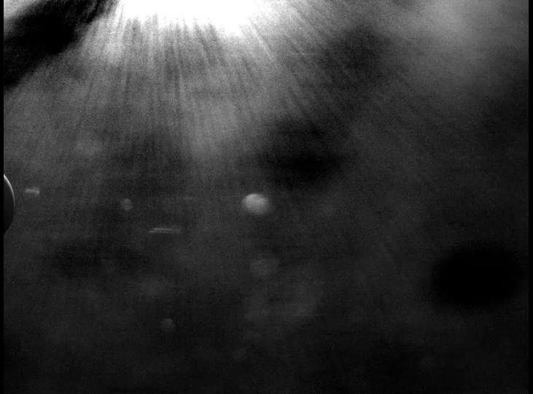
Questions?
Earth
SRC
Sample Return Capsule (SRC) Release
12

