Slide 1
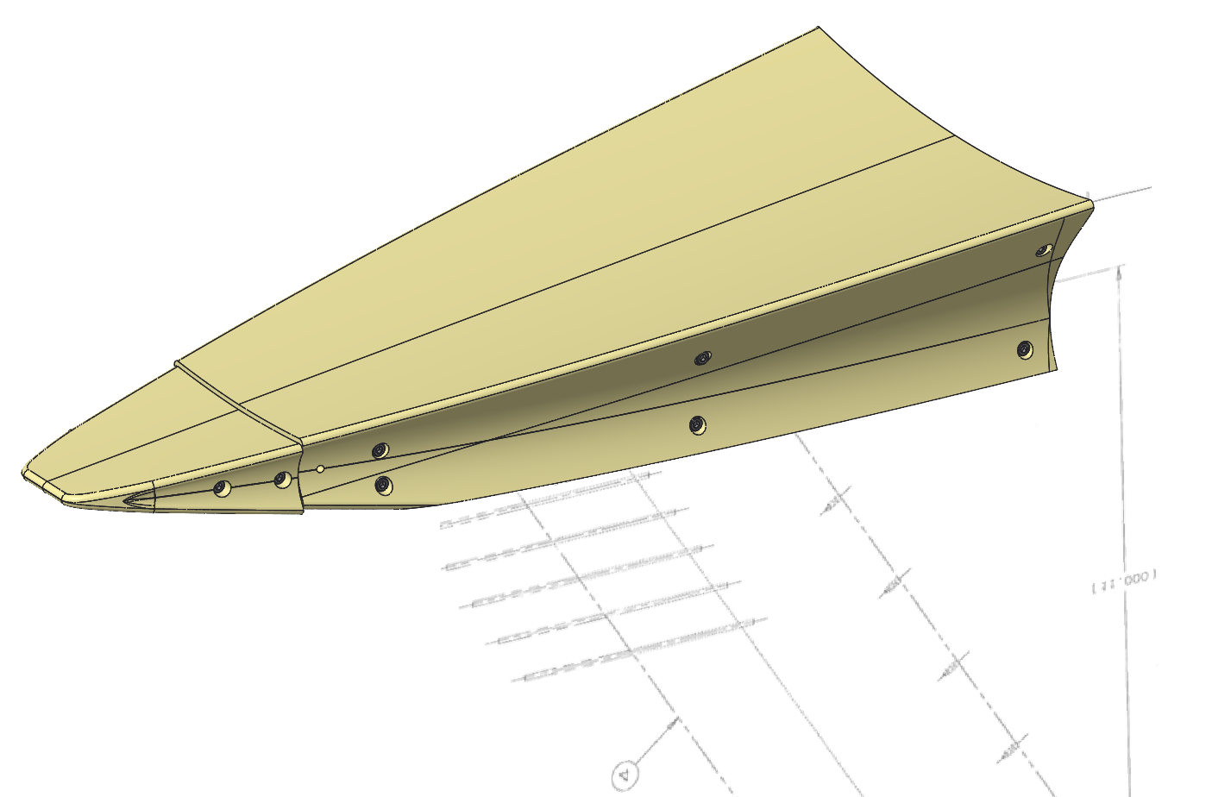
Preliminary Assessment of Step Effects on the BOLT Geometry
Presented to:
AIAA Aviation
July 25, 2024
Presented by:
Carey Scott
NASA Langley Research Center
Co-authors:
Scott Berry & Frank Greene
NASA Langley Research Center
Kevin Basore & Stefan Wernz
Raytheon
Distribution Statement A. Approved for public release: distribution is unlimited.
Notes:
BOLT is hypersonic flight test
Reduce words on screen
BOLT on flight configuration
Use takeaways – remove correlation bullet

Slide 2
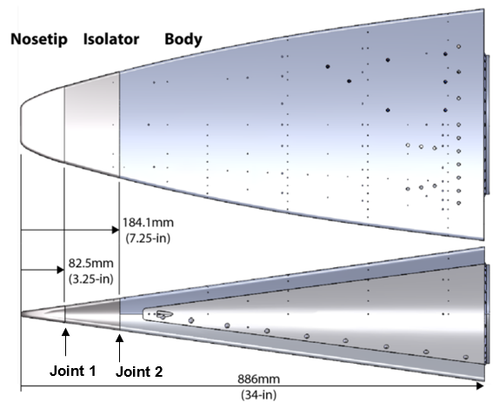
Motivation & Goals
Project Overview
Test Methodology
Preliminary Results
Discussion
Future Work
Why BOLT Step Test?
The Boundary Layer Transition (BOLT I) flight test article was designed with 2 different joints near the nose to accommodate the TPS and isolator materials.
There are differences in the CTE of the material on either side of the joint.
The difference in CTE is expected to cause a 2-dimensional step at the joint locations.
The step on the flight test article was designed to be rearward facing (RF).
The goals of this test include:
  Demonstration of a quantitative infrared thermographic test technique at LaRC.
  Complete a parametric study of forward and rearward facing 2-dimensional steps and their impact on the chord-wise transition location (x/L) of the boundary layer from laminar to turbulent in Mach 6 flow by varying flow conditions and step height, k.
Figure 1. BOLT I Flight Vehicle Design.
BOLT: BOundary Layer Transition
Hypersonic Flight Test
AFOSR funded study of hypersonic boundary layer transition in simple conical shapes to develop new physics-based transition prediction tools.

Slide 3
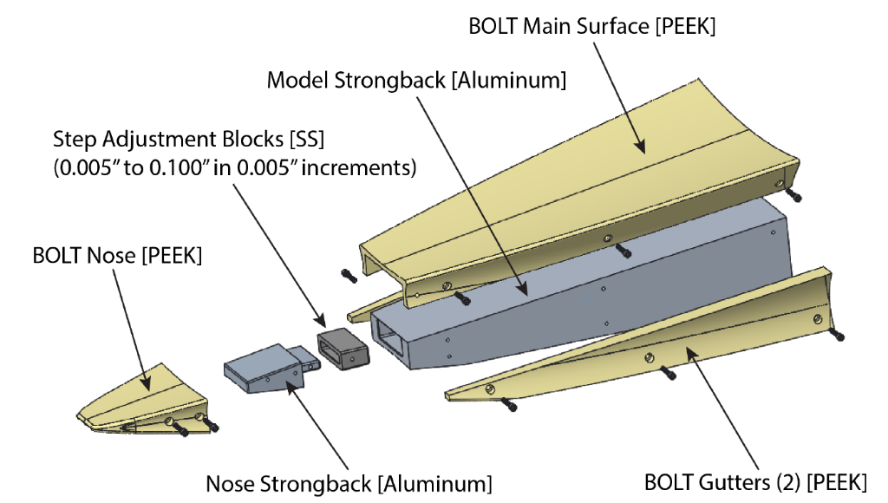
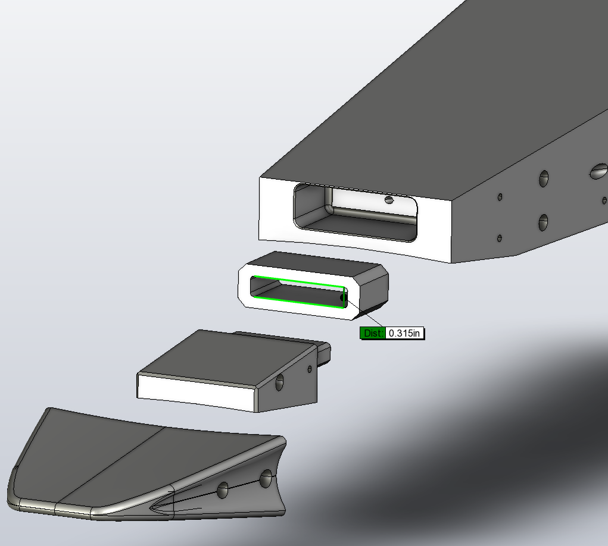

Model Design
Project Overview
Test Methodology
Preliminary Results
Discussion
Future Work
Model Design Concept:
The BOLT Step Test (BST) model utilized an aluminum ‘strongback’ for the main body and nose with a PEEK OML for the outer mold line (OML).
The nose was built as a separate piece with a set of slotted spacers to create offsets for the forward-facing (FF) or rearward-facing (RF) step configurations.
BST Assembly:
PEEK OML
Al strongback
Al nose spacers (multiple)
  Creates steps in OML
  Center slot offsets
  0.005” increments
  1 spacer = 2 steps(+/-)
Figure 2. BST Model Design.
Figure 3. BST Model Exploded View
Figure 4. BST Nose and 0-Step Insert

Slide 4
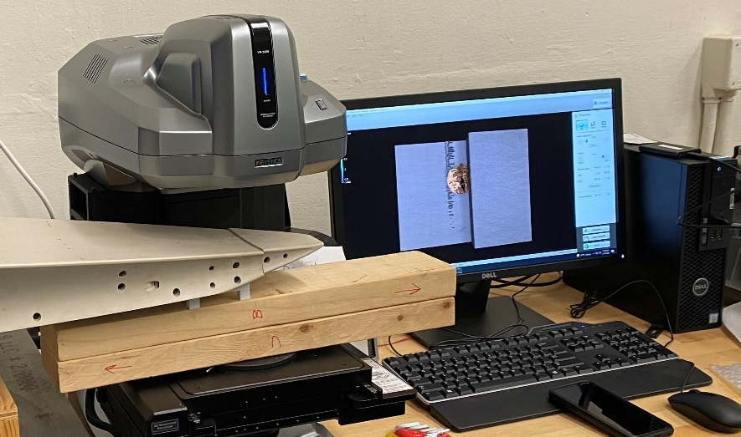
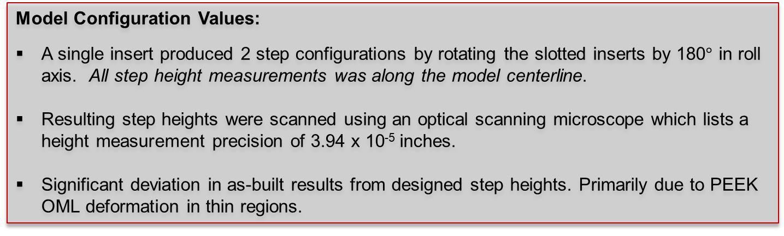
Model Fabrication
Project Overview
Test Methodology
Preliminary Results
Discussion
Future Work
Model Configuration Values:
A single insert produced 2 step configurations by rotating the slotted inserts by 180$°$ in roll axis. All step height measurements was along the model centerline.
Resulting step heights were scanned using an optical scanning microscope which lists a height measurement precision of 3.94 x 10⁻⁵ inches.
Significant deviation in as-built results from designed step heights. Primarily due to PEEK OML deformation in thin regions.
Closest to a no-step case
Table 2. Step Height Values for As-Built Configurations
BST Insert | Step Direction | k_{Measured} |  | Baseline %
 |  | (mm) | (in) | (k_{B}=0.005-in)
IR-21b | RF | 1.718 | 0.0676 | 13.5 k_{B}
IR-11b | RF | 1.101 | 0.0433 | 8.7 k_{B}
IR-06b | RF | 0.438 | 0.0172 | 3.5 k_{B}
IR-02b | FF | 0.076 | 0.0030 | -0.5 k_{B}
IR-01a | FF | 0.089 | 0.0035 | -0.7 k_{B}
IR-01b | FF | 0.157 | 0.0062 | -1.2 k_{B}
IR-02a | FF | 0.272 | 0.0107 | -2.1 k_{B}
IR-06a | FF | 0.777 | 0.0306 | -6.1 k_{B}
IR-11a | FF | 1.409 | 0.0554 | -11 k_{B}
IR-21a | FF | 2.033 | 0.0800 | -16 k_{B}
Note: Negative values denote FF steps.
Figure 5. BST Model on Optical Scanner Bench
Notes:
Shelly’s paper for reference

Slide 5
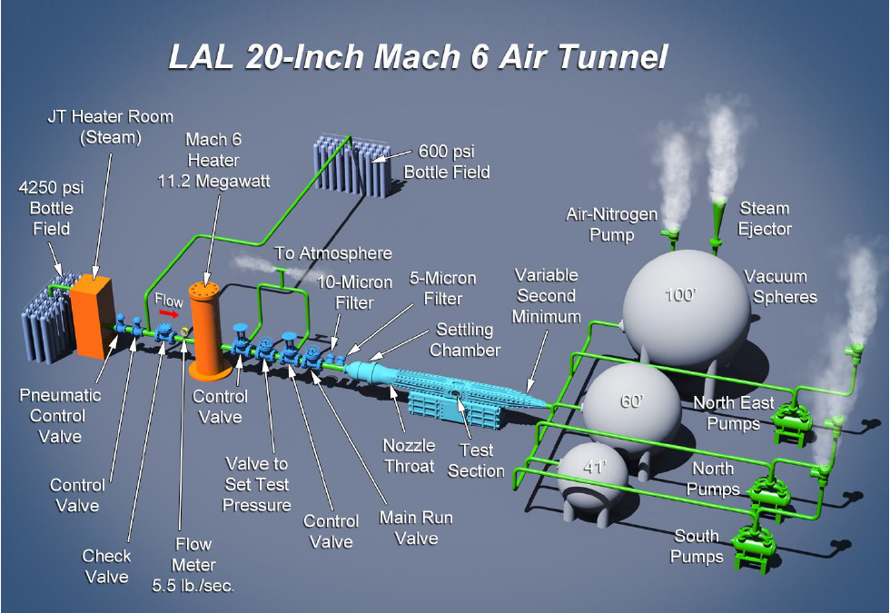
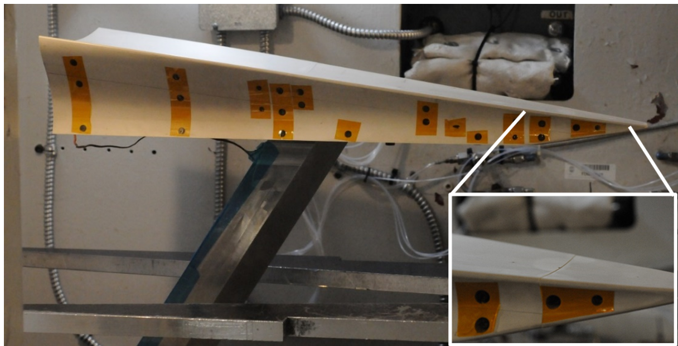
Test Facility
Project Overview
Test Methodology
Preliminary Results
Discussion
Future Work
Langley Aerothermodynamic Laboratory (LAL):
Average run time for this test was 10 seconds.
Reynolds number sweeps from 1.05x10⁶ /ft to 7.97x10⁶ /ft were conducted for 10 step heights.
LongBOLT Extension
Figure 6. LAL 20-Inch Mach 6 facility in Hampton, VA. ^{[1]}
Figure 7. BST Model in the test section. LongBOLT configuration is ~170% BOLT I length.
Notes:
Use arrows / limit text…kB repeat here
Measurements across the centerline
Order of 3 BL height changes between CL vs leading edge.
Leading edge is very sensitive .

Slide 6
Quantitative IR Test Technique
Project Overview
Test Methodology
Preliminary Results
Discussion
Future Work
IR Thermography Workflow:
Define calibration coefficients of the Sakuma-Hattori equation for a single integration time of the camera over the range of expected temperatures.
Export the raw counts from the IR software for a pre-run frame and at frame 300 during the test entry.
Apply calibration equation to all pixels to get the transfer from
Counts > Temp(K) > Temp(C) then export as .csv files.
Import the temperature .csv files to IHEAT for processing to heat transfer and non-dimensionalize by Fay-Riddell film coefficient reference values.
Extract line cuts along regions of interest using the built-in IHEAT profiling tool.

Slide 7
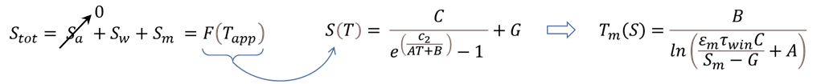

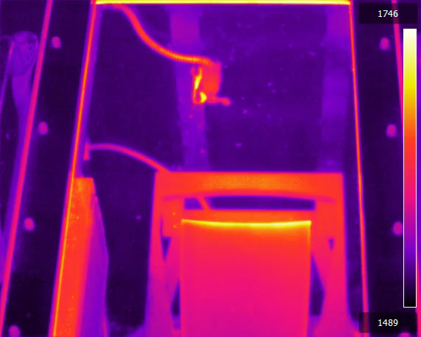
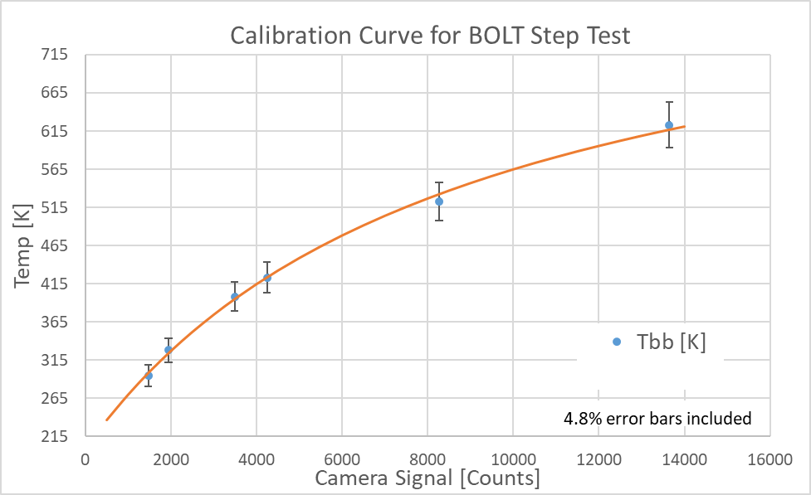
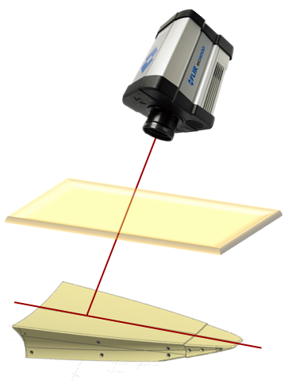



Data Acquisition
Project Overview
Test Methodology
Preliminary Results
Discussion
Future Work
Infrared Thermography Test Technique
Model temperature range (no-wind vs. wind-on) required custom radiometric calibration and temperature retrieval methodology.
Use Planckian version of Sakuma-Hattori equation as a basis for Signal to Temperature transfer function.
IR Camera System Specs:
FLIR SC6701 SLS (LWIR)
FLIR 50mm Ge lens
11-in x14-in AR coated ZnSe Window
Integration time = 0.038 ms
Frame rate = 60 Hz
A | B | C | G
1.008 | 0.7235 | 6.368 | 1962.22
$$τ_{w}$$
$$θ$$
$$d$$
$$ε_{m}$$
$$d<1.0m ∴ { S}_{a}≈0$$
Figure 8. Temperature retrieval calibration curve provides greater dynamic range while imaging

Slide 8
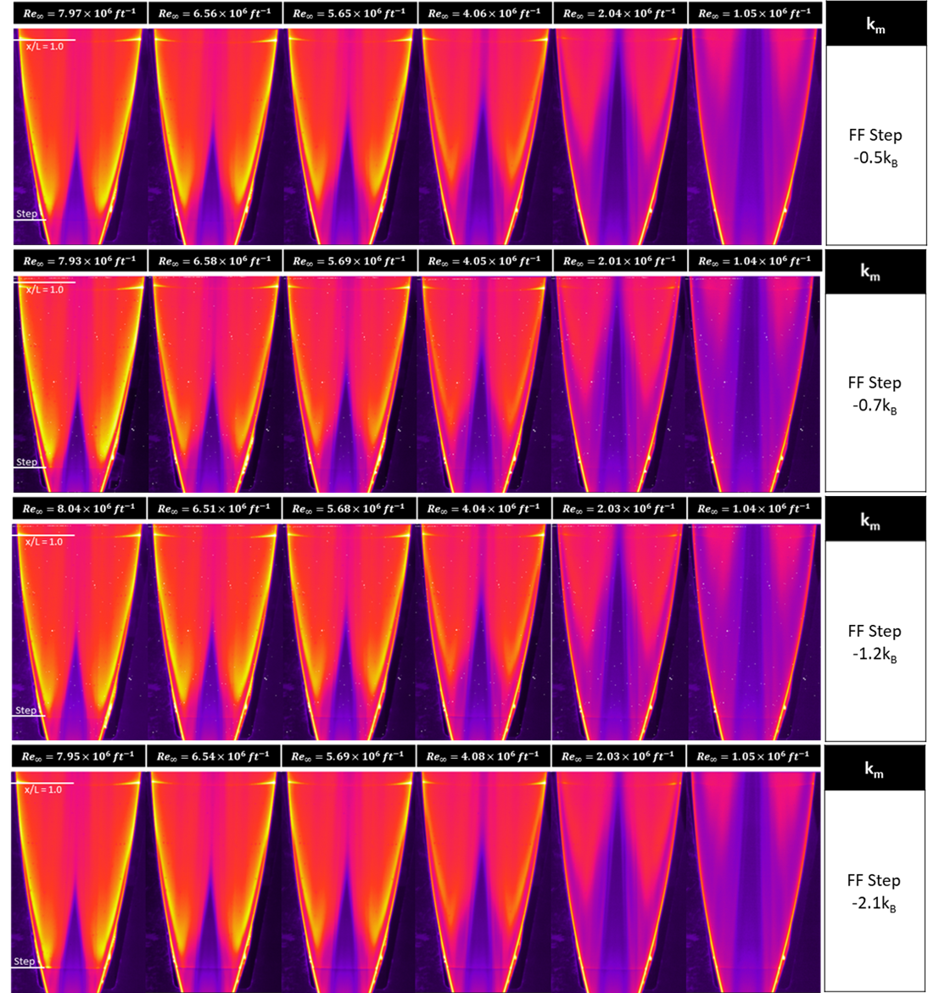
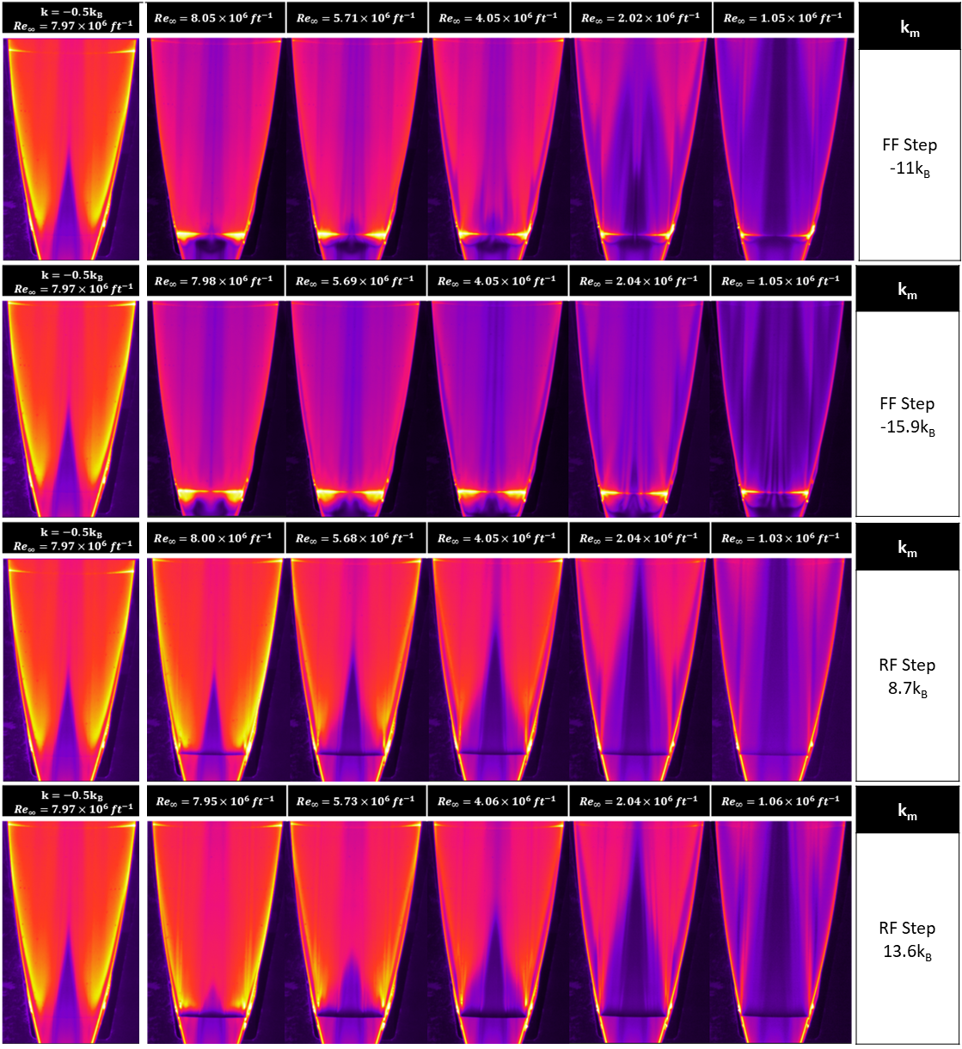
Raw IR Data – 83 Rotal Runs

Slide 9
Raw IR Data – Baseline vs. Large FF Steps
Baseline step height:
k_{B} = 0.005 inches
Closest to a no-step case

Slide 10
Raw IR Data – Baseline vs. Large RF steps
Baseline step height:
k_{B} = 0.005 inches
Closest to a no-step case

Slide 11
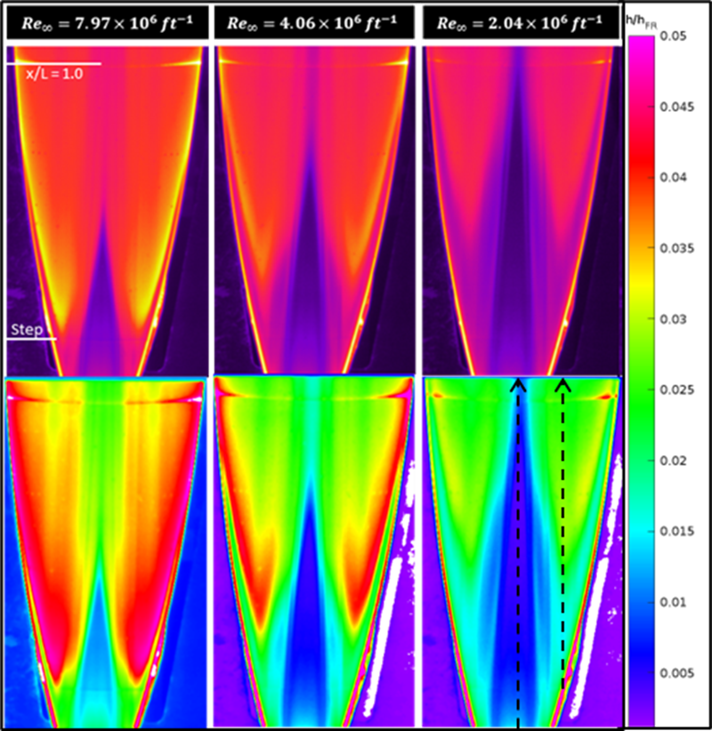
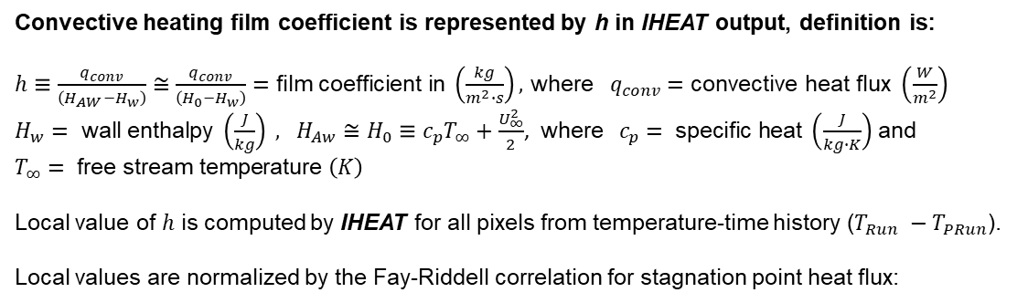
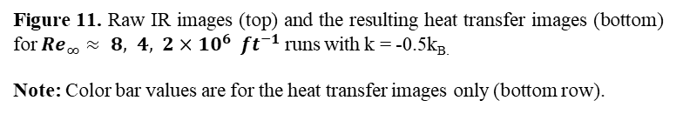


Data Analysis
Project Overview
Test Methodology
Preliminary Results
Discussion
Future Work
IHEAT Data Analysis Software
Aerothermal data processing package developed at LaRC.
Details of the IHEAT software are given by Mason, et al. ^{[2]}
Inputs to heat transfer calculations are given by Merski ^{[3]}
One-dimensional heat transfer results are output as heat transfer images.
Convective heating film coefficient is represented by h in IHEAT output, definition is:
  $h≡\frac{q_{conv}}{\left(H_{AW}−H_{w}\right)}≅$ $\frac{q_{conv}}{\left(H_{0}−H_{w}\right)}=\text{film} \text{coefficient} \text{in} \left(\frac{kg}{m^{2}∙s}\right),$ where$q_{conv}=\text{convective} \text{heat} \text{flux} \left(\frac{W}{m^{2}}\right)$
    $H_{w}= \text{wall} \text{enthalpy} \left(\frac{J}{kg}\right) , H_{Aw}≅H_{0}≡c_{p}T_{∞}+\frac{U_{∞}^{2}}{2}$, where $c_{p}= \text{specific} \text{heat} \left(\frac{J}{kg∙K}\right)$ and $T_{∞}= \text{free} \text{stream} \text{temperature} \left(K\right)$
  Local value of $h$ is computed by IHEAT for all pixels from temperature-time history ($T_{Run} −T_{PRun}$).
  Local values are normalized by the Fay-Riddell correlation for stagnation point heat flux:
$$\left(\frac{h}{h_{FR}}\right)≡\left[\frac{h\left(x,y,z,{Re,t,T}_{w}\right)}{h_{FR}\left(R_{n},Re,T_{300K}\right)}\right]$$
$$h_{FR}≡\frac{q_{FR,300K}}{\left(H_{0}−H_{w,300K}\right)}$$
Figure 11. Raw IR images (top) and the resulting heat transfer images (bottom) for $Re_{∞}≈ 8, 4, 2×{10}^{6} ft^{−1}$ runs with k = -0.5k_{B.}
Note: Color bar values are for the heat transfer images only (bottom row).

Slide 12
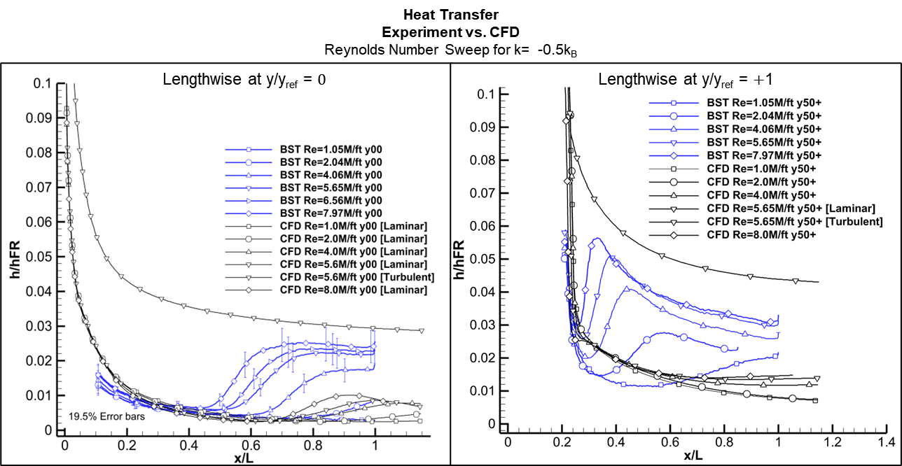
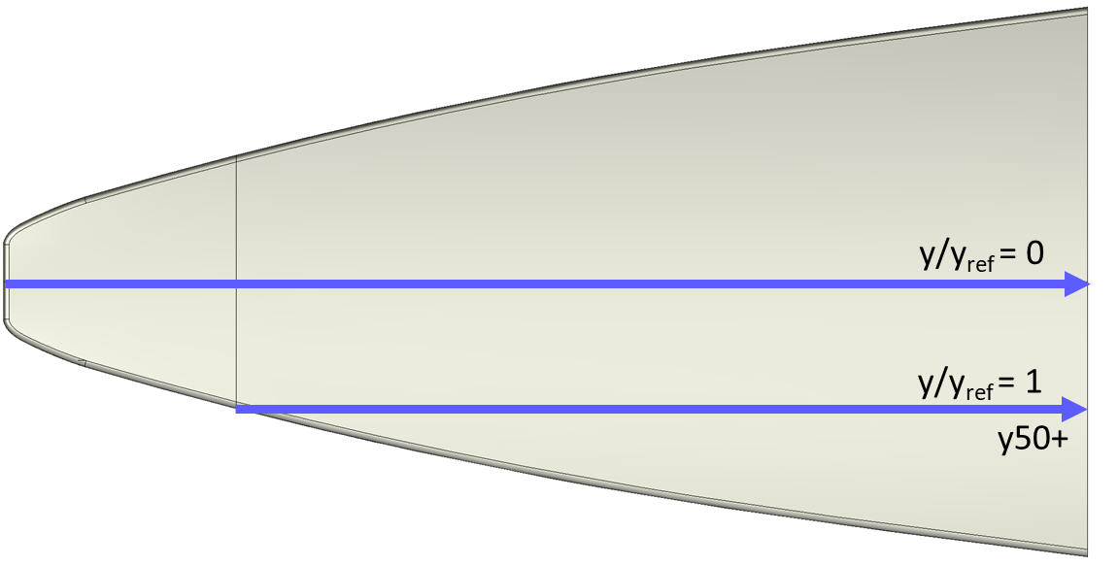
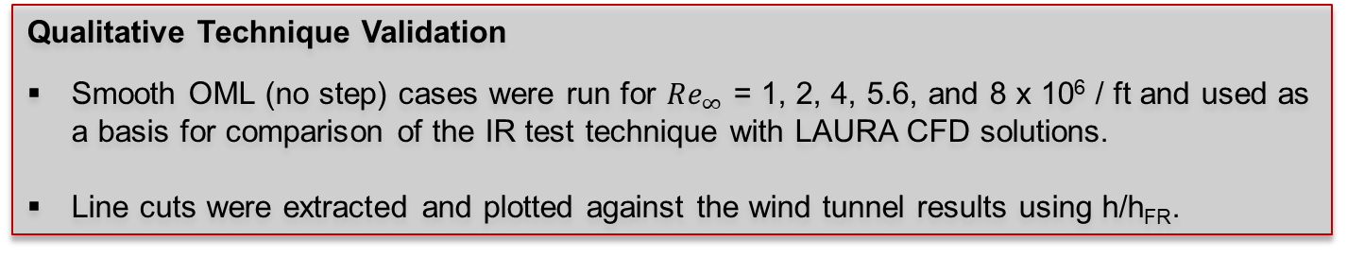
Comparison with CFD - Longitudinal
Project Overview
Test Methodology
Preliminary Results
Discussion
Future Work
Qualitative Technique Validation
Smooth OML (no step) cases were run for $Re_{∞}$ = 1, 2, 4, 5.6, and 8 x 10⁶ / ft and used as a basis for comparison of the IR test technique with LAURA CFD solutions.
Line cuts were extracted and plotted against the wind tunnel results using h/h_{FR}.
Centerline
Joint Edge
Baseline step height:
k_{B} = 0.005 inches

Slide 13
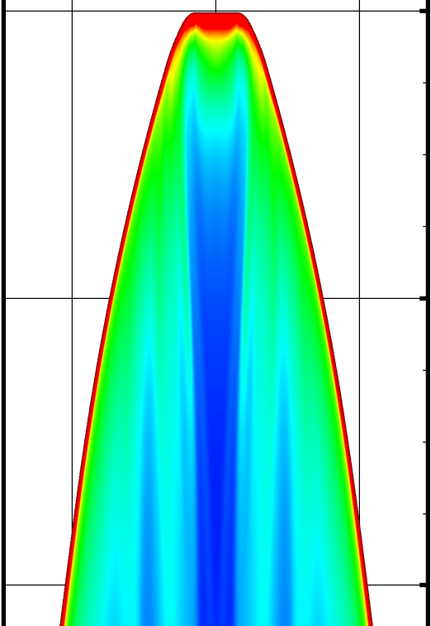
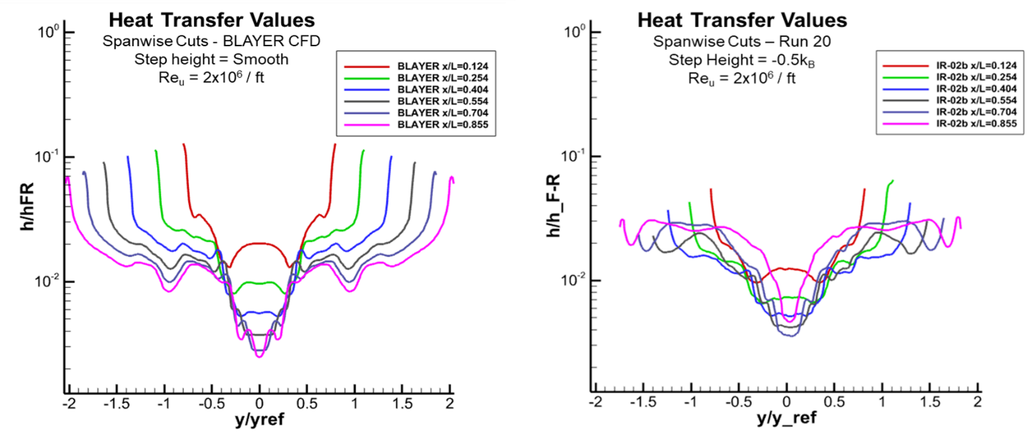
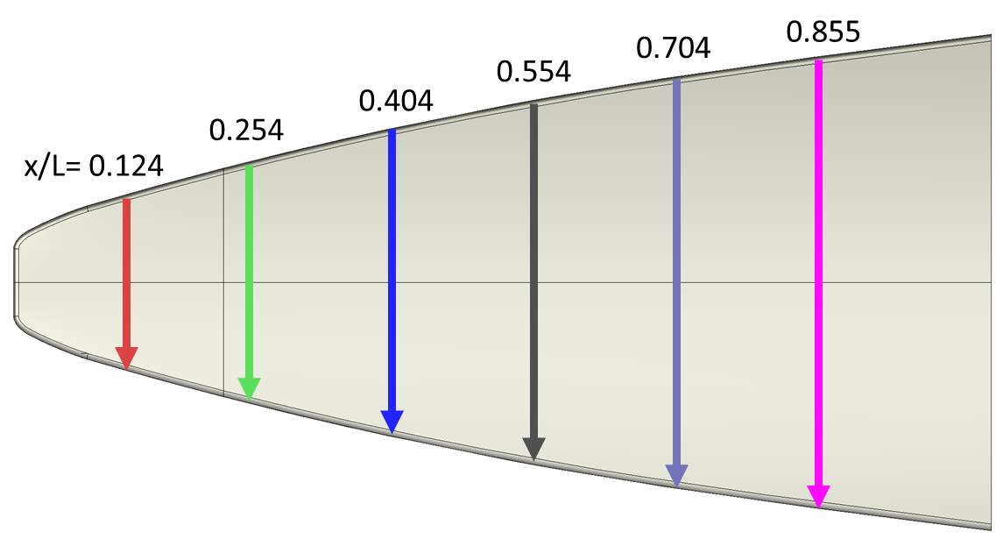
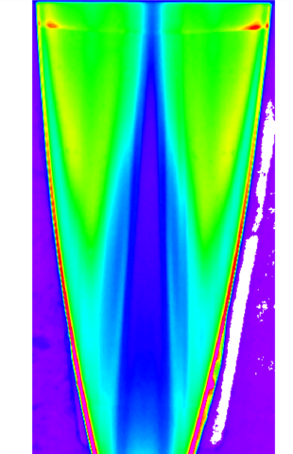
Comparison with CFD – Spanwise Cuts for Re_{u} = 2x10⁶ ft⁻¹
Project Overview
Test Methodology
Preliminary Results
Discussion
Future Work
Qualitative Technique Validation
Smooth-wall CFD solutions are used as a basis for data validation.
Line cuts were extracted and plotted against the wind tunnel results using h/h_{FR}.
Spanwise cuts shown here show the augmented heating at the lobes.
CFD
Smooth wall
Re_{u} = 2x10⁶ ft⁻¹
Experiment
CFD Smooth wall
Experiment
No-Step
Re_{u} = 2x10⁶ ft⁻¹
LAURA CFD
Augmented heating at lobes
FF Step Height = -0.5k_{B}
Augmented heating at lobes
Notes:
Smooth CFD vs. ‘smooth’ experiment
Add joint location
Add text box with LAURA CFD not BLAYER

Slide 14
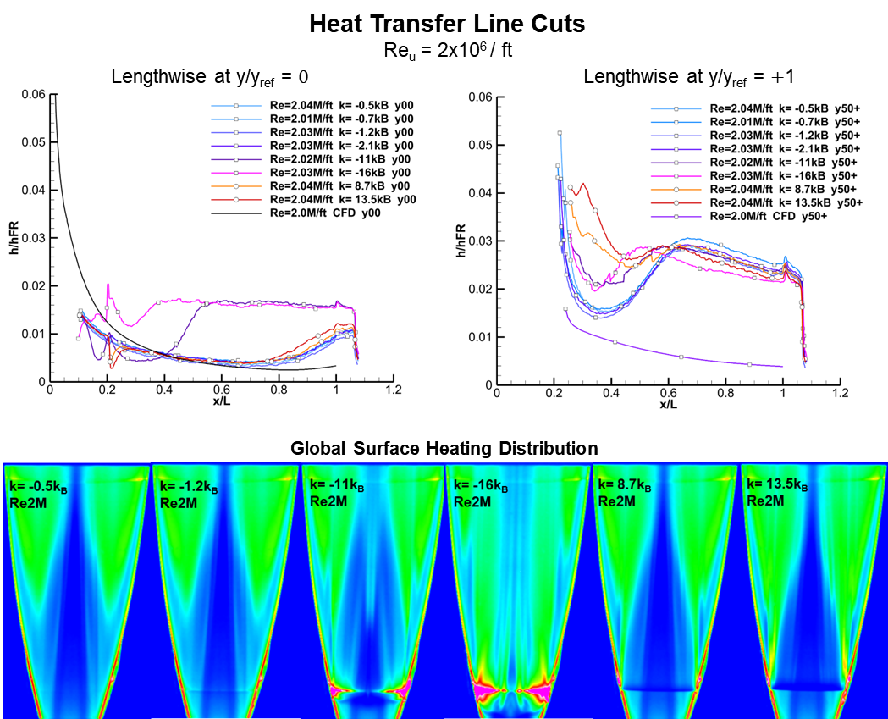
Heat Transfer Data – Constant Re, Variable Step Height
Project Overview
Test Methodology
Preliminary Results
Discussion
Future Work
CFD Smooth Wall
y/y_{ref} = 0
+1
Step Location
CFD
NOT TO SCALE
Notes:
Define L early on.
CL strong effect when FF
RF strong effect near leading edge

Slide 15
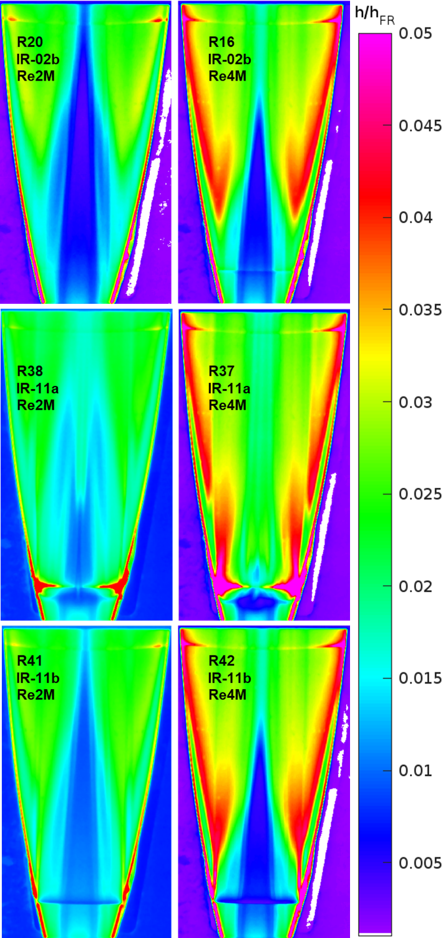
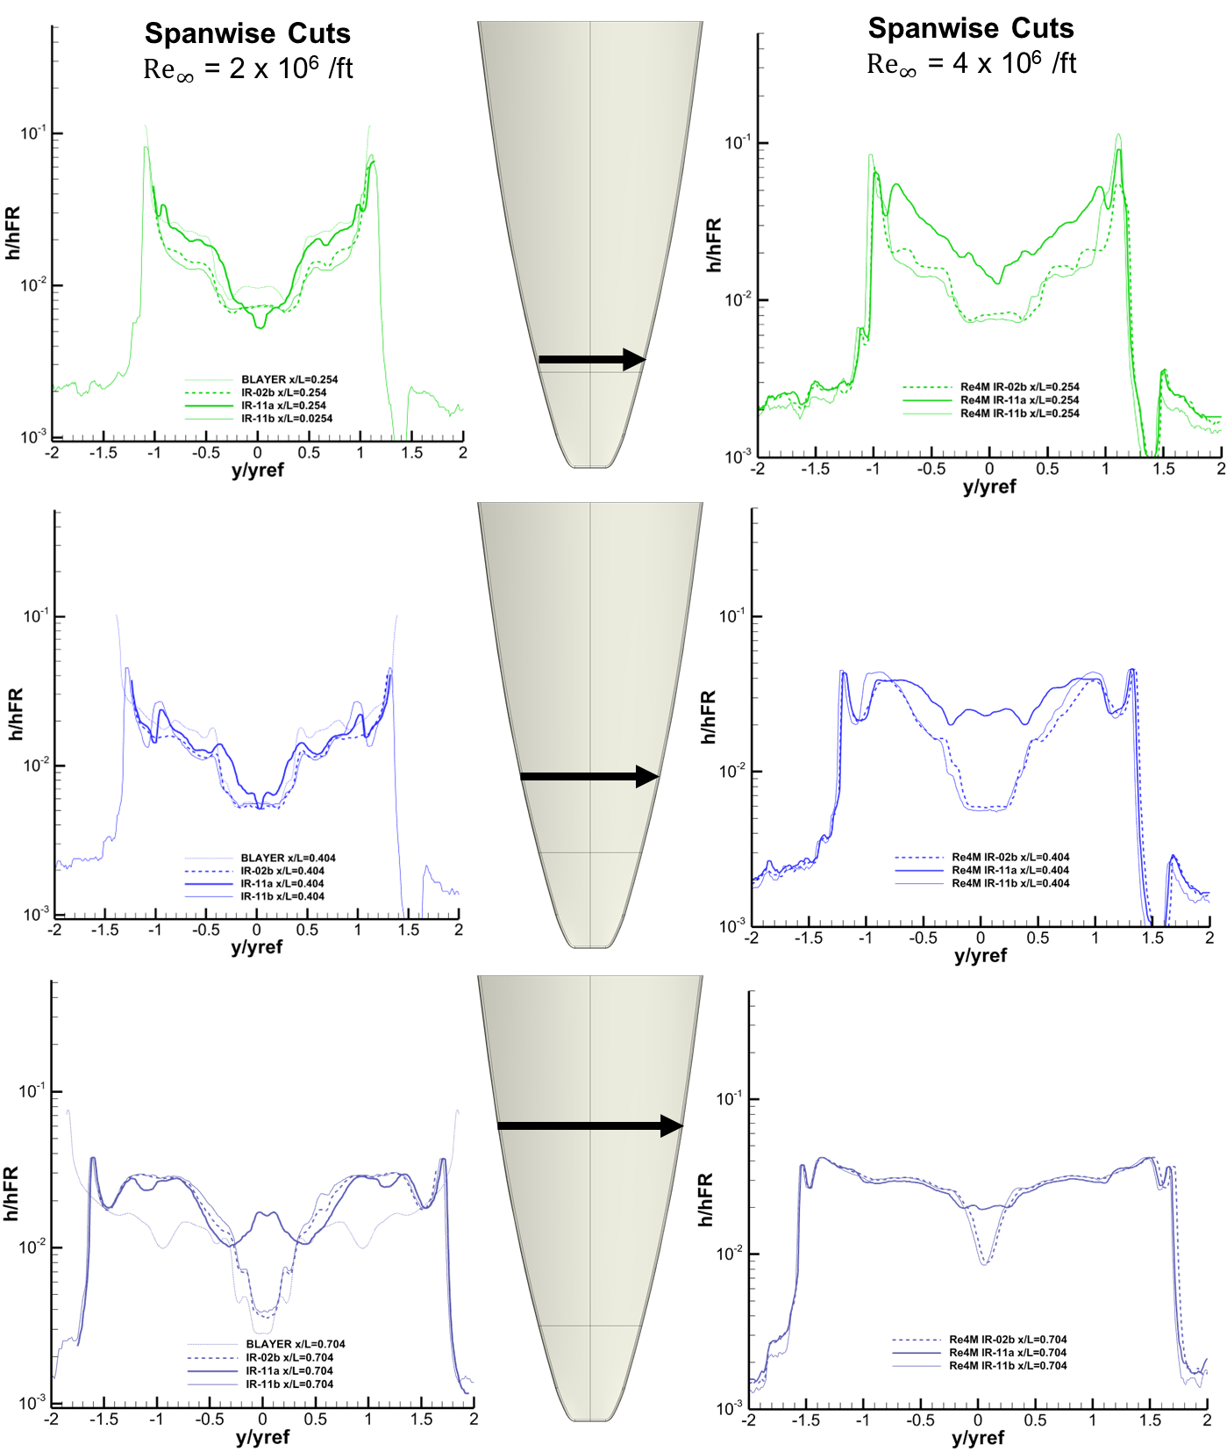
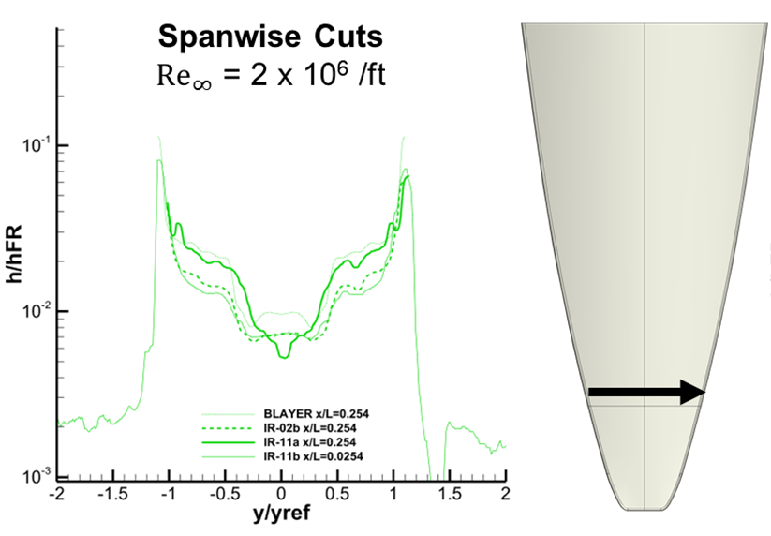
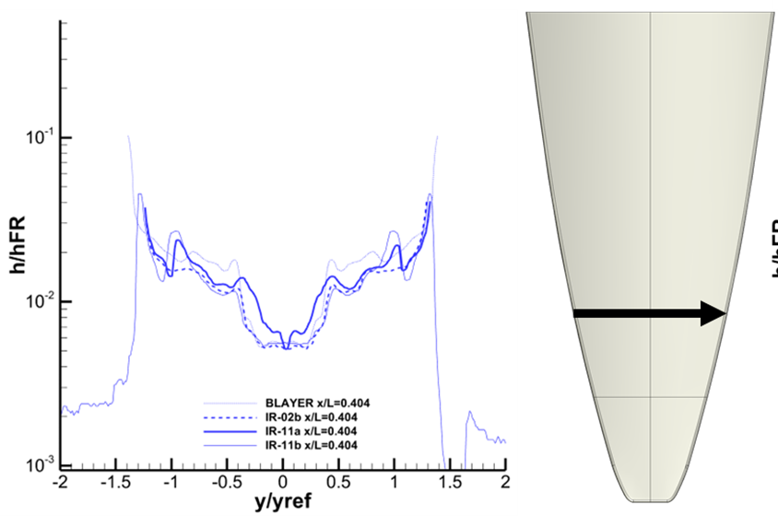
Spanwise Cuts - Constant Re, Variable Step Height
LAURA CFD
LAURA CFD
0.2540
Notes:
ADD bigger text
Descriptive titles
Change BLAYER to LAURA

Slide 16
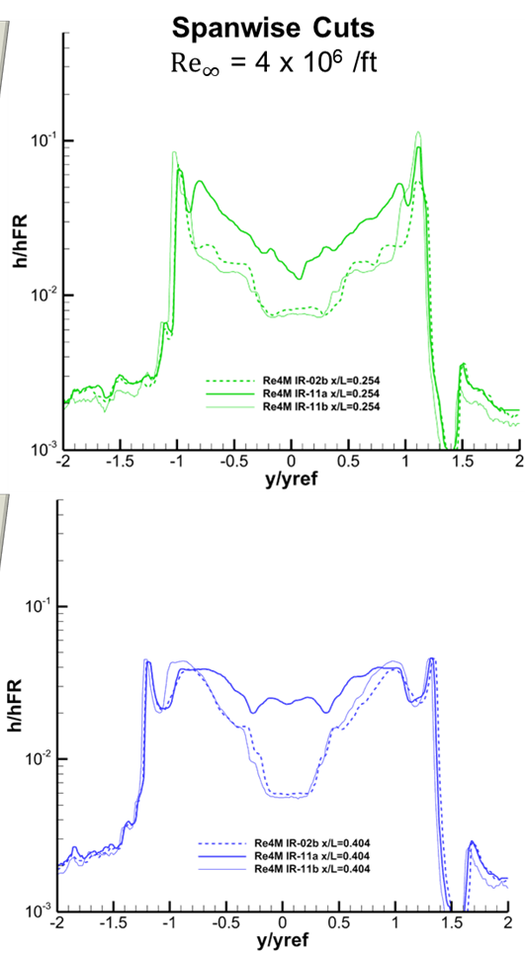
Spanwise Cuts - Constant Re, Variable Step Height
0.254
Notes:
ADD bigger text
Descriptive titles
Change BLAYER to LAURA

Slide 17
Summary
Project Overview
Test Methodology
Preliminary Results
Discussion
Future Work
Quantitative IR Thermography:
Significant forward progress was made toward quantitative IR thermographic test technique development at LAL.
This measurement technique offers potential cost, manufacturability, and supply chain benefits over the legacy phosphor thermography technique, but with previously undetermined accuracy.
BOLT Step Effects:
Forward-facing steps significantly disrupt the boundary layer, causing augmented heating forward of the step boundary, and more evenly distributed surface heating downstream.
Rearward-facing steps show reduced heating immediately downstream, suggesting boundary layer separation immediately aft of the step.
Observations suggest the region near the leading edge and the joint is highly sensitive to step effects.

Slide 18
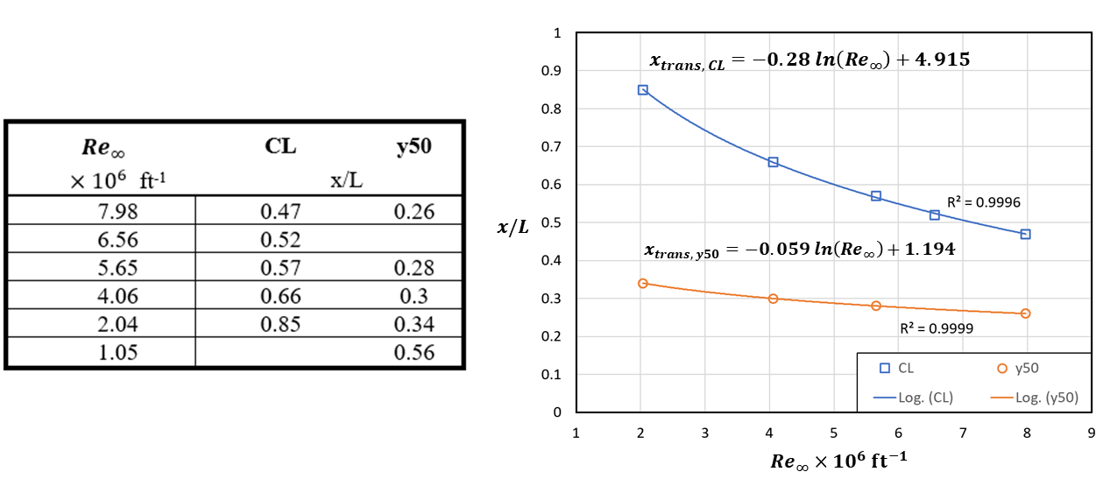
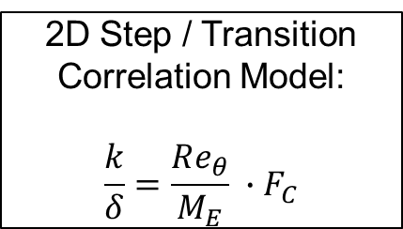
Next Steps
Project Overview
Test Methodology
Preliminary Results
Discussion
Future Work
BOLT Step Effects:
Continue data processing for additional Reynolds numbers and measure step heights near leading edge.
Investigate additional BOLT-derivative designs (i.e., Flat-BOLT, various nose shapes).
Explore use-cases for BST and BST-derivative models in other flow conditions.
Table 3. Approximate transition onset locations for k= -0.5k_{B} as a function of Reynolds number.
Goal: Develop a step height vs transition onset correlation model for BOLT geometry.
2D Step / Transition
Correlation Model:
$$\frac{k}{δ}=\frac{Re_{θ}}{M_{E}} ∙F_{C}$$
Figure 12. ‘No-step’ transition data will be used as a baseline for comparing step effects for different configurations.

Slide 19
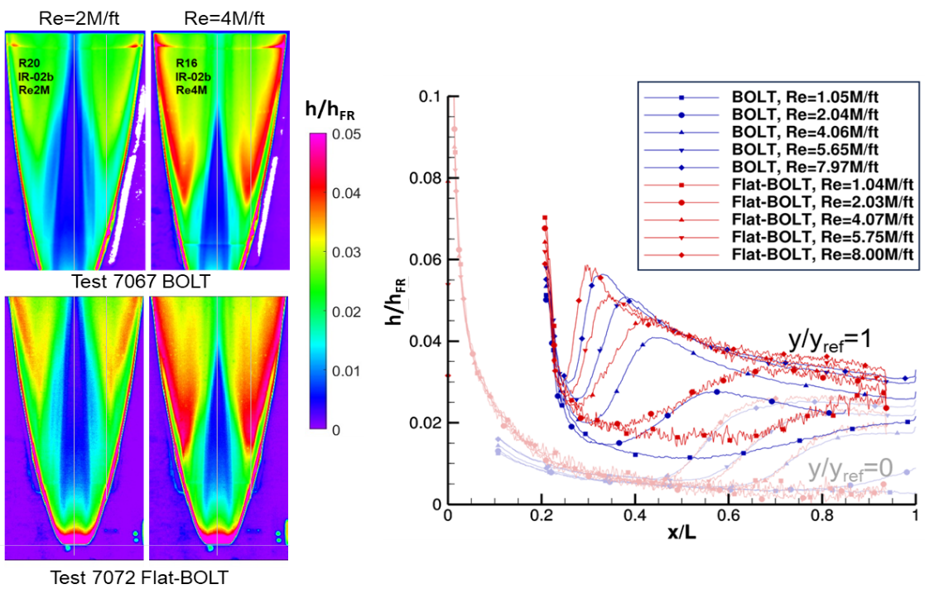
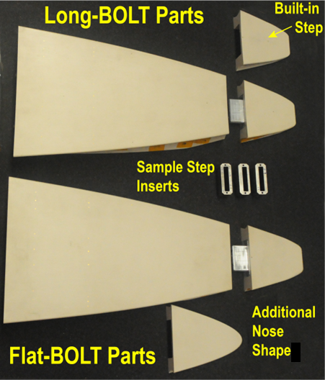
Next Steps: Flat-BOLT
Project Overview
Test Methodology
Preliminary Results
Discussion
Future Work
Benefits of Flat-BOLT Design:
Isolates the effect of the planform shape on leading-edge and acreage heating.
Permits optical measurements of the boundary layer such as Focused Schlieren and Focused Laser Differential Interferometry (FLDI).
Flat-BOLT acreage can host standard flat material coupons for testing

Slide 20
Questions?
References:
[1] NASA Langley Hypersonic Experimental Aerothermodynamic Capabilities and Recent Contributions, AIAA Aviation 2024
[2] Mason, M. L. and Rufer, S. J., “Features of the Upgraded Imaging for Hypersonic Experimental Aeroheating Testing (IHEAT) Software,” AIAA 2016-4322, Jun. 2016. doi:10.2514/6.2016-4322.
[3] Merski, N., “Reduction and Analysis of Phosphor Thermography Data with the IHEAT Software Package,” presented at the 36th AIAA Aerospace Sciences Meeting and Exhibit, Reno,NV,U.S.A., 1998. https://doi.org/10.2514/6.1998-712

Slide 21
Backup

Slide 22
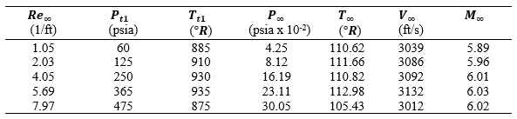
Test Design
Project Overview
Test Methodology
Preliminary Results
Discussion
Future Work
Background
This investigation is focused on the 2-dimensional step at the joint between the stainless-steel isolator and the aluminum body (Joint 2). [Figure 1]
The BOLT Step Test (BST) model utilized a nose step location that accurately represents the step location on the BOLT I flight geometry. [Figure 2]
The intent of the present experiment is to provide a controlled data set to assist in flight test data analyses and provide data for future design considerations.
Additional comparisons to other BOLT-derivative geometries (i.e. Flat-BOLT) were conducted using similar model design principles and are presented in later sections for reference.
Figure 1. BOLT I Flight Vehicle Design.
Table 1. 20-Inch Mach 6 Air Tunnel Test Conditions
The BOLT Step Test (BST) was conducted at the 20-Inch Mach 6 Tunnel at NASA LaRC.
Figure 2. BST Model Design.
Notes:
Initial – 24 minutes –need to trim/
Trim slides for content – refer to content
Pathfinder test → include test dates
Acknowledge Drew’s am paper – refer to Drew’s talk
More results?

Slide 23
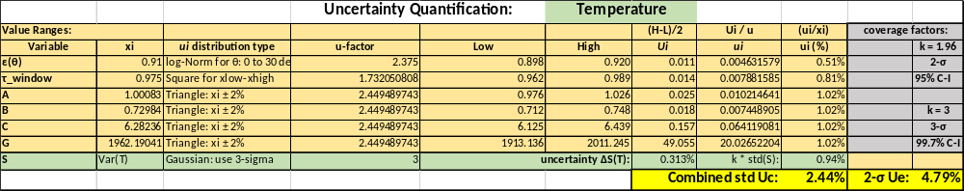
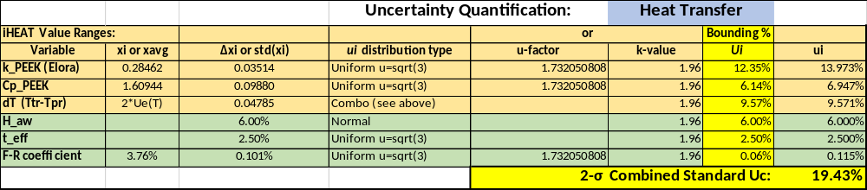
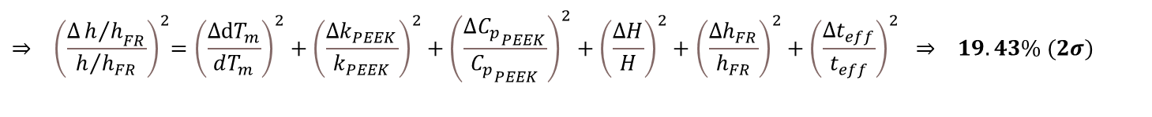
Uncertainty Quantification
Project Overview
Test Methodology
Preliminary Results
Discussion
Future Work
Total Combined Standard Uncertainty with 95% confidence interval:
Temperature Uncertainty
$⇒ {\left(\frac{{∆T}_{m}}{T_{m}}\right)}^{2}={\left(\frac{∆S}{S}\right)}^{2}+{\left(\frac{∆ε}{ε}\right)}^{2}+{\left(\frac{∆τ_{win}}{τ_{win}}\right)}^{2}+{\left(\frac{∆A}{A}\right)}^{2}+{\left(\frac{∆B}{B}\right)}^{2}+{\left(\frac{∆C}{C}\right)}^{2}+$ ${\left(\frac{∆G}{G}\right)}^{2} ⇒ 4.79\% (2σ)$
$${⇒ \left(\frac{{∆h/h}_{FR}}{h/{h_{FR}}}\right)}^{2}={\left(\frac{∆dT_{m}}{dT_{m}}\right)}^{2}+{\left(\frac{∆k_{PEEK}}{k_{PEEK}}\right)}^{2}+{\left(\frac{∆{C_{p}}_{PEEK}}{{C_{p}}_{PEEK}}\right)}^{2}+{\left(\frac{∆H}{H}\right)}^{2}+{\left(\frac{∆h_{FR}}{h_{FR}}\right)}^{2}+{\left(\frac{∆t_{eff}}{t_{eff}}\right)}^{2} ⇒ 19.43\% (2σ)$$
Heat Transfer Uncertainty
Figure 6. LAL 20-Inch Mach 6 facility in Hampton, VA.

Slide 24
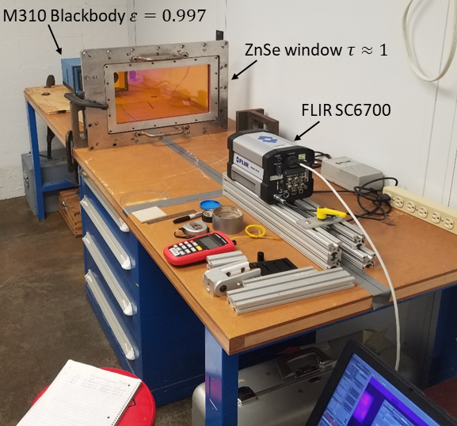
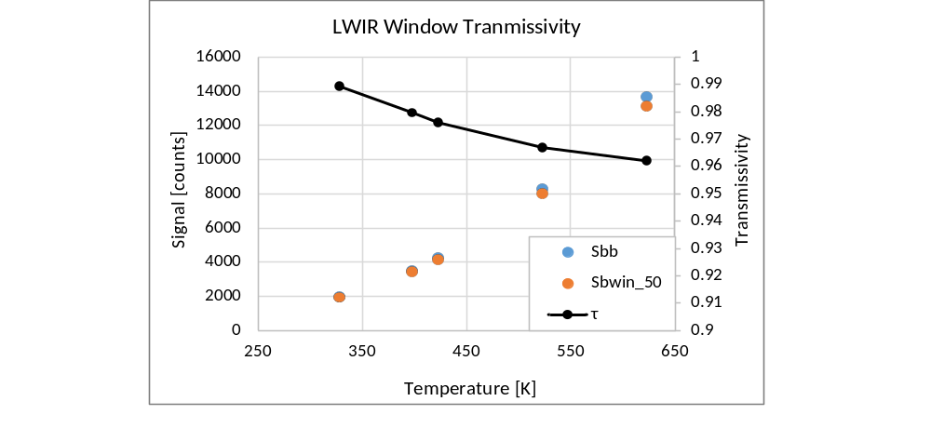
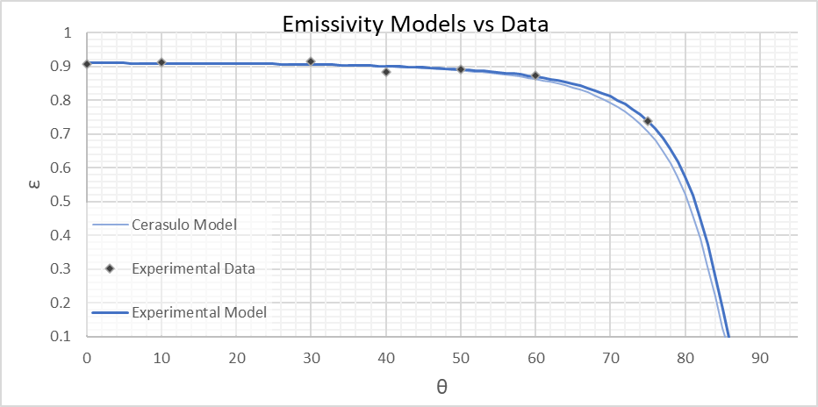
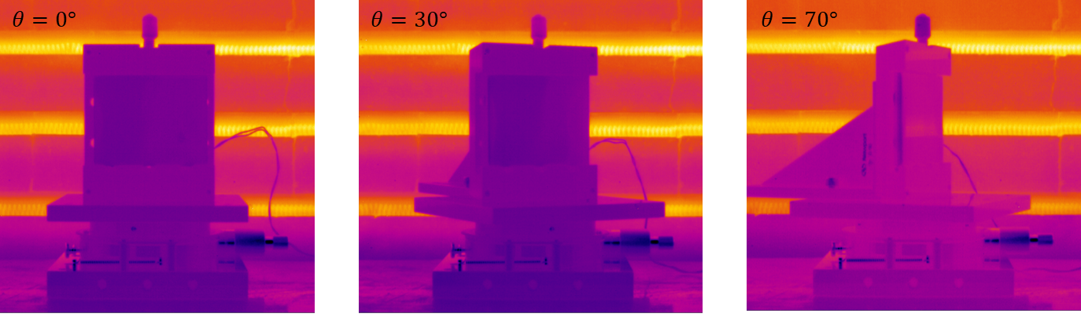
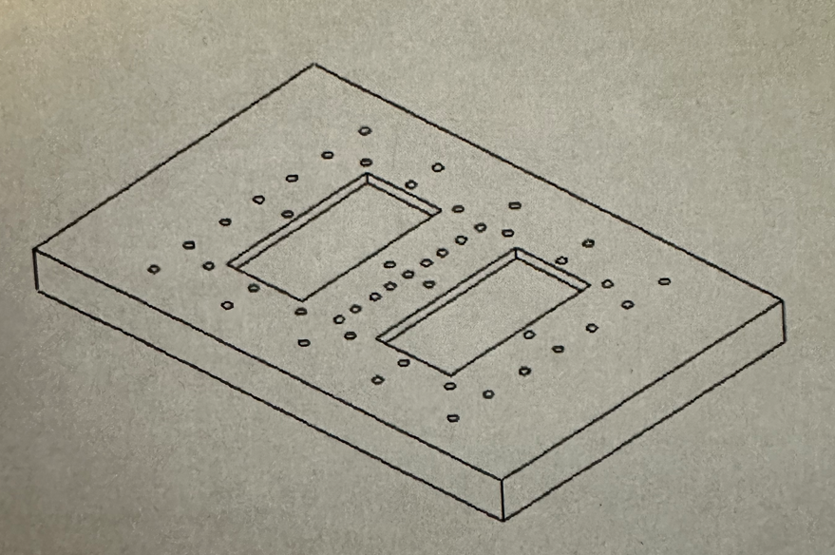

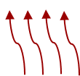




Data Acquisition
Project Overview
Test Methodology
Preliminary Results
Discussion
Future Work
Infrared Thermography Test Technique
Empirical measurements made for window transmission and PEEK emissivity values.
$$τ_{win}=\frac{S_{bb}{\left(T_{i}\right)}_{win}}{ε_{bb}∙S_{bb}\left(T_{i}\right)}$$
$$ε_{m}(θ)=ε_{n}{\cos\left(θ\right)}^{\frac{\hat{α}}{\cos\left(θ^{\hat{β}}\right)}}$$
$\hat{α}=$ 0.0255 & $\hat{β} =1.3345$
Blackbody Cavities
Target
Sample
Target
Sample
Control
Sample
Heat Source
Figure 9. Two methods of emissivity measurement were used. Convective and conductive heating methods provided data for ratio method of determination. Black electrical tape was used as a control.
Figure 10. Window transmissivity and directional emissivity measurements help quantify uncertainty in $T.$

Slide 25
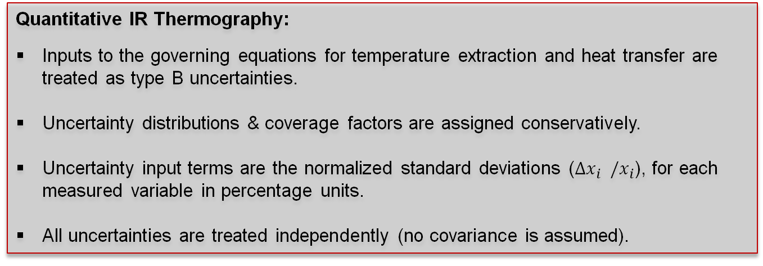
Uncertainty Quantification
Project Overview
Test Methodology
Preliminary Results
Discussion
Future Work
Quantitative IR Thermography:
Inputs to the governing equations for temperature extraction and heat transfer are treated as type B uncertainties.
Uncertainty distributions & coverage factors are assigned conservatively.
Uncertainty input terms are the normalized standard deviations ($Δx_{i} /x_{i}$), for each measured variable in percentage units.
All uncertainties are treated independently (no covariance is assumed).
Total Combined Standard Uncertainty with 95% confidence interval:
Temperature Uncertainty
$⇒ {\left(\frac{{∆T}_{m}}{T_{m}}\right)}^{2}={\left(\frac{∆S}{S}\right)}^{2}+{\left(\frac{∆ε}{ε}\right)}^{2}+{\left(\frac{∆τ_{win}}{τ_{win}}\right)}^{2}+{\left(\frac{∆A}{A}\right)}^{2}+{\left(\frac{∆B}{B}\right)}^{2}+{\left(\frac{∆C}{C}\right)}^{2}+$ ${\left(\frac{∆G}{G}\right)}^{2} ⇒ 4.79\% (2σ)$
$${⇒ \left(\frac{{∆h/h}_{FR}}{h/{h_{FR}}}\right)}^{2}={\left(\frac{∆dT_{m}}{dT_{m}}\right)}^{2}+{\left(\frac{∆k_{PEEK}}{k_{PEEK}}\right)}^{2}+{\left(\frac{∆{C_{p}}_{PEEK}}{{C_{p}}_{PEEK}}\right)}^{2}+{\left(\frac{∆H}{H}\right)}^{2}+{\left(\frac{∆h_{FR}}{h_{FR}}\right)}^{2}+{\left(\frac{∆t_{eff}}{t_{eff}}\right)}^{2} ⇒ 19.43\% (2σ)$$
Heat Transfer Uncertainty
Notes:
Add toback up

