Slide 1
Published by the American Institute of Aeronautics and Astronautics, Inc. with permission.

Slide 2
Assembly Sequence Optimization for Space Structures
1 AUGUST 2024
Dalan C. Loudermilk, John R. Cooper, Michael W. Otte
Autonomous Integrated Systems Research Branch, NASA LaRC
Motion and Teaming Lab, UMD College Park
Published by the American Institute of Aeronautics and Astronautics, Inc. with permission.

Slide 3
Introduction
Why Autonomous Assembly Sequencing?
3 | #ascendspace

Slide 4
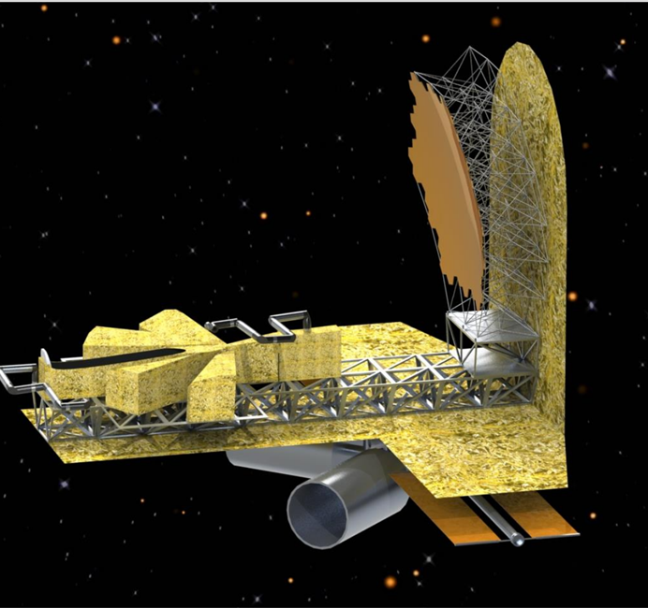
In-Space Assembly (ISA)
iSAT Study, R. Mukherjee et al.
Larger allowable final structures than would fit inside fairings.
Less mechanical complexity than deployables.
Flexibility to work across multiple launch schedules.

Slide 5
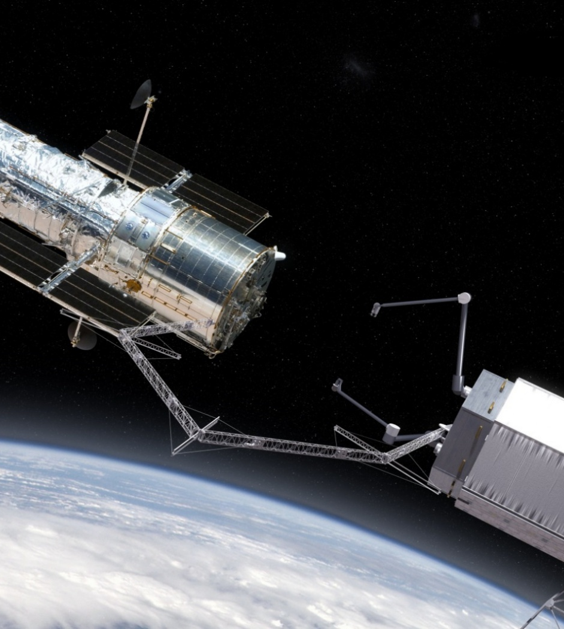
Autonomous ISA
TALISMAN Concept, W. Doggett et al.
Decision making under constraints.
  Limited space-rated hardware.
    Computational power limited.
    Lower fidelity simulations.
  Power, thrust, stability, etc.
Lower mission requirements:
  Bandwidth
  Personnel / Crew time
Resilience:
  Communication
  Fault recovery time

Slide 6
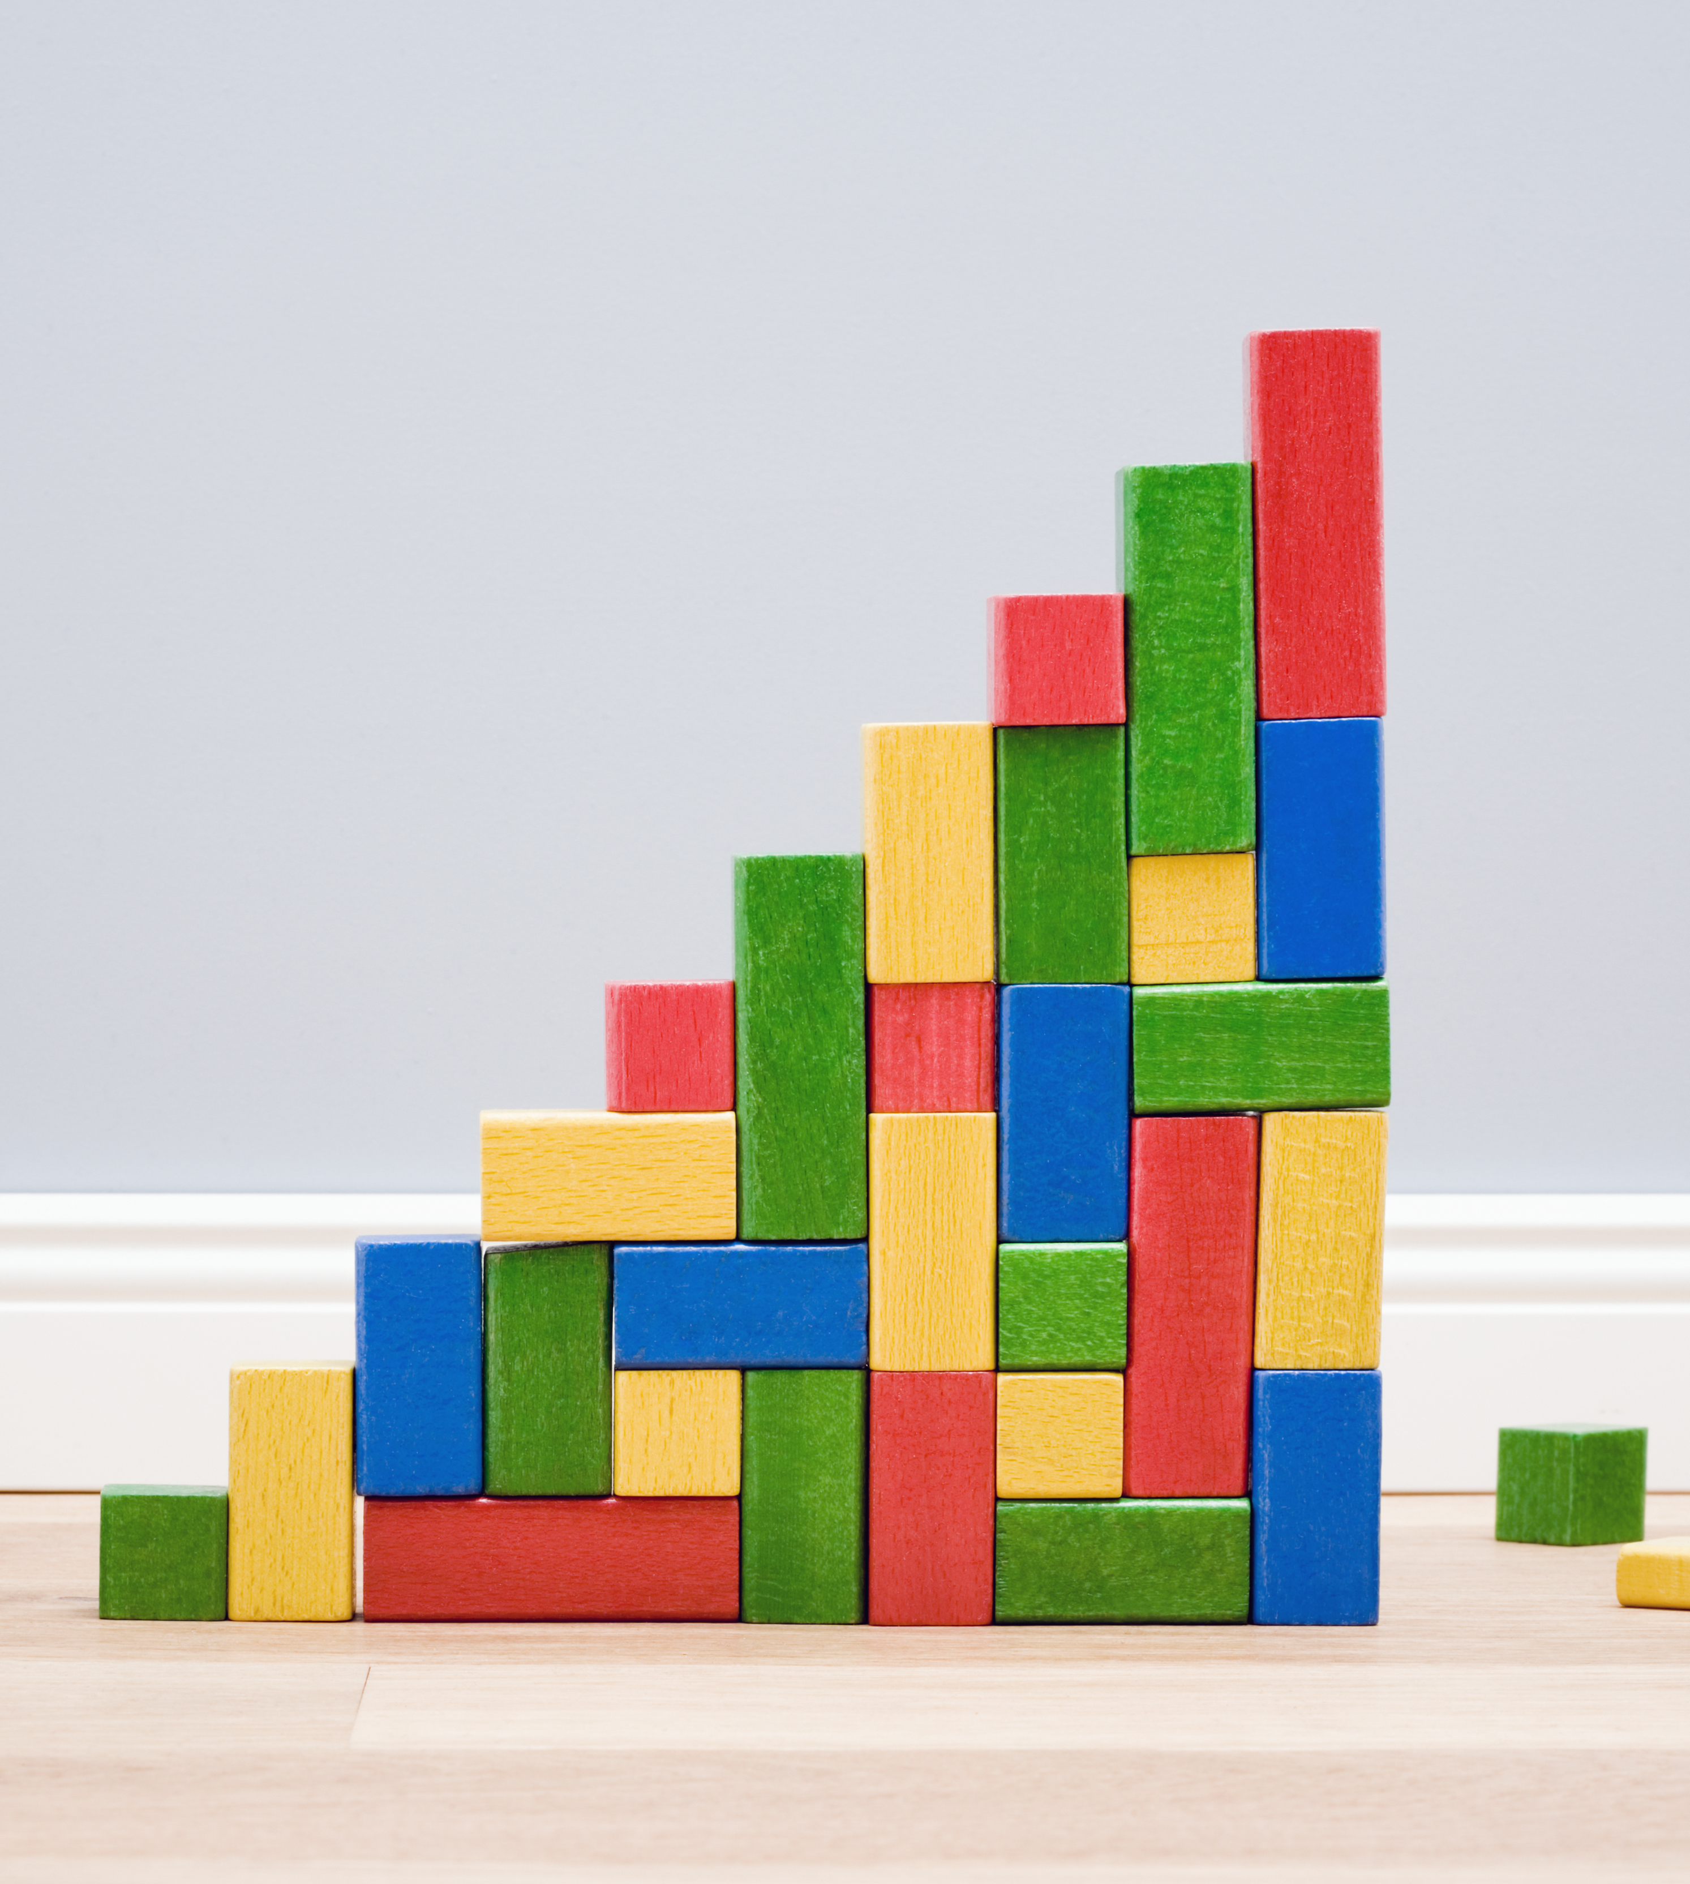
Autonomous Assembly Sequencing
How to build a structure?
  Precomputation leads to inflexibility for replanning.
  If agent can build, it can rebuild or adjust with similar logic.
Decisions must be justifiable to human operators.
Need to consider structure as well as agent.

Slide 7
Problem Formulation
How does an agent assemble a structure?
7 | #ascendspace

Slide 8
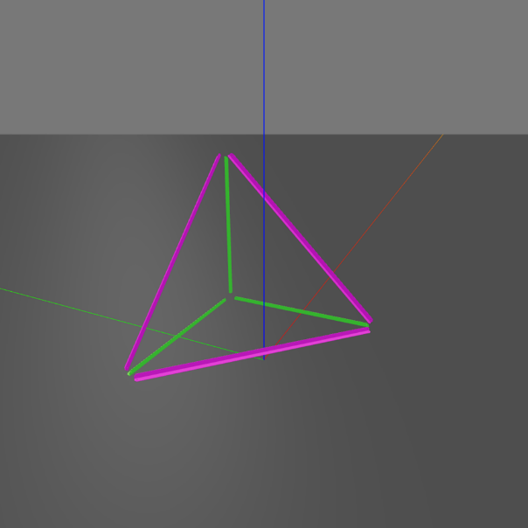
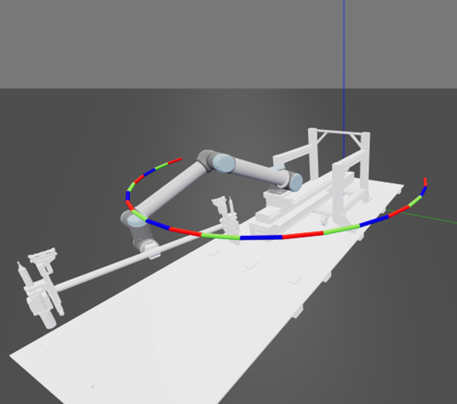
Problem Formulation
Consider an assembly graph:
  Vertices -> sub-assemblies.
  Edges -> Transitions
Vertex cost associated with the sub-assembly’s structural characteristics .
Edge cost associated with transitions between sub-assemblies.
Two step solution:
  Find the optimal sequence with respect to vertex costs (ignoring edge costs).
  Find the optimal sequence considering the edge costs in a relaxed region around the first sequence.
8

Slide 9
Example: Planar Simplex (3 Elements)

Slide 10
Assembly Graph
Directed Acyclic Graph
  1 Root Vertex
  1 Terminal Vertex
Sequences represent a valid assembly ordering.
Vertices (circles) representing valid sub-assemblies.
Edges (arrows) represent transitions between sub-assemblies.

Slide 11
Assembly Sequence
Collection of both vertices and edges required to assemble structure in particular order.
Represents the order in which to add elements to structure.
1
2
3

Slide 12
Vertex / Sub-Assembly
Vertex costs represent the inherent properties of a particular sub-assembly.
  Algebraic Connectivity:
    How “connected” a sub-assembly is.
  Difference of Centroids:
    Spatially compact.
  Degrees of Freedom:
    Reduces “wiggle” in sub-assembly.
Search these using a graph search algorithm.

Slide 13
Edge / Transition
Edges represent a transition between two sub-assemblies.
Encode the action(s) necessary for an assembly step.
Costs associated with the robot placing the element:
  Joint movement.
  Time to move.
  Energy expended.

Slide 14
Path Planning Between Sub-Assemblies
Transitions as trajectories:
  Trajectory found by path planner.
  Valid goal with inverse kinematic solver.
  Fixed amount of time to solve.
Majority of the computational overhead.

Slide 15
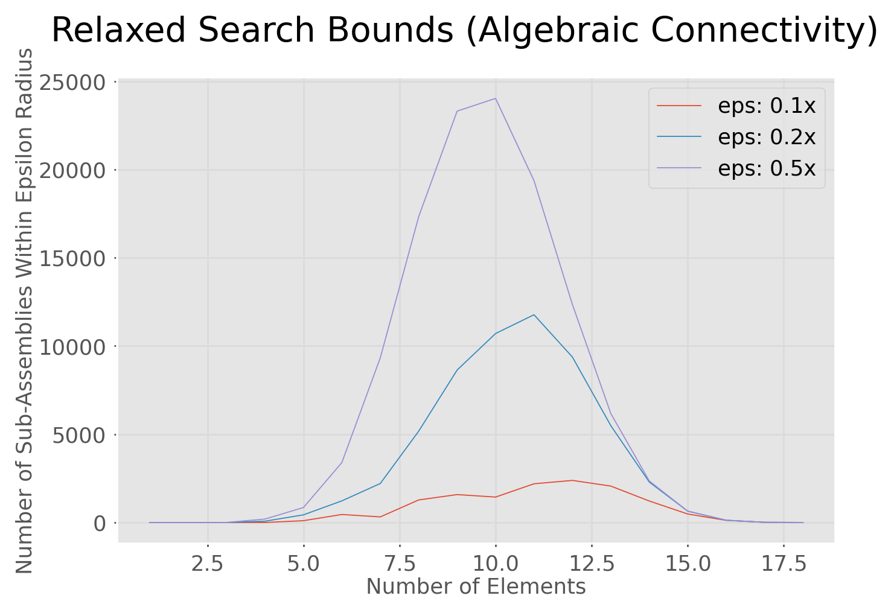
Limiting Edge Cost Calculations
Use subset of assembly sequences.
  Limit number of edges to generate.
  Better use of computational resources.
Use vertex costs to decide which edges to generate.
Bounded region around vertex optimal sequence(s).

Slide 16
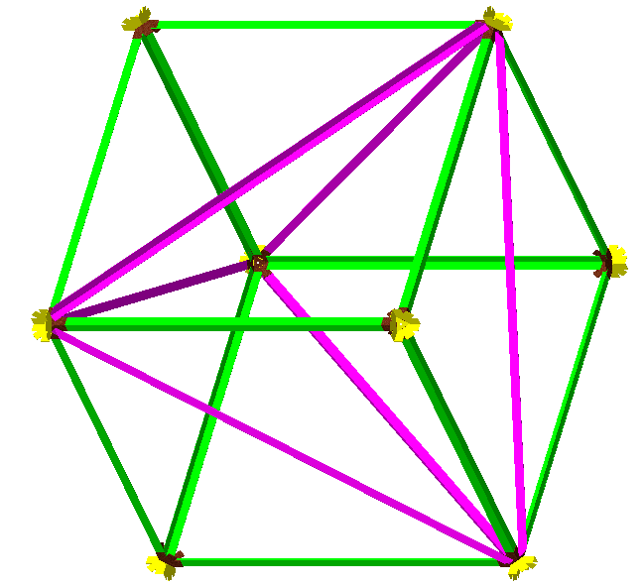
Example: Cube
Cube with 18 elements:
Fixed computational budget of 3600 s.
Number of Edges | Time per Edge
250,000 | 0.01 s
100,000 | 0.04 s
25,000 | 0.14 s
10,000 | 0.36 s
2,500 | 1.4 s
1,000 | 3.6 s
17 | 211 s

Slide 17
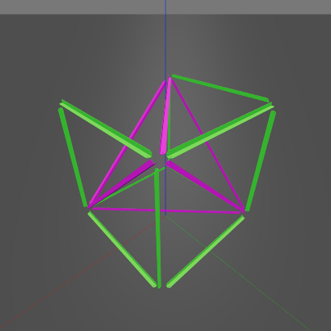
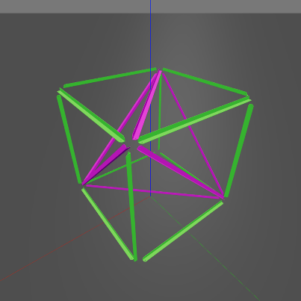
Relaxed Set Vs. Optimal Set
Solutions are not guaranteed to exist for an edge.
  Solution is infeasible.
  Fail to find feasible solution in time.
Relaxing the search space increases the chance of finding viable sequences.
?

Slide 18
Relaxed Set Vs. Optimal Set
Vertex Opt.
Vertex Relaxed
Rest of Edges
Trade off between:
  Entire search space
    Costly to compute all transitions.
    No guarantees on vertex costs.
  Vertex optimal sequences
    Not guaranteed to have valid edges.
    Limited selection of transition costs.

Slide 19
Implementation
19 | #ascendspace

Slide 20
High Level Overview of Algorithm
Provide Structure Plan and Cost Functions
Generate Graph with Valid Vertices
Generate Vertex Costs on Valid Graph
Search
Vertex Costs
Expand Vertex Optimal Assembly Sequence Set By 𝜖
Generate
Edge Costs on
Relaxed Set
Search Edge Costs
Final Assembly Sequence

Slide 21
High Level Overview of Algorithm
Provide Structure Plan and Cost Functions
Generate Graph with Valid Vertices
Generate Vertex Costs on Valid Graph
Search
Vertex Costs
Expand Vertex Optimal Assembly Sequence Set By 𝜖
Generate
Edge Costs on
Relaxed Set
Search Edge Costs
Final Assembly Sequence
1
2
Vertex Opt.
Vertex Relaxed
0
1
3
0
Edge Opt.
2
3

Slide 22
High Level Overview of Algorithm
Provide Structure Plan and Cost Functions
Generate Graph with Valid Vertices
Generate Vertex Costs on Valid Graph
Search
Vertex Costs
Expand Vertex Optimal Assembly Sequence Set By 𝜖
Generate
Edge Costs on
Relaxed Set
Search Edge Costs
Final Assembly Sequence
1
2
Vertex Opt.
Vertex Relaxed
0
1
3
0
Edge Opt.
2
3

Slide 23
High Level Overview of Algorithm
Provide Structure Plan and Cost Functions
Generate Graph with Valid Vertices
Generate Vertex Costs on Valid Graph
Search
Vertex Costs
Expand Vertex Optimal Assembly Sequence Set By 𝜖
Generate
Edge Costs on
Relaxed Set
Search Edge Costs
Final Assembly Sequence
1
2
Vertex Opt.
Vertex Relaxed
0
1
3
0
Edge Opt.
2
3

Slide 24
Results
24 | #ascendspace

Slide 25
Vertex Flagging
1
1
1
1
1
1
1+ε
1+ε
1+ε
1+ε
1+ε

Slide 26
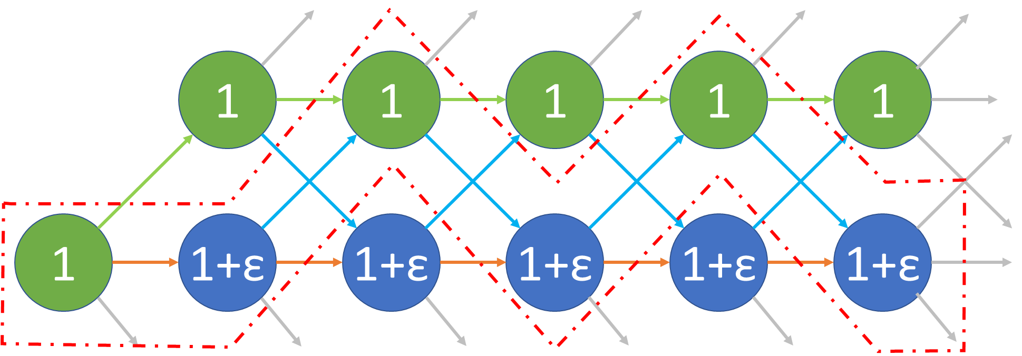
Edge Flagging

Slide 27
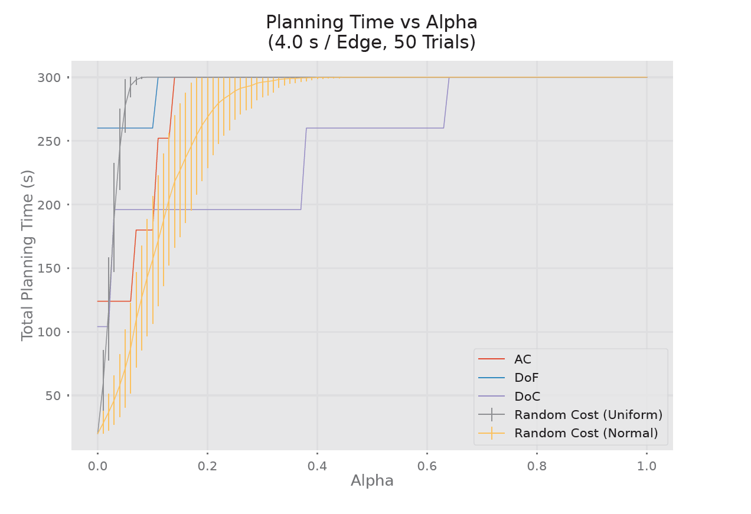
Time to Plan

Slide 28
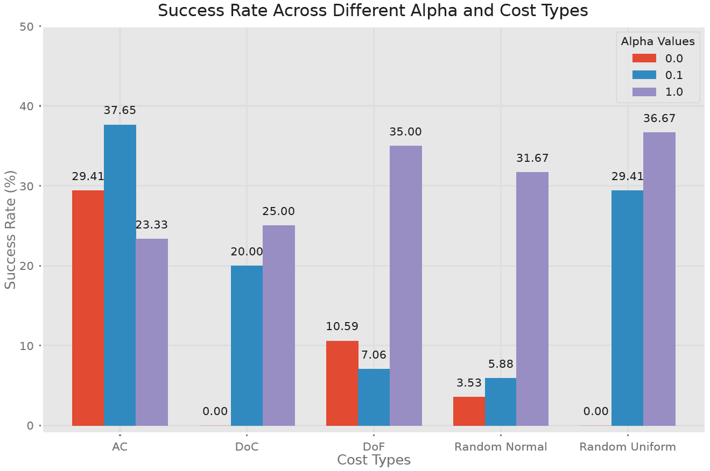
Success Rates

Slide 29
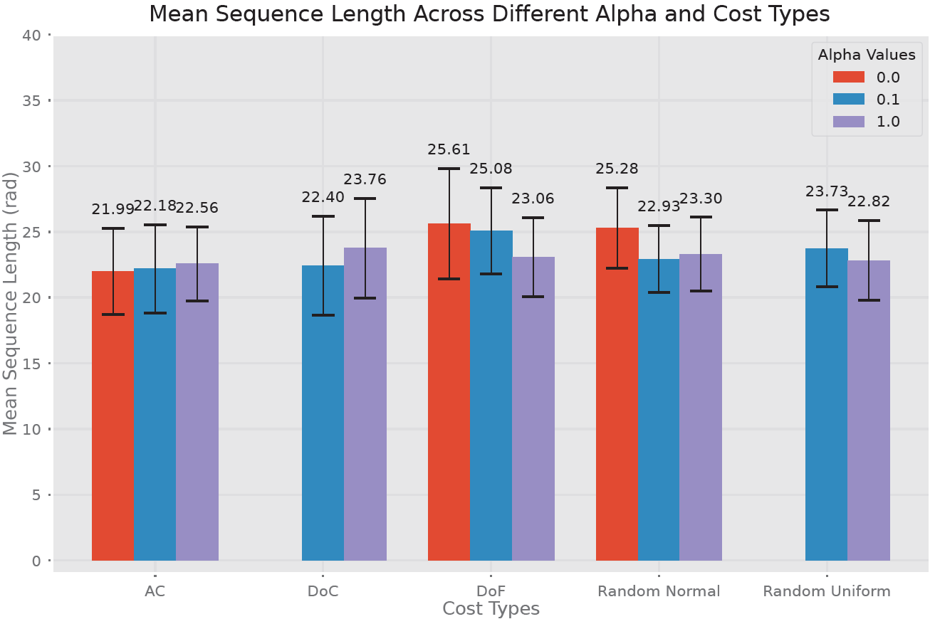
Mean Sequence Length

Slide 30
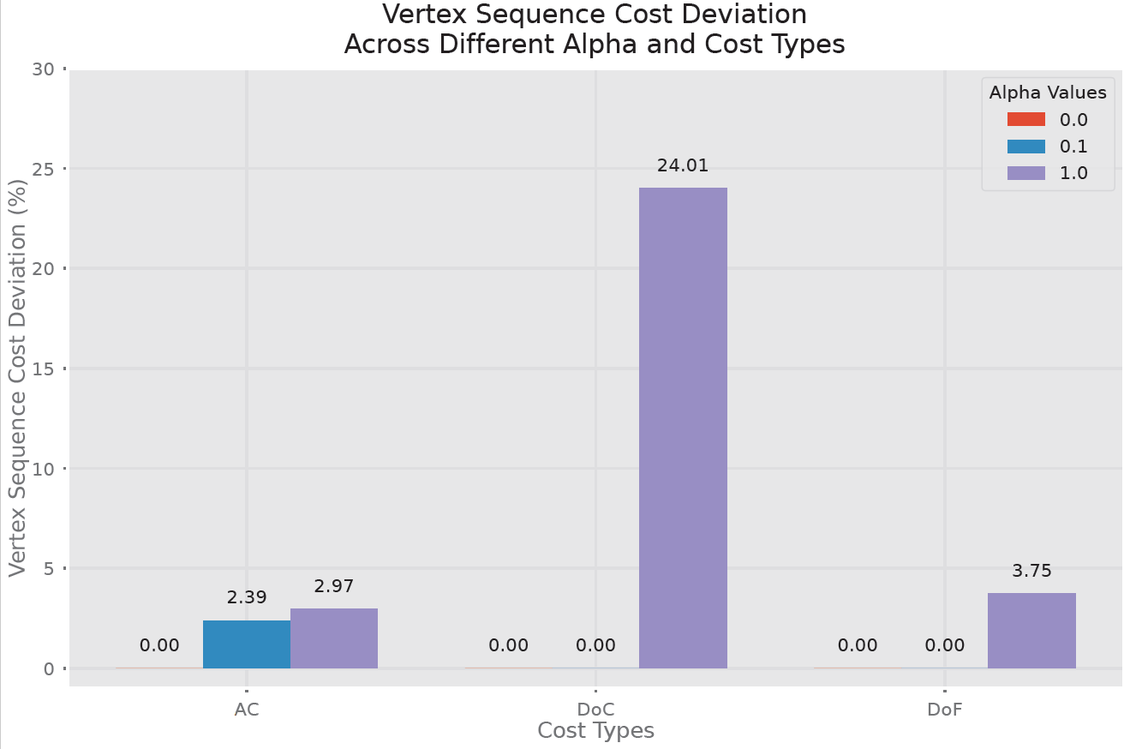
Vertex Cost Deviation

Slide 31
Conclusions
31 | #ascendspace

Slide 32
Conclusions
Autonomous agents can make decisions on assembly sequencing based on both path planning and structural constraints.
Future work:
  More efficient search and path planning methods.
  More varied and complex structures.
  Use knowledge of assembly graph to recognize similar sections.
  Multi-agent division and scheduling of the assembly graph.

Slide 33
Questions?
33 | #ascendspace

Slide 35
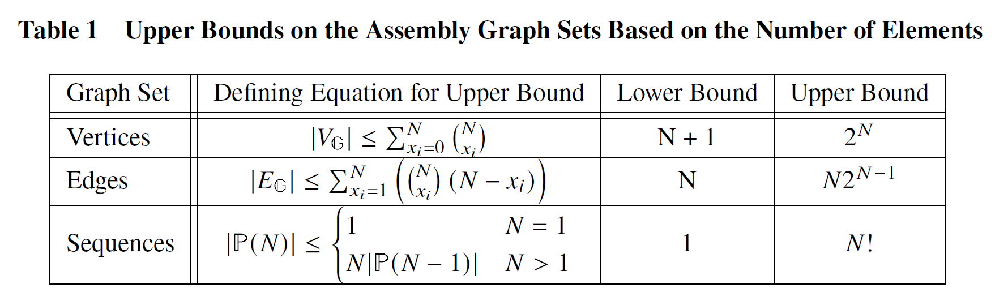
Order of Magnitude of Sets

