Slide 1

Plume Surface Interaction Modeling
Andrew Weaver
Jacobs Space Exploration Group
NASA Marshall Space Flight Center, Huntsville, Alabama
Jeffrey West
NASA Marshall Space Flight Center, Huntsville, Alabama
Johns Hopkins University Applied Physics Lab
LSIC Lunar Launch and Landing Facility Workshop
July 23, 2024

Slide 2
Outline
Introduction
Rationale for use of landing pad / prepared surface
State-of-the-art PSI modeling capabilities for Lunar site planning
How PSI modeling can be used for landing pad/prepared surface considerations
Summary

Slide 3
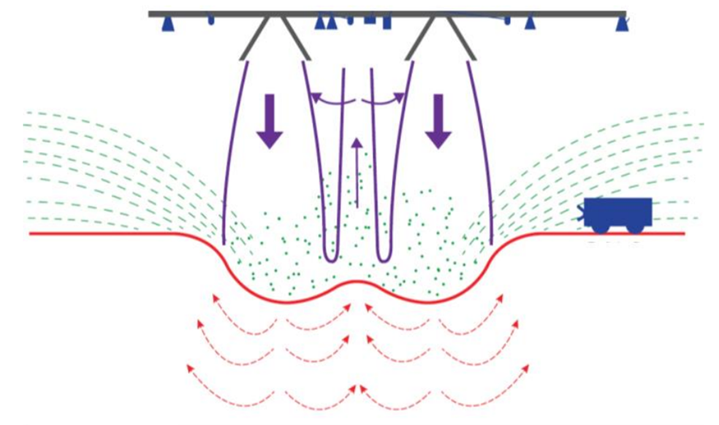
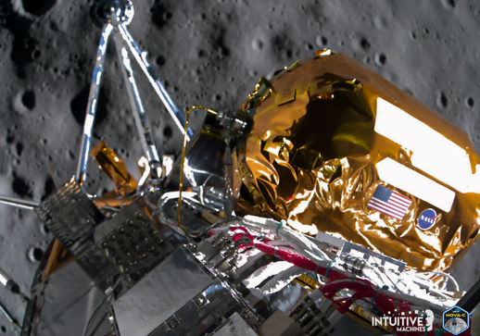
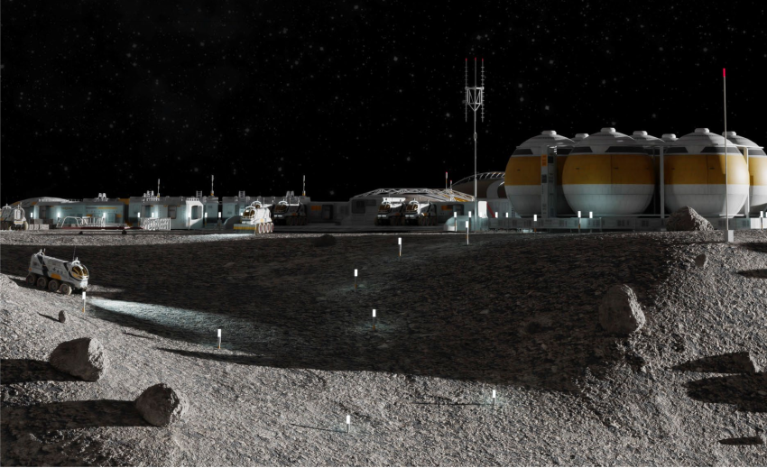
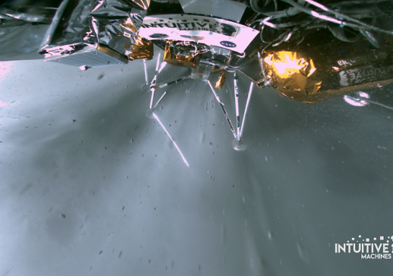
Introduction
Plume surface interaction (PSI) induced environments pose several risks to future Lunar and Martian landers:
  Forming a crater below the lander – potentially causing excessive tilting of the lander
  Obscuring view of Lunar surface below lander
  Eroding surface, potentially causing high-speed ejecta/debris impacts to the vehicle and/or nearby assets
Illustration of PSI Induced Environment (Credit: West et al. 2022)
IM-1 landing At ~30m Altitude and at TouchDown
(Credit: Intuitive Machines)
Illustration of Lunar Base Concept
(Credit: JHU-APL LSIC)
Ejecta
Cratering
With sustained Lunar presence, crew and other vehicles/assets may be in place during a Lunar landing – additional risks from multiple landings compared with single landing mission

Slide 4
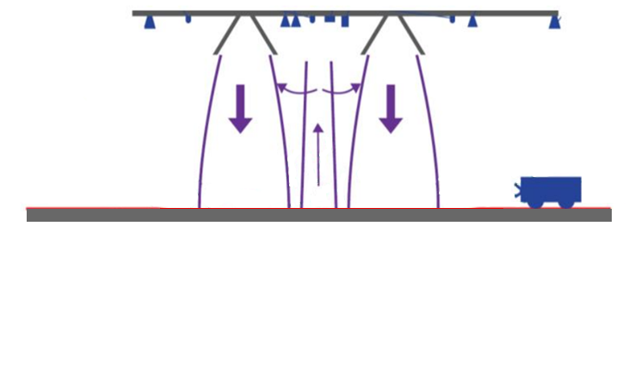
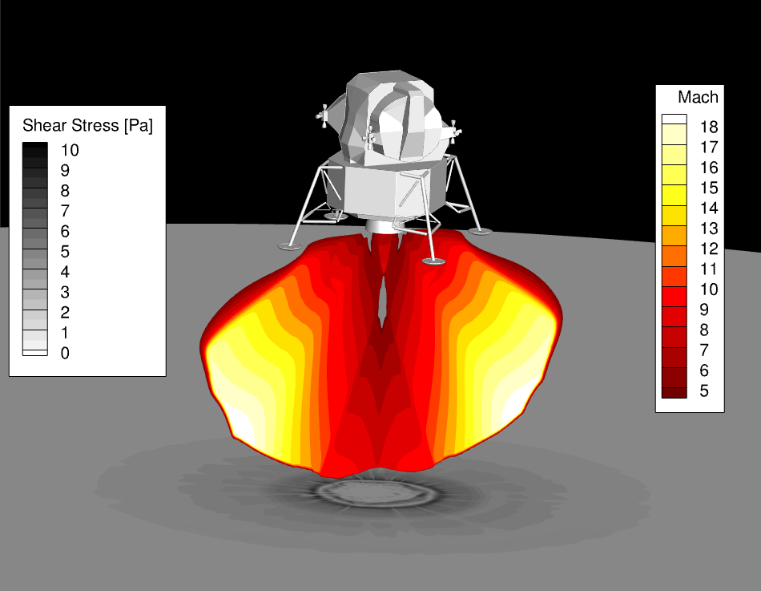
Rationale for Use of Landing Pad / Prepared Surface
A landing pad could eliminate/significantly reduce the PSI risks mentioned on previous chart:
  Cratering ( flat, solid surface instead of erodible, regolith surface )
  View obscuration ( no erodible regolith below lander to obstruct view )
  Regolith particle impacts/accumulation ( no erodible regolith below lander to transport to nearby assets )
Illustration of PSI Induced Environment (Credit: West et al. 2022)
Idealized Landing Pad / Prepared Surface
Ejecta
Landing Pad
Eliminating Cratering/Ejecta
Plume Impingement
Cratering
A well-designed/maintained landing pad ( large enough, does not fracture, etc. ) could eliminate ejecta-based PSI risks and only need to consider plume impingement

Slide 5
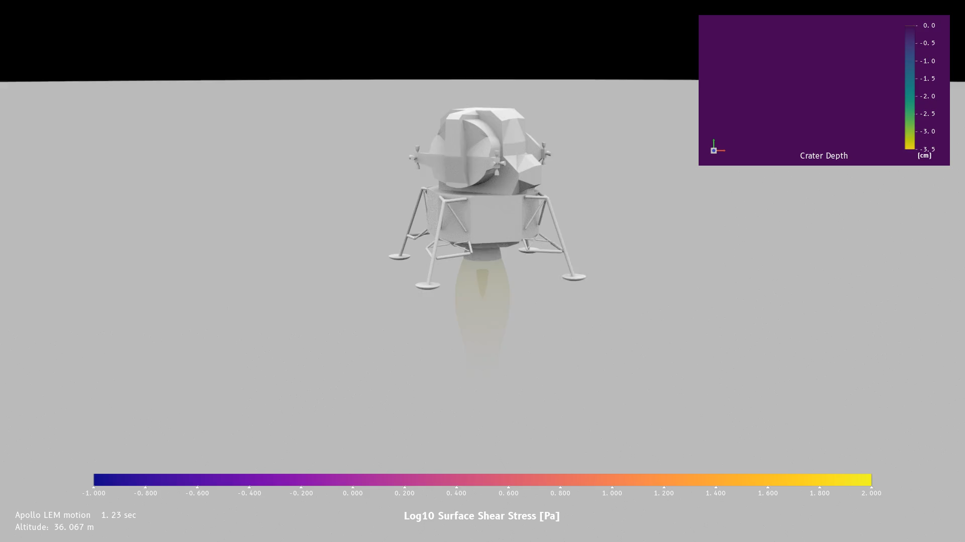
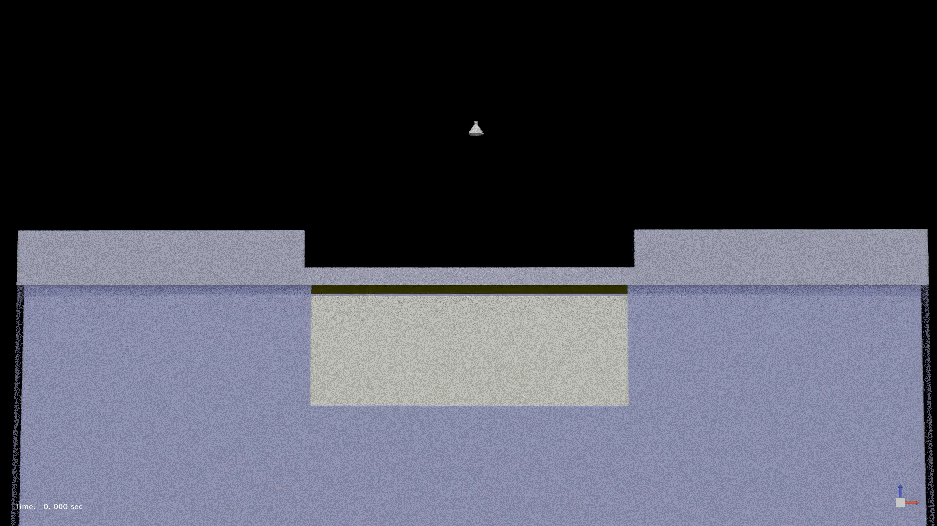
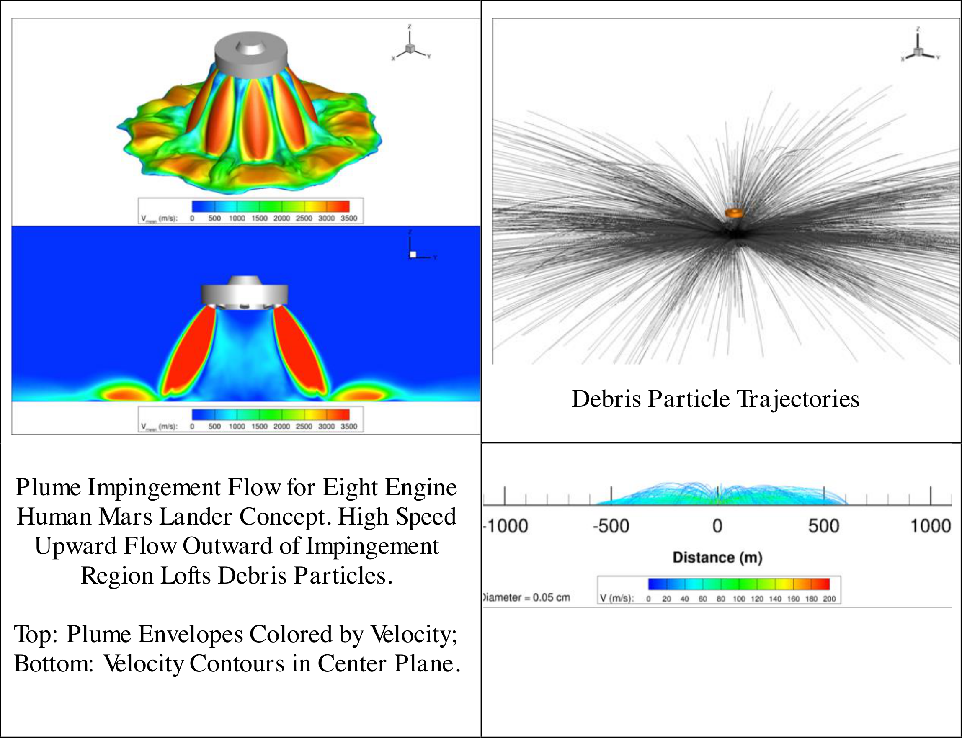
State-of-the-Art PSI Modeling Capabilities for Lunar Site Planning
ER42 Fluid Dynamics Branch at NASA MSFC pushes the current state of the art for PSI modeling through continual development of a cascade of predictive simulation tools, including:
  Loci/Chem-DIGGEM ( hybrid CFD/engineering model, See bottom left animation )
  Loci/GGFS ( multi-phase, multi-physics Gas Granular Flow Solver, See bottom center animation )
  DTA ( Debris Transport Analysis tool based on CFD flowfield, See bottom right image )
Loci/Chem-DIGGEM Simulation of Apollo Descent and Cratering
(Video Credit: Andrew Weaver and Patrick Moran [NASA-Ames])
Loci/GGFS Simulation of Physics Focused Ground Test
(Video Credit: Jason Howison and Patrick Moran [NASA-Ames])
DTA Example: Human Mars Lander Concept (Image from Liever et al., Earth and Space 2018)
We have capabilities to model multi-phase gas/solid interaction with regolith, plume flowfield and impingement, and particle transport to near and farfields
( we have and continue to apply developed tools in support of multiple customers )

Slide 6
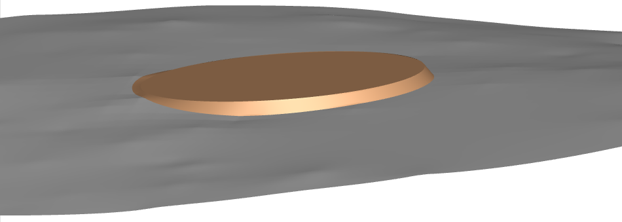
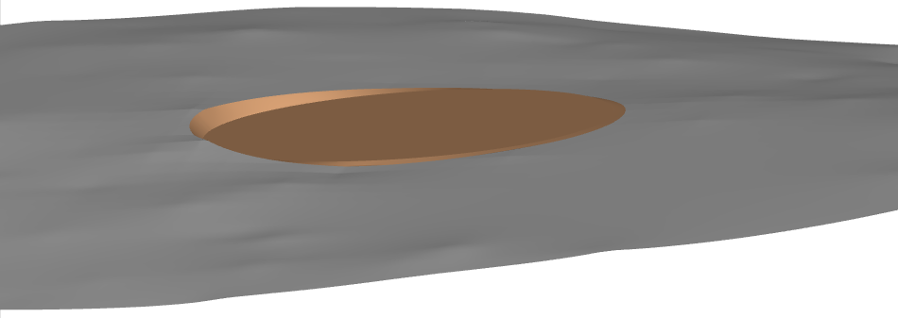
How PSI Modeling Can be Used for Landing Pad / Prepared Surface Analyses
ER42 developed tools can be used to predict PSI metrics such as:
  Impingement pressures
  Impingement shear stresses
  Impingement heat fluxes
  Integrated forces
These metrics can be used to assist in landing pad design, including considerations such as:
  What does the PSI environment look with/without a landing pad ( is there sufficient need? )
  What plume impingement loads are exerted on a landing pad?
  What size is necessary to prevent erosion?
  What configuration should be used (building on top of, or bulldozing/flattening in a “bottom” configuration)?
Particle sizes, positions, velocity, kinetic energy
Fluxes and impacts to assets
Crater evolution
Soil accumulation
Prepared Surface: Top Configuration
Ejecta
Prepared Surface: Bottom Configuration
Ejecta
Diameter of Pad
Diameter of Pad
Multiple landing pad design considerations can be explored from a PSI perspective with current tools (ER42 already modeling landing pads for customers)

Slide 7
Summary
PSI poses risks to the landing vehicle, crew, and nearby assets
  Cratering
  View obscuration due to ejecta
  High-speed ejecta impacts and accumulation to vehicle, sensitive equipment, and nearby assets
Well designed landing pads aim to mitigate these PSI risks by preventing cratering and transport of regolith ejecta
PSI modeling capabilities exist within ER42 Fluid Dynamics Branch at NASA MSFC and have been applied for multiple customers to predict:
  Plume impingement environment
  Particle ejecta transport and impact environment
  Lunar terrain evolution and deposition environment
PSI modeling capabilities can be applied for landing pad / prepared surface considerations
  What happens without a landing pad?
  What plume impingement loads are exerted on a landing pad?
  What if the landing pad is flat but still has dust on it (blown from other lander or otherwise)
  What configuration should be used for landing pad and how large?

