Slide 1
Coupling a CFD Model to a Spacecraft Thermal System Model for the DraMS Instrument Thermal Analysis
ICES-2024-103
Daniel Bae, NASA GSFC 545, DraMS Lead Thermal Analyst
David Steinfeld, NASA GSFC 545, DraMS Thermal Product Development Lead

Slide 2
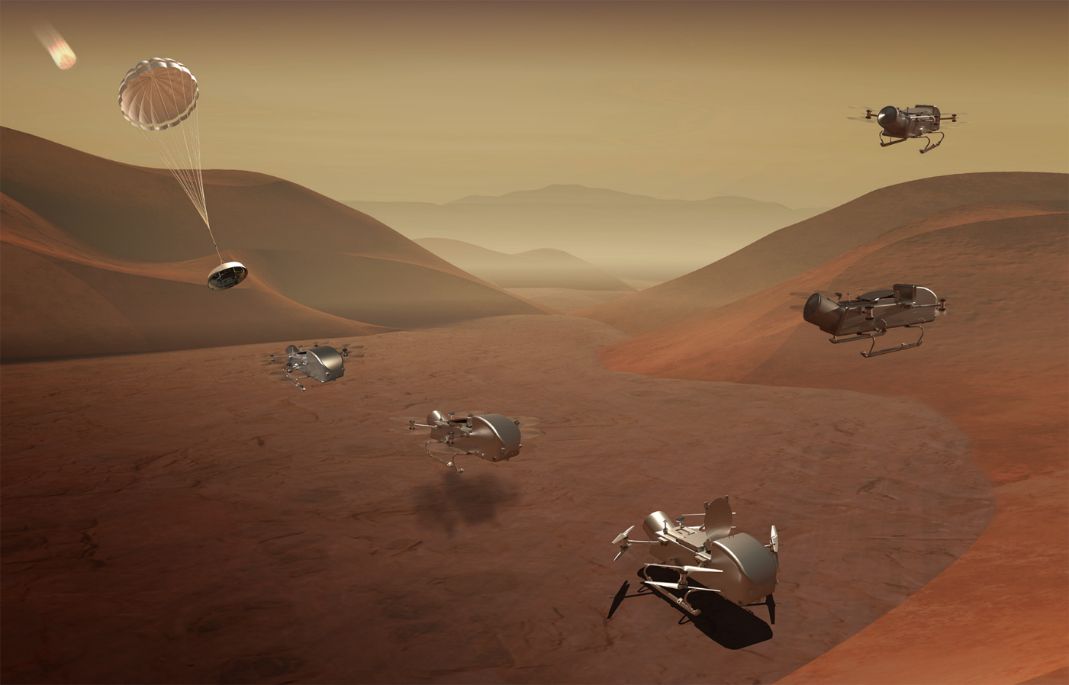
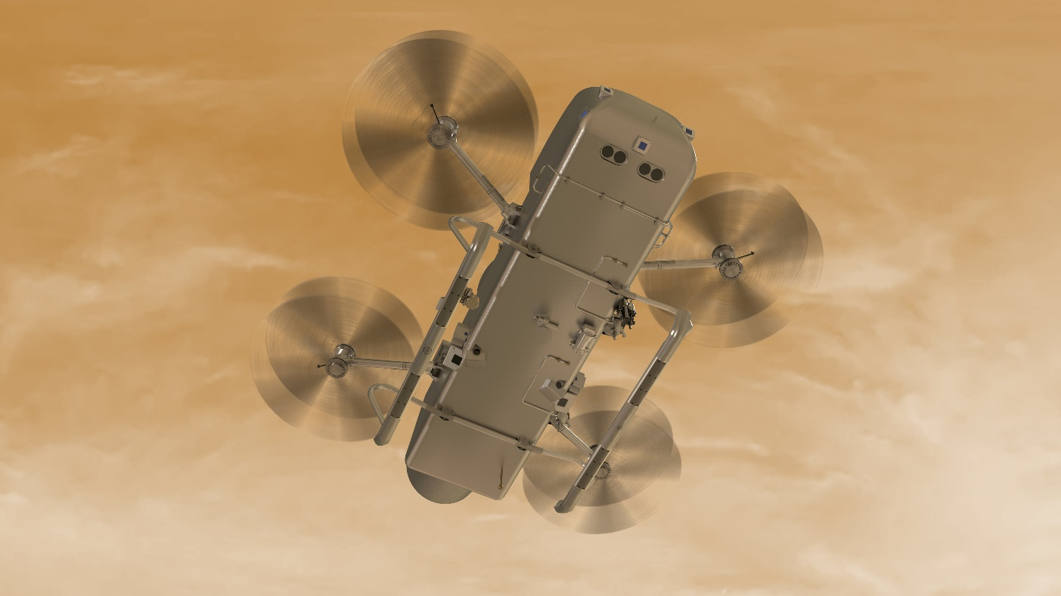
Dragonfly Mission
Science mission to the largest Saturn’s moon, Titan
A relocatable lander to explore Titan’s prebiotic chemistry and habitability
  Range: 10s of kilometers traverse over 3+ years of exploration
Launch date: 2028
For more information:
  https://exoplanets.nasa.gov/news/1764/life-in-the-lab/
  https://www.nasa.gov/press-release/nasas-dragonfly-will-fly-around-titan-looking-for-origins-signs-of-life
  https://dragonfly.jhuapl.edu/
Image credit: NASA/Johns Hopkins APL/Steve Gribben

Slide 3
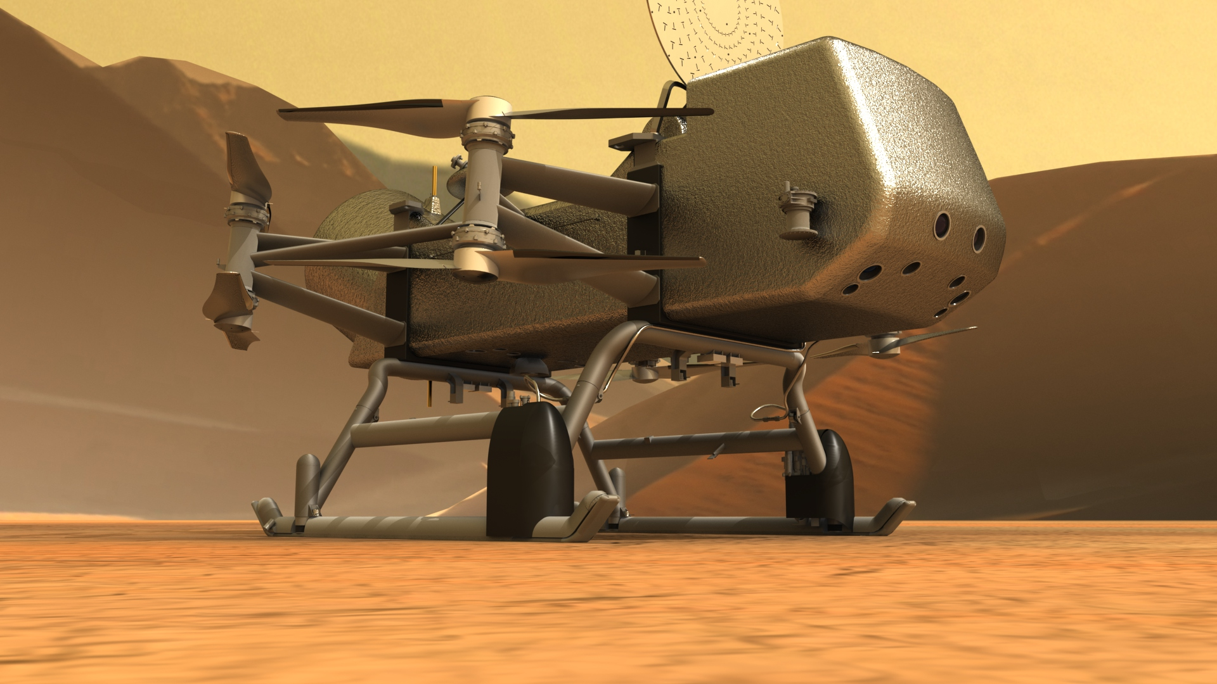
DraMS (Dragonfly Mass Spectrometer)
We are in here!
Dragonfly is more like a helicopter than an orbiting satellite!
Lander Body Approx 3’ X 8’
~Refrigerator Size

Slide 4
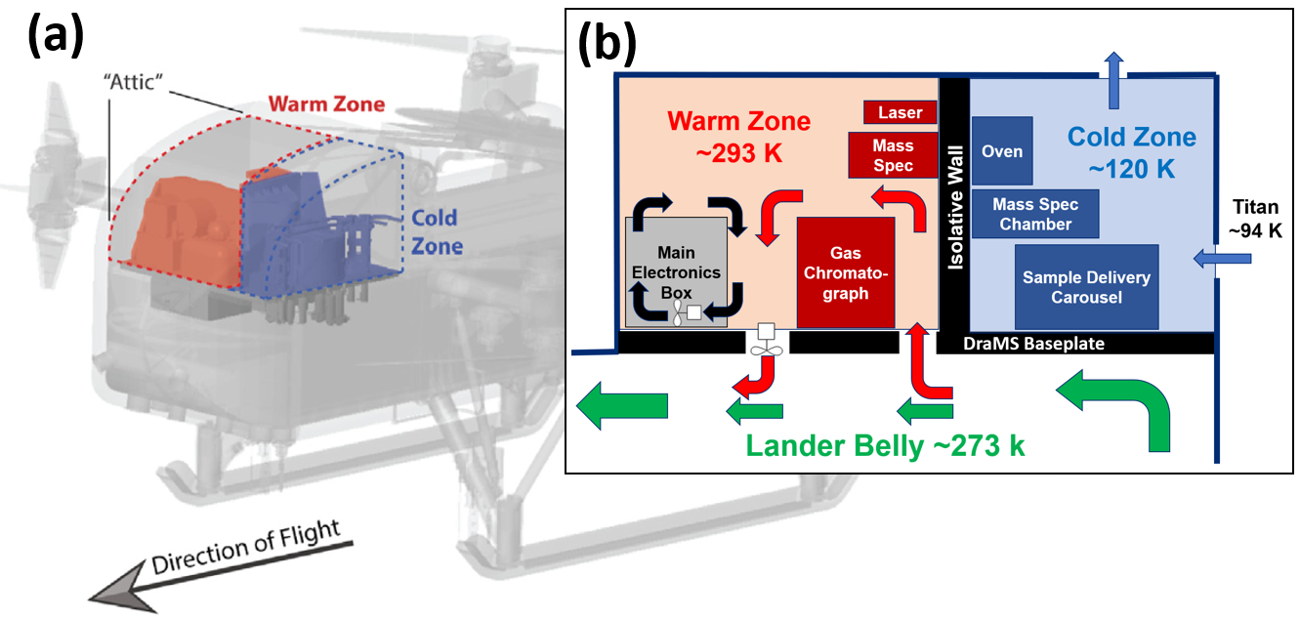
DraMS Thermal Control System: Conduction/Convection/Radiation Analysis is Important!
A simplified DraMS instrument thermal schematic

Slide 5
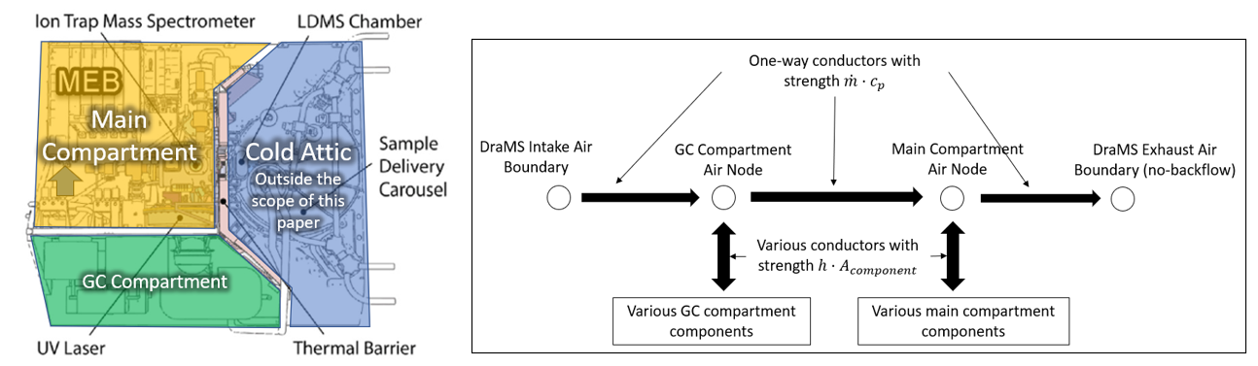
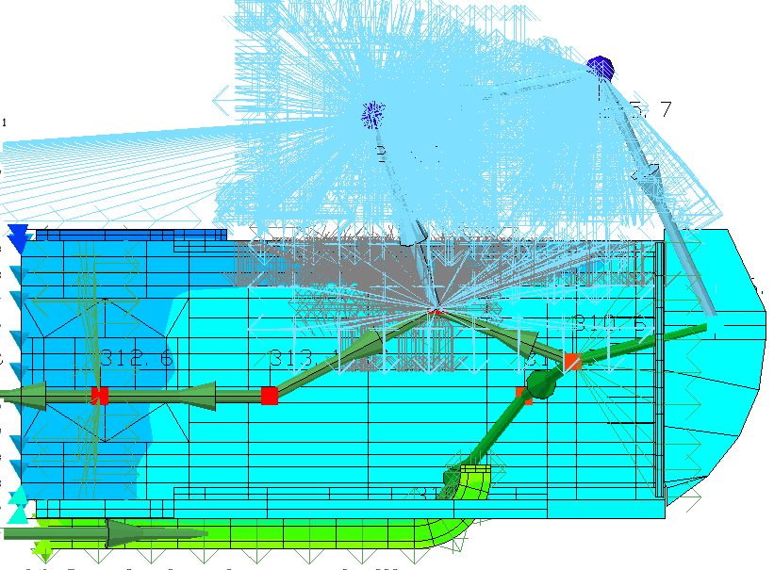
Initial Modeling Methodology: 1-D Convective Boundary Conditions
A top-down view of the DraMS Instrument
MEB: Main Electronics Box, GC = Gas Chromatograph
1-D convection method simplified schematic
Thermal Desktop model with the 1-D convection method

Slide 6
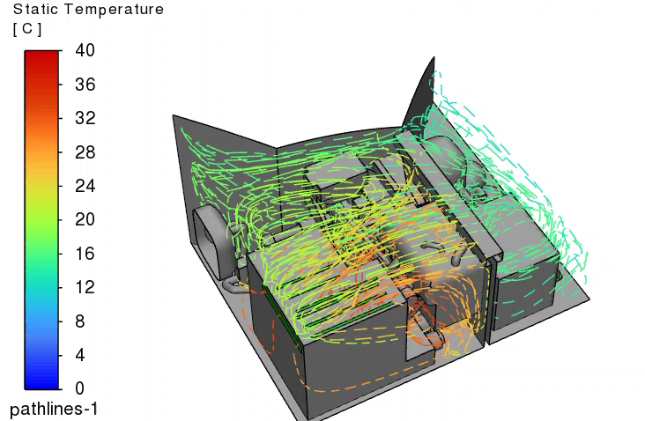
However, Flow within DraMS is Complex!
A video showing the complex flow path lines inside DraMS with temperature plot

Slide 7
CFD is needed, but….
CFD (Computational Fluid Dynamics) is great for capturing complex flows
Computationally expensive
  Transient simulations can be very slow
Difficult to model system level behaviors
  CFD software are rarely suited for easy system level modeling like spacecraft thermal analysis software (SCTAS), such as Thermal Desktop, ESATAN, etc.
    Meshing workflow is typically more restrictive in CFD software compared to SCTAS
    Orchestrating system level logic and system level post processing is significantly simpler in SCTAS

Slide 8
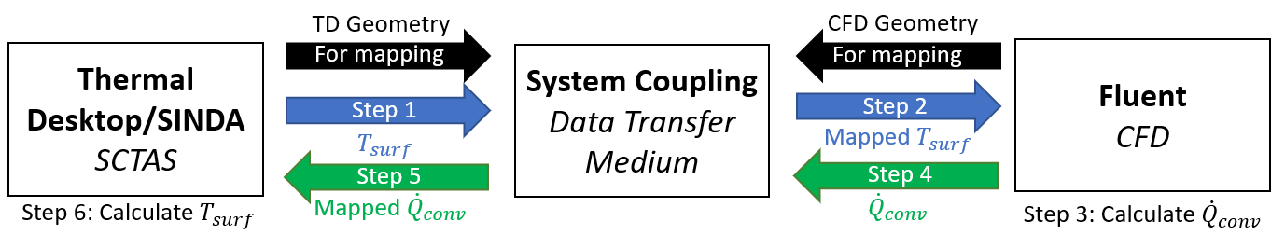
Solution: Co-solving SCTAS and CFD
Simplified TD-Fluent co-solver data transfer process diagram

Slide 9
Co-Solver Investigation Areas of Focus
Numerical Accuracy
Numerical Stability
Workflow process
Transient simulation capability
Model correlation/biasing capability

Slide 10
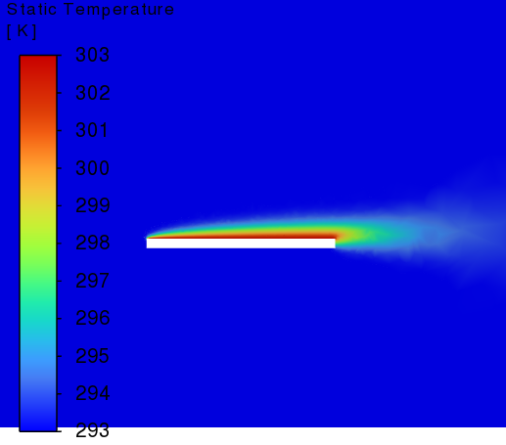
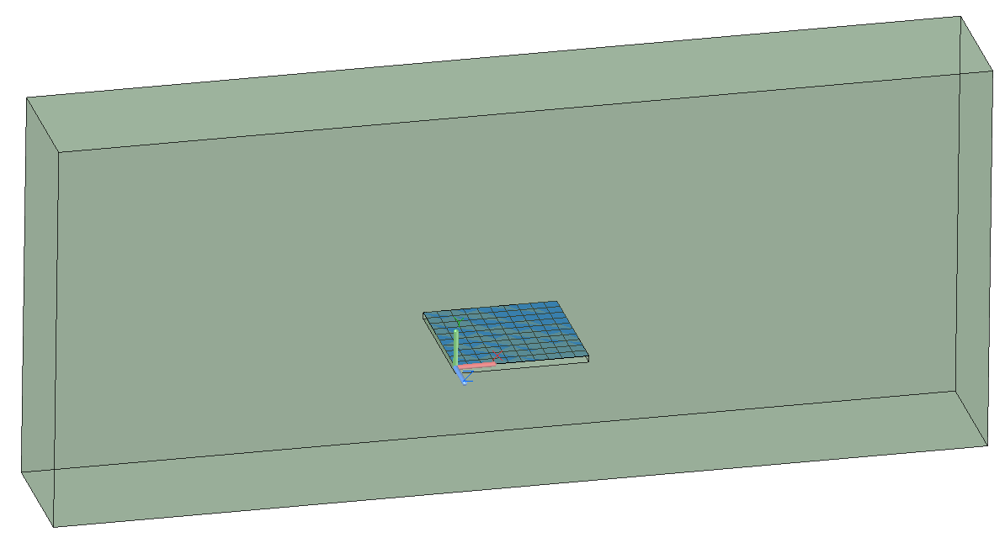
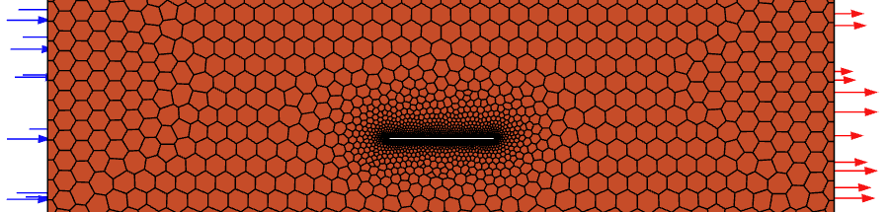
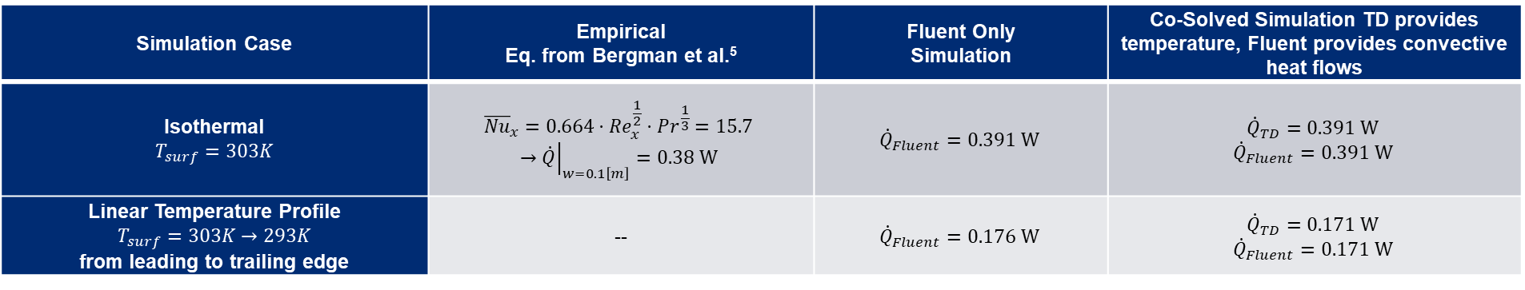
Co-Solver Numerical Accuracy Sanity Check
Simulation Case | Empirical Eq. from Bergman et al.⁵ | Fluent Only Simulation | Co-Solved Simulation TD provides temperature, Fluent provides convective heat flows
Isothermal $$T_{surf}=303K$$ | $${\overline{Nu}}_{x}=0.664⋅Re_{x}^{\frac{1}{2}}⋅{Pr}^{\frac{1}{3}}=15.7$$ $$→{\left.\dot{Q}\right|}_{w=0.1\left[m\right]}=0.38 W$$ | $${\dot{Q}}_{Fluent}=0.391 W$$ | $${\dot{Q}}_{TD}=0.391 W$$ $${\dot{Q}}_{Fluent}=0.391 W$$
Linear Temperature Profile $$T_{surf}=303K→293K$$ from leading to trailing edge | -- | $${\dot{Q}}_{Fluent}=0.176 W$$ | $${\dot{Q}}_{TD}=0.171 W$$ $${\dot{Q}}_{Fluent}=0.171 W$$
CFD (Fluent) mesh
Graphic showing the TD model(just the plate) overlaid on top of the CFD model
Air temperature profile for a plate flow

Slide 11
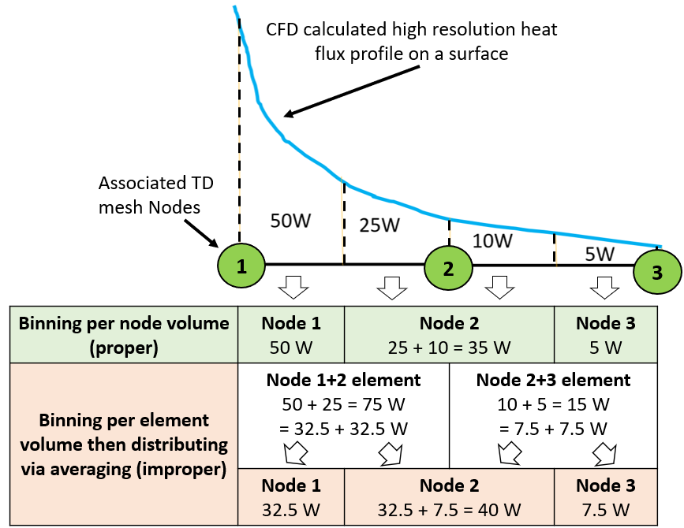
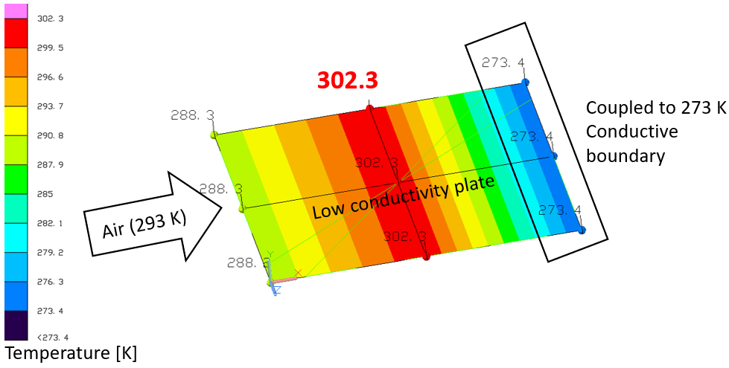
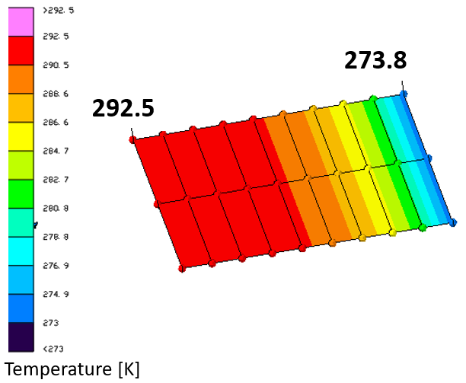
Co-Solver Control Volume Handling Differences
Improper summing of the heat flux data with coarse mesh generating unrealistic results
Finer discretization mitigates the issue
Diagram showing how control volume handling during the data processing can result in significantly different heat flux profile

Slide 12
Co-Solver Numerical Stability
Q-T method
  Convective heat flux values from CFD are mapped to the TD model and are used as boundary conditions (BC)
  Temperatures from TD are mapped to the CFD model and are used as wall BC
  Quite unstable because convective influence is unbounded
    i.e. think of a thermally floating plate with air flowing over it
HT-T method
  Convection coefficient and local fluid temperature are mapped to the TD model and are used as BCs
  Temperatures from TD are mapped to the CFD model and are used as wall BC
  Stable because local fluid temperature bounds how far the convecting surface’s temperature can move per iteration
  Unfortunately, due to control volume handling issues, cannot be used currently (2023 R2)

Slide 13
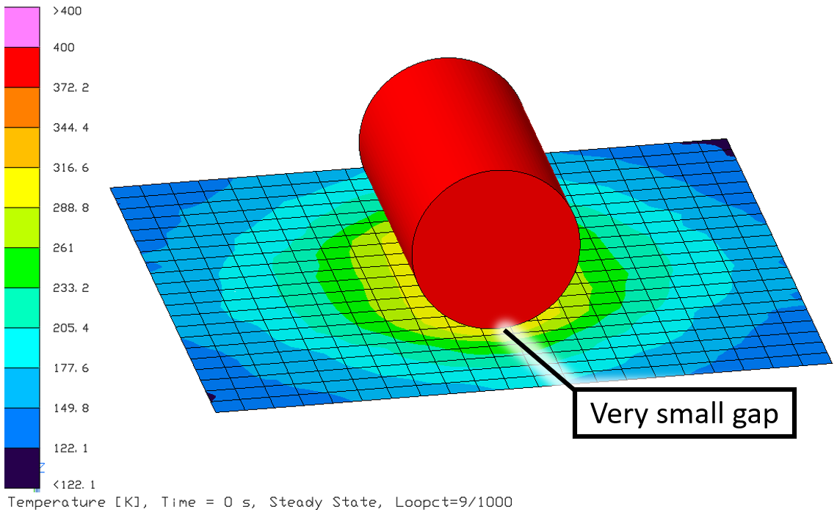
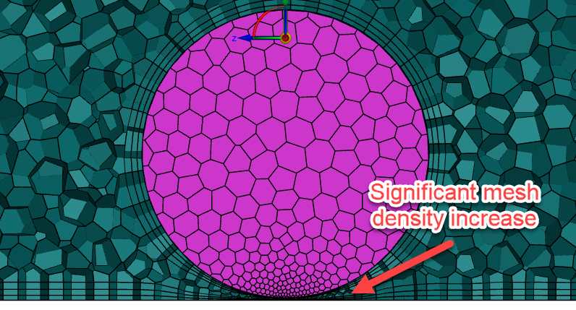
Workflow process
Significantly different geometry clean up process between SCTAS and CFD
  Geometry clean up process can be very different for the two models… would be good to have some degree of separation between the geometry between the two
  Can be problematic when performing data mapping because the geometry must match well between the two for the data transfer to occur properly
Finite Difference TD objects are currently not supported for co-solver data transfer
  DraMS model has many finite difference TD objects
SCTAS model has no significant limitations with simulating conduction/radiation exchange between two objects with infinitesimal gap
CFD models require geometry modification to handle small air gaps

Slide 14
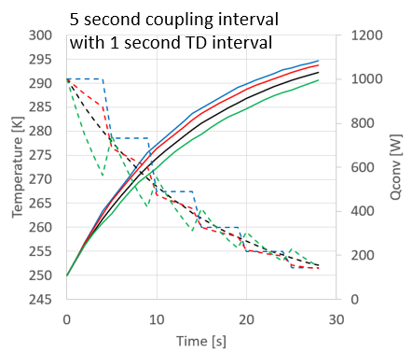
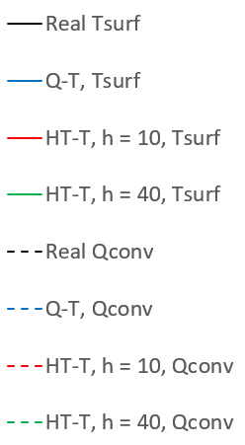
Transient Simulation Capability
TD-Fluent co-solver allows pseudo-transient co-simulation:
TD marches in time and calls steady state CFD simulation at set intervals to update convective boundary condition
  Fluid temperatures and profiles will resolve and reach steady state conditions much quicker than the convection participating solids
  Timestep will not be limited by CFL condition
Longer coupling interval will result in less accurate transient response
Transient temperature and heat flow behavior for a co-solved solution with HT-T and Q-T methods

Slide 15
TD-Fluent Co-Solver Investigation Summary
Capabilities
  Can use complex fluid model to inform system level model iteratively
  Allows pseudo-transient co-solving which lowers computational expenses
  Fairly easy to setup
Limitations
  Geometry must match well between CFD and TD to perform data mapping properly
  Control volume handling issue, which can lead to unrealistic results with coarse meshes
  Not all TD objects are not supported yet for data transport with CFD

Slide 16
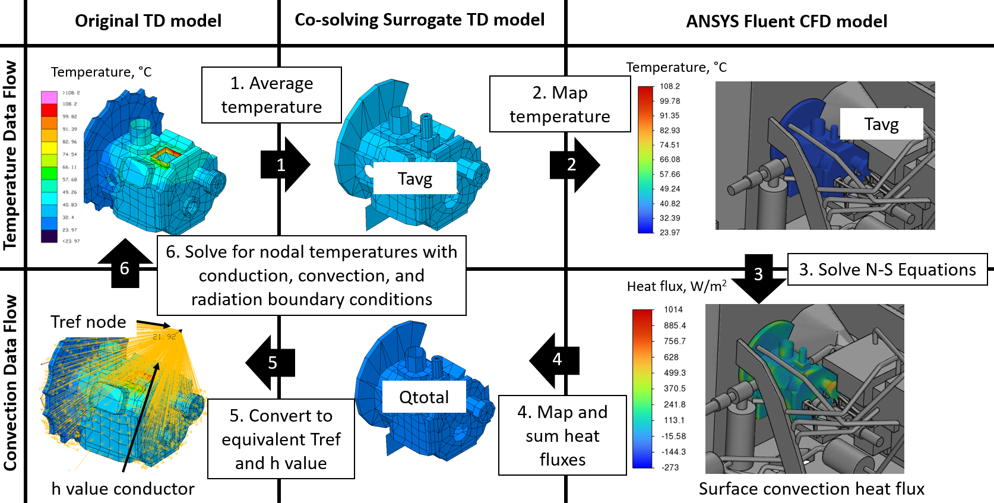
Thermal Iso-value Exchange (TIE) Method
Diagram depicting data flow for the TIE method. Use of the surrogate model for data transfer mitigates the current downsides of the TD-Fluent Co-solver, at the cost of losing local convection information
Notes:
Mention that Qtotal can be adjusted (for biasing or correlation purposes)

Slide 17
1-D vs TIE Method
1-D Method
TIE Method
Conductors with h values approximated from empirical correlations
Uses averaged box surface temperatures
Box to box interaction is weakly coupled via “far-away” air node
Empirical correlations are for ideal/well controlled flow conditions only
Air mesh
Captures all the local air temperature variations
Conductors to local air temperatures with h values from CFD
Uses averaged box surface temperatures
CFD captures box to box interactions via simulating local air nodes
Uses NS-EQ to resolve flow conditions accurately
Air node
Temperature calculated from enthalpy exchange
Box 1
Box 2
Box 1
Box 2
?
Requires less approximations!

Slide 18
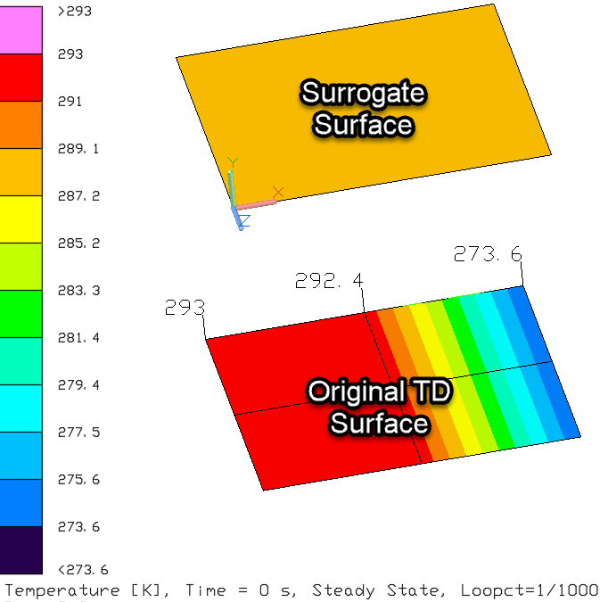
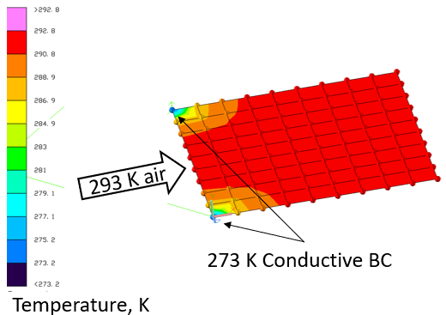
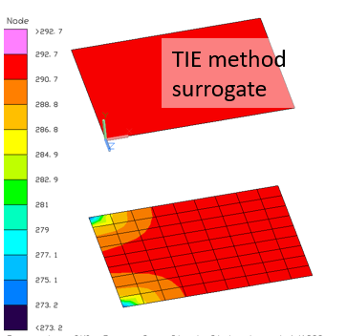
No more unphysical result at the cost of numerical accuracy
Default Co-Solver Method
TIE Method
TIE method (right) vs regular co-solved (left) result for a very coarse mesh problem. Control volume problem is no longer an issue
Default Co-Solver Method
TIE Method
TIE method (right) vs regular co-solved result (left) for a more finely discretized problem. TIE method, as expected, results in the smearing of convection data

Slide 19
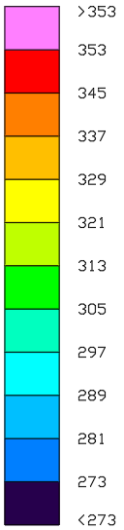
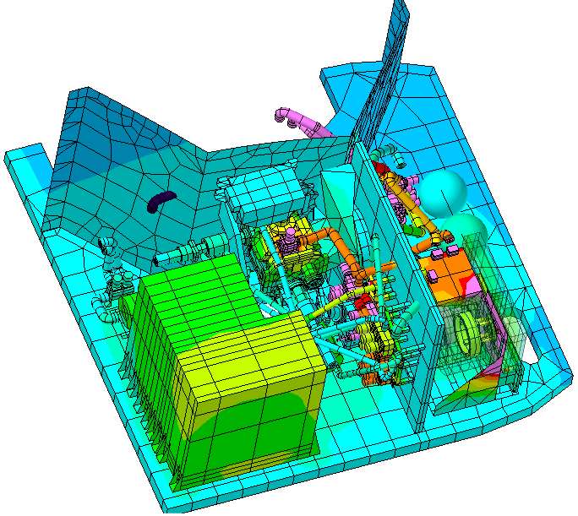
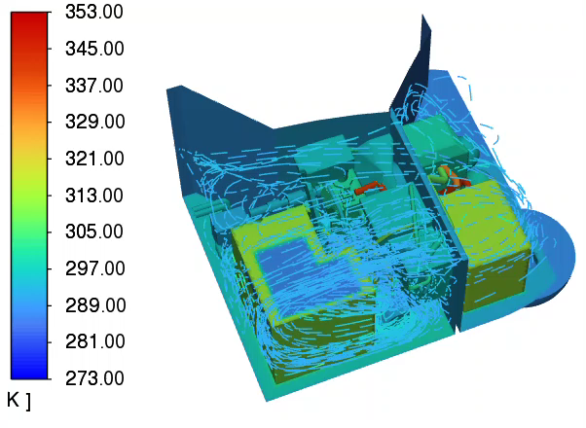
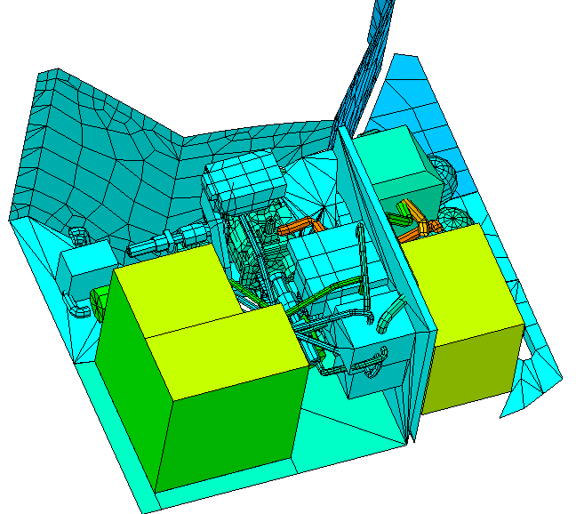
DraMS Model Simulation using the TIE method
Original Model
Co-Solving Surrogate
CFD Model
57 iso-value exchange groups between CFD and TD
TIE Co-solver process is scalable
Temperatures [K]

Slide 20
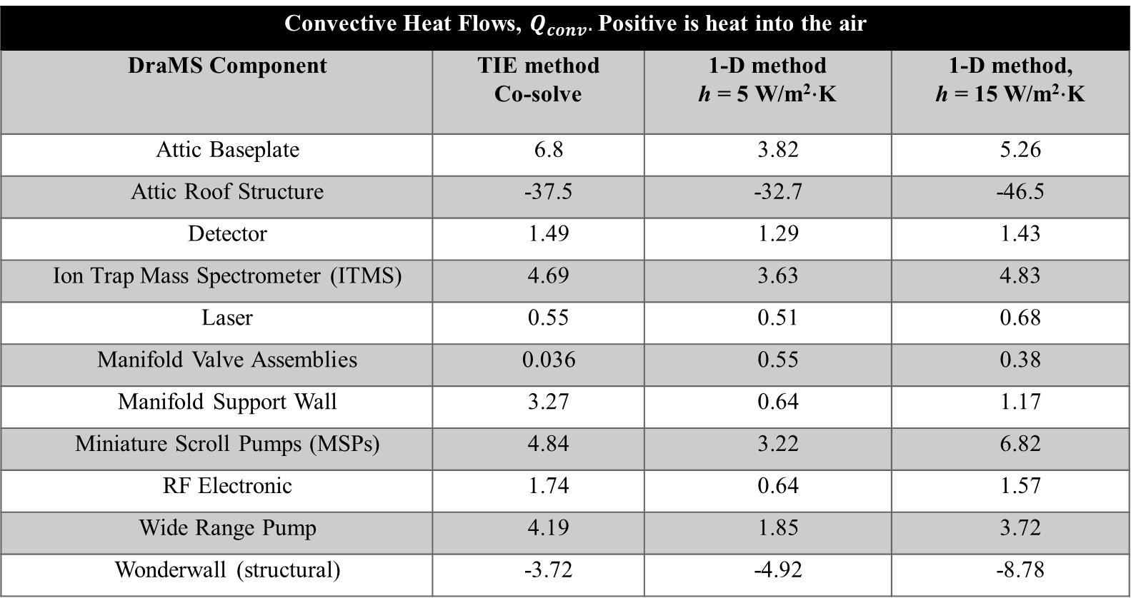
Result Comparison: Co-solved with TIE vs 1-D Method
Convective Heat Flows, ${\dot{Q}}_{conv}.$Positive is heat into the air
DraMS Component | TIE method Co-solve | 1-D method h = 5 W/m²⋅K | 1-D method, h = 15 W/m²⋅K
Attic Baseplate | 6.8 | 3.82 | 5.26
Attic Roof Structure | -37.5 | -32.7 | -46.5
Detector | 1.49 | 1.29 | 1.43
Ion Trap Mass Spectrometer (ITMS) | 4.69 | 3.63 | 4.83
Laser | 0.55 | 0.51 | 0.68
Manifold Valve Assemblies | 0.036 | 0.55 | 0.38
Manifold Support Wall | 3.27 | 0.64 | 1.17
Miniature Scroll Pumps (MSPs) | 4.84 | 3.22 | 6.82
RF Electronic | 1.74 | 0.64 | 1.57
Wide Range Pump | 4.19 | 1.85 | 3.72
Wonderwall (structural) | -3.72 | -4.92 | -8.78

Slide 21
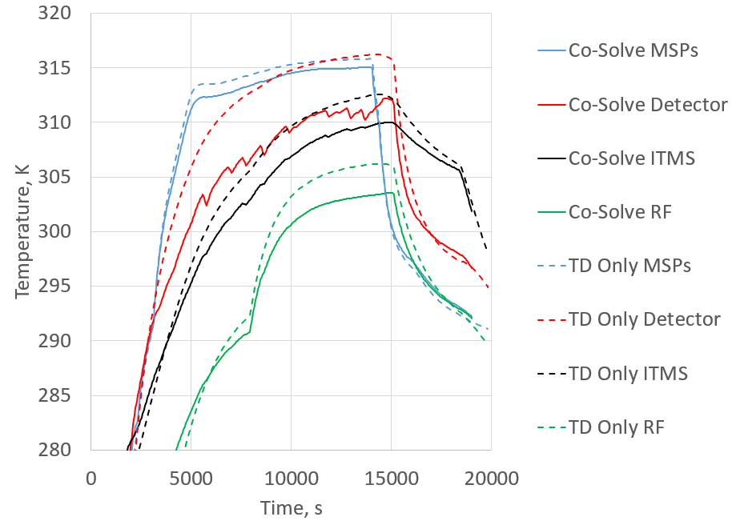
TIE Method Co-Solved DraMS Transient Simulation
Transient simulation using the TIE method. Some instability is detected for low thermal mass component (Detector), but otherwise, the temperature is well behaved.

Slide 22
Conclusion
Complex DraMS instrument has been analyzed successfully using the co-solver TIE method
Co-solver is a fantastic tool to get the best out of both CFD and SCTAS, but there are some limitations currently
TIE method works around the limitations by providing a degree of math model separation and data controllability between the CFD and SCTAS model, at the cost of some numerical accuracy (loss of local heat transfer coefficient information)

Slide 23
Acknowledgements
DraMS
540 MRAD (MSD Internal Research And Development)
Code 540 IT – Troy Dunn and Michelle Longo
ANSYS – Tim Panczak and Purav Patel
Thermal Branch – David Steinfeld, Hume Peabody, and many others

