Slide 1
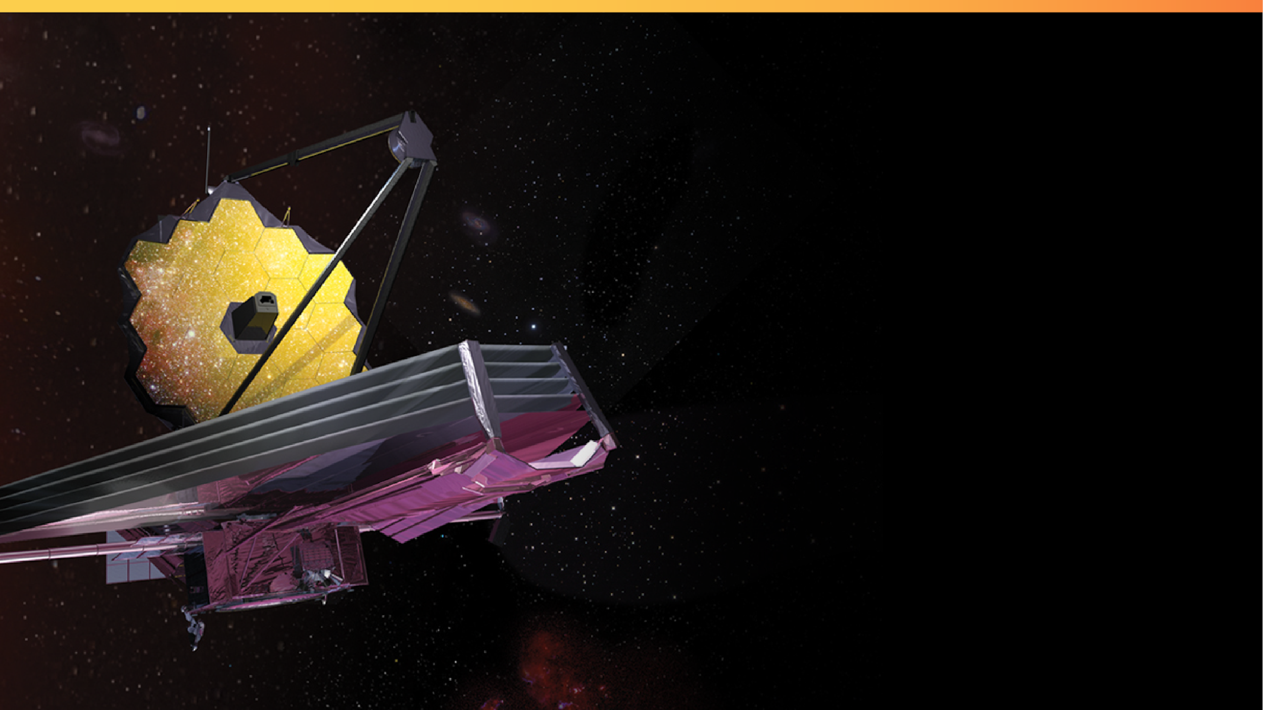

Equitable and Inclusive Public Outreach with the James Webb Space Telescope: Combining Art, Science, and Technology
Ashley Zelinskie
Ashley Zelinskie Studio LLC
Elaine Stewart, Maggie Masetti,
and Kan Yang
NASA Goddard Space Flight Center
Notes:
Please display this slide on screen before your presentation begins and during your introduction.
In this notes pane area, you will find supporting information for each slide and links to additional resources.
You may customize this presentation—removing slides, changing the order, and more. If you would like to add slides, there are templates at the end. We recommend adding slides to this document (not importing slides from this template into your file). Using this as your primary file will preserve the fonts and styling.
You do not have to use all of the slides in this template. Delete any slides that you do not plan to use in your presentation.
If you need to share your presentation, it is best to save your presentation as a PDF file.
The templates are accessible with existing content, but make sure that your final presentation still meets accessibility standards once you add your own content and images. For general PowerPoint Accessibility Guidelines: https://webaim.org/techniques/powerpoint/
__________________________
Image Credit: NASA, ESA, Northrop Grumman
https://webbtelescope.org/contents/media/images/2017/28/4051-Image
Updated: July 19, 2022

Slide 2


Outline
JWST and Scientific Highlights
Communications Methods for International Collaboration
Communications Methods for Accessibility
Exploration of Future Outreach and Communications Avenues
  Communications Methods for Equitable Access
  Communications Methods for Inclusivity
Conclusions
Notes:
[Note to presenter: This slide is optional.]

Slide 3
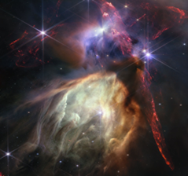
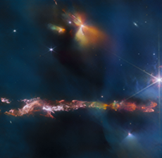
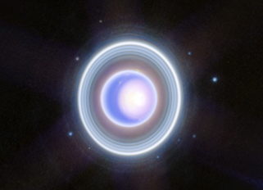
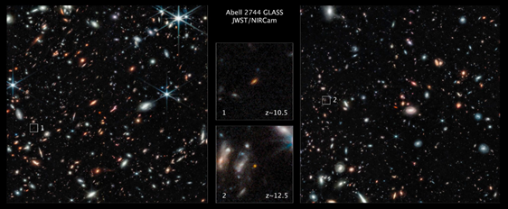
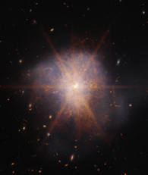
JWST and Scientific Highlights
How do we use art as a medium for science communication to transcend boundaries and improve inclusion and equity?
Notes:
[Note to presenter: This slide is optional.]

Slide 4
Communications Methods for International Collaboration
Webb is an international project with 24 countries, a partnership between NASA, the European Space Agency, and the Canadian Space Agency.
Webb team members need to communicate with each other across culture and language
Outreach and social media teams additionally must consider the languages and cultures of the members of the public who consume their content.
Notes:
[Note to presenter: This slide is optional.]

Slide 5
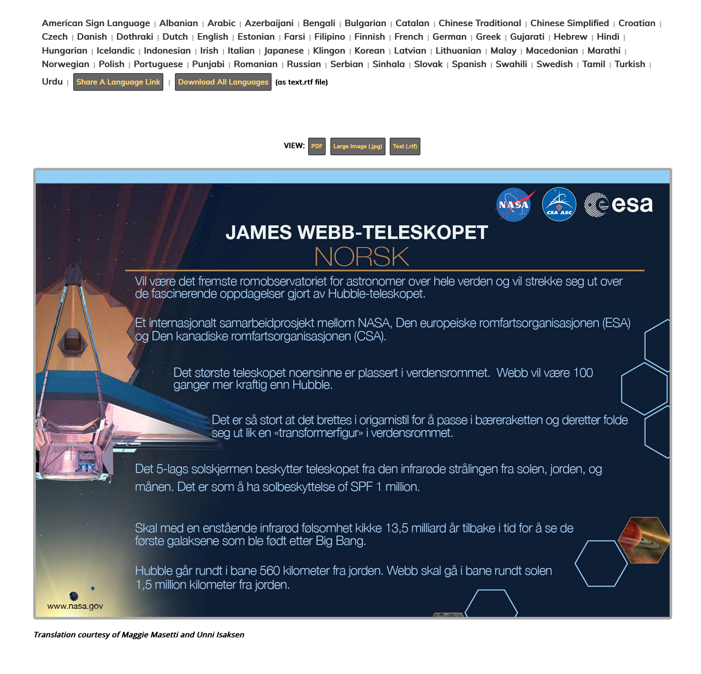
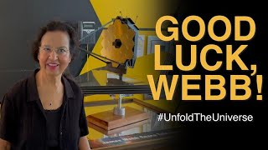
Crowdsourced Translations of Eight Facts About Webb/Good Luck Webb!
Notes:
[Note to presenter: This slide is optional.]

Slide 6
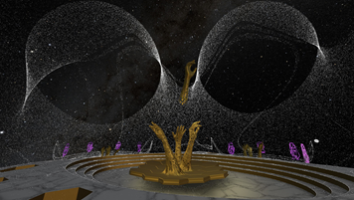
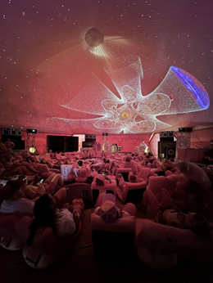
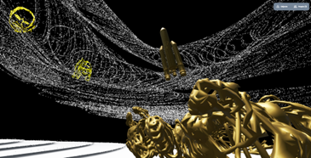
Unfolding the Universe: A NASA Webb VR Experience
Notes:
[Note to presenter: This slide is optional.]

Slide 7
Communications Methods for Accessibility
Notes:
[Note to presenter: This slide is optional.]

Slide 8
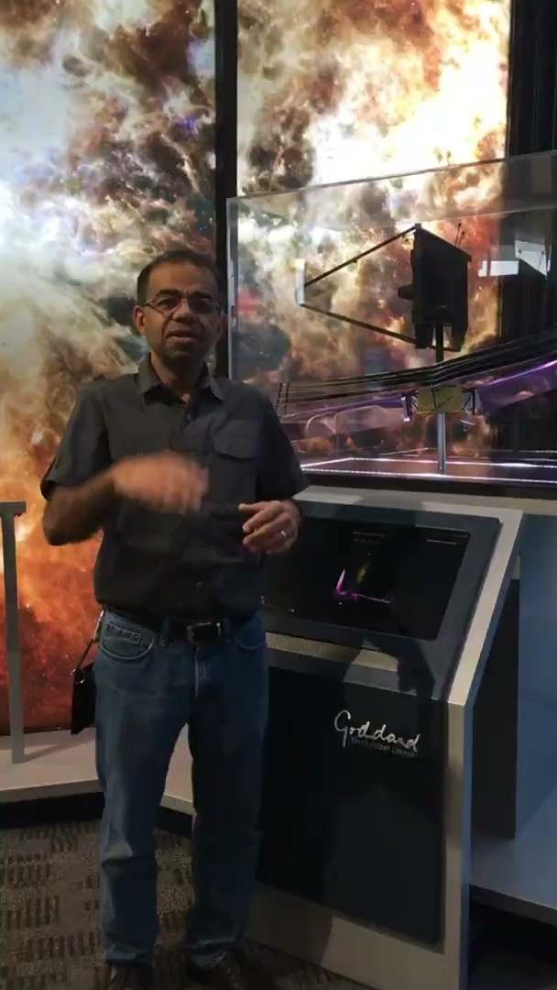
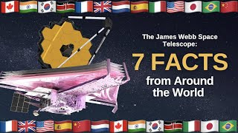
ASL Translated Facts About Webb
The James Webb Space Telescope will be the premier space observatory for astronomers worldwide, extending the tantalizing discoveries of the Hubble Space Telescope
Notes:
[Note to presenter: This slide is optional.]

Slide 9
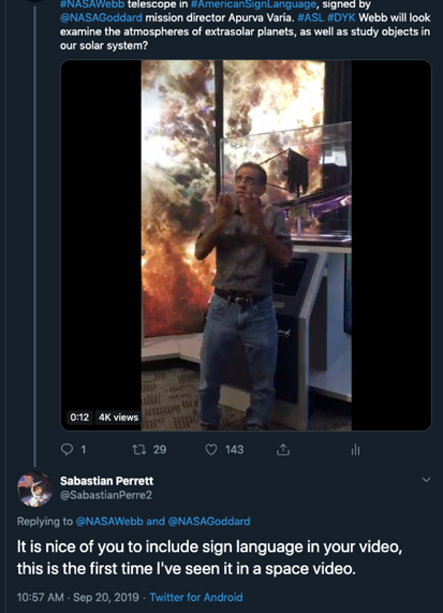
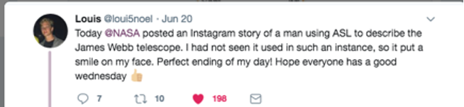
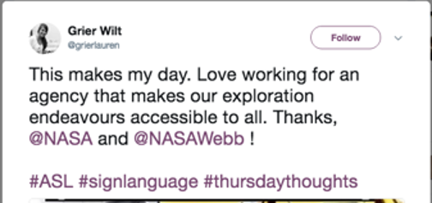
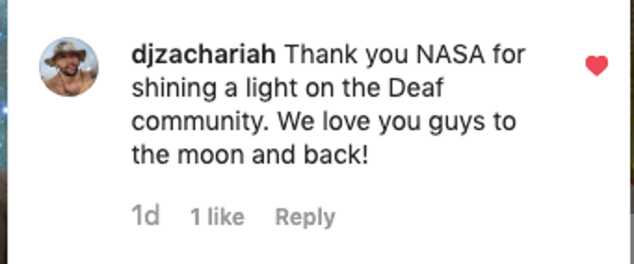
ASL Translated Facts About Webb

Slide 10
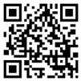
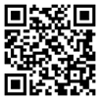
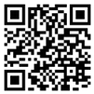
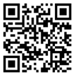
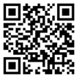
Soundscape for “Unfolding the Universe: A NASA Webb VR Experience”
Able to See
Approaching L2
Sunshield
344 Single Points of Failure
Light Shifts
Notes:
[Note to presenter: This slide is optional.]

Slide 11
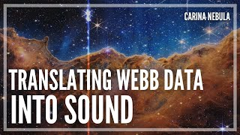
Sonifications
Video credit: ASA, ESA, CSA, STScI, and Kimberly Arcand (CXC/SAO), Matt Russo and Andrew Santaguida (SYSTEM Sounds), Quyen Hart (STScI), Claire Blome (STScI), and Christine Malec (consultant).
Notes:
[Note to presenter: This slide is optional.]

Slide 12
Exploration of Future Outreach and Communications Avenues
How can we continue to interpret Webb’s discoveries into artwork and text that ensure wide accessibility for different audiences?
How can complex topics in engineering and astronomy be best explained to those not from a technical or scientific background, and how can this information be equitably shared across socioeconomic and other barriers?
Notes:
[Note to presenter: This slide is optional.]

Slide 13
Communications Methods for Equitable Access
A few methods to access communities that have historically had low STEM participation include:
Re-centering of historical context for who performs science and engineering
Matching speakers of the same gender similar ethnic or cultural background to the speaking requests received
Implementing a dual-anonymous proposal review process, where the identities of proposal teams are hidden so that reviewers can only focus on the scientific merit of the proposal
Blending art and technology: creating virtual spaces mixing immersive visual and audio experiences with scientific themes, accessible to anyone with an internet connection
Creating engaging art campaigns
Performing outreach to underserved communities
Notes:
[Note to presenter: This slide is optional.]
After launching on December 25, 2021, the Webb telescope underwent months of commissioning including mirror alignment and instrument calibration before the first images were released on July 12, 2022. These five images,²¹ which demonstrate the capabilities of all four instruments on board, were chosen by an international committee of representatives from NASA, ESA, CSA, and the Space Telescope Science Institute (STSci). Processed by Joseph DePasquale and Alyssa Pagan of STScI, the images included the sharpest infrared image of the distant universe to date, a spectrum showing detection of water on exoplanet WASP-96b, the Southern ring nebula around a dying star, Stephen’s Quintet of interacting galaxies, and newly forming stars in the Carina Nebula. Zelinskie used these first images as inspiration for her exhibition.

Slide 14
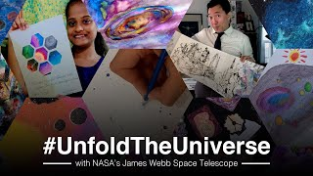
Webb-inspired Art Campaigns: #UnfoldTheUniverse and #JWSTArt web galleries
Campaign invitation: almost 40,000 views with 18,000 during first month
~300 artworks submitted and multiple video compilations
Still engaging thousands of views each month!
Notes:
[Note to presenter: This slide is optional.]

Slide 15

Lady Tech Guild: Meetings in New York and Trip to India
The Lady Tech Guild empowers women by connecting them to technology, and to each other.
The Lady Tech Guild was founded in 2015 by eight women who were equally frustrated with the presence and treatment of female-identifying humans in STEAM fields. Today the LTG hosts monthly meetups for their network of over 500 women where they swap ideas, jobs, tips and tricks of the trades, and generally support one another in their journey to break the glass ceiling.
The LTG strives to help like minded girls, women, and female-identifying/non-binary individuals to become resourceful, inspired creative professionals. The LTG also participates in community outreach to help those who haven’t even been invited to the table to have a voice and travels worldwide to teach, lecture, workshop, raise money, donate electronics and equipment, and introduce opportunities and inspiration to women in communities that would otherwise not think it possible to could participate in STEAM.
Notes:
[Note to presenter: This slide is optional.]

Slide 16
Communications Methods for Inclusivity
Inclusivity in communications recognizes the different needs, abilities, and perspectives of all individuals, and aims to make knowledge accessible to the largest possible audience.
In Universal Design, two principles most apply to JWST’s communications:
Simple and intuitive use: design is easy to understand, regardless of the user's experience, knowledge, language skills, or current concentration level.
Perceptible information: design communicates necessary information effectively to the user, regardless of ambient conditions or the user's sensory abilities.
Notes:
[Note to presenter: This slide is optional.]
After launching on December 25, 2021, the Webb telescope underwent months of commissioning including mirror alignment and instrument calibration before the first images were released on July 12, 2022. These five images,²¹ which demonstrate the capabilities of all four instruments on board, were chosen by an international committee of representatives from NASA, ESA, CSA, and the Space Telescope Science Institute (STSci). Processed by Joseph DePasquale and Alyssa Pagan of STScI, the images included the sharpest infrared image of the distant universe to date, a spectrum showing detection of water on exoplanet WASP-96b, the Southern ring nebula around a dying star, Stephen’s Quintet of interacting galaxies, and newly forming stars in the Carina Nebula. Zelinskie used these first images as inspiration for her exhibition.

Slide 17
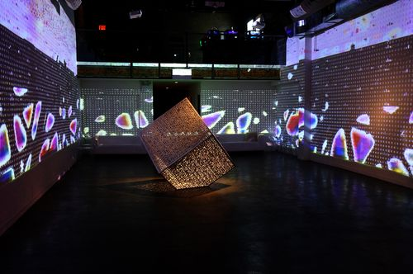
“US Hexahedron” for the US Consulate in Saudi Arabia
Notes:
[Note to presenter: This slide is optional.]

Slide 18
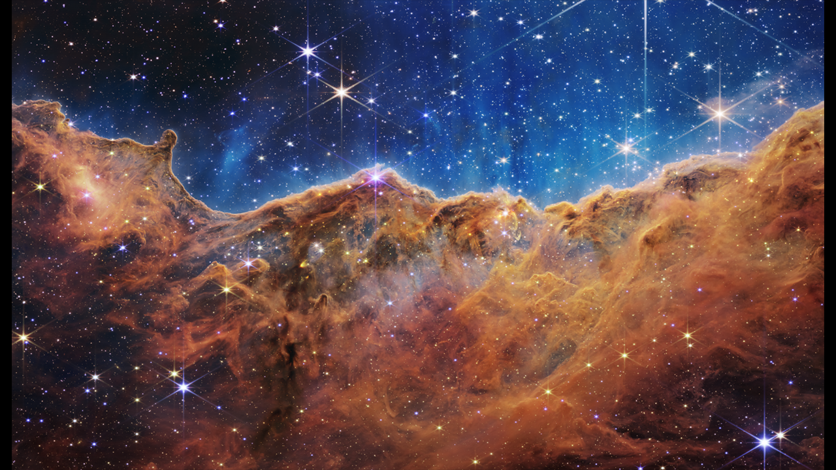
Colorization of Webb’s images
Notes:
[Note to presenter: This slide is optional.]

Slide 19
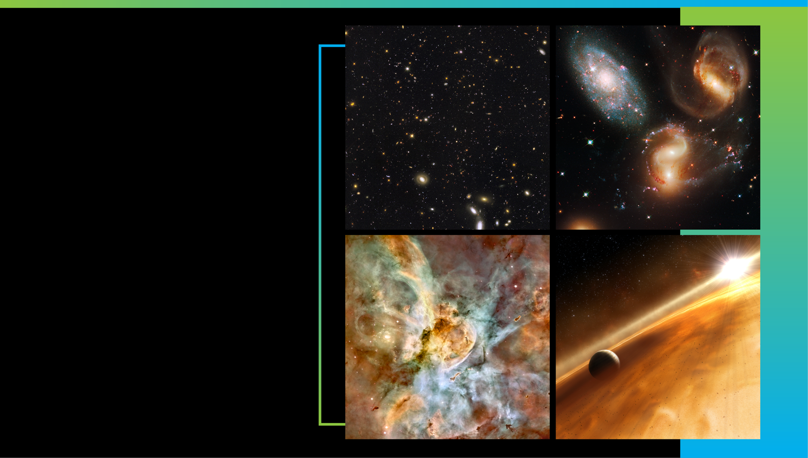
Acknowledgements
this test.
NASA, NASA Webb, European Space Agency, Northrop Grumman, Ball Aerospace, Space Telescope Science Institute, Alyssa Pagan (Space Telescope Institute), Dr. Amber Straughn (NASA Goddard), Dr. Conor Nixon (NASA Goddard), Elaine Stewart (NASA Goddard), Dr. Intae Jung (NASA Goddard), Dr. John C Mather (NASA Goddard), Joseph DePasquale (Space Telescope Institute), Kan Yang (NASA Goddard), Dr. Knicole Colón (NASA Goddard), Krystal Puga (Northrop Grumman), Larkin Carey (Ball Aerospace), Dr. Naomi Rowe-Gurney (NASA Goddard), Paul Geithner (NASA Goddard), Dr. Sarah Kendrew (European Space Agency), Mark McCaughrean (ESA), Pierre Ferruit (ESA), Mike Massimino, Onassis Foundation, ONX Studio, NewInc, New Museum, Mozilla, Mozilla Hubs, Looking Glass Factory, HTC Vive Arts, Metaxu Studios, Gazelli Art House, GAZELL.iO, India Price, Vallejo Gantner
Early Universe
Galaxies over Time
Star Life Cycle
Other Worlds
Notes:
Webb is actively taking new images and spectra! There is so much in the universe it will examine.
Webb will capture light from the first generation of galaxies in the early universe, and help us map how galaxies change over time.
It will help researchers study how stars form, live, and die.
Webb will find and explore the atmospheres of distant worlds.
It will also observe planets in our own solar system, including Mars, Jupiter, Saturn, Uranus, Neptune—along with their moons. Webb will also study small bodies across the Solar System, including asteroids, comets, and Kuiper Belt objects.
Plus, the telescope will observe black holes near and far, including our Milky Way’s supermassive black hole Sagittarius A* (A-star).
Be sure to follow Webb’s discoveries in the news!
__________________________
Ongoing/upcoming news releases: https://webbtelescope.org/news/news-releases
Suggest to viewers that they can sign up to receive our new releases by email by entering their email address at the bottom of this page under “STScI Inbox Astronomy Newsletter”: https://webbtelescope.org/news
Image Credits:
Early Universe: GOODS-S/ERS2 Field
Credit: NASA, ESA, Rogier Windhorst (ASU), S. Cohen (ASU), M. Mechtley (ASU), M. Rutkowski (ASU), Robert O'Connell (UVA), P. McCarthy (OCIW), N. Hathi (UC Riverside), R. Ryan (UC Davis), Haojing Yan (OSU), Anton M. Koekemoer (STScI)
https://webbtelescope.org/contents/media/images/2021/004/01EX2AXKF1EKA0J7K1965PCNBC
Galaxies over Time: Stephan’s Quintet
Credit: NASA, ESA, and the Hubble SM4 ERO Team
https://hubblesite.org/contents/media/images/2009/25/2606-Image.html
Star Lifecycle: Carina Nebula
Credit: Hubble Image: NASA, ESA, N. Smith (University of California, Berkeley), and The Hubble Heritage Team (STScI/AURA); CTIO Image: N. Smith (University of California, Berkeley) and NOAO/AURA/NSF
https://hubblesite.org/contents/media/images/2007/16/2099-Image.html
Other Worlds: Illustration of a planet in a dusty debris disk
Credit: NASA, ESA, and L. Calcada (ESO for STScI)
https://webbtelescope.org/contents/media/images/4193-Image

Slide 20
References
¹NASA., NASA’s James Webb Space Telescope [website], URL: jwst.nasa.gov [cited April 10, 2023].
²NASA., “Webb’s Science Themes,”James Webb Space Telescope [website], URL: https://jwst.nasa.gov/science.html [cited April 10, 2023].
³Winick, Erin., “Painting the Stars,” Lateral Magazine [website], URL:
http://www.lateralmag.com/articles/issue-19/painting-the-stars [cited April 10, 2023].
⁴NASA., “#JWSTArt: Juried Show,” NASA’s James Webb Space Telescope [website], URL:
https://jwst.nasa.gov/content/features/jwstArt/index.html [cited April 10, 2023].
⁵Howerton, Ross., “NASA's New Telescope Is a Muse for Stellar Art,” Tattoodo Magazine [website] (link no longer works), URL: https://www.tattoodo.com/a/2017/01/nasa-s-new-telescope-is-a-muse-for-stellar-art/ [cited March, 2019].
⁶Webster, Andrew., “Painting a NASA Telescope,” Outdoor Painter Magazine [website], URL:
https://www.outdoorpainter.com/painting-a-nasa-telescope/ [cited April 10, 2023].
⁷Saunders, Sarah., “NASA’s Massive James Webb Space Telescope Inspires Out-of-This-World 3D Printed Art,” 3DPrint.com [website], URL: https://3dprint.com/166880/shapeways-3d-printed-artwork/ [cited April 10, 2023].
⁸CBS Baltimore., “Science, Art Unite For Exhibit Inspired By NASA Telescope,” CBS News [website], URL:
https://www.cbsnews.com/baltimore/news/science-art-unite-for-exhibit-inspired-by-nasa-telescope/ [cited March 4, 2017].
⁹Fox 5 DC., “New NASA telescope art exhibit opens,” Fox 5 DC via web.archive [website],
https://web.archive.org/web/20170310013145/https://www.fox5dc.com/news/239232901-video [cited March 4, 2017]
¹⁰NASA., “JWSTArt: Public Submitted Art”, James Webb Space Telescope [website], URL:
https://jwst.nasa.gov/content/features/jwstArt/publicArt.html [cited April 10, 2023].
¹¹Andeson-Ramos, Sam., “‘Far Out’ at Art.Science.Gallery,” The Austin Chronicle [website], URL:
https://www.austinchronicle.com/arts/2017-07-21/far-out/ [cited April 10, 2023].
¹²NASA. “NASA Webb Telescope,” Flickr [website], URL:
https://www.flickr.com/photos/nasawebbtelescope/albums/72157692363250894/ [cited April 10, 2023].
¹³Ault, Dane and Hammond, H., Beyond: The Art of Space Exploration Artbook, Monkey Minion Press, 2018
¹⁴Bizony, Piers. The Art of NASA: The Illustrations that Sold the Missions, Motorbooks, 2020
¹⁵Masetti, Maggie., “Tim Makepeace: Reflections on a Tool of Observation, Artwork Inspired by the James Webb Space Telescope.” The National Academy of of the Sciences Exhibit catalog foreword [website], URL:
http://www.cpnas.org/exhibitions/tim_makepeace_catalog.pdf [cited April 10, 2023].
¹⁶Zelinskie, Ashley and Metaxu Studio., Unfolding the Universe: A James Webb Space Telescope VR Experience [website], URL: https://unfoldtheuniverse.myhubs.net/ [cited April 10, 2023].
¹⁷“NASA.,“NASA’s James Webb Space Telescope #UnfoldTheUniverse Art Challenge”, NASA.gov [website], URL:
https://www.nasa.gov/content/goddard/2021/nasa-james-webb-space-telescope-unfold-the-universe-art-challenge/ [cited April 10, 2023].
¹⁸NASA., “NASA’s James Webb Space Telescope #UnfoldTheUniverse Art Challenge”, YouTube.com [website], URL: https://www.youtube.com/watch?v=S60vF-hmqnA&list=PLcy1hEnsejK2gveoInh4ZZW-dD0JEXO7V [cited April 10, 2023].
¹⁹NASA., “#UnfoldTheUniverse: Public Submitted Art,” jwst.nasa.gov [website], URL:
https://jwst.nasa.gov/content/features/jwstArt/unfoldTheUniverse.html [cited April 10, 2023].
²⁰Gong, Zu., “UnfoldTheUniverse art by Zu Gong,” NASA Webb Telescope’s Flickr [website], URL:
https://www.flickr.com/photos/nasawebbtelescope/52249684045 [cited April 10, 2023].
²¹Space Telescope Science Institute., “Webb’s First Images gallery,” WebbTelescope.org [website], URL:
https://webbtelescope.org/news/first-images/gallery [cited April 10, 2023].
²²Space Telescope Science Institute., “Webb’s Diffraction Spikes infographic,” WebbTelescope.org [website], URL:
https://webbtelescope.org/contents/media/images/01G529MX46J7AFK61GAMSHKSSN [cited April 10, 2023].
²³Shaw, Matt., From the Depths of Space to the Walls of a Gallery,” The New York Times [website], URL:
https://www.nytimes.com/2022/10/13/arts/design/nasa-art-onx-ashley-zelinskie.html
²⁴B. Terry., “Yelp review of ONX Gallery,” Yelp [website], URL: https://www.yelp.com/biz/onx-studio-new-york
Notes:
[Note to presenter: This slide is optional.]
After launching on December 25, 2021, the Webb telescope underwent months of commissioning including mirror alignment and instrument calibration before the first images were released on July 12, 2022. These five images,²¹ which demonstrate the capabilities of all four instruments on board, were chosen by an international committee of representatives from NASA, ESA, CSA, and the Space Telescope Science Institute (STSci). Processed by Joseph DePasquale and Alyssa Pagan of STScI, the images included the sharpest infrared image of the distant universe to date, a spectrum showing detection of water on exoplanet WASP-96b, the Southern ring nebula around a dying star, Stephen’s Quintet of interacting galaxies, and newly forming stars in the Carina Nebula. Zelinskie used these first images as inspiration for her exhibition.

Slide 21
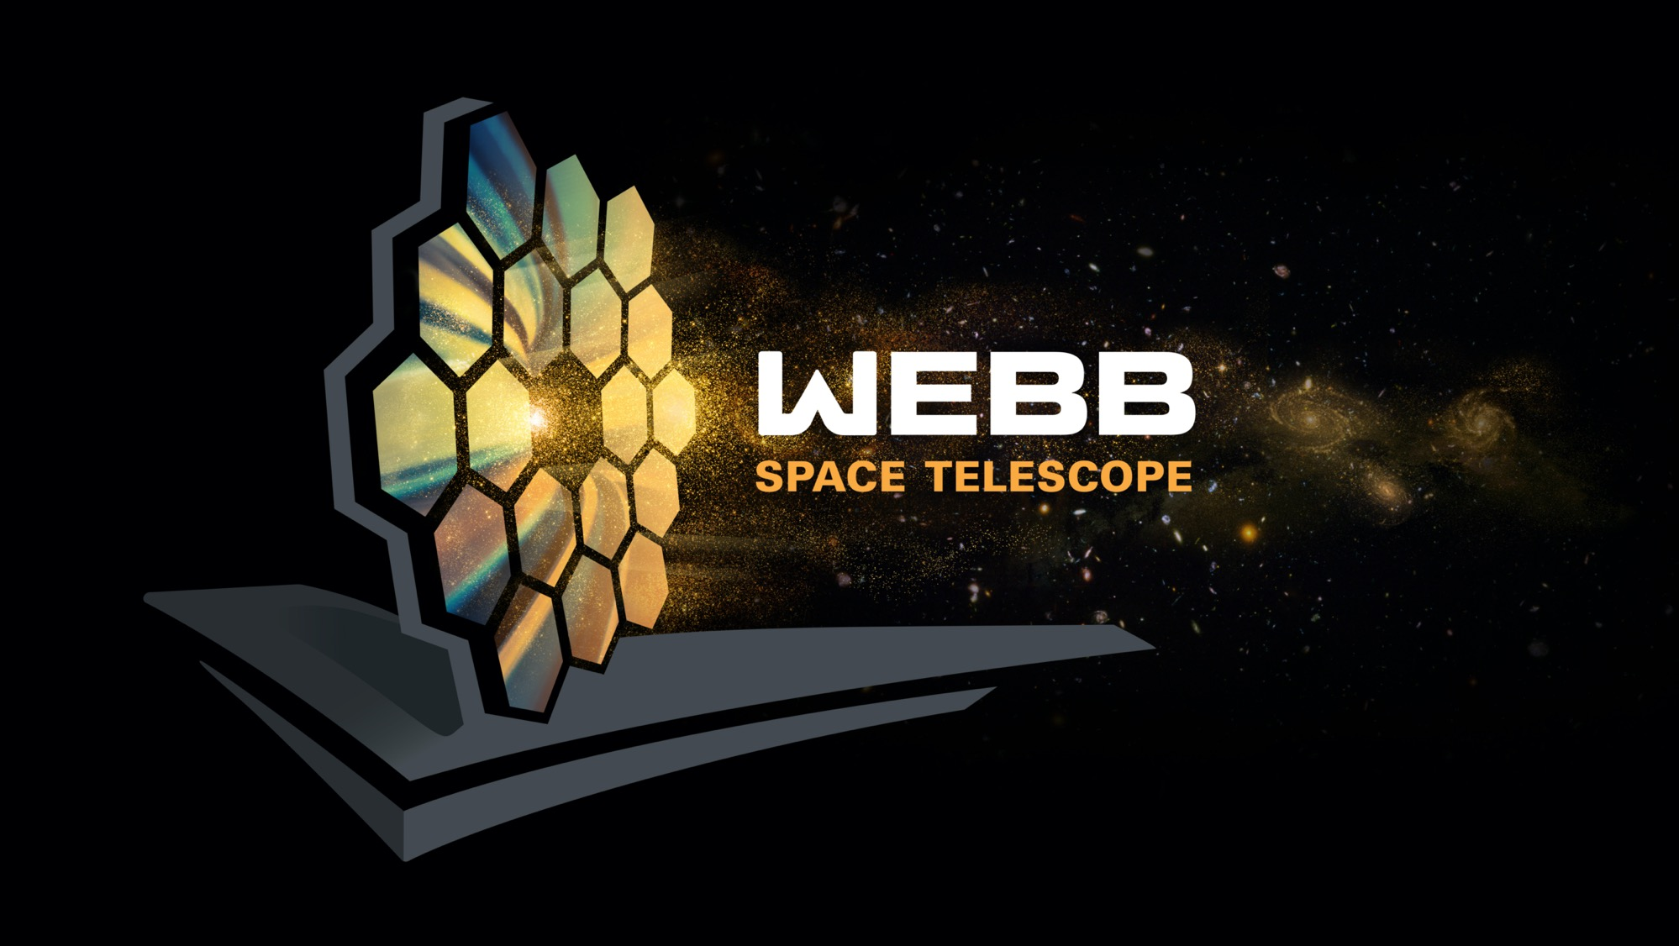
Questions?
Notes:
Complete FAQs:
Why do we have to wait so long between Webb’s launch and its first images?
In the six months after launch, Webb underwent a complex commissioning process. This included:
Deployments: This began when the telescope launched, on December 25, 2021, and continued for about 30 days. In a series of steps, Webb unfolded from its compact launch configuration. This included deploying, tensioning, and separating Webb’s sunshield, extending its secondary mirror support structure, and unfolding the wings of the primary mirror.
Telescope mirror alignments: This began just a month after launch and continued for about three months. Teams aligned Webb’s 18 hexagonal mirror segments so that they work together as one and are in focus for all of Webb’s four science instruments.
Science instrument calibrations: This began about four months after launch and continued for approximately two months. Webb’s instruments underwent a series of calibrations and tests. Engineers and scientists tested each mode to verify they are working as expected, understand their performance, and learn how to optimally extract science information.
During the deployment and alignment phases of commissioning, Webb cooled to its operating temperature. This slow, controlled cooling was necessary to prevent water that was outgassing from Webb to form ice on Webb’s optics and detectors and cold radiator surfaces, which would degrade the telescope’s performance.
How much data will Webb transmit each day?
Webb can downlink at least 57.2 gigabytes of recorded science data each day, with a maximum data rate of 28 megabits per second.
How long does data take to travel from Webb to Earth?
Traveling at the speed of light, it takes about 5 seconds for data to travel from Webb in its orbit around L2 to the Earth. All communications are routed through NASA’s Deep Space Network, with three ground stations located in Canberra, Australia, Madrid, Spain, and Goldstone, California.
Which frequencies do we use to communicate with the telescope?
S-band frequencies are used for command uplink, low-rate telemetry downlink, and ranging. Ka-band frequencies are used for high rate downlink of science data and telemetry.
What is a Lagrange point?
Lagrange points, discovered by mathematician Joseph Louis Lagrange, are special equilibrium points for small objects (like a spacecraft or an asteroid) orbiting two much larger objects (like the Earth and the Sun). At these points in space, the gravity of the two large objects balance the orbital motion of the third object. Lagrange points can be used by spacecraft to reduce propellant consumption needed to remain in position.
There are five Lagrange points for any system, labeled L1 to L5. Of the five points, three are unstable and two are stable. The unstable Lagrange points—L1, L2, and L3—lie along the line connecting the two large masses. Spacecraft orbiting at these points need to perform station keeping to remain in their orbits, by periodically expending small amounts of propellant. The stable Lagrange points—L4 and L5—occur at the apex of two equilateral triangles that have the large masses at their vertices. L4 leads the orbit of Earth and L5 follows.
See the diagram here: https://solarsystem.nasa.gov/resources/754/what-is-a-lagrange-point/
Webb orbits around the second Sun-Earth Lagrange point (L2). This point is approximately 1.5 million kilometers (930,000 miles) from Earth, “behind” the Earth as viewed from the Sun. All Lagrange points move in lockstep with the Earth as it rotates around the Sun, completing an orbit in one year.
Are there other spacecraft that orbit at L2?
Yes. There are several spacecraft that orbit or have orbited at L2. They include the Herschel Space Observatory, the Gaia space observatory, the Planck space observatory, and the Wilkinson Microwave Anisotropy Probe (WMAP).
Does Webb orbit exactly at L2?
No. Webb will orbit around L2, not sit stationary precisely at L2. If Webb were located exactly at L2, it would see the Sun eclipsed by the Earth, blocking the power it receives on its solar arrays. Webb loops around L2 in a six-month, tilted, elliptical orbit, which is slightly larger than the size of the Moon’s orbit around the Earth. This ensures that spacecraft never falls into the shadow of the Earth or the Moon—and remains charged. Here is a diagram of the obit to scale: https://www.flickr.com/photos/nasawebbtelescope/51886649707
What is Webb’s anticipated lifetime?
Webb will contain enough propellant for about 20 years of maneuvers at L2, and the Webb Science and Mission Operations Center at the Space Telescope Science Institute (STScI) will have the ability to adjust the science operations of the observatory to maximize potential as it ages. NASA engineered Webb so that all critical subsystems are dual or will degrade gracefully with age. For instance, the Near Infrared Camera (NIRCam) has two identical camera systems so that the optical quality can be maintained even if one fails.
How much of the sky can Webb see?
Over the course of six months, as Webb orbits the Sun with Earth, it has the ability to observe almost any point in the sky. Webb’s field of regard is limited to a 50-degree swath of the celestial sphere: About 39% of the sky is potentially visible to Webb at any given time. Because Webb must face away from objects that are warm and close enough to interfere with its ability to observe faint infrared light, it cannot observe the Sun, Mercury, Venus, Earth, the Moon, or other objects as they pass through the inner Solar System.
Can we can service Webb?
The quick answer is no. To meet Webb’s science goals, the telescope has to be far away from the heat of the Earth. This is why the telescope had to be so thoroughly tested before launch. This isn’t the first mission that is unserviceable. Other space telescopes, such as Spitzer and Herschel, successfully completed their missions in unserviceable orbits.
What are galaxies?
A galaxy is collection of stars, gas, dust, and dark matter bound together by gravity. The smallest galaxies may contain only a few hundred thousand stars, while the largest galaxies have thousands of billions of stars. Our Milky Way galaxy 100,000 light-years across and contains about 100 billion stars, including the Sun and our solar system.
Galaxies are classified or grouped by their shape. Round or oval galaxies are elliptical galaxies and those showing a pinwheel structure are spiral galaxies. All others are called irregular because they do not resemble elliptical or spiral galaxies.
__________________________
Resources:
News releases: https://webbtelescope.org/news/news-releases
How to receive our releases via email (enter your email address at the bottom of this page under “STScI Inbox Astronomy Newsletter”): https://webbtelescope.org/news
Overview of the telescope: https://webbtelescope.org/webb-science/the-observatory
Image Credit: NASA

Slide 22
Backup
Notes:
[Note to presenter: This slide is optional.]

Slide 23
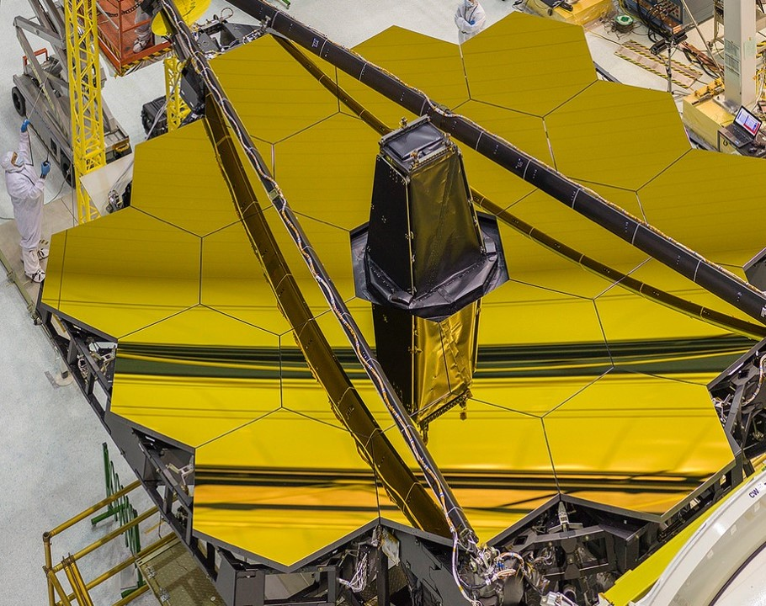
Webb Outreach through Art
NASA’s James Webb Space telescope falls neatly into the nexus of art and science O
Notes:
[Note to presenter: This slide is optional.]
NASA's James Webb Space Telescope falls neatly into the nexus of art and science. Webb is the largest, most complex space telescope built to date, with 18 mirror segments, optimized for reflecting infrared light with a gold coating. The mirrors help the telescope peer back in time to see the universe a few hundred million years after the big bang - but are also visually stunning. Since Webb’s reveal of its first images/data on July 12, 2022, it continues to give us unprecedented and inspirational views of the universe. To create interest in science and technology we must convey the wonder of exploration, which makes Webb+art the perfect combination. Who better to convey that sense of wonder to the public than artists? Art can build bridges between science and those who are tentative, drawing them in, and showing them that science is accessible; one way it does this is by representing complex concepts in abstract ways that can feel more approachable than traditional science outreach. The “Unfolding the Universe: Webb Outreach Through Art” goals were two-fold - to reach out to artists, inspiring and engaging them, and then to have the artists share what excited them with the public and their followers. Though NASA is not new to the use of art, Masetti originated the use of artists and social media to promote the Webb mission. She created a 2016 artist event in front of the actual telescope, while it was at NASA Goddard, that spawned multiple Webb-inspired in-person art exhibits, two social media campaigns that have generated nearly 1000 pieces of art world-wide - and inspired similar art outreach efforts from other missions like Psyche and Artemis. Zelinskie, one of the artists from the 2016 artist event, has gone on to create virtual and physical art based on Webb, most recently in the “Unfolding the Universe” exhibit in NYC at ONX Studio in 2022. The art Zelinskie created both interprets technical concepts (while retaining scientific accuracy) and incorporates elements of the science into the art itself. “Unfolding the Universe: Webb Outreach Through Art,” seeks to break stereotypes of scientists and engineers (of whom Stewart is one) - but also of artists and art. To solve the mysteries of the universe, international collaborations utilizing the universal language of math are essential. Art transcends language; science-based art is very culturally inclusive, and has room for all ages, genders, and races, and allows us to introduce Webb to new, diverse audiences.

Slide 24
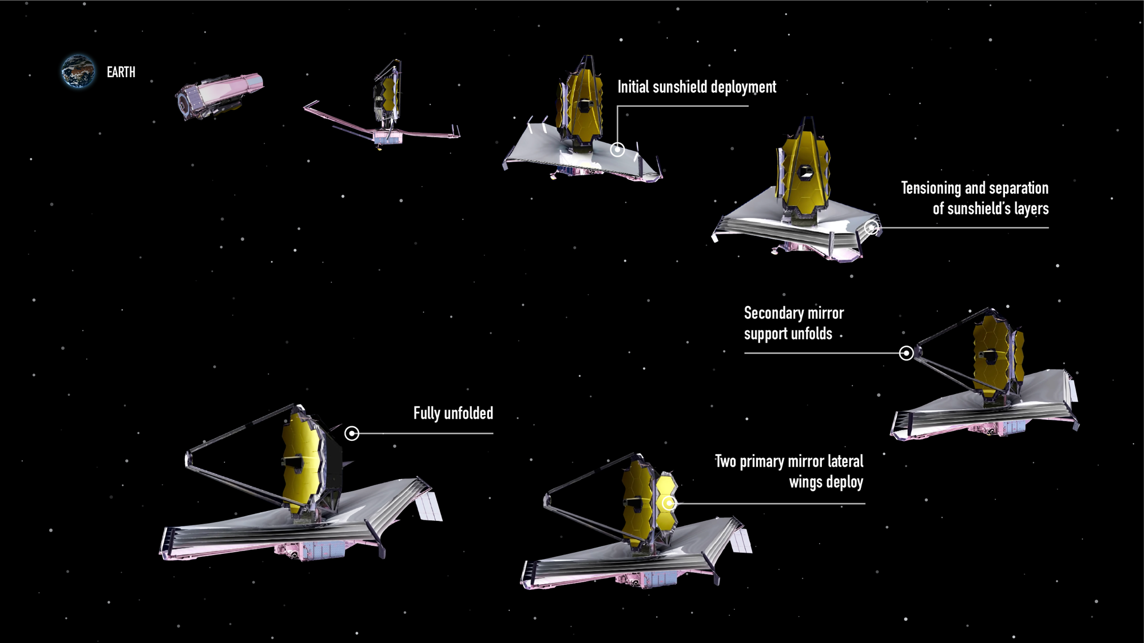


Webb’s Unfolding Sequence-Origami Telescope
Notes:
Engineers in Webb’s Mission Operations Center initiated and oversaw a carefully orchestrated series of major deployments.
After launch, Webb slowly unfolded while traveling to a location approximately 1.5 million kilometers (1 million miles) from Earth known as the second Sun-Earth Lagrange point (L2), a journey that took about a month.
Steps included:
Deploying, tensioning, and separating Webb’s sunshield, a five-layer, diamond-shaped structure the size of a tennis court,
Extending its secondary mirror support structure, and
Unfolding its primary mirror, which has a honeycomb-like pattern of 18 hexagonal, gold-coated mirror segments.
Throughout the next five months, engineers and scientists carefully activated and confirmed each and every instrument worked properly.
What made these innovations possible?
__________________________
FAQ:
Why do we have to wait so long between Webb’s launch and its first images?
In the six months after launch, Webb underwent a complex commissioning process. This included:
Deployments: This began when the telescope launched, on December 25, 2021, and continued for about 30 days. In a series of steps, Webb unfolded from its compact launch configuration. This included deploying, tensioning, and separating Webb’s sunshield, extending its secondary mirror support structure, and unfolding the wings of the primary mirror.
Telescope mirror alignments: This began just a month after launch and continued for about three months. Teams aligned Webb’s 18 hexagonal mirror segments so that they work together as one and are in focus for all of Webb’s four science instruments.
Science instrument calibrations: This began about four months after launch and continued for approximately two months. Webb’s instruments underwent a series of calibrations and tests. Engineers and scientists tested each mode to verify they are working as expected, understand their performance, and learn how to optimally extract science information.
During the deployment and alignment phases of commissioning, Webb cooled to its operating temperature. This slow, controlled cooling was necessary to prevent water that was outgassing from Webb to form ice on Webb’s optics and detectors and cold radiator surfaces, which would degrade the telescope’s performance.
More information: https://www.planetary.org/articles/jwst-first-images
Resources:
Webb’s unfolding sequence: https://webbtelescope.org/contents/media/images/01FJHQXZNXV0GWWJMCX69J57FD
Detailed post-launch deployment timeline: https://webbtelescope.org/contents/media/images/4180-Image
Article about aligning Webb’s mirrors: https://www.nasa.gov/feature/goddard/2017/aligning-the-primary-mirror-segments-of-nasa-s-james-webb-space-telescope-with-light
Webb’s orbit and view of the sky: https://webbtelescope.org/news/webb-science-writers-guide/telescope-overview
Video of Webb’s deployment sequence: https://www.youtube.com/watch?v=RzGLKQ7_KZQ
Illustration Credit: NASA, ESA, and J. Kang (STScI)
https://webbtelescope.org/contents/media/images/01FJHQXZNXV0GWWJMCX69J57FD

Slide 25
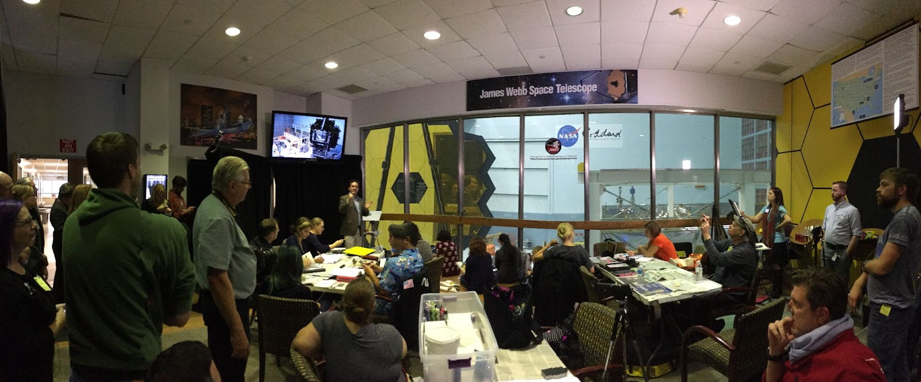

Webb + Art 2016/2017 - and Beyond
18 artists, representing a broad range of artistic media and styles, chosen to view the Webb telescope at Goddard Space Flight Center.
JWST Art + Science exhibit ran from March 3, 2017 until an extended close date of July 5, 2017. Over fiscal year 2017, the Goddard Visitor Center had 45,602 visitors, an average of 3800 visitors a month. Over the
Notes:
[Note to presenter: This slide is optional.]

Slide 26
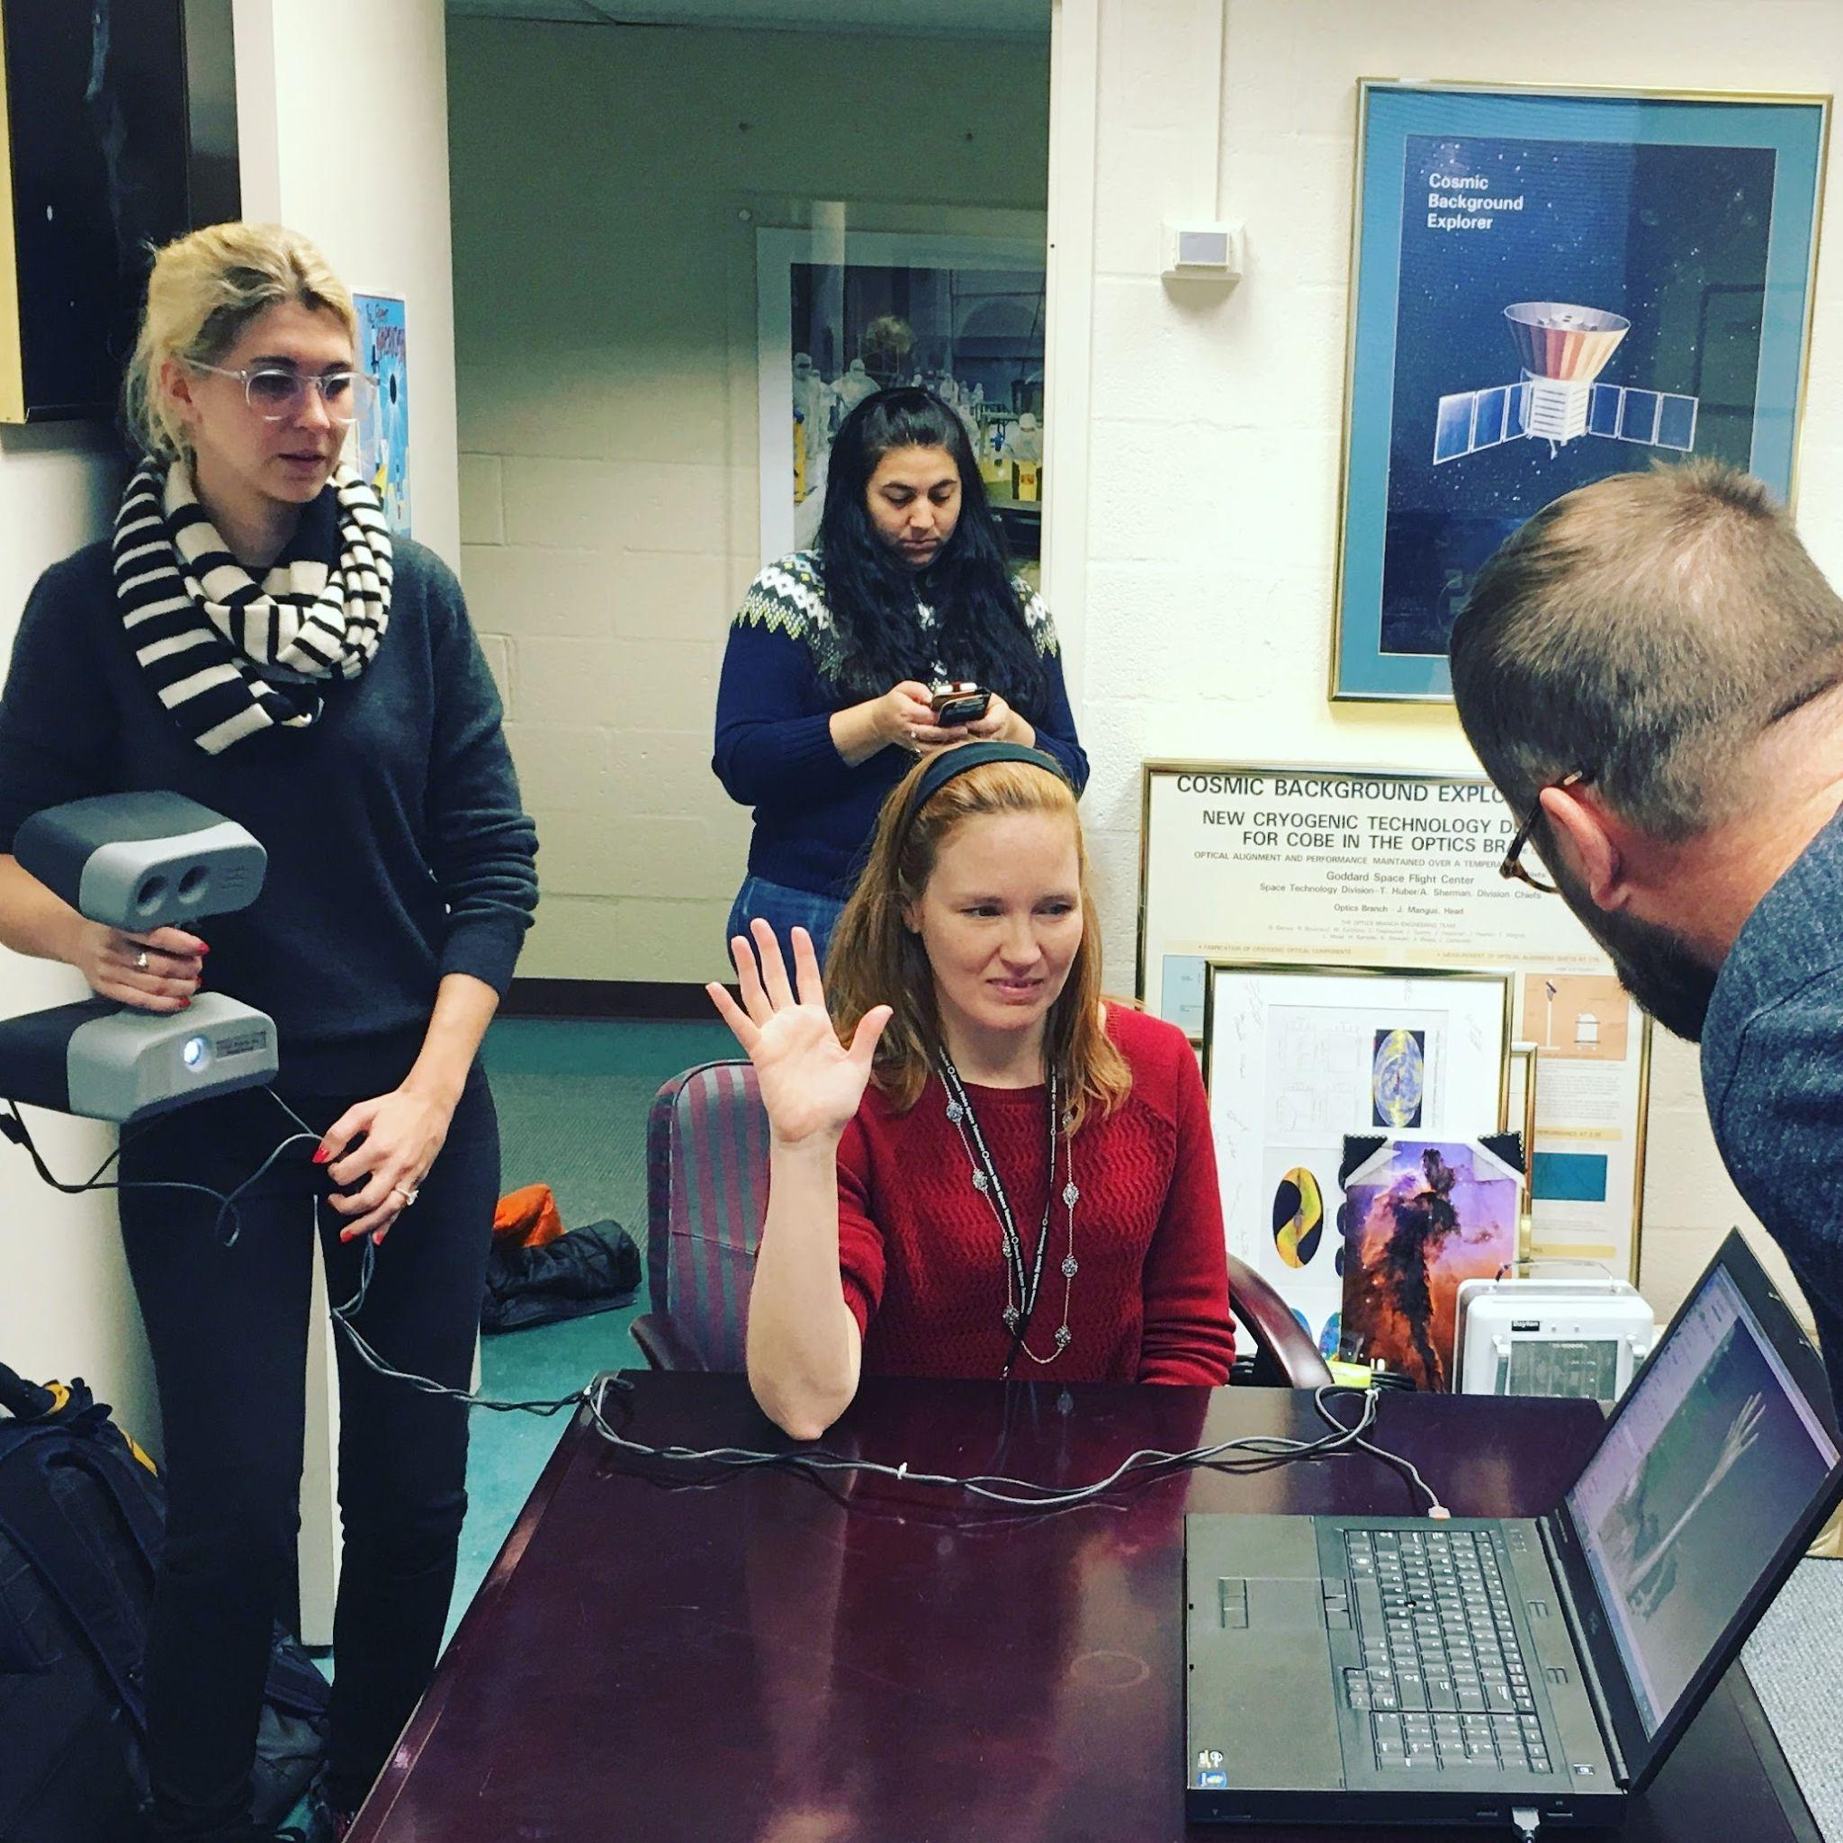
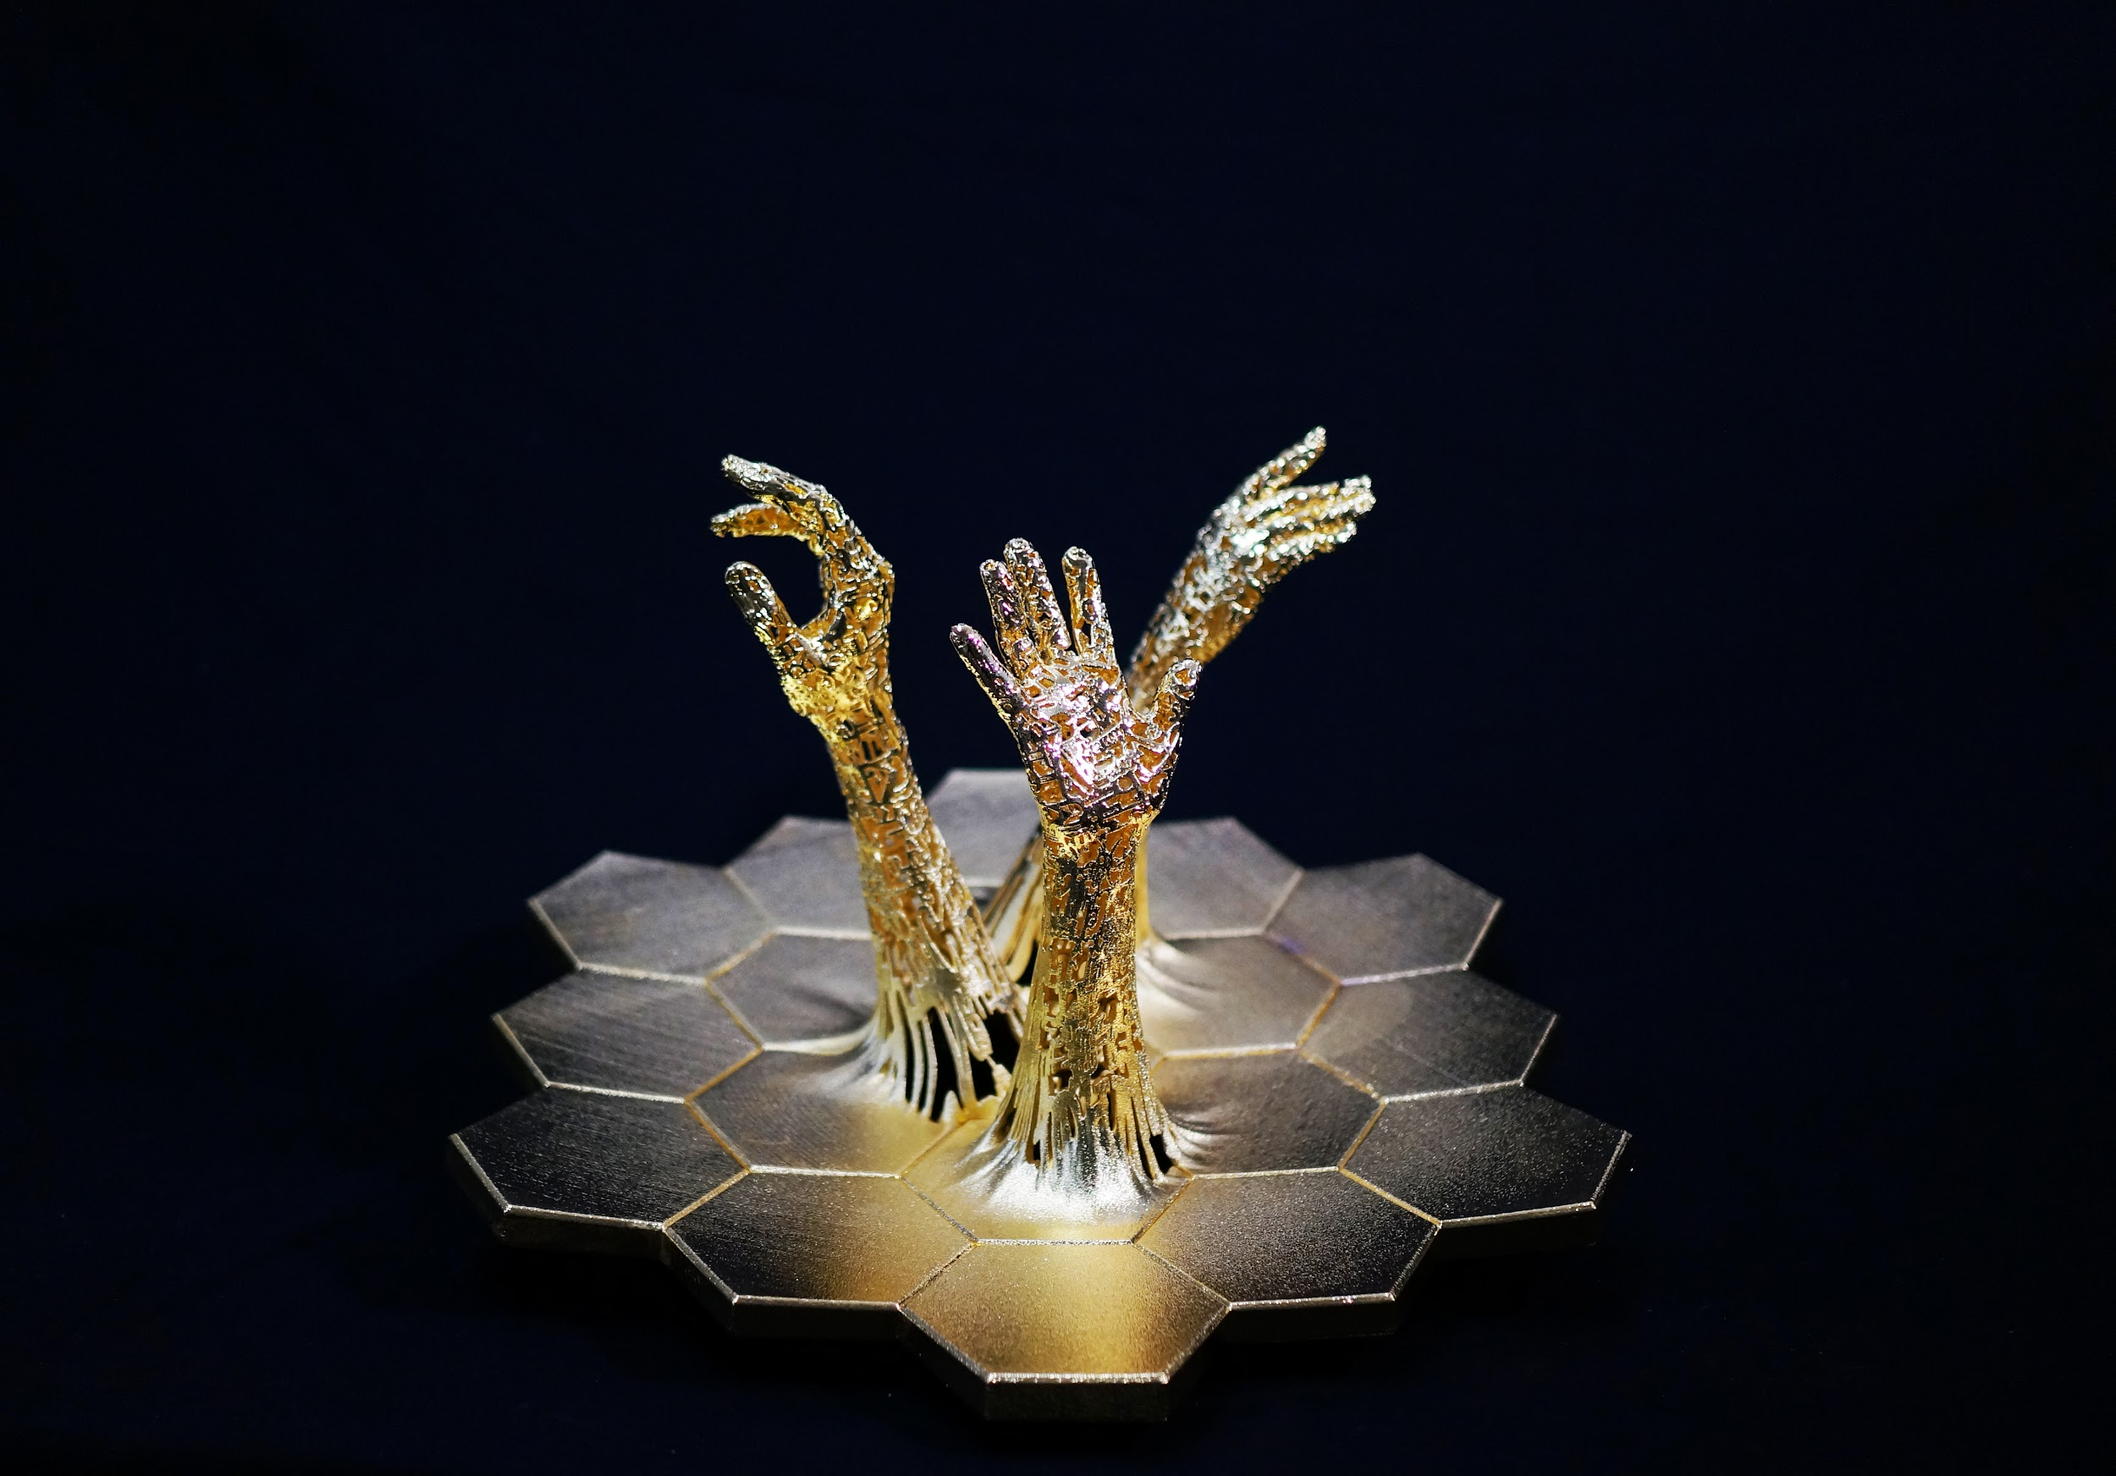
Exploration
Exploration by Ashley Zelinskie (Image by Ashley Zelinskie)
Scanning the arm of Dr. Amber Straughn for “Exploration” using an Artec Eva structured-light 3D scanner. (Image by Ashley Zelinskie)
Notes:
[Note to presenter: This slide is optional.]
After launching on December 25, 2021, the Webb telescope underwent months of commissioning including mirror alignment and instrument calibration before the first images were released on July 12, 2022. These five images,²¹ which demonstrate the capabilities of all four instruments on board, were chosen by an international committee of representatives from NASA, ESA, CSA, and the Space Telescope Science Institute (STSci). Processed by Joseph DePasquale and Alyssa Pagan of STScI, the images included the sharpest infrared image of the distant universe to date, a spectrum showing detection of water on exoplanet WASP-96b, the Southern ring nebula around a dying star, Stephen’s Quintet of interacting galaxies, and newly forming stars in the Carina Nebula. Zelinskie used these first images as inspiration for her exhibition.

Slide 27
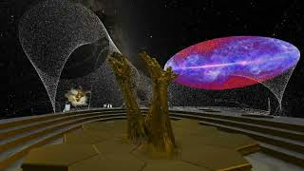
Unfolding the Virtual Universe-Outreach during the COVID Pandemic 2021
Zelinskie worked with the award-winning team at Metaxu Studio to create her first virtual reality artwork, which includes interactive interviews with members of the Webb team, and a 3D animated sculpture, essentially a virtual version of the piece created for the 2017 event at NASA Goddard
Notes:
[Note to presenter: This slide is optional.]

Slide 28
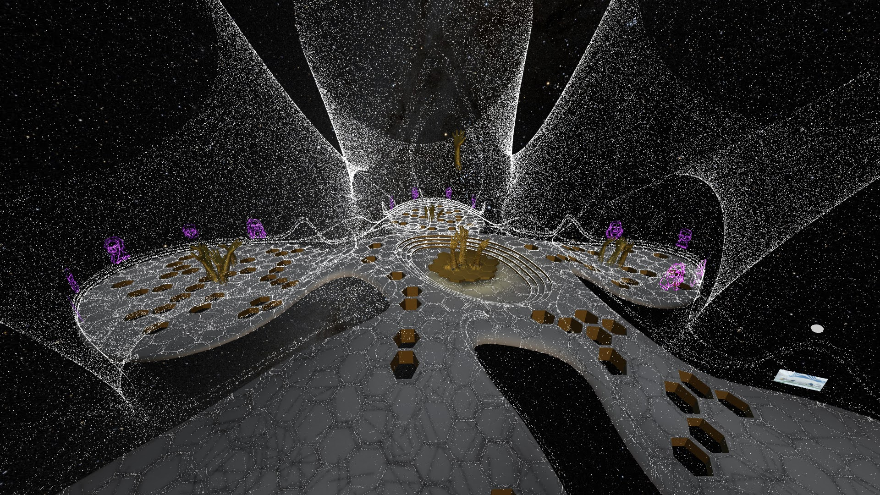
Unfolding the Virtual Universe-Added benefit over alternative outreach
The VR format allowed for improved connection and participation versus alternative COVID-19 pandemic outreach,
typically involving only speaker video and questions limited to chat only. Video chat also does not allow for user movement or exploration in the way that VR does.
Awarded Interior Design MAD Award 2023-Immersive Digital Art!
MONA Creator Award 2022 Renaissance Buildathon - The Largest Metaverse Event in History
MONA Interactivity Award 2022 Renaissance Buildathon - The Largest Metaverse Event in History
VR format allowed for improved connection and participation versus alternative COVID-19 pandemic outreach.
Exploration of VR space
Interaction through voice, chat, and inclusive for participants that do not want video on
Notes:
[Note to presenter: This slide is optional.]

Slide 29
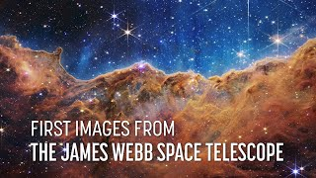
Webb Telescope First Images of the Unseen Universe 2022-Deep Field SMACS 0723
Notes:
[Note to presenter: This slide is optional.]
After launching on December 25, 2021, the Webb telescope underwent months of commissioning including mirror alignment and instrument calibration before the first images were released on July 12, 2022. These five images,²¹ which demonstrate the capabilities of all four instruments on board, were chosen by an international committee of representatives from NASA, ESA, CSA, and the Space Telescope Science Institute (STSci). Processed by Joseph DePasquale and Alyssa Pagan of STScI, the images included the sharpest infrared image of the distant universe to date, a spectrum showing detection of water on exoplanet WASP-96b, the Southern ring nebula around a dying star, Stephen’s Quintet of interacting galaxies, and newly forming stars in the Carina Nebula. Zelinskie used these first images as inspiration for her exhibition.

Slide 30
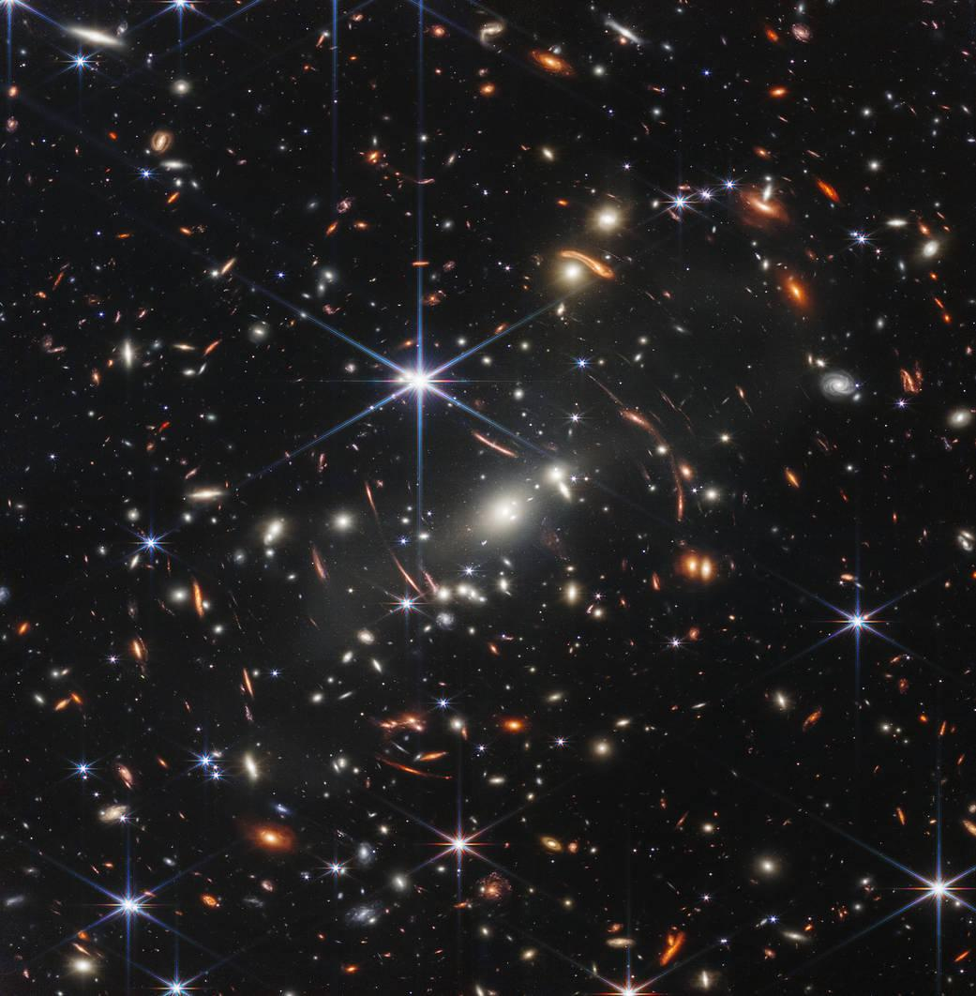
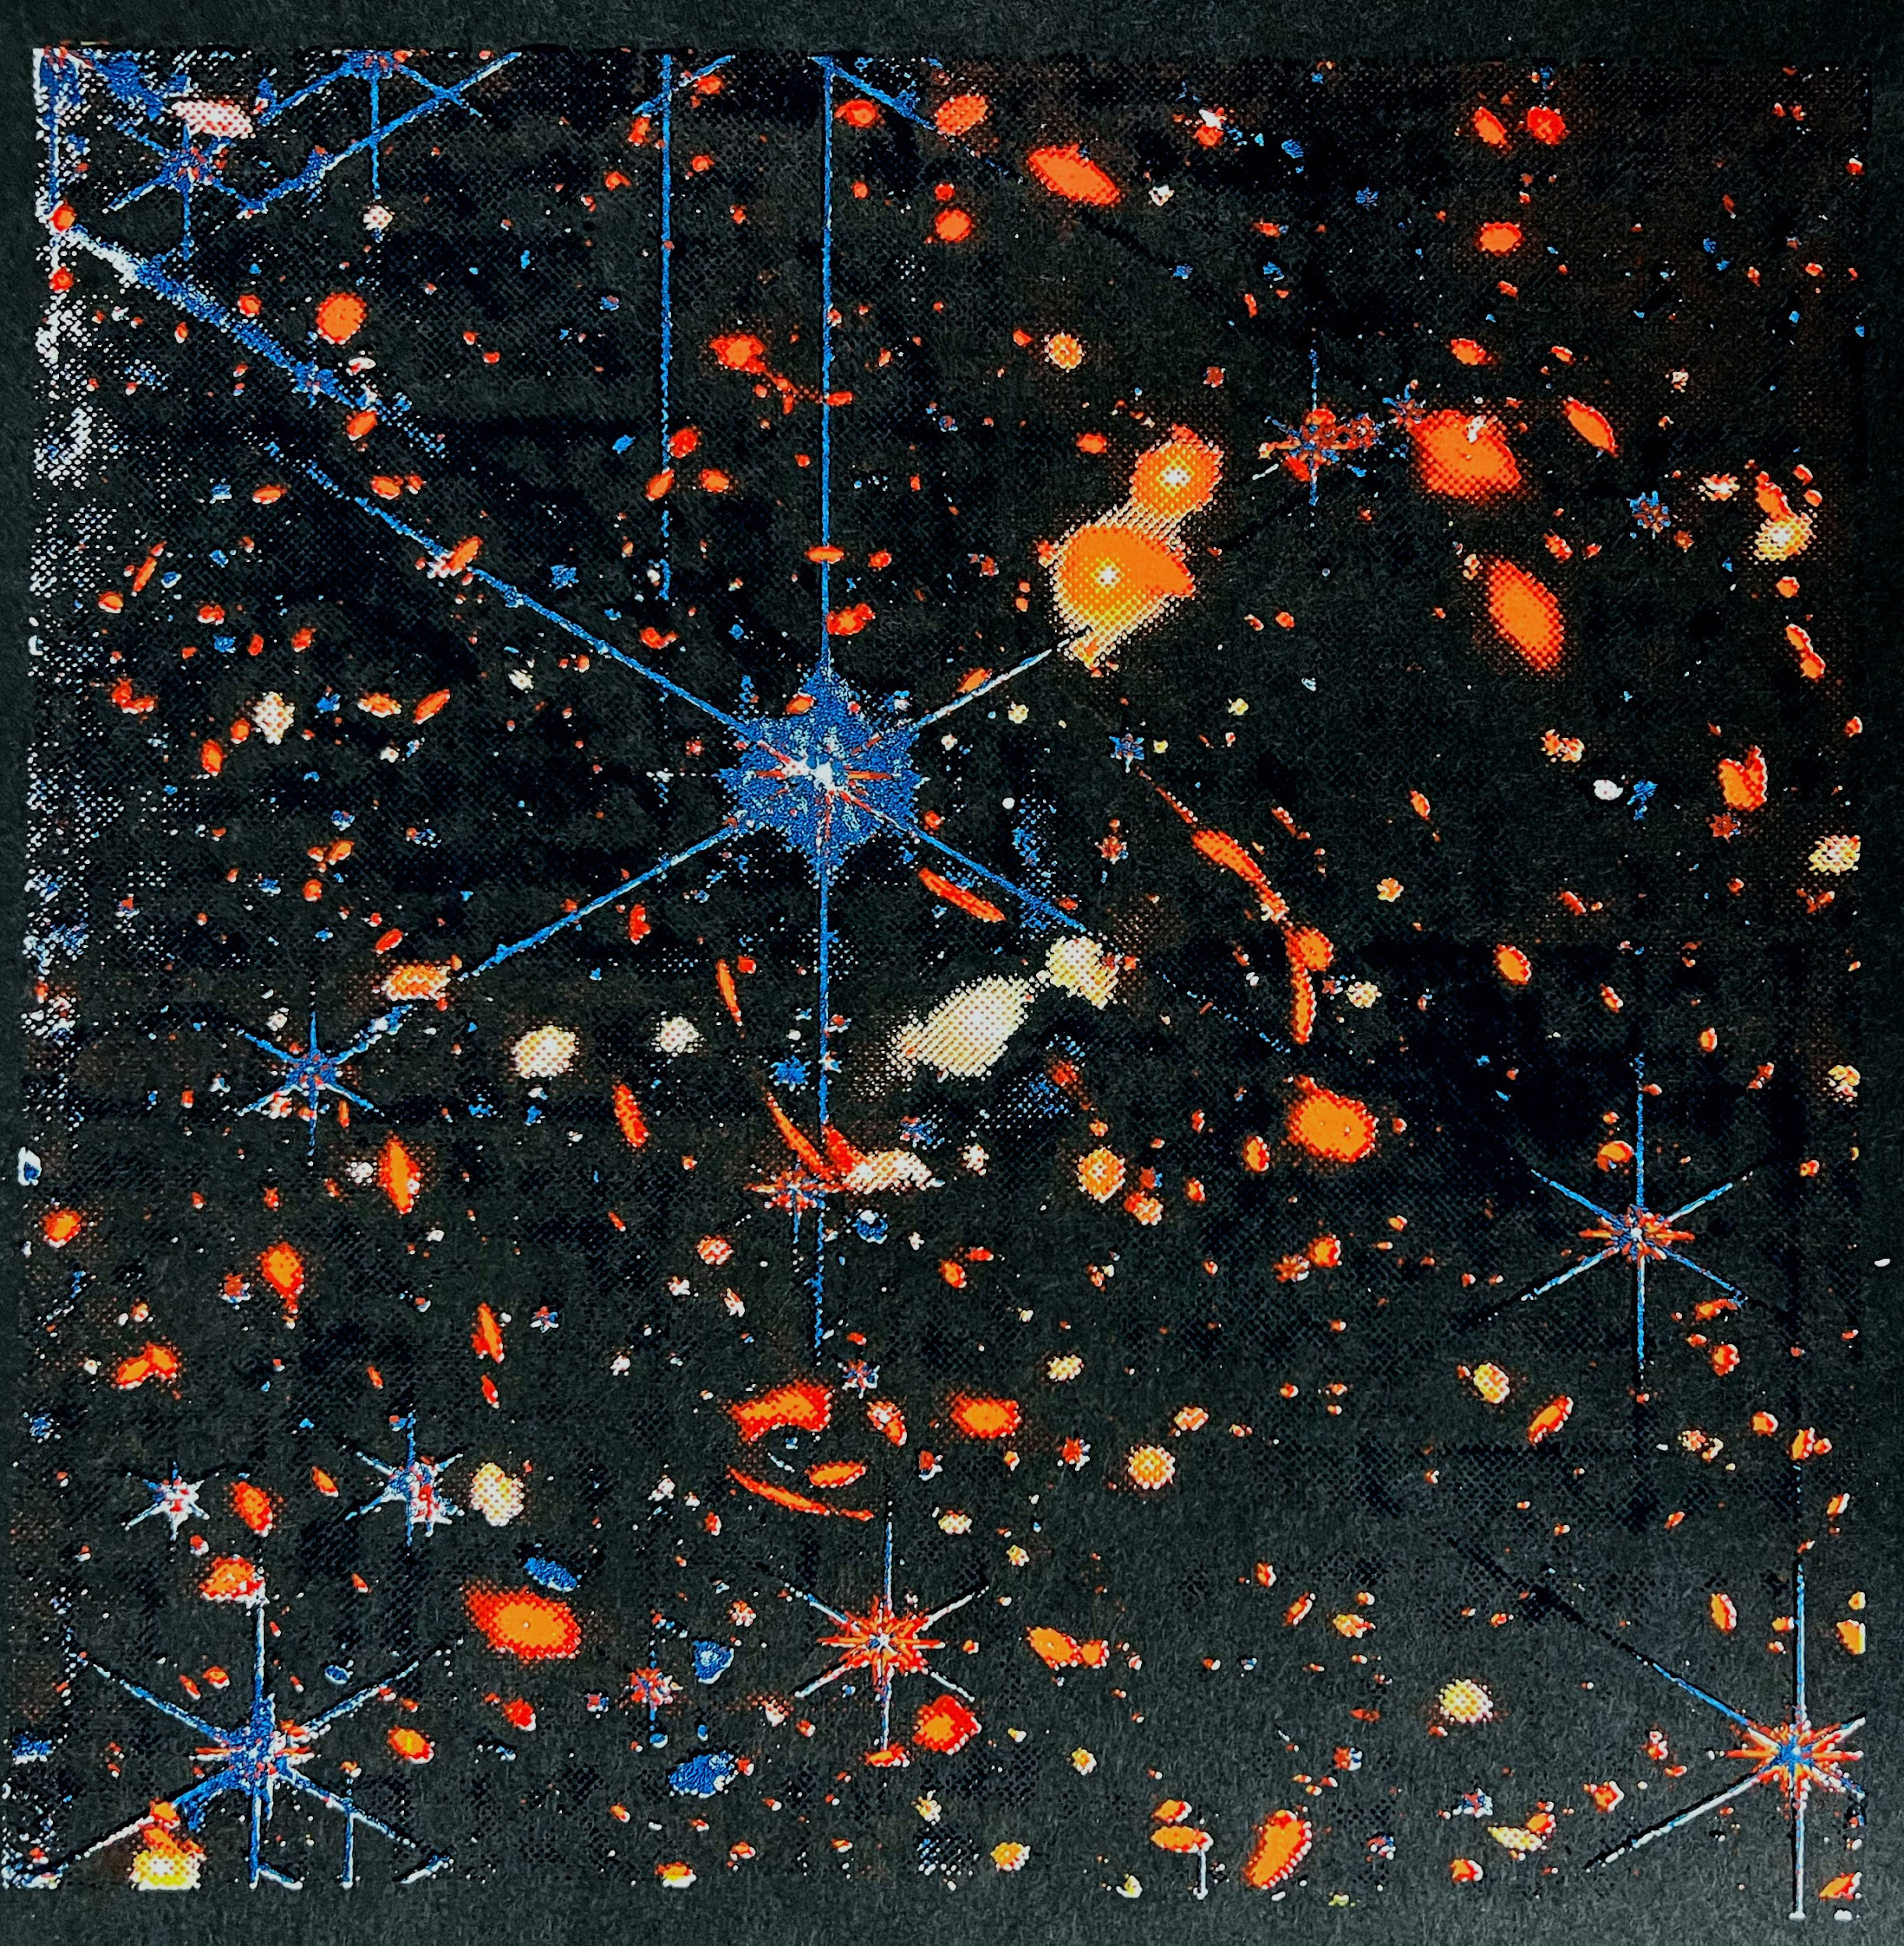
Deep Field-Zelinskie (Silk Screen)
SMACS 0723 (Image by NASA)
“Deep Field” by Ashley Zelinskie. (Image by Ashley Zelinskie)
Notes:
[Note to presenter: This slide is optional.]
After launching on December 25, 2021, the Webb telescope underwent months of commissioning including mirror alignment and instrument calibration before the first images were released on July 12, 2022. These five images,²¹ which demonstrate the capabilities of all four instruments on board, were chosen by an international committee of representatives from NASA, ESA, CSA, and the Space Telescope Science Institute (STSci). Processed by Joseph DePasquale and Alyssa Pagan of STScI, the images included the sharpest infrared image of the distant universe to date, a spectrum showing detection of water on exoplanet WASP-96b, the Southern ring nebula around a dying star, Stephen’s Quintet of interacting galaxies, and newly forming stars in the Carina Nebula. Zelinskie used these first images as inspiration for her exhibition.

Slide 31
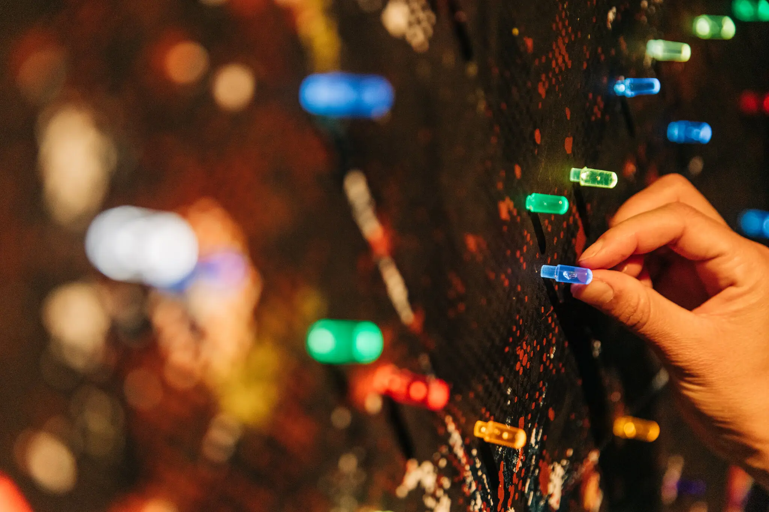
Deep Field-Zelinskie (Silk Screen)
“Deep Field” mimics the digital process of color channel layering using traditional silk-screening techniques. This serigraph comprises four layers—white, yellow, red and blue—built into a light box enclosure. By asking viewers to add their own colored peg to a dark spot within the composition, this interactive installation then invites participants to find their own beacon of light in the darkness, and imagine the possibilities of an endless universe.
“Deep Field” by Ashley Zelinskie. (Image by Ashley Zelinskie)
Notes:
[Note to presenter: This slide is optional.]
After launching on December 25, 2021, the Webb telescope underwent months of commissioning including mirror alignment and instrument calibration before the first images were released on July 12, 2022. These five images,²¹ which demonstrate the capabilities of all four instruments on board, were chosen by an international committee of representatives from NASA, ESA, CSA, and the Space Telescope Science Institute (STSci). Processed by Joseph DePasquale and Alyssa Pagan of STScI, the images included the sharpest infrared image of the distant universe to date, a spectrum showing detection of water on exoplanet WASP-96b, the Southern ring nebula around a dying star, Stephen’s Quintet of interacting galaxies, and newly forming stars in the Carina Nebula. Zelinskie used these first images as inspiration for her exhibition.

Slide 32
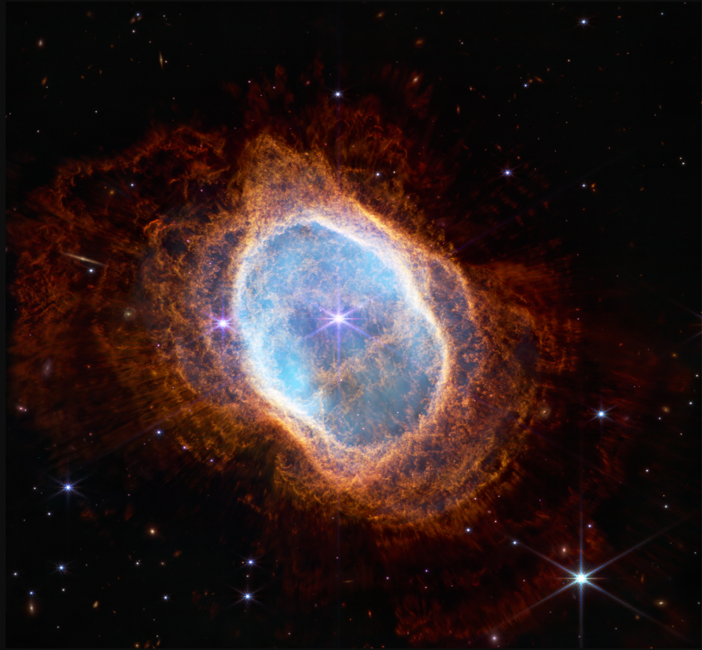
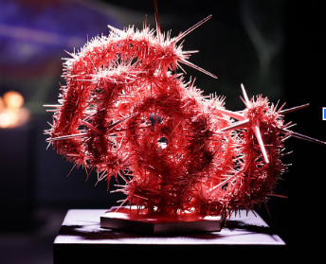
Southern Ring Nebula Sculpture
Southern Ring Nebula (Image by NASA)
“Southern Ring Nebula” by Ashley Zelinskie. (Image by Patrick Delaney)
Notes:
[Note to presenter: This slide is optional.]
After launching on December 25, 2021, the Webb telescope underwent months of commissioning including mirror alignment and instrument calibration before the first images were released on July 12, 2022. These five images,²¹ which demonstrate the capabilities of all four instruments on board, were chosen by an international committee of representatives from NASA, ESA, CSA, and the Space Telescope Science Institute (STSci). Processed by Joseph DePasquale and Alyssa Pagan of STScI, the images included the sharpest infrared image of the distant universe to date, a spectrum showing detection of water on exoplanet WASP-96b, the Southern ring nebula around a dying star, Stephen’s Quintet of interacting galaxies, and newly forming stars in the Carina Nebula. Zelinskie used these first images as inspiration for her exhibition.

Slide 33
Webb Telescope’s First Images of the Unseen Universe 2022-Stephen’s Quintet
Notes:
[Note to presenter: This slide is optional.]
After launching on December 25, 2021, the Webb telescope underwent months of commissioning including mirror alignment and instrument calibration before the first images were released on July 12, 2022. These five images,²¹ which demonstrate the capabilities of all four instruments on board, were chosen by an international committee of representatives from NASA, ESA, CSA, and the Space Telescope Science Institute (STSci). Processed by Joseph DePasquale and Alyssa Pagan of STScI, the images included the sharpest infrared image of the distant universe to date, a spectrum showing detection of water on exoplanet WASP-96b, the Southern ring nebula around a dying star, Stephen’s Quintet of interacting galaxies, and newly forming stars in the Carina Nebula. Zelinskie used these first images as inspiration for her exhibition.

Slide 34
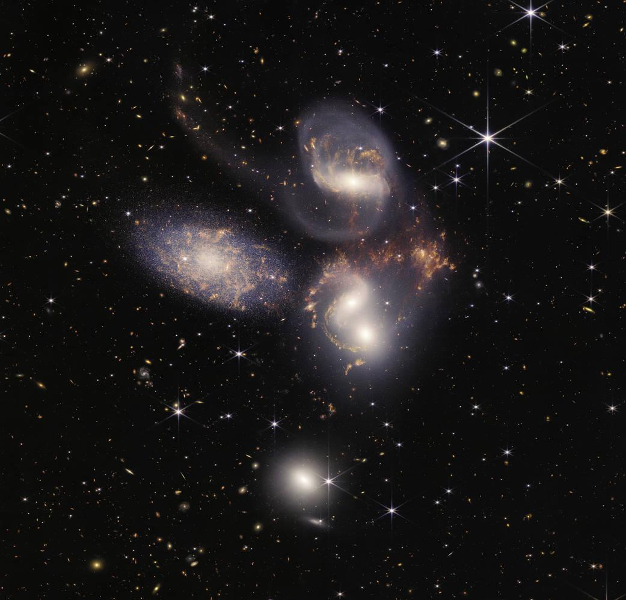
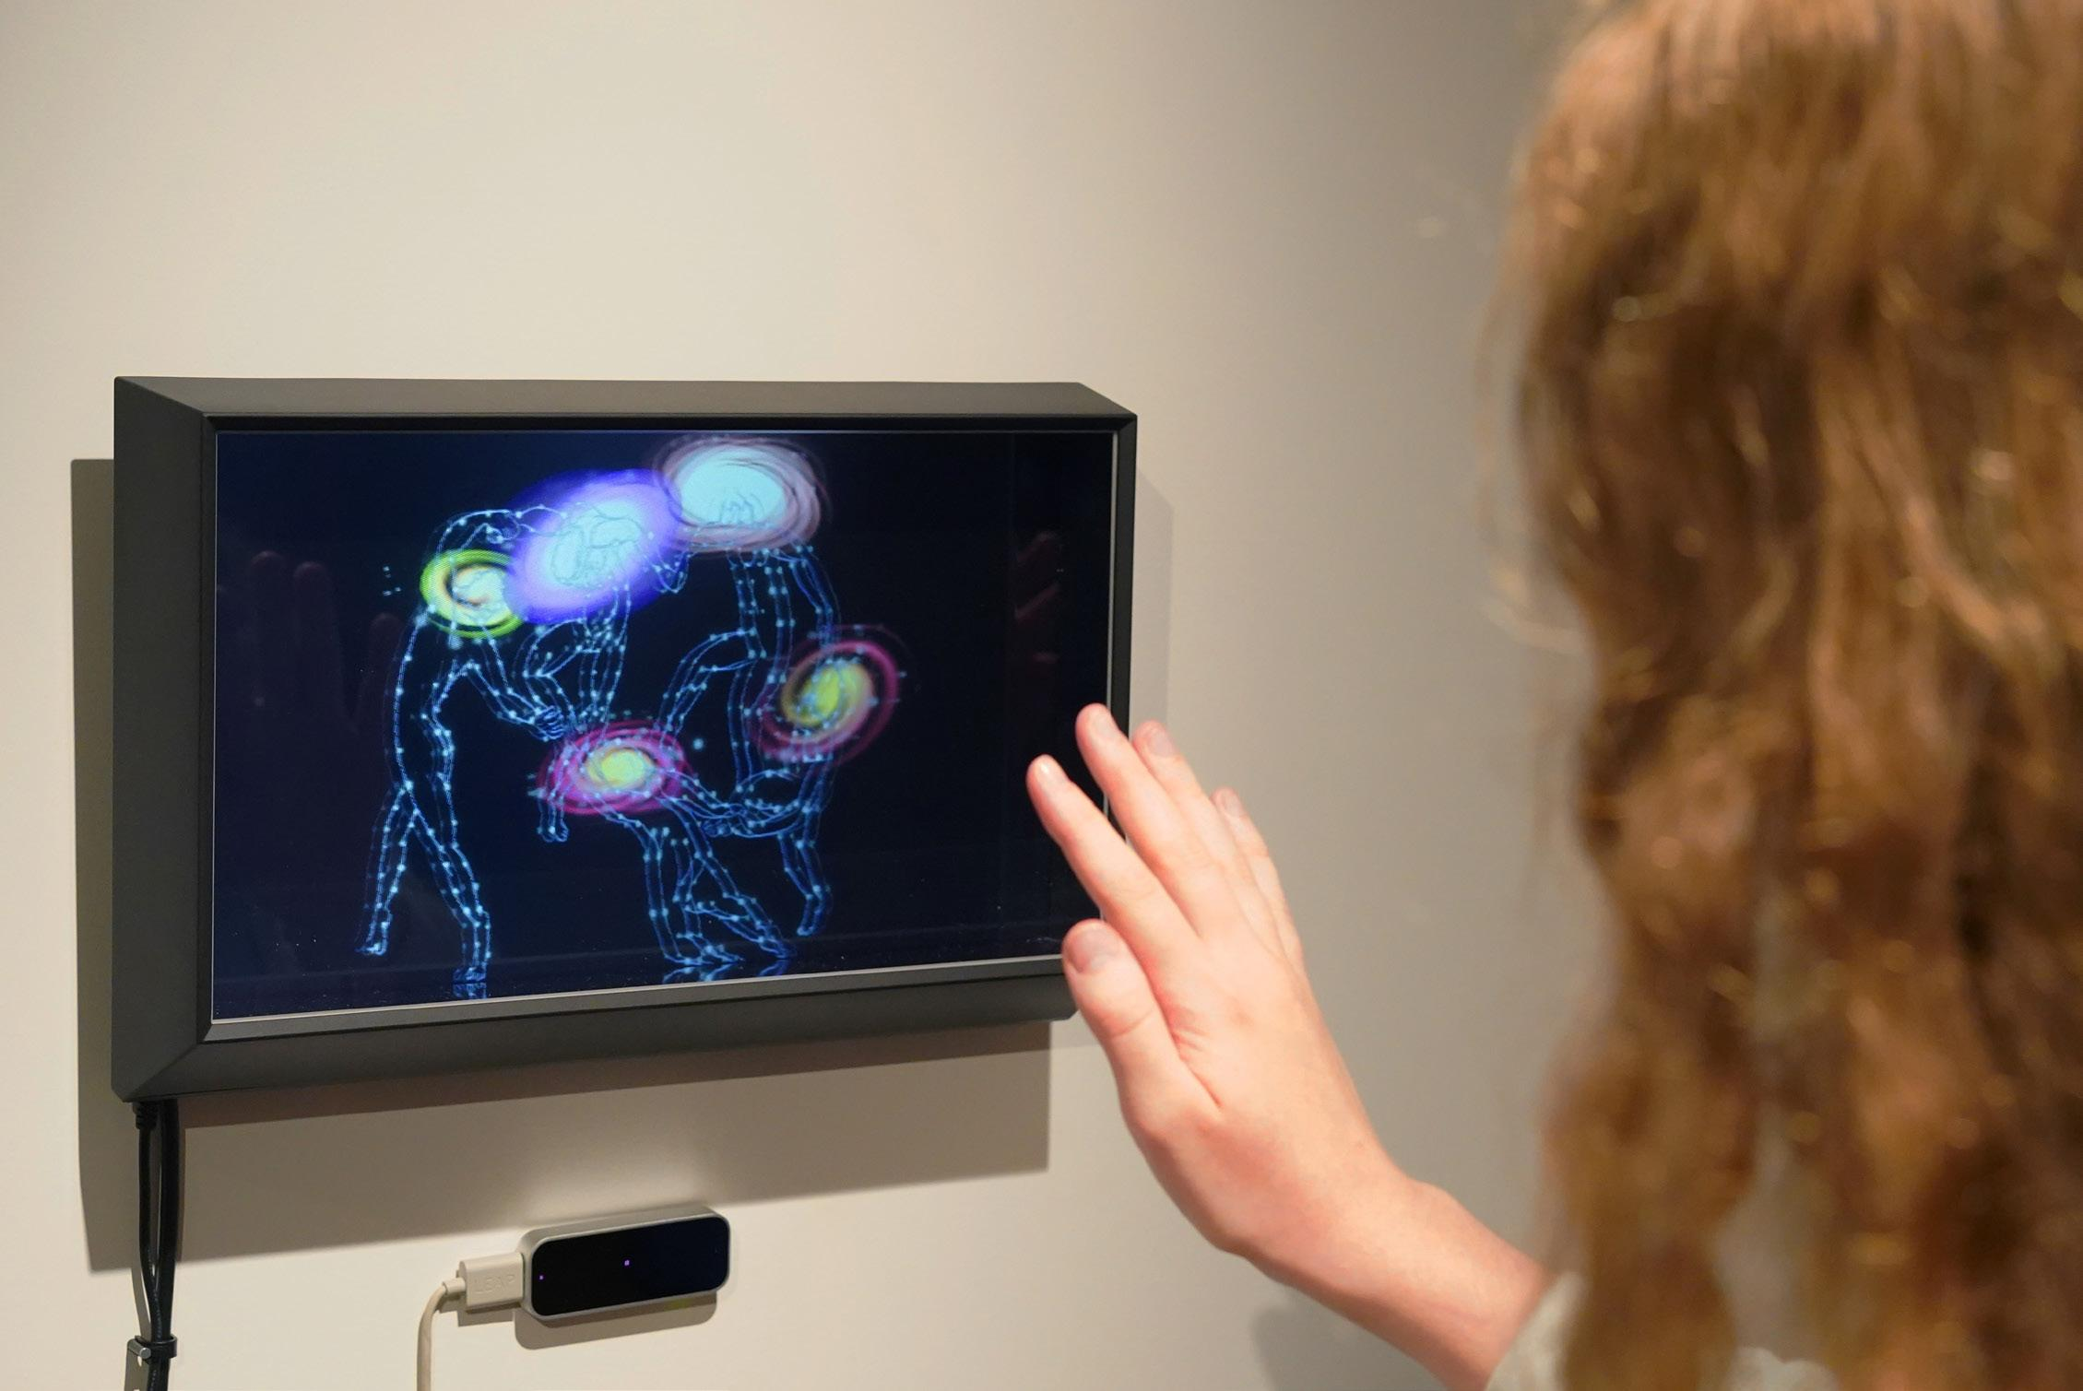
“La Danse” by Ashley Zelinskie
Stephen’s Quintet (Image by NASA)
“La Danse” by Ashley Zelinskie. (Image by Patrick Delaney)
Notes:
[Note to presenter: This slide is optional.]
After launching on December 25, 2021, the Webb telescope underwent months of commissioning including mirror alignment and instrument calibration before the first images were released on July 12, 2022. These five images,²¹ which demonstrate the capabilities of all four instruments on board, were chosen by an international committee of representatives from NASA, ESA, CSA, and the Space Telescope Science Institute (STSci). Processed by Joseph DePasquale and Alyssa Pagan of STScI, the images included the sharpest infrared image of the distant universe to date, a spectrum showing detection of water on exoplanet WASP-96b, the Southern ring nebula around a dying star, Stephen’s Quintet of interacting galaxies, and newly forming stars in the Carina Nebula. Zelinskie used these first images as inspiration for her exhibition.

Slide 35
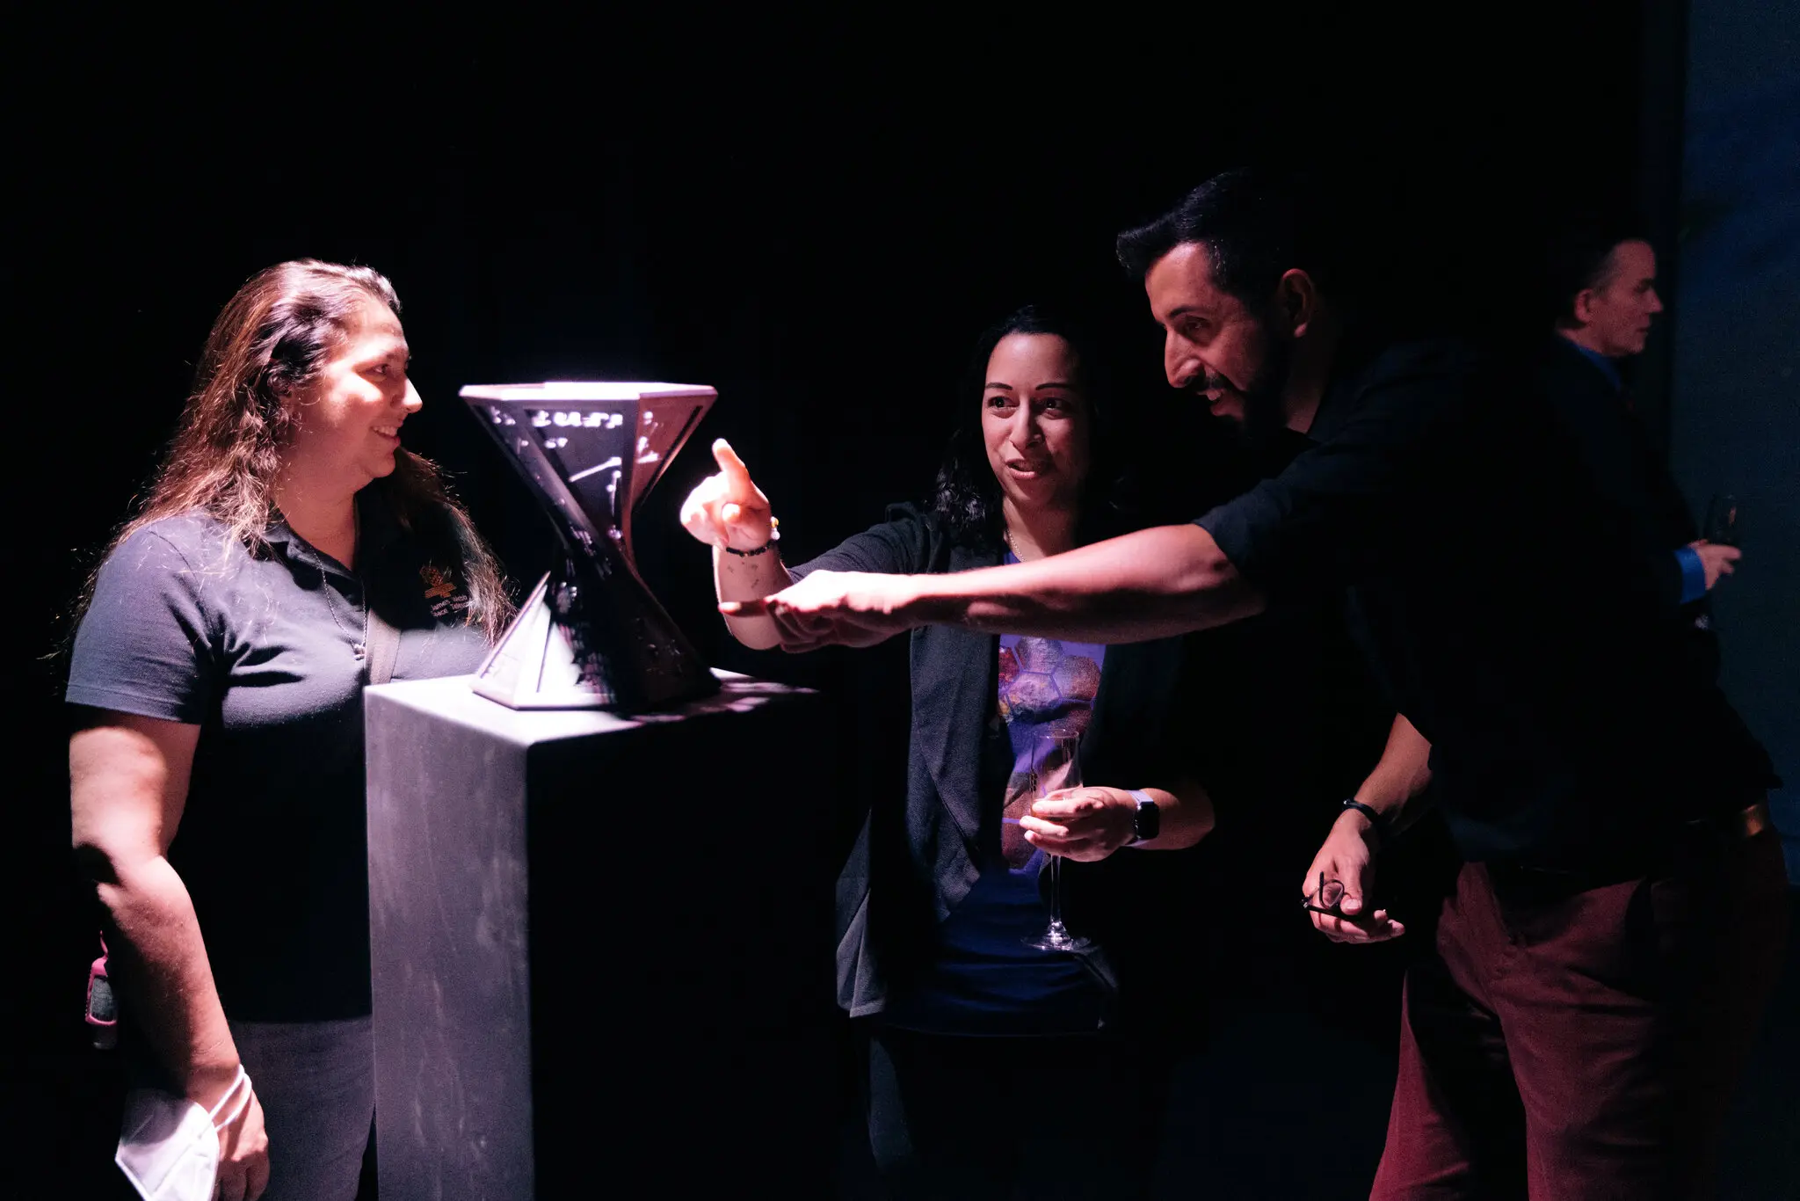
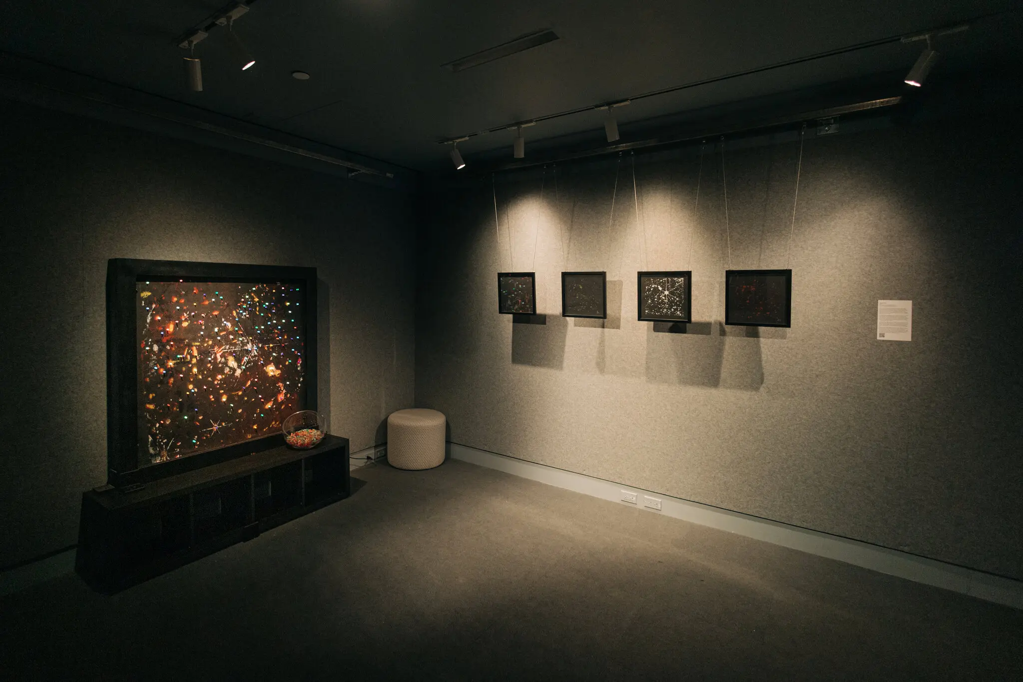
ONYX Art Exhibit-Manhattan, NY
October 2022
(Image by Ashley Zelinskie)
(Image by Ashley Zelinskie)
Notes:
[Note to presenter: This slide is optional.]
After launching on December 25, 2021, the Webb telescope underwent months of commissioning including mirror alignment and instrument calibration before the first images were released on July 12, 2022. These five images,²¹ which demonstrate the capabilities of all four instruments on board, were chosen by an international committee of representatives from NASA, ESA, CSA, and the Space Telescope Science Institute (STSci). Processed by Joseph DePasquale and Alyssa Pagan of STScI, the images included the sharpest infrared image of the distant universe to date, a spectrum showing detection of water on exoplanet WASP-96b, the Southern ring nebula around a dying star, Stephen’s Quintet of interacting galaxies, and newly forming stars in the Carina Nebula. Zelinskie used these first images as inspiration for her exhibition.

Slide 36
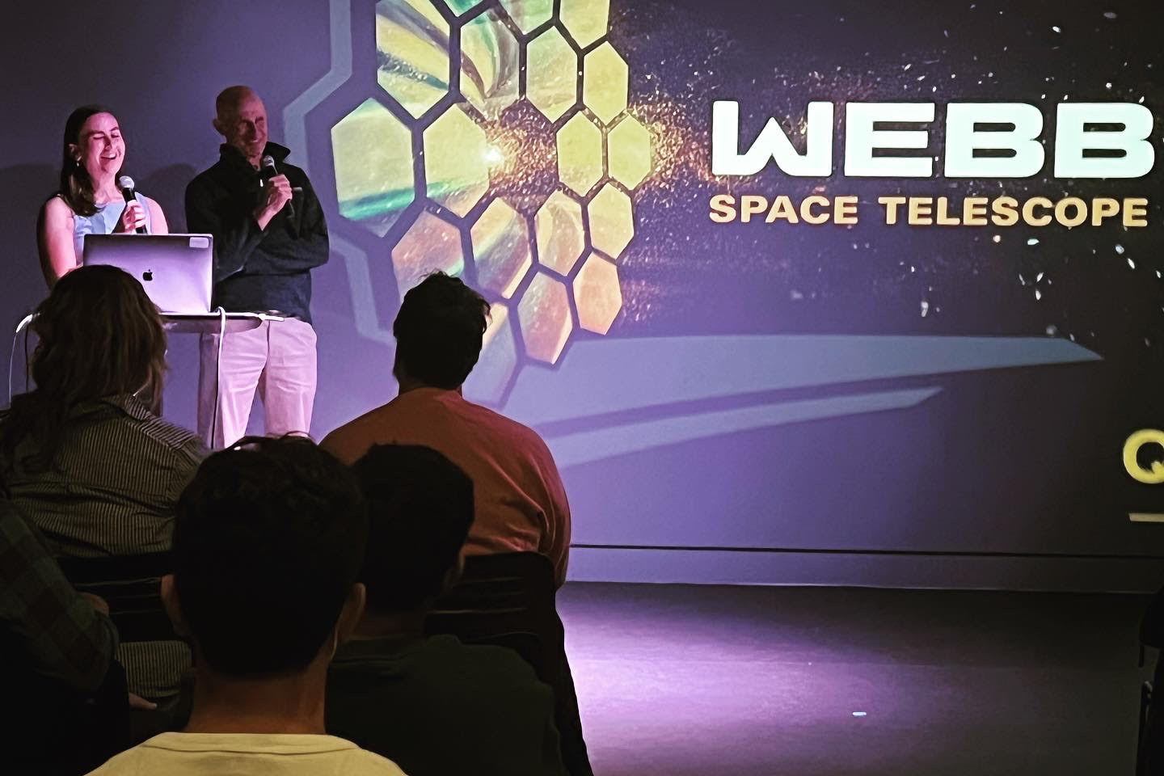
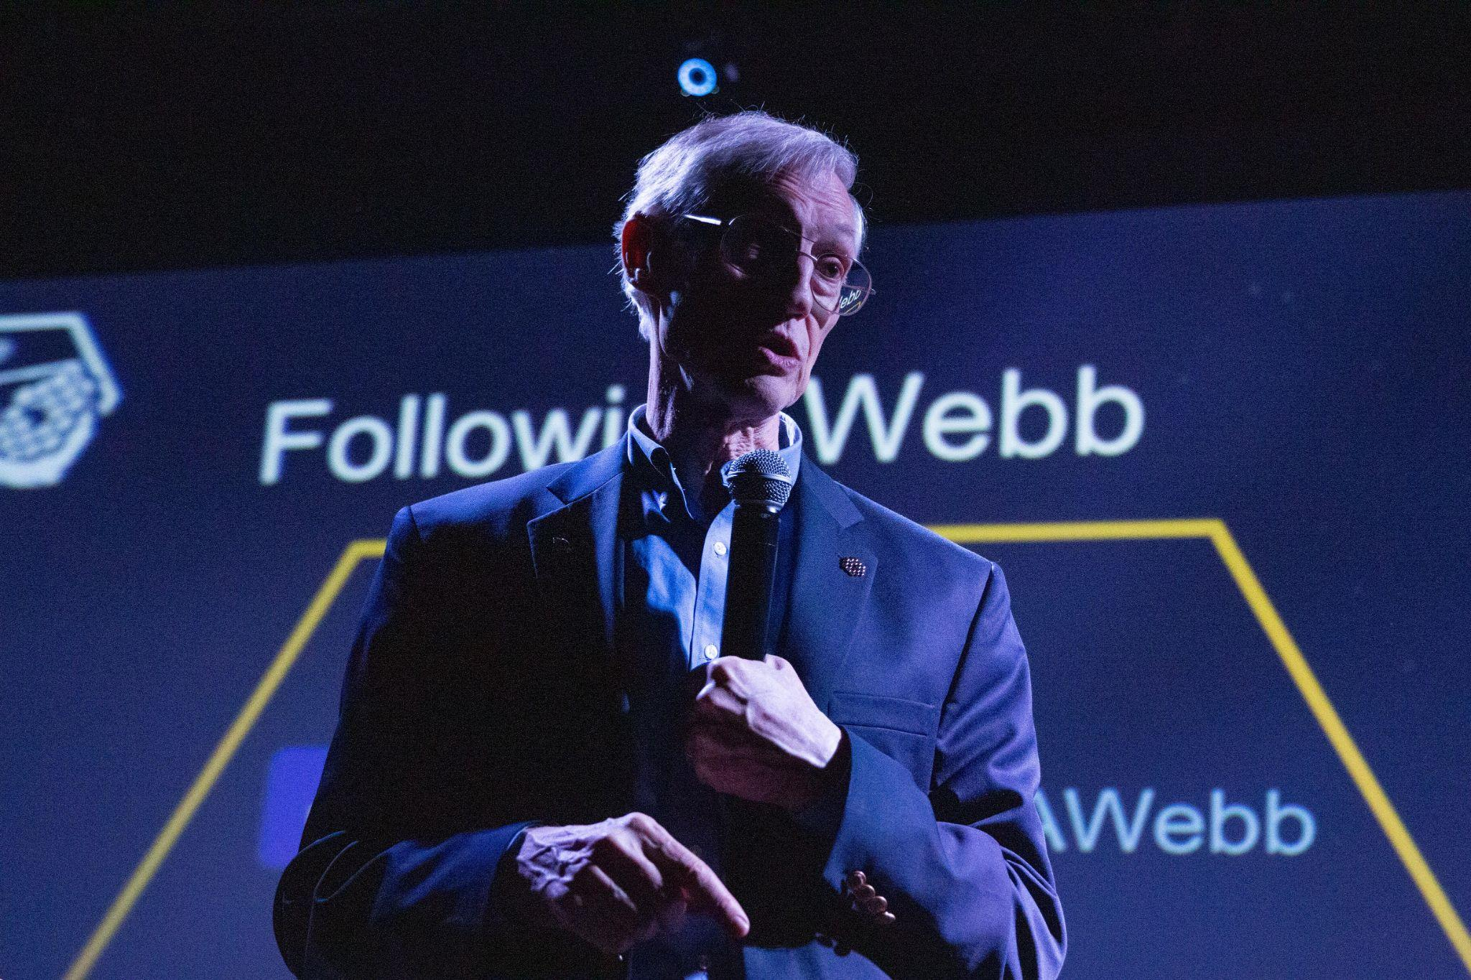
ONYX Art Exhibit-Technical presentations by Webb Scientists and Engineers
(image by Ashley Zelinskie)
(Image by Ashley Zelinskie)
Notes:
[Note to presenter: This slide is optional.]
After launching on December 25, 2021, the Webb telescope underwent months of commissioning including mirror alignment and instrument calibration before the first images were released on July 12, 2022. These five images,²¹ which demonstrate the capabilities of all four instruments on board, were chosen by an international committee of representatives from NASA, ESA, CSA, and the Space Telescope Science Institute (STSci). Processed by Joseph DePasquale and Alyssa Pagan of STScI, the images included the sharpest infrared image of the distant universe to date, a spectrum showing detection of water on exoplanet WASP-96b, the Southern ring nebula around a dying star, Stephen’s Quintet of interacting galaxies, and newly forming stars in the Carina Nebula. Zelinskie used these first images as inspiration for her exhibition.

Slide 37
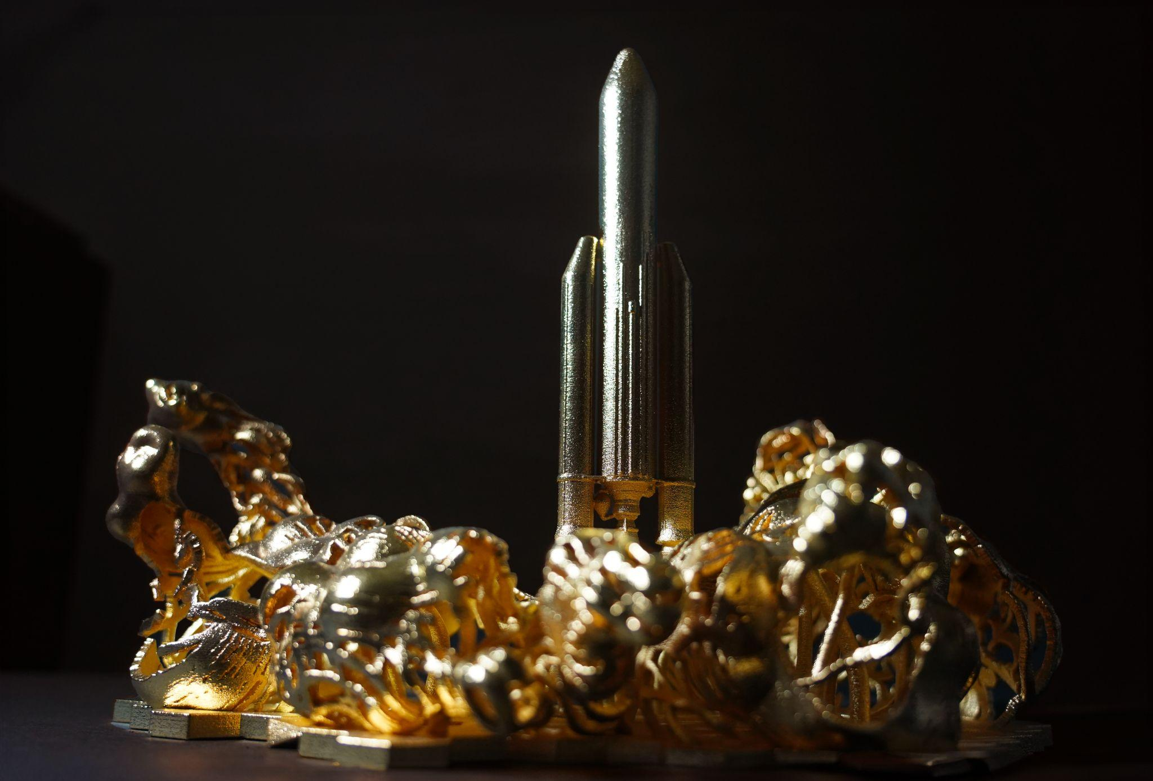
European Space Agency (ESA) Unfolding the Universe
Continued collaboration with a new VR world featuring ESA representatives highlighting international partnerships on Webb
“Ariane 5” by Ashley Zelinskie. (Image by Ashley Zelinskie)
Notes:
[Note to presenter: This slide is optional.]
After launching on December 25, 2021, the Webb telescope underwent months of commissioning including mirror alignment and instrument calibration before the first images were released on July 12, 2022. These five images,²¹ which demonstrate the capabilities of all four instruments on board, were chosen by an international committee of representatives from NASA, ESA, CSA, and the Space Telescope Science Institute (STSci). Processed by Joseph DePasquale and Alyssa Pagan of STScI, the images included the sharpest infrared image of the distant universe to date, a spectrum showing detection of water on exoplanet WASP-96b, the Southern ring nebula around a dying star, Stephen’s Quintet of interacting galaxies, and newly forming stars in the Carina Nebula. Zelinskie used these first images as inspiration for her exhibition.

Slide 38
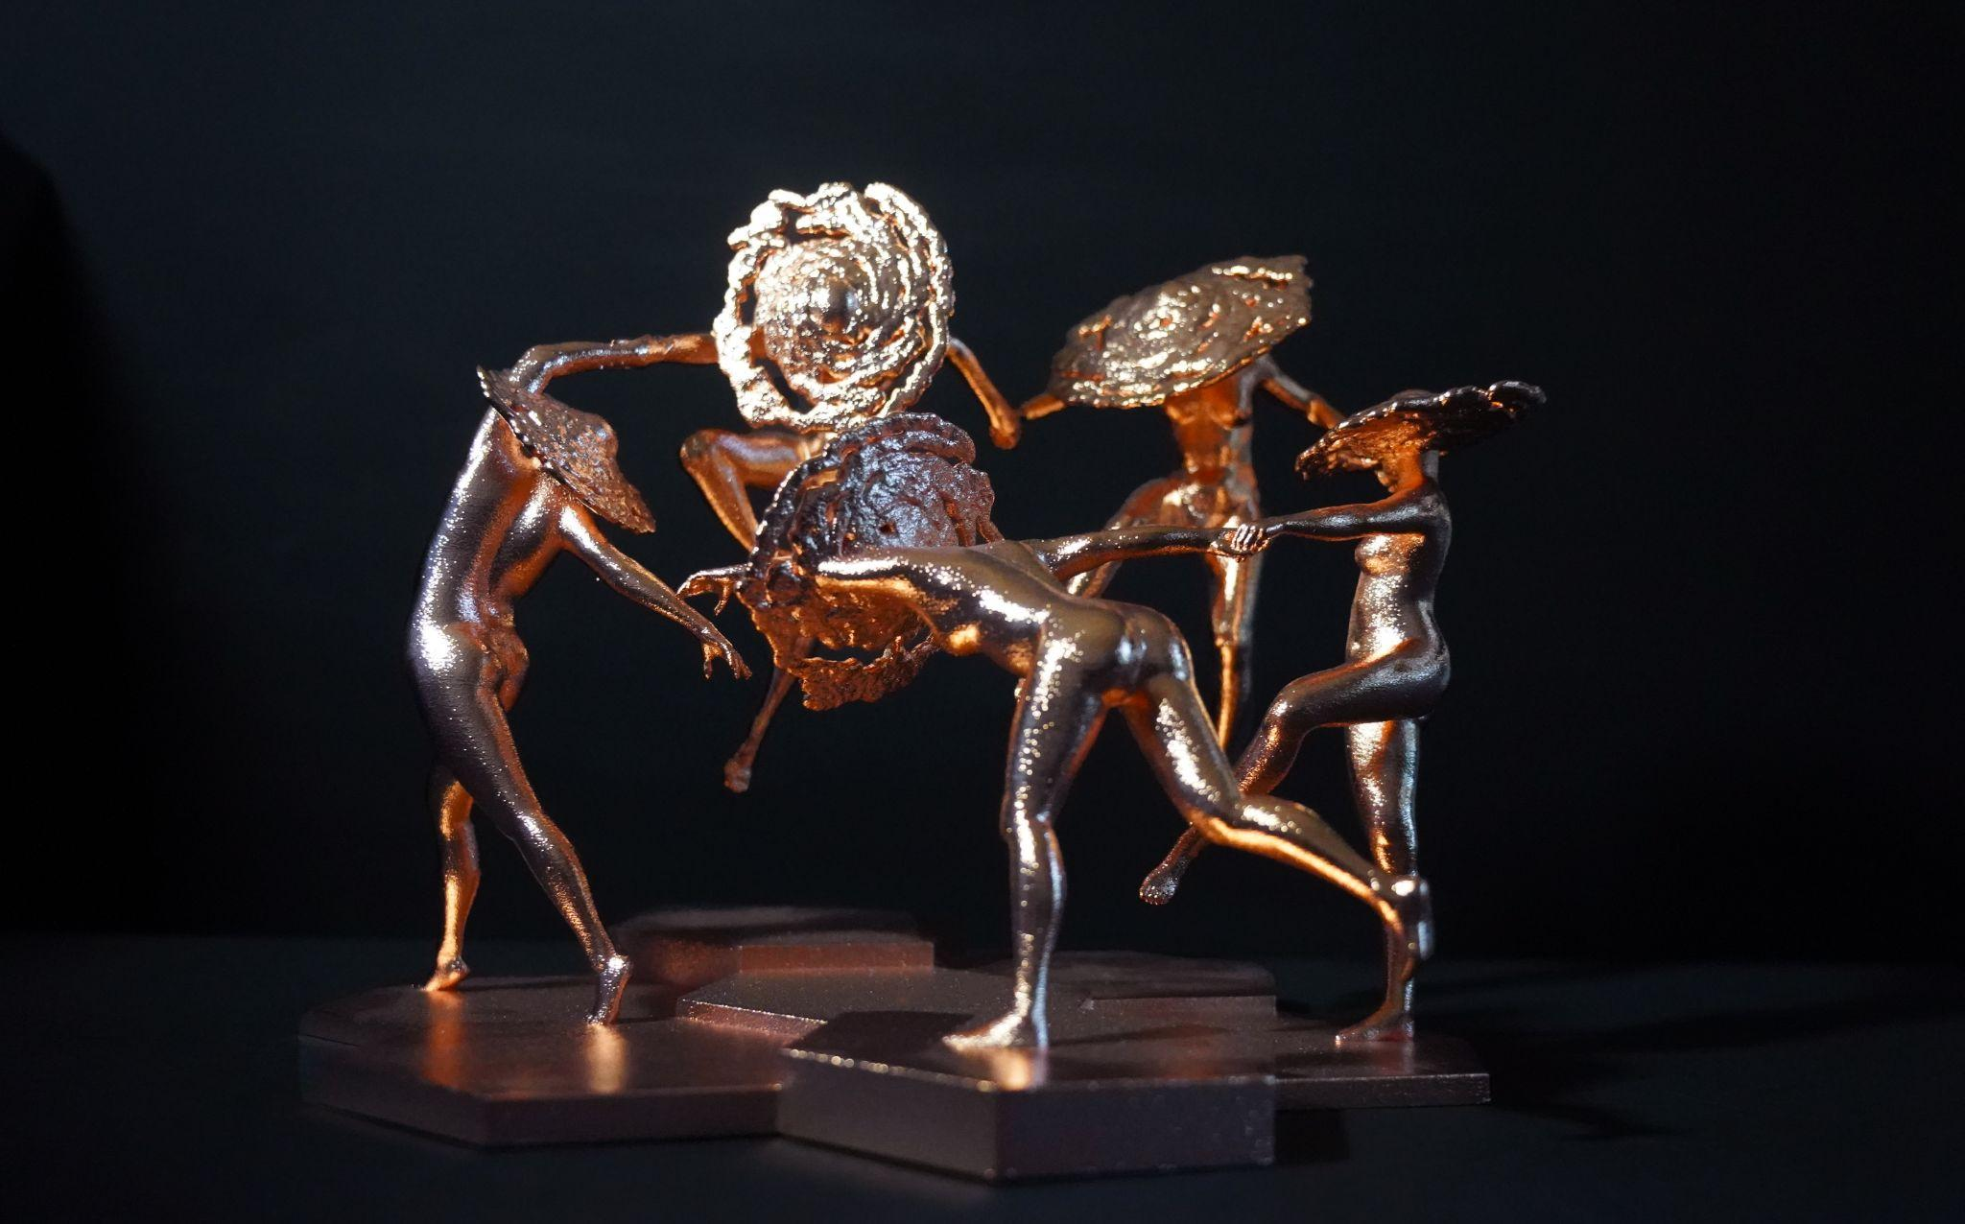
Discussion
For far too long art and science have existed on opposite ends of the spectrum. Stereotypes can allow cross-collaboration to be difficult.
Much can be achieved by adding a dose of diverse artistic and creative thinking to the pursuit of science. Furthermore those achievements can benefit from being shared in artistic arenas because they reach wider audiences when artists have access to new ideas and discoveries.
Each member of the public who participated in an art campaign or viewed an art exhibit may have told friends and family, or posted their own work for their followers to see, and trying to add that up would be an impossible task. But as detailed in this paper, we can see proof of the impact of Webb on the artists who have documented it. We can look at the numbers of art pieces, exhibitions, and website and online gallery views, like artist Gong’s 9.2 million Flickr views. And we can look at the press coverage of Zelinskie’s exhibit.
Artists are able to capture and communicate complex ideas simply and beautifully. Scientists are great thinkers and genius minds that can solve the mysteries of the universe. Imagine what they can do together.
“Stephen’s Quintet ” by Ashley Zelinskie.
(Image by Ashley Zelinskie)
Notes:
[Note to presenter: This slide is optional.]
After launching on December 25, 2021, the Webb telescope underwent months of commissioning including mirror alignment and instrument calibration before the first images were released on July 12, 2022. These five images,²¹ which demonstrate the capabilities of all four instruments on board, were chosen by an international committee of representatives from NASA, ESA, CSA, and the Space Telescope Science Institute (STSci). Processed by Joseph DePasquale and Alyssa Pagan of STScI, the images included the sharpest infrared image of the distant universe to date, a spectrum showing detection of water on exoplanet WASP-96b, the Southern ring nebula around a dying star, Stephen’s Quintet of interacting galaxies, and newly forming stars in the Carina Nebula. Zelinskie used these first images as inspiration for her exhibition.

