Slide 1

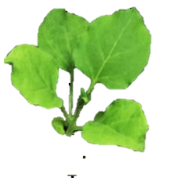

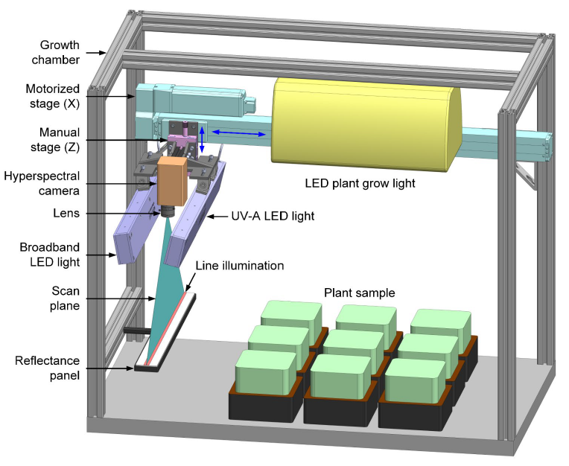
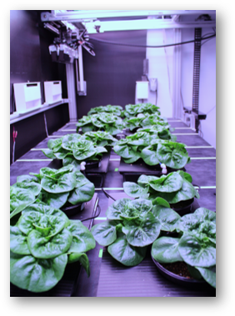
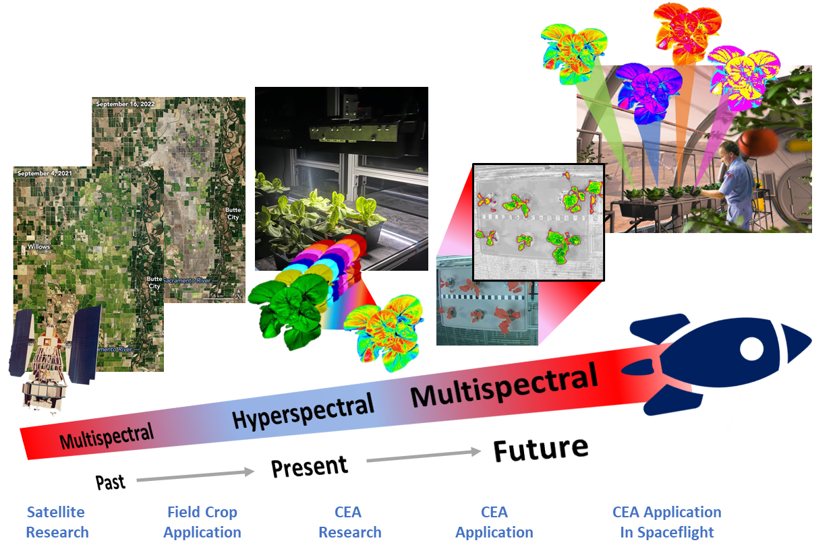
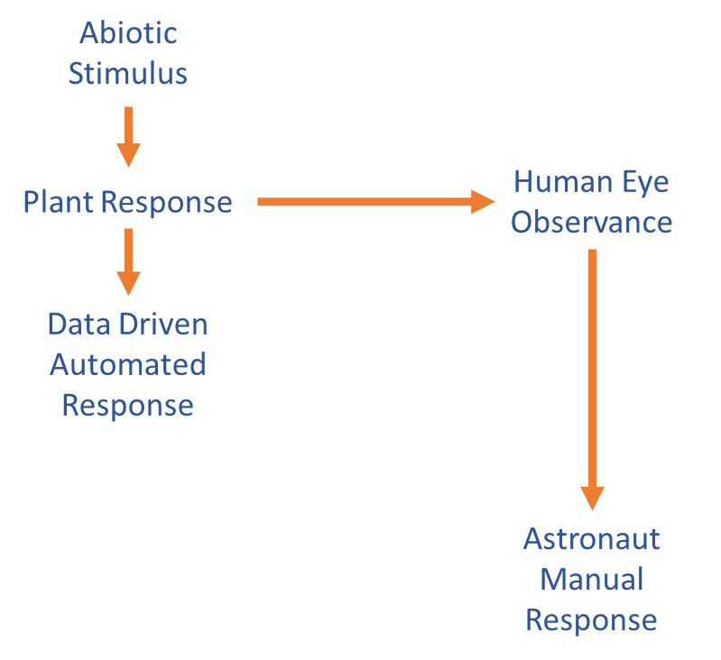
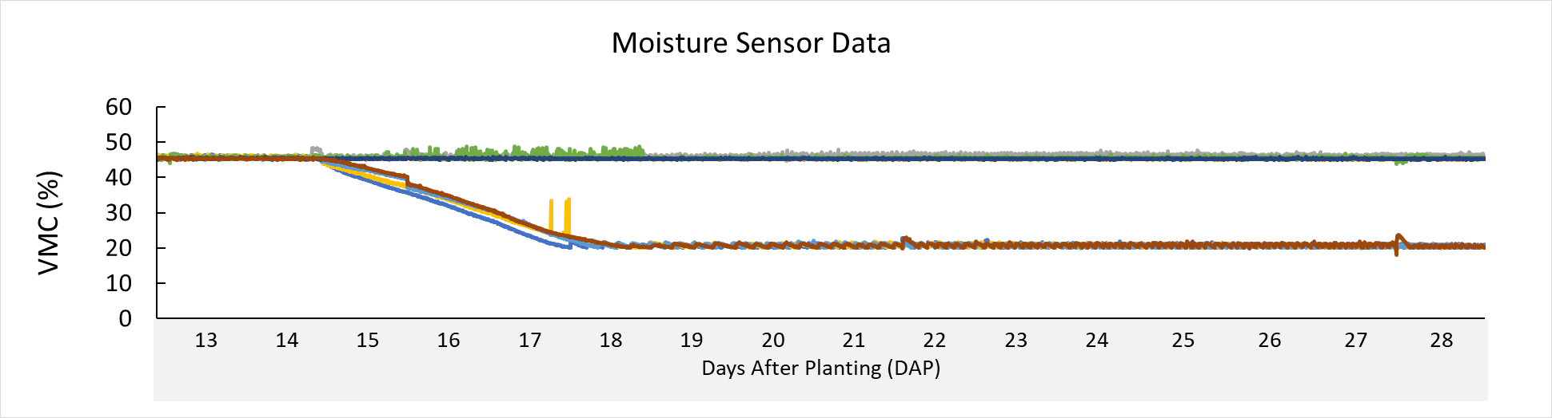
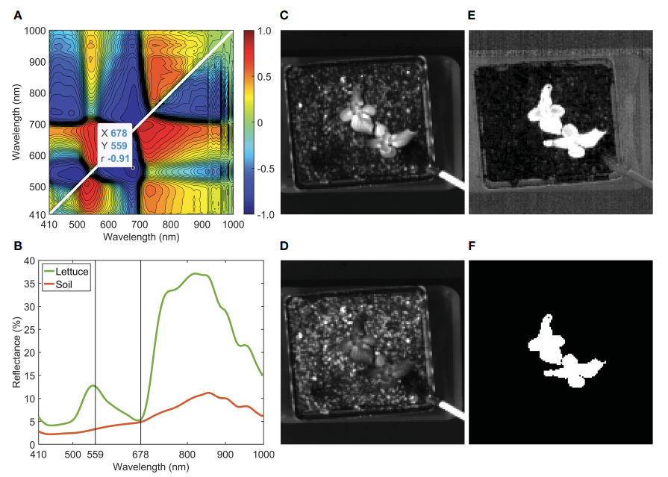
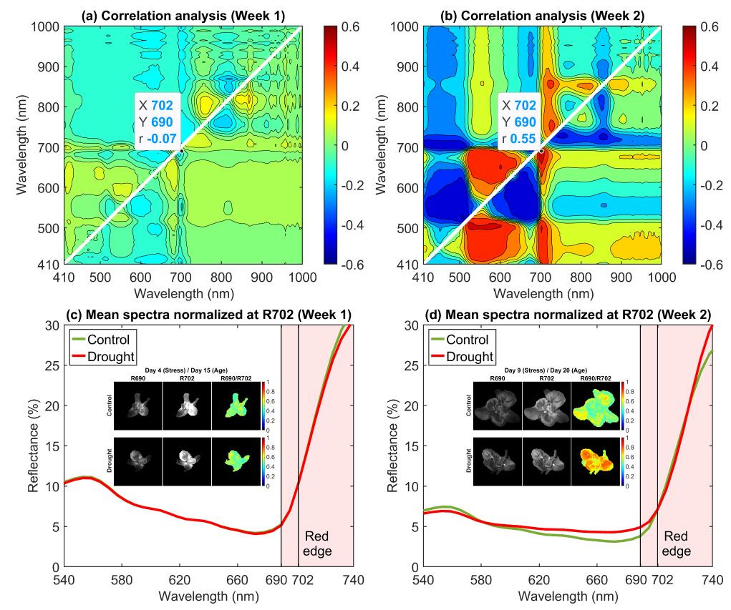
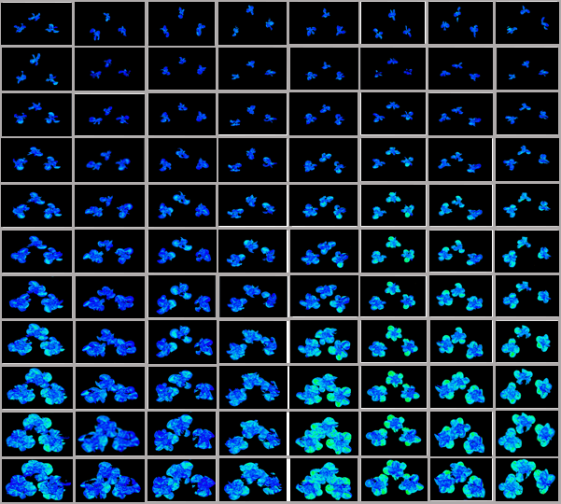
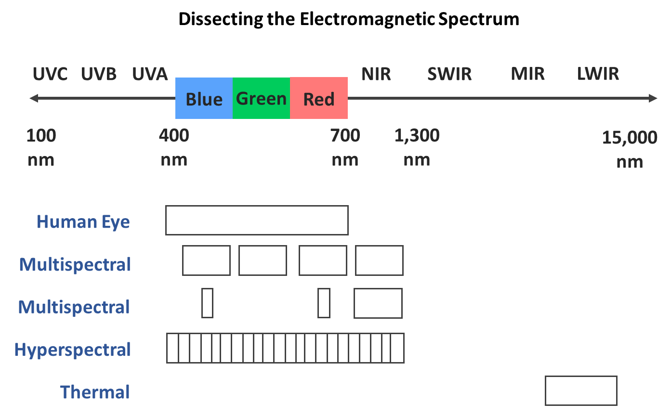
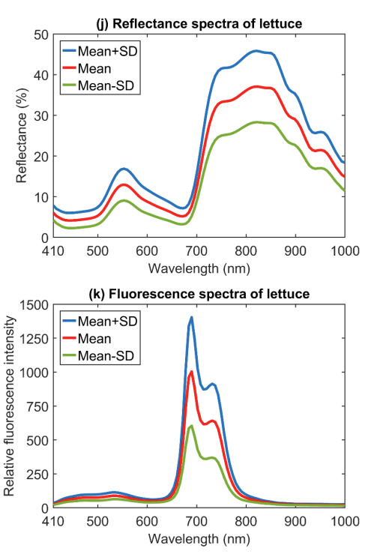
A Multimodal Monitoring Approach to Detect Drought Stress in Space Crop Production
Rachel Tucker₁ Blake Costine₂, Lillian Wang₁, LaShelle E. Spencer₃, Mary E. Hummerick₃, Lawrence Koss₂, Aaron Curry₄, Jason Fischer₂, Jennifer Gooden₂, Moon S. Kim₅, Insuck Baek₅, Jianwei Qin₅, Isabella Pardo₆, Kristine D. Wilson₇, Matthew Mickens₇, and Aubrie E. O’Rourke₇
¹ Bennett Aerospace/LASSO II, KSC, FL , ² Aetos Systems/LASSO II, KSC, FL, ³ Noetic Strategies/LASSO II, KSC, FL, ⁴ ERC/LASSO II, KSC, FL, ⁵ Environmental Microbial and Food Safety Laboratory, Agricultural Research Service, U.S. Department of Agriculture, Beltsville, MD, ⁶ OSTEM Internship Program, KSC, FL ⁷ NASA Exploration Research and Technology, KSC, FL
Background
Imaging as a Tool to Improve Crop Production:
NASA’s Past, Present and Future
Past: Beginning with Landsat I in 1972, NASA has employed satellites to LEO to collect images of Earth’s surface (Fig. 1). These images have provided necessary data to identify oncoming drought, conserve water, and predict crop yield.
Present: Currently, operations to detect and address plant stress in spaceflight involve astronaut observation and manual, human intervention (Fig.2). NASA hopes to use information gained by hyperspectral imaging in CEA to generate data that can drive a quicker, automated response to alleviate plant stress in space. NASA KSC and USDA ARS have an ongoing collaboration to develop and implement a multimodal sensing system for monitoring plant health. This system will serve both as a model for monitoring terrestrial crops in controlled environment agriculture (CEA) and as an enabling technology to identify relevant wavelengths along the electromagnetic spectrum for predicting plant stress in space crop production.
Future: The knowledge gained from hyperspectral imaging research and technology will be applied to multispectral imaging systems that can be deployed in spaceflight to monitor crops in space. These imaging systems will relieve astronauts of the responsibility and labor of closely monitoring and tending to food crops in space, as well as reduce the response time needed to address plant stresses that could decrease crop yield.
Reflectance and fluorescence imaging are captured with a line-scan hyperspectral camera and illuminated by two LED line lights (Fig. 3). The camera and LED assembly is attached to a linear motorized stage, overhead of the sample area. The reflectance line light illuminates the imaging area with visible and near-infrared (VNIR) LEDs with peaks at 428, 650, 810, 850, and 915 nm, and UV-A (365 nm) LEDs for fluorescence.
Methods
Plant Growth Conditions: Lettuce seeds (Lactuca sativa cv. ‘Dragoon’) were grown in a controlled environment chamber (Fig. 4) and irrigated with 13-2-13 Peters (ICL-group; Telaviv, Israel), with an EC of 1200 µS · m-1 and pH range corrected to 5.7-5.8. Lighting was provided by Icarus Vi LED (Bios Lighting; Carlsbad, CA) set to a 16 h light and 8 h dark photoperiod, at 300 µmol · m−2 · s−1 PPFD. Environmental conditions were maintained at 23°C, 50% relative humidity, and 3000ppm CO2.
Figure 3: First prototype of the reflectance and fluorescence imaging system in a controlled environment chamber.
Drought Treatment Application: Irrigation treatments were applied by a custom-made irrigation system with EC-5 soil moisture sensors (METER Group, Inc., Pullman, WA) and controlled by Opto 22 (Opto 22, Temecula, CA). A volumetric moisture content (VMC) curve was generated and used for water treatments. Pots with soil were maintained at 45% VMC until 14 days after planting (DAP), at which, stress treatment setpoints were reduced to 20% VMC and maintained for the remainder of the test (Fig. 5).
Figure 4: Experimental layout in the 2nd larger prototype imaging system gantry.
Figure 1: NASA’s use of multispectral and hyperspectral imaging to improve crop production From left, images 1-3 (NASA Landsat Image Gallery), images 4-5 and 7 (KSC PPA lab), image 6 (NLSP NASA Data Repository, image 8 (modified by KSC PPA lab).
Figure 2: Flowchart depicting the shift from a manual astronaut response to an automated response to address plant stress in spaceflight.
Results and Discussion
Figure 5: Volumetric moisture content (VMC) trends of treatment trays.
To access the fidelity of the 690/702 band ratio, a second multimodal setup was used in conjunction with the same experimental design to induce plant stress. As seen in the proof-of-concept dataset in Figure 11, drought stress is detectable within the first four days of stress implementation (by DAP17). This signal increases with time as size also decreases in droughted plants.
On Day 28, plants under drought conditions were smaller with reduced shoot mass and leaf area compared to control plants. Relative chlorophyll content did not show significant differences (Fig. 10). Initial expectations that the 690/702 nm band ratio could indicate changes in chlorophyll content were not supported by our Day 28 SPAD results. Further investigation into the metabolomic mechanisms underlying the drought phenotype and its spectral profile correlation is ongoing..
Imaging Operations and Processing: Hyperspectral reflectance and fluorescence images (Fig. 6 and 7) were captured every 24h, starting on DAP 14. Images were processed by removing the background (Fig. 7), conducting a correlation analysis to determine an effective index for detecting drought stress (Fig. 9), applying the index to the dataset, and then assigning false color to index values.
Validation of the R690/R702 Index for Drought Stress Detection
Figure 8: Background removal of a lettuce sample: (A) correlation analysis for band-ratio selection to segregate lettuce from soil, (B) mean reflectance spectra of lettuce and soil, reflectance images at (C) 559nm and (D) 678nm, (E) ratio image (R559/R678), and (F) mask image generated using R559/R678. (Qin, 2023).
14
Control, 45% VMC
Drought, 20% VMC
15
16
17
18
Days After Planting
Figure 9: Control and drought lettuce correlation analysis for band-ratio selection at the start of stress application (A) and at the end of the stress period (B). Normalized mean spectra, single band, and selected ratio, prior to stress treatment (C) and after stress treatment (D).
19
20
21
After applying a correlation analysis to the VNIR measurements, the wavelength ratio of 690/702 was found to indicate high treatment classification accuracies (Fig. 9A-D)(Qin, 2023).
22
23
Figure 9:
Figure 10: ‘Dragoon’ lettuce harvest metrics at 28 DAP. Student’s t-test conducted in Prism (GraphPad software; Boston, MA). **** indicates significance of p < 0.0001. ns indicates no significance.
Figure 6: Regions and divisions of the electromagnetic spectrum as captured by the human eye, multispectral imagers, hyperspectral imagers, and thermal imagers.
Figure 7: Reflectance and fluorescence spectra of lettuce plants.
24
Harvest Procedures: At DAP 28, all plants were harvested and plant height, shoot fresh mass, leaf area, and chlorophyll measurements were recorded from all plants (Fig. 10).
Figure 11: Imaging system reflectance image collection. Images support proof-of-concept work revealing that the 690/702 band ratio highlights the drought stress signature.
References
Funding and Acknowledgements
NASA Landsat Image Gallery. Retrieved 07-02-2024.
NASA NLSP Data repository. Retrieved 07-12-2024
This work was made possible through funding provided by NASA’s Biological and Physical Sciences (BPS) division and support by the NASA Kennedy Space Center team, facilities and management.
Qin, J., Monje, O., Nugent, M. R., Finn, J. R., O’Rourke, A. E., Fritsche, R. F., ... & Kim, M. S. (2022, June). Development of a hyperspectral imaging system for plant health monitoring in space crop production. In Sensing for Agriculture and Food Quality and Safety XIV (Vol. 12120, pp. 16-21). SPIE.
Qin, J., Monje, O., Nugent, M. R., Finn, J. R., O’Rourke, A. E., Wilson, K. D., ... & Kim, M. S. (2023). A hyperspectral plant health monitoring system for space crop production. Frontiers in Plant Science, 14, 1133505.

