Slide 1


Beyond SFNP
National Aeronautics and Space Administration
Nateri Madavan and John Cavolowsky
NASA Aeronautics Mission Directorate
ARTR Meeting, Washington, D.C., July 19, 2024
www.nasa.gov

Slide 2
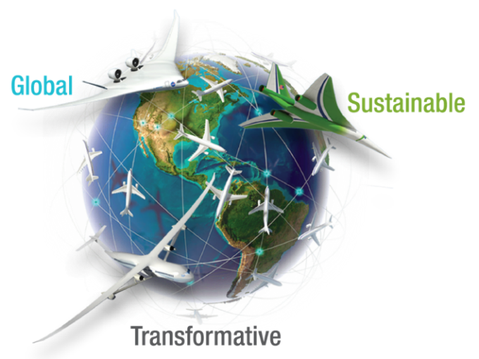
Agenda
Background and Context
Beyond SFNP Strategy Development
Ongoing Discovery and Innovation Activities
Thoughts on a National Partnership
Questions and Reflections
2

Slide 3






Sustainability is Complex
Meet the Mission
Value to People
Mobility
Freedom
Health
Meet the Mission
Value to Business
Profit to Shareholders
Import/Export Trade Balance
Jobs
Meet the Mission
Protect the Planet
Protect Regional & Local Ecosystems
Success requires meeting demand for mobility, connectivity, and improved quality of life with reduced energy/fossil fuel use, while remaining safe, quiet, economical and equitable.
3

Slide 4
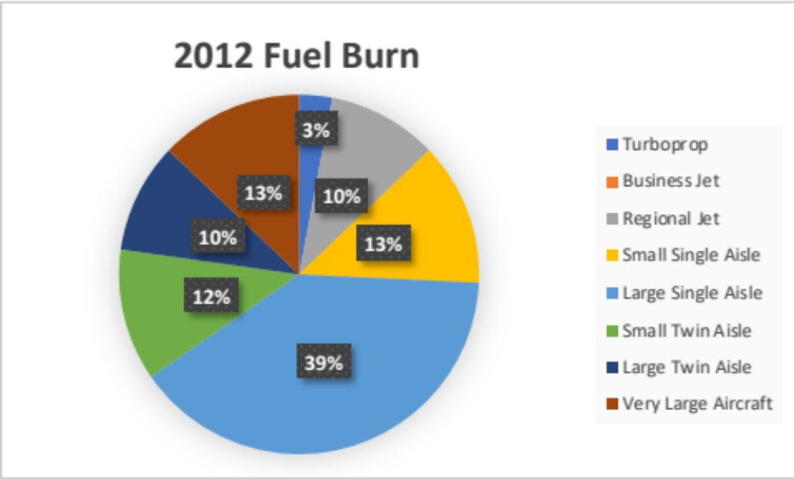
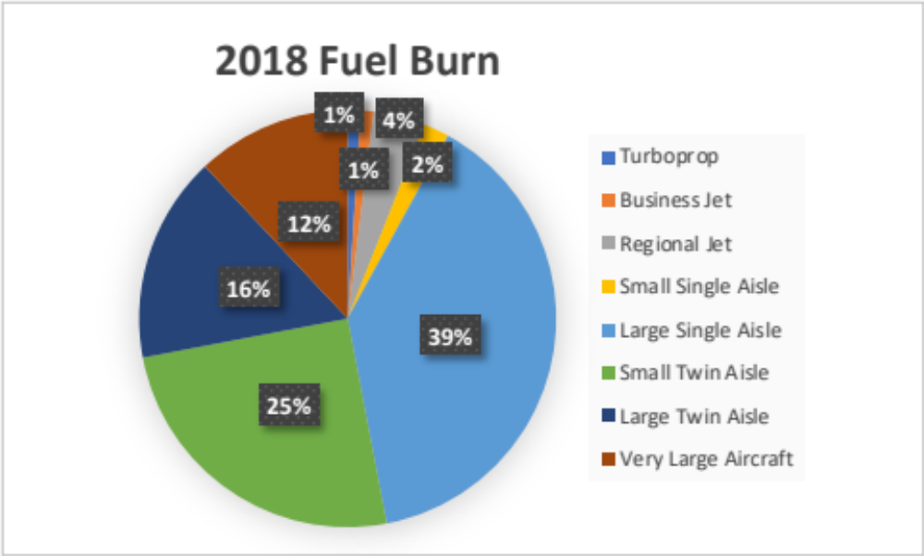
Following the Fuel Burn
Fuel Burn Contributions by Class
ARMD must prioritize technologies and solutions making biggest impact soonest.
Single and twin aisle comprise more than 80% of commercial aviation fuel burn.
4

Slide 5
A Balanced Beyond-SFNP Strategy
The Beyond-SFNP strategy must:
Support the transformation area and express needs of the US aviation industry and flying public
Build from ARMD’s unique capabilities and national role in aviation
Set aggressive, and realizable, vehicle technology and system concept goals
Be subject to the realities of continued budget and schedule pressures
Beyond Net-Zero
Growing Impact
Twin-Aisle
SFNP
Spirals
Striking this balance must be our priority.
5

Slide 6
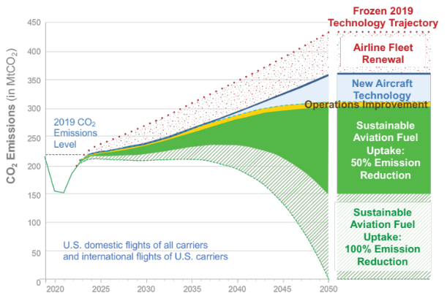
The Long Game: Aviation Eras on the Path Toward Sustainability
Net-Zero GHG, 2050
2020s
2030s
2040s
2050s
2060s
Era One: Evolution (Change is Coming)
Tube-and-Wing, Existing Infrastructure, Transition to Drop-In SAF, Increasing Electrification
Era Two: Revolution (SFNP Realized)
Vehicle Architecture Change, Major SAF Adoption, Mild Hybrid EAP, Minor Infrastructure Change
Growing Risk
Era Three: Transformation (Paradigm Shift)
Major Vehicle Architecture Change, Non-Drop-In Fuel Adoption,
Many-MW EAP, Major Infrastructure Change
Growing Potential Impact
ARMD must make deliberate, long-term investment in broad-ranging technologies outside industry’s risk tolerance.
6

Slide 7
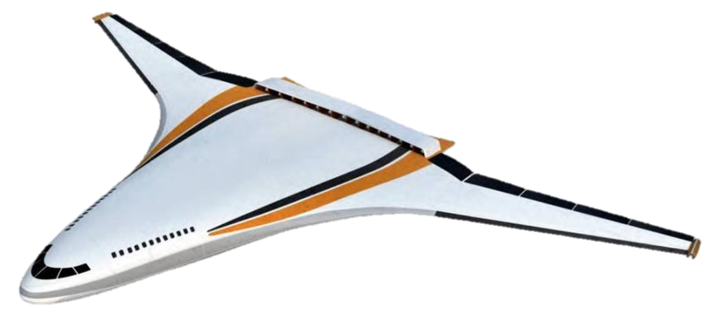
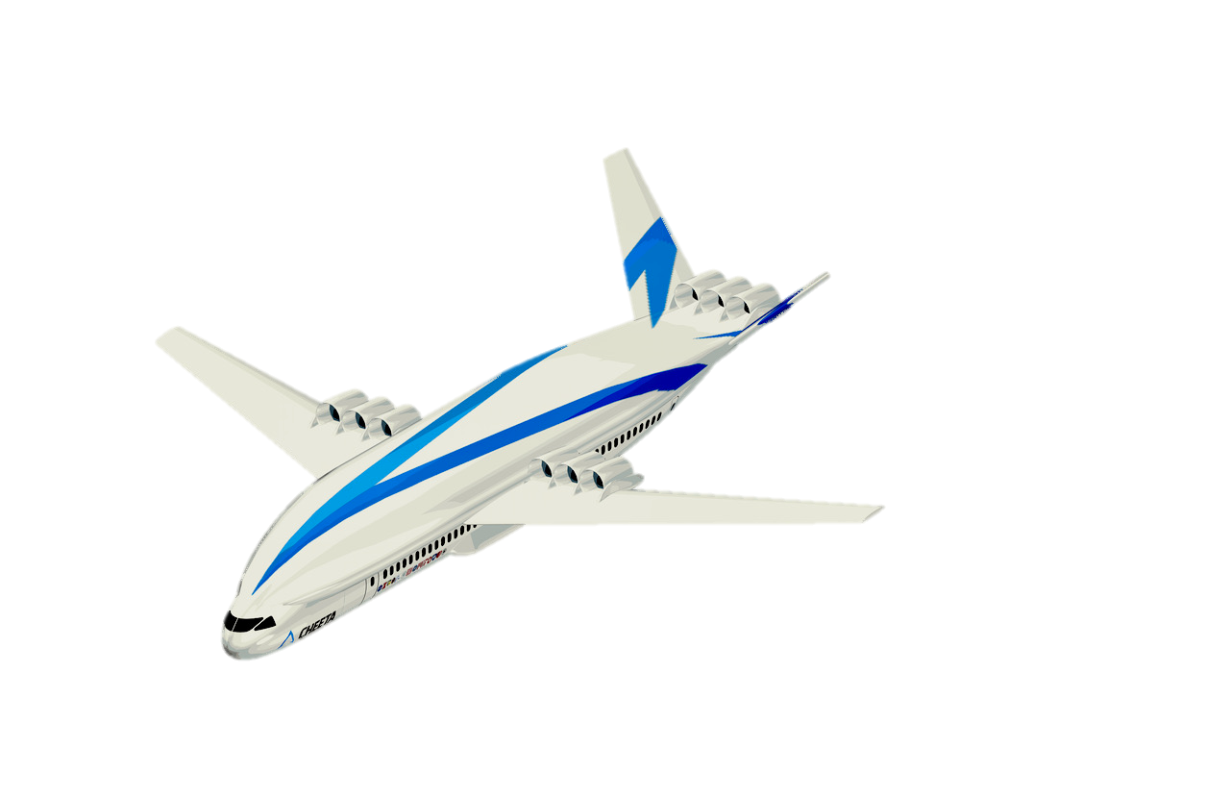
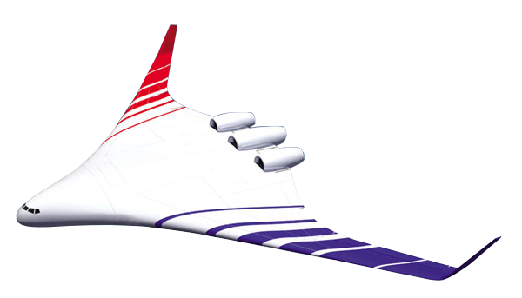
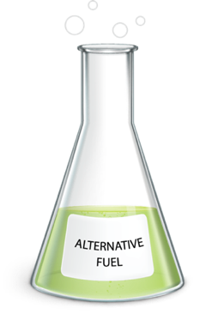

Beyond SFNP: Long-Term Transport Technology and Innovation
Generational studies to inform future technology investments
2008-2019
2020-2029
2030 - 2039
2040 - 2050
Subsonic Fixed Wing
N+2 Studies, ERA for the 2020s Impact
N+3 Advanced Concept Studies for 2030s Impact
Concept Studies and Technology Development Needed for 2040s Impact
Opportunities to Define Future Aviation Systems and Concepts
ARMD-commissioned strategic assessments across multiple areas: Propulsion; Electrified Aircraft Propulsion; Materials, Structures, and Manufacturing; Future Flight Demonstrations
AACES Advanced Concept Studies for 2040+ EIS
Net-Zero Emissions Concepts
Promising Technologies and Architectures
Support Aviation Community with NASA-unique Contributions
Note: Advanced Airspace Operations is also key (not discussed here)
H₂
100%
Hydrogen
Innovations for 2040s and Beyond
7

Slide 8
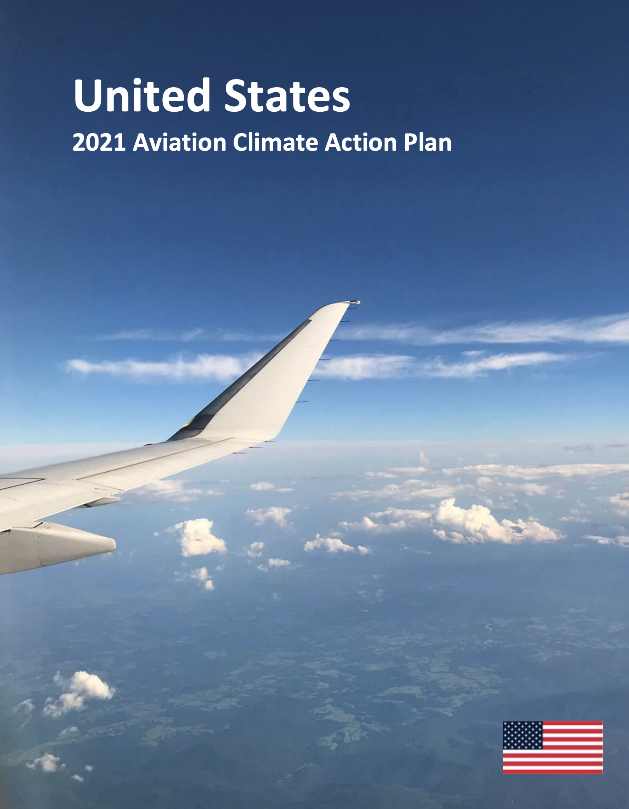
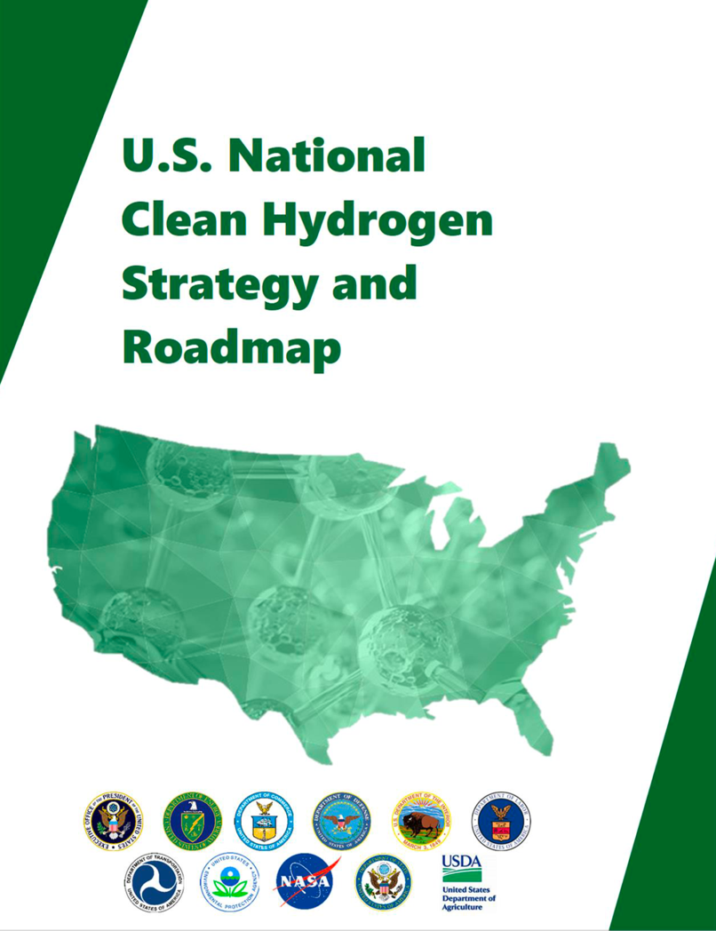
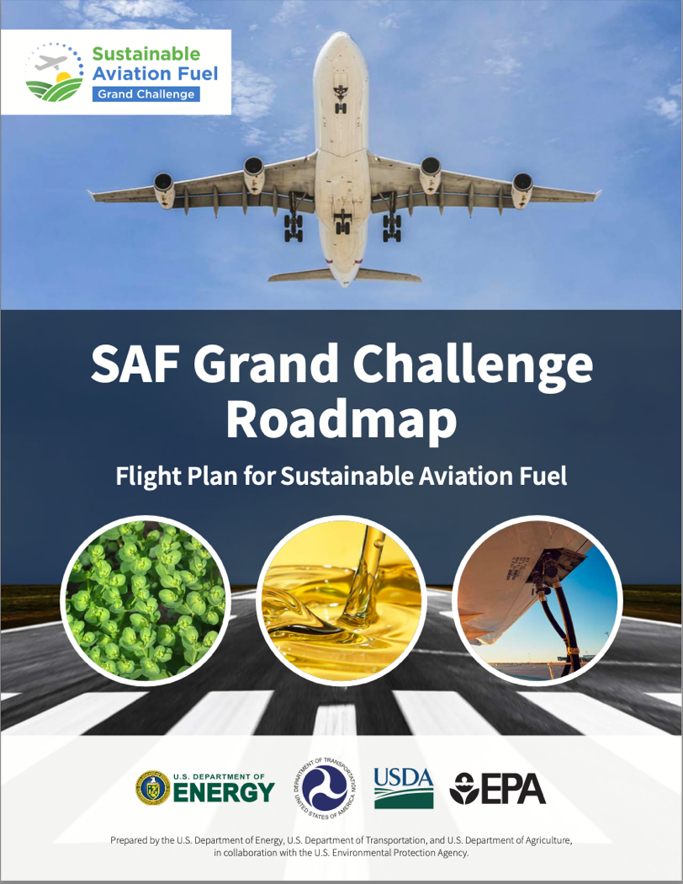
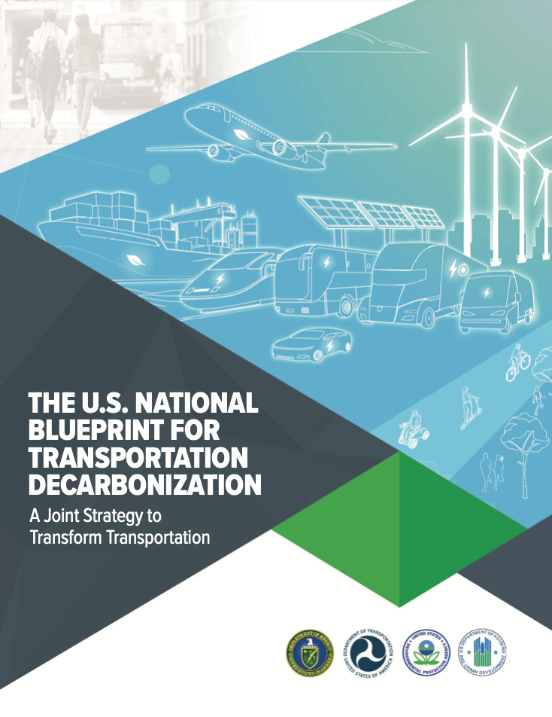
Beyond SFNP as Part of a National Strategy
DOC/DOD/DOE/DOI/DOL/
DOT/EPA/NASA/USDA+
National clean H2 production and infrastructure strategy
National H2 production goals:
- 10MMT/year by 2030
- 20MMT/year by 2040
- 50MMT/year by 2050
FAA
Net-Zero GHG emissions from aviation by 2050
Assumption of SAF-dominated aviation fuels landscape
DOE/DOT/FAA/USDA/EPA
References US Aviation Climate Action Plan goals
Establishes national goals for SAF production of:
- 3B gal/year by 2030
- 35B gal/year by 2050
DOE/DOT/EPA/DOH
Transportation sector wide decarbonization strategy
Three strategic pillars:
Community redesign
Improved efficiency
Transition to clean fuels
Metrics and goals are important. We can look to other government agencies for guidance but must keep in mind the unique role that ARMD plays in the aviation community when setting our own.
8

Slide 9
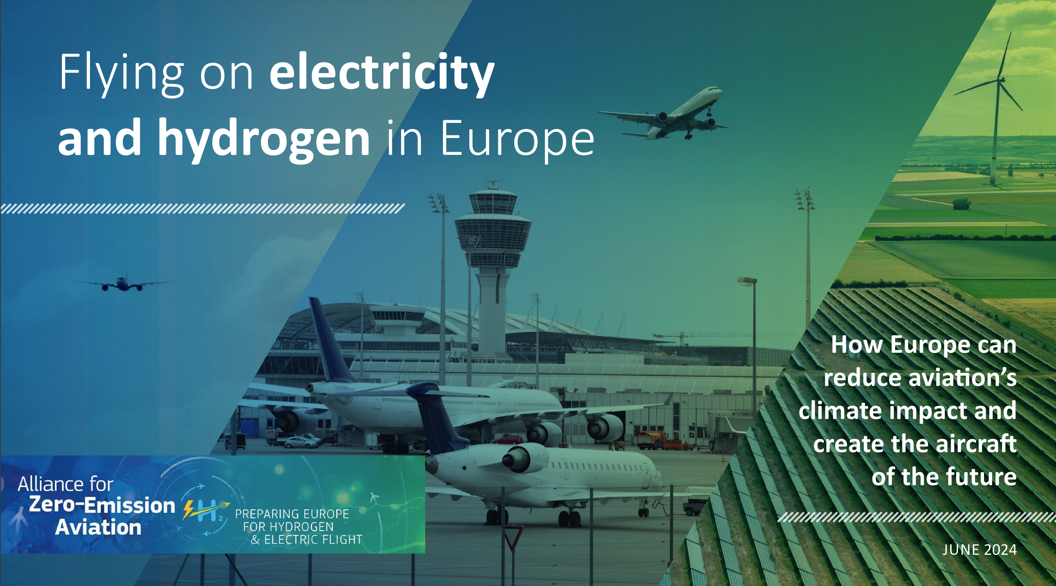
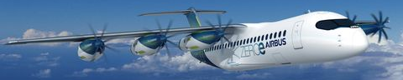
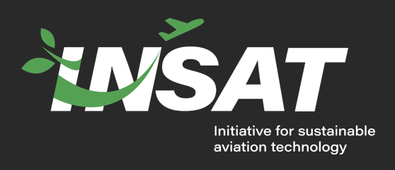
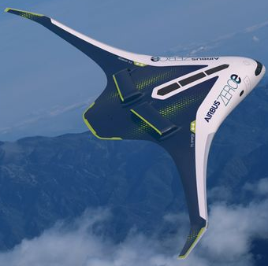
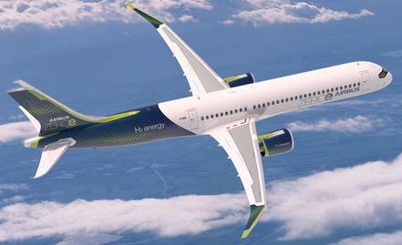

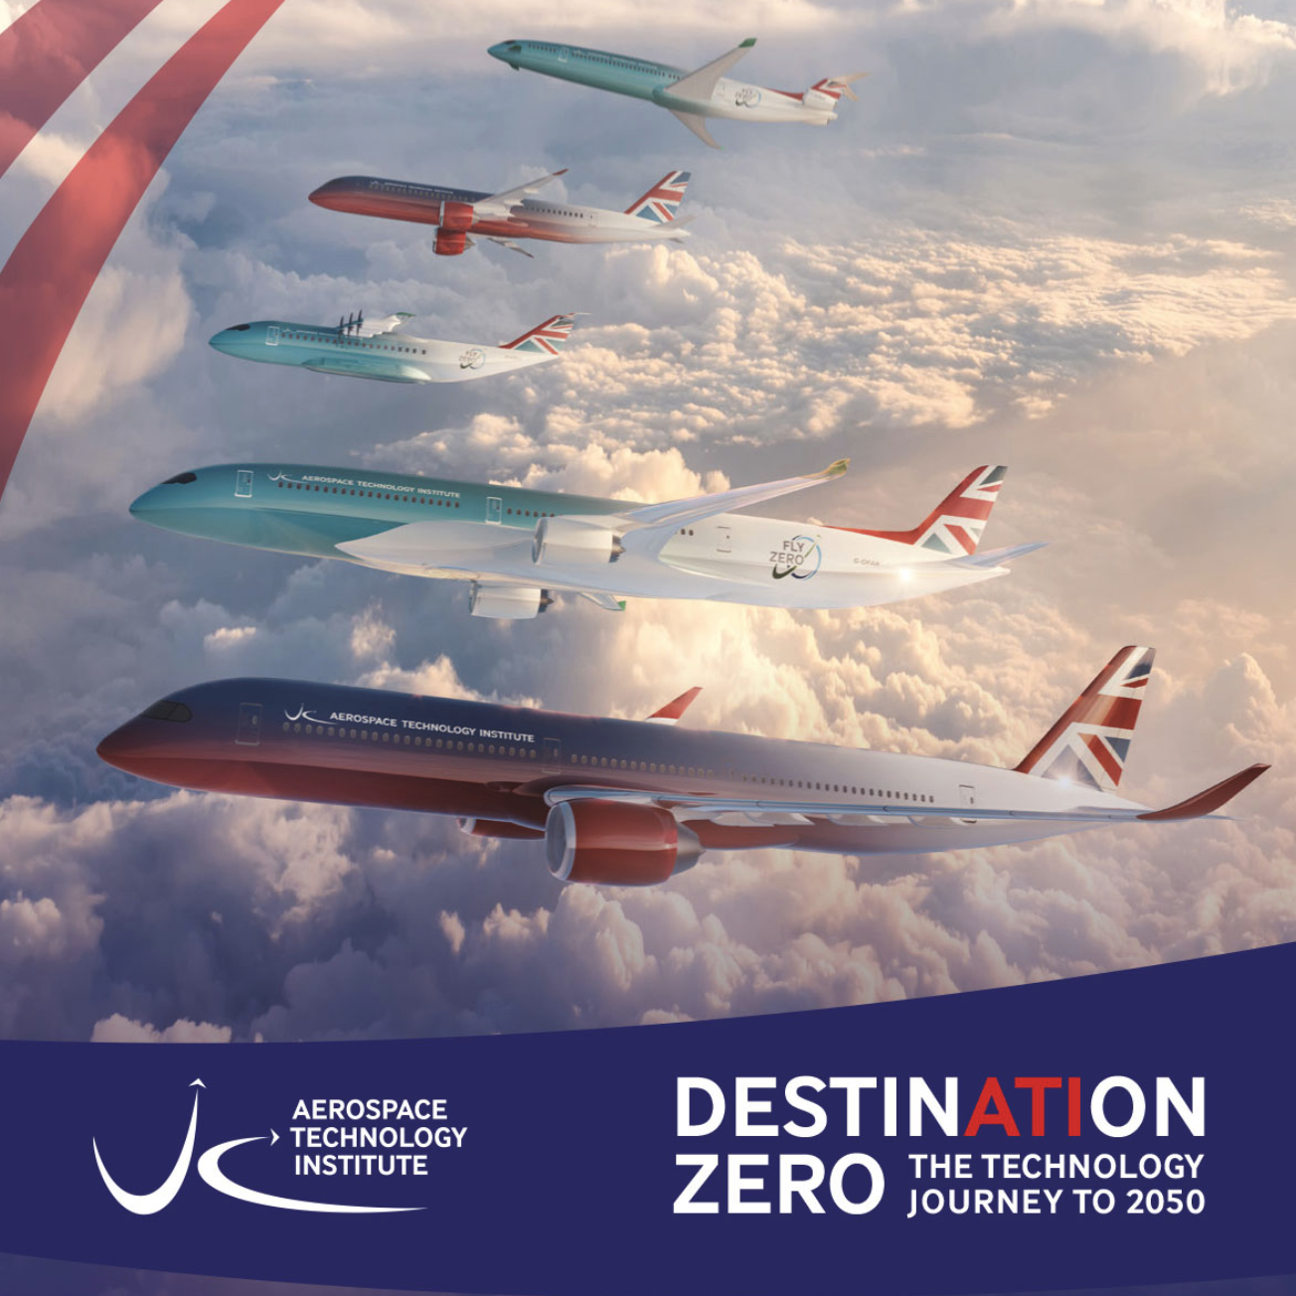

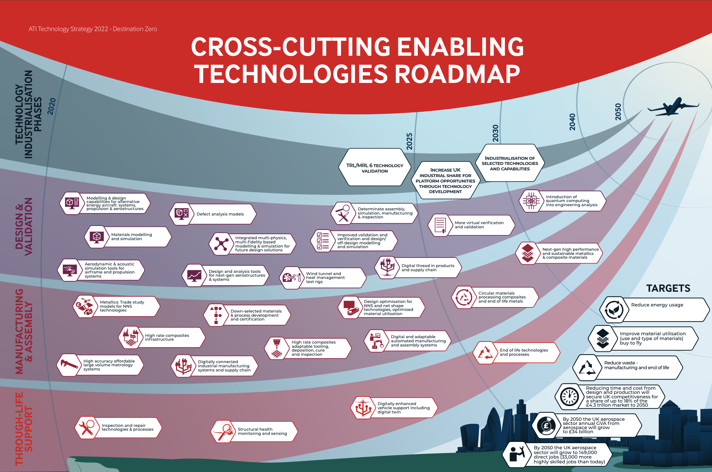
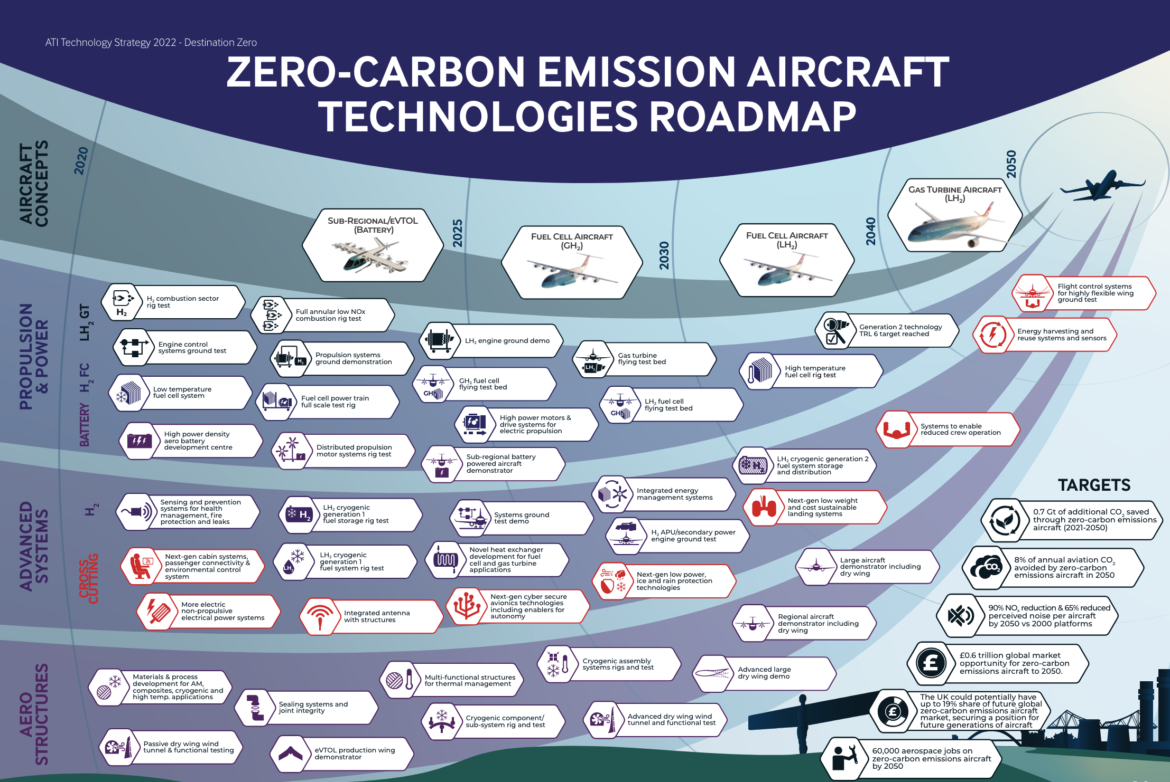


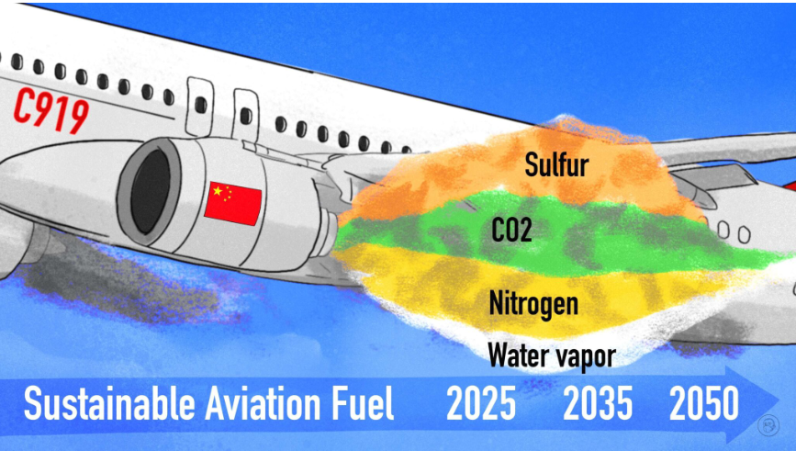

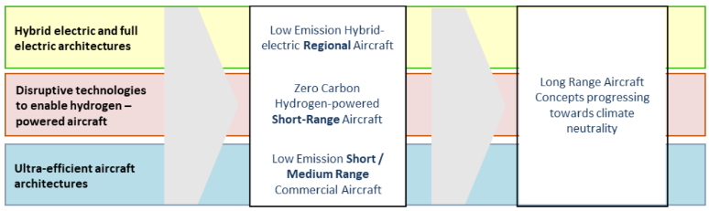
Beyond SFNP as Part of an International Strategy
AIRBUS ZEROe Program
“Green Aviation Manufacturing Development Outline (2023-2035).” Focus on SAF production.
Carbon neutrality is a global objective.
Countries around the world are implementing aviation sustainability strategies to achieve this goal.
9
9
Notes:
JAXA Sky Green+:
En-Core (Environmentally compatible core engine technology research) project
Design and Analysis of Next generation Technologies for jet Engines (DANTE)
Airframe noise reduction technology
Innovative Green Aircraft Technology (iGreen)
MEGAWATT project (Demonstration of Massive Electric
Generation for Aircraft and Wake Adaptive Thruster Technologies
Silent supersonic transport technology
High-speed rotary aircraft technology

Slide 10
The Importance of a Balanced Portfolio
Far-term projections are fraught with uncertainty
In the face of uncertainty, diversification and hedging is a critical element of strategy
Value in broad applicability (future scenario, future vehicle product, stakeholder interest, transformation area, etc.)
SAF production capability is increasing
Biomass pathway SAF production faces scalability challenges (water, land, feedstock)
PtL SAF: The US is leading, and forecast to lead, in production through 2030
Latest forecasts show the US missing its 2030 SAF production goals by ~30% (0.9-1.4 bn gal)
A green hydrogen economy is developing around the world – US, EU, China, +
The US is leading, and forecast to lead, in green hydrogen capacity through 2030
H2 production does not necessarily equate to availability for aviation applications
Latest forecasts show the US will miss its 2030 clean H2 production goal by ~40% (3.9 MMT)
What will the energy carrier of the future be?
10
Notes:
The Global SAF Production Capacity Outlook report by GlobalData’s oil and gas intelligence team put North America far in front of the projected SAF production capacity levels compared to the rest of the world, with the US forecast to have an upcoming capacity of more than 1,200 million gallons per year by 2030. https://www.airport-technology.com/news/us-saf-production-2030-new-report/?cf-view
U.S. production of SAF will be 2.1 billion gallons by 2030, S&P Global Commodity Insights has estimated, based on upcoming projects. https://www.reuters.com/sustainability/us-sustainable-aviation-fuel-production-target-faces-cost-margin-challenges-2023-11-01/
ICAO SAF Projects – several scenarios. Most likely based on back of envelope calculations is 2.1 billion gallons by 2030. https://www.icao.int/environmental-protection/Pages/SAF-Projections.aspx

Slide 11
Key Findings from ARMD Strategy Assessment Studies
Considered information from multiple sources… and still collecting more
  ARMD strategy studies; Gov/Industry Workshops; Internal Studies; AACES; OGA/Industry Engagement
Key themes emerging
  Likelihood of multiple fuels availability
  Heightened opportunities around vehicle integration
  Leveraging Computational Materials and Structures
  Increased need to consider market dynamics and implications beyond the vehicle
Initial assessment identified multiple research and technology opportunities:
  Power and Energy: Superconducting EAP; High-Perf Heat Exchange and TMS; Advanced Cycles
  Aircraft Integration Technologies: Distributed Propulsors; Cryo Fuels; Advanced CFD and MDAO for PAI
  Materials and Structures: Computational Materials; Cryo Tanks and Integrated Structures; Next Gen Manufacturing – Qual/Cert for Additive Manufacturing, and Digital Engineering
Critical gaps requiring further study (Integrated cryogenic fuels strategy and vision concepts, high-power EAP vision concepts, multi-domain, sector-level systems assessment capability, strategy development within computational materials and structures sub-domain)
The time is now for ensuring the future ARMD portfolio reflects complexity of achieving sustainability.
Balanced investment in light of significant uncertainty beyond SFNP is critical to making impact.
11

Slide 12
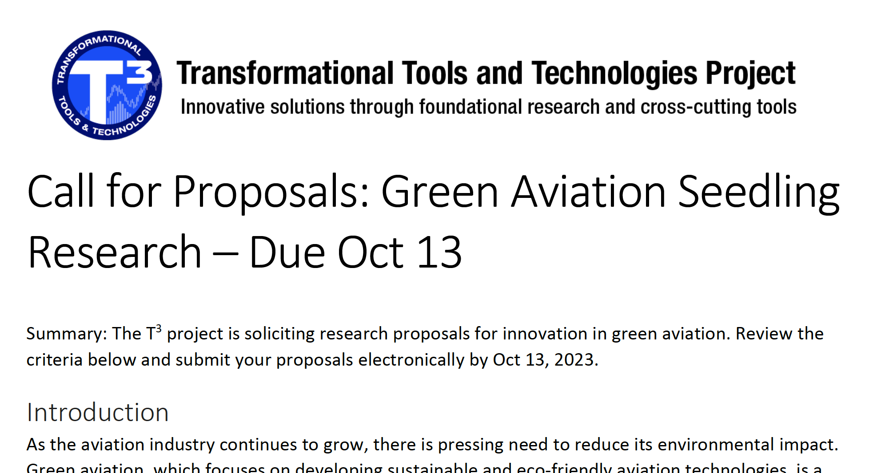
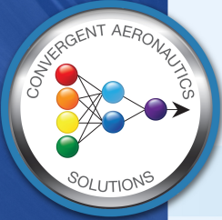
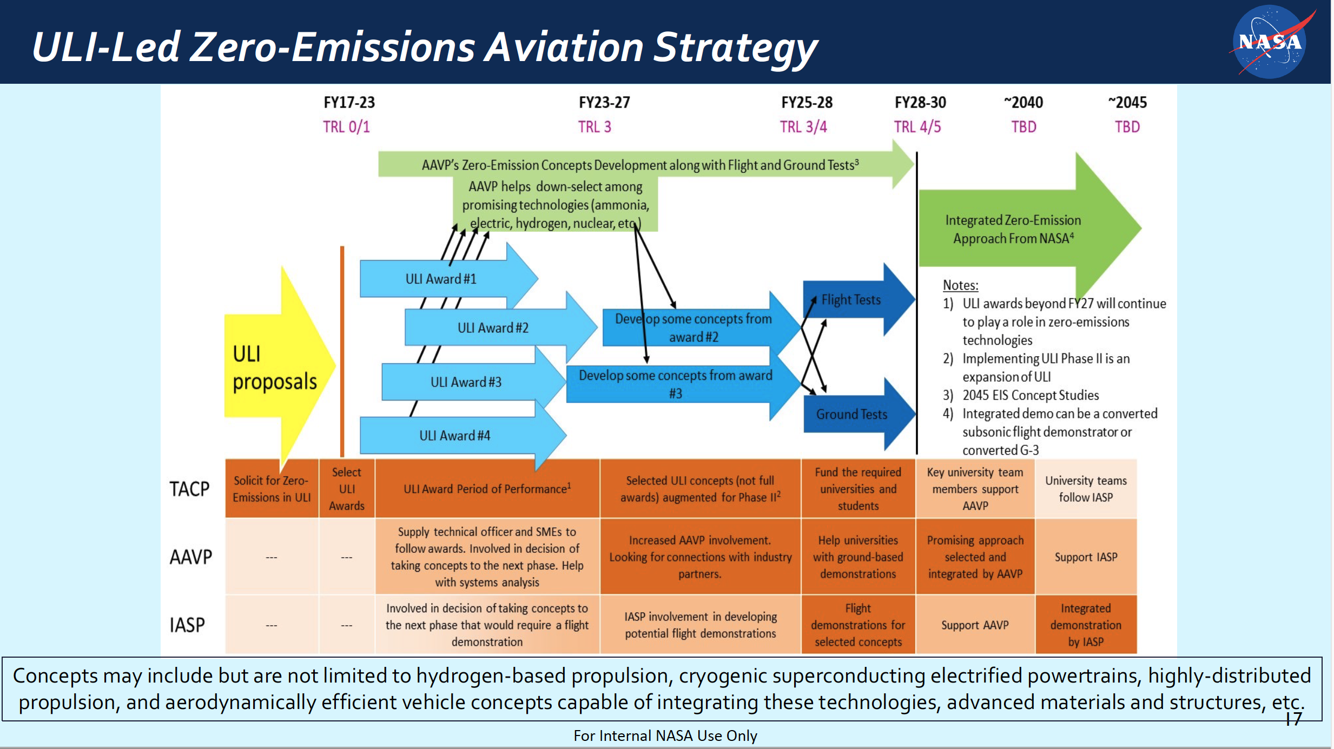


Ongoing Beyond-SFNP Zero Emissions Activities
Convergent Aeronautics Solutions Project
Transformational Tools and Technologies Project
University Innovations Project
Green aviation exploratory investments
Battery systems and prognostic safety
Advanced materials
MDAO tools for advance vehicle configuration design
Green aviation future system concepts
Power beaming
AI discovery tools for transformative future states
TACP serves as the ARMD Innovation Ecosystem evolving an opportunity roadmap
w/ OSTEM
w/ OSTEM
Gateways to Blue Skies Competition
Dream with Us Design Competition
TACP’s Zero Emissions portfolio is a fertile breeding ground for low-TRL concepts and technologies.
Strong ties between AAVP and TACP are foundational to this transformation area.
12

Slide 13
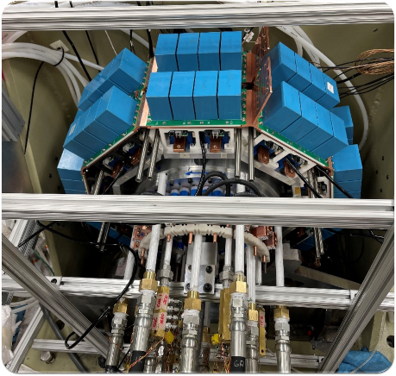
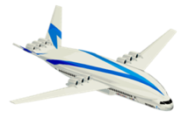
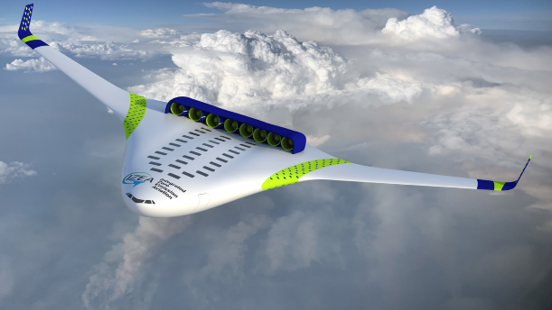
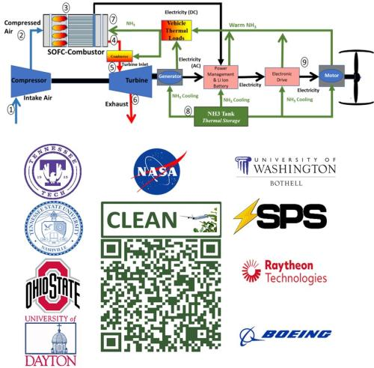
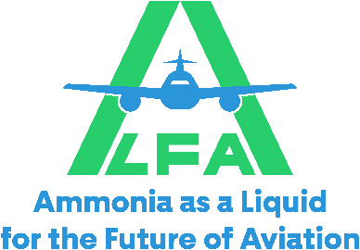
Ongoing Beyond-SFNP University Innovation Project Investments
Electric Propulsion | Ohio State University (1 MW motor) Developed 9 kW/kg, 95.8% efficient integrated modular motor drive No partial discharge observed at 50,000 ft in NASA NEAT facility
Hydrogen | University of Illinois, Urbana-Champaign (Cryogenic hydrogen electric aircraft) Superconducting motors and power transfer, Liquid hydrogen tanks Hydrogen fuel cell, Cryogenically-cooled power electronics | Florida State University (Hydrogen powered hybrid electric aircraft) Combination of turboelectric generators and fuel cells Develop power electronics, power distribution, and manage thermal loads
Ammonia | University of Central Florida (Cracking ammonia for hydrogen propulsion) Ammonia as a hydrogen carrier, NOx control, and thermal management Supercritical carbon dioxide waste heat recovery system | Tennessee Technological University (Ammonia based power generation) Integrate an ammonia-based Solid Oxide Fuel Cell-Combustor and a turbogenerator Distributed electric propulsion
From Student Competition: Aluminum Powder, Energy Beaming, Nuclear

Slide 14
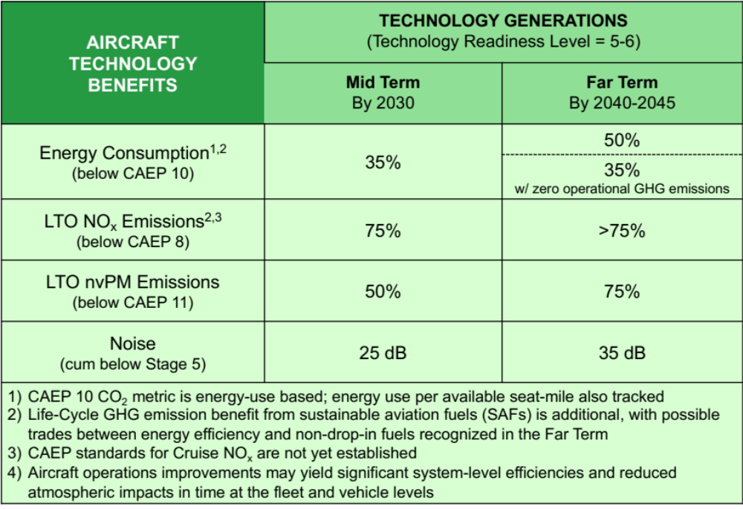
Measuring Progress: Updated Subsonic Transport Metrics
Draft currently undergoing final internal review
Approach for updating table:
  Move toward current standards
  Timeframes reflect current strategy
  Goals traceable to studies
  Balanced goals - aspirational and technically feasible
Mid Term goals reflect latest SFNP strategy and sync with FAA CLEEN Phase IV goals for the same metrics (see next chart)
Far Term goals reflect the uncertainty in the fuel/energy landscape beyond 2040 (i.e., SAF-dominant vs. beyond-SAF)
The updated metrics table represents a move toward standards-based metrics and traceable goals,
while acknowledging uncertainty of Far Term energy futures in the Beyond-SFNP timeframe.
14

Slide 15
Measuring Progress: Updated Subsonic Transport Metrics
Draft currently undergoing final internal review
Approach for updating table:
  Move toward current standards
  Timeframes reflect current strategy
  Goals traceable to studies
  Balanced goals - aspirational and technically feasible
Mid Term goals reflect latest SFNP strategy and sync with FAA CLEEN Phase IV goals for the same metrics
Far Term goals reflect the uncertainty in the fuel/energy landscape beyond 2040 (i.e., SAF-dominant vs. beyond-SAF)
SUBSONIC AIRCRAFT TECHNOLOGY BENEFITS¹ | TECHNOLOGY GENERATIONS (Technology Readiness Level = 5-6)
 | Mid Term By 2030 | FAA CLEEN IV EIS 2035 | Far Term By 2040-2045
Energy Consumption^{2,3} (below CAEP 10) | 35% | 35% | 50%
 |  |  | 35% w/ zero operational GHG emissions
LTO NO_{x} Emissions^{3,4} (below CAEP 8) | 75% | 70% | >75%
LTO nvPM Emissions (below CAEP 11) | 50% | 50% | 75%
Noise (cum below Stage 5) | 25 dB | 25 dB | 35 dB
Aircraft operations improvements may yield significant system-level efficiencies and reduced atmospheric impacts in time at the fleet and vehicle levels CAEP 10 CO₂ metric is energy-use based; energy use per available seat-mile also tracked Life-Cycle GHG emission benefit from sustainable aviation fuels (SAFs) is additional, with possible trades between energy efficiency and non-drop-in fuels recognized in the Far Term CAEP standards for Cruise NO_{x} are not yet established
The updated metrics table represents a move toward standards-based metrics and traceable goals,
while acknowledging uncertainty of Far Term energy futures in the Beyond-SFNP timeframe.
15

Slide 16
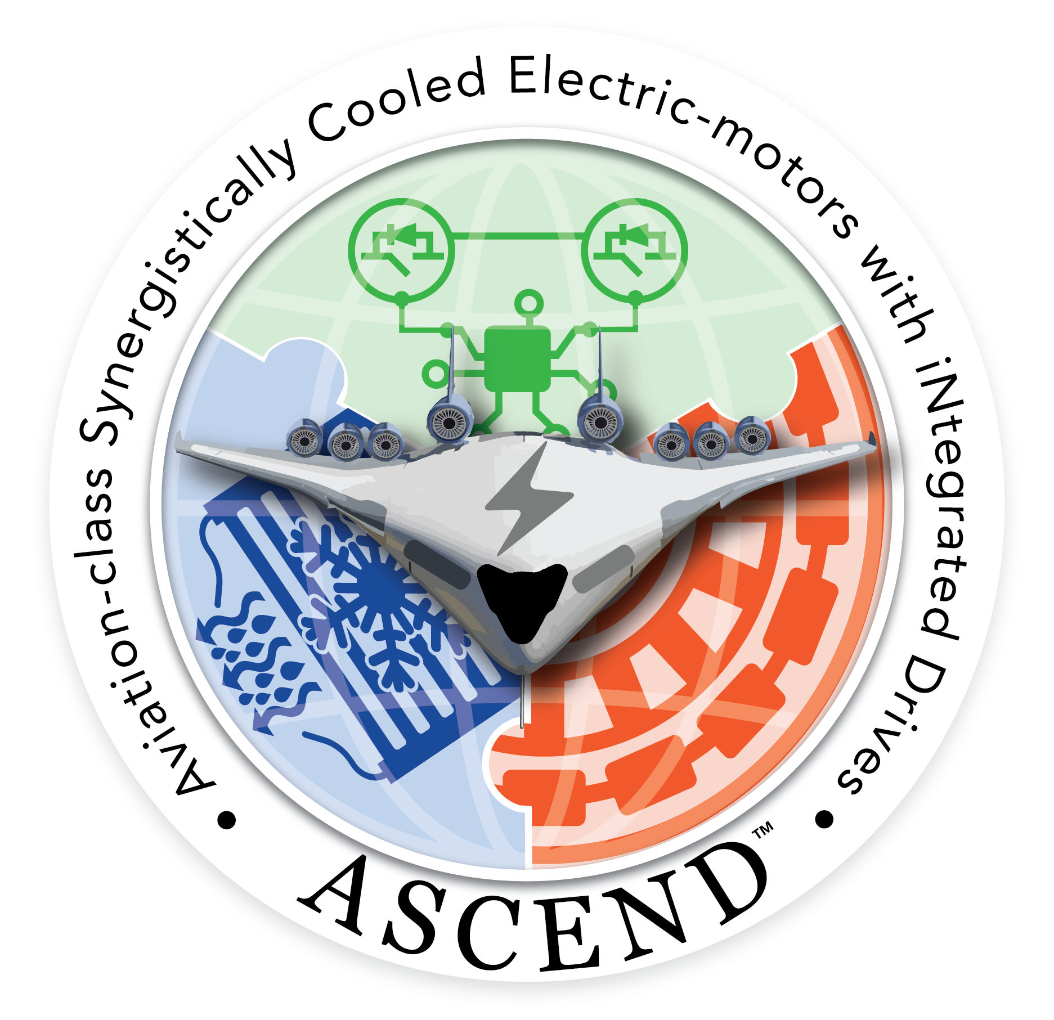












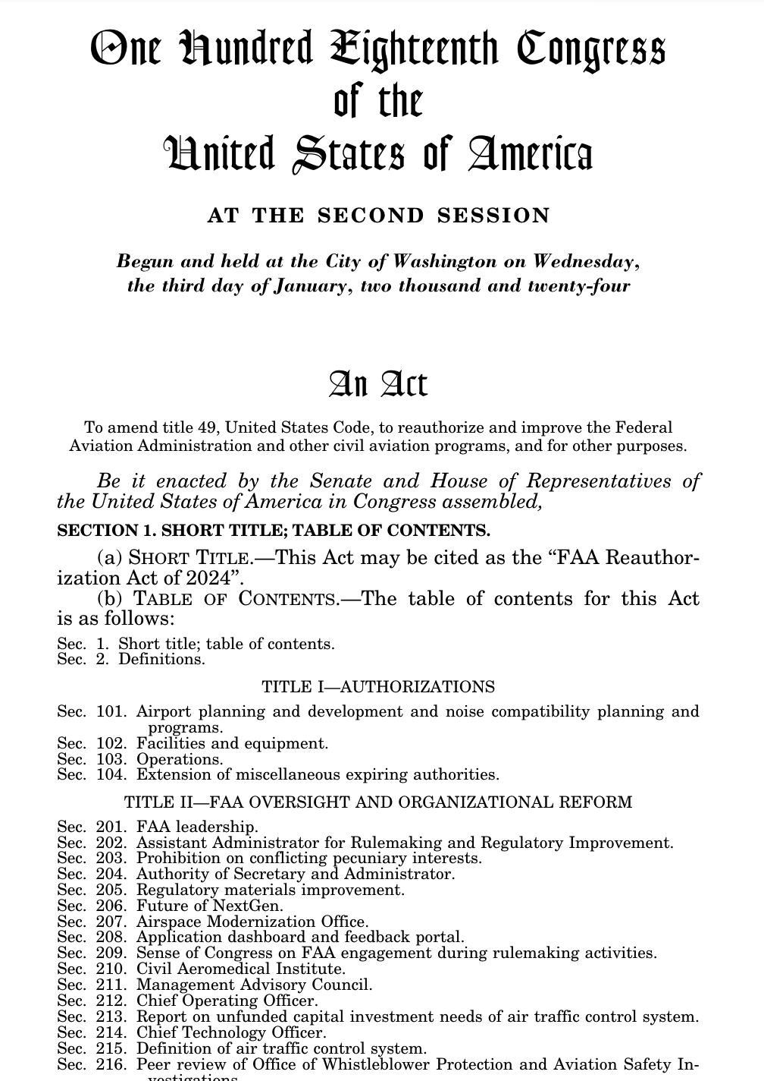
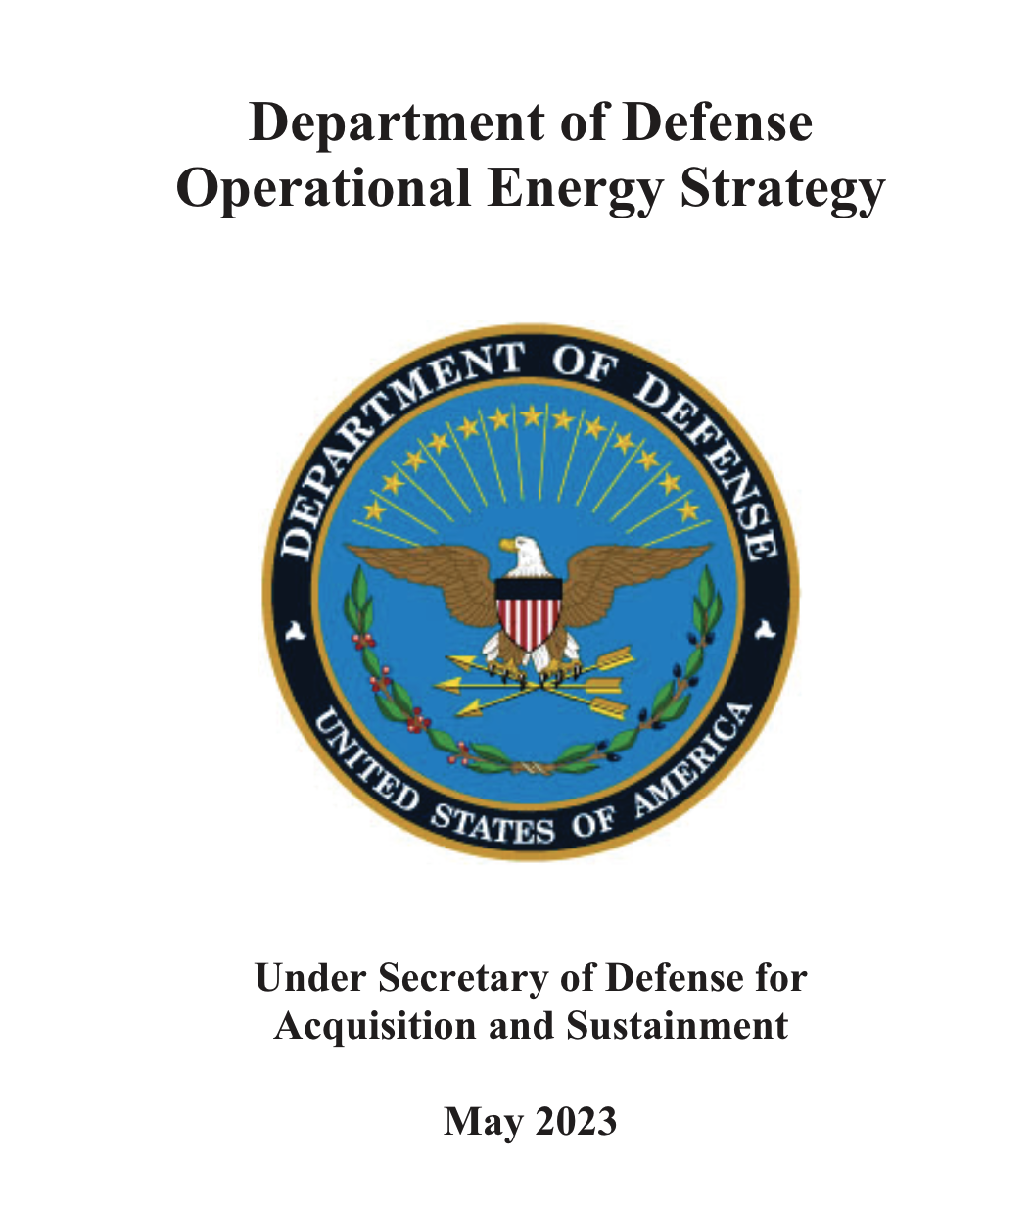


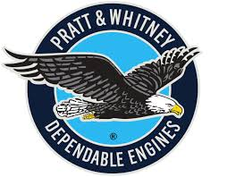



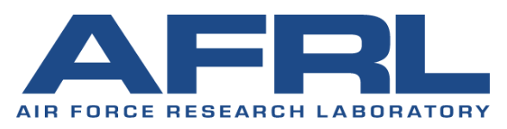




Thoughts on a Beyond SFNP National Partnership
Academic CoEs + UTCs
The next National Partnership will require us to think broadly - beyond the OML.
Strong cross-government and academic partnership will be critical to enabling an alternative fuels future for aviation.
16
16
Notes:
Arpa-e logos:
Propel-1K – advanced batteries
ASCEND – electrify aircraft engine
GreenWells – liquid fuel for energy storage
Circular – EV battery supply chain
REEACH – electrify aircraft powertrain
ECOSynBio – biofuel production

Slide 17
Path to Refining Beyond-SNFP Strategy
Define goals by understanding strategic needs
Engage industry, academia, and OGA
  Component, engine, airframe manufacturers
  Other government agencies (FAA, DoD, DoE, etc.)
Identify major technical challenges
Identify how NASA can support
Assess the broad range of ongoing NASA activity
Leverage past studies
Coordinate between strategy teams to ensure complementary activities with minimal overlap/gaps
Develop paths to reach defined goals
Select/evaluate system-level technology that is ready for maturation
Develop technology timeline for future demonstration / technology maturation
Phase 1
Phase 2
17

Slide 18
Questions and Reflections
To maintain perspective on Beyond SFNP investment opportunities, we expect to remain engaged with a similar stakeholder community as today. Not wrong, but perhaps insufficient.
Who are the most important communities to engage? Industry, Venture Capitalists, OGA, Academia, International Market Players?
We’ve just discussed numerous approaches and examples of potential opportunities
Do you see a roadmap evolving?
What do you see as future trend lines that we should explore?
Are we missing anything?
18

Slide 19


