Slide 1
Intelligent Change Detection System:
Autonomous Intelligent Machine Agent Model Development
Vincent E. Houston
David J. Degaraff
Crew Systems and Aviation Operations Branch
NASA Langley Research Center
Notes:
This the culmination of three phases of research:
Phase I - IAS prototype
Phase II- Enhanced IAS development
Phase III-Human-Agent V&V of IAS
And how this technological development can advance operations in the ever evolving NAS.

Slide 2
Development Outline:
Research Motivations
The Technical Challenge
Net Centric Architecture
    What it is
    Pros
    Cons
Intelligent Change Detection System (ICDS) Architecture
    ICDS Autonomous Trigger (AT)
    Real-Time Intelligent Streaming Distributed Data Architecture
    ICDS Intelligent Machine Agent (IMA) Model
ICDS Component Integration
ICDS IMA Model Development and Test

Slide 3
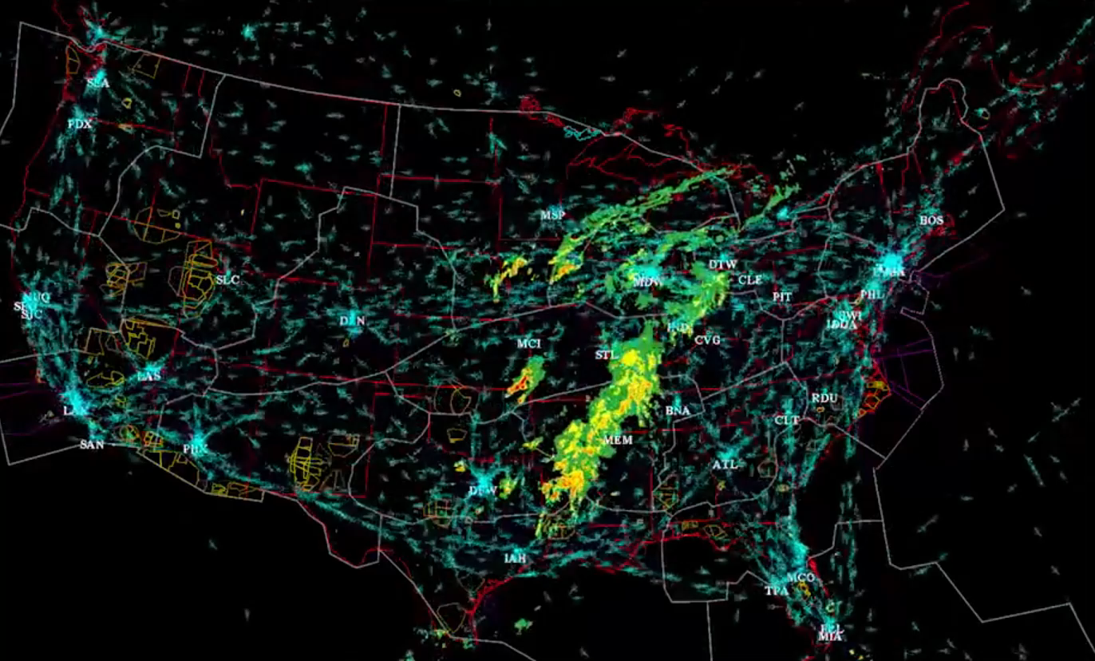
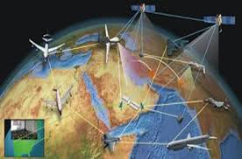
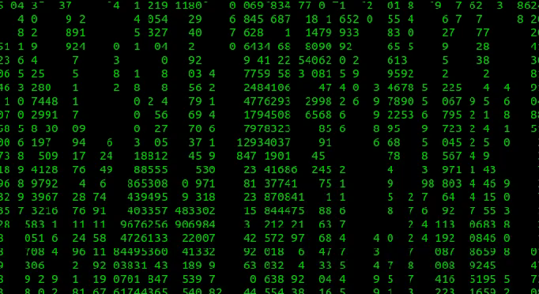
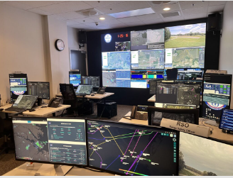



Research Motivations:
Maturation of the NAS
Net-Centric Environment
Data Influx into Ground Control Stations
Complex Visual Infrastructures
Change Blindness
Human and Machine Symbiosis
Credit: NASA
Credit: Department of Defense
Credit: Alpha Coders
Credit: NASA
Credit: Author
Credit: Author
Notes:
NAS Maturation – number of airspace operations exploding over the years causing the NAS to become an arduous environment to operate in.
Net-Centric Architecture – is the byproduct of a Next-Gen NAS, which is a complex environment with which a flight crew is to operate in.
Data influx to Ground Control Stations - “Add Brief Note”
Complex GCS infrastructure - “Add Brief Note”
Change Blindness – “Add Brief Note”
The human and machine agent- “Add Brief Note”

Slide 4
The Technical Challenge:
The Next-Gen National Airspace System (NAS) will need to facilitate the emergence of Advanced Air Mobility (AAM).
An exponential increase in the amount of actionable data (information).
Human-Agents performing direct-action aviation (DAA) tasking, to ensure the safe entry, operation, and egress of unmanned aerial vehicles within the NAS, will require a “collaborator.”
NASA projects have identified an operational challenge for Ground Control Station Operators (GCSOs) that is inherent to the design of their operational environment.
Develop an autonomous system that can be implemented to combat “change blindness”.
Notes:
As the NAS continues to experience a dramatic up shift in the types and number of aerial vehicles.
It is expected that 175 zettabytes of data will be created in all modalities, i.e., visually, textually, auditorily by 2025, which is an 80% over 2022.
Human-Agents cannot handle the vast amounts of data that will permeate their aviation environments. They will be overwhelmed, and catastrophe may not be averted.
Which is designed and structured around a complex monitoring and control configuration.
And improve the operational environment of GCSOs.

Slide 5
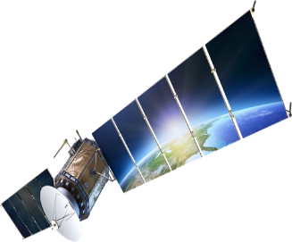






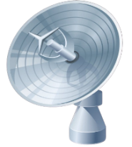



Net Centric Architecture:
A continuously-evolving system architecture
A complex Symbiotic community of:
  People
  Devices (Legacy, Current, and Burgeoning technologies)
  Information and Services
Operating within a Net-Centric Environment Requires:
  Possessing the Coin-Of-The-Realm => Massive Amounts of “Actionable Data”
  Using that coin (aka “Information”) to connect to the environment’s Comms
  Improvements in the ability for humans to data wrangle
  The use of intelligent systems
The GOAL:
  Prevent data overload of human-agents/Direct Action Aviation Personnel (DAAP
  Empower Direct Action Aviation Personnel (DAAP)
  Provide DAAP with preferably-pertinent information
Credit: Author

Slide 6
Intelligent Change Detection System Model Development:
ICDS System Functionalities:
    Ingest all sUAS MPATH data Transmitted to the Remote Operations for Autonomous Missions (ROAM) Lab
    Predict the onset of Change Blindness (CB) in ROAM Ground Control Station Operators (GCSOs)
    Determine whether relevant changes to sUAS state data has been missed due to CB
    Depict missed relevant sUAS state data changes to GCSO display
    Store ingested data for continued ICDS training

Slide 7
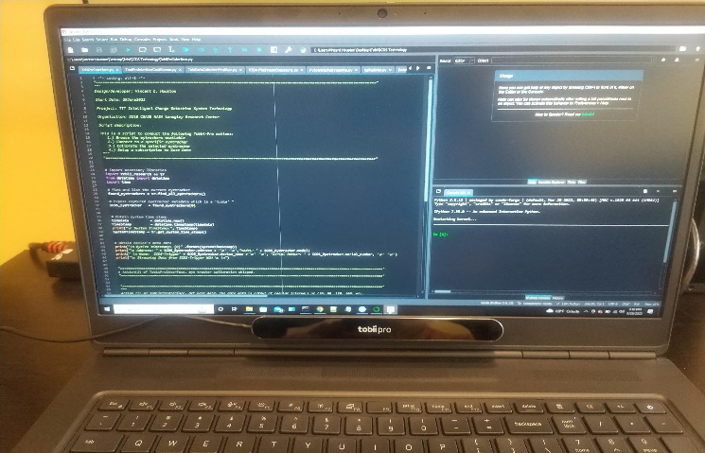
Intelligent Change Detection System Architecture: (AT)
Time synchronized with MPATH data stream
Autonomously identifies loss of GCSO eye focus
Triggers the ingestion of all sUAS MPATH state data
Triggers the implementation of the ICDS relevant data determination
Notes:
Combating CB begins with the calibration of the GCSO’s eye, head, and body position with respect to the visual field he or she is responsible for. This is done by using an eye tracking system.
ICDS triggering occurs autonomously via the eye tracker’s parameter output. Only when the GCSO has lost visual focus with their calibrate visual field (or when the eye tracker is no longer outputting gaze data from a GCSO) does the Autonomous Trigger gets pulled.
It is at this point that the ICDS and the data warehouse use all the ingested data to make predictions as to whether relevant data has been missed or not and then display and store that lost relevant data.
Eye track data is time synchronized and continuously streamed with air vehicle state data provided by MPATH, which is portable, minimalist, fully-functioning GCS for UAVs, for any autonomous system supporting the MAVLink protocol or lightweight messaging protocol for communicating with UAVs.
Data stored in the warehouse is beneficial for model (or ICDS) training in the future.

Slide 8
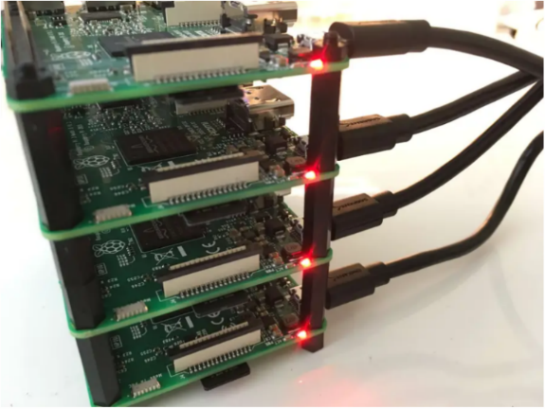


  Intelligent Change Detection System Architecture: (RISDDA)
Cleanse
Enrich
©
©
Normalize
Real-Time
Analytics
Streaming Data Pipeline
Notes:
RISDDA- (performs data wrangling, management, distribution, and storage) utilizing a Kappa Data architecture, which is a streaming-first architecture deployment pattern where data is processed in real-time. However, this hardware structure could be implemented with only Raspberry Pis or one Raspberry Pi containing multiple Virtual Machines.
Apache Spark: is a unified analytics engine for large-scale data processing, it supports high-level tools including SQL and structured data processing, pandas, MLlib, GraphX for graph processing, and computation and Structured Stream processing.
Apache Kafka: is provided in a distributed, highly scalable, elastic, fault-tolerant, and secure manner. Kafka can be deployed on hardware, virtual machines, and containers, and on-premises as well as in the cloud
It is a system that would accommodate the ingestion of multiple types of aviation communication data
It provides intelligent data distribution from multiple sources to intelligent machine connectors
Offers closed loop cloud data storage
And occupies a small physical footprint
In a nutshell, this entire architecture stream process data from the messaging system(data sources through Apache Kafka messenger), transforms it, and publishes the enriched data to the messaging system, making it available for real-time predictive analytics, alerts, machine learning (ML), reporting, dashboarding, predictive and preventive maintenance.

Slide 9
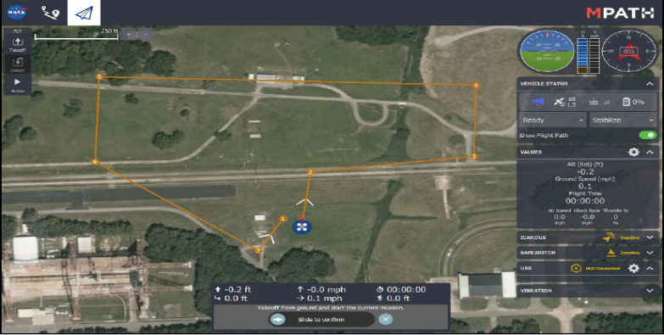
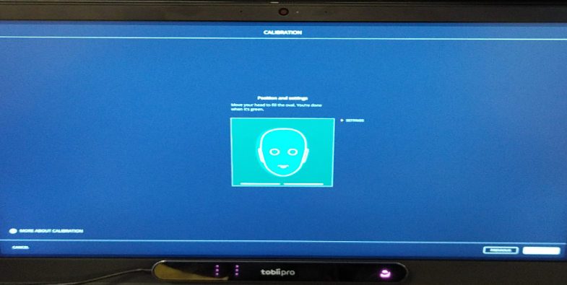


Intelligent Change Detection System Architecture: (ICD ML Model)
MPATH Full Parameter List & Synchronized Timestamp
Intelligent Change
Detection System
(ICDS)
Left & Right Eye Gaze Data + Device Timestamp

Slide 10
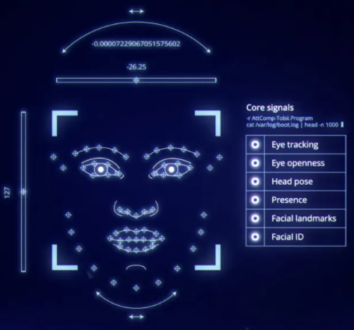





Intelligent Change Detection System Architecture
Autonomous
Trigger
Dat a
L
ake
Cleanse
Enrich
^
©
©
ICD
ML Model
MPATH Data
Normalize
Real-Time
Analytics
UAS State Data
Weather
Streaming Data Pipeline
Flight/Flow
Enroute
Real-Time Intelligent Streaming Distributed
Data Architecture (RISDDA)
Data Warehouse
Multimedia
Data
MetaData Repository

Slide 11
Intelligent Change Detection ML Model (Dataset Design):
Parameter | Normal Value | Units
Ground Speed | 20 | Knots
Vertical Speed | -2 | Feet / Seconds
Position Change | +1024 | Feet
Distance Traveled | +1400 | Feet
Flight Time | +15 | Seconds
Altitude | +3200 | Feet
Battery Time Remaining | +7.5 | Hours
Battery Percentage | 71 | Percent
Tobii Eye Tracker (Gaze-Left) | 60 | Hertz
… | … | …
Twenty-two Parameters Representing MPATH sUAS data
Ten thousand rows every 15 seconds
Eight hundred and eighty thousand data points per minute
Random value starts for each parameter
Tobii Eye Tracker gaze and eye-close data
Timestamp for data inputs
Nominal and off-nominal data values

Slide 12
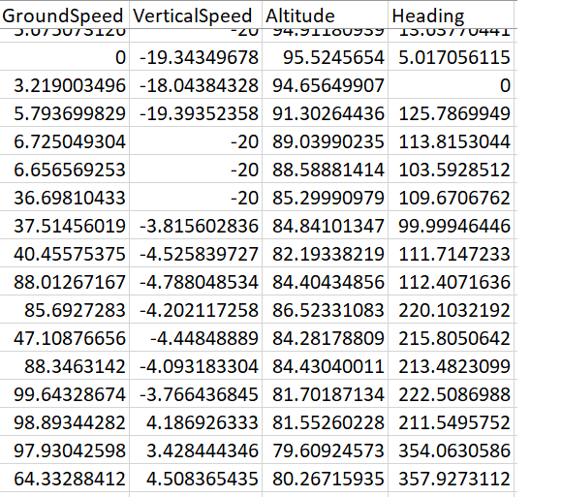
Intelligent Change Detection ML Model (Dataset Design):
Data Processing and Normalization
  Raw data rounded, reducing data input and increasing model speed
  Actual model input is the change in parameters between time steps
  Eight hundred-eighty-eight thousand entries of the 23 input parameters implemented as model input

Slide 13
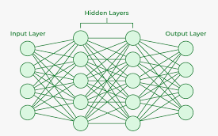
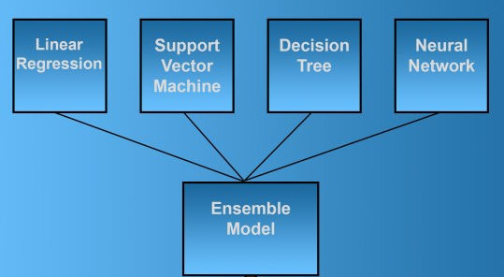
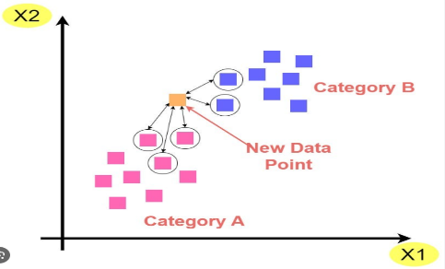
Intelligent Change Detection ML Model (Model Selection & Feature Extraction):
Machine Learning Algorithms Considered
  Neural Networks
  Ensemble Methods
  K-Nearest Neighbor
Feature Extraction to Improve Model Accuracy
  Altitude
  Heading
  Ground Speed
  Vertical Speed
  Pitch
  Roll
  Battery Percentage
Neural Network
Ensemble Method
K-Nearest Neighbor

Slide 14
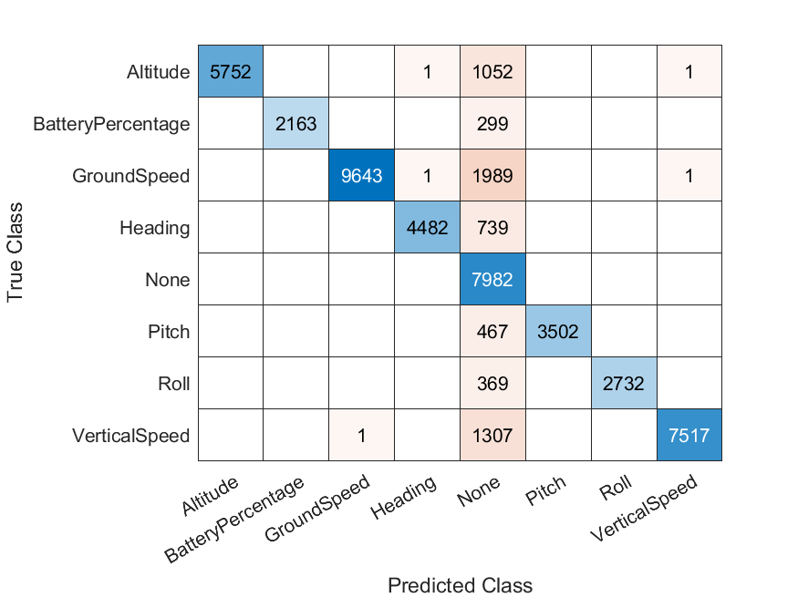
Intelligent Change Detection ML Model (Test Results):
Supervised machine learning model test and
evaluation conducted with MATLAB
ICD Machine Learning model top performer:
RUSBoosted Tree
Model parameters and input vectors fine
tuned with RUSBoosted Tree
Accuracy of change blindness detection and
missed relevant sUAS stated state data is: 87.55%

Slide 15

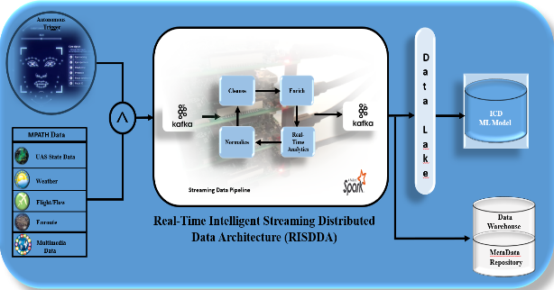

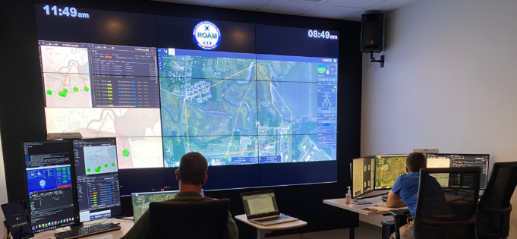
Intelligent Change Detection Future Research Efforts:
Real-Time Streaming MPATH data ingestion into ICDS
  Verify ICDS improved accuracy w/non-simulated data
Full ICDS Integration into the ROAM Lab
System footprint reduction
  Verify non-intrusive portability of full ICDS
Human-In-The-Loop research study
  Determine ICDS design correctness
  Verify ICDS effectiveness at human-machine teaming
  Acquisition of human knowledge w/respect to missed data relevance

Slide 16

Questions/Comments:

