Slide 1
The Lightning Instrument Package
Presented by
Christopher J. Schultz
NASA/Marshall Space Flight Center
LIP Team:
Monte Bateman, Doug Mach, Timothy Lang, Sebastian Harkema, Mason Quick, Rich Blakeslee, Michael Stewart, Scott Podgorny, David Corridor
IMPACTS Science Team Meeting
July 2024

Slide 2
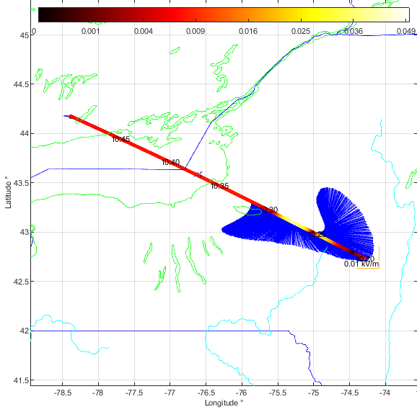
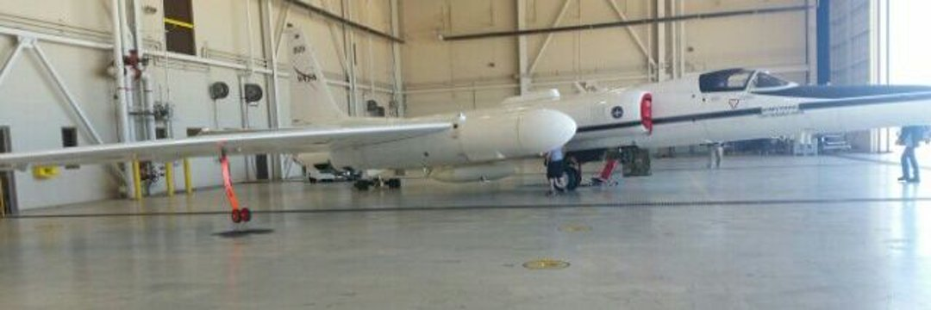
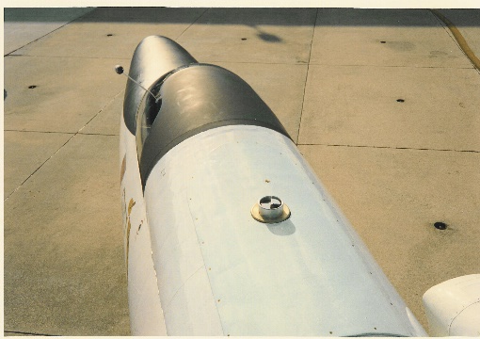
LIP Measurements
Canada
NY
Instrumentation
  Electric Field Mills (7)
Measurements
  Vector components of the electric field ( E_{x} , E_{y} , E_{z} )
  Aircraft Charge
  Lightning statistics ( identified from electric field changes )
  Storm electric currents (derived result )
  Storm charge structure (derived result )
Measurement Range / Accuracy
  Electric Field : few V/m to ten’s of kV/m 10 - 20%
PA

Slide 3
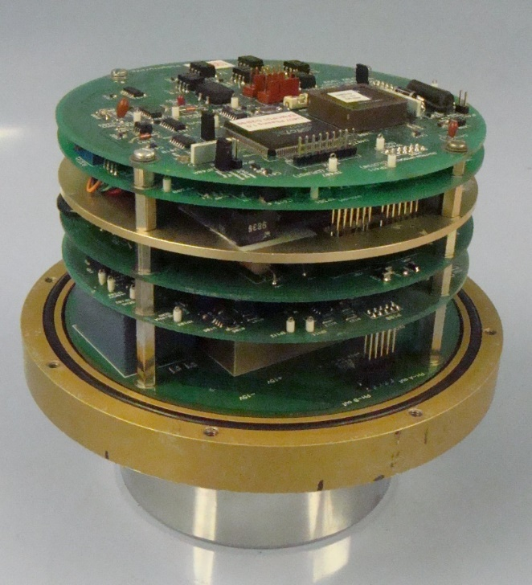
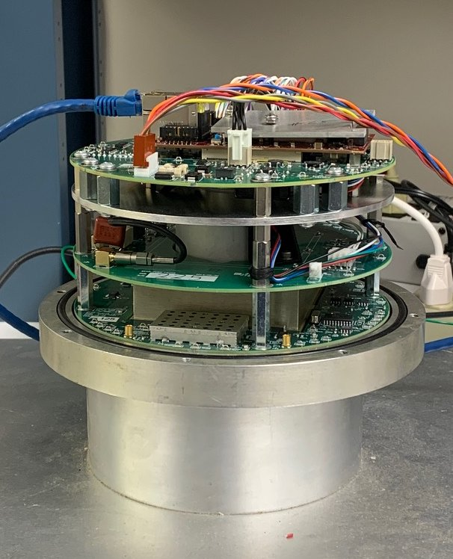
NASA/MSFC Airborne Electric Field Mill
Legacy ABFM
Upgrade ABFM
5 Circuit cards
3 Circuit cards
8-bit MCU
& FPGA
MCU & Linux Arm Processor instantiated in Xilinx FPGA
Command / Data packet exchange
Hosted web page + NTP client
Asynchronous Serial I/O
Ethernet (direct connect to ER2 LAN)
ABFM Electric Field Sensitivity, Dynamic Range & Linearity Requirements:
  Aircraft form factor calibration: Fair weather fields ~70 V/m so for 5% accuracy requires ~ 3 V/m resolution
  Aircraft in-situ charging to ~200 kV/m: Full scale needs to be ~ 2x EF_{Q} -> 400 kV/m
  Detect 100 V/m external field in the presence of 200 kV/m common mode due to highly charged aircraft -> 0.05% linearity
ABFM Upgrade Performance: 1 V/m to 512 kV/m with .03% non-linearity (verified via test)
  Same mass and volume, reduced total power requirements (only one instead of four Embedded Linux Systems needed)

Slide 4
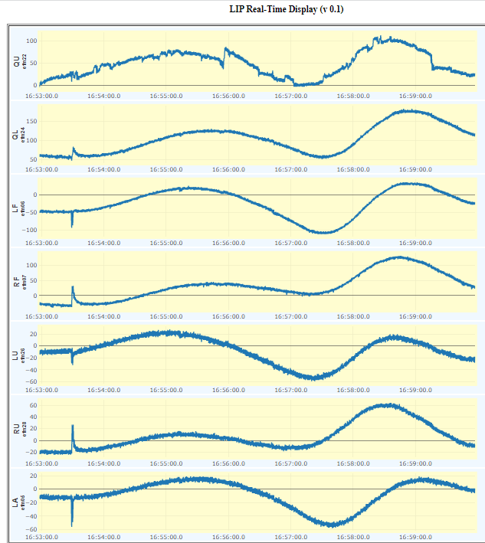
IMPACTS Summary
LIP ran flawlessly for each of the IOPs between 2020, 2022, and 2023
- Zero data was lost due to mill issues, zero mills went down during any of the
flights
Great characterization of winter cyclone charge structures
Only lightning observed was in thunderstorms along flight legs and the two cyclone cases out in the Atlantic
Real time data display from pass through a winter cyclone off the Atlantic Coast on January 15, 2023. Both lightning and broad scale electric fields are observed during this pass through the cyclone.

Slide 5

Electrification Within Wintertime Stratiform Regions Sampled During the 2020/2022 NASA IMPACTS Field Campaign
(J. Geophy. Res. Atmos., https://doi.org/10.1029/2023JD038708)
Sebastian S. Harkema (UAH), Lawrence D. Carey (UAH), Christopher J. Schultz (MSFC), Edward R. Mansell (NOAA),
Emily B. Berndt (MSFC), Alexandre O. Fierro (BP), Toshi Matsui (GFSC/UMD)
On 7 February 2020 during the IMPACTS field campaign, microphysical probe data indicated that the environment could be weakly electrified as the NASA P-3 was sampling the snowband over central New York
  Graupel, a hydrometeor often the focus of cloud electrification, was not present in the P-3 data, but rimed and non-rimed aggregates were observed (Panel A, B, right). Electrification was observed with the non-rimed aggregates, but not with the rimed aggregates, which is different from traditional electrification theory.
A theoretical model was developed to determine whether accretion or diffusion growth regimes were preferential during periods of greatest electrification In-situ observations
  The electrification was observed in regions where hydrometeors were growing by vapor diffusion and not traditional accretion processes that typically drive electrification and lightning (Panel C, right).
Snow hydrometeors were found to carry more charge density; compared to graupel, in simulated wintertime stratiform regions
  Large-scale electrification was simulated for two nor’easters during NASA IMPACTS to provide context to aircraft in-site observations using the Weather Research and Forecasting with electrification parameterization (NU-WRF-ELEC)
  The simulations match the microphysical probe data suggesting the potential for snow and ice hydrometeors to carry more charge than graupel hydrometeors in wintertime stratiform regions, which is contrary to typical graupel based electrification theories.
Observed and derived microphysical probe data from the NASA IMPACTS field campaign. Electrification (black lines) occur in regions with lower liquid water content (green), but higher ice supersaturation values (red line), which were observed and modeled to occur in regions of diffusional ice growth.

Slide 6
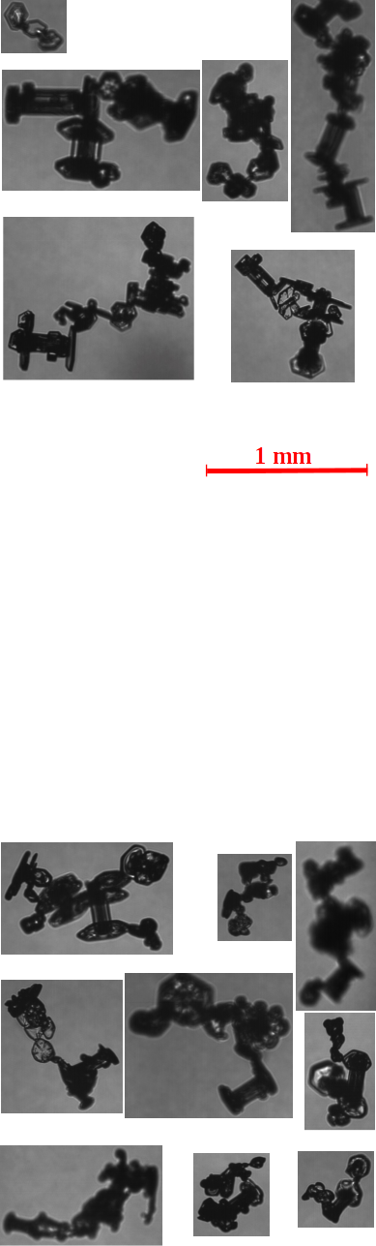
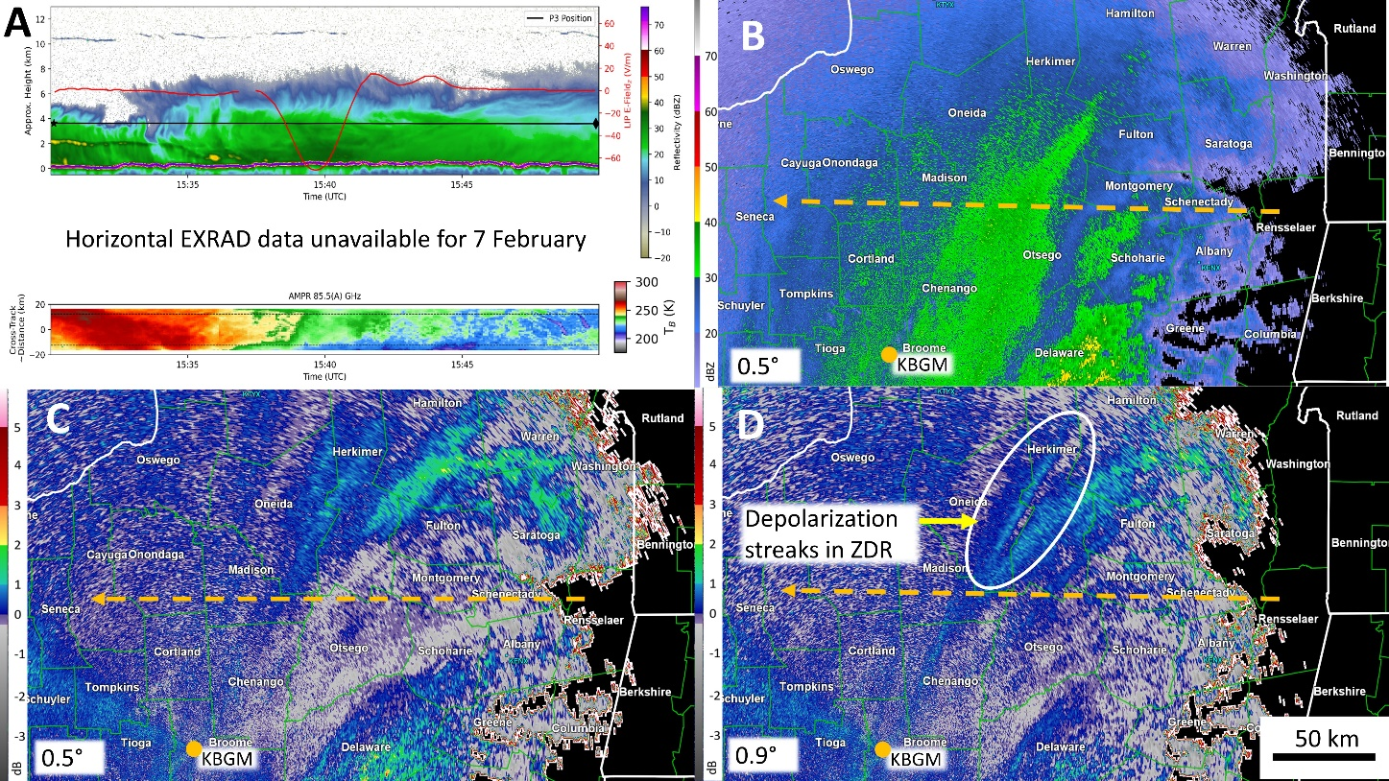
IMPACTS Collaboration with UND (Christian Nairy)
Work ongoing between CPI probes, LIP, EXRAD, and AMPR to characterize frequency and concentrations of chain aggregates in winter storms (right, top)
Understanding the impact of chain aggregation on radar, electrical, and radiative properties.
Hypothesized to contribute to the signal of depolarization within differential reflectivity and linear depolarization ratio
  These aggregates align in the vertical electric field and change their shape relative to the radar (see right panel D) in regions of known electrification (panel A, red line)
From Nairy et al. 2024, AMS)
From Schultz et al. 2021, JGR, https://doi.org/10.1029/2021JD034704

Slide 7
Questions? Ask one of us!
LIP Team POCs
Chris Schultz (christopher.j.schultz@nasa.gov)
Doug Mach (dmach@nasa.gov)
Monte Bateman (monte.bateman@nasa.gov)
Timothy Lang (timothy.j.lang@nasa.gov)
Sebastian Harkema (sebastian.harkema@nasa.gov)
GHRC DAAC POCs
Leigh Sinclair (slb0012@uah.edu)
Geoffrey Stano (gts0007@uah.edu)

