Slide 1


VALIDATION OF ARTEMIS I AEROTHERMAL DESIGN MODELS
USING DEVELOPMENTAL FLIGHT INSTRUMENTATION
B
Brandon L. Mobley
NASA MSFC, Aerothermodynamics Team Lead, Huntsville, Alabama
Samantha Summers
NASA MSFC, GeoControl Systems, Huntsville, AL
TFAWS Aerothermal Paper Session
Thermal & Fluids Analysis Workshop
TFAWS 2024
August 26-30, 2024
NASA Glenn Research Center
Cleveland, OH

Slide 2
Notice to the Reader
The Space Launch System, including its performance and certain other features and characteristics, have been defined by the U.S. Government to be Controlled Unclassified Information (CUI). Information deemed to be CUI requires special protection and may not be disclosed to an international audience. To comply with CUI restrictions, details such as absolute values have been removed from plots and figures. It is the opinion of the authors that, despite these alterations, there is no loss of meaningful technical content. Analytical methodologies and capabilities are discussed, technical results and trends are presented, conclusions are captured.

Slide 3
BLUF
The Aerosciences Branch at NASA MSFC had the responsibility to develop aerothermal environments for the ascent portion of the Artemis I mission
Purpose:
  Overview of the aerothermal measurements collected during the Artemis I launch
  Compare flight data against aerothermal design models
Goal:
  Validate aerothermal ascent design environments and models
  Make model refinements based on flight observations

Slide 4
Aerothermal Instrumentation Summary
Orion Multi-Purpose Crew Vehicle (MPCV)
  22 Calorimeters with embedded sensor thermocouples
  22 Static pressure gauges
  6 Radiometers
  90 combined thermocouples and resistance temperature detectors embedded in TPS
Integrated Spacecraft and Payload Element (ISPE)
  3 Calorimeters with embedded sensor thermocouples
  3 Static pressure gauges
Core Stage (CS)
  38 Calorimeters with embedded sensor thermocouples
  27 Static pressure gauges
  8 Radiometers
  7 Gas temperature probes
Core Stage Engines
  5 Calorimeters with embedded sensor thermocouples
  3 Static pressure gauges
  3 Radiometers
  2 Gas Temperature Probes
Solid Rocket Booster (SRB)
  24 Calorimeters with embedded sensor thermocouples
  24 Static pressure gauges
  4 Radiometers
  3 Gas Temperature Probes
  2 Flow direction probes

Slide 5
Why These Gauges?
Main measurement is heating rate
gaseous radiation
convection
Parameter Measured by
Calorimeter, Thermocouple
Calculated or Gas temperature probe
Radiometer
Calculated
Flow direction probes characterize plume induced flow separation region
Static pressures provide local flow conditions and CFD validation data

Slide 6
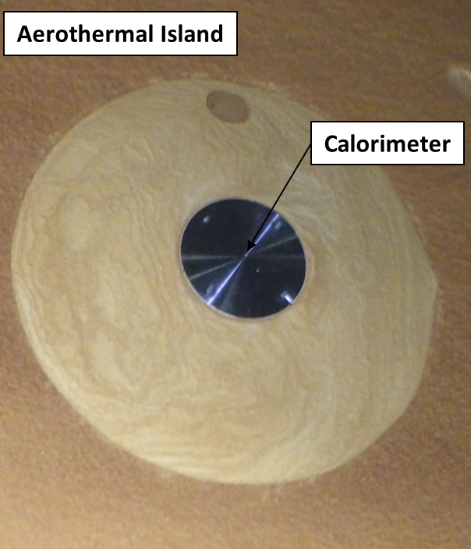
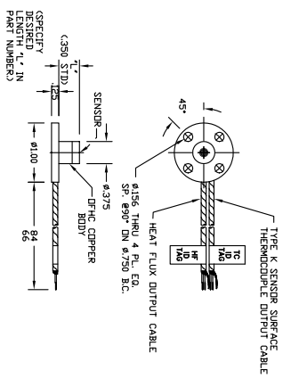
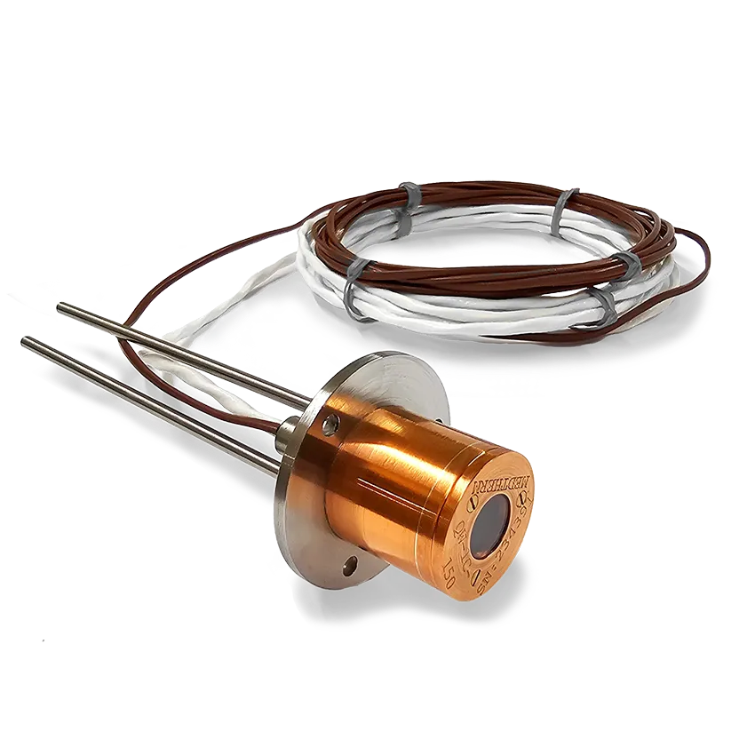
Calorimeters and Thermocouples
Schmidt-Boelter type calorimeter with embedded thermocouple (two-channel)
  Medtherm model 20850
Performance
  90 out of 92 calorimeters provided data
  88 out of 92 thermocouples provided data
Lessons Learned
  Frost built up on sensors near/on cryogenic tanks
  Filtering caused a delay in response and magnitude clipping
  Gauge surface re-radiation not negligible during Rarefied and Free Molecular regimes
https://raptor-scientific.com/about-us/medtherm-corporation/

Slide 7
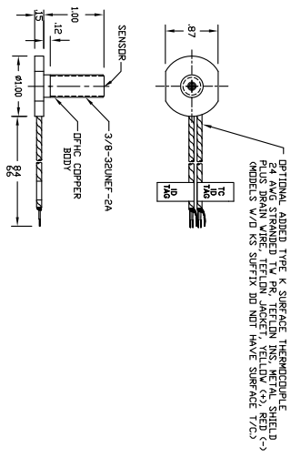
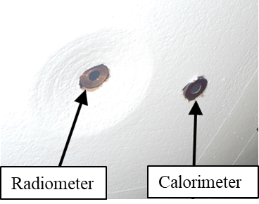
Radiometers
Calorimeter with a sapphire window
  Medtherm model 22121
Performance
  21 out of 21 provided data
Lessons Learned
  Filtering caused a delay in response and magnitude clipping
  Line of sight and FOV limitations
  High concentration of surface contamination
  Attenuation from the cork combustion
https://raptor-scientific.com/about-us/medtherm-corporation/

Slide 8
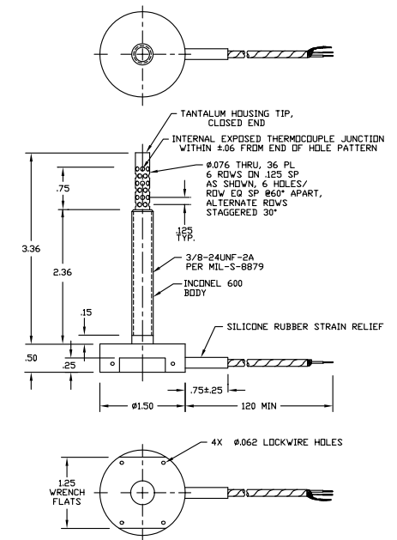
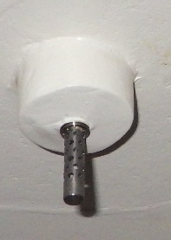
Gas Temperature Probes
Base Gas Temperature Probe
  Medtherm model 11290
Performance
  10 out of 12 provided data
Lessons Learned
  Thermocouple junction was fragile
  and prone to damage
  Local to P50 cork and RT455 offgas
  Faster response time provided
  better synchronization of environment
  events, to assist determination
  of the convective film coefficient in time
  (from calorimeter data)
https://raptor-scientific.com/about-us/medtherm-corporation/

Slide 9
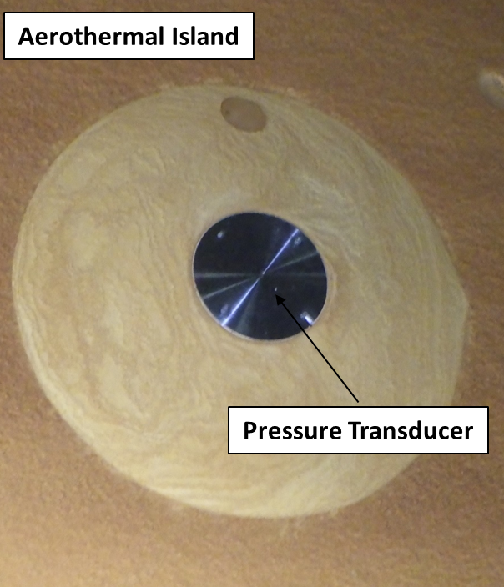
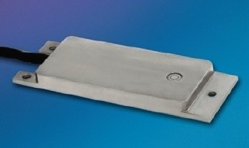
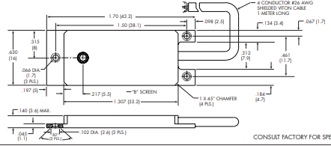
Static Pressure Gauges
Pressure Transducer
  Kulite Model LLE-17DC-500
Performance
  80 out of 82 provided data
Lessons Learned
  Not all gauges read ambient pressure at launch, required post flight adjustments
  Island (thermal mass, isolator) delayed ice formation
https://kulite.com/products

Slide 10
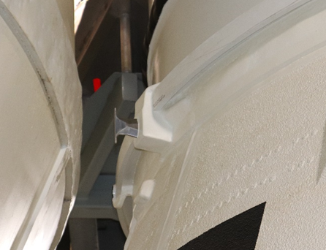
Flow Direction Probes
Bi-Directional Pressure Probe
  Medtherm model 50532
Performance
  Unable to get valuable data
  Half the pressure data was erroneous
https://raptor-scientific.com/about-us/medtherm-corporation/

Slide 11
Validation of Aerothermal Design Models
Aerothermal environments consist of different heating and pressure sources, DFI were installed in support of six aerothermal flight test objectives (FTO) to measure:
Aerodynamic Heating
Base Plume-Induced Radiation
Base Plume-Induced Convection
Plume-Induced Flow Separation
Plume Impingement
CAPU Plume Heating
For each FTO DFI data was used to substantiate and revise models where necessary

Slide 12
Flight Adjustments
Artemis I Reconstructed Flight Environments Accounted For:
    Best Estimated Trajectory
    Hot wall heating using Flight DFI temperatures
    Flight derived Boundary Layer Transition criteria
    Flight Factors
    Thermal Mismatch Correction
    Calorimeter Re-radiation
    Updated Flight Radiation Files
    New Flight derived plume models
    Remove Model Uncertainty Factor
    Cold wall env using above model corrections/factors

Slide 13
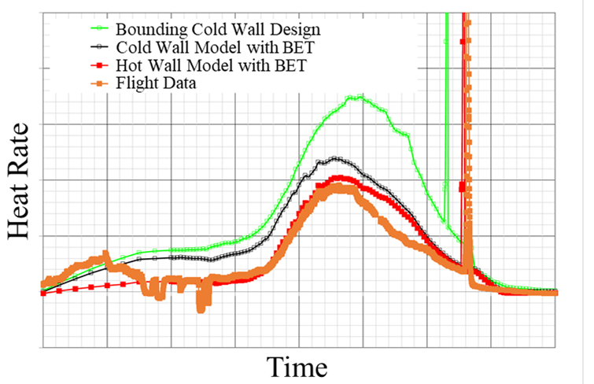
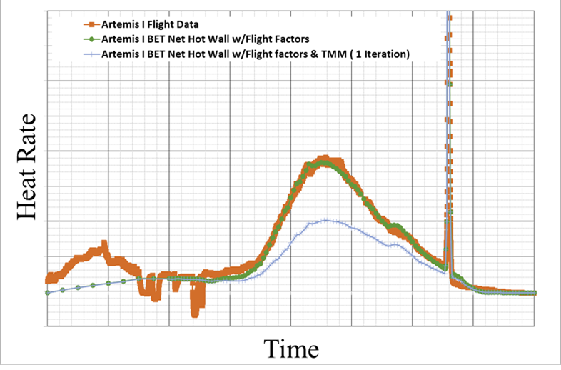
Aerodynamic Heating
Example of Flight Adjustments:
Design models were adequately conservative, updates to the models were implemented to improve modeling accuracy and reduce conservatism

Slide 14
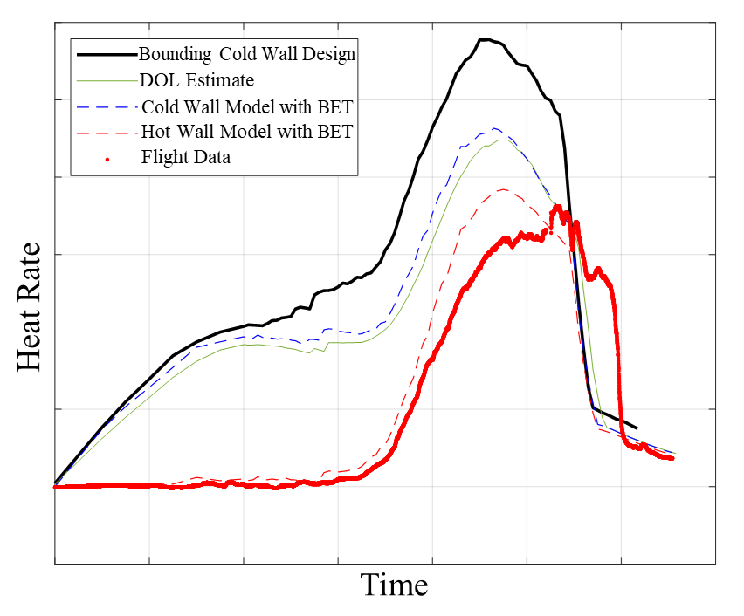
Aerodynamic Heating
Boundary Layer Transition Criteria
Design criteria based on Shuttle
Flight data showed transition happens later
Implications
Increase duration of turbulent heating
Increase heat load
Flight-derived transition criteria has been implemented

Slide 15
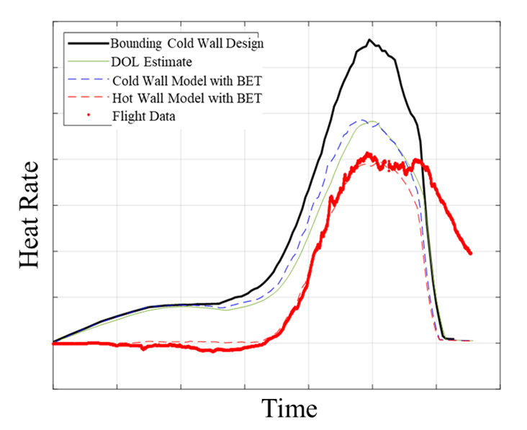
Aerodynamic Heating
Boundary Layer Transition Criteria
Design criteria based on Shuttle
Region in between Core and SRB transition was not observed
Implications
Flow remains turbulent
Increased heat load
Design models, in-between CS and SRB, were updated to turbulent until SRB separation

Slide 16
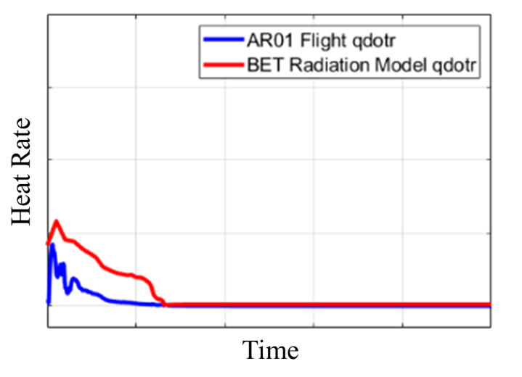
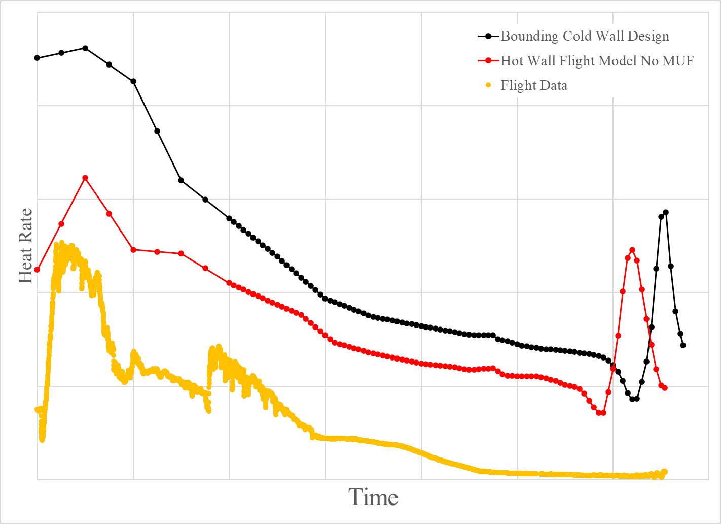
Base Plume-Induced Radiation
Minor radiation model changes were implemented to better agree with flight:
Model Uncertainty Factor has been removed
All aft facing areas received an additional radiation knock down factor
Further investigation of the effects of sensor contamination and attenuation from TPS offgas on incident radiation should be pursued

Slide 17
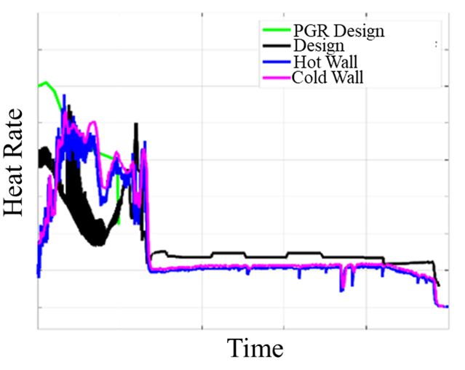
Base Plume-Induced Convective Heating
Plume Convective Heating models were updated after Green Run
Observed TPS burning on the base heat shield
Used ground test data to model burning
during flight
Flight Observations:
May not have captured peak heat rate
Overall heat load was bounding
Model Adjustments:
Revised TPS burning-induced convection model
Spatially expanded TPS burning environments to
additional areas
New methodology to account for BHS TPS combustion increased the overall plume induced convection

Slide 18
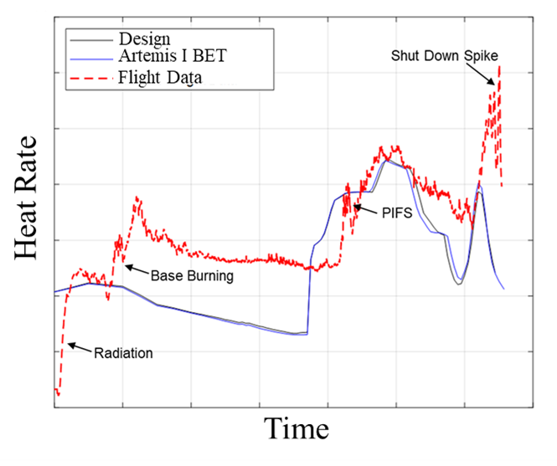
Base Plume Convective Heating
SRB Nozzle and CS Engine Configuration is unique to SLS
Booster aft skirt is downstream of CS base heat shield
and engines
Flight Observations:
Models were not updated after Green Run
Inboard regions experienced effects from CS
base TPS burning
Model Adjustments:
Created new methodology to include increases
from upstream TPS burning
SRB experienced increased plume convective heating from CS TPS Burning

Slide 19
Plume Induced Flow Separation
Several instrumentation islands were mounted on the CS and SRB to observe PIFS environments
  Capture the time and spatial distribution of the forward freestream separation point induced by the plume
  Capture the pressure and heating characteristics of the recirculated gas in the separation zone
Flight Observations:
Unable to get usable data from flow direction probe
PIFS environments occurred later in flight than predicted, were less in magnitude, did not travel up the vehicle as far as expected
PIFS environments were minimal after SRB separation (density of gases within PIFS region decreased, considerably reduced convection)
PIFS models were found to be conservative and MUFs were removed

Slide 20
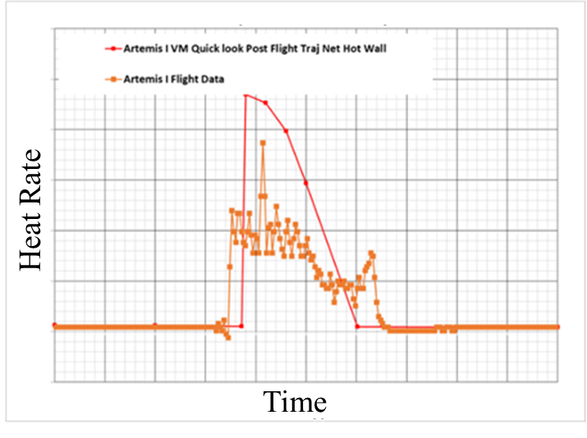
Plume Impingement
Booster Separation Motor Plume Impingement
Quick event (1-2 seconds)
Plume sweeps across and engulfs entire vehicle
Impacts from data filtering:
Timing of events
Magnitudes may have been clipped
Post Flight Adjustments
Design environments were conservative
New models developed over a CFD database (multiple separation conditions)
BSM impingement location and magnitude was dependent on separation altitude and dynamic pressure (plume expansion, injection into freestream crossflow)

Slide 21
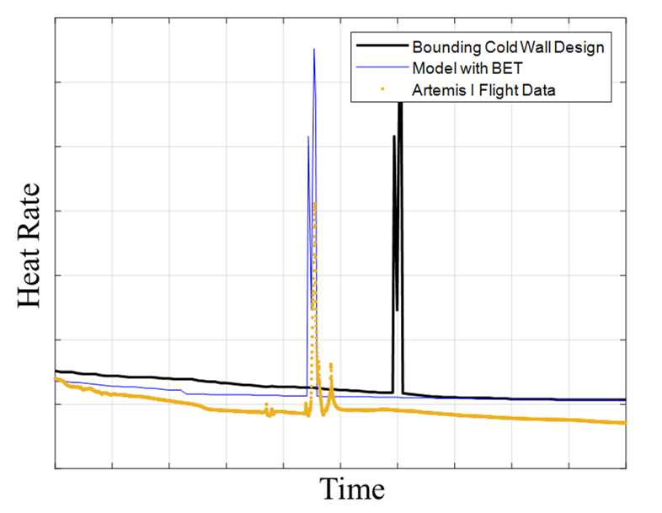
Plume Impingement
LAS Jettison Motor Plume Impingement
Quick event (1-2 seconds)
LAS jettisons off the vehicle and plumes impinge on Orion MPCV
Impacts from data filtering:
Timing of events
Magnitudes may have been clipped
Predicted LAS JM environments were found to be conservative and bounded all flight data

Slide 22
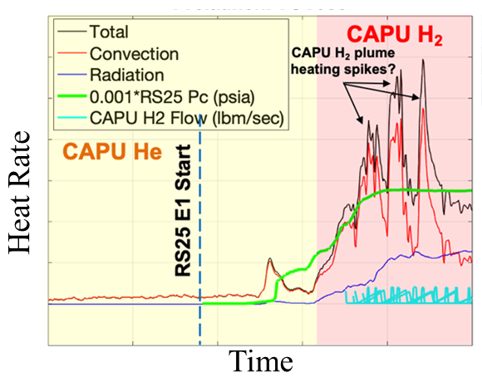
CAPU Plume Heating
Core Auxiliary Power Unit (CAPU) ports on the CS BHS
  Enables the gimballing of the RS-25 engines for vehicle control authority
Prelaunch
  High/low flow rate oscillations were observed
  Dumps gaseous hydrogen exhaust into base region
Flight
  Free hydrogen ignites in close proximity to the BHS
  Increases plume induced convection
CAPU heating only observed in prelaunch, during flight became integrated with plume convection

Slide 23
Conclusion
Artemis I SLS vehicle had a nominal flight
Aerothermal design models largely aligned with the flight data
No thermal exceedances or anomalies were observed due to excessive aerothermal environments
Several updates to the models were implemented to improve overall modeling accuracy:
  Boundary Layer Transition Criteria
  Flight Factors
  Removed Model Uncertainty Factors
  Flight derived Plume-Induced Flow Separation models
  New Base Burning Methodology

Slide 24
References
1. Engel, C. D., Praharaj, S. C., and Schmitz, C. P., “MINIVER II Upgrade for the AVID System, Volumes I&II”, Remtech Report RTR 123, February 1988.
2. NASA, “NASA’s Space Launch System: Reference Guide”, Version 2, released August 2022.
3. Westkaemper, J.C., “On the Error in Plug-Type Calorimeters Caused by Surface-Temperature Mismatch”, Journal of the Aerospace Sciences, Volume 28 Issue 11, Nov. 1961.
4. Morris, C.I. (2015), "Space Launch System Ascent Aerothermal Environments Methodology", 53rd AIAA Aerospace Sciences Meeting, AIAA SciTech, (AIAA 2015-0561), Kissimmee, FL.
5. Svehla, R.A., and B.J. McBride, "FORTRAN IV Computer Program for Calculation of Thermodynamics and Transport Properties of Complex Chemical Systems," NASA TN D 7056, January 1976.
6. Smith, S.D., "High Altitude Supersonic Flow of Chemically Reacting Gas Particle Mixtures Volume I, A Theoretical Analysis and Development of the Numerical Solution," LMSC HREC TR D867400 I, Lockheed Missiles & Space Company, Huntsville, Ala., October 1984.
7. Taylor, M.W. and H.S. Pergament, “Standardized Plume Flowfield Model SPF II, Version 5, Volume II – Program User’s Manual, PST TR-60-II, Propulsion Sciences and Technology, Langhorne, PA, September 2005.
8. Reardon, J. E. and Lee, Y. C., “A computer Program for Thermal Radiation from Gaseous Rocket Exhaust Plumes,” REMTECH RTR 014-9, December 1979.
9. Everson, J. and Nelson, H.F., "Development and Application of a Reverse Monte Carlo Radiative Transfer Code for Rocket Plume Base Heating,'' Journal of Thermophysics and Heat Transfer, 7 - 4, (1993)
10. Mehta, M., Mobley, B., Smith, S.D. (2024), “Space Launch System Base Aerothermodynamics Post-Flight Reconstruction for Artemis I”, AIAA SCITECH 2024 Forum, (AIAA 2024-0256), Kissimmee, FL.

