Slide 1
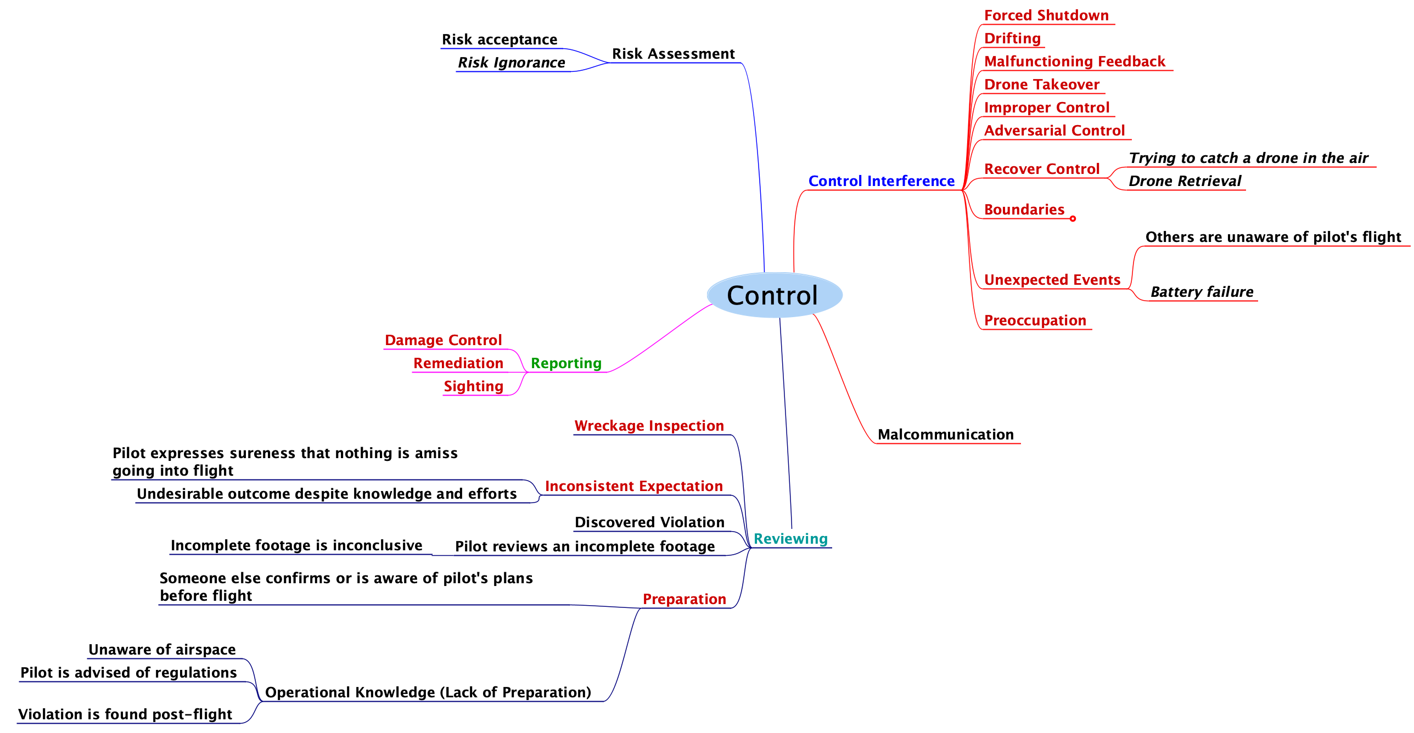
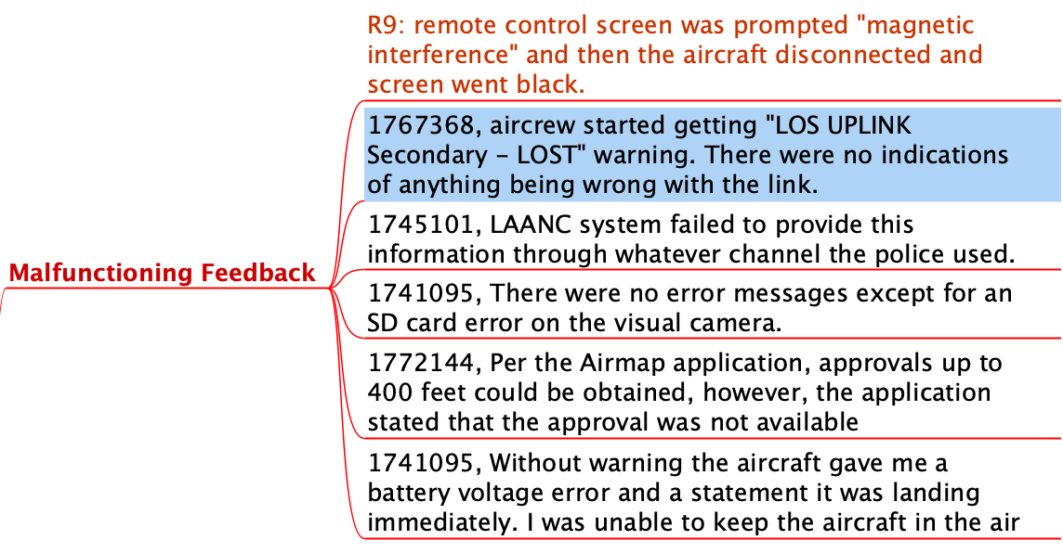
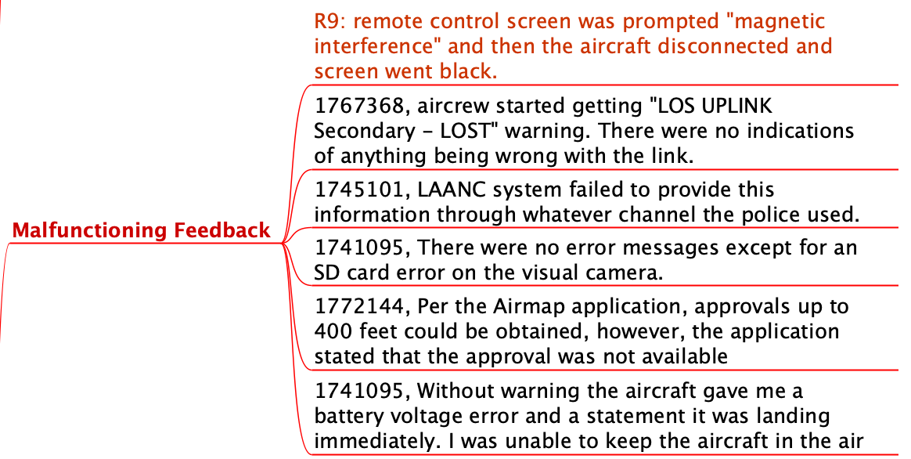
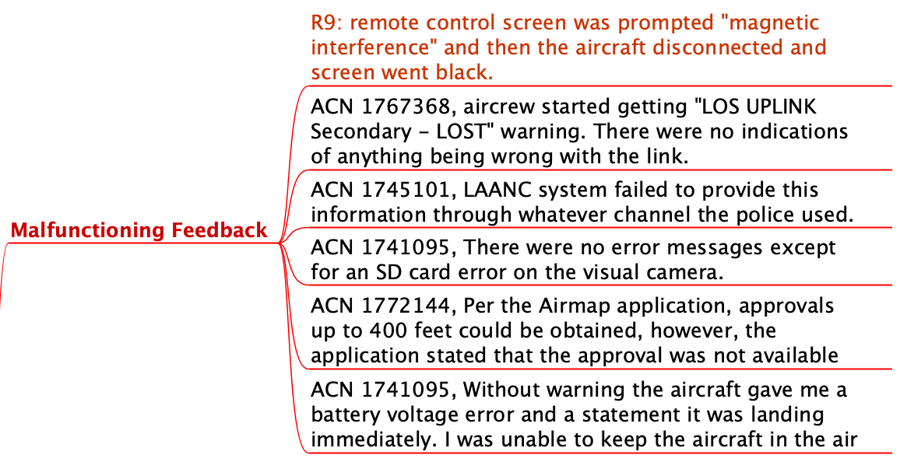
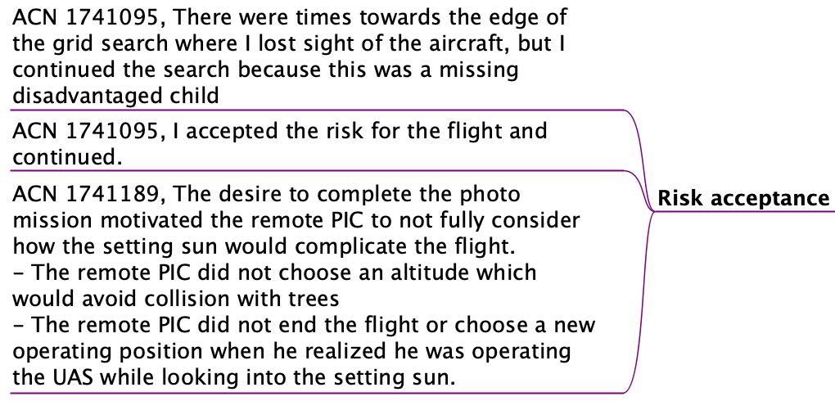
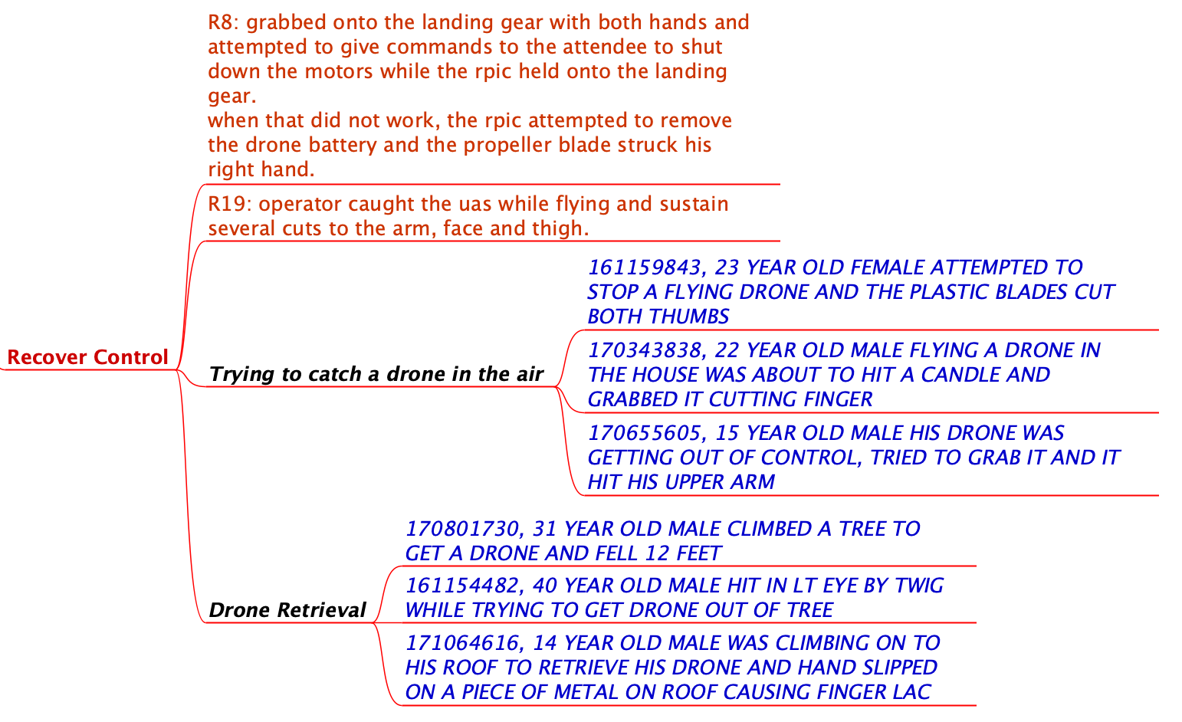



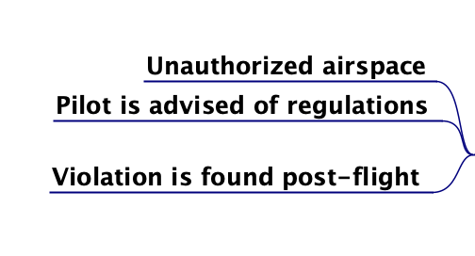
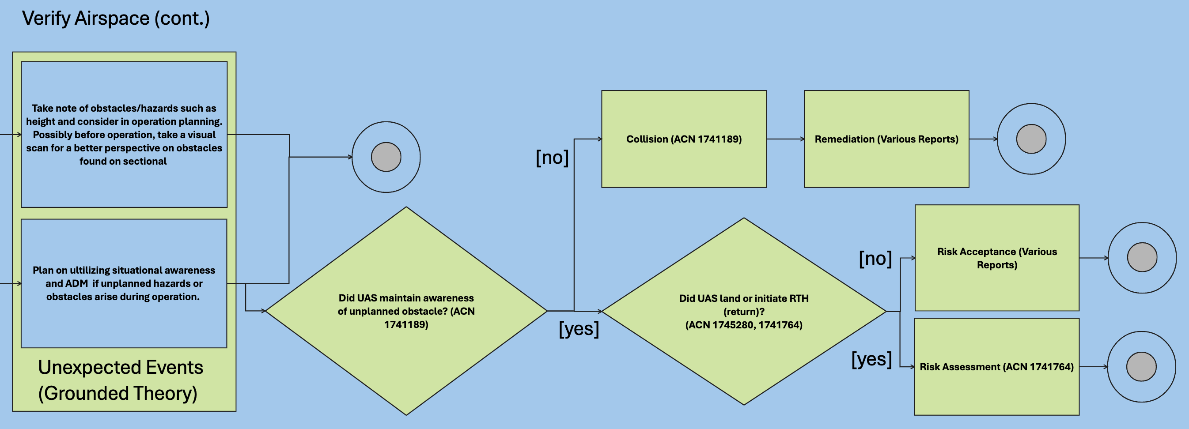
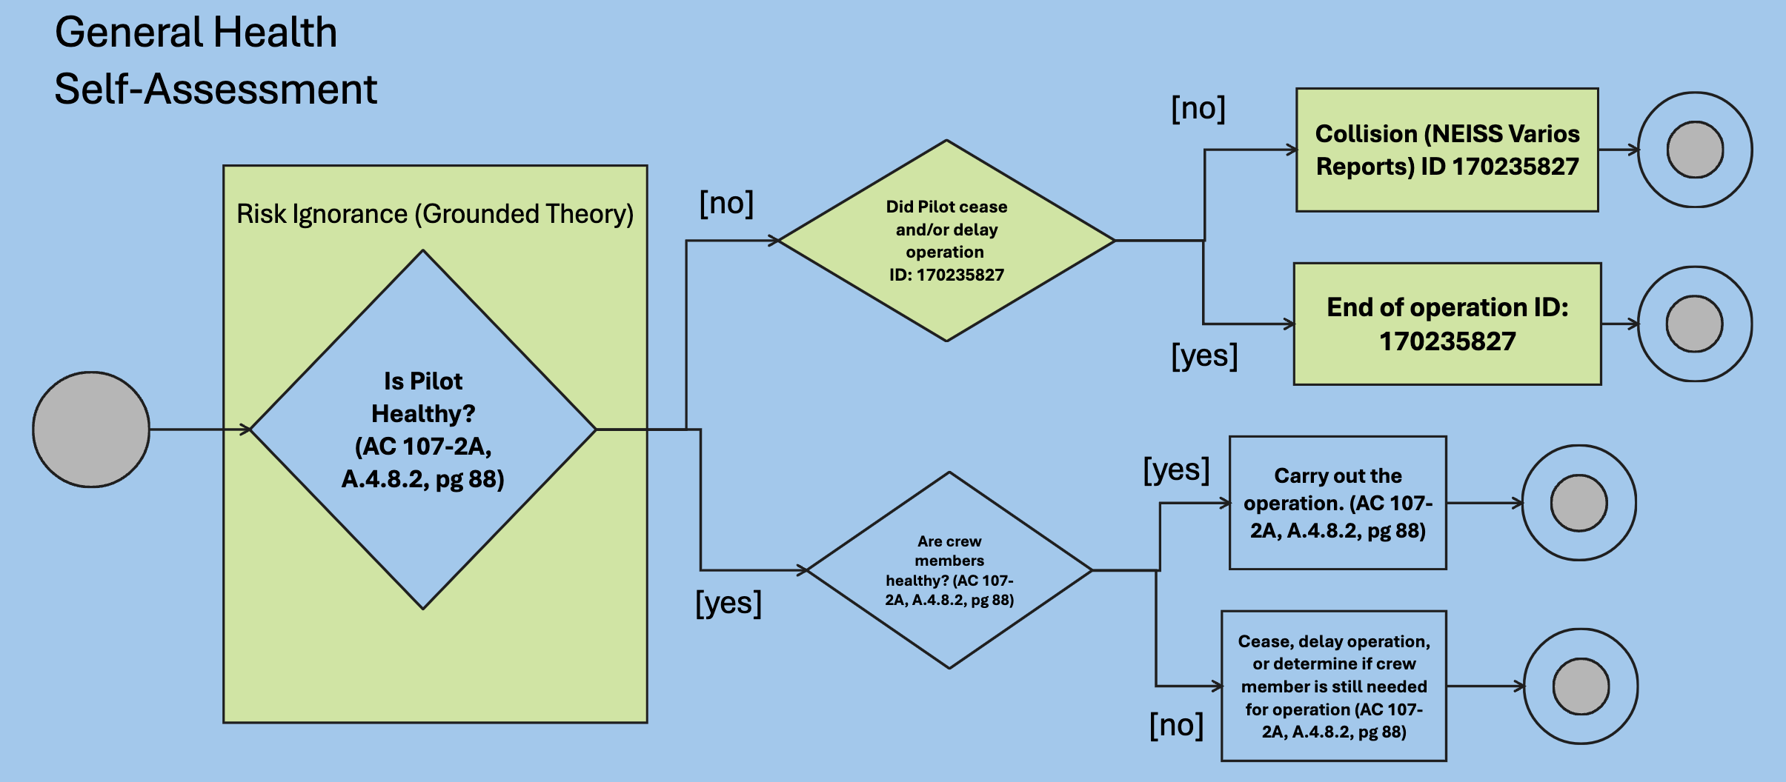





Grounded Theory Analysis of UAS Incidents and Accidents
Ella Jeon
Amador Valley High School
Ananya Balakrishnan
James Logan Highschool
Carlos Paradis
KBR, Inc
Misty Davies
NASA Ames Research Center
Charles Werner
DRONERESPONDERS
Becky Hooey
NASA Ames Research Center
Introduction
Purpose: Improve aviation safety and regulation by analyzing patterns in narrative reports on UAS incidents and accidents
Method
FAA/FOIA
N.=101
Grounded Theory
CORE CONCEPT
Activity Diagram
Database
2016 - 2022
Activity Diagrams embedded with incidents and accident events help us see “what if” hazardous scenarios
ASRS
N.=190
Grounded Theory
Make/Model: UAS
Top 30
CORE CONCEPT
CORE CONCEPT
Database
These “what if” scenarios can further be re-combined to explore additional hazardous situations
NEISS
2010 - 2020
N.=142
Toy Vehicles (Excluding Riding Toys)
Keywords: “Drone”, “UAV”, “UAS”
Grounded Theory Mind Map
Activity Diagram
Conclusion
Threats to Validity
Database
2015 - 2023
Incomplete/Nondescript Narratives
Search Bias
Specialized Vocabulary
Data time range (i.e. ASRS, 2020)
Core Category: Control
  All elements of faulty UAS flight is characterized as a fight for control
Most Common Cases
  Recover Control (FAA, NEISS)
  Operational Knowledge (ASRS)
CORE CONCEPT
Related Work
Acknowledgments
Grounded Theory
C. Paradis, S. Mbaye, M. Davies, C. Werner. A Grounded Theory of UAS Reported Accidents. To appear on AIAA Aviation'24.​
B. Glaser, A. Strauss. The Discovery of Grounded Theory: Strategies for Qualitative Research.
S. Gorucu and Y. Ampatzidis. Drone Injuries and Safety Recommendations. AE560/AE560, 06/2021. EDIS 2021.

