Slide 1
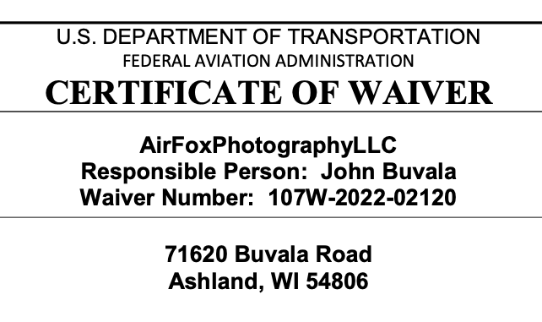


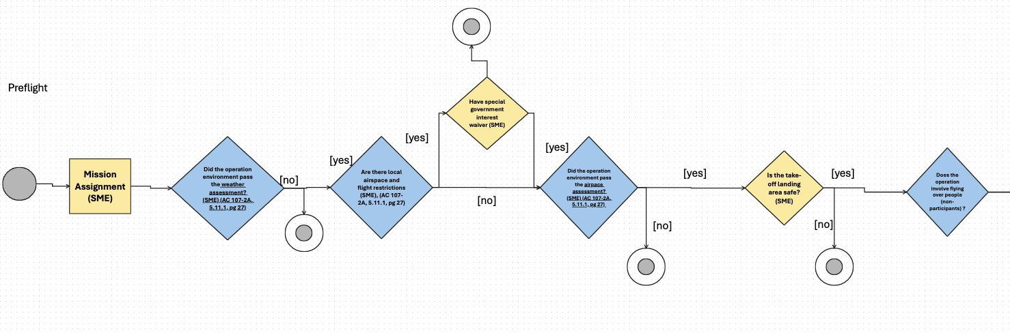
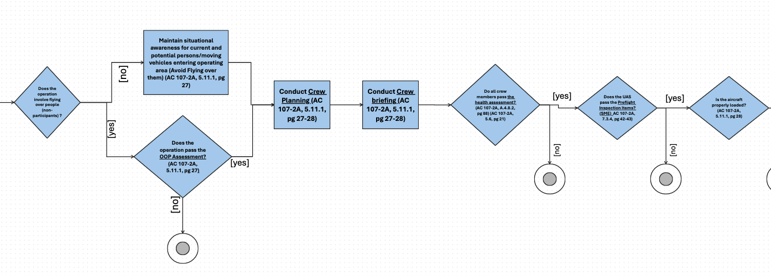
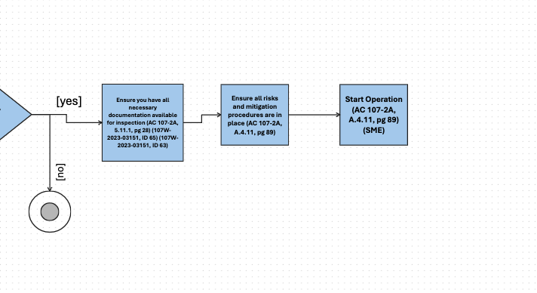
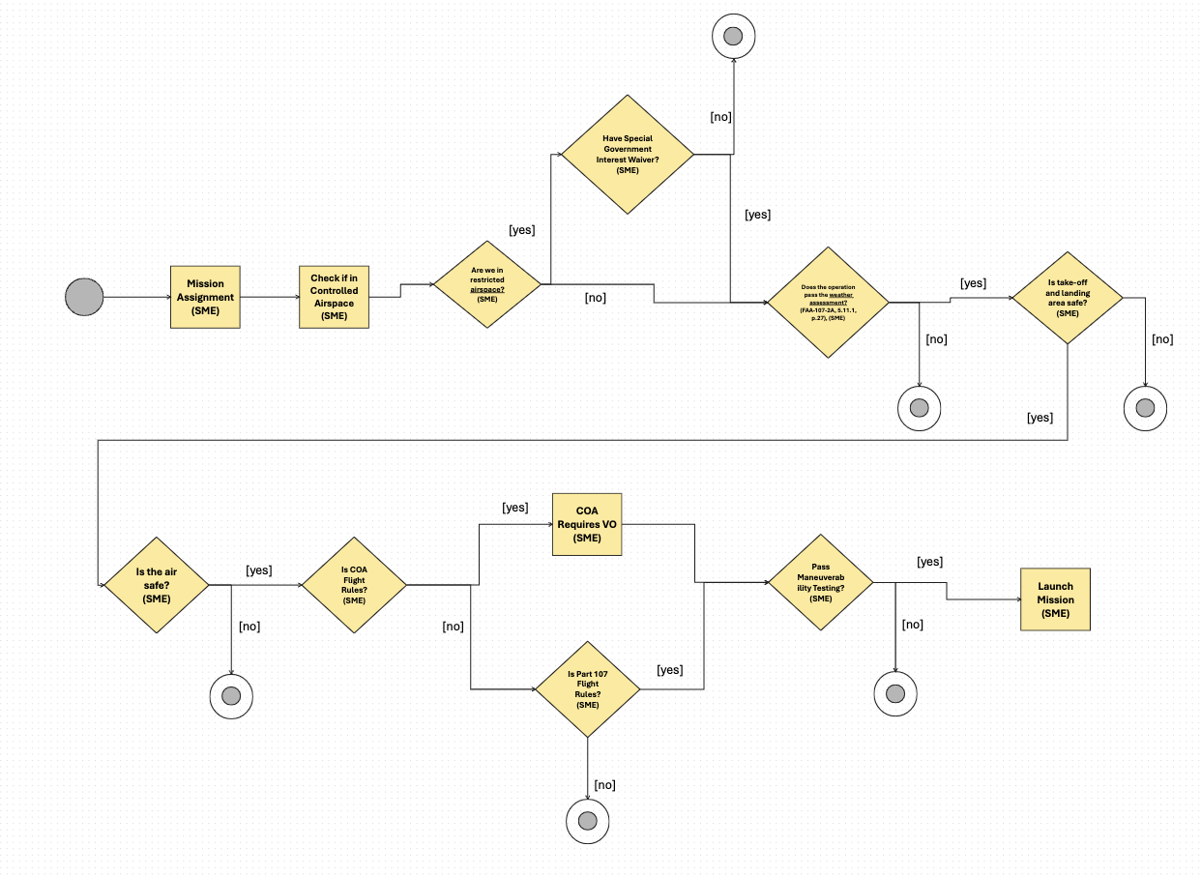
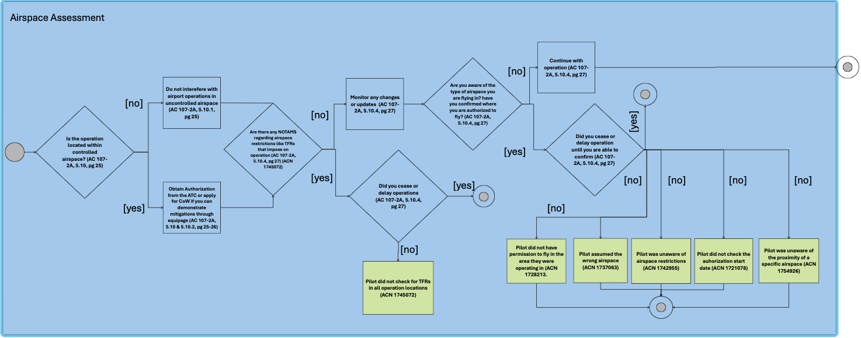
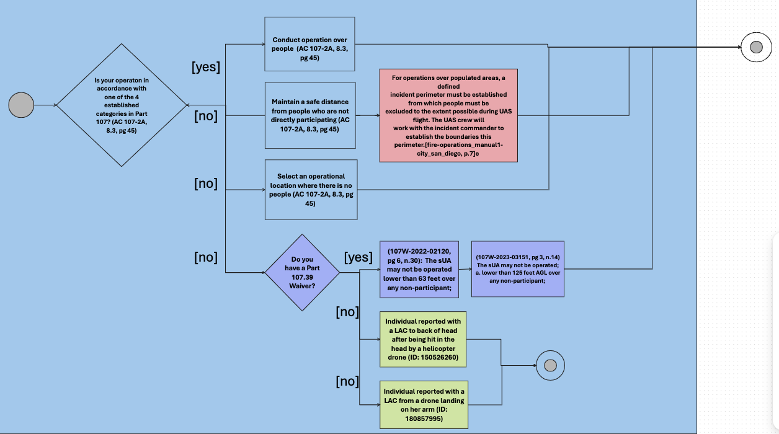






Modeling Mitigations and Hazards in UAS Emergency Response Operations
Terrance Fung
University of Michigan
Julianne Rodriguez
Florida International University
Elizabeth Rachwald
Carondelet High School
Carlos Paradis
KBR, Inc
Misty Davies
NASA Ames Research Center
Charles Werner
DRONERESPONDERS
Introduction
Method
Purpose: To define UAS safety procedures from mitigation and hazards information silos
FAA AC Circular
Public Agency SOP
DRONERESPONDERS
-----------
Activity Diagram
-----------
-----------
Subject Matter Expert
FAA Issued Waivers
ASRS/
NEISS
FAA FOIA
DRONERESPONDERS Dashboard
Search Public
Agencies
Standard Operating Manual
FAA Issued Waiver Website
-----------
Activity Diagram
Related Work
Part 107 – Waiver and Provisions
- E. Jordan, C. Paradis, M. Davies and C. Werner, “Textual and Network Analysis of Part 107 Waivers’’, in 2024 IEEE/AIAA 43th Digital Avionics Systems Conference (DASC).
- C. Paradis, S. Mbaye, M. Davies, C. Werner, “A Grounded Theory of UAS Reported Accidents”, in AIAA Aviation 2024 Forum.
- S. Cigal, “Comparative Analysis of Small Unmanned Aircraft Systems Operations Manual”, M.S. Thesis, Embry-Riddle Aeronautical University, 2019.
- H. Ray, Capt. R. Singer and N. Ahmed, “A Review of the Operational Use of UAS in Public Safety Emergency Incidents”, 2022 International Conference on Unmanned Aircraft Systems ICUAS.
CORE CONCEPT
ASRS, NEISS,
FAA FOIA
Database
Incident Narrative
Grounded Theory
Activity Diagram
Overlayed Activity Diagrams
AC107-2A
Results
Subject Matter Expert
Advisory Circular Pre-Flight
Overlayed activity diagrams can be utilized to aggregate siloed safety operation strategies and the hazardous consequences of not following them.
Advisory Circular 107-2A
Activity Diagram
Activity Diagram
Subject Matter Expert Pre-Flight Diagram
Airspace Assessment
Operations Over People (OOP) General Assessment
Subject Matter Expert Emergency Response operational procedure transcription was used as basis for the additional activity diagram layers of mitigations and hazards.
Acknowledgments

