Slide 1
Automating Maneuvers: Considerations for Collision Avoidance
Lauri K. Newman
NASA Conjunction Assessment Program Officer
HQ Science Mission Directorate
Office of the Deputy Associate Administrator for Programs
August 6, 2024

Slide 2
Agenda
Changing Orbit Environment Poses Increasing Safety Challenges
Basic Conjunction Assessment (CA) Concepts and General Processes
Automation Considerations
Starling/Starlink Automation Experiment

Slide 3
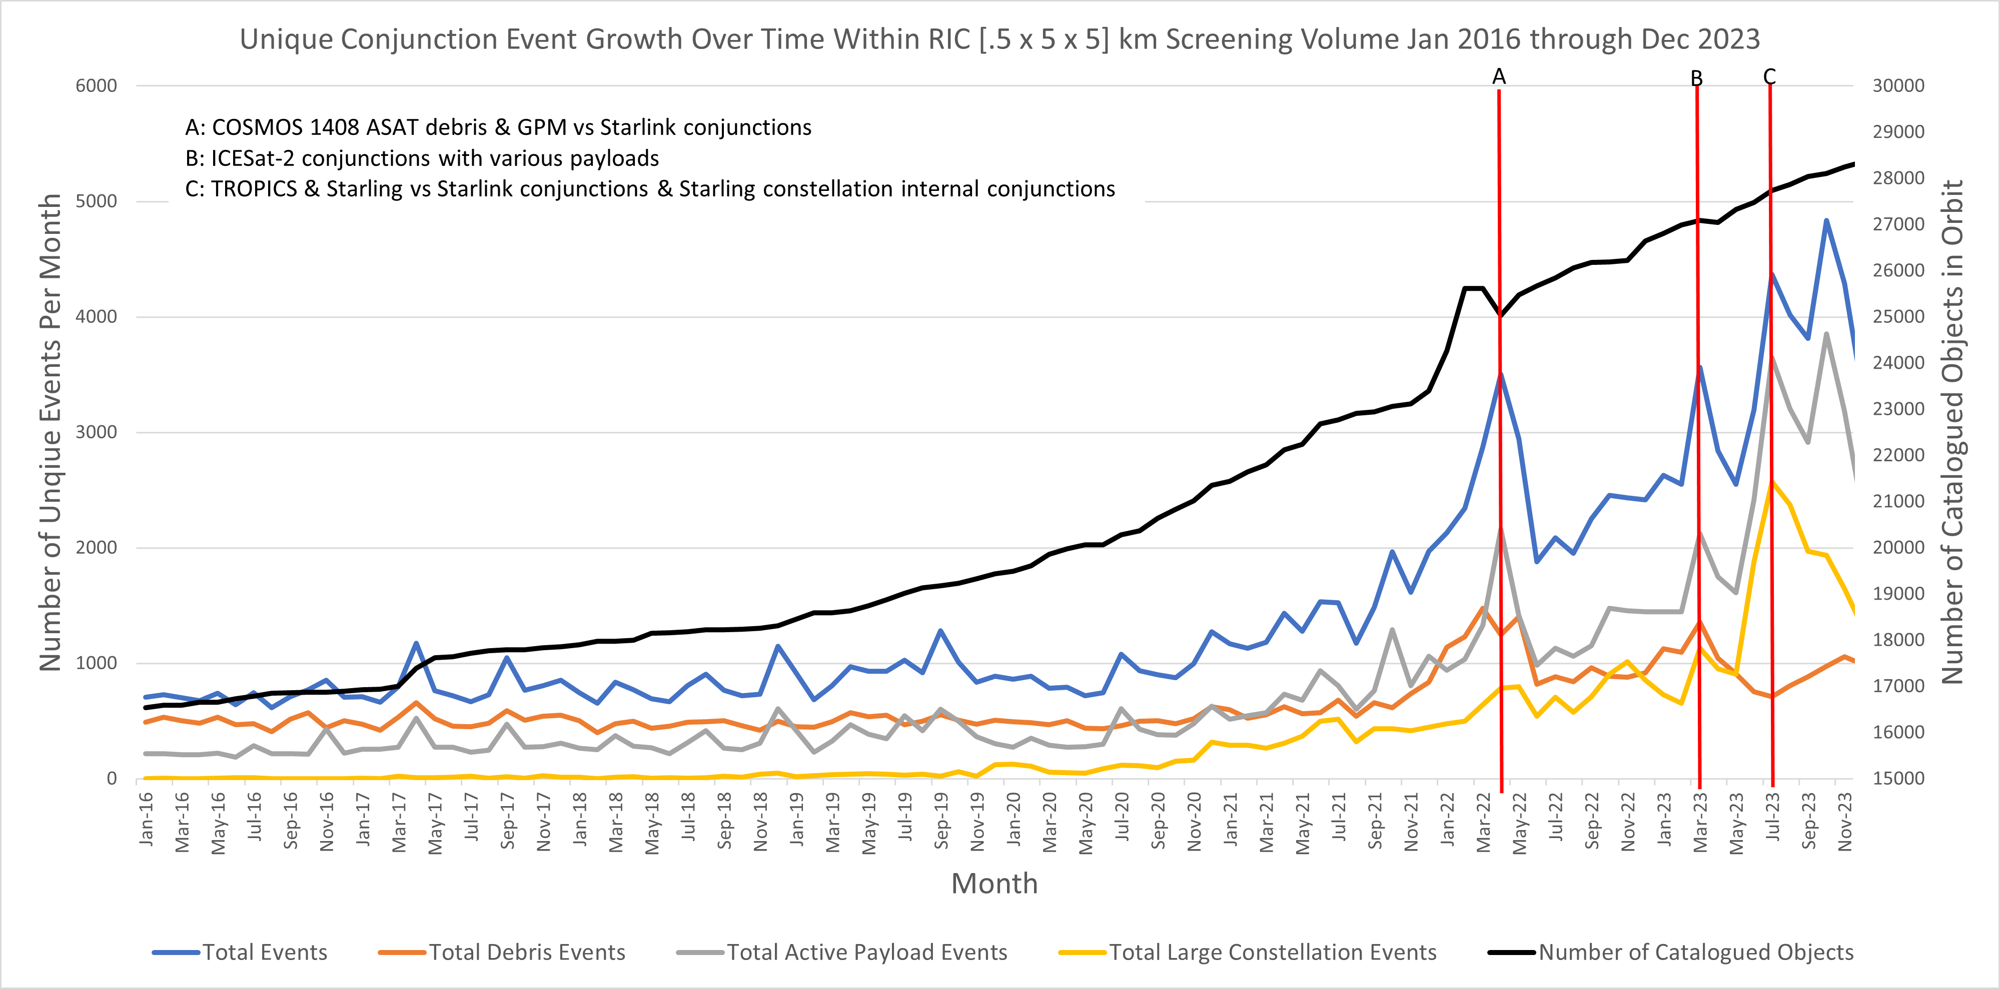
Conjunction Assessment Trends:
Situation is Getting Worse!
+28,000 Catalogued Objects
Increase in total conjunction events as of Dec 2023:
• 40% since 12/2022 (~1 year)
• 133% since 12/2021 (~2 years)
• 250% since 12/2020 (~3 years)
Large constellations will continue to drive the close approach event risk.
Notes:
The number of satellites over time continues to grow.
Number of conjunctions with operational spacecraft now outnumbers conjunctions with debris
Several ultra-large constellations (up to 30k space vehicles) have been announced (for Low Earth Orbit), though not yet deployed.

Slide 4
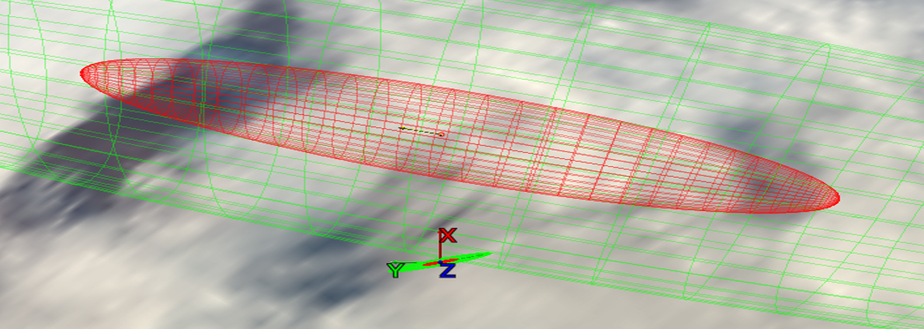
Satellite Conjunction Assessment:
Basics
High-risk satellite conjunction shown below
  Protected satellite well maintained (with axes at bottom); small 1-σ (red/inner) / 3-σ (green/outer) error ellipses
  Debris object “above” it, with very large error ellipses (3-σ extends beyond image)
Conjunction “screening” activities predict encounters
“Risk assessment” determines that actual likelihood/consequence of collision
Mitigation planning helps select maneuver for protected asset to avoid collision

Slide 5
Satellite Conjunction Assessment:
NASA Process Details
Catalog Object i+1
Secondary Object
Secondary Object
Catalog Object i+2
Maneuver
∆V
Primary S/C
Primary S/C
Catalog Object i
Primary S/C
Primary S/C
Conjunction Assessment (CA) is the process of identifying close approaches between two orbiting objects; sometimes called conjunction screening.
The 18th Space Defense Squadron (18 SDS) at Vandenberg Space Force Base (VSFB) maintains the high accuracy catalog of space objects. Orbital Safety Analysts (OSAs) at VSFB screen NASA protected assets against the catalog, perform tasking requests, and generate close approach data.
CA Risk Analysis (CARA) is the process of assessing collision risk and assisting satellites in planning maneuvers to mitigate that risk, if warranted.
The NASA CARA program performs risk assessment for all NASA operational satellites not affiliated with Human Spaceflight (HSF), as well as for some partner missions.
JSC Flight Operations Directorate (FOD) performs risk assessment for all NASA HSF program assets and is the O/O for maneuver decisions and execution.
Collision Avoidance is the process of executing mitigative action, typically in the form of an orbital maneuver, to reduce collision risk.
Each satellite Owner/Operator (O/O) – mission management, flight dynamics, and flight operations – is responsible for making maneuver decisions and executing the maneuvers.

Slide 6
Screening Latency
DOD can track spacecraft, but they have no way of knowing about planned future maneuvers unless operators share their predicted ephemerides with the planned maneuvers included in them
  Maneuverable spacecraft send their ephemerides to 19 SDS for screening
At the time of writing of this paper, 19 SDS screens once every 8 hours.
  If one screening is missed, need to wait for the next one
This means that in order to ensure other operators have knowledge of your planned future maneuver, 16 hours should be allotted
  19 SDS is currently working to reduce their latency based on user feedback

Slide 7
Automation Considerations
Many operators are employing automated maneuvering vs ground-controlled maneuvers to manage workload
  Large constellations are hard to operate without automation
Automated maneuvering is often near-real-time in current practice
  Does not incorporate screening
  Causes risk to other nearby spacecraft who don’t have a way to know where the autonomously maneuvering spacecraft is
  Collison would not only potentially destroy involved spacecraft but also put debris in orbit that jeopardizes other third-party spacecraft
Automated maneuvers do not always need to be real-time
  Can build in time for screenings with appropriate latency
  Can still be automated (no human in loop)
If real-time automated maneuvers are necessary, other CA means should be employed

Slide 8
Starlink/Starling Experiment
Starling is a NASA constellation of 4 cubesats that is collocated with the SpaceX Starlink constellation
Both constellations perform automated maneuvering
Starlink considers CA when planning maneuvers, but the maneuvers are altered by the spacecraft in NRT to employ latest GPS solution
In fully automated mode for both satellites, neither would have maneuvers explicitly screened prior to execution
  Satellites could maneuver into each other
  A version of this situation is what happened with the Iridium-COSMOS collision
Starling and Starlink are jointly pursuing an experiment to manage collision risk with autonomous systems
  Ground system provides extremely rapid screening of maneuver ephems
  Mitigation action management systems assists responsibility assignment

Slide 9
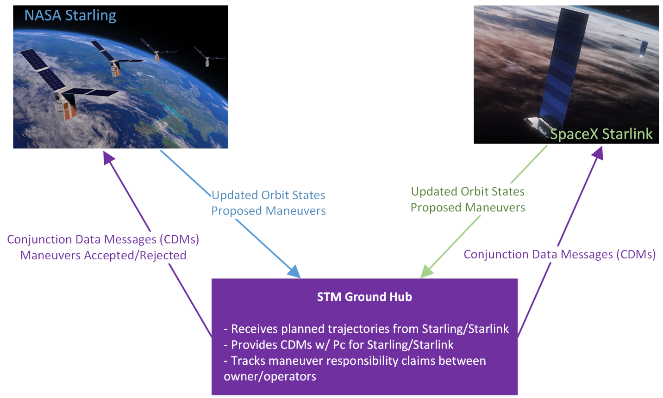
Experimental Ground Node Details
Receives each predicted ephemeris update for every satellite in autonomous constellations
Screens each ephemeris against all other ephemerides in its database and returns CDMs
  Extremely low-latency screening—essentially on-demand screenings, with CDMs returned within ~1 min
  Could also screen against remainder of catalogue and provide CDMs for that, if catalogue available to ground node
Updates database with current trajectory for each protected object

Slide 10
“Collaborative” Conjunction Adjudication
Collaborative: participants are free to pursue their own strategies bilaterally; only the state of conjunctions is centrally tracked
When the ground node finds a conjunction between ephemerides in its DB, alert sent to both O/Os
  CDM accompanies alert to provide basic astrodynamics info and other event details
O/Os can choose from among three categories to indicate their posture toward
this collision
O/Os could embrace general rules for managing the assignment of responsibility, while allowing specific bilateral arrangements between pairs of O/Os

Slide 11
Advantages of Collaborative Model
Insulates against outages or other communication breakdowns
  Ruleset could indicate O/O #1 supposed to mitigate, but O/O #1 may not receive message or have other issues
  With current proposal, ground node makes explicit whether O/O #1 actively plans to mitigate conjunction
Allows bilateral modification of standard rules
  Thus enables particular solutions for problems that exist largely between two constellations, such as deorbit of OneWeb satellites through Starlink constellation
  Eliminates need for ground node to take cognizance of bilateral rulesets, which would be both cumbersome and perhaps not possible (if bilateral arrangement would require functionality modifications to ground node)
Promotes paradigm of ex post facto audit rather than ante factum direct enforcement
  Each O/O can follow the licensing rules of its particular governing authority; ground node can make available historical performance data to allow authority to assess compliance
  Much more amenable to multinational collaborative paradigm

Slide 12
Office of Space Commerce:
Space Traffic Coordination
The Department of Commerce (DOC)/NOAA Office of Space Commerce has been tasked to develop a Space Traffic Coordination system that will take over the CA service currently being provided by 19 SDS to commercial and international entities per Space Policy Directive-3.
DOC has been participating in the Starlink/Starling experiment as an observer
It is hoped that as the DOC Tracking Coordination System for Space (TraCSS) is developed, a version of this capability could be incorporated for use in operations by other parties.

Slide 13

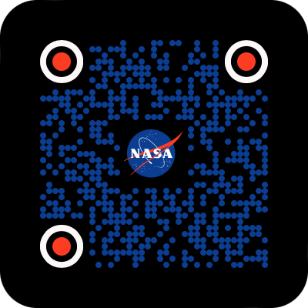

Summary
Increasing congestion of space accentuates need for robust CA practice
Performing a maneuver without sharing the plan with other nearby spacecraft causes a risk that two spacecraft will collide
  Ephemerides should be shared with 19 SDS
Automated maneuvers must be screened for close approaches to prevent collision
  Process should allow sufficient time for this
  Even test burns should be screened
Future process should be faster thanks to Starlink/Starling experiment
NASA CA website
NASA CA Handbook
CARA Tools

Slide 14

Questions?

Slide 15
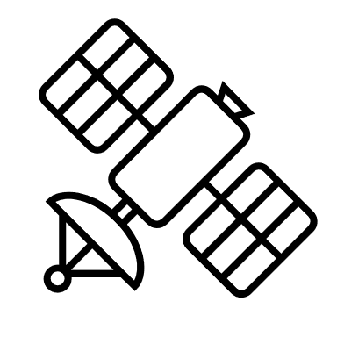

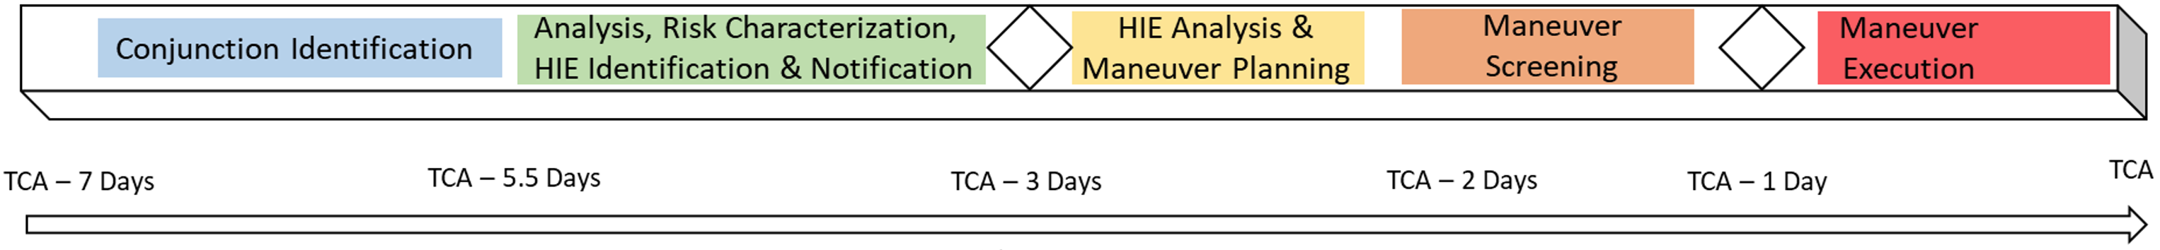
CARA Real-Time Process
Orbital Safety Analysts (Vandenberg)
DOD SSN
tracking data
LEGEND:
CARA
External
ephemerides
Screening results
Mission Ground Station
tracking data
ephemerides
reports
Mission
CARA System
CARA Operations
acquisition data
reports/recommendations
risk assessment
Data actionability
CARA Analysis
CA PROCESS IS COMPLEX!
Each event is unique
Automated system still requires manual analysis
Decision Point: Begin Maneuver Planning
Decision Point: Maneuver Go / No-Go
Notes:
Main talking points:
CARA real-time ops processes: Run screenings 3x a day with notifications as early as 7 days from TCA: Generic five steps outlined in the progress bar below
Involves the 5 CARA groups to analyze the information to notify and engage with the missions
Overall: 7-41 active interfaces and 7-25 total data sets transfered

