Slide 1
PLATTE RIVER BASIN WATER RESOURCES II
Predicting Land Cover Change in the Platte River Basin to Select Wetland Protection Sites Vulnerable to Urban Encroachment
Nancee Uniyal
Olivia Kirkland
Shaibal Ahmed
Yulia Shaffer
Georgia – Athens | Summer 2024
Notes:
[Nancee]
Hello Everyone, Thank you for joining us today!
We are the Platte River Basin Water Resources II team. Today we are going to talk about our project which is; predicting Land Cover Change in the Select Wetland Protection Sites Vulnerable to Urban Encroachment in Platte River Basin.
Hello, I am Nancee Uniyal
Hello, I am Olivia Kirkland
Hello, I am Shaibal Ahmed
Hello, I am Yulia Shaffer

Slide 2
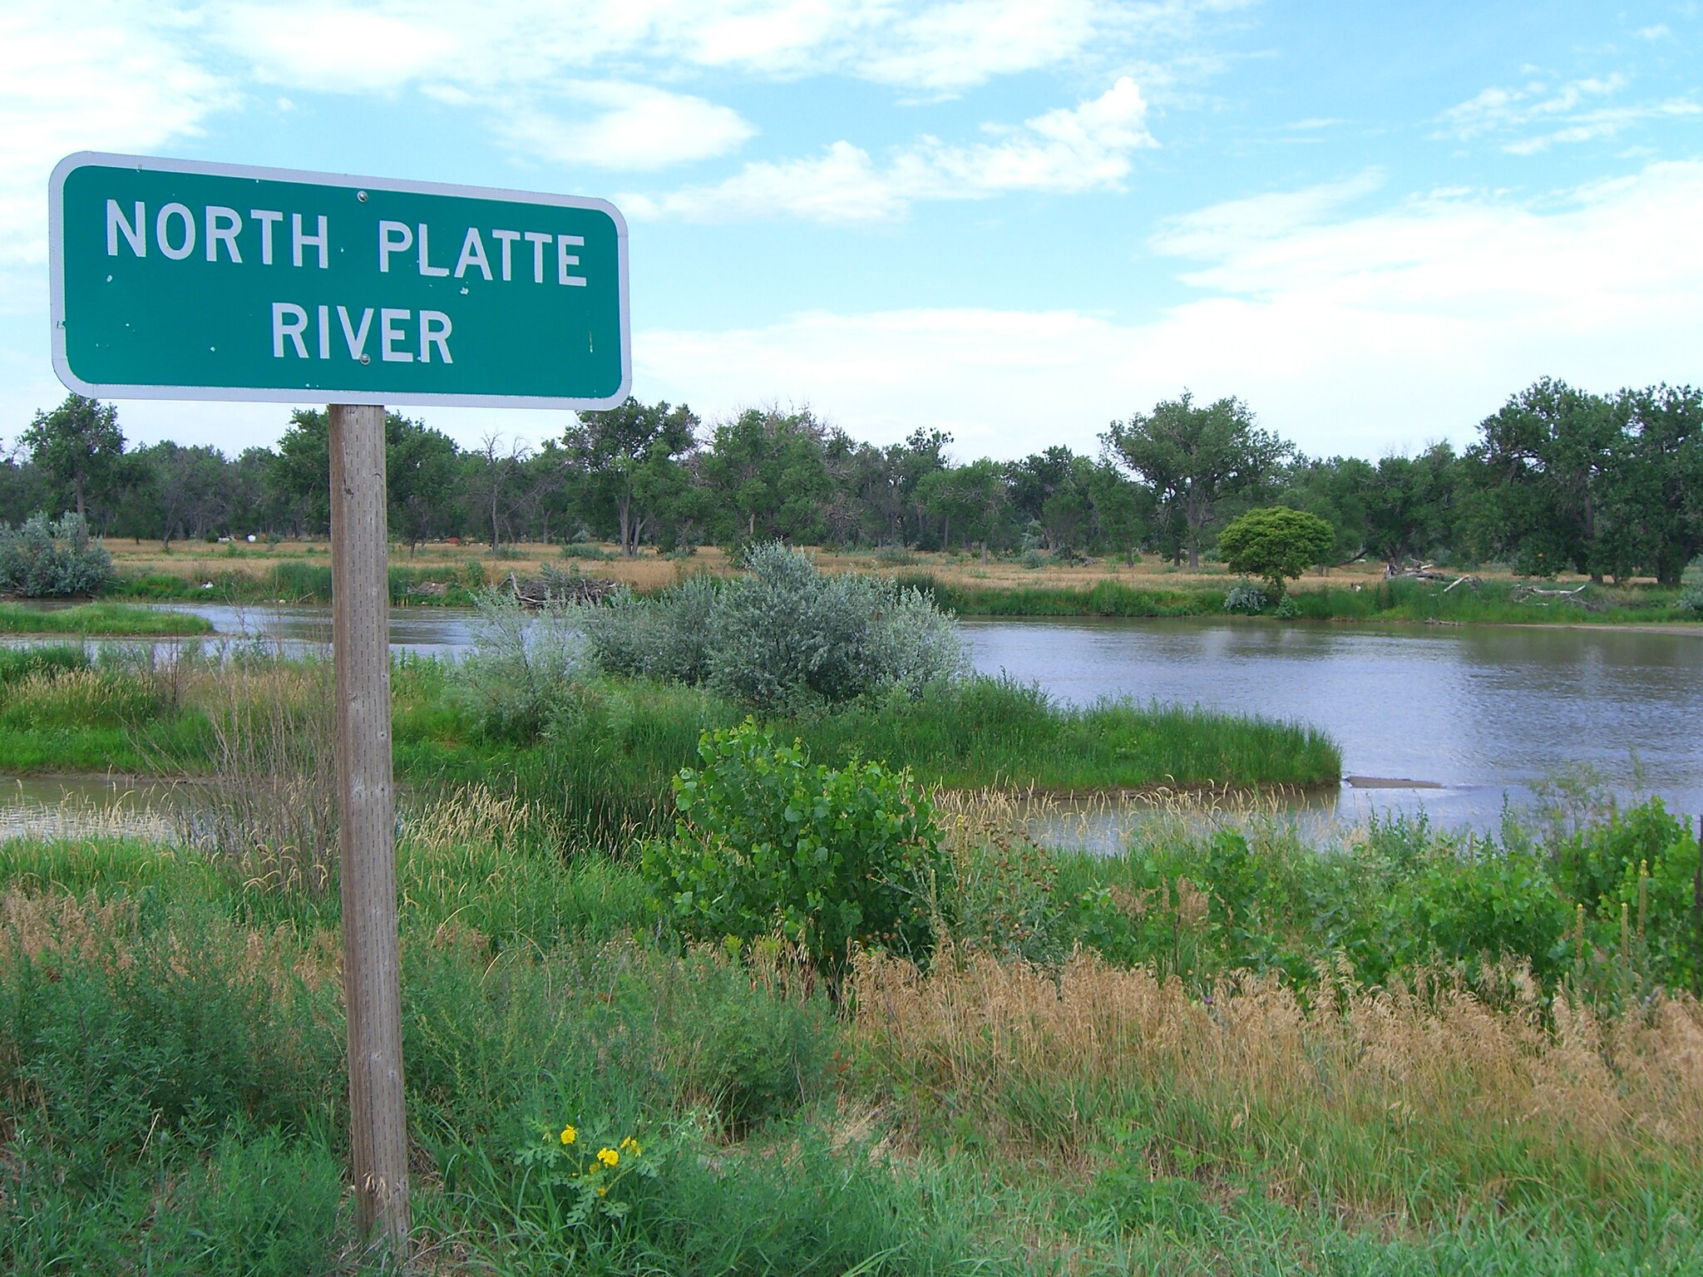
Background
Platte River Basin (PRB) – Most prominent waterway system in the US Northern Great Plains; a major river in Nebraska (563 km) Tributaries:
  North Platte (1690 km) flows into Wyoming
  South Platte (706 km) flows into Colorado
PRB wetlands are crucial for wildlife biodiversity and provide essential ecosystem services
Major challenges:
  Climate change that causes extreme weather events
  Pressure from urban development encroachment
Image Credit: Napa
Notes:
[Nancee]
Let me share a little background about our study site.
Platte River is one of the most important water systems in the United States Northern Great Plains and is the largest river in the state of Nebraska, about 1690 kilometers long. Its tributaries include North Platte (1690 kilometers) that flows into Wyoming and South Platte (706km) that flows into Colorado.
It provides essential yet vulnerable ecosystem services that need to be protected and serves as a critical wildlife habitat.
This was the second term of the Platte River Basin Water Resources project. The first term in spring 2024, assessed Urban Flood Vulnerability for selecting restoration sites for urban woods and prairies in the Great Plains. The spring team used satellite imagery to assess land use land cover change, as well as flood extent.
This term’s objective is to predict future urban growth and identify the most vulnerable wetland areas.
----------Image Information Below----------
[Photo 1 Identifier]
Image Credit: [Napa/Wikimedia] [CC-BY-SA-3.0]
Image Source: [File:North platte river.jpg - Wikimedia Commons]

Slide 3
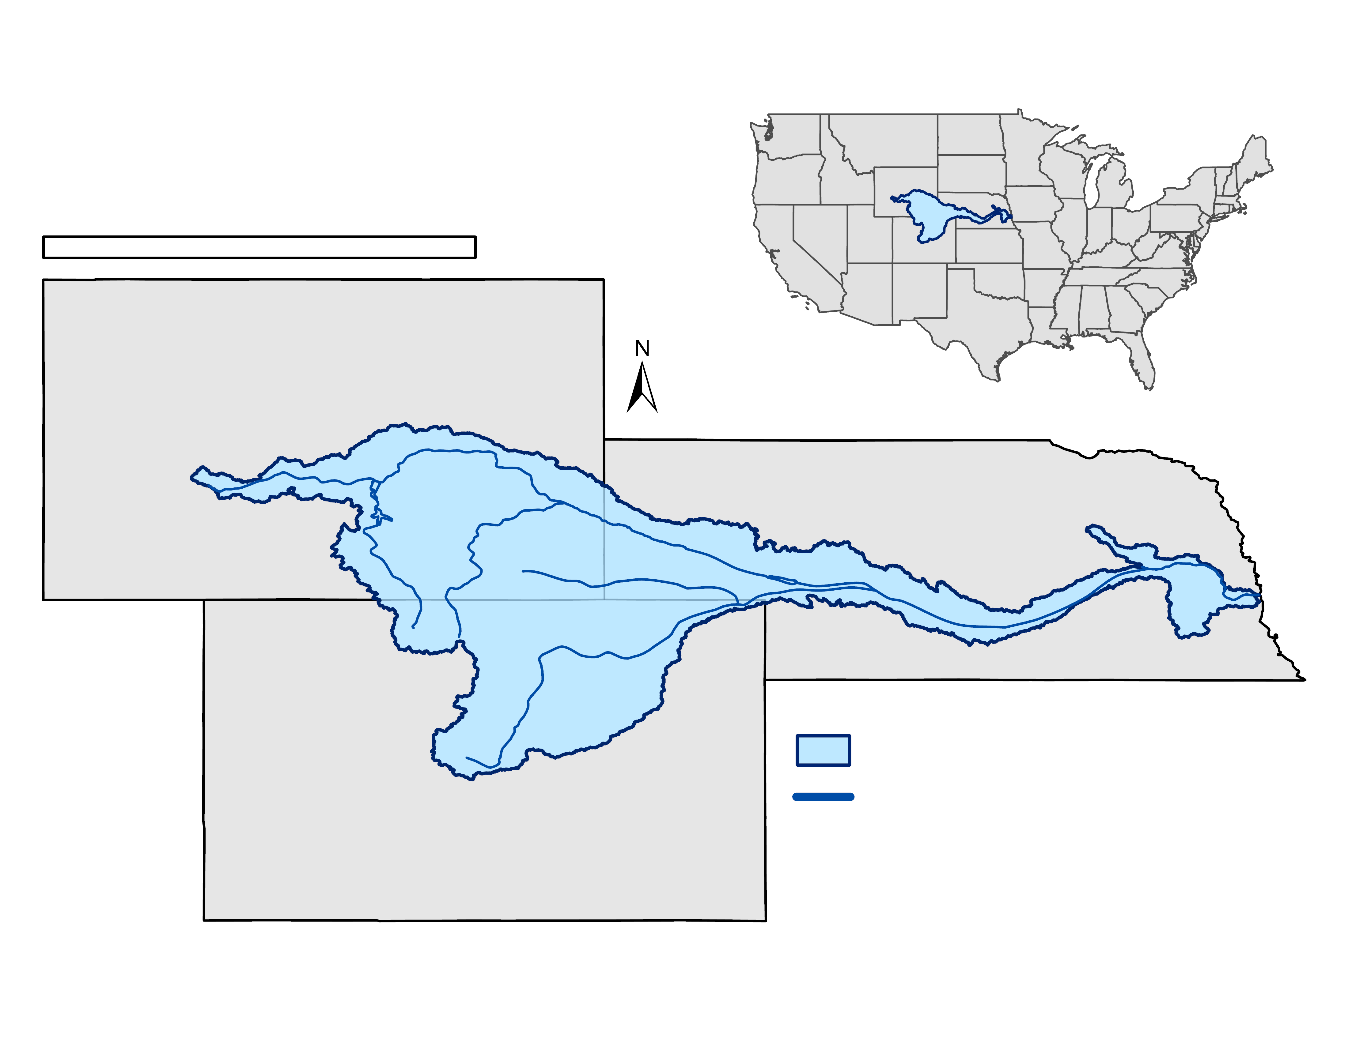

Study Area & Period
Study Area
  Platte River Basin in Nebraska, Colorado, and Wyoming
  Nearly 223,000 square kilometers
Study Period
  50 years total
Platte River Basin
United States of America
0
300
600
km
N
Nebraska
Wyoming
Colorado
2001
—
2021
2030
2040
2050
HISTORICAL CHANGE
FORECAST CHANGE
Platte River Basin
Platte River System
Service Layer Credits: ESRI ArcGIS Pro
Notes:
[Nancee]
The study area includes three states in the Platte River Basin: Nebraska, Colorado and Wyoming. We focused on 13 priority cities, selected by our partner, spanning these three states and 81 counties.
The study period began in January 2001 – December 2021 and forecasting for 2030, 2040, & 2050
----------Image Information Below----------
Image Credit: [Platte River Basin Water Resources I, DEVELOP Team]
Image Source: ArcGIS Pro

Slide 4
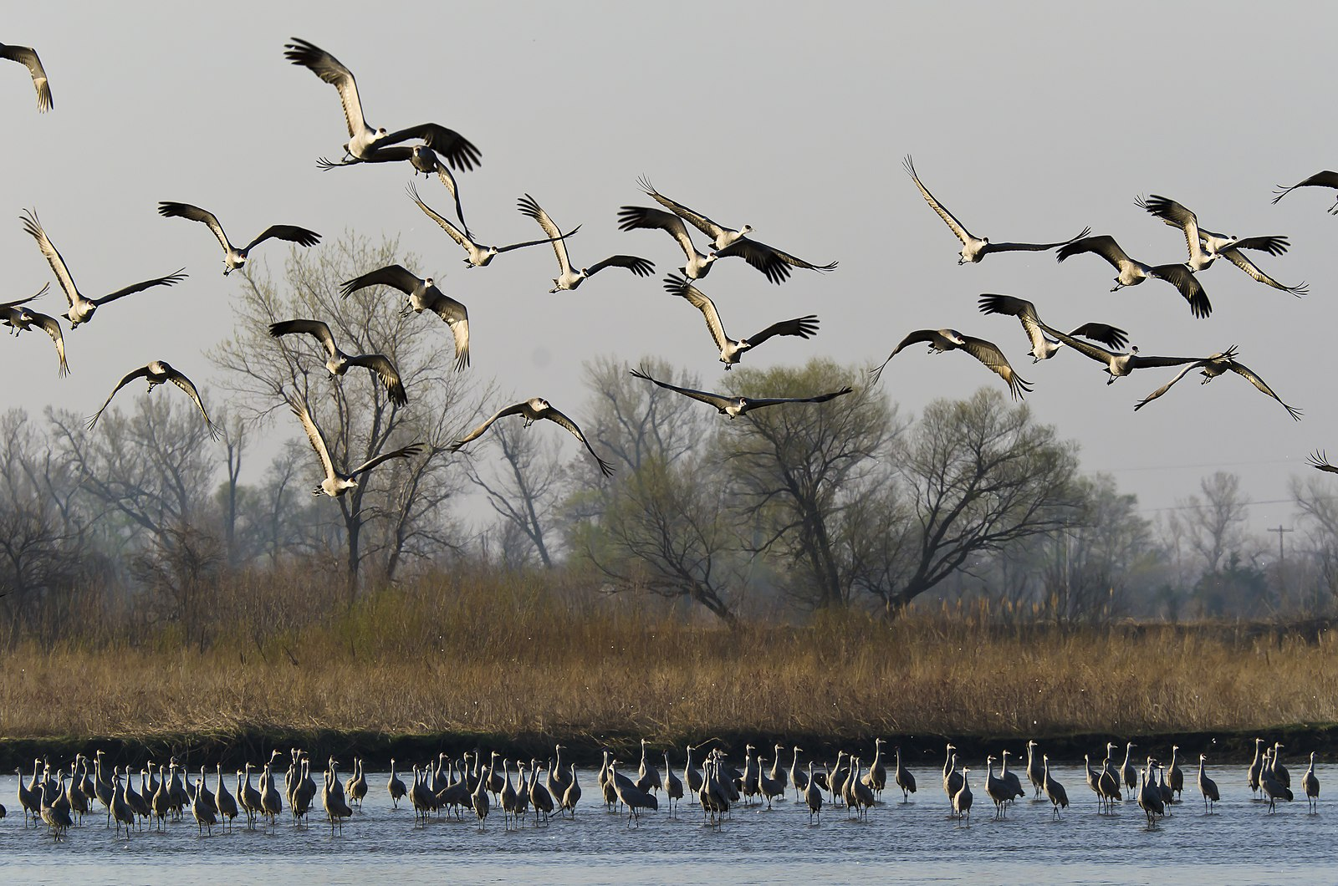
Partner Organization
Audubon Great Plains
The National Audubon Society regional office
for Nebraska, North Dakota, and South Dakota.
”Where birds thrive, people prosper“
Goal: Using science, habitat restoration, outreach, and education to address the core threats faced by birds in the region.
Mission: Protect birds and the places they need, today and tomorrow.
Image Credit: Larry Crist
Notes:
[Nancee]
•Following the first term, DEVELOP continued its partnership with Audubon Great Plains, which is the regional office of the National Audubon Society serving Nebraska, North Dakota, and South Dakota.
• Audubon is a nonpartisan bird conservation organization.
•Major agenda of the organization is using science, habitat restoration, outreach and education to address the core threats faced by birds in the region.
•Mission of the organization is to protect birds and the places they need, today and tomorrow.
----------Image Information Below----------
Image Credit: [Larry Crist] [CC BY 2.O]
Image Source: [https://commons.wikimedia.org/wiki/File:Sandhill_Migration_on_the_Platte_River_(7371874564).jpg ]

Slide 5
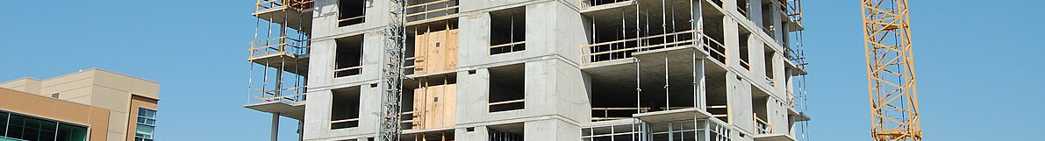
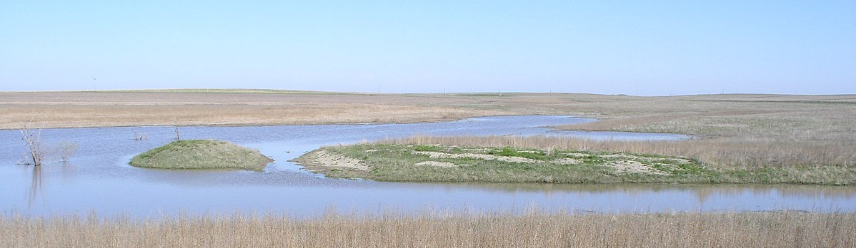
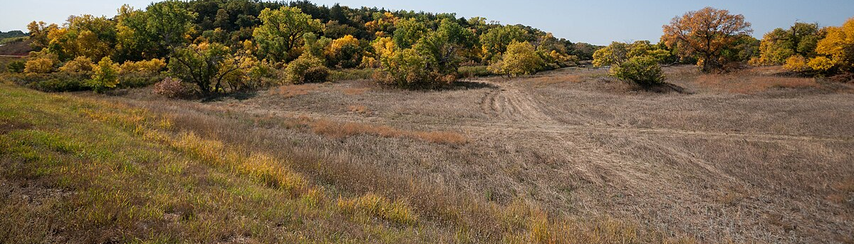
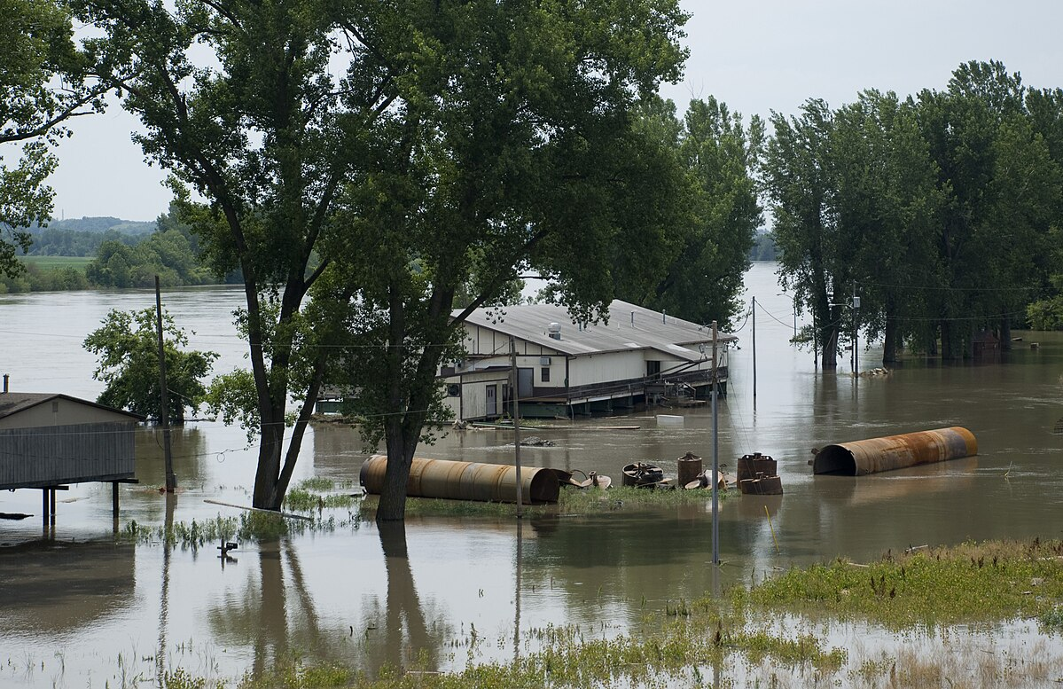
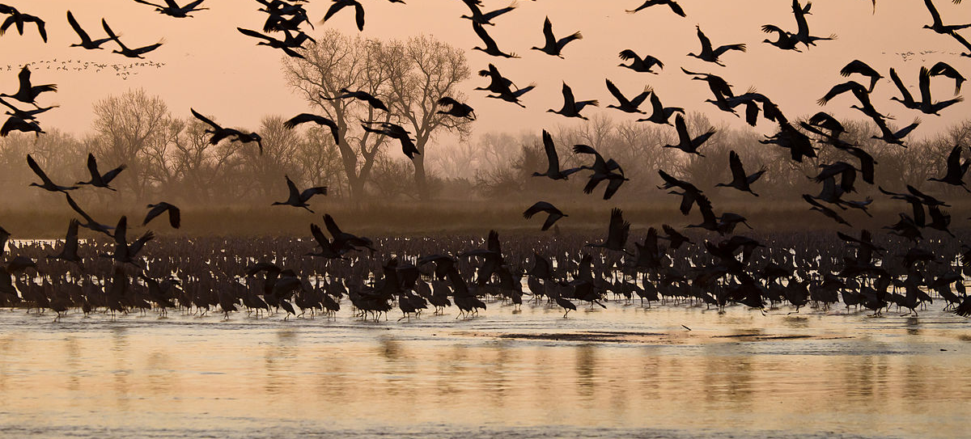
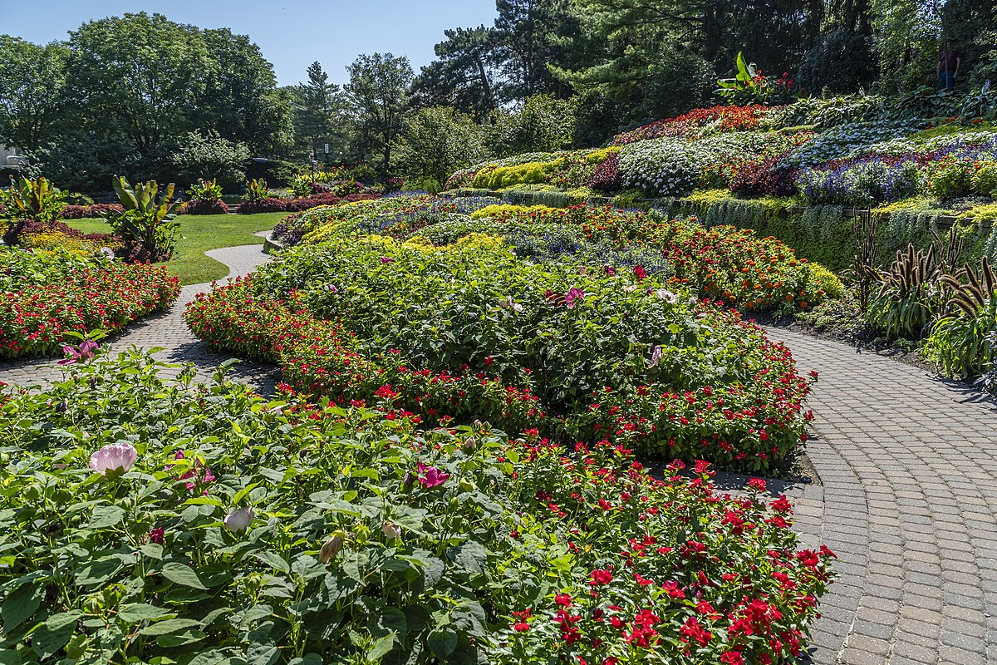
Community Concerns
Urbanization
Image Credit: Ryan Renner
Wetland Degradation
Habitat Fragmentation
Image Credit: USDA
Image Credit: Andrew Filer
Flooding
Bird Habitat Loss
Community Green Space Loss
Image Credit: Diana Fredlund
Image Credit: Larry Crist
Image Credit: Chuck Haacker
Notes:
[Nancee]
Decades of urbanization has changed the natural landscape of the Platte River Basin. Unfortunately, this urbanization has caused wetland degradation and habitat fragmentation. These consequences further impact the environment by reducing natural protections against flooding and contributing to the loss of native and migratory bird habitats as well as the loss of community green spaces.
Environmental restoration is necessary to mitigate the damage done. To plan these restoration efforts, it is critical to look at both what has been changed already and what future change might look like.
----------Image Information Below----------
Top
Image Credit: Ryan Renner; CC BY 2.0
Image Source: https://flickr.com/photos/omaha-homes-for-sale/
Middle left
Image Credit: USDA; Public Domain
Image Source: https://commons.wikimedia.org/wiki/File:White_River_bottom_Lyman_County_South_Dakota.jpg
Middle right
Image Credit: Andrew Filer; CC BY 2.0
Image Source: https://commons.wikimedia.org/wiki/File:Brocksburg,_Nebraska_(9094714249).jpg
Bottom left
Image Credit: Diana Fredlund (US Army Corps of Engineers); CC BY 2.0
Image Source: https://flickr.com/photos/55127822@N07/5846530366
Bottom middle
Image Credit: Larry Crist (USFWS); CC BY 2.0
Image Source: https://commons.wikimedia.org/wiki/File:11th_Place_-_March_Morning_on_the_Platte_River_(7371879846).jpg
Bottom right
Image Credit: Chuck Haacker; CC BY 2.0
Image Source: https://flickr.com/photos/43619751@N06/53163872444

Slide 6




Project Objectives
Model future urban growth in the Platte River Basin
Produce Land Use Land Cover (LULC) Change maps for 2030, 2040, and 2050
Identify wetland areas vulnerable to urban expansion
Create Protected Wetlands Vulnerability maps
Notes:
[Yulia]
Our project objectives for the second term of the Platte River Water Resources project entails:
forecasting future land use land cover change using an urban growth model,
identifying wetland areas most vulnerable to urban development encroachment,
and Finally creating maps of urban growth projections in the Platte River Basin for 2030, 2040, and 2050, as well as maps of projected wetland vulnerability on a finer scale (per priority cities)
----------Image Information Below----------
Icons Credit: [Microsoft Office Stock Images]

Slide 7
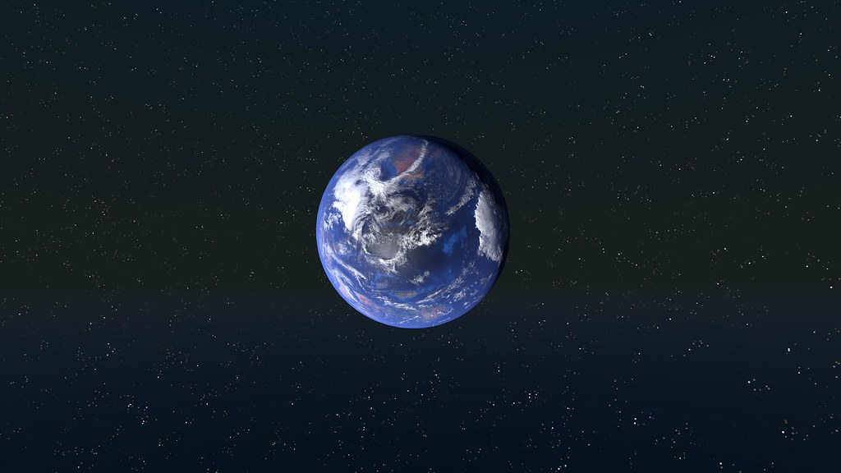
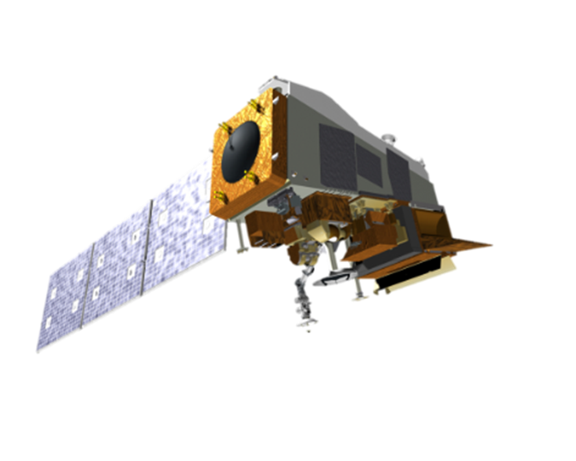
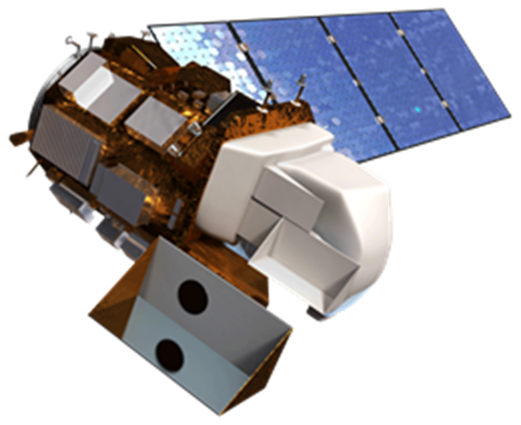
Earth Observation
Suomi-NPP VIIRS
Landsat 8 OLI
Image Credit: NASA
Image Credit: NASA
Image Credit: Wallpaperflare
Image Credit: Kristian Fagerström
Notes:
[Yulia]
For our Earth observations, we used Landsat 8 Operational Land Imager (OLI) images to derive Normalized Difference Vegetation Index (NDVI), that measures vegetation health and change.
We also included as supporting, stationary data - nighttime lights data obtained from Visible Infrared Imaging Radiometer Suite (VIIRS) of Suomi National Polar-orbiting Partnership (NPP) satellite. This imagery uses Day Night Band that shows visible artificial lights at night, representative of populous area (urban).
----------Image Information Below----------
Image Credit: NASA
Image Source: https://science.nasa.gov/multimedia/spacecraft-icons/
Image Credit: NASA
Image Source: https://earth.gsfc.nasa.gov/climate/missions/suomi-npp
Image Credit: Kristian Fagerström, CC BY-SA 2.0
Image Source: https://www.flickr.com/photos/147764143@N07/32995070824/

Slide 8
Methods
Raw Data
Processing
Analysis
Products
Raw Data
Processing
Analysis
Products
Earth Observations
Validation
Earth Observations
Quantity and allocation disagreements
Validation method (TBD)
Urban growth forecasts for 2030, 2040, 2050
Suomi-NPP VIIRS
NDVI
Nighttime Lights
Urban growth forecasts for 2030, 2040, 2050
Landsat 8
OLI
Suomi-NPP
VIIRS
NDVI
Nighttime Lights
Landsat 8 OLI
Ancillary Data
Ancillary Data Sets
FUTURES simulations
Status Quo
Alternate: TBD
Data Integration
U.S. Census Bureau
NASA SEDAC
Data integration
U.S. Census Bureau
NASA SEDAC
Wetlands are protected
Wetland vulnerability maps
Wetland
vulnerability maps
NLCD
Wetlands are not protected
NLCD
FUTURES Urban Growth Drivers
Analysis method 1 (TBD)
FUTURES Urban Growth Drivers
Population
NLCD
USGS DEM
Population
NWI
USGS DEM
LULC
Statistical LULC change analysis
LULC
Analysis method 2 (TBD)
Data relating to:
TIGER/Line
USGS PADUS
TIGER/Line
USGS PADUS
Environmental
Population drivers
Environmental
LULC drivers
Environmental drivers
Notes:
[Olivia]
We used these Earth observation outputs, in addition to ancillary data sets relating to population, as we mentioned we got this from VIIRS, land use land cover, or LULC, which we obtained from NLCD from 2001 to 2021, and various environmental factors, as inputs in forecasting urban growth using the FUTURES model.

Slide 9
Methods: FUTURES Explanation
Raw Data
Processing
Analysis
Products
Raw Data
Processing
Analysis
Products
Historical and projected population
Likelihood of growth
Earth Observations
Validation
Earth Observations
Quantity and allocation disagreements
Validation method (TBD)
Urban growth forecasts for 2030, 2040, 2050
Suomi-NPP VIIRS
NDVI
Nighttime Lights
Urban growth forecasts for 2030, 2040, 2050
Landsat 8
OLI
Suomi-NPP
VIIRS
NDVI
Nighttime Lights
Landsat 8 OLI
Historical LULC change
Location of growth
FUTURES simulations
Ancillary Data
Development predictions
Ancillary Data Sets
FUTURES simulations
Status Quo
Alternate: TBD
Data Integration
U.S. Census Bureau
NASA SEDAC
Data integration
Wetlands are protected
U.S. Census Bureau
NASA SEDAC
Wetlands are protected
Wetland vulnerability maps
Wetland
vulnerability maps
Wetlands are not protected
NLCD
FUTURES Urban Growth Drivers
Wetlands are not protected
NLCD
FUTURES Urban Growth Drivers
Analysis method 1 (TBD)
FUTURES Urban Growth Drivers
Population
Environmental factors
Suitability for growth
Population
NLCD
USGS DEM
Population
NWI
USGS DEM
LULC
Statistical LULC change analysis
LULC
LULC
Analysis method 2 (TBD)
Data relating to:
TIGER/Line
USGS PADUS
TIGER/Line
USGS PADUS
Environmental
Population drivers
Environmental
Environmental
LULC drivers
Environmental drivers
Notes:
[Olivia]
Let's focus in on what FUTURES is. The FUTURES urban growth model, developed by NC state university, is a flexible, free, open source model. It combines population trends, LULC change, and both natural and created environmental factors to determine the likelihood and suitability for urban growth. This likelihood and suitability then combine to determine the likely locations for urban growth, and to produce development predictions.

Slide 10
Methods: FUTURES Explanation
Raw Data
Processing
Analysis
Products
Raw Data
Processing
Analysis
Products
Earth Observations
Validation
Earth Observations
Quantity and allocation disagreements
Validation method (TBD)
Urban growth forecasts for 2030, 2040, 2050
Suomi-NPP VIIRS
NDVI
Nighttime Lights
Urban growth forecasts for 2030, 2040, 2050
Landsat 8
OLI
Suomi-NPP
VIIRS
NDVI
Nighttime Lights
Landsat 8 OLI
Ancillary Data
FUTURES simulations
Ancillary Data Sets
FUTURES simulations
Status Quo
Alternate: TBD
Data Integration
U.S. Census Bureau
NASA SEDAC
Data integration
Wetlands are protected
U.S. Census Bureau
NASA SEDAC
Wetlands are protected
Wetland vulnerability maps
Wetland
vulnerability maps
Wetlands are not protected
NLCD
FUTURES Urban Growth Drivers
Wetlands are not protected
NLCD
FUTURES Urban Growth Drivers
Analysis method 1 (TBD)
FUTURES Urban Growth Drivers
Population
Population
NLCD
USGS DEM
Population
NWI
USGS DEM
LULC
Statistical LULC change analysis
LULC
LULC
Analysis method 2 (TBD)
Data relating to:
TIGER/Line
USGS PADUS
TIGER/Line
USGS PADUS
Environmental
Population drivers
Environmental
Environmental
LULC drivers
Environmental drivers
Notes:
[Olivia]
Using this model, we created two scenarios of future urban growth: one where wetlands are completely protected and are not allowed to be developed on, and one where wetlands are completely unprotected and are therefore allowed to be developed on. These scenarios informed how urban growth responds to the status of wetland protection.

Slide 11
Methods
Raw Data
Processing
Analysis
Products
Raw Data
Processing
Analysis
Products
Earth Observations
Validation
Earth Observations
Quantity and allocation disagreements
Validation method (TBD)
Urban growth forecasts for 2030, 2040, 2050
Suomi-NPP VIIRS
NDVI
Nighttime Lights
Urban growth forecasts for 2030, 2040, 2050
Landsat 8
OLI
Suomi-NPP
VIIRS
NDVI
Nighttime Lights
Landsat 8 OLI
Ancillary Data
Ancillary Data Sets
FUTURES simulations
Status Quo
Alternate: TBD
Data Integration
U.S. Census Bureau
NASA SEDAC
Data integration
U.S. Census Bureau
NASA SEDAC
Wetlands are protected
Wetland vulnerability maps
Wetland
vulnerability maps
NLCD
Wetlands are not protected
NLCD
FUTURES Urban Growth Drivers
Analysis method 1 (TBD)
FUTURES Urban Growth Drivers
Population
NLCD
USGS DEM
Population
NWI
USGS DEM
LULC
Statistical LULC change analysis
LULC
Analysis method 2 (TBD)
Data relating to:
TIGER/Line
USGS PADUS
TIGER/Line
USGS PADUS
Environmental
Population drivers
Environmental
LULC drivers
Environmental drivers
Notes:
[Olivia]
As seen on the right side in green, we then visualized these scenarios to produce urban growth forecasts for 2030, 2040, and 2050 as well as wetland vulnerability maps.

Slide 12
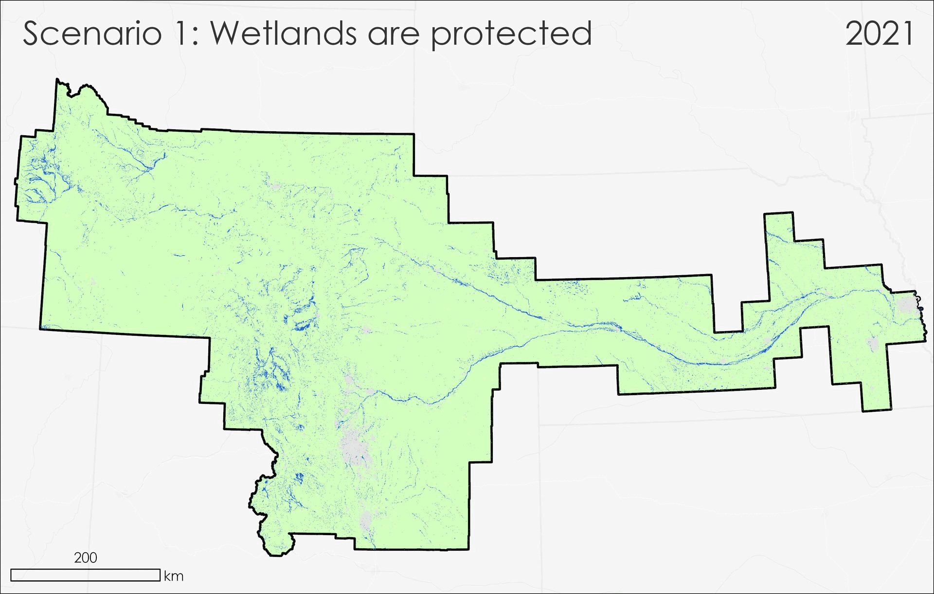

Results: Platte River Basin Forecasts
Projected urban growth in the Platte River Basin
Wetland
Nonurban
Urban (2021)
Projected urban
Service Layer Credits: Nebraska Game & Parks Commission, Esri, TomTom, Garmin, FAO, NOAA, USGS, EPA, NPS, USFWS
Notes:
[Shaibal]
Our results show basin-wide projected urban development. Approximately, 5% of non-urban areas are projected to be converted to urban areas by 2030, 8% by 2040, and 11% by 2050 in the scenario where wetlands are protected. In the scenario where wetlands are not protected, the projected urban growth is similar but the pattern of urban growth is different.
Image Credits: Platte River II DEVELOP Team
Image Source: ArcGIS Pro
Service Layer Credits: Nebraska Game & Parks Commission, Esri, TomTom, Garmin, FAO, NOAA, USGS, EPA, NPS, USFWS

Slide 13
Results: Platte River Basin Forecasts
Projected urban areas in the PRB (km²)
11800
≅11% ↑
≅8% ↑
≅5% ↑
10400
9800
2021
2030
2040
2050
Notes:
[Shaibal]
Here's a bar chart that shows the projected urban growth. As we mentioned, we had the same amount of urban growth for each of the scenario. Which makes sense because we had the same underlying data but the pattern was different because the wetlands were not protected anymore in the second scenario.
Image Credits: Platte River II DEVELOP Team
Image Source: ArcGIS Pro
Service Layer Credits:
Nebraska Game & Parks Commission, Esri, TomTom, Garmin, FAO, NOAA, USGS, EPA, NPS, USFWS

Slide 14
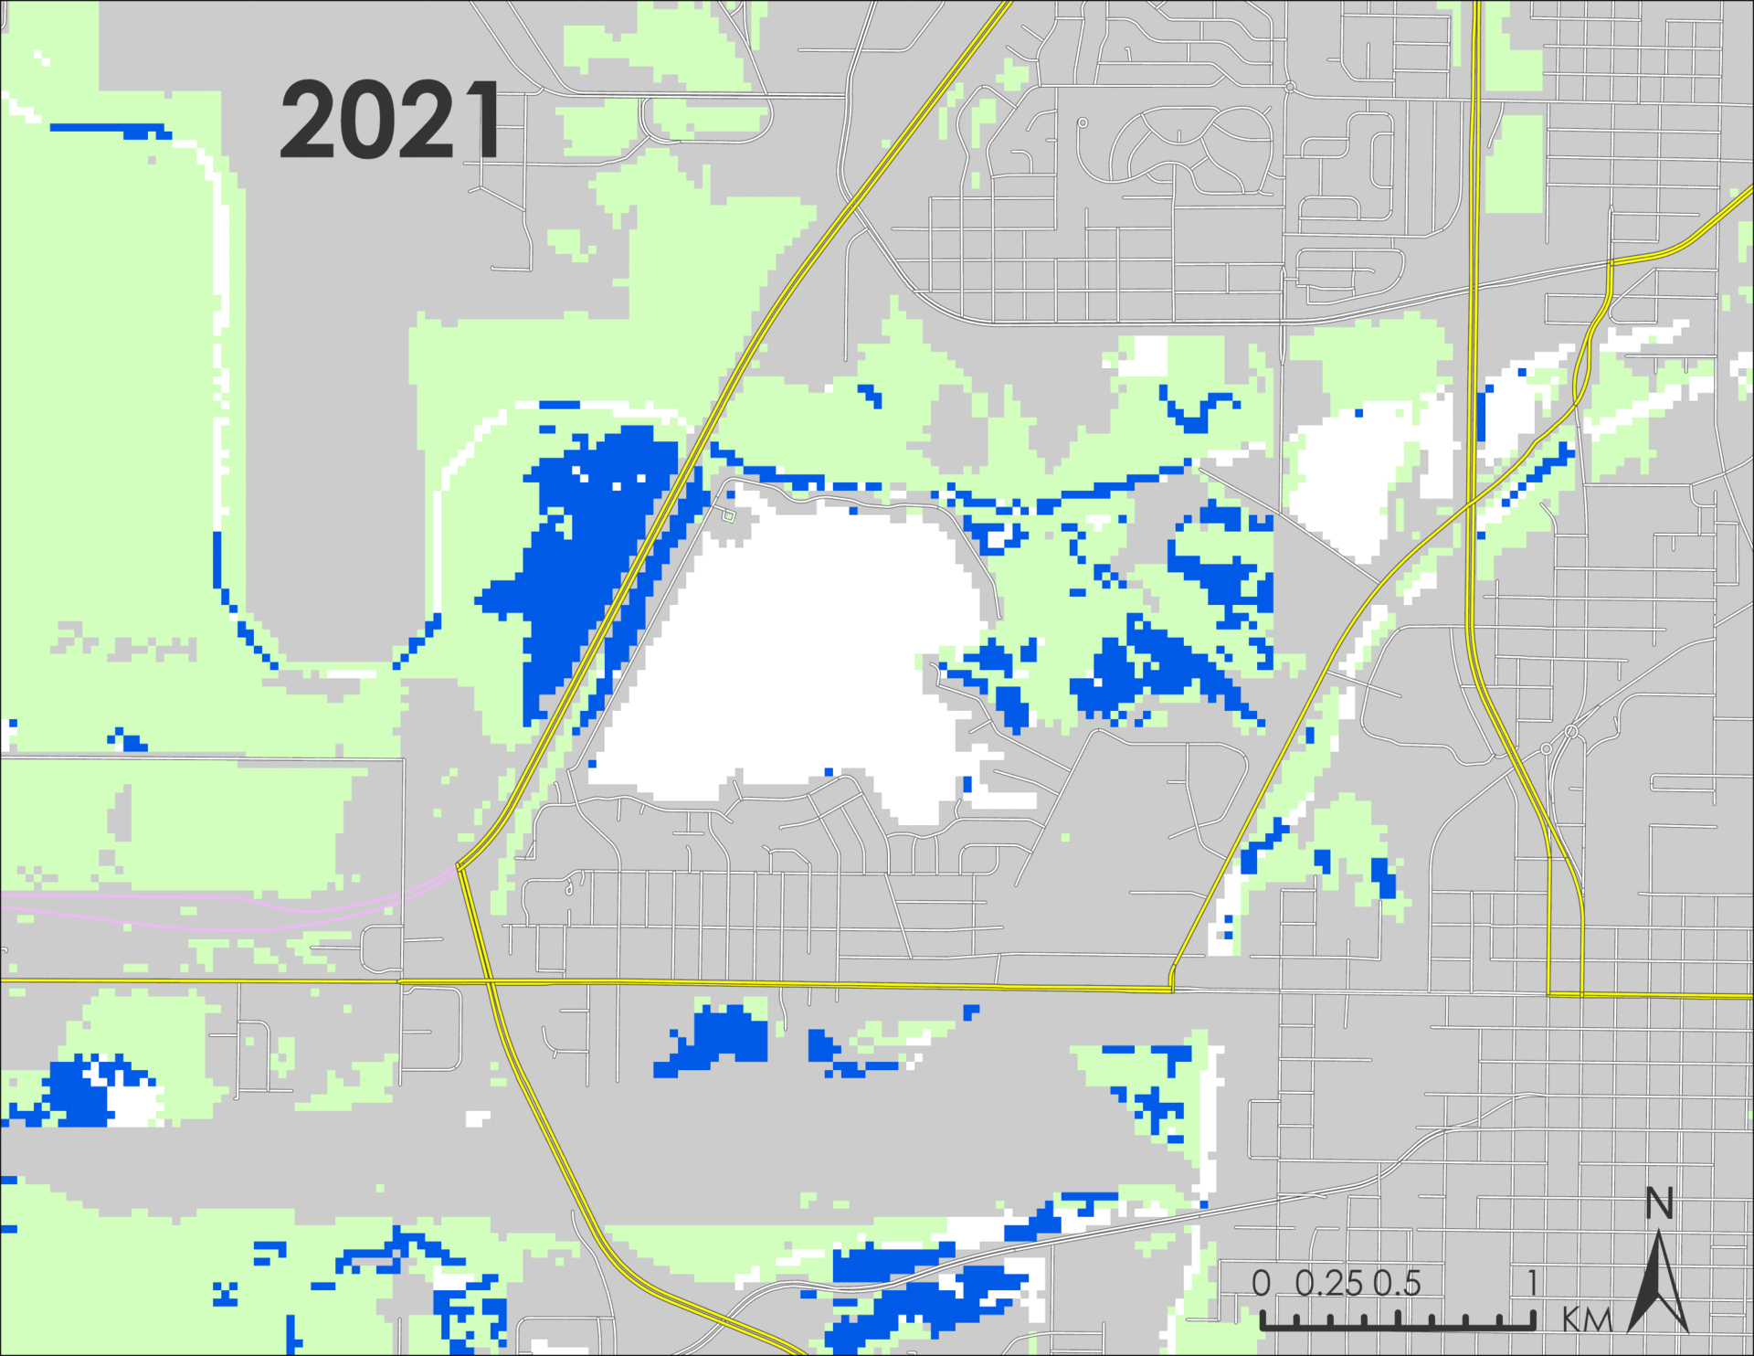
Results: Fragment of Urban Change
This animation map shows three different scenarios 2021, Scenario 1 (all wetlands are protected) for 2050, and Scenario 2 (all wetlands are unprotected) for 2050 of fragment of urban area in Lincoln, NE.
While the growth happens in both scenarios, the impact on wetlands is significantly more extensive for Scenario 2.
Scenario 2 | Area Loss | % Loss
2050 | 0.65 Sq KM | 24.3 %
Major Roads
Minor Roads
Wetlands
Non-urban
Protected/Water
Urban (2021)
Projected (2050)
Notes:
[Shaibal]
Here we are looking at an animation of a fragment area of Lincoln, Nebraska. The first animation is for 2021, the second animation is for Scenario 1 for 2050 where all wetlands are protected and the third animation for 2050 is for no wetlands are protected. As we can see, the urban growth does occur for both scenarios, yet the impact on wetlands is significantly larger for the second scenario. For the given urban fragment, 23.4% of wetlands would be lost to urban encroachment.
Image Credits: Platte River II DEVELOP Team
Image Source: ArcGIS Pro
Service Layer Credits: City of Lincoln/Lancaster County, Nebraska Game & Parks Commission, Esri, TomTom, Garmin, SafeGraph, GeoTechnologies, Inc, METI/NASA, USGS, EPA, NPS, USDA, USFWS

Slide 15
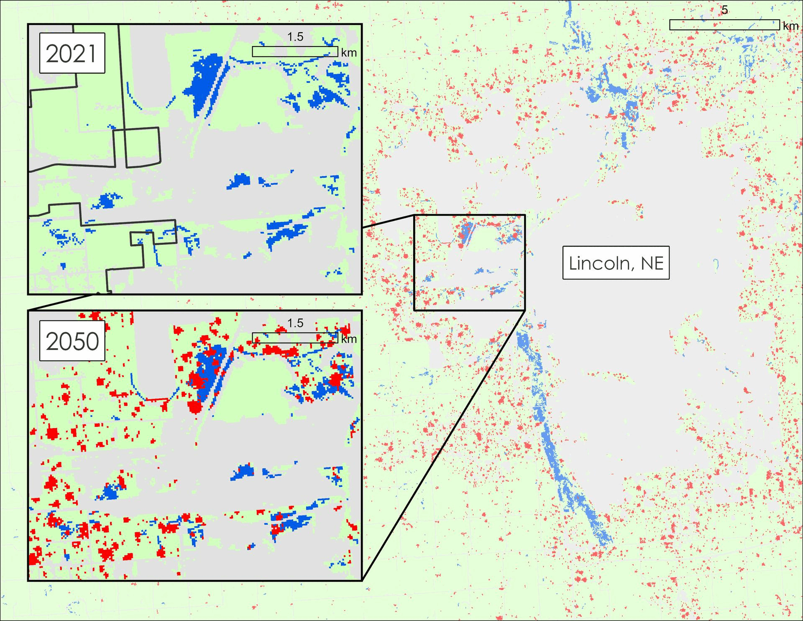
Results: Wetland Vulnerability
Wetland loss due to urban growth within PRB (km²)
Wetland
Nonurban
7440
Urban (2021)
Projected Urban
7390
7340
2021
2030
2040
2050
Wetland loss due to urban growth within Lancaster County (km²)
19
18.4
17.8
Service Layer Credits: City of Lincoln/Lancaster County, Nebraska Game & Parks Commission, Esri, TomTom, Garmin, SafeGraph, GeoTechnologies, Inc, METI/NASA, USGS, EPA, NPS, USDA, USFWS
2021
2030
2040
2050
Notes:
[Shaibal]
Here's another closeup look into area of Lincoln, Nebraska. On the bar chart, we can see the diminishing pattern of wetlands areas for the whole of Platte River Basin and for Lancaster County as an example. In the map, we see the gradual wetland encroachment through 2050, compared to the static map of urban growth by 2050. Approximately, 2% of wetland areas are lost by 2030, 3% by 2040, and 3.63% by 2050 in the scenario where wetlands are not protected which amounts to a total of approximately 0.69 square kilometers.
Image Credits: Platte River II DEVELOP Team
Service Layer Credit:
City of Lincoln/Lancaster County, Nebraska Game & Parks Commission, Esri, TomTom, Garmin, SafeGraph, GeoTechnologies, Inc, METI/NASA, USGS, EPA, NPS, USDA, USFWS

Slide 16



Errors and Uncertainties
Lack of precision in population distribution
Urban growth forecasting
Did not consider agents that drive change
Notes:
[Yulia]
Couple of uncertainties that we need to consider:
1) Our population estimations were based on county level, rather than census blocks, which would have provided a better population distribution across PRB.
2) Moreover, another uncertainty is with the nature of urban growth forecasting itself. We cannot exactly predict how the population and urban development in the region will continue to grow, or whether there will be new factors that could influence population growth (e.g., migration, urban planning strategies, climate change impact on wetlands).
3) We did not consider agents that might influence the trajectory of how the region continues to develop. For example, different agents or actor might have different demand for the land, which might influence how land use might change.
Icons Credit: Microsoft Office Stock Images

Slide 17



Feasibility & Partner Implementation
Earth Observations
These methods are feasible!
FUTURES Urban Growth Model
Audubon Great Plains can implement these methods to enhance wetland protection and restoration prioritization.
Earth observations are reliable and accessible.
FUTURES model is flexible, accessible, and capable.
Wetland Vulnerability
Identification
Notes:
[Yulia]
Despite these uncertainties, we found that these methods are feasible for future use.
Earth observations are reliable and accessible data. The FUTURES urban growth model is flexible with data inputs, is free, open source, and accessible, and is capable of forecasting over large scales.
Because of this, Audubon Great Plains can implement these methods to enhance their wetland prioritization methods for their protection and restoration efforts.
----------Image Information Below----------
Icons Credit: [Microsoft Office Stock Images]

Slide 18
Conclusions
Wetland protection status influences urban growth patterns
Notes:
[Olivia]
Following our analyses, we found that the wetland protection status influenced the patterns of urban growth. For example, we tend to see less urban sprawl when wetlands are protected.
----------Image Information Below----------
Icons Credit: [Microsoft Office Stock Images]

Slide 19
Conclusions
Wetland protection status influences urban growth patterns
Wetland loss is projected to occur across the basin and within cities
Notes:
[Olivia]
Our analyses also revealed that wetland degradation is likely to occur both across the basin and within individual cities. Lancaster County, which holds Lincoln, Nebraska, is projected to experience wetland reduction by 3.63%, or roughly .69 square kilometers, and we see a similar trend across the entire basin.
----------Image Information Below----------
Icons Credit: [Microsoft Office Stock Images]
Icons Source: [insert URL]

Slide 20
Conclusions
Wetland protection status influences urban growth patterns
Wetland loss is projected to occur across the basin and within cities
Audubon Great Plains can use this information to inform restoration/protection work
Notes:
[Olivia]
Knowing how wetland protection can influence urban growth and knowing how much wetland loss is expected is useful to Audubon Great Plains in their wetland restoration and protection efforts.
----------Image Information Below----------
Icons Credit: [Microsoft Office Stock Images]

Slide 21
Previous Team: Platte River Basin Water Resources I team
  Jennifer Mathis
  Jackie Encinas
  Emma Vail
  Olivia Kirkland
Science Advisor:
  Marguerite Madden (University of Georgia)
DEVELOP Center Lead:
  Megan M. Rich (Georgia – Athens)
Special Thanks:
  Dr. Georgina Sanchez (North Carolina State University)
Notes:
[Nancee]
On the behalf of our team I want to thank people who made this project successful. Firstly, I would like to thank first term team of Platte River Basin Water Resources : Jennifer Mathis, Jackie Encinas, Emma Vail and Olivia Kirkland.
A huge thank you to our science advisor Dr. Marguerite Madden from University of Georgia for hervaluable time and suggestions.
Many thanks to our smart and intelligent center lead Megan Rich.
We are very thankful to Dr. Georgina Sanchez from North Carolina State University.
Finally, we want to Thank you all for listening to us.
----------Image Information Below----------
[Photo 1 Identifier]
Image Credit: [insert author] [insert license]
Image Source: [insert URL]
[Photo 2 Identifier]
Image Credit: [insert author] [insert license]
Image Source: [insert URL]

