Slide 1
A Method of Compliance for Achieving Target Collision Risk in UTM Operations
Min Xue✧
Vincent Kuo*
José Ignacio de Alvear Cárdenas✦
Priyank Pradeep◇
✧ NASA Ames Research Center
*Metis Technology Solutions
✦ San Jose Sate University Research Foundation
◇ Universities Space Research Association
Moffett Field, CA
Aviation Forum, Aug. 1, 2024

Slide 2
How to develop a method of compliance to show that a target UA-to-UA Collision Risk level can be achieved by core UTM services?
Target
(10^{-n} NMACs per flight hour)
Safety Credit
(Conformance Monitoring)
Safety Credit
(Strategic Conflict Detection)
Safety Credit
(Intent sharing)
Safety Credit
(USS)

Slide 3
Outline
Background
  Method of Compliance
  Reich Collision Risk Model
  ASTM USS Specification
Method of Compliance for Strategic Coordination Services
  Baseline ASTM requirements
  Volume-based Collision Risk Model
  Flow Diagram: test harness and data collection
Sensitivity Analysis
Conclusions and Future Work

Slide 4
Background I: Method of Compliance
Advisory Circulars 107-2A:
“A method of compliance (MOC), or a means of compliance, is one method, but not the only method, to show compliance with a regulatory requirement”.
An MOC can help break down the initial requirement, substitute it with sub-requirements, and show that satisfying the sub-requirements is equal to satisfying the initial requirement.

Slide 5
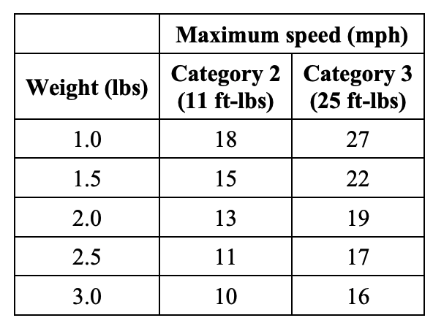

Sample MOCs in AC 107-2A
A small UA
  Does not exceed the applicable injury severity limit upon impact with a human being
  Does not contain any exposed rotating parts that would lacerate human skin
  Does not contain any safety defects
“Manufacture the small UAS so that the propellers are internal to the UAS, such as in a ducted fan configuration, then the rotating parts would not be exposed.”
FAA-provided MOC
The small UA’s maximum kinetic energy calculated using:
is less than:
$${KE}_{impact}=0.0155×w×v^{2}$$
Category 2 : 11 ft-lbs
Category 3 : 25 ft-lbs
FAA-provided MOC
Kinetic energy limits
Speed limits

Slide 6
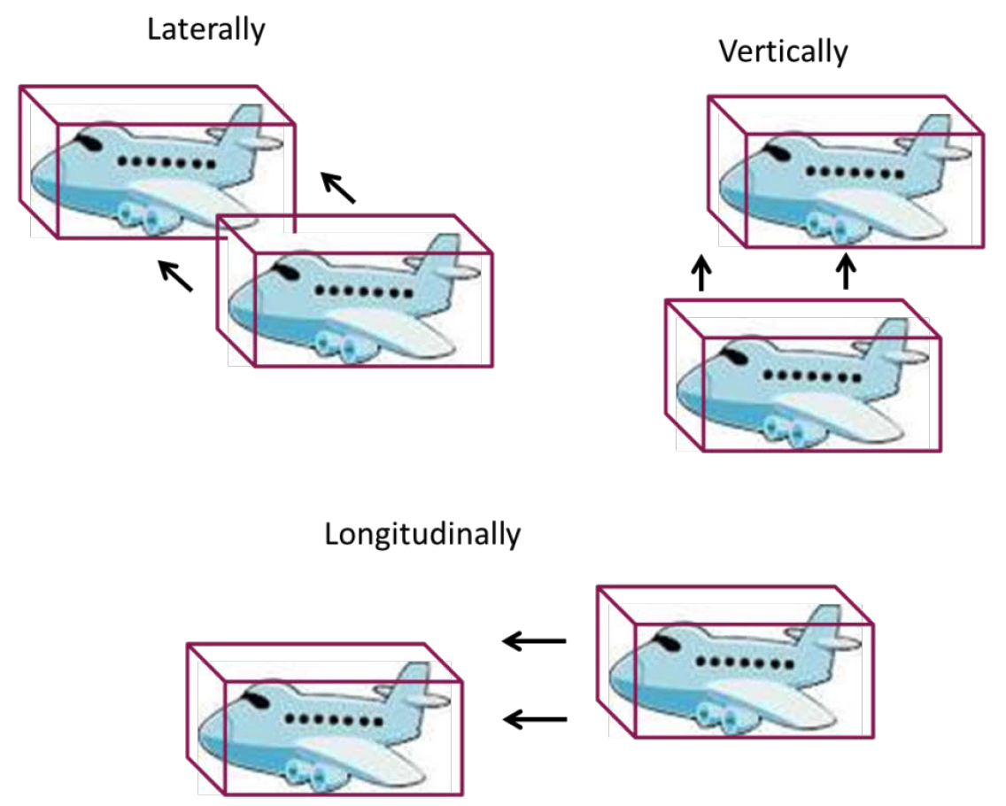
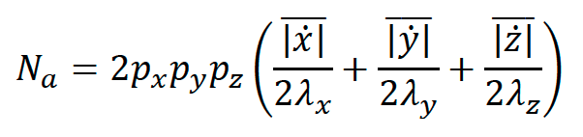
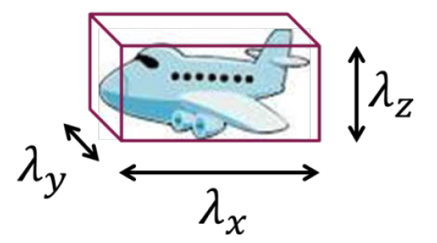
Background II: Reich Collision Risk Model
The Reich Collision Risk Model was developed to assess safety assessment for the North Atlantic Reduced Longitudinal Separation Minimum (RLongSM) project by providing a collision risk estimation.
Avg. relative passing speeds
Why the Reich model is not suitable for UTM at the current stage:
Requires adequate and representative traffic data to derive probabilistic distributions
Performs effectively only with parallel routes over extended ranges

Slide 7
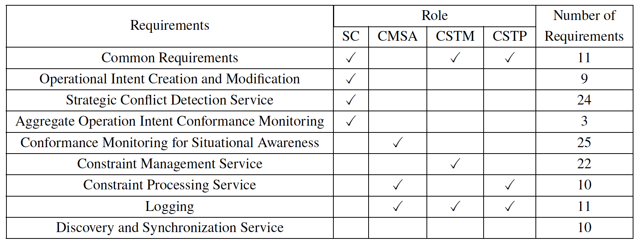
Background III: ASTM UTM USS Specification
ASTM F3548-21

Slide 8
Outline
Background
  Method of Compliance
  Reich Collision Risk Model
  ASTM USS Specification
Method of Compliance for Strategic Coordination Services
  Baseline ASTM requirements
  Volume-based Collision Risk Model
  Flow Diagram: test harness and data collection
Sensitivity Analysis
Conclusions and Future Work

Slide 9
Baseline ASTM Requirements
"Operational intents shall (OPIN0010) be constructed such that the UA’s actual position is inside an operational intent in the Activated state at least 95 percent of total flight time.”
Operational Intent Creation and Modification (OICM)
Strategic Conflict Detection (SCD)
"A managing USS shall (SCD0035) verify that before transitioning an operational intent to the Accepted state, it does not conflict with an equal priority operational intent when the regulation does not allow conflicts within the same priority level."
Operational Intent Conflict, not permitted
Operational Intent Conflict, permitted
Method of Compliance

Slide 10
Outline
Background
  Method of Compliance
  Reich Collision Risk Model
  ASTM USS Specification
Method of Compliance for Strategic Coordination Services
  Baseline ASTM requirements
  Volume-based Collision Risk Model
  Flow Diagram: test harness and data collection
Sensitivity Analysis
Conclusions and Future Work

Slide 11




Volume-base Collision Risk Model
What is the UA-UA collision risk?
$$A_{i}$$
Rectangular intent
$$r_{i}$$
$$A_{j}$$
Rectangular intent
$$r_{j}$$

Slide 12










Volume-base Collision Risk Model: Collision Risk between Elliptical Shapes
Combined elliptical intent
Combined circular intent
Elliptical intent
$$y$$
$$ε_{i}$$
$$ε_{i}+ε_{j}$$
$$x$$
$$A_{i}$$
$$A_{j}$$
$$∆_{y}$$
$$δ_{y}$$
Elliptical intent
Elliptical collision zone
$$ε_{j}$$
Circular collision zone
$$δ_{x}$$
$$∆_{x}$$

Slide 13







Volume-base Collision Risk Model: Collision Risk between Rectangular Cuboids
Inscribed elliptical intent
Circumscribed
elliptical intent
$$ε_{ii}$$
$$ε_{ic}$$
Upper bound of the collision risk
$${(P}_{up})$$
UA-UA collision risk
$$A_{i}$$
$${(P}_{up}+P_{lb})$$
Rectangular intent
Inscribed elliptical intent
Lower bound of the collision risk
$$r_{i}$$
$$A_{j}$$
$$ε_{ji}$$
$${(P}_{lb})$$
Circumscribed
elliptical intent
$$ε_{jc}$$
Rectangular intent
$$r_{j}$$

Slide 14
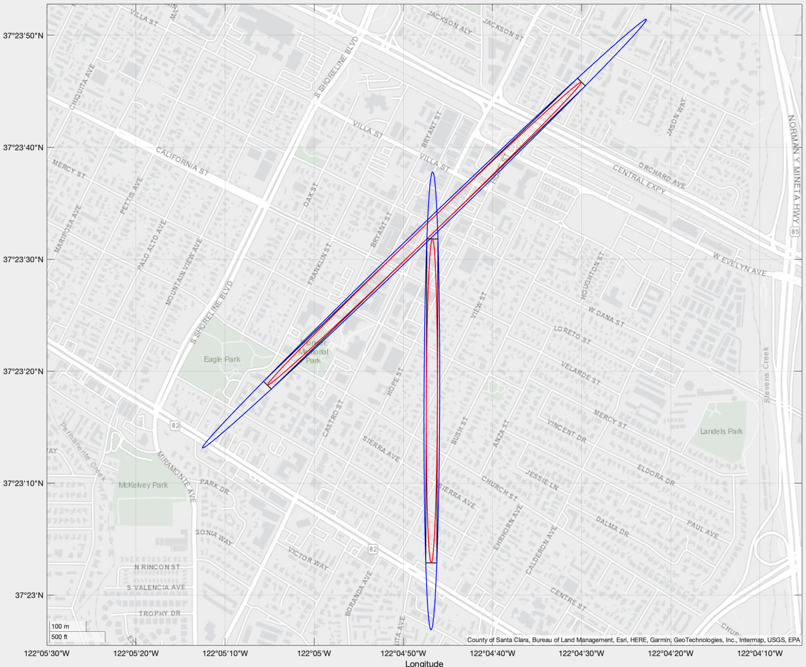
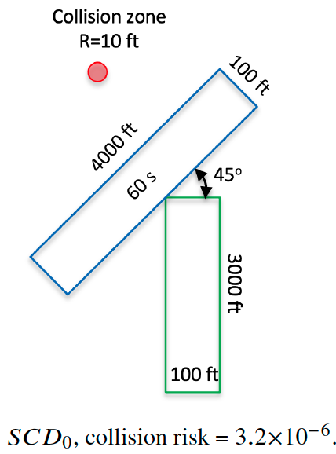
Volume-base Collision Risk Model: Example

Slide 15
Outline
Background
  Method of Compliance
  Reich Collision Risk Model
  ASTM USS Specification
Method of Compliance for Strategic Coordination Services
  Baseline ASTM requirements
  Volume-based Collision Risk Model
  Flow Diagram: test harness and data collection
Sensitivity Analysis
Conclusions and Future Work

Slide 16
Flow Diagram: MOC for the Strategic Coordination Services
ASTM requirement
Test case
Strategic Conflict Detection Service
(target)
Assumptions
[OPIN0010]
OiMinConformance = 95%
Volume-based Collision Risk Model
UA-UA collision risk
Volume-based Collision Risk Model
[OPINxxxx]
Distribution Type = Normal
Test cases
New OPIN requirement
OIs are required not to conflict with each other
UA-UA collision risks
Operational/testing data
Conformance Data
< TLS?
Fail
New SCD requirement
Pass

Slide 17
Outline
Background
  Method of Compliance
  Reich Collision Risk Model
  ASTM USS Specification
Method of Compliance for Strategic Coordination Services
  Baseline ASTM requirements
  Volume-based Collision Risk Model
  Flow Diagram: test harness and data collection
Sensitivity Analysis
Conclusions and Future Work

Slide 18
Impact of Different SC Services
Collision zone
R=10 ft
100 ft
4000 ft
500 ft
45º
60 s
3000 ft
100 ft
Deconflict without buffer
(Collision risk = 3.2x10⁻⁶)
Deconflict with buffer
(Collision risk = 7.5x10⁻⁷)

Slide 19
Impact of Layout of Operational Intents
Collision zone
R=10 ft
100 ft
100 ft
100 ft
4000 ft
4000 ft
Deconflict without buffer
(Collision risk = 2.1x10⁻⁴)
Deconflict with buffer
(Collision risk = 5.7x10⁻⁸)

Slide 20
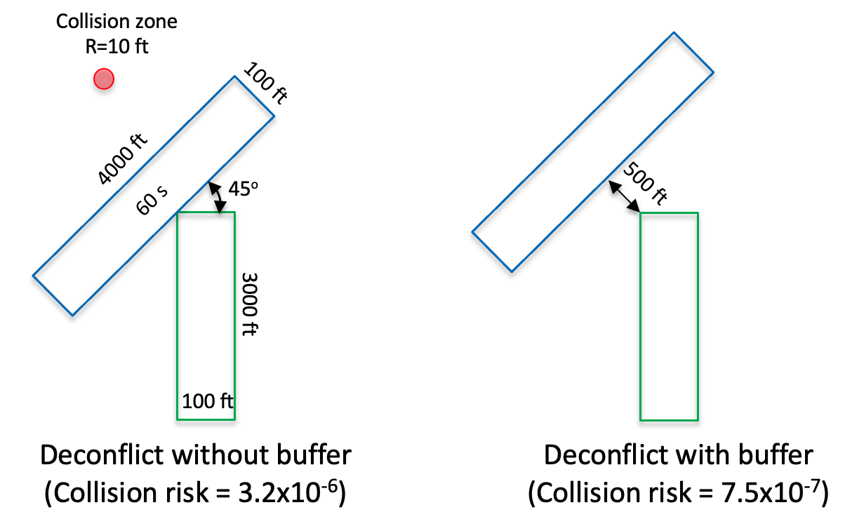
Impact of Operational Intent Size: larger intents
Collision zone
R=10 ft
500 ft
4000 ft
500 ft
60 s
3000 ft
500 ft
Deconflict without buffer
(Collision risk = 4.36x10⁻⁶)
Deconflict with a 500-ft buffer
(Collision risk = 1.4x10⁻⁶)

Slide 21
Impact of Operational Intent Size: smaller intents
100 ft
2000 ft
45º
60 s
500 ft
1500 ft
100 ft
Deconflict without buffer
(Collision risk = 1.12x10⁻⁵)
Deconflict with buffer
(Collision risk = 4.48x10⁻⁷)

Slide 22
Conclusions
An MOC for Strategic Coordination services is developed for nominal situations
An SCD service needs to include dynamic extra buffers
Test cases in the test harness need to consider the layout and size of operational intent volumes, as they play important roles in risk assessment
When the operational tempo is high, the SCD service reduces the tempo to mitigate the collision risk.
This MOC can serve as a proof while providing guidance on test harness and data collection.

Slide 23
Future work
Strategic Conflict Detection (SCD)
Conformance Monitoring for Situation Awareness(CMSA)
Operational Intent Conflict, not permitted
Operational Intent Conflict, permitted
Off-nominal situations
Method of Compliance
Method of Compliance
Method of Compliance

