Slide 1
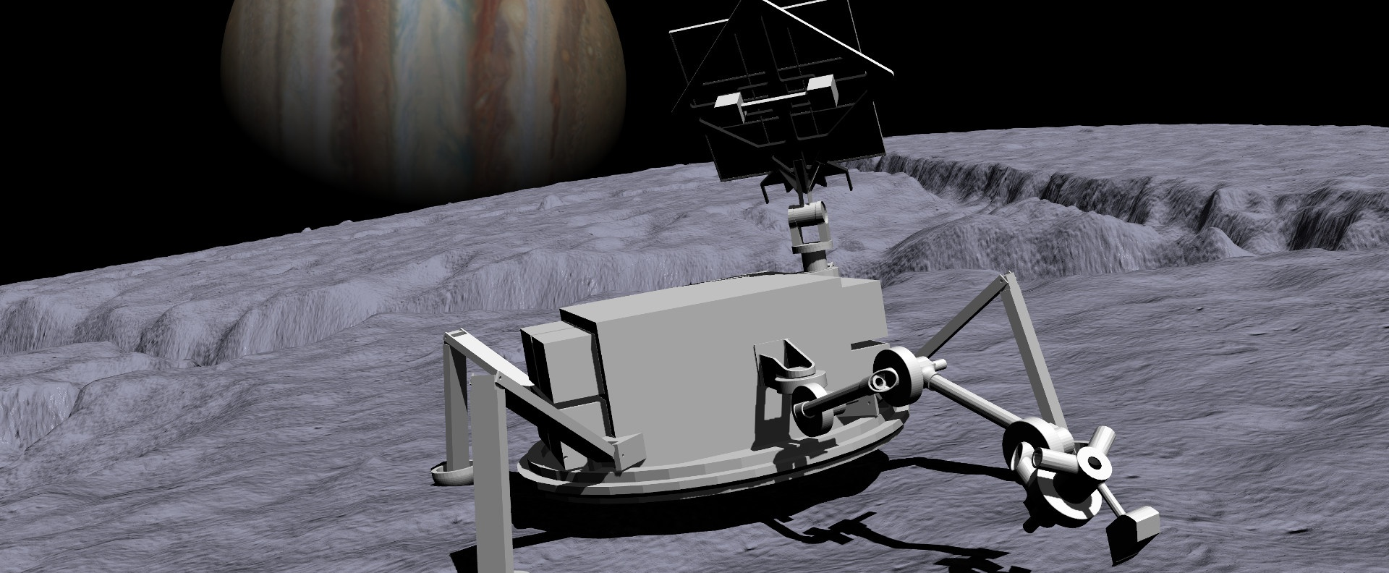
Autonomous Ocean World Exploration:
Advancement of a Software Testbed
K. Michael Dalal Chetan S. Kulkarni Thomas R. Stucky
KBR Inc. at NASA Ames Research Center, Moffett Field, CA, 94035, USA
Terence M. Welsh
Logyx LLC at NASA Ames Research Center, Moffett Field, CA, 94035, USA
Presented by Michael Dalal

Slide 2
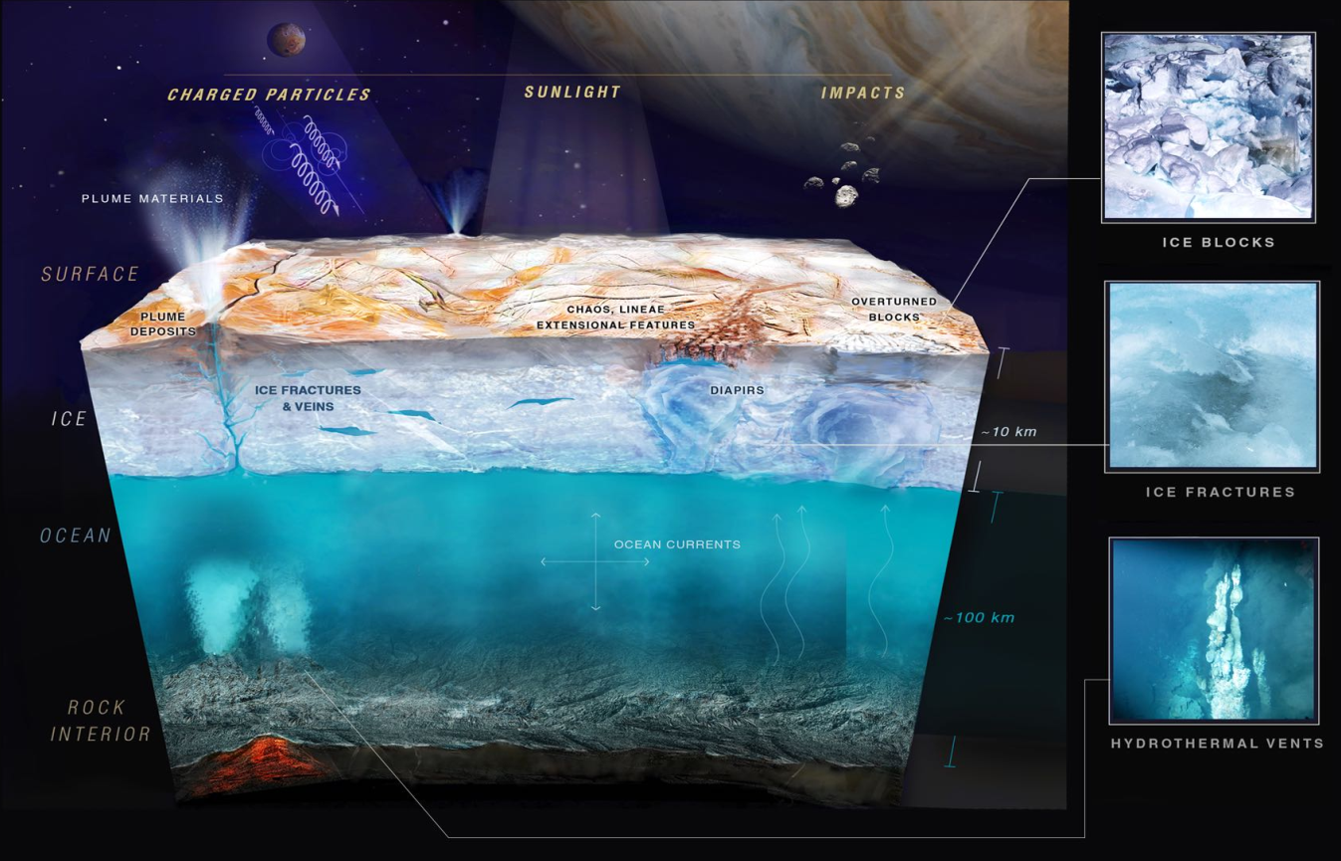
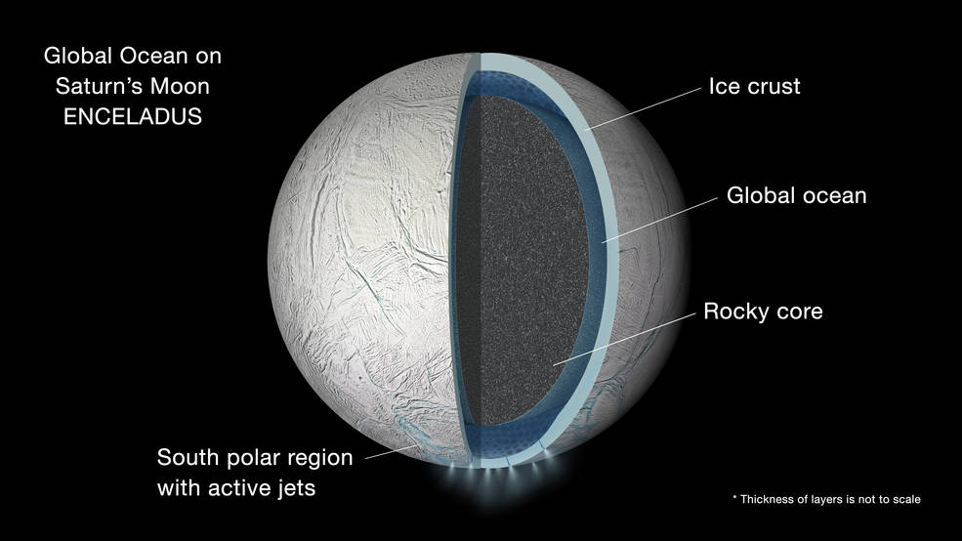
Motivation: develop autonomy for surface missions to Ocean Worlds
The search for life (extinct or extant) is
one of NASA’s top priorities.
Bodies containing liquid water are prime destinations for such exploration.
Several Solar System moons are known
or suspected to harbor large subsurface
”oceans”. These include:
  Europa (above)
  Enceladus (below)
Missions to such distant worlds need a
high degree of autonomy.
  Long communication lag with Earth
  Harsh environments
  Limited battery life

Slide 3

OceanWATERS is a testbed for lander autonomy software
Provides visual and physical simulation of a lander on Europa
Provides interface for autonomy to interact with simulation
  Includes plan execution framework and sample plans
Built using ROS (Robot Operating System) and Gazebo simulator
  Runs on Ubuntu Linux computers
Entirely open source at github.com/nasa/ow_simulator
Uses two other open-source packages from Ames:
  PLEXIL autonomy plan language and executive
  GSAP prognostics engine for the power system model

Slide 4
OceanWATERS history: 2018 - 2024
Developed at NASA Ames, starting in late 2018
  Funded by NASA’s Science Mission Directorate (SMD)
  Initial development based on JPL’s Europa Lander Study (2016)
Released as open source on GitHub in 2020
Used by two SMD-funded research programs
  ARROW : Autonomous Robotics Research for Ocean Worlds
  (2020-2023)
  COLDTech : Concepts for Ocean Worlds Life Detection Technology
  (2021-2024)

Slide 5
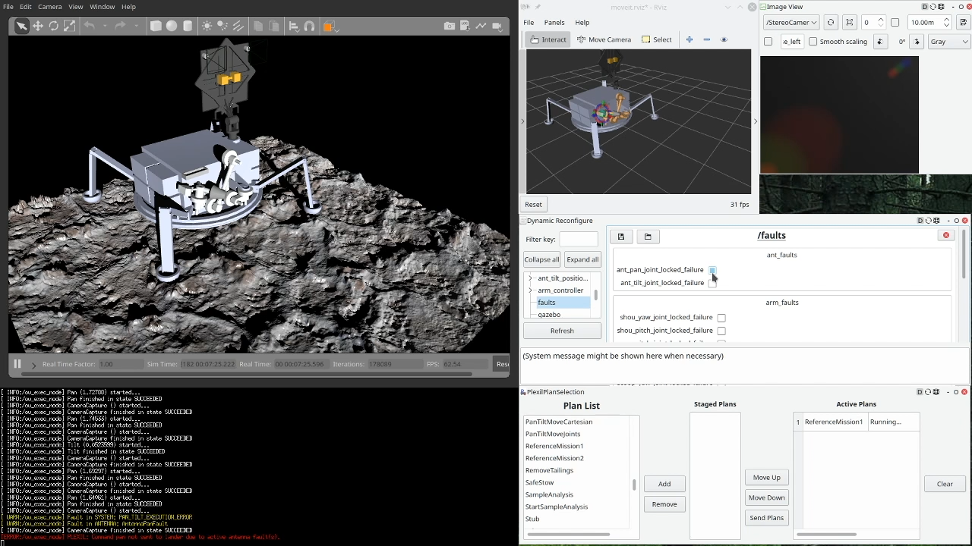
OceanWATERS Demo
Survey landing site, dig a trench, collect regolith sample

Slide 6
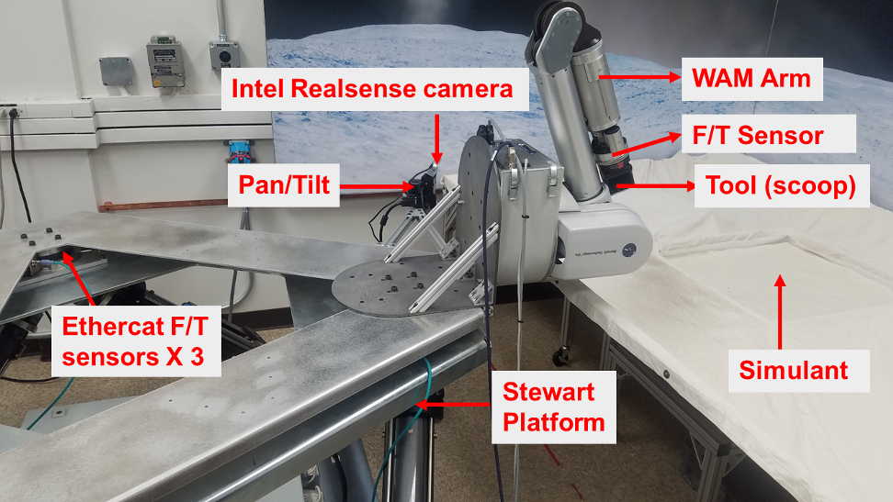
Unification with Physical Testbed at JPL
Ocean Worlds Autonomy Lander Testbed (OWLAT)
Developed at JPL concurrently with OceanWATERS
  Also funded by NASA’s Science Mission Directorate
OceanWATERS and OWLAT teams collaborated to have both testbeds:
  Have a similar set of supported lander operations
  Share an autonomy interface so that solutions could be more easily used on either testbed
Unification results:
  Large overlap in lander functions
  Highly unified ROS interface
    Commands
    Telemetry
  Shared PLEXIL autonomy plans

Slide 7
Research and Development using OceanWATERS and OWLAT
Two ARROW teams (2020 – 2023)
  Honeybee Robotics
  University of South Carolina + others
Four COLDTech teams (2021 – 2024)
  University of Illinois + others
  Caltech/JPL/Okean Solutions
  Lockheed Martin/JPL
  University of Colorado + others
Mission challenges addressed include:
  Sample target selection
  Fault detection and mitigation
  Science return prioritization
Technologies used include:
  Many forms of machine learning
  Automated planning
  Causal reasoning
  Image analysis
  Formal methods
Publications are described and referenced in paper.

Slide 8
End of Presentation
Thank you!
Questions?
Ocean Worlds Autonomy Testbed for Exploration Research and Simulation
… OceanWATERS
github.com/nasa/ow_simulator

