Slide 1








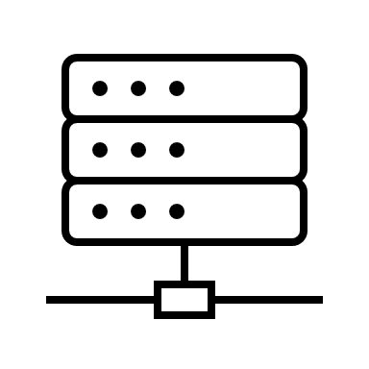
Telescience Resource Kit (TReK)
Functional Areas
Configuration Options
Robust telemetry and command processing including application programming interfaces (APIs) for user extensibility.
File Transfer using the CCSDS File Delivery Protocol (CFDP).
Connectivity to ground stations with Space Link Exchange (SLE).
Automation of ground activities to lower operational costs.
Integration into OpenMCT for browser access to capabilities.
FIPS 140-2 encryption compliant software.
Standalone desktop setup that communicates with external sources or other TReK instances.
Server-based configurations with desktop and/or web-based TReK clients.
Custom applications built using TReK API.
TReK running onboard.
Encryption *
Custom Applications
Telemetry Displays
Telemetry Monitoring
TReK Onboard
CFDP *
DTN *
Commands *
Telemetry *
Custom using TReK API
TReK Desktop
Automation & Timelines
Web Server
Message Logging *
Planning Inputs
External Interfaces
Telemetry & Command Metadata *
* Available via programmatic APIs (C/C++, .NET, Python)
Supports TCP, UDP, HTTP, RS-422, etc. pathways.
TReK Web
TReK Server
Supported Standards
Application
CCSDS File Delivery Protocol (CFDP) Class 1 and Class 2.
Delay/Disruption Tolerant Networking (DTN).
CCSDS SLE Transfer Services: Return All Frames (RAF), Return Channel Frames (RCF) and Forward CLTU.
CCSDS Space Packet and TM/TC framing protocols.
FIPS 140-2 Encryption.
Used throughout the mission life-cycle from inception, through testing, and flight operations.
Supporting ISS payload operations since 2000 in both remote and onboard scenarios.
Used onboard for WB57 Ascent Vehicle Experiment (WAVE).
FASTSAT-HSV01 – Development through Operations (2009-2013).
Upcoming ground system for Green Propellant Dual Mode (GPDM) small sat.

