Slide 1


Global Reference Atmospheric Model (GRAM) Suite and Uranus-GRAM Upgrades
Justin Garland
Planetary GRAM Developer
Analytical Mechanics Associates
NASA Langley Research Center
Justin.Garland@nasa.gov
Hilary L. Justh
Planetary GRAM Lead
Natural Environments Branch (EV44)
NASA Marshall Space Flight Center
Hilary.L.Justh@nasa.gov
Research, Engineering, and Science Symposium (RESSPO) 2024
August 8, 2024
Notes:
Title Slide

Slide 2
GRAM Upgrade Team
NASA Langley Research Center
Project Manager
Soumyo Dutta
Code Architect
James Hoffman
Analytical Mechanics Associates
Project Scientist
Kunio Sayanagi
Planetary GRAM Developer
Justin Garland
Analytical Mechanics Associates
Implementation Expert
John Aguirre
Analytical Mechanics Associates
NASA Marshall Space Flight Center
Planetary Atmosphere Specialist
Planetary GRAM Lead
Hilary Justh
Earth-GRAM Developer
Patrick White
GRAM Developer
Lee Burns
Jacobs Space Exploration Group
Data Implementation
Corey Walker
Jacobs Space Exploration Group
Paul Bremner

Slide 3

GRAM Overview
Engineering-oriented atmospheric models that estimate mean values and statistical variations of atmospheric properties for numerous planetary destinations
Available for Venus, Earth, Mars, Jupiter, Titan, Uranus, and Neptune
Outputs include atmospheric density, temperature, pressure, chemical composition, radiative fluxes (for Mars-GRAM), and wind components along a user-defined path
    Includes seasonal, diurnal, geographic, and altitude variations
Widely used by the engineering community because of their ability to create realistic atmospheric dispersions at a rapid runtime
Can be integrated into high fidelity flight dynamic simulations of launch, entry, descent and landing (EDL), aerobraking and aerocapture

Slide 4
GRAM Overview (Continued)
Optional trajectory input file can be used to provide the GRAM trajectory path
Optional auxiliary profile may be used to replace model data in the GRAMs
GRAMs are statistics-based models, not physics-based predictive forecast/simulation models
GRAMs are distributed in the GRAM Suite available through the NASA Software Catalog https://software.nasa.gov/software/MFS-33888-1
Version History (details can be found in GRAM Suite Change Log included in the documentation folder within the GRAM Suite distribution files)
Version 1.0 - May 2020 Version 1.4 - November 2021
Version 1.1 - September 2020 Version 1.5 - April 2023
Version 1.2 - July 2021 Version 2.0 - October 2023
Version 1.3 - October 2021 Version 2.1 - August 2024

Slide 5
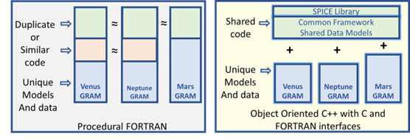
GRAM Suite
Common object-oriented C++ framework that simplifies model updates, integration, testing, and maintenance
Supports all solar system destination models
Provides a uniform user interface for all GRAMs
Includes C++ library with C and Fortran interfaces that can be incorporated in a trajectory or orbit propagation code
Includes Python Application Program Interface (API)
All future GRAM Upgrades will be released in the GRAM Suite
Legacy GRAMs
GRAM Suite

Slide 6
Uranus-GRAM
Updated Uranus-GRAM is contained in GRAM Suite Version 2.1
Atmospheric density, temperature, and pressure as a function of altitude are characterized by a Uranus Atmospheric Model developed by the GRAM team that includes:
  Modern reanalyses of Voyager flyby measurement recent observational data
  Zonal wind speeds with an estimated vertical shear
Uranus-GRAM’s atmospheric reference basis is a 3-segment atmospheric model that consists of “families” of profiles covering the full range of uncertainty in Uranus’ atmospheric properties
  Thermospheric model “family” covers the full range of observed temperature changes, sufficient data is not currently available to construct a true seasonal trend in Uranus’ temperatures and zonal wind structure
Details regarding the Uranus-GRAM upgrades can be found in the Uranus-GRAM User Guide included in the documentation folder within the GRAM Suite distribution files

Slide 7
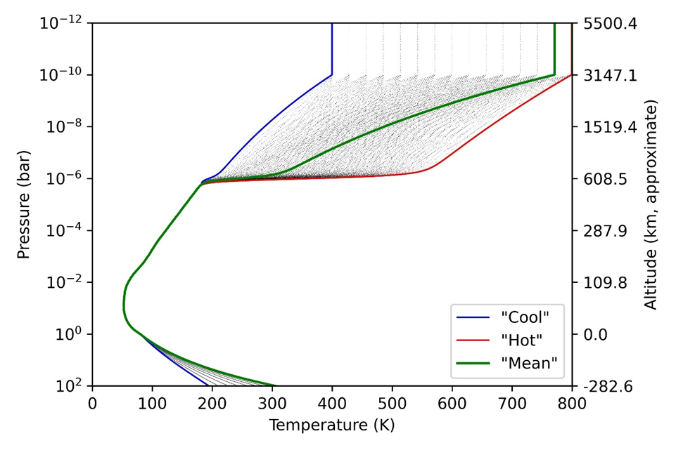
Uranus-GRAM Temperature Profile
Temperature vs altitude and pressure for full range of Uranus-GRAM
Modelled “family” of thermospheric profiles between 15 temperature steps shown as dotted black lines
Deep atmospheric temperature spread over 10 estimated BV frequency steps is also shown

Slide 8
Future Uranus-GRAM Improvements
GRAMs have been essential in designing probe and potential aerocapture missions, this will continue with the Uranus Orbiter and Probe (UOP) Flagship Mission
One of the findings of the Aerocapture Demonstration Relevance Assessment Team (ADRAT) was to continue efforts to update and improve the fidelity of GRAMs for the outer planets, including Titan
Future planned updates include:
  Update molecular abundances
  Addition of a 2D (varying with latitude) model
  Enhance wind sheer estimates
  Construct improved seasonal trends in Uranus’ temperatures and zonal wind structure as data is available
  Assess the uncertainties contained in the GRAMs
  Assess additional data and analyses that have not been incorporated into the GRAMs for their applicability to altitudes of interest for aerocapture

Slide 9
Summary
GRAMs are frequently used toolsets and vital in assessing effects of atmospheres on interplanetary spacecraft during the program life cycle process
GRAM Suite Version 2.0 is available via the NASA Software Catalog https://software.nasa.gov/software/MFS-33888-1
Upgrades of GRAM Suite are continuing
  Updating the inherent data in the GRAMs to reflect current best estimates
  Next GRAM Suite release Version 2.1 in August 2024
  Ongoing discussions with:
    Modeling groups within NASA and academia regarding status of their models
    Planetary mission teams (VERITAS, DAVINCI, Dragonfly, MAV, MAVEN, etc.) to determine potential mission support by the GRAM team, utilization of collected atmospheric data, and needed GRAM upgrades
Feedback regarding the GRAMs is encouraged and welcomed

