Slide 1


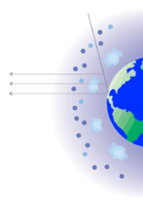

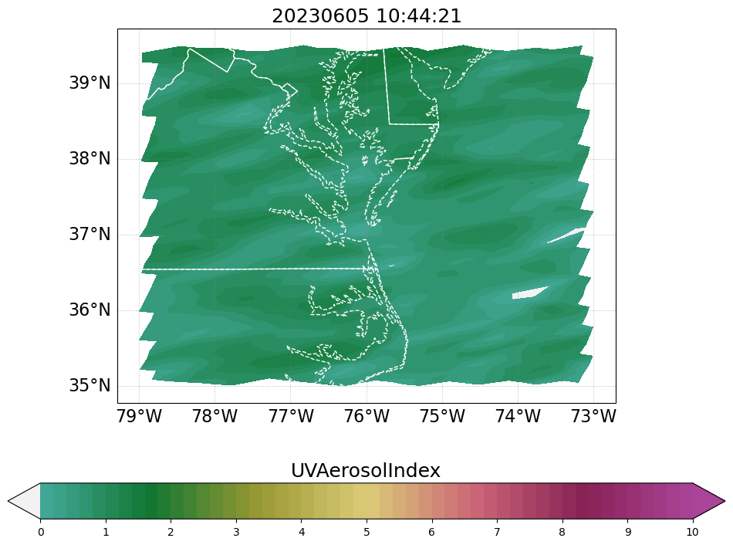
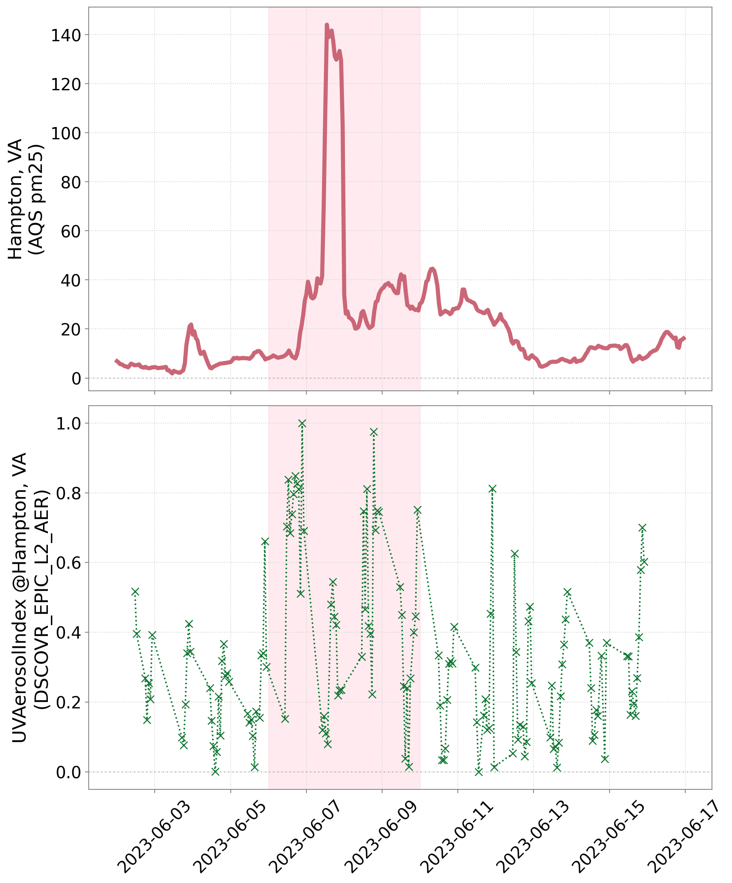
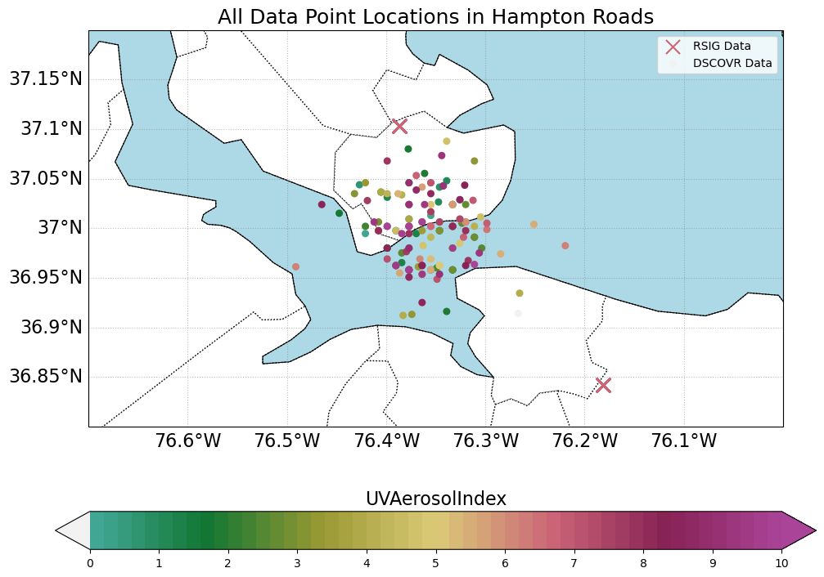
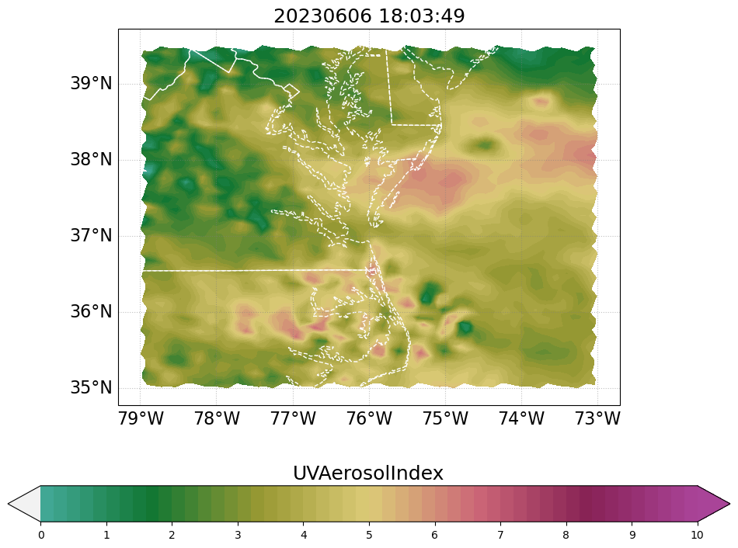
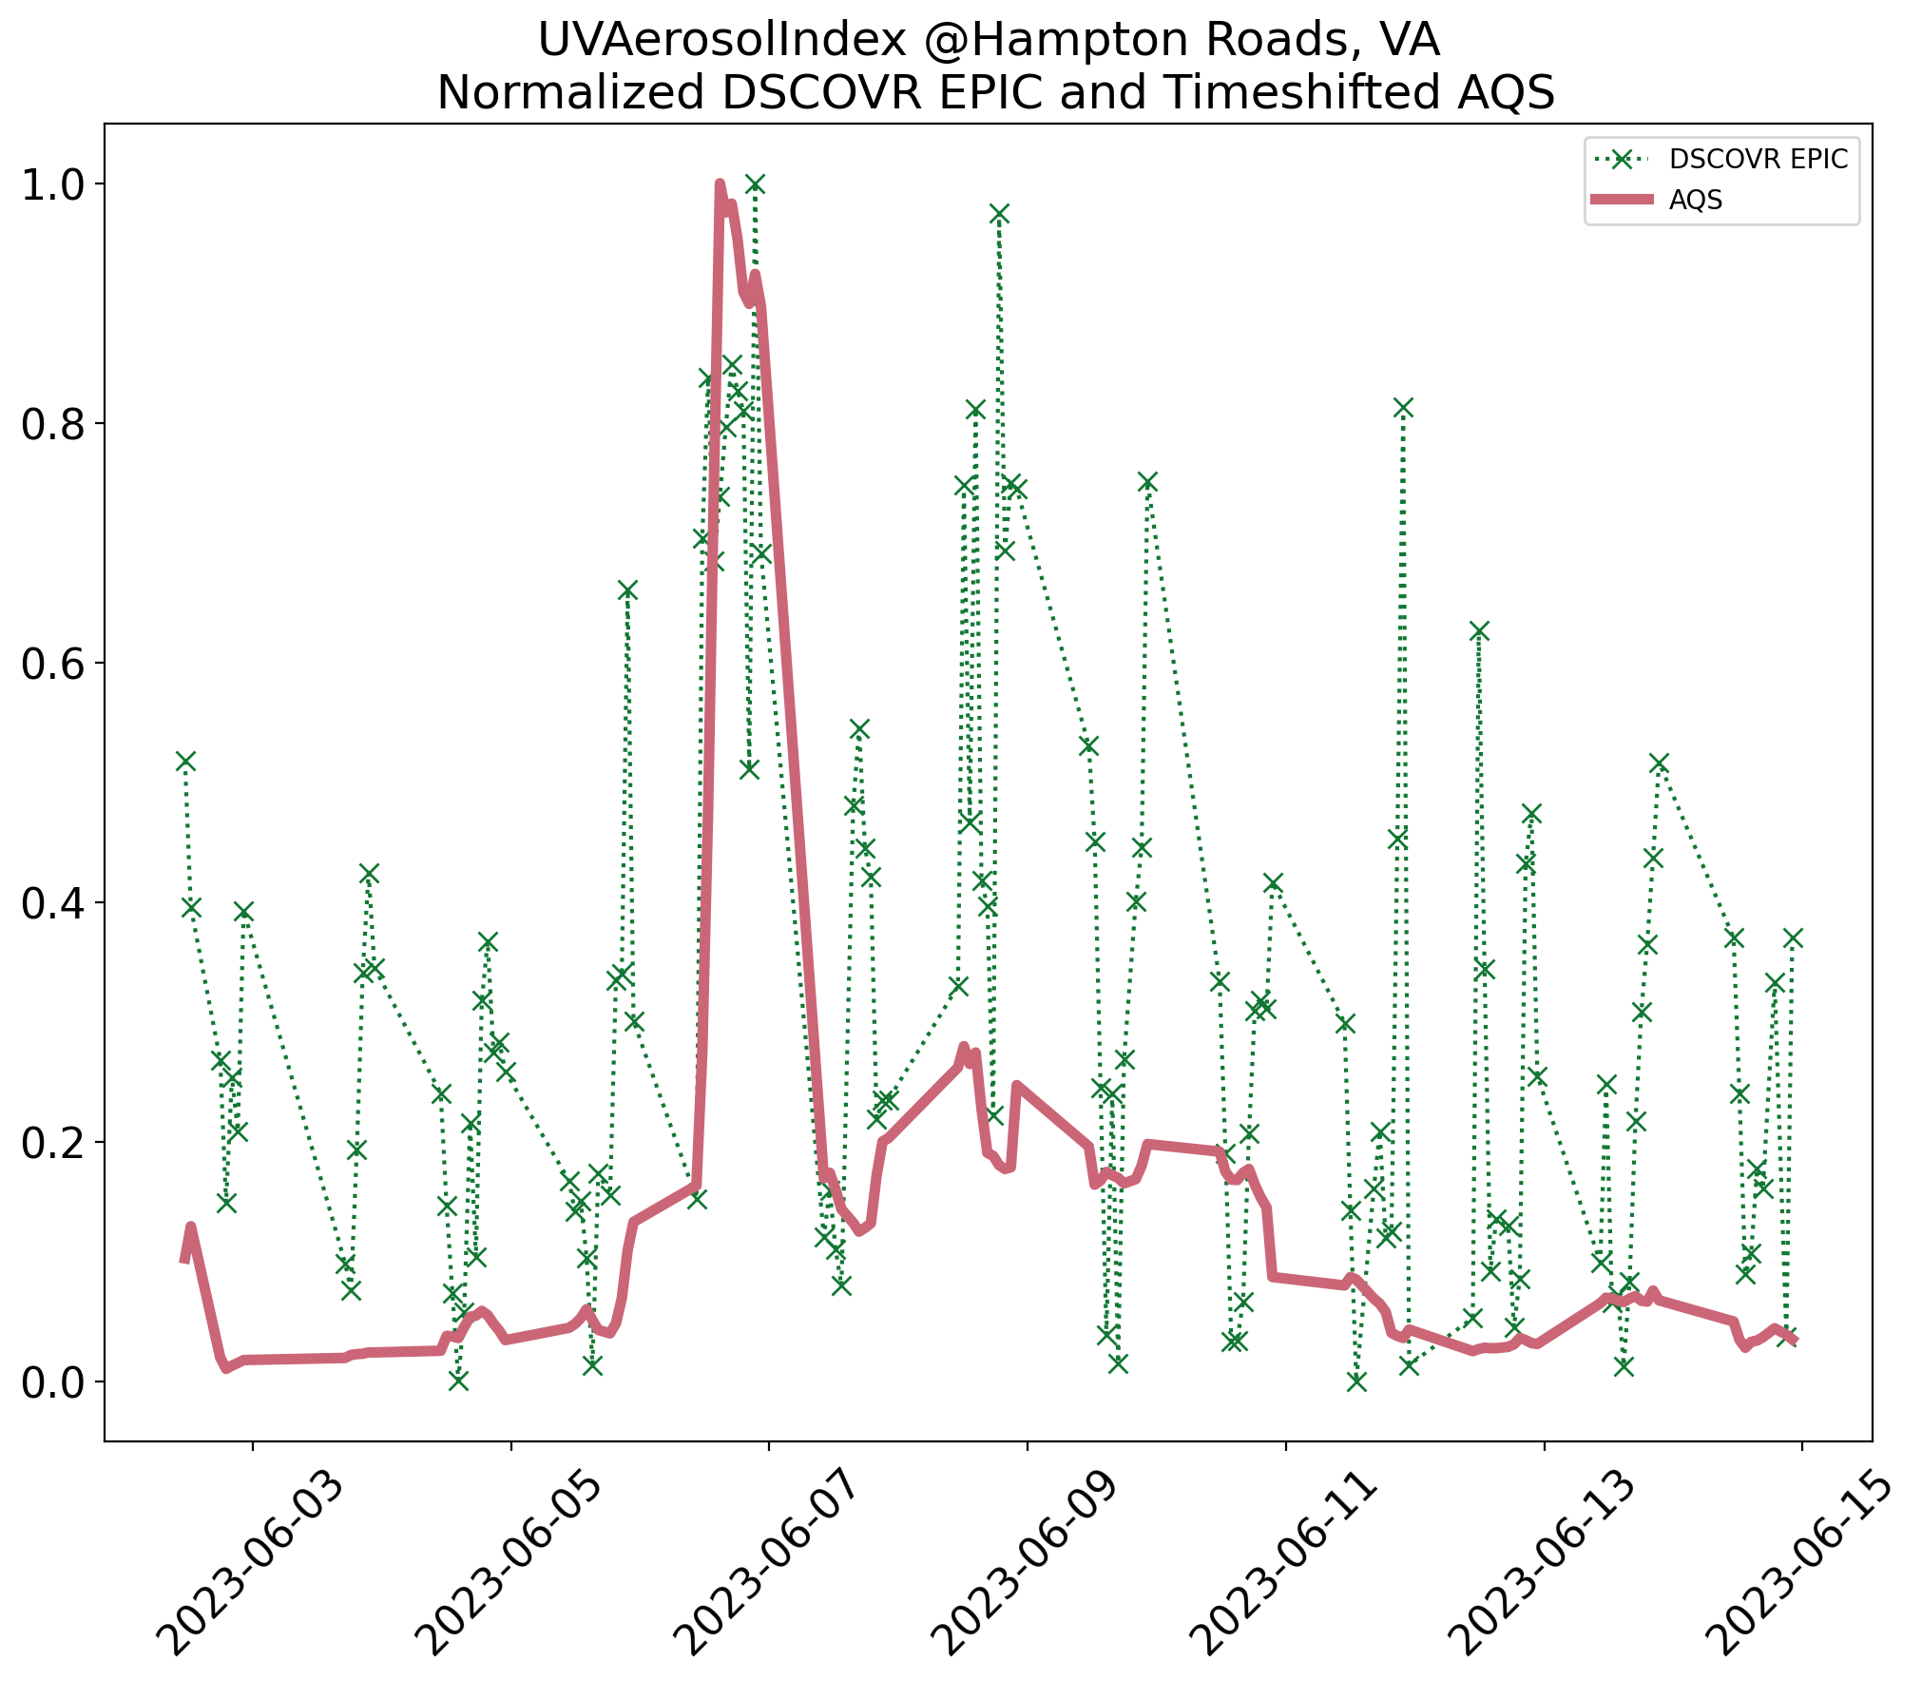
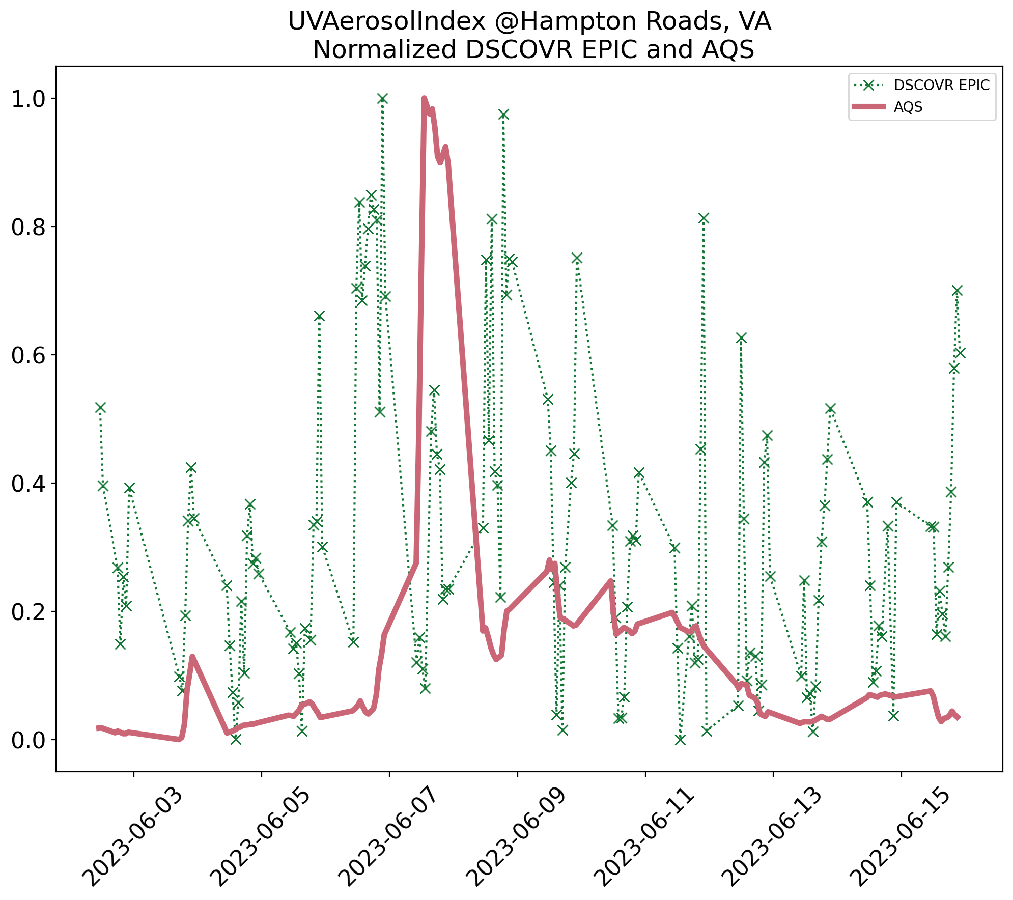
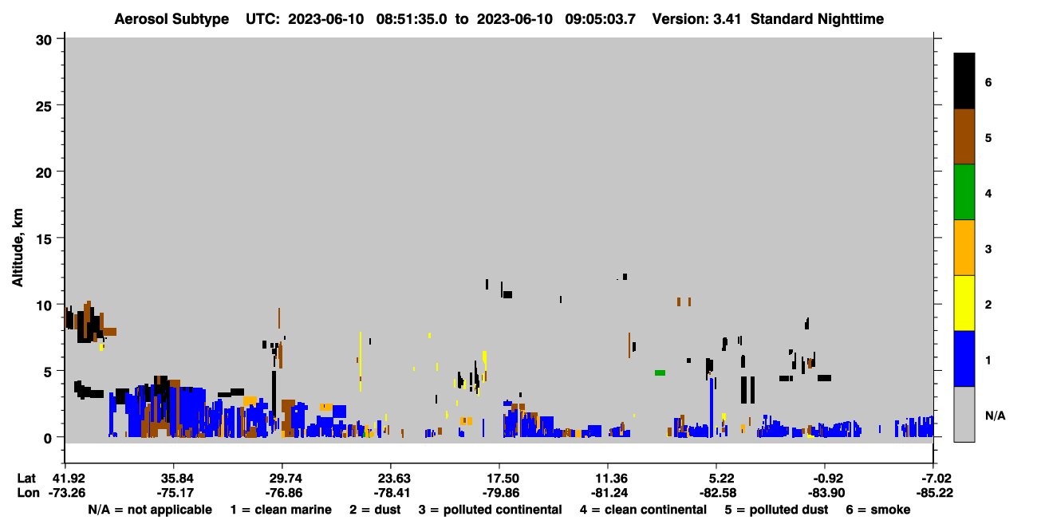
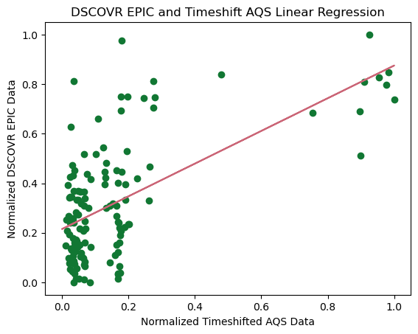
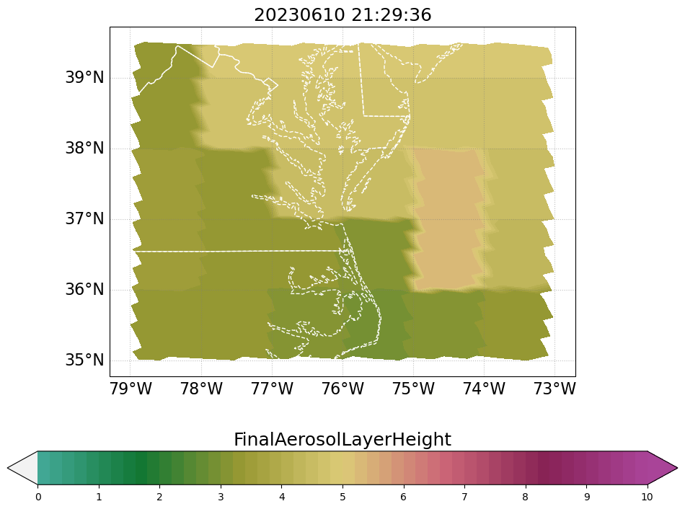
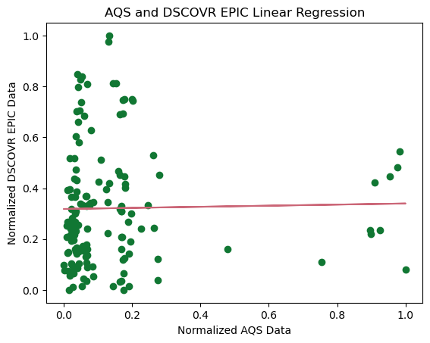






June 2023 Canadian Wildfire Effects on Hampton Roads VA using ASDC Data
${\text{Roberto} \text{Jackson} \text{Baeza}}^{1,4}$, ${\text{Hazem} \text{Mahmoud}}^{12}$, ${\text{Daniel} \text{Kaufman}}^{23}$
(1)NASA Langley Research Center, (2)Adnet Systems, (3)Booz Allen Hamilton, (4)USRA
ATMOSPHERIC
SCIENCE
DATA
CENTER
Introduction:
In June of 2023 thousands of acres of wildfires spread across northwestern Canada. This event emitted huge amounts of smoke, and pollutants that travelled east across the North America, the Atlantic ocean and eventually all the way to Continental Europe. This smoke created a dangerous air quality event throughout the Atlantic Coast. As climate change increases the prevalence of wildfires more cities and states will be affected by the dangerous smoke and pollutants produced by these events. In this poster we documented and investigated the June 06th Air Quality Event over Hampton Roads, VA. To perform a comparative analysis, we utilized two data sources: NASA’s Atmospheric Science Data Center we used the Cloud Aerosol Lidar and Infrared Pathfinder Satellite Observation (CALIPSO), the Deep Space Climate ObserVatoRy (DSCOVR) Enhanced Polychromatic Imaging Camera (EPIC), data product, and the EPA’s ground-based Air Quality System (AQS).
Overview of the June 6th, 2023, Air Quality Event:
Comparing DSCOVR EPIC Data and Air Quality System Data
A Good Day:
UVAI Map of the Chesapeake Bay on June 5th
The map shows a clear day with minimal pollutants in the air above Hampton Roads.
Ultraviolet Aerosol Index (UVAI) is a proxy for PM 2.5 data and a product within DSCOVR EPIC.
The image on the left shows the UVAI over the Chesapeake Bay, including Hampton Roads, on June 5th at 10:44 AM.
The entire map has a UVAI of less than two meaning very little PM 2.5 can be found in the area.
Initial Normalized AQS and DSCOVR EPIC Comparison
Normalized and Time-shifted AQS and DSCOVR EPIC Comparison
Air Quality System
The graph shows a 130 PM 2.5 spike as smoke entered Hampton Roads.
From AQS a ground-based system by the Environmental Protection Agency.
Breathing fine particulate matter, as measured by PM 2.5 can lead to a myriad of adverse health outcomes.
Location Graph
We Investigated if the difference in location lead to the high error rate seen previously.
This graph shows the location of the two AQS stations in “X.”
The other points are locations of every EPIC point in the timeseries graph.
Any error from location is trivial as they are much closer than the AQS stations.
A Poor Air Quality Day:
UVAI Map of the Chesapeake Bay on June 6th
On June 6th, 2023, smoke engulfed the Atlantic Coast.
The Image on the left shows the UVAI over the Chesapeake Bay, including Hampton Roads, on June 6th at 6:03 PM.
7.3 is the maximum UVAI of the graph. This shows a huge projected difference in the PM 2.5 in the area.
In just over 24 hours the smoke blew in creating an adverse air quality event, increasing risk of asthma and worsening other respiratory conditions.
The area is mostly experiencing unhealthy air quality.
DSCOVR EPIC UVAI
This time series graph shows the normalized UVAI pulled from the closest data point to the latitude and longitude of Hampton Roads overtime.
EPIC data is much noisier, shows multiple large spikes, and peaks noticeably earlier than AQS.
Time-shifted Comparison
We removed points from the start of AQS data and the end of EPIC until the peaks aligned.
RMSE was reduced by nearly a quarter. Error is now 25%
The discrepancy is because the satellite detects the smoke before ground-based sensors.
AQS only detects fallen pollutants. EPIC sees them while in the atmosphere.
CALIPSO and Aerosol Layer Height:
Initial Comparison
In this graph we used min-max normalized the AQS data
We removed points, according to minimize time difference, to have the same number of points between AQS and EPIC data for error calculations.
Residual Mean Squared Error (RMSE) is .36.
Error is 36% for AQS predicting EPIC data.
CALIPSO Curtain Graph
Graph shows Aerosol Subtype as calculated from two spectrometers on CALIPSO.
Four days later, a smoke plume lingers. That smoke plume is bifurcated in a higher and lower layer.
Using lidar CALIPSO produces a cross section of the atmosphere.
Due to temporal resolution, there is very little CALIPSO data from the desired area during the event’s timeframe.
Linear Regression
Slope: 0.660, Intercept: 0.215, and Standard Error: 0.075
R Value: 0.62, P Value:5.52e-15
Our R Value is high enough to see a moderately strong positive relationship.
Our P Value is low, so we have sufficient evidence to believe AQS PM2.5 and EPIC UVAI are correlated.
Linear Regression
Slope: 0.022, Intercept: 0.318, and Standard Error: 0.092
R Value:0.012, P Value: 0.814
Our R value is very close to 0 which means they are likely uncorrelated.
Our P Value is high, so we lack sufficient evidence to believe AQS PM2.5 and EPIC UVAI are correlated.
Aerosol Layer Height Graph
This graphs shows the geographic extent of the lower smoke plume seen above.
Aerosol Layer Height describes the maximum height of aerosols within a given space of the atmosphere.
The tail end of the plume at 35, and -75 is shown in the darkest part of this graph in the middle of the left side.
The temporal and spatial resolution for Aerosol Layer Height is worse than UVAI, which explains for the blocky gradient in this graph.
Acknowledgements
This research was generously funded by the Texas Space Grant Consortium
This research was supported and lead by the Earth Science Data Systems Projects
I personally thank Hazem Mahmoud for his leadership and guidance in this process.
If there are any further questions, please ask on the Earth Data Forum

