Slide 1
The NASA Meteoroid Environment Office
Meteoroid spacecraft anomalies
Bill Cooke, Lead

Slide 2
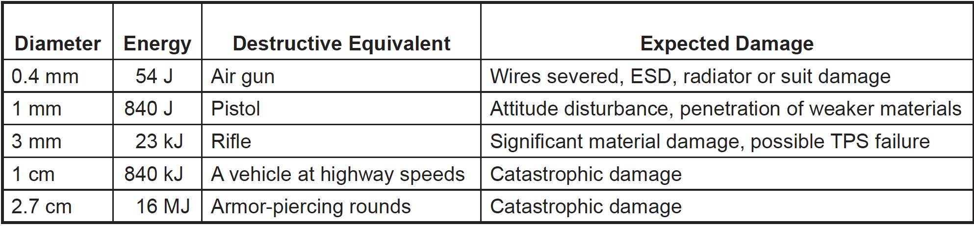
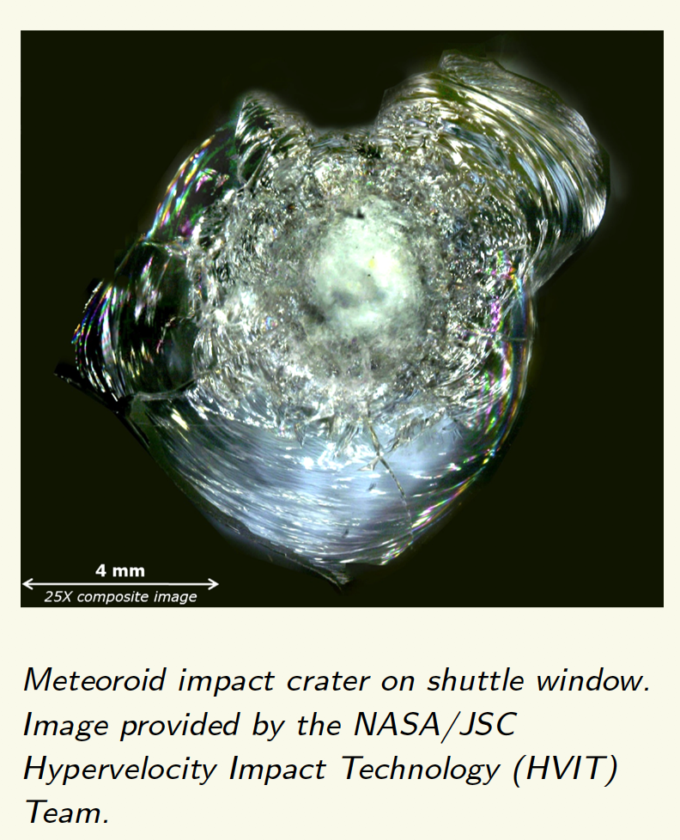
Damage potential
From the NASA Meteoroid Handbook (https://ntrs.nasa.gov/api/citations/20200000049/downloads/20200000049.pdf)
Space debris poses the greatest hazard to humans or vehicles once they are in space!

Slide 3
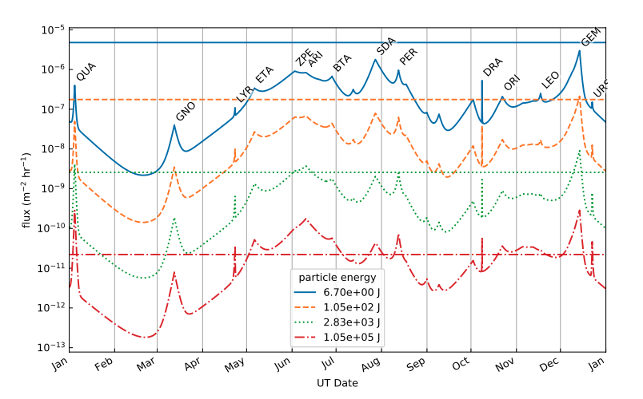
Forecast damage thresholds
NASA MEO/A. Moorhead
Why these 4 energy levels?

Slide 4
Relics from Shuttle/early ISS years…
Energy (Joules) | Damage
6.7 | EVA suit penetration
105 | Shuttle payload bay radiator penetration; Critical thermal tile damage
2830 | Shuttle pressure wall penetration
105,000 | ISS shield penetration
Optical surfaces/CCDs, etc. can be damaged by particles with lower energies, e.g. JWST primary mirror (~1 joules).

Slide 5
A note about damage equations
Practically all hypervelocity damage equations used in spacecraft risk assessments were determined using orbital debris characteristics (Al projectiles on Al targets, speeds < 10 km s⁻¹).
Questions:
  How valid are the currently used damage equations in assessing meteoroid risk?
    Are some better than others?
  Do new damage equations need to be developed?
  Should hydrocodes be used in the development of damage equations for meteoroid risk assessments, given that the particles have speeds well outside hypervelocity gun capability?

Slide 6
Pegasus
LDEF
NASA MEO/A. Moorhead

Slide 7
Meteoroid/Orbital Debris Comparison
Meteoroid flux varies by only a factor of a few over all surfaces and earth orbit altitudes; that of orbital debris spans several orders of magnitude..
Meteoroids dominate the damaging flux (particles capable of penetrating a 1 mm thick aluminum plate) at altitudes below 250 km and above 4000 km.
At ISS altitude, damaging flux of orbital debris roughly equal to that of meteoroids.
At 1000 km, the number of debris penetrations is 9x that of meteoroids.

Slide 8
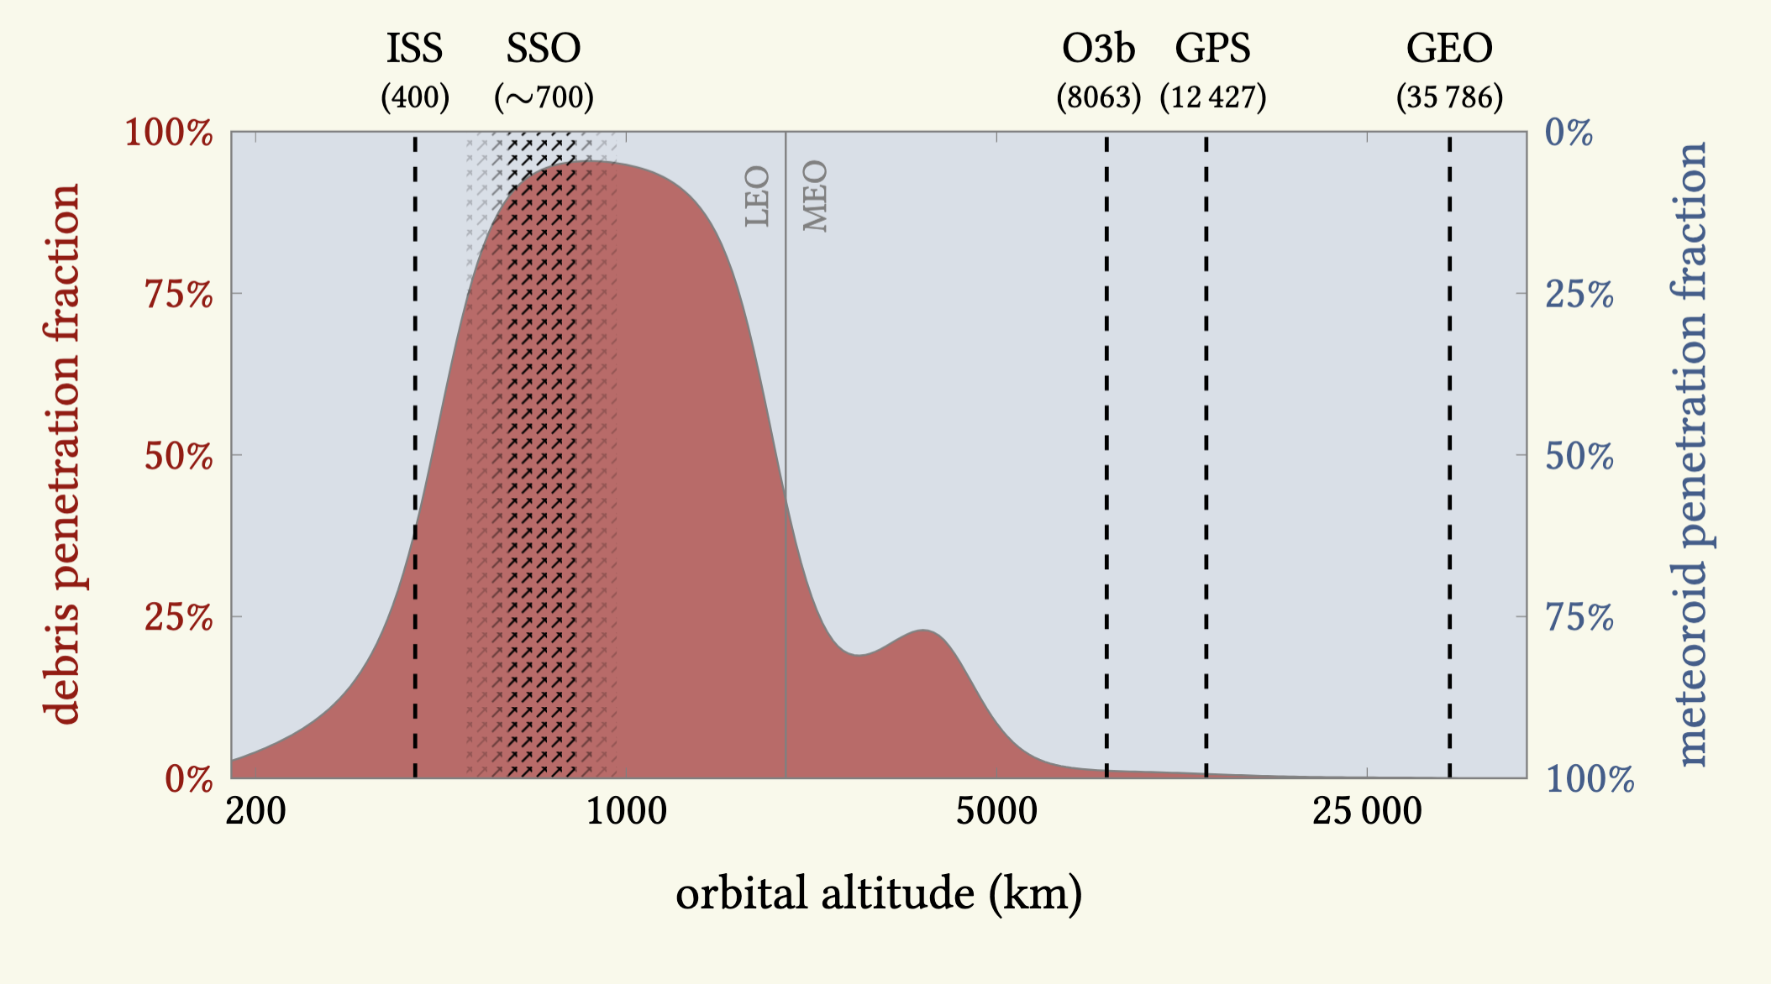
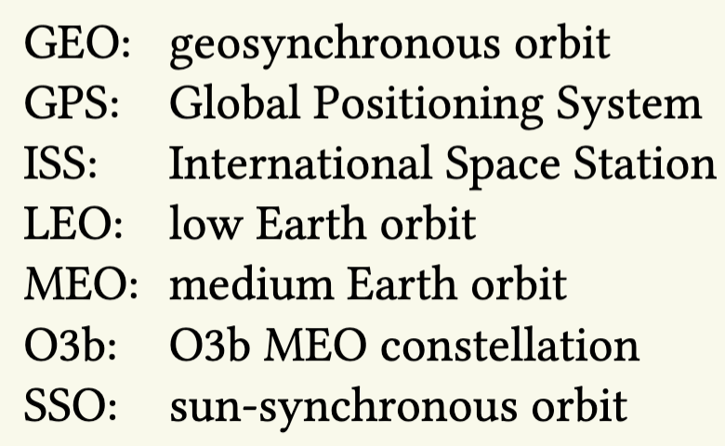
Comparison of flux (particles that can penetrate 1 mm AL plate)
1 mm thick Al
NASA MEO/A. Moorhead
A. Moorhead, MEO

Slide 9
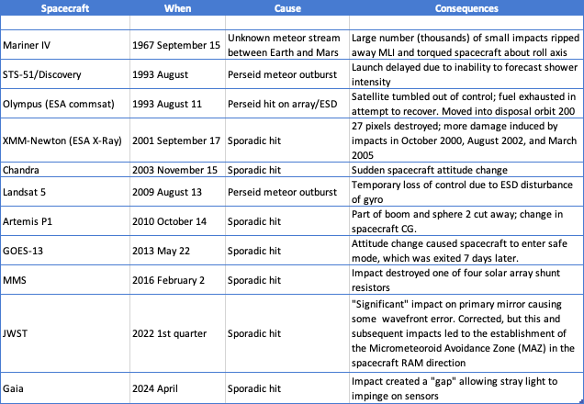
Some meteoroid anomalies

Slide 10
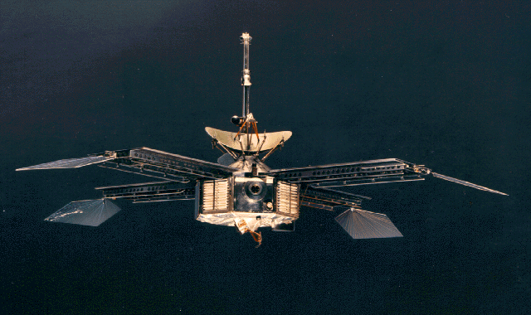
Mariner IV
NASA

Slide 11
Launched 28 November 1964; flew by Mars on 14-15 July 1965.
From Astronautics and Aeronautics, 1967, pg. 270-271, September 15 entry:
“Mariner IV, launched Nov. 28, 1964, survived apparent micrometeoroid shower. Spacecraft’s cosmic dust detector registered 17 hits within 15 min, while Mariner IV traveled between orbits of earth and Mars. Spacecraft was 29.6 million miles from earth and had traveled about 1.4 billion miles in its 1,020 days of flight. Micrometeoroid shower had caused temporary change in spacecraft’s attitude but no loss of power. Scientists concluded, from one-degree temperature drop inside spacecraft, that only the thermal shield was damaged. Within about a week, spacecraft was operating normally without any apparent effect from incident…”

Slide 12
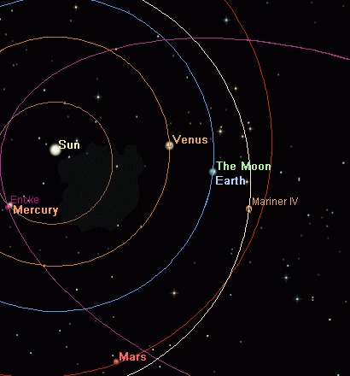
Position of spacecraft at encounter:
Heliocentric distance: 1.273 AU
Ecliptic Longitude: 343.6 degrees
Ecliptic Latitude: 2.25 degrees N.
Spacecraft torqued about roll axis; thermal insulation ripped away.
Report estimates that the spacecraft was struck by 2 or 3 orders of magnitude more particles than the 17 recorded by the dust instrument (Mariner IV is only U.S. spacecraft sent to Mars with meteoroid detector).
Impact rates this high have only been measured near comet nuclei (Halley).
NASA MEO/B. Cooke

Slide 13
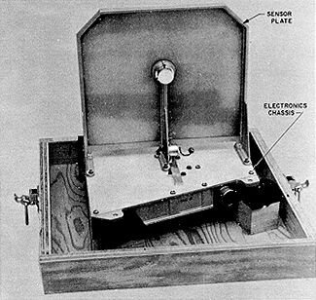
Number of hits during shower was 1500x higher than mission average, and only 60x lower than Giotto’s hit rate at closest approach to Halley.
Impacts suffered by M4 may have resulted from a passage through a cometary meteoroid stream or the debris of or perhaps even the “coma” of an undetected dead or nearly-dead comet.
NASA
Mariner IV Cosmic Dust Detector: 22.1cm on a side, 0.8 mm thick

Slide 14
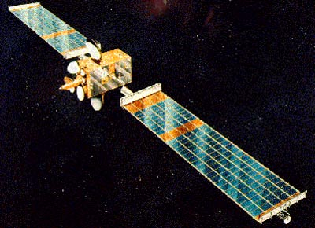
Olympus
ESA

Slide 15
Technology demonstration satellite - launched 12 July 1989; largest civilian comm satellite built up to that time.
South solar panel stopped tracking the Sun in January 1991 (particle impact?).
19 June 1991– attitude control issue; incorrect commands uplinked from ground resulted in tumbling and drift off station. Vehicle recovered and put back into service at 19W on 7 August 1992.

Slide 16
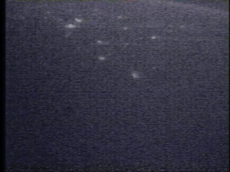
The 1993 Perseids
Before modern shower forecasting techniques – no one knew what to expect.
Parent comet (Swift-Tuttle) had just passed perihelion in December of 1992, so there were many “predictions” of a major outburst.
Launch of STS-51 (Discovery) delayed until after shower peak – only Shuttle launch ever delayed because of a meteor shower.
An outburst did occur, with meteor rates exceeding 250 per hour around 3:30 UTC on August 12.
NASA
STS-105, August 2001
Olympus roll gyro stops at 23:32 UTC August 11. Spacecraft enters ESA mode and fails to acquire the Sun.

Slide 17
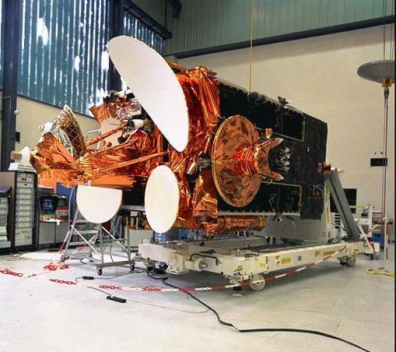
Attempts to recover spacecraft exhausted most of remaining fuel, making it impossible to return the vehicle to service. Mission was terminated August 12, and the spacecraft was moved into a disposal orbit 200 km below GEO.
ESA anomaly investigation attributed the failure to a Perseid strike on the south solar array.
  South array had 8.5 m⁻² of area exposed to the stream.
  There was a possible conducting path to the gyro though the spacecraft umbilical.
  Ground hypervelocity tests showed plasma generated by a meteoroid strike to be proportional to v^{3.5}.
ESA

Slide 18
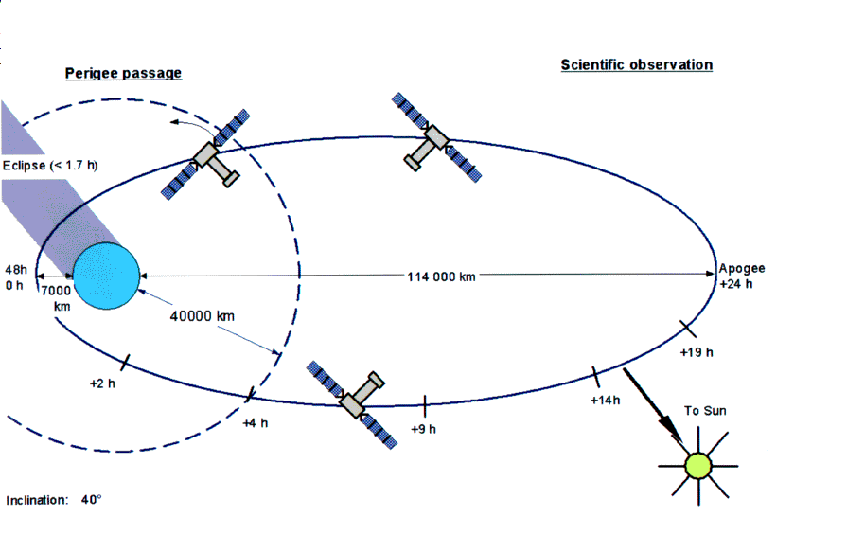
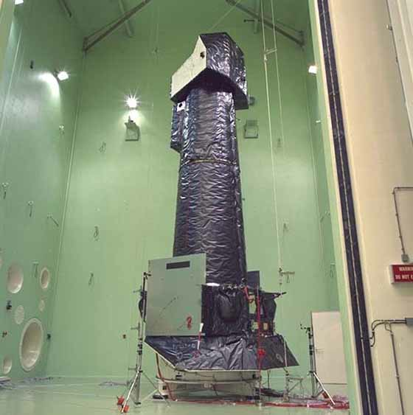
XMM-Newton
ESA X-ray observatory
Launched on 10 December 1999; still operational
ESA
ESA

Slide 19
On 17 September 2001 at 23:31 UTC, a diffuse light was observed in a single frame taken by the MOS1 camera.
Immediately after the event, 27 new bad pixels were noted.
  Anomaly investigation concluded meteoroid impact.
  Camera was observing an X-ray object located in the same direction as the south Toroidal sporadic source.
XMM-Newton has taken other hits: 15 October 2000, 12 August 2002, and 9 March 2005.
The 2005 hit destroyed the CCD6 segment of the MOS1 camera.
XMM-Newton’s multiple cameras have an estimated 22% per annum impact probability for the ensemble.

Slide 20
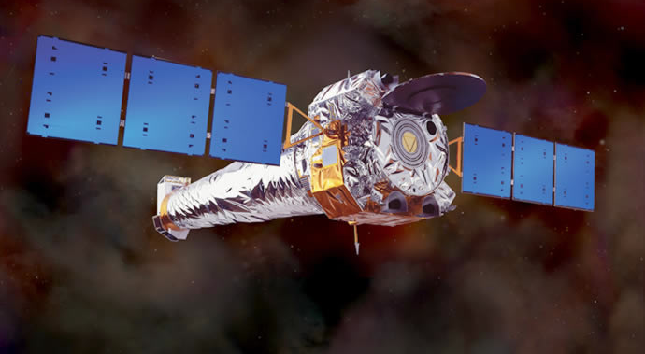
Chandra
NASA

Slide 21
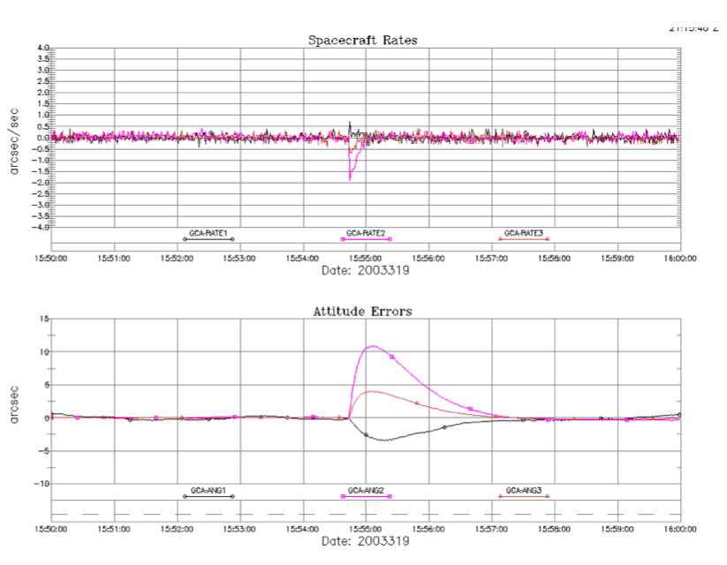
Disturbance in pointing stability just before 4:00 UTC on 15 November 2003.

Slide 22
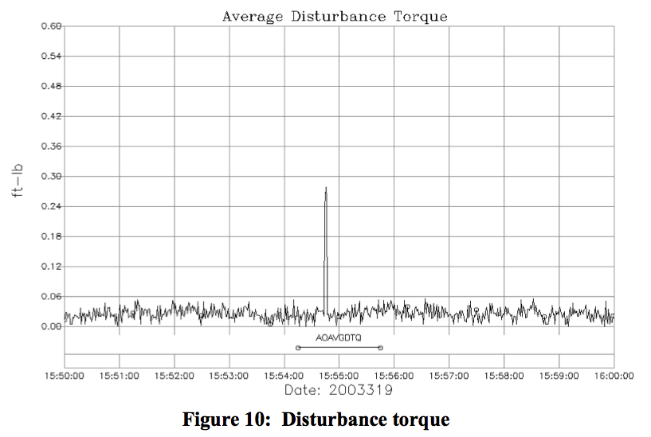

Slide 23
Program computed that an impact by a 1 mm Leonid could account for observed displacement – other causes ruled out.
  Impact out near apogee.
However, there was no Leonid storm in 2003, and the impact occurred well away from the observed shower maximum. At time of impact, meteor rates were <20 per hour.
Measurements of the sporadic flux shows that it was over an order of magnitude larger than the Leonid flux at the event time.
  Leonid radiant is located within the north Apex sporadic source, which has an average speed of 55 km s⁻¹.
  Fluxes would indicate that an impact by a north Apex sporadic is 5 times more likely than that from a Leonid.

Slide 24
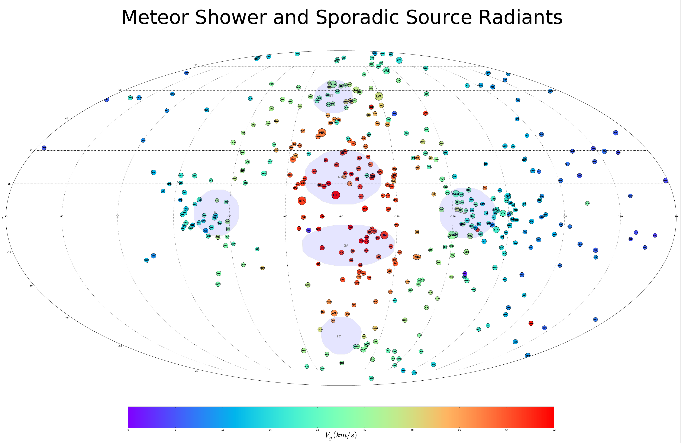

Slide 25
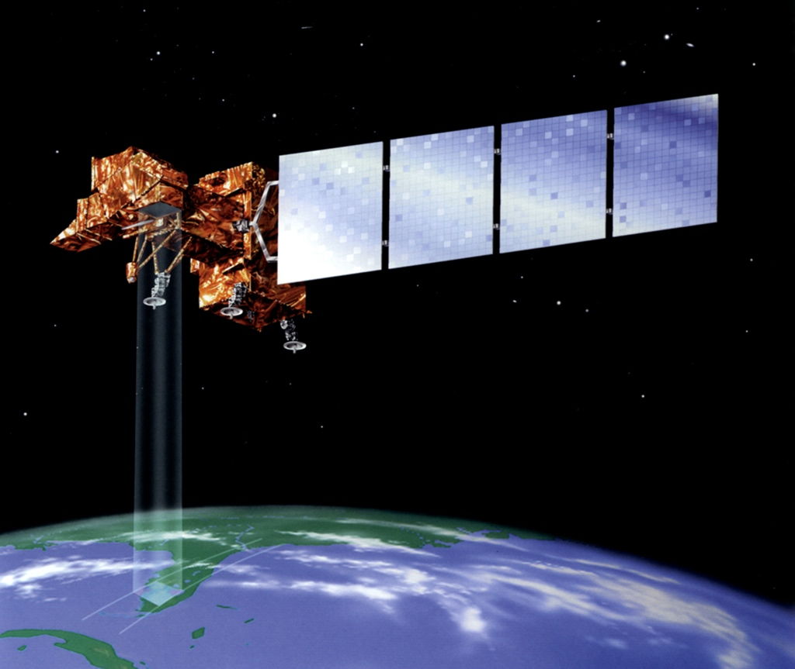
Landsat 5
What: Remote sensing satellite.
Event: Struck by a Perseid near the time of the shower peak on August 13 2009.
Consequences:
  Gyro temporarily failed; spacecraft began tumbling.
Outcome: Normal operations restored by August 17.
NOAA/NASA

Slide 26
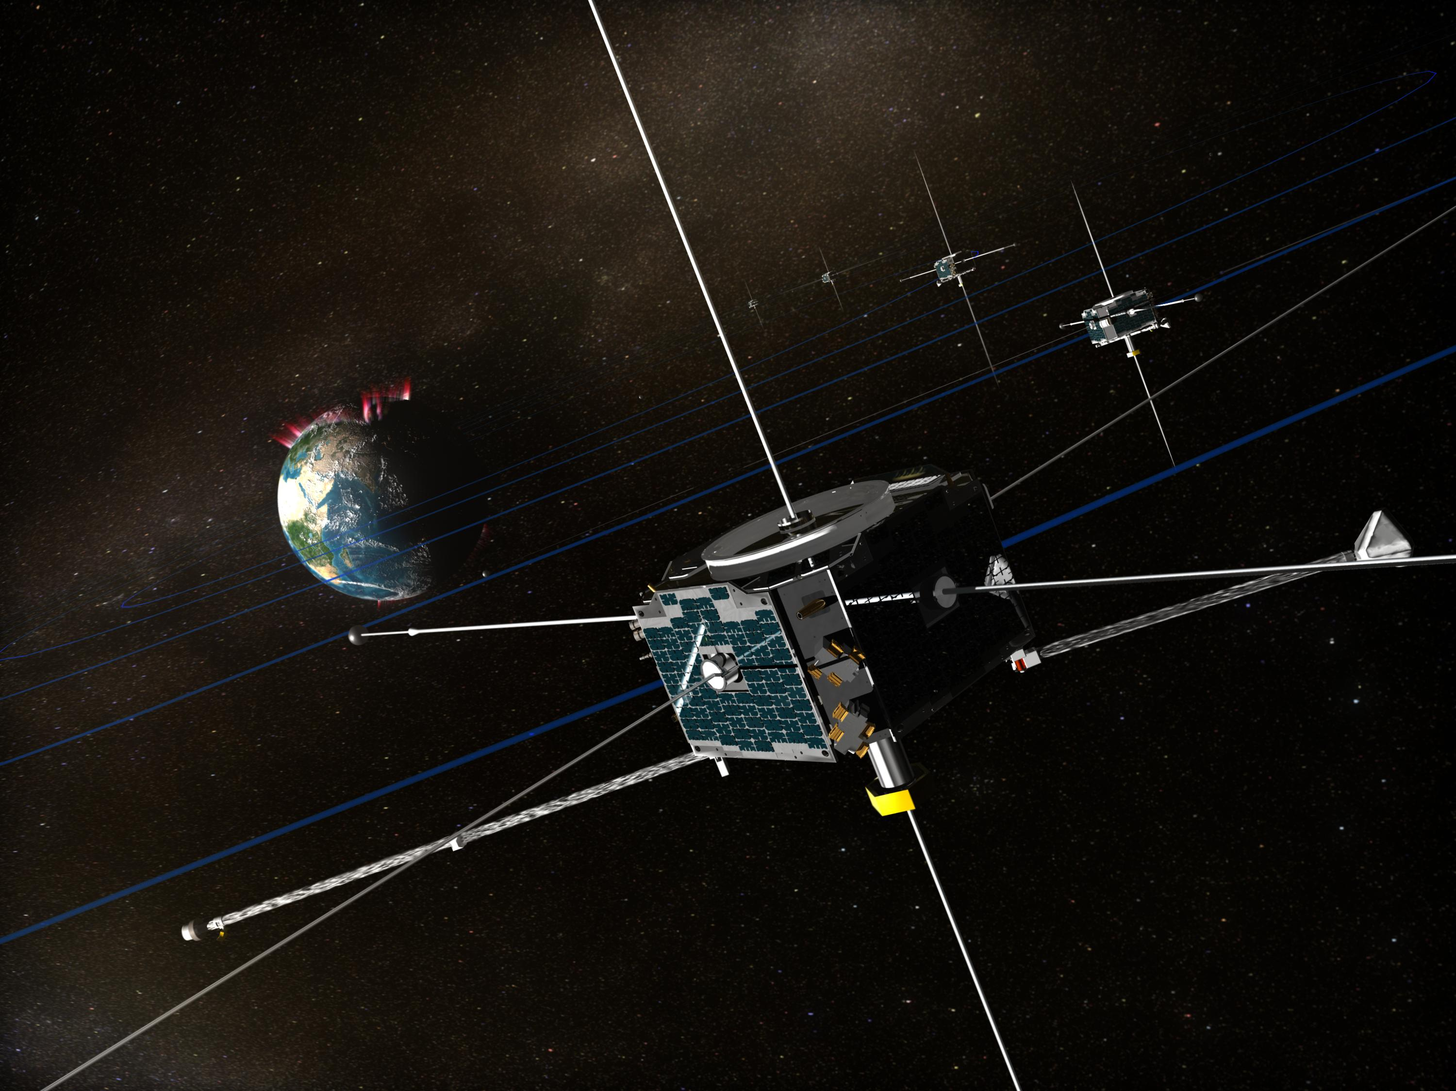
Artemis P1
What: NASA Science satellite.
Event: Struck by a meteoroid on 14 Oct 2010.
Consequences:
  Sphere 2 cut away
Outcome: Normal operations restored almost immediately.
NASA

Slide 27
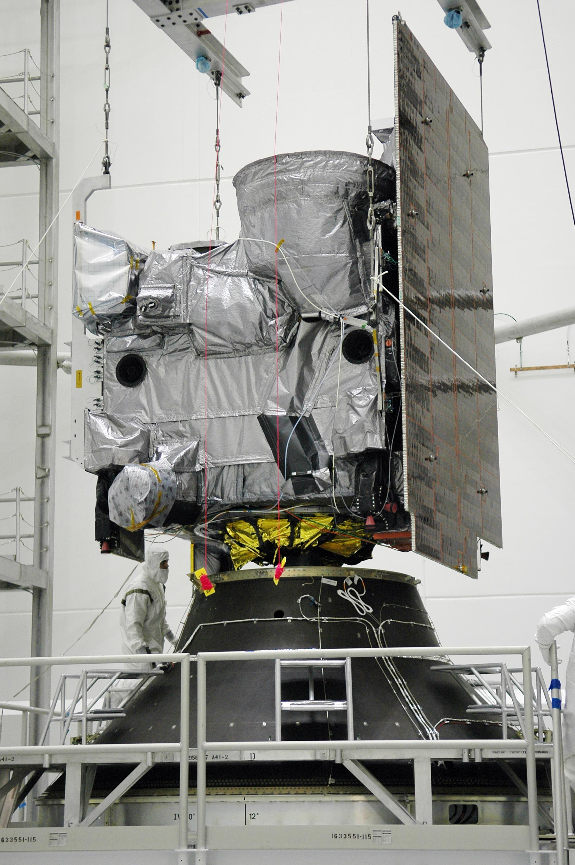
GOES 13
What: USG weather satellite.
Event: Struck by a Helion meteoroid on 22 May 2013.
Consequences:
  Attitude drift of 2° per hour from nadir
  Spacecraft entered safe mode
Outcome: Normal operations restored 7 days later.
NOAA

Slide 28
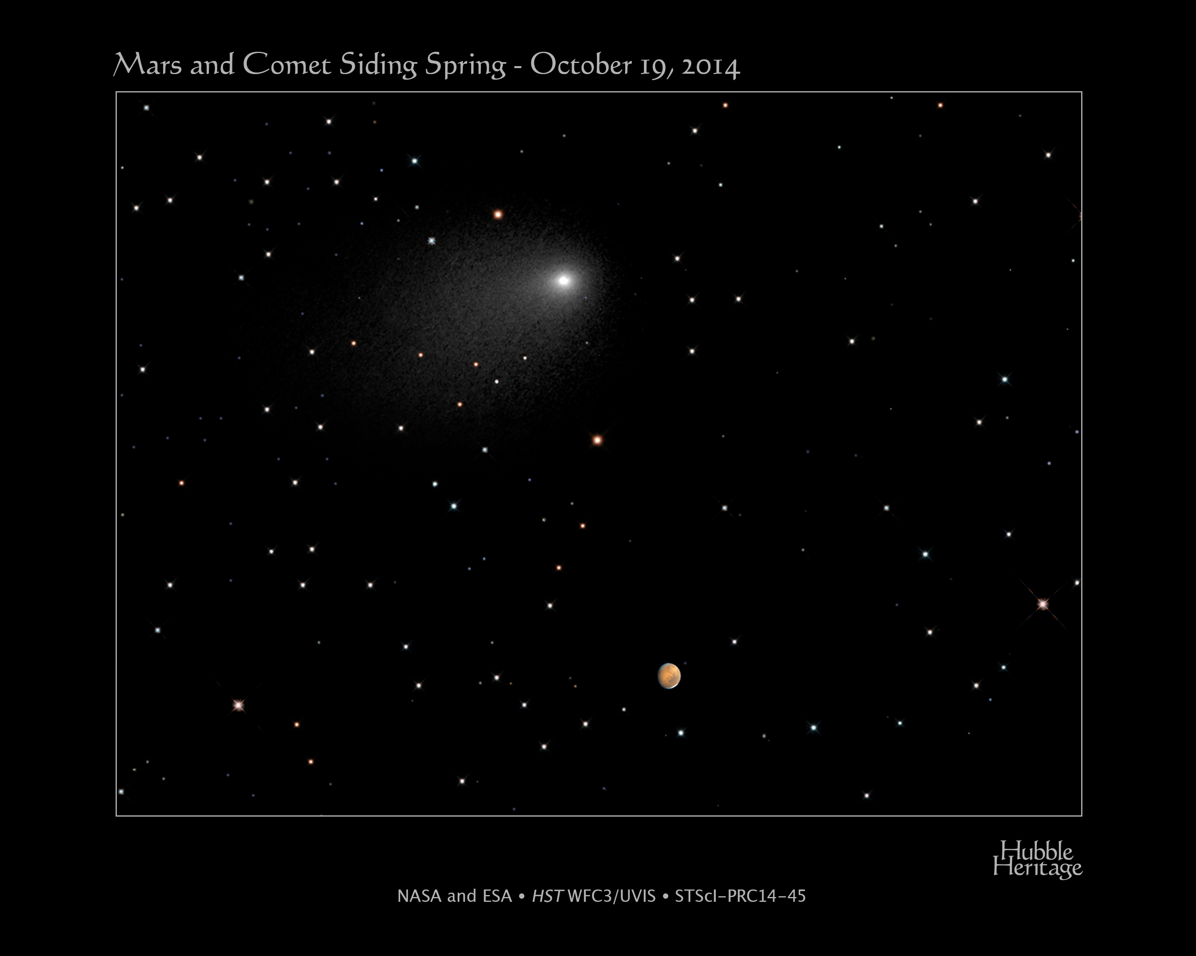
C/2013 A1 (Siding Spring)
Discovered January 3, 2013 by Rob McNaught.
Retrograde Oort Cloud comet.
Close flyby of Mars (140,500 km) on October 19, 2014.
Concern that Mars orbiters could suffer damage from particles in cometary coma.
Orbits were phased to use planet as a shield.

Slide 29
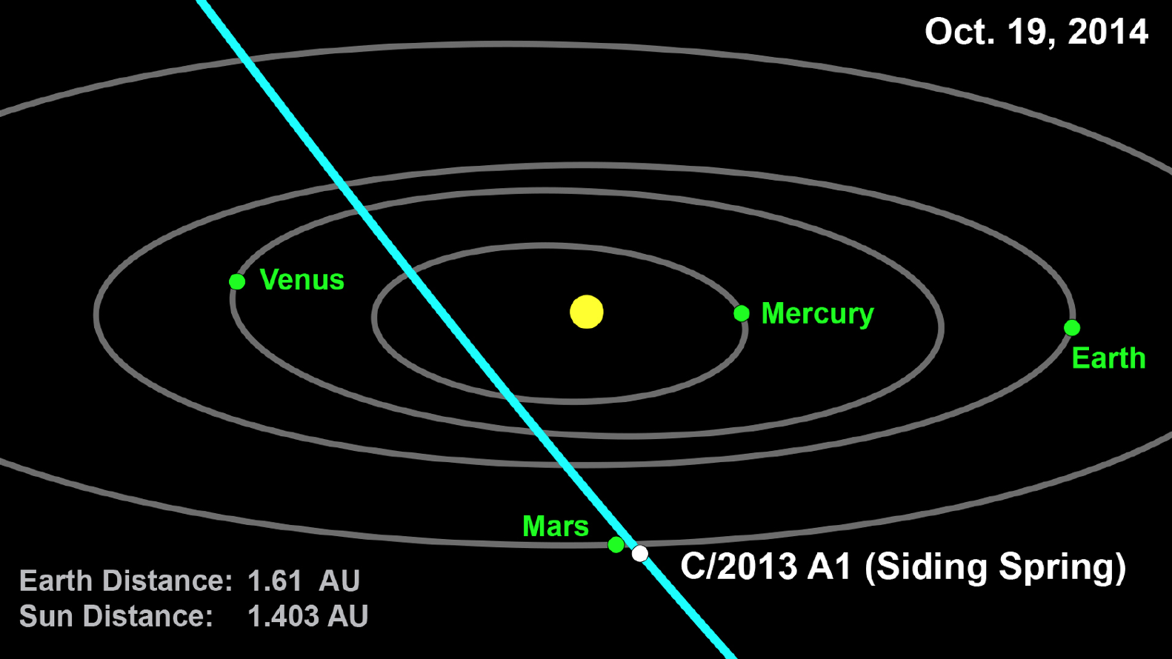
NASA/JPL/CNEOS

Slide 30
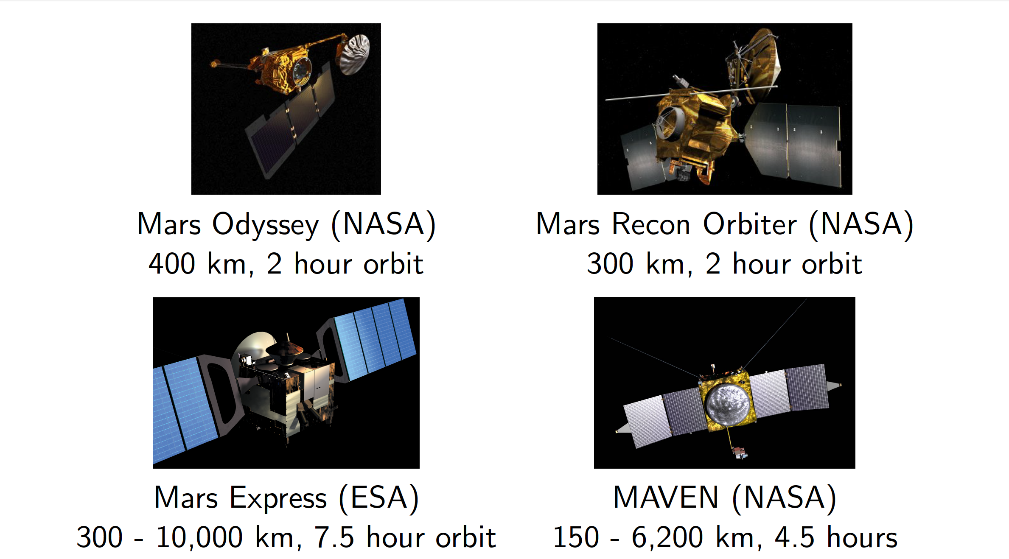
All images NASA

Slide 31
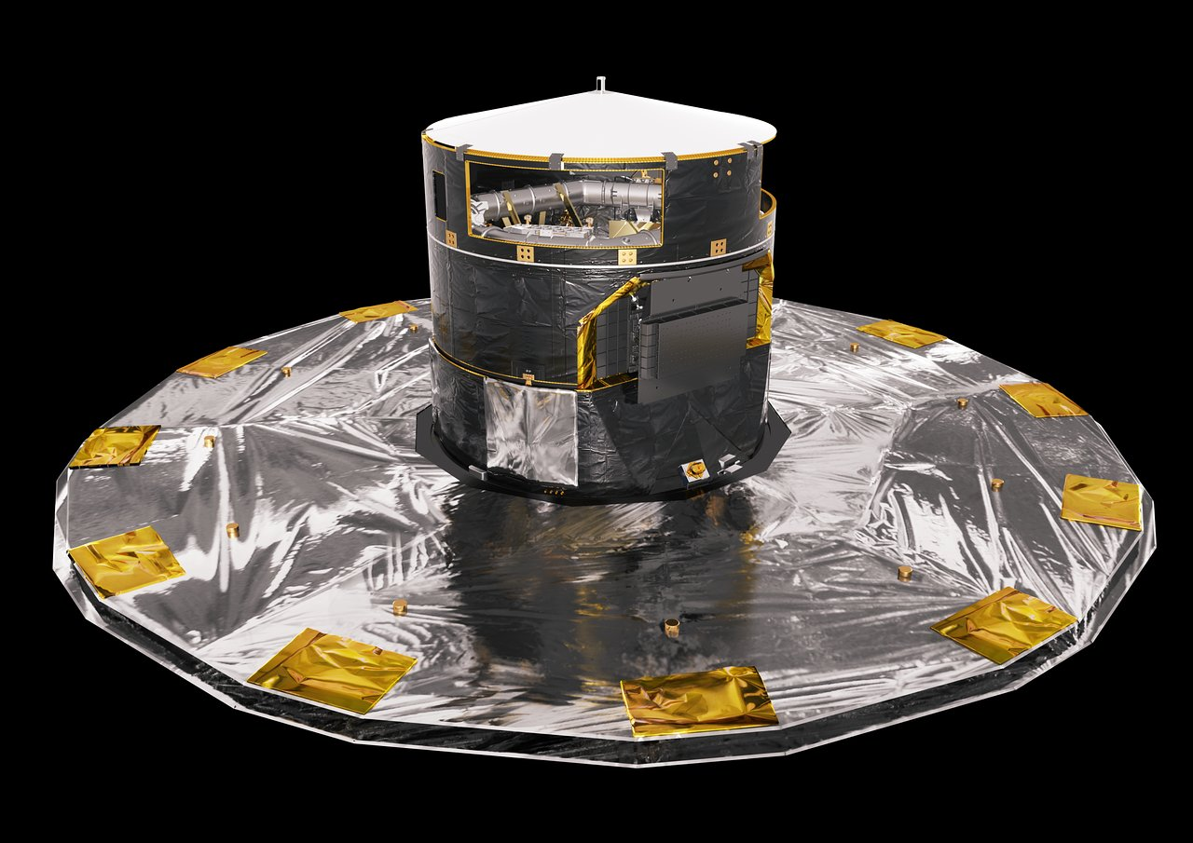
Gaia
ESA astrometry satellite in an halo orbit about Earth-Sun L₂.
Launched December 19, 2013.
Design life of 7 years; nominal mission ends in 2025.
1 billion pixel camera, 10 meter sunshield.
ESA/ATG medialab

Slide 32
In April 2024, an “high-speed” meteoroid impacted Gaia’s protective cover.
A ”little gap” was created, allowing stray sunlight to “occasionally disrupt” Gaia’s sensors.
Gaia’s camera was refocused for the last time in May/June of 2024.

Slide 33
Some take-away points
Meteoroid anomalies are infrequent (but more common than most realize).
  Meteor showers pose less risk than sporadic background except for major outbursts/storms.
Meteoroid impacts usually result in (small) attitude changes.
  If tolerances too tight, vehicle may go into safe mode (GOES 13).
Significant physical damage can result (Mariner IV, XMM-Newton, Artemis P1).
Impact induced ESD or EMP(?) can disable control electronics for high speed meteoroids (Perseid outbursts).

