Slide 1
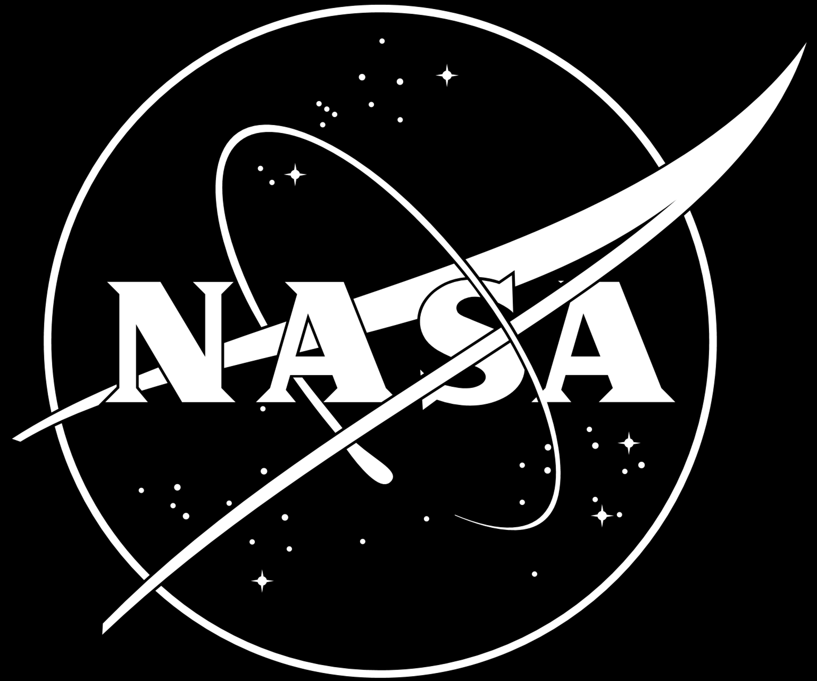

Implementation of a WENO High-Resolution Scheme
TFAWS Aerothermal Paper Session
Replace Passive Thermal with Active Thermal, Aerothermal, Cryothermal, or Interdisciplinary, depending on session topic
Presented By
Michael F. Harris Ph.D.
Launch Services Program, Kennedy Space Center
Thermal & Fluids Analysis Workshop
TFAWS 2024
August 26-30, 2024
NASA Glenn Research Center
Cleveland, OH

Slide 2
Introduction
CFD at Launch Services Program
Why use high order methods?
Governing Equations: 2-D Euler Equations
Implementation
  Immersed Boundary Cut Cell
  Boundary Conditions: Interpolation using WLS
  WENO Reconstruction
  Local Lax-Friedrich/Rusanov flux splitting
Examples
  Supersonic flow over cylinder
  Forward facing step
  Double Mach reflection

Slide 3
CFD at Launch Services Program
Commercial CFD software used
    StarCCM+ for general use
NASA software used
  Launch Ascent Vehicle Aerodynamics (LAVA)
    Ignition overpressure and launch acoustic predictions
  Overflow
    External flow / aerodynamic predictions of launch vehicles
    6 DOF or prescribed motion simulations for booster separation
  Fun3D
  Vulcan
    Hypersonic / Re-entry
    Commercial launch vehicles are able to recover hardware
Meshing
  Pointwise, CGT, StarCCM+

Slide 4
Why use high order methods?
Good understanding of fluid mechanics and heat transfer first principles will only get you so far
  Able to use engineering software and get results
  How good is the result?
Understanding of the numerical schemes is important
  Provides insight into strengths and limitations of the scheme
  Helps build confidence in the results
  Don’t want to use the software as a “black box”
    I’m guilty of this but can do better
Interest in high order methods
  PhD topic: Radial Basis Function Interpolation for Shock Capturing
  Wanted to understand WENO schemes following PhD

Slide 5
Why use high order methods?
Advantages
  Higher accuracy can be achieved with fewer grid points
    Even better results compared to lower order schemes with increasing number of grid points
    More efficient in that regard
Disadvantages
  Instabilities: High order methods like smooth solutions
  Complexities: Difficult to implement on irregular grids and along boundaries
  Computational expense: Larger stencil, more memory needed
We pay a price for higher accuracy “No free lunch”
Interested in high speed flows and capturing thin shock waves
Higher accuracy is needed for effective shock capturing
  Need many grid points near shock to resolve it well
    Grid adaption or adaptive mesh refinement (AMR)
  Use a higher order method such as WENO

Slide 6
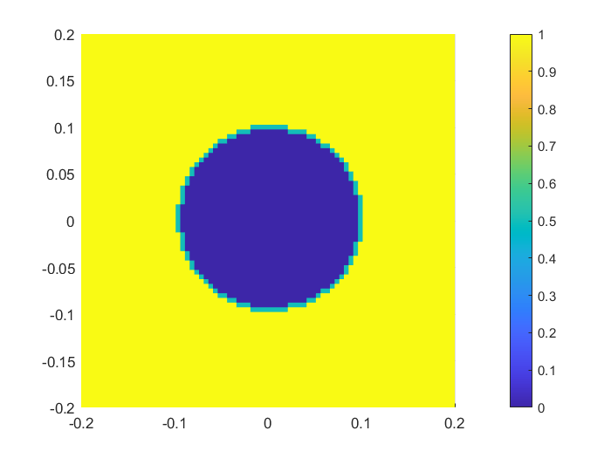
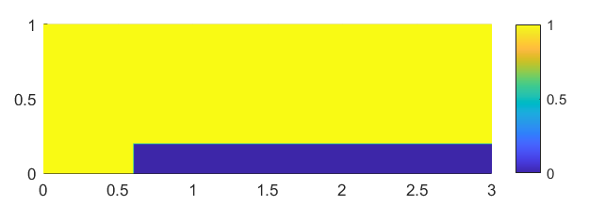
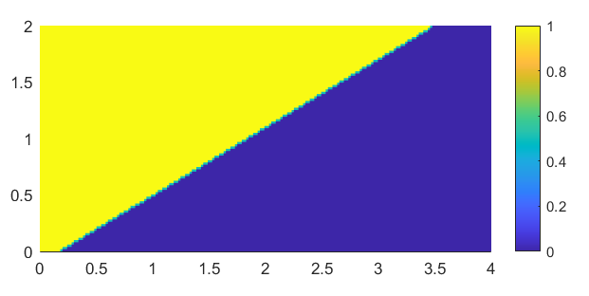
Immersed Boundary Method
Cartesian Mesh
  Cut cell cartesian mesh
  No inaccuracies due to high aspect ratios or skewness
  Easy to change geometries for testing numerical methods
Level set function is created to differentiate between domain, boundary (ghost nodes), and interior grid points (blanked)
Weight Least Squares is used to interpolate inside the domain and apply boundary conditions to ghost nodes
Inviscid flow - Slip flow on the walls

Slide 7

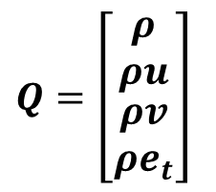

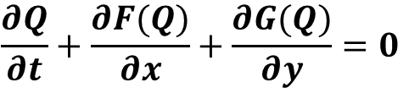
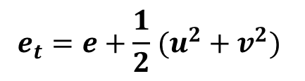
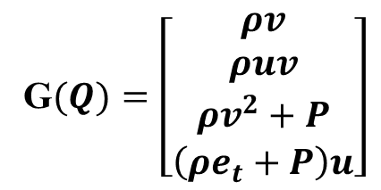
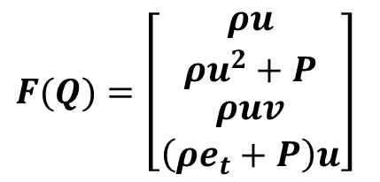
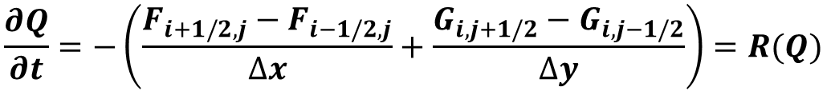
Governing Equation and Solvers
2-D Euler Equations, Calorically Perfect Gas
$$\frac{∂Q}{∂t}+\frac{∂F(Q)}{∂x}+\frac{∂G(Q)}{∂y}=0$$
$$Q=\left[\begin{matrix}ρ \\ ρu \\ \begin{aligned}ρv \\ ρe_{t}\end{aligned}\end{matrix}\right]$$
$$F(Q)=\left[\begin{matrix}ρu \\ ρu^{2}+P \\ \begin{aligned}ρuv \\ \left(ρe_{t}+P\right)u\end{aligned}\end{matrix}\right]$$
G$(Q)=\left[\begin{matrix}ρv \\ ρuv \\ \begin{aligned}ρv^{2}+P \\ \left(ρe_{t}+P\right)u\end{aligned}\end{matrix}\right]$
$$e_{t}=e+\frac{1}{2} (u^{2}+v^{2})$$
$$P=ρRT$$
$$e=c_{v}T$$
$$\frac{∂Q}{∂t}=−\left(\frac{F_{i+1/2,j}−F_{i−1/2,j}}{∆x}+\frac{G_{i,j+1/2}−G_{i,j−1/2}}{∆y}\right)=R(Q)$$

Slide 8

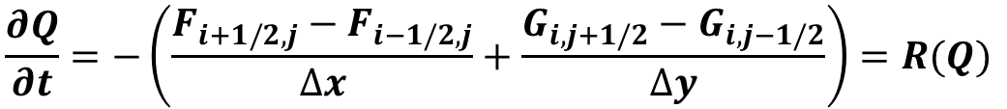
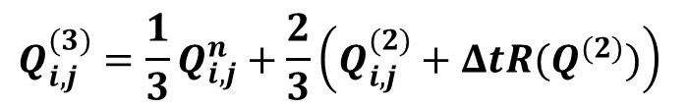
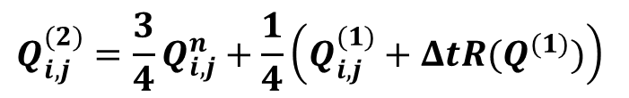
Governing Equation and Solvers
Strong Stability Preserving Runge Kutta (SSP RK3) is used from time integration
3 stage scheme
$$\frac{∂Q}{∂t}=−\left(\frac{F_{i+1/2,j}−F_{i−1/2,j}}{∆x}+\frac{G_{i,j+1/2}−G_{i,j−1/2}}{∆y}\right)=R(Q)$$
$$Q_{i,j}^{(1)}=Q_{i,j}^{n}+ΔtR(Q^{n})$$
$$Q_{i,j}^{(2)}={\frac{3}{4}Q}_{i,j}^{n}+\frac{1}{4}\left(Q_{i,j}^{(1)}+ΔtR(Q^{(1)})\right)$$
$$Q_{i,j}^{(3)}={\frac{1}{3}Q}_{i,j}^{n}+\frac{2}{3}\left(Q_{i,j}^{(2)}+ΔtR(Q^{(2)})\right)$$

Slide 9

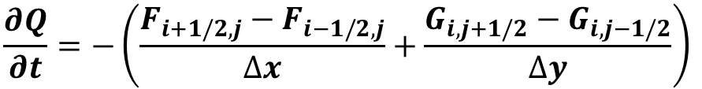
Governing Equation and Solvers
Local Lax Friedrich / Rusanov Flux Splitting
$$\frac{∂Q}{∂t}=−\left(\frac{F_{i+1/2,j}−F_{i−1/2,j}}{∆x}+\frac{G_{i,j+1/2}−G_{i,j−1/2}}{∆y}\right)$$
$$S=max(\left|λ\right|)$$
S is the maximum
of the eigenvalues
Taking a local maximum
gives the local Lax-Friedrich
flux splitting
$$F_{i+1/2,j}=\frac{1}{2}\left(F_{i+1/2,j}^{L}+F_{i+1/2,j}^{R}\right)−\frac{1}{2}S_{i+\frac{1}{2},j}\left(Q_{i+1/2,j}^{R}−Q_{i+1/2,j}^{L}\right)$$
$$F_{i−1/2,j}=\frac{1}{2}\left(F_{i−1/2,j}^{L}+F_{i−1/2,j}^{R}\right)−\frac{1}{2}S_{i−1/2,j}\left(Q_{i−1/2j}^{R}−Q_{i−1/2,j}^{L}\right)$$
$$G_{i,j+1/2}=\frac{1}{2}\left(G_{i,j+1/2}^{L}+G_{i,j+1/2}^{R}\right)−\frac{1}{2}S_{i+1/2,j}\left(Q_{i,j+1/2}^{R}−Q_{i,j+1/2}^{L}\right)$$
Fluxes need to be
reconstructed at each
half cell’s left
and right interface
$$G_{i,j−1/2}=\frac{1}{2}\left(G_{i,j−1/2}^{L}+G_{i,j−1/2}^{R}\right)−\frac{1}{2}S_{i−1/2,j}\left(Q_{i,j−1/2}^{R}+Q_{i,j−1/2}^{L}\right)$$

Slide 10




























WENO Scheme
Builds upon Essentially Non-Oscillatory (ENO) schemes developed by Harten et. al. [1]
  ENO reconstruction uses a the smoothest stencil among a set of selected stencils that include a given cell
  Smoothness indicator is used to determine stencil to be used
  A reconstruction polynomial is built using the single smoothest stencil of k^{th} order
$$i−\frac{1}{2}$$
$$i+\frac{1}{2}$$
$u_{i+\frac{1}{2}}^{1 L}=\frac{1}{3}u_{i−2}−\frac{7}{6}u_{i−1}+\frac{11}{6}u_{i}$
$$u_{i−3}$$
$$u_{i−2}$$
$$u_{i−1}$$
$$u_{i+1}$$
$$u_{i+2}$$
$$u_{i+3}$$
$$L$$
$$R$$
$$L$$
$$R$$
$u_{i+\frac{1}{2}}^{2 L}=−\frac{1}{6}u_{i−1}+\frac{5}{6}u_{i}+\frac{1}{3}u_{i+1}$
$$i−3$$
$$i−2$$
$$i−1$$
$$i$$
$$i+1$$
$$i+2$$
$$i+3$$
$$S_{1}$$
$u_{i+\frac{1}{2}}^{3 L}=\frac{1}{3}u_{i}+\frac{5}{6}u_{i+1}−\frac{1}{6}u_{i+2}$
$$S_{2}$$
$$S_{3}$$
Third order accurate
$S_{1}$= [$i−2$, $i−1, i]$
$S_{2}$= [$i−1$, $i, i+1]$
$S_{3}$= [$i$, $i+1, i+2]$

Slide 11



















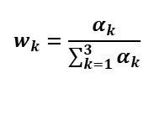

















WENO Scheme
Weighted Essentially Non-Oscillatory (WENO) reconstruction uses a convex combination of all the selected stencils [2]
  Weights are determined based local smoothness of the stencil such that:
  Reconstruction polynomial of 2k^{th}+1 order is achieved in smooth regions
  Reverts to k^{th} order ENO reconstruction near discontinuities
$$i−\frac{1}{2}$$
$$i+\frac{1}{2}$$
$$u_{i−3}$$
$$u_{i−2}$$
$$u_{i−1}$$
$$u_{i+1}$$
$$u_{i+2}$$
$$u_{i+3}$$
$$β_{1}=\frac{13}{12}{\left(u_{i−2}−2u_{i−1}+u_{i}\right)}^{2}+\frac{1}{4}{\left(u_{i−2}−4u_{i−1}+{3u}_{i}\right)}^{2}$$
$$L$$
$$R$$
$$L$$
$$R$$
$S_{1}$= [$i−2$, $i−1, i]$
$$i−3$$
$$i−2$$
$$i−1$$
$$i+1$$
$$i+2$$
$$i+3$$
$$β_{2}=\frac{13}{12}{\left(u_{i−1}−2u_{i}+u_{j+1}\right)}^{2}+\frac{1}{4}{\left(u_{i+1}−u_{i−1}\right)}^{2}$$
$$i$$
$S_{2}$= [$i−1$, $i, i+1]$
$$S_{1}$$
$$S_{2}$$
$S_{3}$= [$i$, $i+1, i+2]$
$$β_{3}=\frac{13}{12}{\left(u_{i}−2u_{i+1}+u_{i+2}\right)}^{2}+\frac{1}{4}{\left(3u_{i}−4u_{i}+u_{i+2}\right)}^{2}$$
$$S_{3}$$
$S_{4}$= [$i−1, i−2,i$, $i+1, i+2]$
$$S_{4}$$
$$α_{k}=\frac{γ_{k}}{β_{k}+ε}$$
where $ε$is small to avoid division by zero
$u_{i+\frac{1}{2}}^{(1) L}=\frac{1}{3}u_{i−2}−\frac{7}{6}u_{i−1}+\frac{11}{6}u_{i}$
$$u_{i+\frac{1}{2}}^{ L}=w_{1}u_{i+\frac{1}{2}}^{(1) L}+w_{2}u_{i+\frac{1}{2}}^{(2) L}+w_{3}u_{i+\frac{1}{2}}^{(3) L}$$
$$γ_{1}=\frac{1}{10}$$
$$γ_{2}=\frac{3}{5}$$
$$γ_{3}=\frac{3}{10}$$
$u_{i+\frac{1}{2}}^{(2) L}=−\frac{1}{6}u_{i−1}+\frac{5}{6}u_{i}+\frac{1}{3}u_{i+1}$
$$w_{k}=\frac{α_{k}}{\sum_{k=1}^{3}{α_{k}}}$$
5th order accurate if all stencils are smooth
$u_{i+\frac{1}{2}}^{(3) L}=\frac{1}{3}u_{i}+\frac{5}{6}u_{i+1}−\frac{1}{6}u_{i+2}$

Slide 12






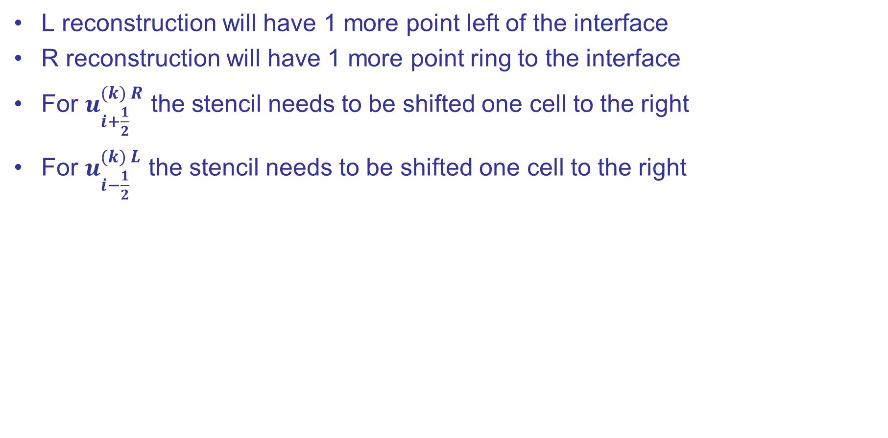












WENO Scheme
L reconstruction will have 1 more point left of the interface
R reconstruction will have 1 more point ring to the interface
For $u_{i+\frac{1}{2}}^{(k) R}$ the stencil needs to be shifted one cell to the right
For $u_{i−\frac{1}{2}}^{(k) L}$ the stencil needs to be shifted one cell to the right
$$i−\frac{1}{2}$$
$$i+\frac{1}{2}$$
$$i−\frac{1}{2}$$
$$i+\frac{1}{2}$$
$$u_{i−3}$$
$$u_{i−2}$$
$$u_{i−1}$$
$$R$$
$$u_{i+1}$$
$$u_{i+2}$$
$$u_{i+3}$$
$$u_{i−3}$$
$$u_{i−2}$$
$$u_{i−1}$$
$$u_{i+1}$$
$$u_{i+2}$$
$$u_{i+3}$$
$$L$$
$$L$$
$$R$$
$$L$$
$$R$$
$$L$$
$$R$$
$$i−3$$
$$i−2$$
$$i−1$$
$$i$$
$$i+1$$
$$i+2$$
$$i+3$$
$$i−3$$
$$i−2$$
$$i−1$$
$$i$$
$$i+1$$
$$i+2$$
$$i+3$$
$$S_{1}$$
$$S_{1}$$
$$S_{2}$$
$$S_{2}$$
$$S_{3}$$
$$S_{3}$$
$u_{i+\frac{1}{2}}^{(1) R}=−\frac{1}{6}u_{i−1}+\frac{5}{6}u_{i}+\frac{1}{3}u_{i+1}$
$u_{i−\frac{1}{2}}^{(1) L}=−\frac{1}{6}u_{i+1}+\frac{5}{6}u_{i}+\frac{1}{3}u_{i−1}$
$u_{i+\frac{1}{2}}^{(2) R}=\frac{1}{3}u_{i}+\frac{5}{6}u_{i+1}−\frac{1}{6}u_{i+2}$
$u_{i+\frac{1}{2}}^{(2) R}=\frac{1}{3}u_{i}+\frac{5}{6}u_{i−1}−\frac{1}{6}u_{i−2}$
$u_{i+\frac{1}{2}}^{(3) R}=\frac{1}{3}u_{i+1}−\frac{7}{6}u_{i+2}+\frac{11}{6}u_{i+3}$
$u_{i+\frac{1}{2}}^{(3) R}=\frac{1}{3}u_{i−1}−\frac{7}{6}u_{i−2}+\frac{11}{6}u_{i−3}$

Slide 13
Supersonic Flow over Cylinder
Test Problem 1
Domain initialized using inlet conditions
400x200 grid points
800x400 grid points
Inviscid/Slip Wall
M = 2
P = 101325 Pa
T = 300 K
γ = 1.4
R = 287 J/kg K
d=0.2
2 m
Extrapolation
Inviscid/Slip Wall
1 m
4 m

Slide 14
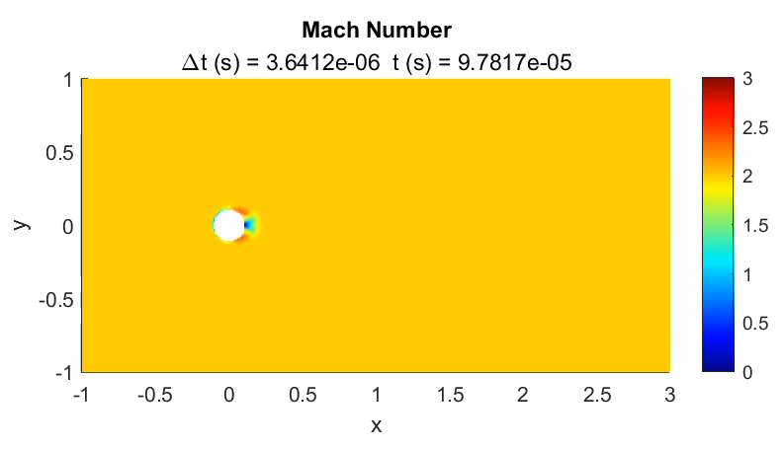
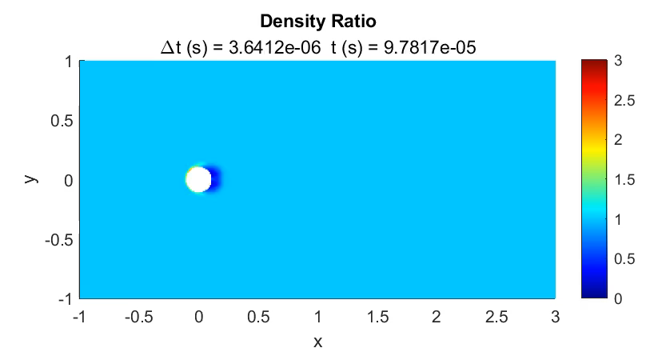
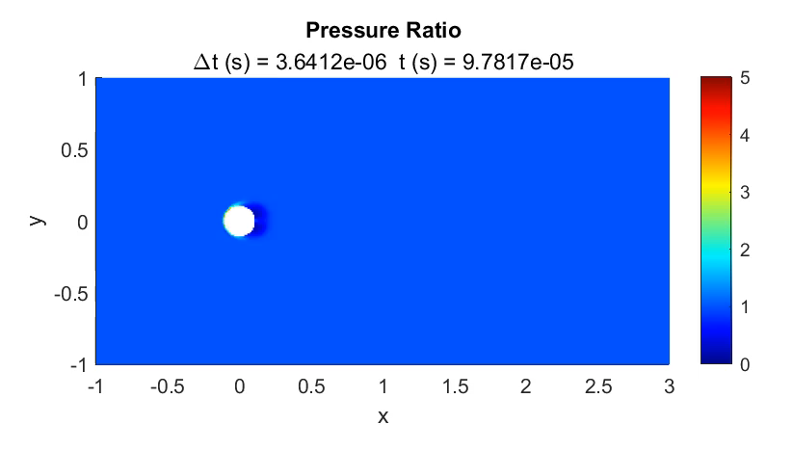
Supersonic Flow over Cylinder (400x200 Grid)

Slide 15



Supersonic Flow over Cylinder (800x400 Grid)

Slide 16
Forward Facing Step
Test Problem 2
Domain initialized using inlet conditions
600 x 200 grid points
Inviscid/Slip Wall
M = 3
P = 1 Pa
T = 1 K
γ = 1.4
R = 0.714286 J/kg K
1 m
Extrapolation
Inviscid/Slip Wall
0.2 m
0.6 m
3 m

Slide 17
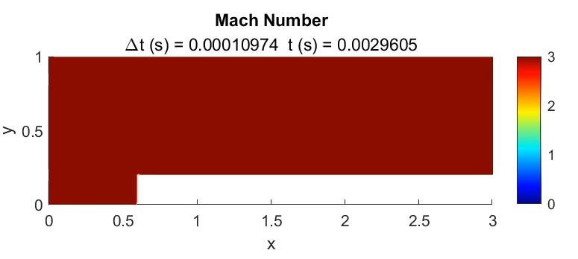
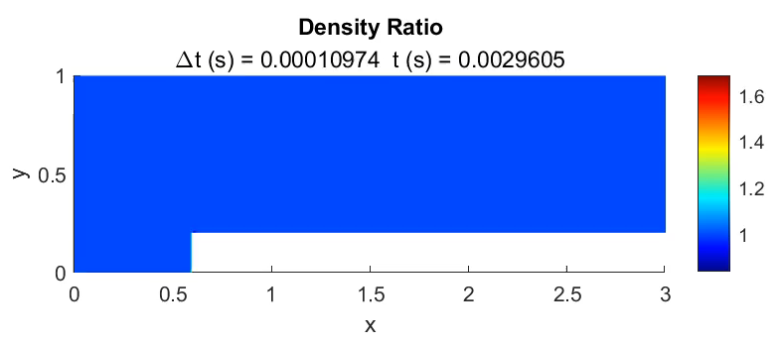
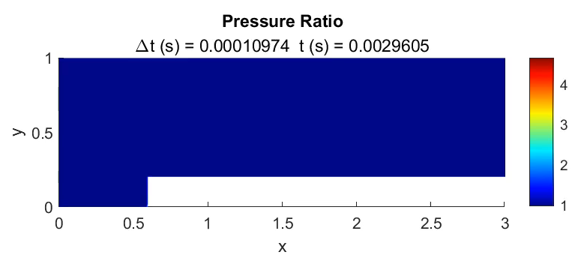
Forward Facing Step (600 x 200 Grid)

Slide 18
Double Mach Reflection
Test Problem 3
Grid points x<1/6 m are initialized to give Mach 10 moving shock wave
dx = 0.003
Extrapolation
ρ = 8 kg/m³
P = 116.5 Pa
u = 8.25 m/s
γ = 1.4
R = 0.714286 J/kg K
2 m
Inviscid/Slip Wall
30°
1/6 m
Inviscid/Slip Wall

Slide 19
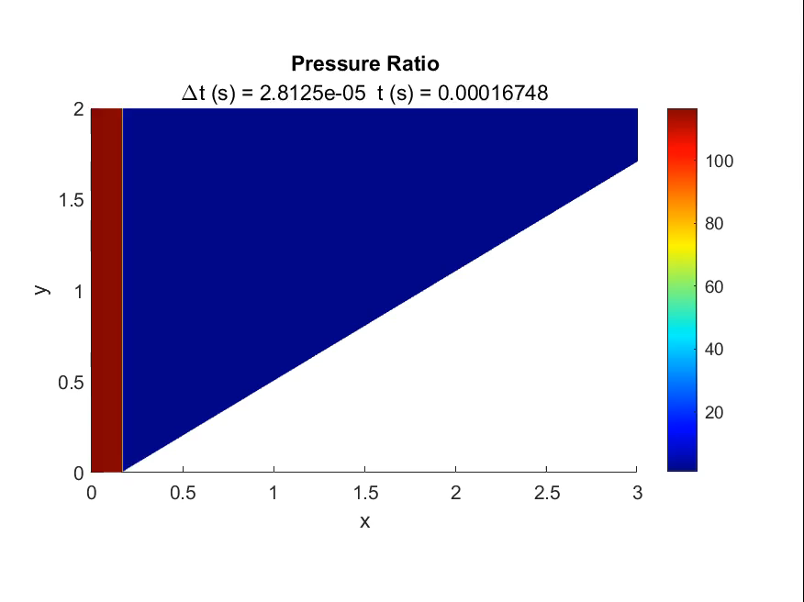

Double Mach Reflection
Test Problem 3
Grid points x<1/6 m are initialized to give Mach 10 moving shock wave
dx = 0.003

Slide 20
Conclusions and Future Work
Successfully developed a solver for the Euler Equations using the WENO formulation
  “Prototype” code for future development
  Many lessons learned about the WENO method while developing the solver
    WENO polynomials
    Nonlinear weights
    Smoothness indicator
    Riemann solvers / Flux Splitting
Solved many test problems and obtained good agreement
Find uses in LSP work
  Find coefficient of pressure along fairing for venting calculations
Future Work
  Create 3D and axissymetric solver using lessons learned
  Utilize GPU computing

Slide 21
References
Harten, A., Engquist, B., Osher, S., & Chakravarthy, S.R. (1987). Uniformly high order accurate essentially non-oscillatory schemes, 111. Journal of Computational Physics, 71, 231-303.
Jiang, G., & Shu, C. (1995). Efficient Implementation of Weighted ENO Schemes. Journal of Computational Physics, 126, 202-228.
Zahran Y. (2017) Weighted non-oscillatory (WENO) methods for solving hyperbolic conservation laws. Lap Lambert Academic Publishing
Yao G. (2018) Immersed Boundary Method for CFD: Focusing on its implementation Second Edition
Vázquez-Cendón E. (2011) Lecture Notes on Numerical Methods for Hyperbolic Equations: Short Course Book
Hesthaven J. (2018) Numerical Methods for Conservation Laws: From Analysis to Algorithms, Society of Industrial and Applied Mathematics

