Slide 1

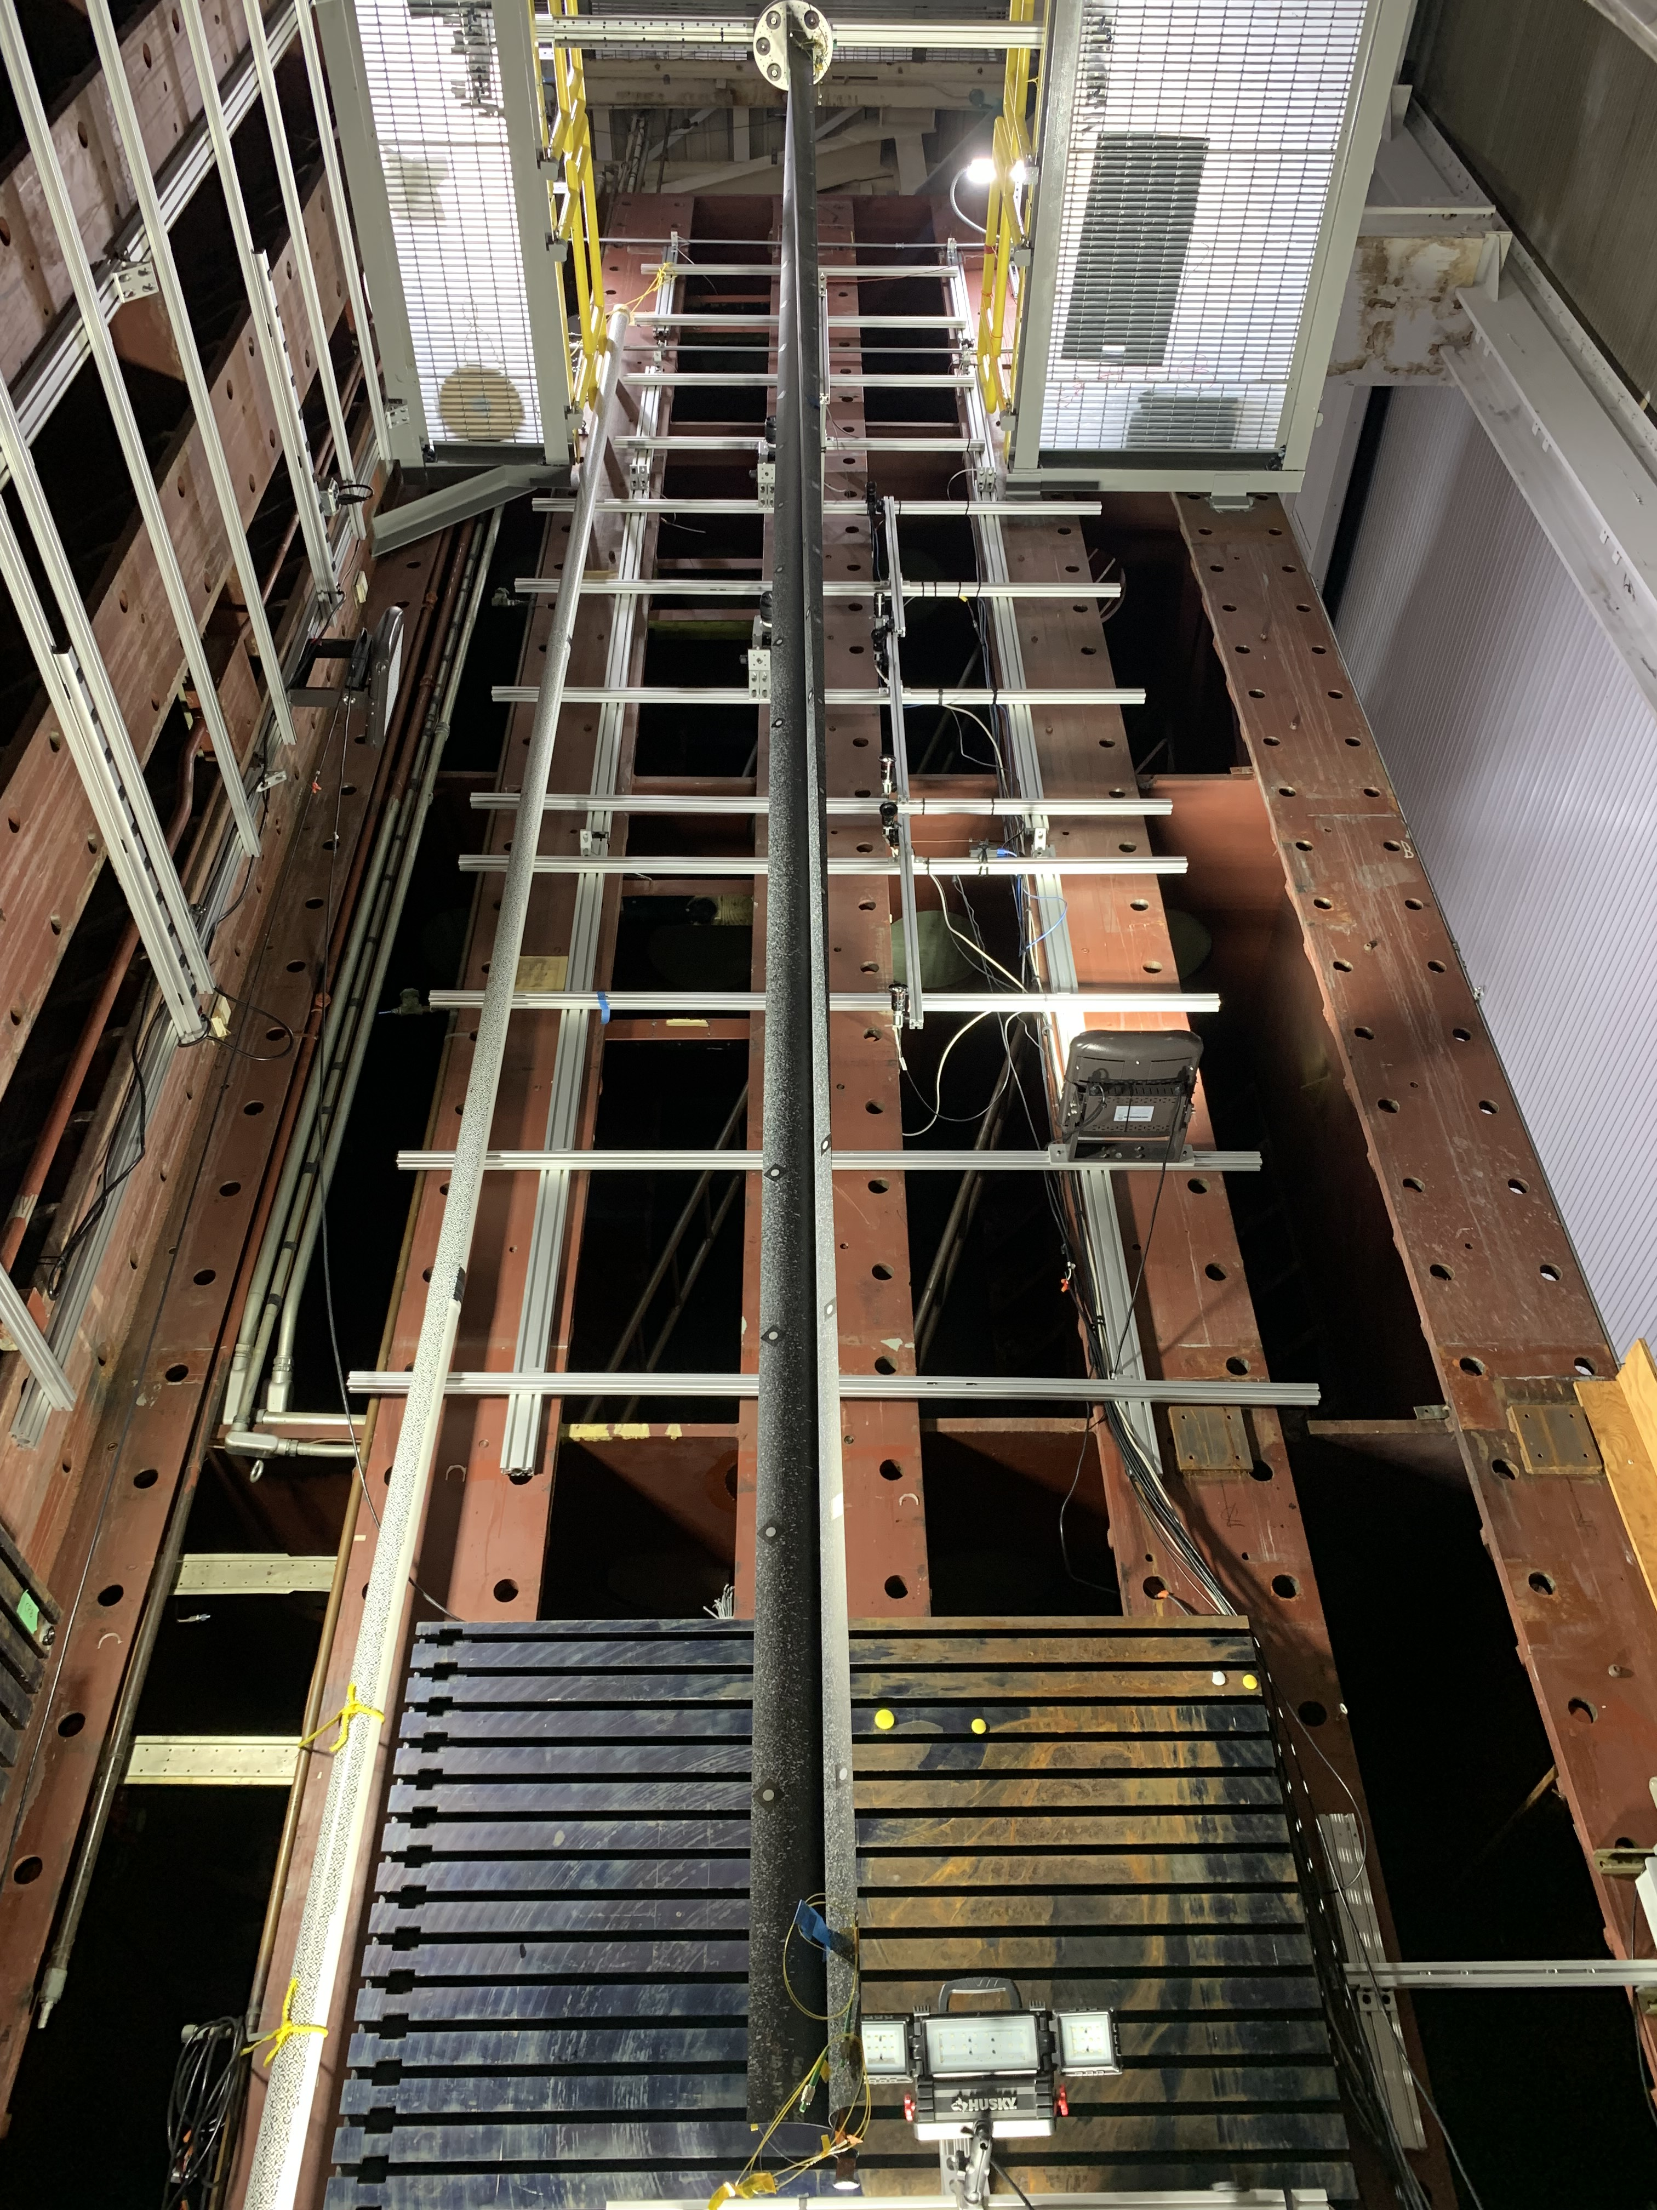
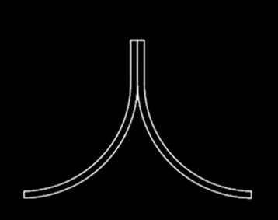
Gravity Offloading and Analysis of Long Imperfection-Sensitive Elements (GOALIE)
Project Overview
Use of large-scale deployable structures (e.g., iROSA) can enable space exploration and science missions (e.g., ACS3, Solar Cruiser). Numerical models predicting behavior of deployable structures in microgravity are difficult to validate because ground testing of long, slender, and flexible booms is challenging due to the influence of Earth’s gravity.
Technical Approach
Collect data for model validation through experimental testing to increase confidence in numerical models.
Triangular, Rollable, and Collapsible (TRAC) Boom Cross Section
Point of Contact:
Cyrus Kosztowny, GOALIE PM/Co-PI
cyrus.j.Kosztowny@nasa.gov
Contributing Partners
Redwire, Inc. provided a subscale (7 m, below) and a full-scale (30 m) TRAC boom to use for test development. Other boom designs may be tested in the future.
Root (clamped) end
Strain and motion capture cameras
Speckle pattern and motion targets enabling full-field data capture
Web
Flange
Flange
Distal (free) end and loading point
Laser tracker target
Subscale (7 m) TRAC boom

