Slide 1
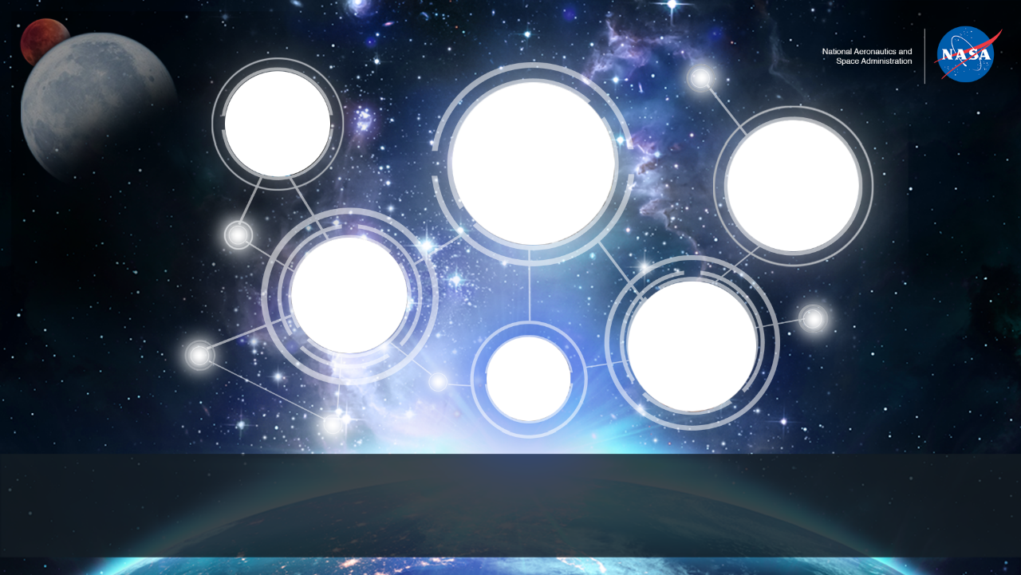
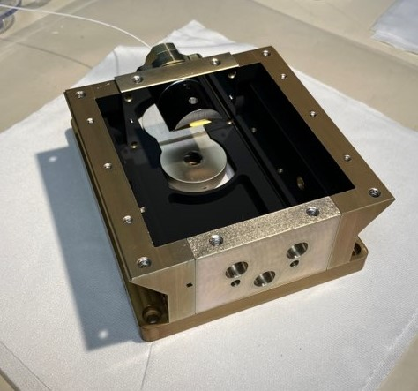
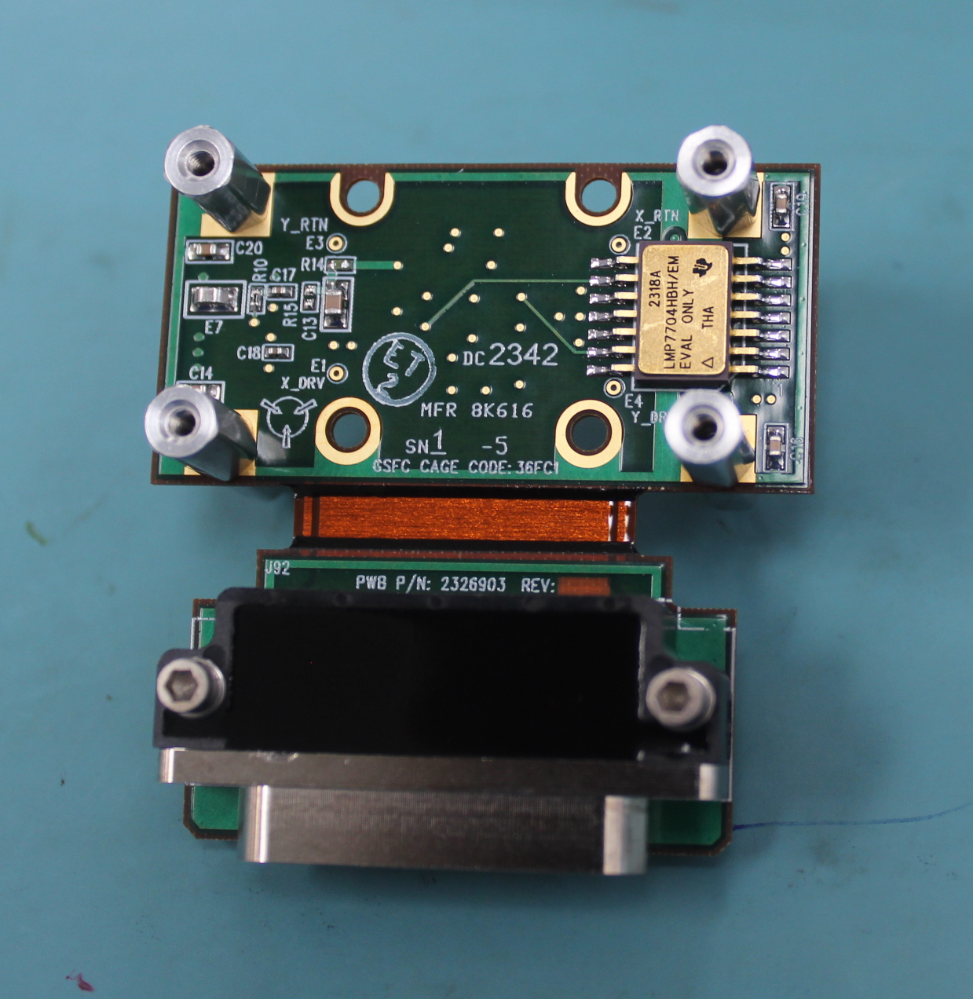
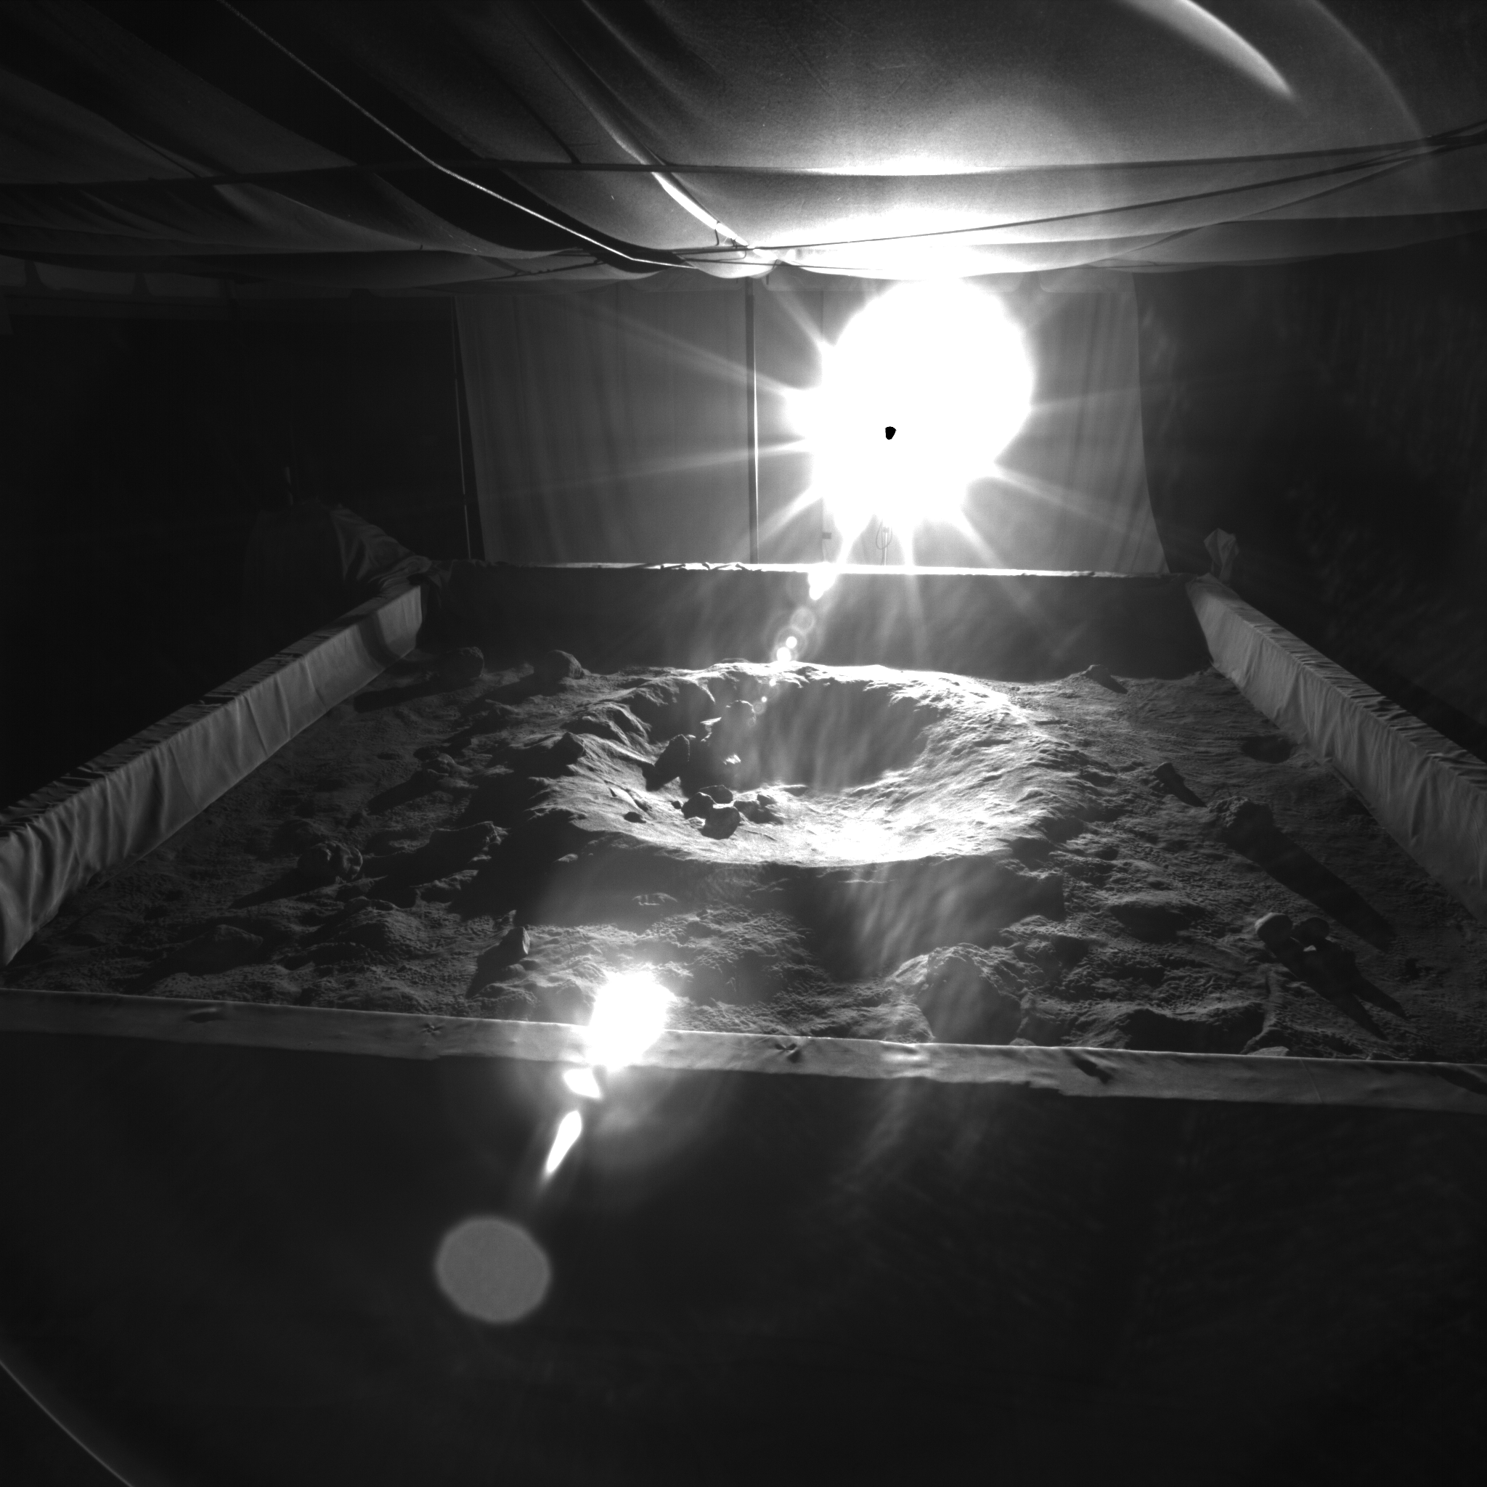
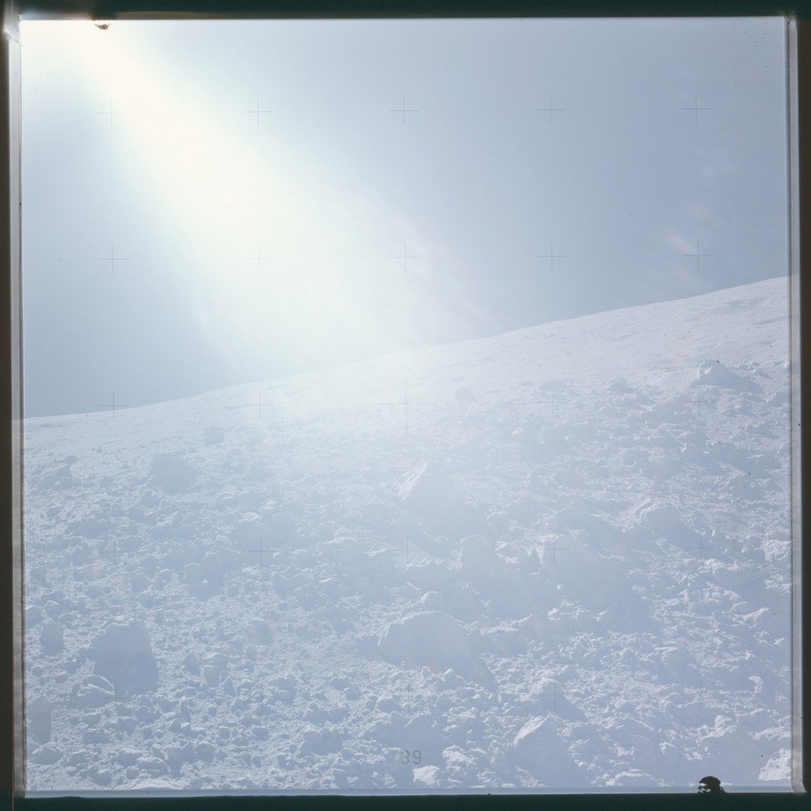
Space Technology Mission Directorate
Game Changing Development Program
Nathaniel Gill, High TRL Rover LIDAR (HTRL) Annual Program Review | September 10-12, 2024

Slide 2
HTRL / Space Qualified Rover Lidar (SQRLi) Overview
Needs Addressed by Project
STMD | Develop technologies for science instrumentation supporting new discoveries. [Low TRL STMD/Mid-High TRL SMD. SMD funds mission specific instrumentation (TRL 1-9)] TX08.X
LTV / Endurance-A | Sensing and perception technologies for autonomous systems collect and process information internal and external to the system from sensors and instruments. TX10.1.1
Project Goals
Goal #1 | Design and build an engineering test unit of a high TRL (5-6) rover LIDAR system and demonstrate its operating capabilities at 30 m or greater with an increased field of view under ideal, low sun angle, and poor light conditions.
Project Objectives
Objective #1 | Complete System Requirements, Trade Studies, and Risk Reduction Testing
Objective #2 | Design, build and test the Front-End Box (FEB).
Objective #3 | Design build and test the components, cards, and subassemblies of Main Electronics Box (MEB)
Objective #4-7 | Integrate HTRL FEB with MEB emulator to environmentally and performance test the FEB Engineering Test Unit (ETU) FEB

Slide 3
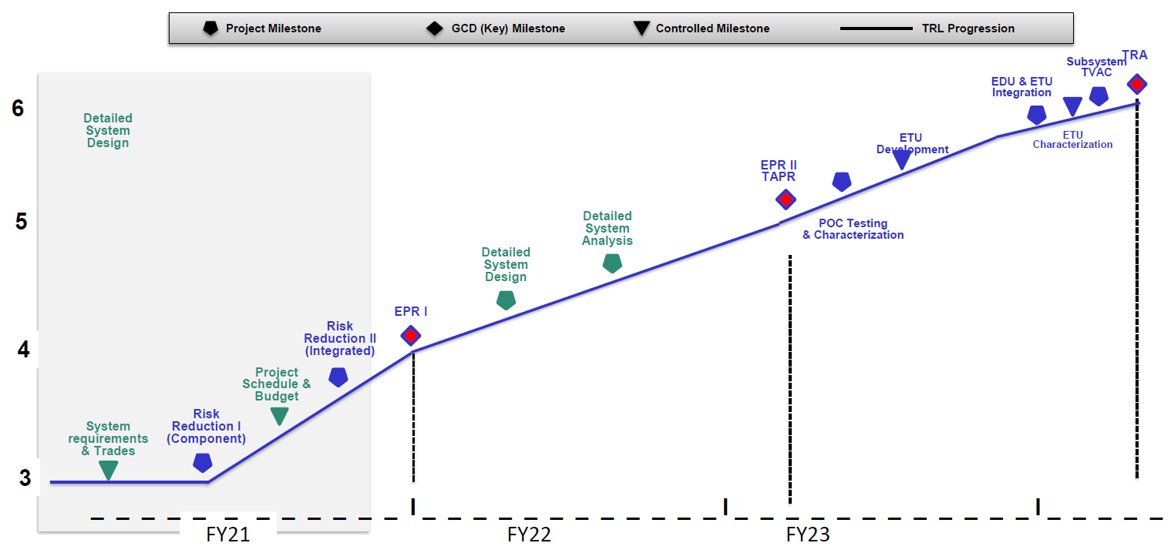
HTRL Lifecycle Milestone/Maturity Schedule
FY24

Slide 4
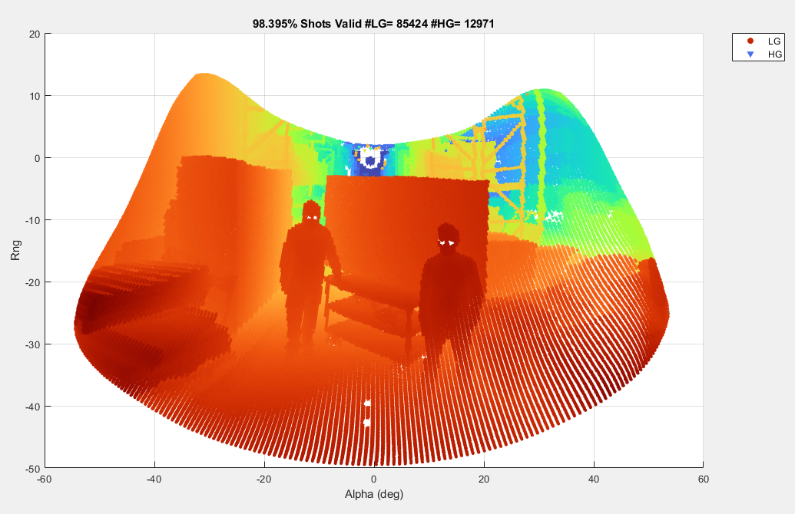
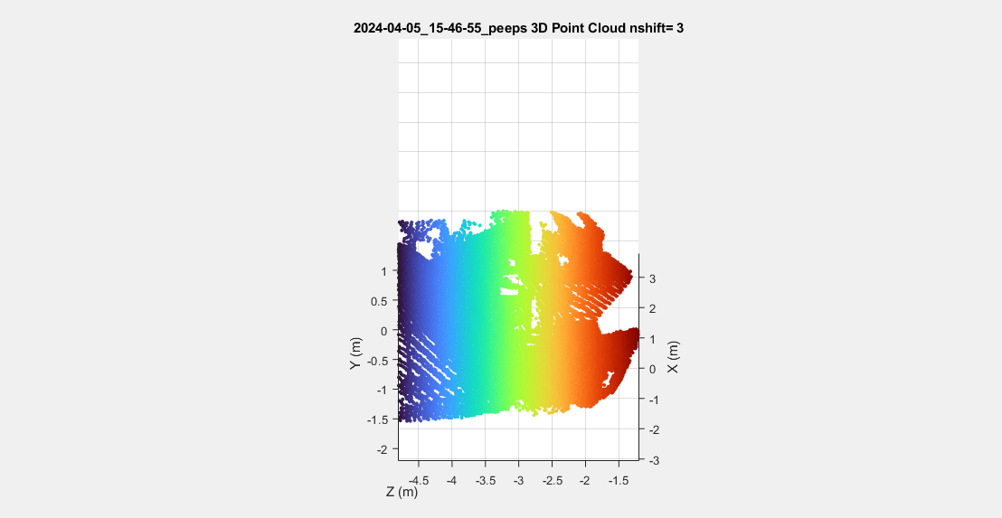
HTRL/SQRLi Technical Progress and Results
2D Team Member Lidar Range Image
First and Only TRL6 Rover Lidar Complete
Key specs:
60m range
100x50 degree FOV
FEB mass 1.85kg
MEB mass 4.82kg
All major elements of technical plan have been completed and closed out, including final Technology Readiness Assessment (TRA) including:
MEB emulator integration completed
FEB calibration completed
Vibration testing completed
Open air testing completed
TVAC completed
GSFC and GCD Chief Engineers agree the HTRL/SQRLi Front End Box is TRL6.
When sister project Dragonfly-Ocellus completes Main Electronics Box (MEB) environmental tests in 2025, MEB is considered TRL6.
Beta (deg)
3D Team Member Lidar Image

Slide 5
HTRL/SQRLi Transition/Infusion Status
The Space Qualified Rover Lidar is applicable to any planetary surface or relative navigation use case.
Endurance-A, VIPER, EHP (LTV/EVA) Projects and programs have all been engaged
Commercialization and licensing underway, patent pending.

Slide 6
HTRL/SQRLi Assessment Summary
Project Name | Performance |  |  |  | Comments
 | C | S | T | P
Annual |  |  |  |  | We now have a space qualified rover lidar! All major milestones completed per the project plan. Only APR and closeout report remain. This year included a major scope change, project plan update, granted CR request for additional funds, and closeout of the project. Overall, a busy but successful year.
 | Oct | Nov | Dec | Jan | Feb | MYR | Apr | May | Jun | Jul | Aug | APR
C
S
T
P
Yellows and reds post-MYR related to CR request for additional funds to complete TVAC. Funds were granted and TVAC was completed successfully in May leading to successful TRA in July. Pre-MYR yellows and reds are driven by project rescope, then part and subsystem lead times which were resolved prior to I&T.

