Slide 1



National Aeronautics and Space Administration
ECLSS-CHP SCLT Overview and Perspectives on CLD Utilization
8/22/2024
Jim Broyan – Lead
www.nasa.gov

Slide 2
Overview
Technology Needs – ADD, Shortfalls, Human Needs, Gaps
LEO vs Deep Space
Review ECLSS-CHP Scope
Question and Answers
Notional ECLSS-CHP CLD Utilization
2

Slide 3
Perspective on ECLSS-CHP Priorities for CLD
NASA programs are still determining what payload types and overall capacity is required
Exploration needs are being defined by the M2M ADD and remain at high level to allow implementation flexibility to best meet the high-level objectives
This presentation does not define or provide specific technology recommendations
This presentation provides the ECLSS-CHP SCLT perspectives to consider in what ECLSS-CHP needs are for a range of mission classes
General round trip human mission to Mars surface
General longer duration human lunar surface missions eventually leading to continued presence
CLD payload resource needs will be defined by the CLD program based on formal inputs from the NASA mission directorates
3

Slide 4


ECLSS-CHP Scope - Capability Areas
Close alignment with TX.06 on NASA Technology Taxonomy
6
New: EARTH INDEPENDENT HUMAN OPERATIONS TECHNOLOGIES
Decision Support & Situation Awareness Tools
Human-Hardware Maintenance Interfaces and Tools
Procedure Execution Support Tools
Asynchronous Distributed Operations Management Systems
Integrated Earth-Independent Human Systems Simulation Technologies

Slide 5
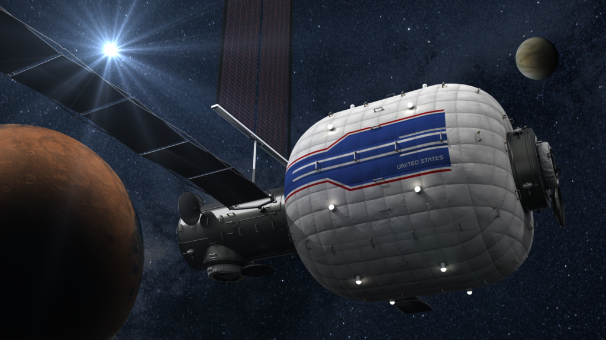

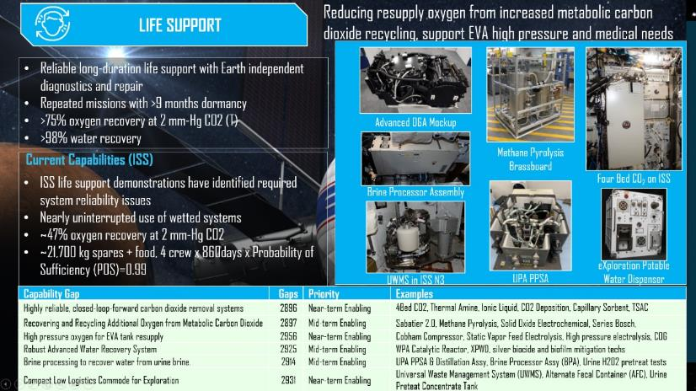
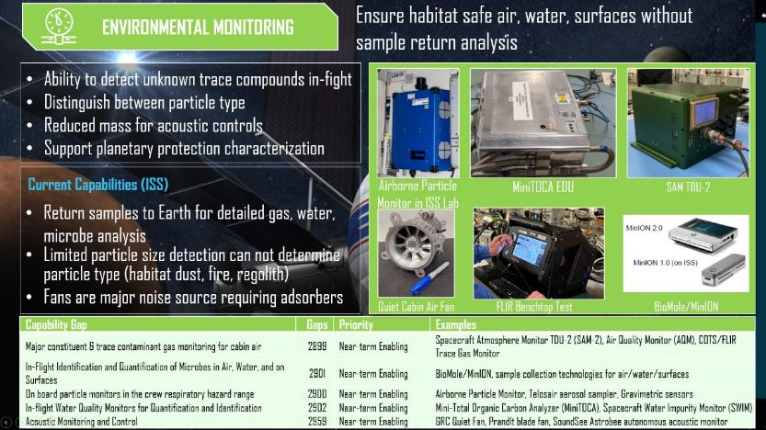
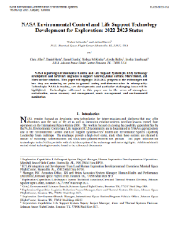
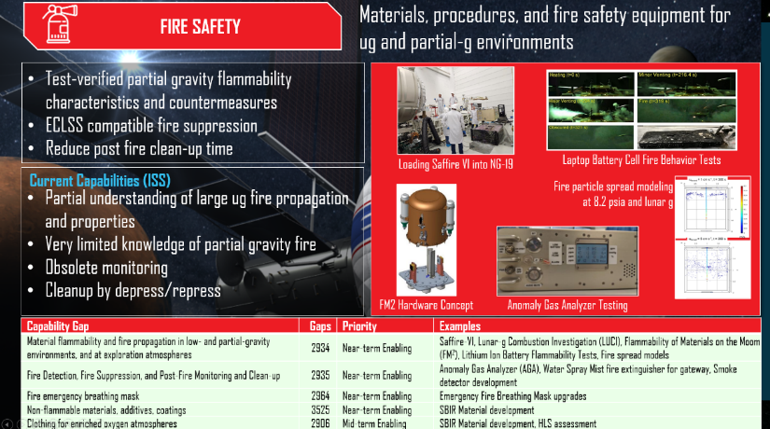
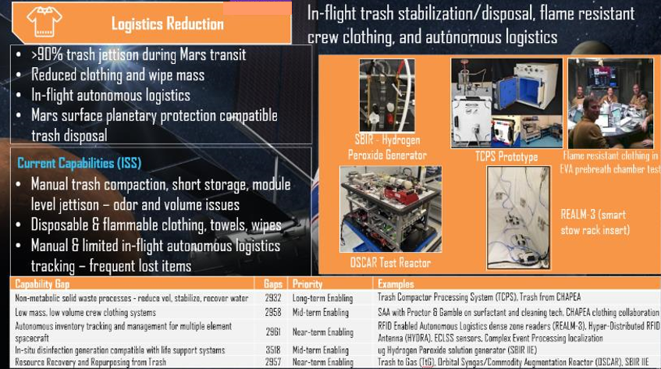
ECLSS Capability Area Status
International Conference on Environmental Systems (ICES) ECLSS Paper: Link
Status charts in backup
5

Slide 6
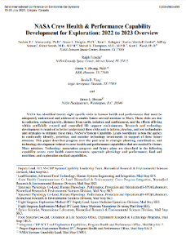
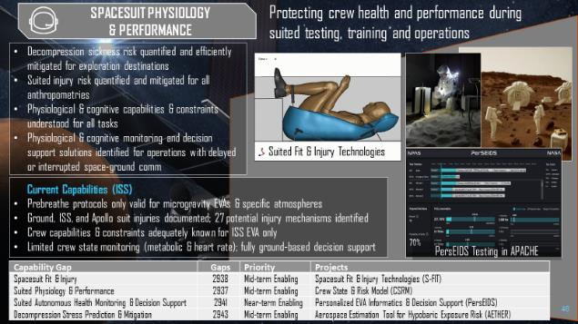
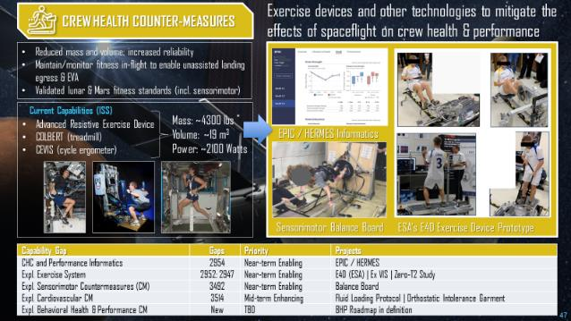
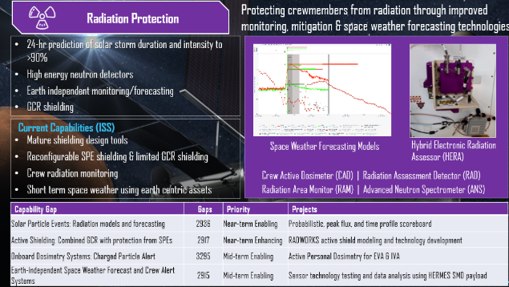
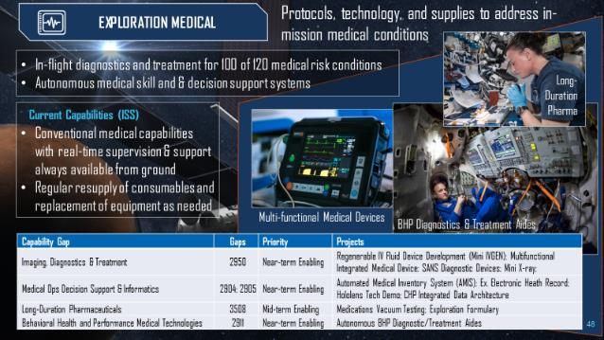
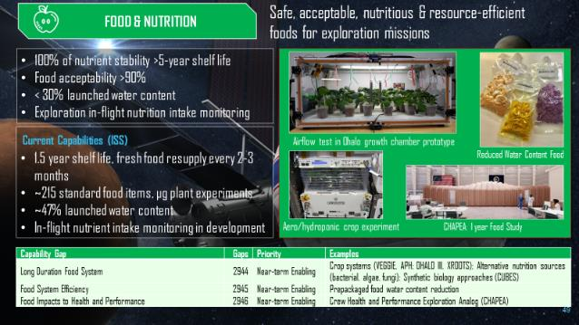
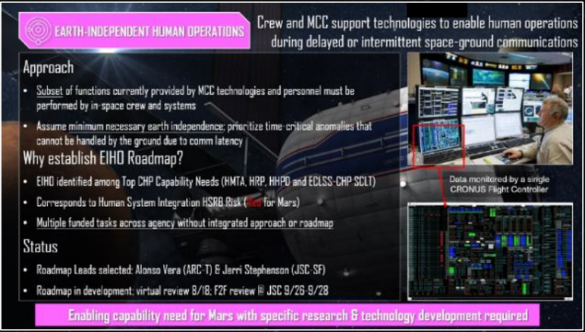
CHP Capability Area Status
International Conference on Environmental Systems (ICES) CHP Paper: Link
Full size status charts in backup
6

Slide 7
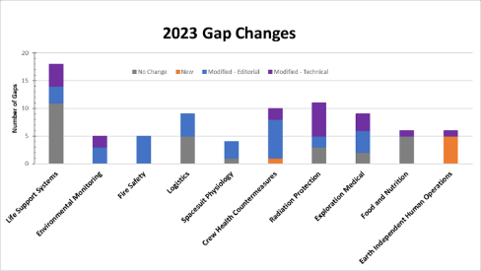
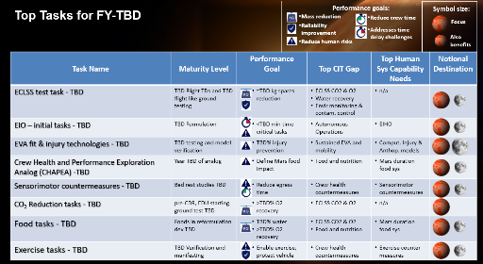
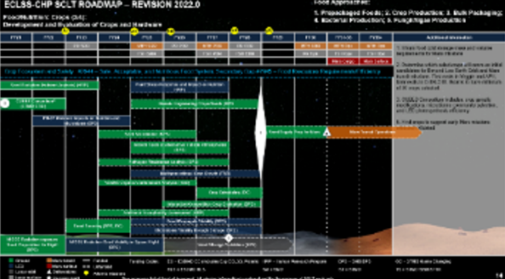
ECLSS-CHP SCLT – Products
Executing from the left
Architecting from the right
Mission Execution
Infusion
Element Technology Infusion
Element Technology Infusion
SCLT & Roadmaps
Gap Closing Technology Dev
Decompose functions and needs to identify capability gaps & develop technology roadmaps for closure
Coordinate and align with SAO, HRP, OCHMO, STMD, NESC
SCLT provides independent strategic recommendations and alignment assessments on technology development investments
Programs make funding decisions based on multiple considerations and inputs
Tech Dev
Capability Gaps
Human Needs
Shortfalls
Needs
ADD Use Cases & Functions
Architecture
M2M Objectives
Support execution from the left to support architecture function needs from the right
7

Slide 8
ECLSS-CHP Exploration Technology Needs Review
Categorization and strategic decomposition of technology needs has rapidly evolved in past several years but the core base ‘gap’ information has remained relatively consistent for ECLSS-CHP
Previously ~800 gaps have been defined internally within NASA (~87 ECLSS-CHP gaps)
Gaps were not generated with a consistent top-down driven architecture focus
Primarily focused on vehicle and mission needs
STMD incorporated the gaps into a NASA-internal database – StarPort
‘Envisioned Future’ frameworks were developed from SCLT/PT perspectives and publicized <see chart 9>
HHPD-OCHMO-SCLT developed an internal list of 8 Top Human System Capability Needs to for Mars complement initial gaps <see chart 10>
ESDMD M2M ADD is a systematic top-down objective decomposition to inform exploration architecture <see charts 11-12>
Updated annually to increase lunar and Mars mission characteristics, needs, functions and provides white papers on specific sub-architecture topics
Internally NASA is developing a high-level architecture driven gaps – (references groupings of previous gaps)
8

Slide 9










Previous (2021-2023) STMD ECLSS-CHP Envisioned Future (goals) by Capability Area – SCLT identified ‘needs’
(Mission need)
L = Lunar surface
T = Transit to Mars
M = Mars surface
LIFE SUPPORT
ENVIRONMENTAL
MONITORING
FIRE SAFETY
LOGISTICS
Reliable long-duration life support with Earth independent diagnostics and repair (L,T,M)
>20% reduction in spares and installed mass (T)
Enable single missions >800 days w/o resupply (T)
Repeated missions with >9 months dormancy (L,T,M)
>75% oxygen recovery at 2 mm-Hg CO₂ (T)
High pressure oxygen recharge for EVA (L,M)
>98% water recovery (L,T,M)
Remove respirable lunar and Mars dust (L,M)
Planetary protection compatible ECLSS venting (M)
Identify and quantify chemical (>12 water, >33 air) and microbial species in-mission with out sample return (L,T,M)
Ability to detect unknown constituents (T,M)
Distinguish between fire, habitat dust, and surface dust particles (L,M)
Support forward and backward planetary protection detection (both microbial and non-DNA techniques) (M)
Test-verified partial gravity flammability characteristics and countermeasures (L,M)
ECLSS compatible fire suppression (L,T,M)
Reduce post fire clean-up time (L,T,M)
Common fire safety strategy across element architectures (L,T,M)
Jettison >90% of trash mass during Mars transit (T)
Mars trash disposal compatible with planetary protection (M)
In-flight autonomous logistics (L,T,M)
Reducing clothing and wipes mass by >50% (L,T,M)
Clothing flammability (and other non-metallics) >36% O2 (L,M)
SPACESUIT PHYSIOLOGY
COUNTER-MEASURES
RADIATION PROTECTION
EXPLORATION MEDICAL
FOOD & NUTRITION
EARTH INDEPENDENT HUMAN OPERATION
100% of tasks within human performance (L,T,M)
Predict and mitigate decompression sickness for surface EVA (L,M)
Predict and mitigate suited injury (L,M)
6 Major physiological informatics parameters provided in-suit to enable real time self-assessment or loss of communication areas (L,M)
Reduce mass and volume (L,T,M)
Maintain/monitor fitness in-flight to enable unassisted landing egress & EVA (L,T,M)
Validated lunar and Mars fitness standards (L,M)
24-hr prediction of solar storm duration and intensity to >90% (L,T,M)
High energy neutron detectors (L,T,M)
Earth independent monitoring/forecasting (T,M)
GCR shielding (T,M)
In-mission diagnostics and treatment for 100 of 120 medical risk conditions (L,T,M)
Autonomous medical skill and & decision support systems (T, M)
Integrated data architecture (L,T,M)
100% of nutrient stability >5-year shelf life (T,M)
Food acceptability >90% (L,T,M)
<30% launched water content (T,M)
Exploration counter-measure in-mission nutrition intake monitoring (L,T,M)
Crew decision support systems (L, T, M)
Asynchronous communication and control systems (L, T, M)
Autonomous response to time to effect emergency <40 min (T,M)
Autonomous critical unplanned repair/stabilization <20 days (T,M)
9

Slide 10
(2023-2024) Top Human System Capability Needs for Mars
Developed by HHPD-OCHMO-SCLT to define the highest priority human centric capability needs
Complements and StarPort gaps and provides input to ADD
Combines aspects of previous defined gaps and Human System risks
Will be published in paper at upcoming IAC, needs include:
Earth-independent human operations
Mars duration food systems
Mars duration effects on crew health & performance
Computational injury & anthropometric models
Individual variability in response to spaceflight
Exploration exercise countermeasures
DCS prevention and treatment
Sensorimotor countermeasures
List does not define all Human System Needs
10

Slide 11
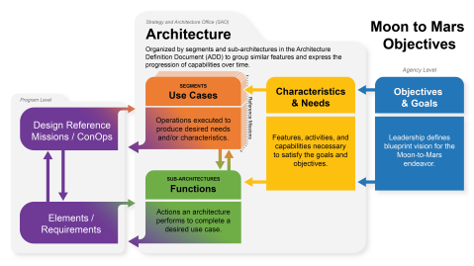
(2021-today) M2M ADD
Intent is to define high level architecture to meet NASA blueprint objectives
Purposely allows flexibility in implementation and is not intended to define specific technologies
ECLSS-CHP maps to a large number of objectives, characteristics & needs, and functions
Highest objective alignments to ECLSS-CHP capability area includes:
TH-04-LM: Develop in-space and surface habitation system(s) for crew to live in deep space for extended durations, enabling future missions to Mars
TH-03-L: Develop system(s) to allow crew to explore, operate, and live on the lunar surface and in lunar orbit with scalability to continuous presence; conducting scientific and industrial utilization as well as Mars analog activities
11

Slide 12
(2021-today) M2M ADD
Over 50 functions map to the ECLSS-CHP capability area with the highest alignment including:
FN-010-L: Provide pressurized, habitable environment in cislunar space for moderate (months+) to extended (year+) durations
FN-025-L: Provide pressurized, habitable environment on the lunar surface for short durations (days to weeks)
FN-026-L: Provide remote crew medical systems on the lunar surface
FN-028-L: Conduct crew lunar surface extravehicular activity
FN-038-L: Provide crew health maintenance capabilities in microgravity environment
FN-228-L: Provide crew health maintenance capabilities in partial gravity environment
FN-271-L: Provide pressurized, habitable environment on the lunar surface for moderate duration (month+) use
Initial Mars specific characteristics and needs are defined and strong ECLSS-CHP alignments include the following (functions are still in development)
CN-018-M: Provide capabilities to conduct mid-duration (month+) crew exploration mission(s) on the Martian surface.
CN-019-M: Provide capabilities that allow crew to live in deep space for Mars duration mission(s)
12

Slide 13
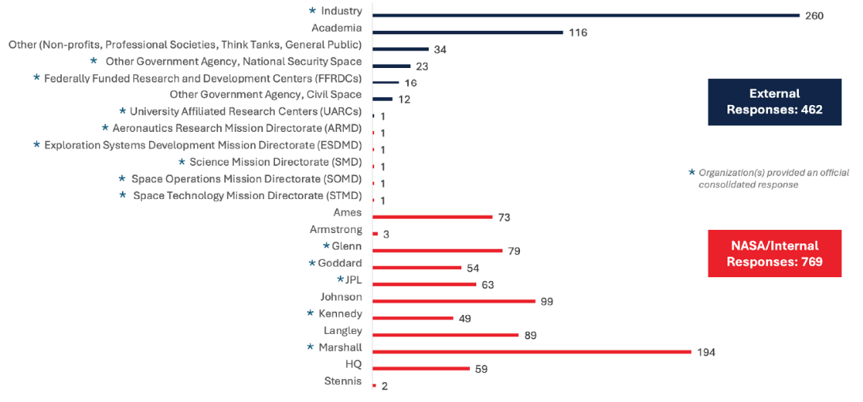
ECLSS-CHP Exploration Technology Needs Review
STMD Shortfall survey was intended to collect wide range of internal and external stakeholder inputs on what ‘problems’ (i.e. shortfalls) need to be solved not what the solutions should be
ECLSS-CHP + EVA Suits are described in STMD nomenclature under Advanced Habitation Systems (AHS)
Incorporated groups of the StarPort gaps into higher level 187 Shortfalls (16 AHS Shortfalls)
Publicly distributed Shortfall quad charts which included many StarPort gap titles but not specific descriptions or metrics
Numerical scoring and text comments received from NASA, academic, commercial, and public
Survey results next six pages
13

Slide 14
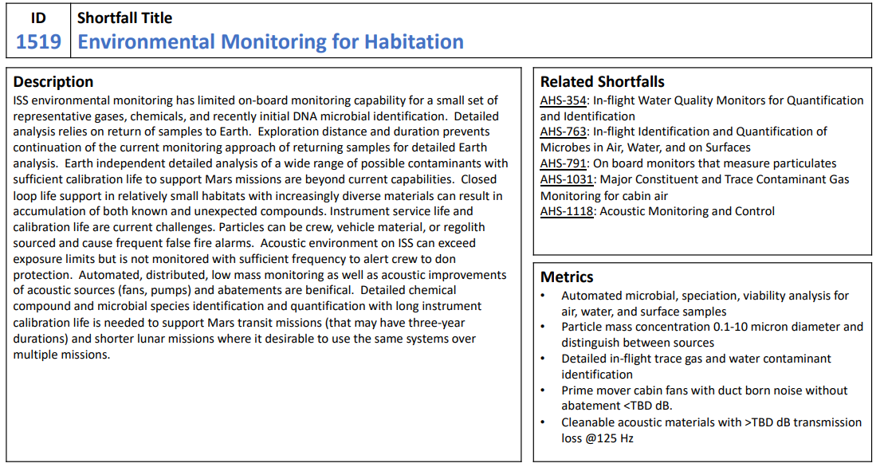
STMD Shortfall - Example
From: Civil Space Shortfalls (nasa.gov)
AHS Shortfall titles largely correlate with ECLSS-CHP SCLT Capability Areas
Related Shortfalls correlate with internal STMD StarPort gaps
Currently only titles are public but in future additional information will be provided
High level examples of the type of parameters used for gap definition and closure progress
Purposely not detailed to allow flexibility for future program and solicitation decisions
General mid-level description of the scope range in the ‘related shortfalls’ defining the problems and challenges not solutions
Purposely not specifying technologies to allow flexibility in solutions
14

Slide 15
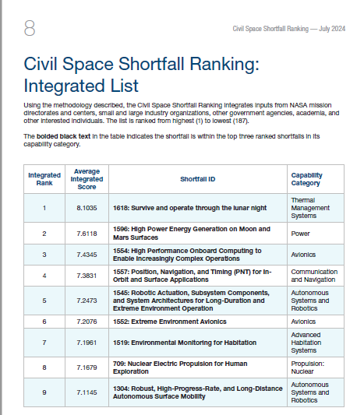
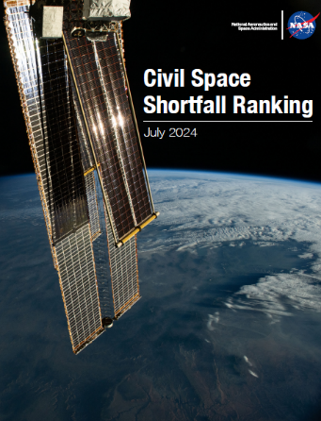
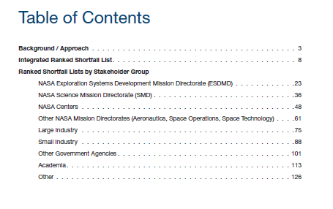
STMD Shortfall Survey Results Summary (1/3)
Published score and rank from each stakeholder group: Civil Space Shortfall Ranking July 2024 (nasa.gov)
15

Slide 16
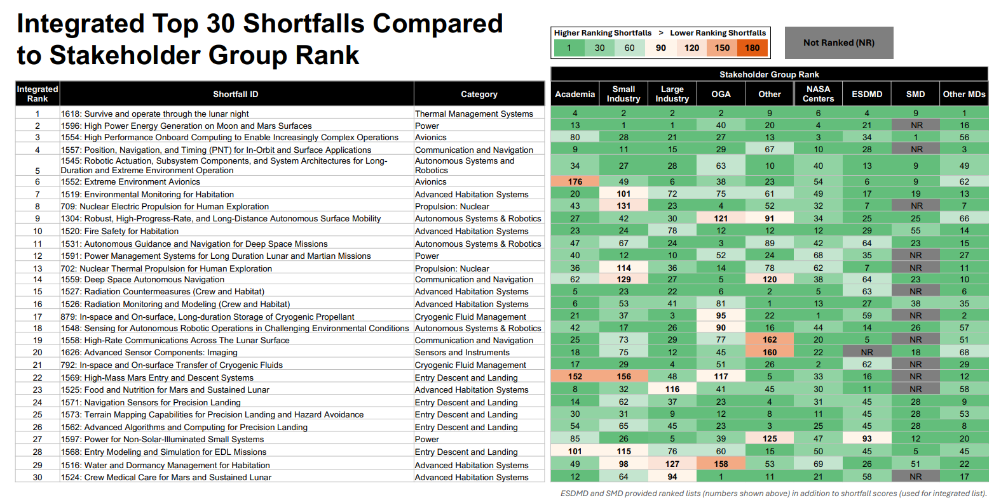
STMD Shortfall Survey Results Summary (2/3)
From 7/26/2024 Webinar: Stakeholder Webinar: Civil Space Shortfall Ranking (nasa.gov)
7 of 16 AHS Shortfalls appear in top 30 shortfalls (15 ECLSS-CHP and 1 EVA-IVA shortfall)
16

Slide 17
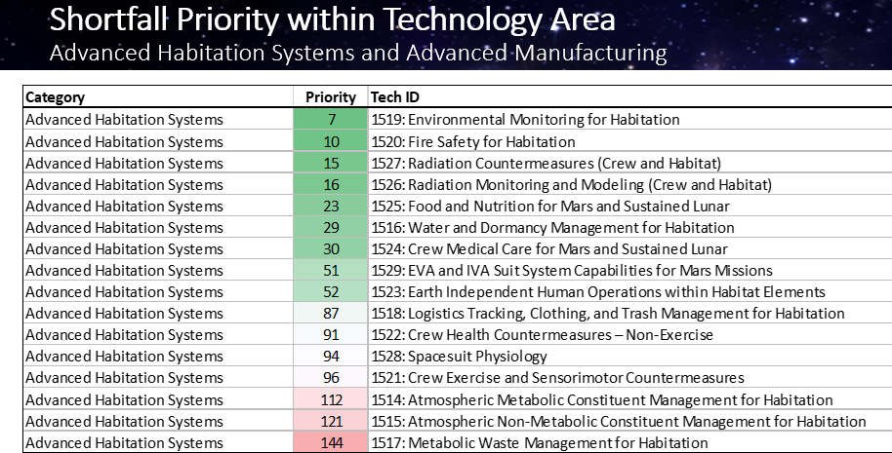
STMD Shortfall Survey Sum. – AHS only (3/3)
1st Quartile
2nd Quartile
3rd Quartile
17

Slide 18
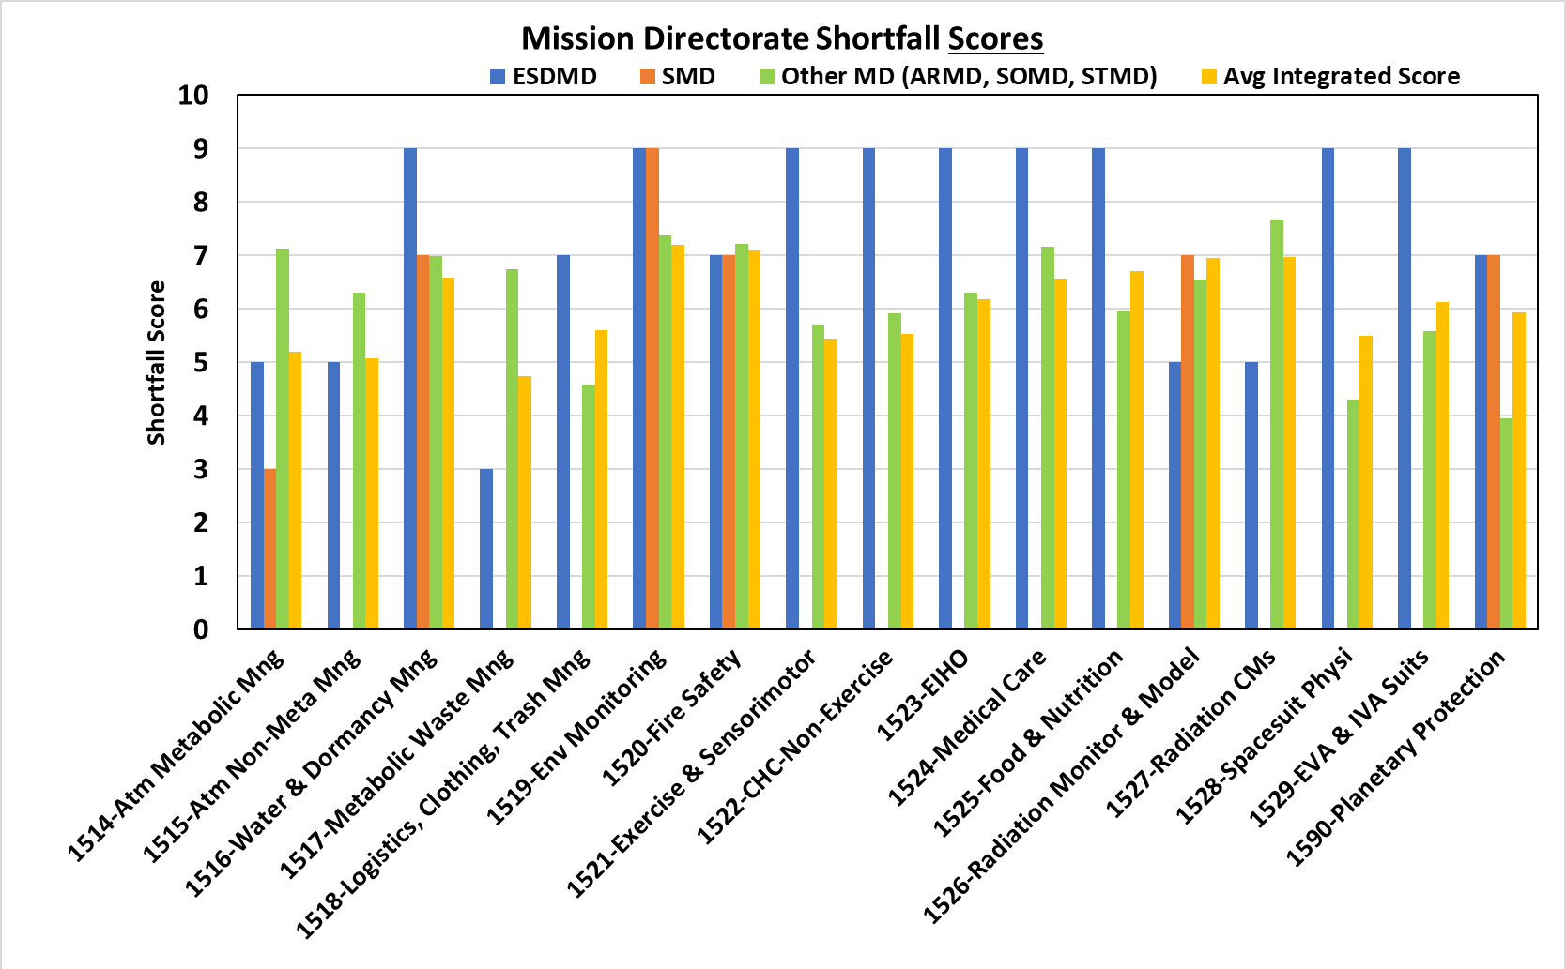
ECLSS-CHP SCLT Analysis of Shortfall Survey- AHS Numerical Results – Scores by MD
REMINDER: SCORE IS ONLY ONE CONSIDERATION IN INVESTMENTS
The same score can be given to multiple shortfalls (1-9)
18

Slide 19
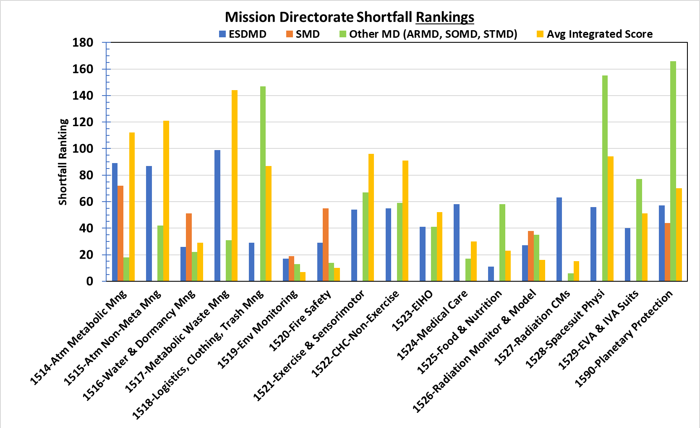
ECLSS-CHP SCLT Analysis of Shortfall Survey- AHS Numerical Results – Ranks by MD
REMINDER: RANK IS ONLY ONE CONSIDERATION IN INVESTMENTS
Rankings provide additional distinction
19

Slide 20
LEO vs Deep Space – Related but Different
Very important to use CLD as demonstration platform and long-term validation of exploration technologies in a relevant environment
Deep space has a few additional drivers, over LEO, for tech development and maturation
Minimize Earth-departure mass (installed, spares, all consumables) to achieve high reliability
Total integrated system mass from departure of cis-lunar to Mars and return to cis-lunar space
Degree of required reliability/crew survivability/self-sufficiency required
Unable to supply unexpected parts or return crew after Earth departure propulsive maneuver
Endurance of 36+ months compared to LEO endurance of 2-6 months
Affordability and partnership contributions to both LEO and deep space are very important and critical but must meet above two parameters of a mission
New technologies are encouraged by must be sufficiently validated with endurance testing in relevant environment and integrated ground tests to reduce spares mass uncertainty and ensure reliability to support crew for full mission duration
Need CLD payload results by ~2035 to influence Mars transit outfitting decisions prior to potential shake down/Mars analog missions
20

Slide 21
Notional ECLSS-CHP CLD Utilization – 1/2 ECLSS-CHP SCLT Perspectives Only (NOT a Program Position)
ECLSS-CHP payloads will adapt to CLD provided resources and capacities, but some general considerations can be drawn from ADD functions, Shortfalls, and previous gap frameworks
To provide crew health maintenance (e.g. exercise), it likely requires larger single volumes, possibly with higher thermal rejection capabilities
To provide for environmental monitoring, dormancy mitigations, crew health/diagnostics, and ECLSS demonstrations, it likely requires a range of ‘locker-sized’ volumes with ‘normal’ power/cooling loads
Fire safety had a high shortfall ranking and it likely requires some unique cooling and venting considerations
Larger single ECLSS volume with higher power and thermal rejection capabilities did not have high shortfall rankings, but it likely does not mean no development or that smaller scale will not be investigated
Metabolic Atmospheric management included CO2 removal, CO2 reduction, and O2 generation
21

Slide 22
Notional ECLSS-CHP CLD Utilization – 2/2 ECLSS-CHP SCLT Perspectives Only (NOT a Program Position)
Considerations for CLD payload development decisions should include
Complexity of integrating with CLD (physically and operationally with CLD baseline vehicle systems) and required CLD resources
Availability of run time on CLD and/or in integrated ground testing to reduce reliability uncertainty
Use of environmental monitors to understand novel CLD vehicles differences from ISS environment to inform higher fidelity ground testing and future exploration vehicle requirements
Example: validate off gassing loads for TCCS, performance of vehicle ECLSS systems on temporal and special CO2 levels from a wide range of crew and tourist activities
CLD payload resource needs will be defined by CLD program based on formal inputs from the NASA mission directorates
22

Slide 23
Backup Charts
23

Slide 24
Exploration ECLSS on ISS - Today
Operational >10 yr
Upgrades planned next 3 yr
Operational >3 yr
New Install next 3 yr
Operational <3 yr
New Install/Upgrade >3 yr
Air String
Water String
Humidity Condensate (H₂O (l))
to WW Bus
Water Processor Assembly
Cabin air
Siloxane + Heavy VOC Removal
CHX
Water Sep
Potable water
Particle Filter
Trace contaminants to cabin
Air out to cabin
Potable Water Dispenser
(Combined HEPA/Charcoal Filter)
Distillate
Low humidity, Low temp
Air
Cabin air
Trace contaminants to cabin
H₂O to crew and science
Light VOC Removal
Urine Processor Assembly
Microbial Monitor
Urine/air
Air out to cabin
CO₂ free air + H₂O (g)
CO2 Removal*
Humidity & trace contaminants to cabin
Brine
ARFTA
Air Particle Monitor
Pre-treated
Urine (PTU)
CO₂
Toilet #1 (UWMS)
Major & Trace Air Monitor
CO₂ to vent
(when needed)
BPA
Urine Transfer System
PTU
CO₂ Accumulator
O₂ to cabin
PTU
Toilet #2 (WHC)
Fire Extinguisher
Humidity
Hi Pressure CO₂
Concentrated brine to trash
Air out to cabin
Emergency Response Equipment
Upgraded OGA
H₂
Sabatier
H₂O (l) to WW Bus
Urine/air
Compressed air
PTU
PTU
H₂
CH₄
CH₄ to vent (when needed)
Methane Reduction
Device
Back-up urine storage
Russian urine
Spacecraft Water Impurity Monitor
EDV
EDV
Total Organic Water Analyzer
H₂ to vent
(when needed)
C₂H₂ + trace gases to vent
Potable water
24

Slide 25
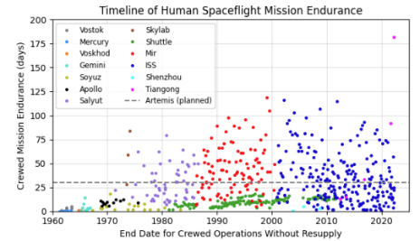
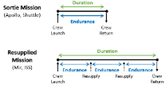
Mission Endurance - Strong Influence on Technology Development
Mars missions require unprecedented endurance
Short mission durations have not occurred since Apollo
ISS Commercial Crew – ~8-36 hours ug
SpaceX & Boeing proprietary
Test Verified Reliablity will be critical
Endurance (crewed time between resupply) will be an order of magnitude greater challenge for crewed Mars missions
Absence of logistics resupply opportunities and an extremely limited abort capability drives the need for an updated logistics strategy to ensure a high level of crew safety
Mars missions: 750-1,200 days without logistics resupply, with potential for dormancy at Mars
Artemis/Gateway: ~30 crewed days without logistics resupply, ~330 days of dormancy between missions
Maximum previous on-orbit experience: up to 119 days without logistics resupply
Dormancy
Each dot represents a time period where a crew remained in space between launch/landing or a new vehicle arrival at stations. Includes missions up to November 19, 2018.
1-Owens, A. C, Cirillo, W. M., Stromgren, C., Cho, J., Lynch, C., Vega, J. M. Integrated Logistics and Supportability Challenges of Sustained Human Lunar Exploration’ 51st International Conference on Environmental Systems, St. Paul, Minnesota, ICES-2022-90, July 10-14, 2022
2-Owens, A. C. Multiobjective Optimization of Crewed Spacecraft Supportability Strategies. Doctoral Thesis. Massachusetts Institute of Technology, Cambridge, MA, 2019.

