Slide 1
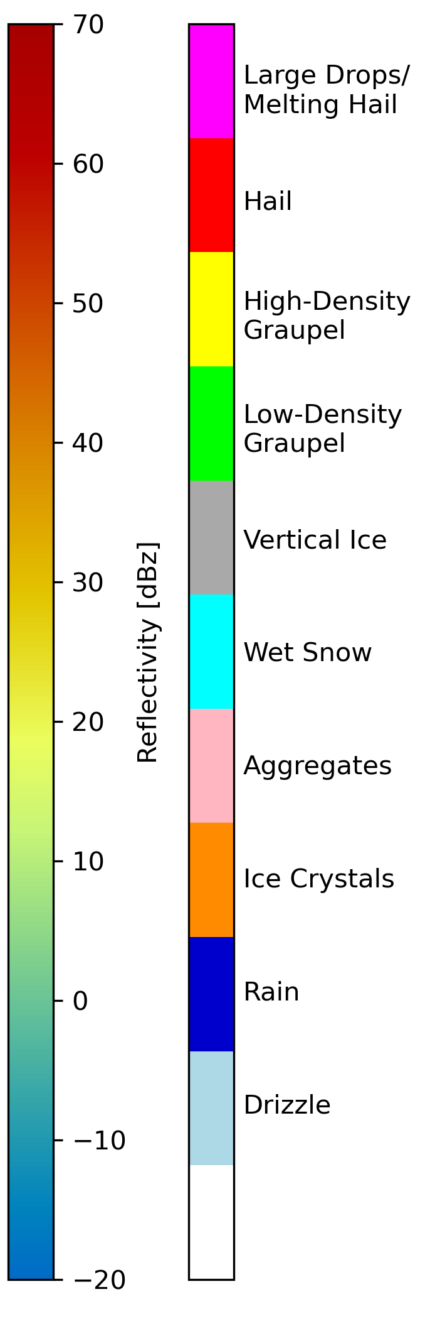
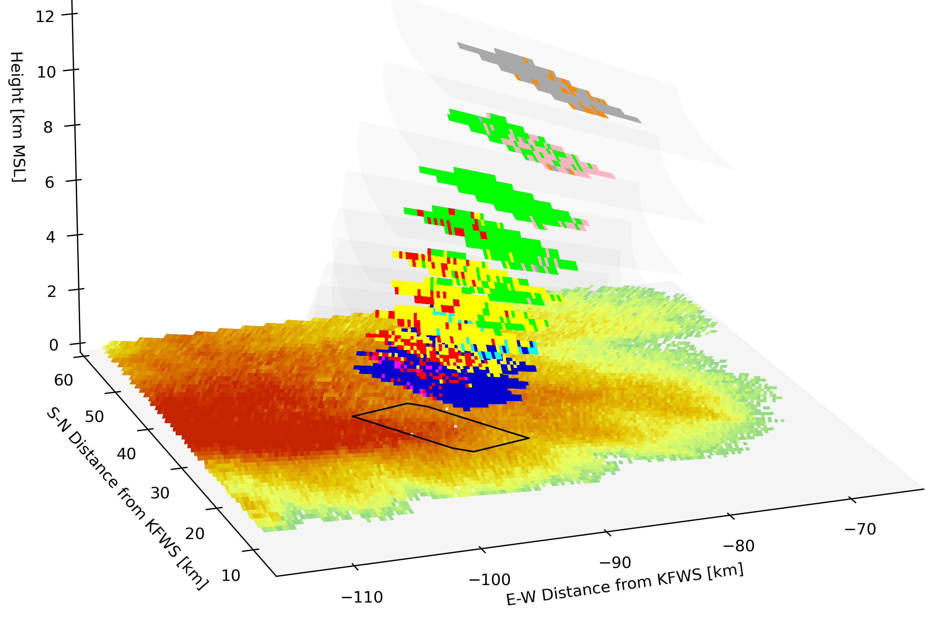
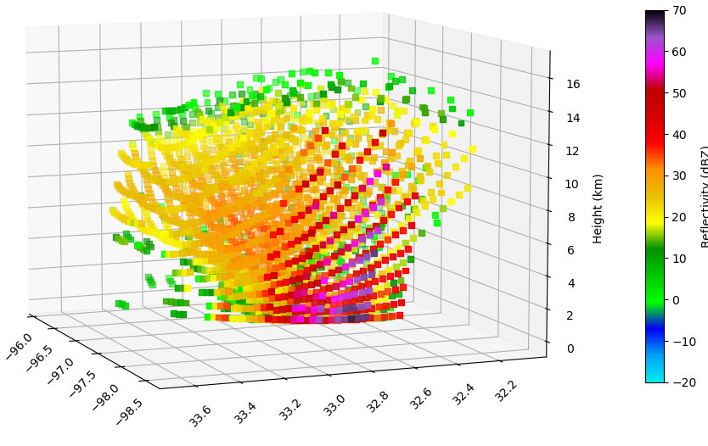
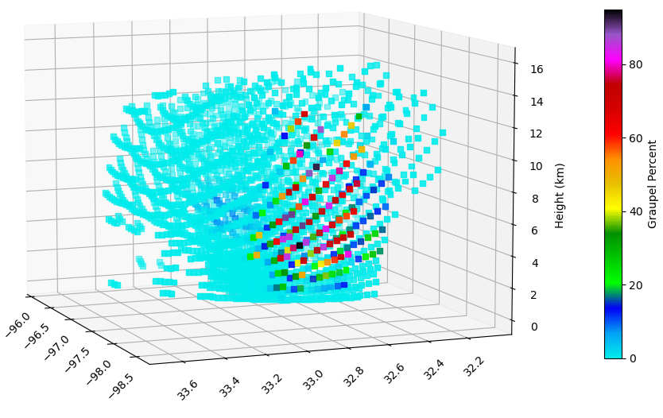
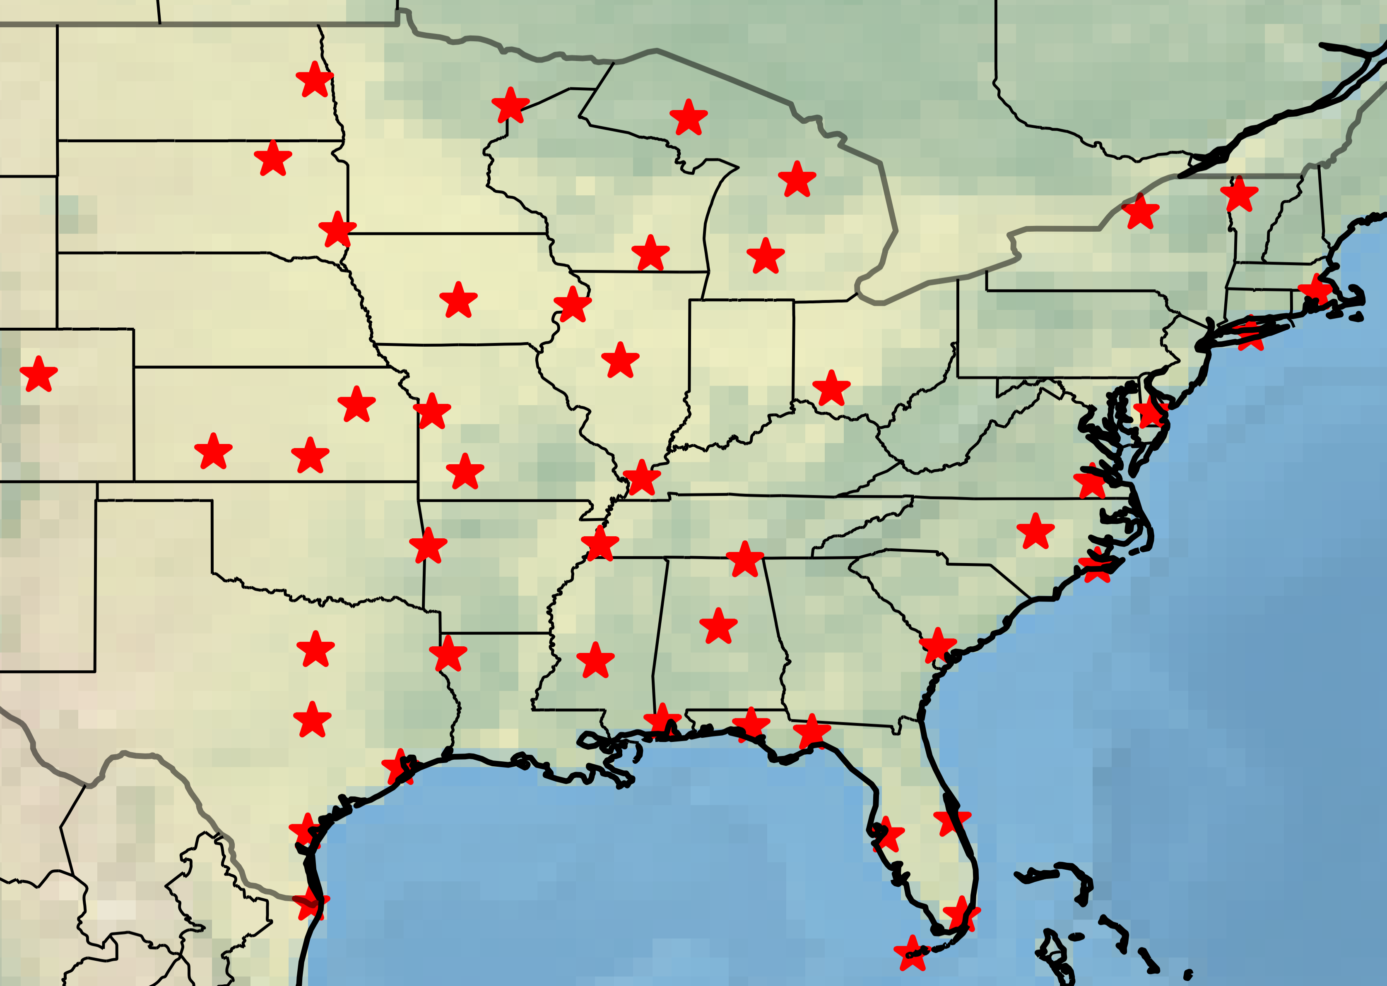
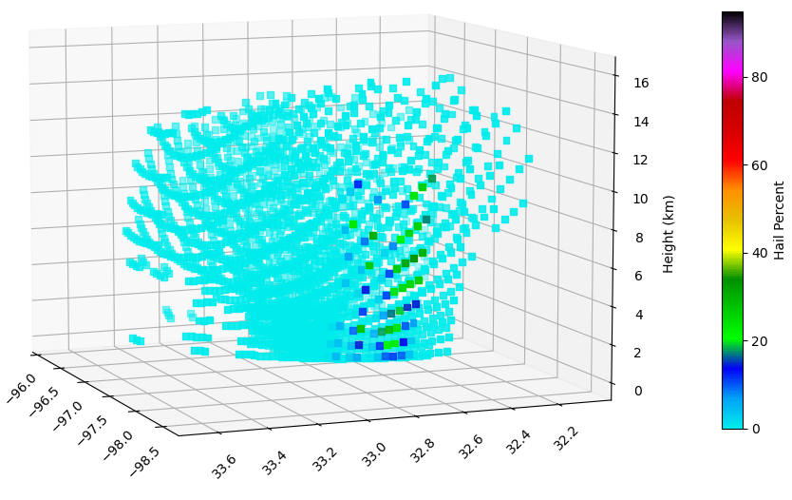
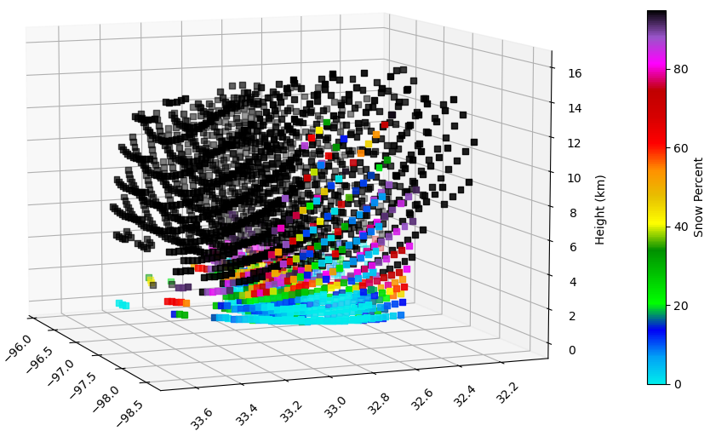
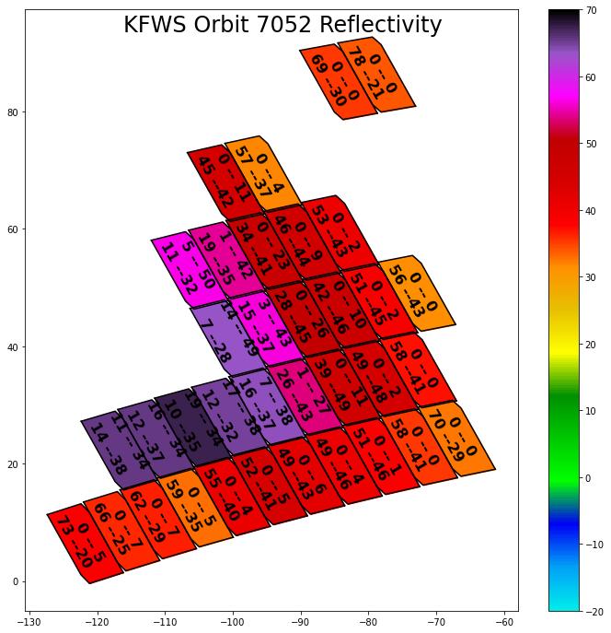

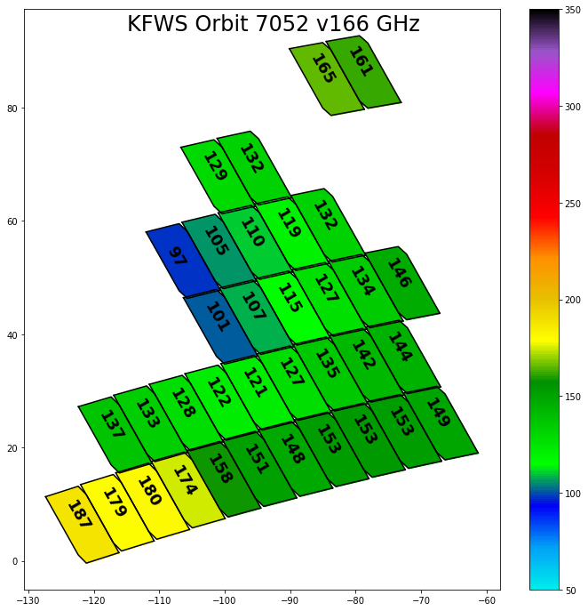
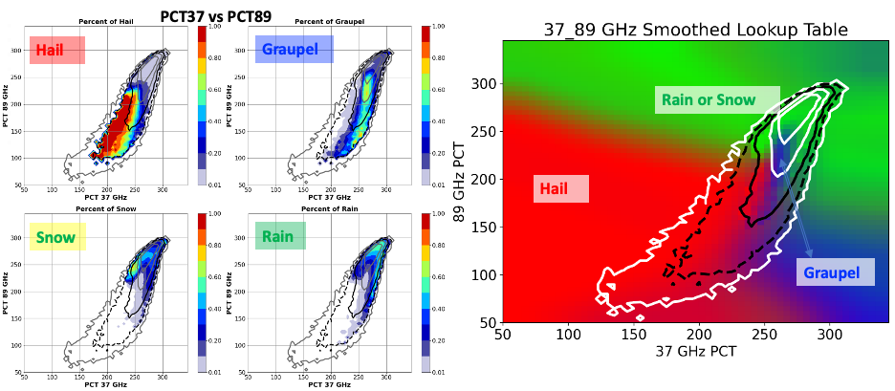
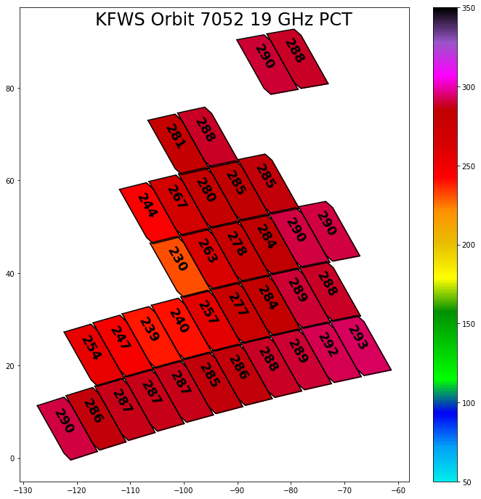
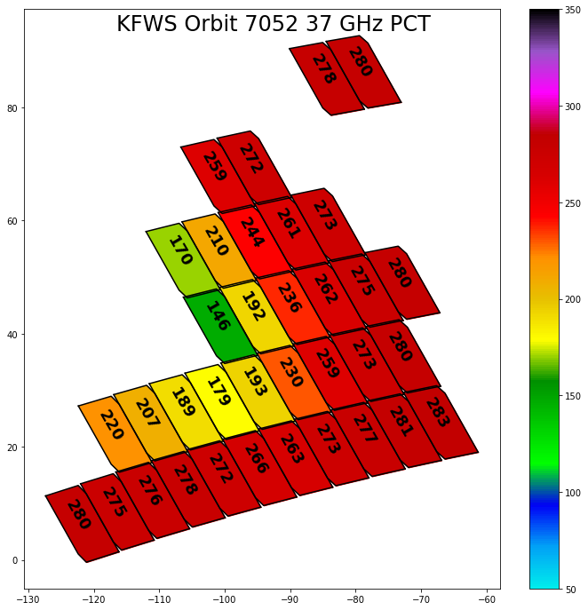
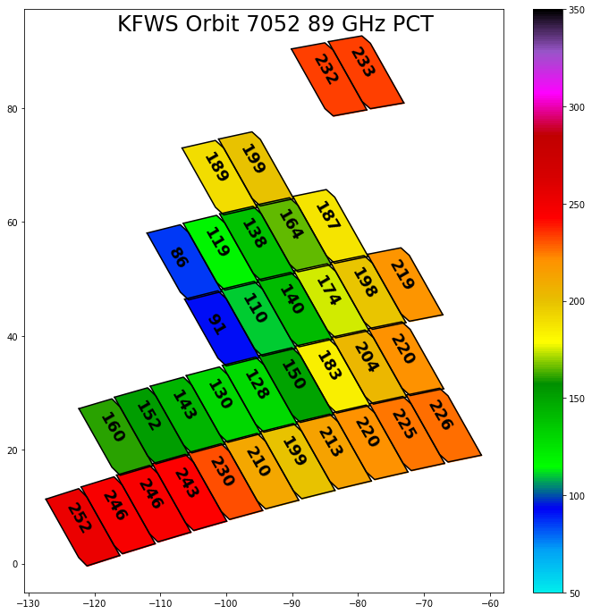
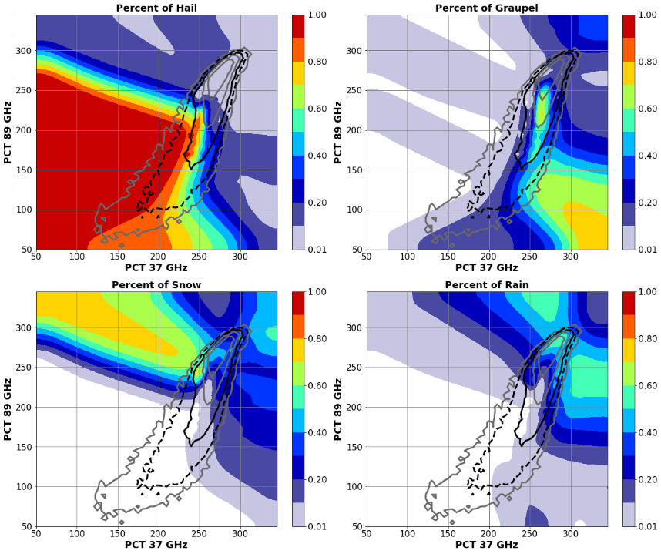
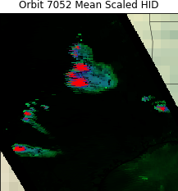
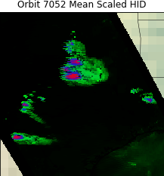
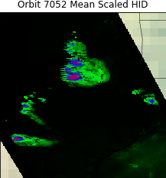
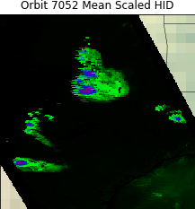
Retrieving Hydrometeor Information from GMI Brightness Temperatures
Daniel J. Cecil, NASA MSFC, Daniel.J.Cecil@nasa.gov
Michael B. Solomon, University of Alabama-Huntsville, mbs0025@uah.edu
Background - details in Cecil et al. 2024 JAMC
https://doi.org/10.1175/JAMC-D-23-0196.1
Newer Directions
Objectives:
Use observational datasets to build empirical relationships between brightness temperatures (TB) and hydrometeor types (hail, graupel, snow, rain)
  GMI TB
  GPM Validation Network Hydrometeor Identifications (HID) (from dual-pol radar, matched to GMI field of view)
Use physical understanding to interpret empirical relationships
Construct lookup-tables of the likelihood of a hydrometeor type being present, based on multi-channel TB
Map the hydrometeor types in individual cases
Accumulate climatological maps of hydrometeor types
Original approach only required at least 1 radar gate anywhere in the matched GMI footprint (projected along the slant path) in order to identify that footprint as representing hail.
A stronger threshold would be appropriate, but even the most robust hail cores have more 3-d coverage by other particle types within a (large) GMI footprint.
Now we are testing thresholds of 1%, 2.5%, and 5% coverage within the 3-d GMI footprint.
Higher thresholds:
tighten up the identification of hail cores, not triggering as easily in strong convection, or along periphery of cores. (That is an improvement over original approach.)
fail to indicate a very high likelihood of hail, rarely indicating even a 50% likelihood of hail for a given set of GMI measurements. (That is a drawback.)
Example radar gates matched to one GMI pixel
Graphic below courtesy Sarah Stough, UAH
Right: 3-d renderings of a supercell near Fort Worth, TX, from GPM Validation Network , KFWS WSR-88D.
Pixels are matchups between GMI slant path and KFWS radar sweeps.
For hail, graupel, and snow HIDs, the colors represent the % of radar gates within the matched volume that have the given HID.
Even above the melting level in the strongest* part of the storm core, less than 40% of the radar gates matched to the GMI footprint are identified as hail. Non-Uniform Beam Filling prevents this percentage from ever getting very high.
* This example is along the edge of the Validation Network’s range. The lowest GMI TBs were slightly further west, not plotted here.
In plot below, the % of radar gates with each HID is calculated along the (quasi-vertical) GMI slant path. The matched GMI-VN volume with the most hail HID signatures only has 19% of its radar gates identified as hail. 34% are graupel, 10% other ice, and 35% liquid rain.
S-band Reflectivity
% of gates with graupel HID
Building the TB-HID Lookup Tables
GPM Validation Network (VN) matches polarimetric radar data to GMI and DPR footprints, accounting for viewing angles. Each GMI footprint has many individual radar gates matched to it, at multiple elevations.
A subset of VN radars were used here from around the USA. We tested subsets by region and season. TB-HID relationships were not sensitive to those distinctions.
Our training and verification is entirely over land (USA)
VN data includes hydrometeor types from CSU algorithm (Dolan et al. 2013).
We use hierarchical categorization from Leppert and Cecil (2015):
If any matched radar gate has HID = Hail, assign the GMI TB to Hail category. If not, then…
If any matched radar gate has HID = Graupel, assign the GMI TB to Graupel category. If not, then…
If any matched radar gate has HID = Aggregates, Dry Snow, Vertically Oriented Ice, or Ice Crystals, assign the GMI TB to Snow category. If not, then…
If any matched radar gate has HID = Rain or Drizzle, assign the GMI TB to Rain category.
% of gates with hail HID
% of gates with snow HID
Building Lookup Tables
GMI channel combinations are paired, and for a given combination of brightness temperatures, the percentage of precipitating profiles identified as hail, graupel, snow, or rain is computed from a 6-year (2015-2020) training database. Testing was done using 2021-2022.
Color fill: Radar reflectivity
Printed digits are % of footprint with:
Hail – Graupel
Snow -- Rain
All footprints plotted here
have at least 1 matched radar gate with hail HID from dual-pol radar
The percentages of profiles with each HID type are smoothed for TB bins with a small sample size (10-100 samples, between the dashed and solid black contours in the 2D-PDFs) and then extrapolated to TB bins with fewer than 10 samples in the training data (outside the dashed contour).
This ensures an HID probability is assigned for any brightness temperature combination in the parameter space.
For plotting purposes, we load the probability of hail to red, probability of graupel to blue, and probability of snow or rain to green in an R-G-B color table (above).
In plots of individual cases, these HID probabilities are further scaled by the GPROF Probability of Precipitation.
Black / dark shades = Low chance of precipitation
Red = Hail present
Purple = Hail or graupel present
Blue = Graupel present (but not hail)
Blue-Green = Mixed chances of graupel, snow, or rain
Green = Snow or rain present (but not graupel or hail)
Weakest threshold – at least 1 radar gate in the matched volume has hail
At least 1% of radar gates in the matched volume have hail
At least 2.5% of radar gates in the matched volume have hail
At least 5% of radar gates in the matched volume have hail
Lookup tables of the probability of each HID type are made for 6 different channel combinations.
Only PCT37 vs PCT89 is shown here as an example.
We average the predicted probability of HID type from all 6 lookup tables, for application to GMI observations.
Lookup tables, interpretation, and verification published in Cecil et al. 2024 JAMC
https://doi.org/10.1175/JAMC-D-23-0196.1
Stricter thresholds in our training process tighten the focus onto the strongest cores for potentially having hail (red shades), but lower the probability of any particular pixel having hail instead of just graupel. Purple shades are mixed likelihoods of hail and graupel.
Since the training database uses polarimetric radar identification of hail aloft that may melt before reaching the surface, the stricter thresholds may be more appropriate / understandable for many users.

