Slide 1
Random Micron Surface Roughness Effects on Swept Wing Boundary Layer Transition
Jenna Eppink
NASA Langley Research Center

Slide 2
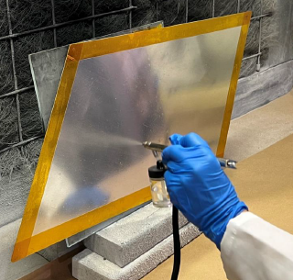
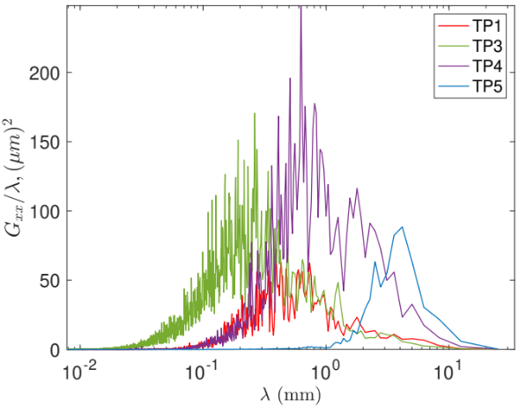
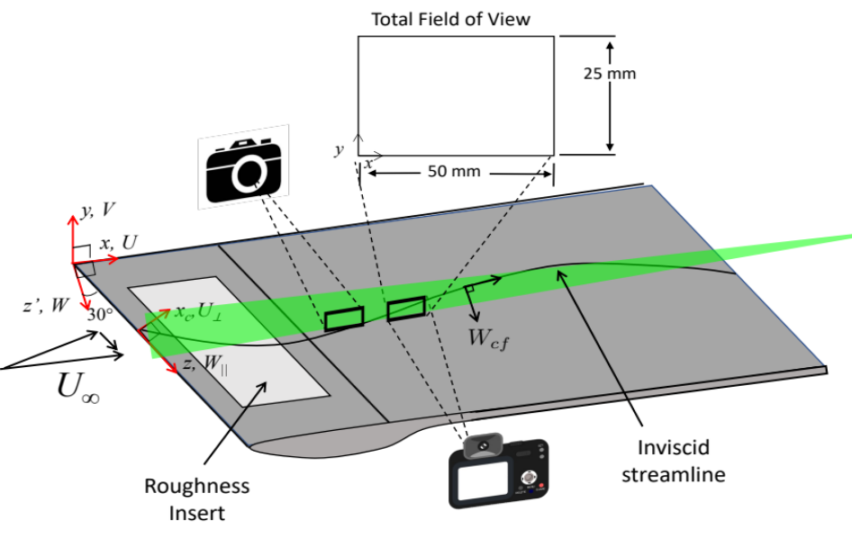

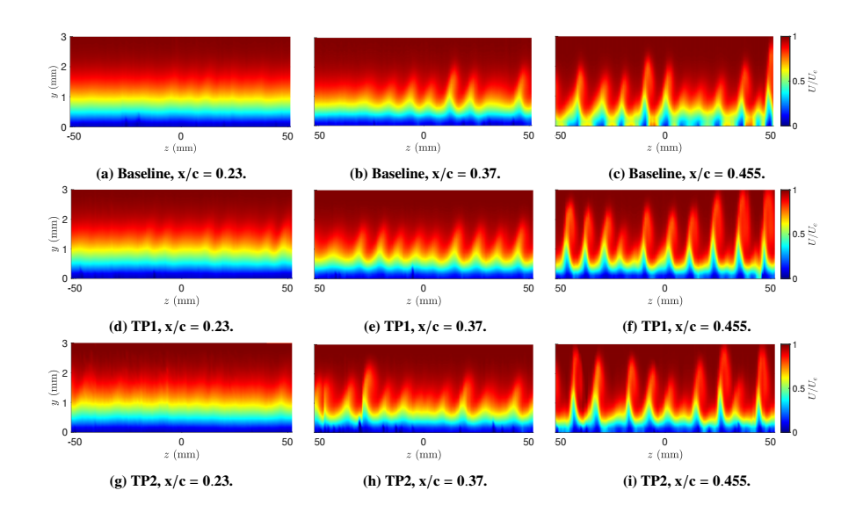
Experiment Setup
Roughness panels of varying nano-particle formulations were fabricated and measured.
Panel | RMS (μm) | Peak-to-peak (μm) | Correlation length (μm)
Baseline | 0.42 | 1.79 | 822
TP1 | 8.64 | 39.36 | 172
TP2 | 4.78 | 20.68 | 384
TP3 | 13.93 | 66.21 | 92
TP4 | 16.92 | 65.85 | 317
TP5 | 8.78 | 20.84 | 876
Wavelength Pre-multiplied Spectra
Testing was performed in the 2’x3’ Low Speed Tunnel.
PIV measurements were performed to capture the stationary crossflow amplitudes.
A three-axis traverse system was used to build up spanwise planes at various streamwise positions.

Slide 3
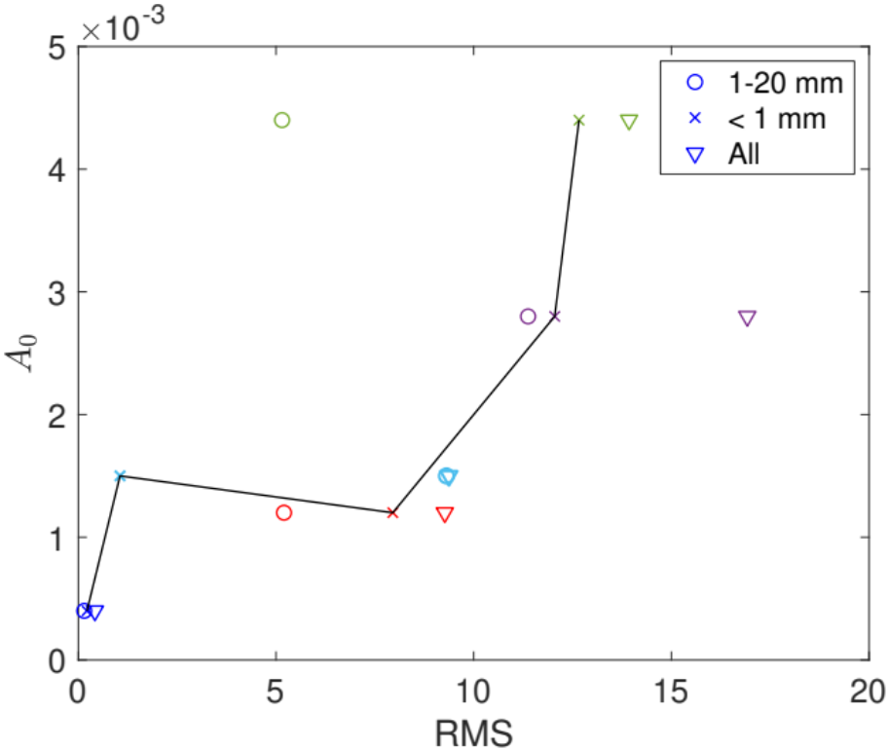
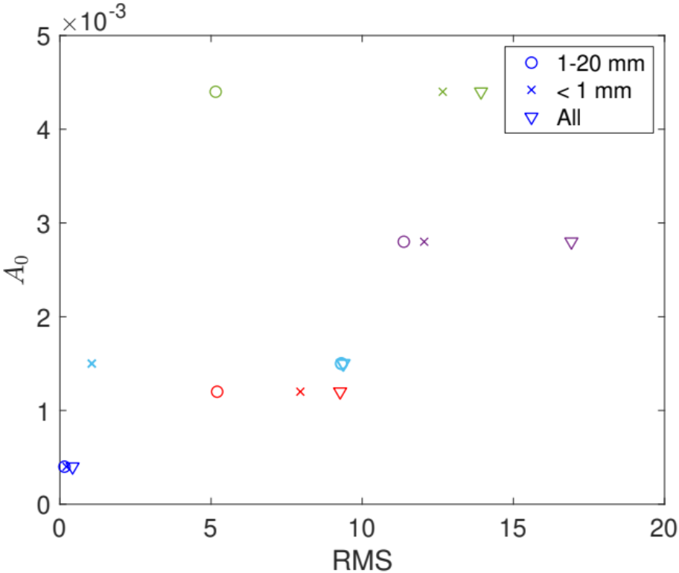
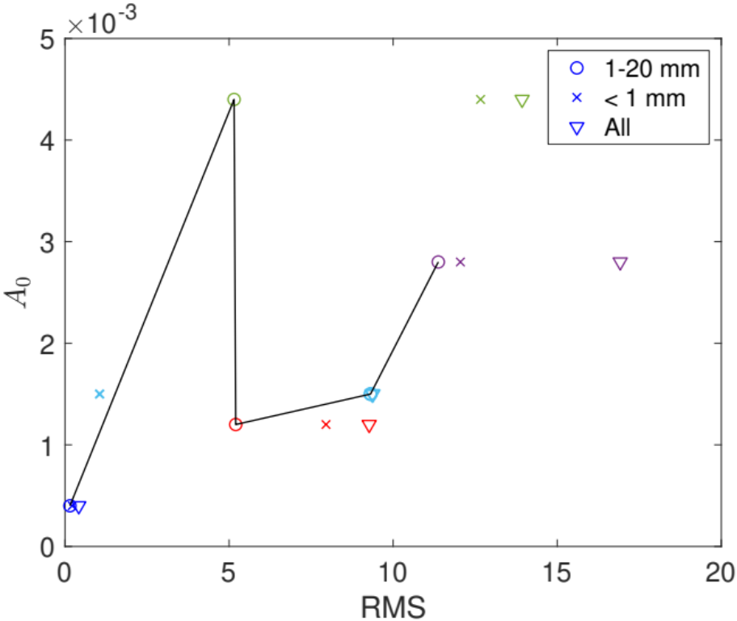
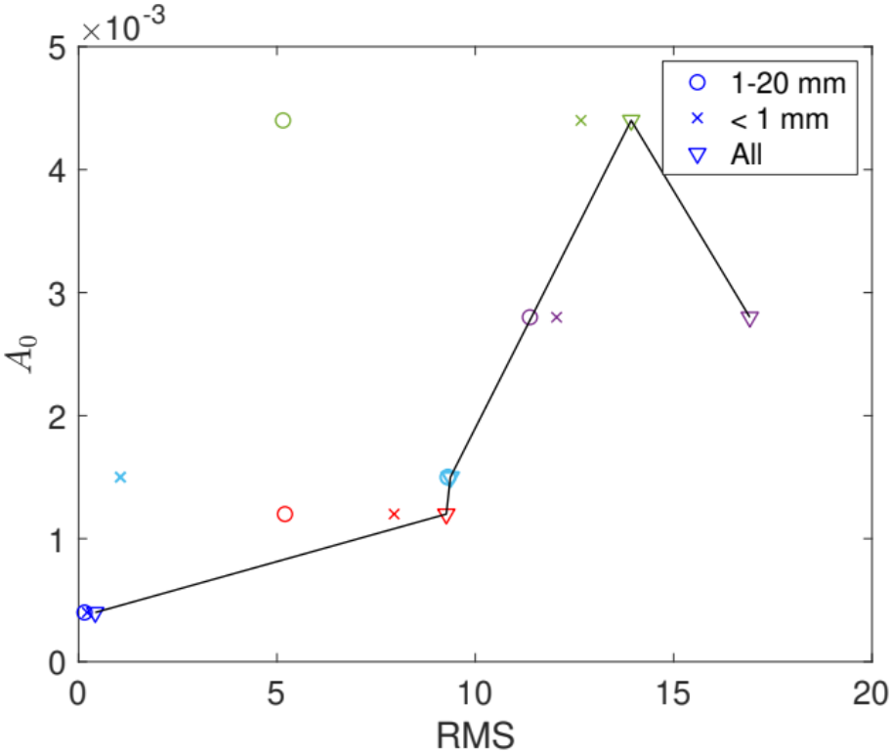
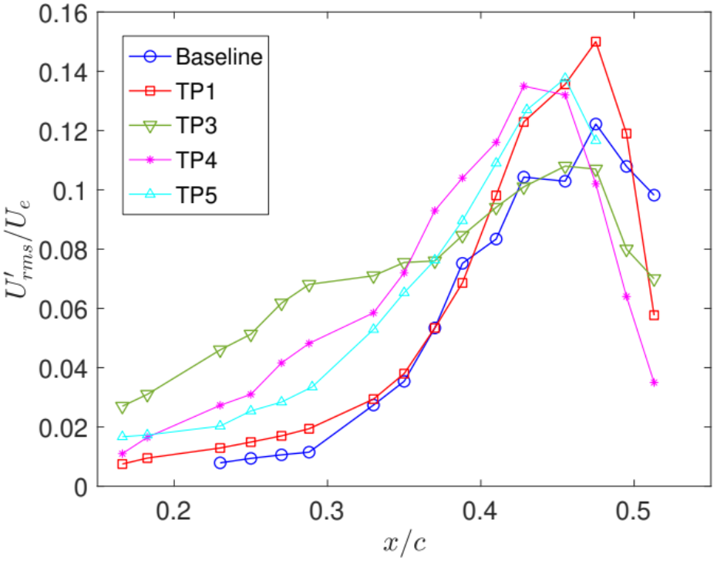
Results
The results do not indicate a clear correlation between roughness RMS and stationary crossflow initial amplitudes.
No obvious correlation was observed between wavelength content and stationary crossflow mode wavenumber distributions.
More advanced roughness characterization is needed.
Roughness RMS vs. Estimated Initial Amplitude (λ=8 mm)
Stationary Crossflow Amplitudes
TP3
TP4
TP5
TP1
Baseline

