Slide 1

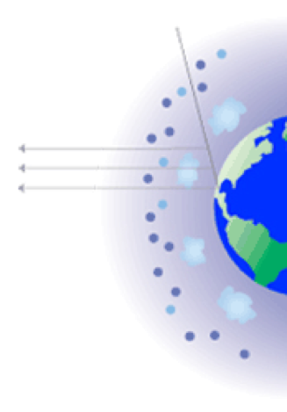
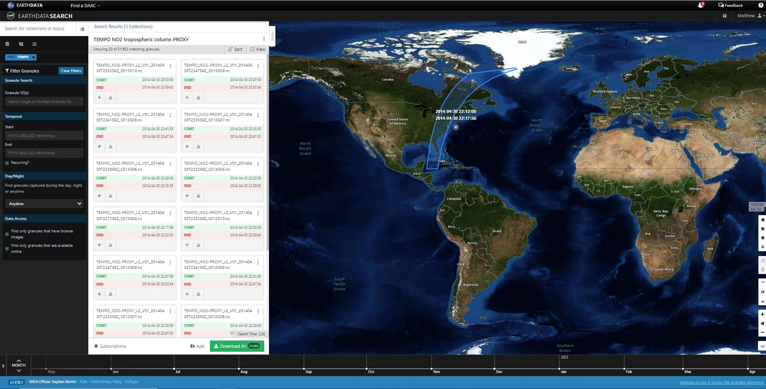
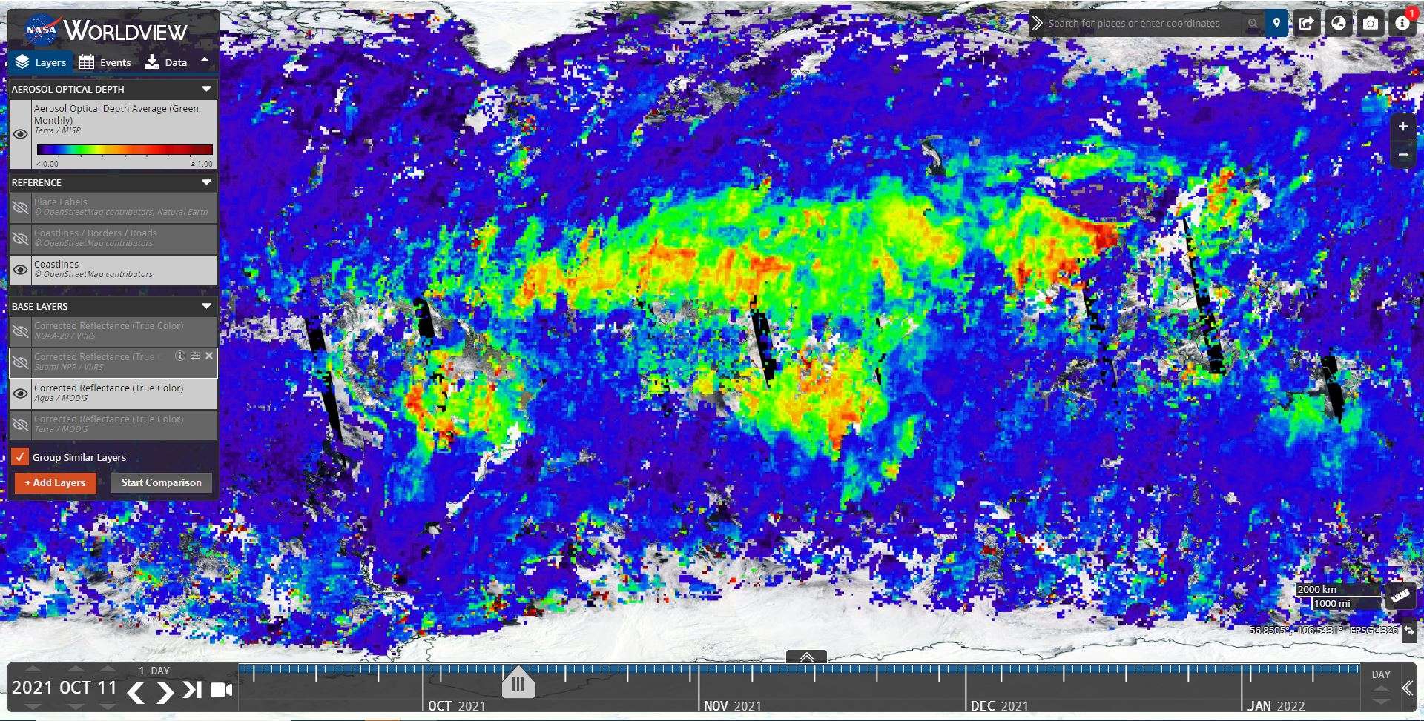
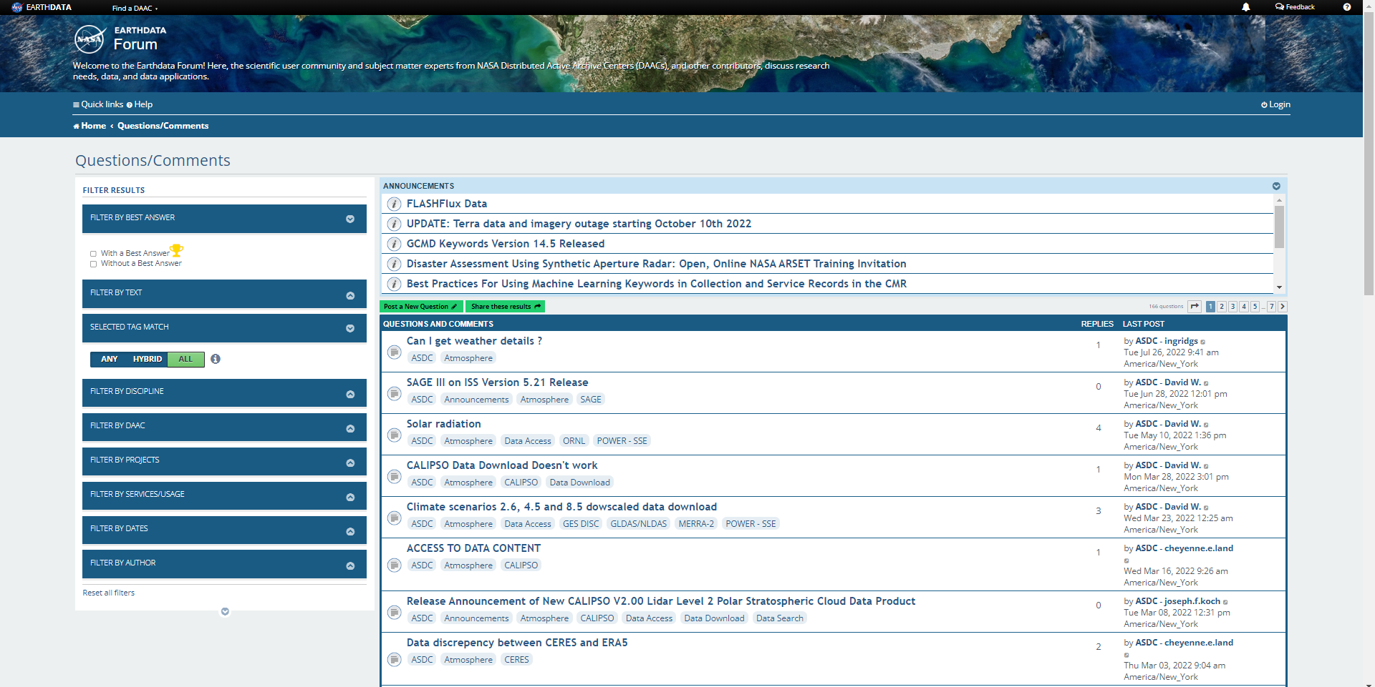
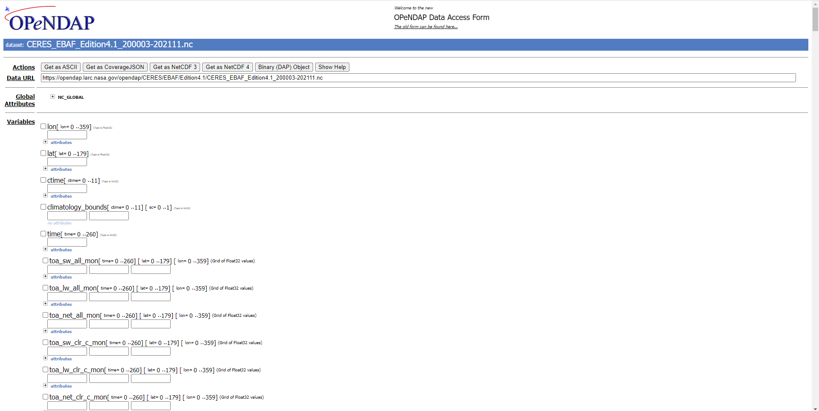
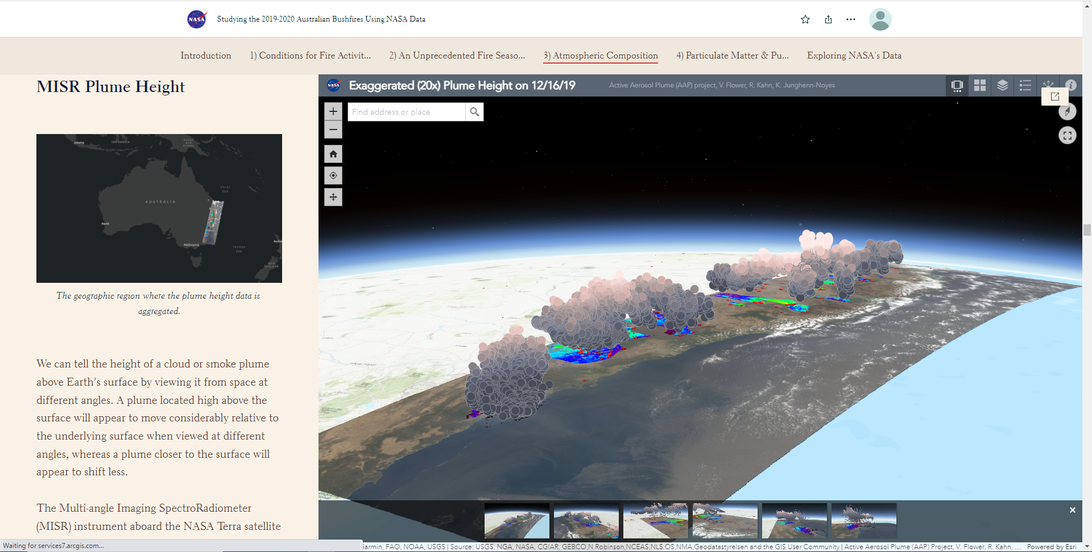
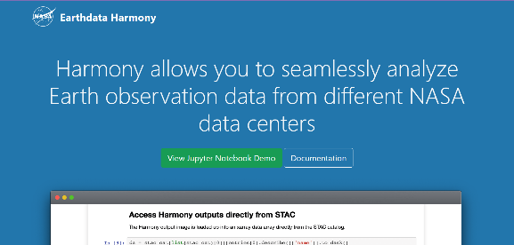
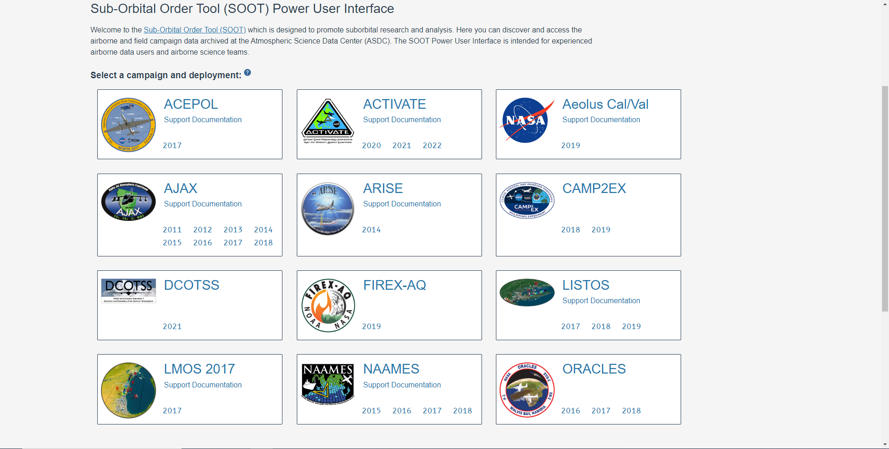
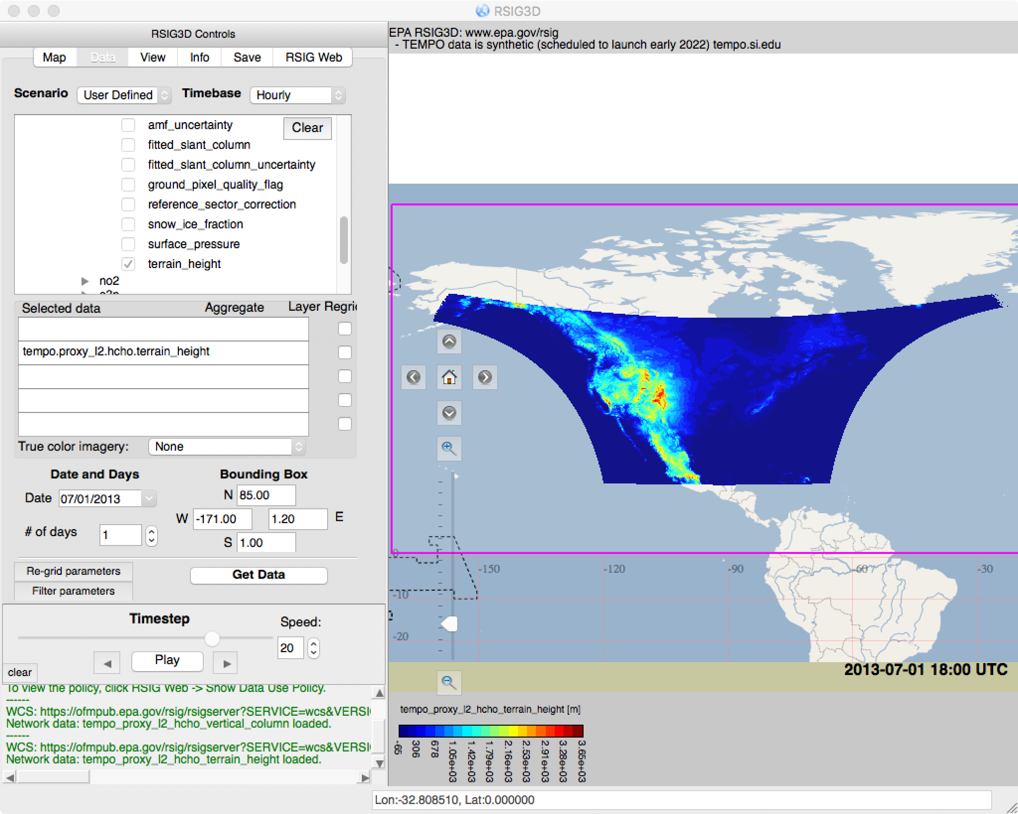
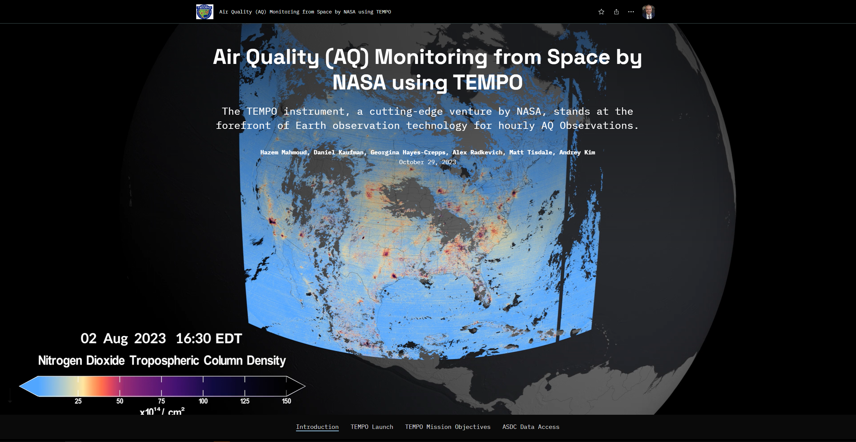
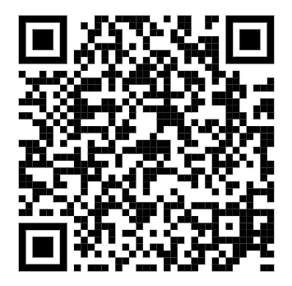
National Aeronautics and Space Administration
TEMPO Data Distribution at ASDC
Matt Tisdale¹, Hazem Mahmoud², Walt Baskin²,Georgina Hayes-Crepps³, Daniel Kaufman⁴
NASA Langley Research Center, Hampton, VA, (2) ADNET-SYS Hampton, VA (3) Analytical Mechanics Associates, Hampton, VA (4) Booz
Allen Hamilton, Norfolk, VA
ATMOSPHERIC
SCIENCE
DATA
CENTER
ASDC Overview
The Atmospheric Science Data Center (ASDC) is in the Science Directorate located at the NASA Langley Research Center (LaRC), in Hampton, Virginia. The Science Directorate's Climate Science Branch, Atmospheric Composition Branch, and Chemistry and Dynamics Branch work with ASDC to study changes in the Earth and its atmosphere. Data products translate those findings into meaningful knowledge that inspires action by scientists, educators, decision makers, and the public. The ASDC supports over 60 projects and provides access to more than 1,000 archived collections. These datasets were created from satellite measurements, field experiments, and modeled data products. The ASDC projects focus on the Earth science disciplines Radiation Budget, Clouds, Aerosols, and Tropospheric Composition.
NASA Earthdata Search
NASA Worldview
NASA Earthdata Forum
OPeNDAP
Earthdata Search is a tool for discovering Earth science data in NASA's Earth Observing System Data and Information System (EOSDIS) collections, as well as from other U.S and international agencies across the Earth science disciplines. Users (including those without specific knowledge of the data) can search for and read about data collections, search for data files by date and spatial area, preview browse images, and download or submit requests for data files.
The NASA Worldview data visualization application enables users to interactively browse more than 1,000 global, full-resolution satellite imagery layers and then download the underlying data. Many of the available imagery layers are updated within three hours of observation, which supports time-critical application areas such as wildfire management, air quality measurements, and flood monitoring.
The Earthdata Forum provides the scientific user community, subject matter experts from NASA Distributed Active Archive Centers (DAACs), and other contributors a place to discuss research needs, data, and data applications..
OPeNDAP provides users access to data using an OPeNDAP URL of any database server that supports OPeNDAP. This can be done via command-line, Internet browser, or software tools (e.g.. Matlab, R, IDL, IDV, and Panoply).
https://search.earthdata.nasa.gov
https://worldview.earthdata.nasa.gov
https://forum.earthdata.nasa.gov
https://opendap.earthdata.nasa.gov/
TEMPO Storymap
EPA Remote Sensing Information Gateway (RSIG)
NASA Earth GIS (EGIS)
Subsetting and Aggregation using Harmony Services
SOOT
Tropospheric Emissions: Monitoring of Pollution (TEMPO) :
Will be the first space-based instrument to monitor major air pollutants across the North American continent every daylight hour at high spatial resolution.
The Sub-Orbital Order Tool (SOOT) supports the discovery and access of airborne and field campaign data archived at ASDC. The SOOT Power User Interface is intended for experienced airborne data users and airborne science teams. A general user interface is currently being developed to support a broader audience in accessing these data.
NASA Earth GIS Online provides access to geospatial web services, spatial analysis,, maps, applications, and story maps using ASDC data products..
The ASDC Search and Subsetting web applications enable a more sophisticated approach to selecting and ordering project data from CALIPSO, CERES, MOPITT, and TES by date, time, and geolocation.
The Remote Sensing Information Gateway (RSIG) allows for 2D/3D visualization and quick and easy access to subsets of multi-terabyte environmental datasets. These include satellite, modeled, and in-situ sensor data.
https://asdc.larc.nasa.gov
https://www.epa.gov/hesc/remote-sensing-information-gateway
https://gis.earthdata.nasa.gov/portal/
https://subset.larc.nasa.gov
https://asdc.larc.nasa.gov/soot/power-user
Notes:
References:
NASA/GSFC/LaRC/JPL, MISR Team.

