Slide 1
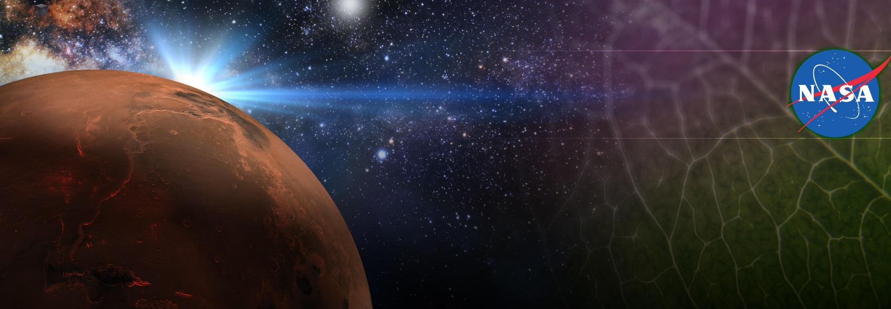
Space Crop Production Gaps and Challenges
Gioia Massa, Raymond Wheeler, Matthew Mickens, Trent Smith Exploration Research & Technology Programs
NASA, Kennedy Space Center
F1. ISLSWG WORKSHOP: PLANT BIOLOGY
Theme 2: Plants for Life Support Systems (ECLSS) in Space
28th European Low Gravity Research Association symposium

Slide 2
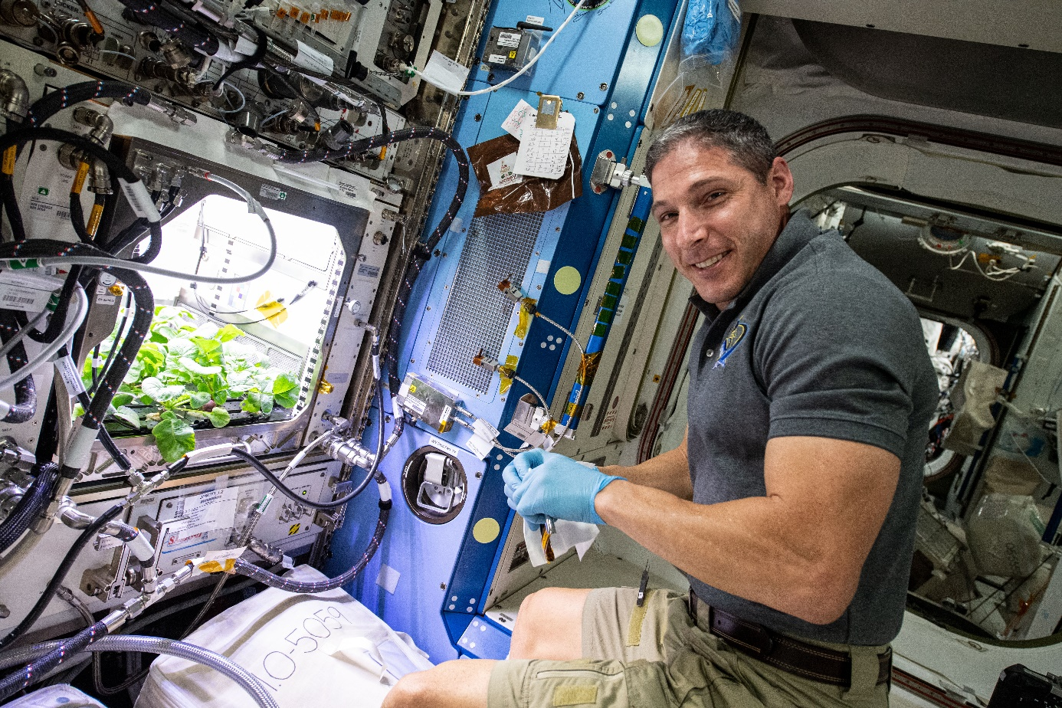
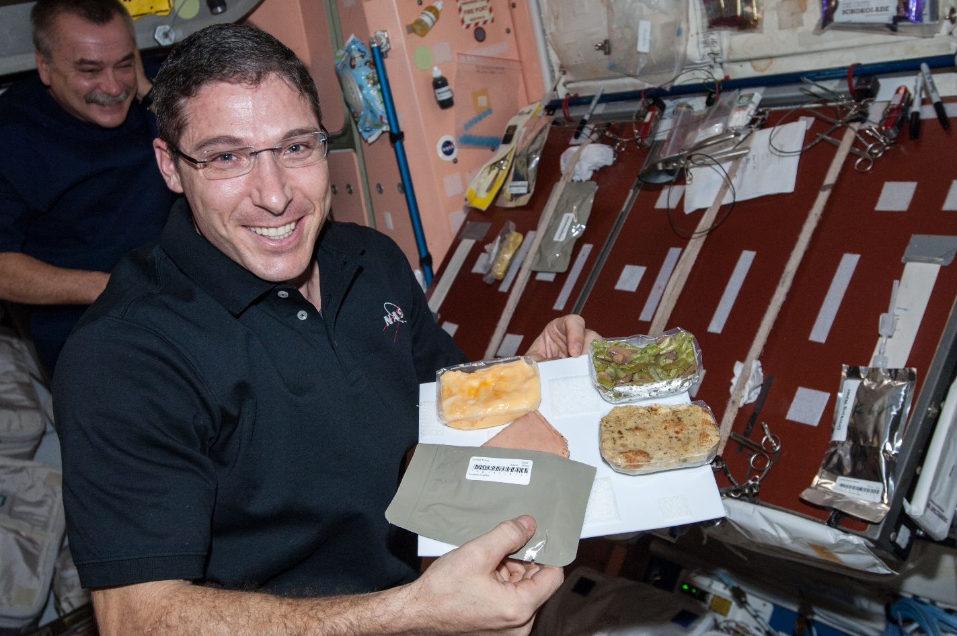
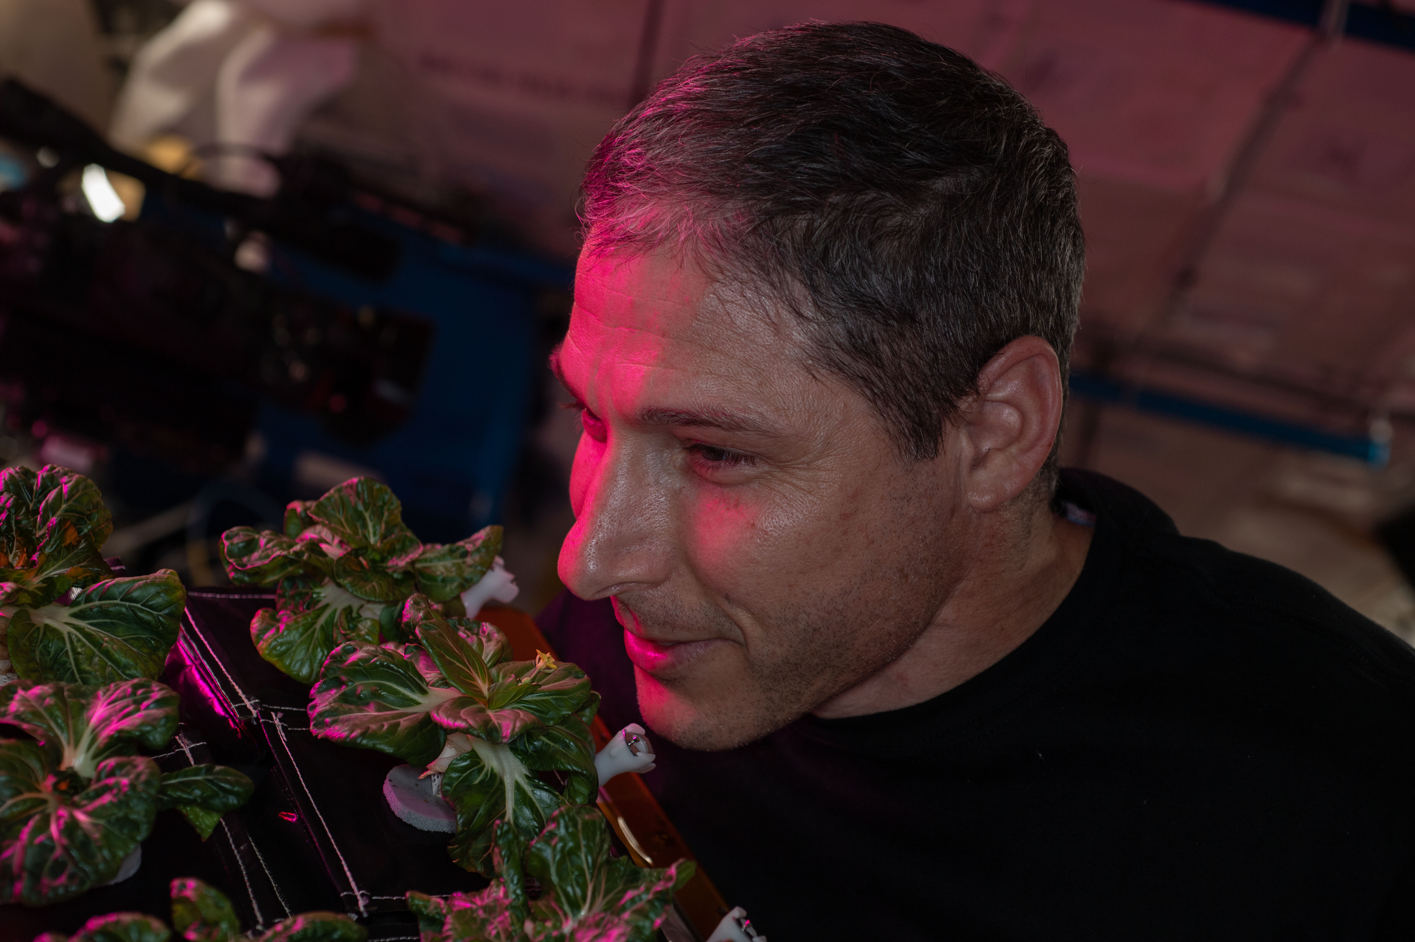
Why grow plants in space?
Food
Psychological well being
ECLSS

Slide 3
NASA’s Space Crop Production Vision
Ensure Food System Security on Long Duration Missions Beyond LEO
Near-Term Goal
Nutrient Supplementation of Prepackaged Food
Near term missions will rely on Physico-Chemical Regenerative ECLSS and Stowed Food with Supplemental Fresh Food
Long-Term Goal
Caloric Replacement to Facilitate Earth Independence
For future, longer duration habitation on the Moon or Mars, Bioregenerative Life Support including Plants can be expanded to increase Mission Autonomy and Earth Independence
Notes:
Ralph
Ensure Food System Security on Long Duration Missions Beyond Low Earth Orbit (LEO)
Food and nutrition are the first line of defense for crew health and performance
Provide safe, nutritious and acceptable fresh food
Add variety to crew diet
Enhance morale
* Food security is the condition in which crew have continuous access to sufficient safe and nutritious food which meets both their dietary needs and food preferences in order to maintain peak health and performance.
Nutrient Supplementation of the Prepackaged Food System - Needed for: Deep Space Transport
Fresh produce supplements vitamins (B₁, K, C) and bioactive compounds that degrade in the stored food system on multi-year exploration missions
“Pick-and-Eat” crops that require no processing and minimal preparation will provide variety, customization, and psychological appeal
Enable testing and demonstration of dependable crop production before reliance on system.
Limiting factors are vehicle resources mass, power, volume, water, air, crew time
Near Term Missions for NASA to Mars Will Rely on Physico-Chemical Regenerative ECLSS and Stowed with Supplemental Fresh Food
Caloric Replacement to Facilitate Earth Independence - Needed for: Long duration Surface missions on the Moon and Mars
Reduce up-mass associated with pre-packaged food
In addition to “pick and eat” crops, include staple crops that require processing and preparation
Bioregenerative capability will be required for long duration surface missions
For future, longer duration habitation on Mars or the Moon, Bioregenerative Life Support Including Plants can be Expanded to Increase Mission Autonomy and Earth Independence

Slide 4
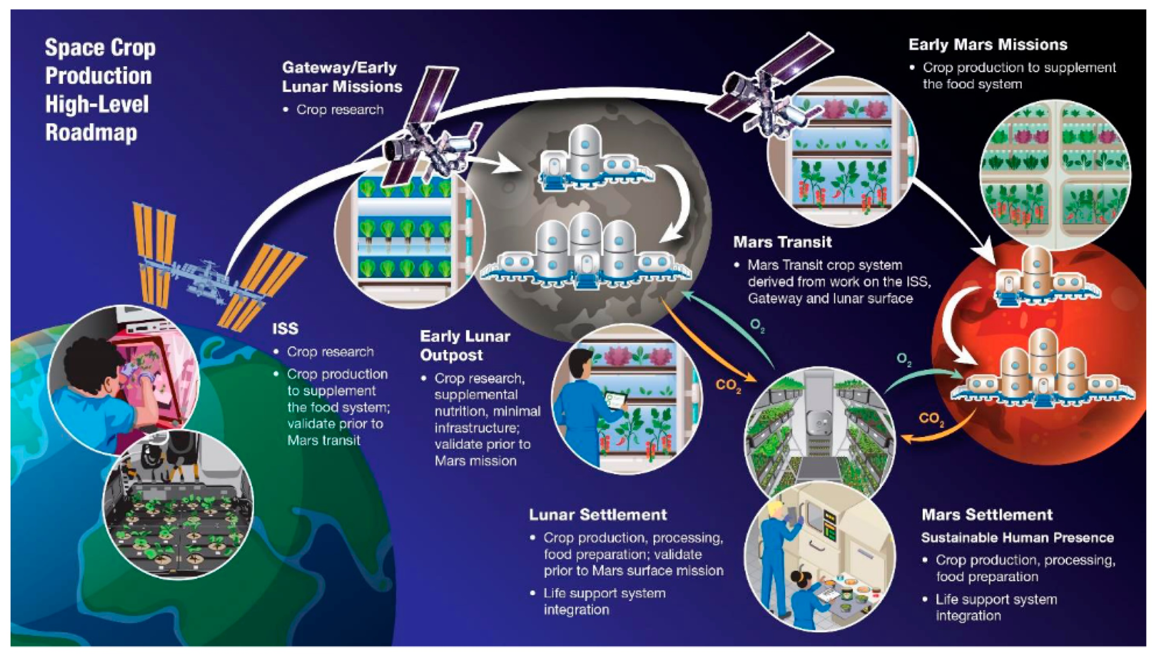
Douglas et al., 2021, Sustaining Astronauts: Resource Limitations, Technology Needs, and Parallels between Spaceflight Food Systems and those on Earth, Sustainability
Notes:
Figure
https://www.mdpi.com/sustainability/sustainability-13-09424/article_deploy/html/images/sustainability-13-09424-g001.png

Slide 5
Space Crop Production Challenges
LEO/Deep Space
Water
Recycling
Radiation
Pressure
Micrometeorites
Surface
Microgravity
Fluid movement
No convection
Dust & Regolith
Partial gravity
Plant Size
High CO₂
Food Safety & Microbiome
Nutrient output
Sustainability
Abiotic stresses
Vehicle resources
Crew time
Waste
Productivity
Stress tolerance
Environmental optimization
Crop scheduling
Crop

Slide 6
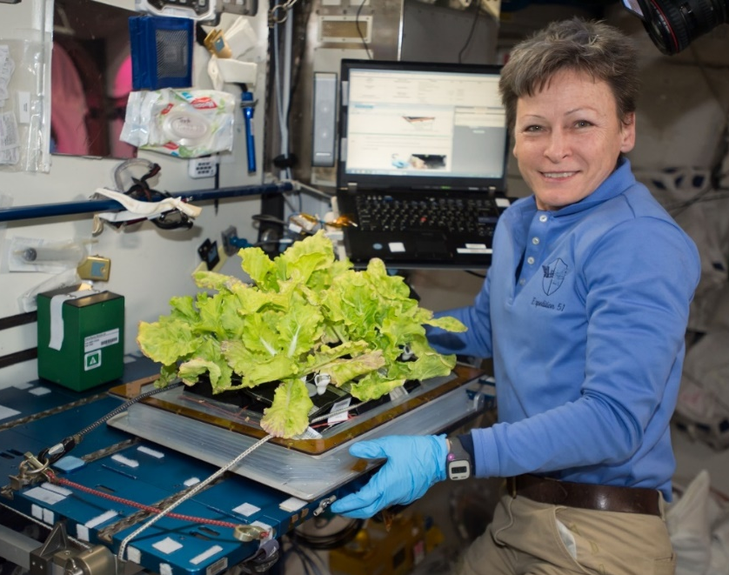
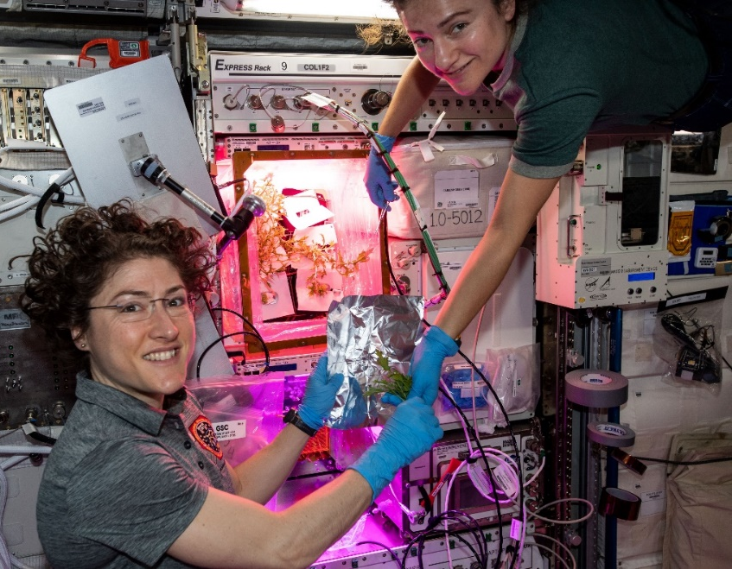
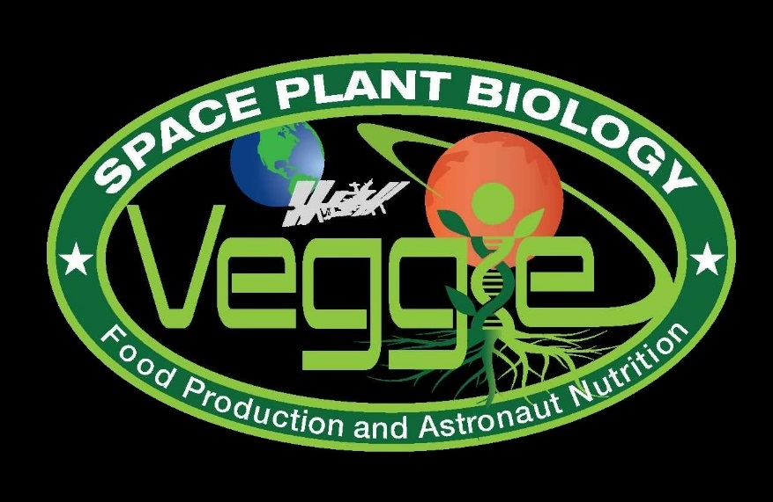
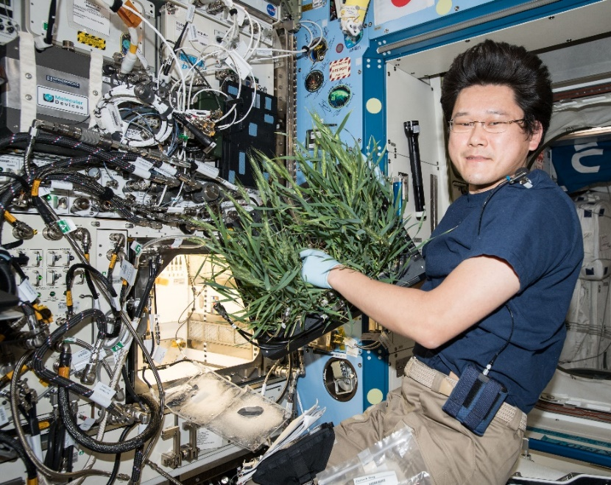
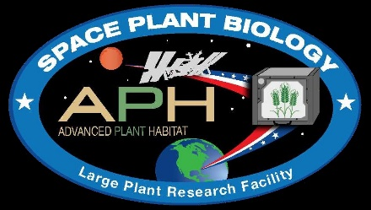
Current NASA Large Plant Research Capabilities On ISS
Notes:
Veggie and the Advanced Plant Habitat

Slide 7
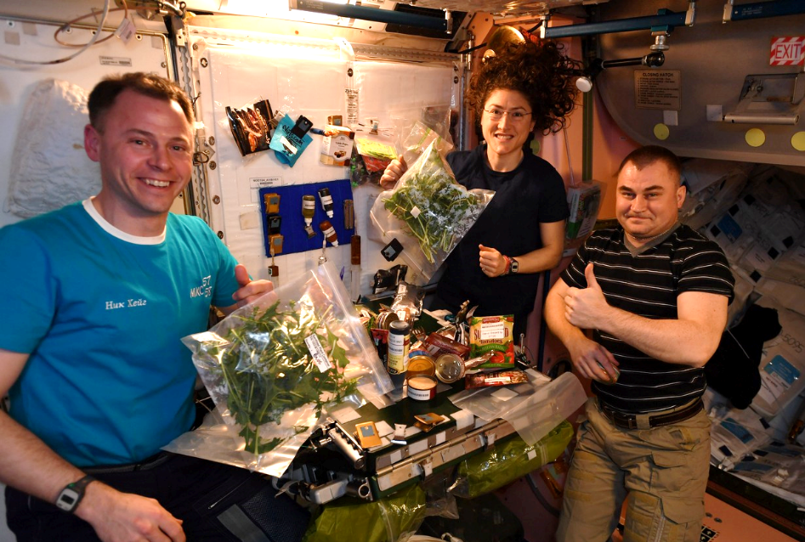
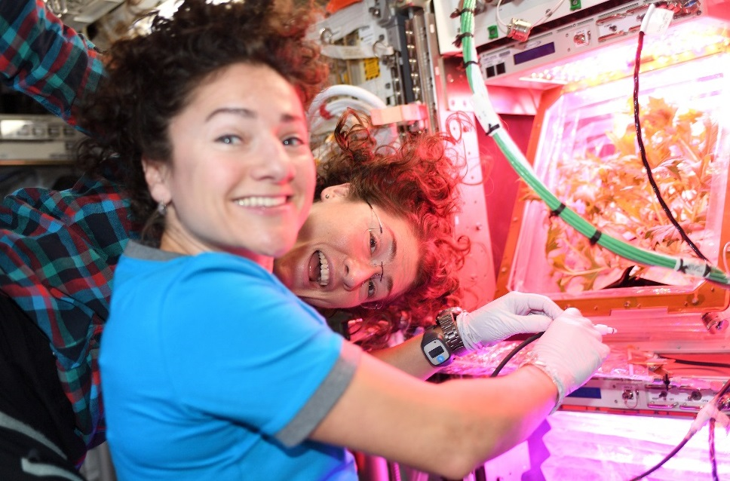
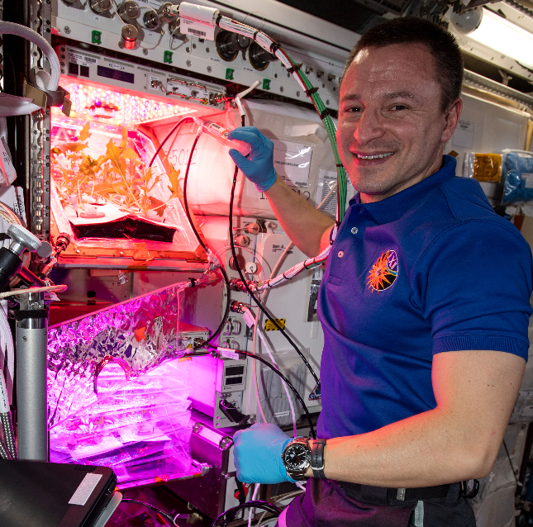
VEG-04 Crew Engagement

Slide 8
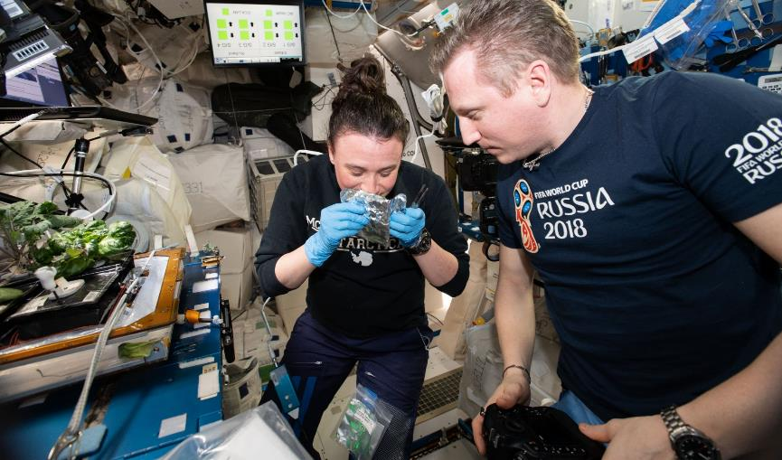
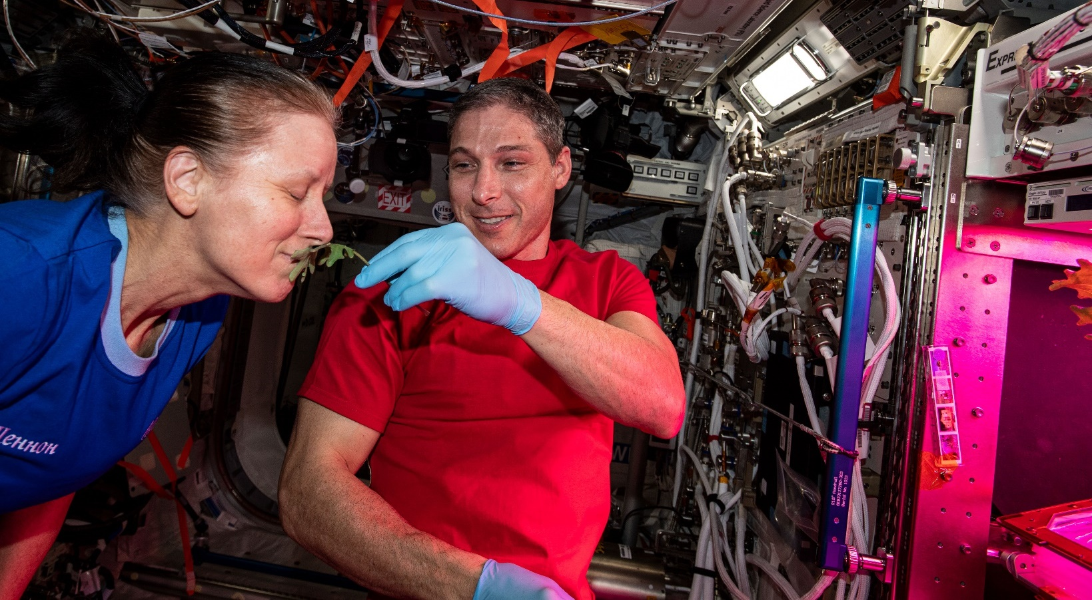
Plant Aromas Also Enhance Astronaut Experiences

Slide 9
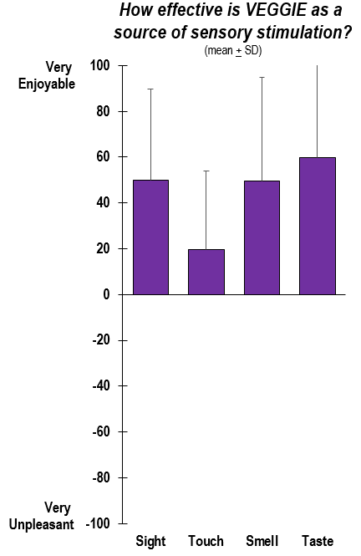
Veggie and Behavioral Health
  Amount of interaction and responses to Veggie varied widely by individual
  Enjoyable tasks had higher impact than non-enjoyable tasks
  Interacting with Veggie:
    Viewed as engaging and meaningful work
    Had positive impact on mood, well-being, and relationships with crew mates
    Enhanced subjective connection to Earth and desire to work with Veggie through harvest and consumption
    Positive source of sensory stimulation

Slide 10
‘Outredgeous’ Lettuce Microbiology
Data distribution Box and whiskers plots for aerobic bacteria (APC) and yeast and mold counts on cleaned (water rinse) and not cleaned lettuce from various sources. CACA=cut and come again harvest. + indicates mean, whiskers are max and min values. Market lettuce n=18, Chamber, n=6, VEG-03A n=5, VEG-03D n=4.
Notes:
Significant differences in APC (P<0.05)
VEG 03 D is significantly higher than all other trials with the exception of uncleaned market lettuce. (P values ranged from 0.0035 to <0.0001)
Both harvests of VEG 03 A are significantly lower than market/not clean but not chamber grown produce.
Significant differences in Y & M (P<0.05)
Market uncleaned is higher than all except VEG 03A final harvest and VEG 03 D.
VEG 03 A 2nd Harvest is lower than the 4th and final harvest. (P=.0027)

Slide 11
VEG-05 Tomato Microbiome
Some differences between flight and ground but larger differences between tissue types
Root and adventitious root samples had higher community diversity than leaf or fruit samples

Slide 12
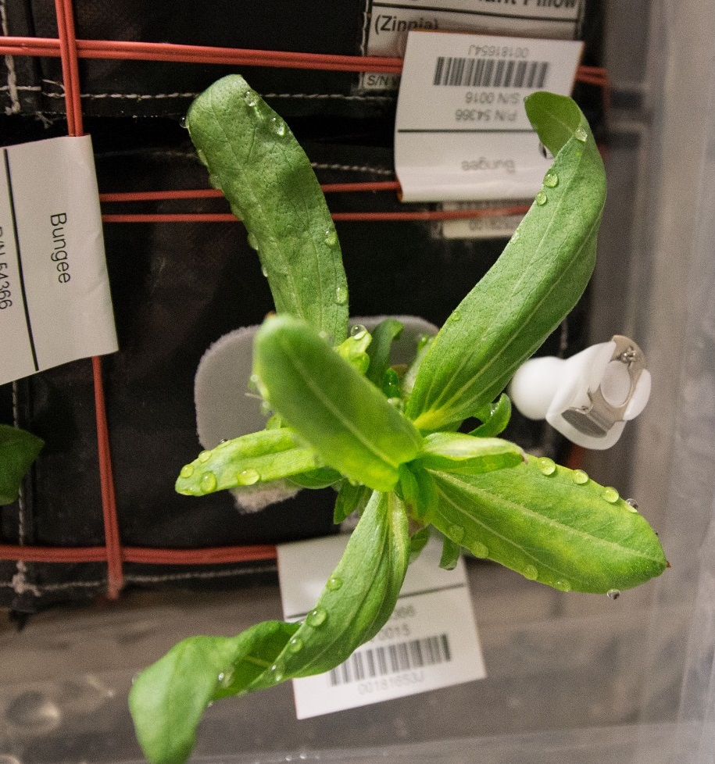
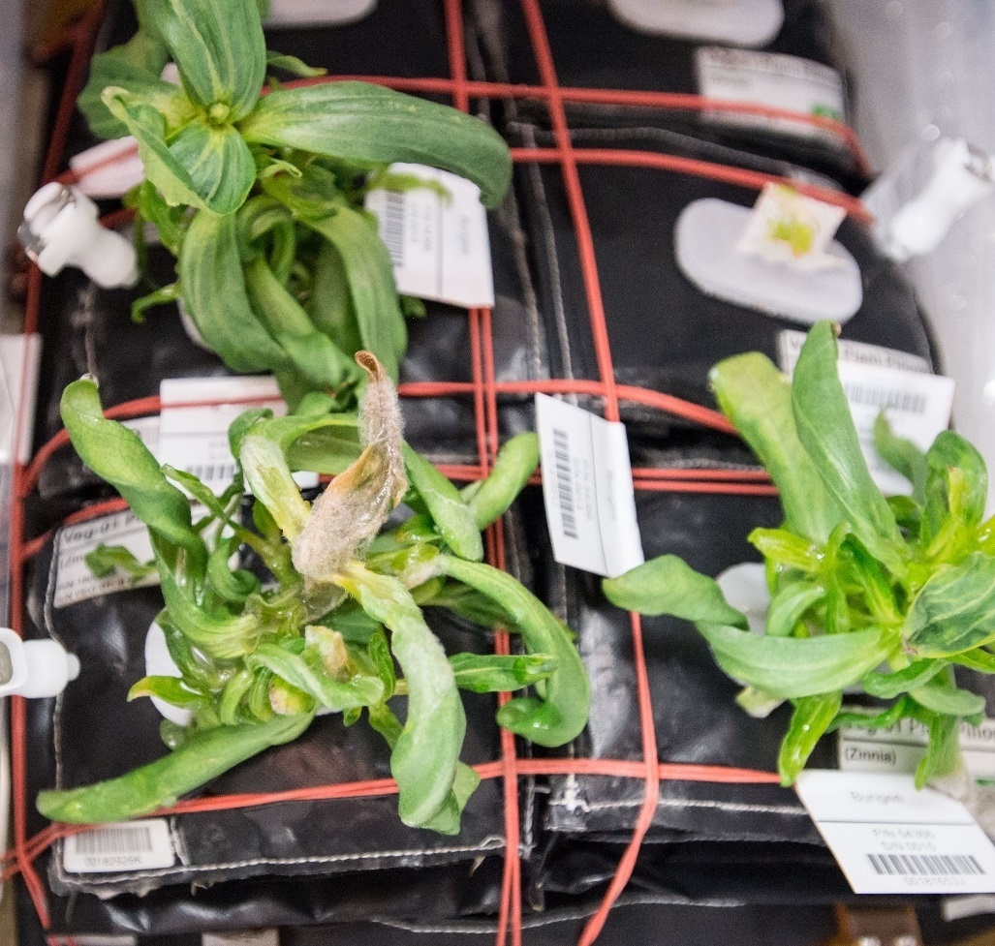
Ventilation and Water Issues & Consequences in Zinnia
Guttation and Leaf Curling
Fungal Development & Abnormal Growth

Slide 13
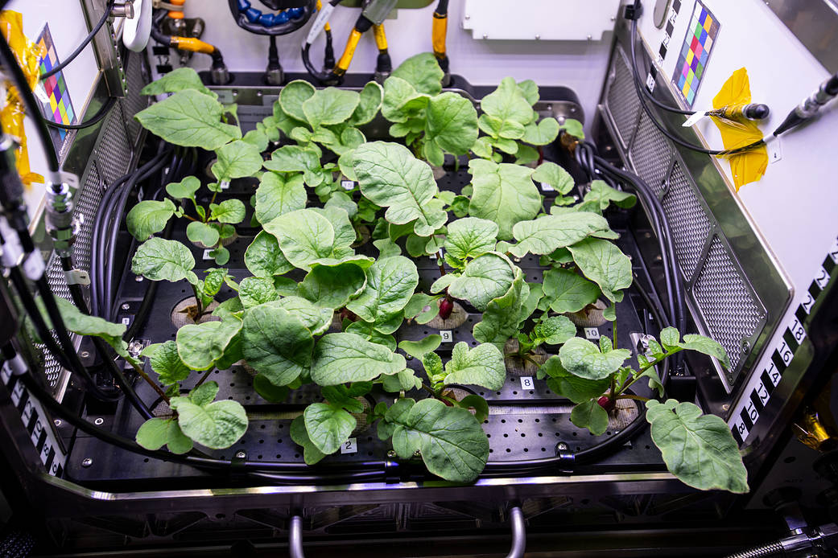
APH Crop Research
PH-02 Radish Experiment
PI Karl Hasenstein from the University of Louisiana, Lafayette

Slide 14
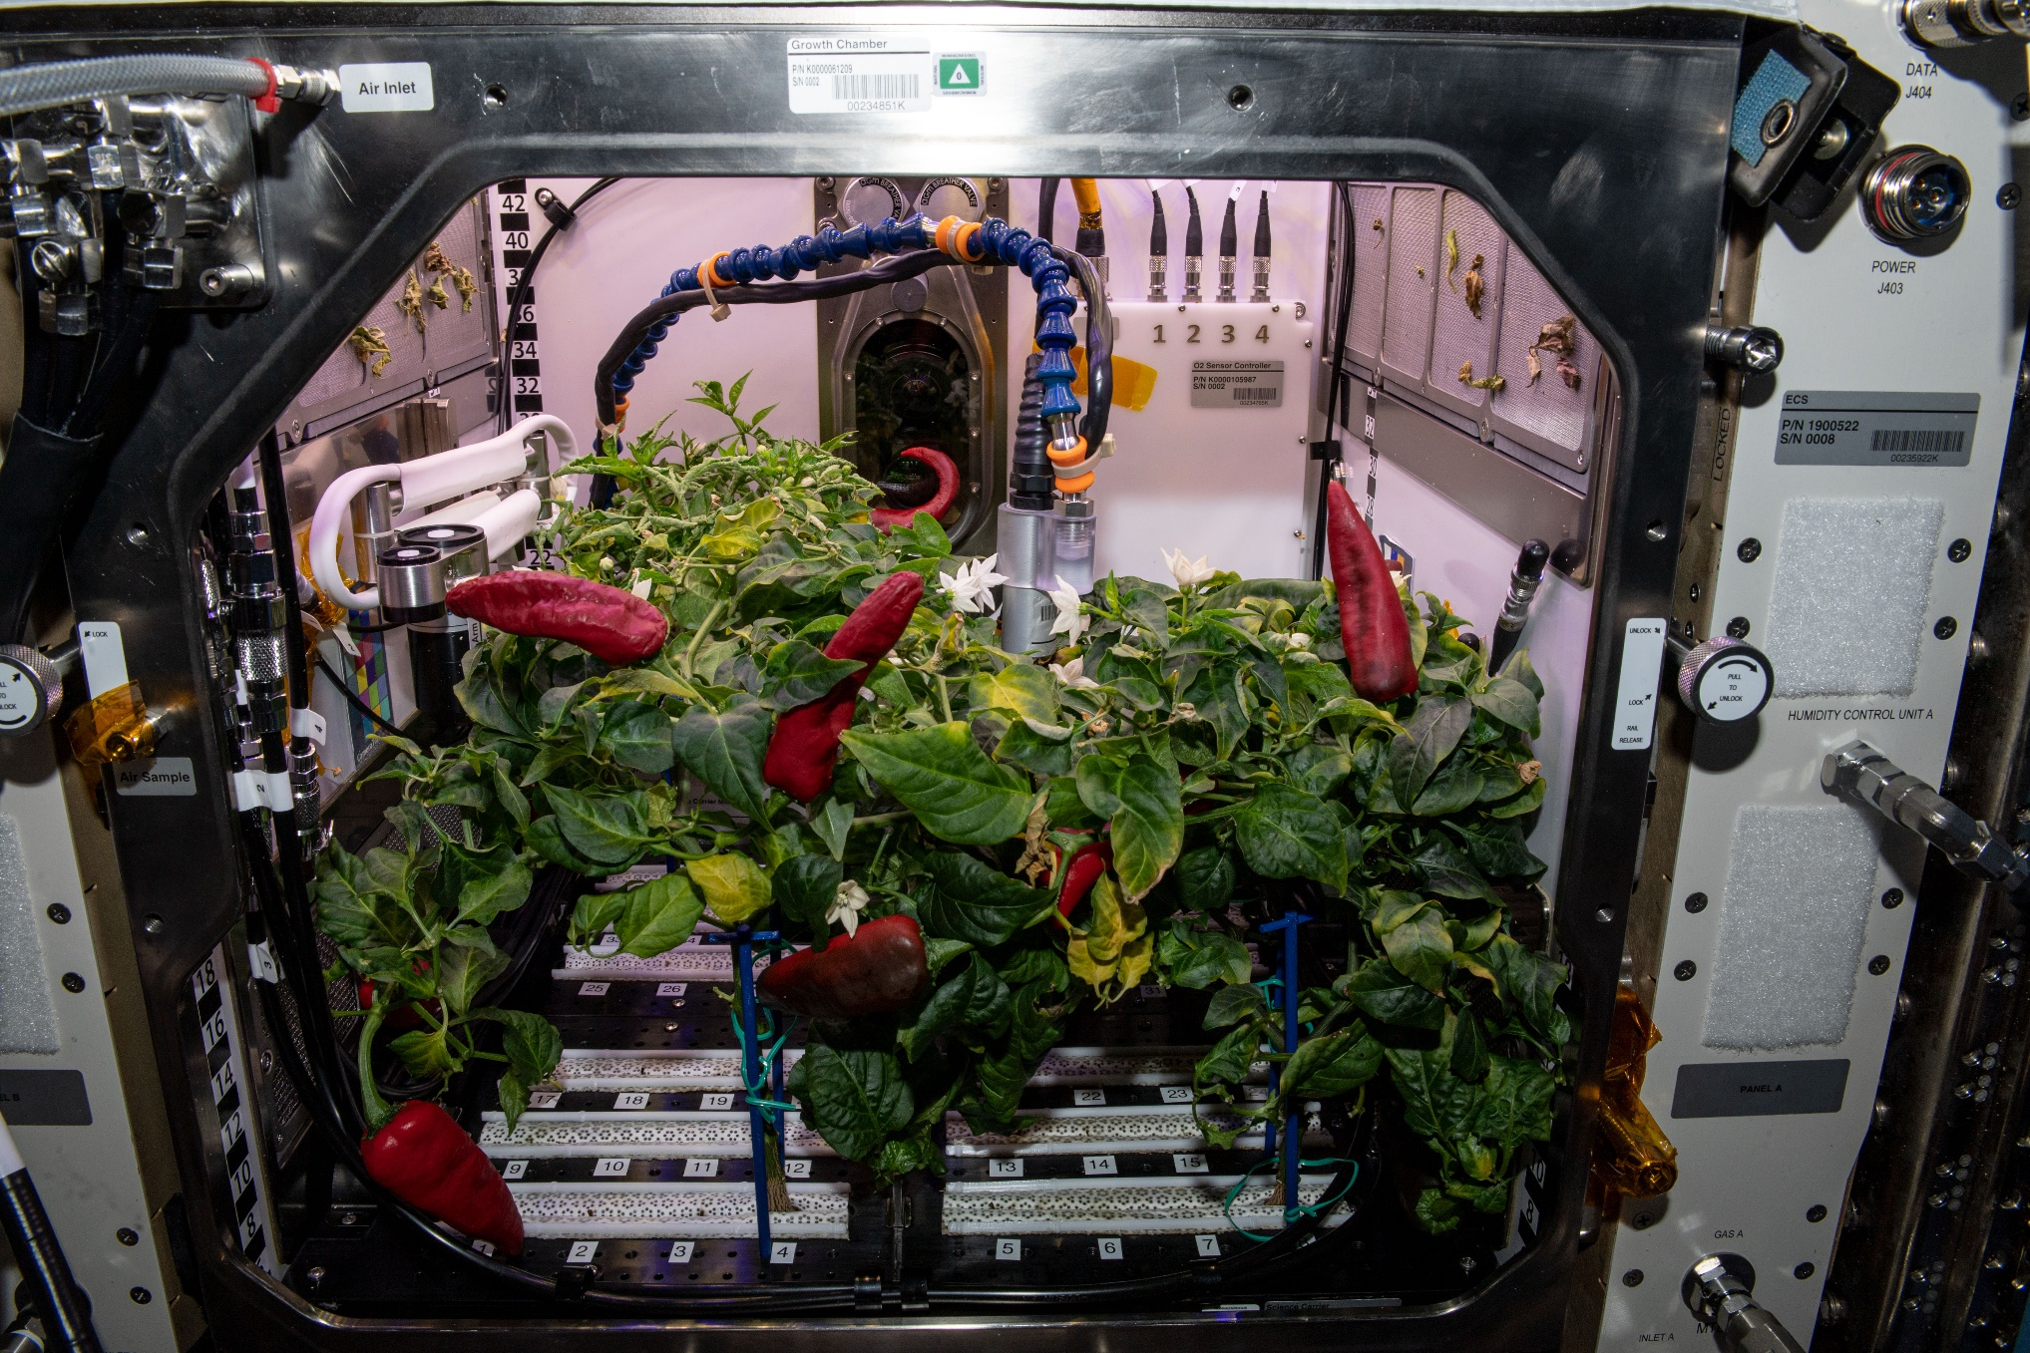
APH Crop Research
Española Improved Hatch Chile Peppers
PH-04 mission ran July – Nov. 2021

Slide 15
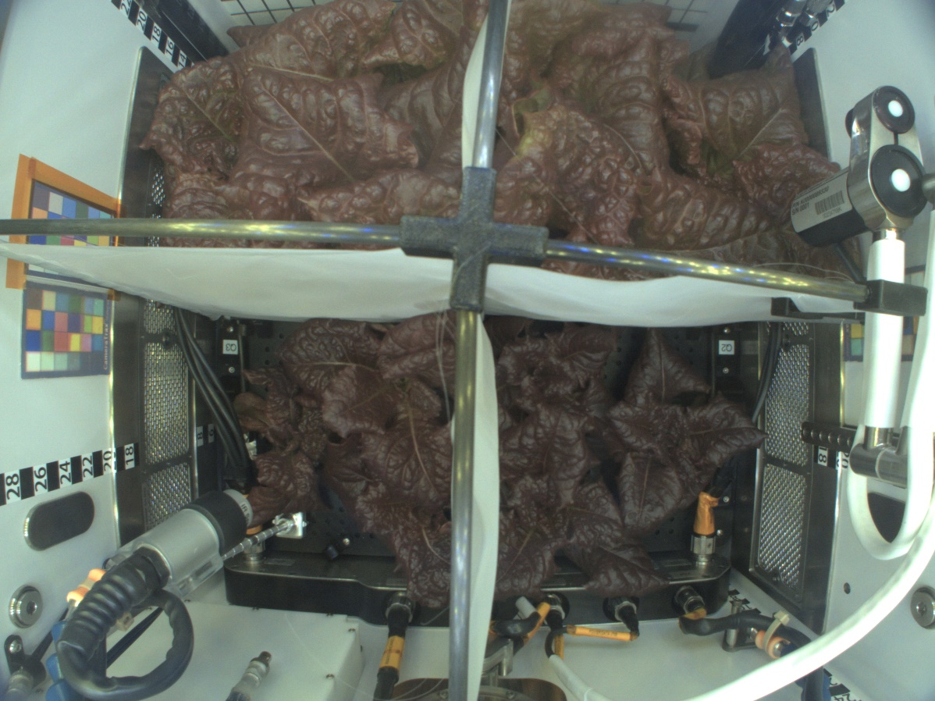
Upcoming APH Crop Research
Q4 Flood
Q1 Control
‘Outredgeous’ lettuce grown with different substrate moisture levels
PH-07 mission- launching Oct. 2024.
Q3 Wilt
Q2 Drought
PH-07 Science Verification Test

Slide 16
Key Crop Plant Takeaways
Data indicate astronauts enjoy growing and eating plants in spaceflight
Crop yield is similar between ground and flight when plants are not stressed¹
Some differences between ground and flight plant nutrient content, but these are not consistent between species or experiments ^{1, 2}
  Influenced by crop type, harvest scenario, other environmental conditions (e.g., light, stress)
Microbial counts and compositions vary between flight and ground-grown plants^{1, 2}
  Microbes typical of the space station environment are often associated with ISS-grown plants
  Human pathogens are rarely identified on space-grown plants and only below levels of concern to human health
Microbial communities vary between shoot and root tissues and but not as much between flight and ground ²
Plants adapt well to the space environment, and to date, space-grown crops are safe to eat, nutritious, and highly acceptable to astronauts ^{1,2}
Bunchek et al., 2024, Pick-and-eat space crop production flight testing on the International Space Station, J. Plant Interact.
Khodadad et al., 2020, Microbiological and Nutritional Analysis of Lettuce Crops Grown on the International Space Station, Front. Plant Sci.

Slide 17
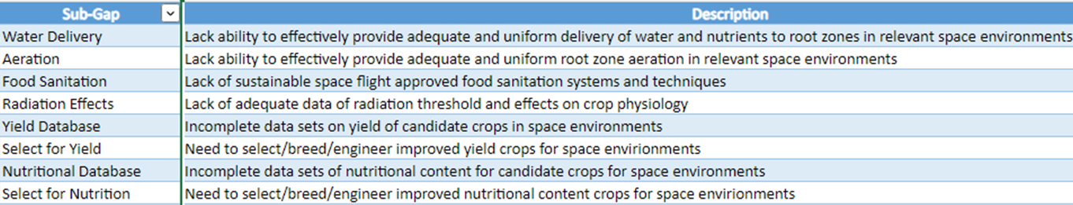
Space Crop Production Gaps
Living list of ~65 different Knowledge and Technology Gaps
Gaps fall into 13 areas related to crops, ecosystems, and hardware
Highest priority gaps are in the areas of:
  Crop Performance
  Environmental Control and Monitoring
  Food Safety and Security
  Plant Environmental Response
  Horticultural Practices
  Sustainability
  Systems Architecture
  Human-Plant Interaction

Slide 18
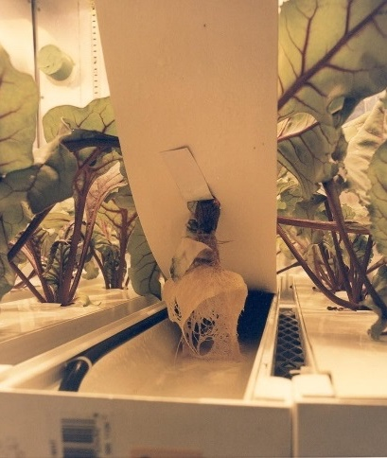
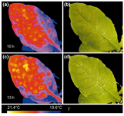
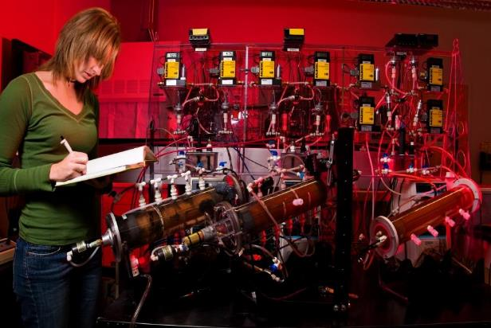
Example Knowledge and Technology Gaps for Bioregenerative Life Support Systems
We Need:
Water and nutrient delivery approaches at different gravity levels
Non-invasive plant health monitoring and pathogen detection technologies
Effective options to recover resources from inedible plant wastes and human waste streams

Slide 19
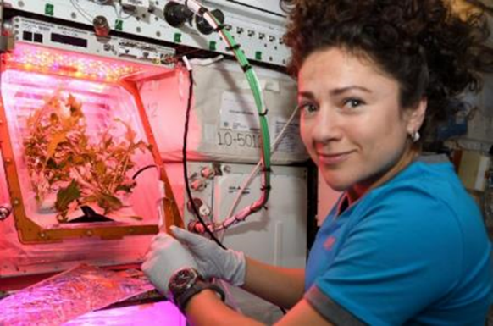
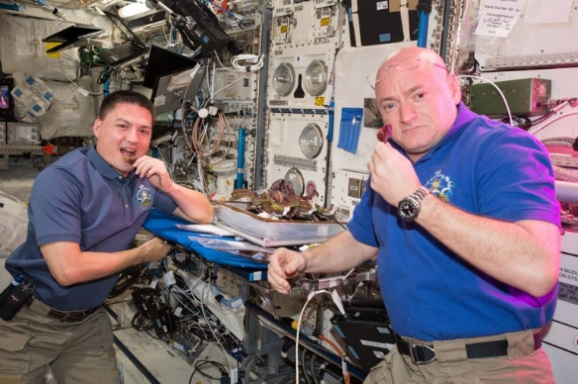
Examples of Knowledge Gaps for Space Crop Production
The library of crops tested is limited – we need to test a wider diversity of different crops and crop types for exploration
  One plant family should not make up >1/3 of the entire crop library
Plant Microbiome - Food Safety/Plant Health
  Crops will be grown hydroponically in space habitats near to mid-term. Many questions remain around hydroponic water and nutrient delivery, and few data exist for the hydroponic microbiome.
  Plant performance in exploration atmospheres (reduced pressure) is largely unstudied, including plant-microbial interactions, responses to pathogens, etc.
Deep-space radiation impacts on seeds and plants remain unknown

Slide 20
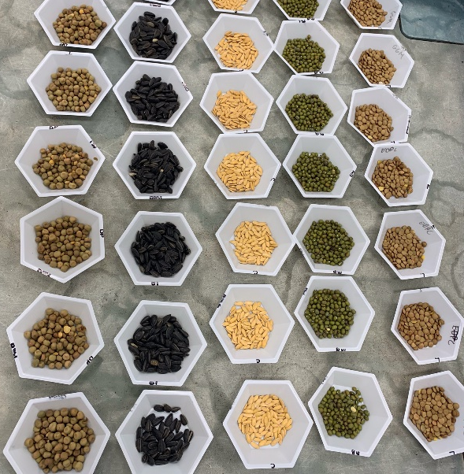
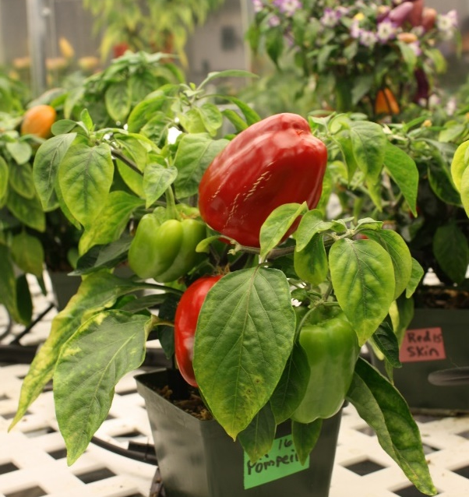
Selection Factors for Space Plants
Targeted breeding areas could fall into several categories:
Plant Growth and Development
  E.g., Compact size (low height and volume), high harvest index, uniform growth
Plant Physiology
  E.g., Stress tolerance, high sodium tolerance (e.g., urine recycling)
Produce Nutrition
  E.g., High normal levels of antioxidants and beneficial phytonutrients
Produce Organoleptic Acceptability
  E.g., Excellent, intense flavors, good texture, appearance, color, aroma
Postharvest
  E.g., Good shelf life, reduced processing, easy degradation of inedible biomass

Slide 21
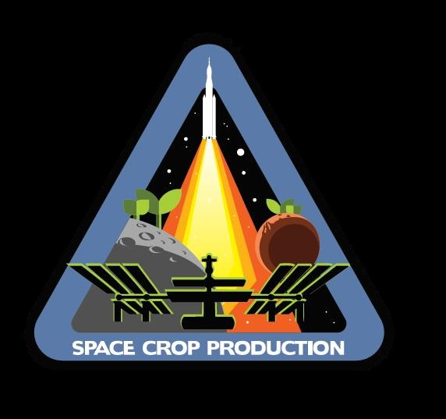


Space Crop Production
-Feeding Exploration-
ISS LEO Research
Gateway Research
Mars Transit Vehicle Operations
HARDWARE SYSTEMS
TECHNOLOGY TASKS
µG Water and Nutrient Delivery
µG Volume Optimization
Growth System Concepts
Subsystem Technologies
CROP SCIENCE TASKS
Candidate Crop Selection
Plant Science
Terrestrial vs. µg Nutrition
ECOSYSTEM TASKS
µG Plant/Human Microbiomes
Food Safety
Long-Duration Radiation Studies
HUMAN FACTORS
Long-term Isolation
Psychosocial Plant/Crew Interactions
HARDWARE SYSTEMS
Plant Research Habitat
Suite of Plant Research Tools Adapted from ISS
TECHNOLOGY TASKS
Seed Storage Systems
Water and Nutrient Delivery for Gateway Plant Habitat
CROP SCIENCE TASKS
Candidate Crop Selection
Long-Duration Seed Storage
ECOSYSTEM TASKS
Microbiome Studies
Radiation Studies
Food Safety Assessments
OPERATIONAL SYSTEM
Supplemental Food Production Capability for Pick-and-Eat Crops
Plant Care as Meaningful Work
Preliminary Long-Duration Shakedown
Mars Surface Operations
OPERATIONAL SYSTEM
Leverage Lunar Surface and µG Experience in Operational Crop Production
  Systems to Move towards Earth Independence
Pick-and-Eat and Staple Crops
  Scale to Habitat, Mission
  Robotics and Automation
Bioregenerative Life Support Systems (BLiSS)
Potential for Incorporation of ISRU
LEVERAGE GATEWAY CONCEPT OF OPERATIONS
Logistics Flights
Ground Research
Lunar Surface Operations
HARDWARE SYSTEMS
Water Delivery Testing
Ground Control Hardware
TECHNOLOGY TASKS
Water and Nutrient Delivery
Water Loop Closure
Volume and Resource Optimization
Lighting
Plant Health Monitoring and Advanced Plant Imaging
Automation
Sensors
CROP SCIENCE TASKS
Candidate Crop Selection
Plant Science
Nutrition
Sensory Acceptability
Radiation Studies
ECOSYSTEM TASKS
Microbiome Characterization and Engineering
Food safety
HUMAN FACTORS
Use of Ground Analogs
  CHAPEA
  EDEN-ISS
  DLR Ground Test Demonstrator
HARDWARE SYSTEMS
Develop and Test H/W Systems
Sustained Operations
Demonstrate Component Longevity and Crew Operability
TECHNOLOGY TASKS
Partial G Water and Nutrient Delivery
3/8 G Simulation with Centrifuge
Model Validation for Water and Airflow
Hybrid Lighting
Regolith Evaluation
Automation
CROP SCIENCE TASKS
Long-Duration and Multigenerational Growth
Crop Responses to 1/6 G
Crop Validation
ECOSYSTEM TASKS
Microbiome Studies
Ecosystem Succession and Evolution
Funding Sources
Space Biology
Human Research Program
Mars Campaign Office
Other
Unfunded
Partnerships
USDA
Australian Centre of Plants for Space (P4S)
Canadian Space Agency
German Space Agencyy
Growing Beyond Earth
Winston Salem State Univ.
Florida Inst. of Technology
Univ. of Florida
DOD
EARTH INDEPENDENCE

Slide 22
Space Crop Production
-Feeding Exploration-
ISS LEO Research
Gateway Research
Mars Transit Vehicle Operations
HARDWARE SYSTEMS
TECHNOLOGY TASKS
µG Water and Nutrient Delivery
µG Volume Optimization
Growth System Concepts
Subsystem Technologies
CROP SCIENCE TASKS
Candidate Crop Selection
Plant Science
Terrestrial vs. µg Nutrition
ECOSYSTEM TASKS
µG Plant/Human Microbiomes
Food Safety
Long-Duration Radiation Studies
HUMAN FACTORS
Long-term Isolation
Psychosocial Plant/Crew Interactions
HARDWARE SYSTEMS
Plant Research Habitat
Suite of Plant Research Tools Adapted from ISS
TECHNOLOGY TASKS
Seed Storage Systems
Water and Nutrient Delivery for Gateway Plant Habitat
CROP SCIENCE TASKS
Candidate Crop Selection
Long-Duration Seed Storage
ECOSYSTEM TASKS
Microbiome Studies
Radiation Studies
Food Safety Assessments
OPERATIONAL SYSTEM
Supplemental Food Production Capability for Pick-and-Eat Crops
Plant Care as Meaningful Work
Preliminary Long-Duration Shakedown
Mars Surface Operations
OPERATIONAL SYSTEM
Leverage Lunar Surface and µG Experience in Operational Crop Production
  Systems to Move towards Earth Independence
Pick-and-Eat and Staple Crops
  Scale to Habitat, Mission
  Robotics and Automation
Bioregenerative Life Support Systems (BLiSS)
Potential for Incorporation of ISRU
LEVERAGE GATEWAY CONCEPT OF OPERATIONS
Logistics Flights
Ground Research
Lunar Surface Operations
HARDWARE SYSTEMS
Water Delivery Testing
Ground Control Hardware
TECHNOLOGY TASKS
Water and Nutrient Delivery
Water Loop Closure
Volume and Resource Optimization
Lighting
Plant Health Monitoring and Advanced Plant Imaging
Automation
Sensors
CROP SCIENCE TASKS
Candidate Crop Selection
Plant Science
Nutrition
Sensory Acceptability
Radiation Studies
ECOSYSTEM TASKS
Microbiome Characterization and Engineering
Food safety
HUMAN FACTORS
Use of Ground Analogs
  CHAPEA
  EDEN-ISS
  DLR Ground Test Demonstrator
HARDWARE SYSTEMS
Develop and Test H/W Systems
Sustained Operations
Demonstrate Component Longevity and Crew Operability
TECHNOLOGY TASKS
Partial G Water and Nutrient Delivery
3/8 G Simulation with Centrifuge
Model Validation for Water and Airflow
Hybrid Lighting
Regolith Evaluation
Automation
CROP SCIENCE TASKS
Long-Duration and Multigenerational Growth
Crop Responses to 1/6 G
Crop Validation
ECOSYSTEM TASKS
Microbiome Studies
Ecosystem Succession and Evolution
Funding Sources
Space Biology
Human Research Program
Mars Campaign Office
Other
Unfunded
Partnerships
USDA
Australian Centre of Plants for Space (P4S)
Canadian Space Agency
German Space Agencyy
Growing Beyond Earth
Winston Salem State Univ.
Florida Inst. of Technology
Univ. of Florida
DOD
EARTH INDEPENDENCE

Slide 23
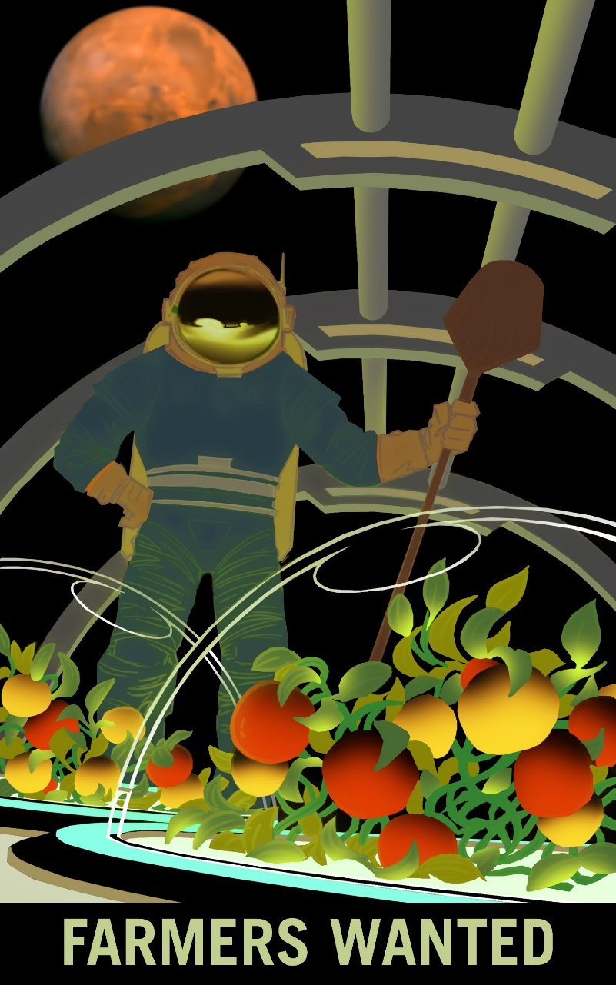
Thank you!
Space Crop Production team
NASA’s Space Biology Program, Human Research Program, Mars Campaign Office, SBIR program

