Slide 1
General Ballistic-Limit Equations for Whipple Shields Against Low- and High-Density Meteoroid Surrogates
Joshua E. Miller^{1,2}, Bruce (Alan) Davis² and
Kevin D. Deighton²
¹ University of Texas at El Paso, 500 W. University Ave., El Paso, TX 79986
² Jacobs, NASA Johnson Space Center, 2224 Bay Area Blvd., Houston, TX 77058
17th Hypervelocity Impact Symposium, Tsukuba, Japan
8-13 September 2024

Slide 2
Lunar Gateway reliability and survivability analyses requires use of simulations
Lunar Gateway is an international collaboration to build a long-duration, habitable outpost that orbits the moon with close approaches and distant loiters to ease surface operations on the moon at its poles
As a result of its large size and long duration of operation, meteoroids pose challenges that have not been realized in previous experiences
To address these challenges, hydrodynamic impact simulations are a necessary part of determining Lunar Gateway shield performance
This paper describes the effort to extend ground-based testing and simulation model development to design equations for the Lunar Gateway’s shields

Slide 3
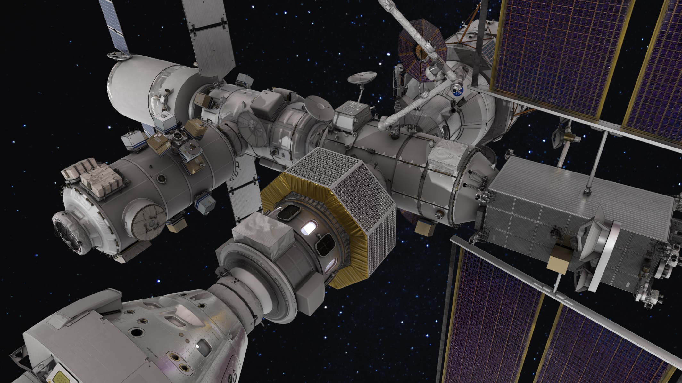
Lunar Gateway is an outpost assisting visiting vehicle operations between the Earth and Moon
Canadarm
DSL
IHAB
HLS
HALO
ALM
PPE
ESPRIT-RM
Orion

Slide 4
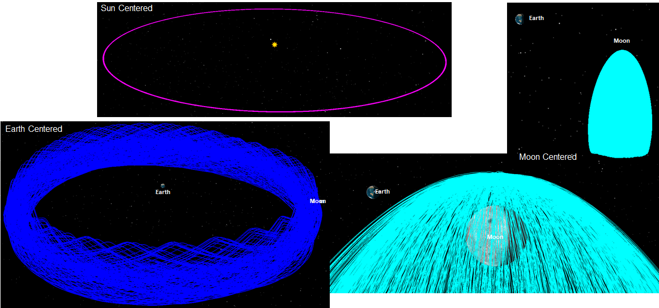
Lunar Gateway NRHO orbit’s perilune of ~3,500 km and apolune of ~71,000 km at the south pole

Slide 5
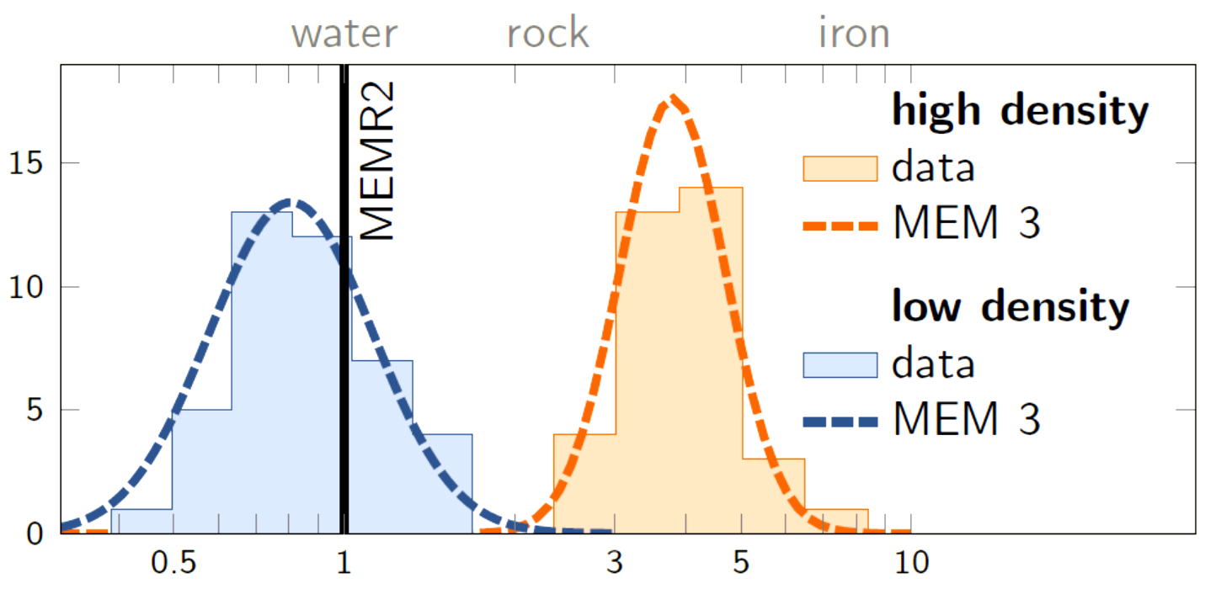
Current NASA meteoroid models have two density families (dirty snow and rocky/metallic)
Nylon
Al₂O₃
NASA has settled on using Nylon and Al₂O₃ to represent these families

Slide 6
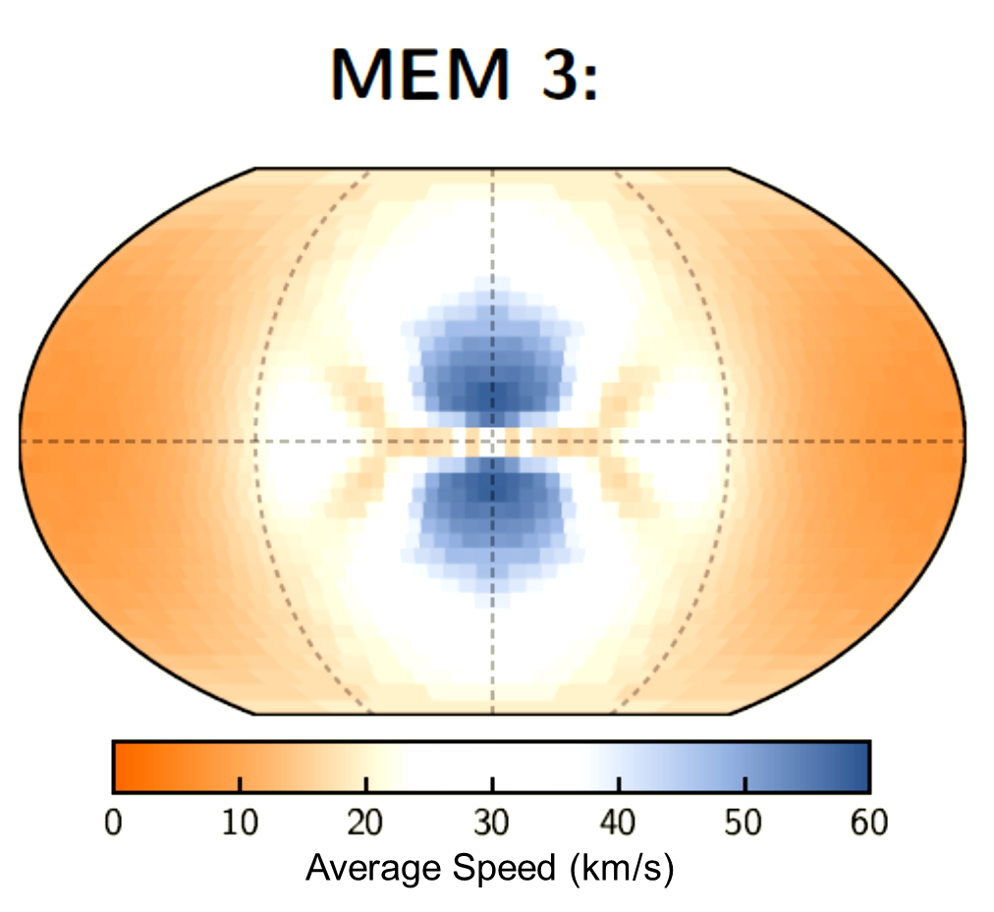
Current NASA meteoroid models are well outside of the range of multi-stage, light-gas-guns
Impact speeds between 20 and 60 km/s are of critical concern to Gateway

Slide 7
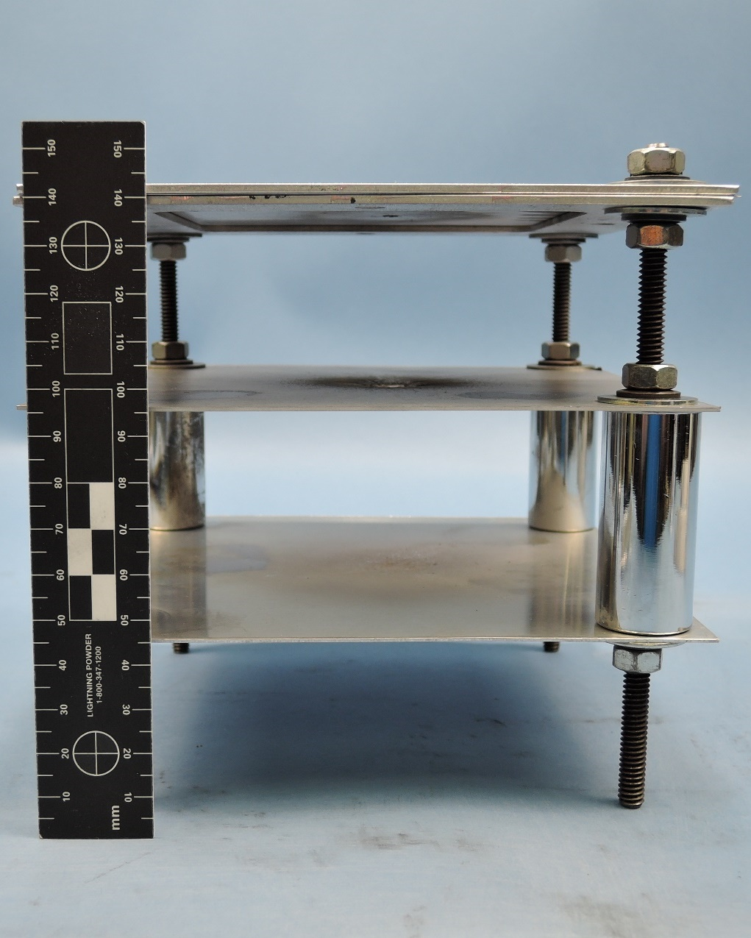
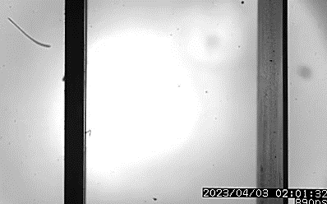
High-density meteoroid anchor data for simulations has been developed
Projectile: Al₂O₃ sphere
D=2.52 mm, m= 0.03267 g
ρ=3.9 g/cm³
Impact: V_{i}=6.62 km/s, θ_{i}=0°
Bumper: Al6061, t_{B}=0.29 mm, D_{H}=3.6 mm, S=4.5 cm (back to front)
Rear wall: Al2219, t_{RW}=1.07 mm, A_{H}=124.8 mm² , D_{RW}=13.9 mm, <D_{H}>=12.6 mm

Slide 8
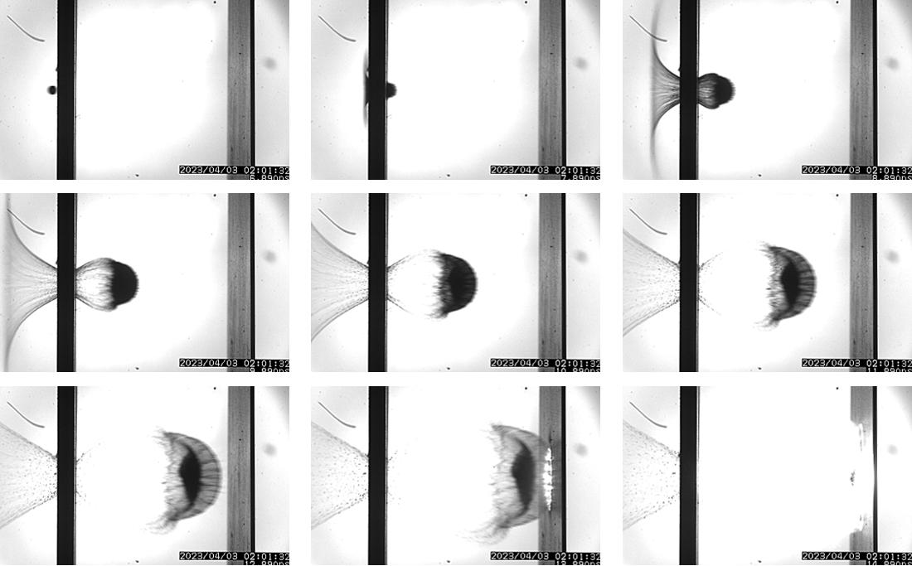
Stills from video at 1 μs interframe rate (debris cloud took ~ 7 μs to traverse gap)

Slide 9
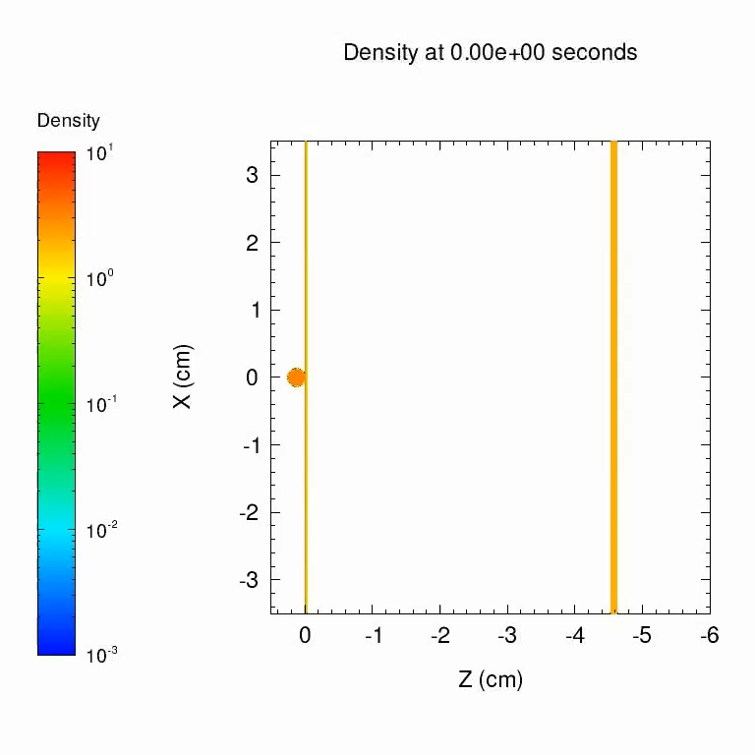
Simulation model developed for CTH uses high pressure material models and anchor data
Projectile: Al₂O₃ sphere,
SESAME B601 (Kerley, G.)
Y=2.6 GPa, ν=0.173, T_{M}=2,000 K
σ_{F}=-260 MPa
Bumper: Al6061
SESAME 3700 (ρ=2.703 g/cm³)
A_{JO}=266.8 MPa, B_{JO}=126.8 MPa C_{JO}=0.015, M_{JO}=1, N_{JO}=0.26 ν=0.33, T_{M}=800 K
σ_{F}=-361 MPa
Rear Wall: Al2219
SESAME 3700 (ρ=2.82 g/cm³)
A_{JO}=274.0 MPa, B_{JO}=432.8 MPa C_{JO}=0.015, M_{JO}=1, N_{JO}=0.26 ν=0.33, T_{M}=800 K
σ_{F}=-517 MPa

Slide 10
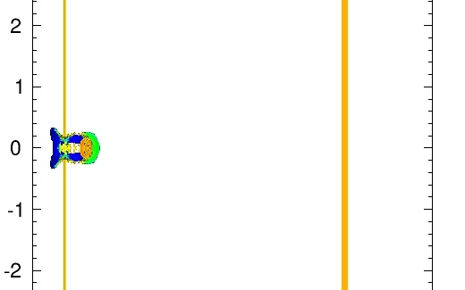
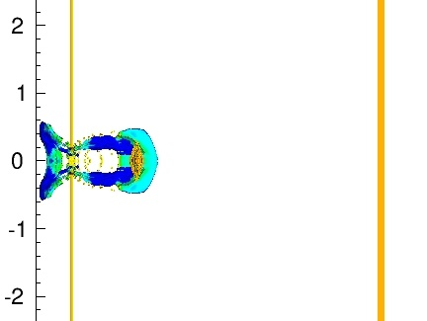
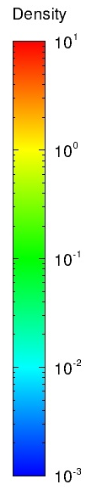
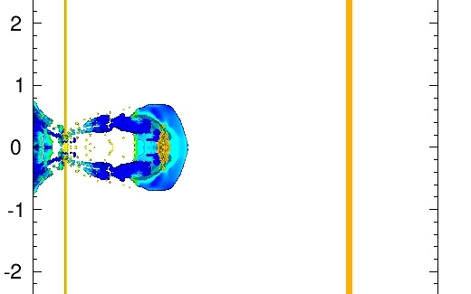
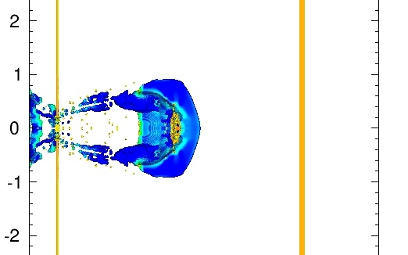
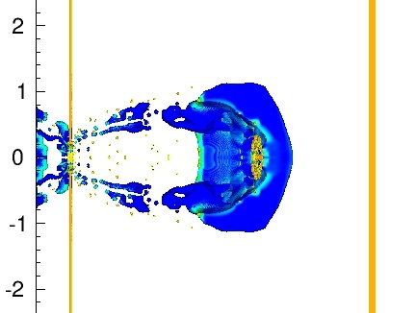
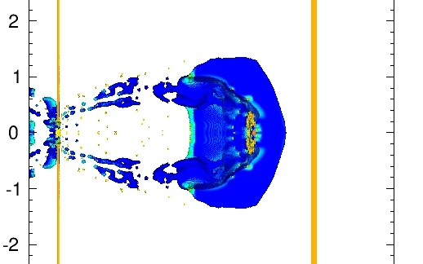
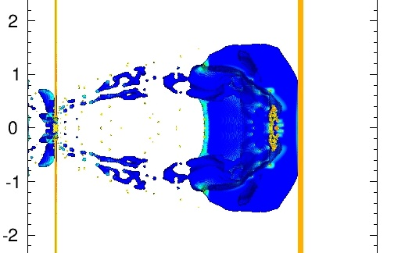
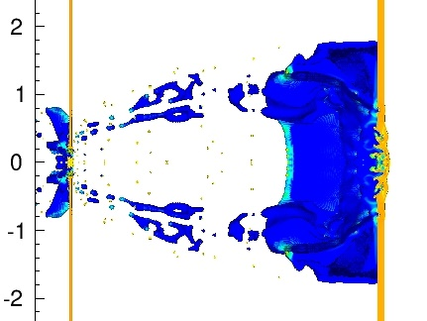
Overplot of simulation debris cloud with stills from the high-density anchor data

Slide 11
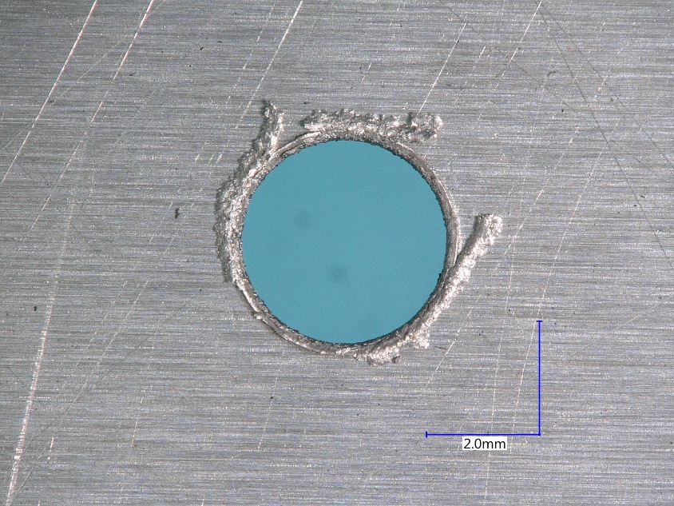
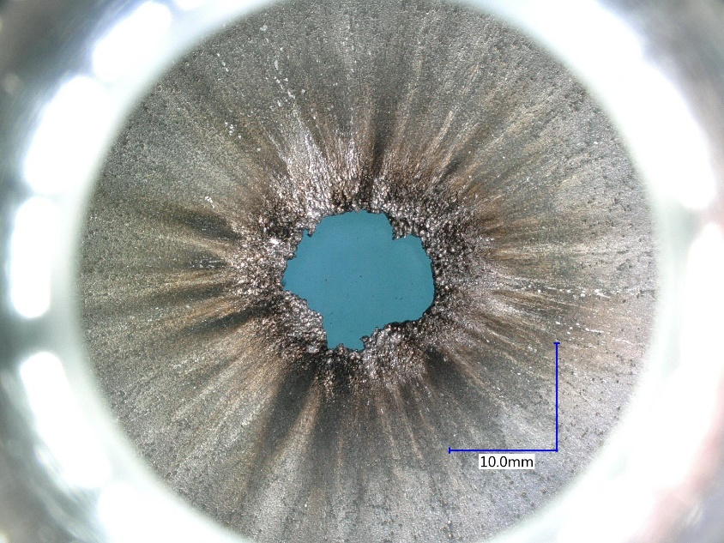
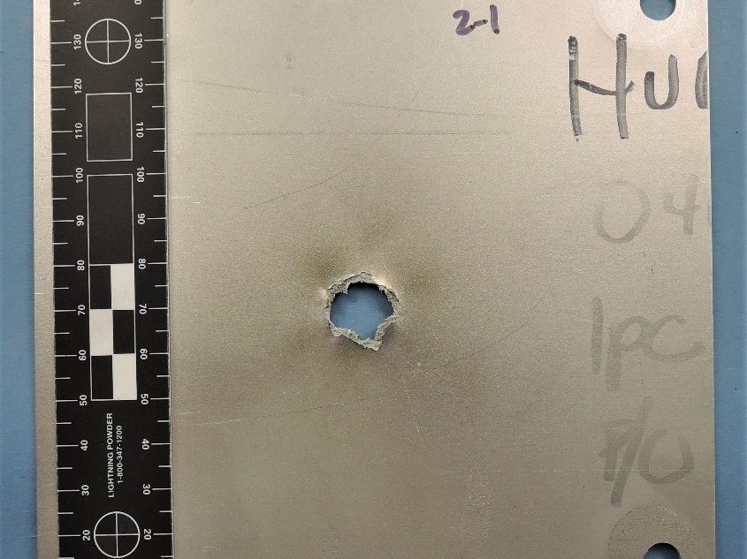
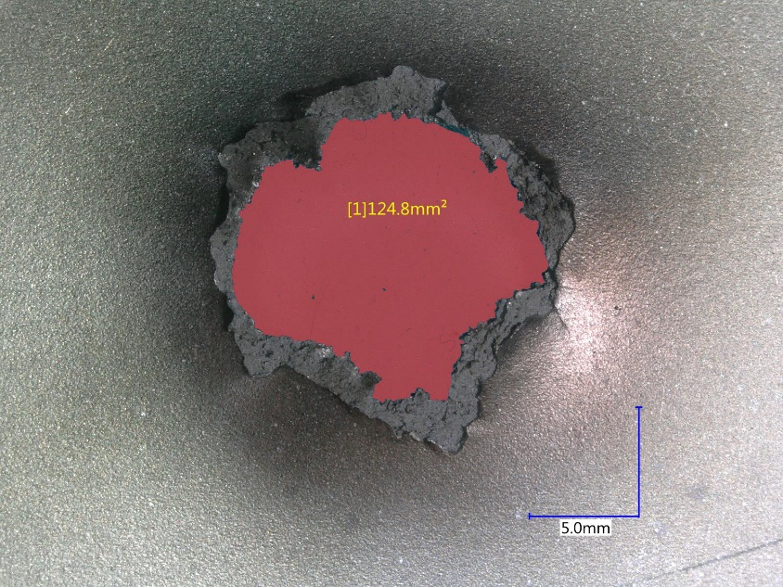
Images of the shield wall damage high-density meteoroids anchor data

Slide 12
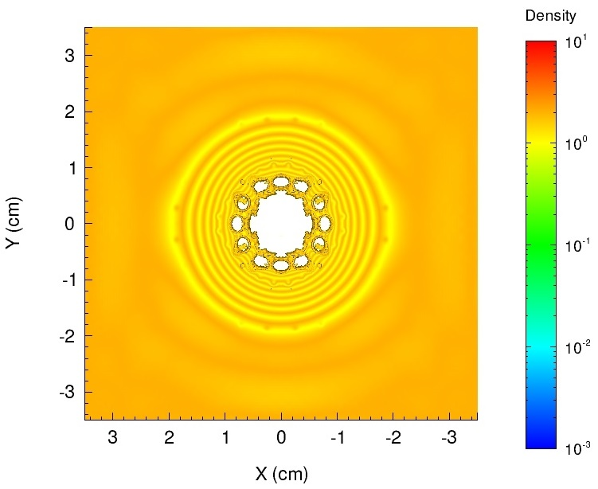
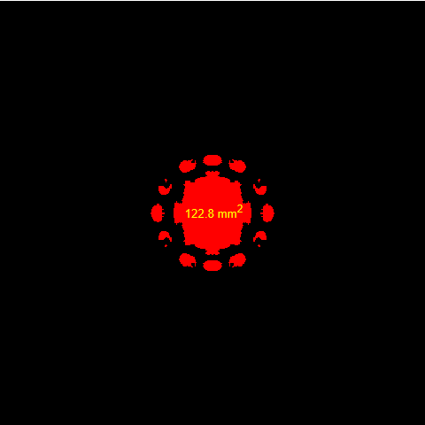
Comparison of the anchor data and the simulated damage for the shield
Experiment:
D_{RW}=19.6 mm
A_{H}=124.8 mm²
<D_{H}>=12.6 mm
Simulation:
D_{RW}=17.6 mm
A_{H}=122.8 mm²
<D_{H}>=12.5 mm

Slide 13
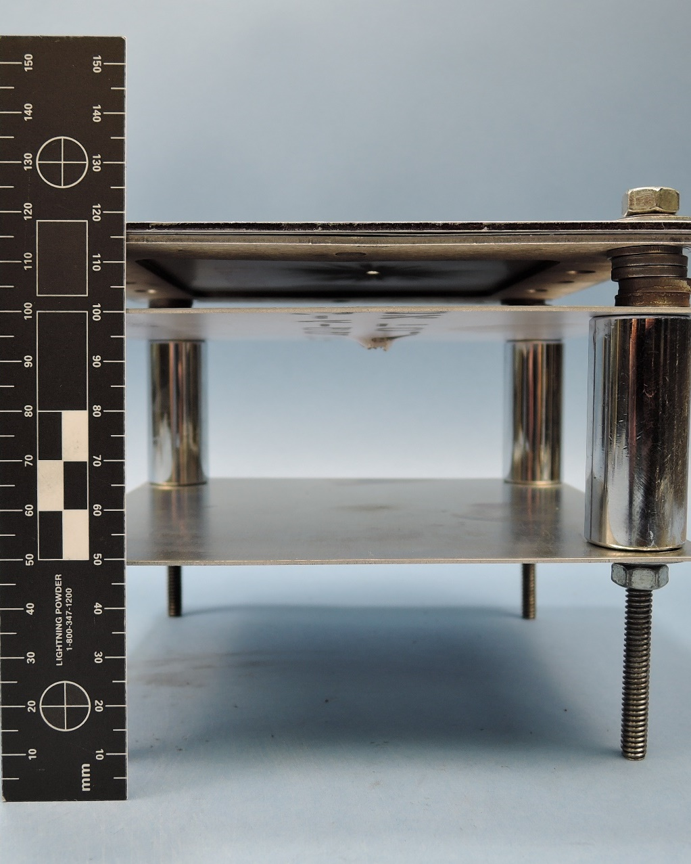
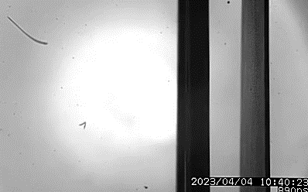
Low-density meteoroid anchor data for simulations has been developed
Projectile: Nylon sphere
D=2.75 mm, m=0.01243 g
ρ=1.14 g/cm³
Impact: V_{i}=6.49 km/s, θ_{i}=0°
Bumper: Al6061-T6, t_{B}=0.29 mm, D_{H}=3.6 mm, S=1.5 cm (back to front)
Rear wall: Al2219-T87, t_{RW}=1.07 mm, A_{H}=19.4 mm², <D_{H}>=5.0 mm

Slide 14
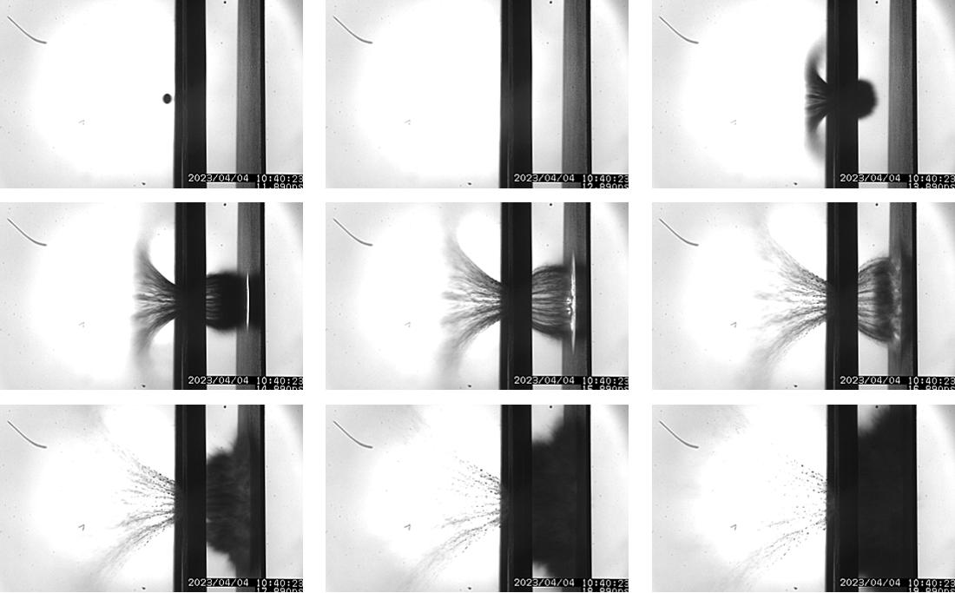
Stills from video at 1 μs interframe rate (debris cloud took ~ 2.5 μs to traverse gap)

Slide 15
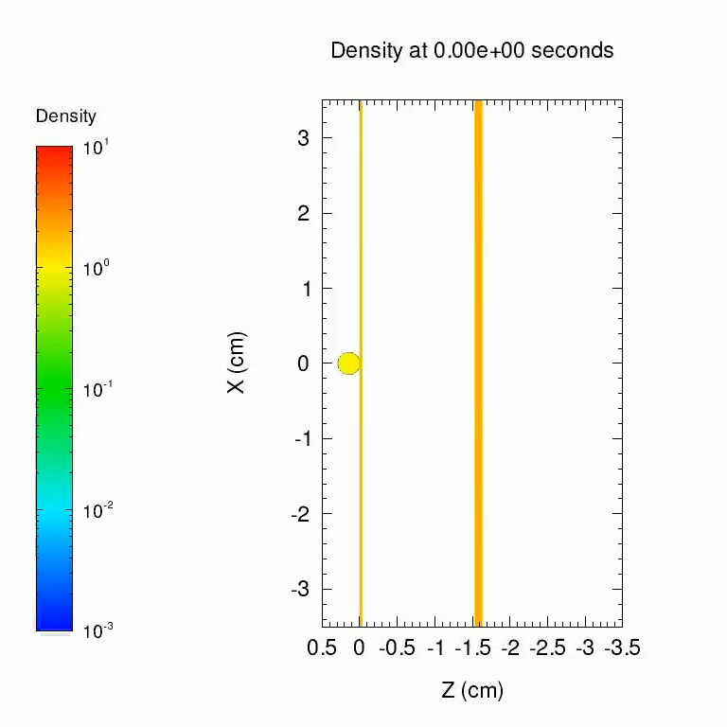
Simulation model developed for CTH uses high pressure material models and anchor data
Projectile: Nylon sphere,
SESAME 7300 (ρ=1.147 g/cm³)
Y=62.4 MPa, ν=0.4, T_{M}=487.4 K
σ_{F}=-63.0 MPa
Bumper: Al6061
SESAME 3700 (ρ=2.703 g/cm³)
A_{JO}=266.8 MPa, B_{JO}=126.8 MPa C_{JO}=0.015, M_{JO}=1, N_{JO}=0.26 ν=0.33, T_{M}=800 K
σ_{F}=-361 MPa
Rear Wall: Al2219
SESAME 3700 (ρ=2.82 g/cm³)
A_{JO}=274.0 MPa, B_{JO}=432.8 MPa C_{JO}=0.015, M_{JO}=1, N_{JO}=0.26 ν=0.33, T_{M}=800 K
σ_{F}=-517 MPa

Slide 16
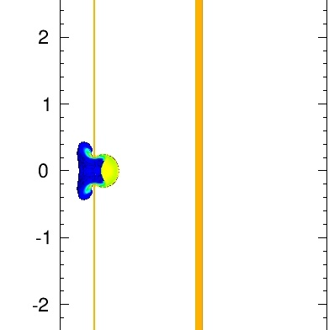
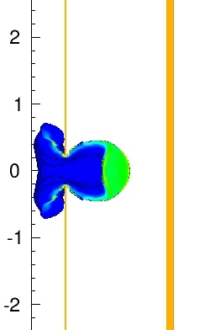
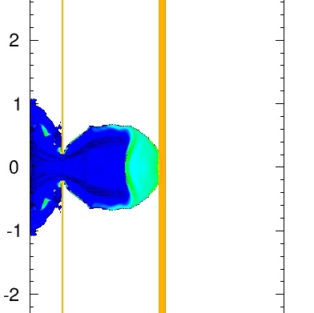
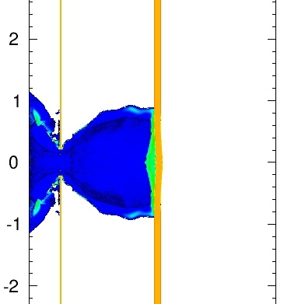
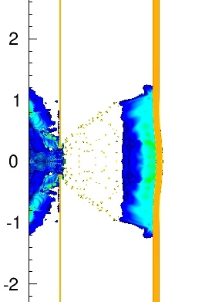
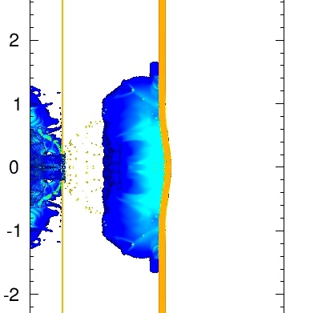
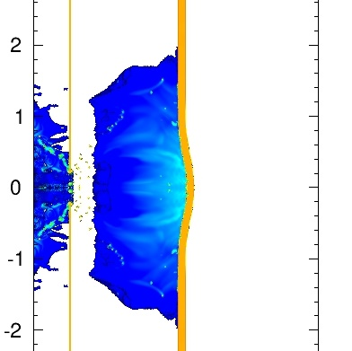
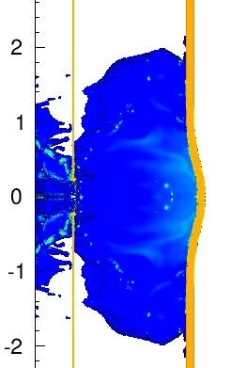
Overplot of simulation debris cloud with stills from the low-density anchor data

Slide 17
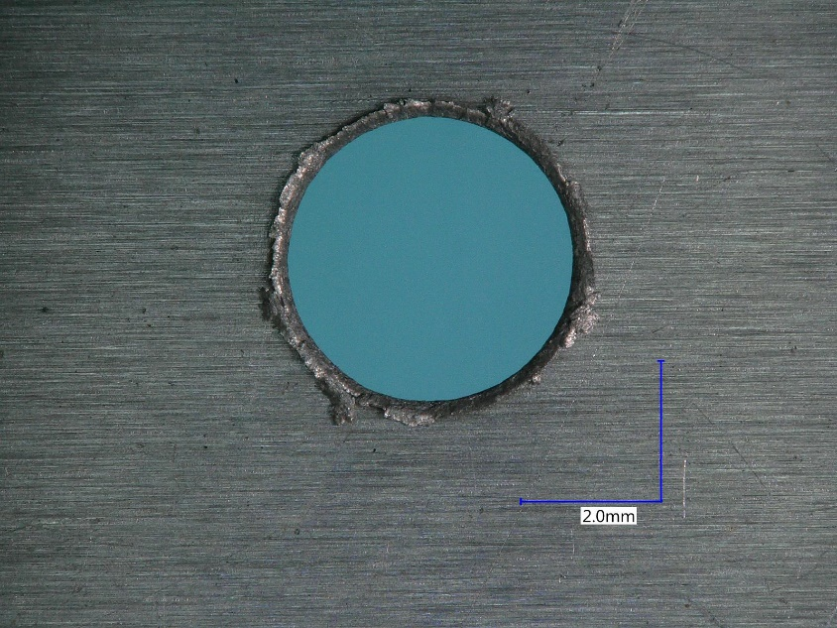
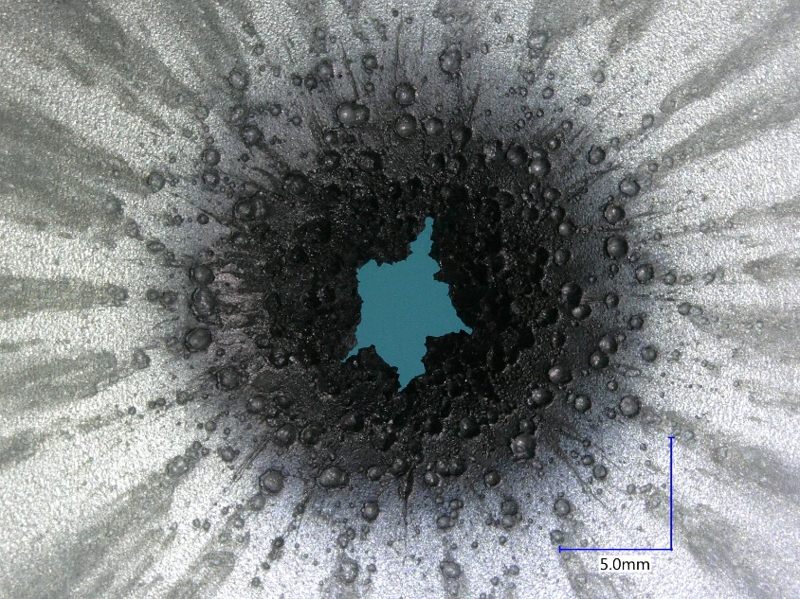
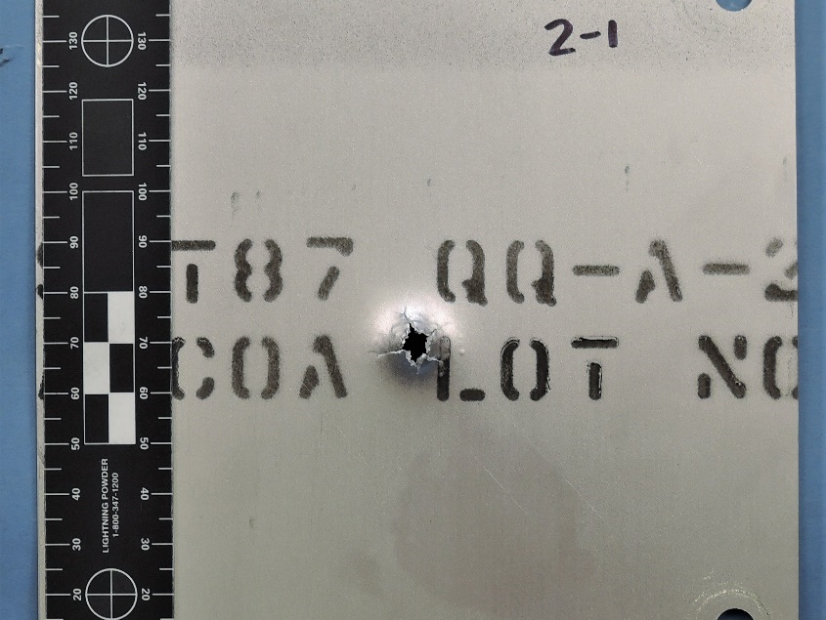
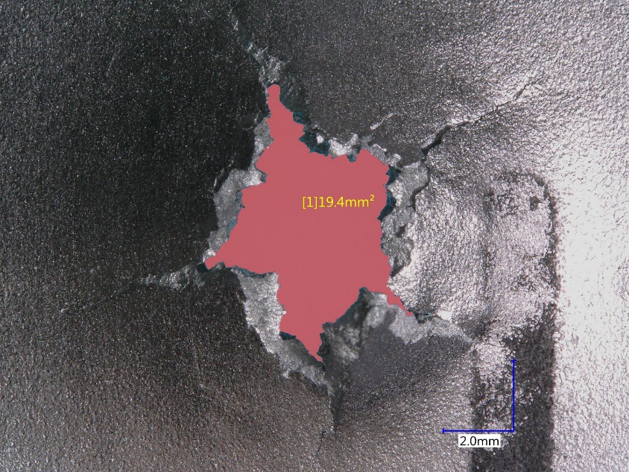
Conditions and images from the proposed numerical benchmark for Nylon

Slide 18
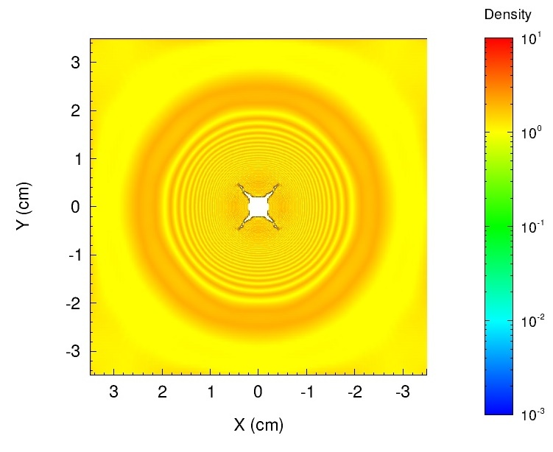
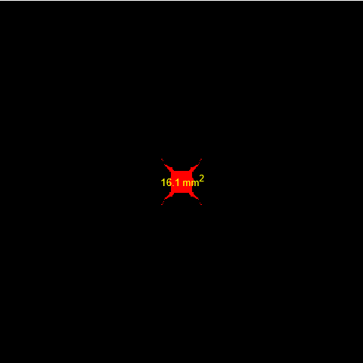
Comparison of the anchor data and the simulated damage for the shield
Experiment:
D_{RW}=13.9 mm
A_{H}=19.4 mm²
<D_{H}>=5.0 mm
Simulation:
D_{RW}=13.1 mm
A_{H}=16.1 mm²
<D_{H}>=4.5 mm

Slide 19
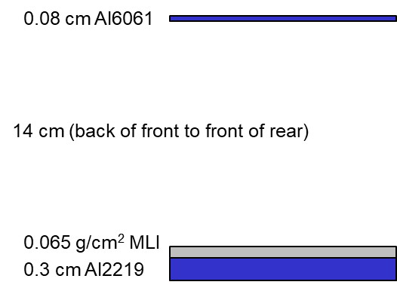
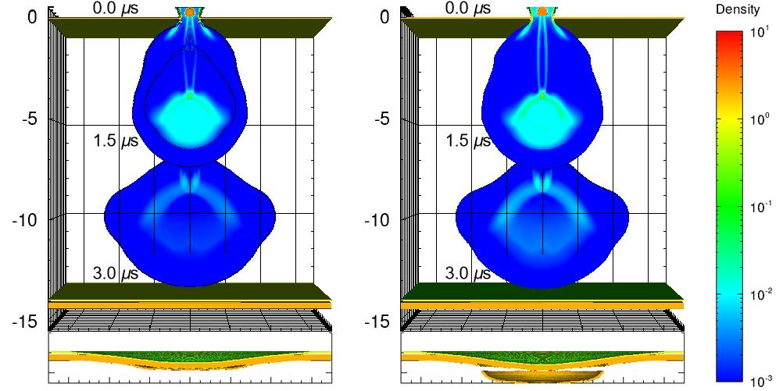
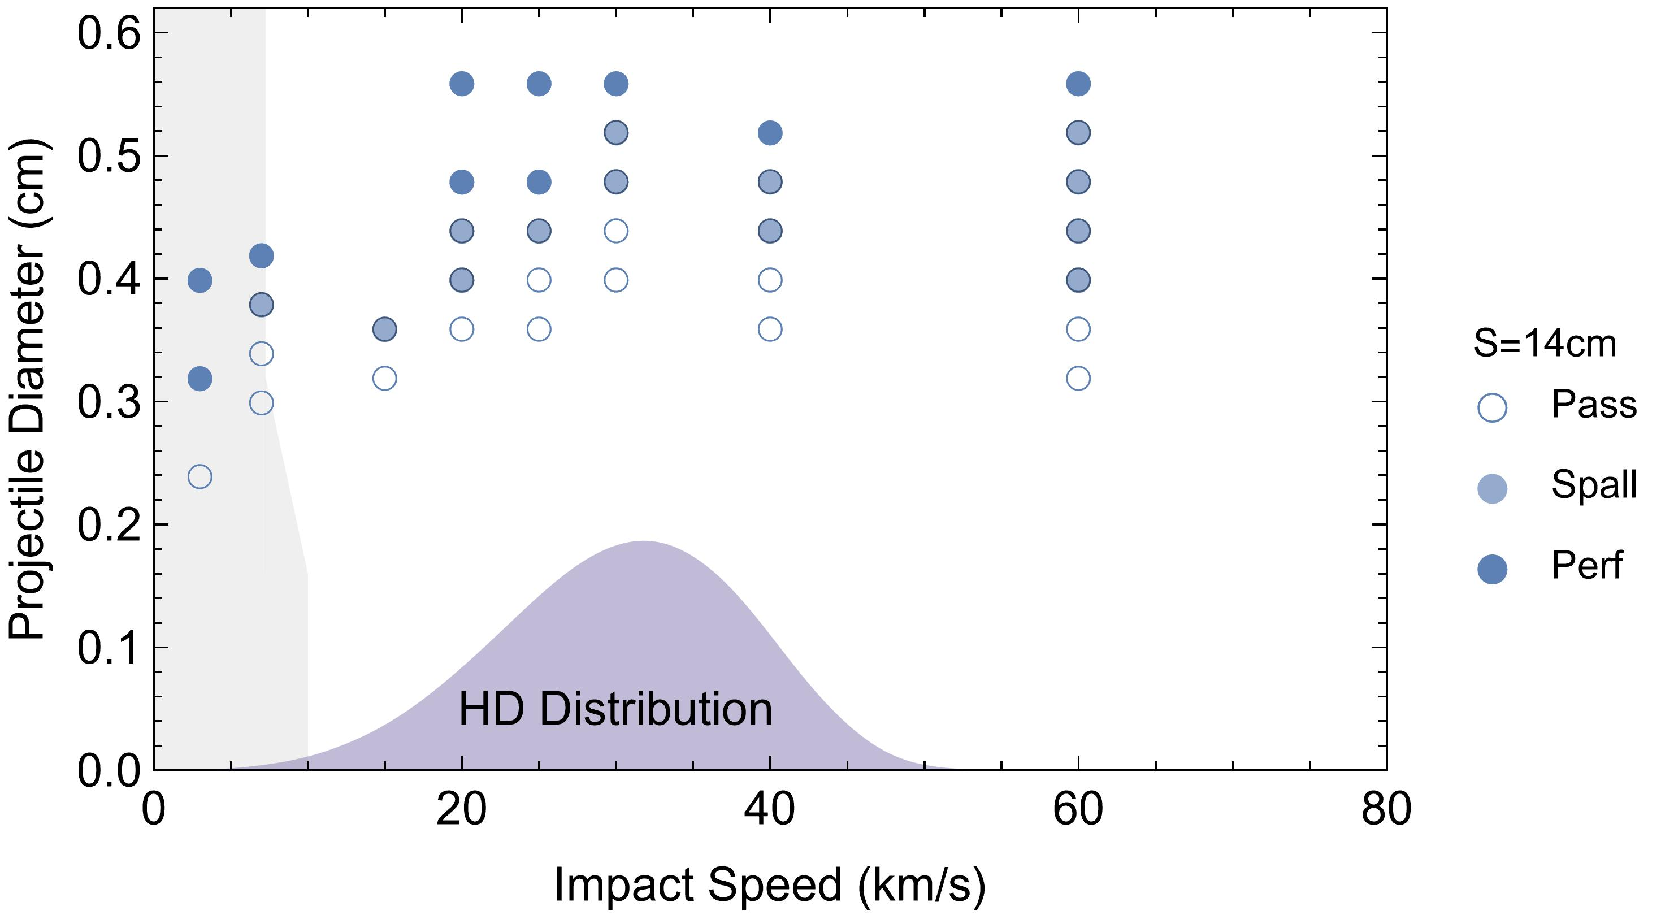
Simulations carried out over a high impact speeds to map performance above testable range
4.0 mm Al₂O₃ at 40 km/s
4.4 mm Al₂O₃ at 40 km/s
Bounding simulations carried out at 3, 7, 15, 20, 25, 30, 40 and 60 km/s
Many of the simulations are above the testable range but in the range of the meteoroid velocities of concern
Failure is taken as either detached spall or perforation
Taken together the simulations help improve extrapolation for ballistic limit equations
Fail

Slide 20
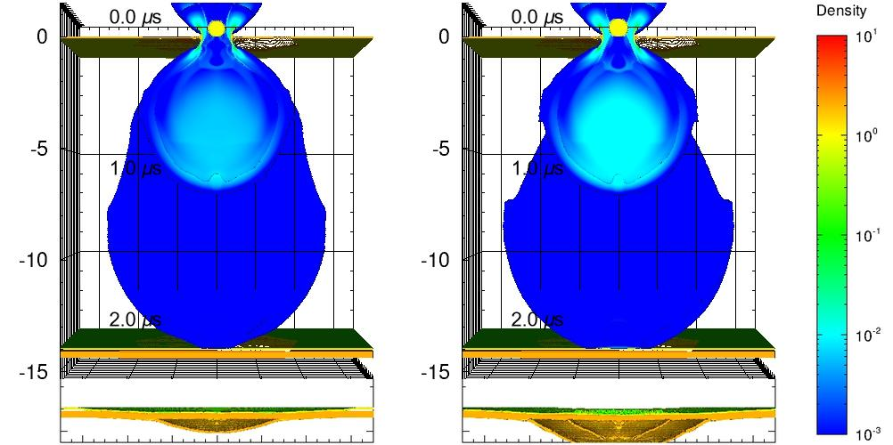
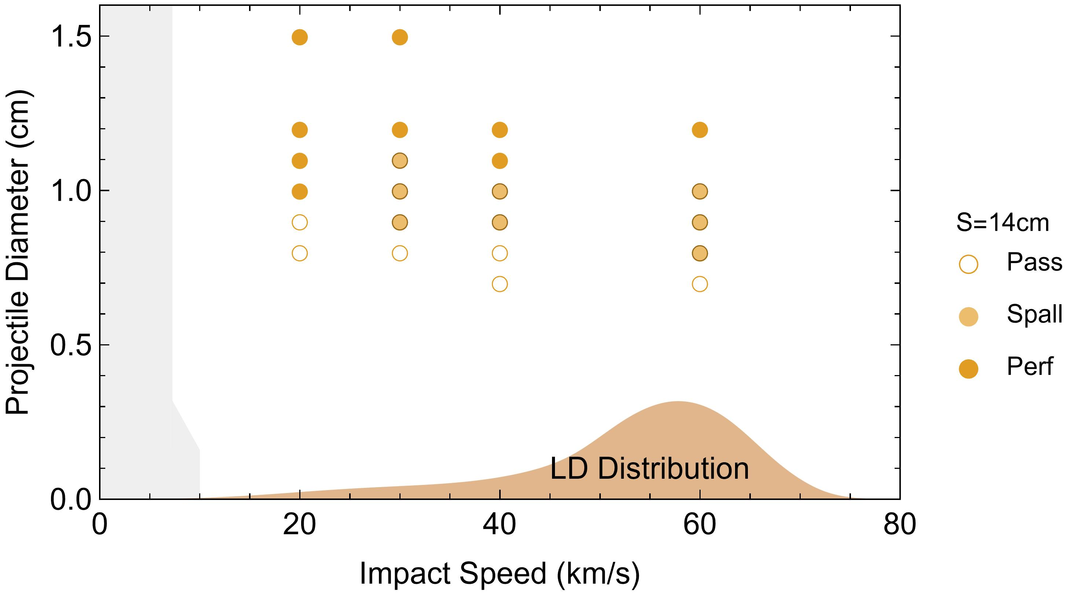
Simulations carried out over a high impact speeds to map performance above testable range
7.0 mm nylon at 60 km/s
8.0 mm nylon at 60 km/s
Bounding simulations carried out at 20, 30, 40 and 60 km/s
Simulations are above the testable range but in the range of the meteoroid velocities of concern
Failure is taken as either detached spall or perforation
Taken together the simulations help improve extrapolation for ballistic limit equations
Fail

Slide 21
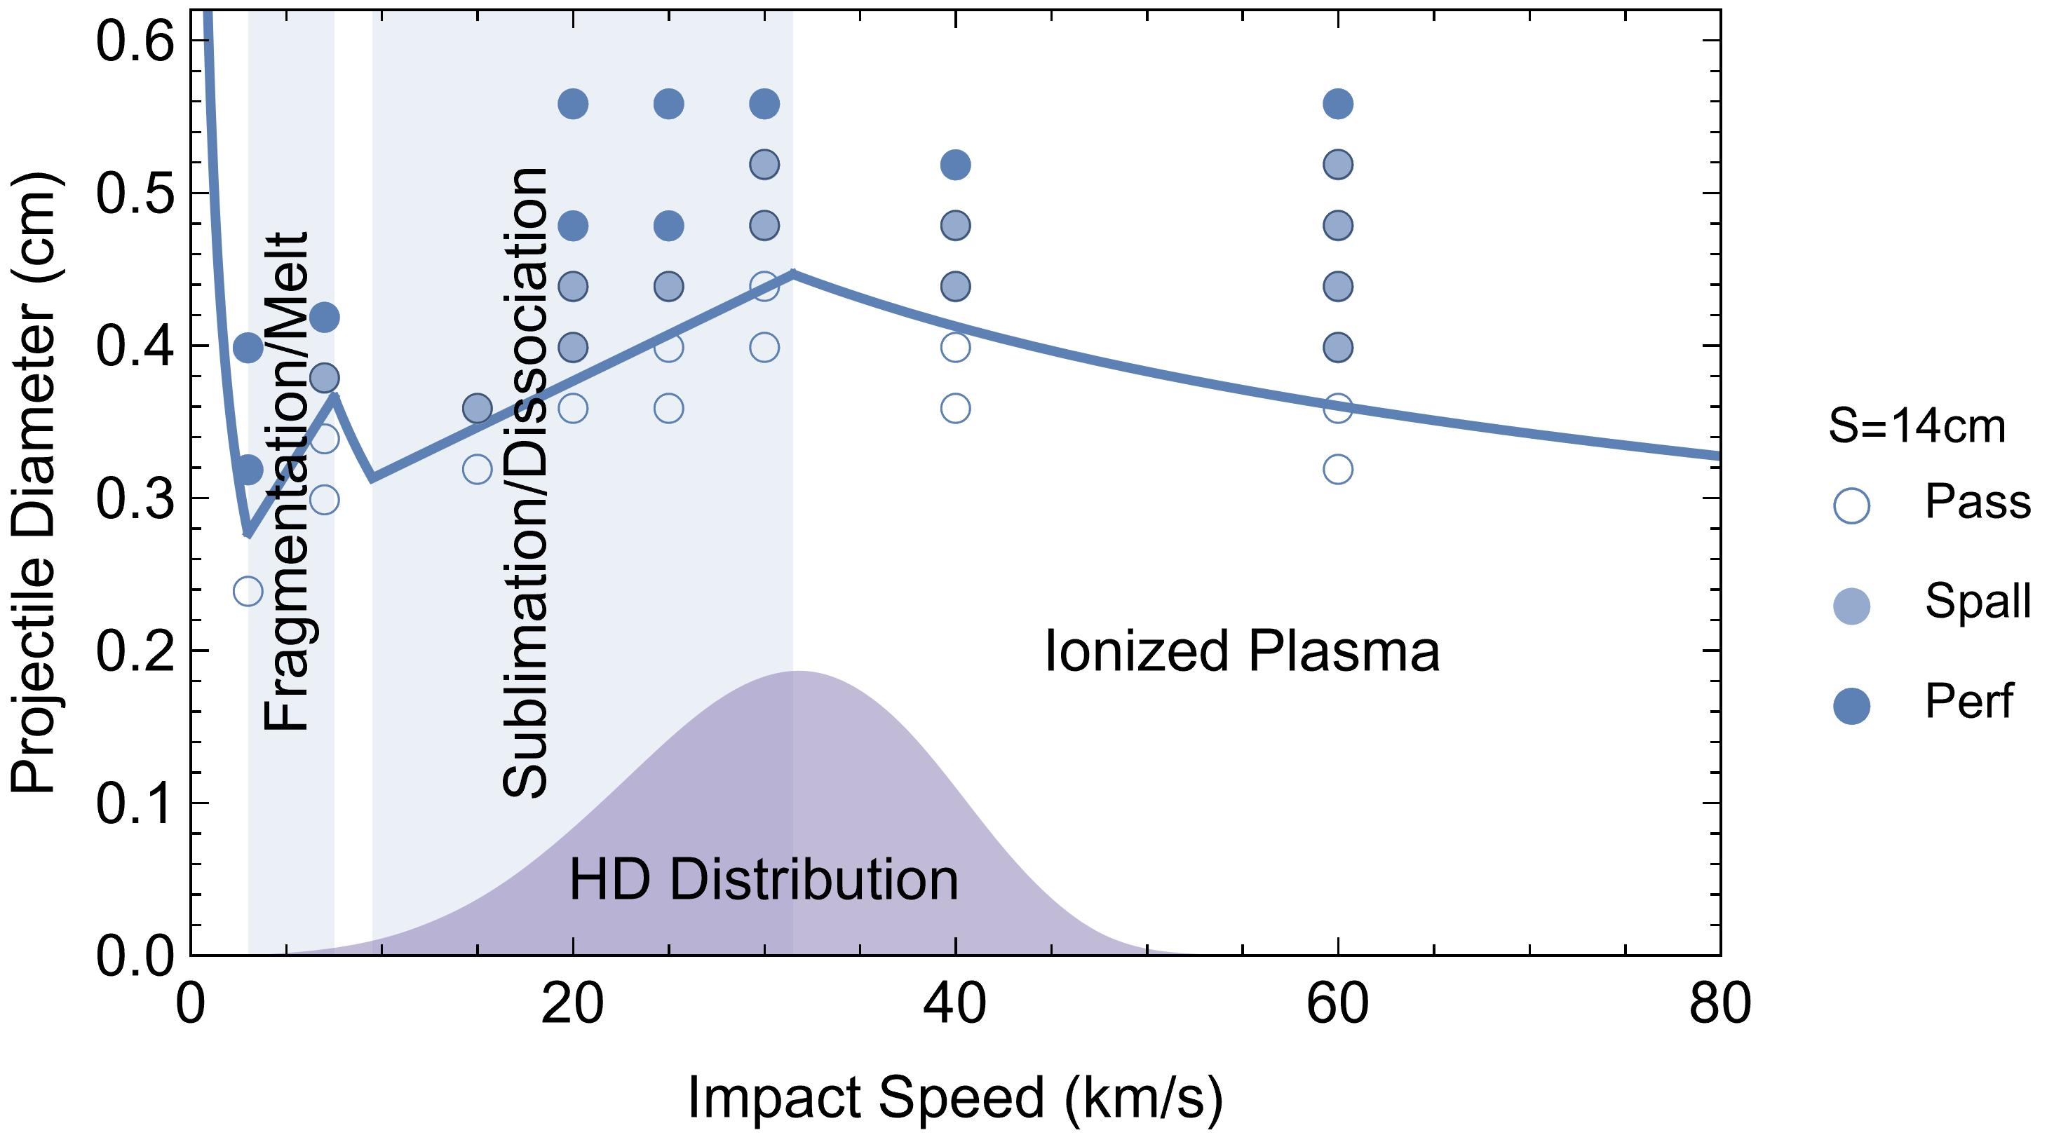
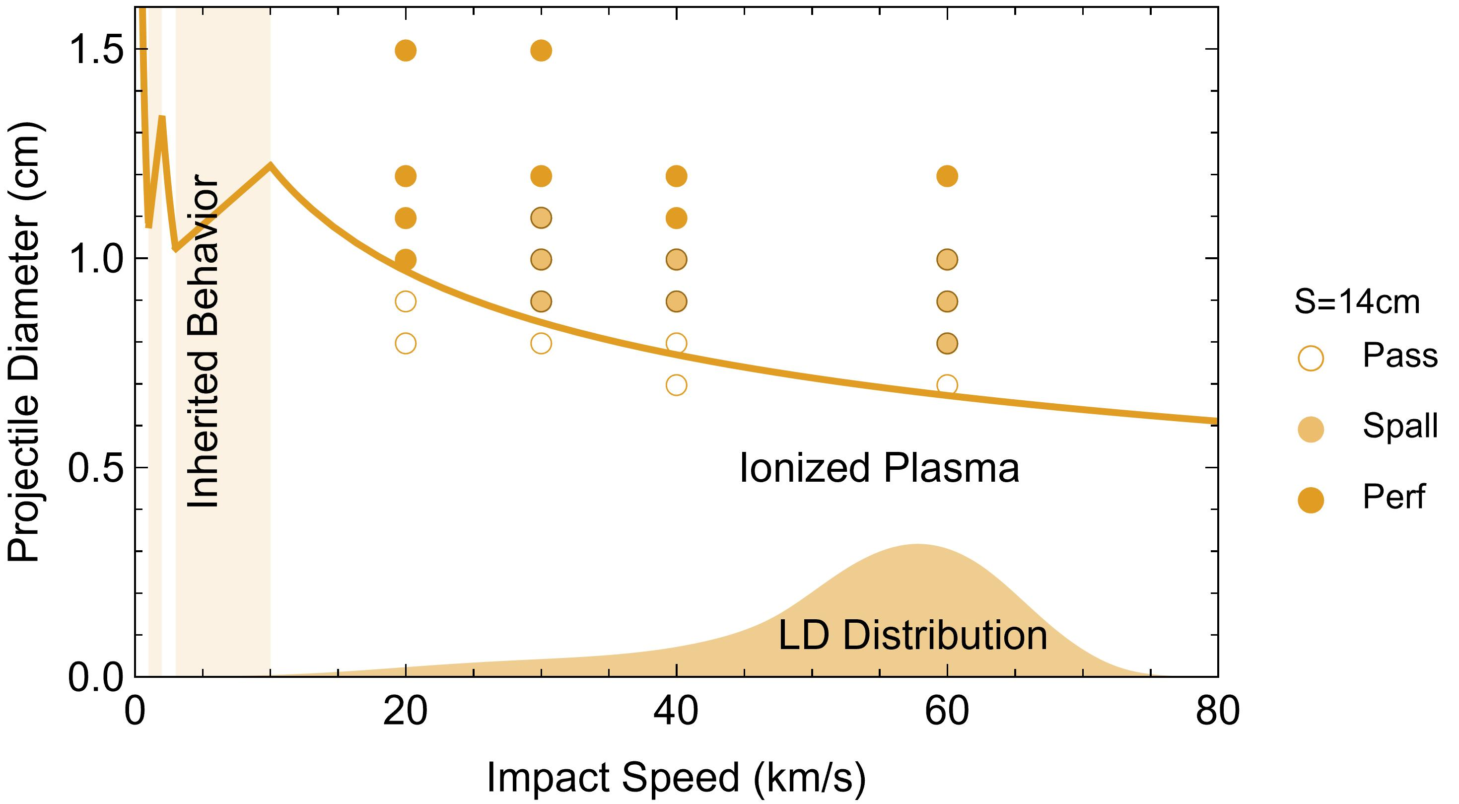
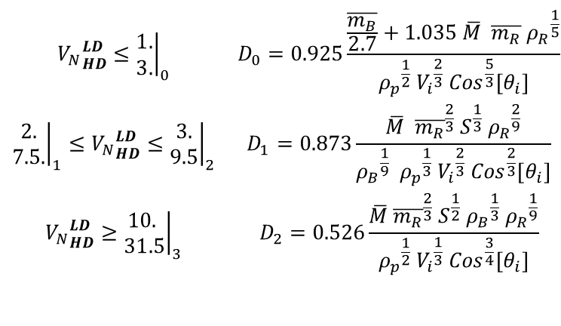
A piecewise, ballistic-limit model has been developed for these simulation observations
$$\begin{matrix}{V_{N}}_{HD}^{LD}≤{\left.\begin{matrix}1. \\ 3.\end{matrix}\right|}_{0} & D_{0}=0.925\frac{\frac{\overline{m_{B}}}{2.7}+1.035 \overline{M} \overline{m_{R}} {ρ_{R}}^{\frac{1}{5}}}{{ρ_{p}}^{\frac{1}{2}} {V_{i}}^{\frac{2}{3}} {Cos}^{\frac{5}{3}}\left[θ_{i}\right]} \\ {\left.\begin{matrix}2. \\ 7.5.\end{matrix}\right|}_{1}≤{V_{N}}_{HD}^{LD}≤{\left.\begin{matrix}3. \\ 9.5\end{matrix}\right|}_{2} & D_{1}=0.873\frac{\overline{M} {\overline{m_{R}}}^{\frac{2}{3}} S^{\frac{1}{3}} {ρ_{R}}^{\frac{2}{9}}}{{ρ_{B}}^{\frac{1}{9}} {ρ_{p}}^{\frac{1}{3}} {V_{i}}^{\frac{2}{3}} {Cos}^{\frac{2}{3}}\left[θ_{i}\right]} \\ {V_{N}}_{HD}^{LD}≥{\left.\begin{matrix}10. \\ 31.5\end{matrix}\right|}_{3} & D_{2}=0.526\frac{\overline{M} {\overline{m_{R}}}^{\frac{2}{3}} S^{\frac{1}{2}} {ρ_{B}}^{\frac{1}{3}} {ρ_{R}}^{\frac{1}{9}}}{{ρ_{p}}^{\frac{1}{2}} {V_{i}}^{\frac{1}{3}} {Cos}^{\frac{3}{4}}\left[θ_{i}\right]}\end{matrix}$$
Piecewise, ballistic-limit model for the projectile and bumper state
  Ballistic (largely unitary solid fragment)
  Fractured/molten (dispersed fragments/molten material)
  Plasma (diffusing vapor cloud)
Linear interpolation for mixed states at the threshold of failure

Slide 22
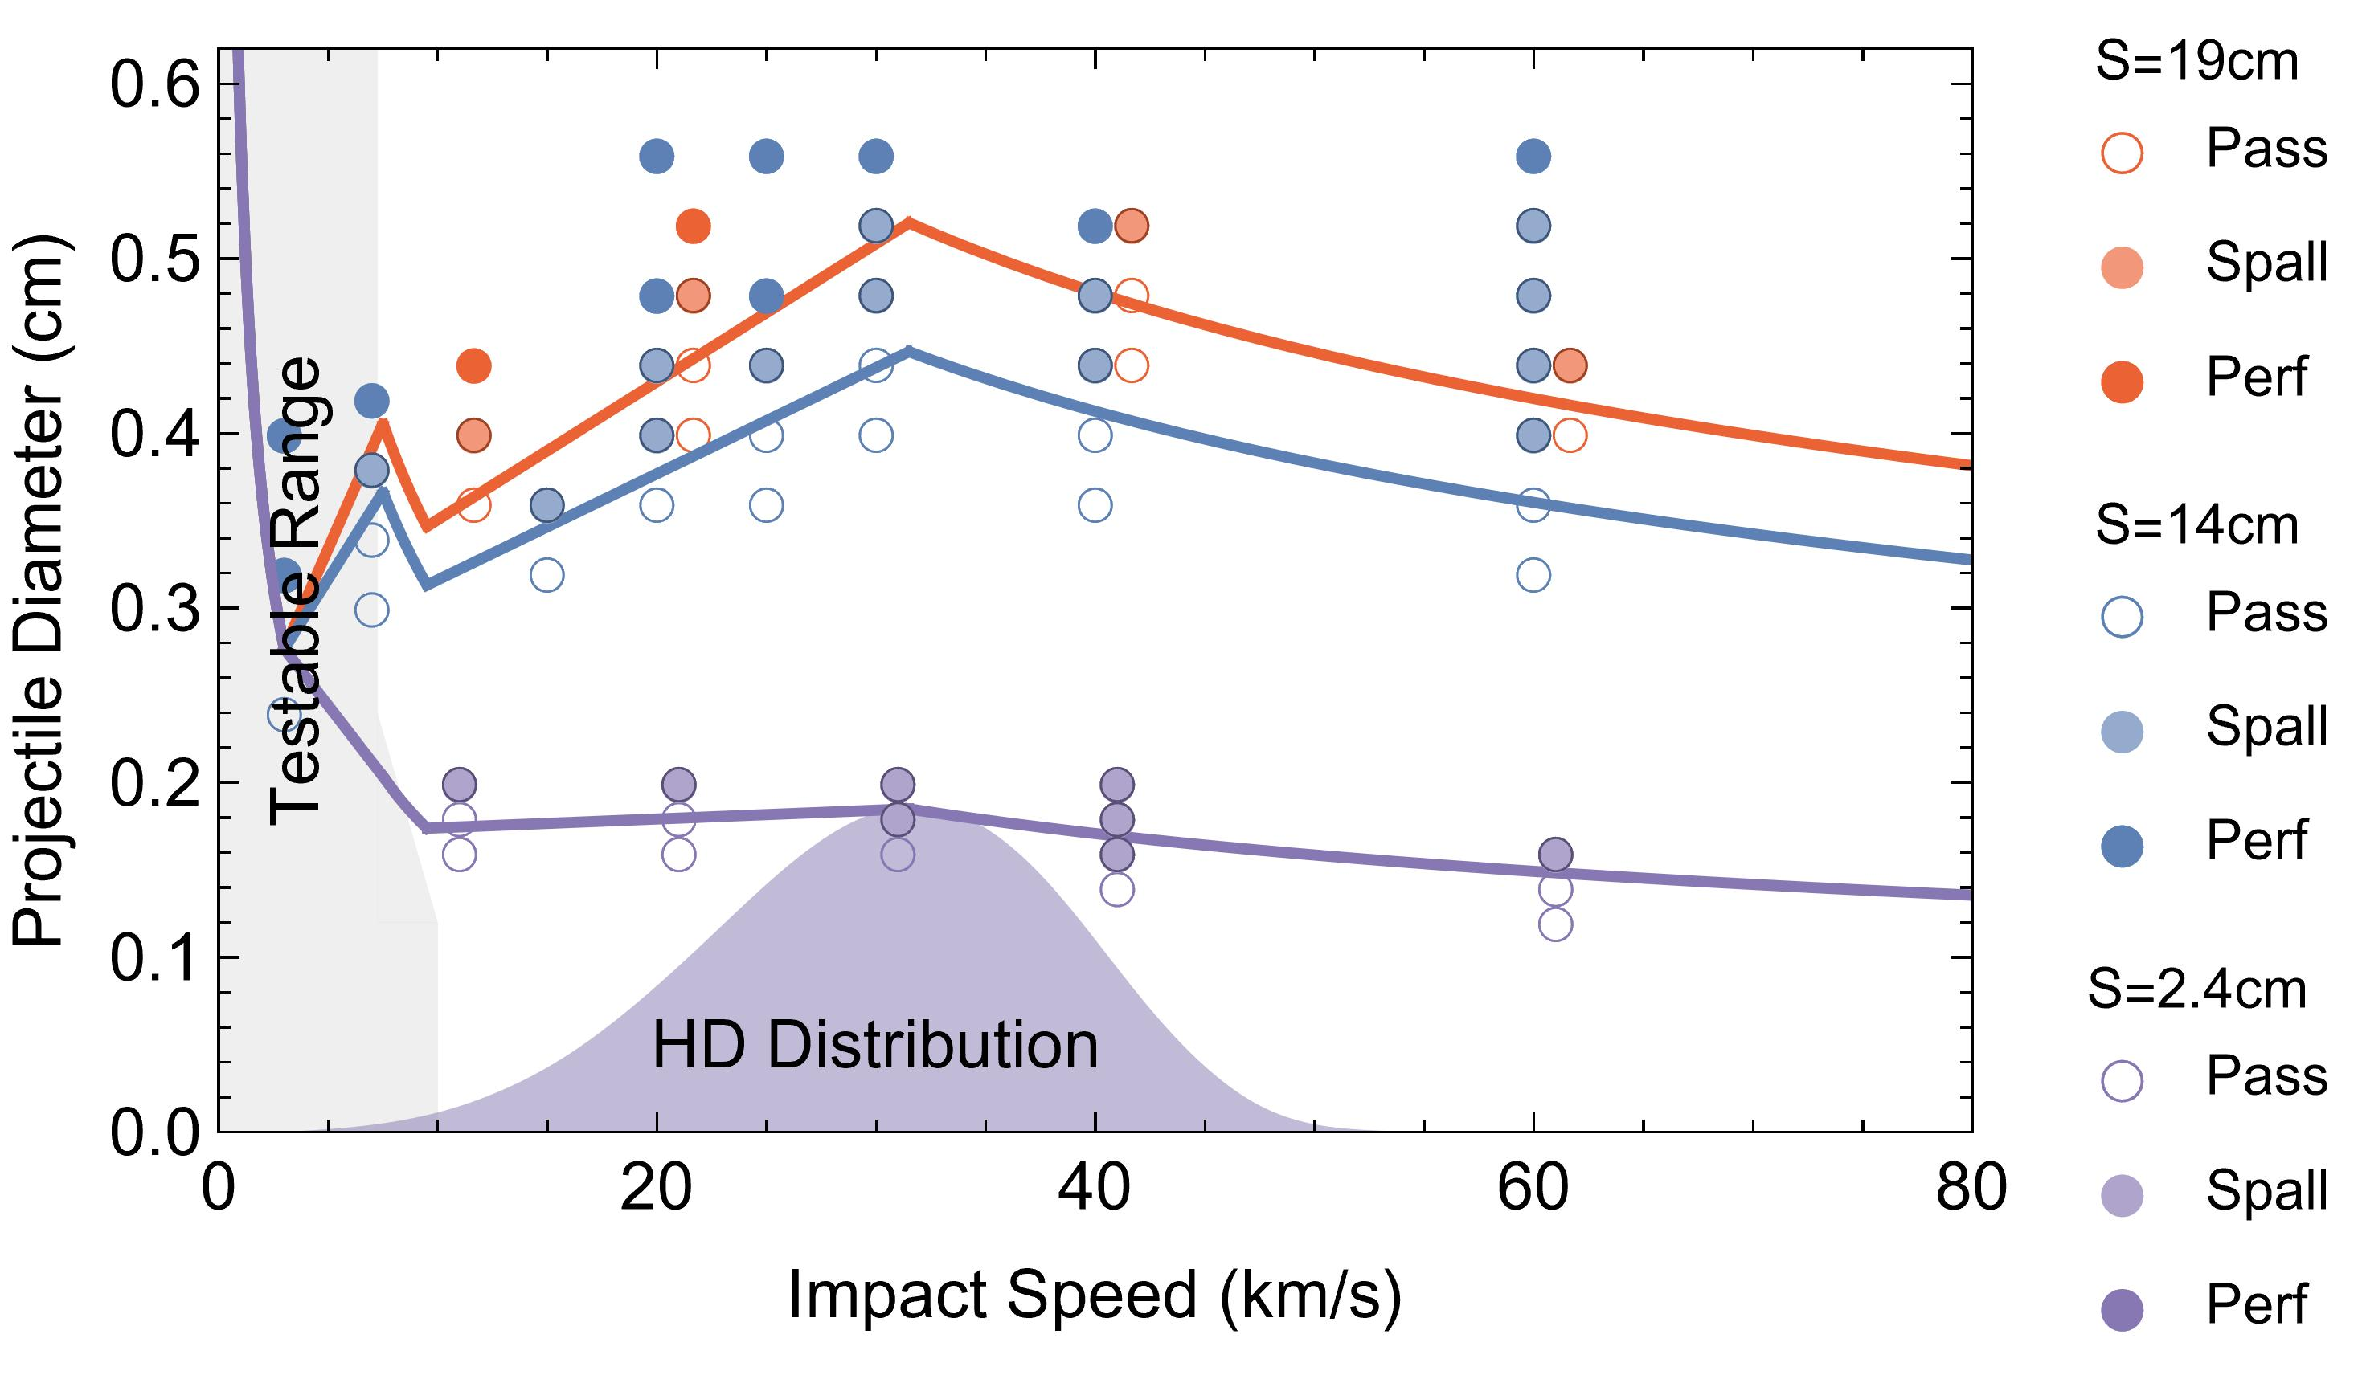

Simulations and model for variable separation at high impact speeds
0.08 cm Al6061
Variable Separation
0.065 g/cm² MLI
0.3 cm Al2219
Normal impact of Al₂O₃ and nylon near the ballistic limit.
Modeled performance against meteoroid surrogates
Different shield wall separations while all else his held constant
Data points are simulation results
Solid fill are penetration
Shaded fill are detached spall
No fill are intact shields

Slide 23


Simulations and model for oblique impacts at high impact speeds
4.8 mm Al₂O₃ at 40 km/s
5.2 mm Al₂O₃ at 40 km/s
Oblique impact of Al₂O₃ near the ballistic limit.
Modeled performance against meteoroid surrogates
Shield is a common Gateway configuration of 14 cm
Different impact obliquities while all else his held constant
Data points are simulation results
Solid fill are penetration
Shaded fill are detached spall
No fill are intact shields
Shield obliquity impacts with plates separated by 14 cm and rotated 45° to projectile velocity vector
Simulations just below and above failure limit
Simulations carried out over impact speed
Simulations also performed at 30° obliquity

Slide 24


Simulations and model for variable rear wall material at high impact speeds
0.08 cm Al6061
2.4 cm
0.065 g/cm² MLI
0.3 cm Al2219
0.11 cm CRES316L
Rear walls are approximately equal mass but varied density
Simulations for high- and low-density meteoroid surrogates
Shield properties constant with 2.4 cm separation
Data points are simulation results
Solid fill are penetration
Shaded fill are detached spall
No fill are intact shields

Slide 25


Simulations and model for variable rear wall thicknesses at high impact speeds
0.08 cm Al6061
9.6 cm
0.065 g/cm² MLI
Varied Al2219
Rear walls are varied thickness
Simulations for high- and low-density meteoroid surrogates
Shield properties constant with 9.6 cm separation
Data points are simulation results
Solid fill are penetration
Shaded fill are detached spall
No fill are intact shields

Slide 26
Lunar Gateway reliability and survivability analyses simulation (conclusions)
Lunar Gateway is an international collaboration to build a long-duration, habitable outpost that orbits the moon with close approaches and distant loiters to ease surface operations on the moon at its poles
As a result of its large size and long duration of operation, meteoroids pose challenges that have not been realized in previous experiences
To address these challenges, hydrodynamic impact simulations are a necessary part of determining Lunar Gateway shield performance
This paper describes the effort to extend ground-based testing and simulation model development to design equations for the Lunar Gateway’s shields

