Slide 1
Solar Array Performance
Modeling for NASA’s Artemis Missions
28th SPRAT (Space Photovoltaic Research & Technology) Conference
Cleveland, OH
Sept 4-6, 2024
Spencer Furin
NASA Glenn Research Center
spencer.c.furin@nasa.gov
Brandon Klefman
NASA Glenn Research Center
Brandon.klefman@nasa.gov
Hector Hernandez
NASA Johnson Space Center
hector.hernandez@nasa.gov

Slide 2
Overview
NASA’s Artemis Campaign
Unique PV challenges for human spaceflight
SPACE
The Integrated SPACE Solar Array Model
  Array Electrical Design
  Solar Cell IV Curve
  Solar Cell Thermal Modeling
  Degradation
  Shadowing
Orion Artemis I performance vs predictions
Conclusion

Slide 3
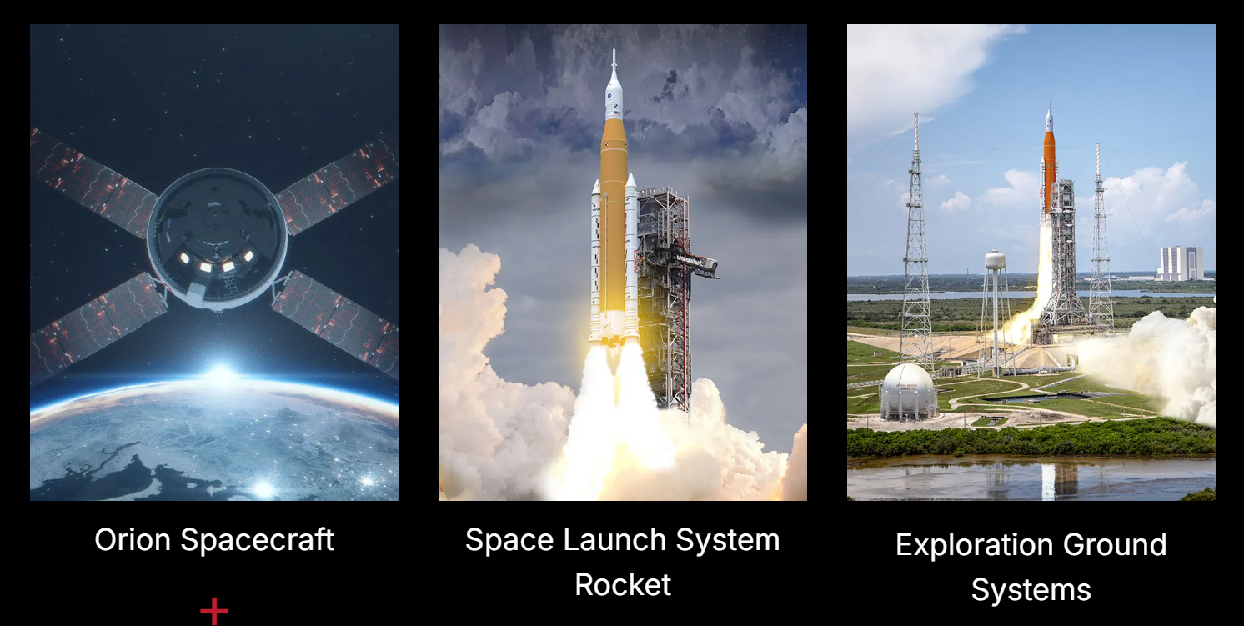
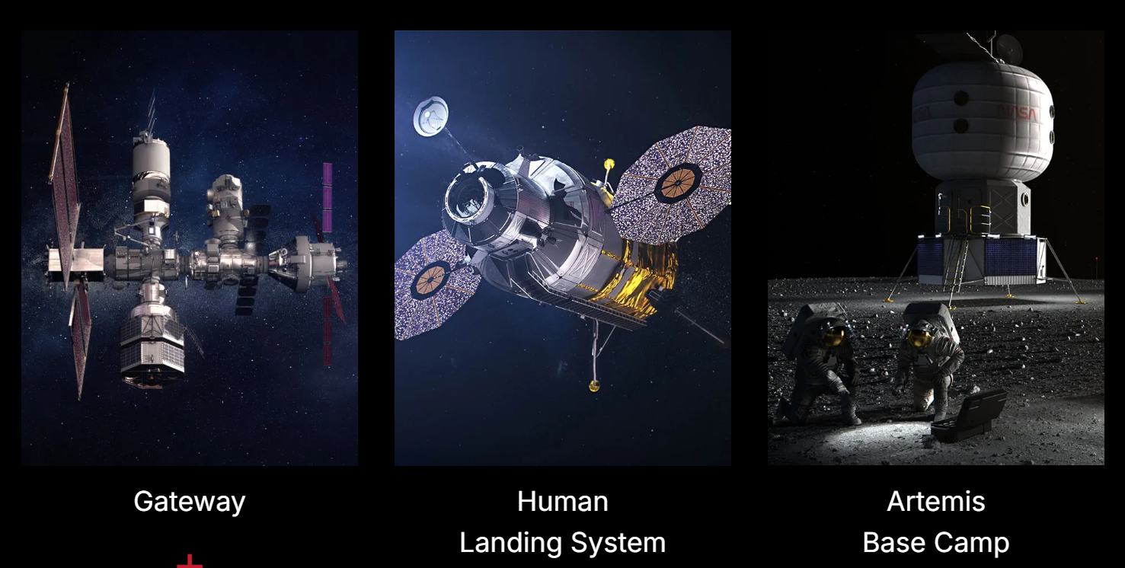
NASA’s Artemis Campaign
Lunar exploration will require a variety of vehicles and capabilities
Power is a critical function necessary to enable everything else
  Developing a power system is the #1 infrastructure goal for both Lunar and Mars in NASA’s Moon to Mars Strategy and Objectives document
  Several Artemis systems do (or may ) utilize solar arrays for power generation

Slide 4
PV-Powered Human Spaceflight
Photovoltaic power generation has advantages especially for long-duration missions
  Only renewable resource available in space
Complexities of human spaceflight present challenges for solar power
  High and variable load demand → larger arrays
  Long mission duration, high reliability requirements → additional testing, redundancy
  Large magnitude propulsion, attitude control thruster firings → array positioning constraints for loads, thermal
  Rendezvous and docking with other vehicles → shadowing
  Complex mission design → eclipse proximity to other stressing events
Successfully navigating these challenges requires accurate modeling to analyze the power system performance

Slide 5
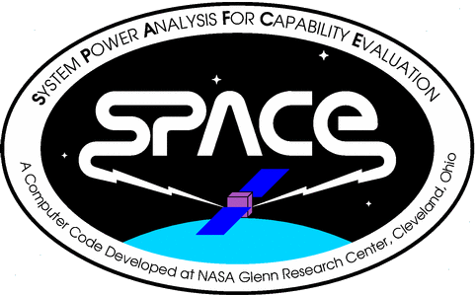
What is SPACE?
SPACE (System Power Analysis for Capability Evaluation)
is a computer model used to predict the electrical
performance of space-based power systems
Developed entirely at NASA Glenn Research Center
  Working closely with customers and collaborators at
  NASA Johnson Space Center
Critical for assessing electrical power systems (EPS) that cannot be
assembled & tested end-to-end on the ground
  Physical size
  Incremental assembly
  Environment
SPACE determines EPS capability and predicts the EPS state (power generation,
battery SoC, etc.)

Slide 6
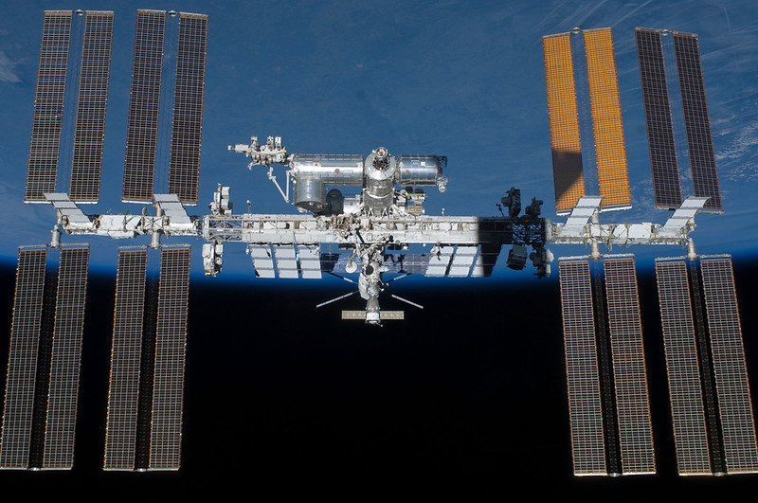
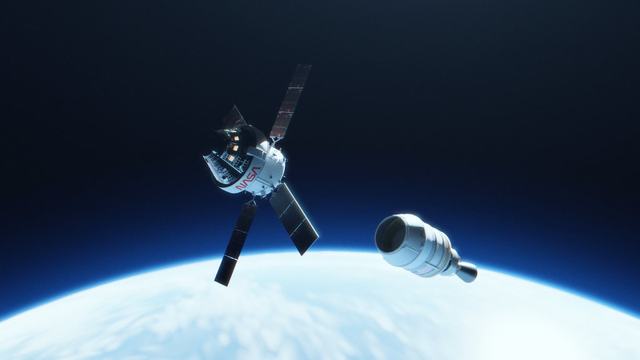
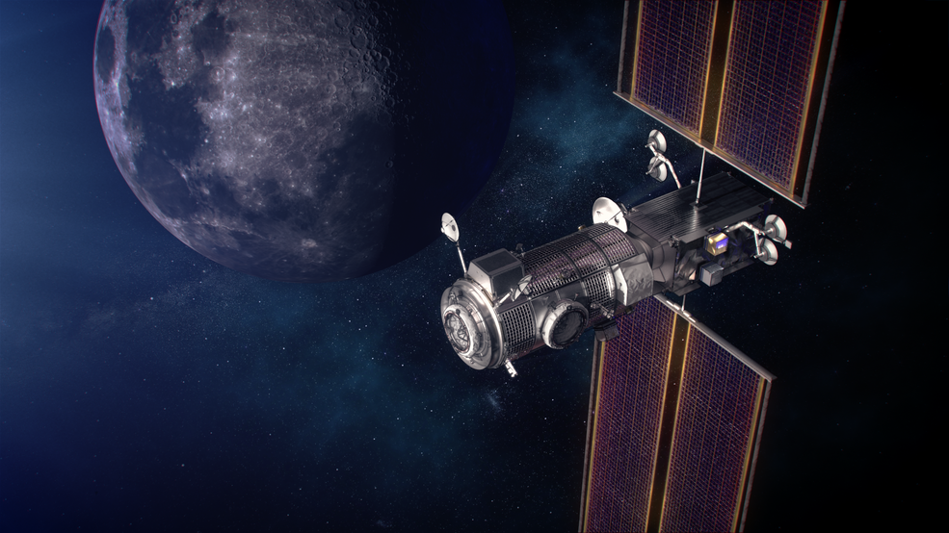
SPACE Use Cases
Vehicle | ISS | Orion | Gateway / PPE
Used | 1988 - present | 2010 - present | 2018 - present
Solar Cell Technology | Silicon | 3-junction III-V | 4-junction III-V
EPS Architecture | Regulated | Unregulated | Regulated
Trajectory | Circular LEO | LEO, Translunar Direct, NRHO | Earth Orbit Raise, NRHO
Current/Future Model Usage | Mission planning/trade studies | Mission planning/trade studies IV&V of contractor models | Design trade studies IV&V of contractor models Requirements verification Real-time operations
Unique Challenges | Beyond-EOL age | Launch, entry, aborts | Solar Electric Propulsion
Notes:
PPE: https://www.nasa.gov/press-release/nasa-awards-contract-to-launch-initial-elements-for-lunar-outpost/
EP: https://www.nasa.gov/feature/nasa-gives-solar-ionic-propulsion-a-monster-boost
Orion image: https://www.nasa.gov/feature/around-the-moon-with-nasa-s-first-launch-of-sls-with-orion/

Slide 7
SPACE is a Complex Integrated Model
Accurately modeling solar cell performance requires knowledge of the integrated spacecraft
  Off-nominal attitudes & off-pointed conditions
  Degradation (function of time on-orbit)
  Temperature
  Solar flux
  Environment (LEO, GEO, lunar orbit, etc.)
SPACE accounts for these many factors and provides a robust solution to assess a wide variety of mission operating conditions
  Solar array code fully integrates multiple components: solar cell IV modeling, array electrical design, PMAD, degradation, thermal, shadowing

Slide 8
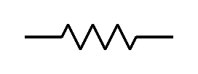

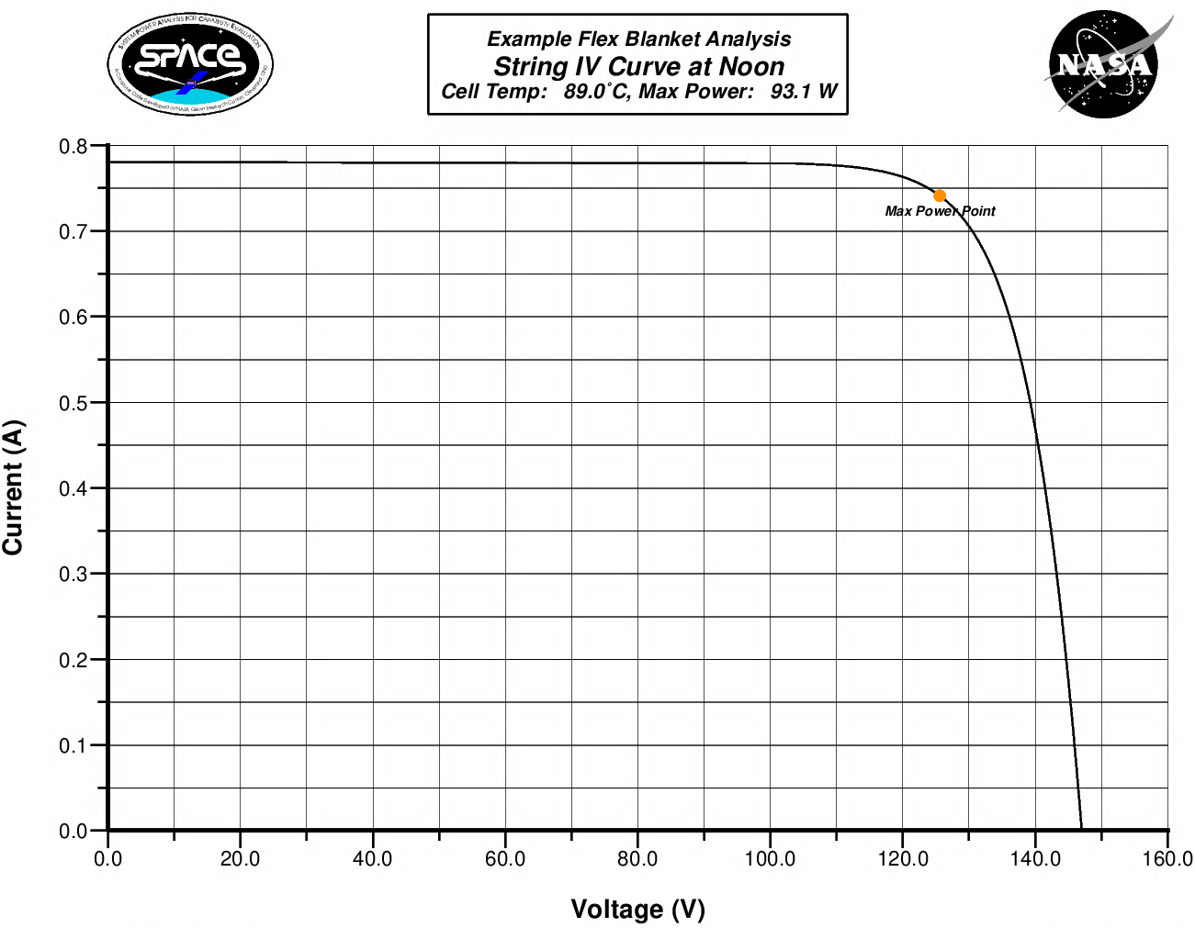
Solar Array Model
SPACE models the entire solar array electrical design
  From solar cells to the upstream array regulator and any discrete components in between
  User specifies the desired operating voltage of the solar array, or SPACE can utilize the maximum power point
Individual strings are modeled, accounting for appropriate connections to PMAD channels
  Blocking diode voltage drop, harness losses, & array regulator voltage drop are all modeled
  IV curve is re-generated for any partially shadowed solar array strings to determine operating point
  Accounts for PMAD channelization, which routes the solar array power to the appropriate spacecraft loads
Array Regulator
R_{circuit}
R_{string}
V_{blocking}
V_{ARU} / R_{ARU}
Strings of Solar Cells
Main Bus

Slide 9
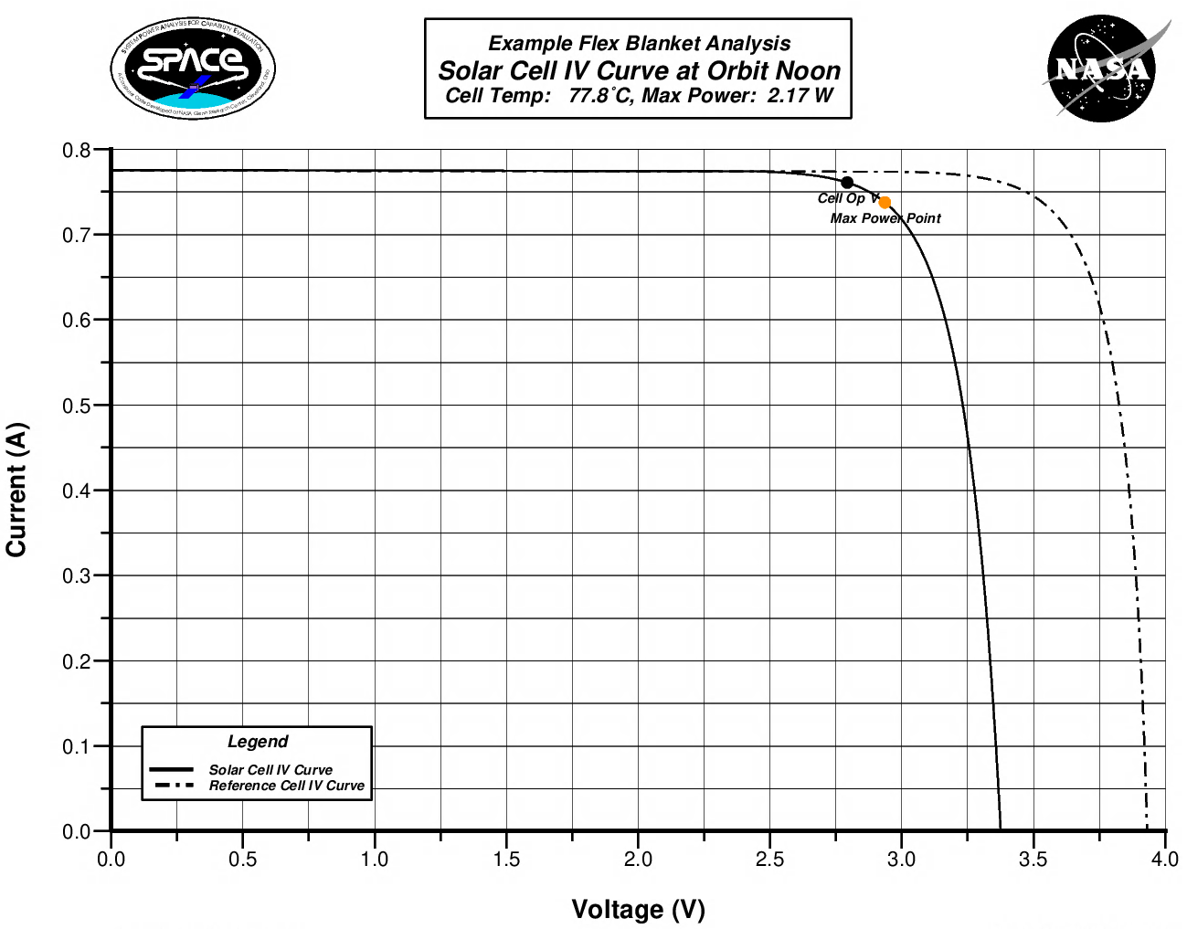

Solar Cell IV Model
Solar cell IV curve generated using the Hughes model¹
  Solar cell operating voltage determined by user input minus voltage drop in upstream components (harness, diodes)
  When Hughes model cannot find a solution, SPACE resorts to a simple linear model
Highly robust – Hughes model solves even with non-optimal conditions
  Can model beyond EOL conditions (e.g., ISS) at extreme temperatures, in off-nominal scenarios, and more
  Challenging to integrate newer/other solar cell IV models, as robustness is a unique advantage of SPACE
$$I=I_{sc} −I_{sc}K_{2}\left[exp\left(\frac{V+IR_{s}}{K_{1}V_{oc}}\right) −1\right]$$
¹ Rauschenbach, H. S. (1976). Solar Cell Array Design Handbook. NASA Technical Reports Server. https://ntrs.nasa.gov/citations/19770007250

Slide 10
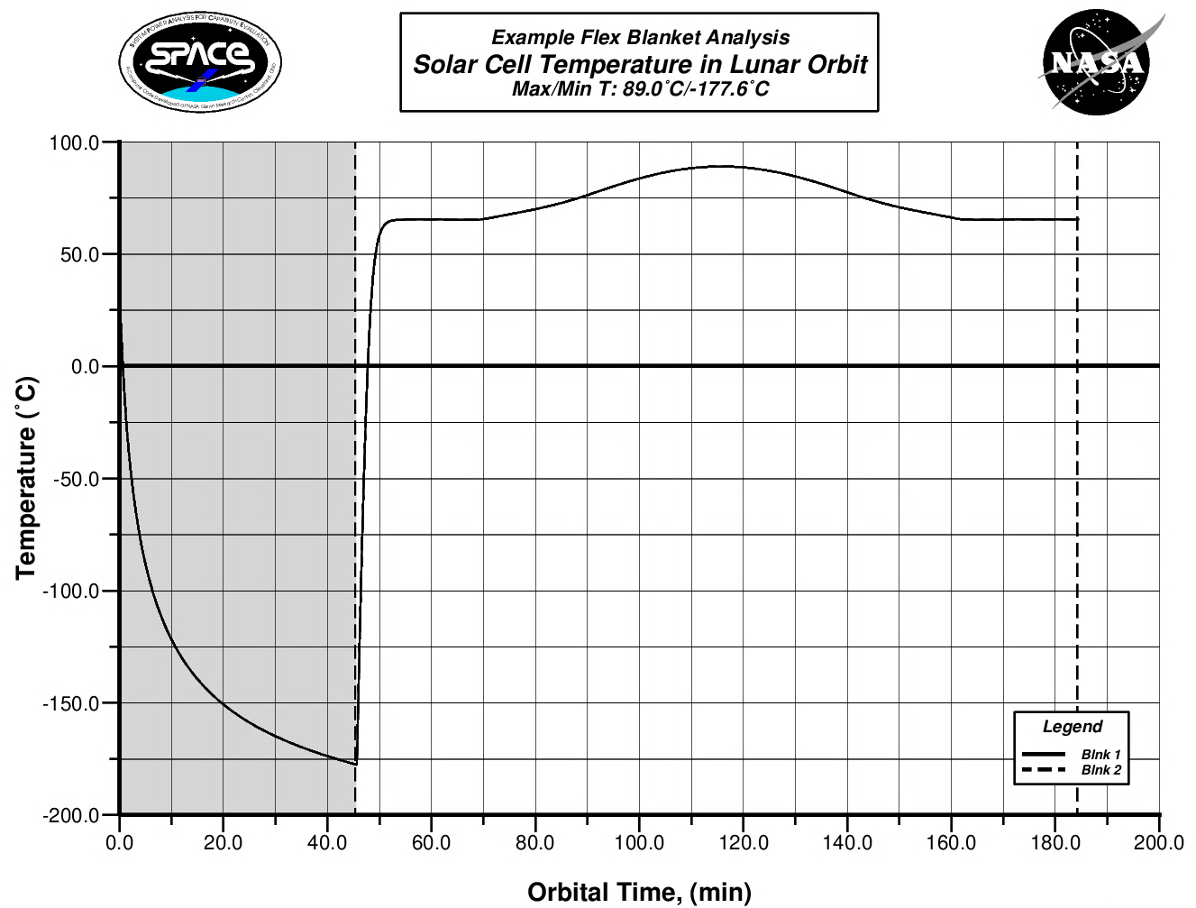
Generic N-Node Solar Cell Thermal Model
Simplified thermal model designed to predict solar cell operating temperatures in various operational conditions & environments
  Generalized nodes allow flexibility in modeling different types of solar cells & substrates (supports flex blankets and rigid panels)
  Models degradation of material properties & variation due to temperature
  Time-phased model predicts temperature in eclipse & sunlight
  Limited to modeling solar cell alone in space (emulates tip of wing); neglects cross-wing conduction & spacecraft heating effects
Iterative calculation with cell IV model, as cell power generation varies with solar cell operating temperature
  This thermal model is integrated within the SPACE solar cell IV code (not a separate model)
1
1
2
4
Coverglass
Solar Cell
2
3
Foam
Substrate
Examples of 2- and 4-node models of solar cells on a rigid panel or flexible blanket substrate

Slide 11

Degradation Model
Degradation Mechanisms in SPACE
Modeling/Measurement Uncertainty | Thermal Cycling
Cell Mismatch Loss | Atomic Oxygen
Blanket Flatness Angle | Plasma Sputtering
Glassing Loss | Contamination
MMOD | Rework Loss
UV Darkening | Random Failures
Radiation | Other Losses
Degradation modeling is data-driven & generic
  Variety of knockdown factors are available and specified as inputs to SPACE
  Factors are all time-phased, allowing variation in damage throughout a multi-year mission
  Radiation can be specified as an annualized fluence or a time-phased profile; SPACE calculates knockdown factors accordingly
  Knockdown factors are specified independently for each cell property: Isc, Imp, Vmp, & Voc
  Provides flexibility to tune the model with on-orbit telemetry
Modeling the radiation during the EOR phase of PPE is a new challenge for SPACE
  Significant radiation damage during first year of flight due to the spiral through the radiation belts
  Results in non-linear degradation profile over the life of PPE

Slide 12
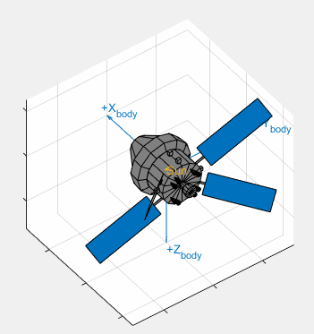
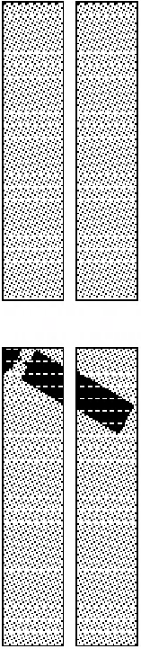
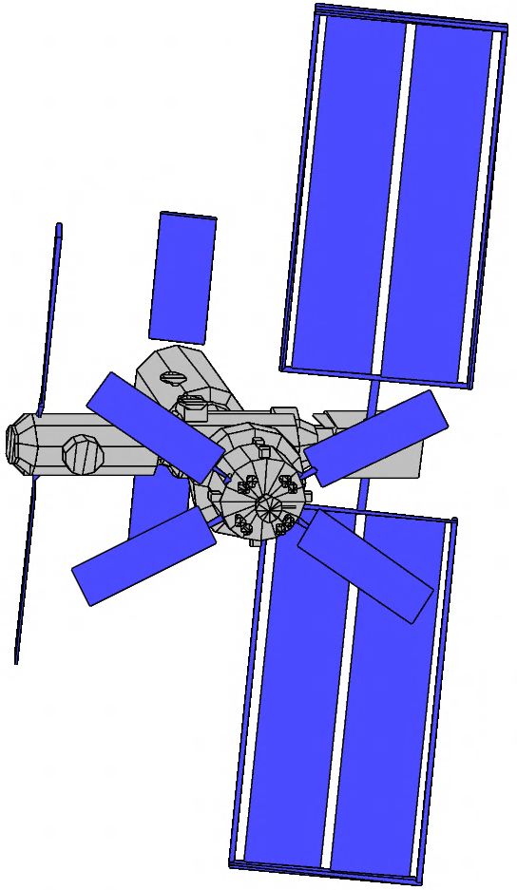

Shadowing Model
Calculates shadows cast by nearby hardware to compute realistic array power
  Uses actual solar cell & wiring layout
  Properly computes string-by-string power loss (not just shadowed area)
SPACE shadowing process:
  Model external spacecraft geometry on-orbit
  Incorporate electrical layout for array(s) of interest
  Orient vehicle (attitude) & gimbal components
    Optimize array/radiator pointing within constraints
    Account for gimbal locks, keep-out zones, etc.
  Calculate solar array shadow patterns
    3D ray intersection method
    Every solar cell checked for shadowing
  Assess array performance from shadow patterns
(4)
(1, 2, 3)
(5)

Slide 13
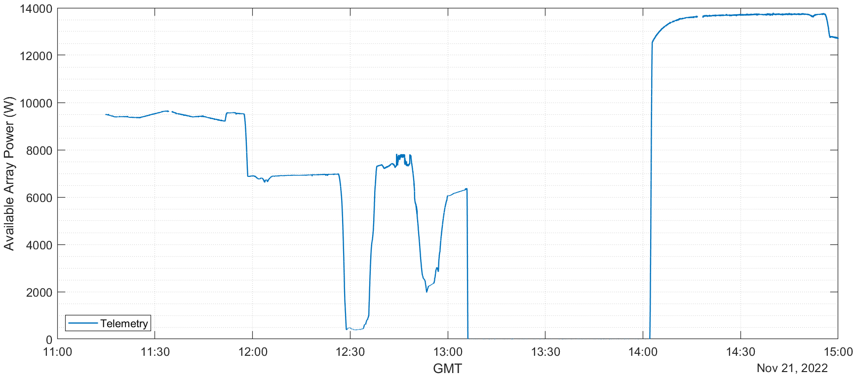
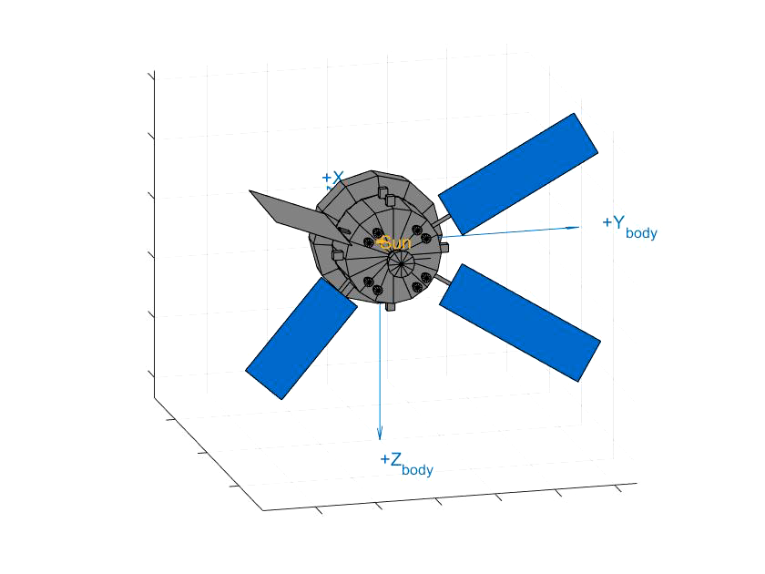
SPACE Comparison to Artemis I Flight Data
Array parking + maneuver
for lunar flyby burn
Eclipse

Slide 14
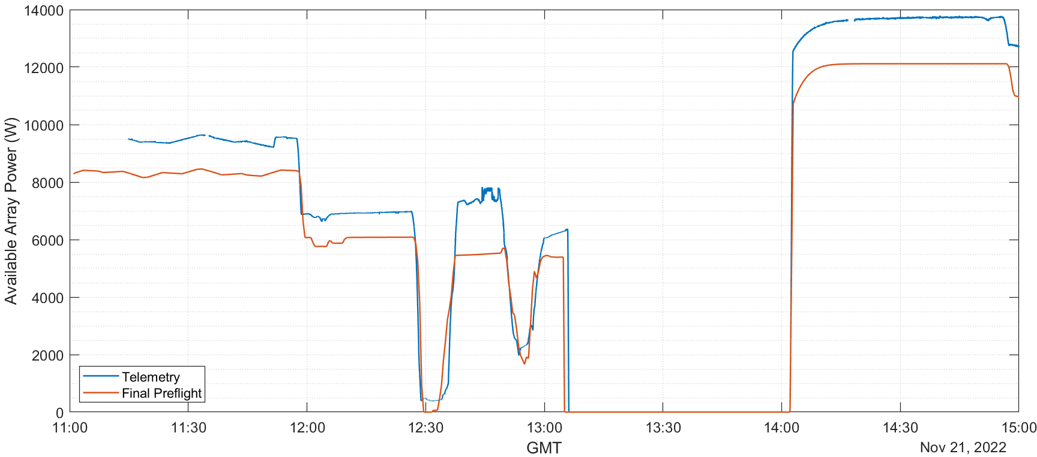
SPACE Comparison to Artemis I Flight Data
Array parking + maneuver
for lunar flyby burn
Eclipse
Preflight analysis designed to be bounding – conservative assumptions on degradation and minimum annual solar flux

Slide 15
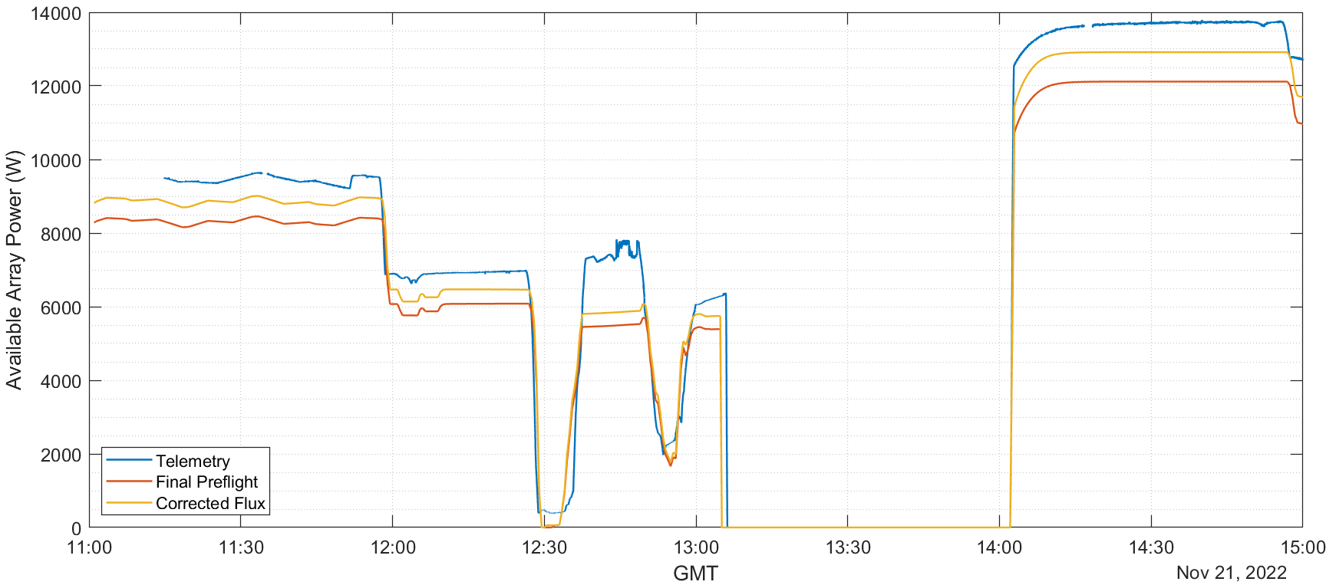
SPACE Comparison to Artemis I Flight Data
Array parking + maneuver
for lunar flyby burn
Eclipse
Using as-flown solar flux reduces underprediction by ~50%

Slide 16
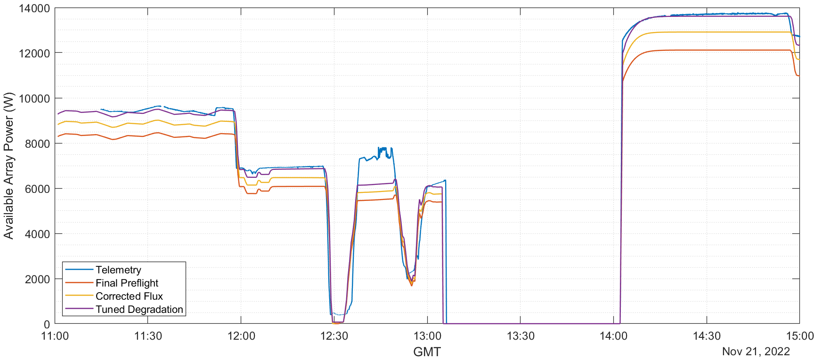
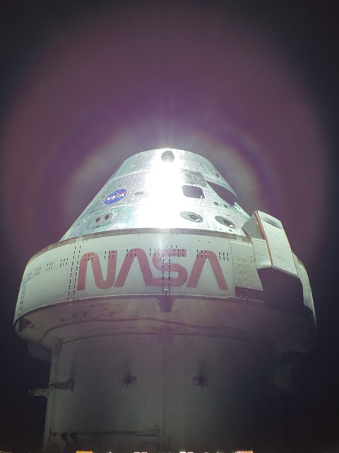
SPACE Comparison to Artemis I Flight Data
Array parking + maneuver
for lunar flyby burn
Eclipse
Remaining notable discrepancy due to glint (not modeled in SPACE)

Slide 17
Conclusions
Accurate modeling of PV-based spacecraft power systems is essential to the success of ever-more-complicated missions
GRC’s SPACE code is a complex integrated tool that provides that capability
  SPACE has been used in support of engineering development & operations of NASA’s leading human spaceflight programs for over 30 years, and will continue to do so in the future

Slide 18
Acknowledgements
Special thanks to Jeff Hojnicki, Tom Kerslake, & Dave McKissock for their excellent mentorship over the years while passing the baton to the next generation of the SPACE team.
Adam Sajdak
Alex Jurcago
Amy Bartlett
Andy O'Connor
Ann Delleur
Barb McKissock
Barb Olsafsky
Ben Abshire
Ben Curatolo
Beth Hietanen
Bill Stone
Bob Green
Bob Klimek
Bobby Millinghausen
Brandon Klefman
Brendan Cheng
Brian Munguia
Bruce Canright
Bruce Manners
Carlos Rodriguez
Caroline Austin
Charlie Finlay
Clint Ensworth
Colleen Withrow
Connor Beierle
Courtney Gras
Cynthia Munoz
Danny Robert
Dave Hoffman
Dave McKissock
Dave Smith
Dean Petters
Derek Roberts
Destinee Jackson
Dick Secunde
Dylan Pederson
Eric Gustafson
Erin DeWillie
Erin Tesny
George Kukich
Greg Mackey
Greg Newstadt
Ian Dux
James Blankschaen
James Fincannon
Jeff Farmer
Jeff Follo
Jeff Hojnicki
Jeff Trudell
Jim Guptill
Jim McKim
Joanne Walton
John Dunning
John Straigis
Jorge Colón
José Davis
Josh Freeh
June Zakrajsek
Kandee Hogan
Katie Bechtold
Kevin Duncan
Kristen Bury
Kristen McDougal
Lance Jacobsen
Laura Stokley
Lisa Lambert
Livette Santiago
Lucia Tian
Mackenzie Lykins
Mark Cutshaw
Mary Vickerman
Michael Collins
Michelle Northcutt
Natalie Goldin
Nick Schifer
Nicole Scholtz
Pam Hudson
Pat Folz
Pete Staiger
Ray Burns
Rochelle May (Sears)
Sandy Reehorst
Sara Miller
Sarah Bergstrom
Sarah Tipler
Shuonan Dong
Spencer Furin
Stephen MacNeil
Stephen Ryan
Steven Korn
Stuart Wodzro
Terrian Nowden
Thomas Patton
Thuy Truong
Tom Hacha
Tom Kerslake
Tony Jannette

Slide 19
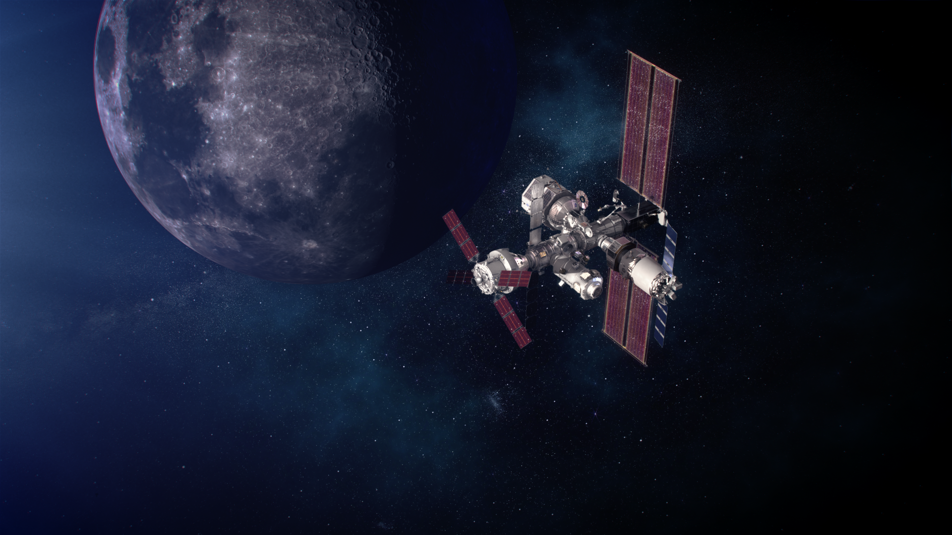

Questions?
Spencer Furin & Brandon Klefman
NASA Glenn Research Center
Hector Hernandez
NASA Johnson Space Center

Slide 20
Acronyms Used
BOL Beginning of Life
EOL End of Life
EOR Earth Orbit Raise
EPS Electrical Power System
GEO Geostationary Earth Orbit
GRC Glenn Research Center
Imp Max-Power Current
Isc Short-Circuit Current
ISS International Space Station
IV Current-Voltage
IV&V Independent Verification & Validation
LEO Low Earth Orbit
MMOD Micrometeoroids & Orbital
Debris
NRHO Near-Rectilinear Halo Orbit
PMAD Power Management and
Distribution
PPE Power & Propulsion Element
PV Photovoltaic
SoC State of Charge
SPACE System Power Analysis for
Capability Evaluation
SPRAT Space Photovoltaic Research & Technology
UV Ultraviolet
Vmp Max-Power Voltage
Voc Open-Circuit Voltage

