Slide 1
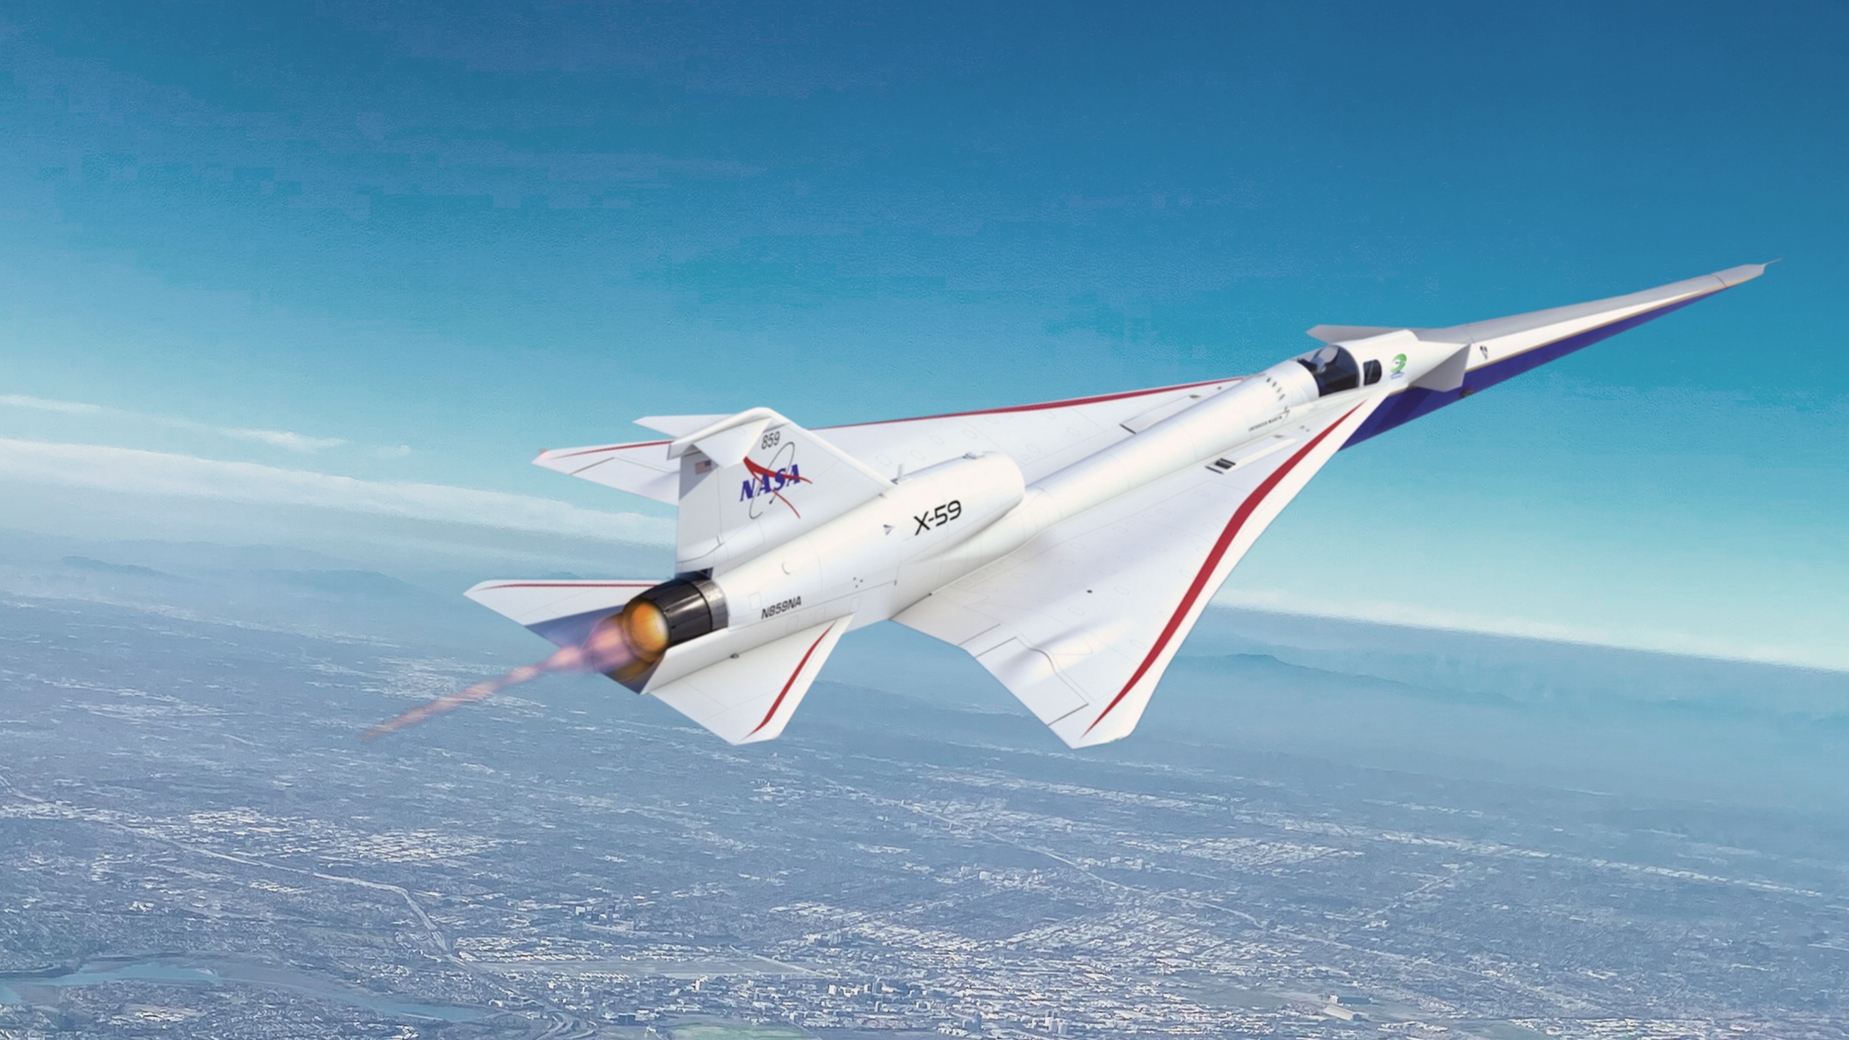

Quesst Mission and the X-59 Aircraft
Briefing for the Senior Capstone Design Class
Department of Mechanical and Aerospace Engineering
University of Virginia
“Converting customer needs to mission objectives and design requirements”
Craig Nickol
NASA Langley Research Center
9/17/24
www.nasa.gov

Slide 2
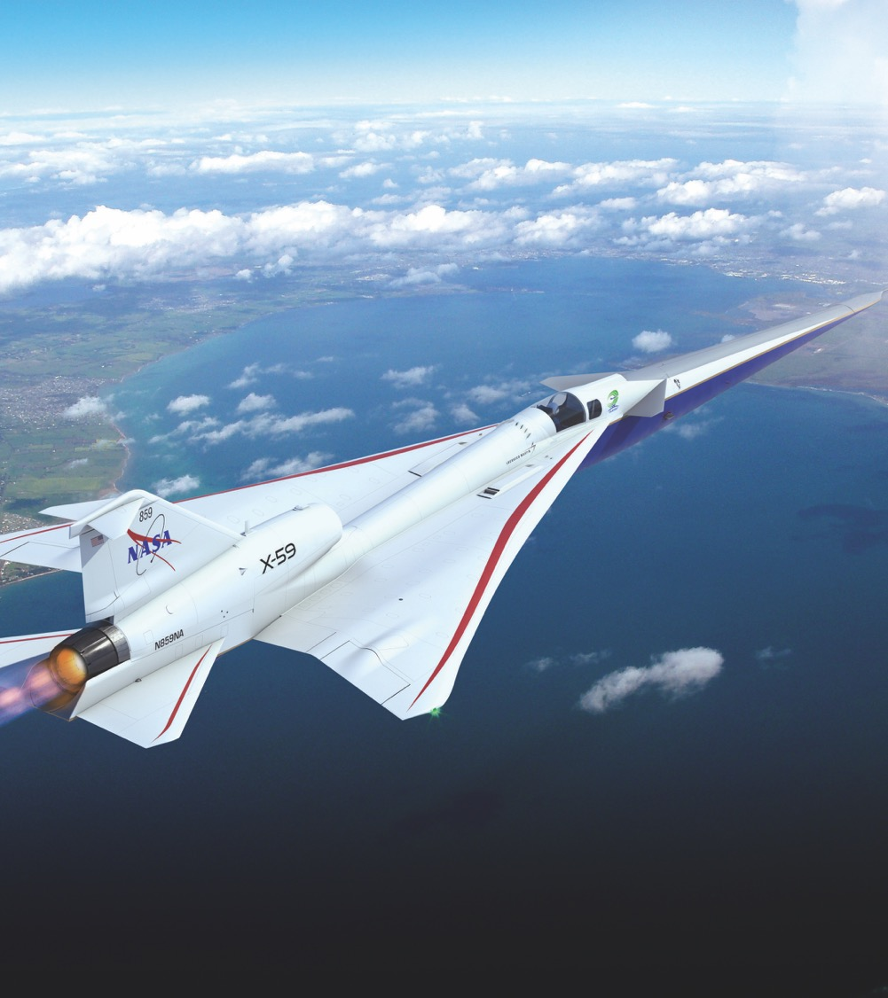
Presentation Topics
X-Planes
Customer Need: Barriers to Commercial Supersonic Flight
Sonic Boom 101
Requirements Development Process
X-59 Early Concept Evolution
Mission Overview
X-59 Aircraft Development
Current status
www.nasa.gov
Illustration Credit: Lockheed Martin

Slide 3
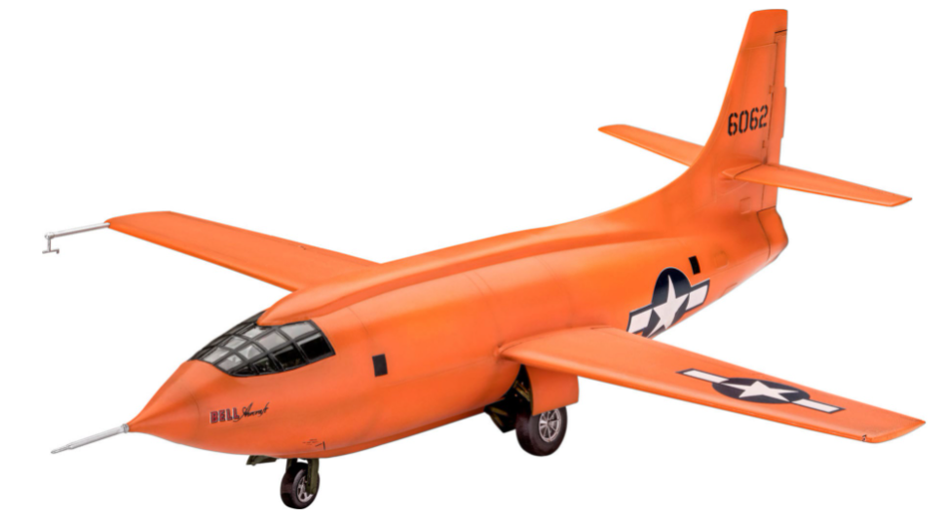
X-Planes
Notes:
Image credit: www.3djake.com/revell/bell-x-1-1rst-suipersonic, circa 1946

Slide 4
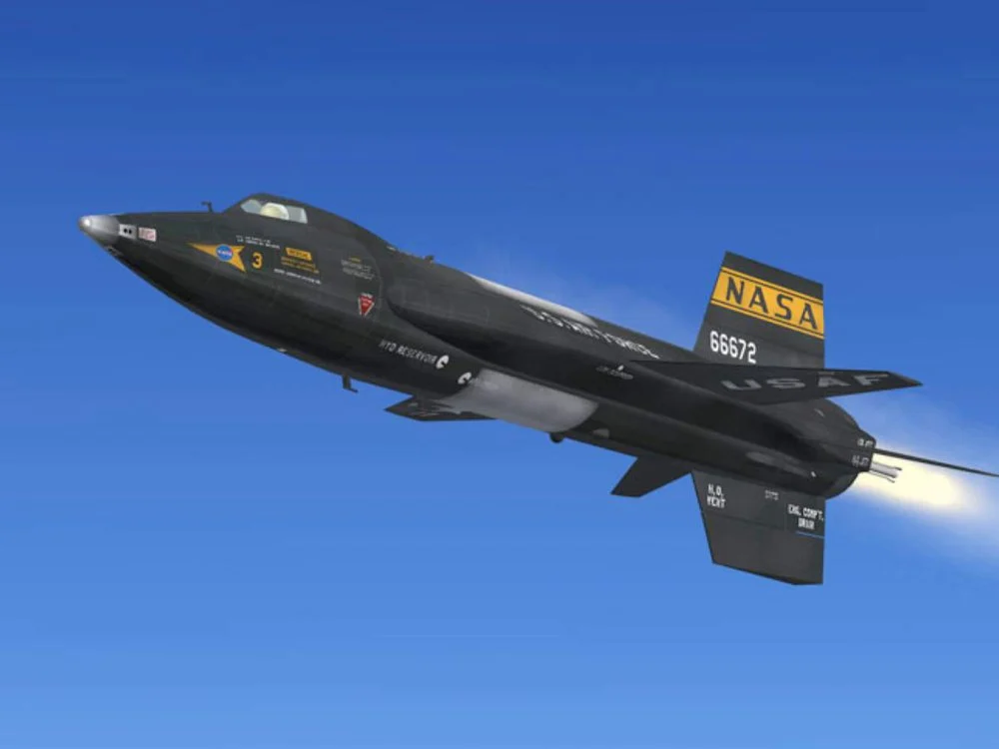
X-Planes
Notes:
Image credit: https://www.smithsonianmag.com/air-space-magazine/x-15-walkaround-22512890/
Circa 1959

Slide 5
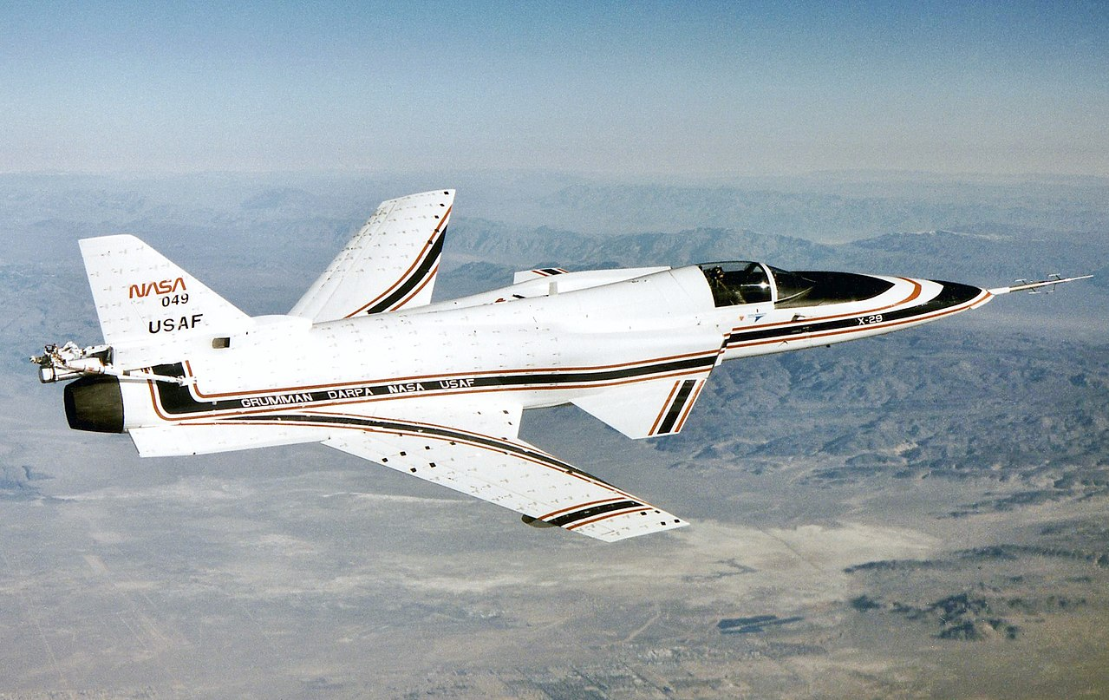
X-Planes
Notes:
Image credit: https://en.wikipedia.org/wiki/Grumman_X-29
Circa 1984

Slide 6
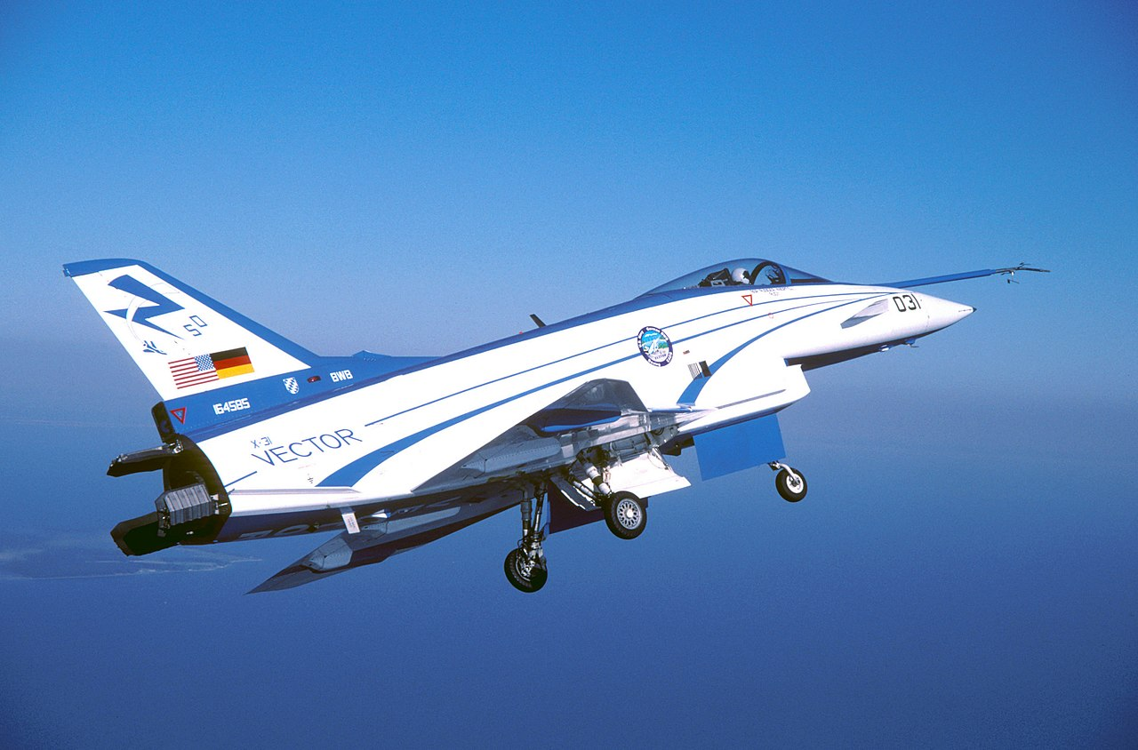
X-Planes
Notes:
Image credit: https://en.wikipedia.org/wiki/Rockwell-MBB_X-31
1990

Slide 7
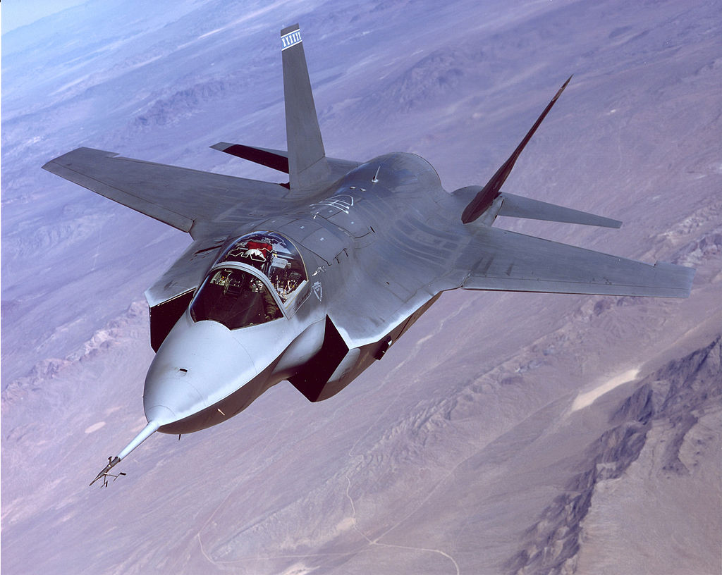
X-Planes
Notes:
Image credit: https://en.wikipedia.org/wiki/Lockheed_Martin_X-35
2000

Slide 8
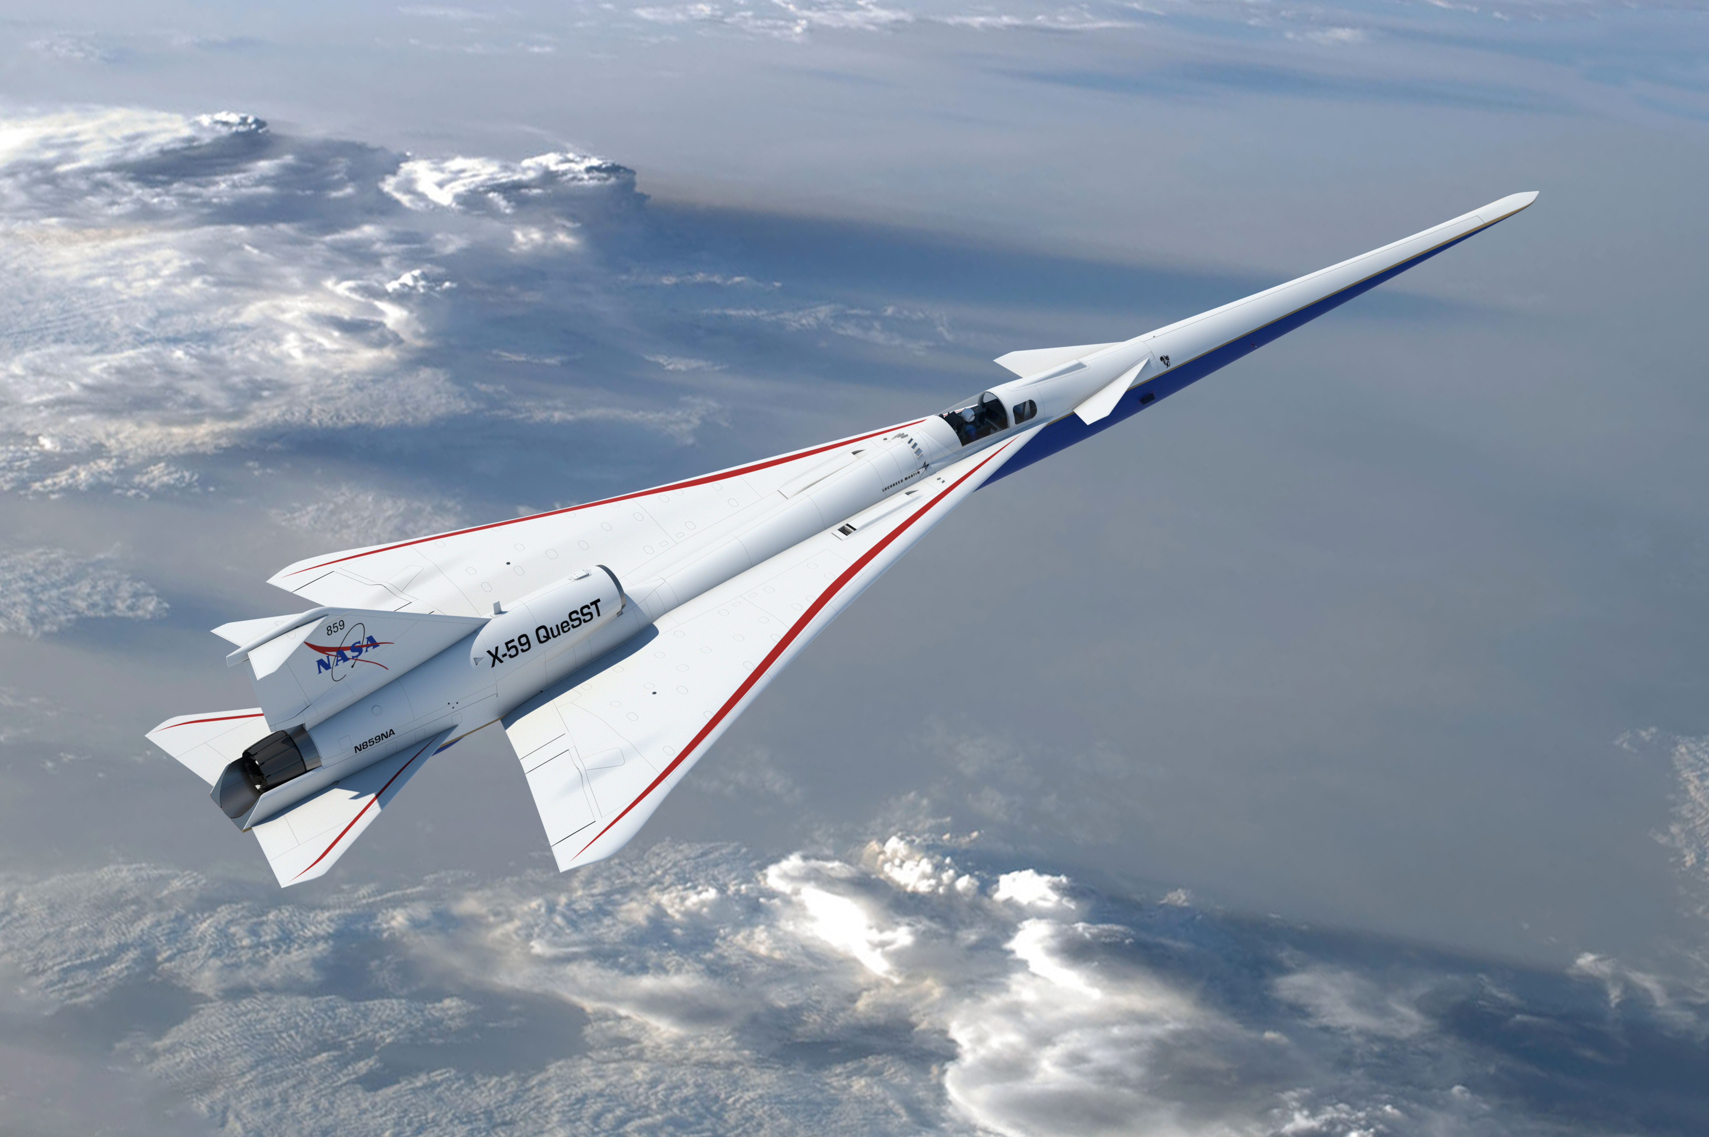
X-Planes
https://www.youtube.com/watch?v=DPd0OHrmCBc

Slide 9
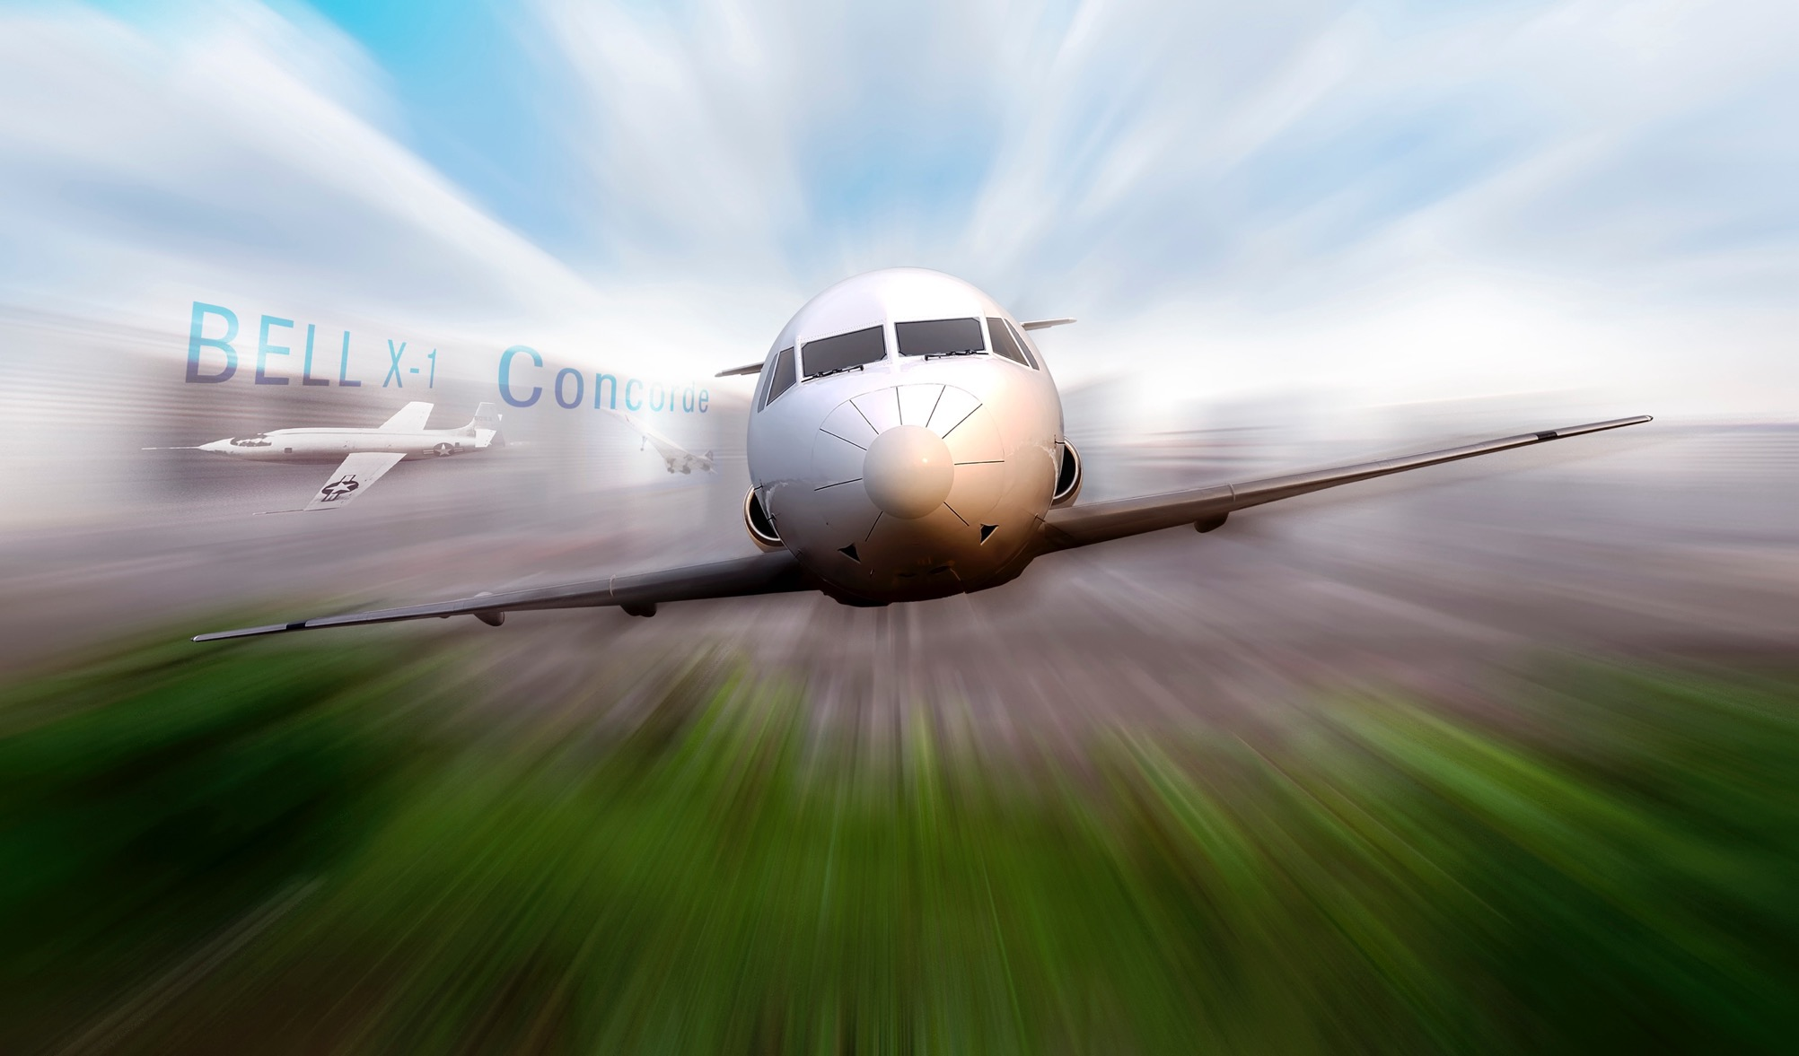
Barriers to Commercial Supersonic Flight
Sonic Boom Noise and Overland Flight Prohibitions
First supersonic flight: 1947
Introduction of supersonic commercial transports in 1970s brought the problem of sonic boom noise to public attention & showed sonic boom noise to be unacceptable
Supersonic overflight restrictions followed
  US: FAA Regulation (FAR) prohibits supersonic flight over US
  Worldwide: ICAO Assemble Resolution – “No unacceptable situation for the public due to sonic boom”
Restriction dramatically limited market potential for supersonic commercial flight
The creation of a market for supersonic commercial aircraft requires eliminating sonic boom as a barrier to overland flight
www.nasa.gov
Notes:
New technology and design approaches are required to reduce or eliminate the noise from sonic boom
An international certification standard based on acceptable sound levels must be developed to replace current overflight restrictions
1947 – Supersonic flight
1964 – Community study
1973 – Federal ban
2003 – Shaped Sonic Boom
2016 – Design of LBFD
2023 – LBFD community response test

Slide 10
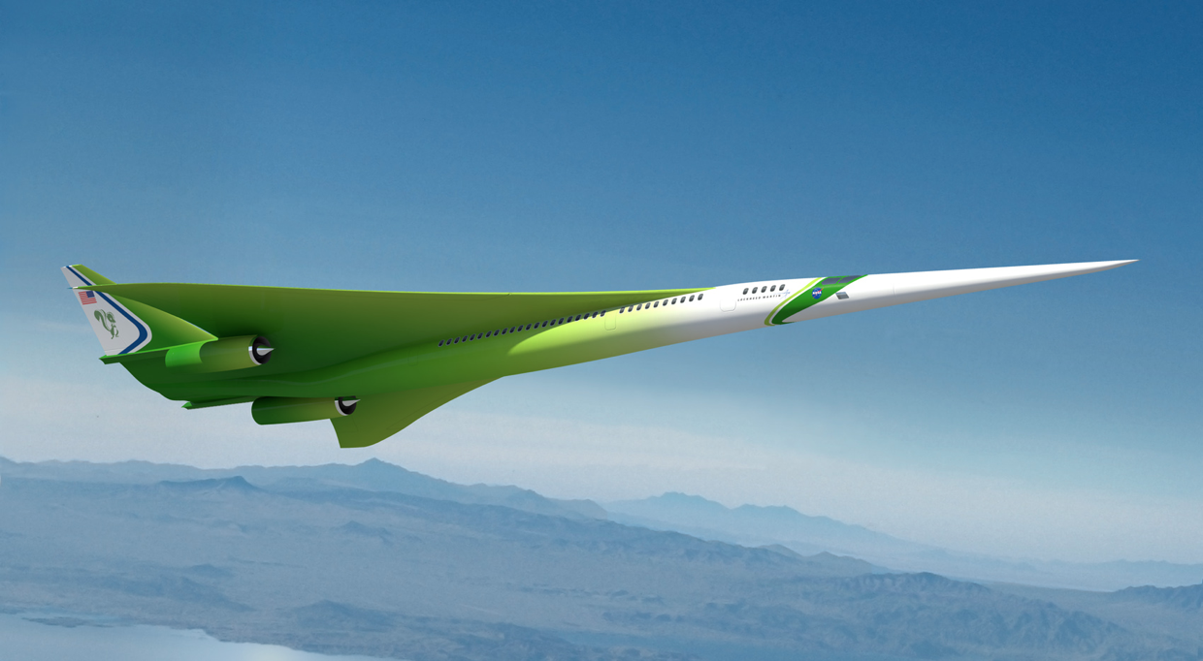
Vision for Commercial Supersonic Flight
Overland Flight Restrictions based on unacceptable sonic boom noise are viewed as the main barrier to this vision
An emerging potential market has generated renewed interest in civil supersonic aircraft
Evidenced by the appearance of several commercial programs despite lack of standards for en route noise or landing and takeoff noise, emissions
NASA plays a vital role in developing technology and the data that will enable this transformative new market
Illustration Credit: Lockheed Martin
The vision of the Supersonics Community is a future where fast air travel is available for a broad spectrum of the traveling public.
Future supersonic aircraft will not only be able to fly overland without creating an “unacceptable situation” but will also be environmentally responsible, affordable and sustainable
www.nasa.gov

Slide 11
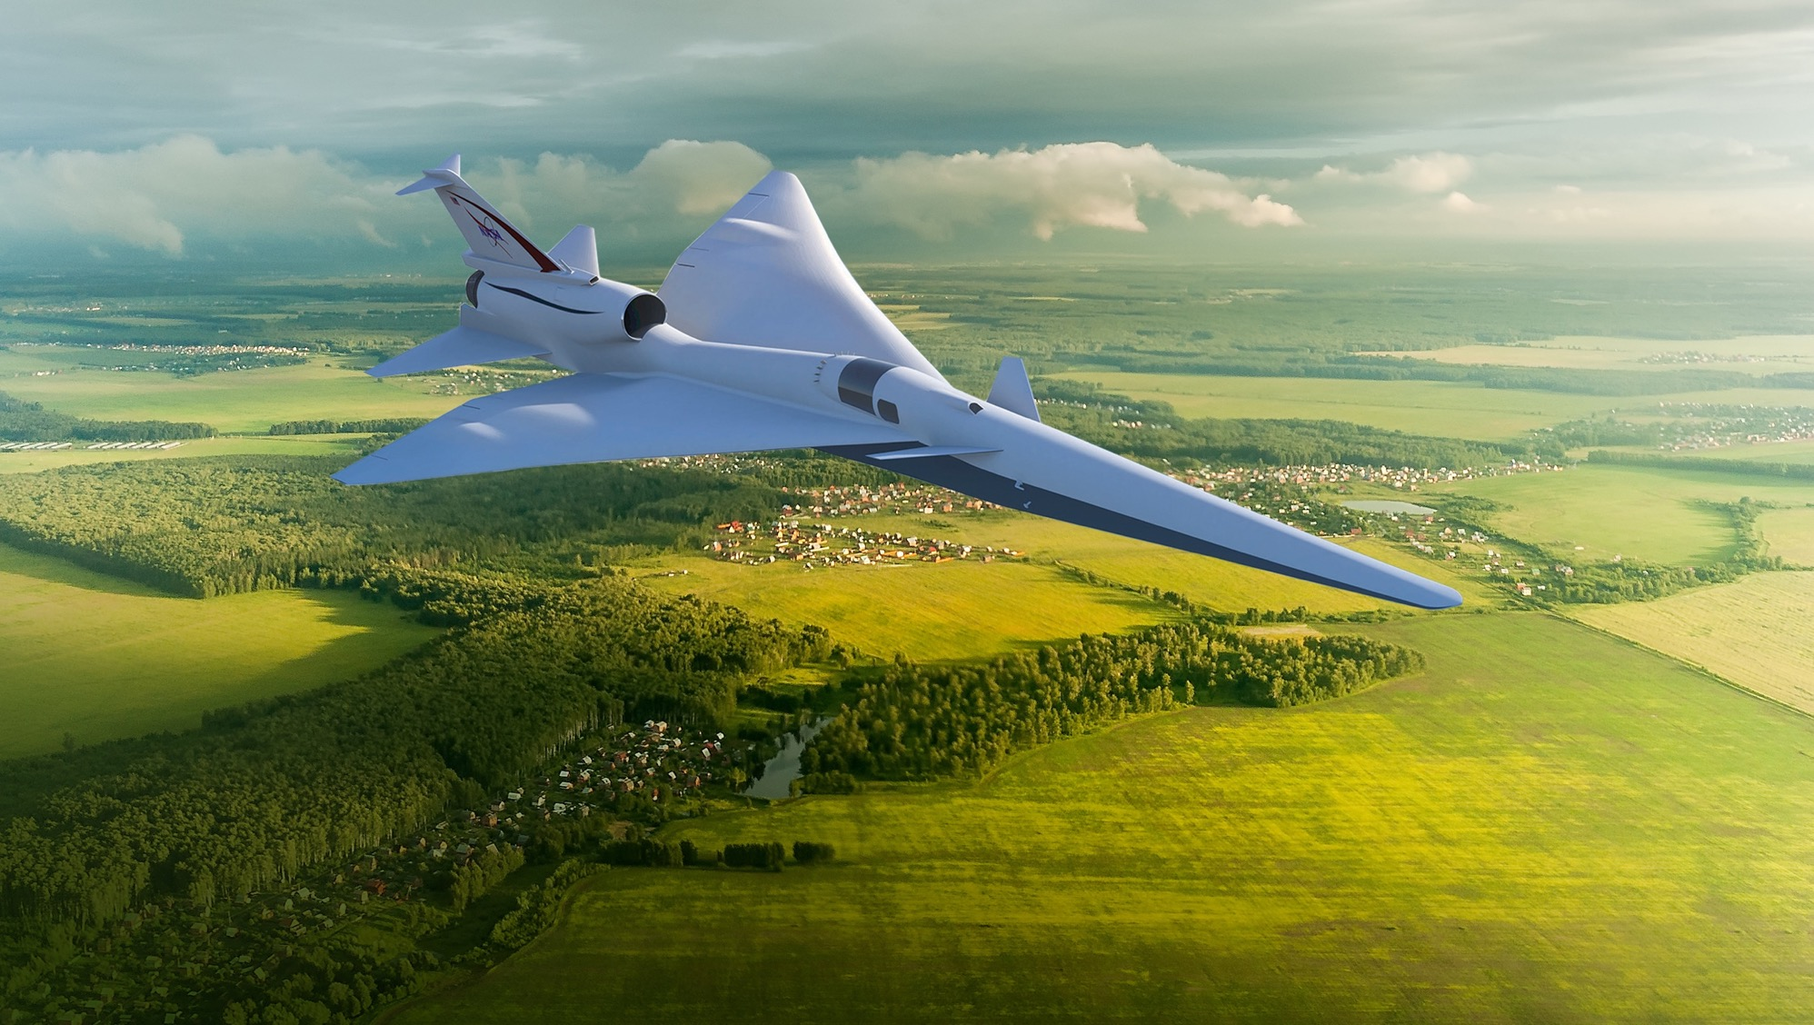
Overcoming the Barrier to Overland Supersonic Flight
NASA’s Quesst Mission is specifically planned to generate key data supporting the development of en route certification standards based on acceptable sound levels
New Environmental Standards are needed to open the market to supersonic flight
An En route Noise Standard is the biggest challenge
  Requires proof of new design approaches
  Must replace current prohibitions
  No relevant data exists to define limits
    Community data from large, diverse population is a requirement
  Standard must be accepted internationally
www.nasa.gov
Illustration Credit: Lockheed Martin

Slide 12
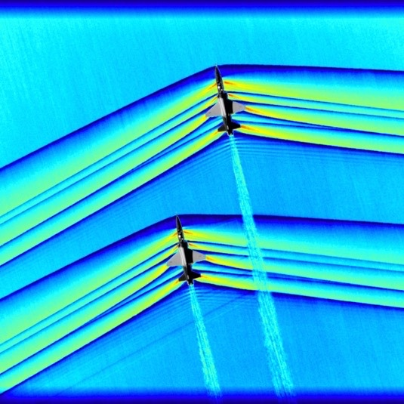
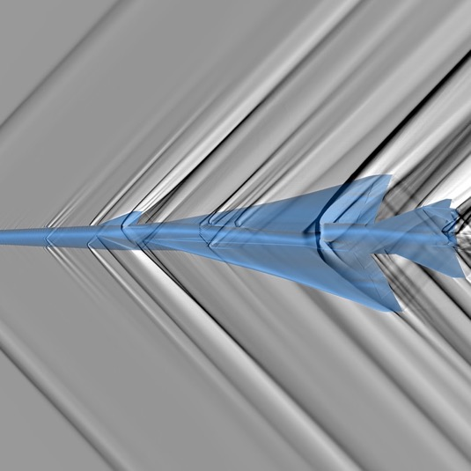

SONIC BOOMS
NASA IS TURNING A BOOM INTO A THUMP

Slide 13
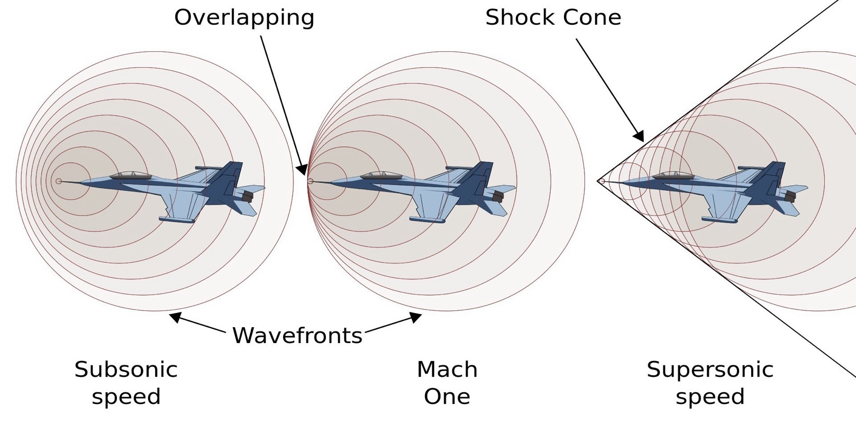
What Makes a Sonic Boom?
Shock front
Conical shock wave produces sonic boom at ground which moves with the airplane
Boom is created over entire length of supersonic flight path, just as a boat wake is continuous
www.nasa.gov

Slide 14
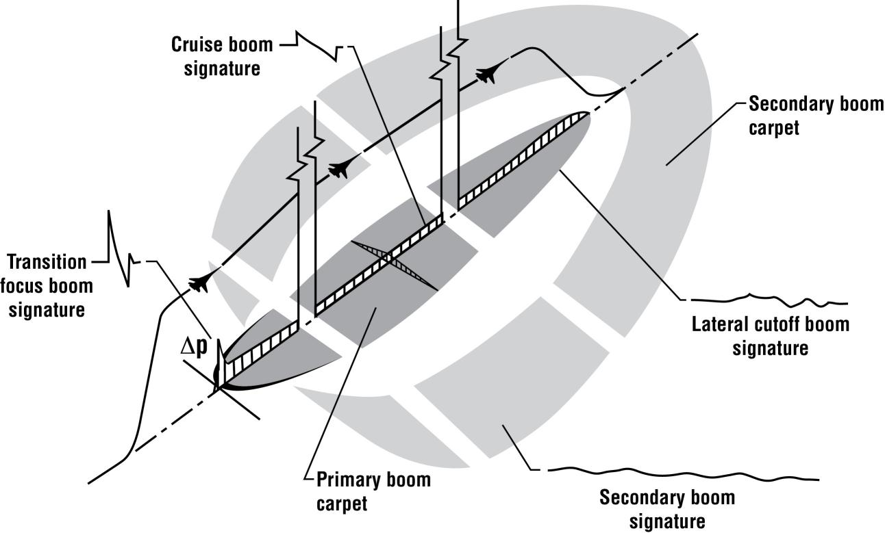
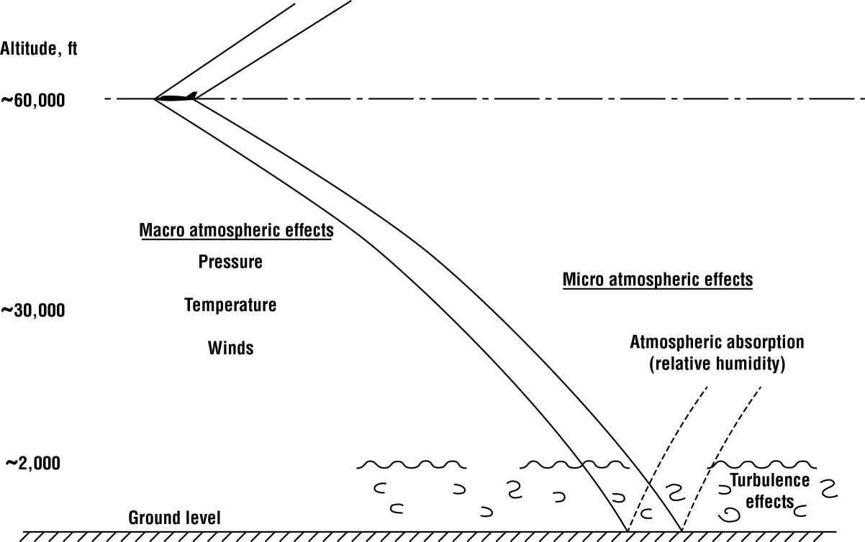
Sonic Boom Explained
Sonic Boom With Atmospheric Effects
Boom Signature Carpet

Slide 15

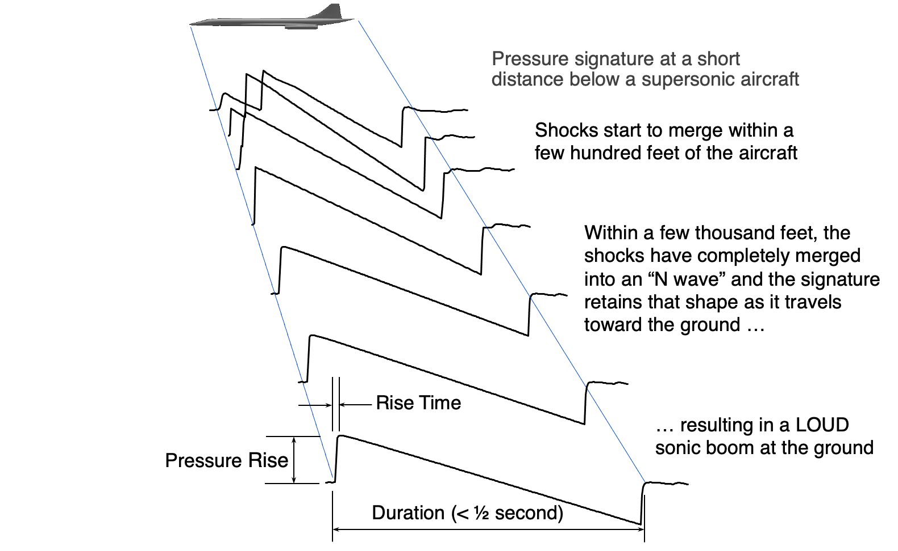
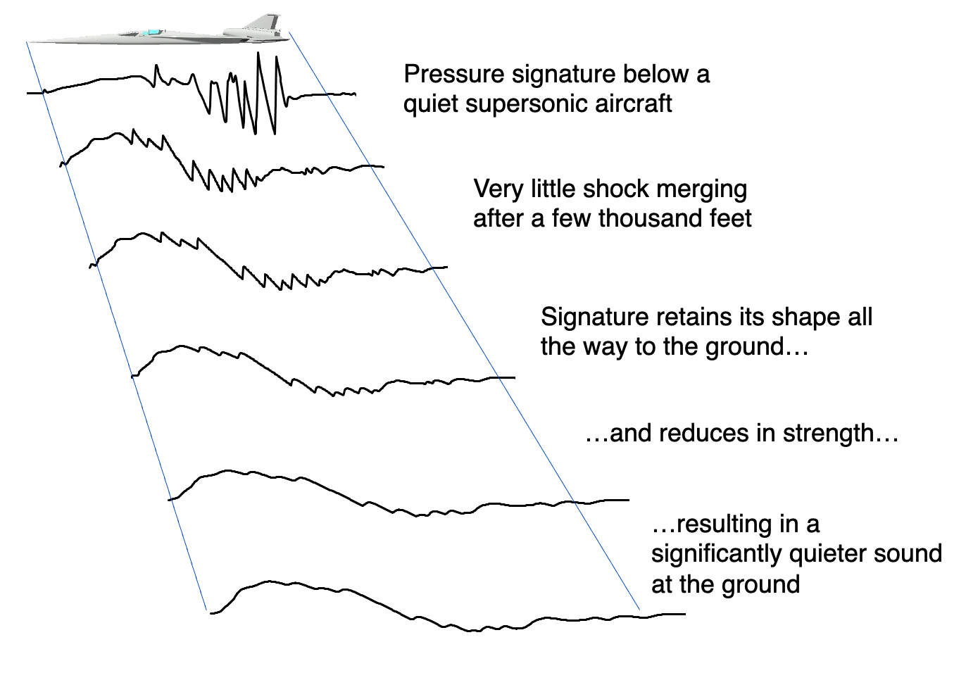
Sonic Boom Basics
N-Wave Sonic Boom
Shaped Pressure Signal
www.nasa.gov

Slide 16
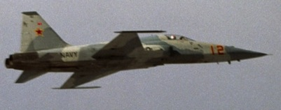
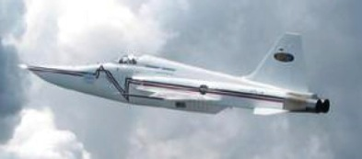
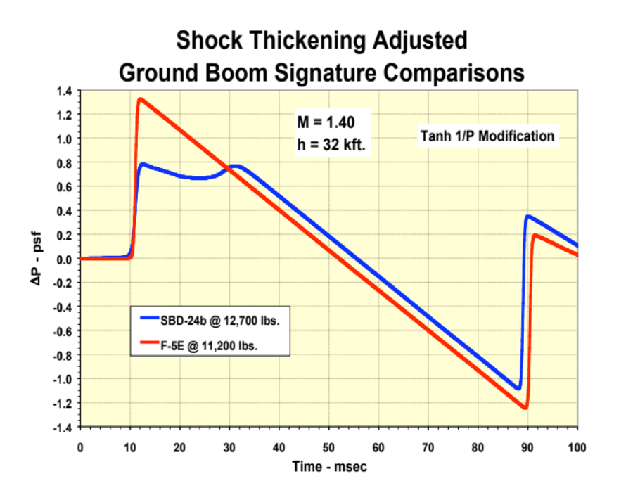
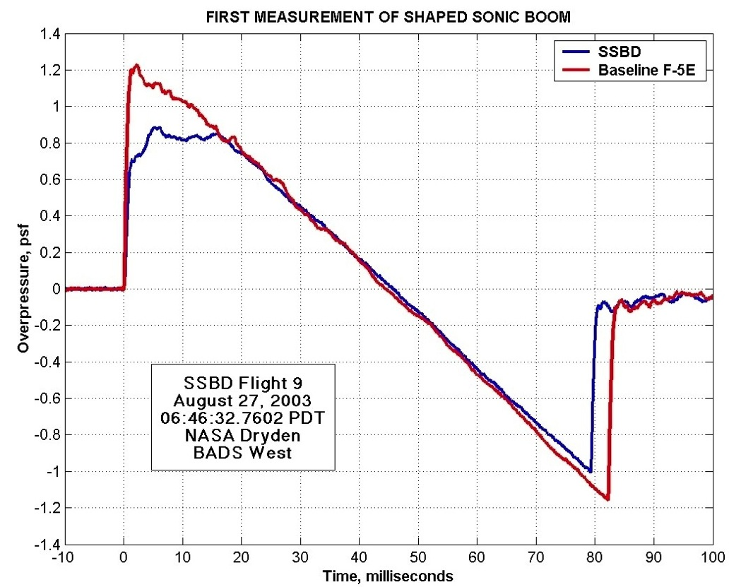
NASA/DARPA Shaped Sonic Boom Demonstration (SSBD) Project 2003
Back-to-Back Flights of Modified and Unmodified F-5s
F-5SSBD
F-5E
Design
Flight Results
First-Ever Shaped Sonic Boom Recorded 27 August 2003
Notes:
Chart from Tom Jones EAA AirVenture brief in Oshkosh, WI, July 28, 2017

Slide 17
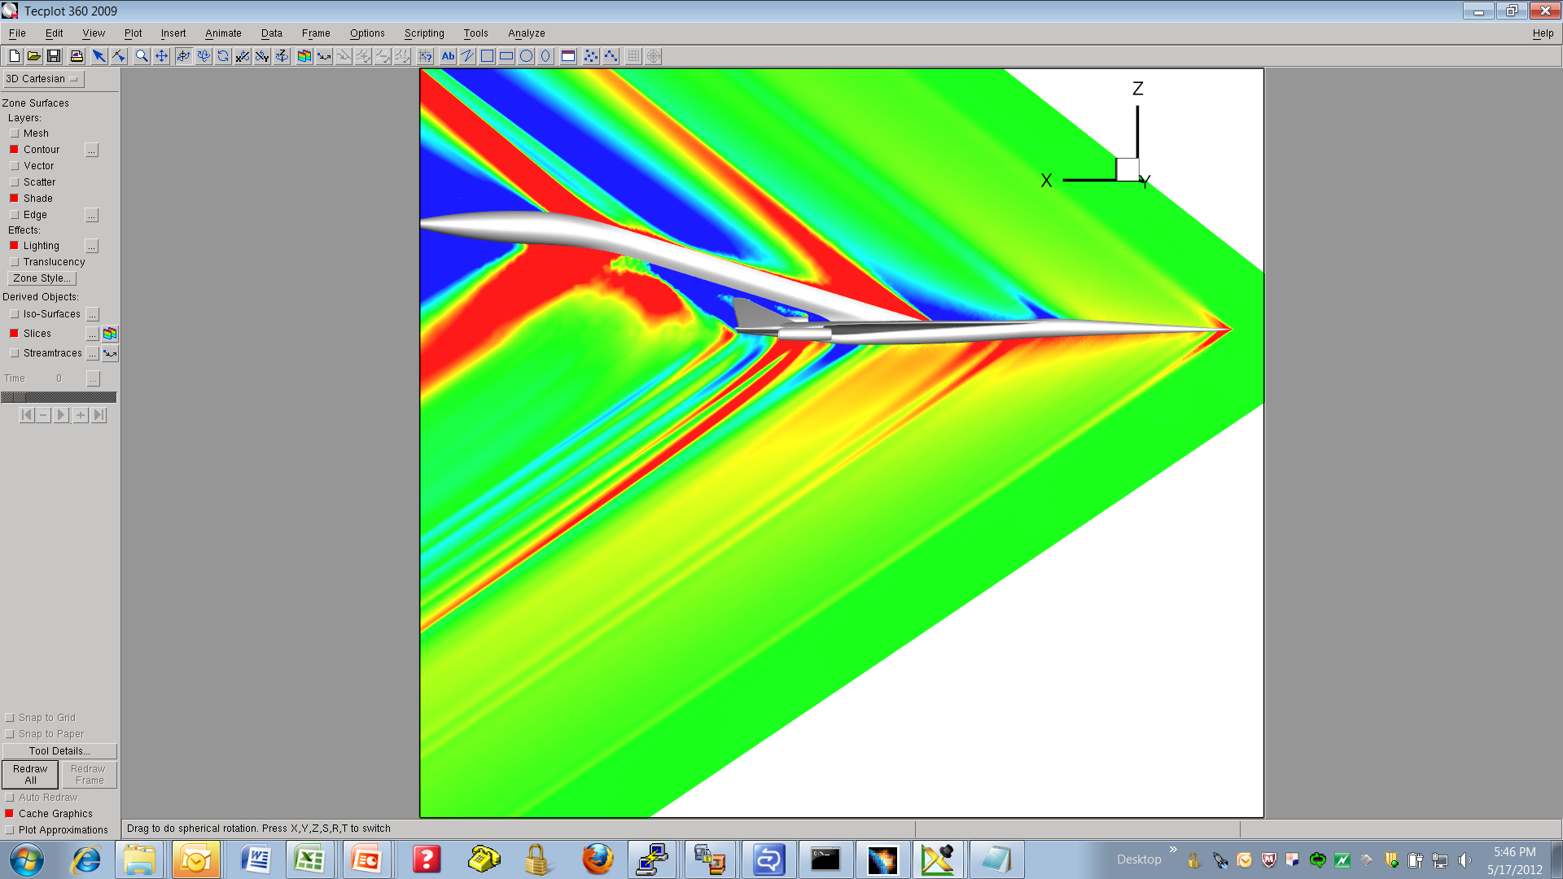
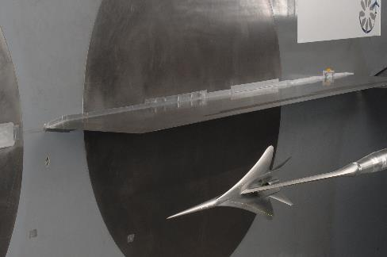
Why Now for X-59?
CFD
Experiment
Comparison of Pre-test CFD and Wind Tunnel Measurements @ C_{L} = 0.142
0.025
0.02
Pre-test CFD
Measured Data
0.015
0.01
0.005
0
-
5
-
0
5
10
15
20
25
0.005
-
0.01
-
0.015
-
0.02
β
X
-
r (inches)
Modern Design Tools are Ready for Shaped Boom Design (Tip to Tail)
Notes:
X-beta*r is a coordinate transformation; Same x location half a body length is the same at the ground
Chart from Tom Jones EAA AirVenture brief in Oshkosh, WI, July 28, 2017

Slide 18
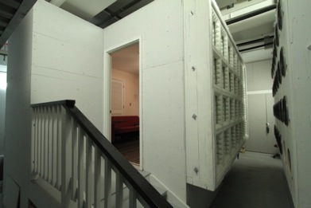
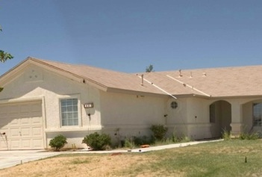
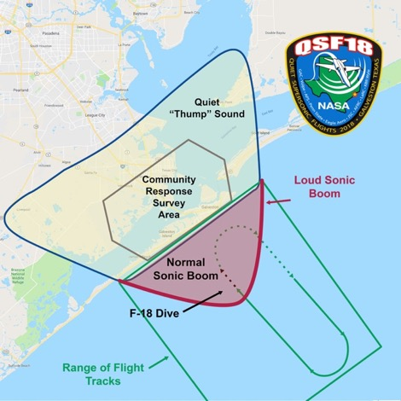
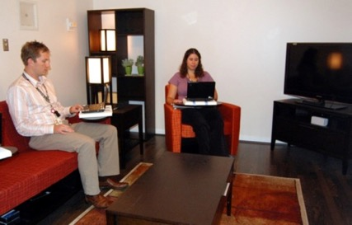
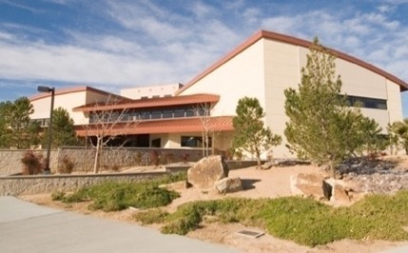
Why do we think the “Thump” is quiet enough?
Indoor human response and annoyance is the main concern for public acceptance
Quiet Supersonic Flights 2018
Galveston, Texas
Large Community
Risk Reduction
Laboratory Tests
Small Community Tests
Tests of increasing complexity have provided preparation and confidence
Ready to take the next step with flight testing over very large communities

Slide 19
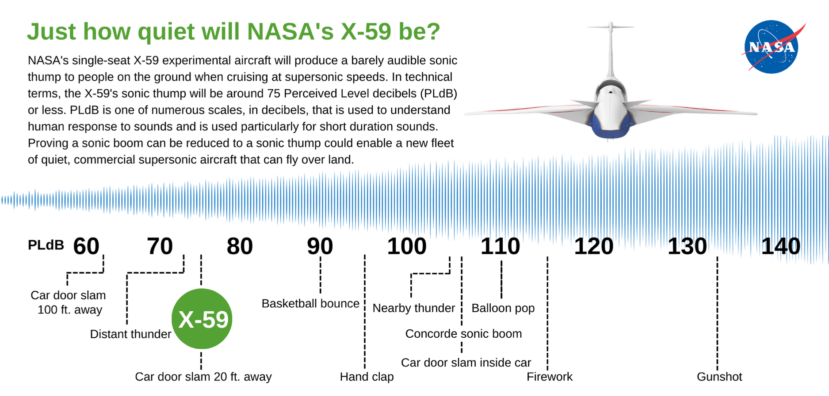
Sonic Thump
www.nasa.gov
Notes:
NASA's single-seat X-59 experimental aircraft will produce a barely audible sonic thump to people on the ground when cruising at supersonic speeds. In technical terms, the X-59's sonic thump will be around 75 Perceived Level decibels (PLdB) or less. PLdB is one of numerous scales, in decibels, that is used to understand human response to sounds and is used particularly for short duration sounds. Proving a sonic boom can be reduced to a sonic thump could enable a new fleet of quiet, commercial supersonic aircraft that can fly over land.
Additional detail if more technical audience: AESL metric uses a reference window of 1 sec. LAF_{max} metric (A-weighted, Fast, Sound Level) uses a reference window of 125 msec that tends to be more representative of rapid events like a sonic boom. For this comparison, PLdB will be compared to LAF_{max} metric which is the most representative comparison.
Aircraft ASEL (dB) LAFmax (dB) PL (dB)
Concorde 94 101 109
F-18 87 94 102
Demonstrator 60 66 75

Slide 20
Introduction – Where did X-59 come from?
Answer: a lot of hard and excellent work by a lot of people! See “Brief History of Boom Reduction” in backup charts.
“Continuity of effort drives revolutionary achievement” Peter Coen
MCR 9/2013
MDR 3/2014
SRDR 9/2015
ASRR 6/2016
KDP A/B 8/2016
PDR 6/2017
FY 17
Concept Development
Pre-Phase A
Concept Studies
Phase A
Concept & Technology Development
Phase B
PD & Technology Completion
NPR 7120.5 Project Phase
LBFD Concept Formulation Study
(CFS)
~$4M (Task
orders only)
KDP A/B
Mission Concept Review (MCR)
Mission Design Review (MDR)
LBFD Concept Refinement Study
(CRS)
~$10M (Task orders only)
Preliminary Design Review (PDR)
Systems Requirements & Design Review (SRDR)
The team did their homework which resulted in:
  Well grounded, concise and feasible requirements
  Government and industry teams with experience and understanding of the technical baseline
  Cost, schedule, and risk products to assist with full scale development planning
QueSST Preliminary Design
$20.9M
(Task Order Base Effort)
Aircraft Systems Requirements Review (ASRR)

Slide 21

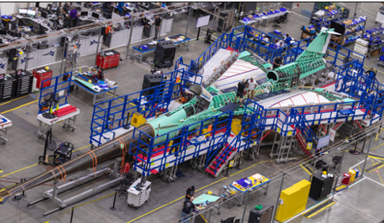
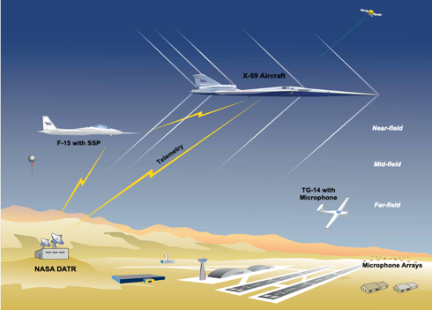
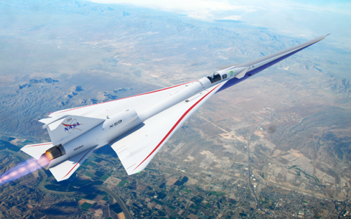
Quesst Timeline
Phase 1 – X-59 Aircraft Development
Aircraft design, fabrication, and ground test
Checkout and envelope expansion
Systematic Approach Leading
to Community Testing
Credit: Lockheed Martin
First Flight 2024
Phase 2 – Acoustic Validation
Detailed ground and flight measurements
Validation of sonic boom signature and prediction tools
Phase 3 – Community Response
Community response overflights, ground measurements, and surveys over representative communities across the U.S.
2025
2026
Credit: Lockheed Martin
www.nasa.gov
Notes:
Phase 1 Image
The X-59, unwrapped after transport back to Lockheed Martin’s Skunk Works facility in Palmdale, California, will now undergo final integration.
Credits: NASA/Lauren Hughes
Phase 2 Image
Juliet Page, a physical scientist with the Volpe National Transportation Systems Center, calibrates a microphone station during the CarpetDIEM flight series. The array featured high-fidelity microphones arranged in several configurations, giving researchers the ability to obtain accurate sound data and assess the loudness of the sonic booms, just as they will measure the quiet sonic thumps from the X-59.
Credits: NASA Photo / Lauren Hughes
Phase 3 Image
Suburb of the USA, filmed from a height, trees and houses.
Credits: Getty Images

Slide 22
Requirements Flow for Preliminary Design
Level
LBFD Needs, Goals and Objectives
Project
Plan
Community Response Objectives (CST Project)
1
2
Concept of Operations
Mission and Airworthiness Certification Requirements
Mission Level Requirements
Documents
Aircraft Requirements and Assumptions (ARA)¹
NASA Airworthiness Criteria (NAC)¹
3
Contractor Requirements,
Criteria and Specifications
NASA Requirements,
Criteria and Specifications
Aircraft Specification and System Requirements Documents^{1, 2}
Flight Systems
Safety and Mission Assurance
Requirements,
Criteria and Specifications
Interface Control Documents (ICDs)
4
Airworthiness Requirements and Criteria^{1, 2}
Systems Integration
and Testing
Aircraft Operations
Assumptions^{1,2}
Range Support
Ground Support
¹Mutually agreed upon and consolidated during technical meetings (PDR, CDR, …)
²Contractor controlled documents with NASA review/approval

Slide 23
Level 1: Needs, Goals, and Objectives
CST Objective / LBFD Need | LBFD Goals | LBFD Objectives
CST-Objective 1 – Conduct an initial low-noise sonic boom acoustic validation and community response overflight study to: 1) validate the community response test design and 2) establish community acceptance of the LBFD sonic boom signature noise level. | LBFD-Goal 1 – Design and build a LBFD aircraft with low-noise sonic boom signature characteristics acceptable to communities and traceable to future civil supersonic airliners. | LBFD-Objective 1 – Apply low-noise sonic boom design tools and technologies to design a LBFD aircraft that meets the LBFD mission and airworthiness certification requirements.
 |  | LBFD-Objective 2 – During Phase 1, build a LBFD aircraft and conduct the LBFD first flight within the baseline project budget and schedule.
 |  | LBFD-Objective 6 – During Phase 3, the LBFD aircraft shall perform the baseline mission with standard day environmental conditions using hydro-processed renewable jet fuel blends (JP-8/HRJ).
 | LBFD-Goal 2 – Acquire sonic boom signature data that will validate low-noise sonic boom design theory and improve the understanding and prediction of atmospheric effects on low-noise sonic boom signatures. | LBFD-Objective 3 – During Phase 1, demonstrate that the LBFD aircraft meets the LBFD airworthiness certification, safety, and performance standards throughout the flight envelope.
 |  | LBFD-Objective 4 – During Phase 2, measure and validate: 1) the near-field acoustic characteristics of the LBFD aircraft and 2) the atmospheric effects on the far-field and ground sonic boom signatures.
 | LBFD-Goal 3 – Demonstrate that the LBFD aircraft will produce a predictable range of low-noise sonic boom signatures appropriate for community response testing. | LBFD-Objective 5 – During Phase 2, conduct an initial low-noise sonic boom acoustic validation and community response overflight study to: 1) validate the community response test design and 2) establish acceptable sonic boom signature noise levels based on community response.

Slide 24
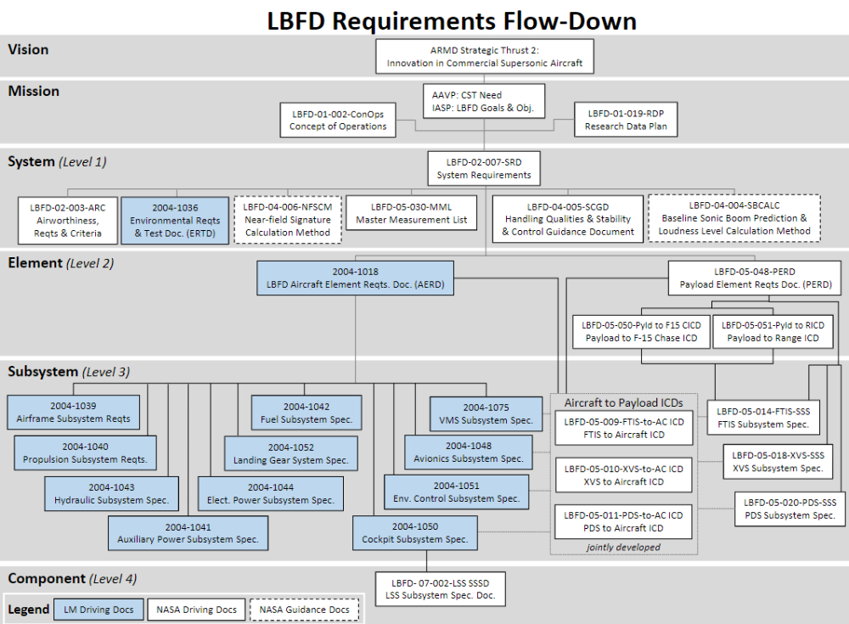

Slide 25
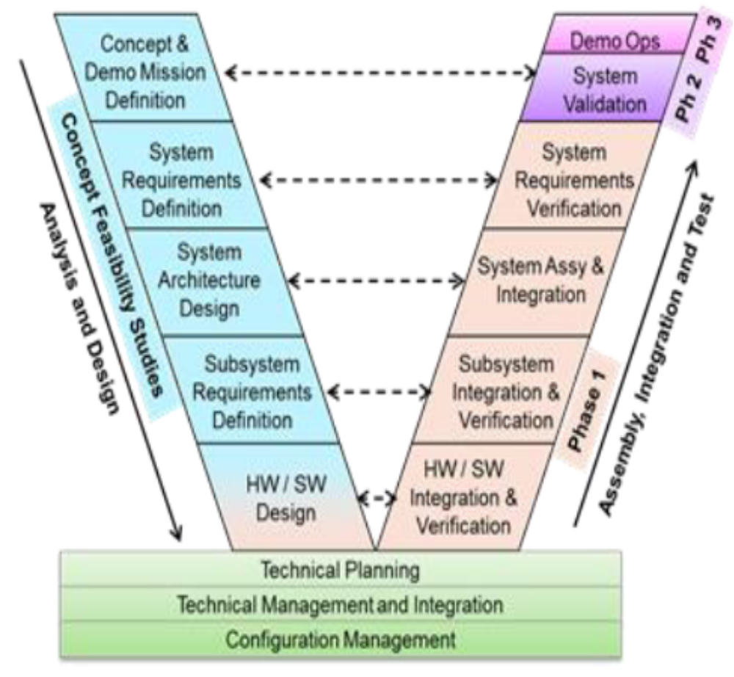
Systems Engineering “V”

Slide 26
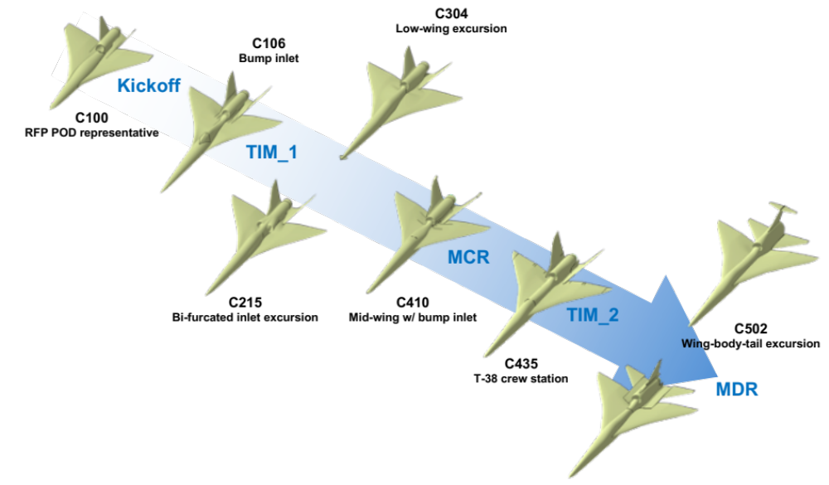
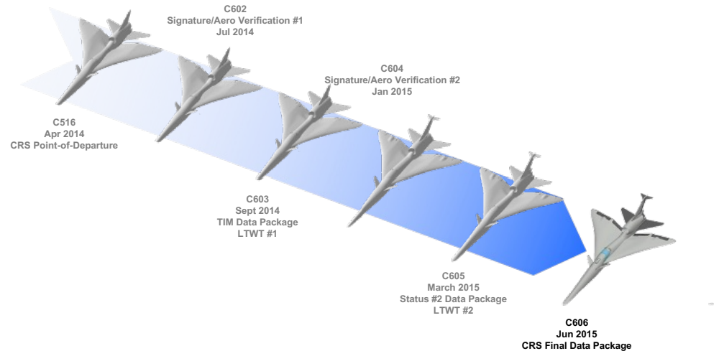
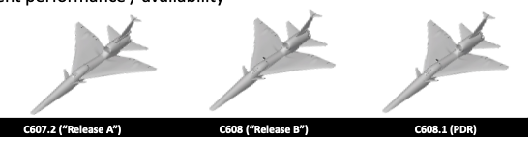
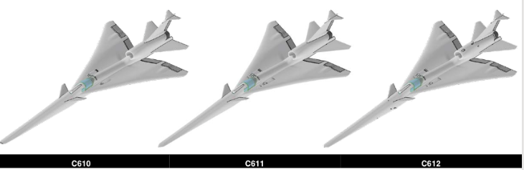
X-59 Evolution – Early Concepts to Final Design
Concept Formulation
Concept Refinement
C610 C611 C612
Preliminary Design
Detail Design
www.nasa.gov
Illustration Credit: Lockheed Martin
Notes:
NASA's single-seat X-59 experimental aircraft will produce a barely audible sonic thump to people on the ground when cruising at supersonic speeds. In technical terms, the X-59's sonic thump will be around 75 Perceived Level decibels (PLdB) or less. PLdB is one of numerous scales, in decibels, that is used to understand human response to sounds and is used particularly for short duration sounds. Proving a sonic boom can be reduced to a sonic thump could enable a new fleet of quiet, commercial supersonic aircraft that can fly over land.
Additional detail if more technical audience: AESL metric uses a reference window of 1 sec. LAF_{max} metric (A-weighted, Fast, Sound Level) uses a reference window of 125 msec that tends to be more representative of rapid events like a sonic boom. For this comparison, PLdB will be compared to LAF_{max} metric which is the most representative comparison.
Aircraft ASEL (dB) LAFmax (dB) PL (dB)
Concorde 94 101 109
F-18 87 94 102
Demonstrator 60 66 75

Slide 27
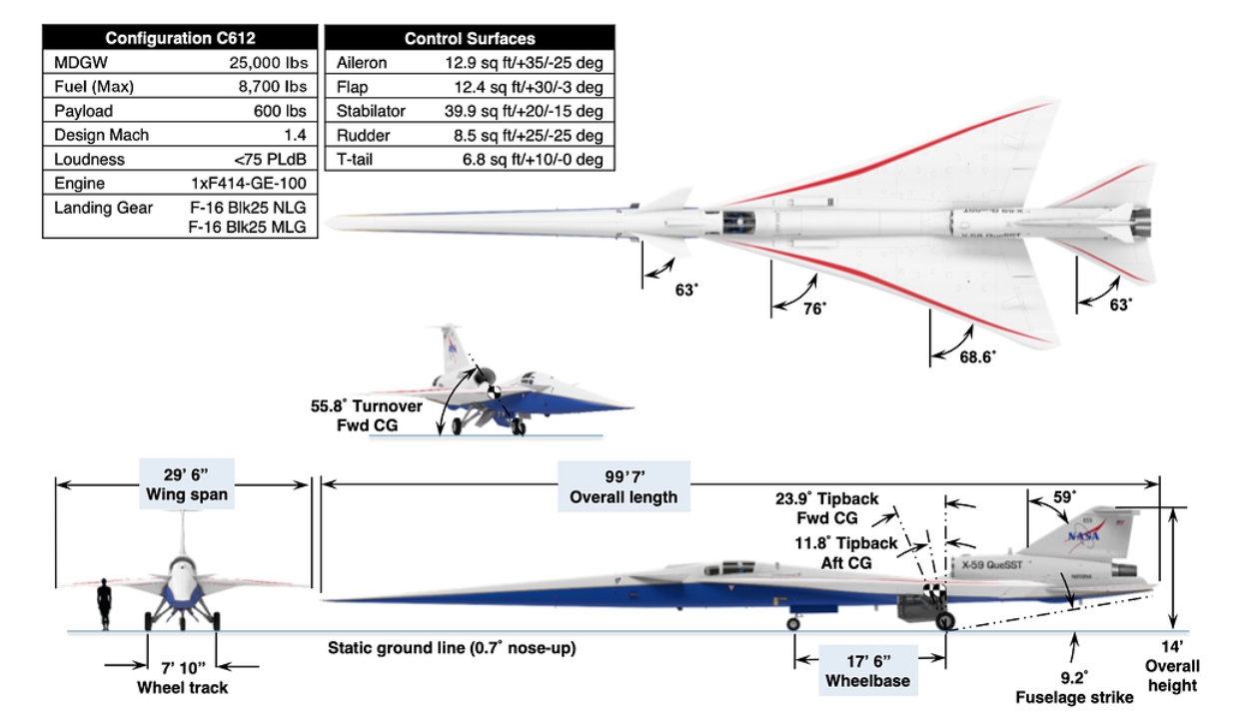
X-59 Aircraft 3-View
www.nasa.gov
Illustration Credit: Lockheed Martin

Slide 28
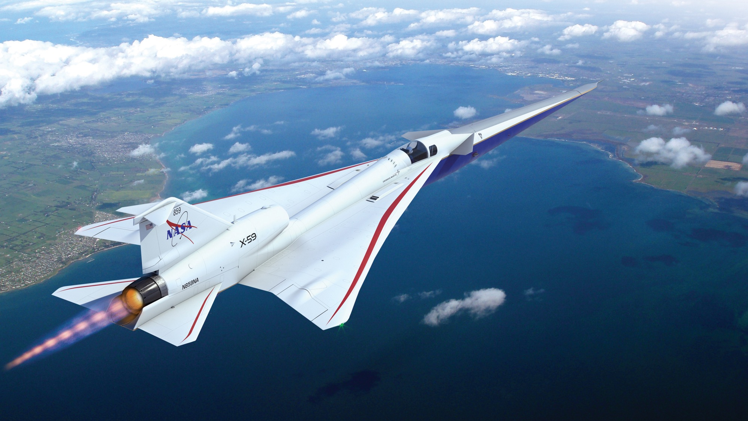
Overview of X-59 Aircraft Features
X-plane approach that meets key requirements in a cost-effective design
Long nose to shape forward shock
External and forward visions systems for forward visibility
T-38 aft canopy and ejection seat to minimize qualification cost and schedule
Fixed canard for nose-up trim at low-boom design point
T-tail to minimize aft shock
Large, unitized skins reduce parts count and manufacturing cost
F-16 landing gear and other systems from high performance aircraft to minimize qualification cost and schedule
Wing shielding to minimize impact of inlet spillage on sonic boom
Design Parameters
Length: 99 ft
Span: 29.5 ft
Speed: Mach 1.4 (925 mph)
Altitude: 55,000 ft
Conventional tail arrangement to simplify stability and control considerations
Single GE-F414 engine with standard nozzle to minimize cost and schedule
www.nasa.gov
Illustration Credit: Lockheed Martin

Slide 29
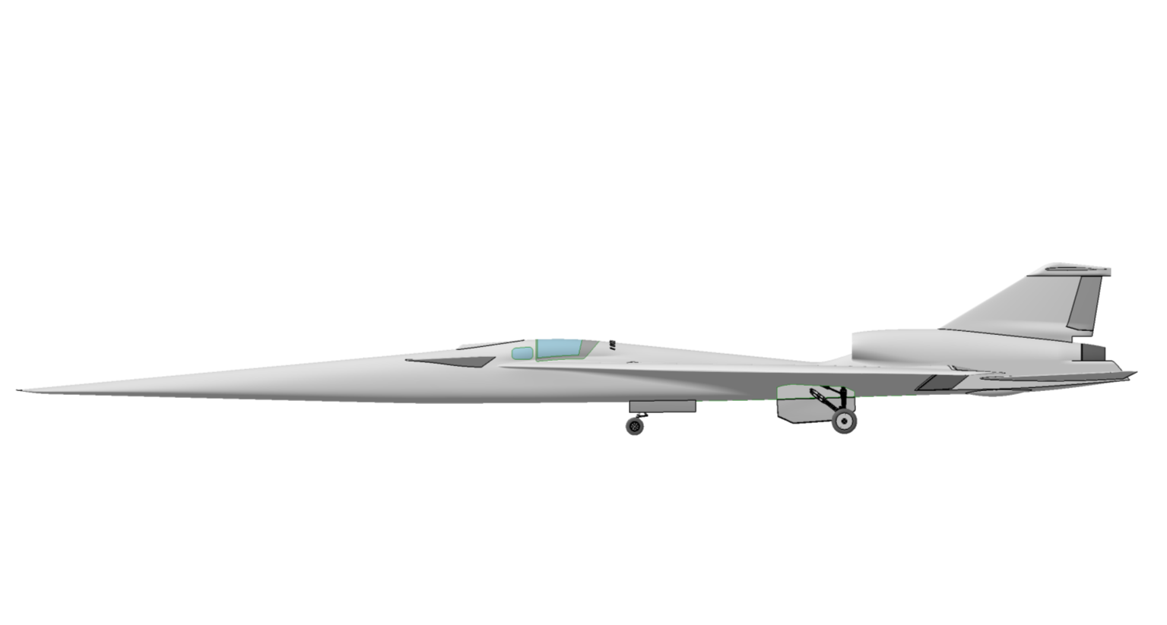
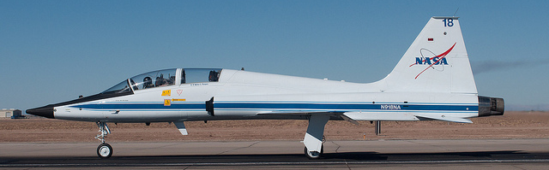
X-59 QueSST Design
T-38 Rear Cockpit and Canopy Utilized on X-59
Saves Qualification and Testing Costs
NASA T-38
X-59
Notes:
Slide from Brett Pauer SAFE Symposium Presentation, October 17, 2018 (Approved for Public Release – NASA DAA 61775)

Slide 30
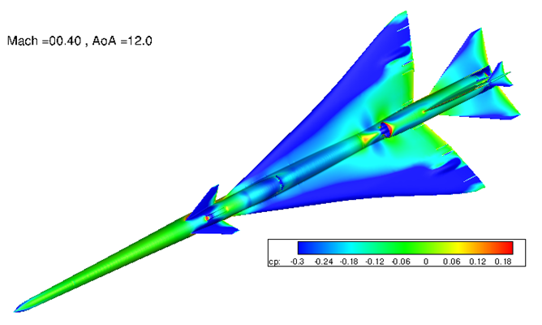
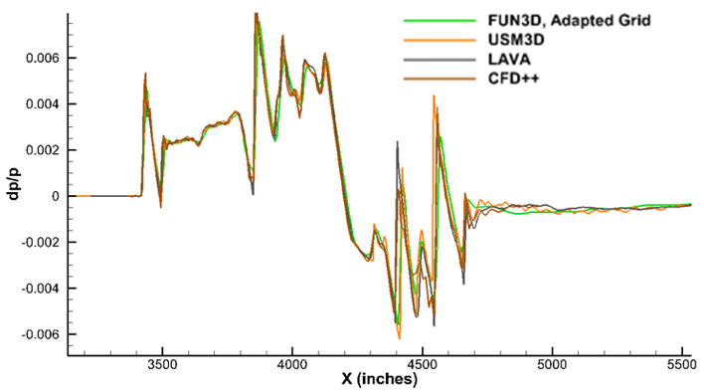
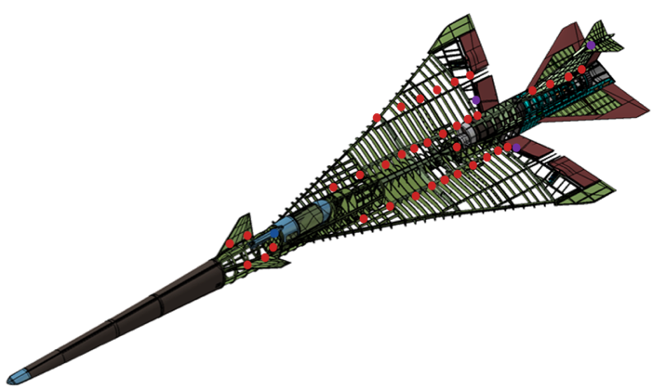
X-59 Aircraft Assessments
Aerodynamic Performance
Sonic Boom
Handling Qualities
Structural Modeling
www.nasa.gov
Credit: Lockheed Martin Corporation

Slide 31
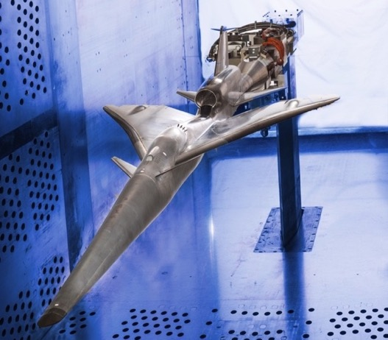
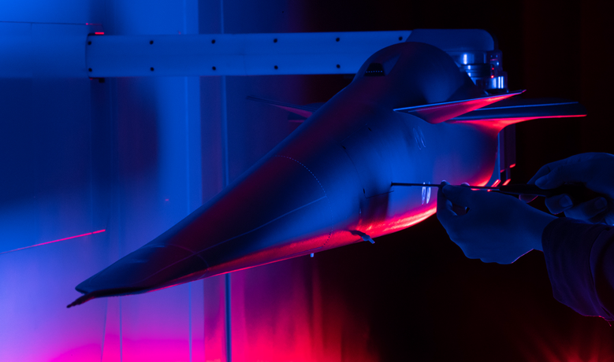
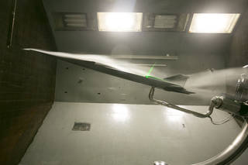
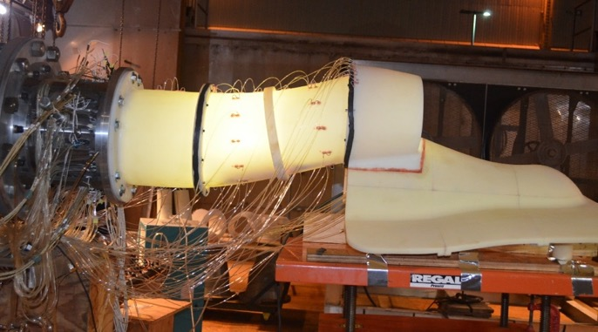
Wind Tunnel Validations
Low-and high-speed aerodynamic and Propulsion Airframe Interaction (PAI) wind-tunnel tests validate predictions and ensure readiness of the design
Photo Credit: Lockheed Martin
www.nasa.gov
Photo Credit: Lockheed Martin

Slide 32



Prediction Tools and Validation
In preparation for community response testing, NASA is creating a suite of prediction tools to support timely and accurate validation of the acoustic performance of the X-59 aircraft, rapid pre-flight exposure planning for Community Testing, and provide a foundation for future configuration design and certification analysis of supersonic aircraft.
Sonic Thump on the Ground
(75 PLdB Target)
High Fidelity Computational Results (CFD)

Slide 33





Acoustic Validation Test Planning and Execution
Plan and execute a test series to validate ground acoustic signature loudness is acceptable for community response testing and to gather airborne and ground data that will be used to anchor sonic boom propagation and acoustics models in a real atmosphere. Coordinate multiple ground and flight assets to efficiently gather multiple data types.
F-15 With Shock Sensing Probe
Advanced Air-Air Schlieren Imaging
Ground Recording Systems
Flight Planning

Slide 34








Community Test Planning and Execution
Plan and execute sonic boom tests with the X-59 aircraft over large non-experienced communities within the U.S. to provide a robust dose-response database of community annoyance
Airfield and Community Selection
Survey Design and Analysis
Dose-Response Relationship
Image Credits: HMMH
https://www.dreamstime.com/179235021
Community Engagement
Flight and Test Planning
Exposure Estimation

Slide 35

Manufacturing: First Chip Ceremony, November 13, 2018

Slide 36

X-59 – Early Aircraft Fabrication and Integration
www.nasa.gov
Photo credits: Lockheed Martin
Photo Credits: Lockheed Martin

Slide 37


X-59 Aircraft Fabrication and Integration
Photo Credits: Lockheed Martin (left and top right)
Photo Credit: General Electric
www.nasa.gov

Slide 38


X-59 Aircraft Ground Testing in Ft. Worth
Preparing the Aircraft for Structural Testing
The Long Journey
www.nasa.gov
Photo Credits: Lockheed Martin

Slide 39


X-59 Aircraft Ground Testing in Ft. Worth
Structural Testing
Fuel Systems Testing
www.nasa.gov
Photo Credits: Lockheed Martin

Slide 40






System Installations and Checkouts
www.nasa.gov
Photo Credits: Lockheed Martin

Slide 41


eXternal Vision System (XVS)
XVS - enabling technology - combination of Ultra-High-Definition (UHD) sensor, display, and image processing technologies to provide the pilot with equivalent forward vison
XVS 4K Camera
(top)
XVS Display
Forward Vision System (bottom)
XVS Computer
System components qualified for flight environment – imagery integrated with HUD symbology
System performance verified in flight test - guest pilots evaluated normal vision and XVS on see-to-avoid and see-to-follow tasks
Final component qualification, installation, and ground checkout in the X-59 aircraft completed
View of X-59 Cockpit with
XVS Image with HUD Symbology
www.nasa.gov
Notes:
FVS - Enhanced Vision System (EVS) camera
XVS Processor takes inputs from the 2 camera systems and state/traffic/surveillance data (ADS-B, TCAS)

Slide 42


X-59 Life Support and Crew Escape Systems
Ejection Seat System
NASA has worked with hardware vendors to ensure pilot safety by providing the hardware, checkout, and certification of the X-59 aircraft life support and crew escape systems
  The Crew Escape System (CES) provides the pilot with an integrated ejection seat and canopy systems to ensure pilot safety during normal and emergency flight and ground scenarios.
Canopy
System
Credit: Martin Baker
  The Life Support System (LSS) provides the pilot with breathing oxygen at the right pressure, flowrate, and concentration to maintain the pilot’s well-being in any scenario, from normal flight missions to in-flight emergencies. Key components of this system were tested in a hypobaric chamber to simulate reduced pressure conditions that the pilots could experience at the higher altitudes.
www.nasa.gov
Hypobaric Chamber Testing
Photo Credit: KBR
Notes:
FVS - Enhanced Vision System (EVS) camera
XVS Processor takes inputs from the 2 camera systems and state/traffic/surveillance data (ADS-B, TCAS)

Slide 43

X-59 Cockpit Simulations
Aircraft and cockpit simulations validate aircraft designs, systems, and performance – also used for pilot training and flight planning
Systems Integration Lab at Lockheed
Flight Simulator at NASA
Photo Credit: Lockheed Martin
www.nasa.gov
Credit: Lockheed Martin Corporation

Slide 44

Control Room Preparations and Training
Control room preparations and display development have matured over the past year. Control room familiarization and training using the X-59 aircraft simulator to emulate flight operations and key sensor data has begun. Control room training is essential to ensure safe flight test and training for nominal and potential less-than-nominal scenarios.
www.nasa.gov
Credit: Lockheed Martin Corporation

Slide 45

Integrated Testing Outdoors, Run Stall 5 – August 2023
www.nasa.gov
Photo Credit: Lockheed Martin
www.nasa.gov
Photo Credit: Lockheed Martin

Slide 46

X-59 Aircraft Rollout – January 2024
Photo Credit: Lockheed Martin
www.nasa.gov
Photo Credit: Lockheed Martin

Slide 47
Next Steps
Engine runs
Emergency engine restart system test
Electromagnetic Interference (EMI) test
Aircraft-in-the-loop integrated system testing
Low speed and high-speed taxi testing
First Flight

Slide 48

Quesstions?
www.nasa.gov
Photo Credit: Lockheed Martin
Photo Credit: Lockheed Martin

Slide 49

nasa.gov/quesst
www.nasa.gov

