Slide 1
Recent Progress on Forward and Inverse Model Development for Satellite Hyperspectral Remote Sensing
Point of Contact: Xu.Liu-1@nasa.gov
Xu Liu, Wan Wu, Qiguang Yang, Xiaozhen Xiong, Ming Zhao, Liqiao Lei, Hyun-sung Jang, Daniel K. Zhou, Allen Larar, Yolanda Shea, Jeffrey Mast
NASA Langley Research Center, Hampton, VA, USA
Robert Spurr, RT Solution Inc.
And many more ….
Acknowledgement: NASA Advanced Supercomputing Facility and NASA financial support

Slide 2
Outline
Overview of PCRTM
Recent progress of PCRTM
  High-fidelity simulator and end-to-end performance simulations
  Forward model for L2 and L3 retrieval algorithms
  Satellite calibration and intercalibrations
  Generating high-quality training data for AI-based forward and inverse models
A PCRTM-based physical inversion scheme: spectral fingerprinting
Summary and Conclusion

Slide 3
Challenges for Performing Radiative Transfer (RT) Calculations
Line-by-line radiative transfer calculations through atmosphere is very time consuming
  Multi-scattering calculation is very time-consuming (Rayleigh, aerosol, and clouds)
  Need to properly resolve the atmospheric gas absorption lines (limited by Doppler Width)
  More than 2 million monochromatic RT calculations for IR (3-20 μm)
  More than 2 million monochromatic RT calculations for VSWIR (0.25-2.5 μm)
  ~70 thousand monochromatic RT calculations for TEMPO (0.29-0.49 μm, 0.54-0.74 μm)
Convolving monochromatic radiances with Sensor Response Function (SRF) is also time consuming
  Traditional fast RT models usually perform RT calculation at channel frequency grid (e.g correlated-K, CRTM, RTTOV etc…)
  Still too many RT calculations for high spectral resolution remote sensors such as TEMPO
  The Beer’s Law is no longer valid after convolving with SRF:
  It’s difficult to handle inhomogeneous path and multiple gases
Principal Component-based Radiative Transfer Model (PCRTM) accelerates RT calculations in two ways
  Explore the spectral correlations by Principal Component Analysis (PCA)
  Perform RT calculations at fewer monochromatic frequencies than the number of spectral channels

Slide 4
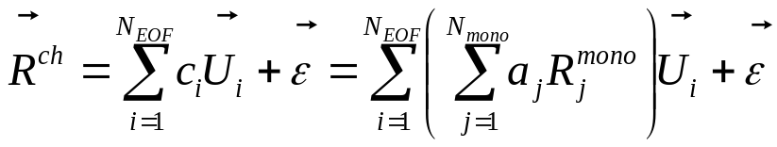
PCRTM is a Physical-based Fast Radiative Transfer Model
Calculates channel radiances (or transmittances ) by linearly combine a set of pre-stored EOF:
Coefficient C_{i} are predicted from a few monochromatic radiances
  The relationship is derived from the properties of eigenvectors and SRF
Treats the whole spectra as a whole
  No need to perform redundant RT calculations
  RT calculations are performed monochromatically with a number much smaller than the number of spectral channels
  A factor of 2-100 times faster than channel-based RT models
Therefore, the PCRTM is physical-based RTM
  Accuracy relative to LBL can be adjusted by increasing/decreasing the number of monochromatic RT calculations
    RMS errors are smaller than 0.03 Kelvin (0.01-0.015%) in IR
    RMS errors are typically 0.02-0.1% in VSWIR
  Provide radiative derivatives of radiance or reflectance with respect to atmospheric and surface variables
    Needed by all physical retrieval algorithms
    No need to perform finite-difference time consuming calculations

Slide 5
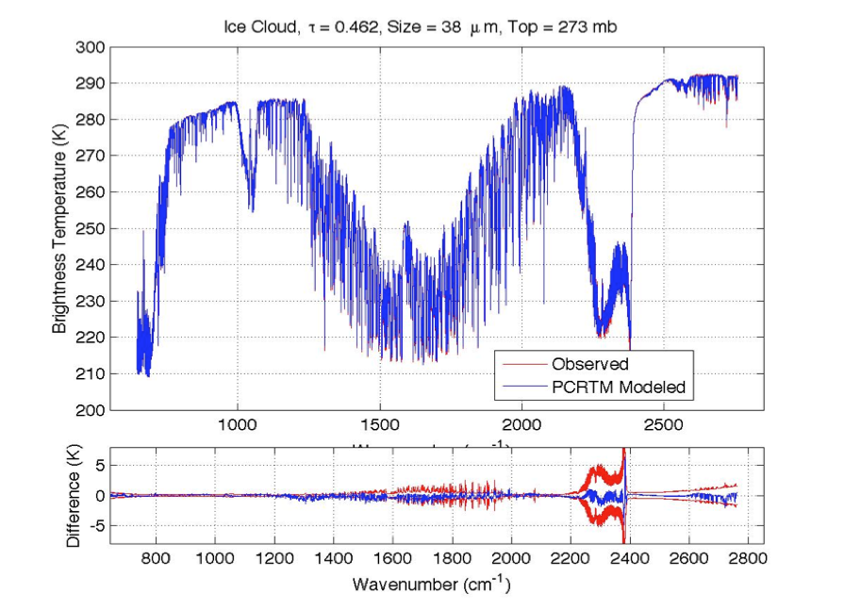
PCRTM Simulations of IR sounders
IASI
CrIS
AIRS
Sensor | Channel Number | PC score (seconds) | PC score + radiance | PC score + PC Jacobian
CLARREO, 0.1 cm⁻¹ | 19901 | 0.014 s | 0.022 s | 0.052 s
CLARREO, 0.5 cm⁻¹ | 5421 | 0.011 s | 0.013 s | 0.039 s
CLARREO, 1.0 cm⁻¹ | 2711 | 0.0096 s | 0.012 s | 0.036 s
IASI, 0.25 cm⁻¹ | 8461 | 0.011 s | 0.012 s | 0.044 s
AIRS, 0.5-2.5 cm⁻¹ | 2378 | 0.0060 s | 0.0074 s | 0.031 s
CrIS,0.625-2.5 cm⁻¹ | 1317 | 0.0050 s | 0.0060 s | 0.021 s
NAST-I, 0.25 cm⁻¹ | 8632 | 0.010 s | 0.013 s | 0.045 s
S-HIS, 0.5 cm⁻¹ | 4316 | 0.008 s | 0.008 s | 0.038 s
CrIS, 0.625 cm⁻¹ | 2211 | 0.009 s | 0.009 s | 0.033 s
Spectral coverage (50-3000 cm⁻¹)
Multilayer, multiple scattering clouds included
15 variable trace gases
Output analytical Jacobians
4 orders of magnitude faster than LBLRTM
Milliseconds to fraction of seconds in IR

Slide 6
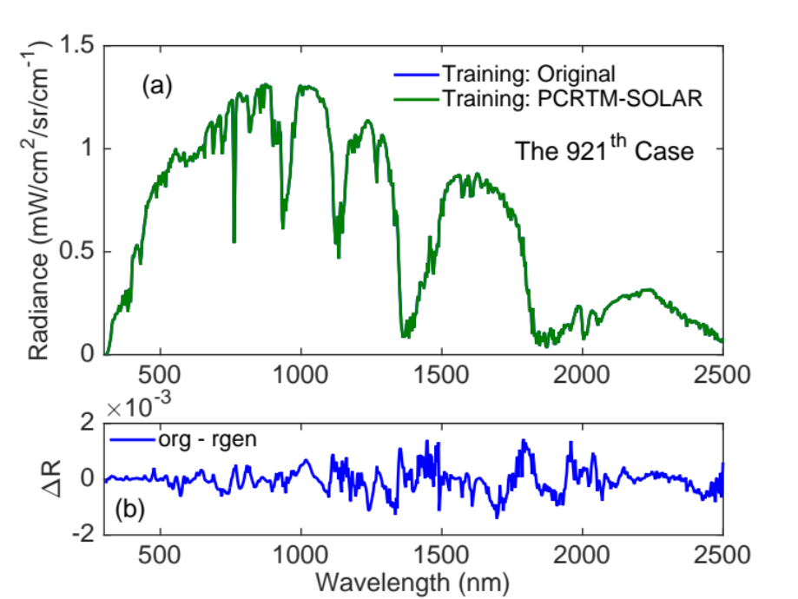
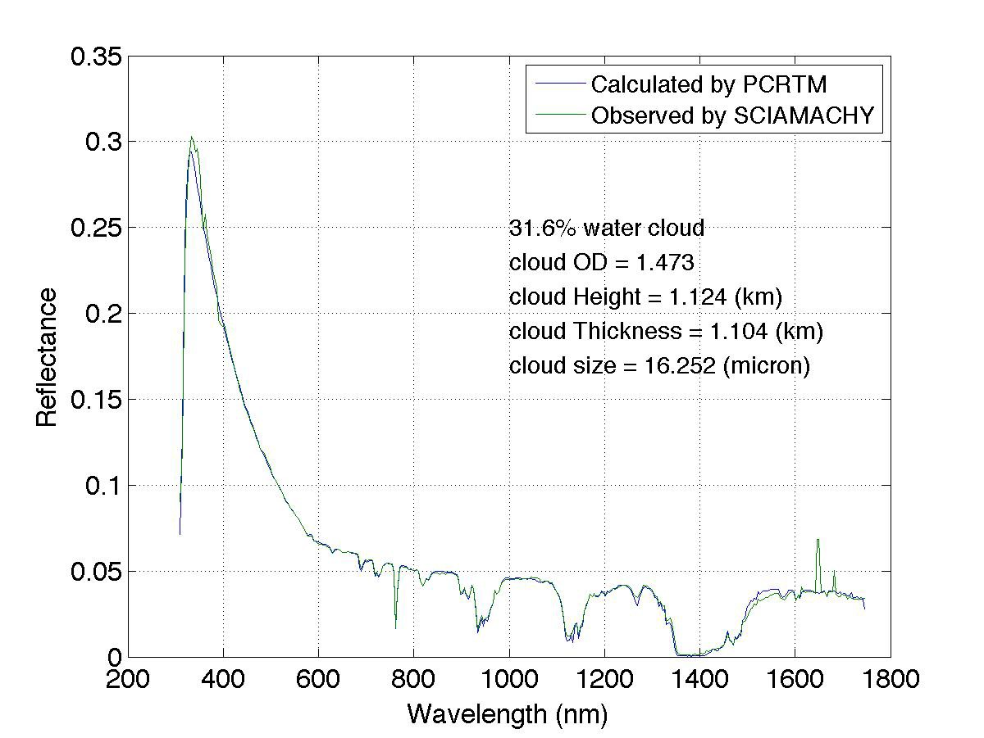
PCRTM Reduces RT Calculations by 3-4 Oders of Magnitude Relative to Correlated- Method for CPF-type Spectrometer
SCIAMACHY
PCRTM | nmo | nch | npc | nsmo | Speed -up
Land (8 nm) | 259,029 | 546 | 220 | 262 | 988
Ocean (8 nm) | 259,029 | 546 | 267 | 240 | 1079
Number of radiative transfer calculations for PCRTM are reduced by 3 orders of magnitude relative to modtran for spectral range from 300 nm to 2500 nm
PCRTM | M1 | M2 | Speedup to Regular PCRTM- SOLAR | Speedup to MODTRAN5
Land 8 nm | 263 | 49 | 5 | 5286
Ocean 8 nm | 241 | 23 | 10 | 11,262
Hybrid Stream method further speed up PCRTM-SOLAR by another factor of 5-10 relative to 32-stream PCRTM
MODIS L2 + CPF simulator @646nm

Slide 7
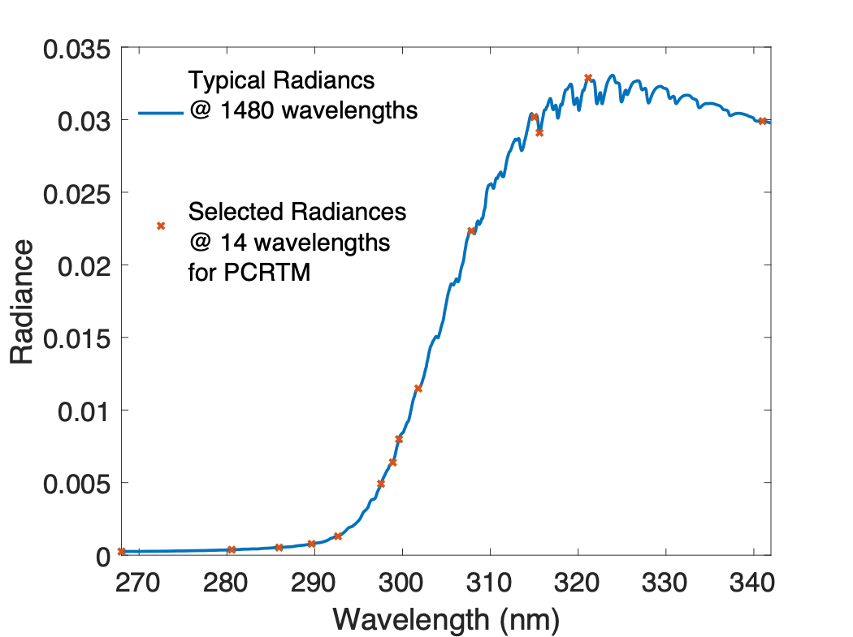
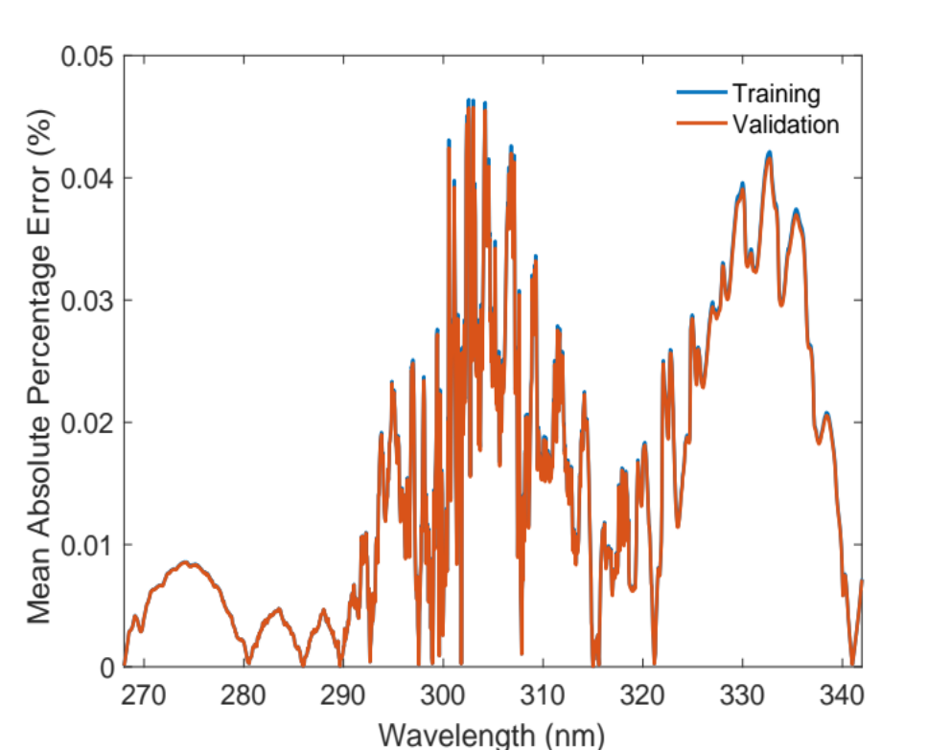
PCRTM for TEMPO/OMI Ozone Spectral Region
2 Orders of magnitude speed up in the OMI Ozone spectral region for a high-spectral resolution (0.05 nm) PCRTM
Redundant RT calculations are avoided in PCRTM approach
Can further reduce the number RT calculations at TEMPO or OMI spectral resolutions

Slide 8
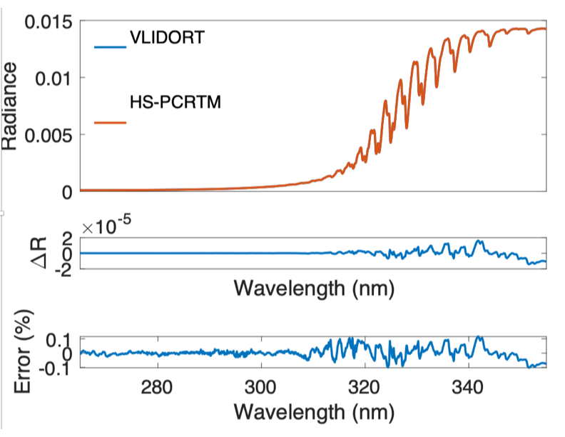
Further speed up by hybrid stream approach
The Hybrid Stream PCRTM (HS-PCRTM) can further reduce the computational time
  Perform 2-stream monochromatic RT calculations at original PCRTM selected frequencies
  Perform higher streams RT calculations at even less monochromatic frequencies
  The accuracy is not comprised (see example below)

Slide 9

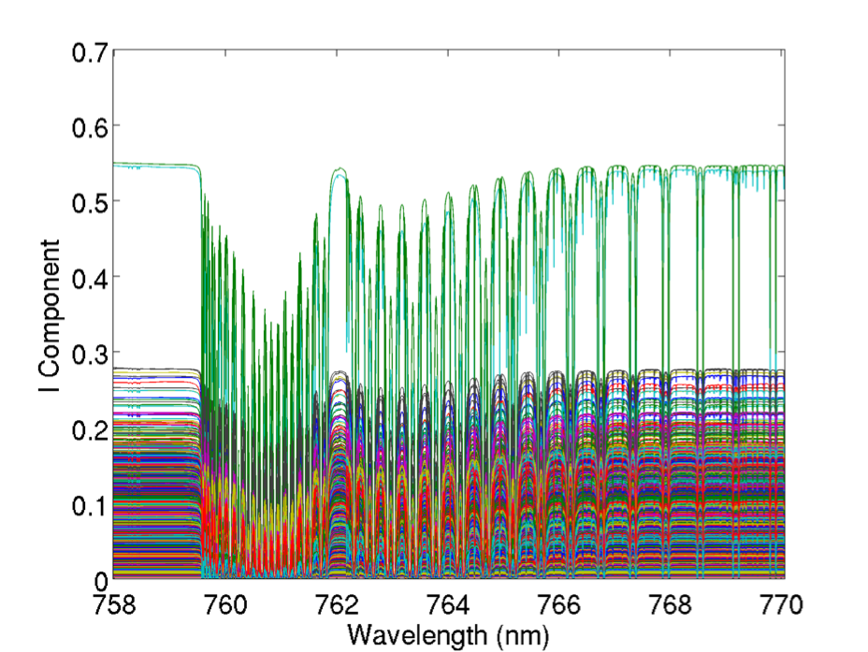
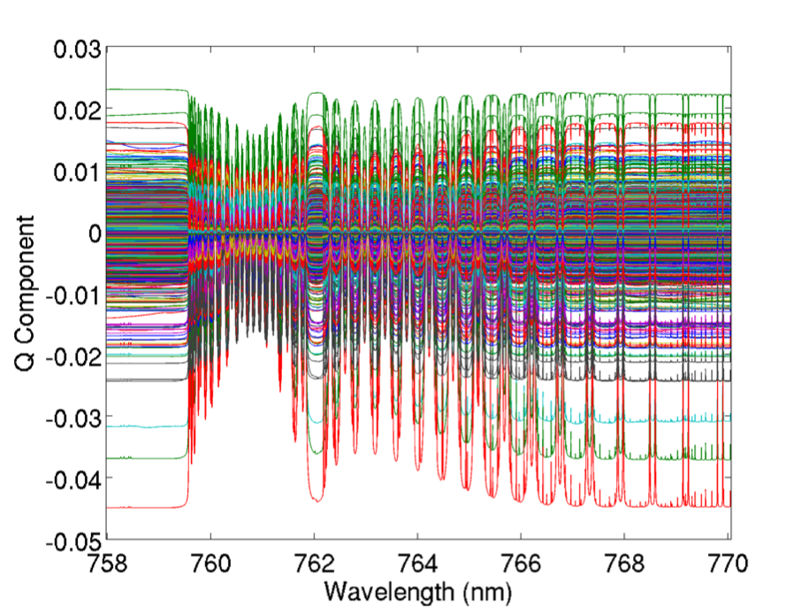
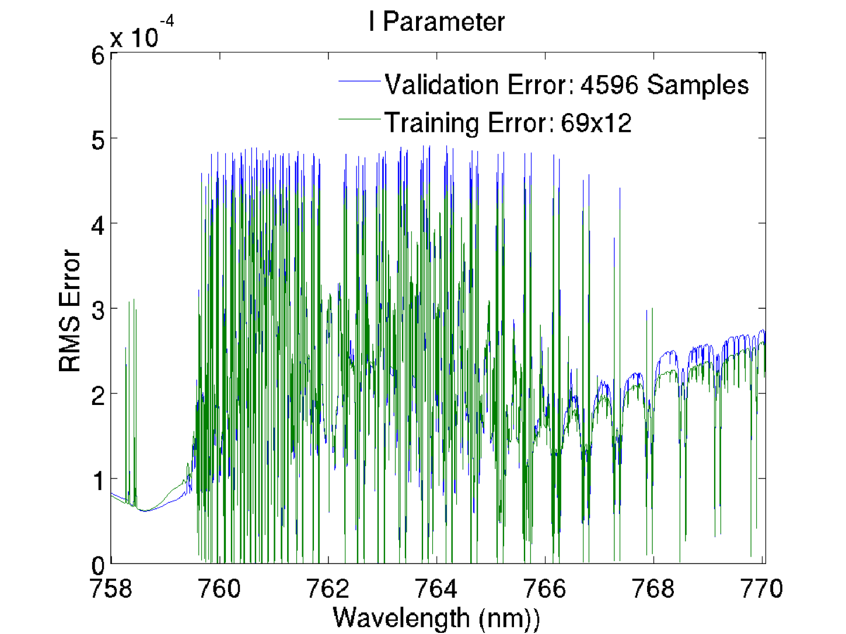
Example of PCRTM for very high spectral resolution(0.001 nm) polarized O₂-A band
Only 12 monochromatic RT calculations are needed to faithfully represent the 0.001 nm O₂-A band
A few dozens more monochromatic RT calculations are needed to include Q, U polarized components of the Stokes vector

Slide 10
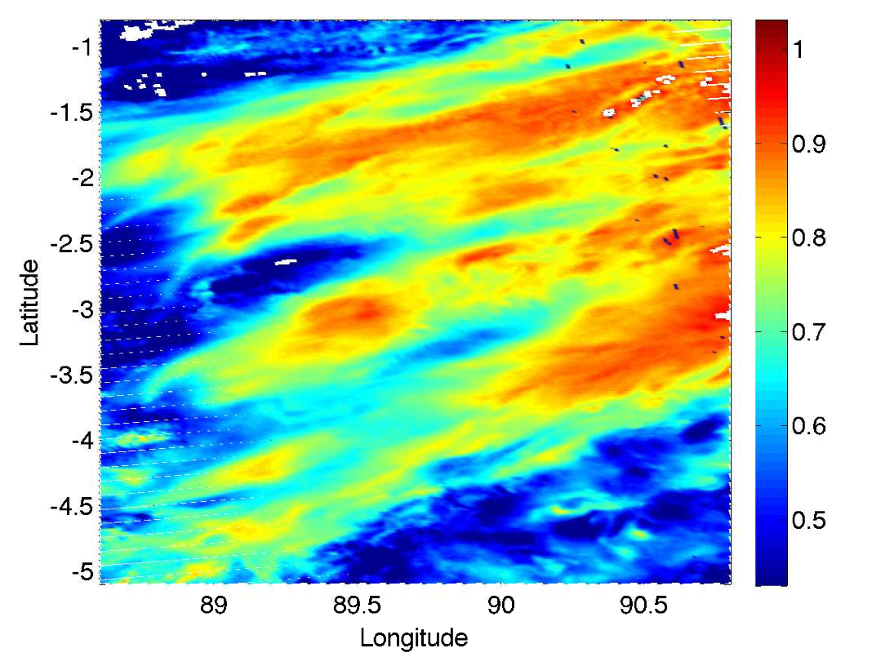
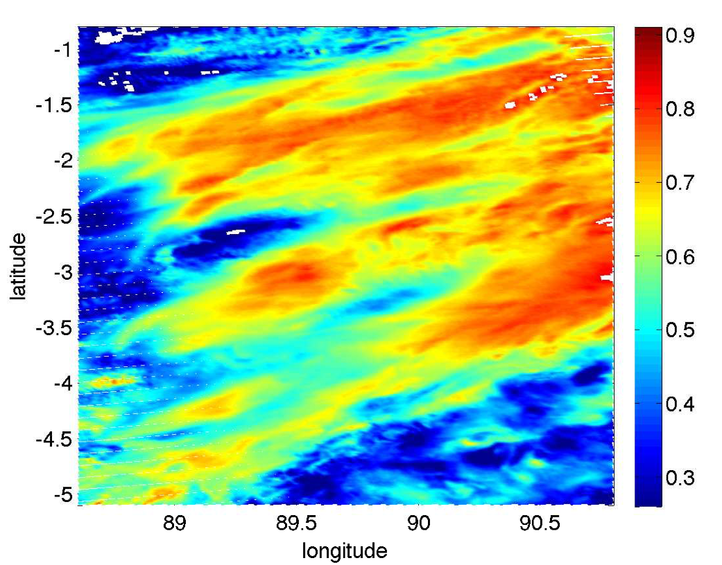
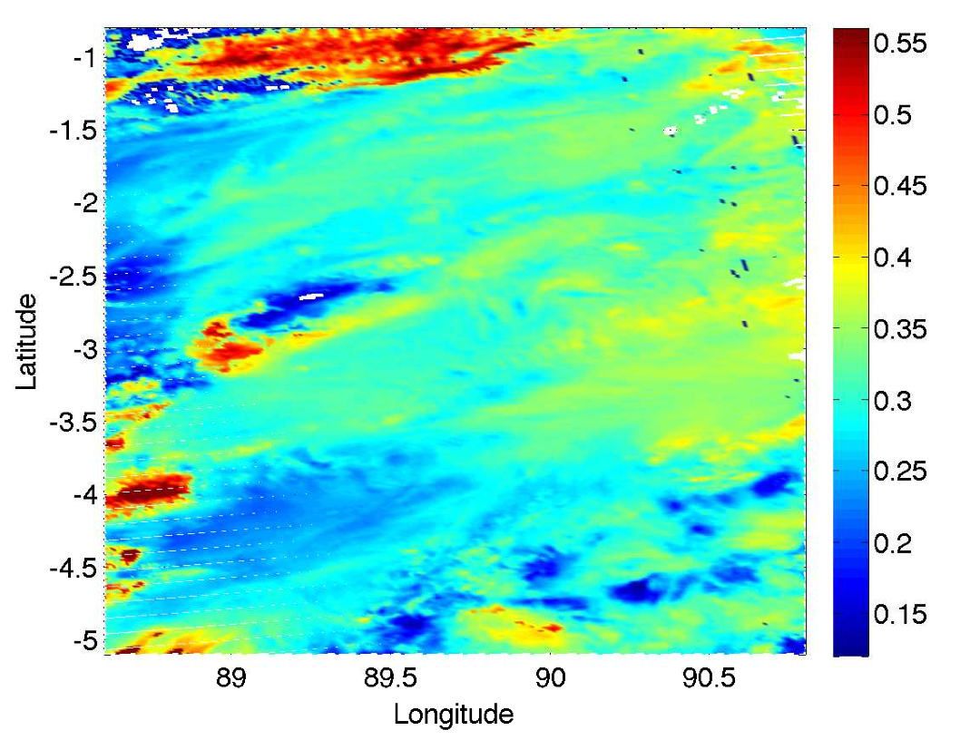
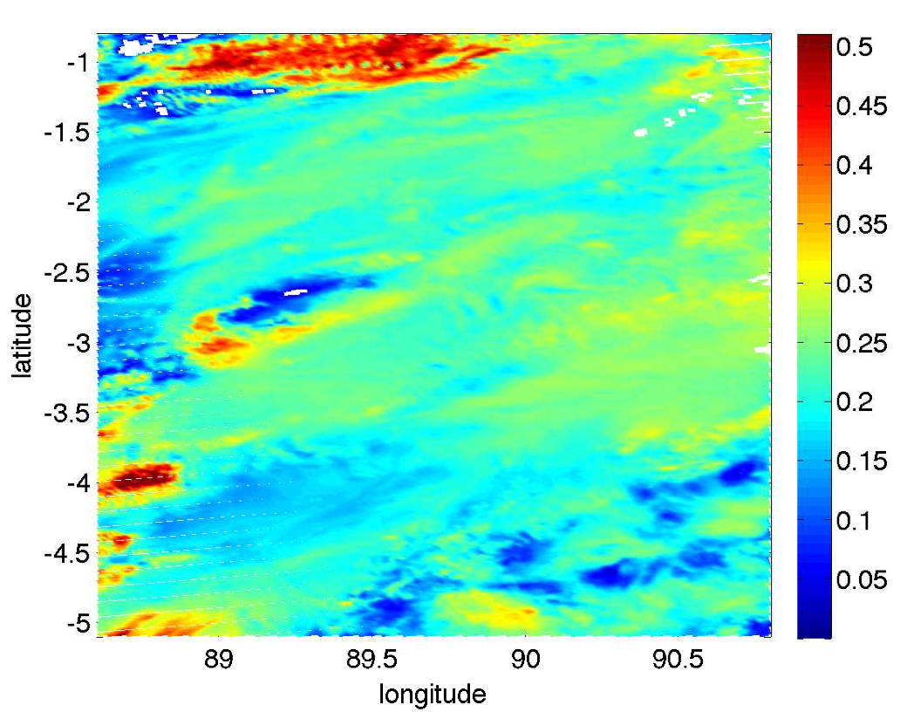
Examples of using PCRTM to generate high-resolution Proxy Data for Satellite Remote Sensing Applications
From PCRTM high-res Spectrum @488 nm
From observed VIIRS M3band @488 nm
From PCRTM high-res Spectrum @1610 nm
From observed VIIRS M10-band @1610 nm
(Xu.Liu-1@nasa.gov )

Slide 11
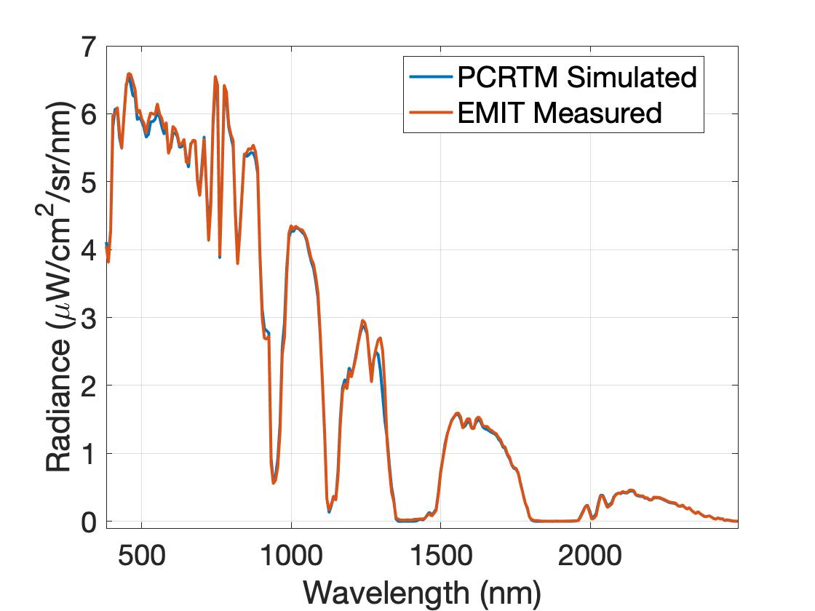
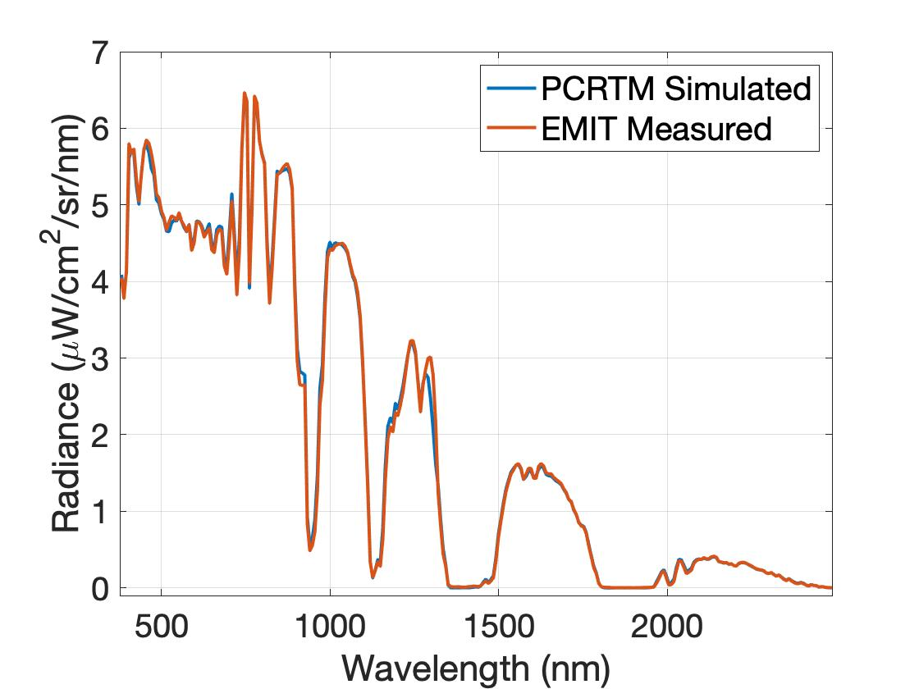
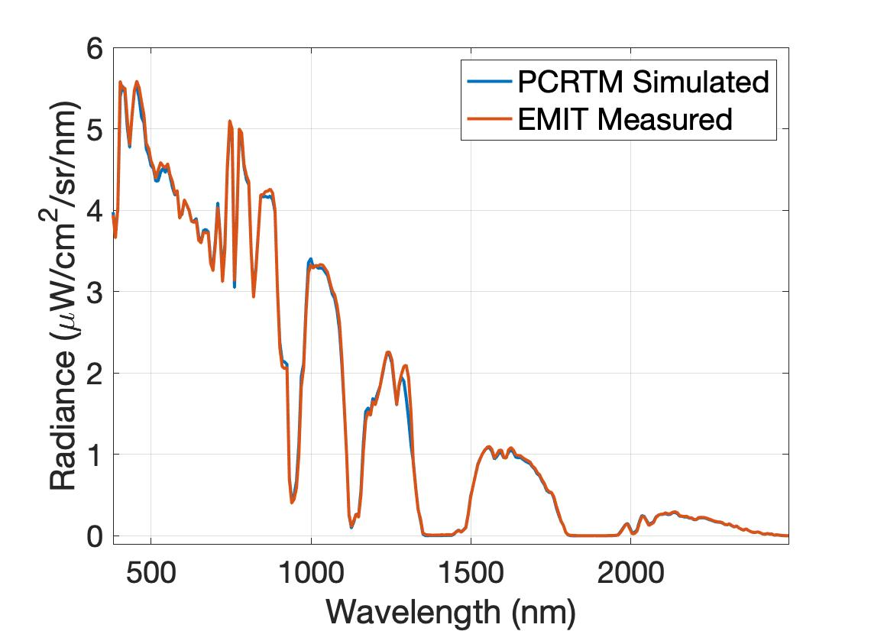
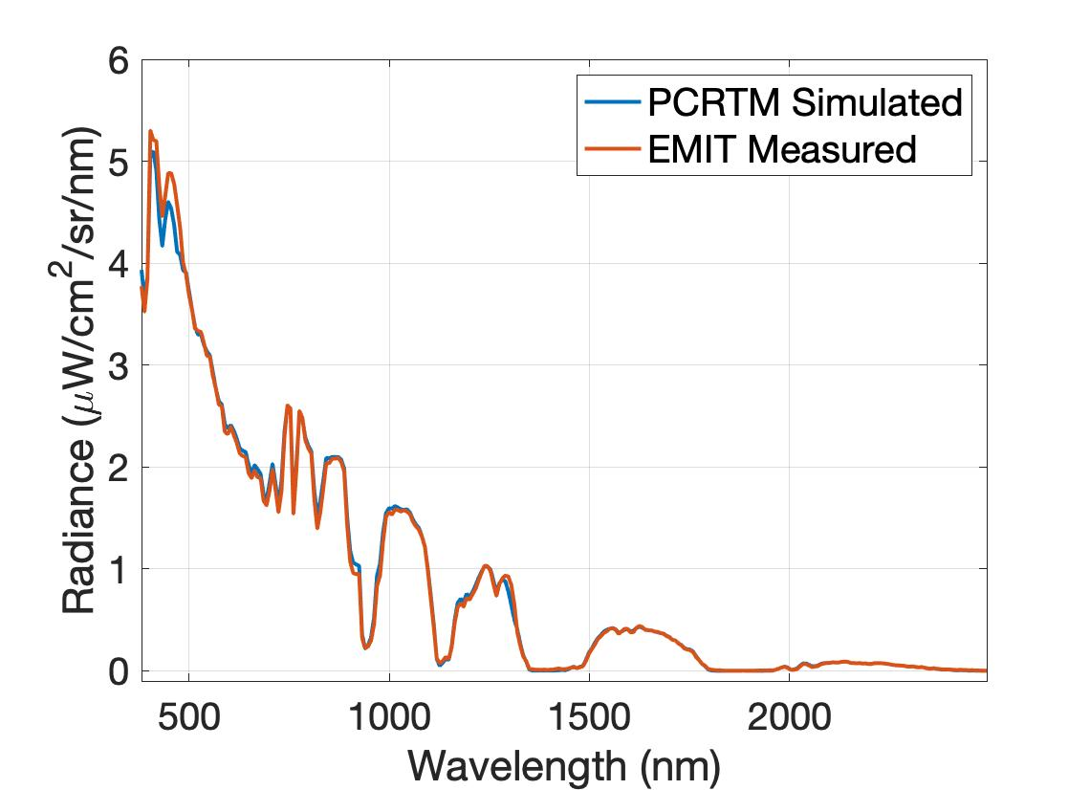
Examples of PCRTM simulated and EMIT observed spectra

Slide 12
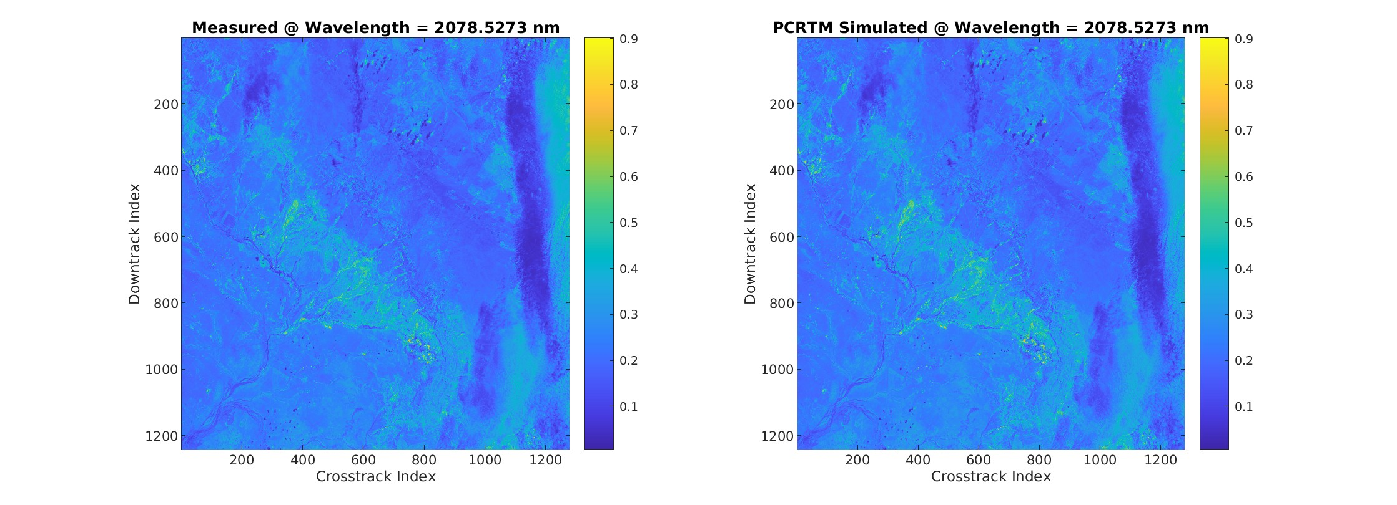
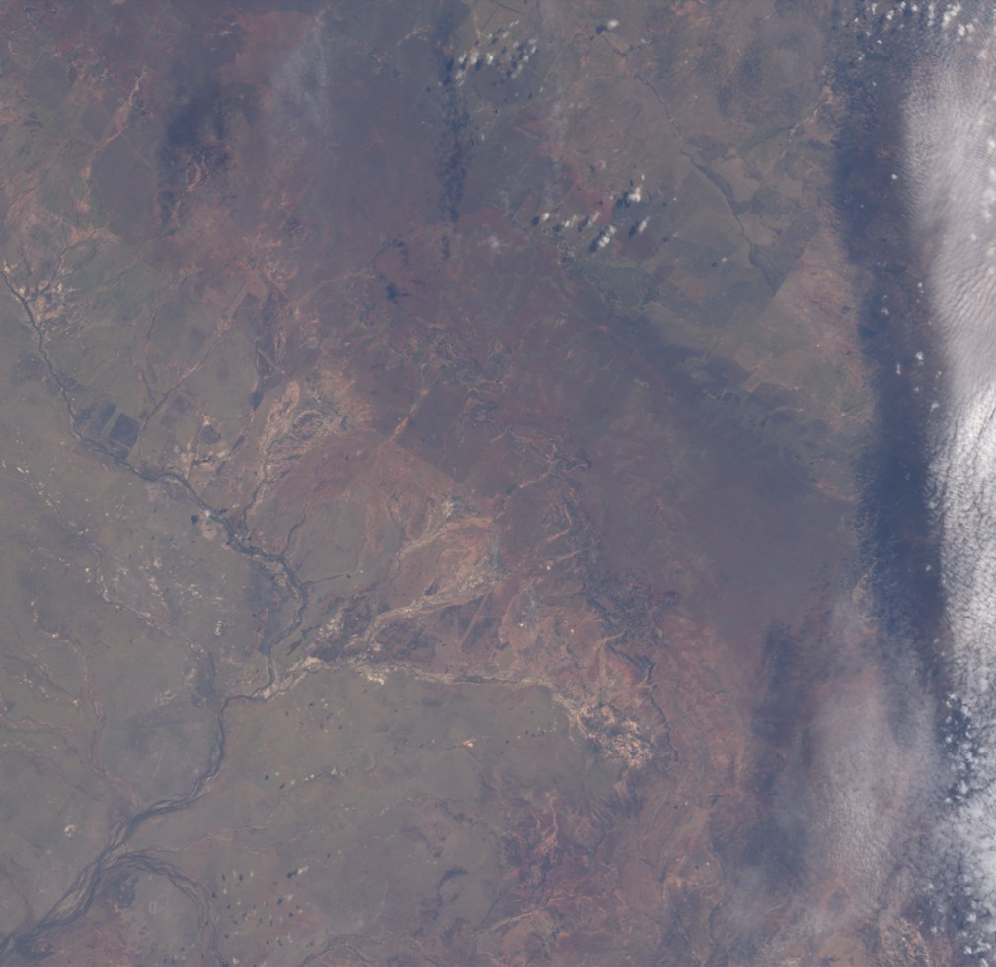
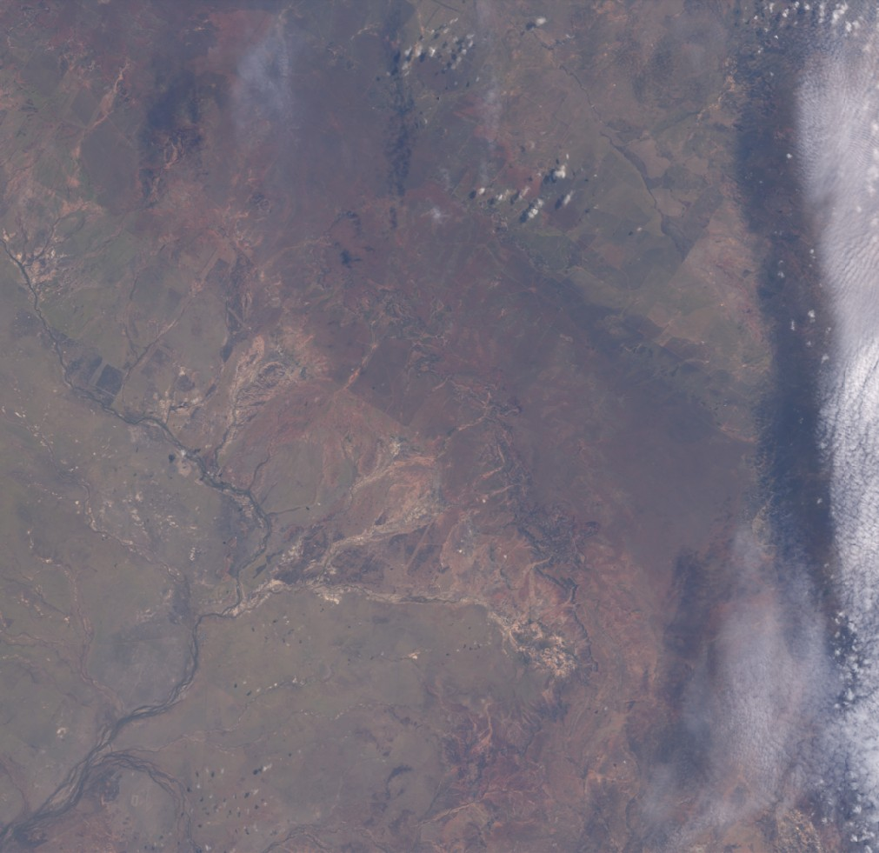
PCRTM simulated spectra agree all well with EMIT observation at different wavelengths and 1.6 million pixels
EMIT observed radiance at 2078.5 nm
PCRTM simulated radiance at 2078.5 nm using EM L2 product as input
EMIT observed RGB image
PCRTM simulated RGB image

Slide 13
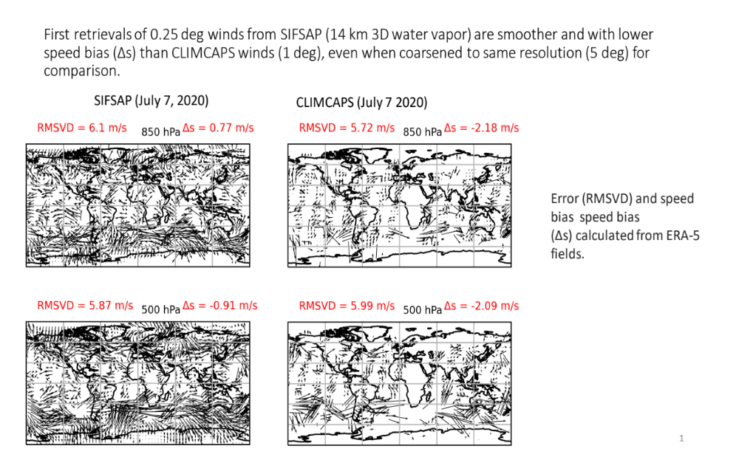
HIger Spatial Resolution Help 3D Wind

Slide 14
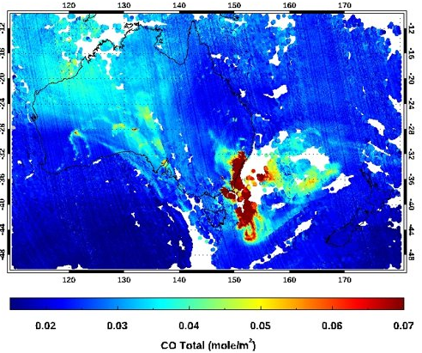
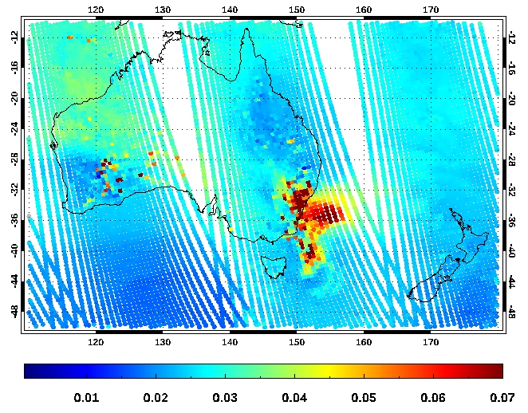
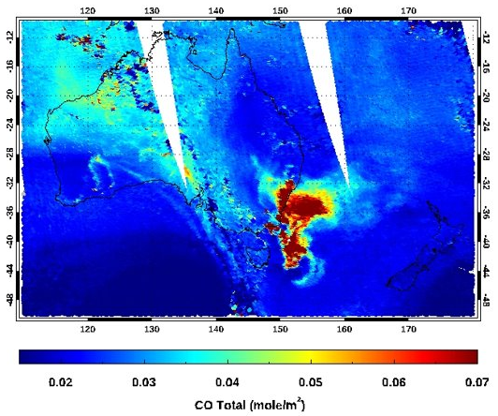
PCRTM-based SiFSAP L2 and L3 products operational at NASA GES DISC for public data access since 2023
CLIMCAPS total CO from CrIS
TROPOMI total CO
Both TROPOMI and SiFSAP from CrIS show high spatial resolution CO product from the Australia fires at the end of 2019 and early 2020
The Cloud-clearing products (CLIMCAPS) have 9-times less area spatial resolution relative to SiFSAP
SiFSAP total CO from CrIS

Slide 15
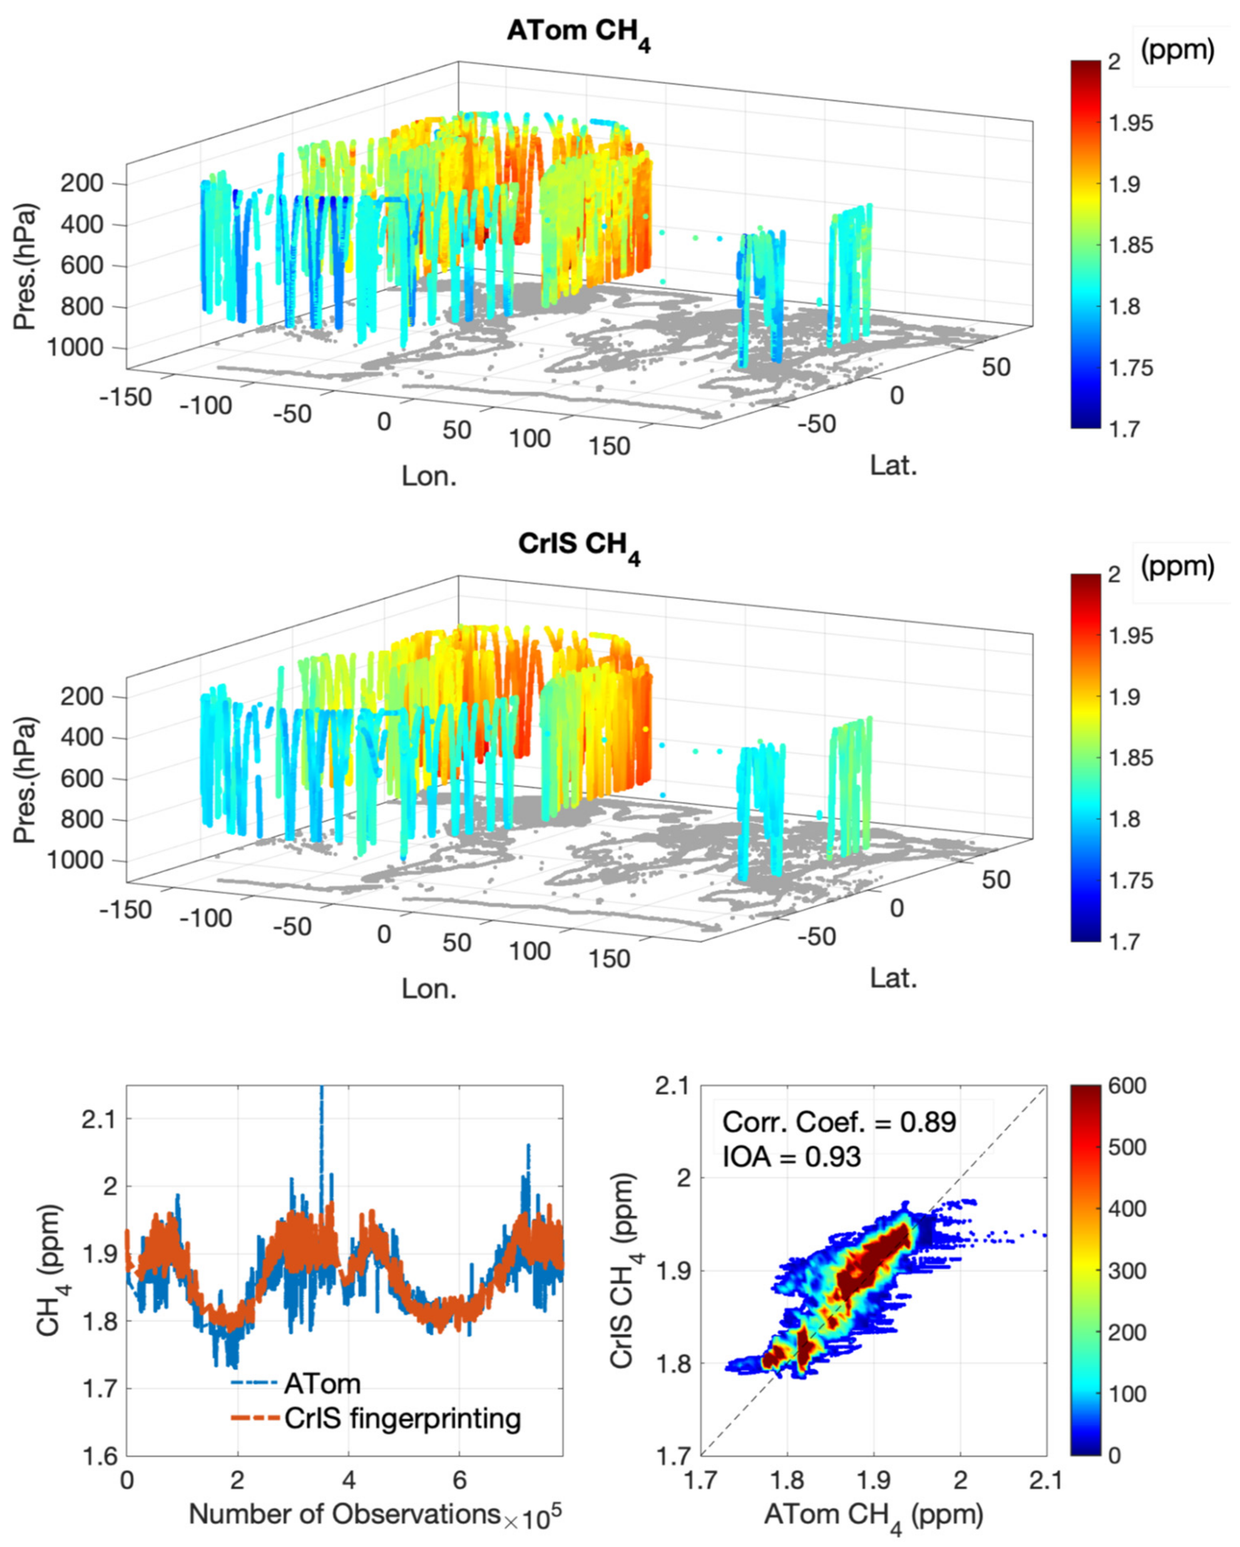

Slide 16
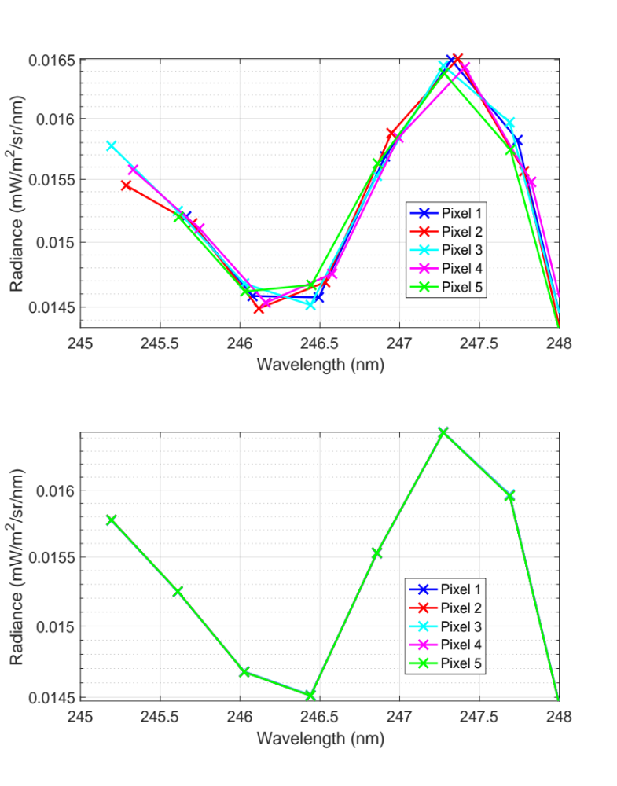
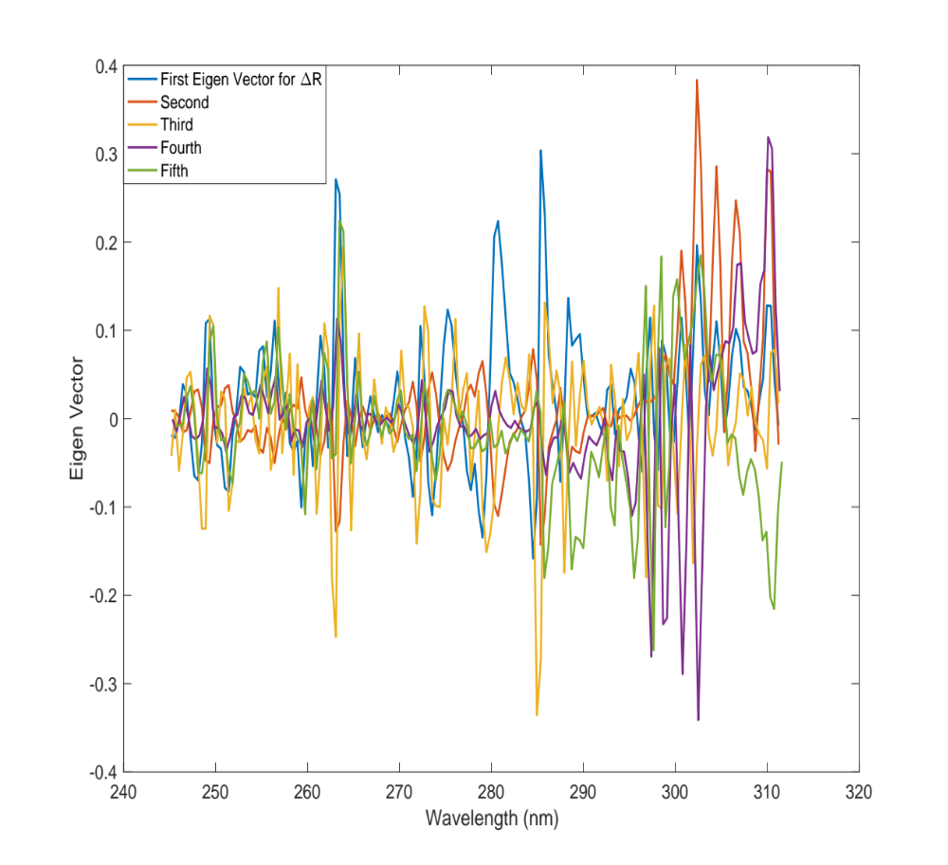
Characterizing satellite L1 data spectral shift using PCRTM

Slide 17
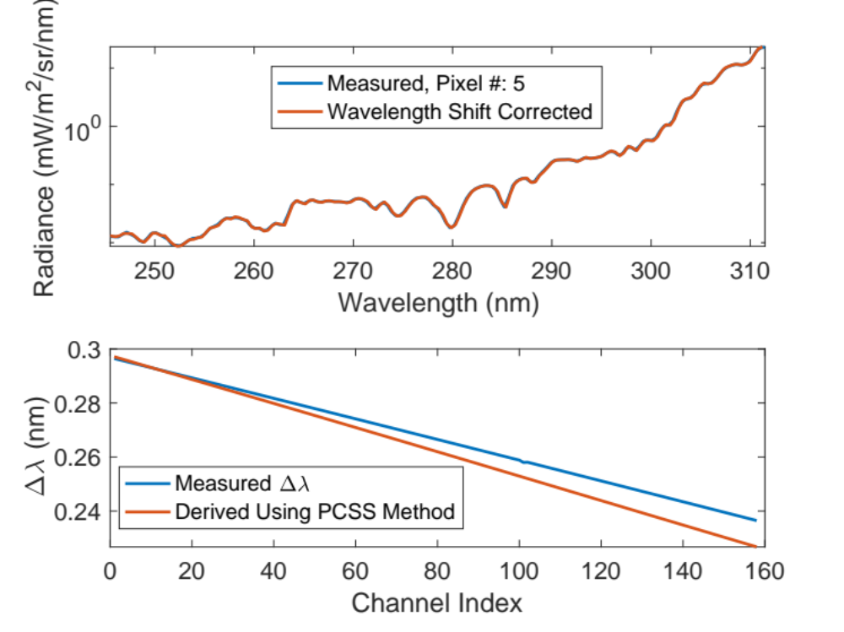
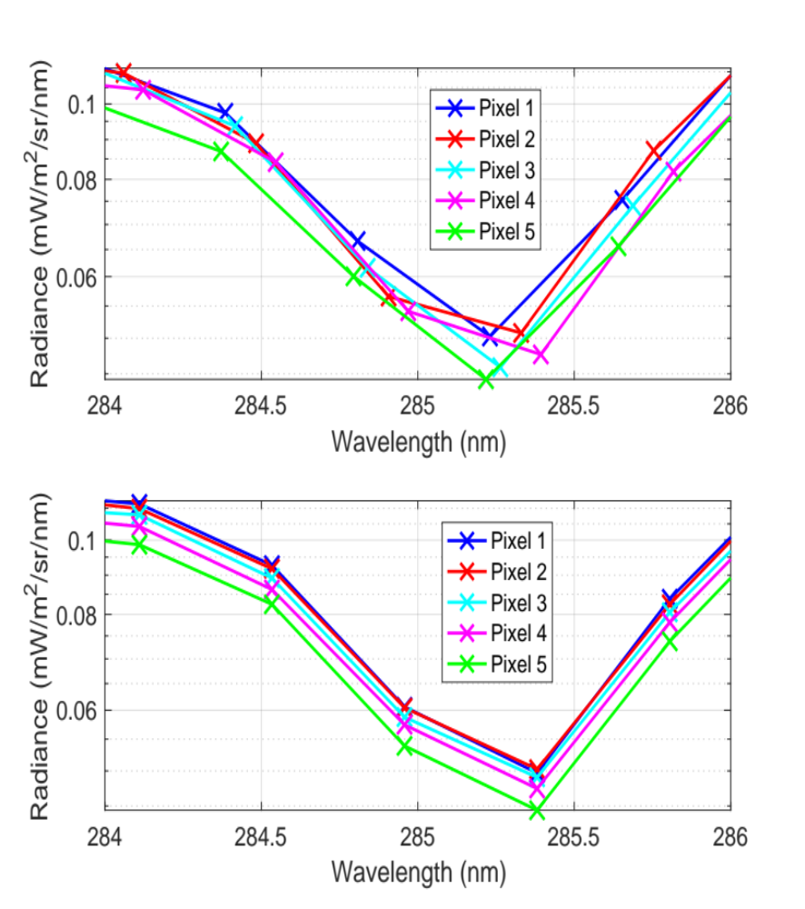
Examples of Principal Component Based Spectral Standardization for Measured OMPS Spectra
Before Wavelength Shift Correction
Examples of Wavelength Shift Correction for Pixel #5
After Wavelength Shift Correction, the difference in magnitude is due to the different scene of each pixel.

Slide 18
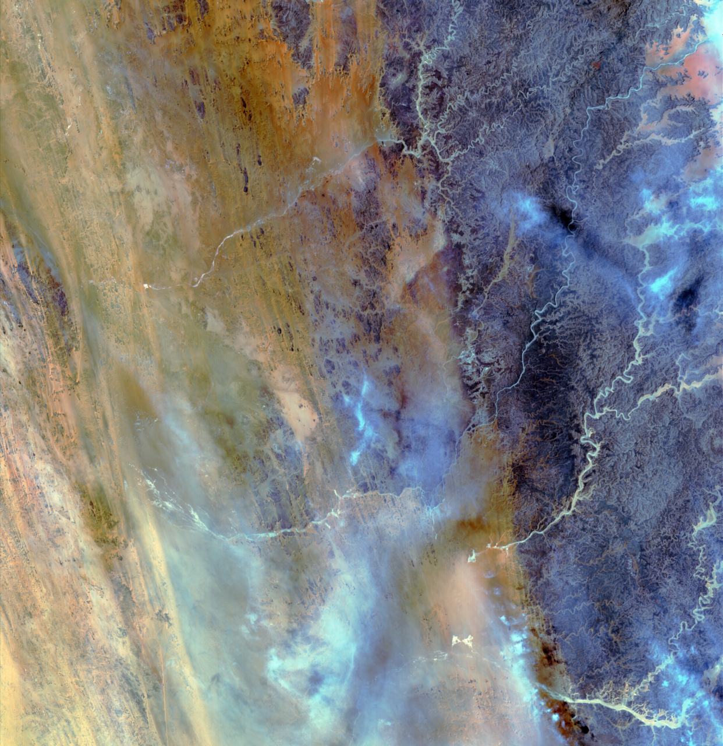

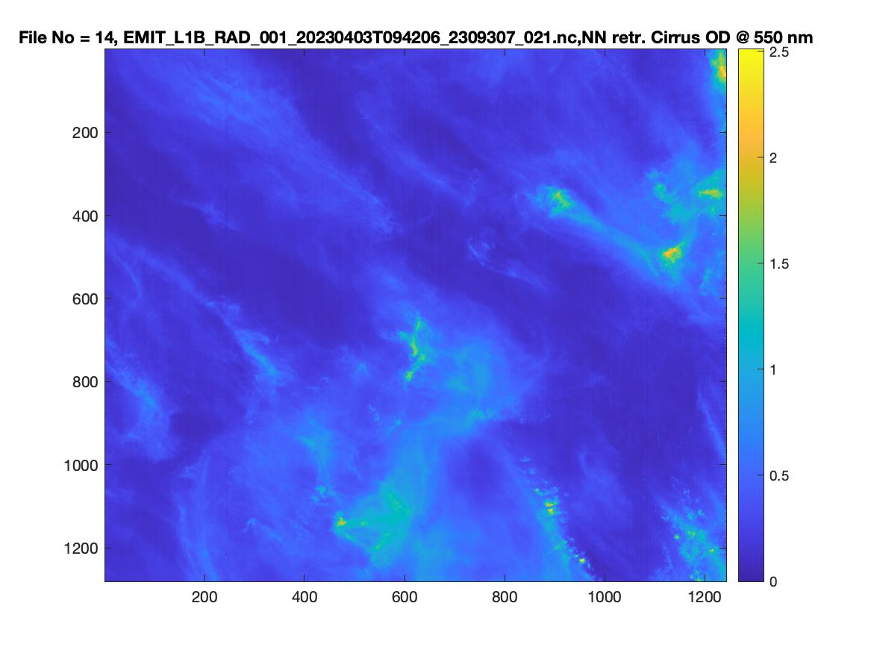
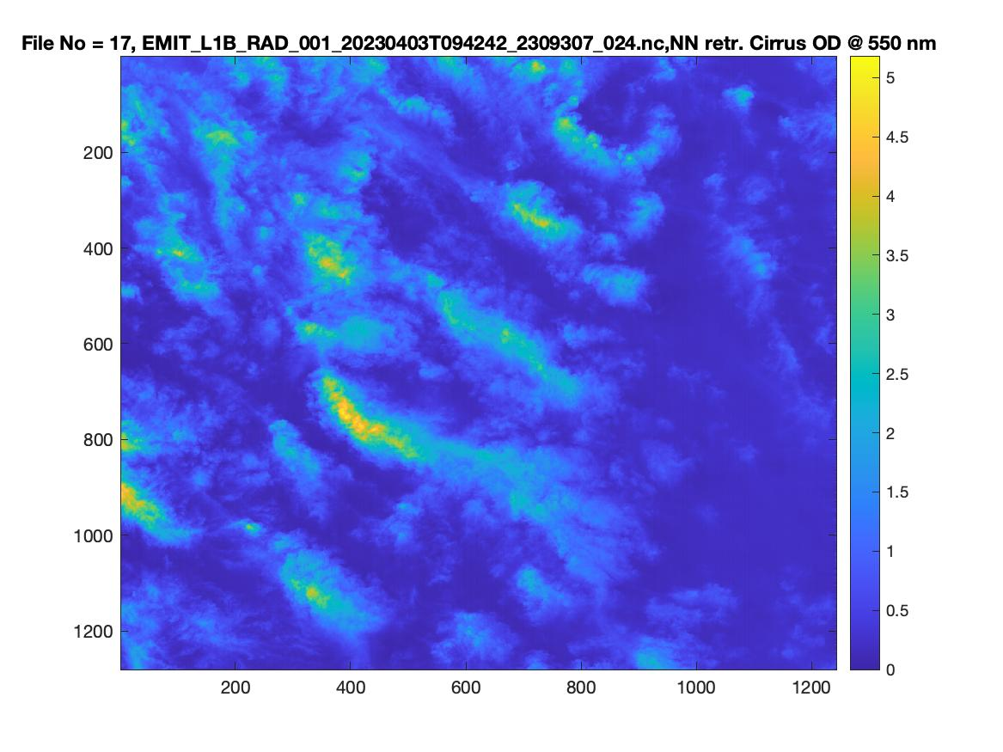
PCRTM trainrf AI Cloud Retrieval algorithm for EMIT
RGB EMIT Image
RGB EMIT Image
PCRTM Retr. COD from EMIT
PCRTM Retr. COD from EMIT

Slide 19


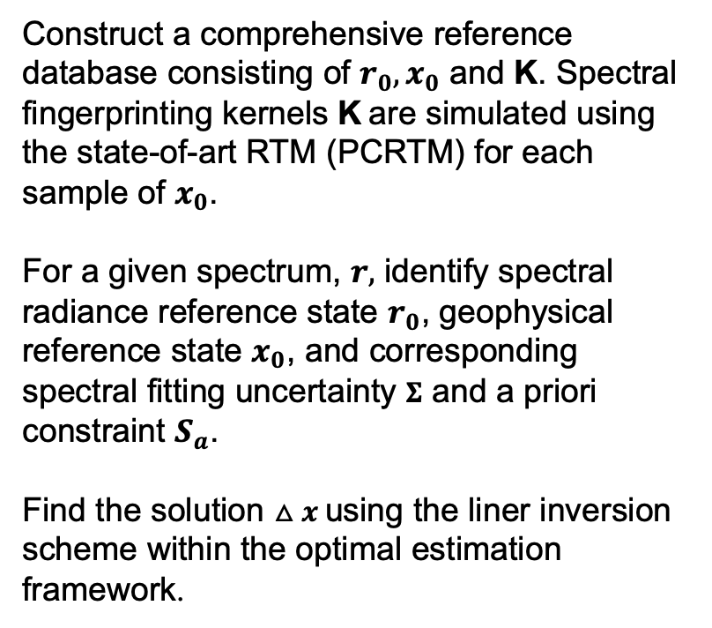

A new PCRTM-based physical inversion scheme – spectral fingerprinting
Construct a comprehensive reference database consisting of $r_{0}, x_{0}$ and K. Spectral fingerprinting kernels K are simulated using the state-of-art RTM (PCRTM) for each sample of $x_{0}$.
For a given spectrum, $r,$ identify spectral radiance reference state $r_{0}$, geophysical reference state $x_{0}$, and corresponding spectral fitting uncertainty $Σ$ and a priori constraint $S_{a}$.
Find the solution $△x$using the liner inversion scheme within the optimal estimation framework.
K – spectral fingerprinting kernel
$$△r =r −r_{0}$$
$$△x =x −x_{0}$$
Efficiency: orders of magnitude faster than traditional physical retrieval algorithm with all spectral information used
Accuracy : Achieve radiometric consistency by using kernels and the optimal estimation
Spatial and temporal resolution: instantaneous single footprint (pixel) or spatiotemporally averaged data

Slide 20
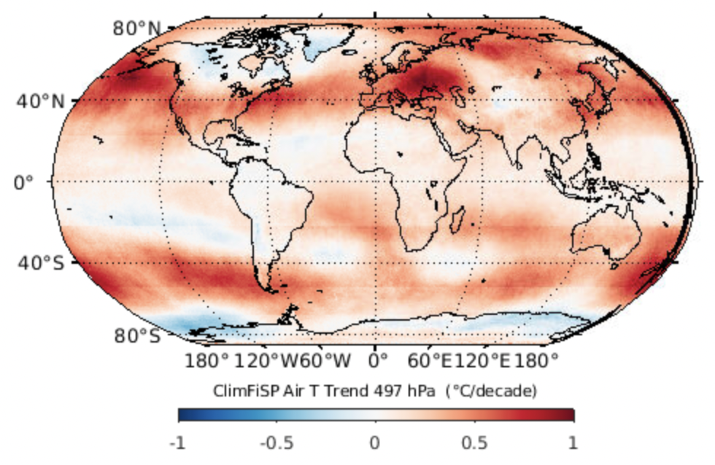
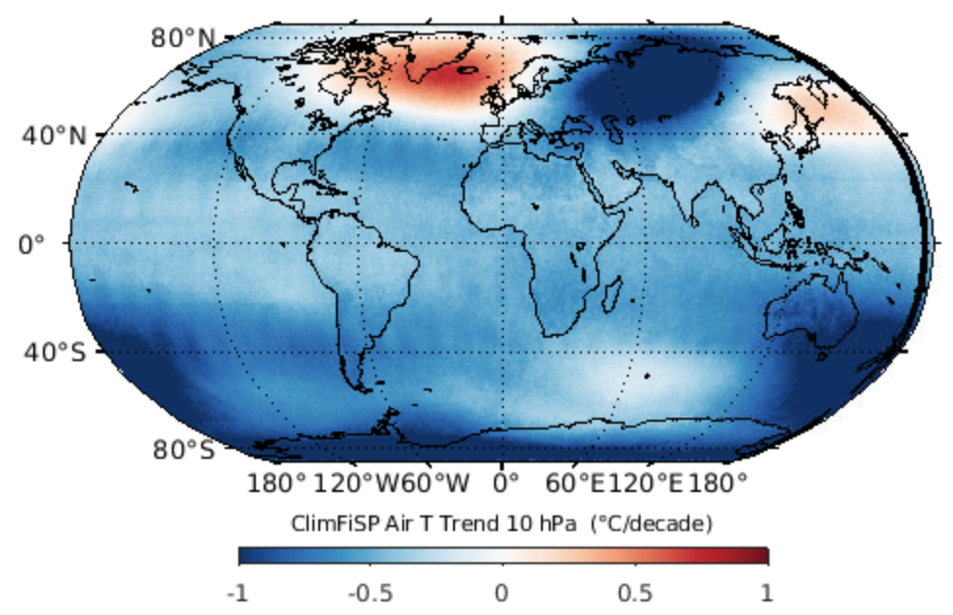
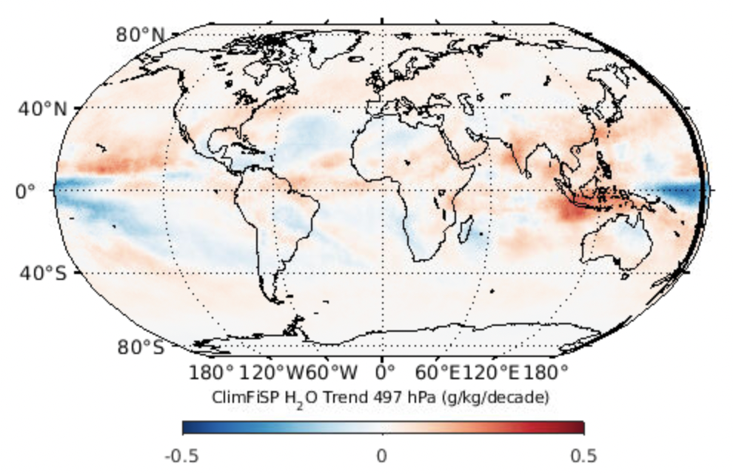
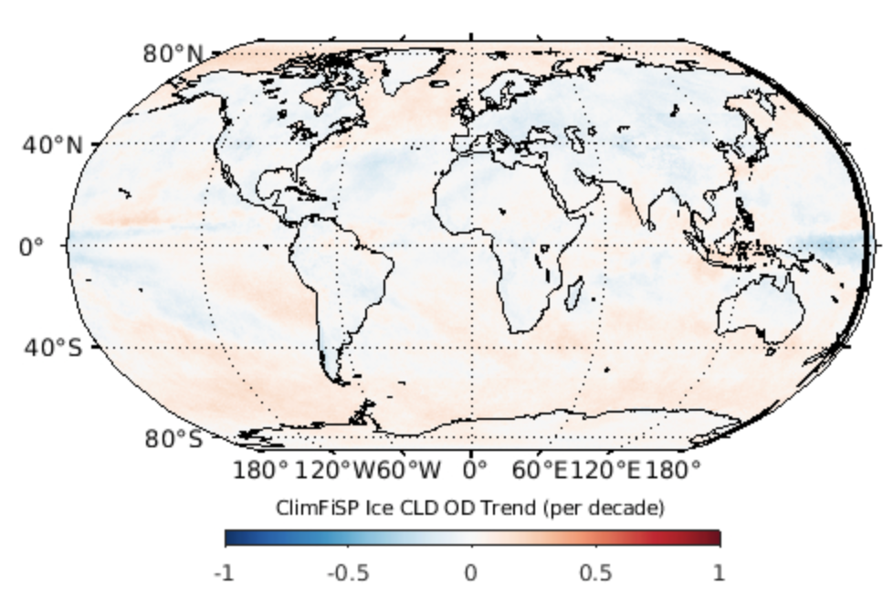
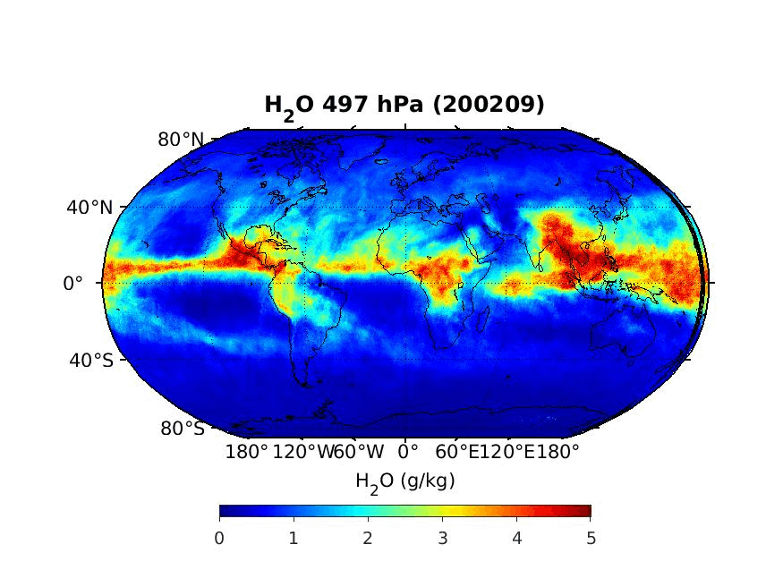
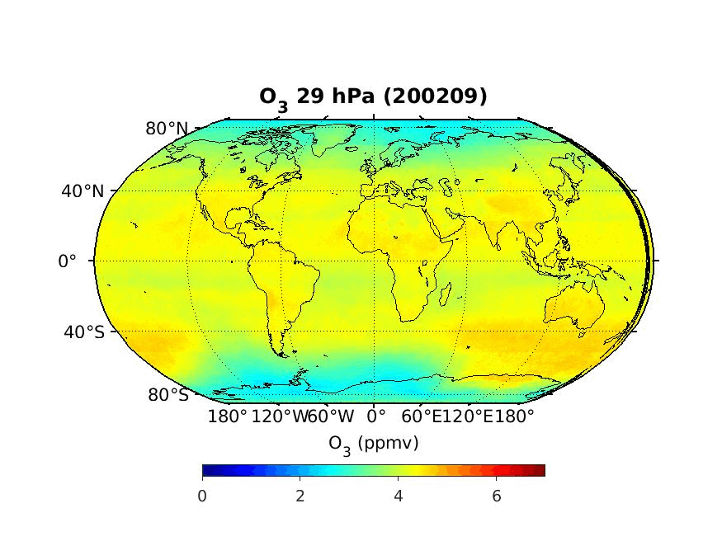
20-year Climate Trends from ClimFiSP
Tropospheric warming (500 hPa)
Stratospheric cooling (10 hPa)
Water Vapor Trend at 500 hPa
ClimFiSP Ice Cloud Optical Depth Trend
20-years of monthly H₂O at 500 hPa
20 years of monthly O₃ at 30 hPa

Slide 21
Summary and conclusions
PCRTM Accelerates the RT calculations by exploring spectral correlations
  PCRTM performs RT calculations monochromatically (i.e. accurate and physical)
  Hybrid-Steam PCRTM (HS-PCRTM) can further reduces RT calculation times
  Handle multiple scattering clouds
  Works for polarized RT calcuations of (I, Q, U)
  A few ms per spectrum in IR spectral region
  3-4 orders of magnitude faster than MODTRAN in solar spectral region
  Accurate relative to line-by-line models
  PCRTM provides Jacobian needed for a physical retrieval algorithm
PCRTM was first developed for IR in 2004
  NAST-I, AIRS, CrIS, IASI, SHIS, CLARREO, PREFIRE….
  PCRTM based SiFSAP hyperspectral sounding product available at NASA GES DISC
PCRTM was extended for solar
  CPF, HYSICS, SCHIAMCHY, EMIT, SBG, OMI/TEMPO O₃ region….
  Plan to extend to the whole TEMPO spectral region
  Has many applications for OMPS, CPF, EMIT, and SBG
PCRTM-based inversion algorithms can use all spectral information which enable retrievals of geophysical parameters simultaneously without having to empirically account for interference spectral features
A New PCRTM and ML-based spectral fingerprinting method has great potential is using all spectral information from hyperspectral sensors

