Slide 1
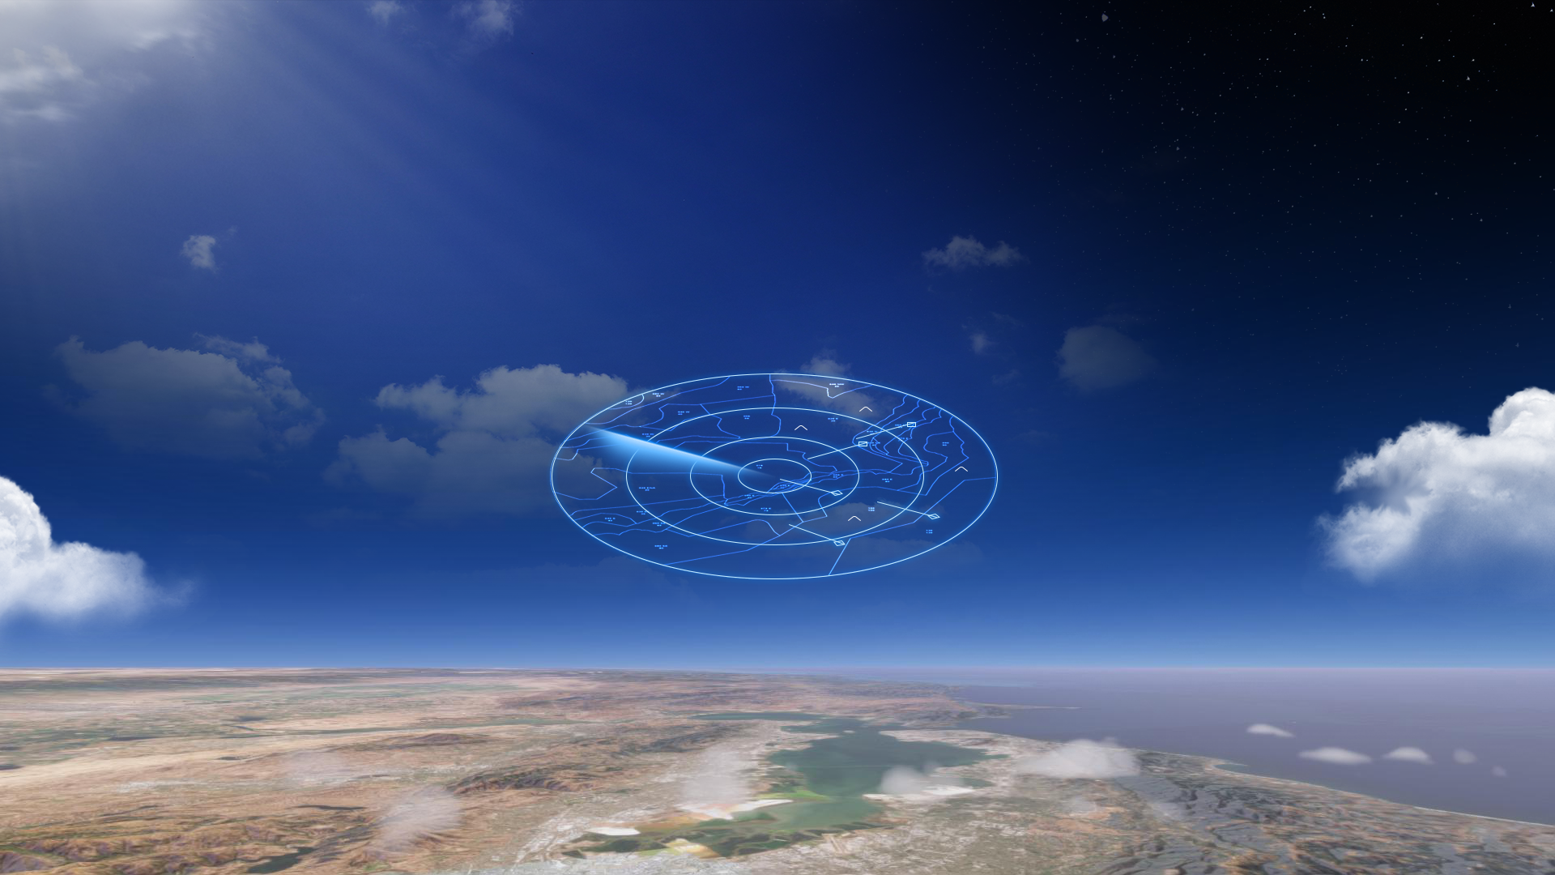

  ICAO ADVANCED AIR MOBILITY SYMPOSIUM
  September 2024
Air Traffic Management Exploration (ATMx)

Slide 2
  Supreet Kaur
  Integration Team Lead
Air Traffic Management Exploration
  Advancing a digital aviation ecosystem through research, development and testing

Slide 3
  AIR LINE PILOTS ASSOCIATION
  September 2024
Air Traffic Management Exploration (ATMx)

Slide 4
  Shivanjli Sharma
  Project Manager
Air Traffic Management Exploration
  Advancing a digital aviation ecosystem through research, development and testing

Slide 5

Air Traffic Management Exploration (ATMx)
Integrated Information
Operations & Automation
Airspace Optimization

Slide 6
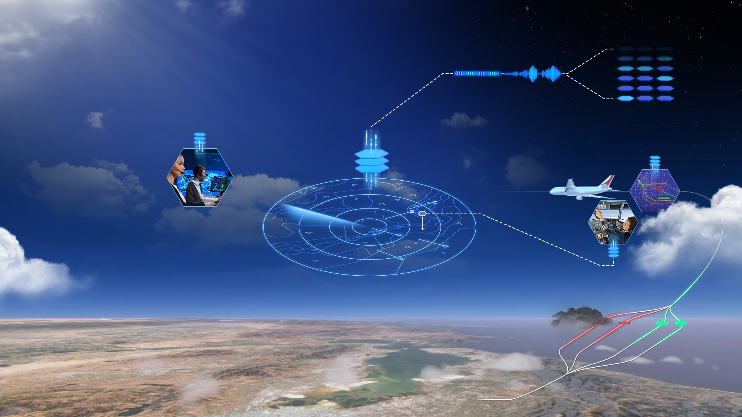
Air Traffic Management Exploration (ATMx)
Enhanced Digital Information
DIP
Cloud-based AI/ML Predictive Services
Sustainable Operations
Integrated Information
Operations & Automation
Airspace Optimization
Digital Trajectory Management

Slide 7
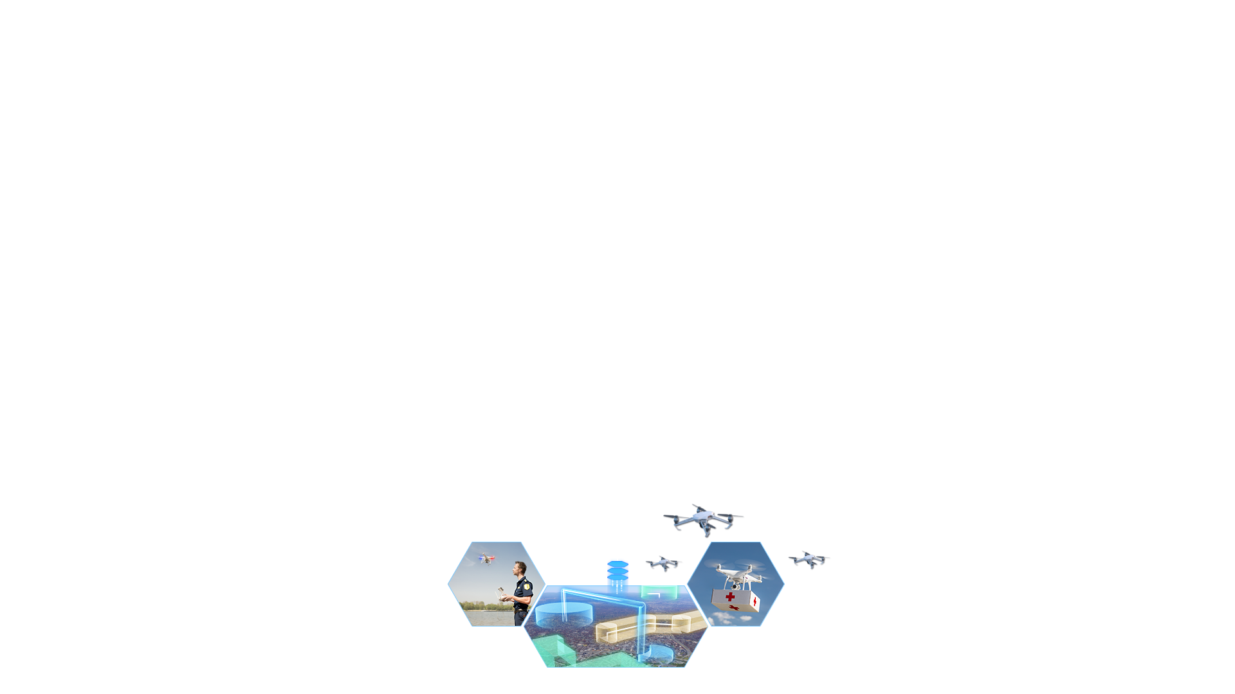
Air Traffic Management Exploration (ATMx)
Enhanced Digital Information
DIP
Cloud-based AI/ML Predictive Services
Sustainable Operations
Integrated Information
Operations & Automation
Airspace Optimization
Digital Trajectory Management
UTM BVLOS
Operationalization
of UTM BVLOS
Automated
Test Harness
Service
Qualification
Shared
Airspace

Slide 8

Air Traffic Management Exploration (ATMx)
Enhanced Digital Information
DIP
Cloud-based AI/ML Predictive Services
Sustainable Operations
Integrated Information
Operations & Automation
Airspace Optimization
PAAV
Remotely Piloted
Aircraft Systems
Contingency
Management
Digital Trajectory Management
UTM BVLOS
Operationalization
of UTM BVLOS
Automated
Test Harness
Conflict Management
Terminal
Automation
Service
Qualification
Shared
Airspace

Slide 9

Air Traffic Management Exploration (ATMx)
Cooperative
Operating
Practices
Information Sharing
Diverse
Operations
Enhanced Digital Information
NExCT
DIP
Extensible Traffic Management
Cloud-based AI/ML Predictive Services
Sustainable Operations
Integrated Information
Operations & Automation
Airspace Optimization
PAAV
Remotely Piloted
Aircraft Systems
Contingency
Management
Digital Trajectory Management
UTM BVLOS
Operationalization
of UTM BVLOS
Automated
Test Harness
Conflict Management
Terminal
Automation
Service
Qualification
Shared
Airspace

