Slide 1
Wake Flow CFD Validation
STMD-ECF / ESM Hypersonic Transition & Turbulence Modeling Workshop
Frank Greene
NASA Langley Research Center
July 8, 2024

Slide 2
ESM Wake Flow
In FY 23 testing was conducted in Langley’s 31-Inch Mach 10 wind tunnel to provide velocity data in the freestream and wake of a blunt body. Velocities measured using planar laser-induced fluorescence (PLIF) and femtosecond laser electronic excitation tagging (FLEET)
  Validation data for CFD simulations
Comparisons of wake flow velocity data with numerical simulation data (LAURA).
  Conditions: Re = 0.5, 1.0, and 1.8 x 10⁶/ft @ AoA = 0
  PLIF data documented @ Jan 24 SciTech Forum in AIAA 2024-2323 (Re=0.5 x 10⁶)

Slide 3
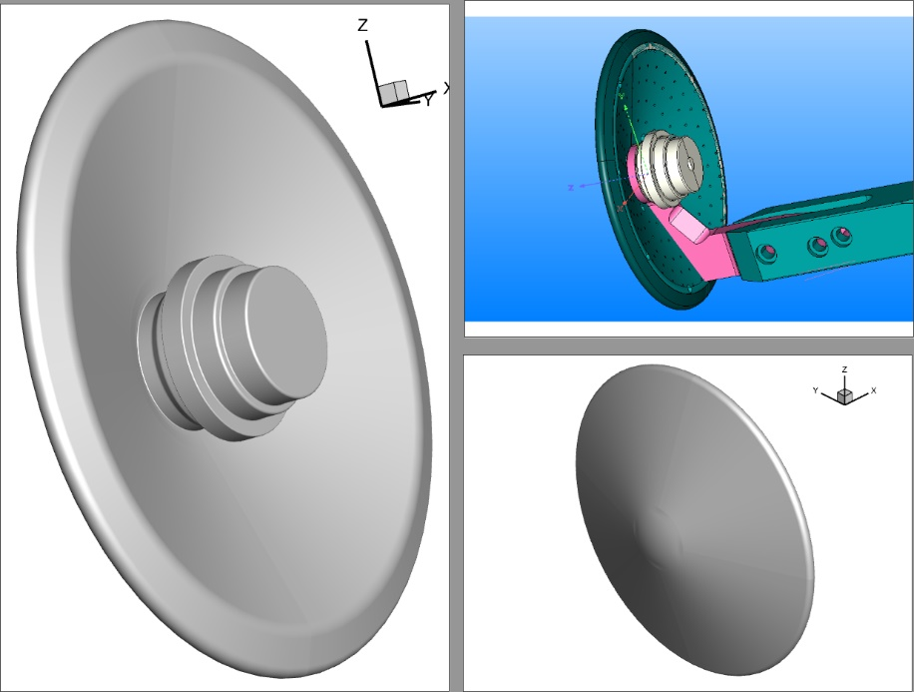
ESM Wake Flow
Geometry and Grid
  Model – 5” diameter 70-degree sphere-cone (representative of hypersonic inflatable aerodynamic (HIAD) decelerator type vehicle)
  Surface and volume grids created using Pointwise.
  Volume grid ~ 23 million cells total w/ 16.3 million in wake (no plane of symmetry)
    71,500 surface cells
  97 blocks decomposed into 635 blocks.
  No sting in CFD
  Attempt to align grid with shear layer

Slide 4
ESM Wake Flow
Langley Aerothermodynamic Upwind Relaxation Algorithm (LAURA)
  While developed for hypersonic blunt body flows, validated for slender as well.
  Perfect gas and reacting gas flows in thermal and chemical non-equilibrium
  3D, axisymmetric, 2D flows
  Steady state and 1st/ 2nd order in time
  Laminar and turbulent flow – algebraic, 1 and 2 equation models
  Grid alignment routine – outer domain follows shock/ Cell_{Re}=3 near wall region
  Structured grid systems
  Simulation data - 3D perfect gas, steady state and 1st order time, laminar
    Conditions – 31-Inch Mach 10 freestream at 0.5 x 10⁶/ft, T_{w} = 300K

Slide 5
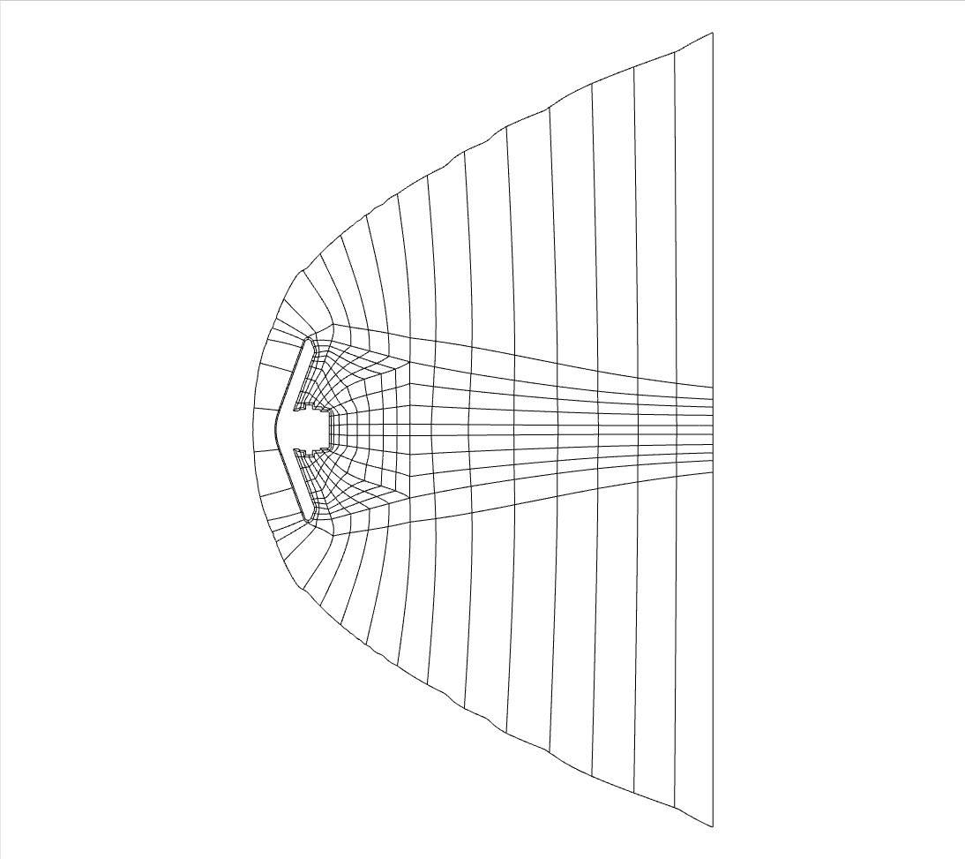
ESM Wake Flow
X = 112 80 44.9 11.5 mm

Slide 6
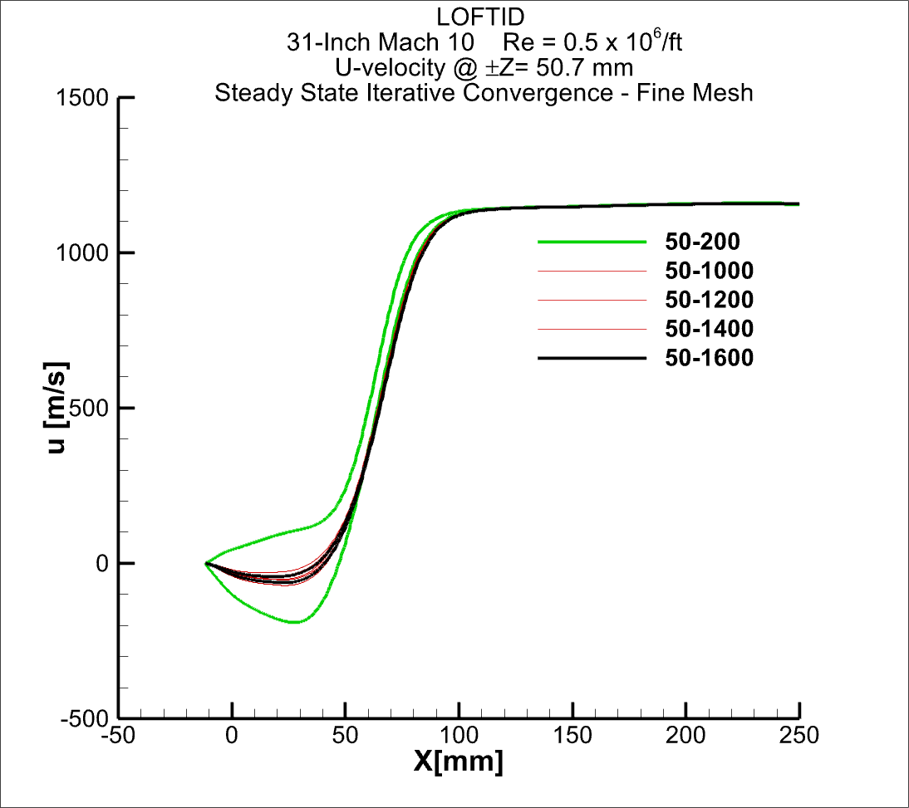
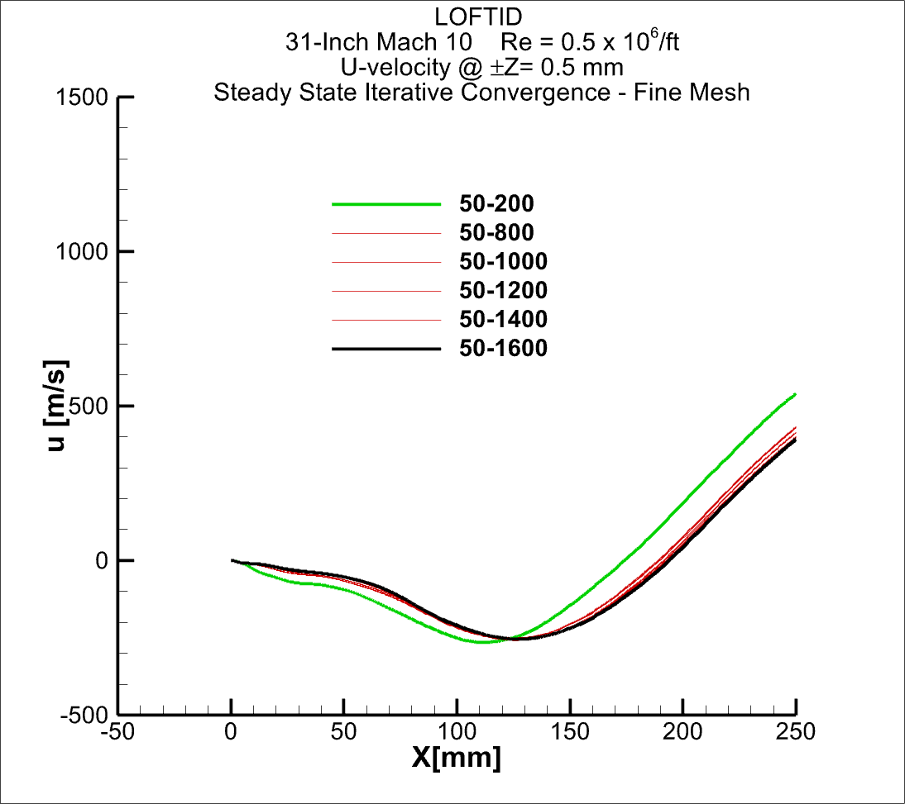
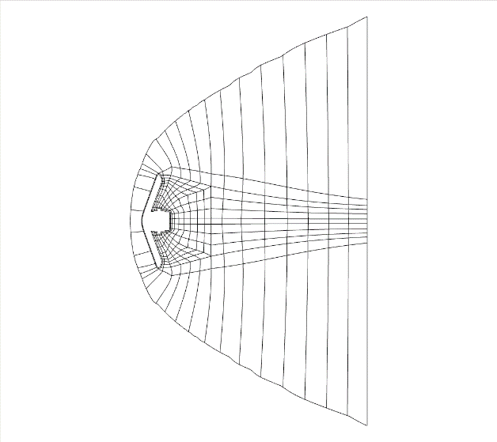
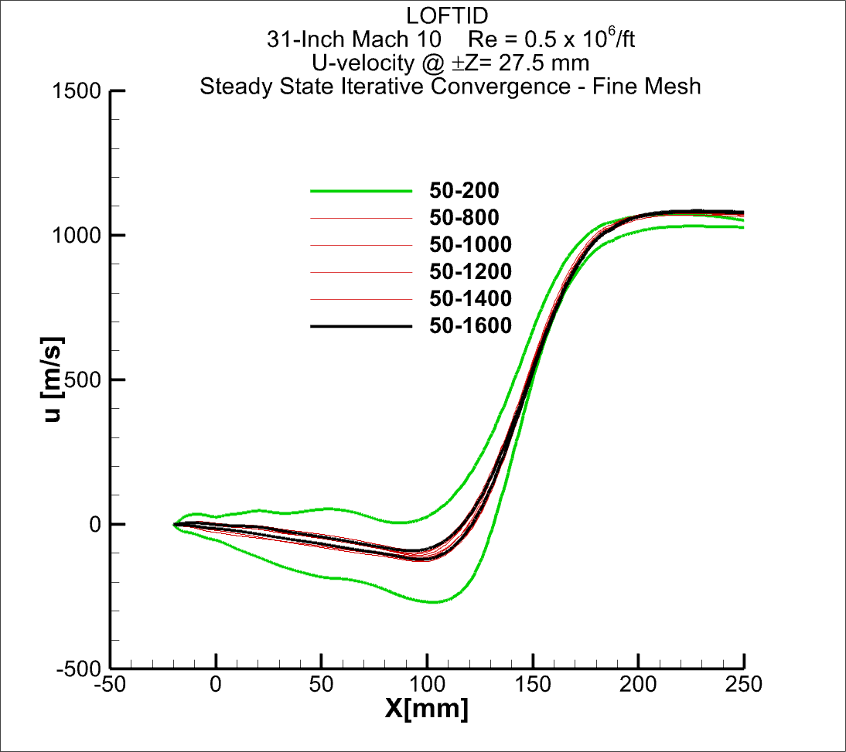
ESM Wake Flow
Iterative Convergence
Z= 50.7mm
Z= 27.5mm
Z= 0.5mm

Slide 7
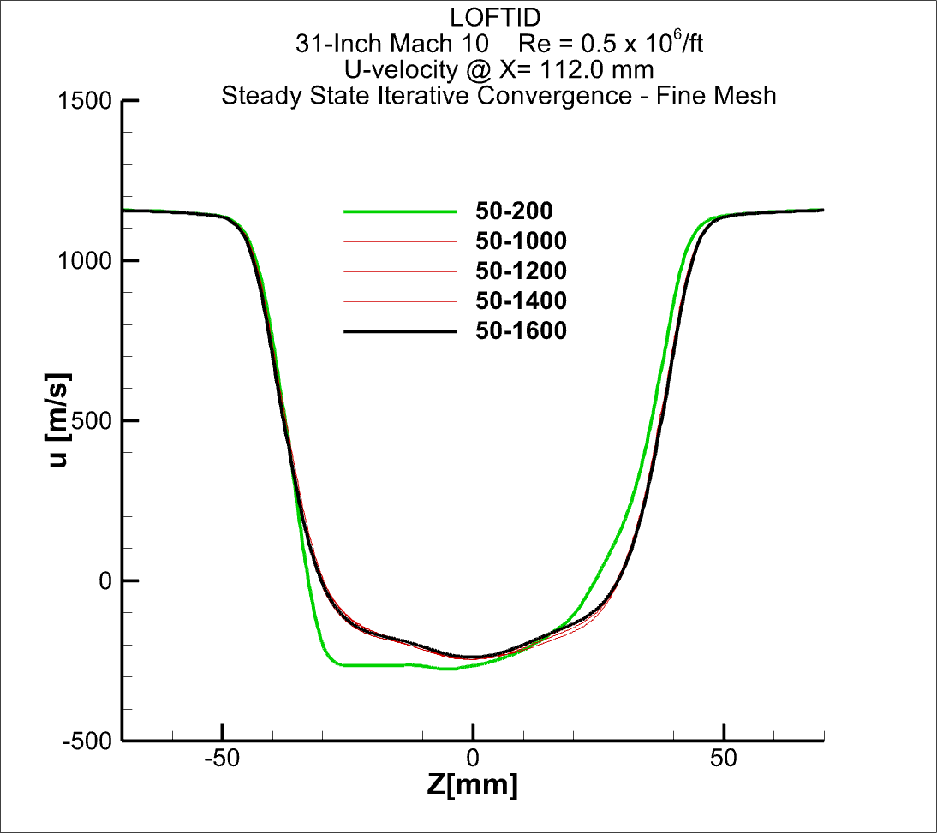
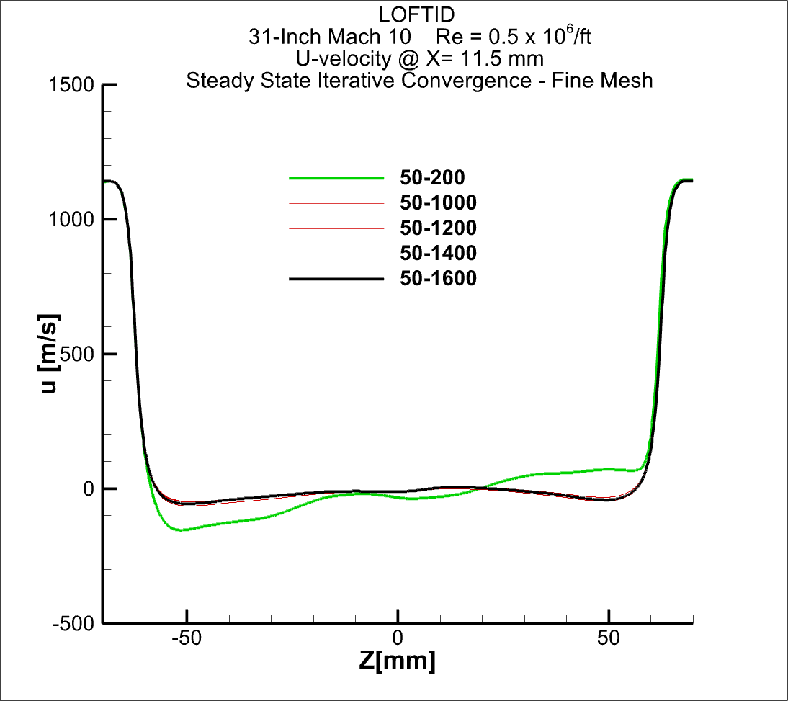
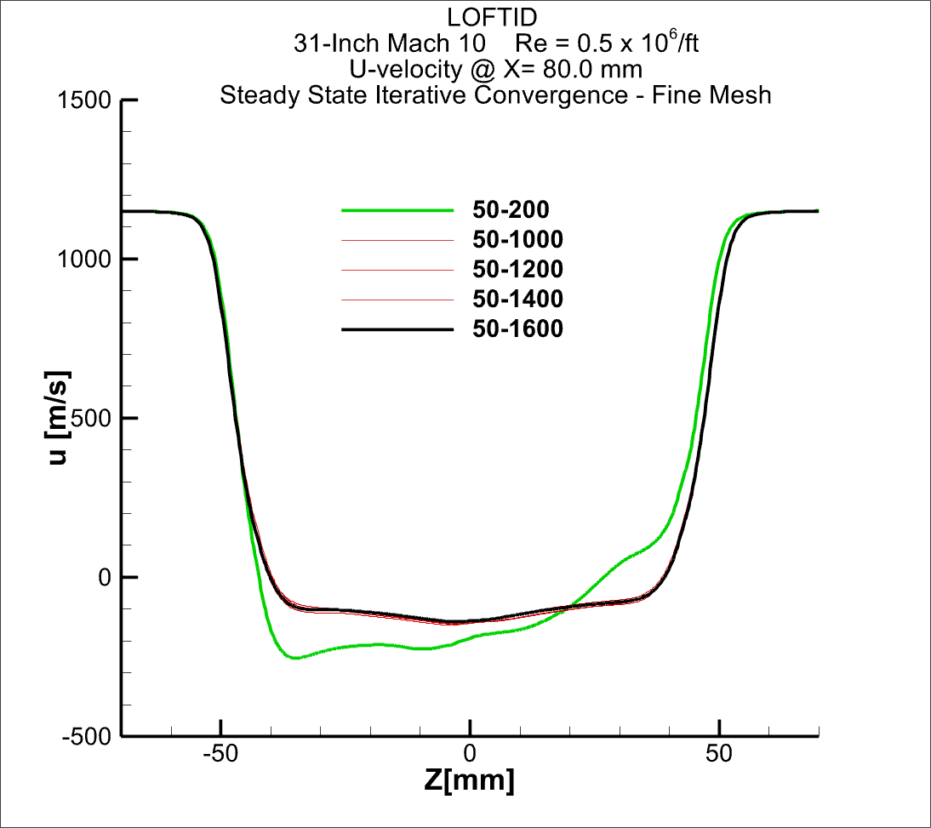
ESM Wake Flow
Iterative Convergence

Slide 8
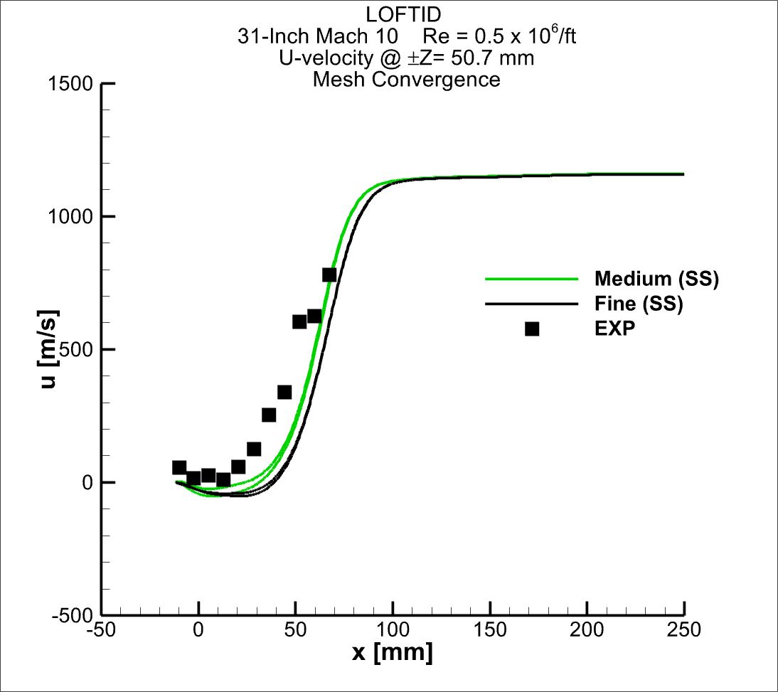
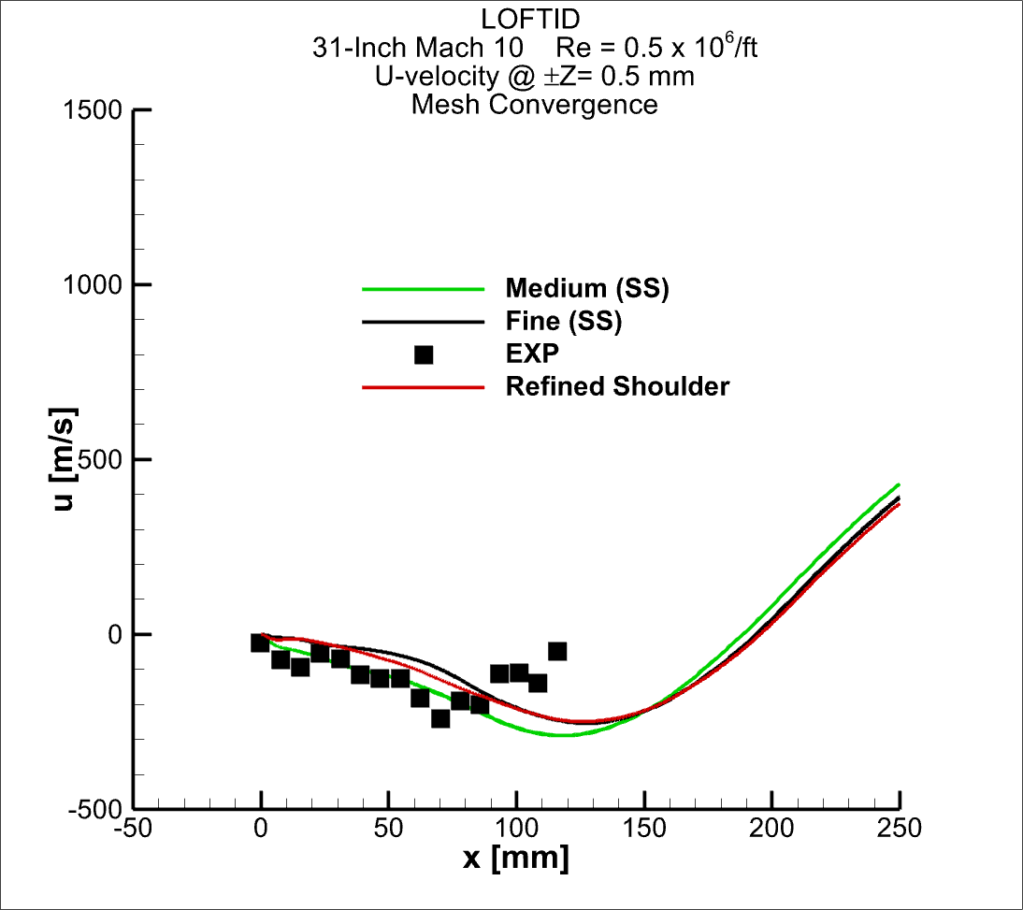
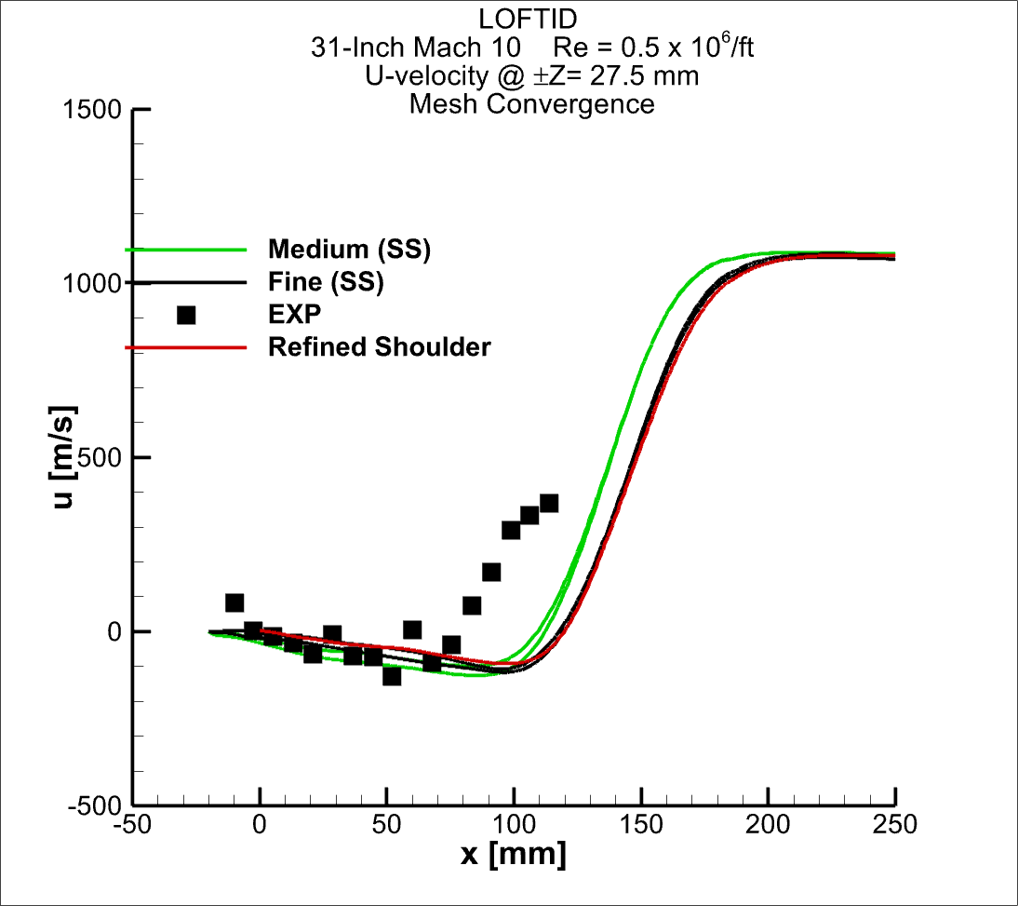
ESM Wake Flow
Mesh Convergence
Z= 50.7mm
Z= 27.5mm
Z= 0.5mm

Slide 9
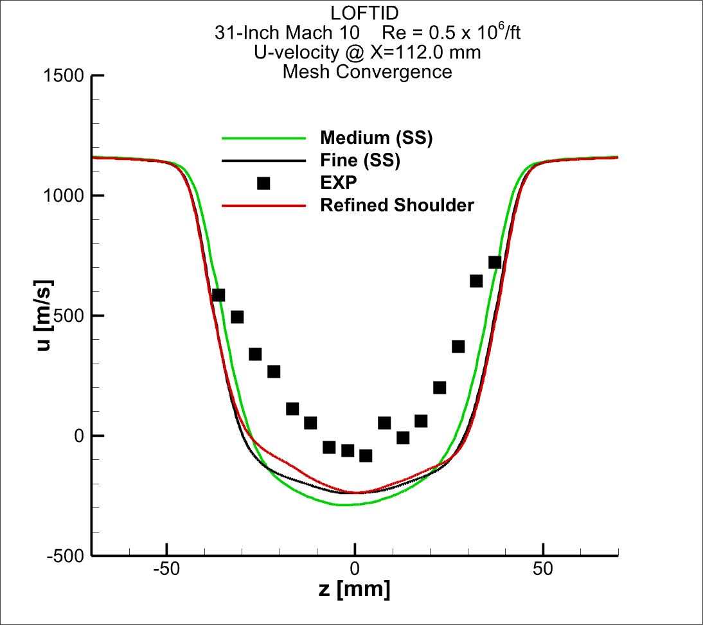
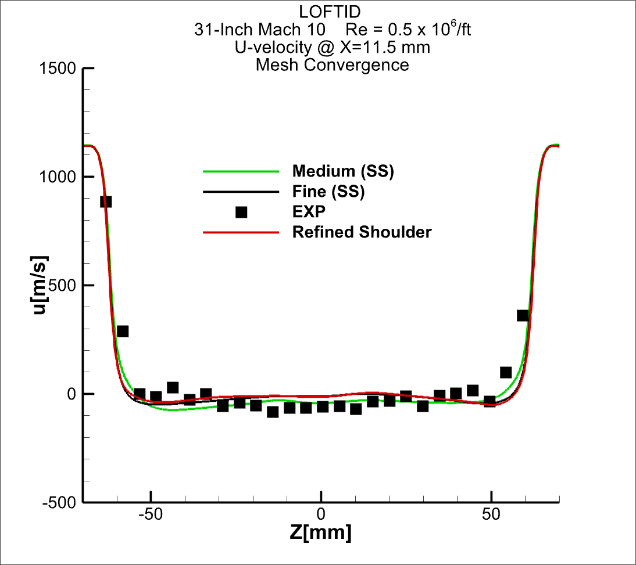
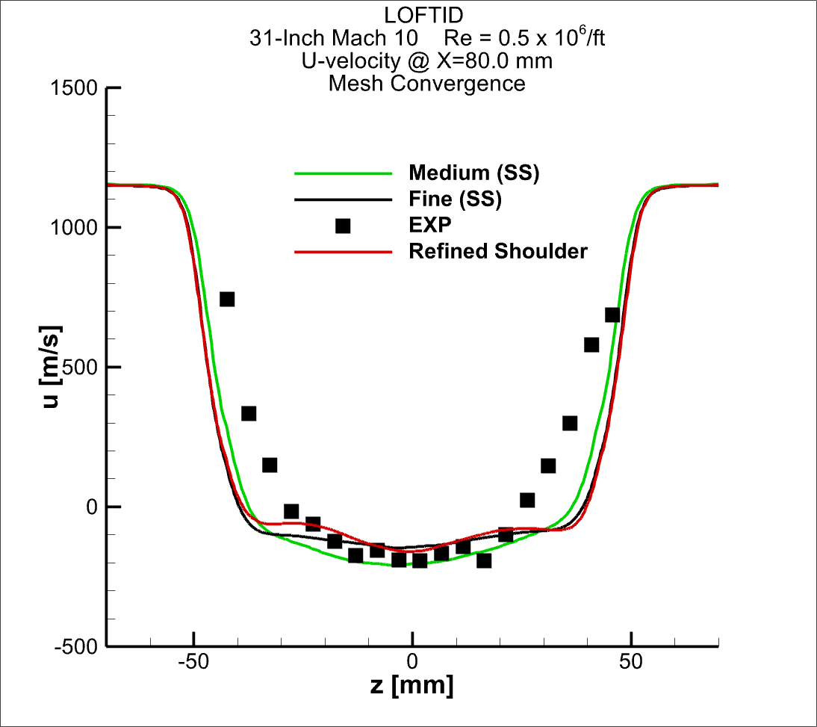
ESM Wake Flow
Mesh Convergence

Slide 10
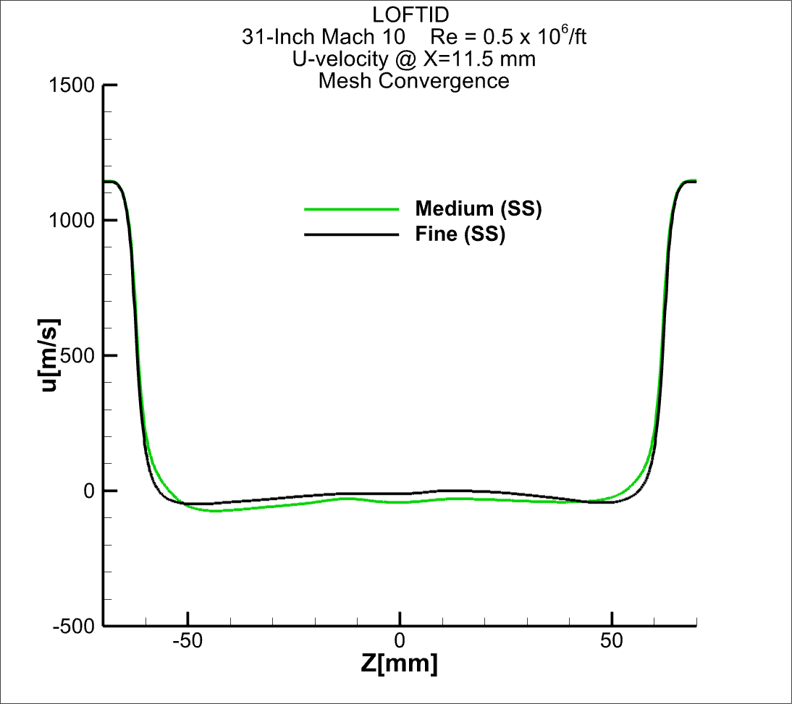
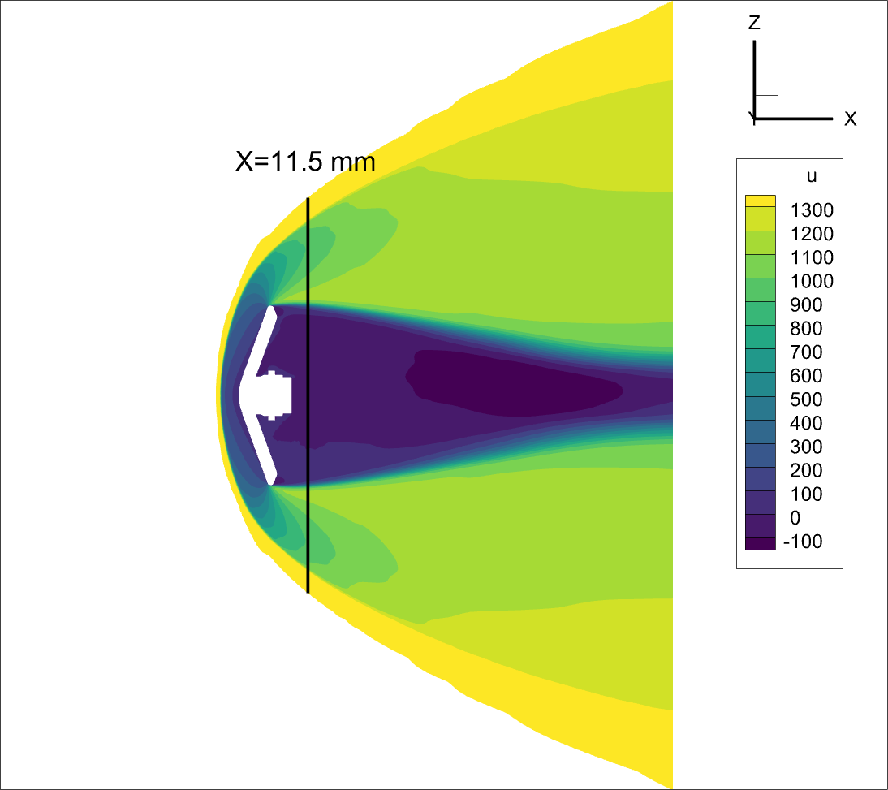
ESM Wake Flow

Slide 11
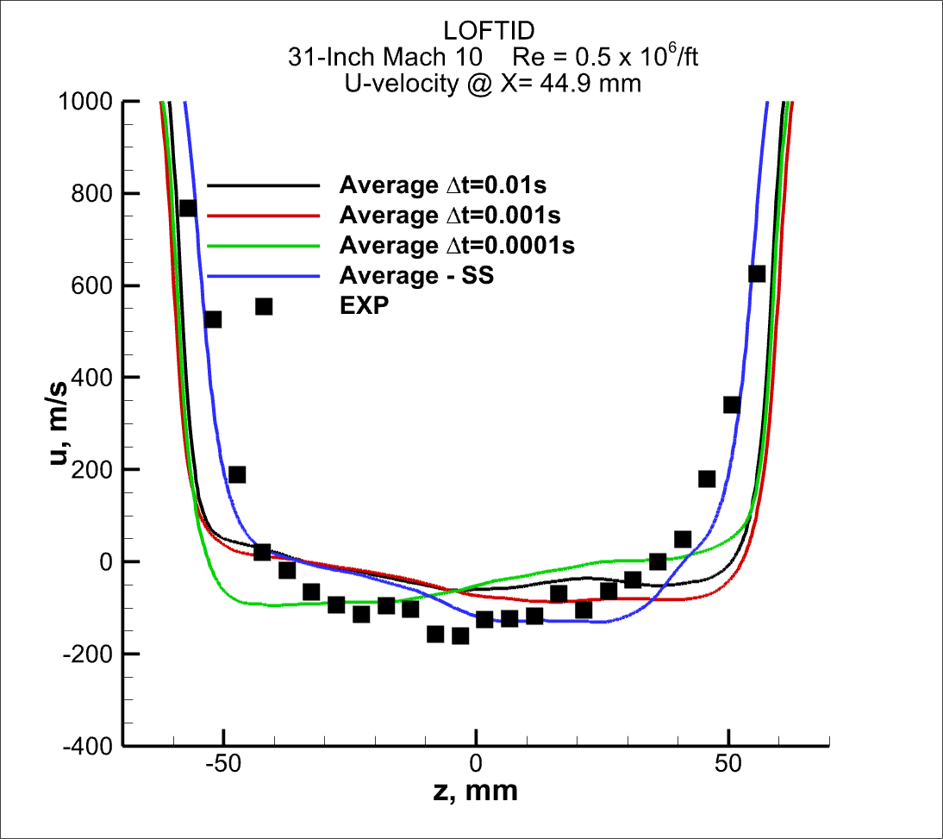
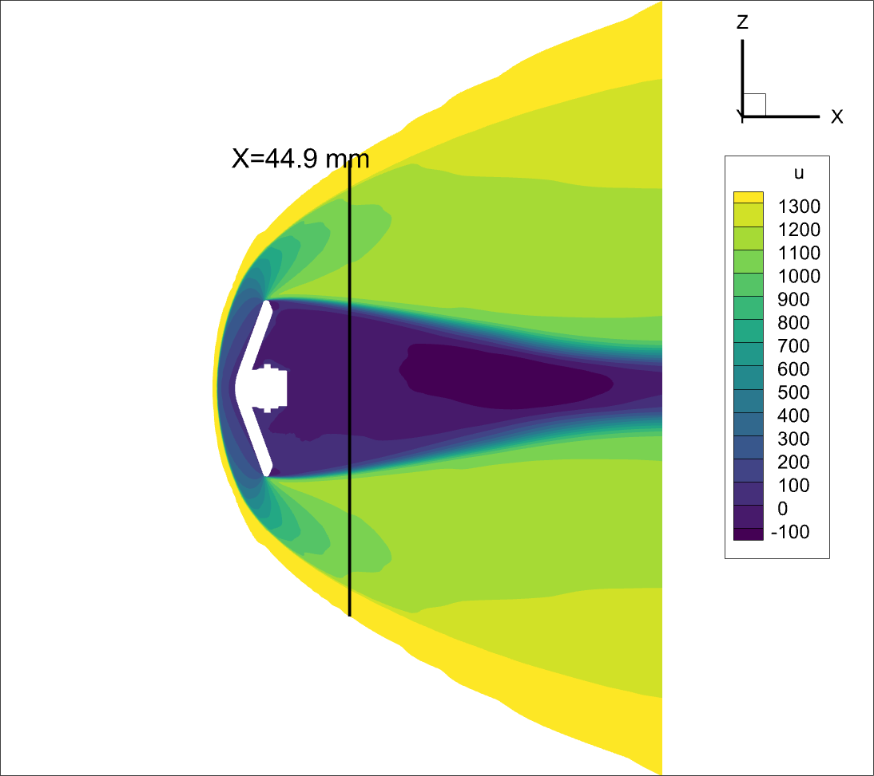
ESM Wake Flow

Slide 12
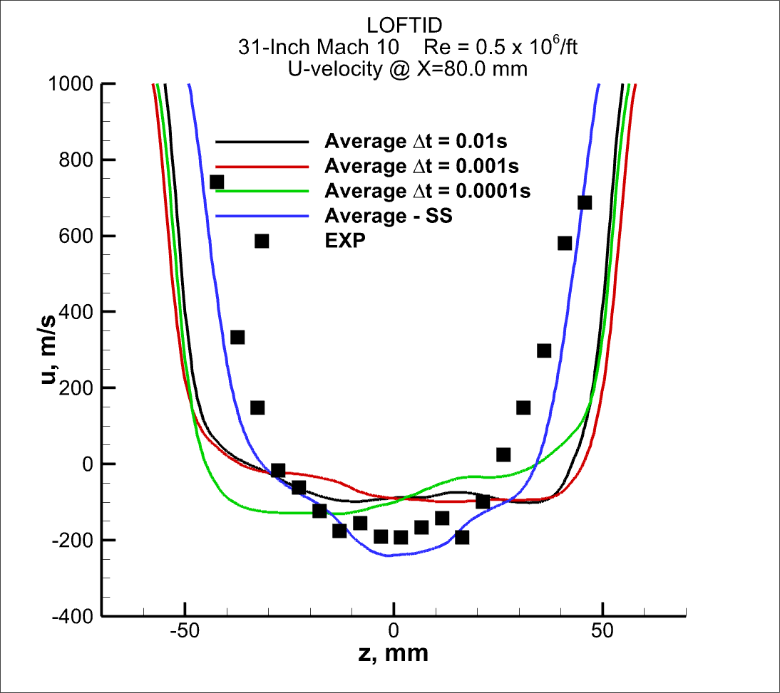

ESM Wake Flow

Slide 13
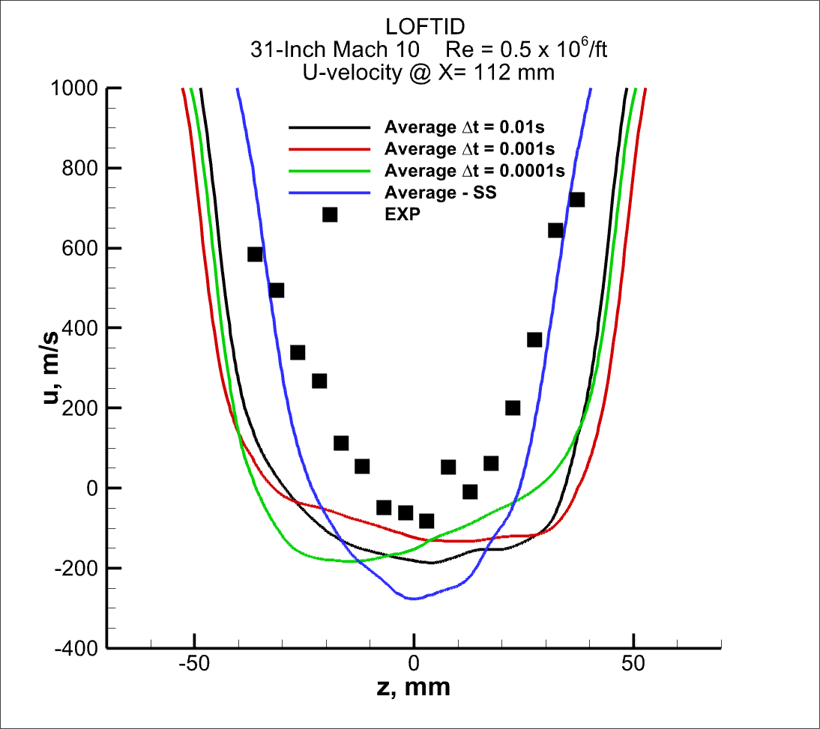

ESM Wake Flow

Slide 14
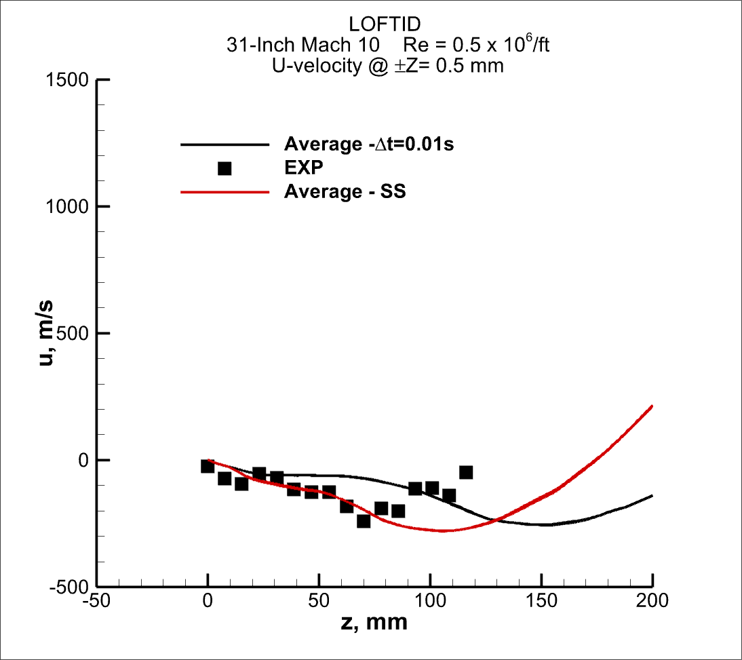
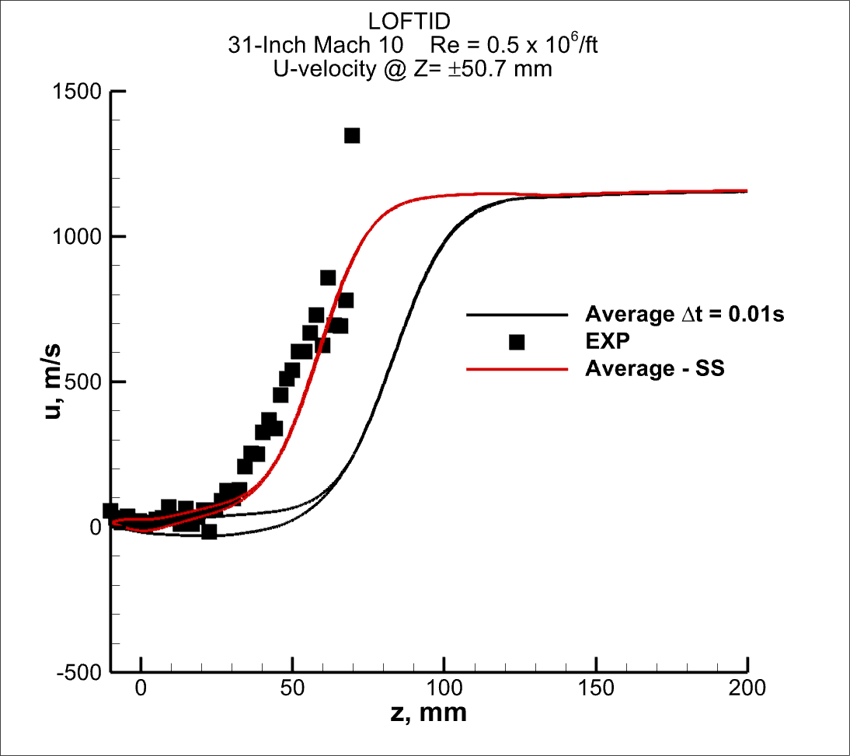
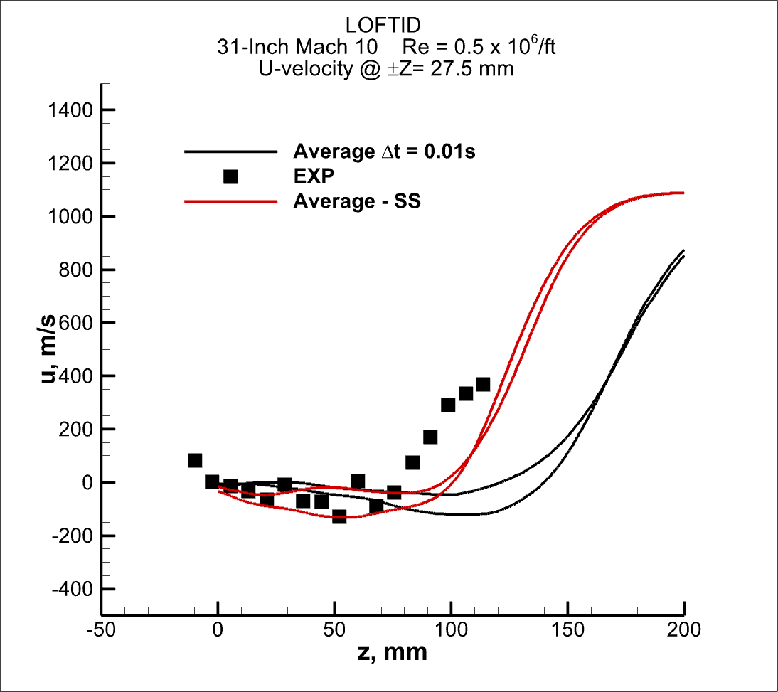
Z= 50.7mm
Z= 27.5mm
Z= 0.5mm

Slide 15
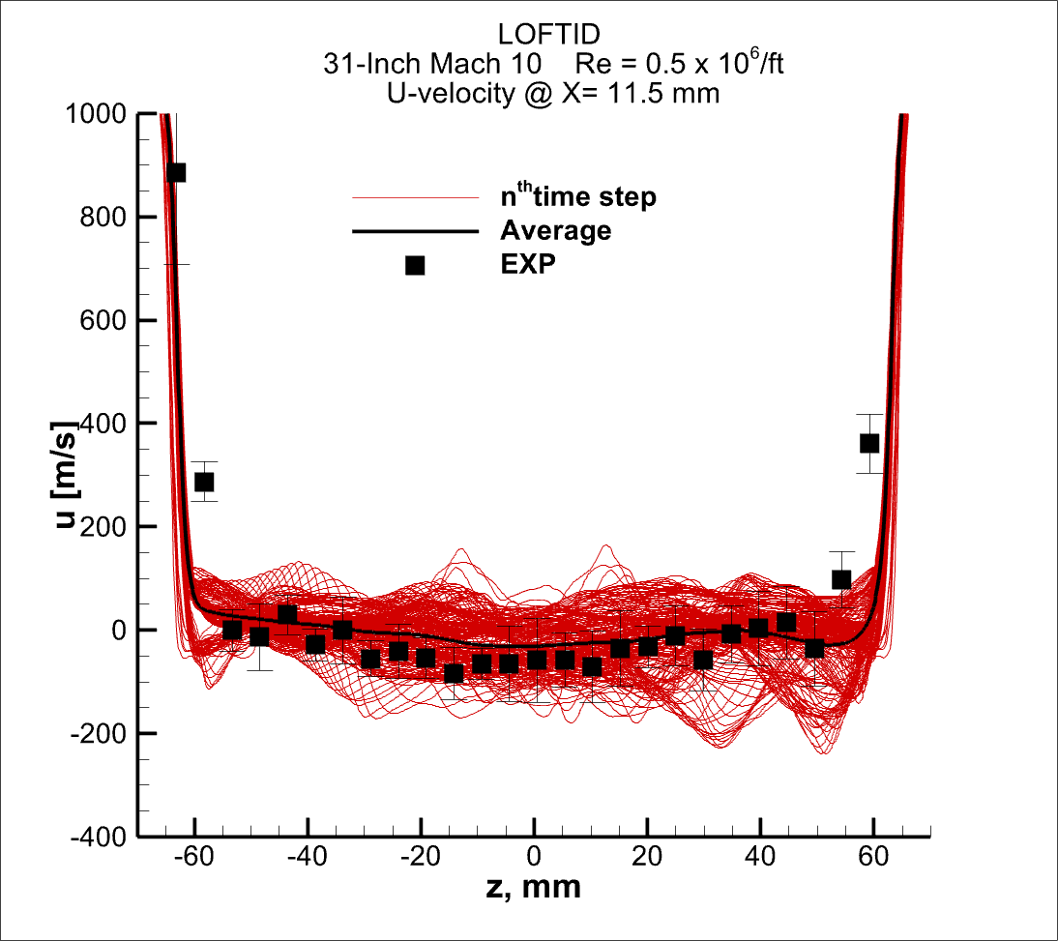
ESM Wake Flow

Slide 16
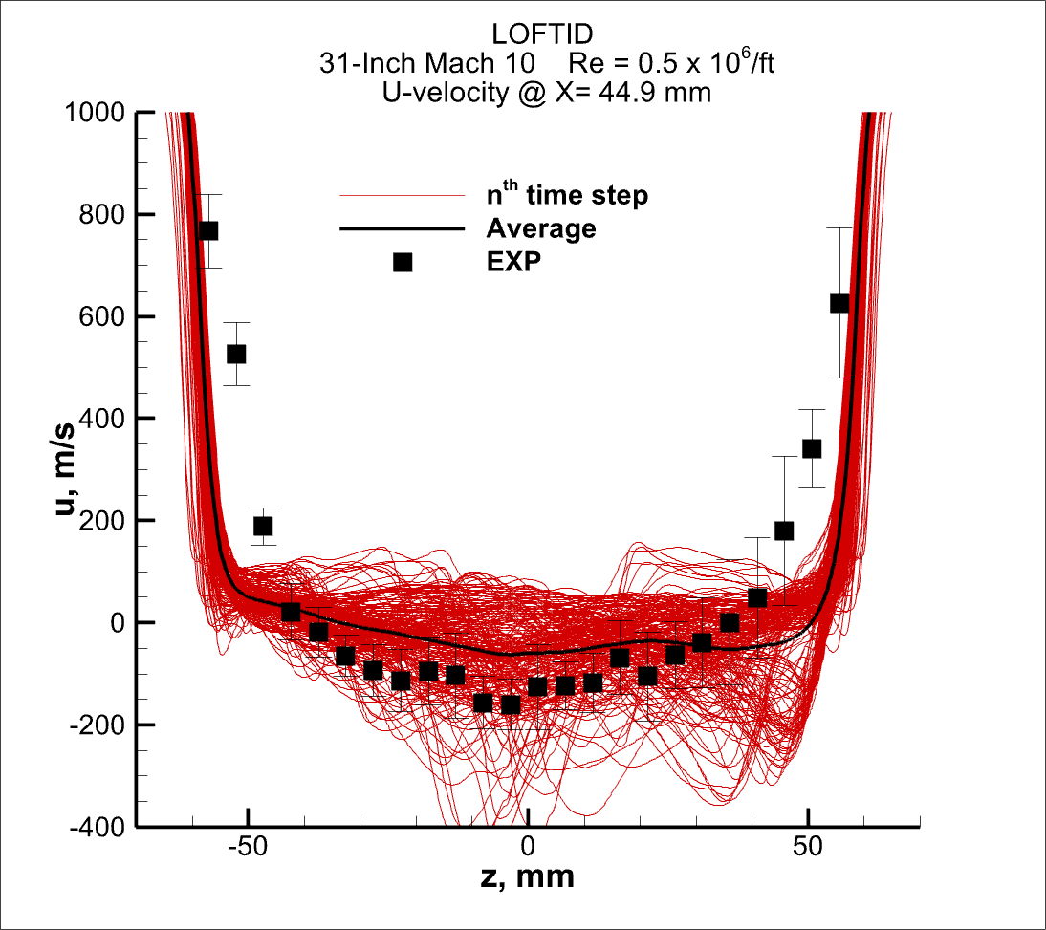
ESM Wake Flow

Slide 17
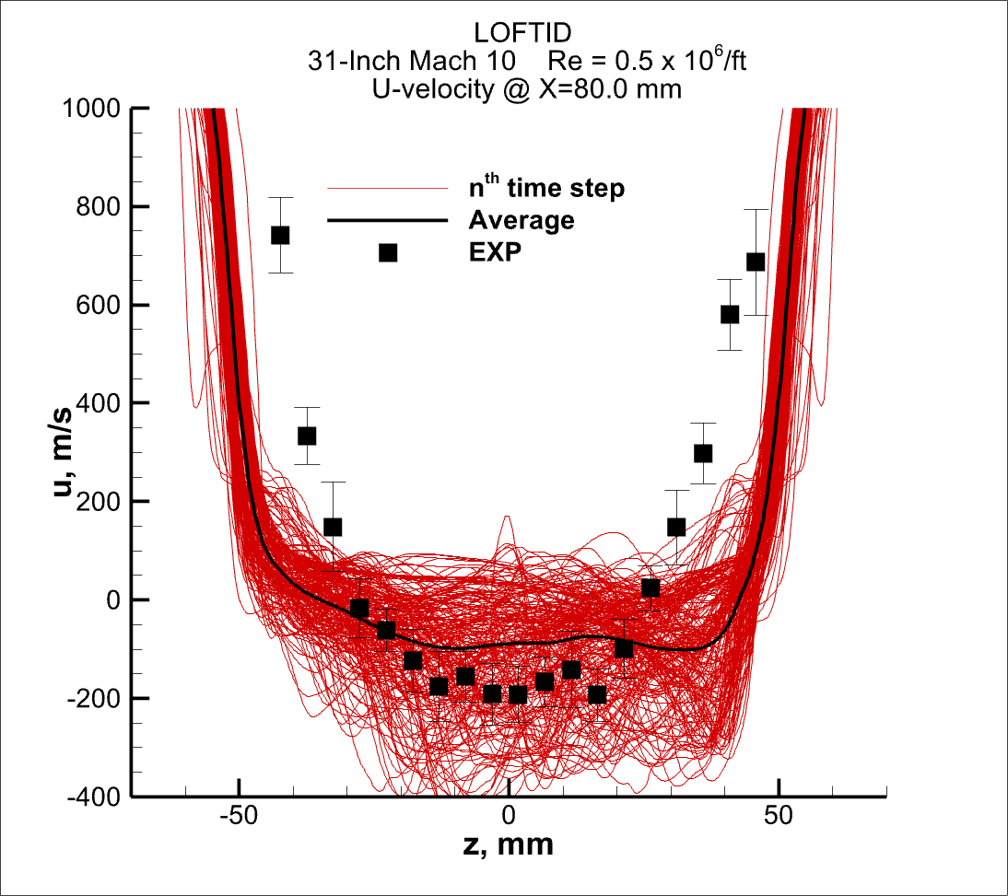
ESM Wake Flow

Slide 18
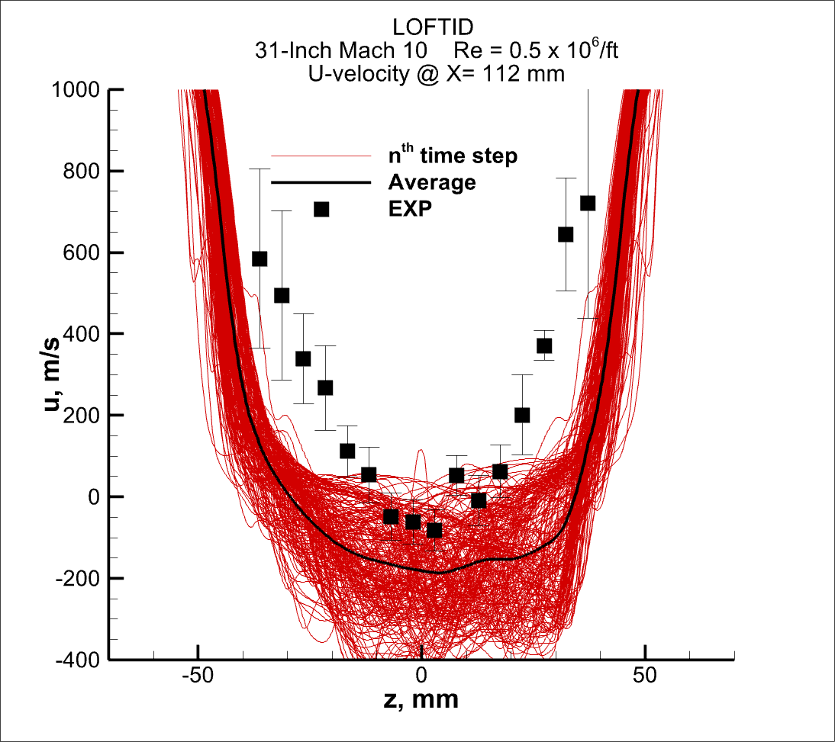
ESM Wake Flow

Slide 19
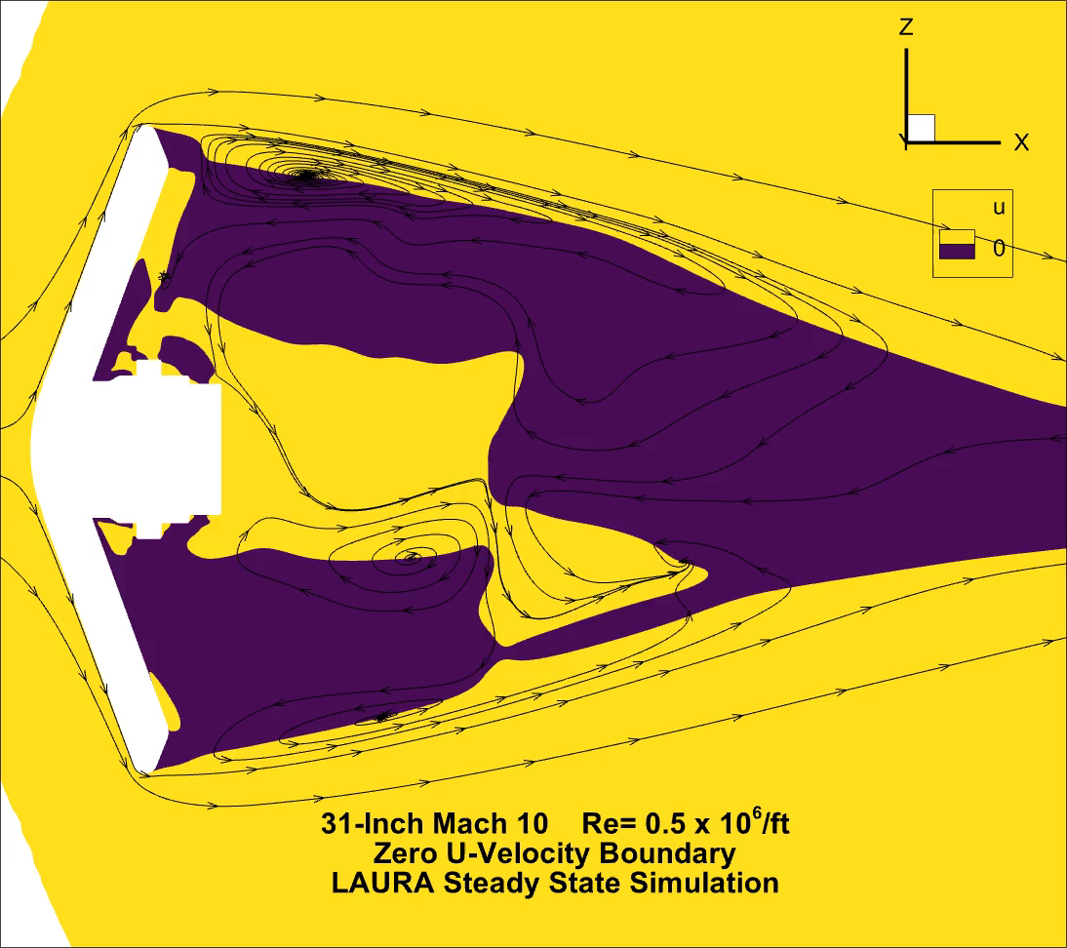
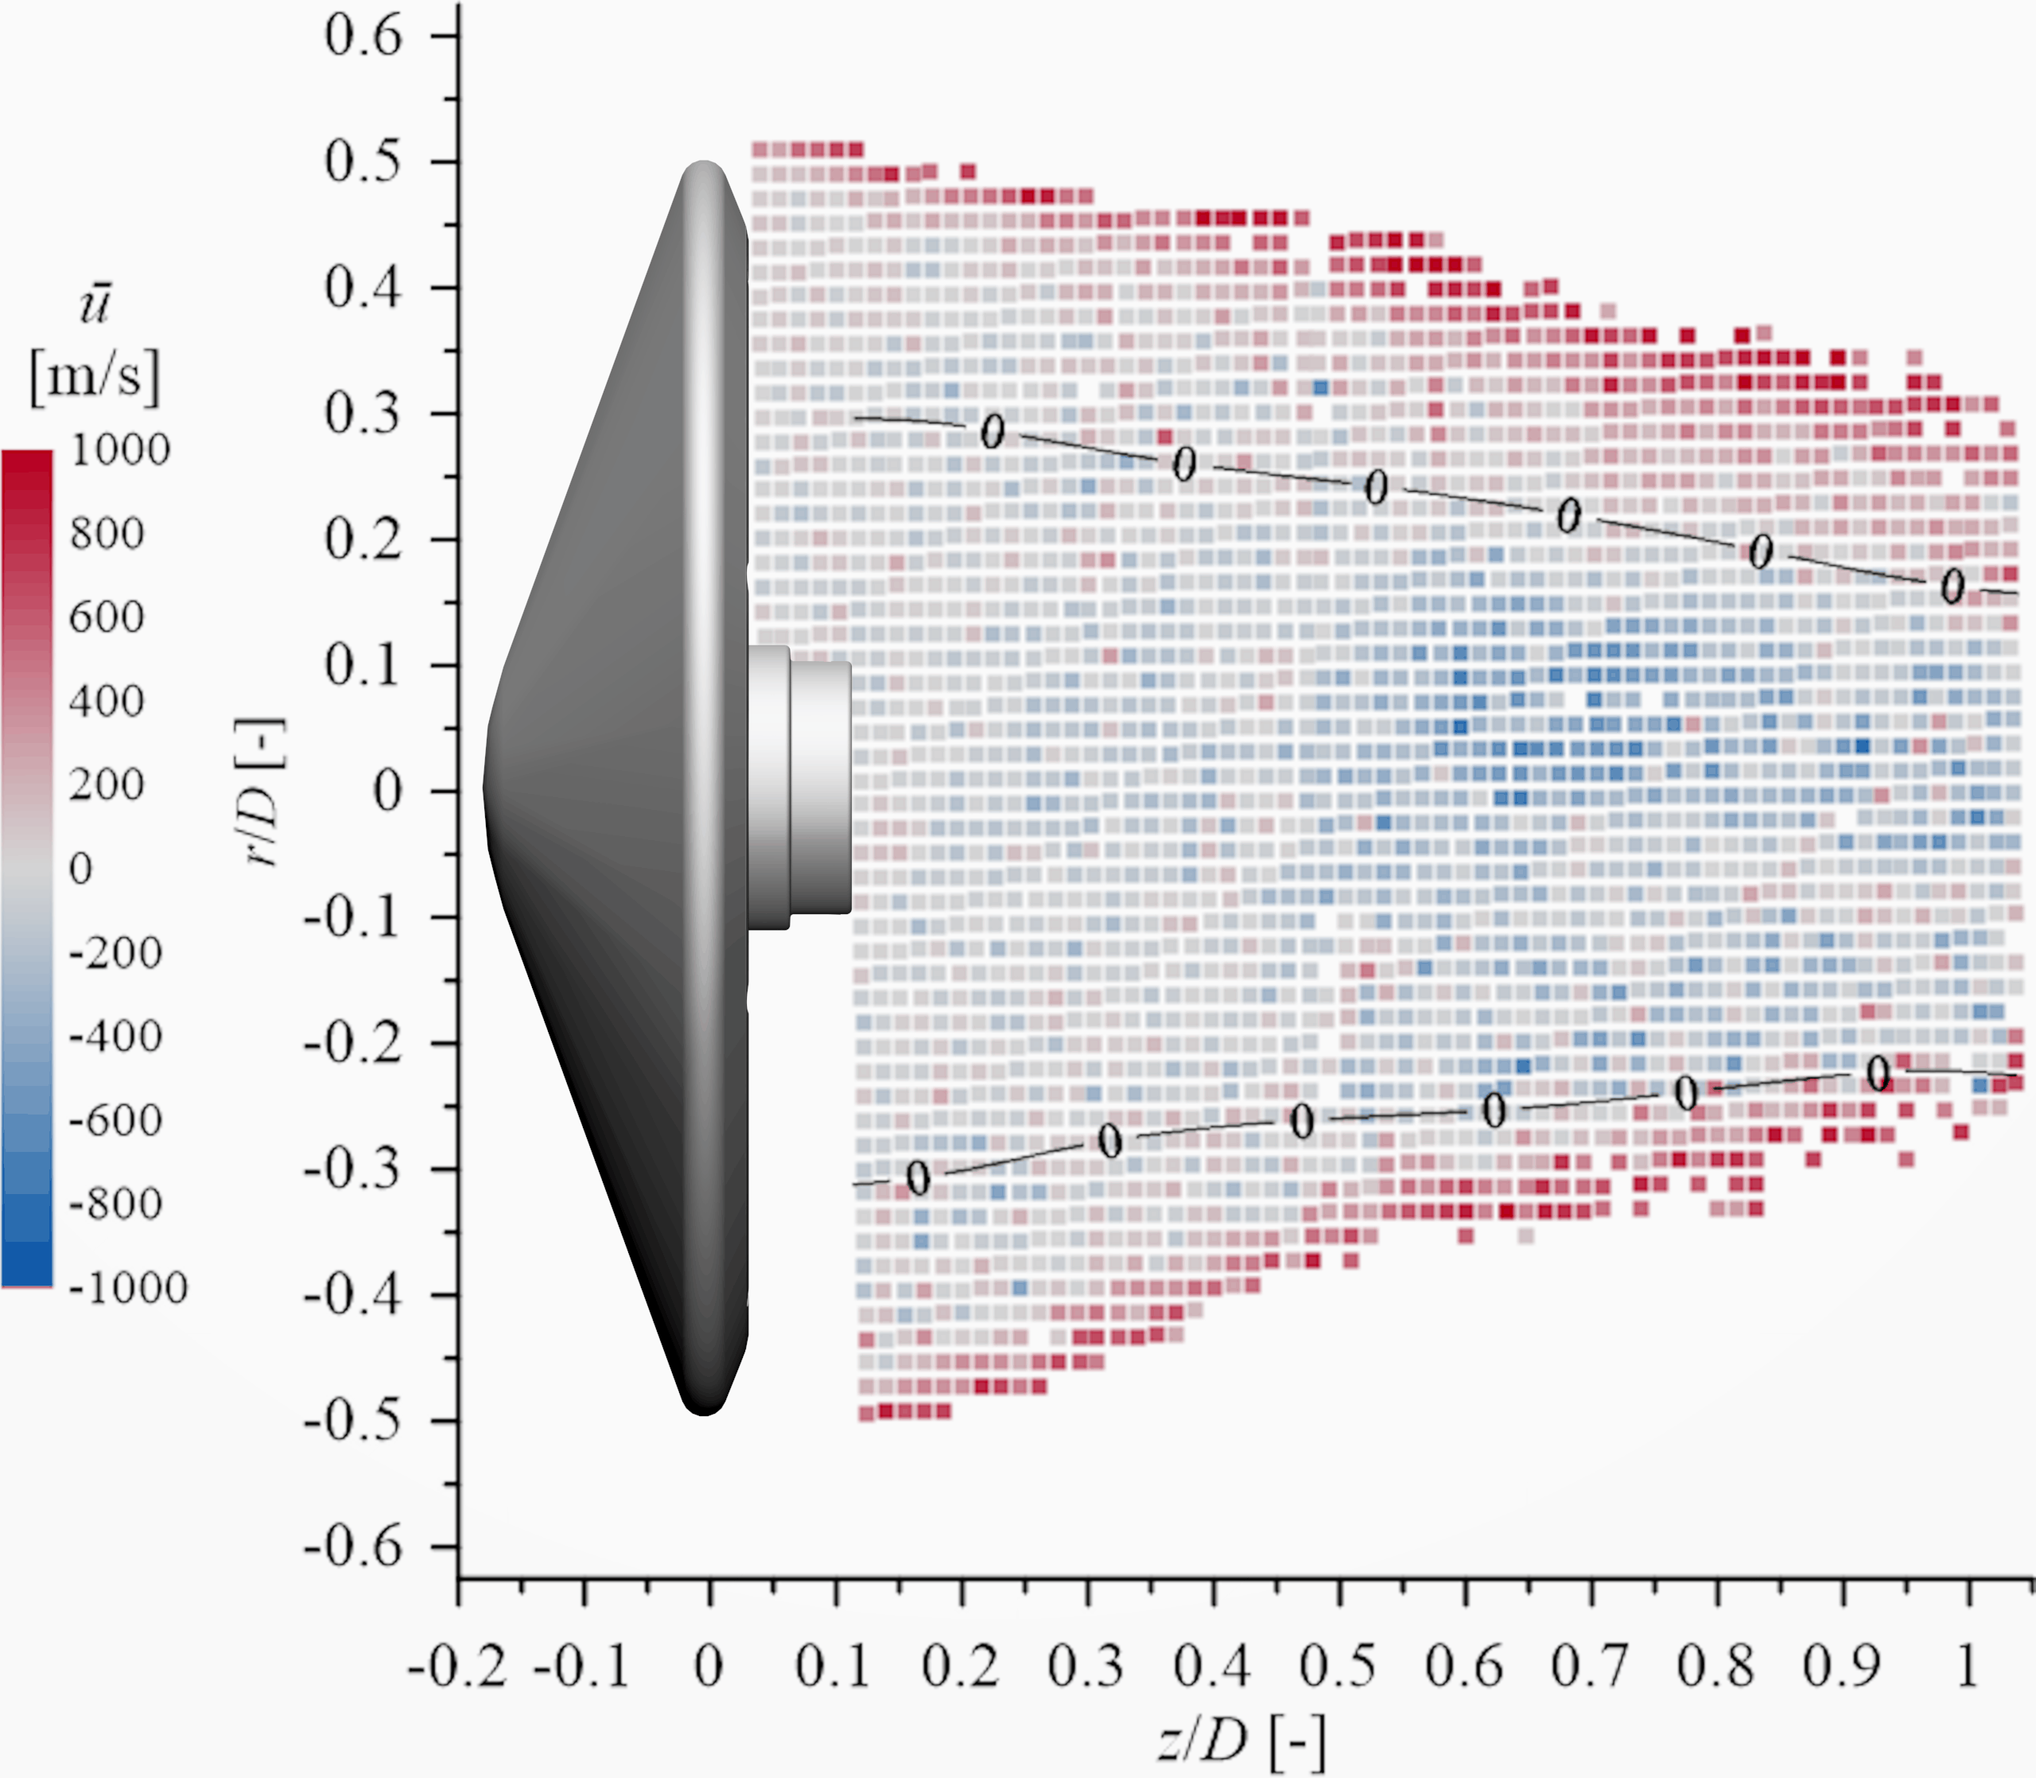
ESM Wake Flow

Slide 20
ESM Wake Flow
Confirm completed solutions not evolving (no impact from additional iterations)
Assess grid resolution
Compute other Reynolds numbers
Compare wake boundary locations with experimental data

