Slide 1
Amplicon Seq Data Visualization
Cameron Wolff
Mentors: Dr. Kirill Grigorev & Alexis Torres
Notes:
Hello, I’m Cameron, a rising Senior studying Computer Science at Cal Poly San Luis Obispo. Today, I am presenting my work towards building a pipeline for creating interactive amplicon sequencing data visualizations. Thank you to my mentors Dr. Kirill Grigorev and Alexis Torres for making this work possible.

Slide 2
Presentation Agenda
1
Project Goals
4
Live Demo
2
Current Work
5
Questions
3
Future Work
Notes:
For a brief outline of the presentation, first I will give an overview of my goals when starting this project. Then, I will discuss current work on the visualizations, future work to be done after this internship period, and finally a live demo and questions as time permits.

Slide 3
Project Goals
Notes:
First, Let’s discuss the project’s goals

Slide 4

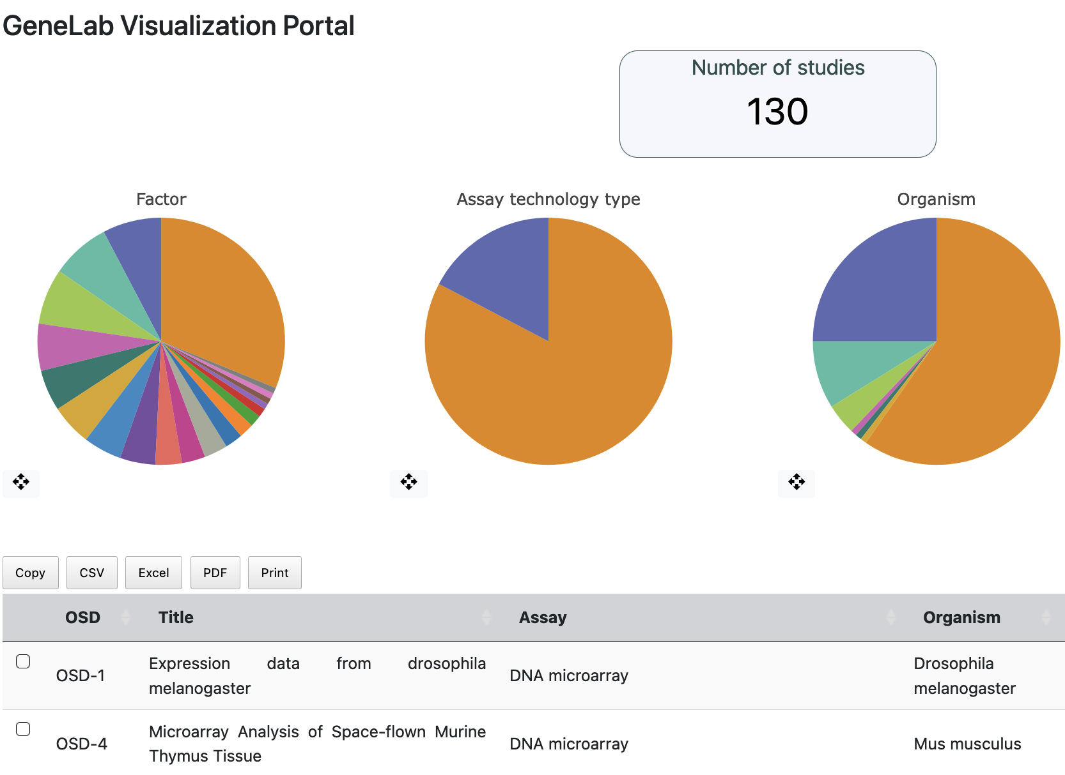
Current GeneLab Visualization Portal
Current portable supports multiple assay types (DNA Microarray, RNA Sequencing, etc.)
Goal: Add support for Amplicon Sequencing Data visualizations
Notes:
For those unfamiliar, the GeneLab visualization portal is part of NASA’s Open Science and Open Data initiatives. Scientists and the community can openly browse data from spaceflights and experiments through the Open Science Data Repository, but researchers are on their own for deriving insight from data. The GeneLab Visualization portal helps to bridge this gap, allowing researchers to easily select one or more DNA Micro-array or RNA Sequencing datasets for visualization and exploration. My goal for this project is to expand the GeneLab portal by adding support for Amplicon Sequencing visualizations.

Slide 5
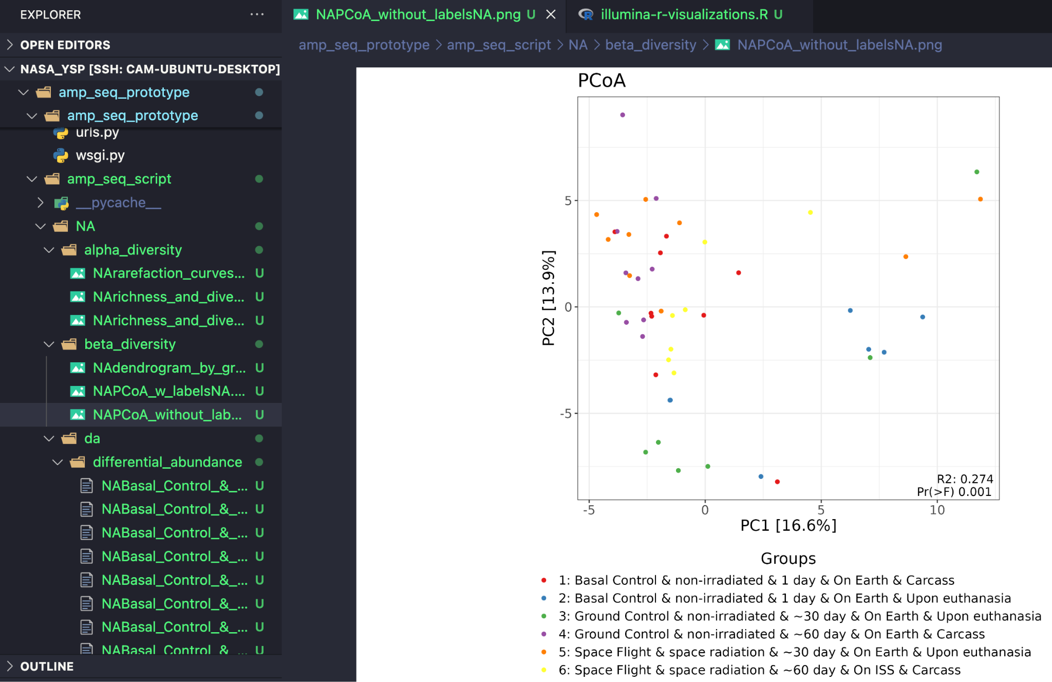
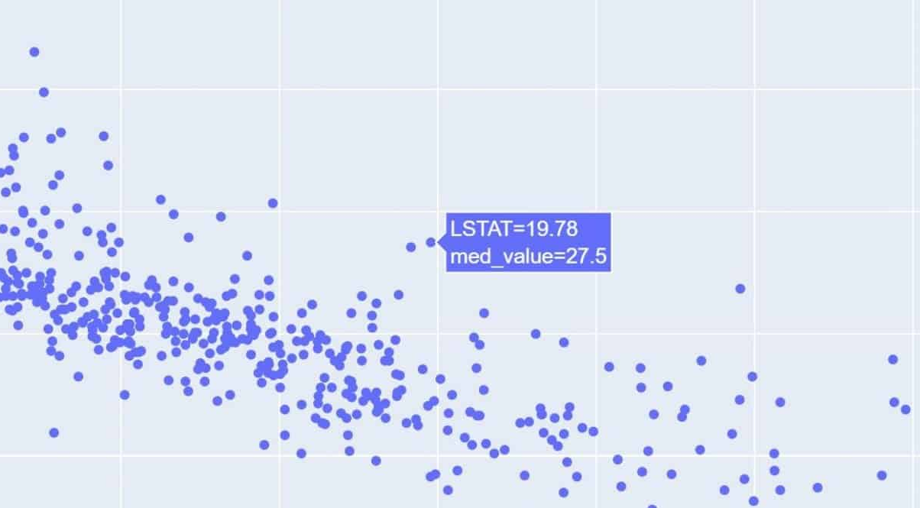

Amp Seq Visualization Script
Current Visualizations written in R by Alexis Torres
Graphs are static PNG files
Goal: Use Plotly to convert static graphs into interactive visualizations embeddable in prototype website
Notes:
In the current Data Processing pipeline, after an OSDR dataset is downloaded and processed, a script written in the R programming language and created by Alexis Torres is run to generate graphs and visualizations. These graphs are stored to the user’s computer, and explored as regular images. While a useful tool, these static images don’t allow for any tweaks or insights to explore the data, and are difficult to share from a local computer to the wider Open Science community. By converting graphs from R native ggplot format to the plotly graphing framework, we can make these visualizations more interactive, and move graphs easily between R, Python, and Javascript. For this project, I will be demonstrating this functionality through the use of a prototype web server hosting these interactive graphs.

Slide 6
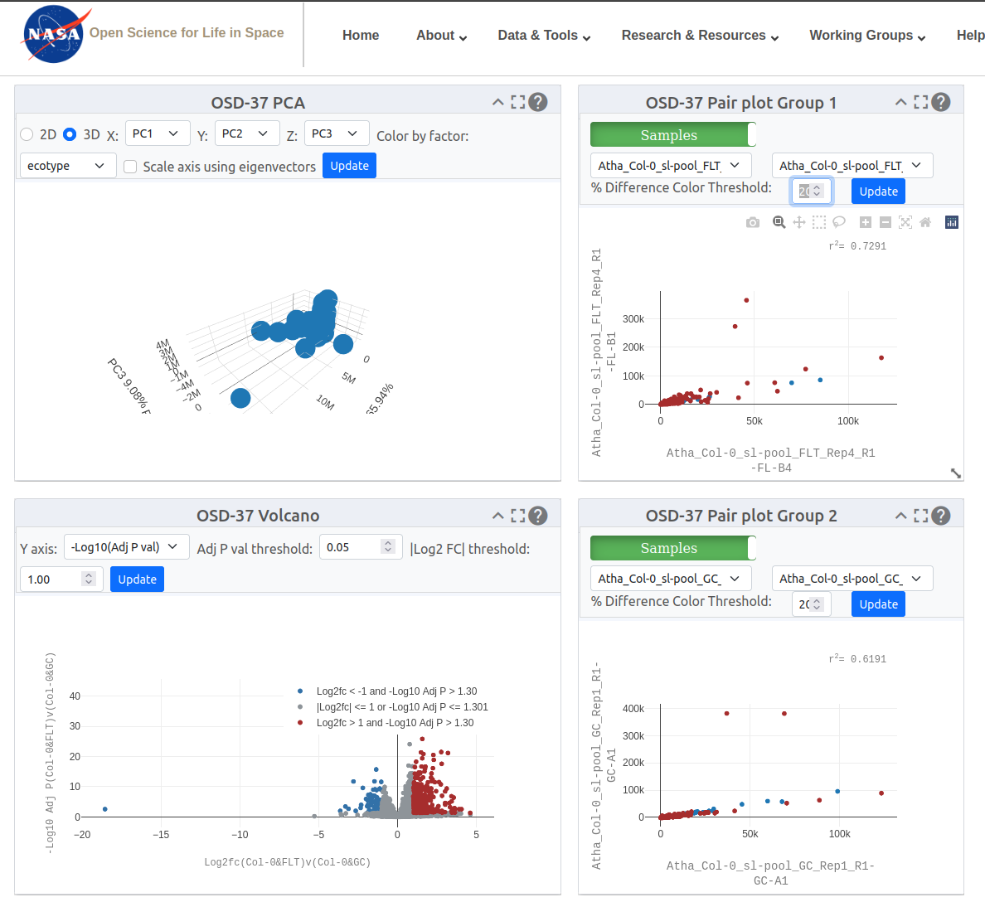
GeneLab Viz Portal
Integration
GeneLab Viz Portal built with moveable tile-based layout with graphs as HTML
+
Amp Seq Visualizer web stack matches Viz Portal
=
Easy graph integration!
Notes:
When you select a dataset In the GeneLab visualization portal, you can see each graph rendered in a separate tile that can be interacted with and moved around. The graphs seen are HTML elements, rendered inside tiles, using the Plotly graphing library. By building a prototype web server that mimics the GeneLab tech stack, visualizations can be developed locally in a simpler multi-page application without the tiles, and later ported easily to the full visualization portal.

Slide 7
Current Work
Notes:
Now that we see the goals of the project, let’s move into current work and application design.

Slide 8

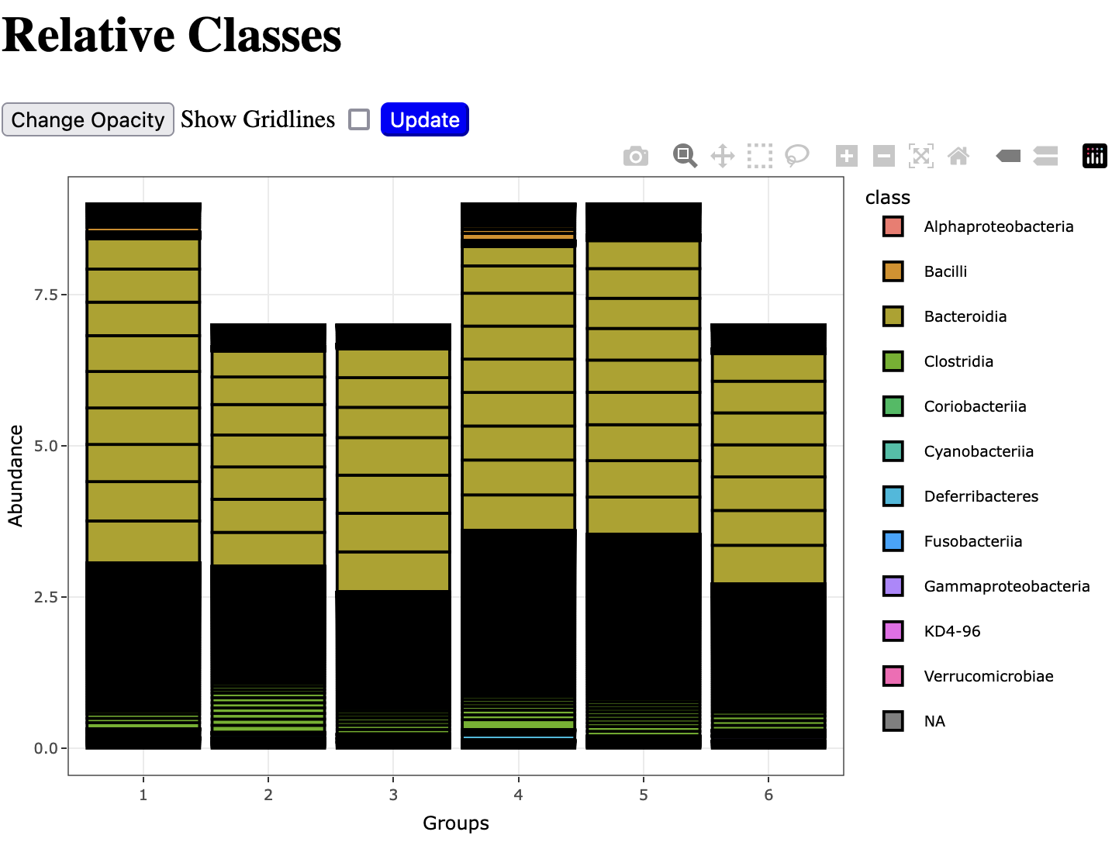
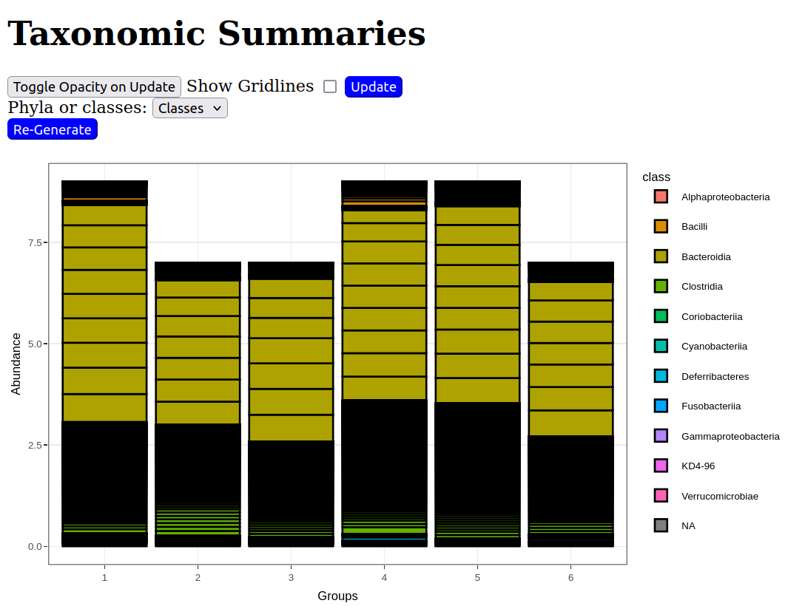
Application Overview
Example Visualization Page
Project is being developed as a prototype web server
Webstack built to mimic GeneLab Viz portal tools for easy porting
Languages used:
  R - Generates graphs with ggplot
  Python - Django webserver
  HTML - Website rendering
  Javascript - JQuery Interactive Elements
Visualization pages are final deliverables, multi-page application is prototype to support development
Notes:
I’ll keep this section a little shorter to make time for the demo, but hopefully this should give a good understanding of how the web application we’ll be looking at is laid out. First off, the Amplicon Sequencing Data Visualizer is built as a prototype web server, with single pages for graphs that will be later integrated into the tile based GeneLab portal. On this slide you can see one of these graphs that would appear in the prototype application, and on the final GeneLab portal. The application layout and hyperlink based navigation is purely to aid development, while the visualizations, graph modifying UI elements, and the software pipeline behind the screens will be ported to the live GeneLab portal. To make this porting process easier, the prototype web server uses the same technologies as the website and the researchers making these visualizations do- R to generate graphs, Python to run the server backend, and HTML + Javascript for the frontend in your browser.

Slide 9
Frontend Design
Application layout designed to mimic GeneLab portal pipeline. Live visualization will be shown at end of presentation.
Page 1: OSDR Dataset selection (development prototype)
Page 2: Graph Selection (development prototype)
Page 3+: Data Visualizations (final visualizations)
Notes:
When you first visit the website, you’ll see a menu to select an OSDR dataset to download. This page mimics the assay selection table in the GeneLab portal. While this feature is not currently integrated with the rest of the application due to limitations in the GeneLab Open API, a dataset will still be downloaded for users who want to run the server locally and manually run the dataset through the amplicon sequencing pipeline. Next, you’ll see a page where you can select a graph to interact with. This page mimics the tile-based view, just separated out onto multiple static pages. Finally, clicking on a graph name will send you to your actual visualization, like the one you saw on the previous slide.

Slide 10
Backend Design
Rscript
Django Web Server
rpy2
call
HTML + JQuery + Plotly
plotly
json
ggplot graph
form data
Python Wrapper
Website Frontend
function call
Notes:
To understand what’s going on behind the scenes, let’s look at how data flows through the web application. First, a slightly modified version of Alexis’s R Script is run to generate the initial graphs. These graphs are each generated by their own function returning a ggplot object. To allow for interaction with the django web server, these R functions are wrapped in python functions, which can be called by the server to request graphs with different modifications and adjustments. This method allows for ease of use and flexibility, as anyone looking to modify a visualization only needs to change the one function, and anyone looking to add a visualization can either add an R function generating a ggplot visualization, or a python function generating a plotly visualization. Next, the wrapper transforms the ggplot graph into a plotly graph. Plotly is a unique graphing framework in that it supports many programming languages, and can be stored in the universal json object format. This means a graph json generated by the web server and sent to a client can be modified in the browser through javascript code. However for alterations to a graph that require an understanding of the data or even a complete re-draw of the graph, we need to use a form to request that the server generate these changes for us. The frontend will send this form to the web server, who will then ask the wrapper to generate a graph with the requested changes, and finally serve the visualization to the user just like the original graph.

Slide 11
Future Work
Notes:
Before we see the visualizer in action, let’s look at next steps for the project, and what needs to be improved.

Slide 12
Post Project Steps and Suggestions
Essential
Integrate graphs with live GeneLab Visualization portal Website
Optional
Add styling to graphs to match GeneLab visual language
refactor graphs to move axis labels and other elements to visualizations
Use pipeline developed in this project to add more UI features to graphs, and possibly more graphs
Optimize backend to modify graph without refreshing webpage
Notes:
At this point, really the only essential next step is to integrate this work with the current GeneLab Visualization portal. Once ported, this pipeline will enable researchers to view Amplicon Sequencing data in the portal just like the other assay types currently supported. For future projects beyond, I have a few suggestions of changes and improvements. The bulk of this project was focused on improving the intractability of these graphs while adding minimal styling, so it could be very beneficial to add styling that matches the current GeneLab portal’s design language. Not only that, but visualizations were initially designed to be presented in a PNG format. Now that graphs can be interacted to show more information, it could be beneficial to make graphs more readable by moving information from axis labels to operations like a mouse hover over data points. With this pipeline, it would also be relatively simple to modify the UI, add additional graphs, or even adapt this pipeline to an entirely different assay type. As a final note, when new graphs are requested by the browser, the entire page needs to be reloaded. Changing this to a “POST” operation and removing the need for refresh could make the experience much more enjoyable for users.

Slide 13
Live Demo and Questions
Application Website (Live at time of presentation)
Notes:
Alright, let’s finally get into the live demo. Because the website will not be up after this presentation, I’ve included some slides of screenshots to illustrate what the website is like to navigate. Let’s take a look

Slide 14
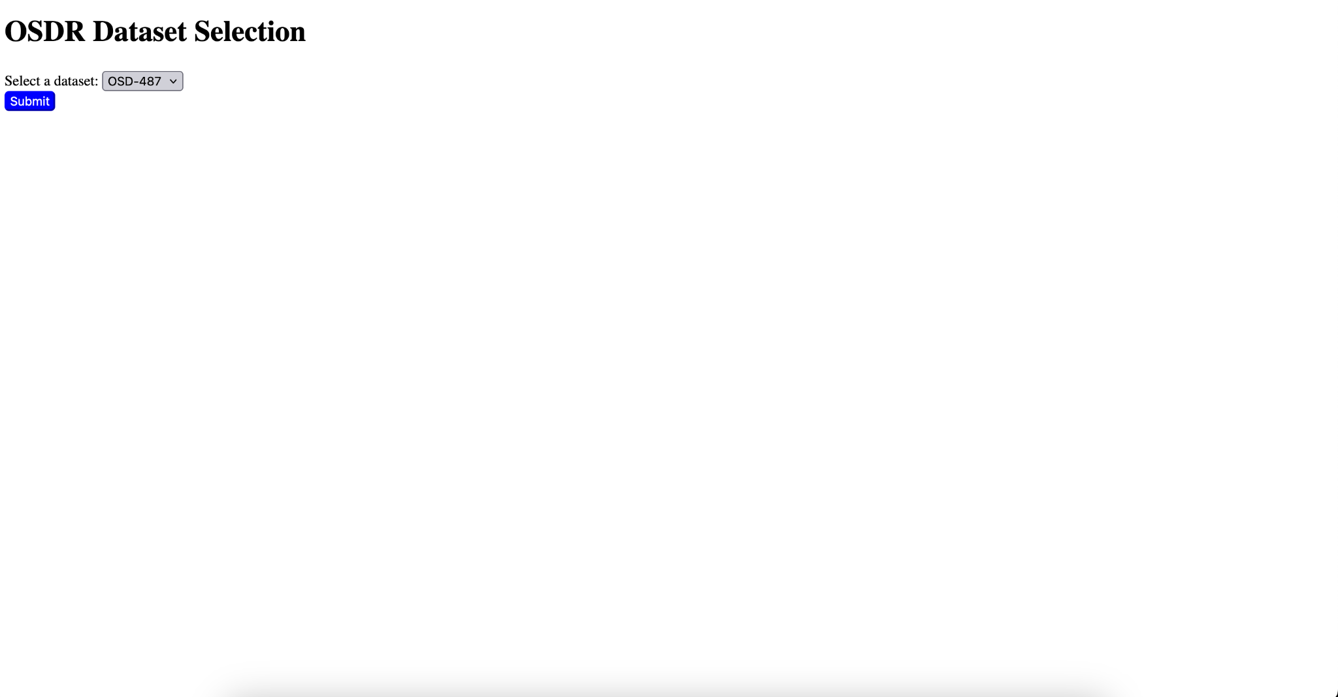

Slide 15
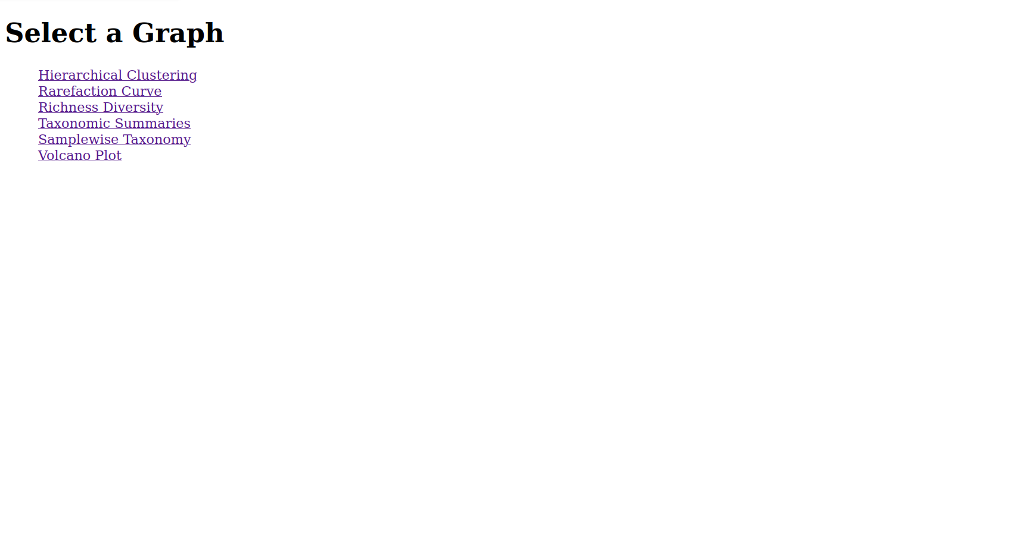

Slide 16
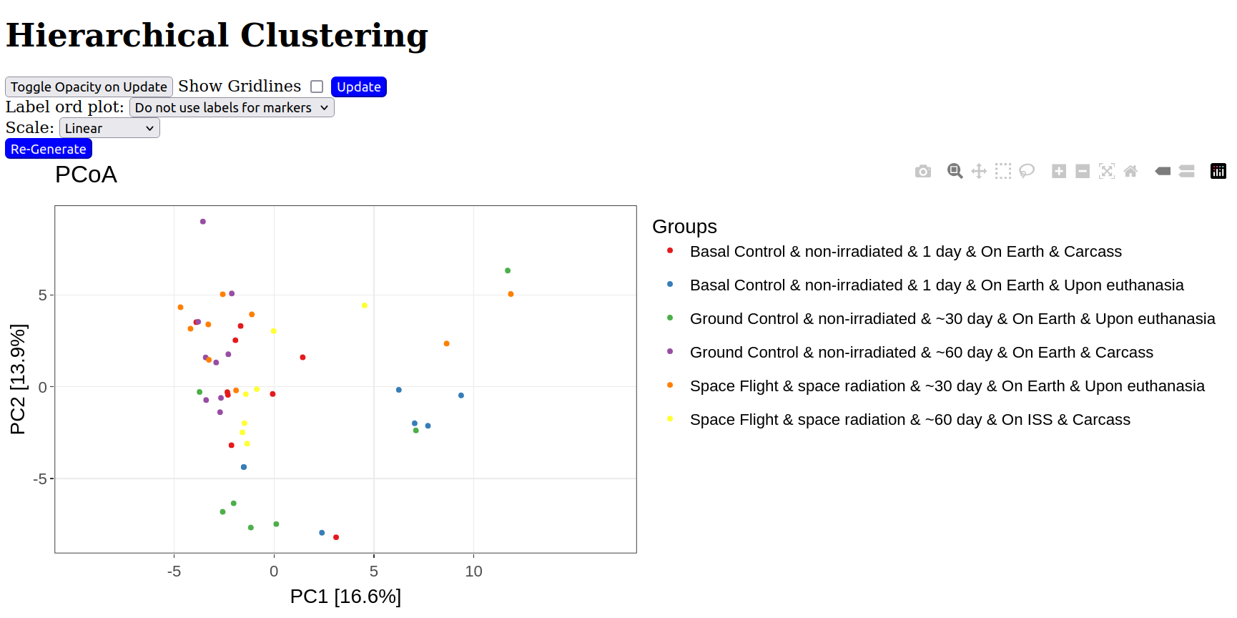

Slide 17
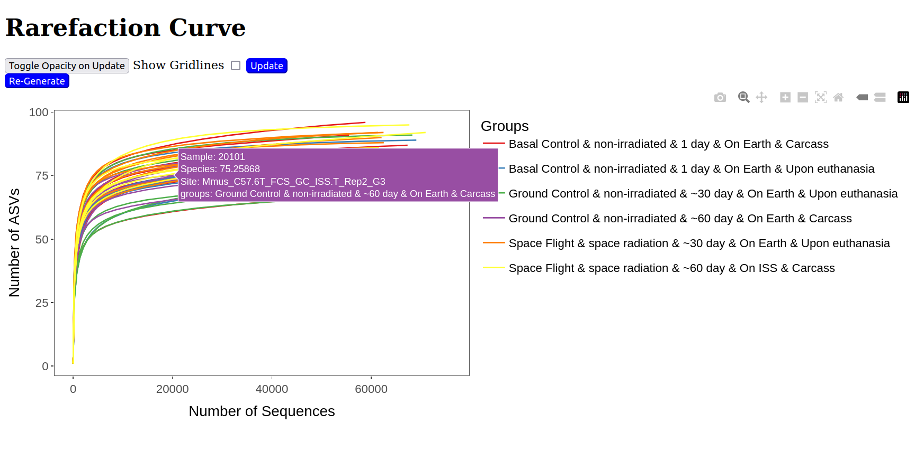

Slide 18
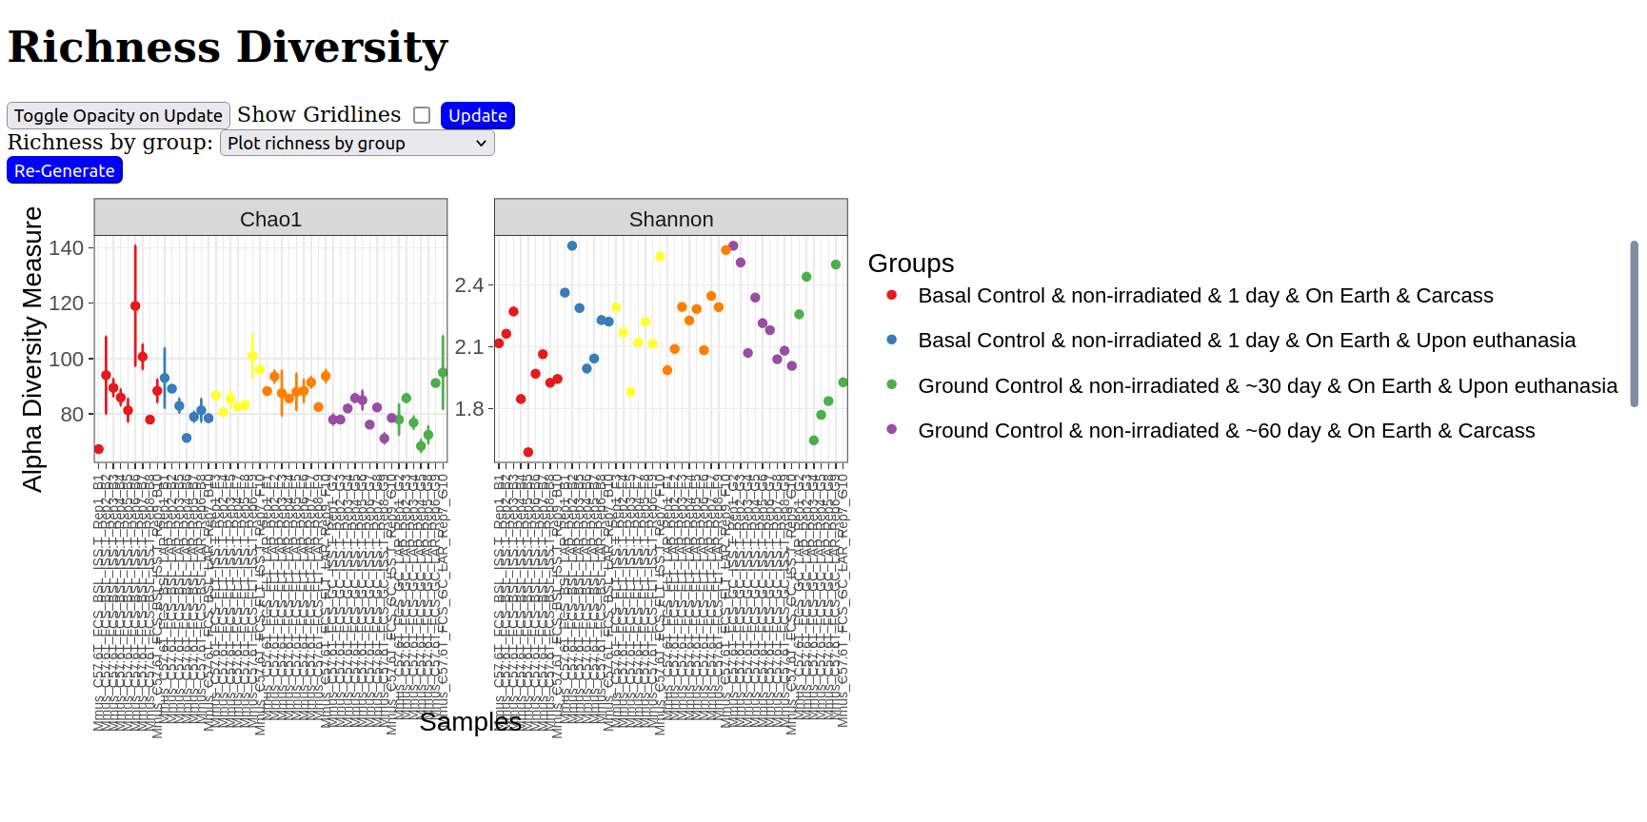
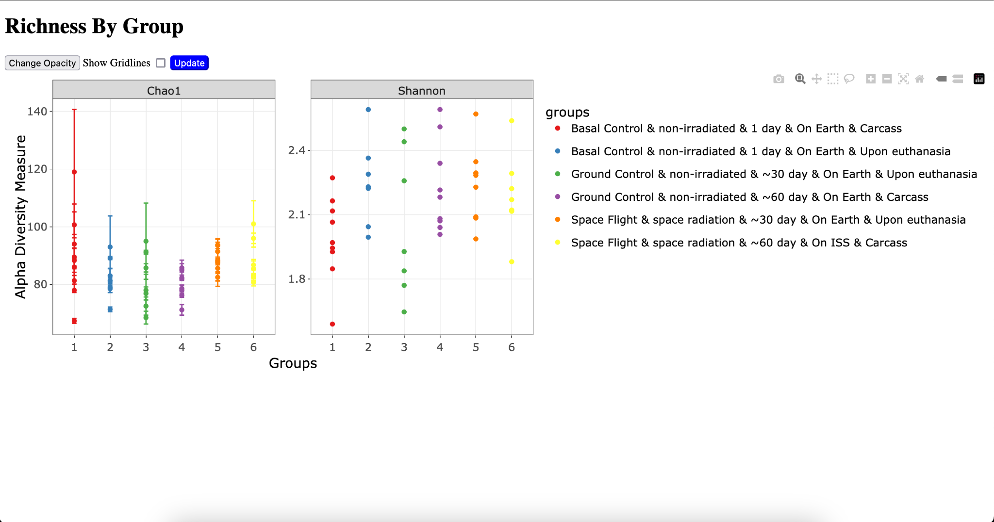

Slide 19
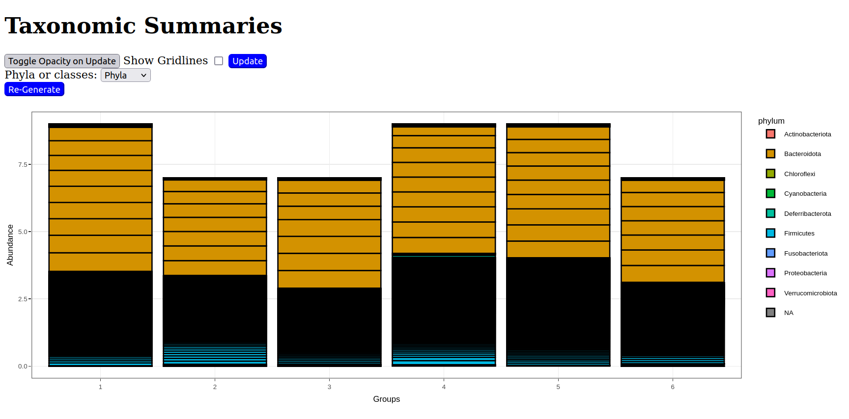
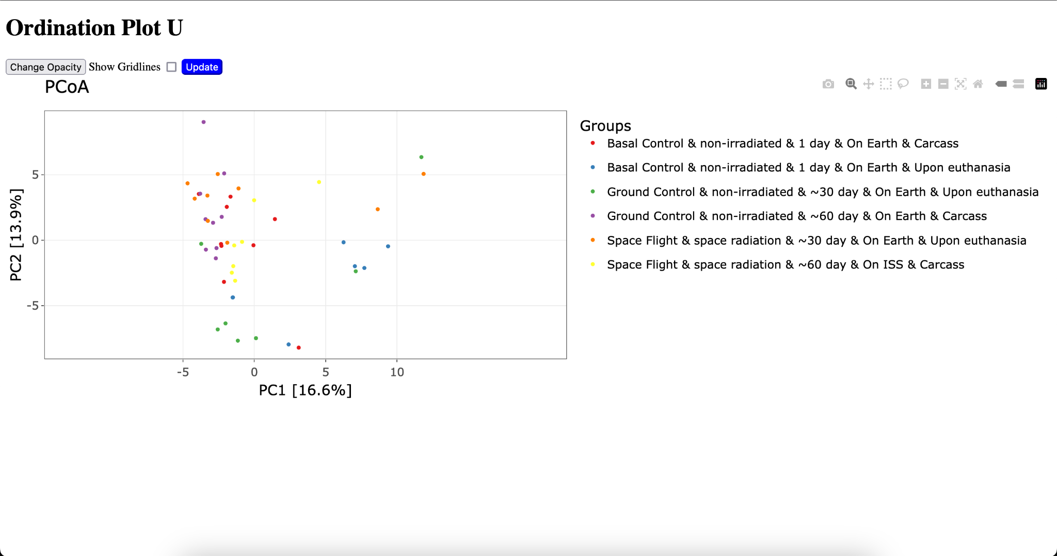

Slide 20
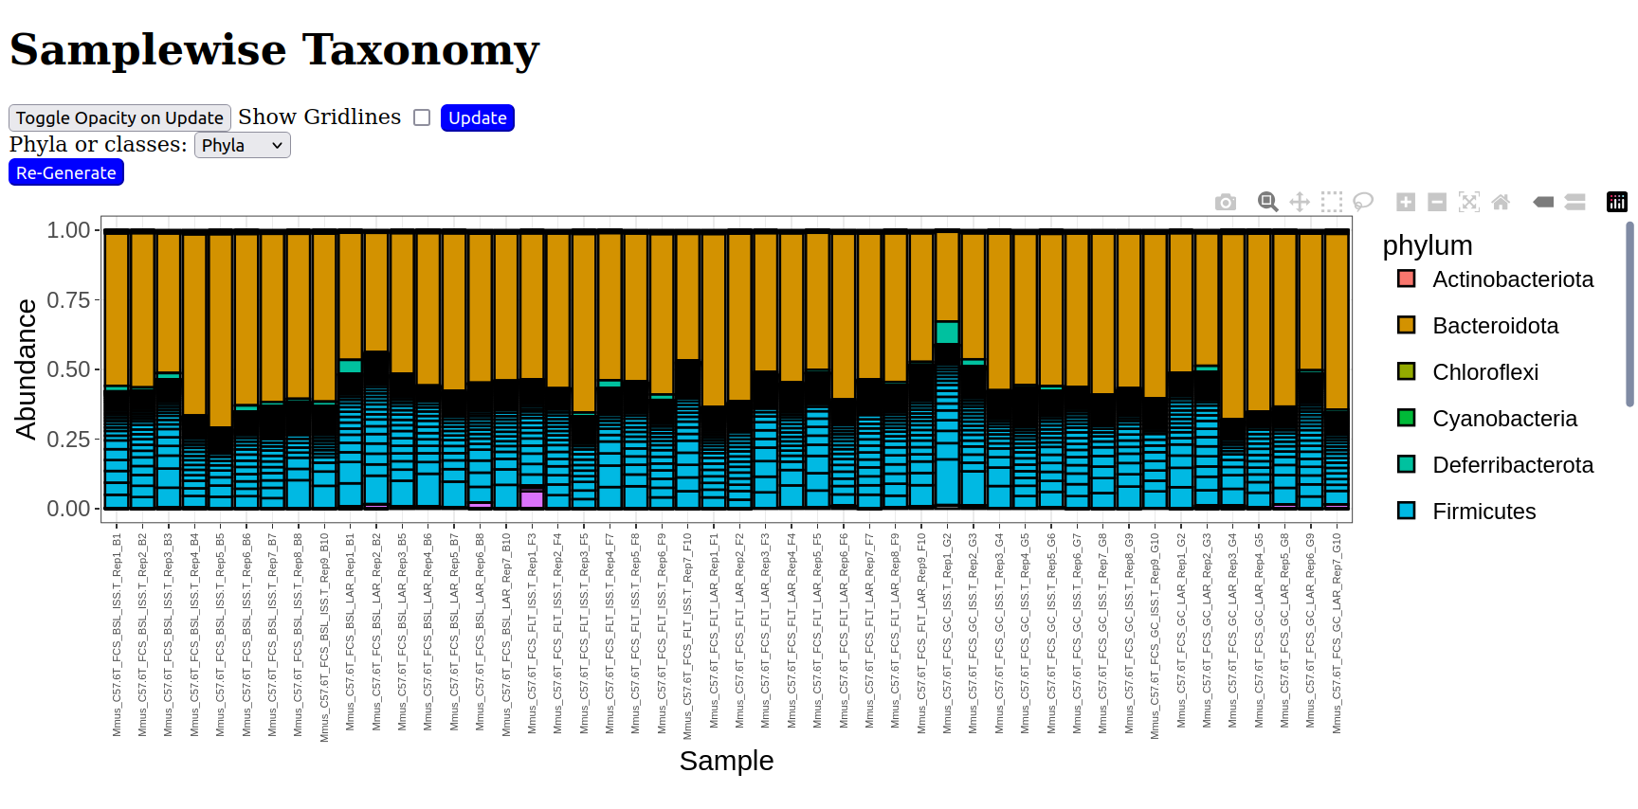
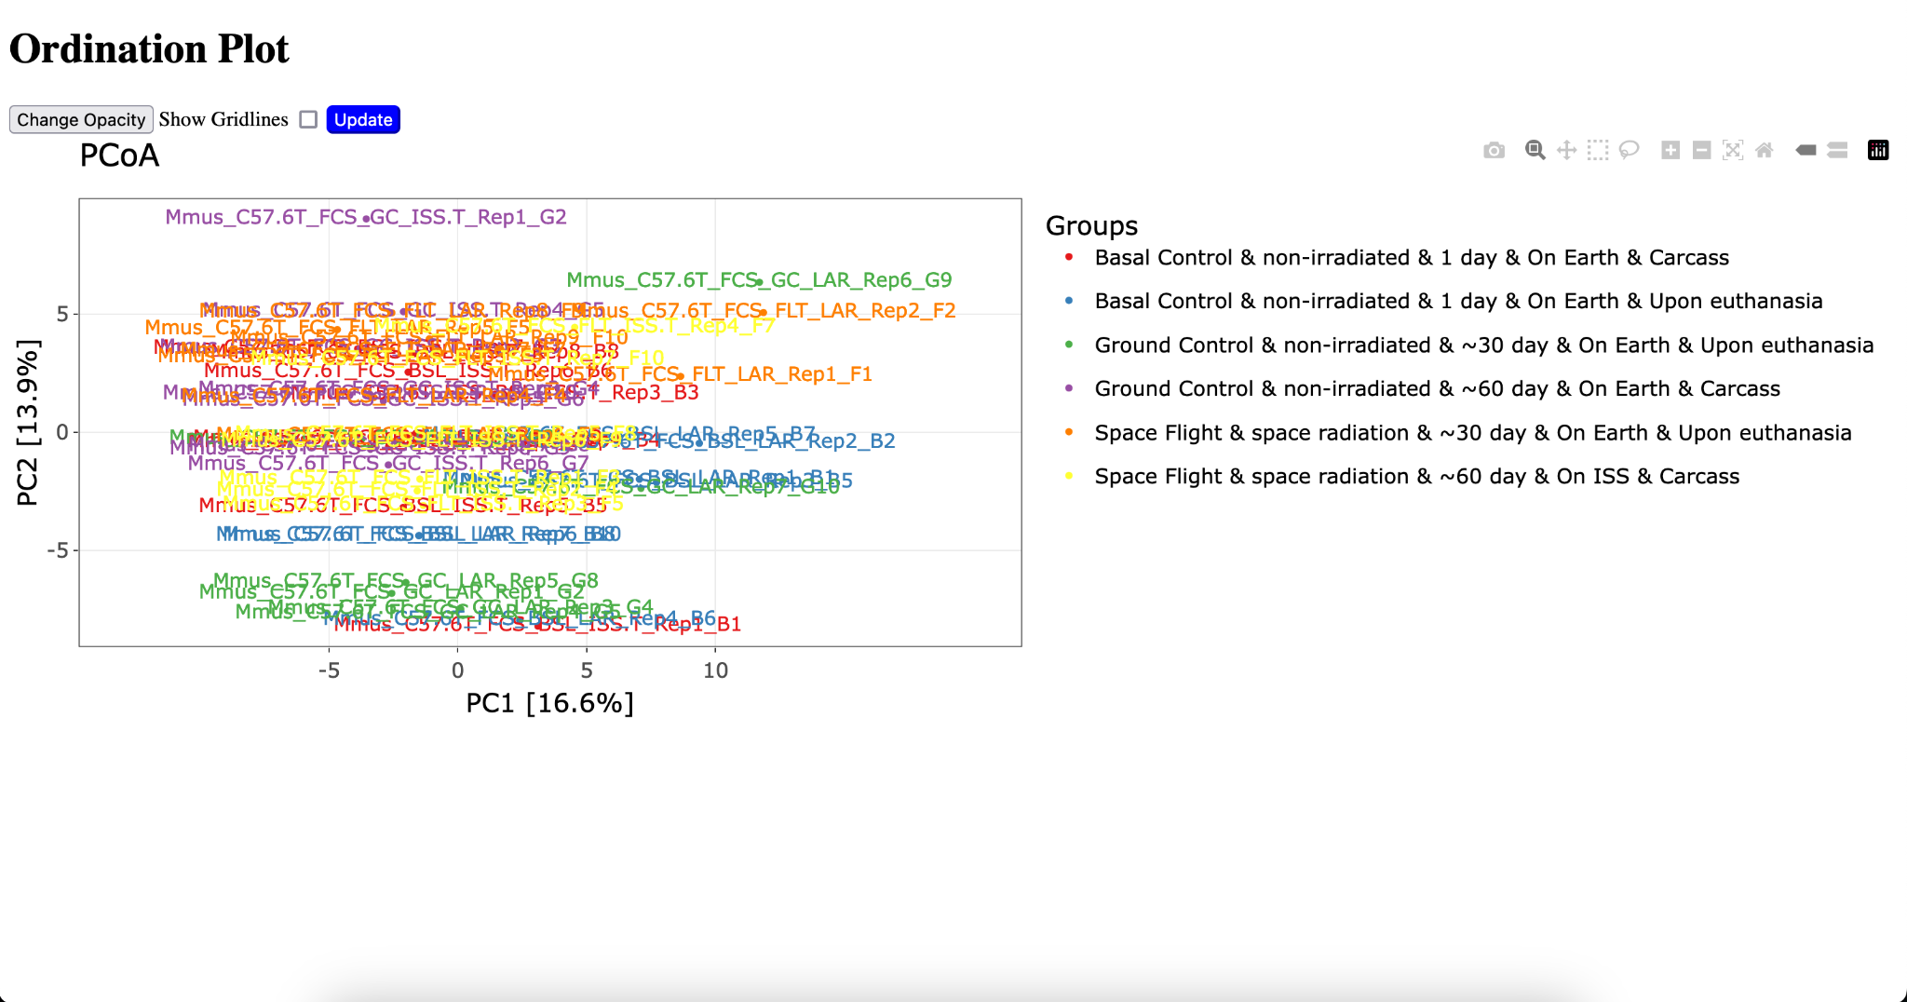

Slide 21
