Slide 1

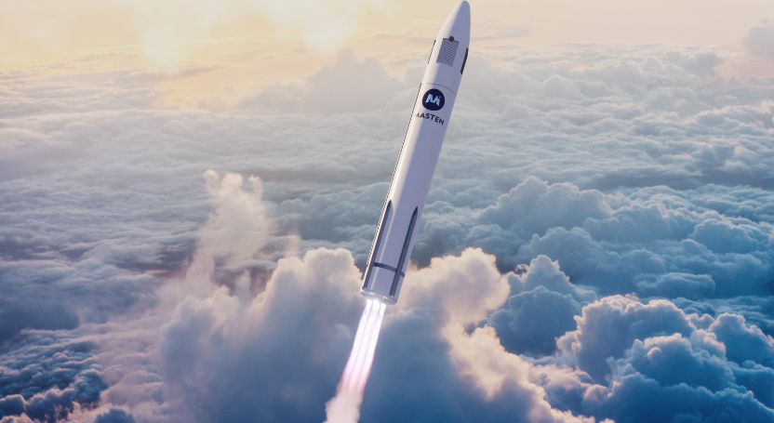
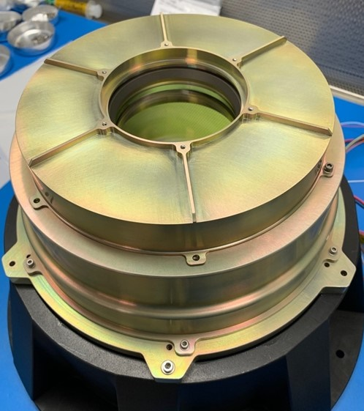
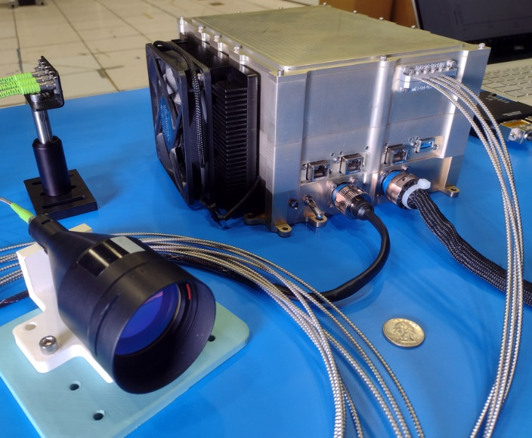
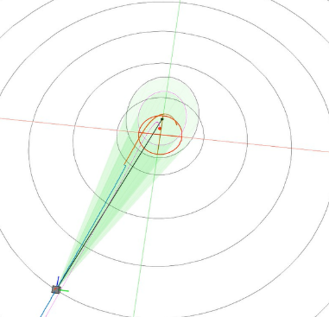

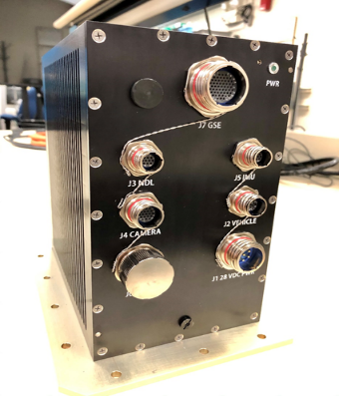
Space Technology Mission Directorate
Game Changing Development Program
Gavin Mendeck, SPLICE | Annual Program Review | September 10-12, 2024
gavin.f.mendeck@nasa.gov

Slide 2
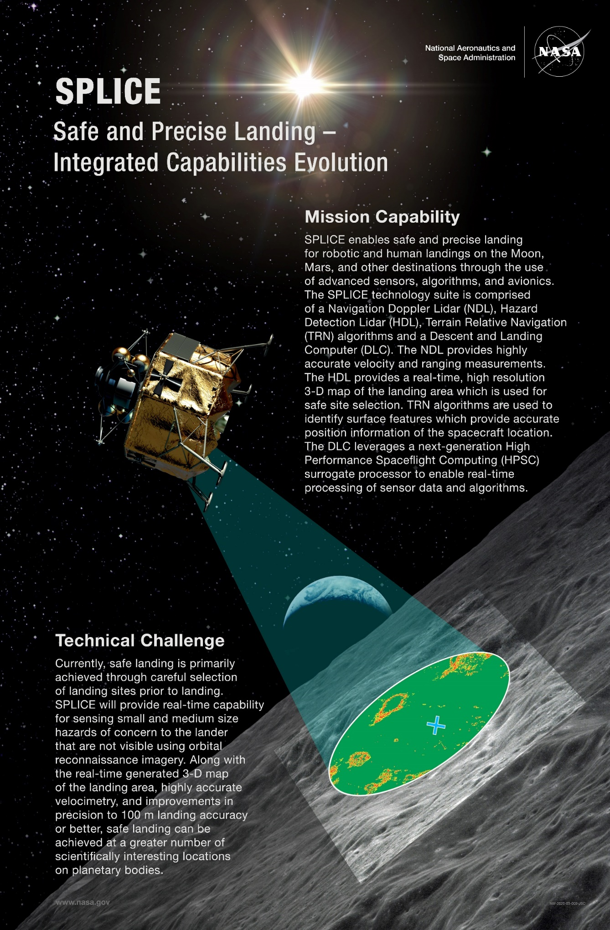
Project Overview
Technology Products Capability
  SPLICE Precision Landing and Hazard Avoidance (PL&HA) technologies will improve landing precision by an order of magnitude and enable high-resolution real-time 3-D mapping for hazard detection and avoidance during descent.
Technical Capabilities
  Portfolio of sensors, avionics and algorithms for PL&HA appropriate to be infused as individual technologies, or can be fully integrated
    Hazard Detection (HD) Lidar - high resolution terrain mapping
    GN&C/PL&HA Algorithms improving integrated functions and real-time performance
    Descent and Landing Computer (DLC) with COTS HPSC surrogate for PL&HA+GN&C computing
  Analysis and Test capabilities to mature PL&HA and GN&C technologies
    Hardware-in-the-loop (HWIL) Simulation Testbed for development, low-cost V&V, and integrated testing (prior to costly field tests)
    Flight Testbeds (terrestrial and suborbital) for component or integrated systems testing in relevant environments (risk mitigation and TRL maturation toward mission infusion)
Exploration & Science Applicability
  Technologies enable precise, safe, and soft landing in close proximity to targeted surface locations (hazardous terrain, pre-positioned cargo, cached samples, etc.) on the Moon, Mars, or other solar system destinations
  Technologies have commercial space applications for companies interested in landing payloads (and eventually people) on the Moon or Mars
INSERT OVERVIEW
PICTURE HERE
Notes:
Provide an overview of the Project
Pictures are encouraged, please provide new pictures as frequently as possible

Slide 3
SPLICE Overview – Needs & Goals
Needs Addressed by Project
HLS, STMD | How do we safely land near where we intend to? Develop precision landing & hazard avoidance sensor and software components for landers at Moon, Mars, and other destinations. | EDL & Precision Landing
HPSC | How do we leverage high performance computing development? Utilize a high performance space computing prototype for processing sensor data and algorithms to flight demonstration precision landing and hazard avoidance. | Advanced Avionics
Project Goals
Goal #1 | Design, integrate, and flight demonstrate a portfolio of sensor and software components that together or independently enable precision landings within 50m while avoiding landing hazards. The portfolio consists of: A descent guidance trajectory-planning software library that generates trajectory solutions within 3 seconds that achieve constraints on sensor pointing, position, and thrust bounds while minimizing propellant use. A Hazard Detection Lidar to scan and provide within 2 seconds a 1 MP digital elevation map of 100x100m area at 1.5cm (1σ) elevation precision. A hazard detection software library that processes a 1 MP DEM within 2 seconds, then provides a prioritized list of safe landing sites meeting lander-specific parameters. A Navigation & FSW architecture using these technologies fused with traditional Navigation sensors to achieve onboard position precision of 3m relative to a safe site within the DEM.
Goal #2 | Design, integrate, and suborbital-flight demonstrate this portfolio of capabilities leveraging an HPSC-class terrestrial prototype computer.
Goal #3 | Achieve TRL 5 with the hazard detection lidar engineering test unit. Achieve SRL 6 for the FSW algorithms of advanced guidance and hazard detection.

Slide 4
SPLICE Overview – Objectives
Project Objectives
Objective #1 | Design and implement a Descent and Landing Computer Engineering Test Unit capable of spaceflight that performs sensor fusion, runs GN&C computing applications, and can transfer, process, and store data at high speeds.
Objective #2 | Complete a full set of flight software and firmware applications using cFS that includes navigation and guidance algorithmic technology advancements, navigation filter for sensor fusion, data input/output and processing, and data storage
Objective #3 | Develop and implement a guidance flight software library that generates a trajectory to the landing site meeting vehicle, sensor, and mission constraints per system requirements.
Objective #4 | Develop, build, and perform laboratory testing of a Hazard Detection Lidar that meets system requirements.
Objective #5 | Develop and implement a hazard detection flight software library that processes the hazard lidar DEM per system requirements.
Objective #6 | Develop both guidance and hazard detection software libraries as C/C++ libraries that meet at least NASA Class C FSW standards, to ease infusion into flight projects.
Objective #7 | Perform hardware-in-the-loop integration and testing of all system components.
Objective #8 | Perform closed-loop flight testing of the integrated SPLICE system with a vertical landing test vehicle.

Slide 5
SPLICE Project Organization
STMD Game Changing Dev
Program Executive
Niki Werkheiser – HQ
Kevin Somervill – HQ
EDL SCLT Lead
Michelle Munk – HQ
STMD TIM for Precision Landing
John M. Carson – HQ
STMD Flight Opportunities
Program Executive
Chris Baker – HQ
STMD Avionics PT
Wes Powell
GCD Program Manager
David Moore – LaRC
FO Program Manager
John Kelly – AFRC
Danielle McCulloch -- AFRC
Campaign Manager
PEM – Wade May -- LaRC
High Performance Spaceflight Computing (HPSC) Project
Safe & Precise Landing
Integrated Capabilities Evolution
(SPLICE) Project
Project Manager
Gavin Mendeck – JSC
Project Manager
Charles Dunn
JPL
Project Chief Engineer
Sam Pedrotty – JSC
PAO + EPO
STMD-GCD/STMD-FO
S&MA
STMD-FO
Legend
Psionic, LLC
Direct Oversight
HWIL/Sim
Teming Tse
JSC
GNC
Kyle Smith
Draper
FSW
James Berck
JSC
HDL
DLC
David Rutishauser
JSC
PS-NDL
CA Downing
Sensor PI
Bryan Blair
GSFC
Proj Mgr
William Potter
GSFC
Coordination
Level 1 (Leadership)
Level 2 (Programs)
Level 3 (Projects)
Notes:
If you have submitted a Project Plan, you could utilize the Organizational Chart found in section 8.3 – Management Structure making sure to add in your assigned PEM and associated PT/SCLT

Slide 6
SPLICE Collaborations & Partnerships
NASA Center
Terrain Relative Navigation demo
(V&V leverages SPLICE Trick Simulation)
Academia
Suborbital Testing 2020/1
SAA Adv. Guidance
Astrobotic
(STMD-TP, A-TRN)
Industry
Guidance Research
Blue Origin
(STMD-TP)
Terrain Relative Navigation
GN&C software
Univ. Washington
Draper
Suborbital Testing 2025
Hazard Detection Lidar (HDL)
cFS
Astrobotic Space Systems
(STMD-TP, Xogdor)
NASA GSFC
Hazard Detection algorithms
High Performance Space Computing
(HPSC)
Psionic
(SBIR & STMD-TP)
SBIR Navigation Doppler Lidar (NDL)
TP NDL Demo 2024 (potential)
NASA JPL
NASA AFRC
(STMD Flight Ops Program)
Inputs to Human Landing System (HLS) Oversight & Insight
Suborbital Test Coordination
NASA JSC
Project Leadership
Descent & Landing Computer
HWIL Simulation Testbed
GN&C Software
Review of ECF Hazard Detection algorithms that leverage Machine Learning
No collaborations or partnerships with organizations outside of Continental United States
Notes:
Infusion: An investment reaches a conclusion where a technology is handed off for use by a mission or other need. Infusions can be made to other NASA Mission Directorates, other Government Agencies, Commercial Entities, or International Partner.
Transition: An investment reaches a conclusion where a technology is handed off for further development. Transitions can be made to other STMD programs, other NASA Mission Directorates, academic institution, other Government Agencies, Commercial Entities, or International Partner.

Slide 7
SPLICE TRL & SRL Progression
(per GCD TRAIT)
Project Milestone
GCD (Key) Milestone
Controlled Milestone
TRL Progression
7
HDL Sensor
S/W Guidance
Xogdor
SPLICE
Flight Test
S/W Haz Detect
6
Prelim Guid on Suborbital
Test NS#2
HDL ETU1 Delivery
Guid DLC
HWIL
5
TRL & SRL
HD in Sim & DLC HWIL Testing
HDL Field Test
HDL EDU Assembled
HDL Static Test
HDL ETU1 complete
4
HDL Dynamic Test
FSW+GNC “CDR”
FSW+GNC
“PDR”
3
Slowed Work
GCD FY22
budget adjustment & rescope
Project Periodic Review
SPLICE Hardware Delivery
2
FY18
SPLICE Software Delivery
FY21
FY22
FY23
FY24
FY25
Notes:
Chart purpose: show TRL/SRL/MRL advancement over the project lifecycle schedule. Show TRL advancements as whole integer increases. Show how Key and Controlled milestones align with TRL advancement.
TRL/SRL/MRL may not advance at each milestone. Often several milestones are required to produce a step increase in TRL/SRL/MRL.
There can be one, or more, of these charts per project as needed.
For projects with fewer technical elements, the TRL/SRL/MRL data can be combined on one chart.
For more complex projects, the TRL/SRL/MRL progression can separated into multiple charts by project technical area.
Show TRL, SRL, and MRL data for each technical element on the same chart.
Delete TRL/SRL/MRL axis-labels that do not apply – e.g., remove SRL/MRL for projects/technical areas where SRL and MRL do not apply.

Slide 8
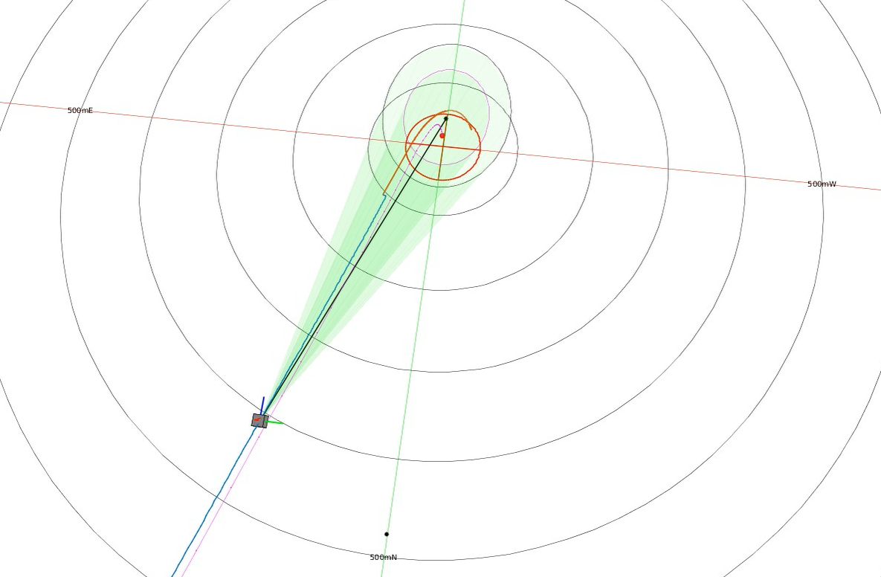
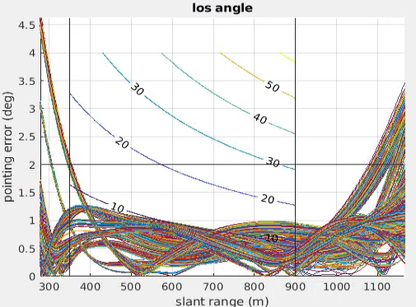
Guidance Flight Software
Project has partnered with University of Washington on Dual Quaternion Guidance (DQG) to provide real-time trajectory solutions that meet multiple constraints, including sensor pointing, while minimizing propellant use.
Initial implementation flew successfully as part of SPLICE “ride-along” payload on New Shepard flight in 2021.
UW developed first-order proportional integral projected gradient (PIPG) solver in FY22-23 to simplify the flight software and improve execution performance to meet project KPPs.
FY24 work has focused on identifying PIPG constraint definition, planning, and now implementation as FSW Class C software library with a cFS application interface.
  FSW PIPG guidance library is being implemented to begin evaluation in simulations and on Descent Landing Computer hardware prior to SPLICE GNC CDR
FY25 work will focus on evaluation in dispersed simulations, HWIL performance, and code review prior to closed-loop testing on Xogdor vehicle in FY26
Plans for Transition / Infusion
  Interest in similar guidance algorithms from HLS Partners and CLPS. SPLICE PIPG will be offered via NASA Software Catalog. Collaboration agreements and RSAAs infusing elements of software.
6DOF lander simulation illustrating SPLICE DQG successfully points the HDL sensor field-of-view (green) within 50m of the site (red circle) and diverts to an identified safe site (red dot).
Dispersed guidance trajectory solutions meet constraints, including narrow pointing angle error for sensor, during landing site approach phase. Slant range decreases during approach. Contours indicate pointing miss distance relative to intended target on the ground.
Ground pointing error (m)
September 10-12, 2024
Notes:
SOCP = second order cone programming
PIPG = proportional integral projected gradient

Slide 9
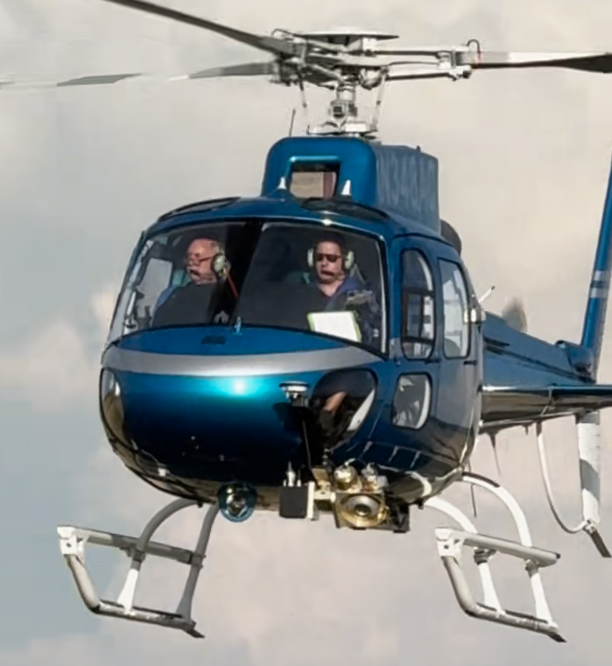
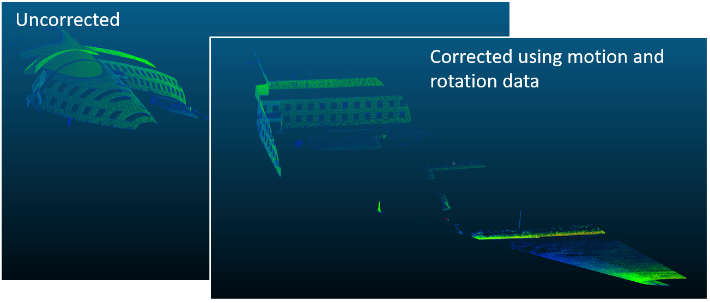
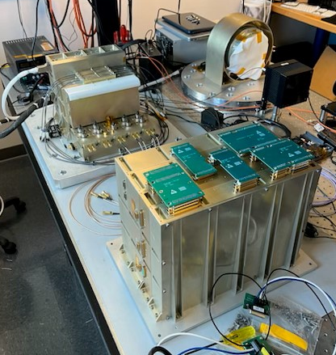
Hazard Detection Lidar
Project partnered with GSFC to design, build, and test the Hazard Detection Lidar (HDL)
  Design implements a scanning lidar with pointing controlled by two high-speed spinning Risley prisms to make millions of precise point measurements per second with <1.5 cm (1σ) range accuracy
  HDL avionics compensate for motion while populating a 1 MP 100x100 m digital elevation map during the 2 sec scan, allowing hazards of 30cm diameter or larger to be identified
FY24 has continued ETU1 assembly, integration and testing to prepare for truck and helicopter testing in late 2024
  Integrated scanner, control mechanism, and range control electronics.
  Updated firmware algorithm to read in IMU data and perform motion compensation and georectification during the scan.
FY25 will complete field testing with SPLICE Descent Landing Computer before hardware delivery and documentation.
Plans for Transition / Infusion
  GSFC considering for New Frontiers missions.
HDL EDU Dynamic Testing w/ Truck (2021)
With Post-Processed Motion Compensation
Scanner Head Assembly
Scanner
Telescope
Laser Assembly
Fiber Delay
Laser
Detector
HDL Helicopter Testing
Environment & Rehearsal Flight
28 August 2024
Electronics Assembly
Range Control Electronics
Scanner Power Ccard
Motor Controller Board
Main Power Interface Board
September 10-12, 2024

Slide 10
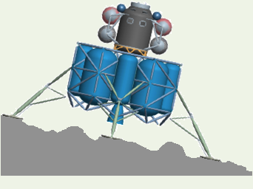
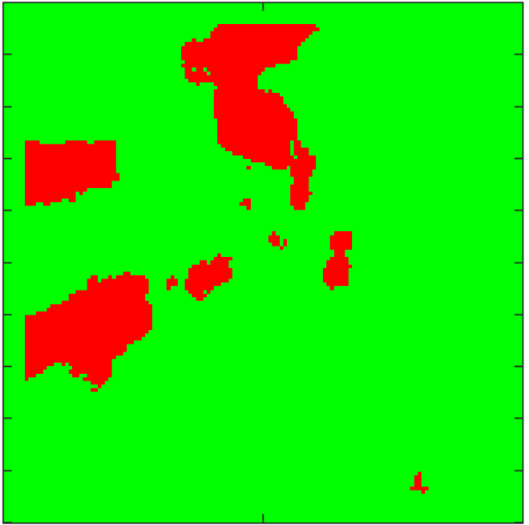

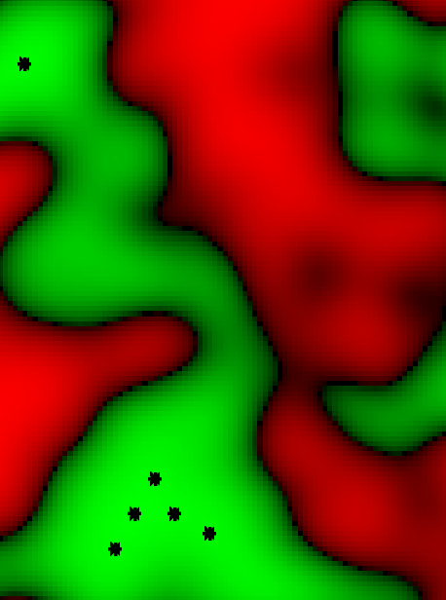

Hazard Detection Flight Software
Project has partnered with JPL to refine the surface hazard detection software used on the Morpheus PL&HA demonstration flights in 2013-2014. Processes a DEM with defined lander characteristics to identify sites most likely to avoid surface slope and roughness (lander clearance) hazards.
  2013 implementation required parallelization on multiple CPUs to process within 6 seconds. Processor speed improvements (i.e., HPSC) and algorithm improvements since then have reduced the need to parallelize this algorithm.
  FY22 focused on algorithm refactoring to improve performance (~60% of original execution time) and development into a FSW Class C software library package.
  FY23 reviewed and matured the library. Testing a 1 MP DEM on DLC EDU ARM A53 achieved 5 second threshold for a 5m diameter lander.
FY24 has focused on evaluation and improvement of algorithm
  Adjusted FSW to work with HDL DEM size
  Finding and evaluating rare false positives of safe sites to determine whether correction is needed.
FY25 will demonstrate real-time processing of HDL DEM on the DLC during helicopter flights.
Plans for Transition / Infusion
  Europa Lander. Offered by CalTech for commercial licensing (HLS, CLPS).
Depiction of
Lander Hazards
roughness
slope
Hazard Detection Processing Steps of DEM
Slope Hazards
Combined Hazards
Combined Hazards w/
Landing Accuracy
Roughness Hazards
September 10-12, 2024

Slide 11
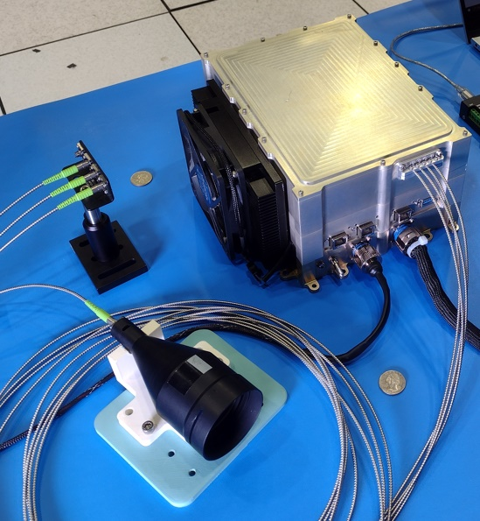
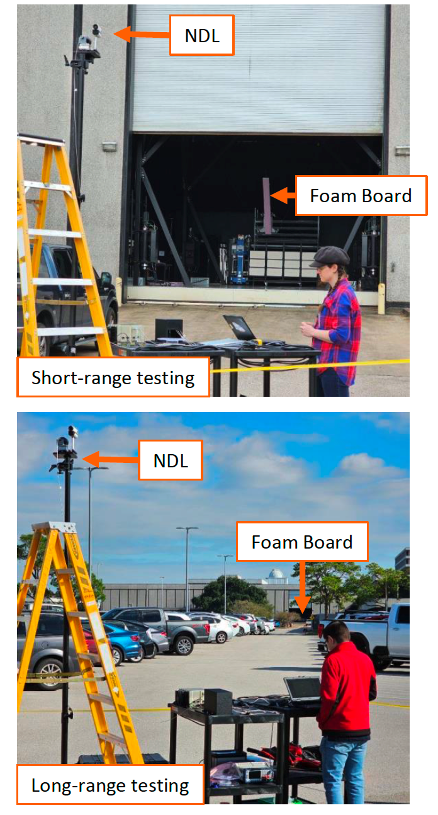
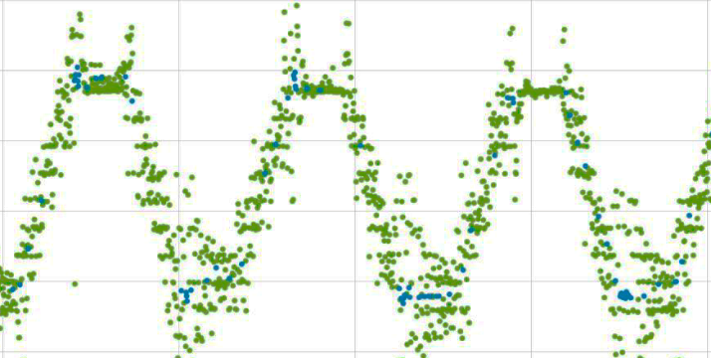
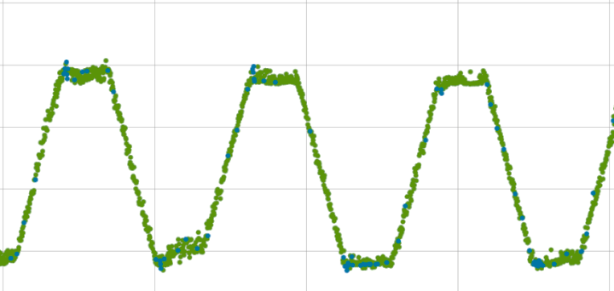
Psionic Navigation Doppler Lidar
Project partnered with Psionic, LLC. to develop and deliver commercial Navigation Doppler Lidar unit
  Sensor provides softer controlled touchdown with low lateral velocity and significantly reduced navigated position error, improving precision landing. Improving on NASA Langley NDL design flown on IM-1.
  SBIR Phase 3 to develop two photonic integrated circuit (PIC) upgrades and build a 5th Generation NDL EDU, reducing mass by 70% from prototype and more redundancy. EDU mass target is 3 kg.
  PPBE25 & 26 funding constraints descoped Psionic NDL from project. GCD open lien to return NDL in scope while periodic funding is approved. FY24 SBIR funding in partnership with US Army.
FY24 focused on evaluating prototype sensor performance
  SENSS dynamic testing of NDL prototype at JSC. Robotic target with controlled motion used to evaluate the dynamic doppler lidar response.
  Psionic used test data and identified a firmware correction to improve of measurement quality. Correction is implemented on prototype and will be used in Psionic Tipping Point flights.
  Psionic is conducting Tipping Point for Validating No-Light Lunar Landing Technology with flight testing in FY25.
FY25 will develop, qual test, and deliver an EDU with a photonic integrated circuit.
Plans for Transition / Infusion
  Candidate descent navigation sensor for SMD and CLPS landers. US Army and commercial terrestrial uses in development by company. Considering for RPOD too.
Psionic NDL Prototype
SENSS Dynamic Testing
NDL Test Data before Correction
NDL Test Data after Correction
September 10-12, 2024

Slide 12
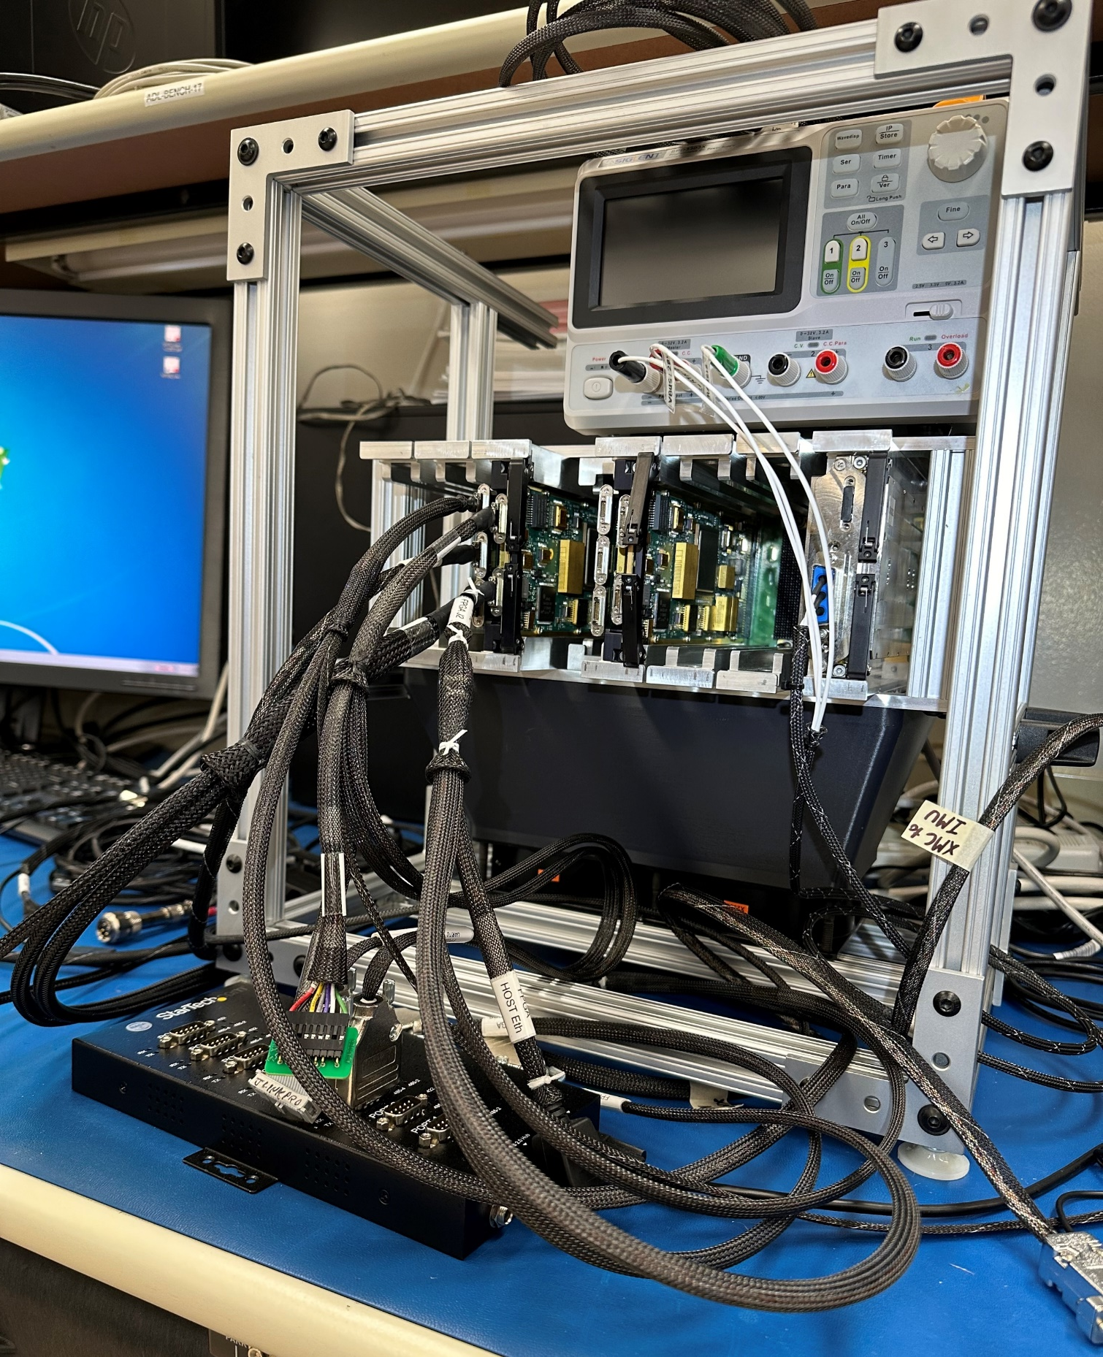
Descent Landing Computer
Descent Landing Computer (DLC), incorporating a surrogate for the High Performance Space Computer (HPSC), is necessary to support testing and validation of precision landing technologies and integrated systems
  Fuse time-stamped sensor measurements with navigation filter, generate guidance trajectories and commands, process hazard DEM data, record data
  Project previously developed and qual’d a Descent Landing Computer EDU for New Shepard flights
DLC ETU design in fabrication and assembly
  Four ARM A53 processors running 64-bit cFS on a Pentalinux OS
  Radiation tolerant design extendable for lunar environment
  ETU design corrects time synchronization deficiencies that were accepted to ride-along on New Shepard. These deficiencies must be corrected for Xogdor, as that vehicle will respond to SPLICE guidance commands.
  Member of Sensor Open Systems Architecture (SOSA) industry consortium developing space standard to guide industry ecosystem development in support of future NASA needs
  Designed to accommodate single board computer from High Performance Space Computing (HPSC) project
Early FY25 will complete assembly, testing, and delivery of two DLC ETU units suitable for terrestrial flight testing
Plans for Transition / Infusion
  ETU DLC with HPSC Single Board Computer (SBC) on-ramp proposed for GSE upgrade path for Orion avionics and Gateway server
DLC ETU Openframe Chassis #1
September 10-12, 2024

Slide 13
SPLICE Assessment Summary
Project Name | Performance |  |  |  | Comments
 | C | S | T | P
Annual | Y | Y | G | R | Cost – Hardware development & testing corrective actions, including re-work. Schedule – Hardware development delays and personnel availability slipped HDL and DLC milestones in FY24. Critical path to Xogdor not affected. Programmatic – Current plan closeout in Dec 2025 not feasible with Xogdor slip.
 | Oct | Nov | Dec | Jan | Feb | MYR | Apr | May | Jun | Jul | Aug | APR
C | Y | Y | Y | Y | Y | G | Y | Y | Y | Y | Y | Y
S | Y | Y | Y | Y | Y | Y | Y | Y | Y | Y | Y | Y
T | G | G | G | G | G | G | G | G | G | G | G | G
P | Y | Y | Y | Y | Y | Y | R | R | R | R | R | R
Xogdor flight with SPLICE has slipped at least four months to Oct 2025. Current plan with project close out in Dec 2025 is not feasible. In FY25 project will ramp down labor analysis and testing work after hardware deliveries to reduce rate of project expenditure coinciding with projected need dates for Xogdor.
Psionic NDL descoped from Xogdor, pending CR to rescope. Development funded in FY24 with GCD and Army Corps of Engineers partnership, but for not yet baselined in future years.
STMD/LAND decision on project replan and funding needed in FY25.

