Slide 1
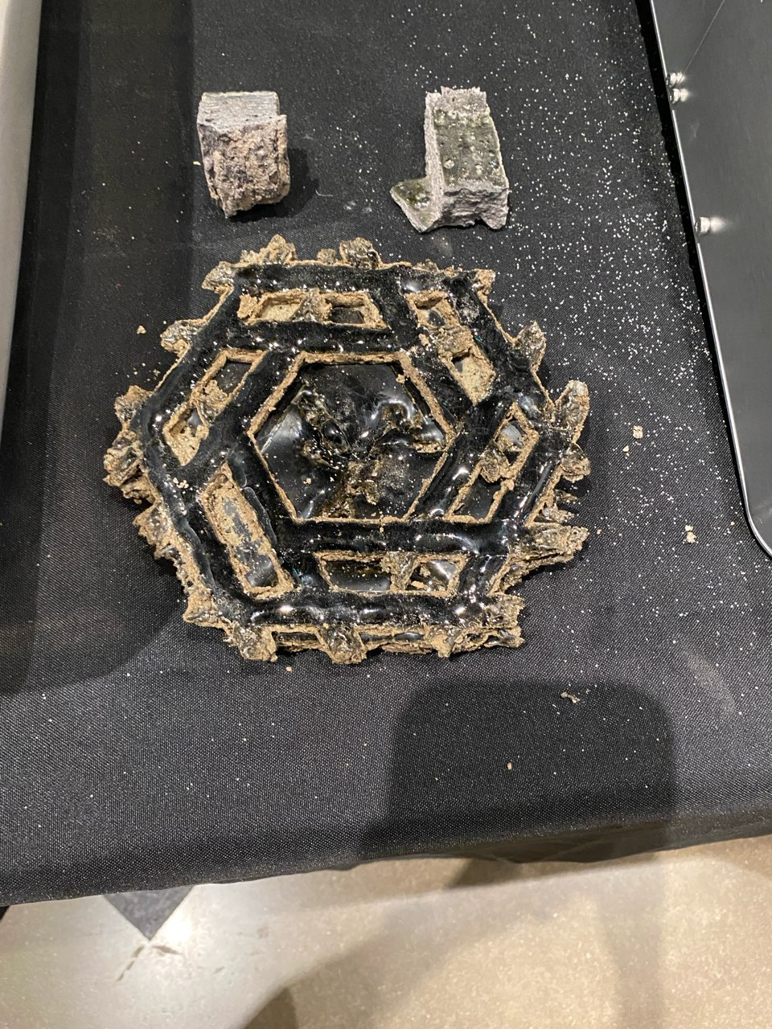
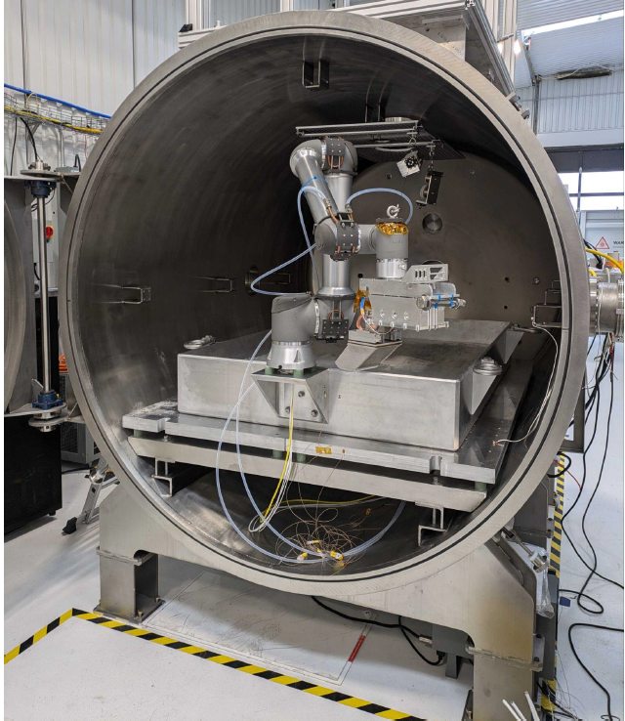
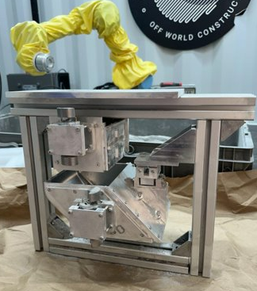
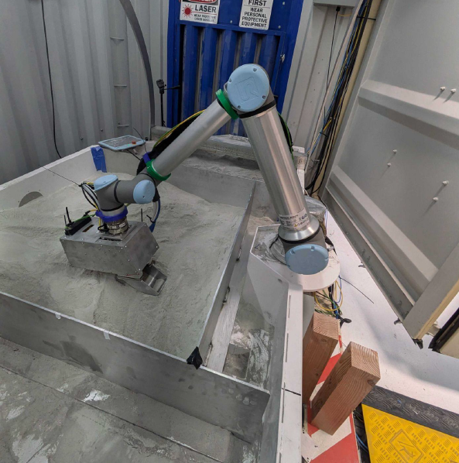
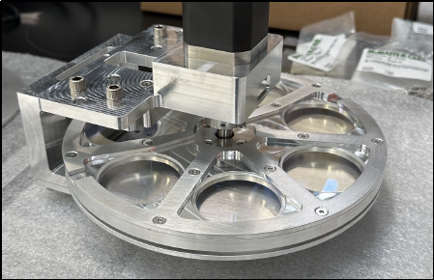
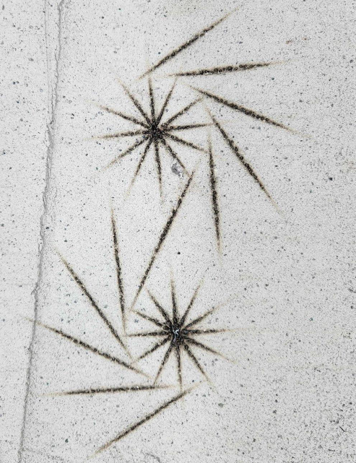
Jennifer Edmunson, MMPACT | Annual Program Review | September 10-12, 2024

Slide 2

MMPACT
Technology Goals & Project Objectives
Technology Goals
Goal #1* | Design, build, and ground demonstrate the feasibility of a subscale lunar additive construction capability for manufacturing structural building elements from in-situ material.
Project Objectives
Objective #1* | Develop additive construction processing technologies, including extrusion and thermal deposition, for evaluation with lunar regolith simulant-based construction materials.
Objective #2* | Develop approaches to test material specimens fabricated by the down-selected processing technology to verify the ability to meet structural, thermal, and other environmental requirements, such as the vacuum environment of the lunar surface as allowed by terrestrial vacuum systems.
Objective #3* | Develop an approach for instrumentation that can monitor the construction system and resultant structural elements both during and after operation.
Objective #4* | Down select the candidate additive construction processing technology for a flight demonstration formulation based on the objective 1 processing technologies.
Objective #5* | Formulate an early demonstration of the construction process system on the lunar surface. Use the formulation output to determine the constraints on the system based on Commercial Lunar Payload Services (CLPS), or other, lander projected capabilities. Also use the formulation output to identify technologies in the system that need maturation to the TRL5/6 level for a flight demonstration.
Objective #6* | Develop and execute a Technology Maturation Plan (TMP) for the technologies needed for an early flight demonstration.
Objective #7* | Demonstrate additive construction of landing pad subscale element(s) using the EDH construction process system in a Dirty Vacuum Chamber (DVAC).
Objective #8* | Evaluate the material and structural performance of subscale elements fabricated by the complete construction system in the DVAC.

Slide 3
MMPACT Phase 1 TRL Progression
Project Milestone
Key Milestone
Controlled Milestone
TRL Progression
FY20 | FY21 | FY22 | FY23 | FY24 | FY25
Laser VMX Process
End Effector (EE) Subsystem
Terrestrial Arm (TA) Subsystem
TA Umbilical (TAU) Subsystem
End Effector Umbilical (EEU) (new)
Engineering Development Hardware System Demonstration at ICON
6
TA and TAU Subsystem Tests (V20 Test 1)
EE Sub-system Test
5
Flight Candidate Laser System Operational
TA/TAU Prototype
4
Lab Print
Proof of Concept 1atm
Lab Print
Proof of Concept vacuum
TRL
TA Component Demos
3
Materials Applied Research
STF Testing at ICON
EE Prototype
2
EE Umbilical for 78” Chamber
Current Status
1
Project
Start
TAPR 1
PPR 1
PPR 2
PPR 3
PPR 4
Phase 1 (Tech Dev) Completion
PPR 5
Notes:
Chart purpose: show TRL/SRL/MRL advancement over the project lifecycle schedule. Show TRL advancements as whole integer increases. Show how Key and Controlled milestones align with TRL advancement.
TRL/SRL/MRL may not advance at each milestone. Often several milestones are required to produce a step increase in TRL/SRL/MRL.
There can be one, or more, of these charts per project as needed.
For projects with fewer technical elements, the TRL/SRL/MRL data can be combined on one chart.
For more complex projects, the TRL/SRL/MRL progression can separated into multiple charts by project technical area.
Show TRL, SRL, and MRL data for each technical element on the same chart.
Delete TRL/SRL/MRL axis-labels that do not apply – e.g., remove SRL/MRL for projects/technical areas where SRL and MRL do not apply.

Slide 4
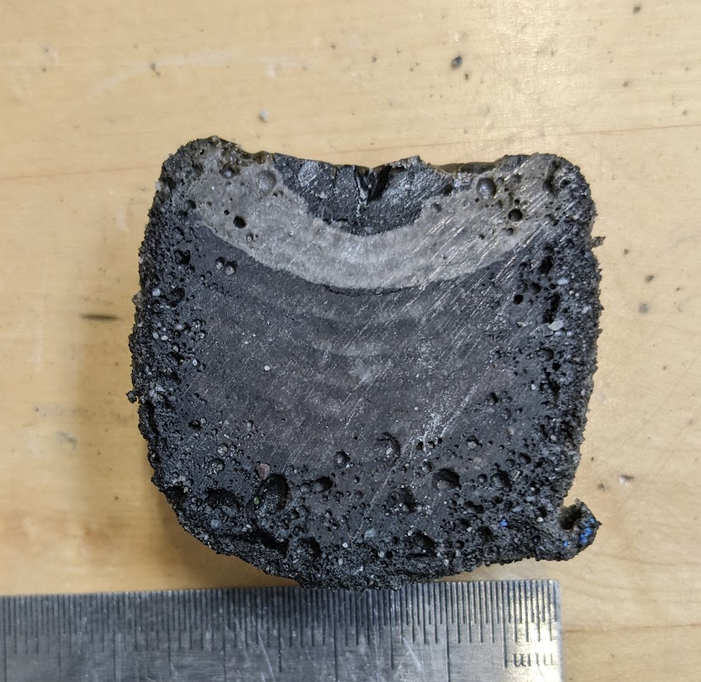
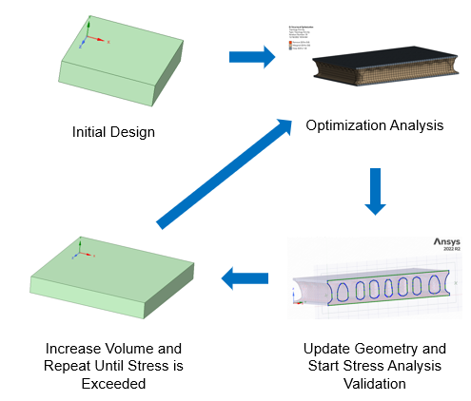
MMPACT Technical Progress and Results
Project Start
7/1/20
Recap of FY23 APR
Down-selected to Laser Vitreous Material Transformation (VMX) process
  Successfully developed and demonstrated Laser VMX polycrystalline material
Technology Maturation Plan developed
Topology-optimized landing pad design produced
Development, characterization, and production of NUW-LHT-5M lunar highlands regolith simulant
Completed Periodic Project Review 1
Baselined End Effector instrumentation
  Visual and Thermal Sensing Suite
  Scoop/Tamp/Filter (STF)
  Laser VMX System
Prepared Test Support Equipment for the Terrestrial Arm for V20 (MSFC dirty thermal vacuum chamber)
Multiple Cooperative Agreement Notices
Duneflow (MMPACT-related lunar-g suborbital flight) completed flight acceptance testing for a flight anticipated in FY25
TAPR 1 10/18-19/21
ECO F2F 3/9/22
Redirection 1/5/23
PPR 1 - 3/1/23
PPR 2 - 9/25/23
V20 Test (Task 26) - 3/8/24
PPR 3 - 3/19/24
Top image: Early laser VMX material example (credit: ICON)
Bottom image: Lunar landing pad topology optimization iterative process
End Effector Subsystem Test - 8/31/24
YOU ARE HERE (APR) – 9/11/24
PPR 4 - 9/16/24
Task 30 DVAC Test Complete – 12/31/24
Phase 1 End - 1/31/25

Slide 5
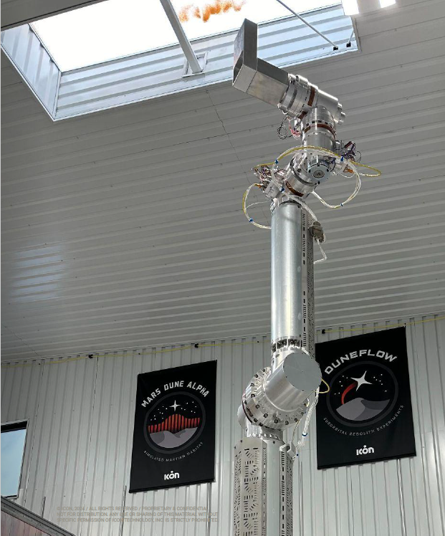
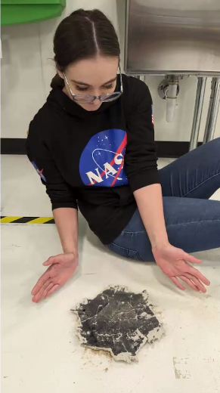
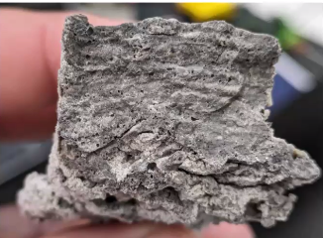
MMPACT Technical Progress and Results
Project Start
7/1/20
Accomplishments 9/25/23-2/22/24
ICON Olympus (Off-Planet Systems) Team grew to 21 people
Terrestrial Arm and Terrestrial Arm Umbilical fabricated
End Effector designed and fabricated
Laser VMX process improvements
Atmospheric adjoined beads
TAPR 1 10/18-19/21
ECO F2F 3/9/22
Redirection 1/5/23
PPR 1 - 3/1/23
PPR 2 - 9/25/23
V20 Test (Task 26) - 3/8/24
PPR 3 - 3/19/24
Left image: Laser VMX cross-section (credit: ICON)
Middle image: ICON’s Valerie Svaldi with a dinner plate-sized VMX sample (credit: ICON)
Right image: Terrestrial Arm at ICON (credit: ICON)
End Effector Subsystem Test - 8/31/24
YOU ARE HERE (APR) – 9/11/24
PPR 4 - 9/16/24
Task 30 DVAC Test Complete – 12/31/24
Phase 1 End - 1/31/25

Slide 6
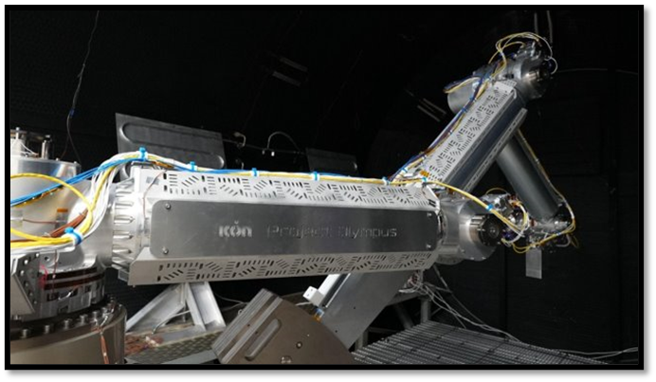
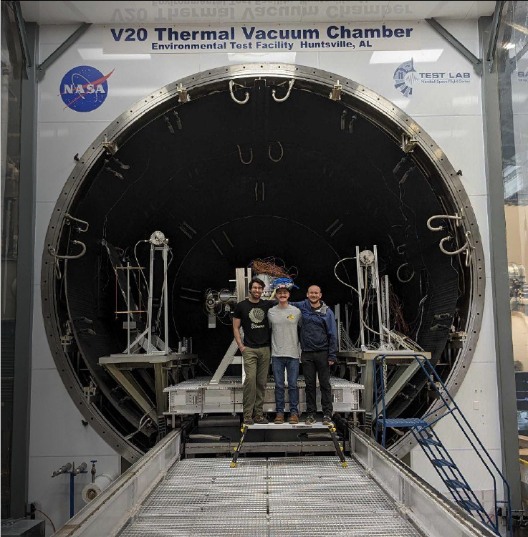
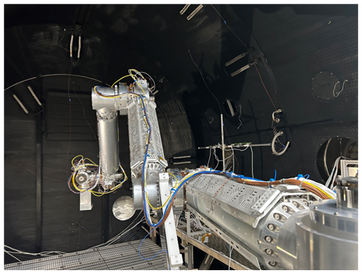
MMPACT Technical Progress and Results
Project Start
7/1/20
V20 Test (TMP Task 26)
Successfully completed an operational/logistical
dress rehearsal
  Lifting/Packing/Shipping
  Arm + Chamber Operations
  Implemented Communication/Command Chain
Verified Terrestrial Arm System Capability in thermal vacuum (TVAC)
  Confirmed electromechanical and software systems will meet Task 30 objectives
  Exercised procedural framework necessary to produce VMX
Verified Terrestrial Arm thermal control system in TVAC
  Ensured thermal control system can maintain acceptable temperatures at the joint output bearings during cold robotic operations
TAPR 1 10/18-19/21
ECO F2F 3/9/22
Redirection 1/5/23
PPR 1 - 3/1/23
PPR 2 - 9/25/23
V20 Test (Task 26) - 3/8/24
PPR 3 - 3/19/24
Top image: Terrestrial Arm in V20 TVAC (credit: ICON)
Middle image: A portion of the ICON V20 Test Team (credit: ICON)
Bottom image: Another view of the Terrestrial Arm in V20 TVAC (credit: ICON)
End Effector Subsystem Test - 8/31/24
YOU ARE HERE (APR) – 9/11/24
PPR 4 - 9/16/24
Task 30 DVAC Test Complete – 12/31/24
Phase 1 End - 1/31/25

Slide 7
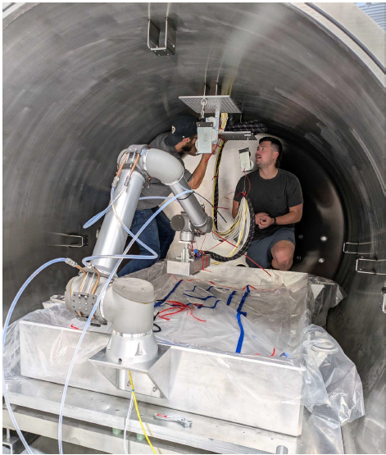
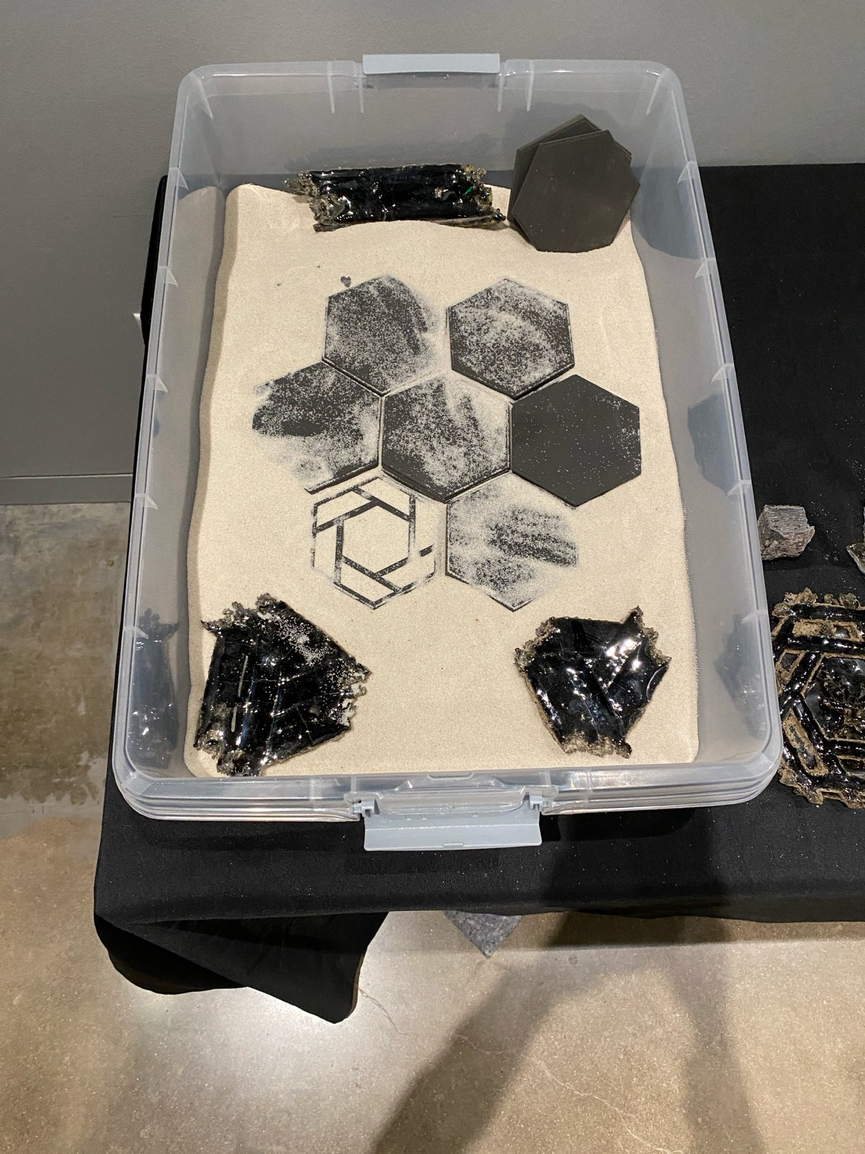
MMPACT Technical Progress and Results
Project Start
7/1/20
Accomplishments 3/9/24-8/30/24
ICON instituted the 78” dirty vacuum chamber (DVAC)
Laser VMX system tested in 78” DVAC
Hexagonal sections of the representative element successfully fabricated by Laser VMX
Bead adjoining demonstrated in vacuum
TAPR 1 10/18-19/21
ECO F2F 3/9/22
Redirection 1/5/23
PPR 1 - 3/1/23
PPR 2 - 9/25/23
V20 Test (Task 26) - 3/8/24
PPR 3 - 3/19/24
Left image: Hexagonal section of the representative element (credit: NASA)
Middle image: “Sandbox” illustrating construction of a representative element (credit: NASA)
Right image: Outfitting a gravity offload system in the 78” chamber (credit: ICON)
End Effector Subsystem Test - 8/31/24
YOU ARE HERE (APR) – 9/11/24
PPR 4 - 9/16/24
Task 30 DVAC Test Complete – 12/31/24
Phase 1 End - 1/31/25

Slide 8
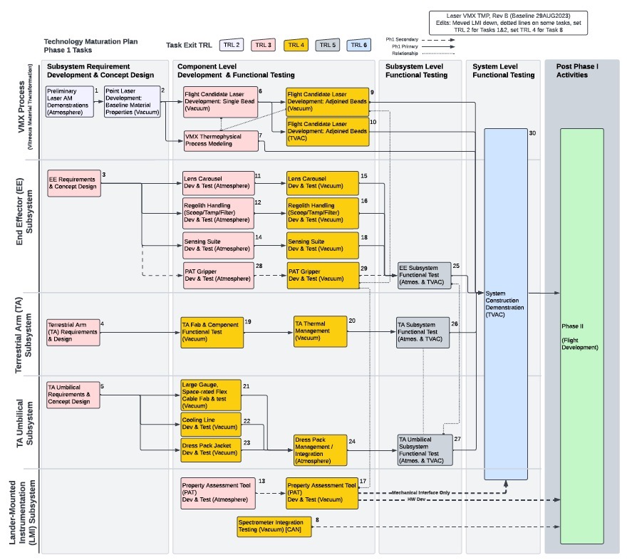
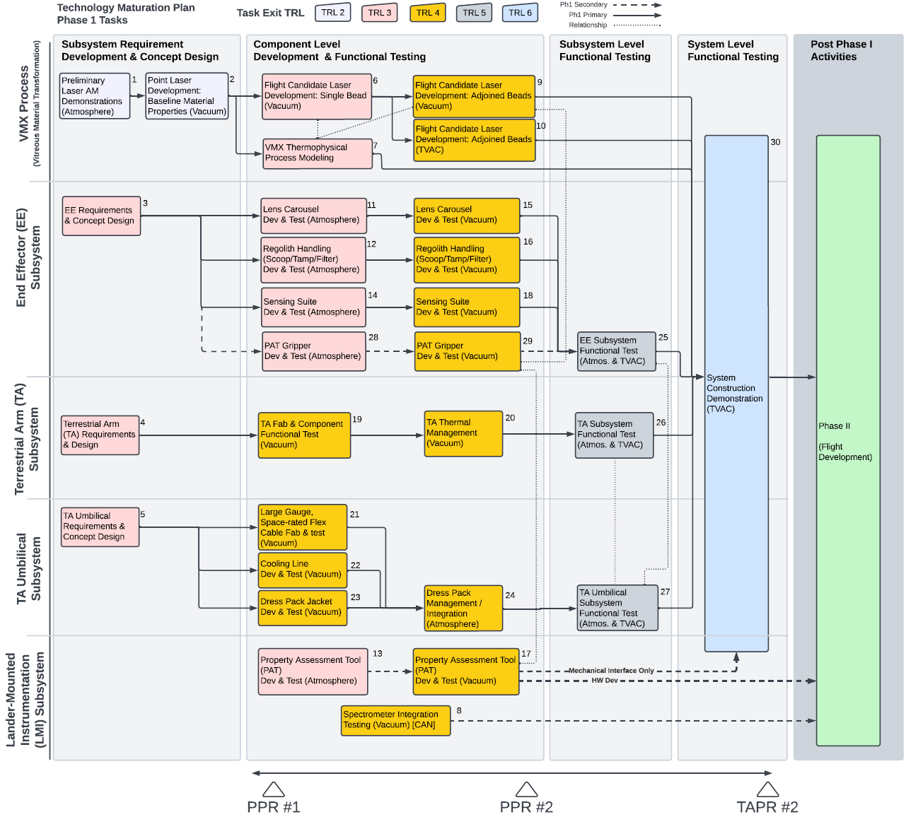
MMPACT Technical Progress and Results
MMPACT is executing TRL progression and Technology Maturation Plan (TMP) tasks as planned
Yellow highlighted tasks are closed
FY23 APR
FY24 APR

Slide 9
MMPACT Transition/Infusion Status
MMPACT Phase 1 technology maturation will conclude in FY25, and MMPACT will pursue the LIFT-1 opportunity for flight system development
The MMPACT technology is targeting launch/landing pads as the first infrastructure element to be emplaced on the lunar surface – Human Lander Systems is a target for MMPACT technologies
Ultimately, the target of the MMPACT technology is infusion into ESDMD/Artemis, providing laboratory structures for academia, and commercialization for industry members interested in the lunar economy
Towards this plan:
  The MMPACT Team has demonstrated the capability for Laser VMX scalability in vacuum
  The MMPACT Team is leaning forward towards a lunar mission by minimizing hardware mass and volume
  The MMPACT Team has discussed landing pad needs with major lander providers

Slide 10
MMPACT Assessment Summary
Project Name | Performance |  |  |  | Comments
 | C | S | T | P
Annual | G | Y/G | Y | Y/G | Technical – Yellow due to significant technical risks the team is working to mitigate in the coming months as the project works to the new baseline Cost – Green Schedule – Yellow/green as margins are tight (slack measured in days) Programmatic – Yellow due to technical risks and green due to team commitment
 | Oct | Nov | Dec | Jan | Feb | MYR | Apr | May | Jun | Jul | Aug | APR
C
S
T
P
Significant yellow portions of the charts were related to the slip in schedule due to lessons learned in Task 26. Applying these lessons learned to Task 30 increased the schedule needed to complete Technology Readiness Level maturation. The MMPACT Team approached the Game Changing Development Program’s Program Office to provide guidance – the guidance was received and implemented. Technical risks will be mitigated by the end of December, at which time the status of all performance metrics will change to green.

Slide 11
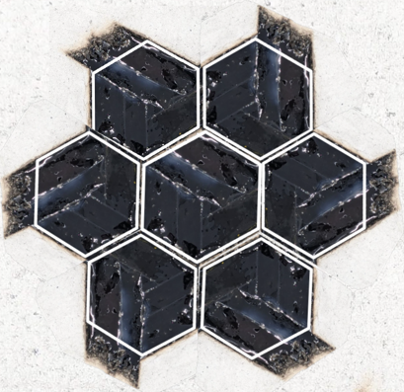
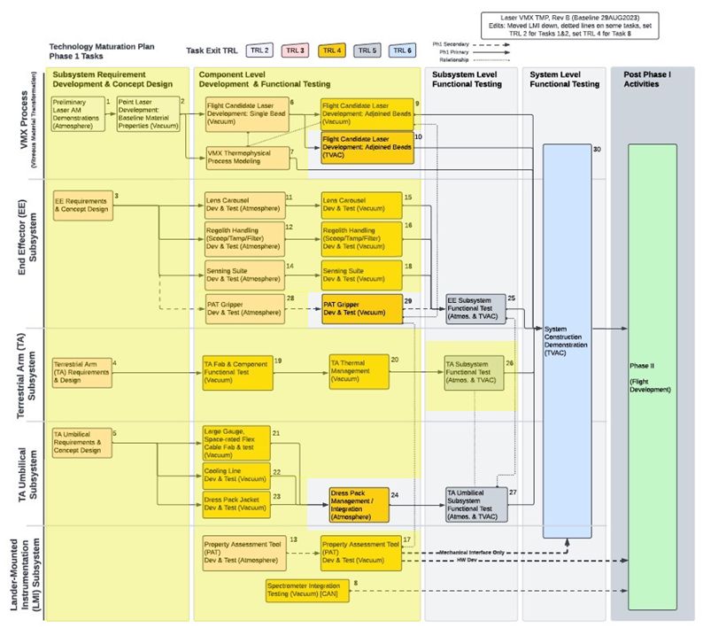
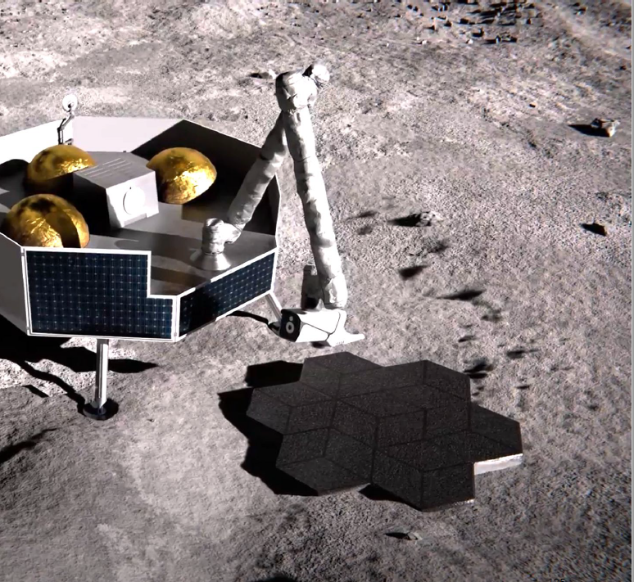
MMPACT Summary
The MMPACT Team has successfully closed 77% of its Technology Maturation Plan tasks
The MMPACT Team has demonstrated the capability for Laser VMX scalability in vacuum
The MMPACT Team is leaning forward towards a proof-of-concept lunar mission (e.g., LIFT-1) by minimizing hardware mass and volume
The MMPACT Team continues to target launch/landing pad construction
The MMPACT Team will seek continued funding for technology development and maturation

Slide 12
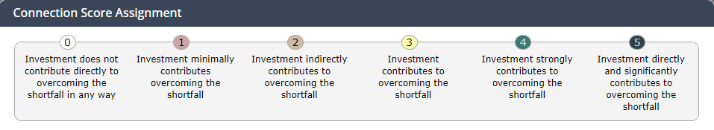
MMPACT Tech Base Connections – 1 of 2
STMD Realignment Crosswalk
Live: Sustainable Exploration
Live LSII Surface Excavation and Construction
Live
Surface Structures and Construction
Shortfall Linkages and Connection Scores
Shortfall ID | Linked | Capability Area | Shortfall Title | Project Connection Assessment Score | Project Connection Assessment Rationale
1491 | Y | MANU (Advanced Manufacturing) | Additive Manufacturing of Large-Scale Components | 4 | MMPACT is an early, first, step to demonstrating AM on the lunar surface, focusing on horizontal surface construction. Lessons from MMPACT will be critical to scale-up for large-scale AM.
416 | Y | AMSC (ECO) | Deposition of construction materials in low-pressure environment while controlling porosity | 5 | Controlling porosity during the VMX process is critical to achieving the required mechanical properties of deposited material. MMPACT tailors the VMX process to control porosity in a variety of environmental conditions.
1293 | Y | AMSC (ECO) | In-situ construction of launch/landing pads | 5 | A primary focus of MMPACT is to develop construction technology for LLP’s. MMPACT’s VMX process has produced, in-situ, construction materials and tested for mechanical properties and exposed to an emulated engine plume using a plasma torch and measured little erosion..
1486 | Y | MANU (Advanced Manufacturing) | In Space and On Surface NDE and Qualification of Components for Manufacturing, Assembly, and Construction Description | 4 | MMPACT has developed, and continues to refine, process modeling software to guide the parameterization of the VMX process. Material property measurement on VMX produced samples anchor this model. MMPACT is developing analysis techniques to assess regolith and product composition using a spectrometer and mechanical properties of VMX produced samples using a Property Assessment Tool.
1492 | Y | MANU (Advanced Manufacturing) | Materials and Process Modeling for In Space and On Surface Manufacturing | 5 | MMPACT has developed, and continues to refine, process modeling software to guide the parameterization of the VMX process. Material property measurement on VMX produced samples anchor this model. MMPACT will use in-situ resources to produce infrastructure on the lunar surface.

Slide 13
MMPACT Tech Base Connections – 2 of 2
STMD Realignment Crosswalk
Live: Sustainable Exploration
Live LSII Surface Excavation and Construction
Live
Surface Structures and Construction
Shortfall Linkages and Connection Scores
Shortfall ID | Linked | Capability Area | Shortfall Title | Project Connection Assessment Score | Project Connection Assessment Rationale
1584 | N | ISRU | Produce manufacturing and construction feedstock from extracted in-situ resources | 4 | MMPACT has developed the STF which will scoop regolith and filter into useable feedstock for the VMX process
418 | Y | AMSC (ECO) | Materials for Landing / Launch pad structural elements | 5 | MMPACT is testing manufactured materials to plume impingement and evaluating the materials’ structural loading through compressive, tensile, and flexural property measurements.
1545 | N | ASR | Robotic Actuation, Subsystem Components, and System Architectures for Long-Duration and Extreme Environment Operation | 3 | MMPACT has developed a 6 DOF robotic arm technology demonstration system with multiple actuators and motors , tested in a Dirty Thermal Vacuum Chamber. When MMPACT proceeds into flight hardware development, the design for the arm will be optimized for the lunar surface environment.
666 | Y | AMSC (ECO) | On-Surface In-situ Construction of Horizontal Structures | 5 | A primary focus of MMPACT is to develop construction technology for LLP’s, roads, walkways, and berms.
369 | N | ECO | Excavation of granular (surface) regolith for ISRU commodities production | 5 | MMPACT has developed a Scoop, Tamp, Filter (STF) device enabling surface and sub-surface regolith to be excavated and filtered prior to delivery for manufacturing
662 | N | ECO | Robotic regolith manipulation and site preparation | 5 | MMPACT has developed the STF, which is an early, first step in site preparation and regolith manipulation.

Slide 14
MMPACT Highlights/Accomplishments
Title | Type | Element | Description | New Image for EPO | Highlight Submitted
Duneflow | Status |  | The Duneflow payload is currently in storage and the team is awaiting an announcement of a flight date from Blue Origin. | No
Periodic Project Review 2 | Milestone |  | The Periodic Project Review 2 took place at ICON’s facility in Austin TX on 9/25/23. | To be submitted by 10/13/23
GCD Annual Program Review (APR) | Status |  | The MMPACT Project Manager provided the year-end status of the MMPACT project at the GCD APR. Additionally, the NASA/ICON team provided and manned an exhibit booth during the review. | No
Property Assessment Tool (PAT) | Status |  | Kratos/Southern Research Engineering (KSRE) has been contracted to provide requirements and a conceptual design of a PAT, working closely with ICON for the interface design. The contract was finally awarded on 9/29/23, and the period of performance is 6 months. | No
Materials and Processes Study Report | Status |  | The final report from KSRE has been provided, and the final draft was provided on 9/22/23. | No

Slide 15
MMPACT Highlights/Accomplishments
Title | Type | Element | Description | New Image for EPO | Highlight Submitted
Cooperative Agreement Notice (CAN) Award | Status |  | A Cooperative Agreement Notice with Northwestern University for the research needed to define the requirements of a Raman spectrometer system that can determine glass content of regolith and calcium content of feldspar minerals (two materials that have the greatest effect on the Laser VMX system) was awarded 10/10/23. | No | No
ICON Visit with MSFC V20 Test Crew | Status |  | MMPACT ICON members traveled to MSFC for a meeting with the V20 crew to discuss the test plan and logistics including shipping, moving the robotic arm into the chamber, feed-throughs, and cable lengths10/30/23-10/31/23. | No | No
MSFC Upcoming Visit to ICON | Status |  | MMPACT MSFC members will travel to ICON for a meeting to discuss V20 Test 1 11/14/23. The meeting will further discuss the test plan, logistics, and schedule. | No | No
NSF Award Notice | Status |  | Louisiana State University won an award from the National Science Foundation (Award ID 2327469) to continue studying different aspects of sulfur-regolith construction 3D printing. This material is a “toolbox” construction material that MMPACT is not funding directly but continues to monitor for the potential to infuse it later in its maturation. | No | No
Artemis 2 Documentary | Status |  | Corky and Jennifer had a meeting with Wall to Wall Productions about potentially highlighting MMPACT in their Artemis 2 documentary. Filming would likely occur in the February timeframe at MSFC. | No | No

Slide 16
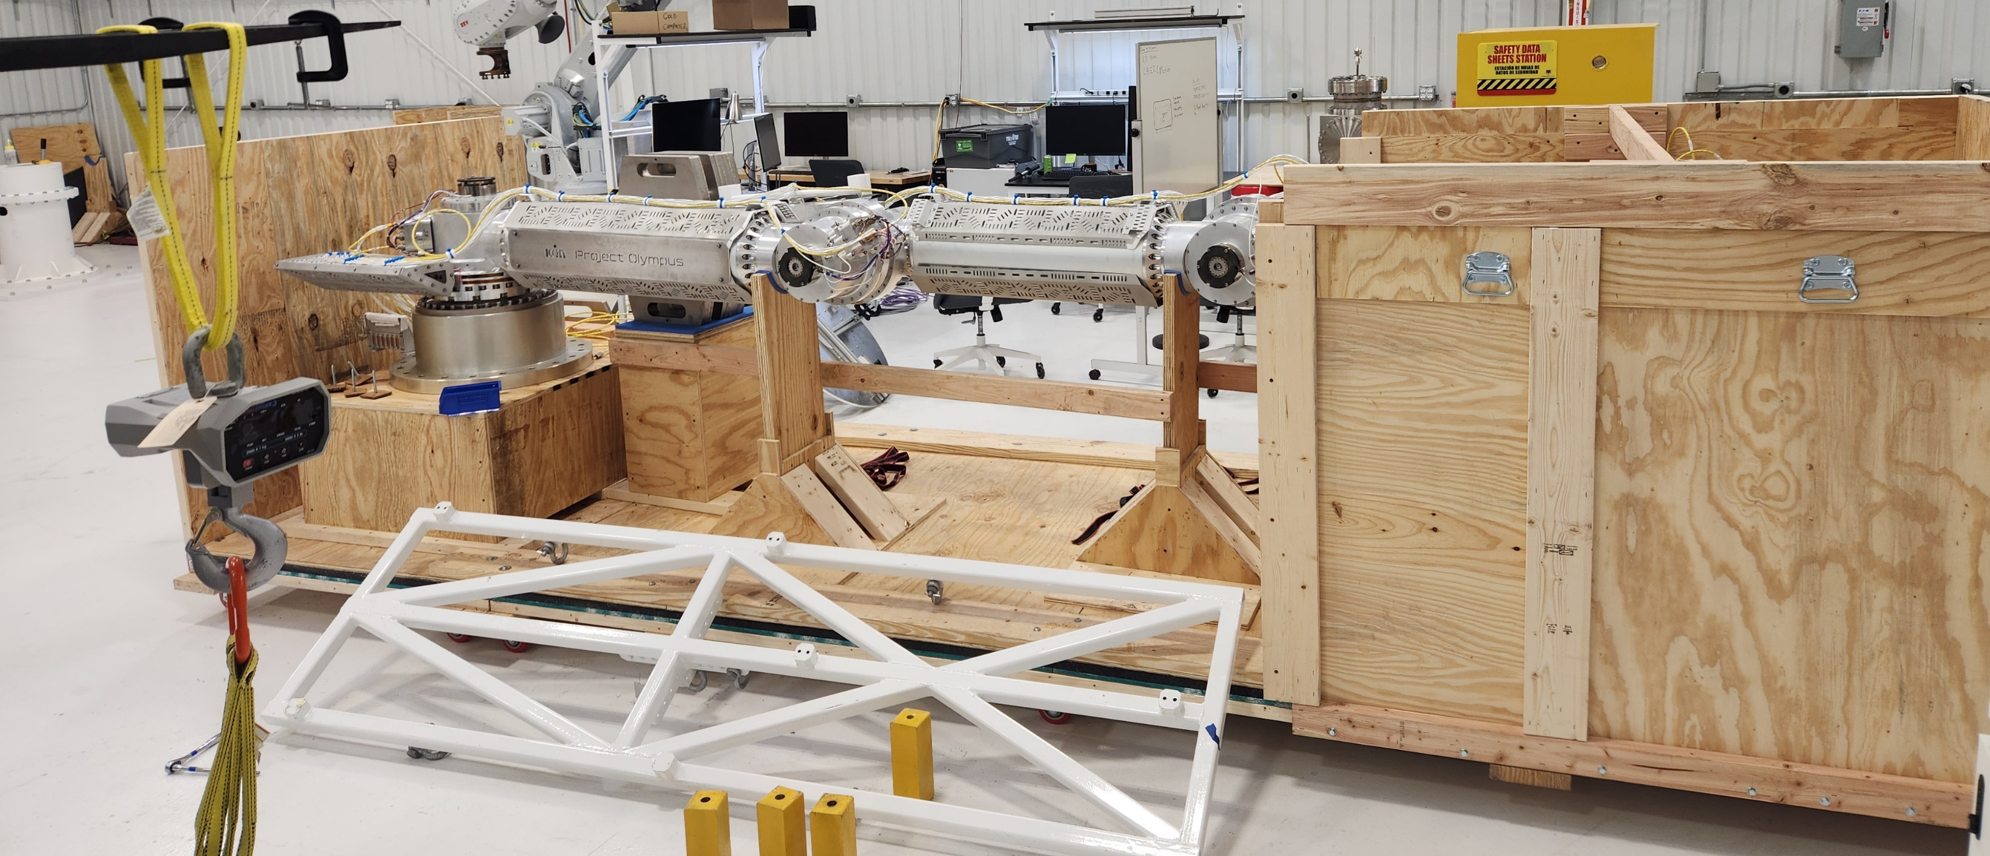
MMPACT Highlights/Accomplishments
Title | Type | Element | Description | New Image for EPO | Highlight Submitted
V-20 Testing | Meeting |  | Members traveled to ICON for a detailed discussion on first V20 test on November 14. A complete review of the logistics, schedule, and draft test plan occurred. The next step is to finalize the test plan and send it for signature/approval, as well as have a Test Readiness Review (TRR). | No | No
V-20 TRR | Status |  | V-20 Test Readiness Review (TRR) was held this month, 1/25/2024, with V-20 testing of ICON’s robotic arm currently scheduled for February 12 through March 4. The team has had numerous meetings on schedule and logistics in preparation for the V-20 test. | No | No
V-20 TRR | Status |  | Shipment and packing of the TA began at ICON the week of 1/29/2024, for delivery to MSFC on the morning of 2/5/24, for scheduled V-20 testing. | Yes | No
IMAGE CREDITS: ICON

Slide 17
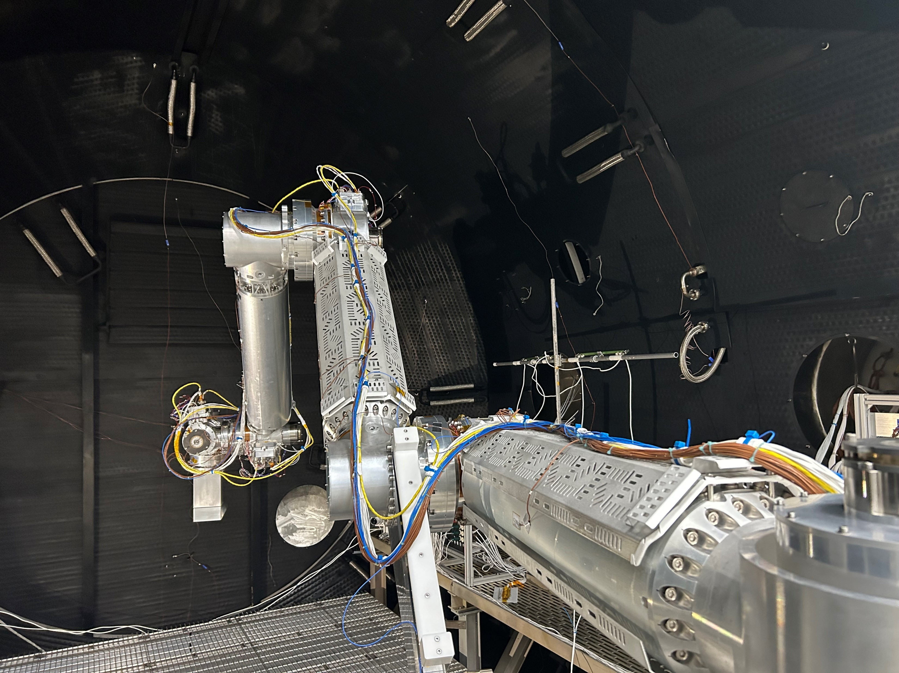
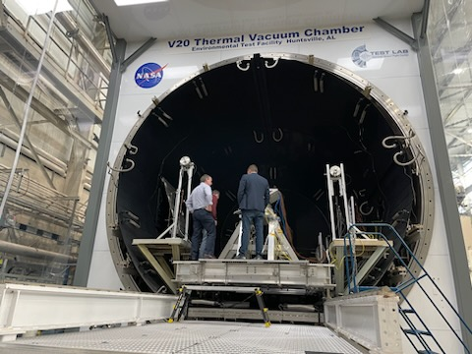
MMPACT Highlights/Accomplishments
Title | Type | Element | Description | New Image for EPO | Highlight Submitted
PPR3 | Status |  | Preparations and working meetings have begun to coordinate the MMPACT Periodic Project Review 3 to be held in Austin, TX on March 19th. Dry-Run to be held March 13th. | Yes | Yes
Published Recognition | Highlight |  | MMPACT Team member Mike Fiske was pictured in an ESIP STMD Media segment, while he supported an ESIP leadership visit to MSFC. | Yes | Yes
IMAGE CREDITS: ICON
IMAGE CREDITS: ICON

Slide 18
Accomplishments
  Laser VMX Development: Samples at PPR3 March 2024

Slide 19
MMPACT Highlights/Accomplishments
Title | Type | Element | Description | New Image for EPO | Highlight Submitted
TMP Task | Closure |  | Task 8: Spectrometer Integration Testing (Vacuum) No | No | N0
TMP Task | Closure |  | Task 26: TA Subsystem Functional Test (Atmosphere and DTVAC) – Final analysis reports and closures shown in ECBs 4/16 and 4/30 | No | No
Risk Mitigation | Closures |  | As of January 2024, we have closed Risks 24, 38, 40, and 50 | No | No
Schedule | Updates |  | Some of the MSFC MMPACT Leadership team traveled to the ICON facility, in Austin, TX, to begin discussion of the future schedule (4/18-4/19) | No | No

Slide 20
MMPACT Highlights/Accomplishments
Title | Type | Element | Description | New Image for EPO | Highlight Submitted
Pending Change Request | Programmatic |  | On 5/9/24, MMPACT Leadership presented three options to the GCD Project Office regarding a change request impacting scope, schedule, and cost. The team received a response on 6/5/24 and following receipt of additional guidance, an official change request will be submitted. | No | No
Risk Retired | Closure |  | Risk 51 was closed out upon the receipt of the 78’’ TVAC chamber | No | No
TMP | Milestone |  | Completed development of Sulfur Concrete Technology Maturation Plan (TMP) Summary. | No | No
Risk Retired | Closure |  | Washington Mills has delivered all remaining NUW-LHT-5M to MSFC. The risk associated with simulant availability for MMPACT has been closed/retired as of 4/23/24. | No | No

Slide 21
MMPACT
Project description: | Lunar Construction Technology Development | Current TRL: 4
Cost:
Y | Y | G
Schedule:
Y | Y | Y/G
Monthly Trend
Monthly Trend
Cost has returned to green. No further additional funding from GCD is anticipated beyond what has already been approved for MMPACT. Procurements in work, and the team is firming up plans for FY25 funds to accommodate Option 2.
Schedule is yellow/green as margins are tight. The schedule has been re-baselined (6/18/24) to reflect the Option 2 schedule. The scheduled completion of the current Technology Maturation Plan (for Laser VMX) is 1/31/25.
Technical:
G | G | Y
Programmatic:
Y | Y | Y/G
Monthly Trend
Monthly Trend
The technical status has been elevated to yellow because there are significant technical risks the team will have to mitigate in the coming months as the project works to the new baseline.
Programmatic is yellow because of the technical risks associated with the Option 2 route and the schedule margin being very slim, and green because of the significant effort of the team over the last few weeks to resolve the schedule, confirm adequate budget, and flesh out the remaining technical tasks. The team is committed to a successful Task 30 demonstration by the end of the calendar year.
21
Notes:
Project Manager’s Assessment Chart
Provide a brief 1 or 2 line description of the Project and the Current TRL
Provide a monthly assessment for each area Cost, Schedule, Technical, and Programmatic (top right corner of each section). Do not change the colors for previously reported months
Red: Challenge or risk requires program support
Yellow: Challenge or risk can be managed within the project
Green: All project performance is satisfactory
Primarily focus on notable achievements or challenges your Project would like to highlight for awareness in that month
Portfolio Projects: Just speak to the ones that are yellow/red – speak to the specific element that has issues…

Slide 22
MMPACT Technical Assessment
Technical Elements | TRL |  |  |  | AD²
 | Entry | Current¹ | Exit | Verification | Entry | Current
VMX Process | 2 | 4 | 6 | Task 30 | 6 | 4
End Effector (EE) Subsystem | 2 | 4 | 6 | Task 30 | 5 | 5
Terrestrial Arm (TA) Subsystem | 2 | 5 | 5 | Closed⁴ | 5 | 5
TA Umbilical Subsystem | 2 | 4 | 4 | Closed⁴ | 5 | 5
EE Umbilical (new)⁵ | 3 | 4 | 5 | Task 30 | 4 | 4
Notes:
VMX Process changed from MRL to TRL, per discussion with GCD CE on 5/10/2024.
PAT removed from table, per discussion with GCD CE on 5/10/2024.
Current TRL values updated in discussion with GCD CE on 5/10/2024.
Element removed from plan at current TRL due to GCD decision on 6/5/24.
Element added to plan due to GCD decision on 6/5/24.
Date of last Technical Assessment was 7/10/24

Slide 23
MMPACT Key Performance Parameter (KPP) Status
Key Performance Parameters
Parameter | Units | State of the Art (SOA) | Threshold | Goal | Current Value To Date | Verified By: | Current State⁶
KPP 1: Compressive strength of lunar construction materials | MPa (psi) | N/A | 17.2 (2,500) | 27.6 (4,000) | 350 | Test | To be confirmed in Task 10
KPP 2: Flexural strength of lunar construction materials¹ | MPa (psi) | N/A | 1.72 (250) | 2.76 (400) | 37.9 | Test | To be confirmed in Task 10
KPP 3: Process energy efficiency² | cm³/MJ (in³/kW-hr) | N/A | 13.7 (3.0) | 27.3 (6.0) | 18 | Test | To be confirmed in Task 30
KPP 4: Demo pad print geometry³ | cm L x cm W x cm T (in. x in. x in.) | N/A | 30 x 30 x 2.5 (~ 12 x 12 x 1) | 60 x 60 x 5 (~ 24 x 24 x 2) | 60 x 60 x 5 | Demonstration | To be confirmed in Task 30
KPP 5: Survivability of material to lunar diurnal cycling⁴ | Cycles (years) | N/A | 13 (1) | 195 (15) | 13 | Test | To be confirmed in Task 10
KPP 6: Lander plume heat flux resistance⁵ | MW/m² | N/A | 3.0 | 6.0 | 3.0 | Test | To be confirmed in Task 10
Notes: The threshold is based on the strength of residential concrete and the goal is based on the strength of commercial concrete. Both the threshold and goal will be updated in future revisions of the document as laser-processed material properties are measured and reported. Evaluating metric based on surface area-based efficiency for demonstration article to account for topology optimized design concept. Confirm size is sufficient to demonstrate scale-up capability using topology optimized design concept. Project is assessing compression strength after thermal cycling. Additional assessments to be tied to functional structural requirement in Phase II. Future discussion required to select lander and number of launches/landings. Task number references the MMPACT/ICON Technology Maturation Plan. KPP closure will be documented in the MMPACT ECB/PCB on 1/7/2025.

Slide 24
MMPACT Milestone Status
Milestone Title (Mirror Project Plan) | Baseline Date | Current Approved Date | Actual/ Planned Date | Complete? | Variance Explanation
Periodic Project Review 2 (Controlled, C3) | 9/30/23 | 9/30/23 | 9/25/2023 | X | Completed on plan
Terrestrial Arm and Umbilical Subsystem Tests (Controlled, C4) | 3/31/24 | 3/31/24 | 3/15/24 | X | Completed on plan
Periodic Project Review 3 Package Delivery (Key, K5) | 3/31/24 | 3/31/24 | 3/15/24 | X | Completed on plan
Periodic Project Review 3 (K6) | 3/31/24 | 3/31/24 | 3/19/24 | X | Completed on plan
Upcoming
End Effector Subsystem Test (C5) | 8/31/24 | 8/31/24 | 9/3/24
Periodic Project Review 4 (K7)​ | 9/16/24 | 9/16/24
Engineering Development Hardware System Demonstration (C6)​ | 12/31/24 | 12/31/24
Periodic Project Review 5 Package Delivery (K9)​ | 1/21/25 | 1/21/25
Engineering Development Hardware System Demonstration Test Report (K8)​ | 1/28/25 | 1/28/25
Periodic Project Review 5 (C7)​ | 1/31/25 | 1/31/25

Slide 25
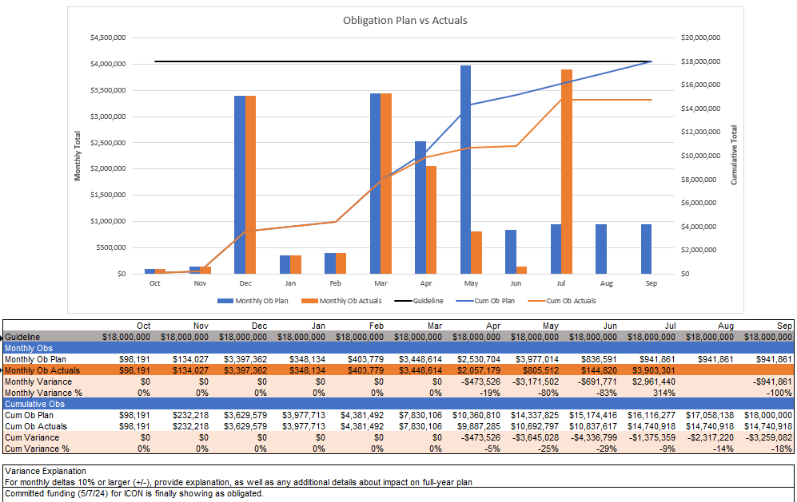
MMPACT Phasing Plan and Variance Explanation

Slide 26

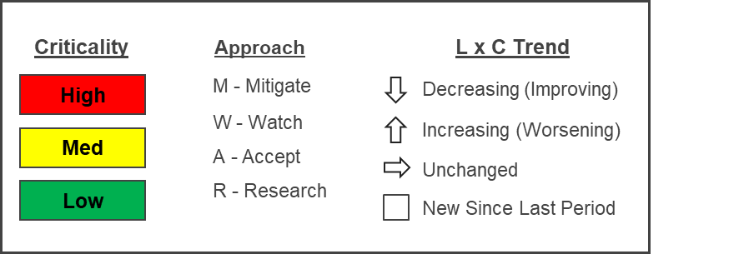
Phase 1 Top 5 Risks
L
I
K
E
L
I
H
O
O
D
5
 |  | 55 58 59 | 56
 |  | 57
Risk ID | Description | Approach | Trend
56 | End Effector Complex Thermal Environment | M
59 | Single Point of Failure in Critical Testing Equipment | W
58 | ICON Workforce and Tasking | W
55 | System Construction Demonstration Delay | W
57 | KPP Closure Sample Production Delay | M
4
3
2
1
1
2
3
4
5
CONSEQUENCES

Slide 27
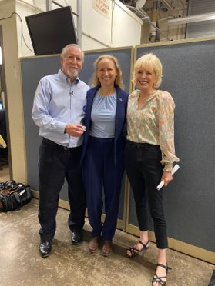
Education/Public Outreach
EPO Involvement
The MMPACT PI and PM were interviewed for an article published by the New York Times entitled “Maybe in Your Lifetime, People Will Live on the Moon and Then Mars”. The article appeared in the paper on 10/1/23.
60 minutes aired a special on 10/8/23 regarding ICON and NASA participation in surface construction.
NASA Plans to Build Homes on the Moon by 2040 (marthastewart.com) – MMPACT Project Manager, Jennifer Edmunson, was quoted from the Times article mentioned above.
The MMPACT Construction Materials Development Lead is chairing a session at the International Conference on Advanced Manufacturing in Washington, DC (10/30/23 – 11/3/23).
Visit from 60 Minutes crew, Interviewed 8/3/23​, Aired October 8th, 2023
L-R: Corky Clinton, Jennifer Edmunson, Lesley Stahl
Notes:
Summary of the EPO activities (papers, conferences, outreach events) participated in over the last 6 months and the forward outlook for 6 months

Slide 28

Education/Public Outreach
EPO Involvement
Jennifer Edmunson, PM, pictured speaking right, spoke to over 300 individuals attending the ‘Marshall Center Brown Bag’ session, focusing “The Moon, Simulants, ISRU, and MMPACT”, on November 7th
MMPACT highlighted in a NASA article,
“Going Beyond the Challenge for New and Continued Success – NASA”
for its partnership with ICON in working towards construction projects on
the moon November 7th
MMPACT PM, Jennifer Edmunson, spoke at the MSFC hosted event
“Adventure in Engineering “ to about 400 high school aged students
November 8th
WHNT News did an interview and wrote an article on MSFC working to
Bring surface construction to the moon. Interviewing Corky Clinton, PI and
Jennifer Edmunson, PM, where they discussed some of our plans for manipulating the moon materials to assist us in further lunar advancements, lunar construction, on the moon, November 24th
PM, Jennifer Edmunson, Highlighted in the Marshall Star for the success of the MSFC Brown Bag session, the largest audience the Brown Bag event has ever seen. November 29th
Notes:
Summary of the EPO activities (papers, conferences, outreach events) participated in over the last 6 months and the forward outlook for 6 months

Slide 29
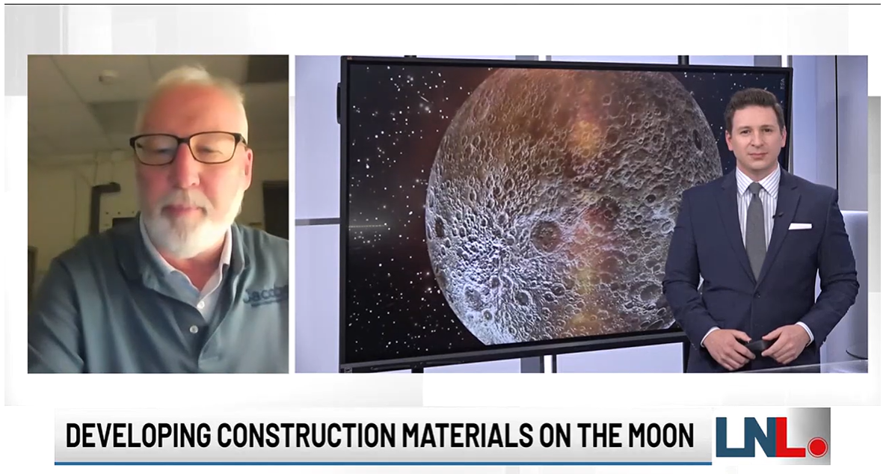
Education/Public Outreach
EPO Involvement
MMPACT team member Mike Fiske chaired as a jury member for the final stage review of 3D developments at Penn State. Which focused on concrete printing to help revitalize Oil City 12/7/23.
MMPACT team member Mike Fiske is planning to conduct a demonstration print of the upgrades made to the gantry system for the Lunar Pad student visit, 1/17/24.
MMPACT E/PO Lead, Richard Fischer, represented MMPACT at the Moon Village Association Meeting in Kurashiki, Japan, 12/7-8/23.
MMPACT Construction Technologies
Development Lead, Mike Fiske, was interviewed by
Local News Live, pictured right, regarding
collaboration with Louisiana State University
professor Ali Kazemian on the use of sulfur concrete
for terrestrial and Extraterrestrial applications.
LNL: Moon Construction Materials Project
(graydc.com)
Notes:
Summary of the EPO activities (papers, conferences, outreach events) participated in over the last 6 months and the forward outlook for 6 months

Slide 30
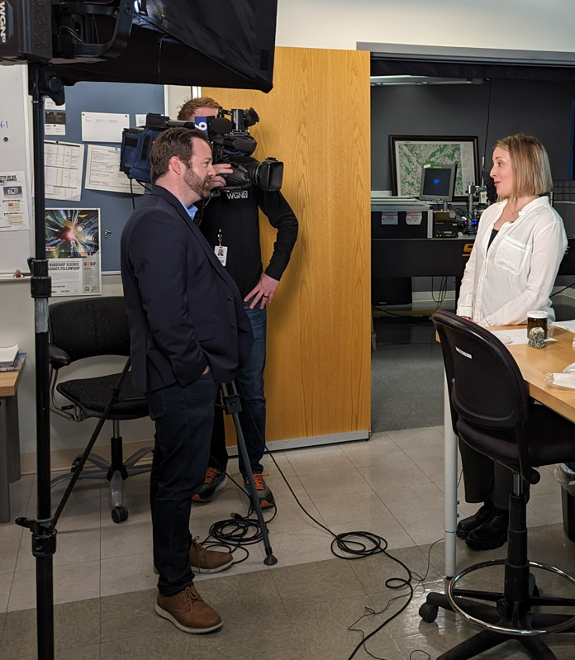
Education/Public Outreach
EPO Involvement
4/3/24 - The Northwestern Weinberg College of Arts and Sciences wrote and article ”Examining Lunar Soil for Moon Based Construction”, which detailed the partnership NASA has with ICON, specifically the lunar material characterization and analysis work, noting the differences in samples, being performed by ICON’s Katie Koube and Dr. Jacobsen of Northwestern. https://news.northwestern.edu/stories/2024/04/examining-lunar-soil-for-moon-based-construction/
4/12/24 – The Northwestern College published their “Sigma Xi SmartBrief” , newsletter which included the ‘Moon Dust’ research formerly mentioned, interviewed right Laura Gardner giving details of the MMPACT/ICON/Northwestern look a heads and partnerships
Mike Fiske and Jennifer Edmunson co-chaired a session at the American Society of Civil Engineers Earth and Space conference, which took place April 15-18
Laura Gardner
Notes:
Summary of the EPO activities (papers, conferences, outreach events) participated in over the last 6 months and the forward outlook for 6 months

Slide 31
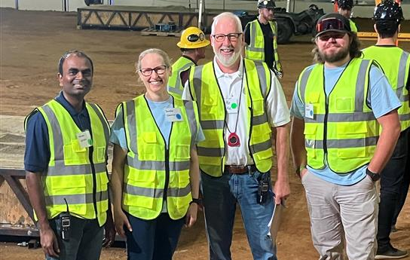
Education/Public Outreach
EPO Calendar Outlook (High Priorities):
6/10-12/2024 – Jaxson Earwood, Mike Fiske, Jennifer Edmunson, and Sierrah Baffa worked to assist in the Break the Ice Lunar Challenge at Alabama A&M’s Agribition Center in Huntsville Alabama. Mike Fiske as a Contest Judge, Jennifer and Jaxson as Ground Support Staff, and Sierrah hosted a MMPACT booth. Pictured right to left you will find Naveen Vetcha (Challenge Manager), Mike Fiske, Jennifer Edmunson, and Jaxson on the contest floor in the middle of two simulated ice regolith concrete bed dig sites.
Notes:
Summary of the EPO activities (papers, conferences, outreach events) participated in over the last 30 days and the forward outlook 30-60 days

Slide 32
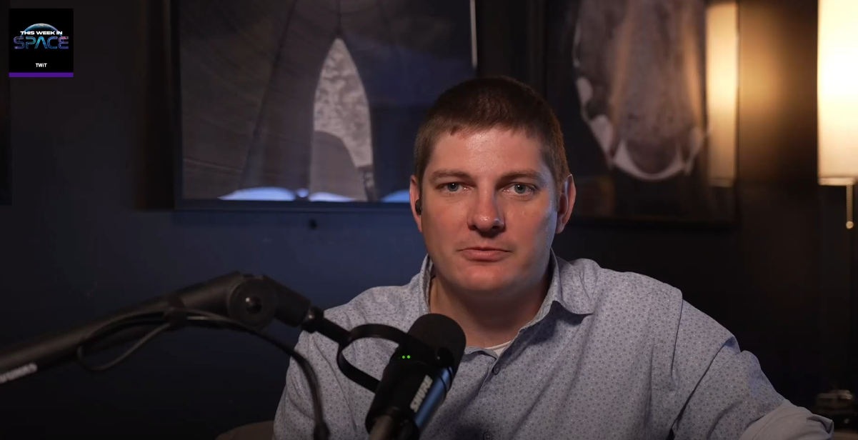
Education/Public Outreach
6/24/24 - Mike Fiske and Jennifer Edmunson were interviewed by a writer for Cadalyst Magazine, who is working on a two-part article on surface construction. 6/28/24 - Evan Jensen of ICON completed a This Week in Tech podcast entitled “3D-Printed Moon Bases with ICON” which can be found via this link: A Home on the Moon (twit.tv). (Pictured Right) 7/7/24 – Re-Airing of MMPACT’s 60-Minutes Episode, which has stirred additional good publicity.
Notes:
Summary of the EPO activities (papers, conferences, outreach events) participated in over the last 30 days and the forward outlook 30-60 days

Slide 33
Cover Slide Annotate Images
Annotated Cover Slide Images
Laser VMX Sample
ICON’s 78” Chamber
Image Credit: ICON
Laser VMX Testing
Photo Credit: ICON
Arm moving simulant in bed at ICON
Photo Credit: ICON
Laser VMX
Photo Credit: ICON​
First Prototype of Lens Carousel
Photo Credit: ICON
Notes:
MAKE SURE THE PICTURES HAVE BEEN APPROVED BY YOUR CENTER FOR PUBLIC RELEASE
Provide an annotated description of the project images on the front cover slide

Slide 34
MMPACT
System Construction Demonstration Delay – Jennifer Edmunson/MSFC
Approach: Watch
Risk ID 55
Categorization
Phase 1
Trend
Criticality
Current LxC
3x3
Affinity Group
Programmatic/ Technical
Planned Closure
12/31/2024
Open Date
03/04/2024
Risk Statement:
Given the complexity of the System Construction Demonstration (Technology Maturation Plan (TMP) Block 30), there is the possibility that the test completion date may be delayed due to technical and/or programmatic issues, resulting in the schedule slipping past the current Game Changing Development (GCD) program milestone and grace period.
Context:
The ICON team will need to factor in/implement the lessons learned from TMP Task 26 into Task 30. Additionally, lessons learned from integration of the terrestrial arm, terrestrial arm umbilical, and V20 chamber are not directly applicable to the UR10 robotic arm and the 78” chamber at ICON; lessons learned would need to be adapted for the new environment. Additional margin for general/systems integration issues was incorporated, but margin is slim (i.e., measured in days).
Med
Impact:
The current GCD program-controlled milestone (C6) for the TMP Block 30 test is 12/31/24. Technical and programmatic issues in the run up to or during the test could push the completion past the milestone even with the 1-month grace period given by the Program.
Cost: Per the presentation to the GCD Program Control Board, the cost of additional work at ICON would be paid for solely by ICON. The MSFC team will monitor this risk and prepare additional FTE/WYE margin as able.
Schedule: TBD
Technical: TBD
Status:
08/20/24 – Likelihood reduced from 4 to 3. Project has implemented mitigation steps and strategies that are enabling reduction of likelihood.
07/23/24 – No proposed updates to risk.
06/25/24 – Added Cost and Context wording.
Mitigation Steps | Dollars to Implement | Trigger/ Start Date | Schedule UID | Completion Date | Resulting LxC
Notes:
Prior Status Updates:
03/04/24 – Risk opened; assessed LxC at 4x3. Assigned risk to Jennifer Edmunson/MSFC.

Slide 35
MMPACT
End Effector Complex Thermal Environment – Chris Schad/ICON
Approach: Mitigate
Risk ID 56
Categorization
Phase 1
Trend
Criticality
Current LxC
3x4
Affinity Group
Technical/ Programmatic
Planned Closure
12/19/2024
Open Date
04/23/2024
Risk Statement:
Given that the quantity of 4 lasers in the end effector (EE) have 1) Relatively tightly regulated cooling fluid temperature requirements, 2) Approximately 12 feet of coolant hose (1 way), and 3) Shared coolant fluid with other EE instruments, there is the possibility that the cooling system may not be able to keep the laser diodes (or other EE instruments) at their required operating temperature, resulting in laser(s) and/or instrument(s) degradation or failure in TMP Task 30 testing.
Context:
The complex thermal environment including the TVAC chamber, robotic arm, EE, and Umbilical could create a situation where the cooling system may not be able to maintain acceptable cooling for the laser diodes or EE instrument(s). This could result in laser or instrumentation degradation or failure.
Impact:
Cost: TBD. Due to the Option 2 selection, a majority of the personnel and facility costs are expected to be incurred directly by ICON and not at the MMPACT Project level.
Schedule: TBD. Depending on the nature and timing of the failure, the estimated time from failure onset to returning to nominal testing is expected to be less than 2 weeks.
Milestone: TMP Task 30 (in ICON’s 78” chamber).
Technical: An in-situ repair or slower/degraded test operations could recover all planned test objectives and KPPs.
Med
Status:
08/20/24 – Initial testing to support TMP Task 25 has not revealed any Umbilical-related thermal concerns. LxC unchanged but initial tests indicate downward trend. Thermal-fluid analysis is in-work. Risk title changed from “Terrestrial Arm Umbilical (TAU) Complex Thermal Environment” to “End Effector Complex Thermal Environment”.
07/23/24 – Reworded Mitigation steps 2 and 3; changed Mitigation step 2 planned completion date from 10/03/24 to 08/27/24.
Mitigation Steps | Dollars to Implement | Trigger/ StartDate | Schedule UID | Completion Date | Resulting LxC
Perform analysis to show that expected out-of-chamber coolant water temperature conditioning and flow rate can adequately maintain laser and instrumentation temperatures. |  |  | N/A | 09/01/24 (TBR) | 3x4
Subsystem vacuum testing (EE, and partial Umbilical) as a part of TMP Task 25 EE development. (Date is based on EE 3.0 ECB presentation) |  | 08/12/24 | 2102 & 2245 | 08/27/24 | 2X4
Subsystem testing (UR10, EE, and Umbilical) in vacuum (78” chamber) supporting TMP Task 25, test sample production, and Task 30 preparation.(Reason for C decrease is gained understanding of conops in chamber and KPP sample production all will accelerate recovery from failure.) |  | 08/19/24 | 1267 & 2064 | 10/03/24 | 2X3
The second EE will be maintained as a “hot backup” during TMP Task 30. |  | 11/02/24 | N/A | 11/02/24 | 2X2
Slow or degraded operations – depending on the nature of the failure, it may be possible to achieve test objectives in a degraded but still functional operational state. |  | 11/27/24 | 2390 | 12/20/24 | Retired
System testing (TMP Task 30) in the 78” chamber. |  | 11/27/24 | 2390 | 12/20/24 | Retired
Notes:
Prior Status Updates:
04/23/24 – Risk opened; assessed LxC at 4x4.

Slide 36
MMPACT
KPP Closure Sample Production Delay – Eamon Carrig/ICON
Risk Statement:
Given the decision to use the 78” chamber (with UR10 arm and EE 3.0) for KPP sample production, there is the possibility that issues with the performance of the chamber/system may arise, resulting in schedule slippage as the issues are resolved.
Risk ID 57
Categorization
Phase 1
Trend
Criticality
Current LxC
2x3
Affinity Group
Programmatic
Planned Closure
10/09/24
Open Date
06/25/2024
Approach: Mitigate
Context:
The KPP closure sample production was added scope to the ICON contract. GCD chose Change Request (CR) Option 2 which utilizes the 78” chamber for TMP Task 30. The team made the decision to also use the 78” chamber to accommodate the additional scope. This should allow the samples to be delivered to KSRE and MSFC PTTF by IMS unique ID 2371 delivery date.
Impact:
Cost: ICON will deliver the samples to NASA / Kratos Southern Research Engineering (KSRE) at no additional cost.
Schedule: Downstream dependencies (KSRE testing) will likely enter a day-for-day slip (or worse) and may preclude the inclusion of results in Phase 1 analyses or push out Phase 1 completion.
Milestone: PPR 5
Technical: Until the test results arrive, the project cannot have maximum confidence in the fitness of the materials for the intended use cases or the ability for the project to meet KPPs.
Med
Status:
08/20/24 – Successfully utilizing the 78” chamber for all EE 3.0 and TMP Task 25 related testing. Successful operations indicating downward trend of LxC.
07/23/24 – Mitigation step 2 completed with resultant LxC of 2x3 and downward Trend. Chamber/system commissioning is underway. Major chamber/subsystems are operational (vacuum pumps, robot arm, thermal management system, offload system). Added wording for Cost, Schedule, Milestone, and Technical. Changed Approach from Watch to Mitigate. Deleted Mitigation step 1 and added planned completion dates for Mitigation steps 3, 4, and 5.
Mitigation Steps | Dollars to Implement | Trigger/ Start Date | Schedule UID | Completion Date | Resulting LxC
Complete initial system commissioning. |  |  | N/A | 07/19/24 | 2x3
Complete final system commissioning. |  | 08/29/24 | 2370 | 08/29/24 | 1X3
Produce and deliver pathfinder sample(s). |  | 08/26/24 | 2372 | 09/05/24 | 1X2
Complete production and delivery (ref. IMS UID 2374). |  | 09/26/24 | 2374 | 10/09/24 | Retired
Notes:
Prior Status Updates:

Slide 37
MMPACT
ICON Workforce and Tasking – Eamon Carrig/ICON
Risk ID 58
Categorization
Phase 1
Trend
Criticality
Current LxC
3X3
Affinity Group
Programmatic
Planned Closure
01/31/2025
Open Date
06/25/2024
Approach: Watch
Risk Statement:
Given that ICON has a relatively small technical workforce, there is the possibility that Phase 1 baselined tasks will be impacted by the diversion of critical resources to Phase 1 risk mitigation activities and other corporate priorities resulting in the additional schedule slippage.
Context:
1. GCD has chosen Change Request (CR) Option 2.
2. A commitment from ICON that additional slippage will be absorbed as a No Cost Extension (NCE) has been secured.
Med
Impact:
Cost: ICON will complete Phase 1 activities at no additional cost.
Schedule: An inadequate workforce cannot complete the contemplated work on schedule; the schedule was built for a particular team size and TMP task priority.
Milestone: All remaining TMP tasks and reporting activities (10, 24, 25, 27, 30).
Technical: All remaining technical products.
Status:
08/20/24 – No proposed updates to risk.
07/23/24 – IMS rebaselined with anticipated team size for the duration of Phase 1. Added wording for Cost, Schedule, Milestone, and Technical. Added planned risk closure date of 01/31/25. Due to completion of Mitigation step 1, changed Approach from Mitigate to Watch.
06/25/24 – Risk opened; assessed LxC at 3x4. Risk assigned to Eamon Carrig/ICON.
Mitigation Steps | Dollars to Implement | Planned Completion Date | Schedule UID | Actual Completion Date | Resulting LxC
ICON to use no-core resources to execute risk mitigation activities where practical. |  | 06/25/24 | N/A | 04/30/24 | 3X3
Notes:
Prior Status Updates:

Slide 38
MMPACT
Single Point of Failure in Critical Testing Equipment – Eamon Carrig/ICON
Risk ID 59
Categorization
Phase 1
Trend
Criticality
Current LxC
3x3
Affinity Group
Programmatic
Planned Closure
12/20/2024
Open Date
08/20/2024
Approach: Watch
Risk Statement:
Given that TMP Tasks 10, 24, 25, 27, and 30 will be serially executed in ICON’s 78” Thermal Vacuum chamber, there is a possibility that any failure during the execution of one of the noted TMP Tasks could impact the task execution timeline and push out the project’s Phase 1 schedule.
Context:
    GCD has chosen Change Request (CR) Option 2.
    A commitment from ICON that additional slippage will be absorbed as a No Cost Extension (NCE) has been secured.
    The Project has elected to conduct remaining work in ICON’s 78” chamber to maximize sample validity.
    ICON has procured spares for most system components.
    ICON has hardened the facility against power outages with a UPS capable of affording time for a graceful system shutdown.
    TMP Tasks 10 and 25 can be accomplished with diminished efficacy in alternate smaller TVAC chambers at ICON.
Med
Impact:
Cost: ICON will complete Phase 1 activities at no additional cost to the Project.
Schedule: Should a failure of the system occur, once remaining margin is consumed, the Project would enter a day-for-day slip until critical functionality is restored.
Milestone: All remaining TMP tasks and reporting activities (Tasks 10, 24, 25, 27, 30).
Technical: All remaining technical products.
Status:
08/20/24 – Risk opened; assessed LxC at 3x3. Risk assigned to Eamon Carrig/ICON. Current approach is Watch from Project perspective; however, Mitigation steps are noted if needed.
Mitigation Steps | Dollars to Implement | Planned Completion Date | Schedule UID | Actual Completion Date | Resulting LxC
ICON to vacuumize a second robot arm. |  | 08/22/24
ICON to complete second instances of all EE subassemblies. |  | 11/02/24
ICON to fabricate hot swappable spare harnesses. |  | 09/20/24
Notes:
Prior Status Updates:

