Slide 1

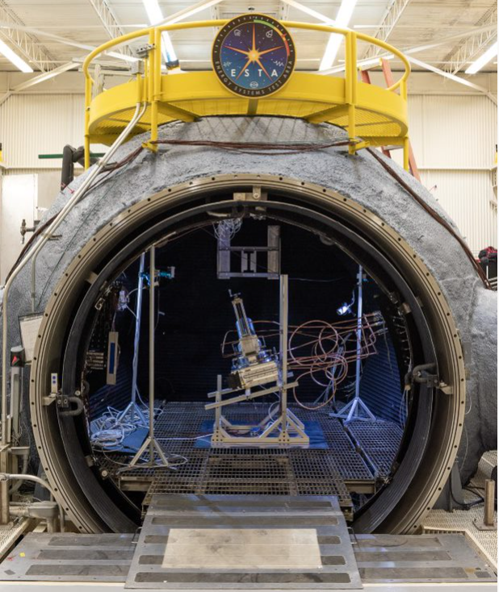
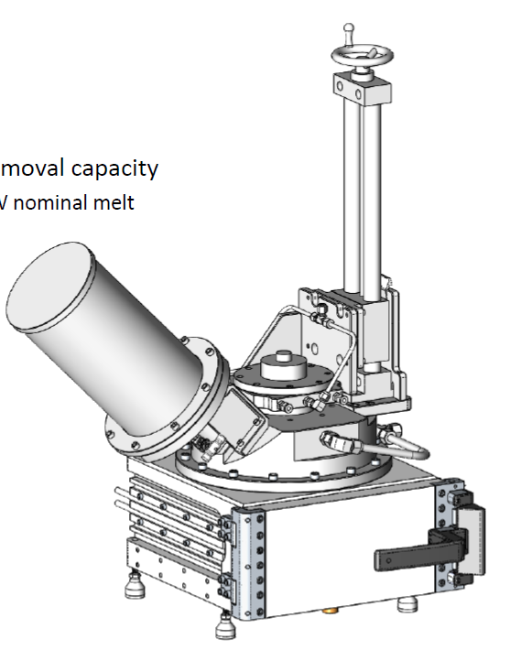
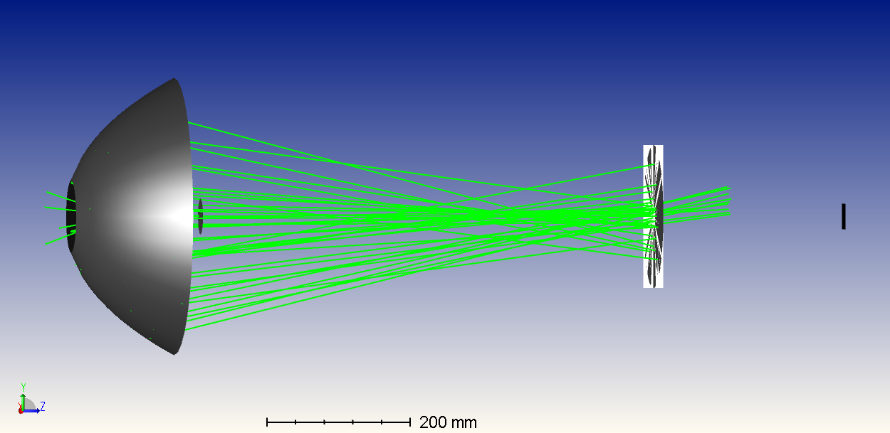
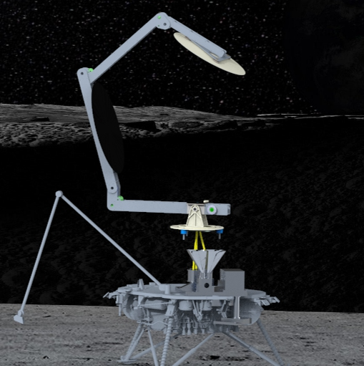
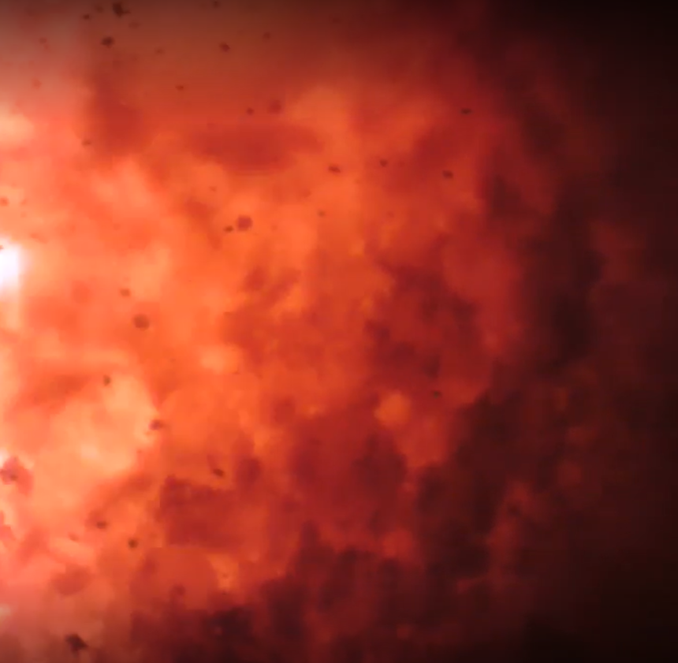
Aaron Paz, Carbothermal Reduction Demonstration| Annual Program Review | September 10-12, 2024

Slide 2
CaRD Overview
Needs Addressed by Project
Artemis | Advancing ISRU technologies could lead to future production of fuel, water, and/or oxygen from local materials, decreasing supply needs from Earth.
Technology Goals & Objectives
Goal #1 | Design, build, and demonstrate performance and efficiency of a prototype solar energy delivery system for a carbothermal reactor.
Objective a. | Demonstrate solar concentrator deployment using prototype avionics and software.
Objective b. | Demonstrate solar tracking using prototype avionics and software.
Objective c. | Collect solar concentrator performance data at Earth operational conditions and using solar flux.
Objective d. | Produce light-weight flight-like concentrator mirrors and integrate them into a deployment and tracking system.
Objective e. | Demonstrate the ability to produce concentrated sunlight at a concentration ratio of ~4000:1 commensurate with the requirements for a carbothermal reactor.
Goal #2 | Integrate solar concentrator, carbothermal reactor, and mass spectrometer to collect Oxygen from Regolith (O2FR) performance and efficiency data.
Objective f. | Collect integrated brassboard performance data under vacuum. Performance data may include thermal management of the reactor and gas analysis accuracy.
Objective g. | Analyze reaction byproducts using a mass spectrometer with hydrogen as the working fluid for carbothermal reaction.
Objective h. | Collect integrated prototype performance data using terrestrial outdoor conditions. Performance data will include optical transmission efficiency and oxygen production efficiency using natural sunlight.
Objective i. | Collect performance data of the partially integrated prototype under vacuum.

Slide 3
Carbothermal Reduction Demonstration
FY22 | FY23 | FY24 | FY25
Prototype Vacuum Test
Integrated Prototype Test
Hydrogen Test
6
Integrated Brassboard Test
5
TRL
Waveguide
Test
4
KCTE-1 Subscale O2FR Demo
KCTE-5 Solar Concentrator to Optical Waveguide/Relay
KCTE-2 Solar Concentrator Subsystem
KCTE-6 Optical Waveguide/Relay to Reactor
KCTE-3 Optical Waveguide/Relay Subsystem
KCTE-7 Reactor Fluid System
KCTE-4 Gas Analysis Subsystem
TRL 4: Component and/or breadboard validation in a laboratory environment
TRL 5: Component and/or breadboard validation in relevant environment
TRL 6: System/subsystem model or prototype demonstration in a relevant environment (ground or space)
TRL 7: System protype demonstration in a space environment
Notes:
Chart purpose: show TRL/SRL/MRL advancement over the project lifecycle schedule. Show TRL advancements as whole integer increases. Show how Key and Controlled milestones align with TRL advancement.
TRL/SRL/MRL may not advance at each milestone. Often several milestones are required to produce a step increase in TRL/SRL/MRL.
There can be one, or more, of these charts per project as needed.
For projects with fewer technical elements, the TRL/SRL/MRL data can be combined on one chart.
For more complex projects, the TRL/SRL/MRL progression can separated into multiple charts by project technical area.
Show TRL, SRL, and MRL data for each technical element on the same chart.
Delete TRL/SRL/MRL axis-labels that do not apply – e.g., remove SRL/MRL for projects/technical areas where SRL and MRL do not apply.

Slide 4
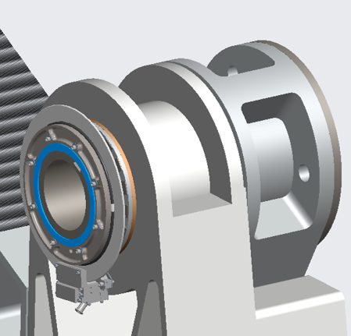
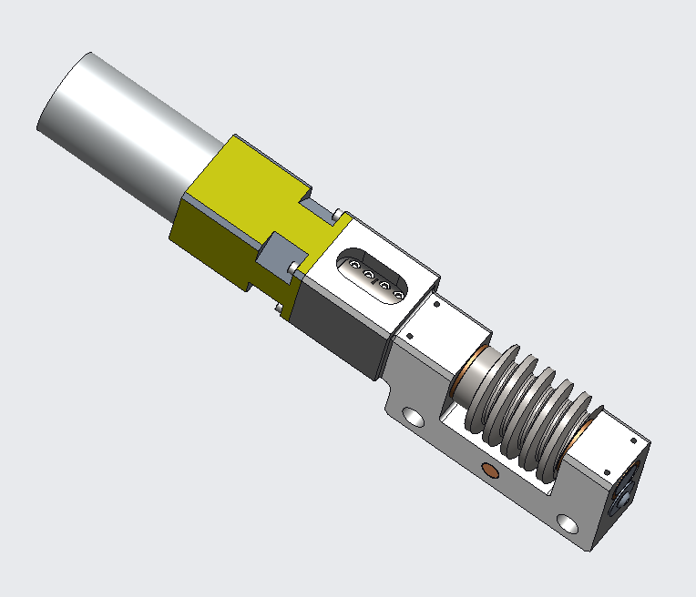
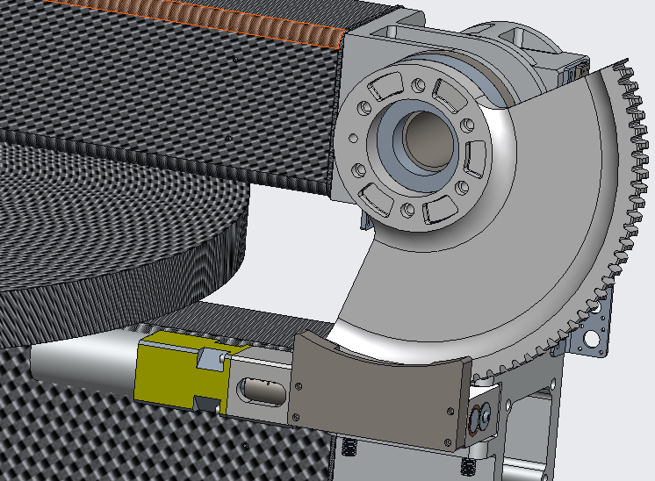
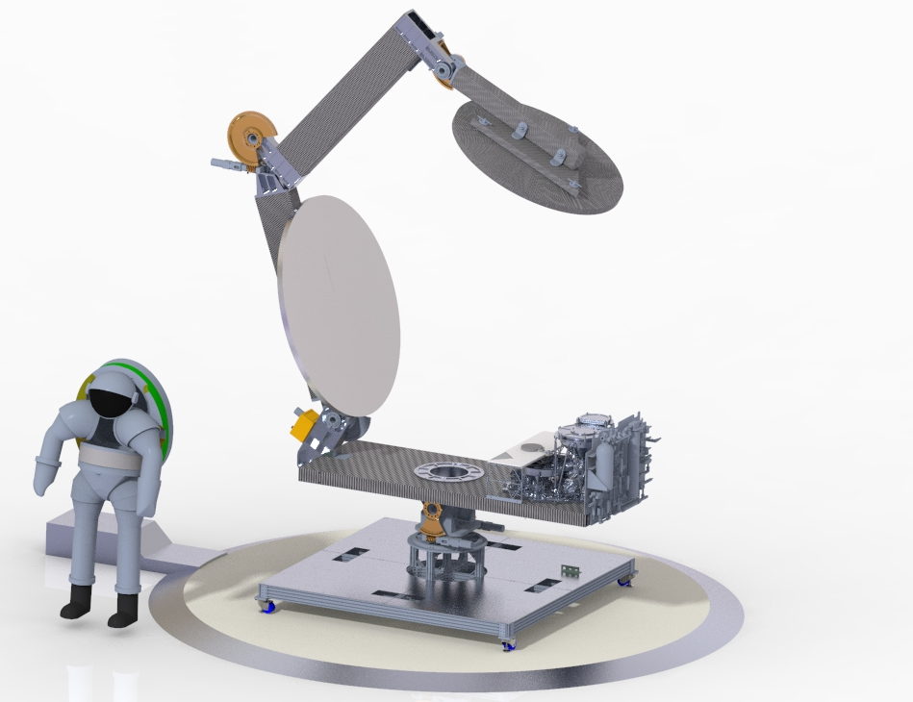
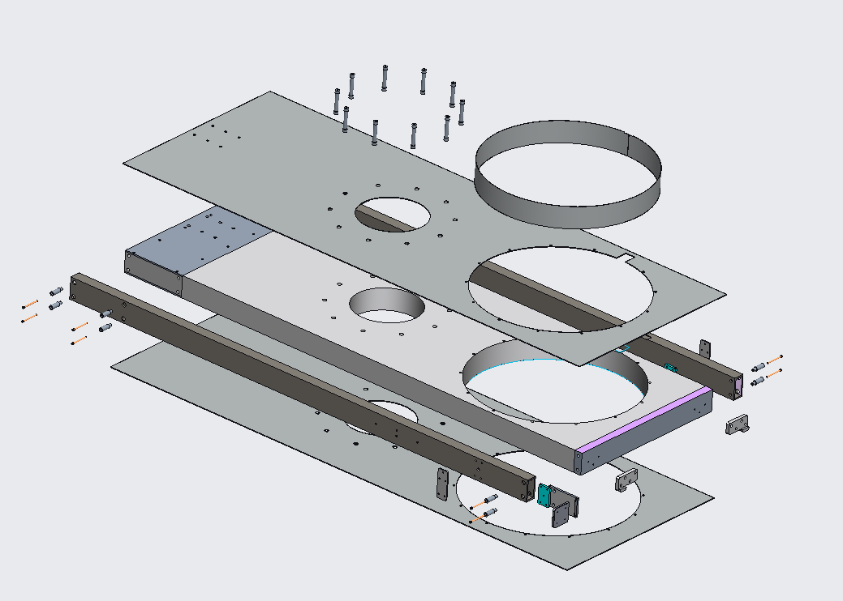
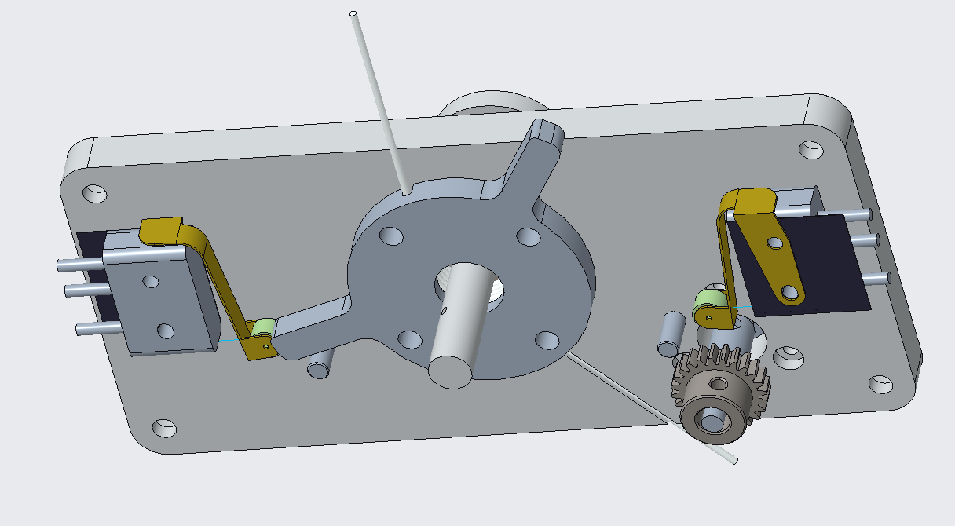
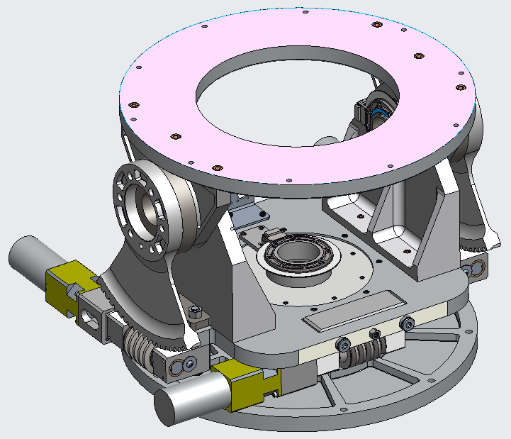
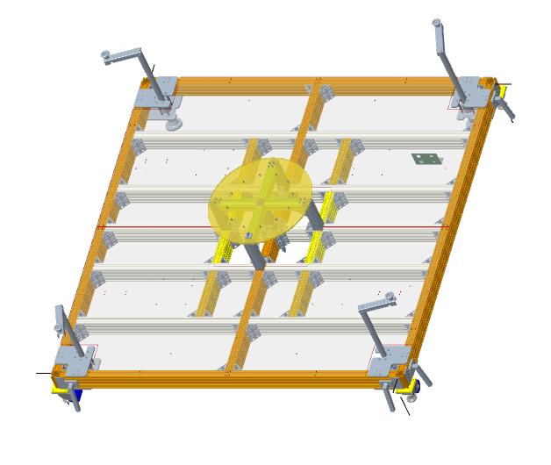
CaRD
Technical Progress and Results
Truss Joints with Encoders
Design complete, Encoders Delivered
Worm Gear Drives
Design Complete – Motors Ordered
Base
Design complete
Optical Shutter
Design Complete
Altitude-Azimuth Mount
Design complete
Lander Mockup
Design Complete, Parts Ordered

Slide 5
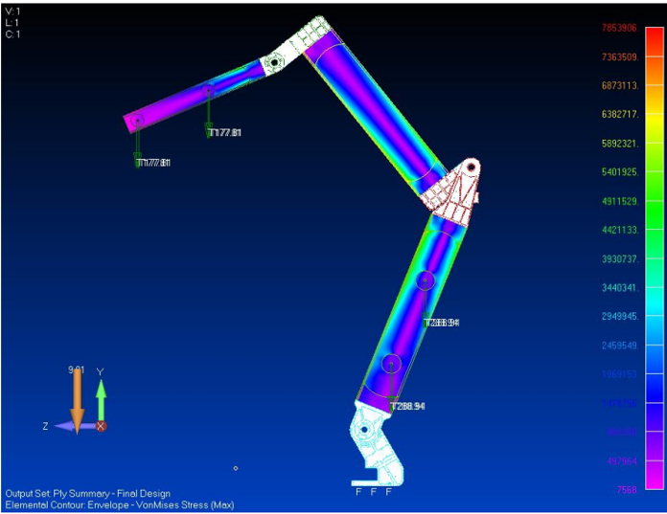
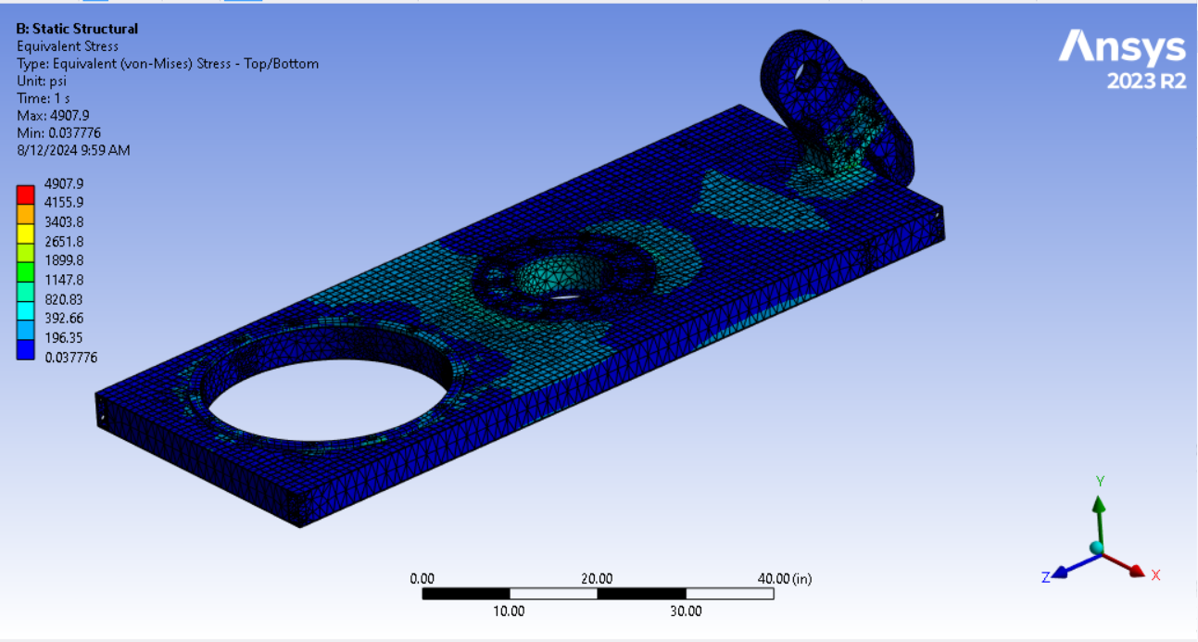
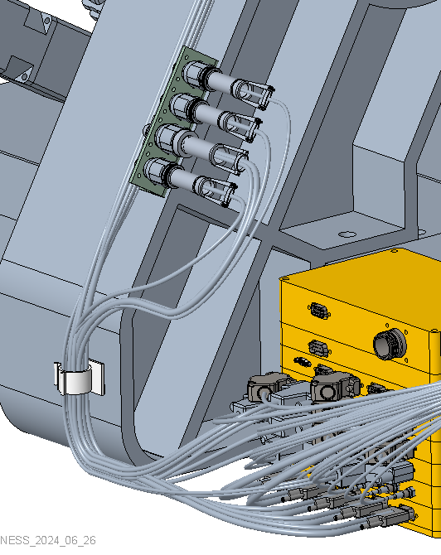
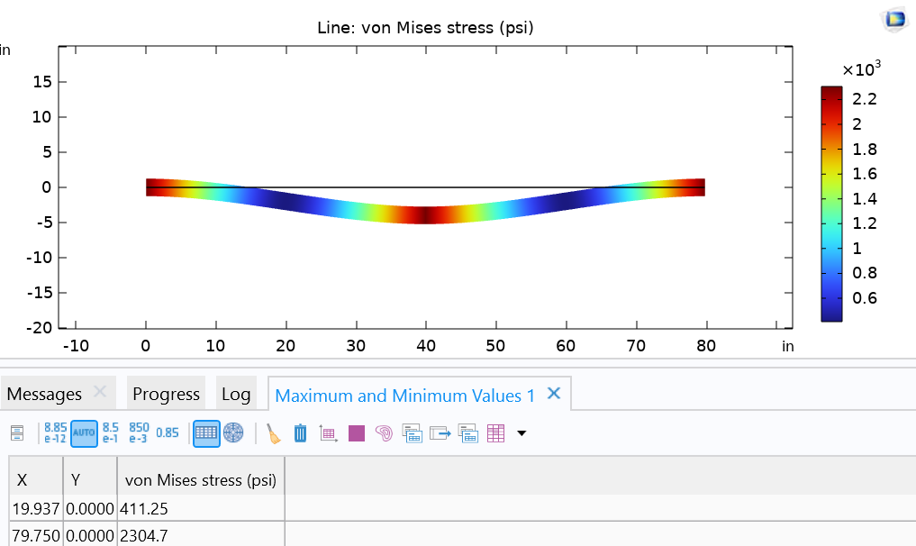
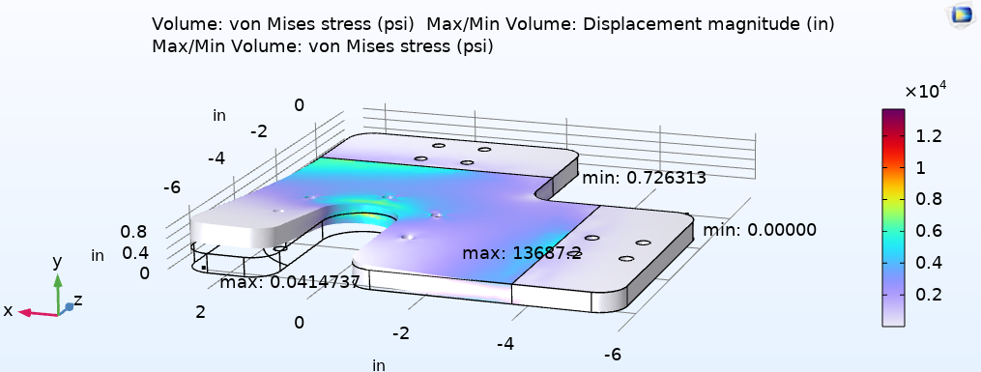
CaRD
Technical Progress and Results
Structural Analysis of Base
Structural Analysis of Carbon Trusses
Electrical Harness Designs Complete
Structural Analysis of Lander Mockup Components

Slide 6
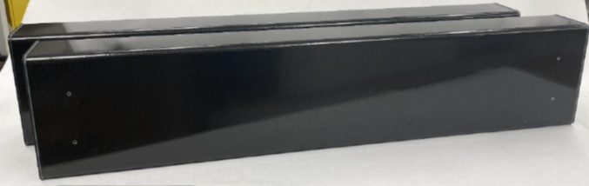
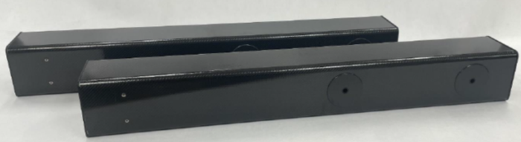
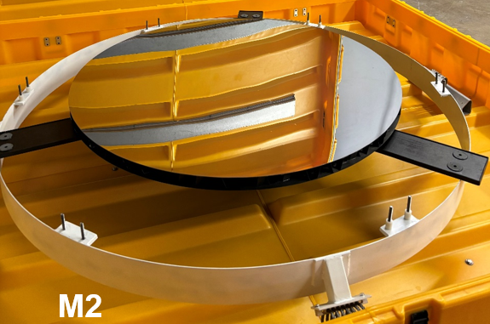
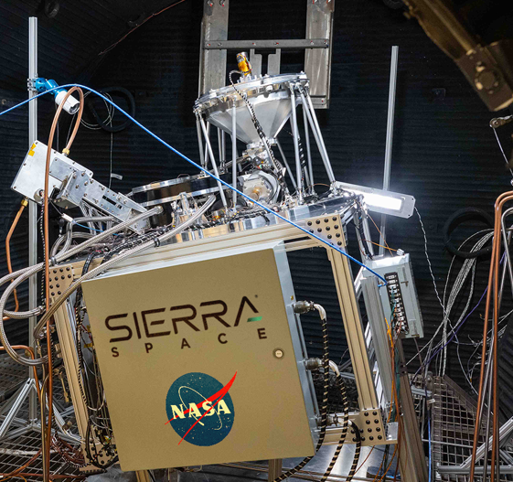
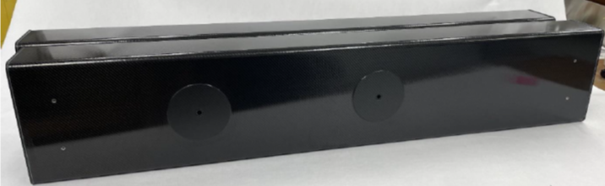
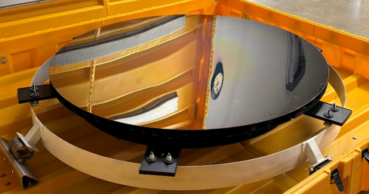
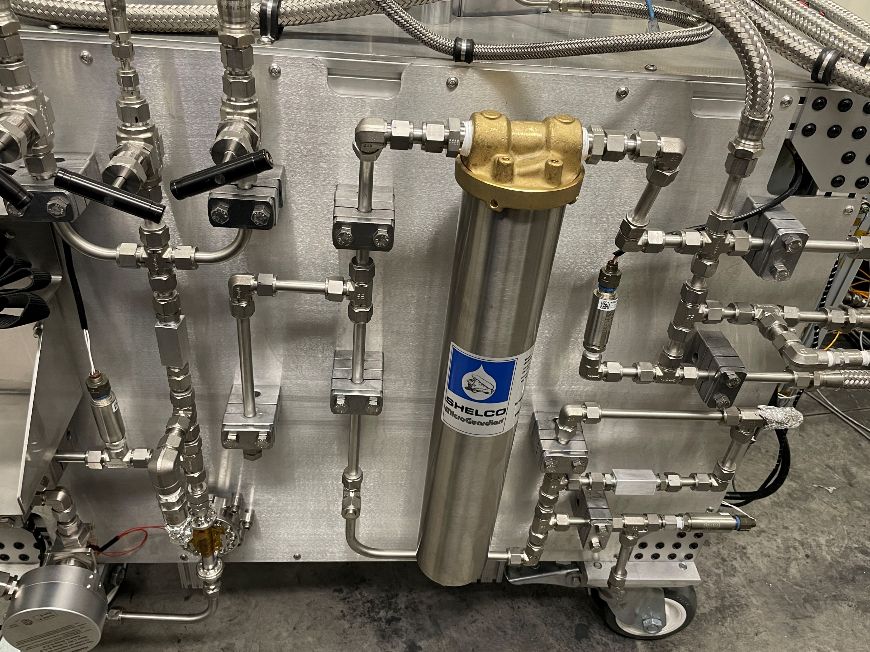
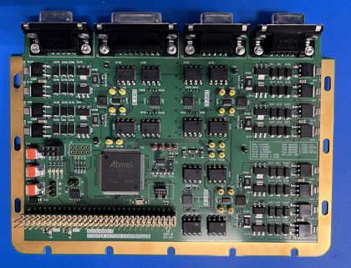
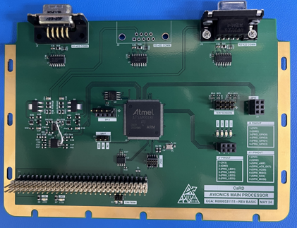
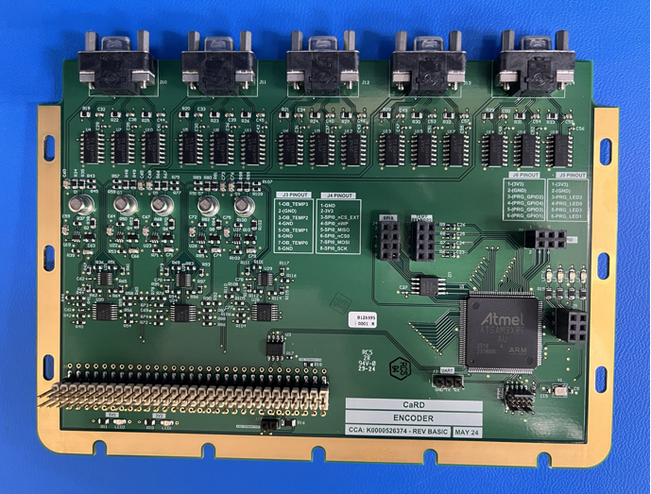
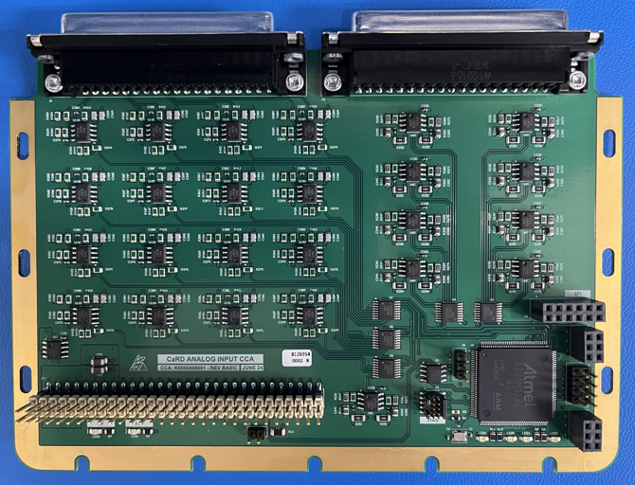
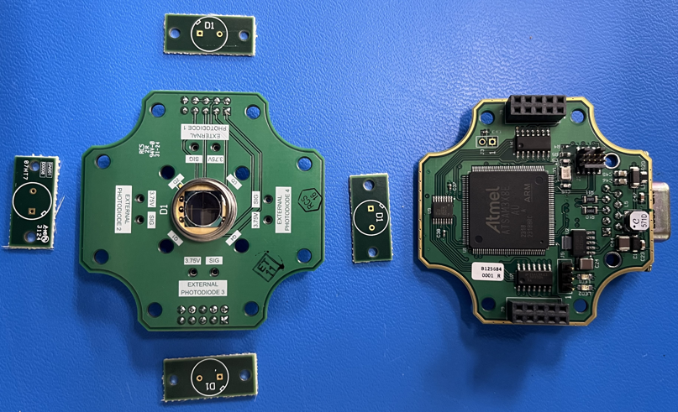
CaRD
Technical Progress and Results
Intermediate Truss
Delivered
Secondary Truss
Delivered
Primary Truss
Delivered
Secondary Mirror
Delivered
Reactor (COPR-Tipping Point)
Completed TVAC Test
Primary Mirror
Delivered
Fluid System
Completed TVAC Test
Avionics
4 out of 7 boards complete
Sun Pointer
Completed

Slide 7
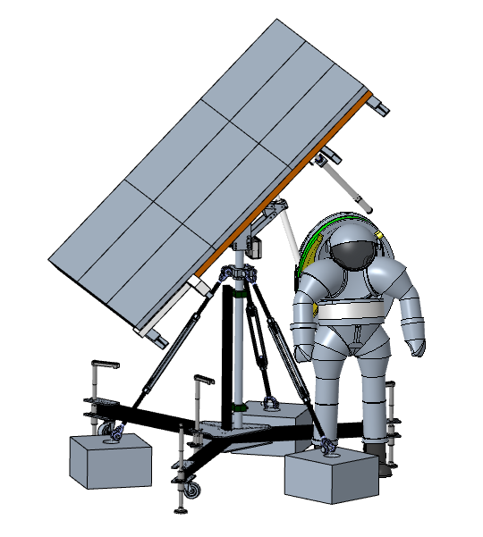
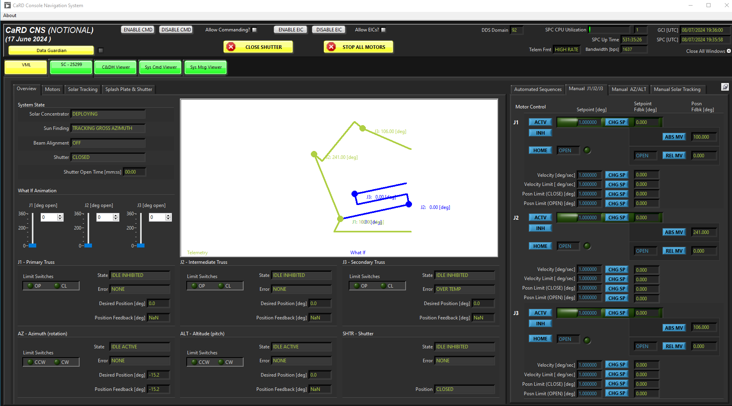
CaRD
Technical Progress and Results
Heliostat Design Complete – Parts Ordered
Flight-Forward Software GUI

Slide 8
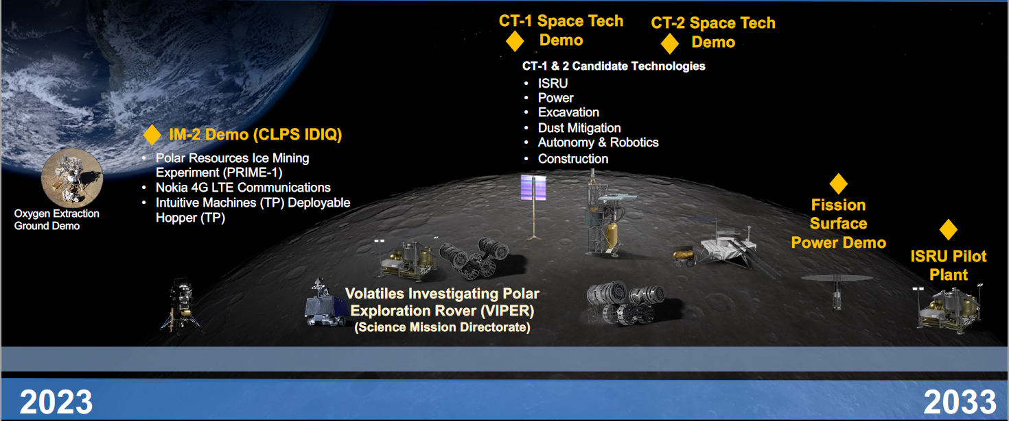
CaRD
Transition/Infusion Status
Slide Presented by Jim Reuter at Space Resources Roundtable 2023
CY23 | CY24 | CY25 | CY26 | CY27 | CY28 | CY29 | CY30 | CY31 | CY32 | CY33
FY23 | FY24 | FY25 | FY26 | FY27 | FY28 | FY29 | FY30 | FY31 | FY32 | FY33
COPR-TP (Sierra Space)
CaRD
LIFT-1 RFP?
LIFT-1?
Pilot Plant Concentrator Prototype?
Pilot Plant Carbothermal?
Pilot Plant Propellant Production?
Pilot Plant?

Slide 9
CaRD
Assessment Summary
Project Name | Performance |  |  |  | Comments
 | C | S | T | P
Annual | * |  |  |  | Technical – Successful TVAC test. CDR complete Cost – Heliostat mirror procurement was not accounted for in baseline plan Schedule – On track to complete objectives by March 2025 Programmatic -
 | Oct | Nov | Dec | Jan | Feb | MYR | Apr | May | Jun | Jul | Aug | APR
C |  |  |  |  |  |  |  |  |  |  | * | *
S
T
P
* Change request for heliostat mirror procurement was under review at the time that this presentation was submitted to STRIVES

Slide 10
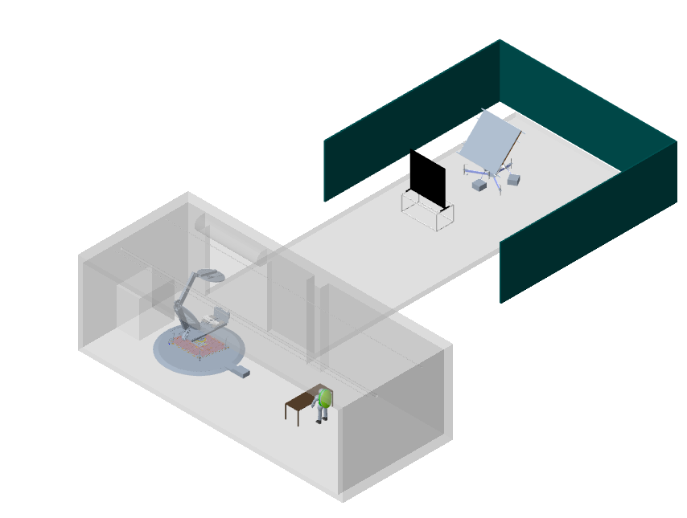
Test Plans
Light Screen
Heliostat
Roll Up Door
CaRD Prototype
Building 360
(cross section view)
Wind Screens
Astronaut for Scale
Turntable
Operations

Slide 11
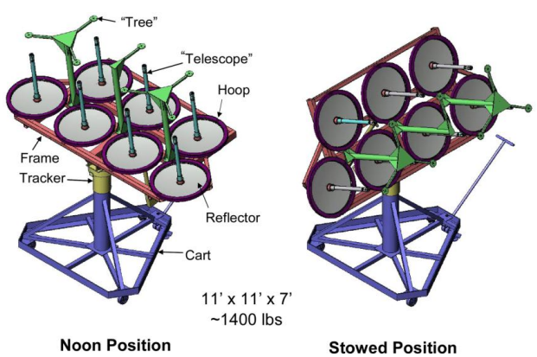
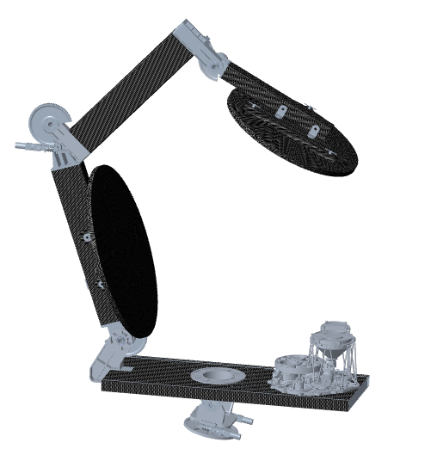
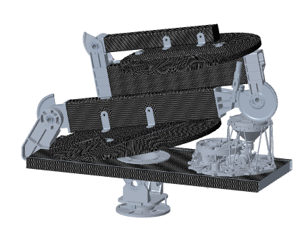
Key Performance Parameters
Stowed
Deployed
1st generation solar-carbothermal system
Reflector Area = 2.3898 m²
635 kg solar concentrator mass
33.4% optical transmission efficiency
1.7 W/kg Delivered Power Density on lunar surface (1080 W/ 635 kg)
CaRD/COPR
Reflector Area = 2.54 m²
193 kg solar concentrator mass
75% optical transmission efficiency
13.5 W/kg Delivered Power Density on lunar surface (2609 W/ 193 kg)
Solar Thermal Power System for ISRU Applications: Field Deployment and Operation at Mauna Kea (aiaa.org)
2010 Field Demonstration of the Solar Carbothermal Regolith Reduction Process to Produce Oxygen (aiaa.org)

Slide 12
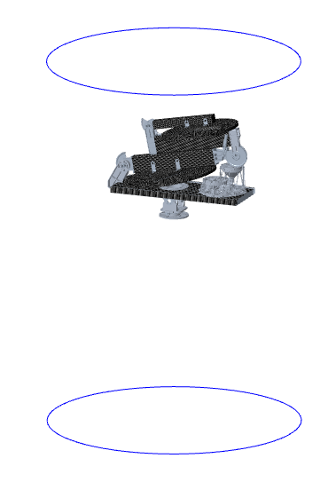
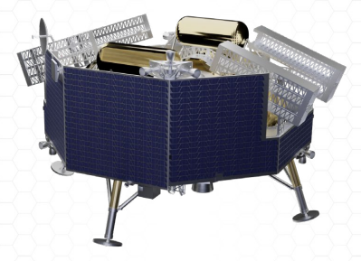
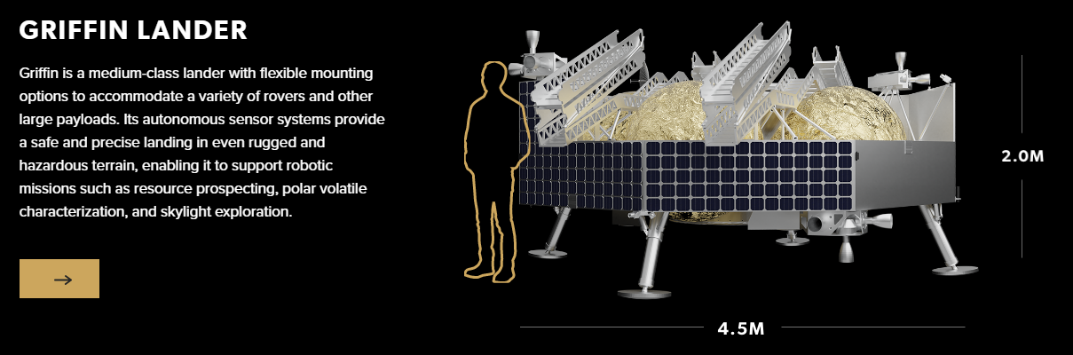
CaRD
Potential Infusion Path
 | Ground Demo (CaRD/COPR) | Flight Demo
Solar Concentrator
Solar Flux | 800W/m^2 (average for Houston) | 1370 W/m^2 (lunar surface)
Primary Mirror Size | 1.8 m DIA | 1.58m DIA
Delivered Power | ~1000-1300W (weather dependant) | 1300W
Electronics | Avionics - Not Radiation Tolerant | Radiation Tolerant
TVAC | Out of scope | Required
Reactor
Electronics | COTS | Avionics
TVAC | Complete
Fluid Subsystem
Electronics | COTS | Avionics
Connections | Fittings | Welded
TVAC | Complete
Shutter
Electronics | Avionics - Not Radiation Tolerant | Radiation Tolerant
TVAC | Out of scope | Required
Gas Analysis | COTS | MSOLO
Fluid Interface | Complete
Other Cameras | COTS | Flight Qualified
System Vibration | Out of scope | Required
Robotic Arm | Out of scope | Required
CaRD CAD model scaled with Falcon 9 payload volume represented by blue circles
Image of Griffin lander (image credit: Astrobotic) scaled roughly to match Falcon 9 payload volume
 | CaRD | Griffin Capacity
Mass (kg) | 365 | 625
Power (W) | 182 | 625
Falcon 9 payload fairing diameter 180 inches (4.572 M)
177.165 in
Image Credit : Astrobotic

